Slide 1
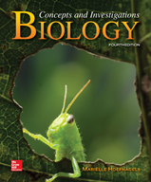
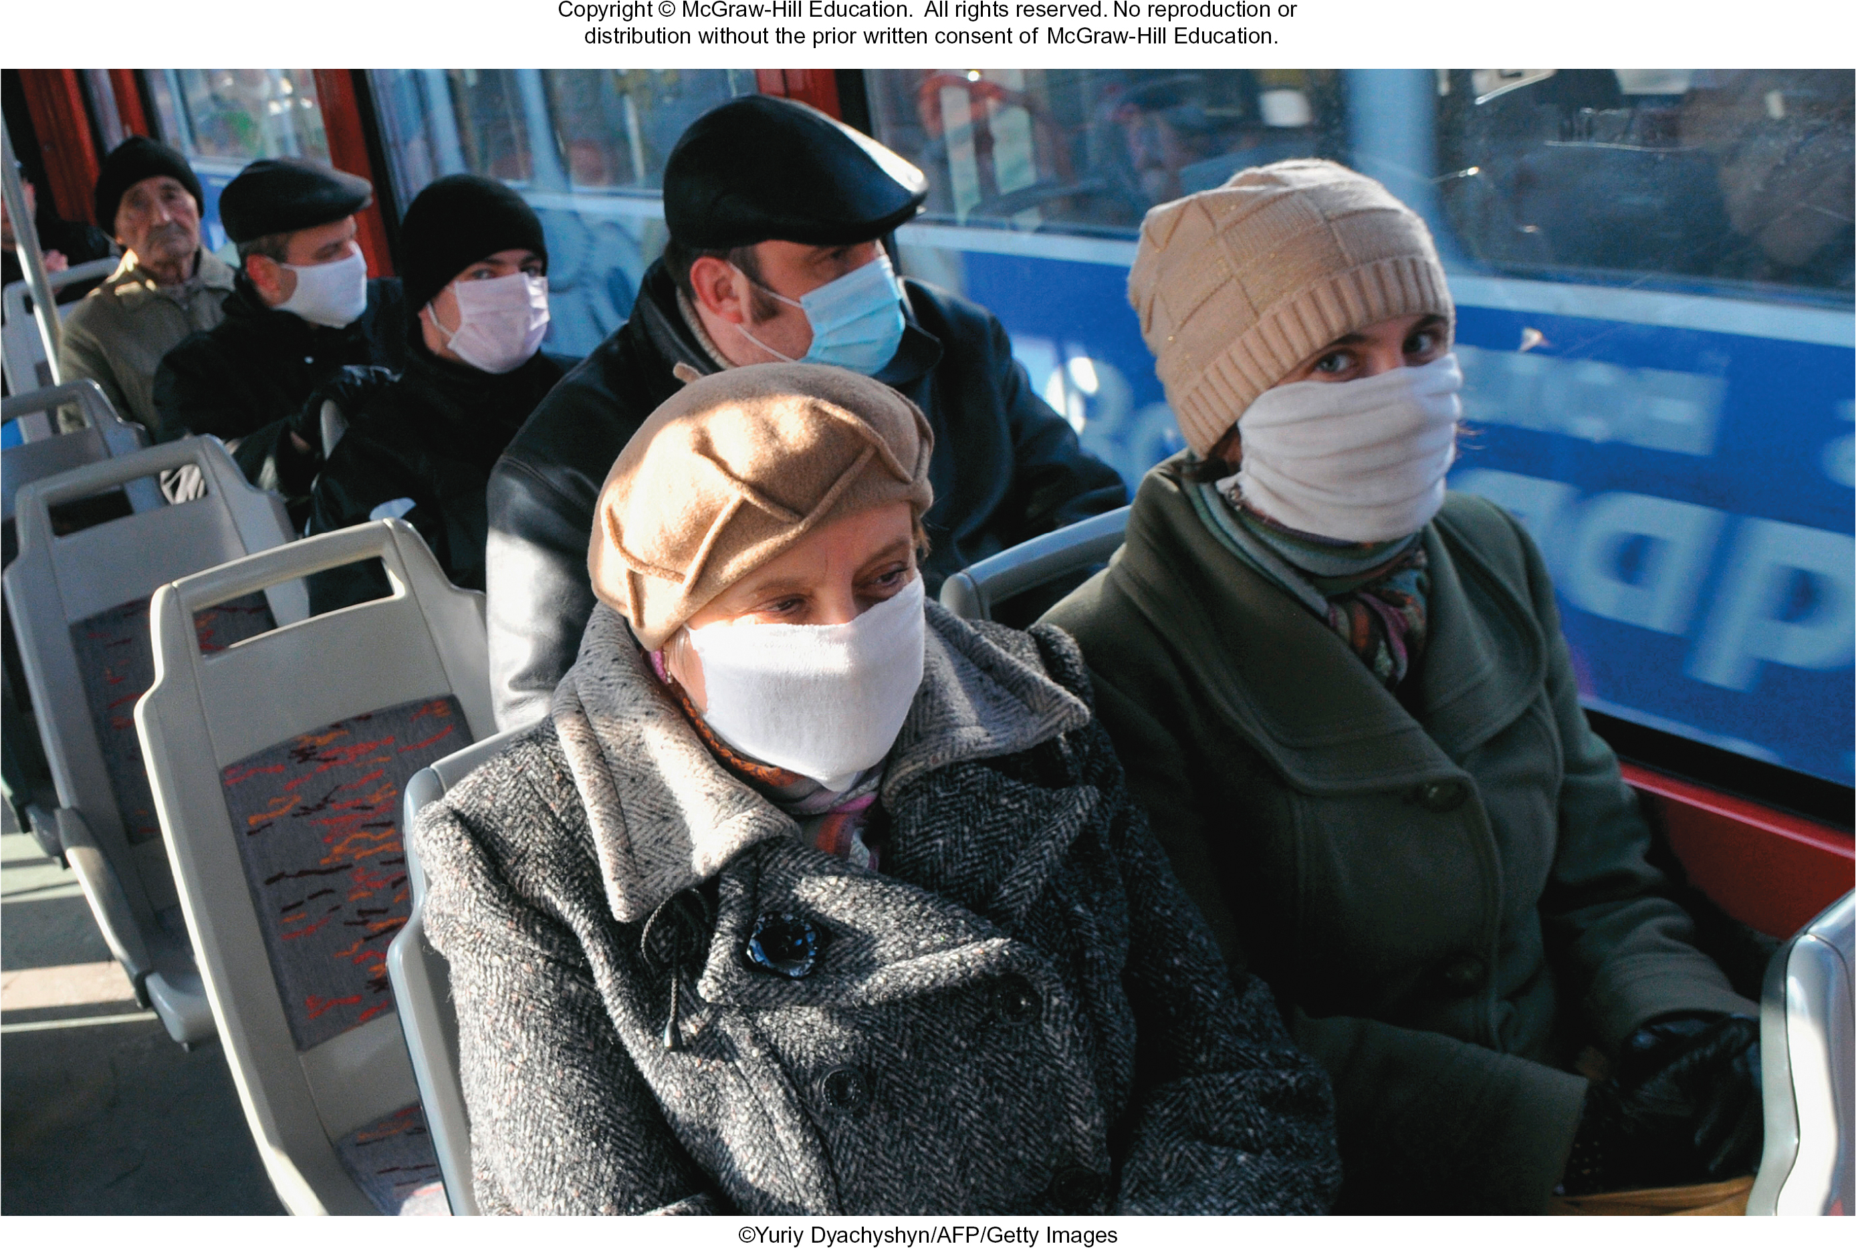
Chapter 16
Viruses
©Yuriy Dyachyshyn/AFP/Getty Images
©McGraw-Hill Education. All rights reserved. Authorized only for instructor use in the classroom.
No reproduction or further distribution permitted without the prior written consent of McGraw-Hill Education.

Slide 2
Viruses are much smaller and simpler than cells
TABLE 16.1 Cells and Viruses Compared
Feature | Cells | Viruses
Size | Typically 1-100 μm | Typically ~80 nm
Genetic Material | DNA | DNA or RNA
Protein coat (capsid) | No | Yes
Cell membrane | Yes | No
Viral envelope | No | Some viruses
Nucleus/membrane-bounded organelles | Eukaryotes only | No
Cytoplasm | Yes | No
Ribosomes | Yes | No
Enzymes | Yes | Some viruses
Metabolism | Yes | No
Independent replication | Yes | No
Section 16.1
Table 16.1

Slide 3
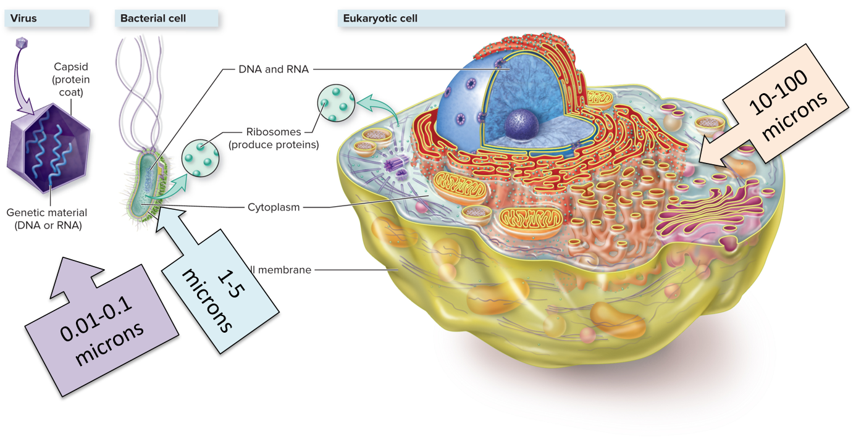
Viruses are genes wrapped in a protein coat
A virus is a small, infectious agent made of nucleic acid and protein.
Section 16.1
Figure 16.1

Slide 4
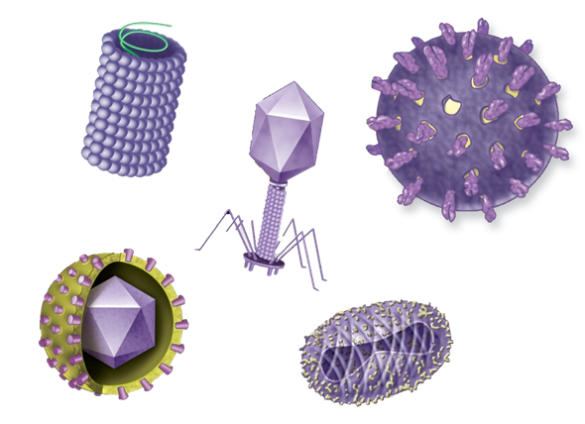
Viruses come in many shapes and sizes
Each virus has genetic material inside, surrounded by a protein coat, or capsid.
Section 16.1
Figure 16.2

Slide 5
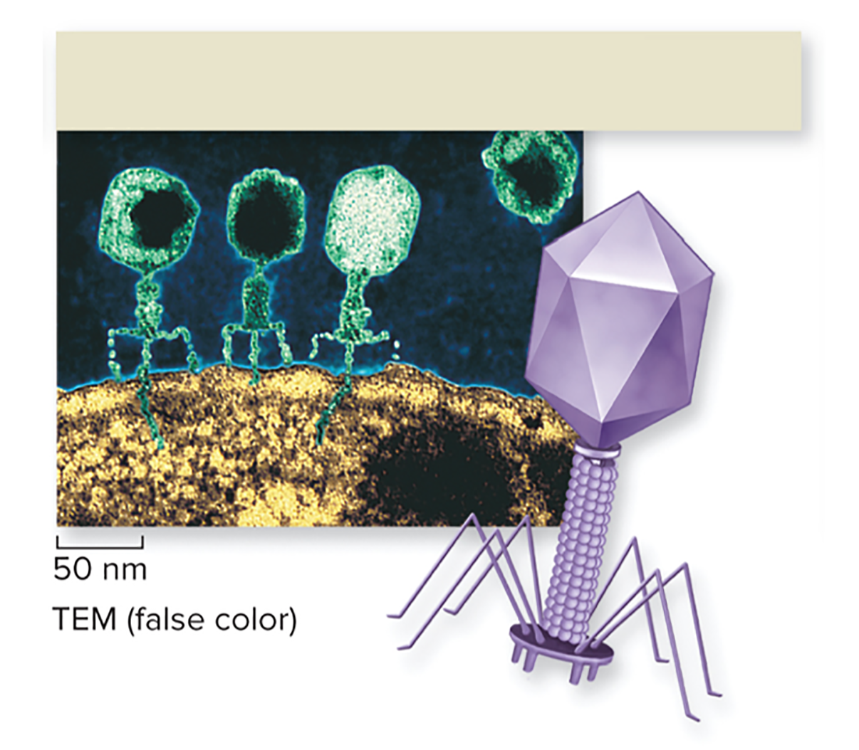
Viruses infect specific host cells
The proteins surrounding each virus are shaped to bind with proteins on host cells.
Each virus has specific target cells that it can match up with to infect.
This virus is a bacteriophage – it can only bind to and infect bacterial cells.
T-even bacteriophage (spaceship; double-stranded DNA)
©Eye of Science/Science Source
Section 16.1
Figure 16.2

Slide 6
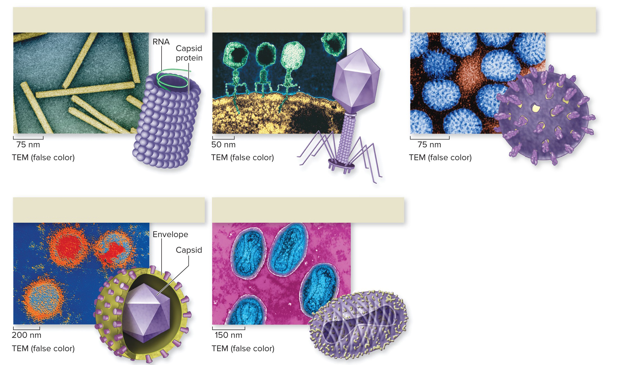
Each virus has a host range
The host range is the types of cells or organisms a virus can infect.
Tobacco mosaic virus (filamentous; single-stranded RNA)
T-even bacteriophage (spaceship; double-stranded DNA)
Rotavirus (spherical; double-stranded RNA)
Viruses can infect plants, bacteria, and human host cells.
Herpesvirus (icosahedral, enveloped; double-stranded DNA)
Poxvirus (oval, enveloped; double-stranded DNA)
(a): ©G. Wanner/ScienceFoto/Getty Images; (b): ©Eye of Science/Science Source; (c): CDC/Dr. Erskine Palmer & Byron Skinner; (d): ©G. Murti/Science Source; (e): ©James Cavallini/BSIP SA/Alamy
Section 16.1
Figure 16.2

Slide 7
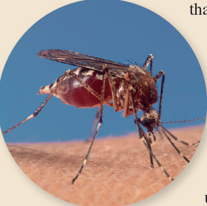
Reservoir hosts help spread viruses to other species
The Zika virus infects human cells and causes birth defects.
It is carried and spread by mosquitoes, without harming the mosquitoes.
The mosquito is a reservoir host, providing a continual source of Zika virus infection for humans.
Section 16.1

Slide 8
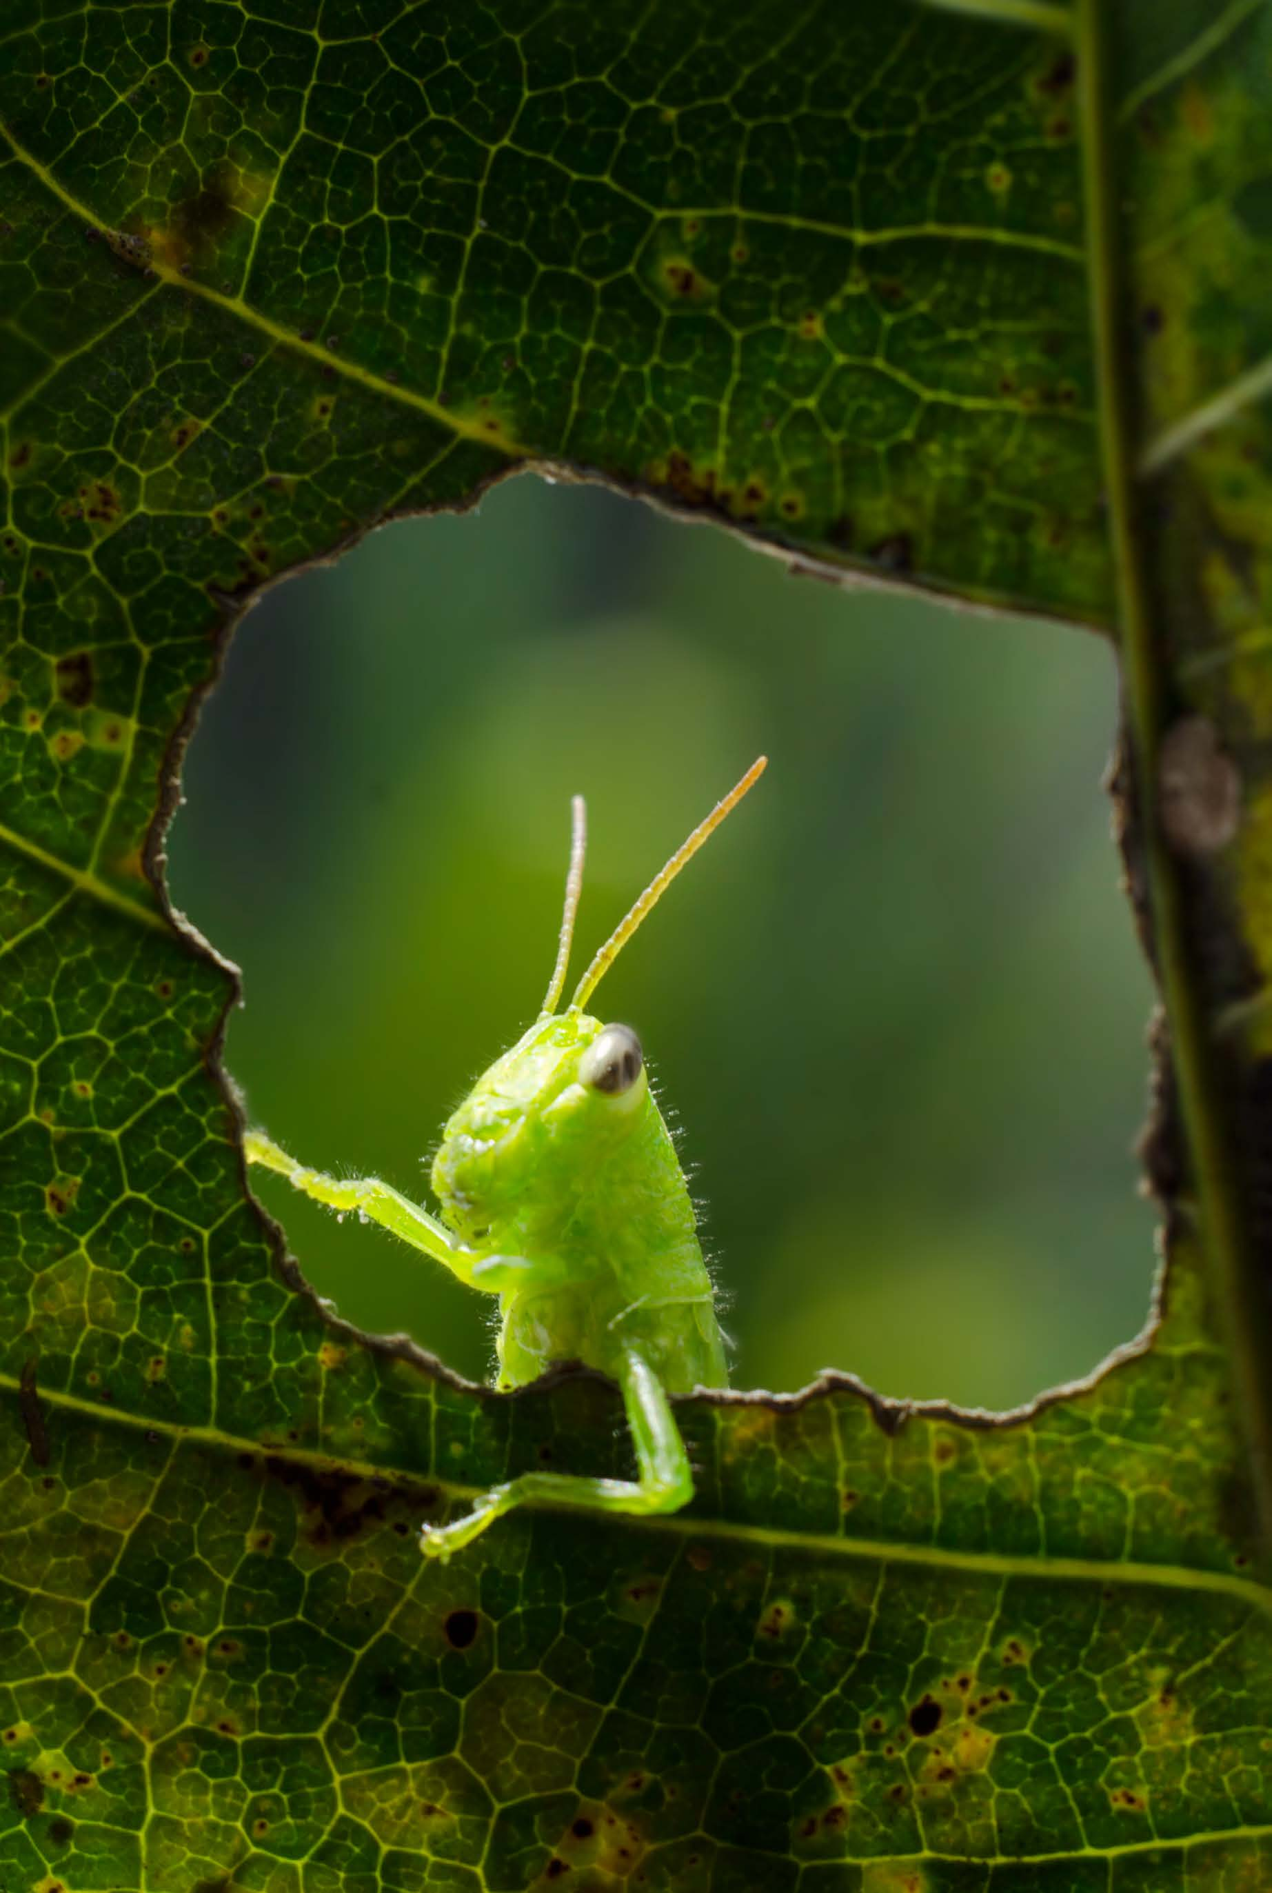
Clicker question #1
What organic molecules are found in all viruses?
Carbohydrates and lipids
Nucleic acids and carbohydrates
Proteins and nucleic acids
Lipids and proteins

Slide 9
Clicker question #1, solution
What organic molecules are found in all viruses?
Proteins and nucleic acids

Slide 10
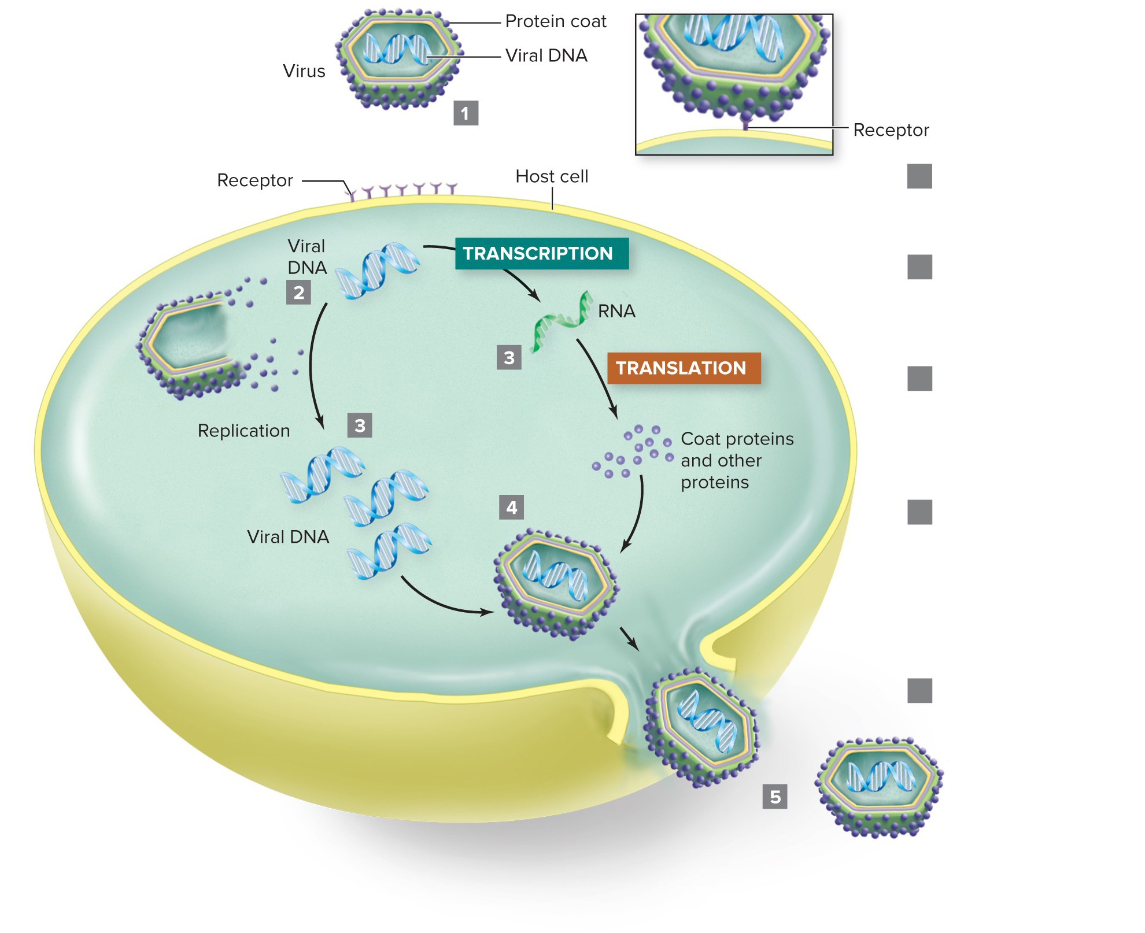
Viruses use cells to replicate
Viral genes contain instructions for making viruses.
Viruses cannot replicate on their own, though. They can only replicate by infecting host cells.
Attachment: Virus binds cell surface receptor.
Penetration: Viral nucleic acid is released inside host cell.
Synthesis: Host cell manufactures viral nucleic acids and proteins.
Assembly: New viruses are assembled from newly synthesized coat proteins, enzymes, and nucleic acids.
Release: New viruses leave the host cell.
Section 16.2
Figure 16.3

Slide 11
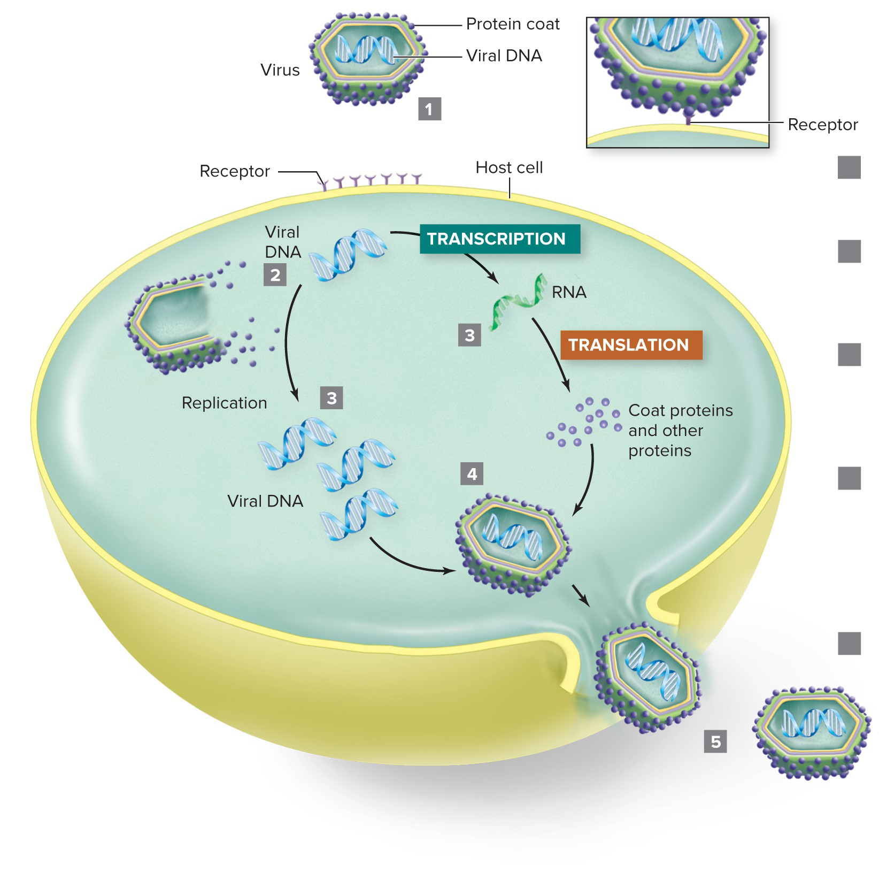
Viruses infect the host cell
Viral replication:
Virus attaches to host.
Virus injects its nucleic acids into the cell.
Attachment: Virus binds cell surface receptor.
Penetration: Viral nucleic acid is released inside host cell.
Synthesis: Host cell manufactures viral nucleic acids and proteins.
Assembly: New viruses are assembled from newly synthesized coat proteins, enzymes, and nucleic acids.
Release: New viruses leave the host cell.
Section 16.2
Figure 16.3

Slide 12
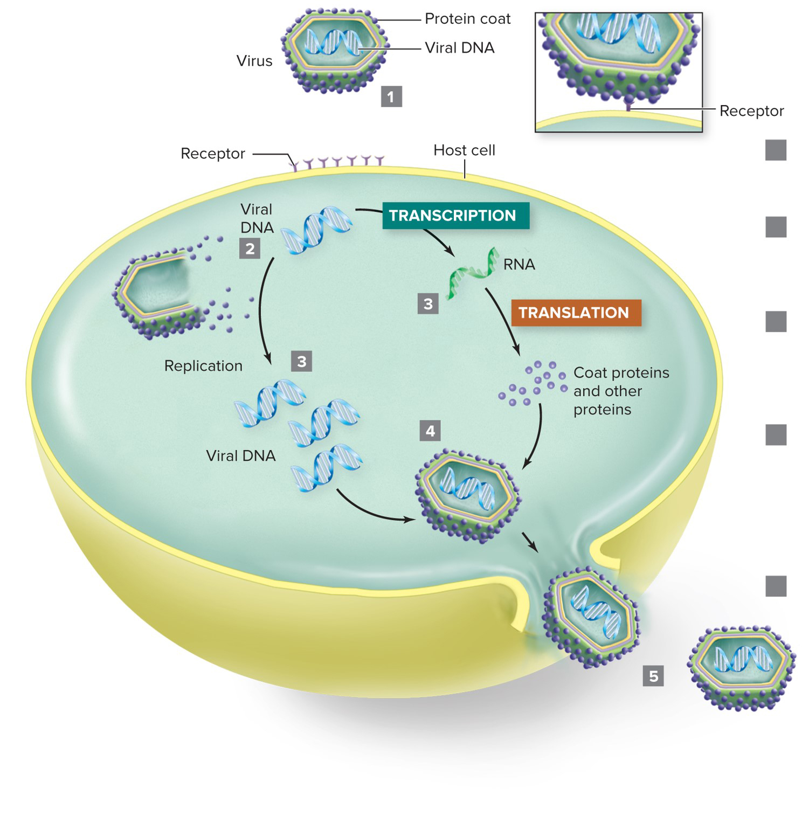
Virus nucleic acids take over the host cell
Viral replication:
Virus attaches to host.
Virus injects its nucleic acids into the cell.
Host transcribes and translates viral DNA as if it were its own.
Attachment: Virus binds cell surface receptor.
Penetration: Viral nucleic acid is released inside host cell.
Synthesis: Host cell manufactures viral nucleic acids and proteins.
Assembly: New viruses are assembled from newly synthesized coat proteins, enzymes, and nucleic acids.
Release: New viruses leave the host cell.
Section 16.2
Figure 16.3

Slide 13
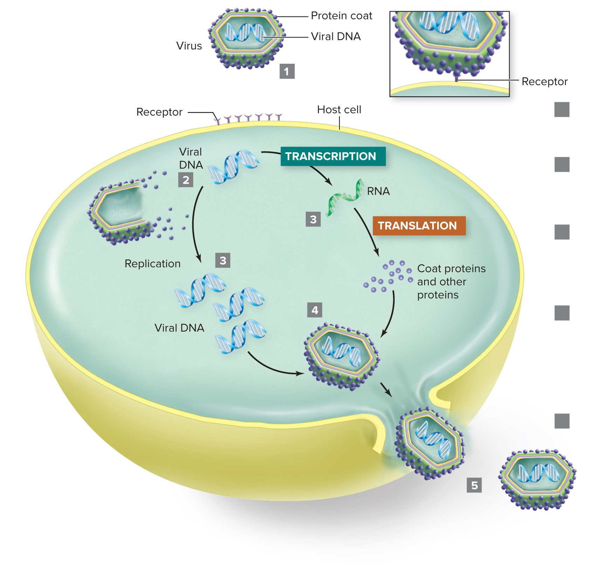
The host cell produces new viruses
Viral replication:
Virus attaches to host.
Virus injects its nucleic acids into the cell.
Host transcribes and translates viral DNA as if it were its own.
New viruses assemble.
Attachment: Virus binds cell surface receptor.
Penetration: Viral nucleic acid is released inside host cell.
Synthesis: Host cell manufactures viral nucleic acids and proteins.
Assembly: New viruses are assembled from newly synthesized coat proteins, enzymes, and nucleic acids.
Release: New viruses leave the host cell.
Section 16.2
Figure 16.3

Slide 14
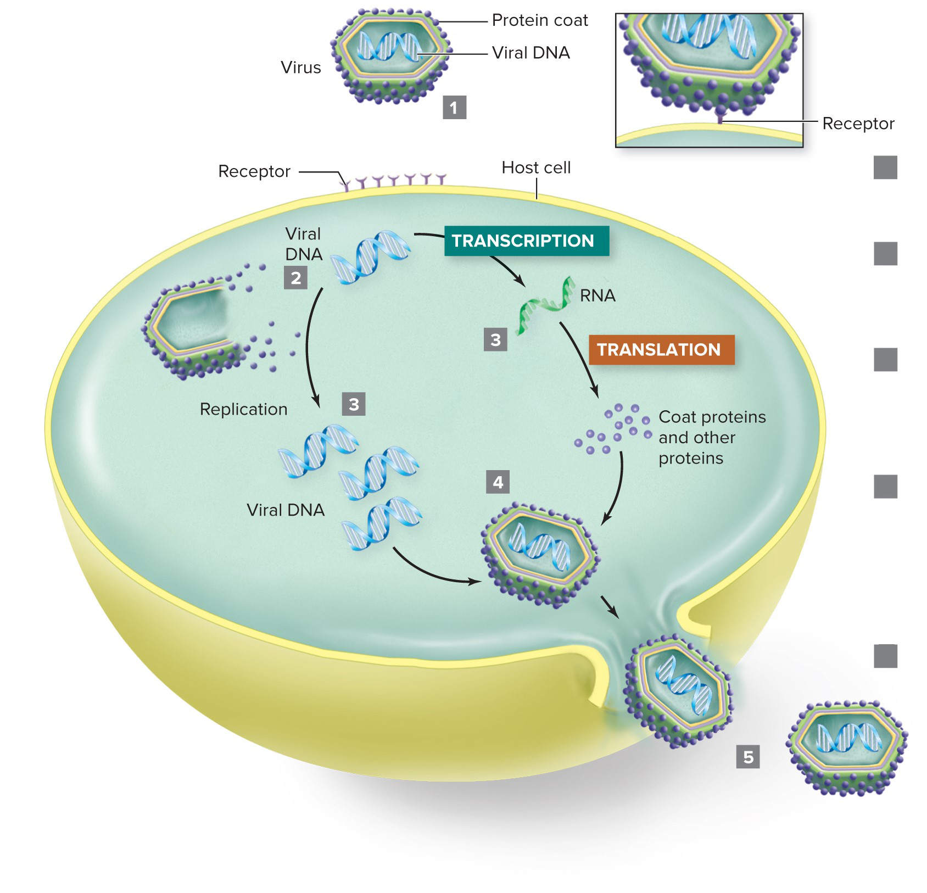
New viruses are released
Viral replication:
Virus attaches to host.
Virus injects its nucleic acids into the cell.
Host transcribes and translates viral DNA as if it were its own.
New viruses assemble.
Viruses leave the cell.
Attachment: Virus binds cell surface receptor.
Penetration: Viral nucleic acid is released inside host cell.
Synthesis: Host cell manufactures viral nucleic acids and proteins.
Assembly: New viruses are assembled from newly synthesized coat proteins, enzymes, and nucleic acids.
Release: New viruses leave the host cell.
Section 16.2
Figure 16.3

Slide 15
Clicker question #2
The five steps of viral replication are listed below in no particular order. If you were to arrange them in order, which step would come fourth?
Assembly
Penetration
Release
Attachment
Synthesis

Slide 16
Clicker question #2, solution
The five steps of viral replication are listed below in no particular order. If you were to arrange them in order, which step would come fourth?
Assembly

Slide 17
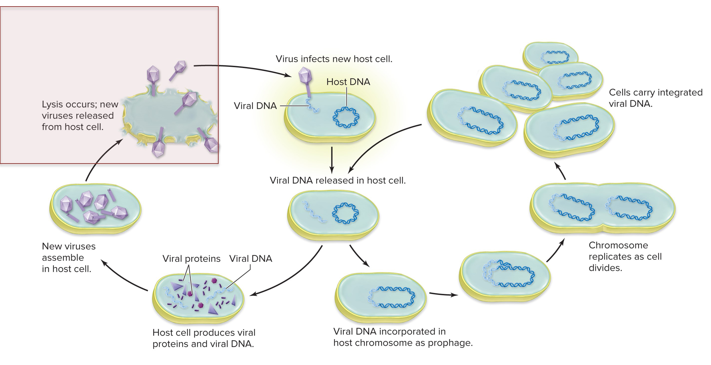
Viruses can kill cells right away
Viruses following the lytic pathway burst from their host cells soon after infection.
Lytic pathway
Lysogenic pathway
Section 16.3
Figure 16.4

Slide 18
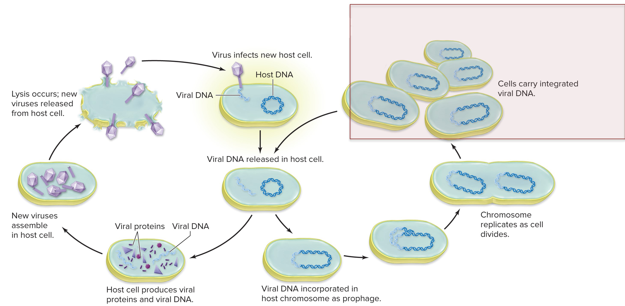
Viruses can lurk inside cells for years
Viruses following the lysogenic pathway “hide” as they replicate, without damaging the host cell.
Lytic pathway
Lysogenic pathway
Section 16.3
Figure 16.4

Slide 19
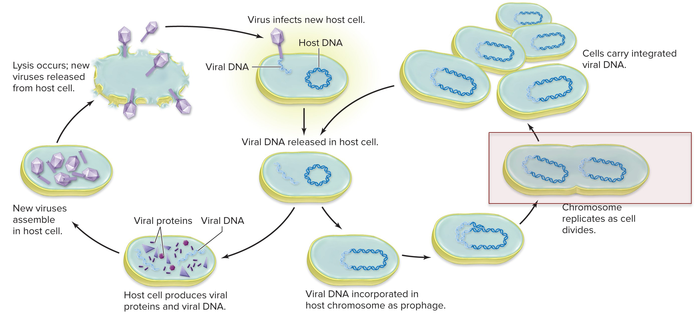
Virus DNA can combine with host DNA
A prophage is the DNA of a lysogenic bacteriophage that is inserted into the host chromosome. The prophage replicates when cells divide.
Lytic pathway
Lysogenic pathway
Section 16.3
Figure 16.4

Slide 20
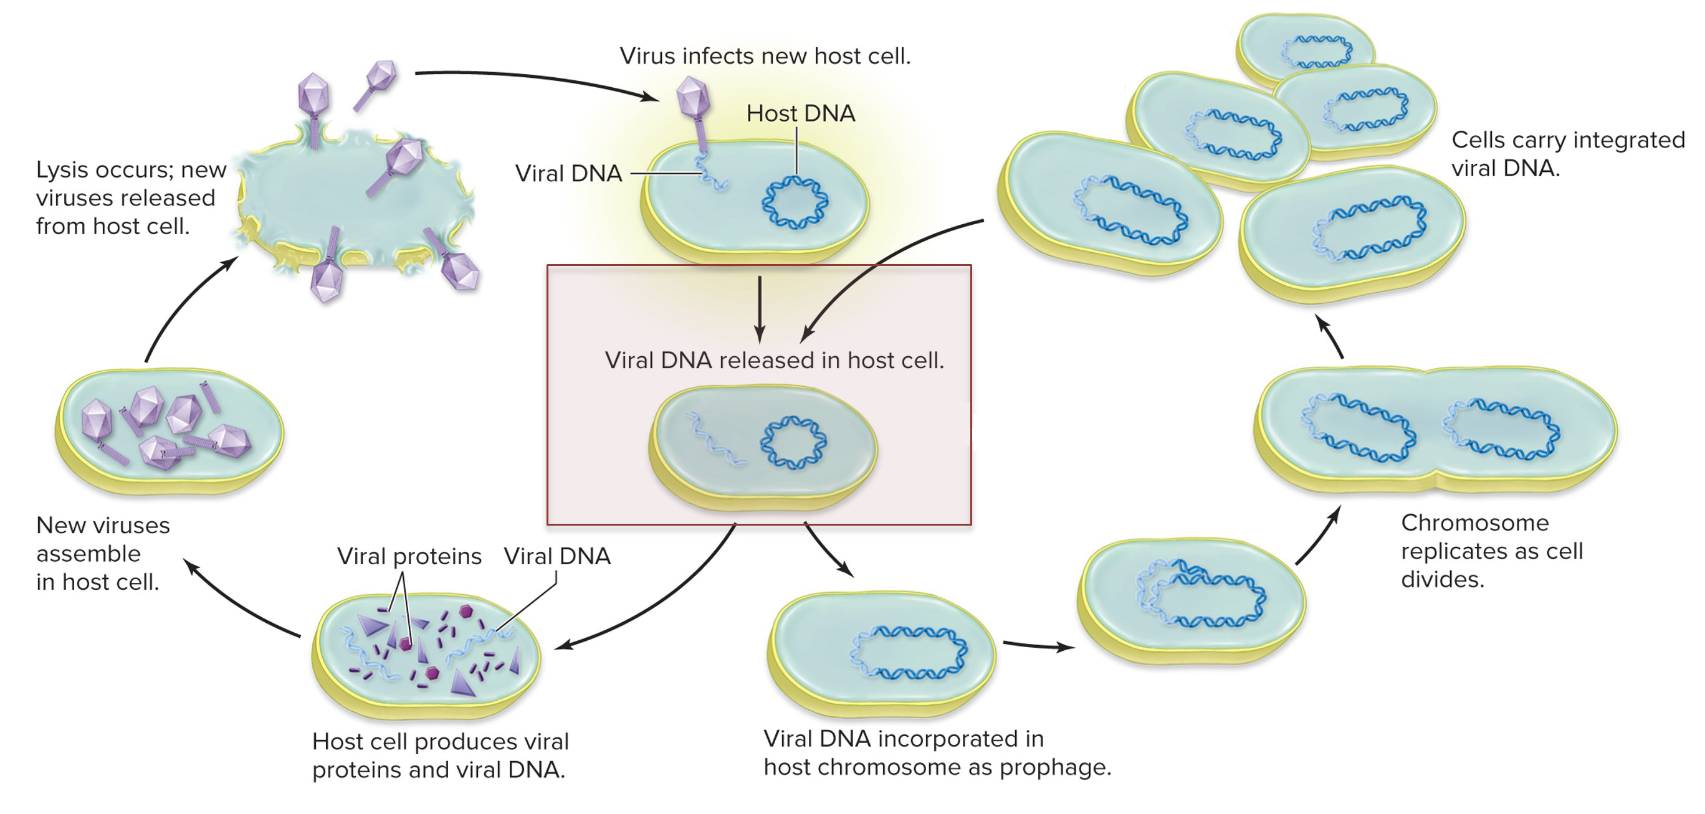
Viruses might or might not kill host cells
Depending on the condition of the host cell, viruses can shift from a lysogenic infection to the lytic pathway.
Lytic pathway
Lysogenic pathway
Section 16.3
Figure 16.4

Slide 21
Clicker question #3
Viruses following the lytic pathway kill their host cell as they replicate.
True
False

Slide 22
Clicker question #3, solution
Viruses following the lytic pathway kill their host cell as they replicate.
True

Slide 23
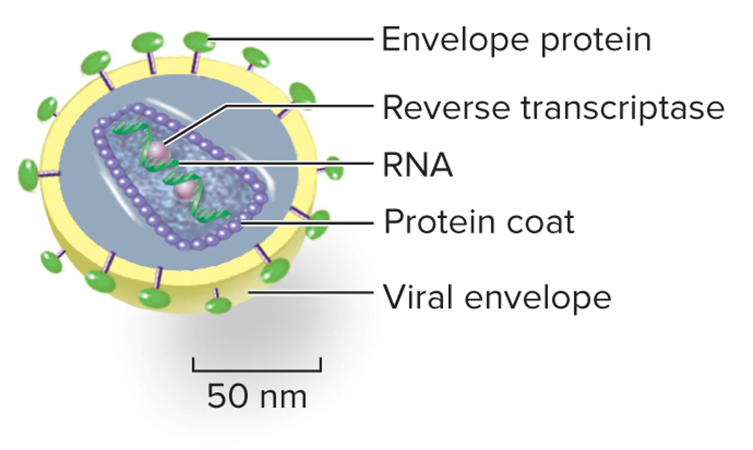
Animal viruses can cause illnesses
When virally infected cells begin to die, symptoms will reflect they type of cells that are destroyed.
Section 16.4
Figure 16.5

Slide 24
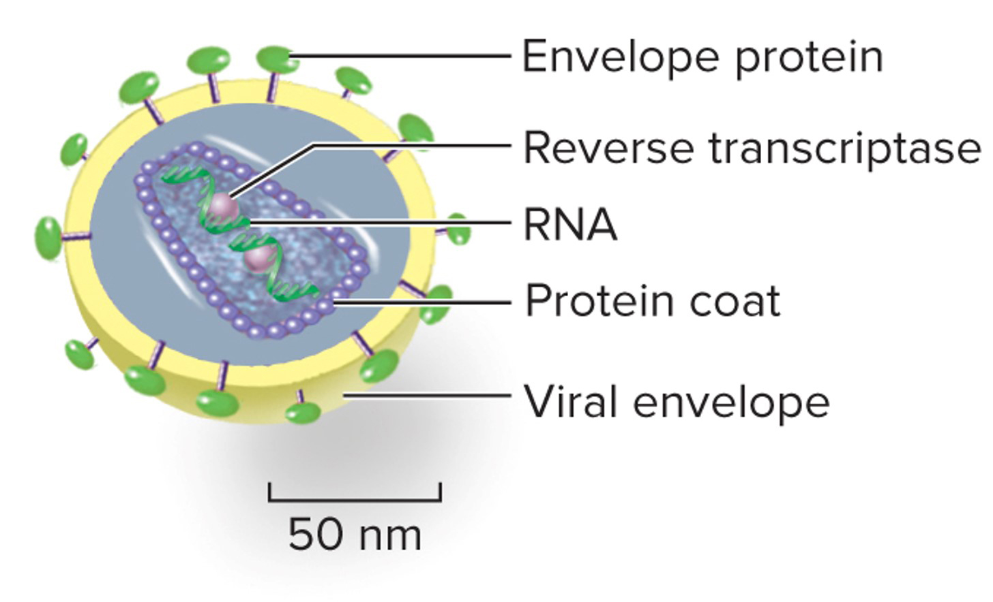
Example: HIV infects human T cells
T cells are needed in the immune system.
Patients infected with HIV show symptoms that reflect a defective immune response (AIDS).
Section 16.4
Figure 16.5

Slide 25
Some viruses might linger for years
HIV often remains latent; it does not immediately induce disease symptoms.
Section 16.4
Figure 16.5

Slide 26
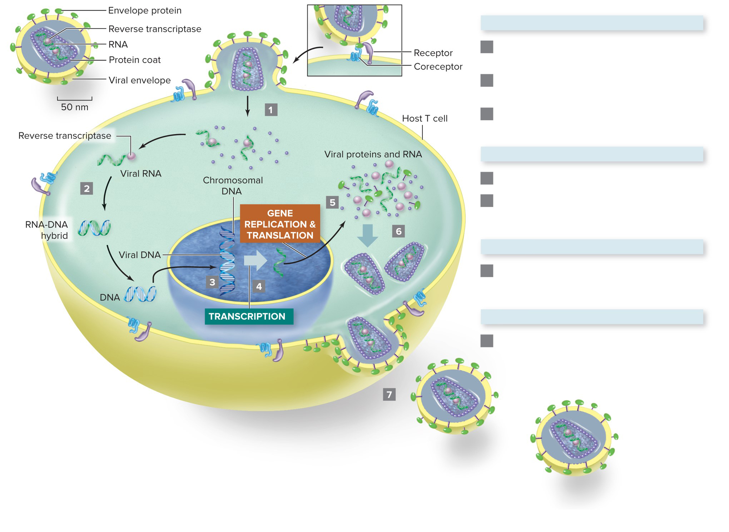
Replication of RNA viruses is complex
Attachment and penetration
HIV contains RNA as its genetic material.
When HIV does replicate, it requires a few more steps than DNA virus replication does.
Virus binds receptors on cell membrane and enters cell. Enzymes remove viral protein coat.
Reverse transcriptase transcribes viral RNA to double-stranded DNA.
Double-stranded DNA is incorporated into host cell’s genome.
Synthesis
Viral genes are transcribed to RNA.
Some RNA is packaged into new viruses. Other RNA is translated into HIV proteins at ribosomes in cytoplasm.
Assembly
Protein coats surround viral RNA and enzymes. Envelope proteins migrate to cell membrane.
Release
New viruses bud from host cell.
Section 16.4
Figure 16.5

Slide 27
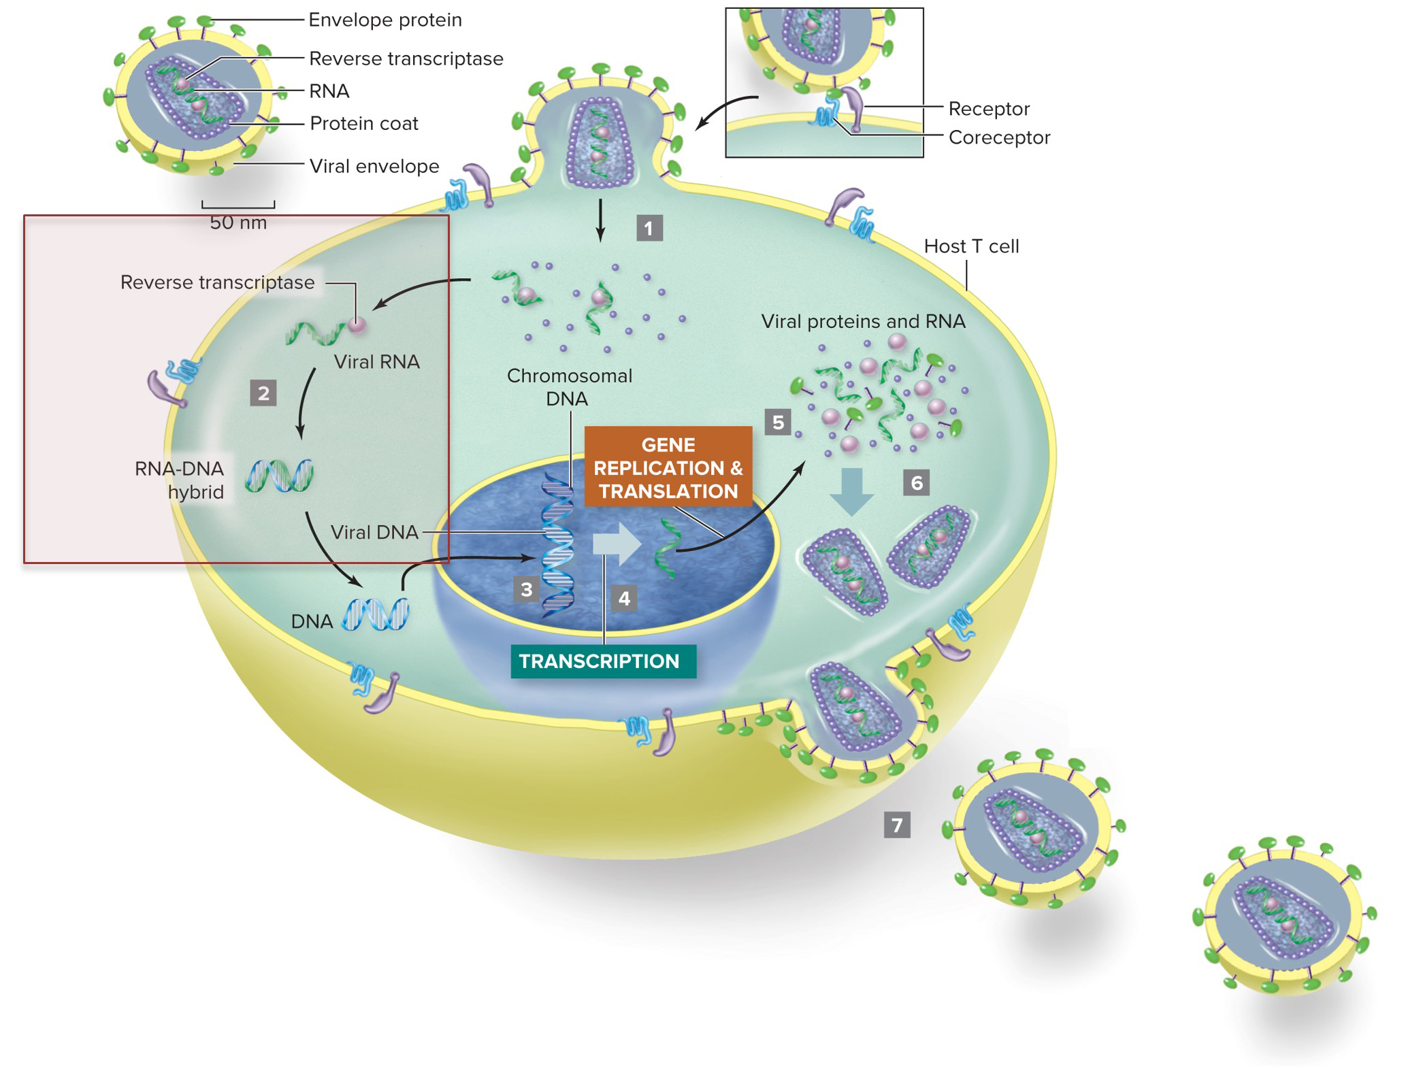
Viral RNA is converted to DNA
HIV must produce a DNA copy of its RNA before incorporating genes into the host’s DNA.
An enzyme called reverse transcriptase carries out the reaction.
Section 16.4
Figure 16.5

Slide 28
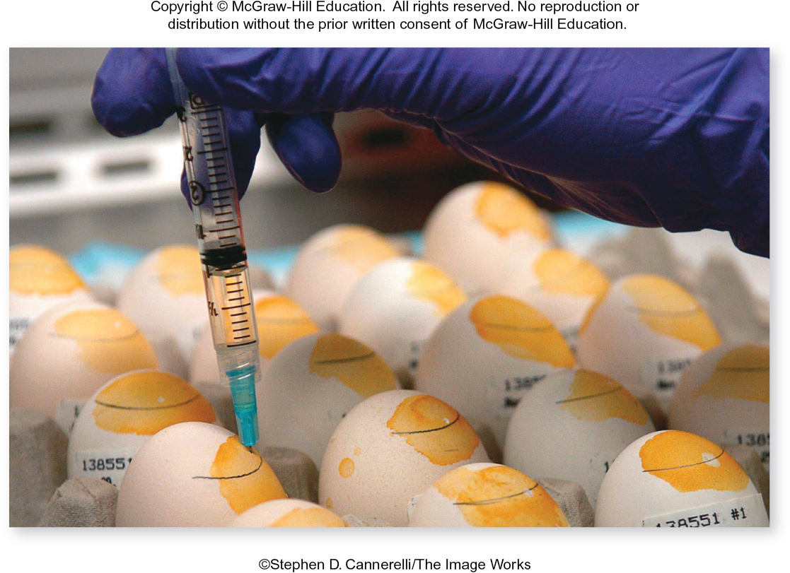
Vaccines help prevent viral infections
A vaccine contains inactive virus or viral proteins.
These molecular components of a virus produce an immune response without causing a disease.
©Stephen D. Cannerelli/The Image Works
Section 16.4
Figure 16.6

Slide 29
Vaccines jump-start the immune system
Vaccines “teach” the immune system to recognize a virus.
If you are exposed to the real virus after being vaccinated, your body will be primed to destroy it before it can infect your cells.
©Stephen D. Cannerelli/The Image Works
Section 16.4
Figure 16.6

Slide 30
To make a vaccine, scientists inoculate host cells with the virus
Scientists inject flu viruses into fertilized chicken eggs which are the host cells. The viruses replicate in the eggs.
Harvesting viruses from the eggs provides the raw materials to produce a vaccine.
©Stephen D. Cannerelli/The Image Works
Section 16.4
Figure 16.6

Slide 31
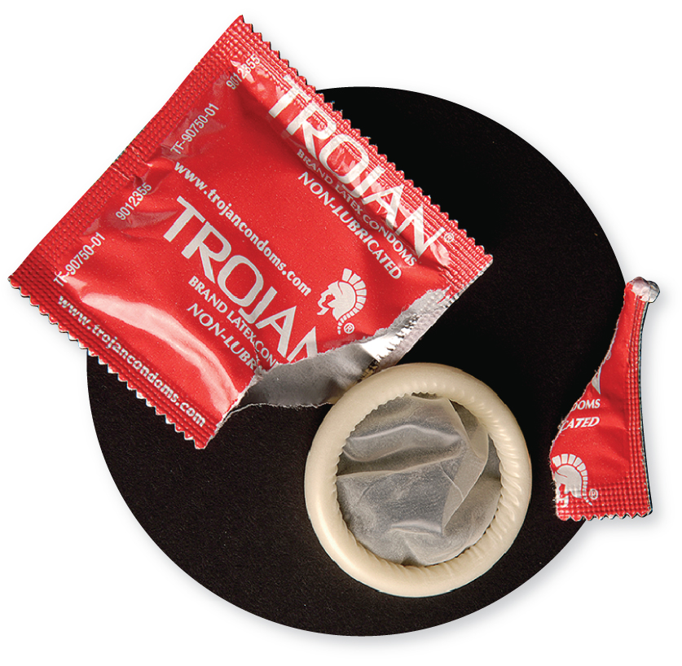
Human papilloma viruses (HPV) cause cancer
Viruses like HPV cause cells to replicate too much, instead of killing the cells.
HPV is sexually transmitted, and can infect epithelial and cervical cells. It causes cervical, oral, and anal cancers.
HPV infection can be prevented by vaccine, condoms, and abstinence.
©Christopher Kerrigan/ McGraw-Hill Education
Section 16.4

Slide 32
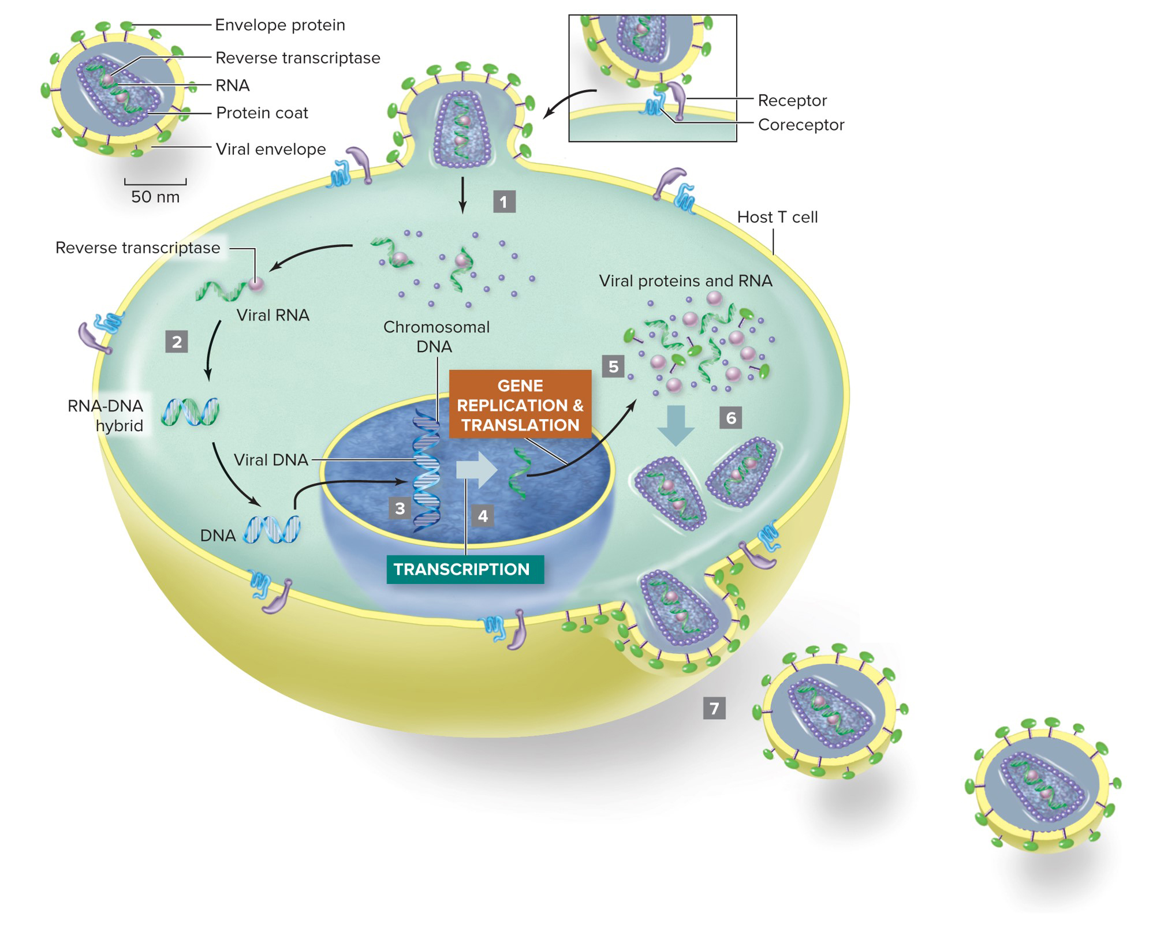
Anti-HIV drugs slow viral replication
For patients already infected with a virus, vaccines won’t be helpful.
Antiviral drugs prevent the virus from interacting with the host cell and using it for replication.
Section 16.4
Figure 16.5

Slide 33
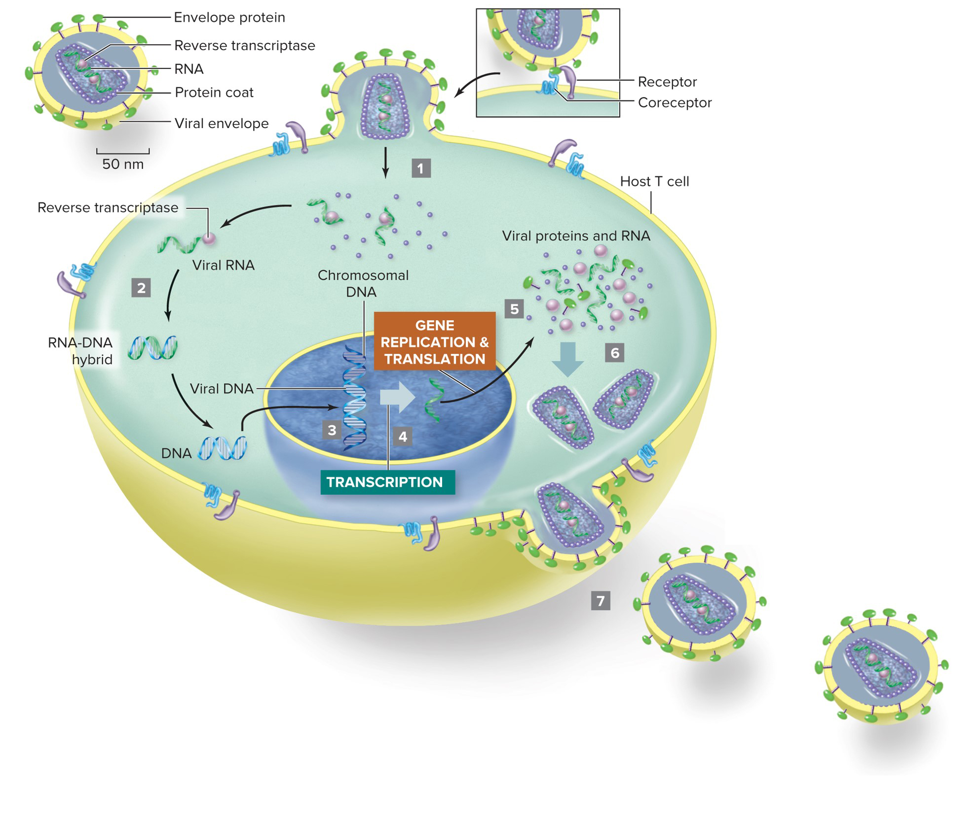
Anti-HIV drugs block the replication steps
Drugs can block viral binding to cells, reverse transcription, integration of viral DNA, or viral release.
Antiviral “cocktails” are combinations of different drugs that interfere with one virus.
Section 16.4
Figure 16.5

Slide 34
Antibiotics kill bacteria, not viruses
Antibiotics are drugs that block bacterial proteins from functioning, which prevents bacterial cells from carrying out life’s processes.
(a): ©Michael Abbey/Science Source; (b): ©CNRI/Science Source; (c): ©Kwangshin Kim/Science Source
Antibiotics are useful for treating bacterial infections.
Section 16.4
Figure 17.6

Slide 35
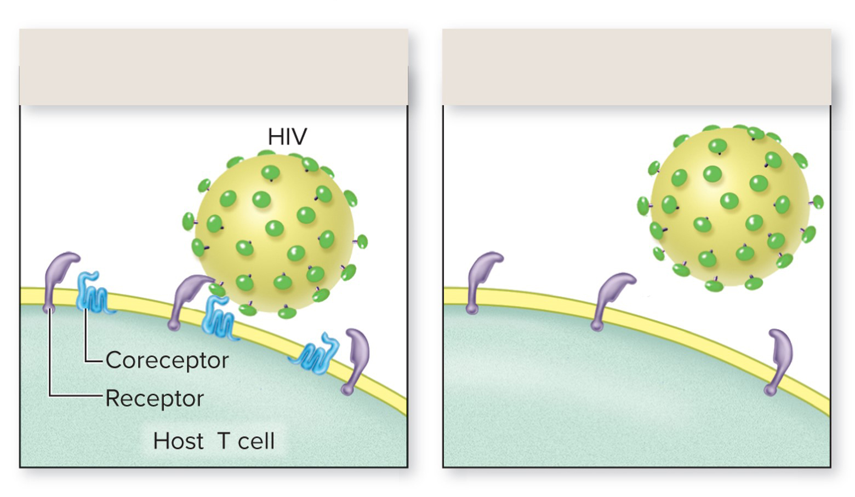
Antiviral gene therapy is a potential treatment strategy
Gene therapy would change the DNA in human cells, so they cannot make proteins the virus needs for infecting them.
The T cell shown here is missing one of the proteins that HIV binds to.
T cell with coreceptor: HIV can infect
T cell without coreceptor: no HIV infection
Section 16.4
Figure 16.B

Slide 36
Clicker question #4
Will taking leftover antibiotics help you fight off the flu?
No, antibiotics will not work against flu viruses.
Yes, but only if you have enough antibiotics left to kill all of the viruses.
Yes, the antibiotics kill the bacteria that produce flu viruses.

Slide 37
Clicker question #4, solution
Will taking leftover antibiotics help you fight off the flu?
No, antibiotics will not work against flu viruses.

Slide 38
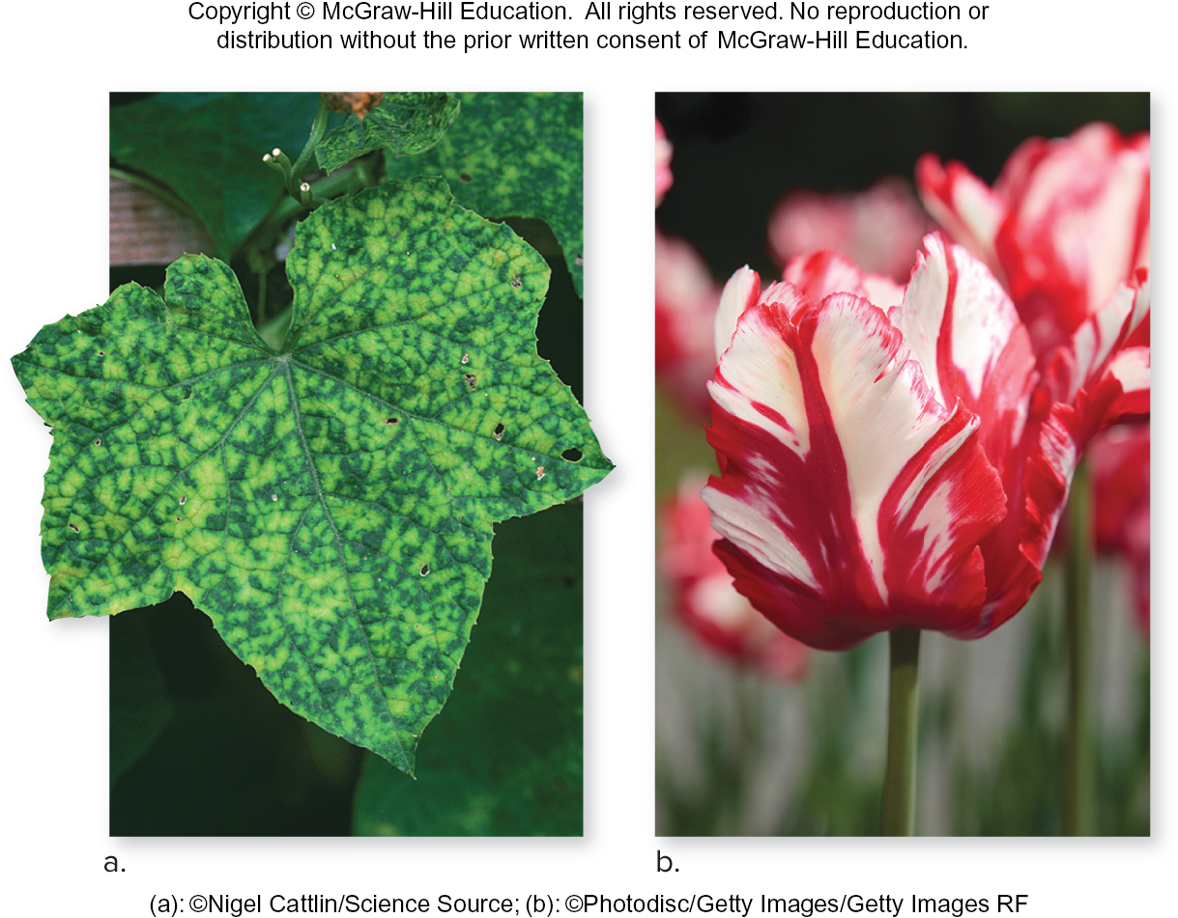
Viruses cause disease in plants
The color patterns on these plants might look interesting to us, but they’re caused by viruses. The pale areas are dead plant cells.
Viral infections often spread on the mouths of plant-eating insects.
(a): ©Nigel Cattlin/Science Source; (b): ©Photodisc/Getty Images/Getty Images RF
Section 16.5
Figure 16.7

Slide 39
Plants can fight viruses too
Although plants do not have an active immune system, their cells can undergo apoptosis (suicide) when infected.
Some plants may prevent viral infections from spreading by degrading viral mRNA.
(a): ©Nigel Cattlin/Science Source; (b): ©Photodisc/Getty Images/Getty Images RF
Section 16.5
Figure 16.7

Slide 40
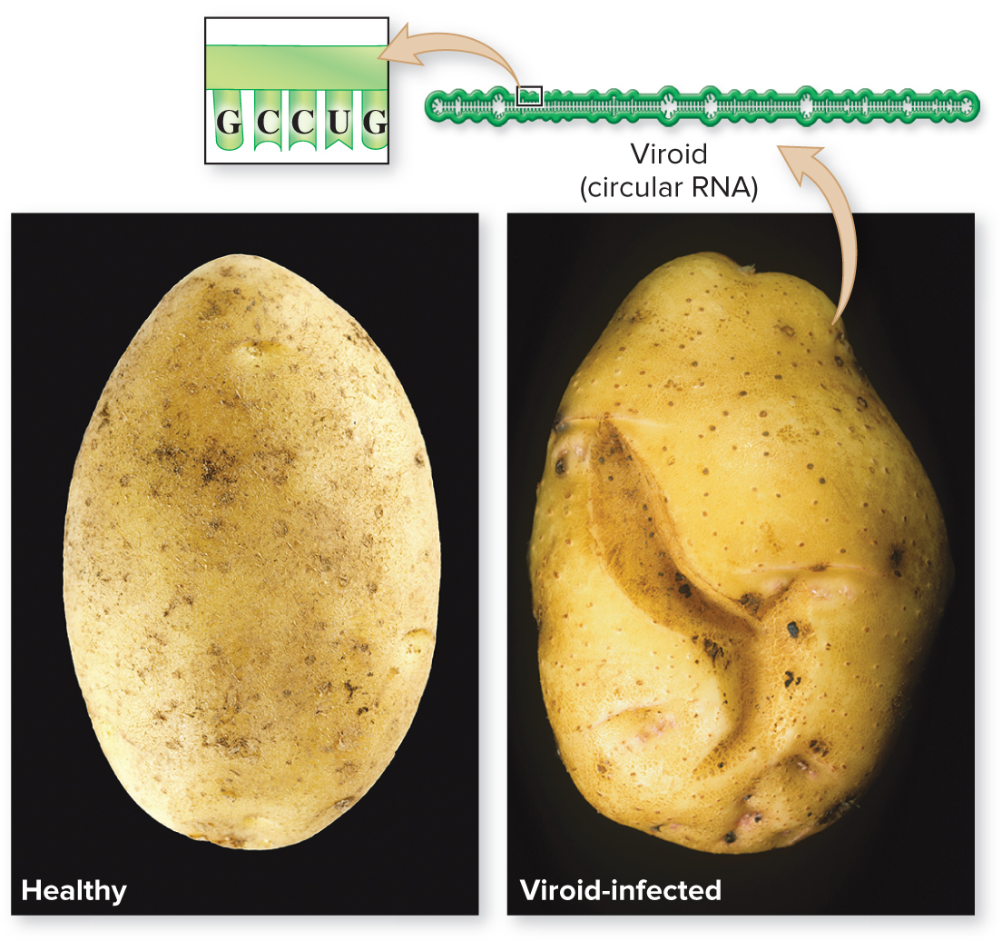
Viroids are infectious RNA molecules
Viroids are circles of RNA that can infect cells.
Viroids do not encode proteins, but they do use host cells to replicate.
(healthy): ©SerAlexVi/Getty Images RF; (infected): ©Nigel Cattlin/Alamy
Section 16.6
Figure 16.8

Slide 41
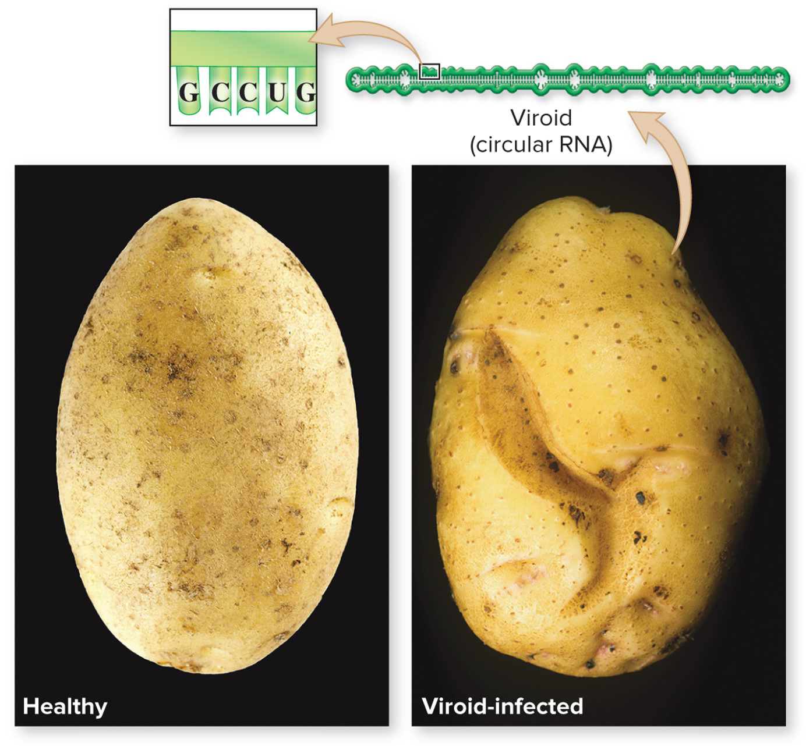
Viroids can cause diseases
The potato spindle viroid kills plant cells by preventing production of essential plant proteins.
(healthy): ©SerAlexVi/Getty Images RF; (infected): ©Nigel Cattlin/Alamy
Section 16.6
Figure 16.8

Slide 42
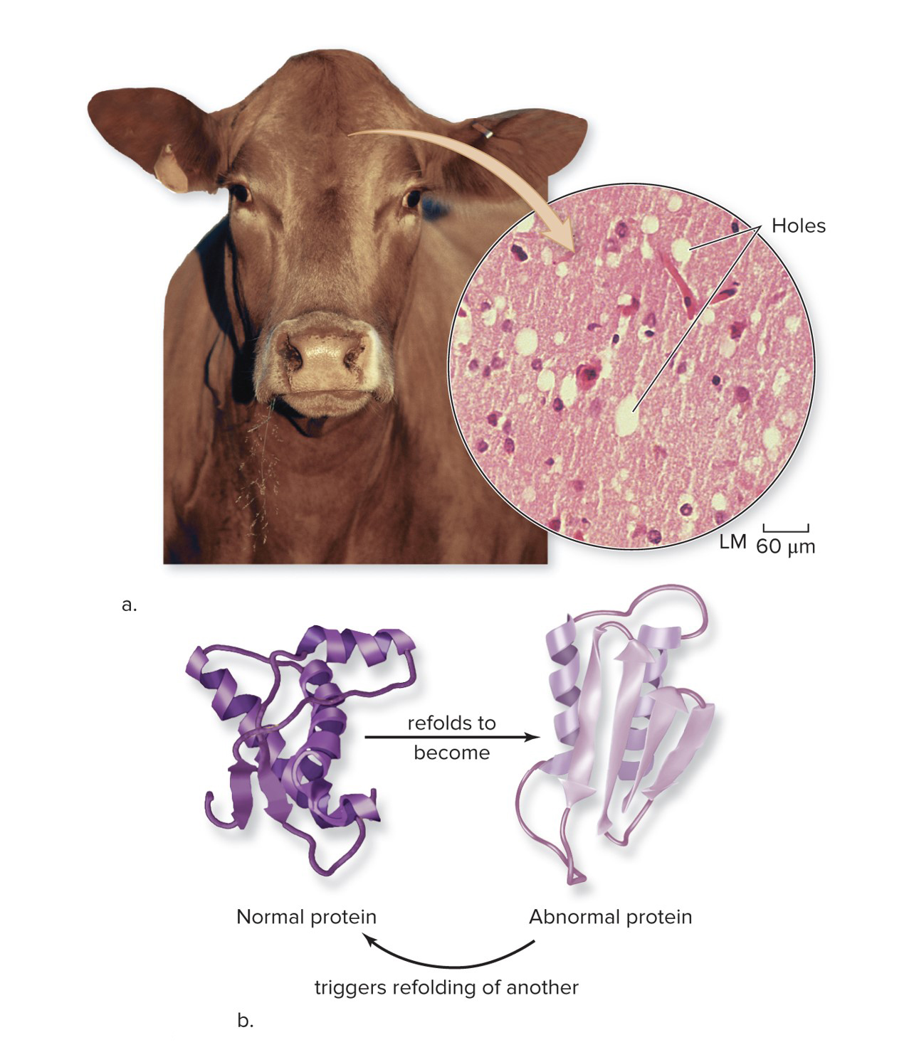
Prions are infectious protein molecules
A prion is a normal cellular protein that sometimes adopts an abnormal shape.
Upon contact with an abnormally formed prion, a normal prion switches to the abnormal shape.
(a, cow): ©Pixtal/age fotostock RF; (a, tissue): ©Ralph Eagle Jr./Science Source
Section 16.6
Figure 16.9

Slide 43
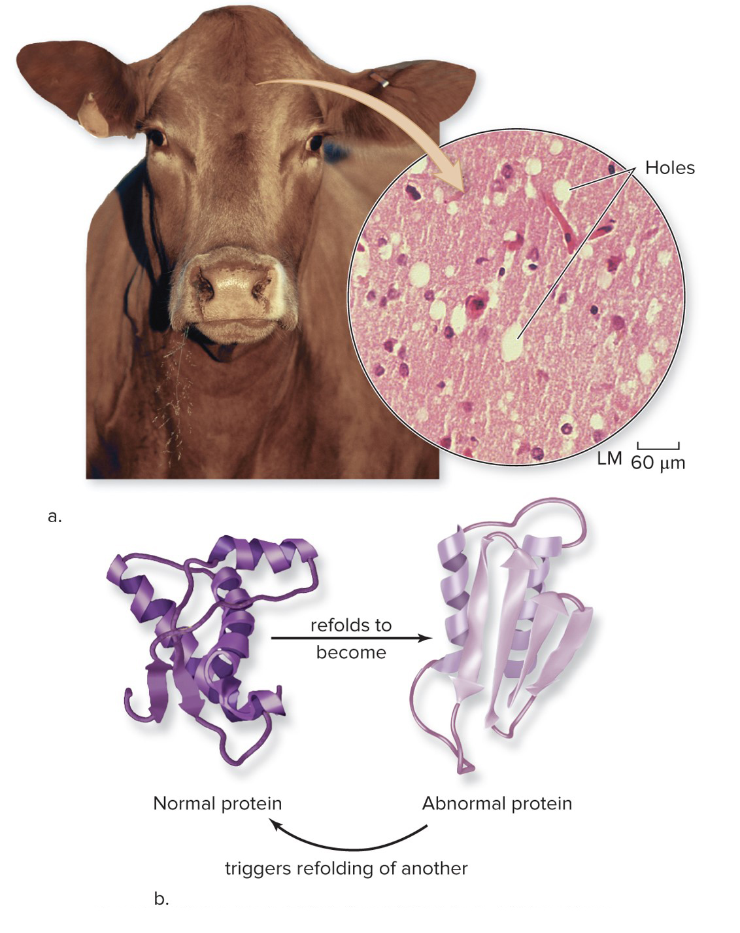
Prions can cause diseases
Prions are responsible for mad cow disease and some cases of Creutzfeldt-Jakob disease in people.
It is very difficult to destroy prions. They are unaffected by heat, radiation, and chemicals.
(a, cow): ©Pixtal/age fotostock RF; (a, tissue): ©Ralph Eagle Jr./Science Source
Section 16.6
Figure 16.9

Slide 44
Clicker question #5
Viroids and prions are infectious agents, but they are not types of viruses.
True
False

Slide 45
Clicker question #5, solution
Viroids and prions are infectious agents, but they are not types of viruses.
True

Slide 46
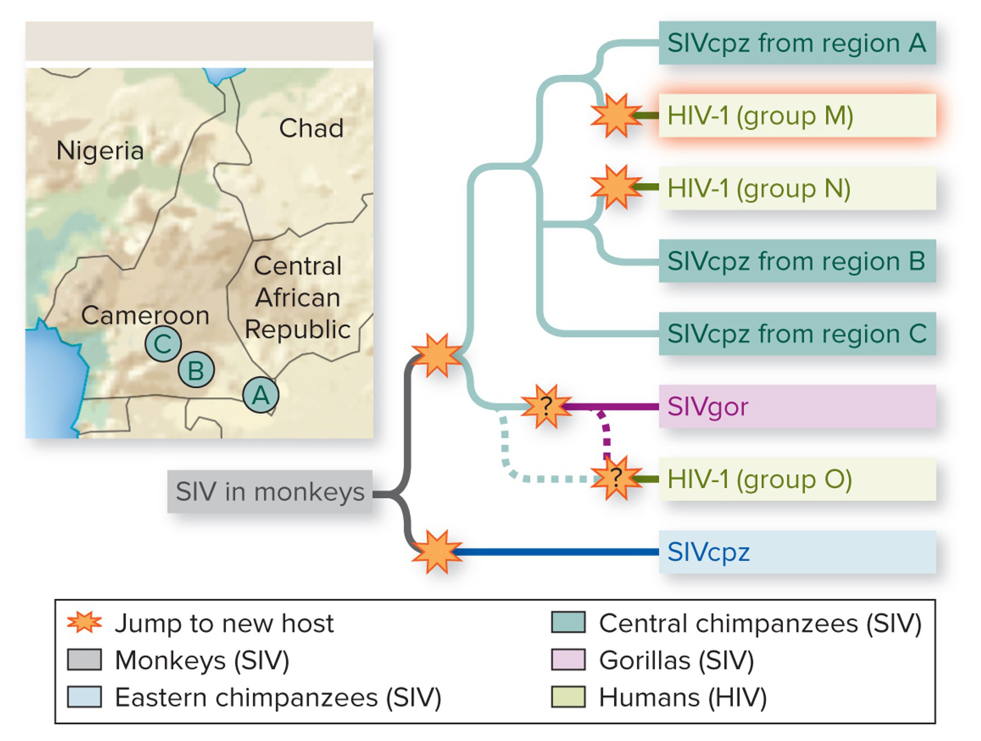
Investigating life: Scientific detectives follow HIV’s trail
HIV likely originated as a related virus, called SIV, that is common in chimps.
Central Africa
Section 16.7
Figure 16.10

Slide 47
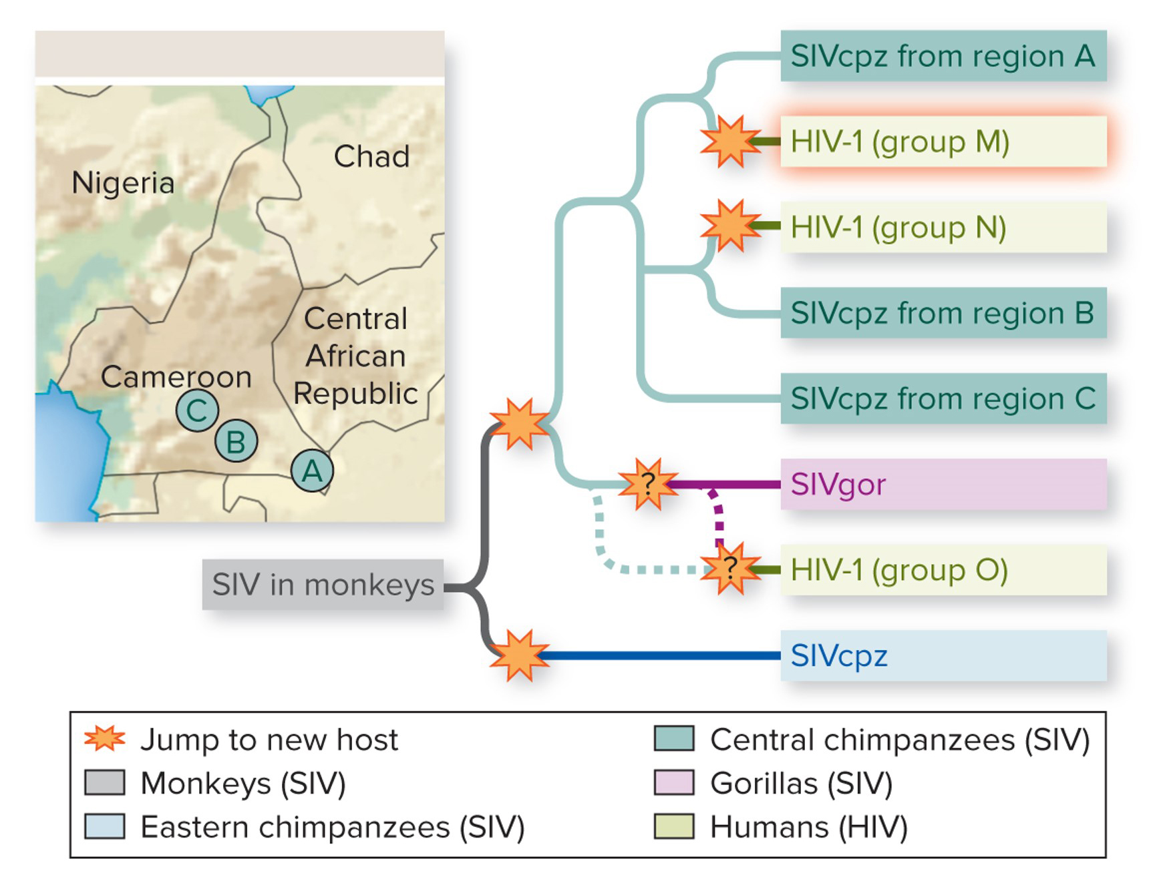
Investigating life: Molecular evidence traces HIV evolution
Amino acid sequences of viral proteins helped researchers to build the evolutionary tree of these related viruses.
Central Africa
Section 16.7
Figure 16.10

Slide 48
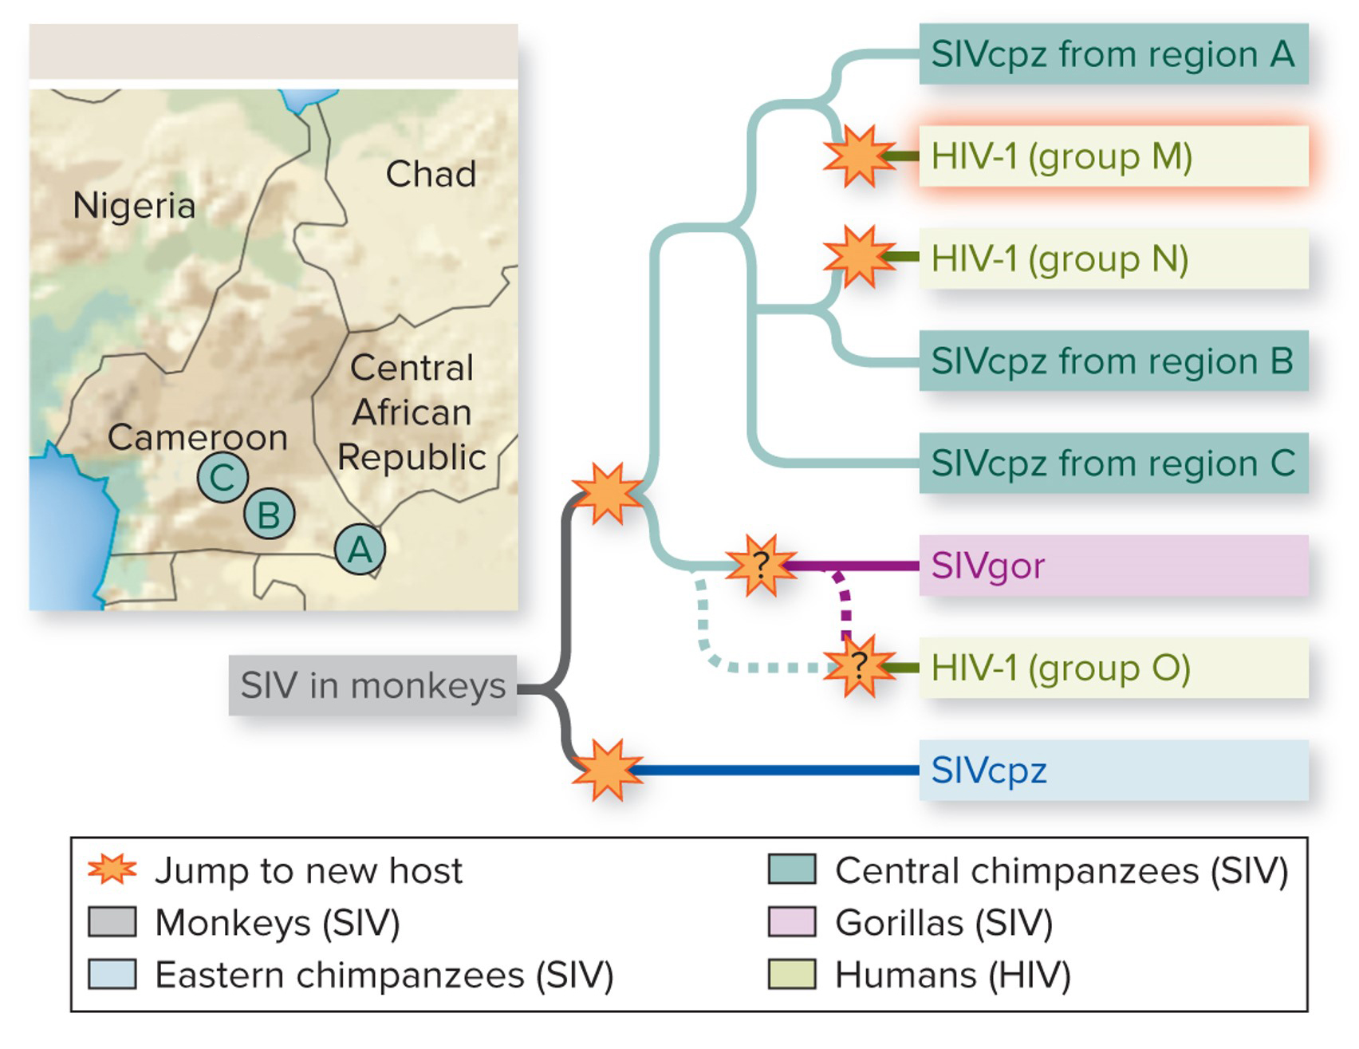
Investigating life: Mutations in viruses can shift the host range
Central Africa
Humans who hunt chimps for meat were likely infected with SIV.
The virus mutated in humans, giving rise to multiple strains of HIV.
Section 16.7
Figure 16.10

