Slide 1
Transcription/Translation
From DNA to Proteins

Slide 2
DNA
RNA
PROTEINS
The central dogma in biology states that information flows from

Slide 3
What is DNA?
You may already know that DNA is the “code” of life, but how do our bodies interpret this information? And what do they do with it?
The simple answer is that DNA is a set of coded instructions which tell cells how to make proteins. Each gene, or section of DNA, contains the instructions a cell needs to assemble a protein.

Slide 4
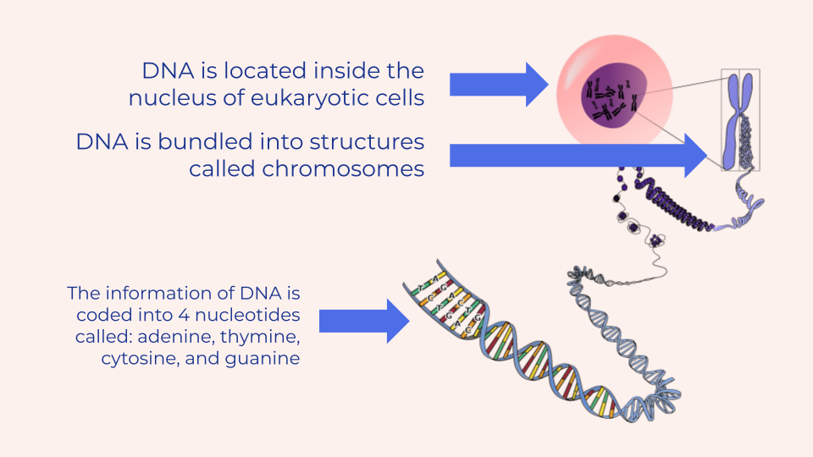

Slide 5
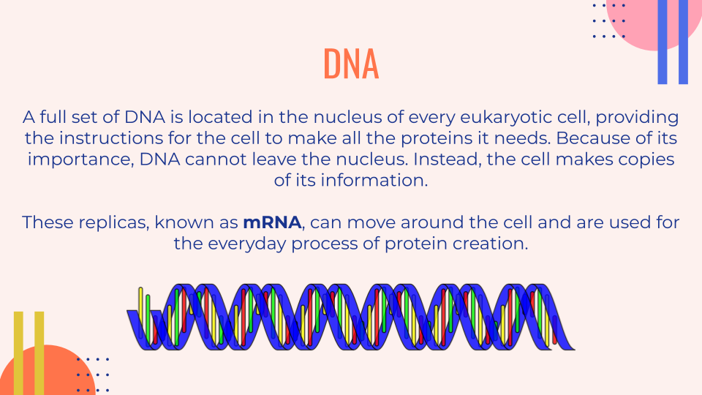

Slide 6
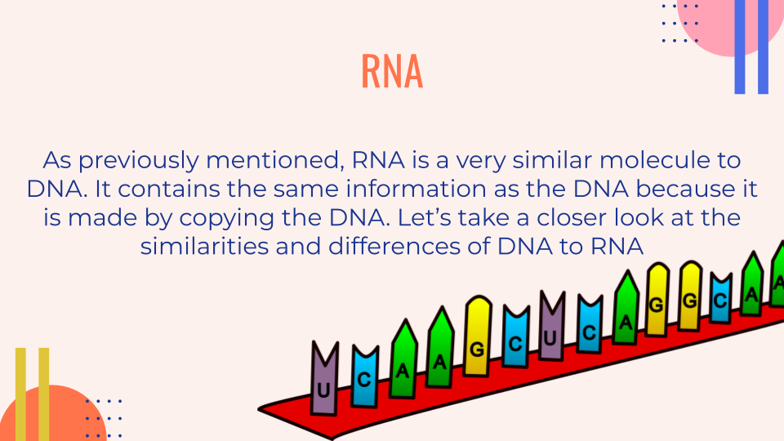
What is RNA?

Slide 7
RNA vs. DNA
DNA has two strands, but RNA has only one.
DNA contains the nucleotide thymine, but RNA replaces it with uracil.
DNA contains the sugar deoxyribose, while RNA contains ribose.
DNA must stay in the nucleus, but RNA can travel out.
Both DNA and RNA contain genetic information.

Slide 8
Types of RNA
There are 3 types of protein which all play an important role in the protein synthesis process:
mRNA carries the information from the DNA in the nucleus to the ribosome where proteins are made
tRNA brings the amino acids to the ribosome to create the amino acid chain
rRNA makes up the structure of the ribosome

Slide 9
PROTEINS
What are proteins?
The DNA and RNA work together to complete one goal: protein production. So what is it about proteins that makes them so essential?
Proteins are massive molecules which are made up of a chain of amino acids. The shape of a protein is directly related to its function, or job.

Slide 10
PROTEINS
It is estimated that our bodies make somewhere between 80-400,000 different proteins.
All of these proteins are made from just 20 different amino acids, and those amino acids are coded for by just 4 different nucleotides (A, T, G, and C).
Let’s dive in now to the process of protein synthesis and how the cell builds a protein using the DNA instructions.

Slide 11
PROTEIN SYNTHESIS
Objective 3: Explain the process of transcription.
Students will be able to:
1) Describe the process of transcription.
2) Describe the 3 differences between DNA and RNA.
3) Describe the role of DNA, mRNA, tRNA, and rRNA.
4) Diagram the structures of DNA, mRNA, tRNA, and rRNA.
5) If given a strand of DNA, be able to draw a transcribed strand of RNA which corresponds to the
strand of DNA.
Objective 4: Explain the process of translation and how proteins are synthesized.
Students will be able to:
1) Describe the steps to transcribe an mRNA molecule and use the mRNA molecule to produce
proteins.
2) Differentiate between transcription and translation.
3) Diagram the steps and illustrate what happens in each stage.

Slide 12
REVIEW: The Central Dogma in Biology
DNA
RNA
PROTEINS
DNA contains the code that tells a cell which sequence of amino acids should be used to create a specific protein. Since DNA can’t leave the nucleus, that message must first be copied to mRNA before it can head to the ribosome to be interpreted.

Slide 13
STEP 1: TRANSCRIPTION
DNA
RNA
Transcription is the first step of this protein synthesis.
This process occurs in the nucleus. At this time, DNA is copied to a more portable form called mRNA. mRNA is created after an enzyme called RNA polymerase “unzips” the DNA. A complementary nucleotide is matched to each base pair on one strand of the DNA. This new strand of mRNA will be identical to the opposite side of the DNA except that where the DNA would have thymine, mRNA has uracil.

Slide 14
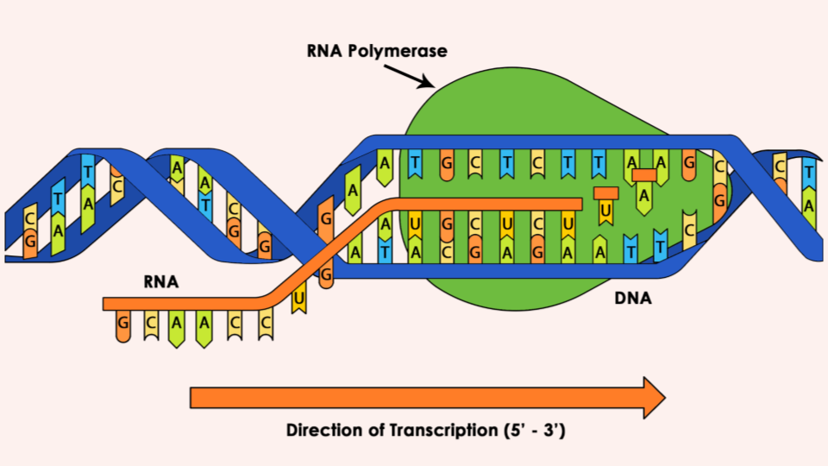

Slide 15
Try it! Transcribe the DNA:
Match each base pair with its complementary nucleotide. Remember, where DNA would use T, mRNA uses U.
DNA | GCA | ATC | GTT | ACT | TAC | CGG | CAT | TAG | GGA | ACG
mRNA

Slide 16
How did you do?
Match each base pair with its complementary nucleotide. Remember, where DNA would use T, mRNA uses U.
DNA | GCA | ATC | GTT | ACT | TAC | CGG | CAT | TAG | GGA | ACG
mRNA | CAU | UAG | CAA | UGA | AUG | GCC | GUA | AUC | CCU | UGC

Slide 17
STEP 2: TRANSLATION
RNA
PROTEINS
Translation is the next step of this protein synthesis.
This process occurs in the ribosome. At this time, the message contained in the mRNA is translated. Every 3 letters, known as a codon, indicates a specific amino acid. Each codon matches with the anticodon located on a tRNA molecule. Each tRNA molecule carries the amino acid specified by the mRNA which it then adds to the chain. In the ribosome, the mRNA is “read” and codons are added the the amino acid chain, known as the peptide chain.

Slide 18
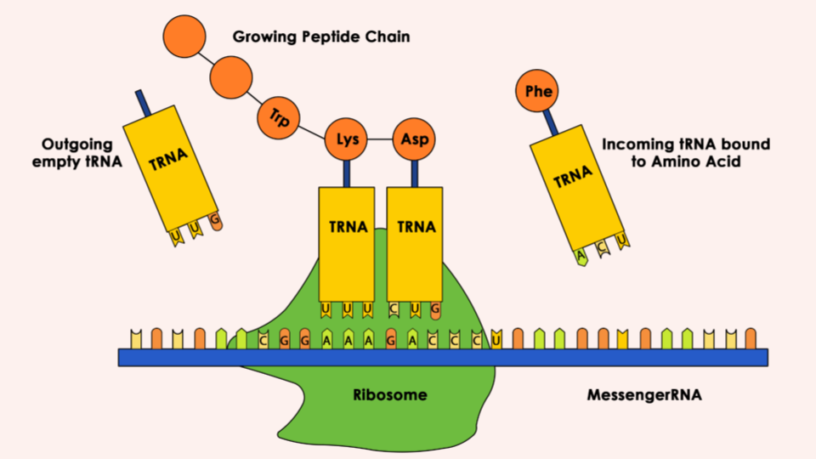

Slide 19
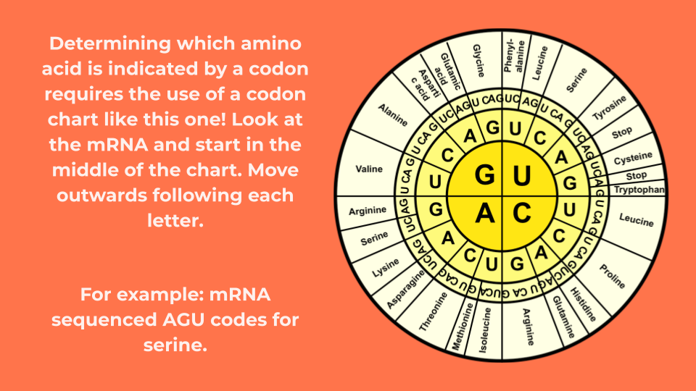

Slide 20
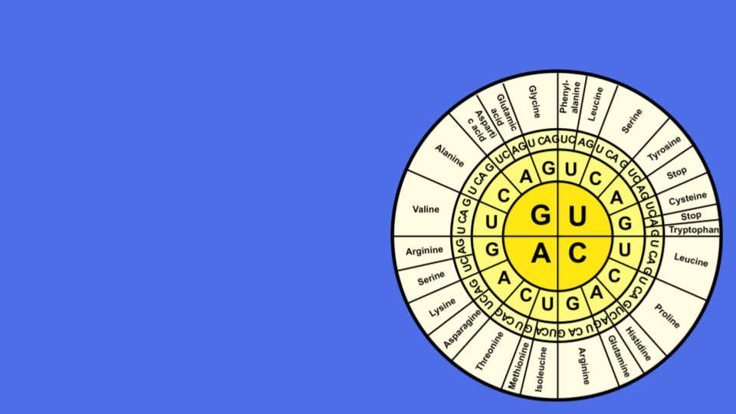
Try it! Match codons with amino acids:
Match each codon with the correct amino acid, by using the codon chart.
mRNA | Amino Acid
GCU
CCC
AUG
GUC
UAG

Slide 21
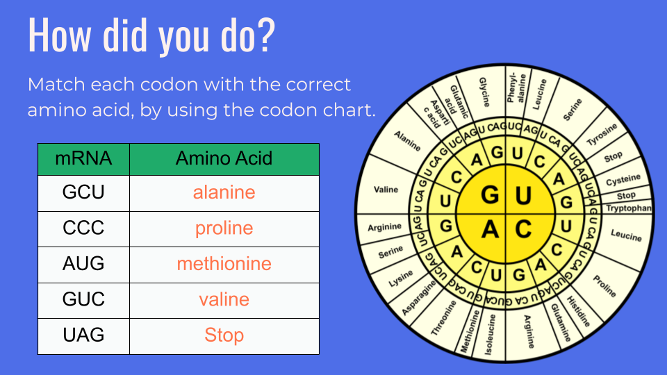

Slide 22
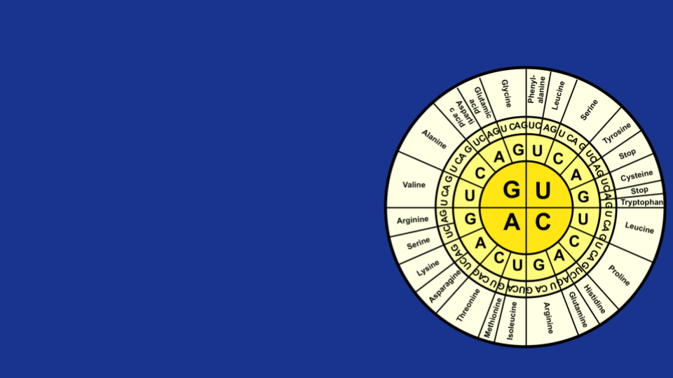
Put it together!
Can you transcribe and translate the DNA to determine the chain of amino acids? Hint: tRNA is just like mRNA where C and G always match and A and U/T always match. Use the mRNA to determine the amino acid, NOT the tRNA.
DNA | GCA | ATA | GTT | ACT
mRNA
tRNA
Amino acid

Slide 23
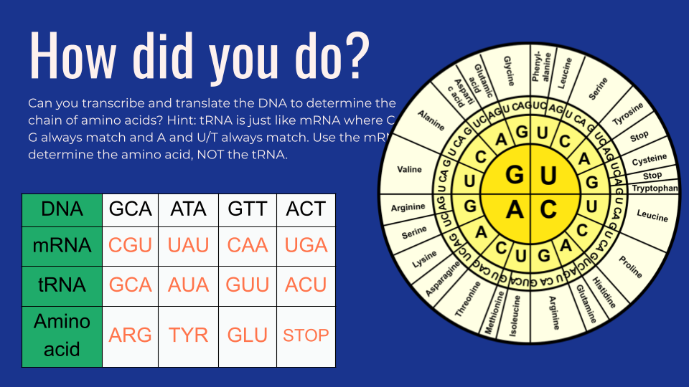

Slide 24
PROTEIN SYNTHESIS: Common mishaps
Protein synthesis is easy once you get the hang of it! Some common mistakes that students make are:
Finding the amino acid using the anticodon (tRNA) rather than the codon (mRNA).
Accidentally using T when they are writing mRNA and tRNA. Remember, RNA never has thymine!
Switching up the U to match with T when U actually matches with A.
TIP: The tRNA should look exactly like DNA except with a U in place of every T.

