Slide 1
Chapter 26
The Nervous System
©Henrik Sorensen/Riser/Getty Images
©McGraw-Hill Education. All rights reserved. Authorized only for instructor use in the classroom.
No reproduction or further distribution permitted without the prior written consent of McGraw-Hill Education.

Slide 2
The nervous system: rapid communication, 1
Rapid communication between cells is fundamental to the function of the animal nervous system.
©Digital Vision RF
Section 26.1
Figure 26.1

Slide 3
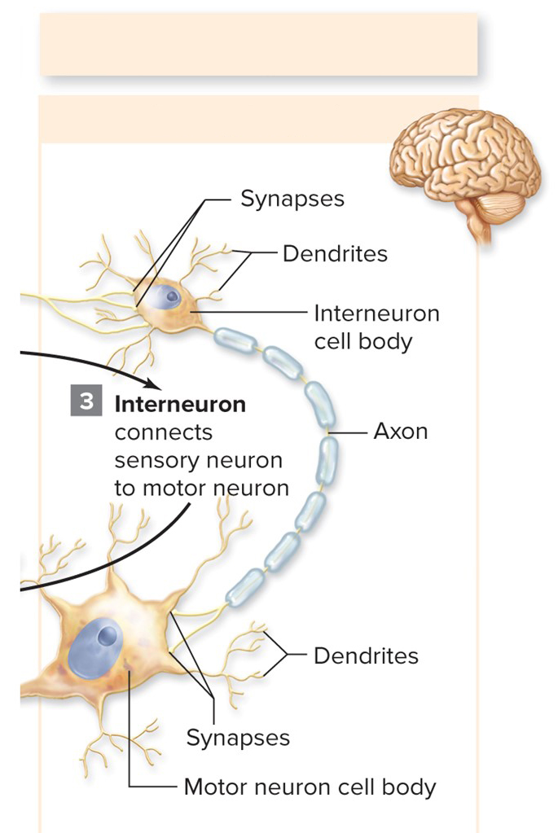
Neurons and neuroglia, 1
The nervous system consists mainly of nervous tissue, which has two types of cells: neurons and neuroglia.
Central nervous system (brain and spinal cord)
Sensory integration
©Digital Vision RF
Section 26.1
Figures 26.1, 26.5

Slide 4
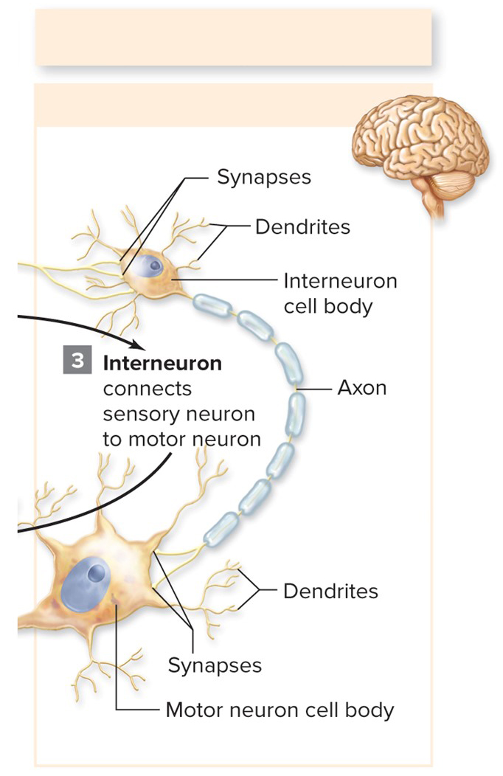
Neurons and neuroglia, 2
Neurons are interconnected cells that communicate via electrical impulses.
Neuroglia support neurons.
Central nervous system (brain and spinal cord)
Sensory integration
©Digital Vision RF
Section 26.1
Figures 26.1, 26.5

Slide 5
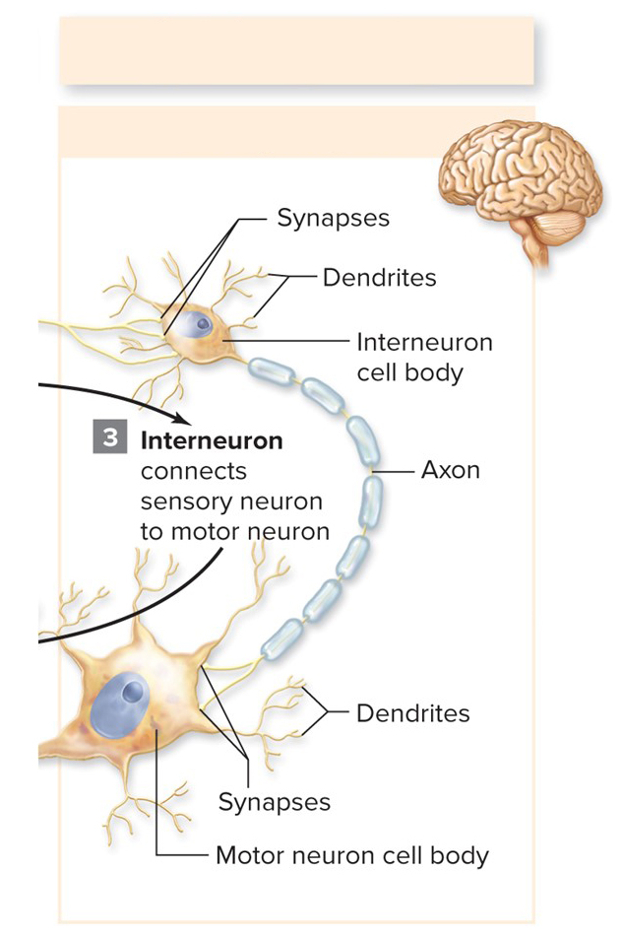
Neurons work together
Many neurons work together as an animal senses and reacts to its surroundings, makes decisions, and maintains homeostasis.
Central nervous system (brain and spinal cord)
Sensory integration
©Digital Vision RF
Section 26.1
Figures 26.1, 26.5

Slide 6
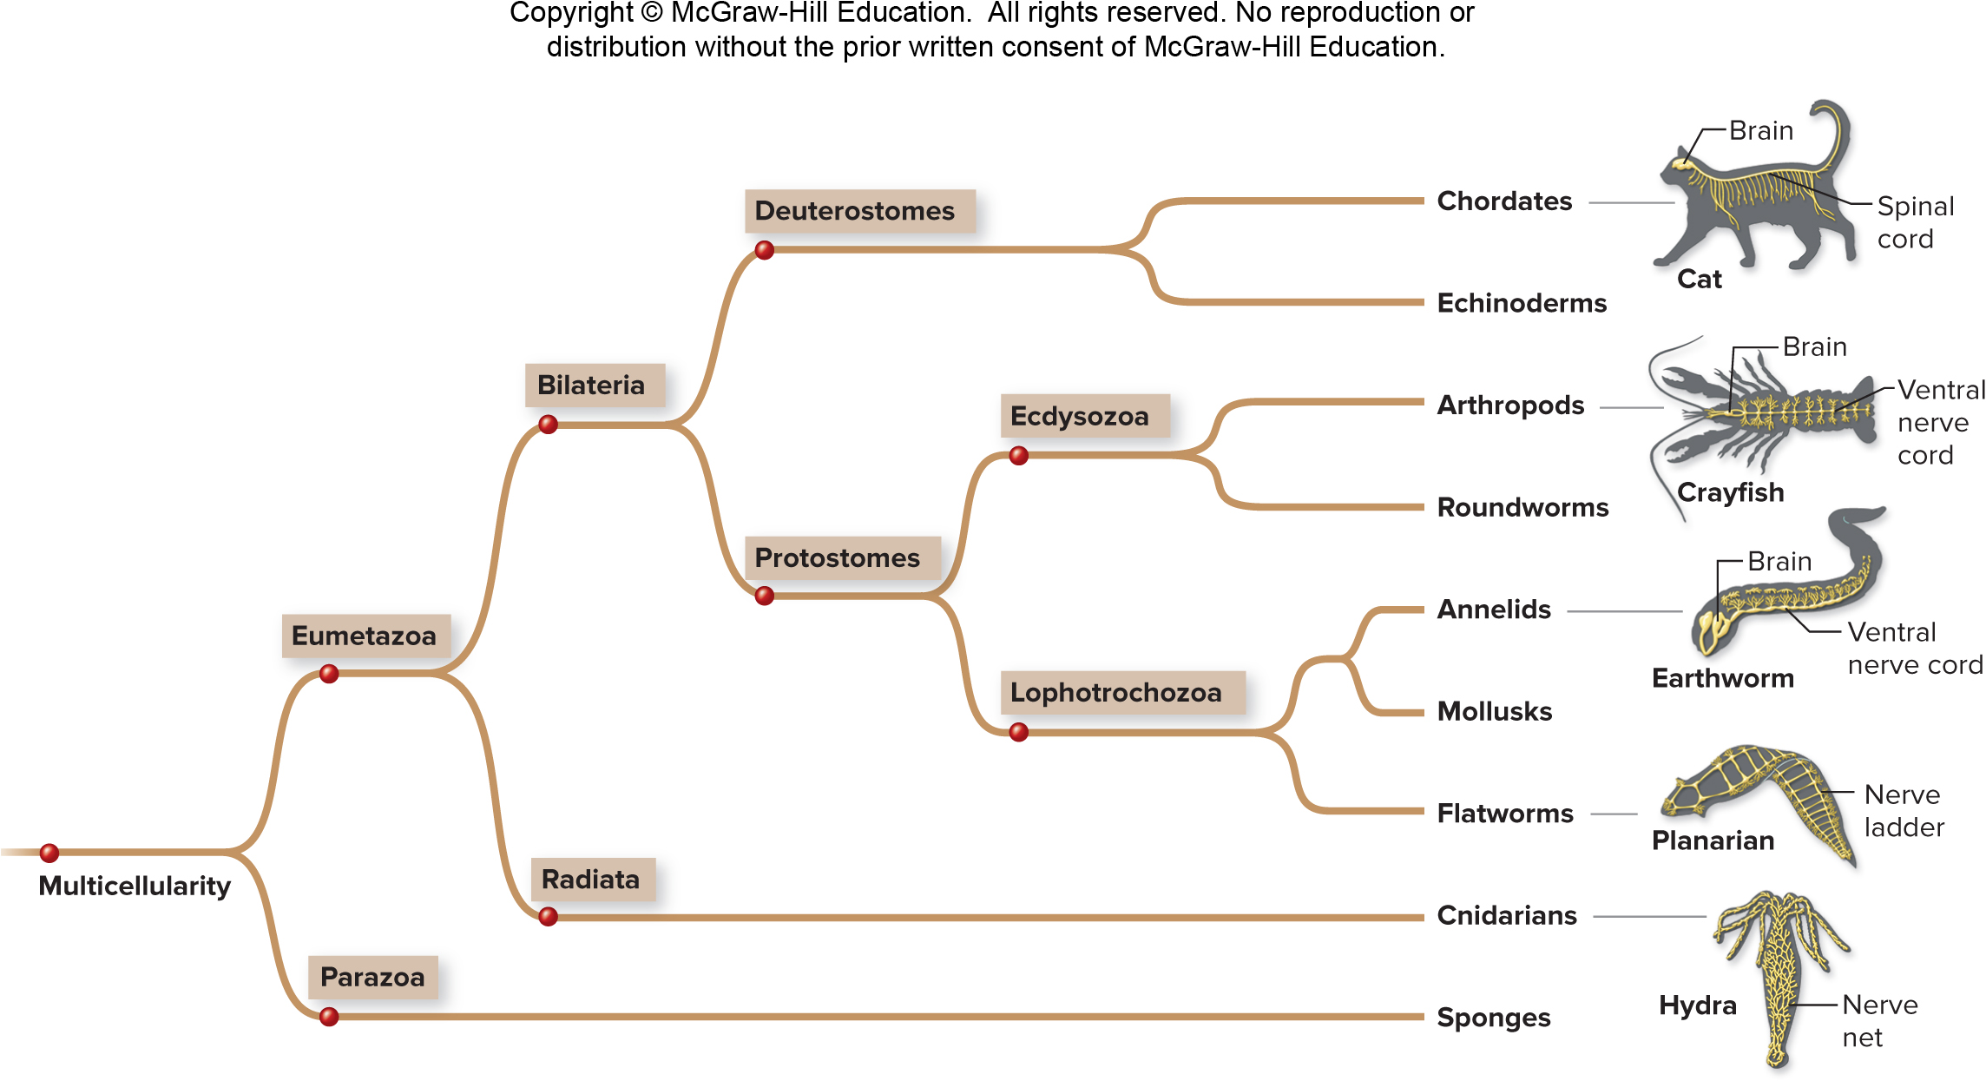
The evolutionary history of the nervous system
Nervous system complexity reflects evolutionary history.
Section 26.1
Figure 26.2

Slide 7
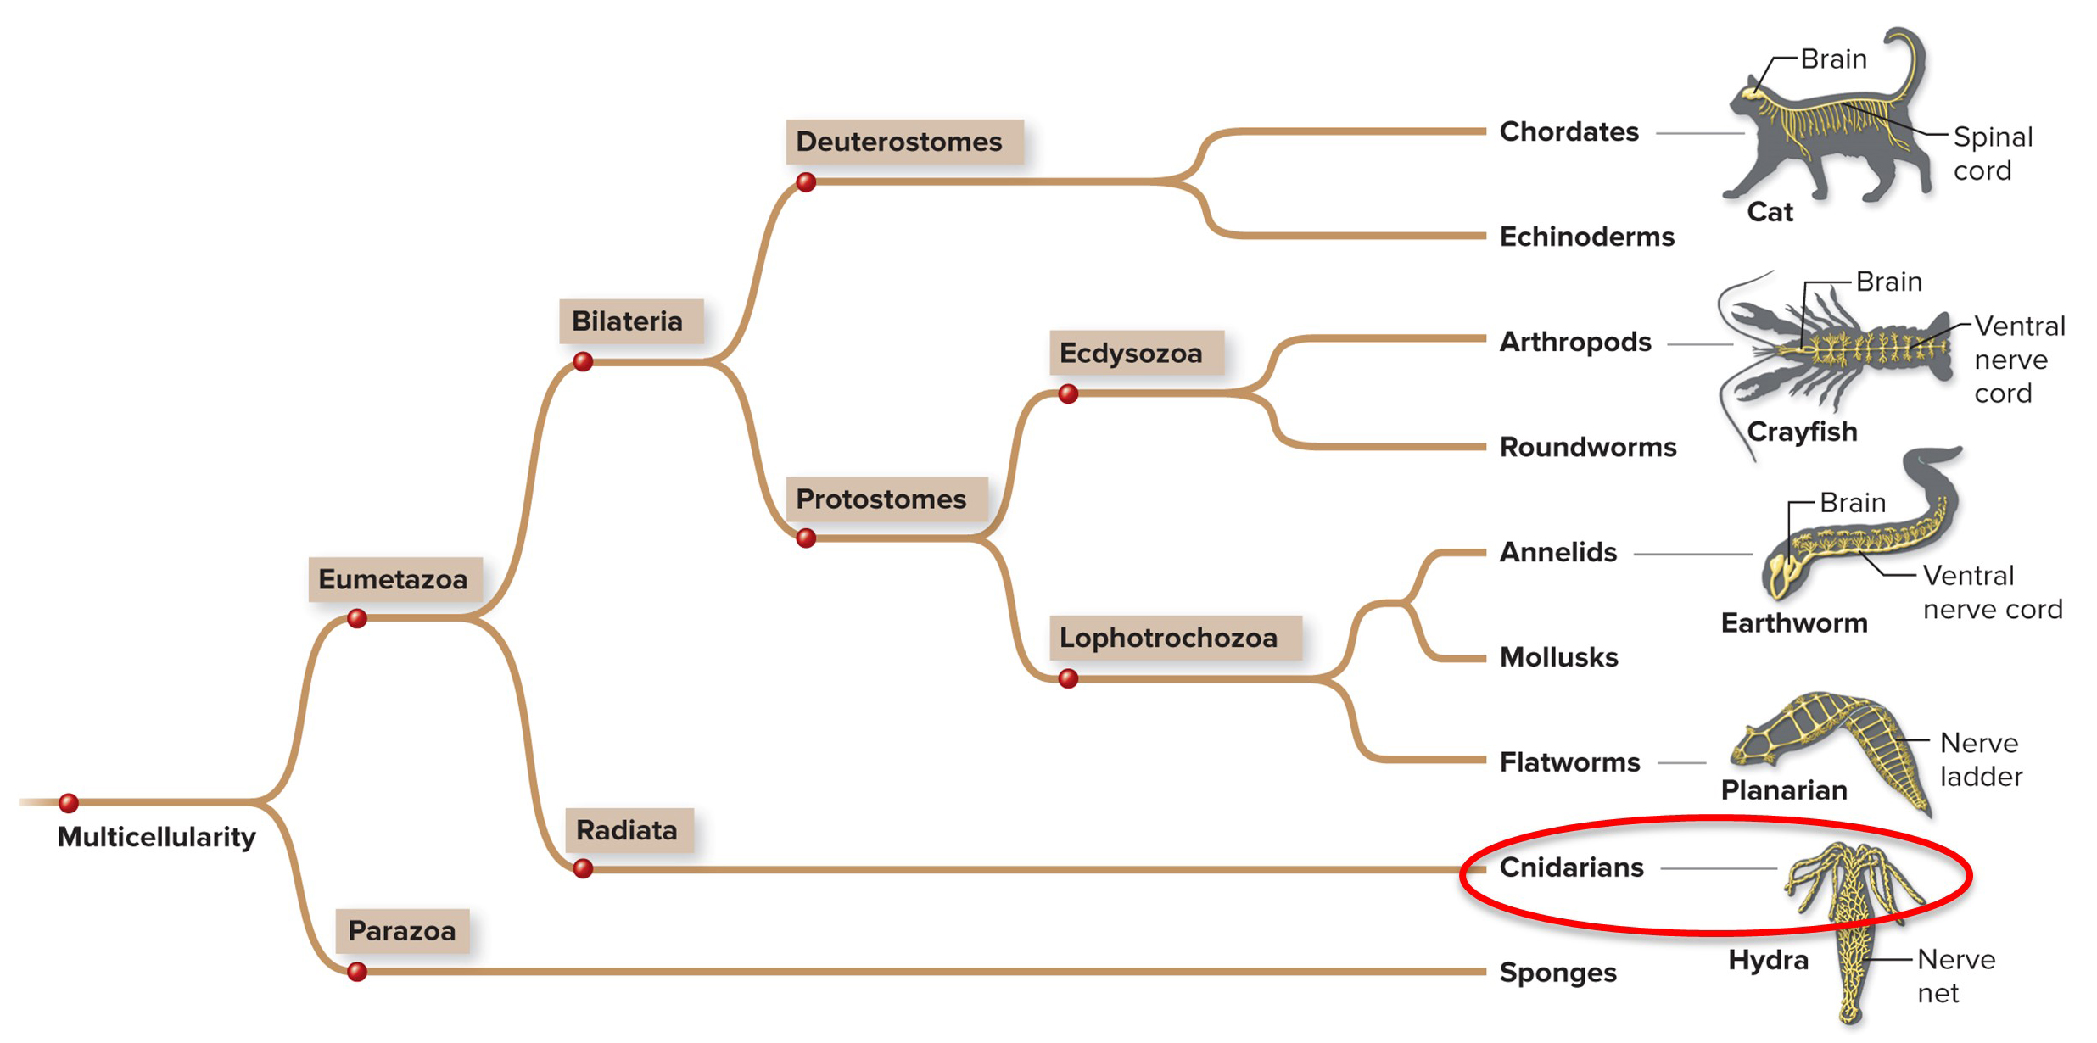
Cnidaria
Cnidaria have nerve nets, in which nervous impulses spread over the entire body surface.
Section 26.1
Figure 26.2

Slide 8
Flatworms
Flatworms and most other animals have ganglia—clusters of neurons.
Section 26.1
Figure 26.2

Slide 9
Flatworms have a nerve ladder
The nerve ladder of flatworms connects to paired muscles on each side of the body, allowing the worm to move rhythmically.
Section 26.1
Figure 26.2

Slide 10
Segmented worms
Segmented worms have a larger brain and a ventral nerve cord that helps the animal coordinate movements.
Section 26.1
Figure 26.2

Slide 11
Arthropods
Arthropods have a brain, a ventral nerve cord, and organs that detect light, sound, chemicals, and balance.
Section 26.1
Figure 26.2

Slide 12
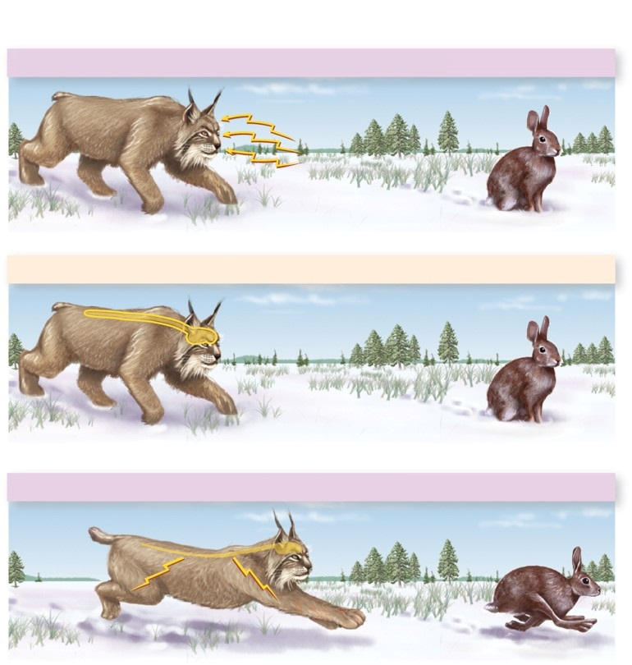
Vertebrates
Sensory input (ears, eyes, and nose detect prey)
Vertebrate nervous systems are divided into the central and peripheral nervous systems.
Sensory integration (brain and spinal cord interpret sensory input)
Even seemingly simple tasks, like this lynx seeing and chasing a hare, require interactions among many neurons in both divisions.
Motor response (muscles and glands react)
Section 26.1
Figure 26.3

Slide 13
The peripheral nervous system: sensory input
Sensory input (ears, eyes, and nose detect prey)
Neurons in the peripheral nervous system carry information to or from the central nervous system.
Sensory integration (brain and spinal cord interpret sensory input)
For example, neurons in sense organs respond to sensory input.
Motor response (muscles and glands react)
Section 26.1
Figure 26.3

Slide 14
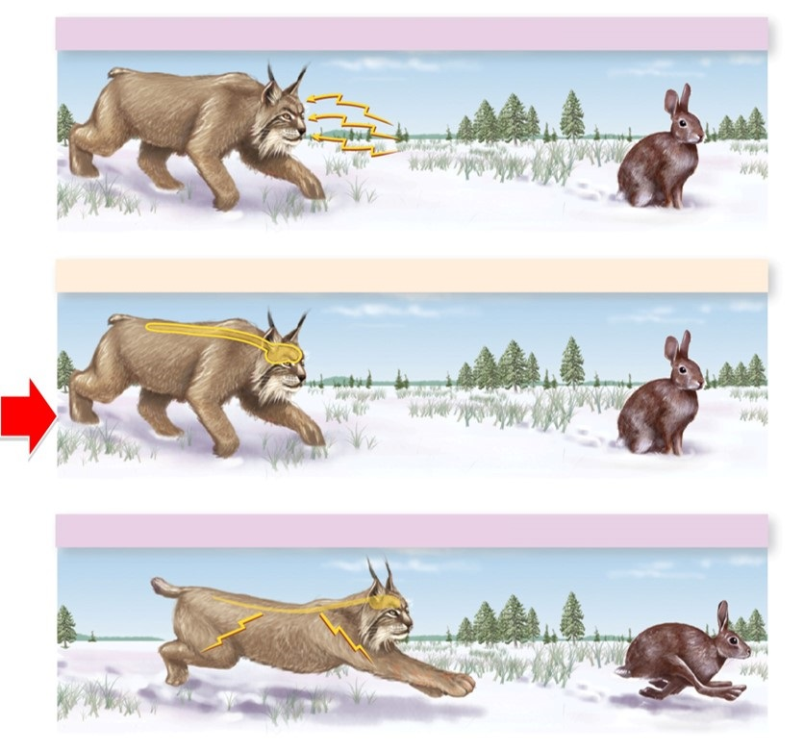
The nervous system: rapid communication, 2
Sensory input (ears, eyes, and nose detect prey)
The central nervous system interprets signals it receives from the peripheral nervous system.
Sensory integration (brain and spinal cord interpret sensory input)
Motor response (muscles and glands react)
Section 26.1
Figure 26.3

Slide 15
Peripheral nervous system: motor response
Sensory input (ears, eyes, and nose detect prey)
In a fraction of a second, the central nervous system signals the peripheral nervous system to stimulate a motor response.
Sensory integration (brain and spinal cord interpret sensory input)
Motor response (muscles and glands react)
Section 26.1
Figure 26.3

Slide 16
26.1 Mastering concepts
Distinguish between the central and peripheral nervous systems.
©Henrik Sorensen/Riser/Getty Images

Slide 17
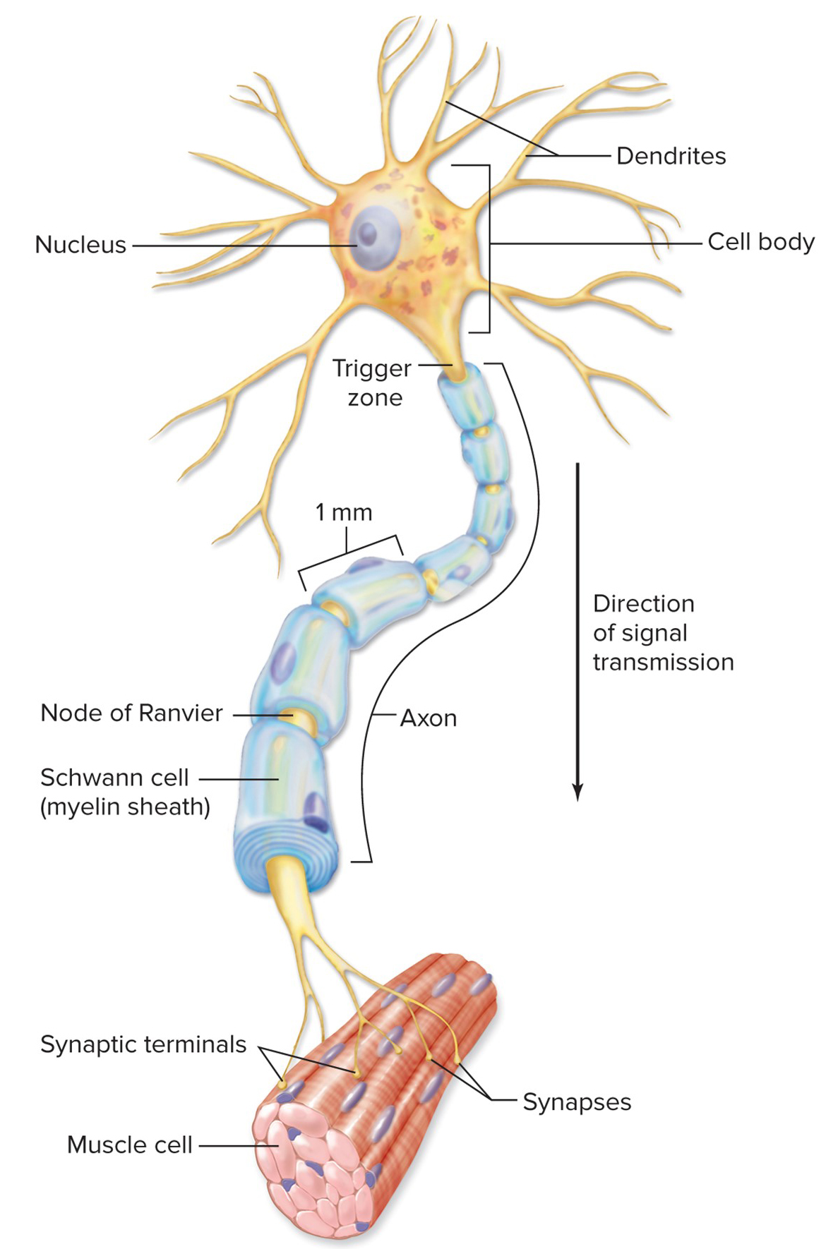
Neuron structure and arrangement
All neurons have the same basic parts:
Cell body
Dendrites
Axon
Section 26.2
Figure 26.4

Slide 18
Cell body
The cell body contains the nucleus, mitochondria, and other organelles.
Section 26.2
Figure 26.4

Slide 19
Dendrites
Dendrites are short, branched extensions that transmit information toward the cell body.
Section 26.2
Figure 26.4

Slide 20
Axon
The axon, or nerve fiber, conducts nerve impulses away from the cell body.
Section 26.2
Figure 26.4

Slide 21
Synapses, 1
The end of the axon meets another cell, forming one or more synapses.
Section 26.2
Figure 26.4

Slide 22
Myelin sheath
Some neurons also have a myelin sheath made of fatty neuroglia cells. The myelin sheath coats sections of the axon and speeds neural impulses.
Section 26.2
Figure 26.4

Slide 23
Nodes of Ranvier
The myelin sheath is made of either Schwann cells or oligodendrocytes. The spaces between myelin sheath cells are called Nodes of Ranvier.
Section 26.2
Figure 26.4

Slide 24
Three classes of neurons
Biologists divide neurons into three classes:
Sensory neurons
Interneurons
Motor neurons
These neurons work together to coordinate reactions to stimuli such as pain.
Section 26.2
Figure 26.5

Slide 25
Sensory neurons
Sensory neurons bring information from the body’s organs (such as heat, pain, taste, etc.) toward the central nervous system.
Section 26.2
Figure 26.5

Slide 26
Interneurons
Interneurons in the central nervous system receive signals from sensory neurons. The message is processed, and a signal is sent to a motor neuron.
Section 26.2
Figure 26.5

Slide 27
Motor neurons
A motor neuron conducts a message from the central nervous system to a muscle or gland, stimulating contraction or secretion.
Section 26.2
Figure 26.5

Slide 28
Clicker question #1
In a typical neuron, the ___ receive(s) information and the ___ communicate(s) that information to a neighboring cell.
cell body; dendrites
dendrites; axon
axon; cell body
axon; dendrites
dendrites; cell body

Slide 29
Clicker question #1, solution
In a typical neuron, the ___ receive(s) information and the ___ communicate(s) that information to a neighboring cell.
dendrites; axon

Slide 30
26.2 Mastering concepts
What are the functions of each of the three classes of neurons?
©Henrik Sorensen/Riser/Getty Images

Slide 31
Action potentials convey information
Each neuron in this network sends a message to the next cell. How is information carried through a neuron to its connection with another cell?
Section 26.3
Figure 26.5

Slide 32
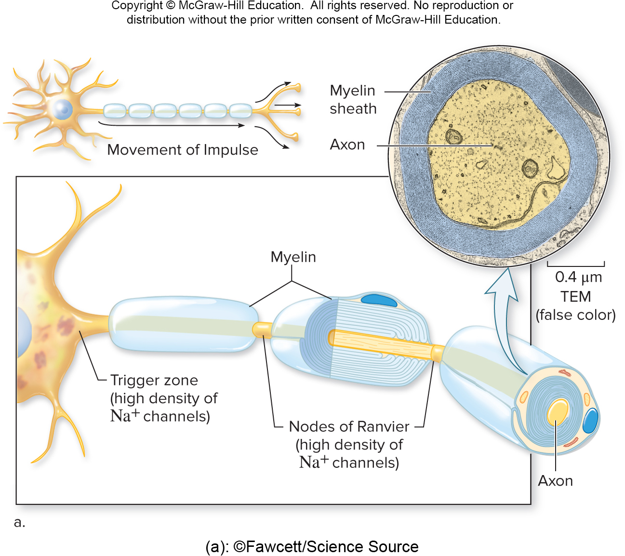
Action potentials
The message is an electrical impulse called an action potential, which travels along a neuron’s axon.
(a): ©Fawcett/Science Source
Section 26.3
Figure 26.8

Slide 33
Action potentials and ions
Action potentials result from the movement of charged particles (ions) across the cell membrane.
Section 26.3
Figure 26.6

Slide 34
Triggering an action potential
Action potentials are triggered by changes in other parts of the neuron.
Section 26.3
Figure 26.8

Slide 35
Dendrites receive and transmit information
A change in pH, a touch, or a signal from another neuron may cause some sodium channel gates in a neuron’s membrane to open, usually at the dendrites or cell
body.
Section 26.3
Figure 26.4

Slide 36
Membrane potential
A small amount of ${Na}^{+}$ leaks into the cell through the open channels. These movements regulate the membrane potential, or charge difference across the membrane.
The resting membrane potential of a neuron is usually negative.
Section 26.3
Figure 26.6

Slide 37
Sodium ions change the membrane potential
${Na}^{+}$ is a positive ion, so as it enters the cell, the interior becomes less negative.
Section 26.3
Figure 26.6

Slide 38
Graded potential
The electrical current caused by moving ${Na}^{+}$ ions shown here is called a graded potential: it weakens with distance from the source of the stimulus and its magnitude depends on the signal’s strength.
Section 26.3
Figure 26.6

Slide 39
Initiating an action potential
If the graded potential that reaches the axon is strong enough (green arrow), then an action potential will initiate.
Section 26.3
Figure 26.6

Slide 40
Action potentials: a closer look
Zooming in on a small patch of an axon’s cell membrane reveals the events of an action potential.
Section 26.3
Figure 26.6

Slide 41
Action potentials require changes in membrane potential
As an action potential passes this patch of axon,
ions move in and then out, causing
the charge in the axon to change.
Section 26.3
Figure 26.6

Slide 42
Establishing action potentials: resting potential
Notice that sodium (${Na}^{+}$) and potassium ($K^{+}$) ions are distributed near the axon membrane. Also, the inside of the axon has negatively charged proteins.
Section 26.3
Figure 26.6

Slide 43
Membrane potential is regulated by the movement of ions
${Na}^{+}$and $K^{+}$move in and out through channels in the axon membrane.
Section 26.3
Figure 26.6

Slide 44
Resting potential: -70mv
When not conducting a neural impulse, an axon maintains its resting potential. The axon’s interior is negatively charged relative to the outside.
Section 26.3
Figure 26.6

Slide 45
Sodium-potassium pumps
This charge difference results from the action of many sodium-potassium pumps, which use ATP to send three${Na}^{+}$ ions out of the cell for every two $K^{+}$ions they let in.
Section 26.3
Figure 26.6

Slide 46
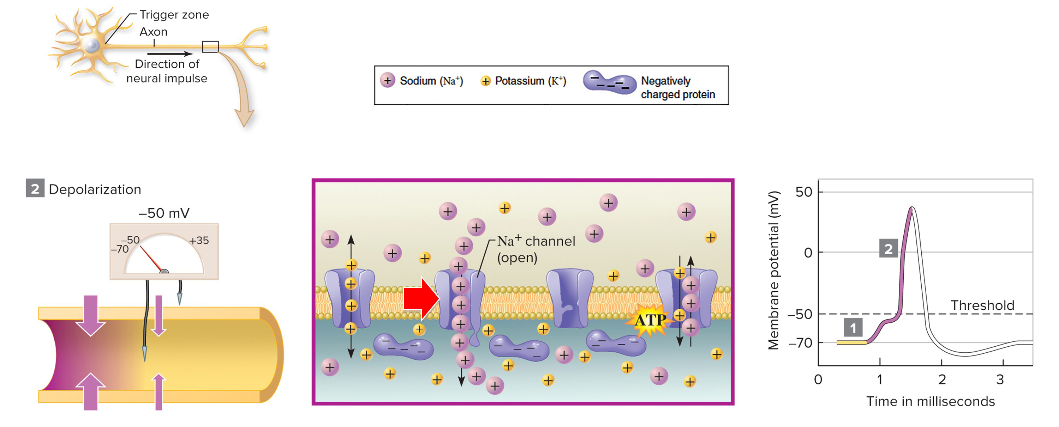
An action potential begins
When a graded potential reaches an axon, a few sodium channels open, allowing sodium ions to trickle into the axon.
Section 26.3
Figure 26.6

Slide 47
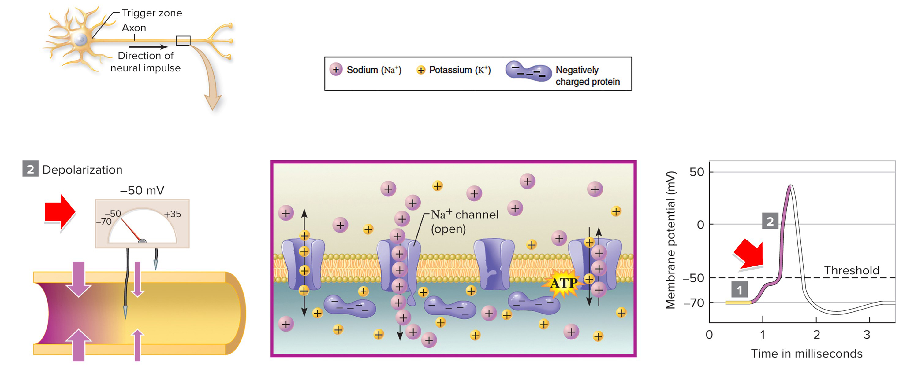
Threshold: -50mv
These positively charged ions make the interior of the axon less negative near the membrane, a process called depolarization.
Section 26.3
Figure 26.6

Slide 48
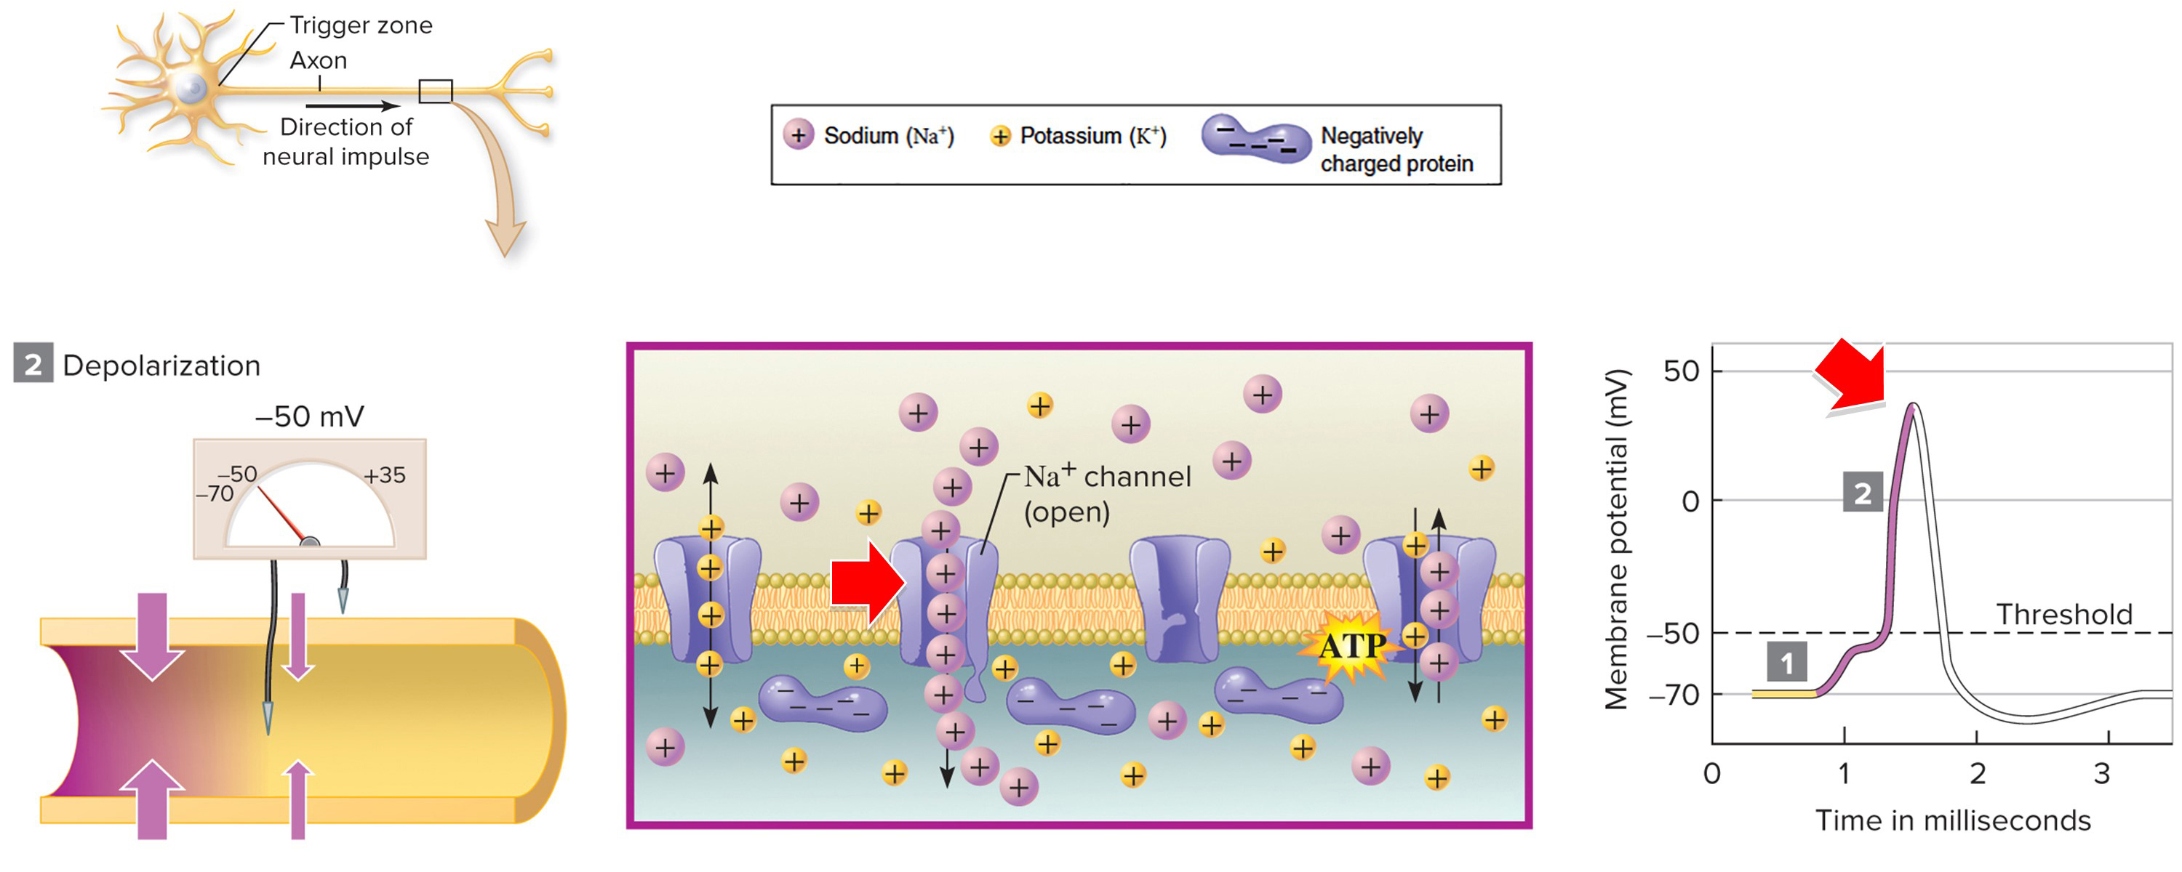
At threshold, more sodium channels open
If the membrane reaches threshold potential, more sodium channels open. ${Na}^{+}$ pours into the cell, driving the membrane potential higher.
Section 26.3
Figure 26.6

Slide 49
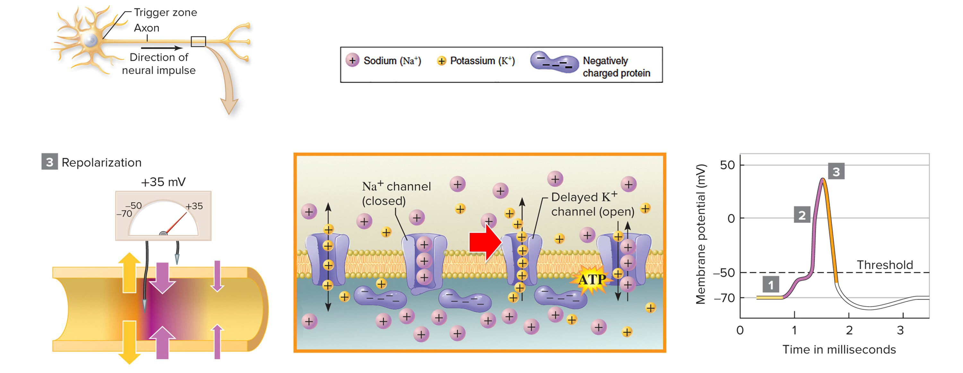
Peak depolarization: +35mv
Peak depolarization is achieved at +35mv.
A split second after sodium ions flow into the axon,
potassium ions exit. Sodium ion channels are now closed.
Section 26.3
Figure 26.6

Slide 50
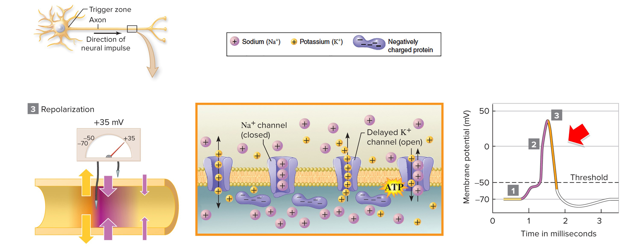
Repolarization
$K^{+}$ ions leaving the cell cause the membrane potential to drop; this process is called repolarization.
Section 26.3
Figure 26.6

Slide 51
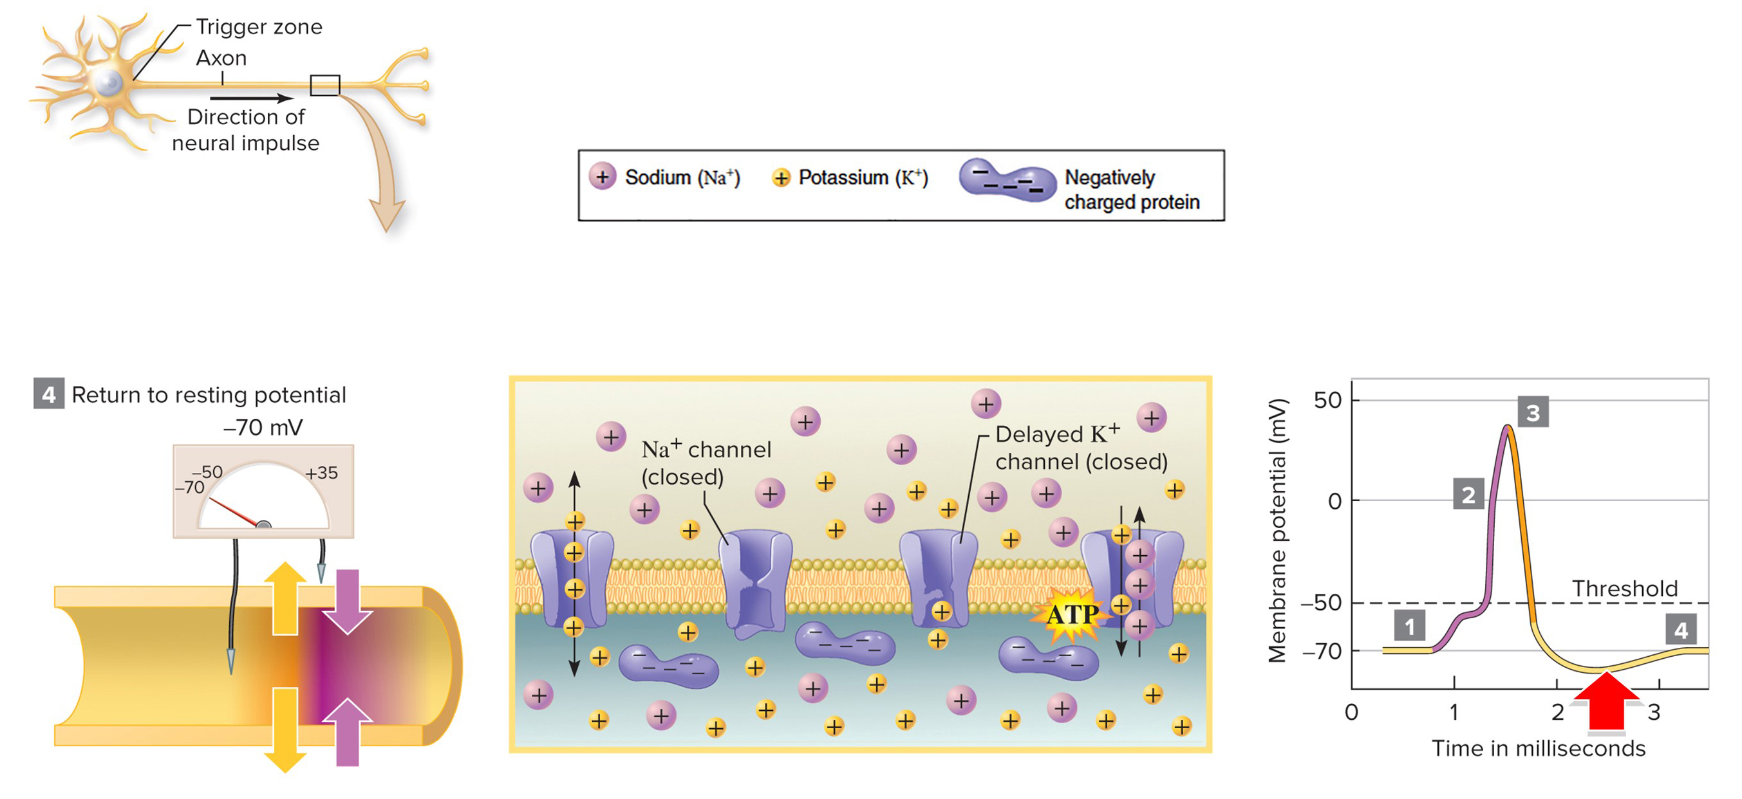
Hyperpolarization
During hyperpolarization, the membrane temporarily dips below resting potential, until the sodium-potassium pumps reestablish it.
Section 26.3
Figure 26.6

Slide 52
One action potential triggers the next
The wave of ion movements progresses to the next patch
of membrane and continues to the end of the axon.
Section 26.3
Figure 26.6

Slide 53
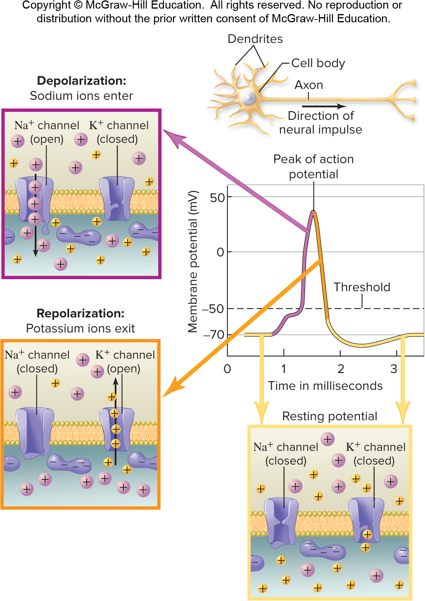
Action potentials are fast
The entire process, from the initial influx of ${Na}^{+}$to the restoration of resting potential, takes only a few milliseconds.
Section 26.3
Figure 26.23

Slide 54
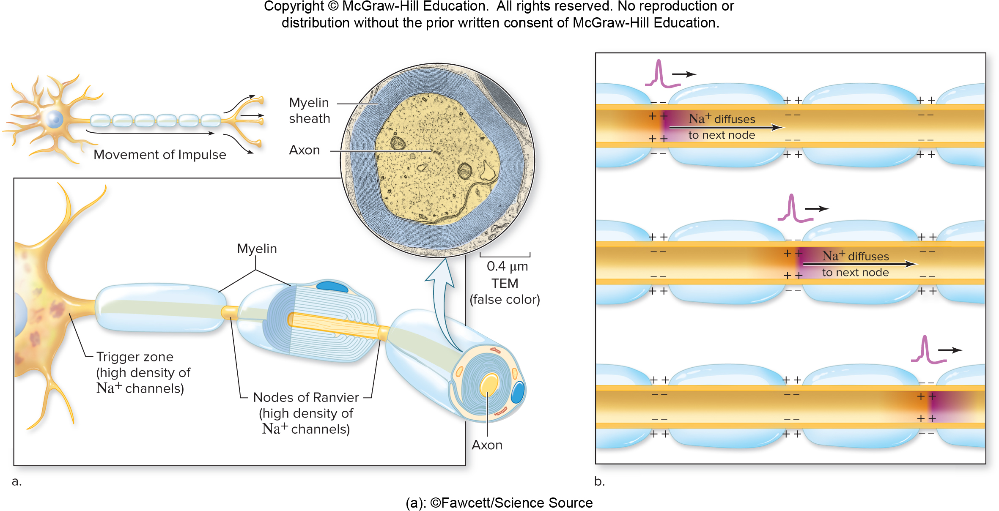
Myelinated vs. unmyelinated axons
Myelinated axons conduct impulses more quickly than unmyelinated axons.
(a): ©Fawcett/Science Source
Section 26.3
Figure 26.8

Slide 55
There are gaps between myelin
Ion channels are concentrated in the gaps between myelin.
(a): ©Fawcett/Science Source
Section 26.3
Figure 26.8

Slide 56
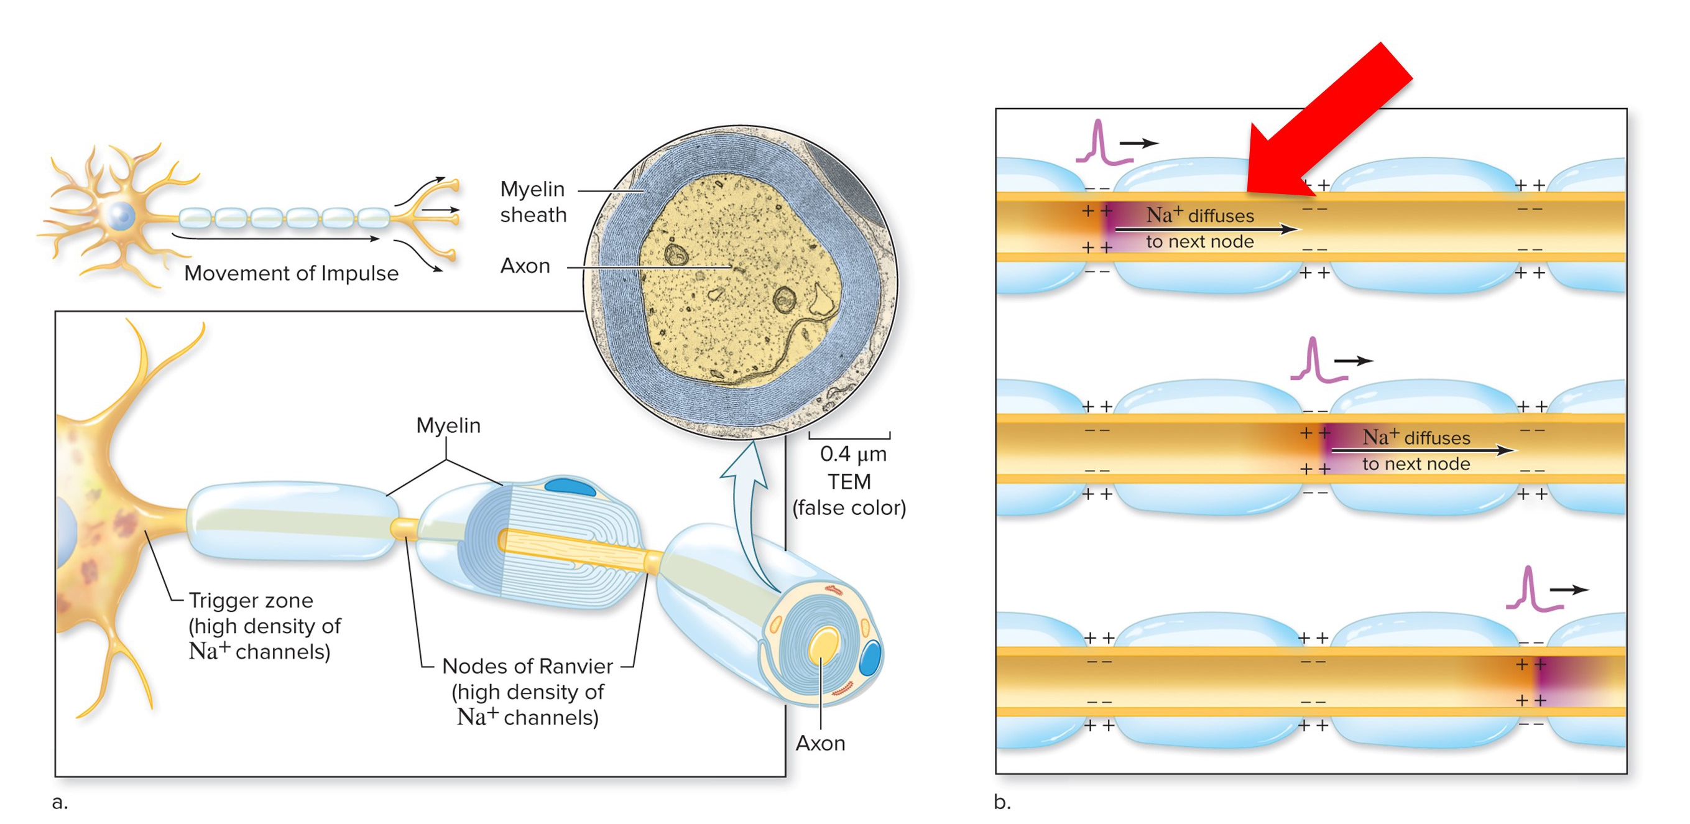
Action potentials move from gap to gap
Some of the sodium ions flooding in at one gap diffuse to the next gap, cueing additional ion channels to open. The action potential therefore seems to jump from one gap to the next.
(a): ©Fawcett/Science Source
Section 26.3
Figure 26.8

Slide 57
Clicker question #2
In several neurological diseases, axons lose their insulating myelin sheath. What is the consequence of this loss?
Nerve cells lose too much heat.
Nerve cells retain too much heat.
Action potential transmission slows down.
Action potential transmission speeds up.

Slide 58
Clicker question #2, solution
In several neurological diseases, axons lose their insulating myelin sheath. What is the consequence of this loss?
Action potential transmission slows down.

Slide 59
26.3 Mastering concepts
How does an axon generate and transmit a neural impulse?
©Henrik Sorensen/Riser/Getty Images

Slide 60
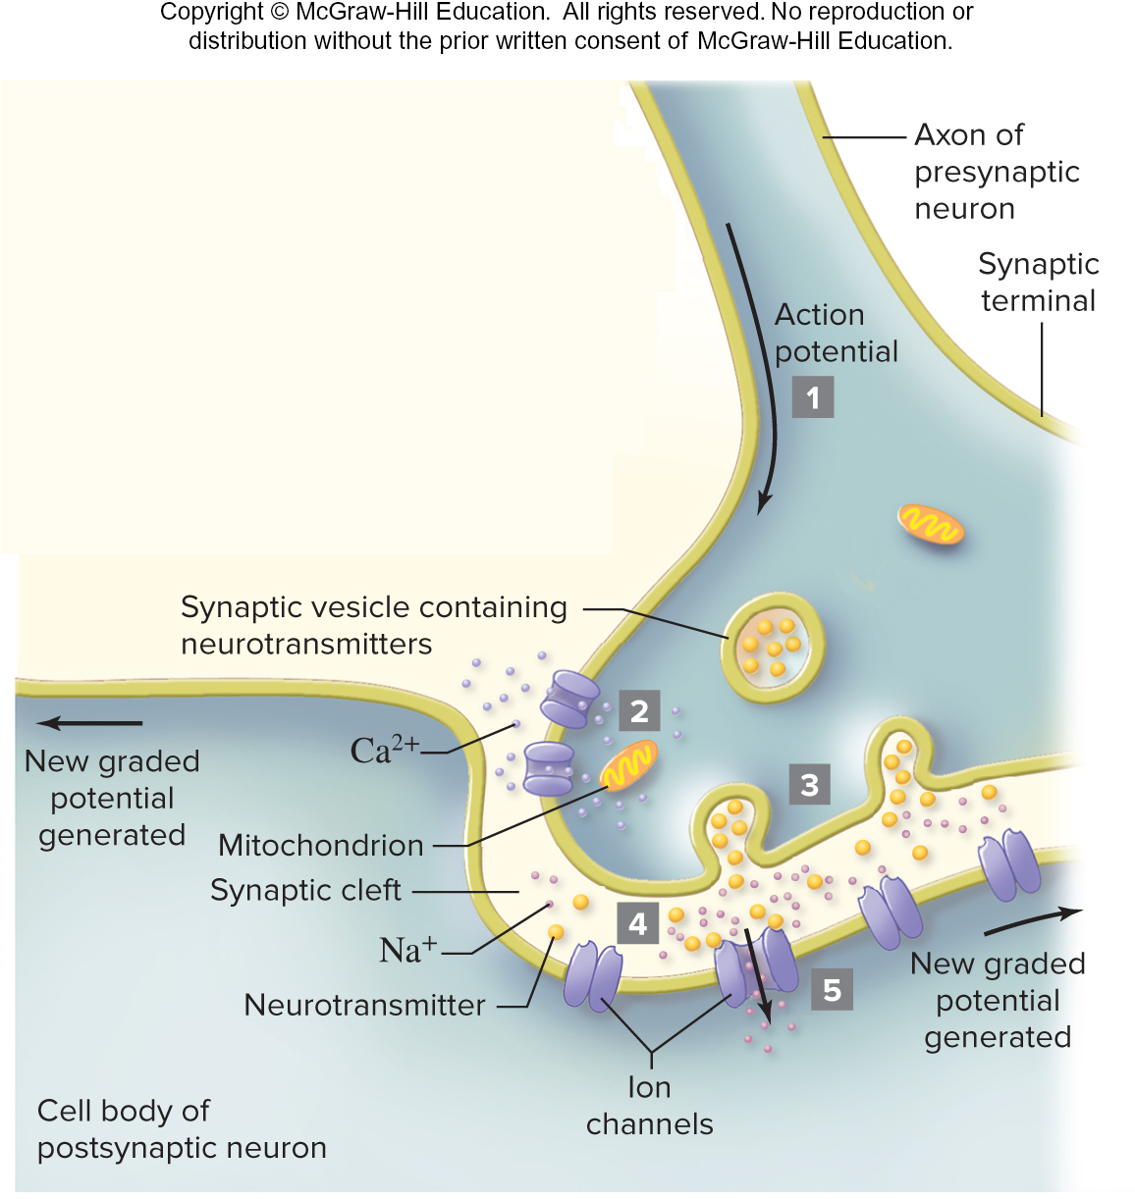
Messages move from cell to cell
We’ve seen how impulses travel along one axon. How do these impulses translate into messages conveyed to other cells?
Section 26.4
Figure 26.9

Slide 61
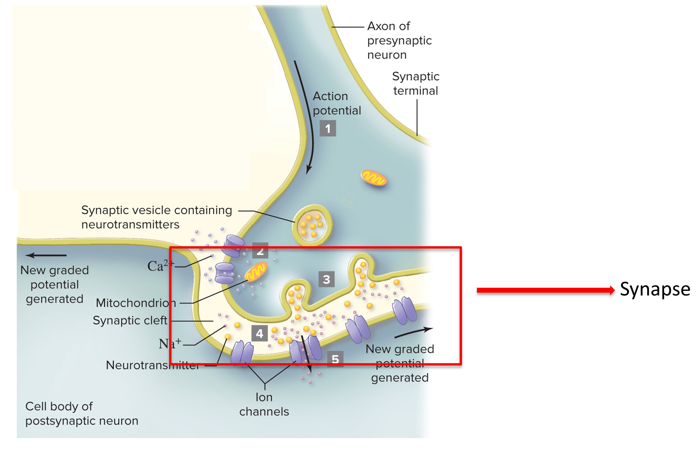
Synapses, 2
This communication occurs at a synapse, a junction between a neuron and another cell.
Section 26.4
Figure 26.9

Slide 62
Neurotransmitters cross the synapse, 1
Molecules called neurotransmitters travel across synapses.
Section 26.4
Figure 26.9

Slide 63
The parts of a synapse
The synapse includes a presynaptic cell, a synaptic cleft, and a postsynaptic cell (which could be a neuron, muscle cell, or gland cell).
ER Lewis, YY Zeevi and TE Everhart
Section 26.4
Figure 26.9

Slide 64
The synaptic terminal
The end of the presynaptic neuron’s axon is the synaptic terminal.
This figure shows how an action potential reaching the synaptic terminal initiates communication with the receiving cell.
ER Lewis, YY Zeevi and TE Everhart
Section 26.4
Figure 26.9

Slide 65
The synaptic terminal has calcium channels
Action potentials cause calcium channels in the synaptic terminal to open.
ER Lewis, YY Zeevi and TE Everhart
Section 26.4
Figure 26.9

Slide 66
Neurotransmitters are released
An influx of calcium stimulates vesicles loaded with neurotransmitters to fuse with the presynaptic neuron’s membrane.
ER Lewis, YY Zeevi and TE Everhart
Section 26.4
Figure 26.9

Slide 67
Neurotransmitters cross the synapse, 2
Neurotransmitters bind to receptor proteins in the membrane of the postsynaptic cell.
ER Lewis, YY Zeevi and TE Everhart
Section 26.4
Figure 26.9

Slide 68
Ion channels on the postsynaptic membrane open
Ion channels open in the postsynaptic cell membrane, changing the likelihood of an action potential in the receiving cell.
ER Lewis, YY Zeevi and TE Everhart
Section 26.4
Figure 26.9

Slide 69
Neurotransmitters can be inhibitory or excitatory
Neurotransmitters might have excitatory, inhibitory, or no effect on the postsynaptic cell.
Excitatory = increased chance of action potential
Inhibitory = decreased chance of action potential
Some may have no effect on the post synaptic neuron
ER Lewis, YY Zeevi and TE Everhart
Section 26.4
Figure 26.9

Slide 70
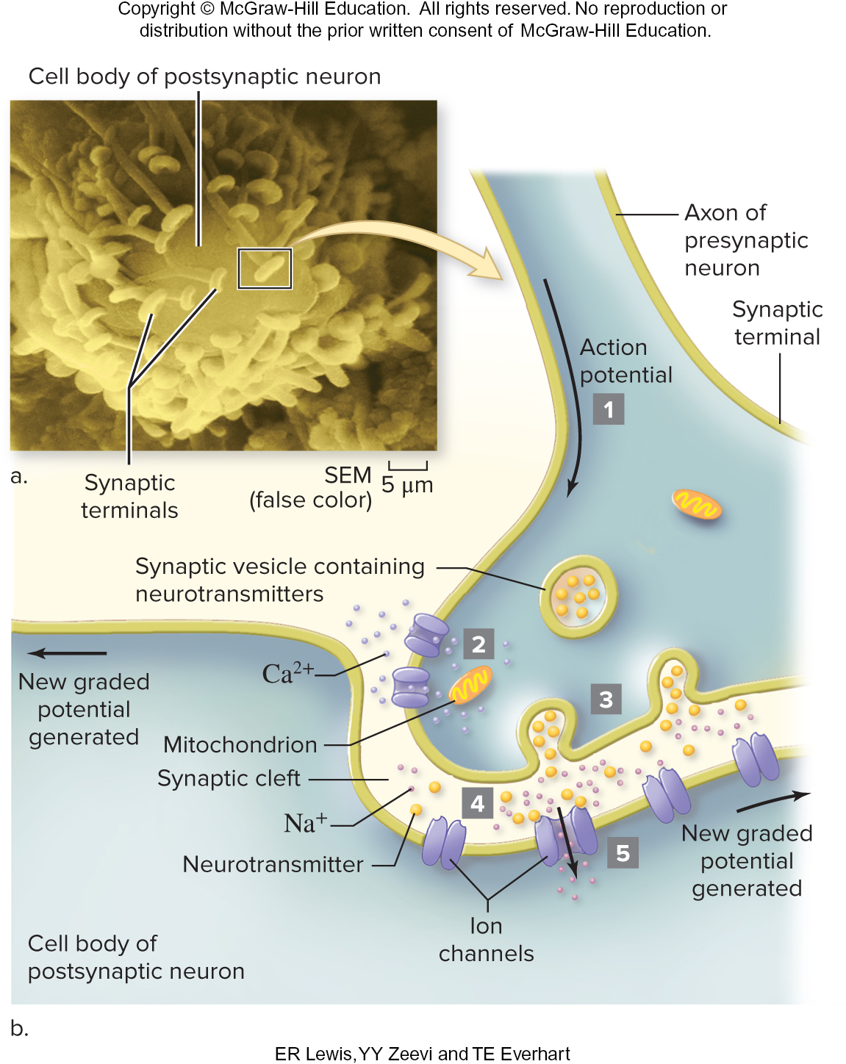
Synaptic integration
The postsynaptic cell may receive many stimuli (both excitatory and inhibitory) at once. Synaptic integration determines the cell’s response: if the majority of stimuli are excitatory, then the postsynaptic cell will likely initiate an action potential.
ER Lewis, YY Zeevi and TE Everhart
Section 26.4
Figure 26.9

Slide 71
How antidepressants work
Some antidepressants work by affecting neurotransmitter concentrations in synaptic clefts. The drugs block the sending neuron from re-uptaking the neurotransmitter serotonin, allowing serotonin to remain abundant in synapses.
Nondepressed individual
Abundant serotonin in synaptic cleft
Depressed individual, untreated Too much reuptake; insufficient serotonin in synaptic cleft
Depressed individual, treated with SSRI
Reuptake blocked; abundant serotonin in synaptic cleft
Section 26.4
Figure 26.A

Slide 72
Clicker question #3
A neurotransmitter travels from a sending cell to a receiving cell, causing ${Na}^{+}$ions to pour into the receiving cell. As a result, an action potential in the receiving cell becomes ___ likely.
more
less

Slide 73
Clicker question #3, solution
A neurotransmitter travels from a sending cell to a receiving cell, causing ${Na}^{+}$ ions to pour into the receiving cell. As a result, an action potential in the receiving cell becomes ___ likely.
more

Slide 74
26.4 Mastering concepts
What event stimulates a neuron to release neurotransmitters?
©Henrik Sorensen/Riser/Getty Images

Slide 75
Subdivisions of the nervous system
Nervous System
The nervous system has several subdivisions.
Main tissue types* | Examples of locations/functions
Connective | Surrounds nerves
Nervous | Makes up brain, spinal cord, and nerves; functions in sensation, communication, and information storage
*See chapter 25 for descriptions.
Brain
Integrates sensory information and coordinates the body’s response
Cranial nerves (12 pairs)
Receive sensations from sense organs of the head; control most movements of the face, neck, and mouth; affect some organs in the chest and abdomen
Spinal cord
Transmits impulses between brain and rest of body; coordinates some reflexes
Spinal nerves (31 pairs)
Receive sensations and control movements from the neck down and from parts of the head and face; affect organs in the chest and abdomen; include cervical, thoracic, lumbar, sacral, and coccygeal nerves
Section 26.5
Figure 26.10

Slide 76
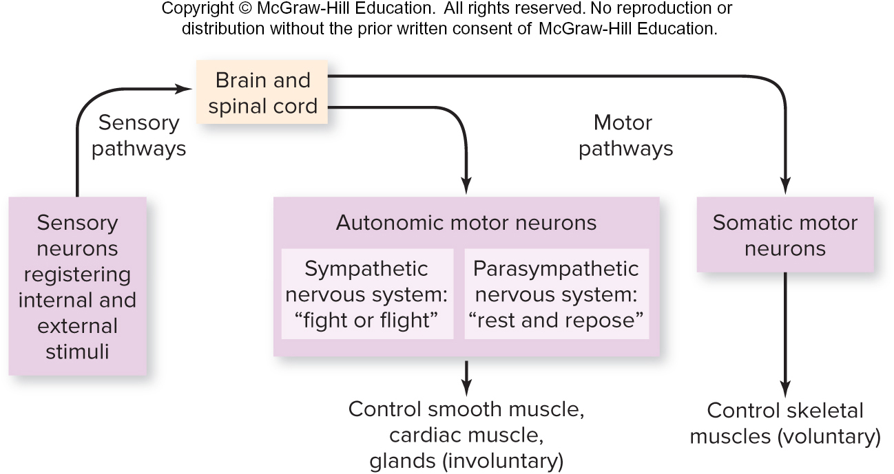
The function of the central nervous system
Nervous System
The central nervous system (tan) integrates sensory information and coordinates the body’s responses.
Main tissue types* | Examples of locations/functions
Connective | Surrounds nerves
Nervous | Makes up brain, spinal cord, and nerves; functions in sensation, communication, and information storage
*See chapter 25 for descriptions.
Brain
Integrates sensory information and coordinates the body’s response
Cranial nerves (12 pairs)
Receive sensations from sense organs of the head; control most movements of the face, neck, and mouth; affect some organs in the chest and abdomen
Spinal cord
Transmits impulses between brain and rest of body; coordinates some reflexes
Spinal nerves (31 pairs)
Receive sensations and control movements from the neck down and from parts of the head and face; affect organs in the chest and abdomen; include cervical, thoracic, lumbar, sacral, and coccygeal nerves
Section 26.5
Figure 26.10

Slide 77
The function of the peripheral nervous system
Nervous System
The peripheral nervous system (pink) carries information between the central nervous system and the rest of the body.
Main tissue types* | Examples of locations/functions
Connective | Surrounds nerves
Nervous | Makes up brain, spinal cord, and nerves; functions in sensation, communication, and information storage
*See chapter 25 for descriptions.
Brain
Integrates sensory information and coordinates the body’s response
Cranial nerves (12 pairs)
Receive sensations from sense organs of the head; control most movements of the face, neck, and mouth; affect some organs in the chest and abdomen
Spinal cord
Transmits impulses between brain and rest of body; coordinates some reflexes
Spinal nerves (31 pairs)
Receive sensations and control movements from the neck down and from parts of the head and face; affect organs in the chest and abdomen; include cervical, thoracic, lumbar, sacral, and coccygeal nerves
Section 26.5
Figure 26.10

Slide 78
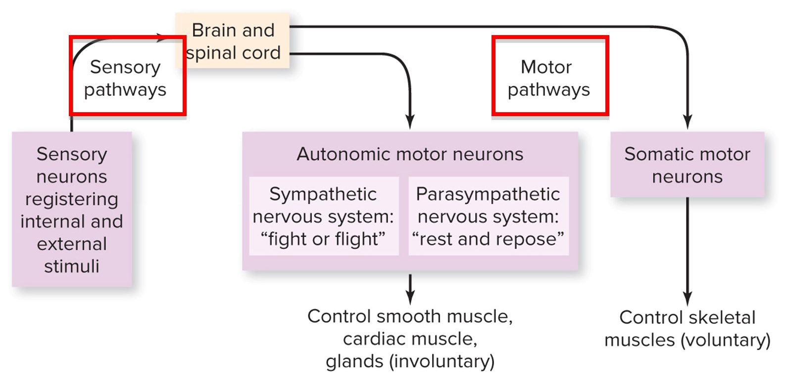
The peripheral nervous system: sensory pathways
In the peripheral nervous system, sensory pathways lead to the brain and spinal cord; motor pathways lead to muscles and glands.
Nervous System
Main tissue types* | Examples of locations/functions
Connective | Surrounds nerves
Nervous | Makes up brain, spinal cord, and nerves; functions in sensation, communication, and information storage
*See chapter 25 for descriptions.
Brain
Integrates sensory information and coordinates the body’s response
Cranial nerves (12 pairs)
Receive sensations from sense organs of the head; control most movements of the face, neck, and mouth; affect some organs in the chest and abdomen
Spinal cord
Transmits impulses between brain and rest of body; coordinates some reflexes
Spinal nerves (31 pairs)
Receive sensations and control movements from the neck down and from parts of the head and face; affect organs in the chest and abdomen; include cervical, thoracic, lumbar, sacral, and coccygeal nerves
Section 26.5
Figure 26.10

Slide 79
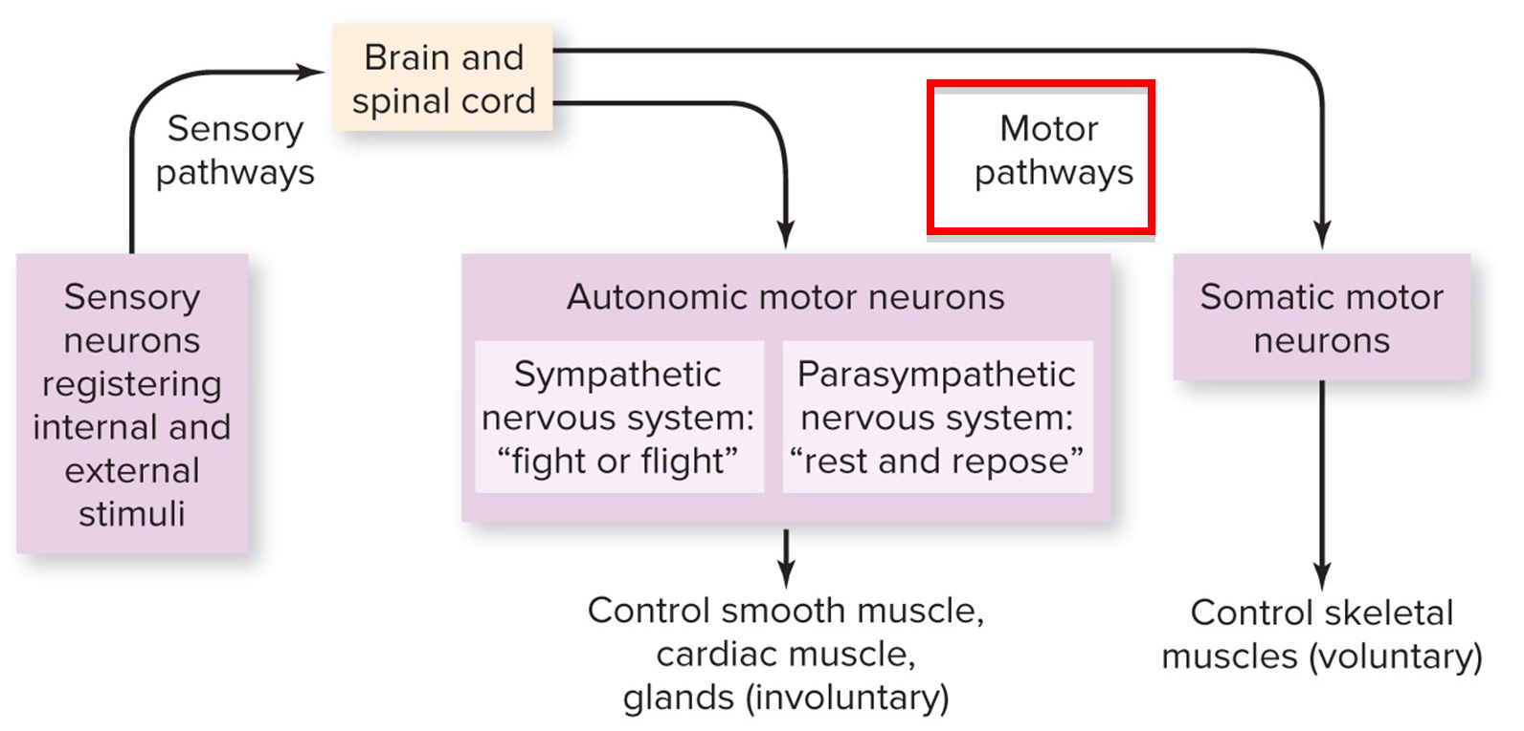
The peripheral nervous system: motor pathways
Nervous System
The neurons controlling motor pathways are classified according to function.
Main tissue types* | Examples of locations/functions
Connective | Surrounds nerves
Nervous | Makes up brain, spinal cord, and nerves; functions in sensation, communication, and information storage
*See chapter 25 for descriptions.
Brain
Integrates sensory information and coordinates the body’s response
Cranial nerves (12 pairs)
Receive sensations from sense organs of the head; control most movements of the face, neck, and mouth; affect some organs in the chest and abdomen
Spinal cord
Transmits impulses between brain and rest of body; coordinates some reflexes
Spinal nerves (31 pairs)
Receive sensations and control movements from the neck down and from parts of the head and face; affect organs in the chest and abdomen; include cervical, thoracic, lumbar, sacral, and coccygeal nerves
Section 26.5
Figure 26.10

Slide 80
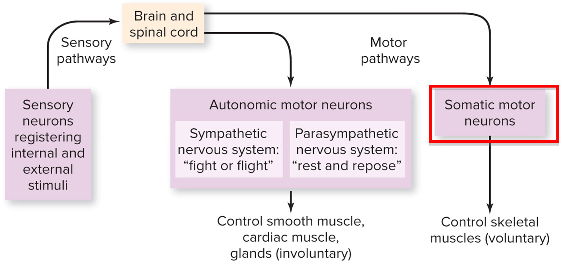
The peripheral nervous system: somatic motor neurons
Nervous System
Somatic motor neurons carry signals to voluntary muscles.
Main tissue types* | Examples of locations/functions
Connective | Surrounds nerves
Nervous | Makes up brain, spinal cord, and nerves; functions in sensation, communication, and information storage
*See chapter 25 for descriptions.
Brain
Integrates sensory information and coordinates the body’s response
Cranial nerves (12 pairs)
Receive sensations from sense organs of the head; control most movements of the face, neck, and mouth; affect some organs in the chest and abdomen
Spinal cord
Transmits impulses between brain and rest of body; coordinates some reflexes
Spinal nerves (31 pairs)
Receive sensations and control movements from the neck down and from parts of the head and face; affect organs in the chest and abdomen; include cervical, thoracic, lumbar, sacral, and coccygeal nerves
Section 26.5
Figure 26.10

Slide 81
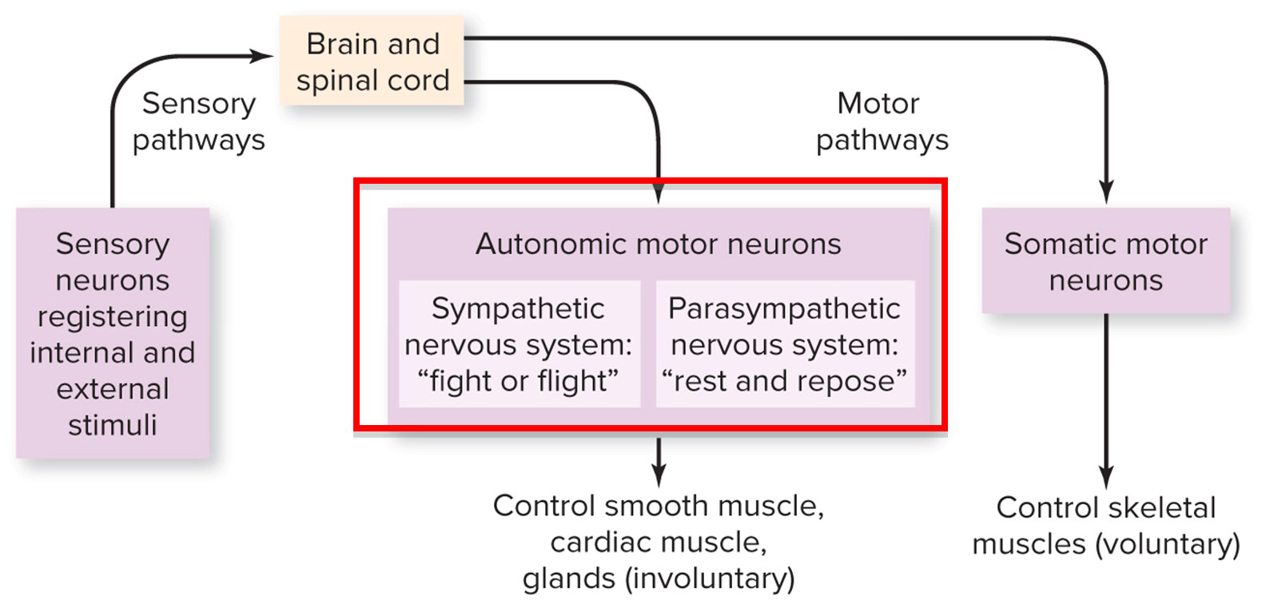
The peripheral nervous system: autonomic motor neurons
Autonomic motor neurons carry signals to involuntary muscles and glands.
Nervous System
Main tissue types* | Examples of locations/functions
Connective | Surrounds nerves
Nervous | Makes up brain, spinal cord, and nerves; functions in sensation, communication, and information storage
*See chapter 25 for descriptions.
Brain
Integrates sensory information and coordinates the body’s response
Cranial nerves (12 pairs)
Receive sensations from sense organs of the head; control most movements of the face, neck, and mouth; affect some organs in the chest and abdomen
Spinal cord
Transmits impulses between brain and rest of body; coordinates some reflexes
Spinal nerves (31 pairs)
Receive sensations and control movements from the neck down and from parts of the head and face; affect organs in the chest and abdomen; include cervical, thoracic, lumbar, sacral, and coccygeal nerves
Section 26.5
Figure 26.10

Slide 82
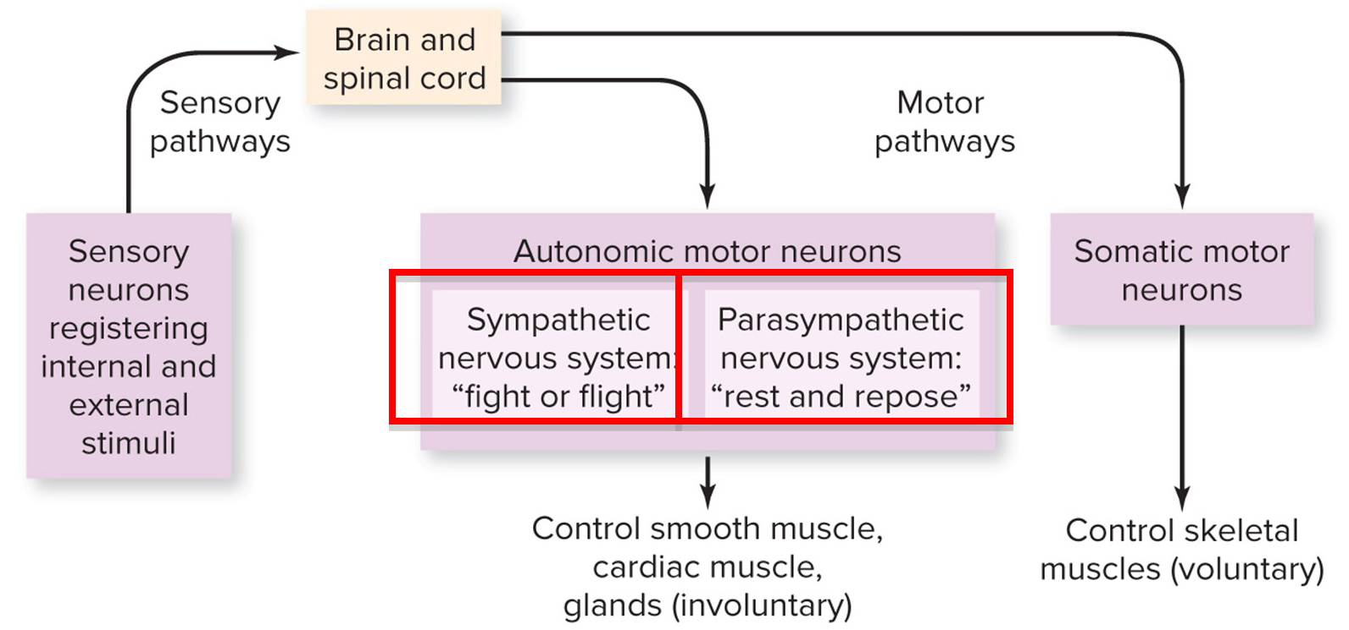
Sympathetic and parasympathetic pathways
Nervous System
The autonomic nervous system is further divided into sympathetic and parasympathetic pathways.
Main tissue types* | Examples of locations/functions
Connective | Surrounds nerves
Nervous | Makes up brain, spinal cord, and nerves; functions in sensation, communication, and information storage
*See chapter 25 for descriptions.
Brain
Integrates sensory information and coordinates the body’s response
Cranial nerves (12 pairs)
Receive sensations from sense organs of the head; control most movements of the face, neck, and mouth; affect some organs in the chest and abdomen
Spinal cord
Transmits impulses between brain and rest of body; coordinates some reflexes
Spinal nerves (31 pairs)
Receive sensations and control movements from the neck down and from parts of the head and face; affect organs in the chest and abdomen; include cervical, thoracic, lumbar, sacral, and coccygeal nerves
Section 26.5
Figure 26.10

Slide 83
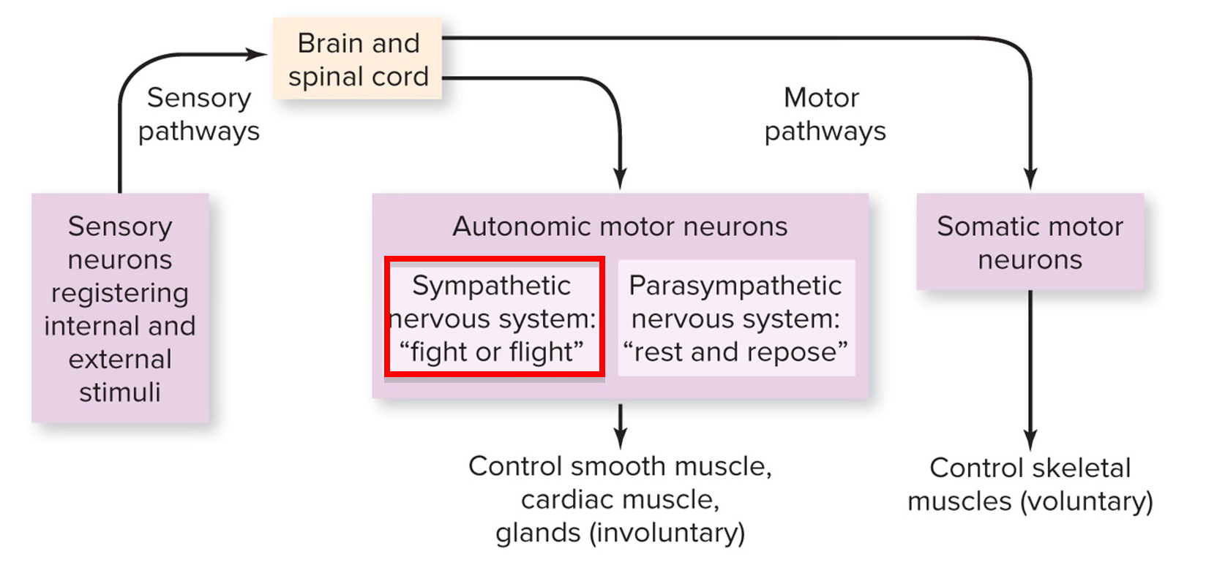
Sympathetic nervous system
Nervous System
The sympathetic nervous system dominates under stress and emergencies. The neurons:
increase heart rate and breathing rate
dilate arteries
Main tissue types* | Examples of locations/functions
Connective | Surrounds nerves
Nervous | Makes up brain, spinal cord, and nerves; functions in sensation, communication, and information storage
*See chapter 25 for descriptions.
Brain
Integrates sensory information and coordinates the body’s response
Cranial nerves (12 pairs)
Receive sensations from sense organs of the head; control most movements of the face, neck, and mouth; affect some organs in the chest and abdomen
Spinal cord
Transmits impulses between brain and rest of body; coordinates some reflexes
Spinal nerves (31 pairs)
Receive sensations and control movements from the neck down and from parts of the head and face; affect organs in the chest and abdomen; include cervical, thoracic, lumbar, sacral, and coccygeal nerves
Section 26.5
Figure 26.10

Slide 84
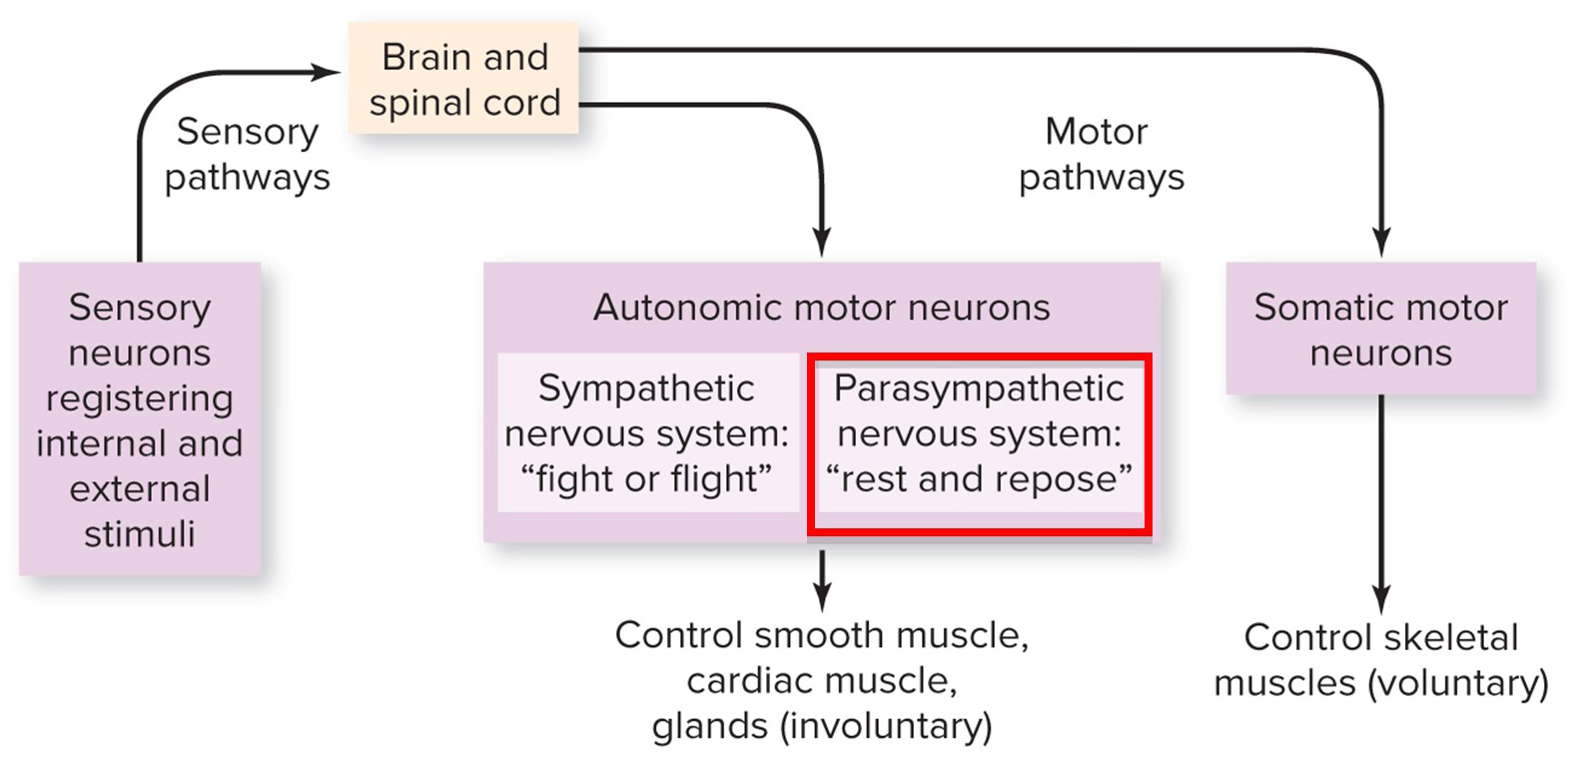
The parasympathetic nervous system
Nervous System
The parasympathetic nervous system returns body systems to normal. The neurons:
decrease heart rate and breathing rate
constrict arteries
Main tissue types* | Examples of locations/functions
Connective | Surrounds nerves
Nervous | Makes up brain, spinal cord, and nerves; functions in sensation, communication, and information storage
*See chapter 25 for descriptions.
Brain
Integrates sensory information and coordinates the body’s response
Cranial nerves (12 pairs)
Receive sensations from sense organs of the head; control most movements of the face, neck, and mouth; affect some organs in the chest and abdomen
Spinal cord
Transmits impulses between brain and rest of body; coordinates some reflexes
Spinal nerves (31 pairs)
Receive sensations and control movements from the neck down and from parts of the head and face; affect organs in the chest and abdomen; include cervical, thoracic, lumbar, sacral, and coccygeal nerves
Section 26.5
Figure 26.10

Slide 85
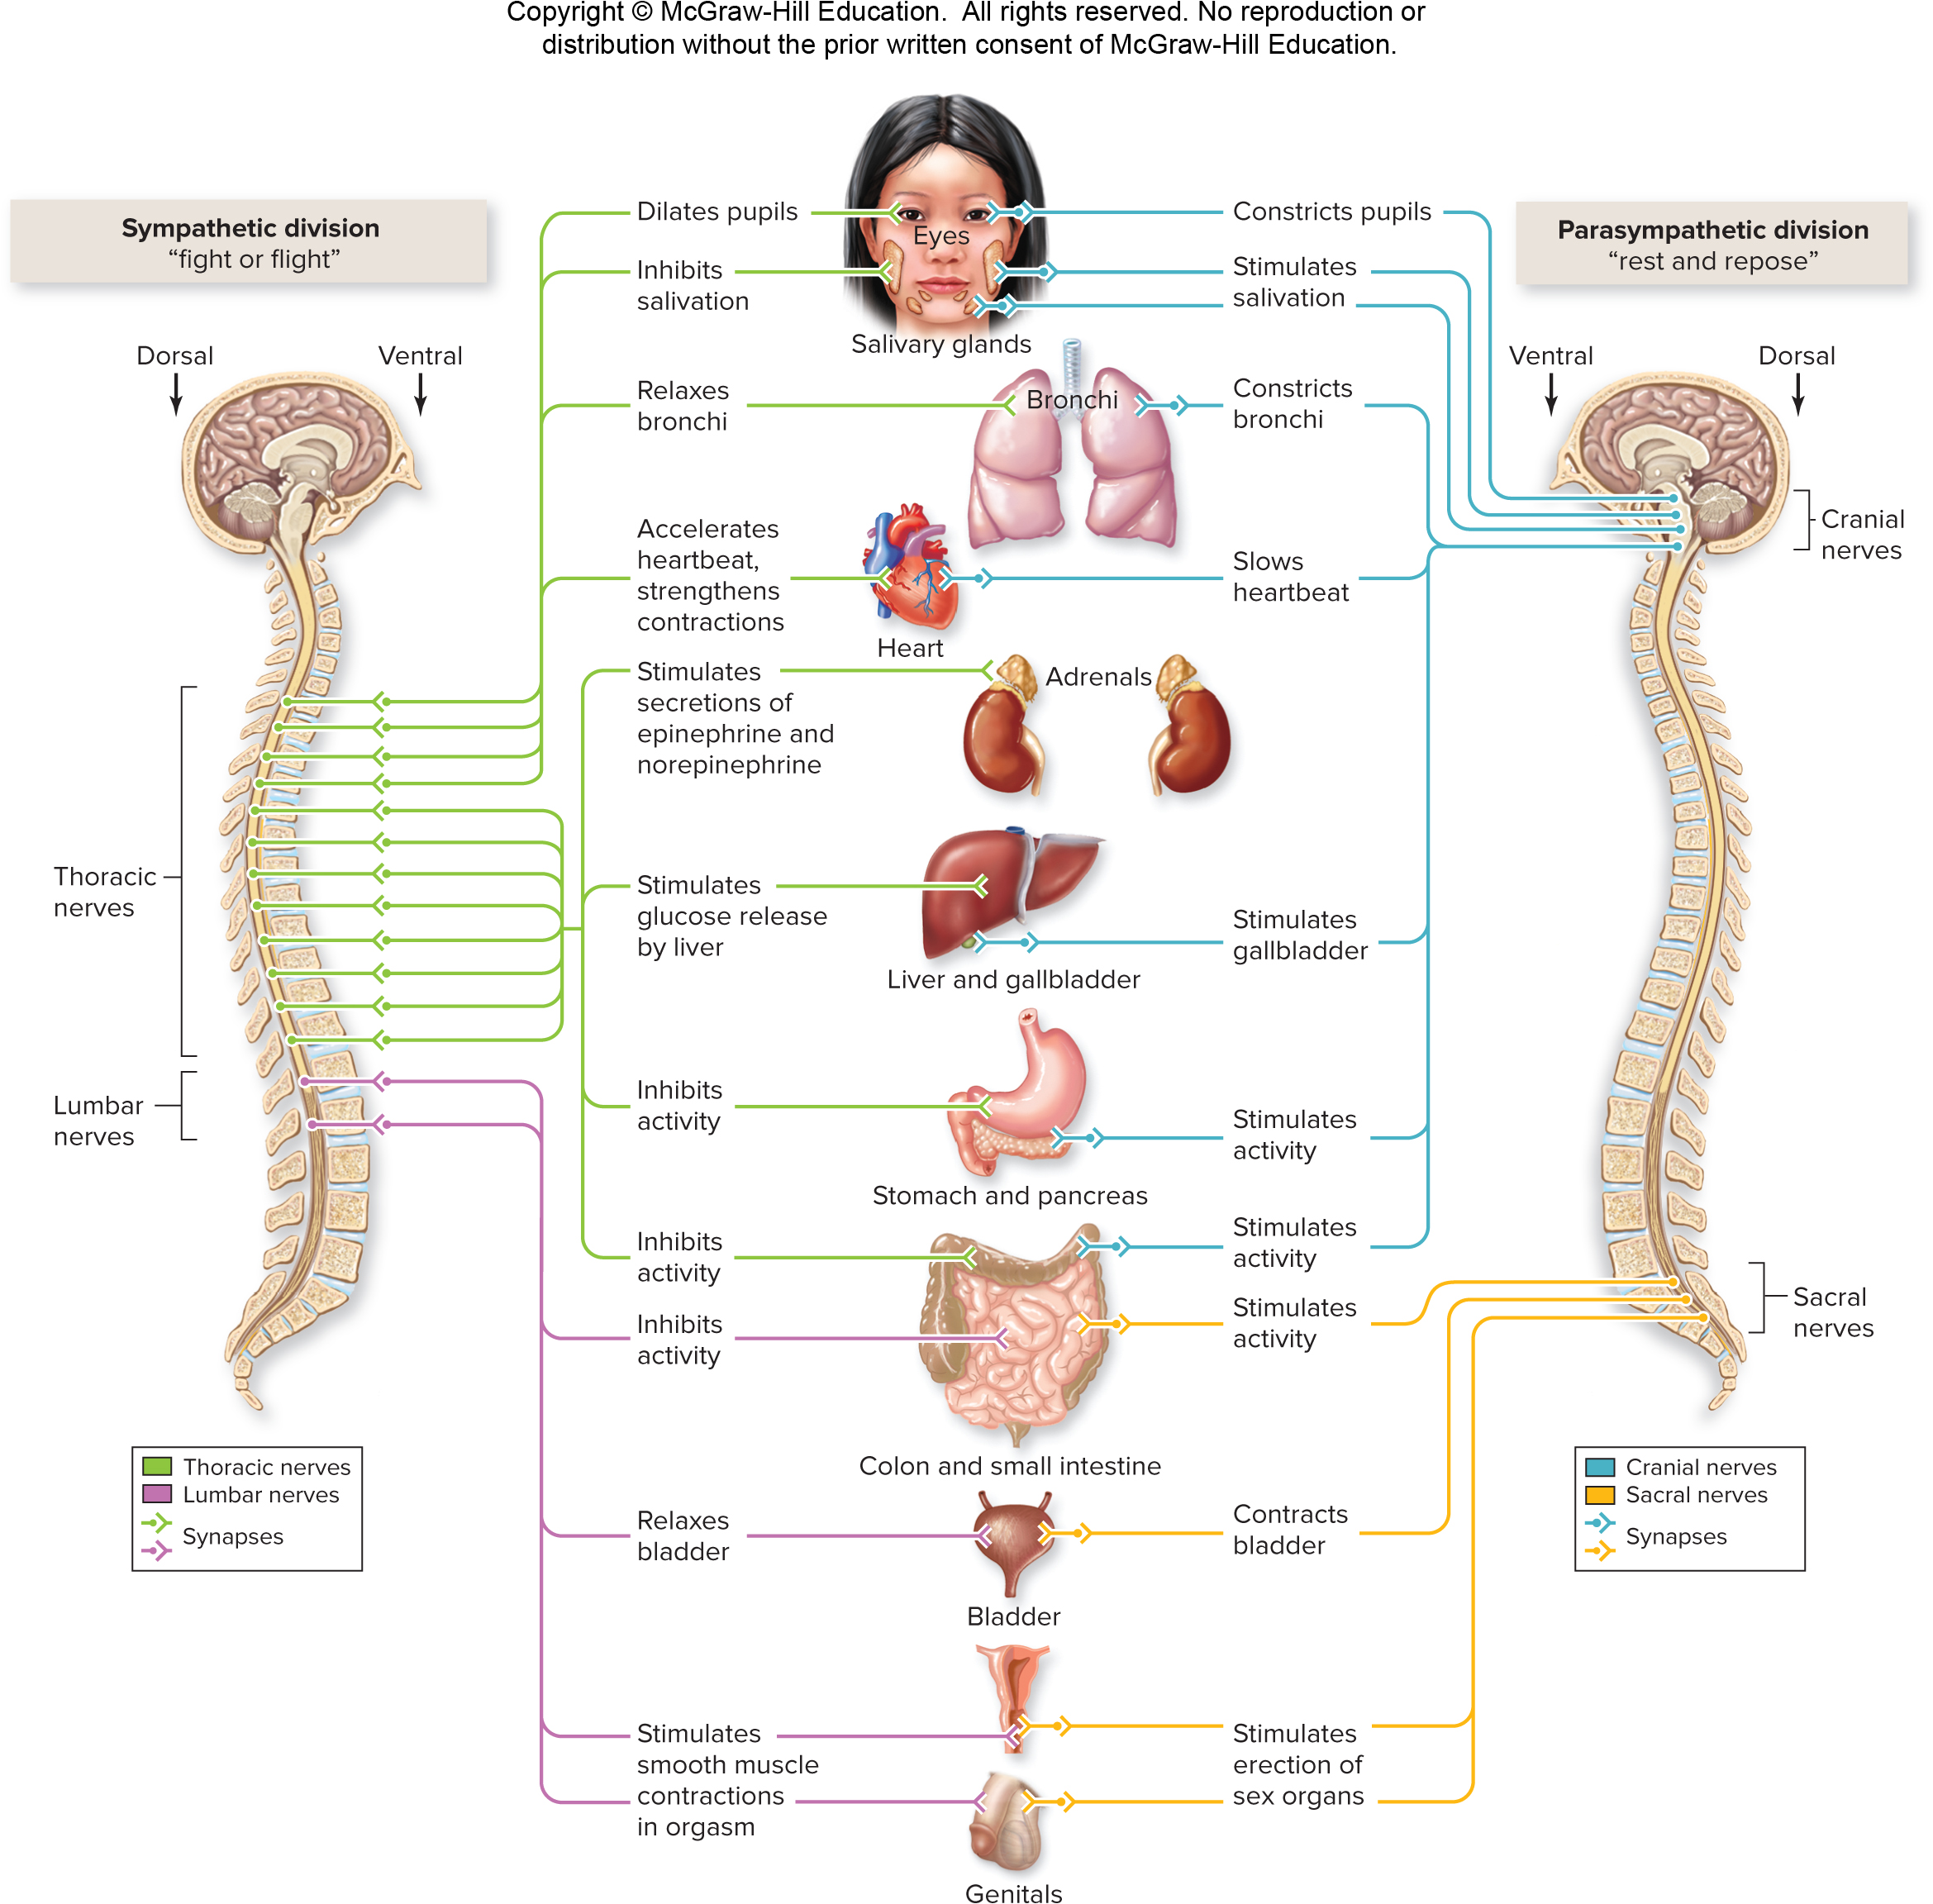
Contrasting roles of the autonomic nervous system
Section 26.5
Figure 26.11

Slide 86
26.5 Mastering concepts
Describe the relationships among the motor, somatic, autonomic, sympathetic, and parasympathetic nervous systems.
©Henrik Sorensen/Riser/Getty Images

Slide 87
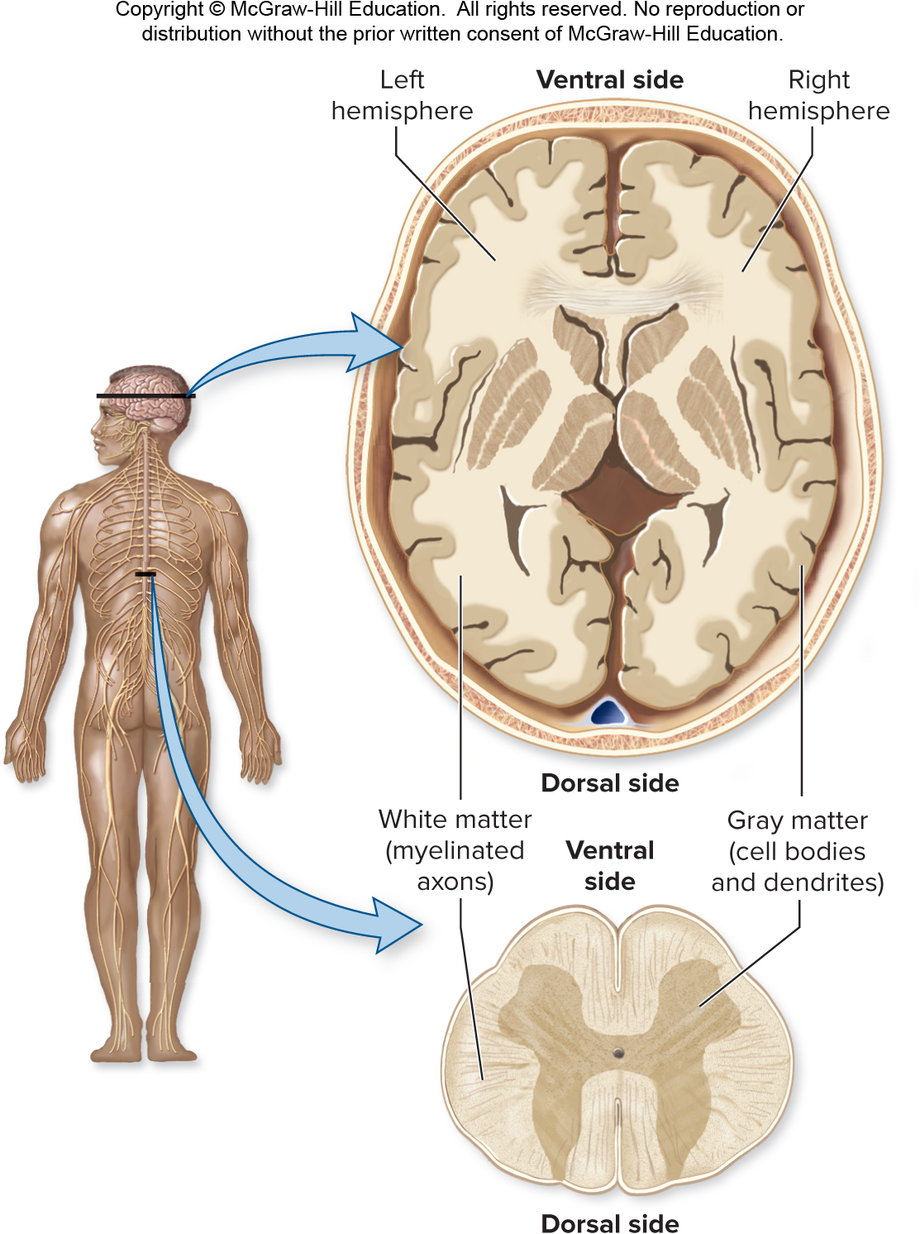
The central nervous system
The central nervous system consists of the brain and spinal cord.
Section 26.6
Figures 26.10, 26.12

Slide 88
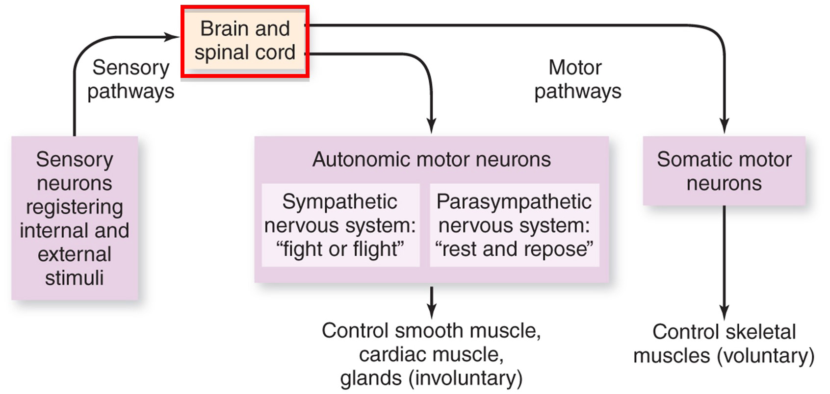
Two types of tissue in the CNS
Two types of nervous tissue occur in the central nervous system:
Gray matter: cell bodies and dendrites
White matter: myelinated axons
Section 26.6
Figures 26.10, 26.12

Slide 89
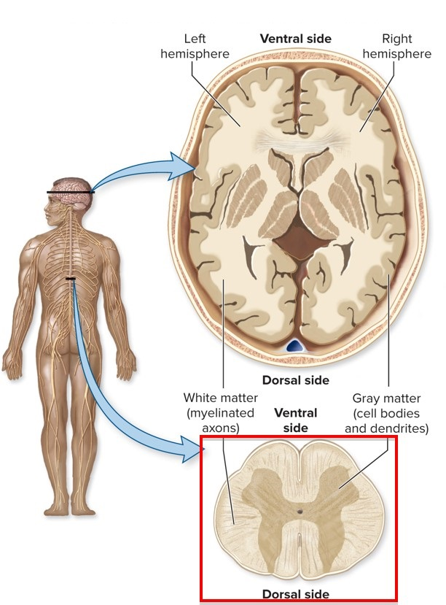
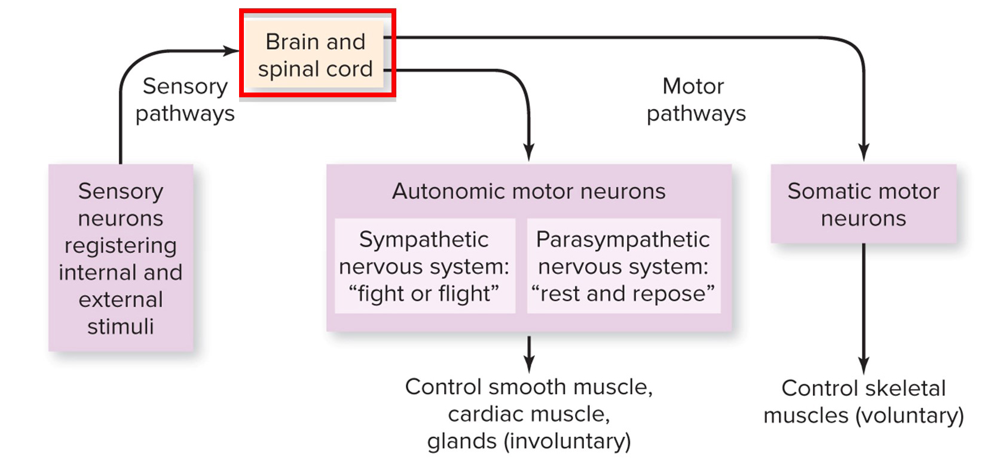
The spinal cord
The spinal cord transmits information between the body and the brain.
Section 26.6
Figures 26.10, 26.12

Slide 90
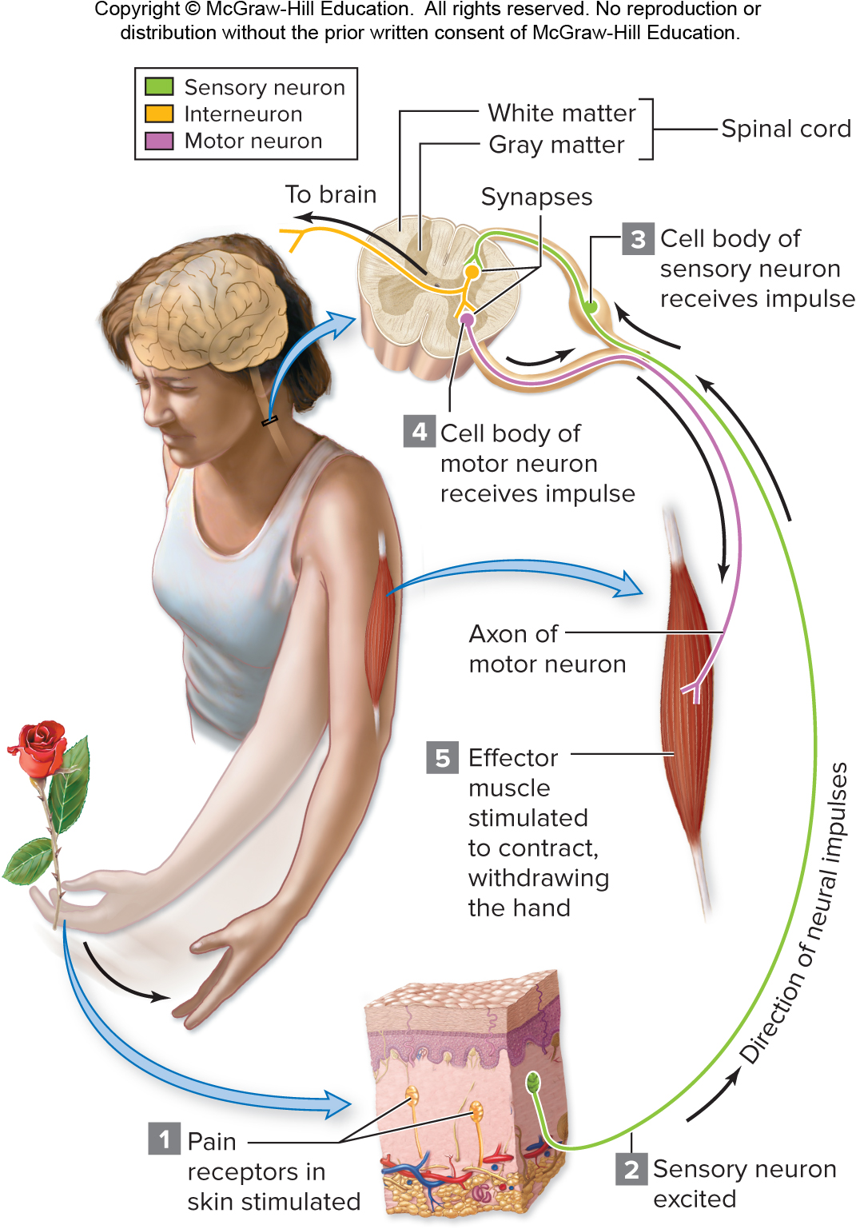
The spinal cord controls reflexes
The spinal cord also controls reflexes without interacting with the brain.
Section 26.6
Figures 26.12, 26.13

Slide 91
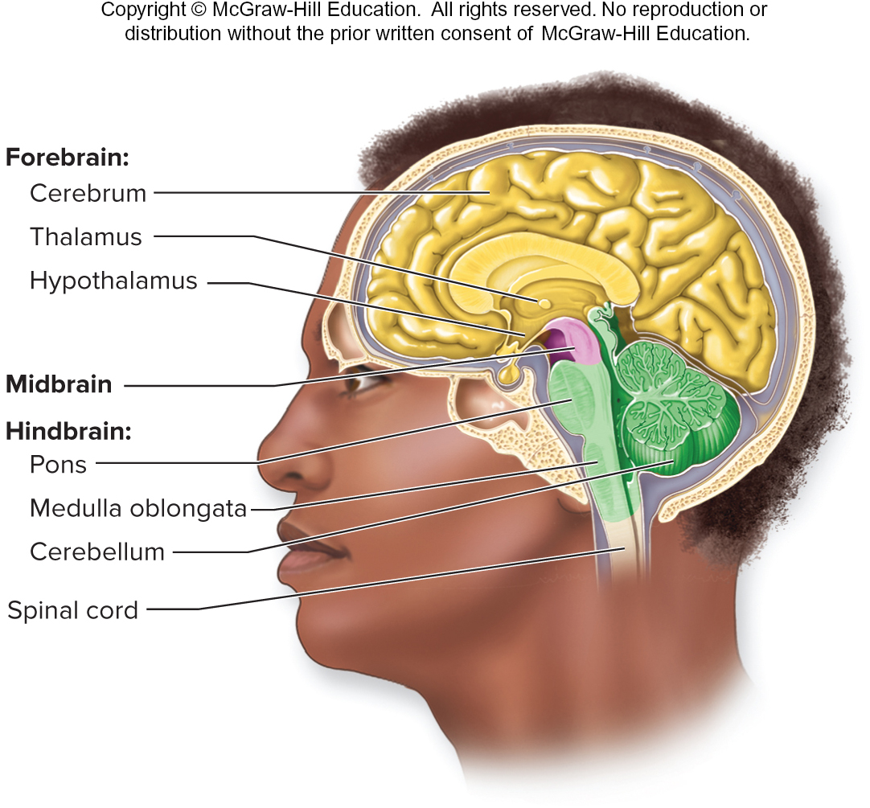
The brain
The brain is divided into several regions.
Section 26.6
Figures 26.12, 26.14

Slide 92
The brain is divided into several regions
Structure | Selected functions
Hindbrain
Medulla oblongata | Regulates essential physiological processes such as blood pressure, heartbeat, and breathing
Pons | Connects forebrain with medulla and cerebellum
Cerebellum | Controls posture and balance; coordinates subconscious muscular movements
Midbrain | Relays information about voluntary movements from forebrain to spinal cord
Forebrain
Thalamus | Processes information and relays it to the cerebrum
Hypothalamus | Homeostatic control of most organs
Cerebrum
White matter | Transmits information within brain
Gray matter (cerebral cortex) | Sensory, motor, and association areas
Section 26.6
Figure 26.14

Slide 93
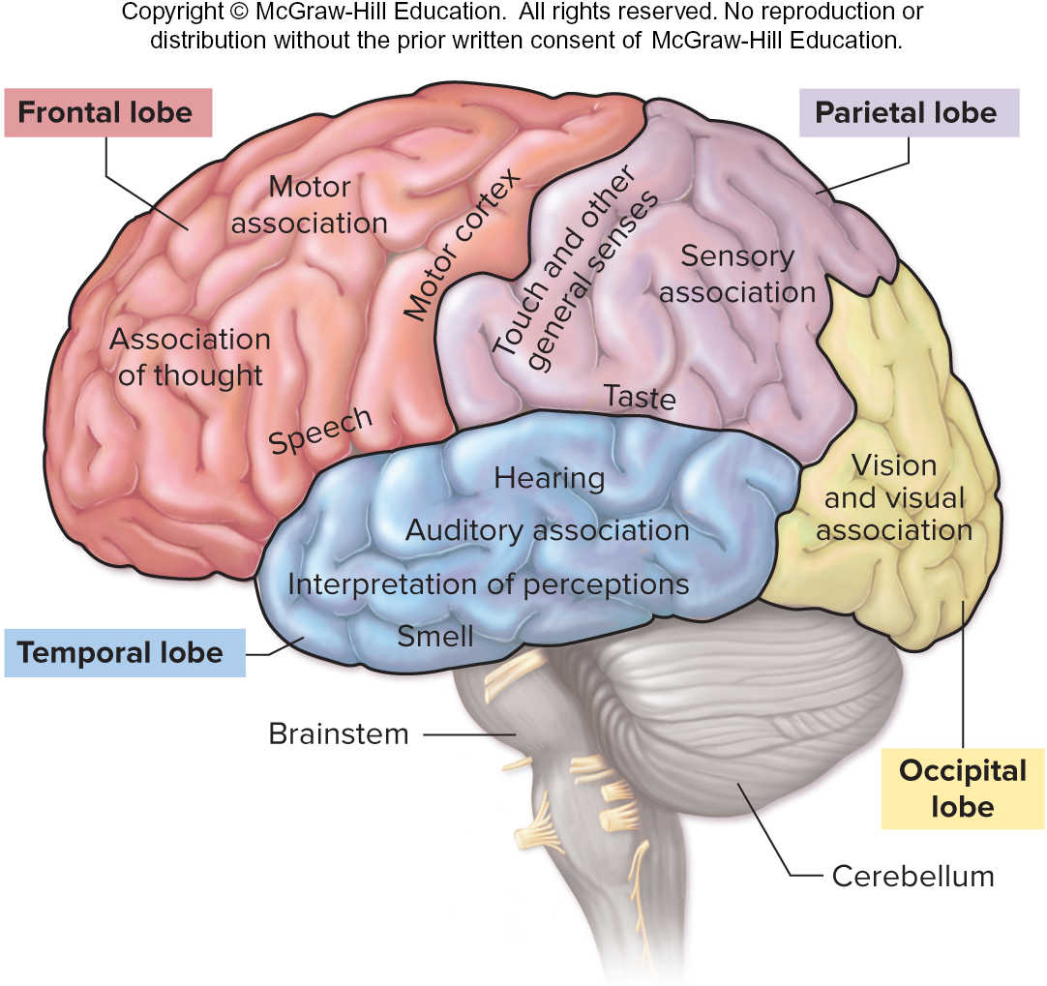
The cerebrum
The cerebrum, part of the forebrain, controls the qualities of what we consider the “mind.”
Structure | Selected functions
Hindbrain
Medulla oblongata | Regulates essential physiological processes such as blood pressure, heartbeat, and breathing
Pons | Connects forebrain with medulla and cerebellum
Cerebellum | Controls posture and balance; coordinates subconscious muscular movements
Midbrain | Relays information about voluntary movements from forebrain to spinal cord
Forebrain
Thalamus | Processes information and relays it to the cerebrum
Hypothalamus | Homeostatic control of most organs
Cerebrum
White matter | Transmits information within brain
Gray matter (cerebral cortex) | Sensory, motor, and association areas
Section 26.6
Figures 26.14, 26.16

Slide 94
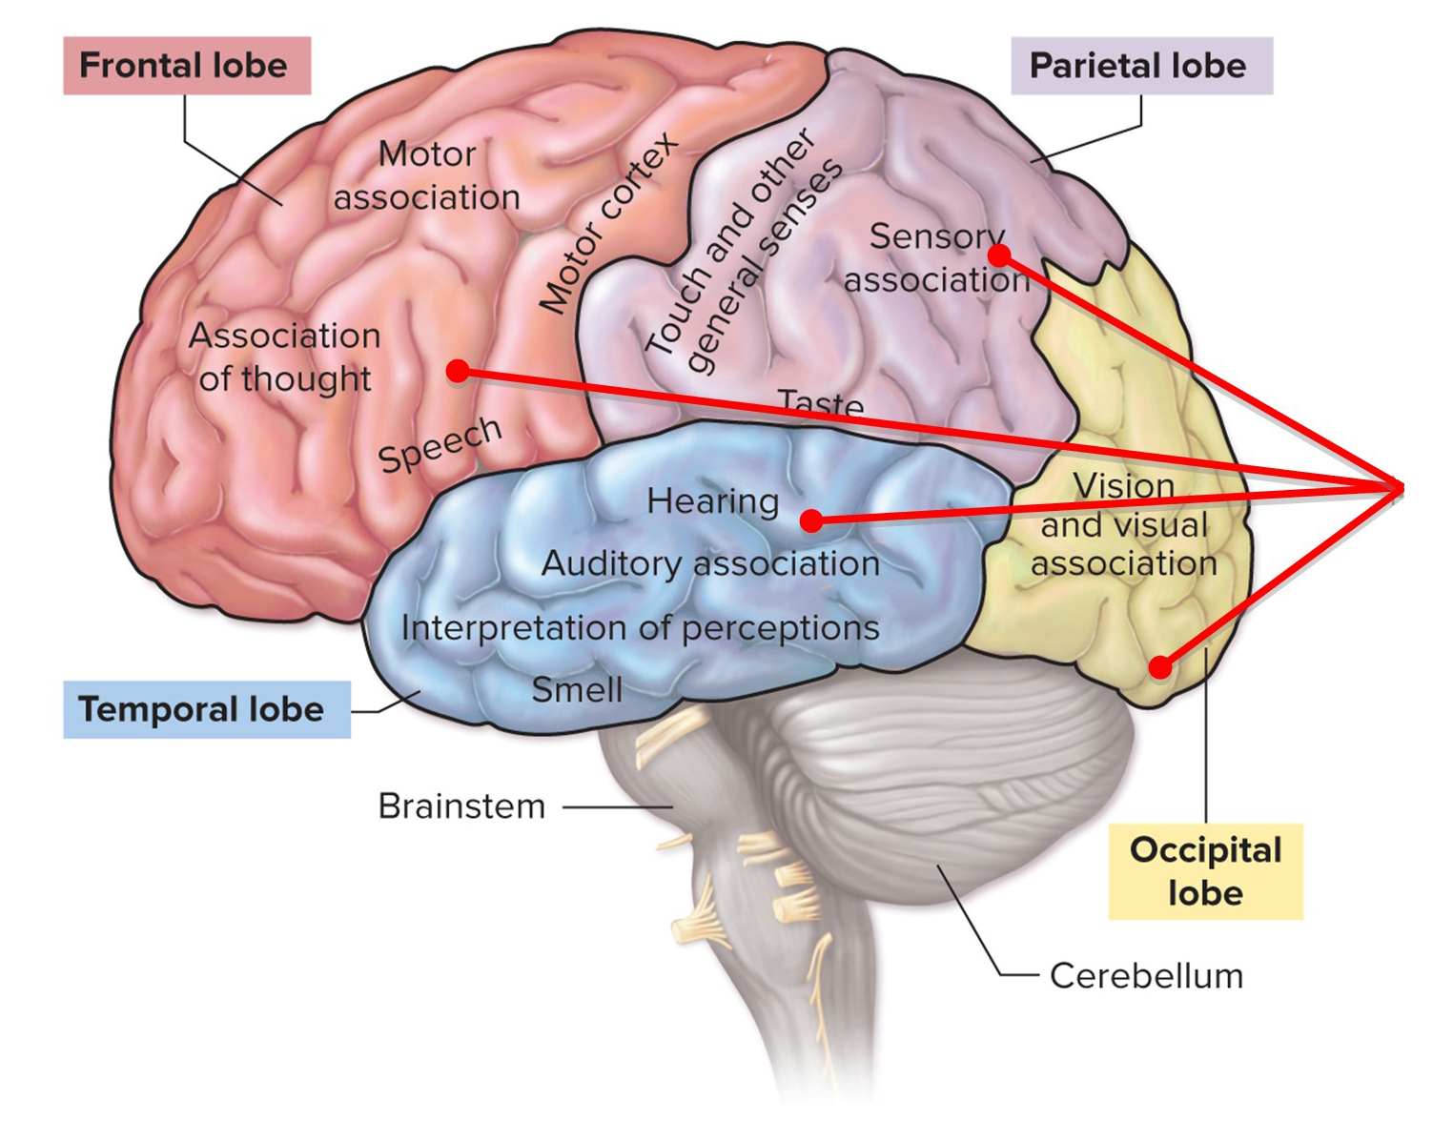
The association areas of the cerebrum
Association functions occur in all four cerebral lobes.
Division | Function(s) | Brain Region(s)
Sensory | Senses of vision, hearing, smell, taste, and touch | Parietal, occipital, and temporal lobes
Motor | Voluntary movements | Frontal lobe
Association | Judgment, analysis, learning, creativity | Frontal lobe and parts of the parietal, occipital, and temporal lobes
Section 26.6
Figure 26.16

Slide 95
The motor areas of the cerebrum
Motor functions are controlled only by the frontal lobe.
Division | Function(s) | Brain Region(s)
Sensory | Senses of vision, hearing, smell, taste, and touch | Parietal, occipital, and temporal lobes
Motor | Voluntary movements | Frontal lobes
Association | Judgment, analysis, learning, creativity | Frontal lobe and parts of the parietal, occipital, and temporal lobes
Section 26.6
Figure 26.16

Slide 96
The sensory integration areas of the cerebrum
Sensory integration occurs in the parietal, temporal, and occipital lobes.
Division | Function(s) | Brain Region(s)
Sensory | Senses of vision, hearing, smell, taste, and touch | Parietal, occipital, and temporal lobes
Motor | Voluntary movements | Frontal lobes
Association | Judgment, analysis, learning, creativity | Frontal lobe and parts of the parietal, occipital, and temporal lobes
Section 26.6
Figure 26.16

Slide 97
The limbic system
The limbic system is also contained within the cerebrum. This “emotional center” of the brain is actually scattered through different brain areas.
Section 26.6
Figure 26.16

Slide 98
The hippocampus
The hippocampus is part of the limbic system responsible for forming long-term memories.
©Gary He/McGraw-Hill Education
Section 26.6
Figures 26.16, 26.17

Slide 99
The amygdala
The amygdala is another part of the limbic system. It is responsible for forming emotions such as fear and pleasure.
©Gary He/McGraw-Hill Education
Section 26.6
Figures 26.16, 26.17

Slide 100
The central nervous system is protected
Because of its many functions, protecting the central nervous system is vital.
Section 26.6
Figure 26.14

Slide 101
The meninges and cerebrospinal fluid
The CNS is surrounded by meninges, layered membranes that help protect it. Cerebrospinal fluid bathes and cushions the brain and spinal cord.
Section 26.6
Figure 26.14

Slide 102
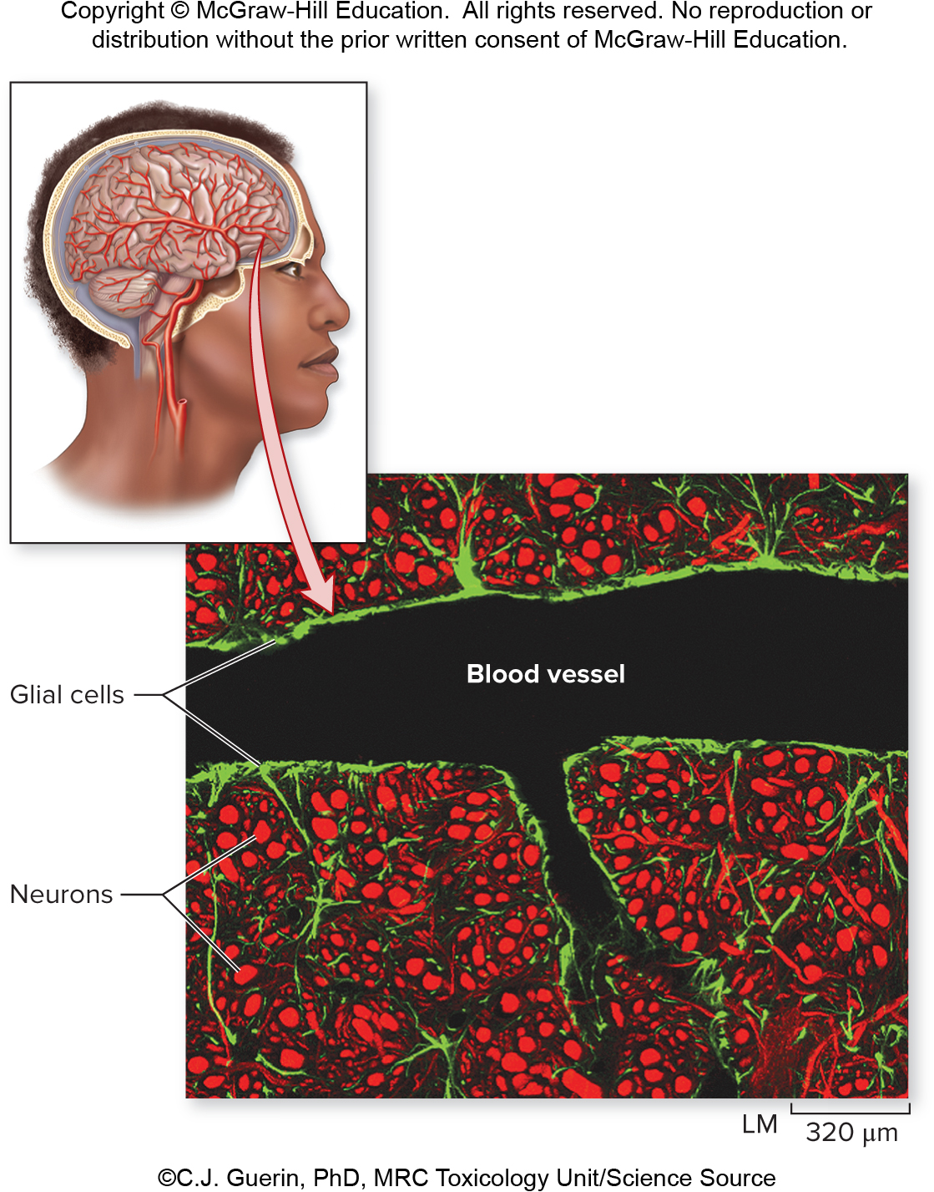
The blood-brain barrier
The blood-brain barrier protects the brain from extreme chemical fluctuations.
©C.J. Guerin, PhD, MRC Toxicology Unit/Science Source
Section 26.6
Figure 26.18

Slide 103
Damage to the CNS can be devastating
Although these protections require energy to produce and maintain, their benefit exceeds their cost. Damage to the CNS can be devastating.
©Natalie Behring/Getty Images
Section 26.6
Figure 26.19

Slide 104
Clicker question #4
How many of the following items are part of the central nervous system?
sensory neurons, spinal cord, cerebrum, sympathetic nervous system, brainstem, motor neurons
one
two
three
four
five

Slide 105
Clicker question #4, solution
How many of the following items are part of the central nervous system?
sensory neurons, spinal cord, cerebrum, sympathetic nervous system, brainstem, motor neurons
three

Slide 106
26.6 Mastering concepts
What are the parts and functions of the cerebral cortex?
©Henrik Sorensen/Riser/Getty Images

Slide 107
Investigating life: Scorpion stings don’t faze grasshopper mice
Scorpion venom causes intense pain in many mammals, including humans and most rodents. However, grasshopper mice are an exception.
Photo by Ashlee and Matthew Rowe
Section 26.7
Figure 26.20

Slide 108
Investigating life: The effects of scorpion venom on lab mice vs. grasshopper mice
Researchers injected scorpion venom or a control solution into the hind paws of typical lab mice and of grasshopper mice.
Photo by Ashlee and Matthew Rowe
Section 26.7
Figure 26.20

Slide 109
Investigating life: Scorpion venom has little effect on grasshopper mice
The lab mice licked a venom-injected paw far more vigorously than they did a control paw, an indication of pain. But venom did not induce the paw-licking behavior in grasshopper mice.
Section 26.7
Figure 26.21

Slide 110
Investigating life: Scorpion venom inhibits action potentials in the pain receptors of grasshopper mice
In a lab mouse, scorpion venom causes sodium channels in pain receptor cells to open and the mouse feels pain.
A grasshopper mouse has unique, specialized sodium channels that do not open when the mouse is bitten. Therefore, the grasshopper mouse does not feel pain.
Section 26.7
Figure 26.22

