Slide 1
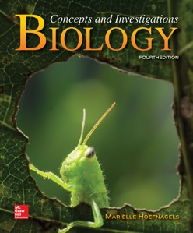
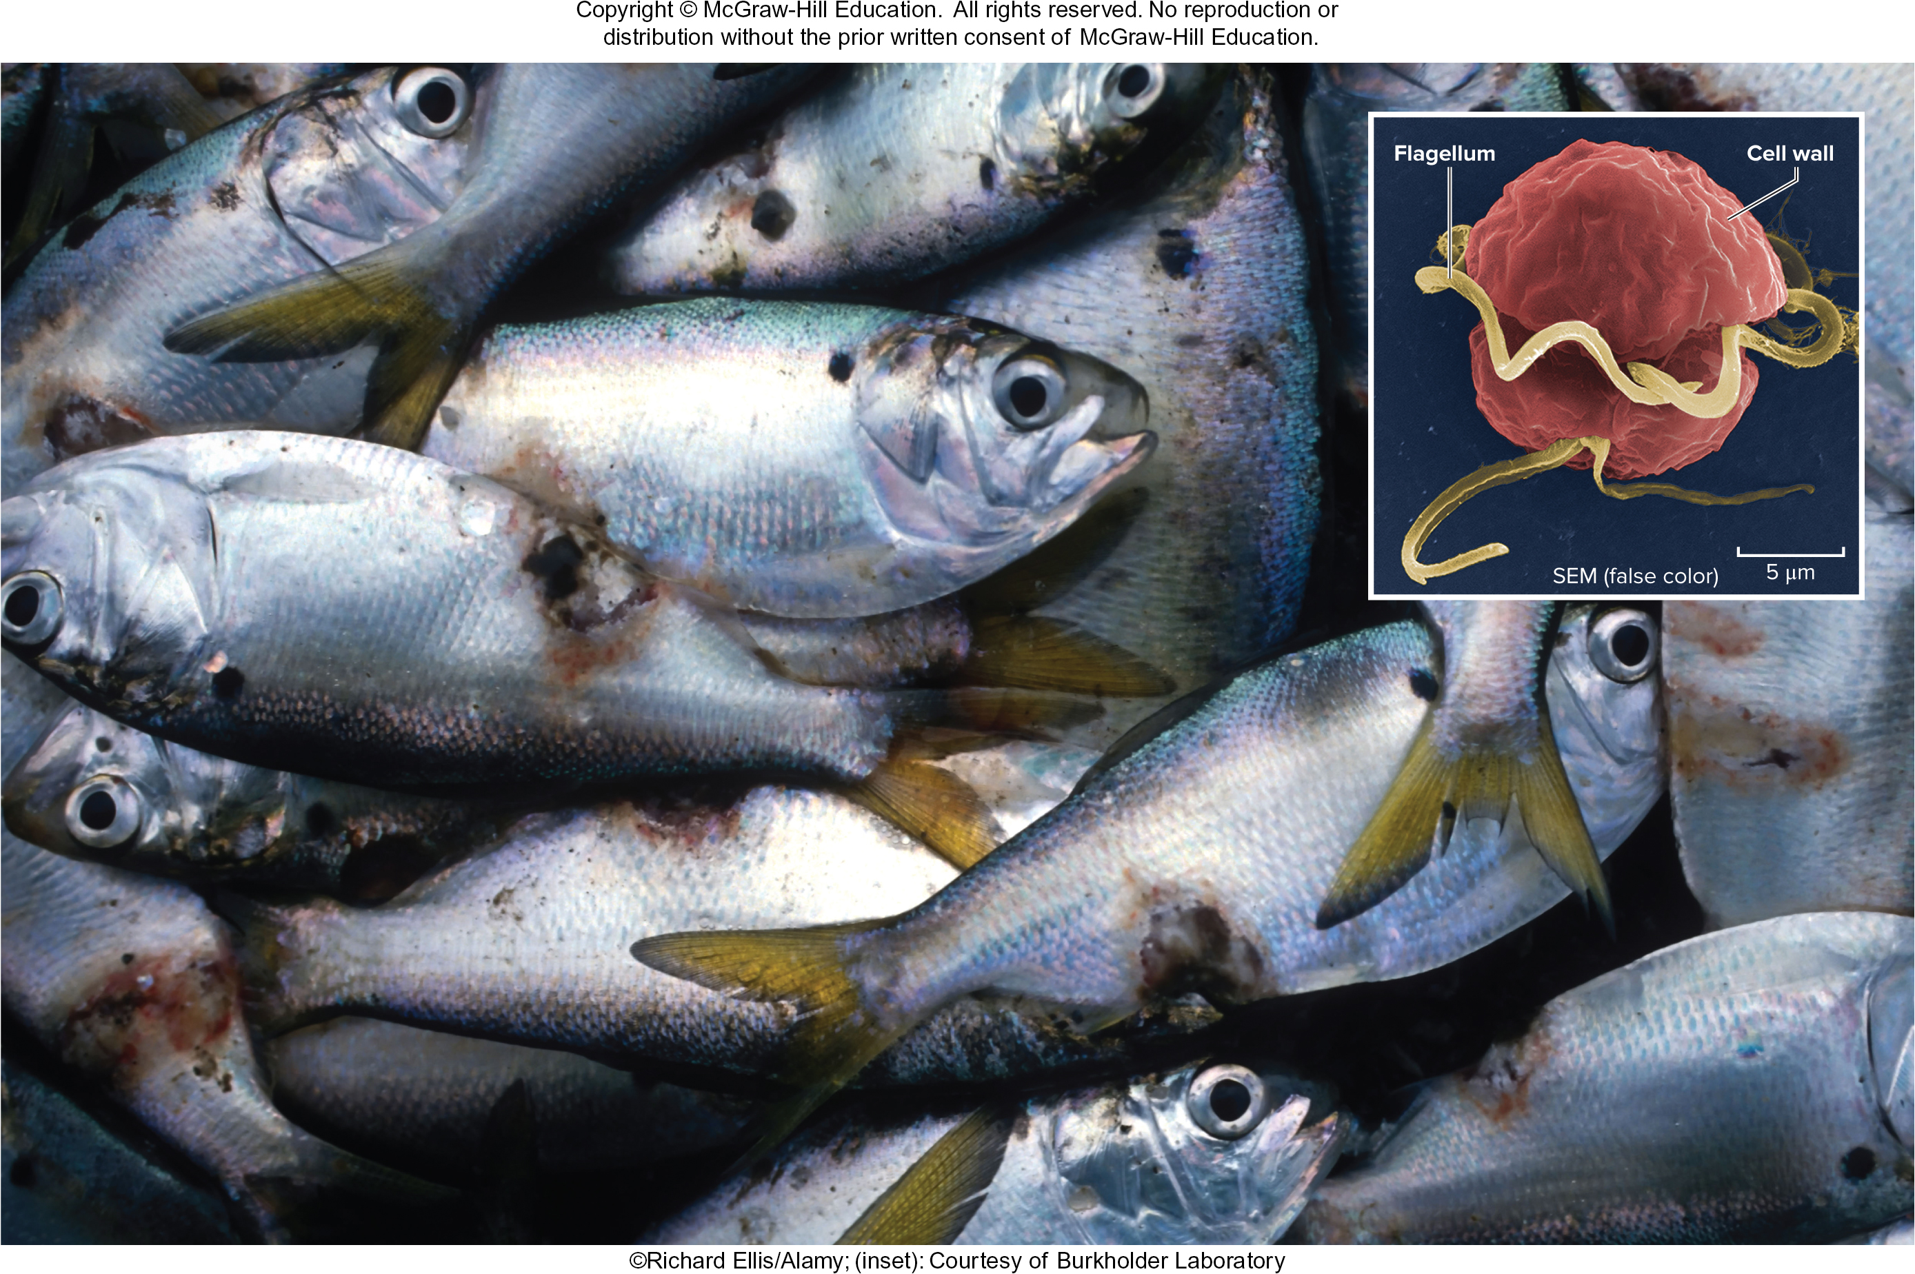
Chapter 18
Protists
©Richard Ellis/Alamy; (inset): Courtesy of Burkholder Laboratory
©McGraw-Hill Education. All rights reserved. Authorized only for instructor use in the classroom.
No reproduction or further distribution permitted without the prior written consent of McGraw-Hill Education.

Slide 2
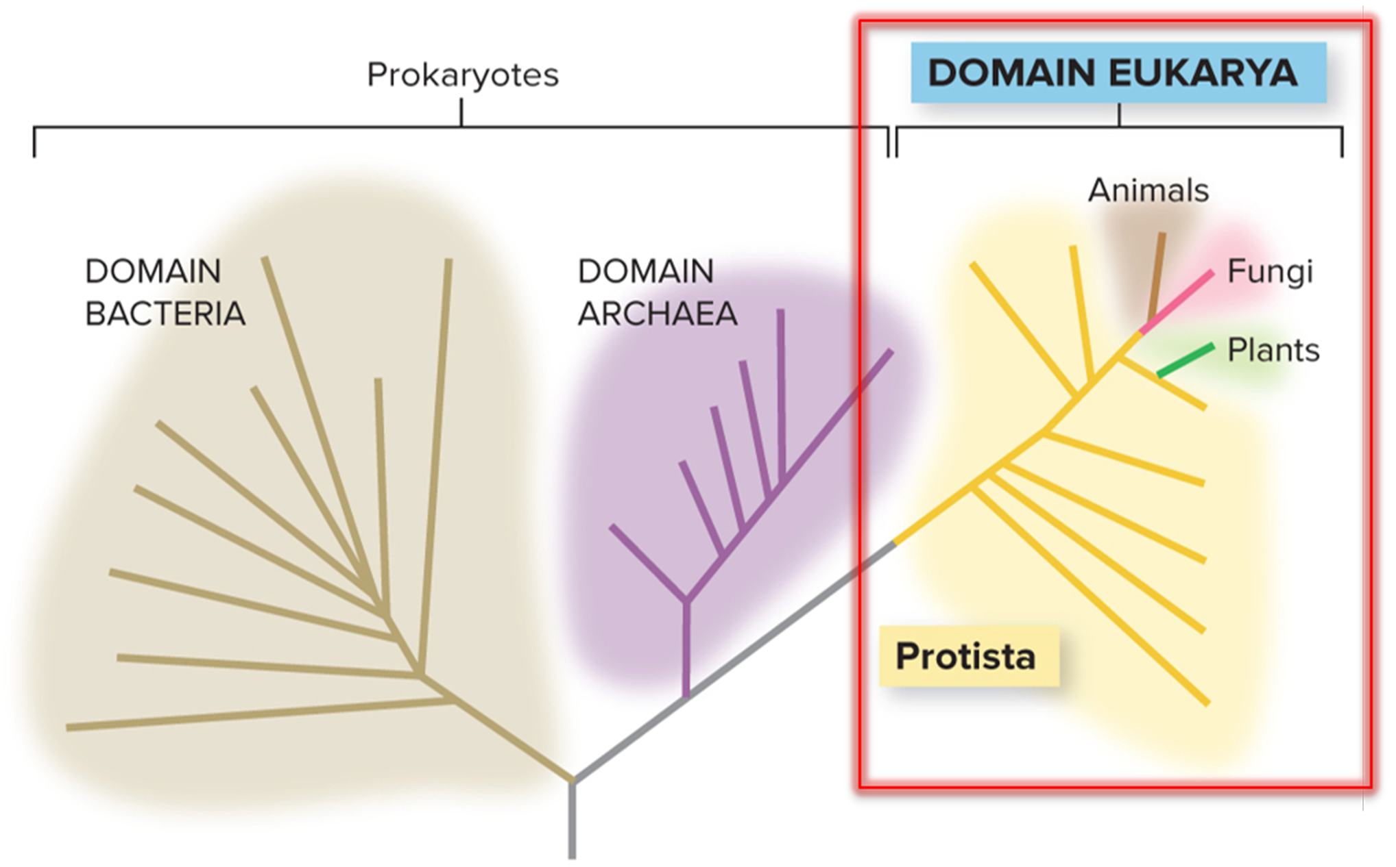
Protists are the simplest eukaryotes
Classifying protists is difficult – they are a paraphyletic group. Originally, protists were defined as eukaryotes that are not plants, fungi or animals.
Section 18.1
Figure 18.1

Slide 3
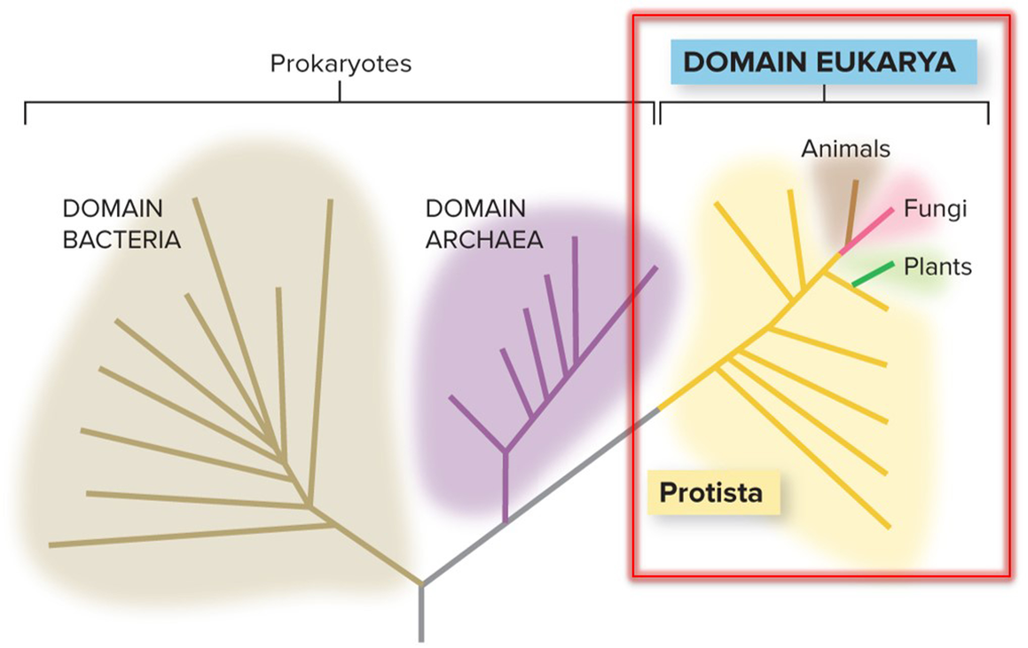
Protists are extremely diverse
Each protist phylum is so different from the others that they may actually be different kingdoms. Evolutionary relationships among protists are being clarified by molecular sequence data.
Section 18.1
Figure 18.1

Slide 4
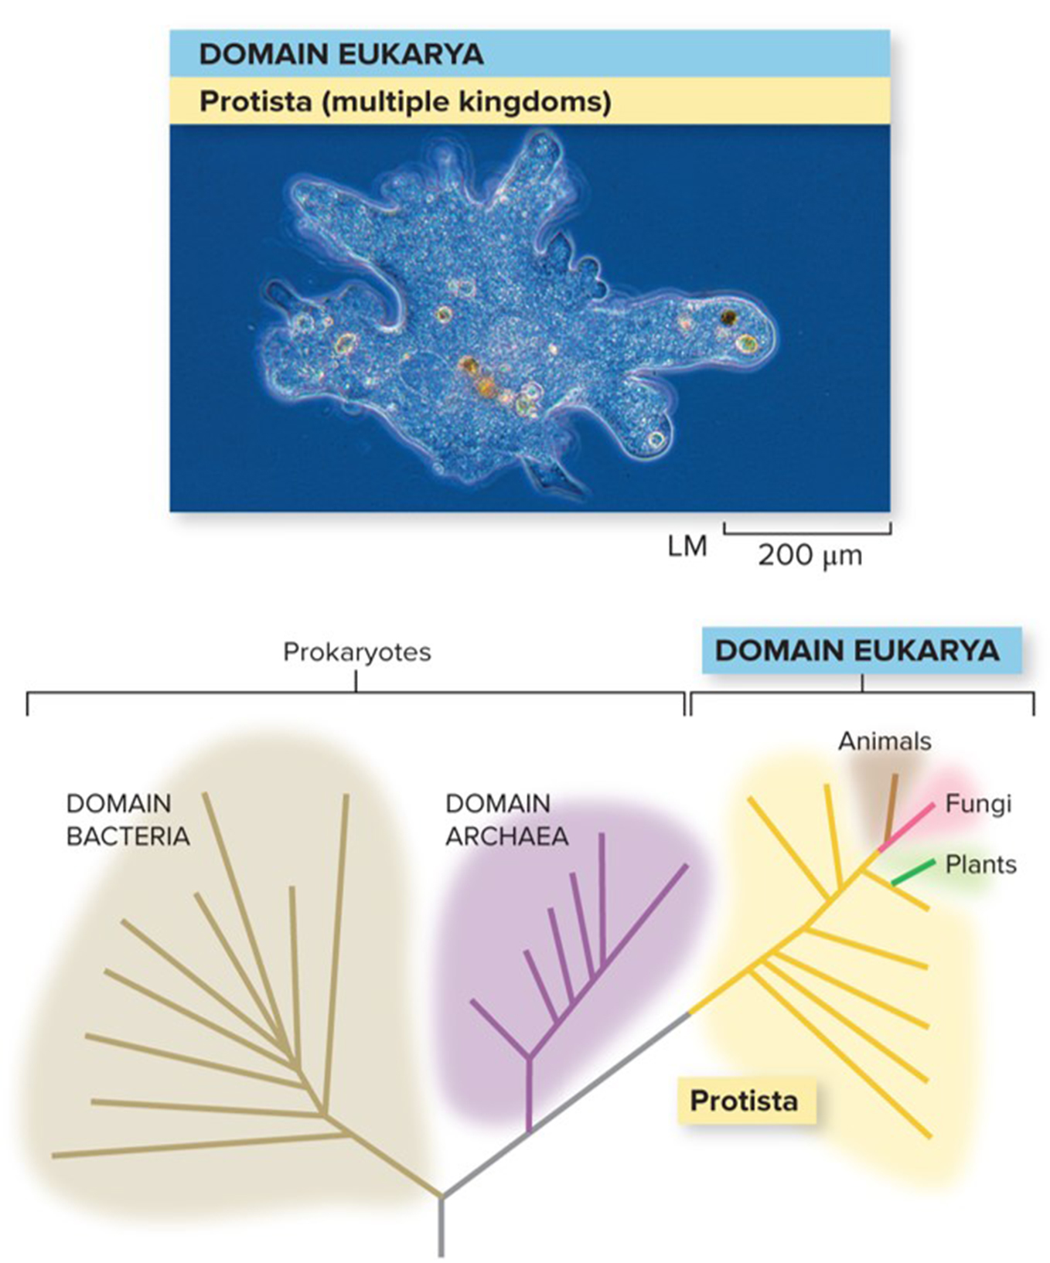
Protists are organized into three groups
Biologists traditionally classify protists in terms of the kingdom they most closely resemble:
Algae—resemble plant cells
Slime molds/water molds—resemble fungal cells
Protozoa—resemble animal cells
©Melba Photo Agency/PunchStock RF
Section 18.1
Figure 18.1

Slide 5
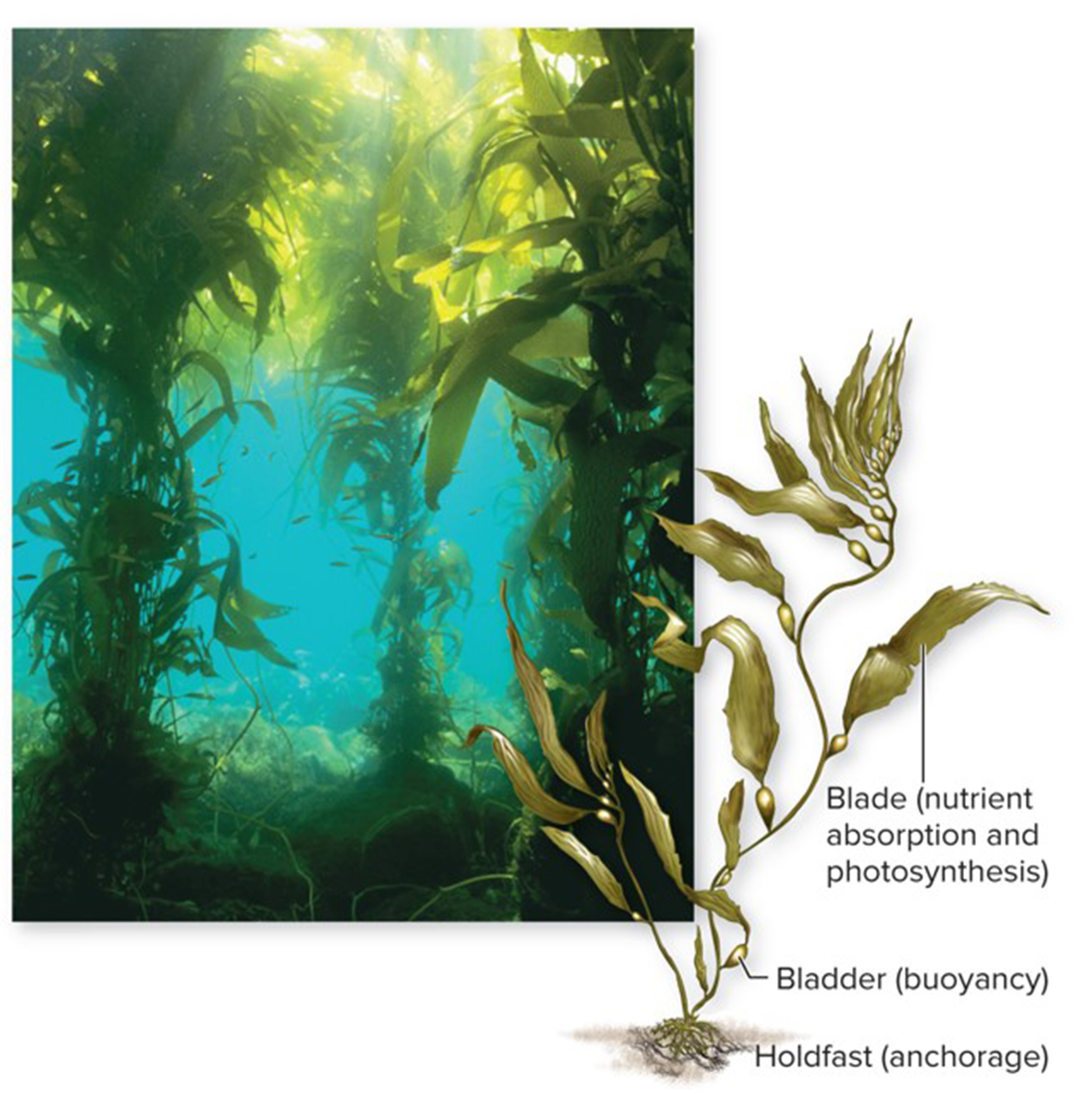
Protists are ecologically important
Algae carry out photosynthesis, producing much of the $O_{2}$ in Earth’s atmosphere and supporting food webs in oceans, lakes, rivers, and ponds.
Algae produce enough energy that scientists are producing algae-powered cars and power plants.
©Ralph A. Clevenger/Corbis
Section 18.1
Figure 18.8

Slide 6
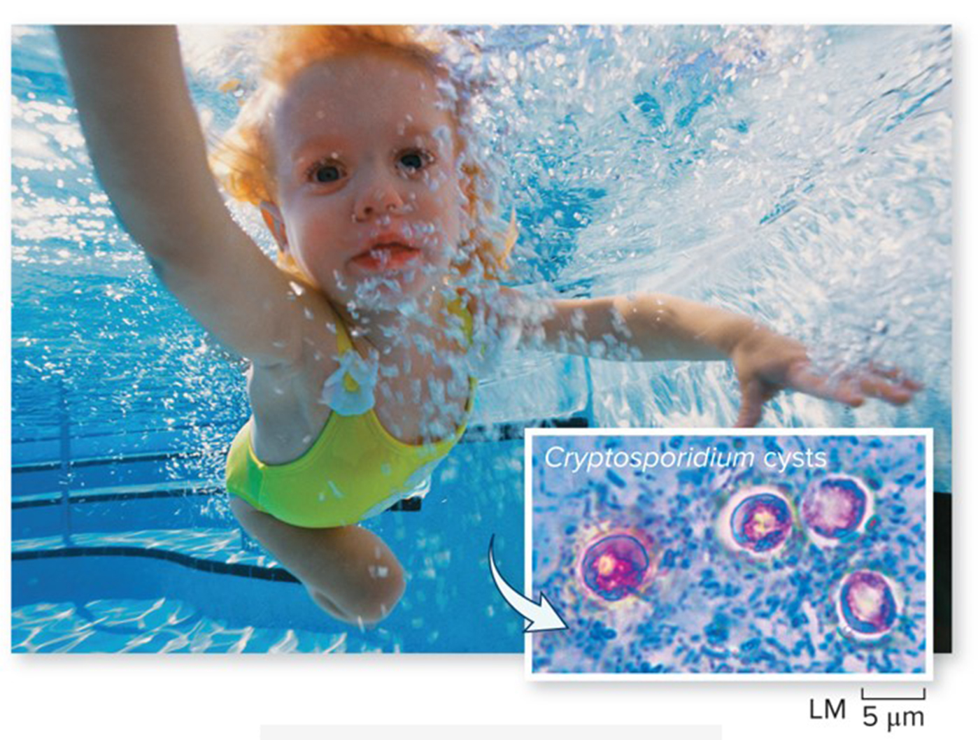
Protists are medically important
Disease-causing protists include Cryptosporidium, which is carried in feces and contaminates swimming water.
Swimmers who ingest this protist become ill with vomiting, diarrhea, cramps, and dehydration.
(girl swimming): ©Photodisc/Getty Images RF; (Cryptosporidium cysts): ©Michael Abbey/Science Source
Section 18.1

Slide 7
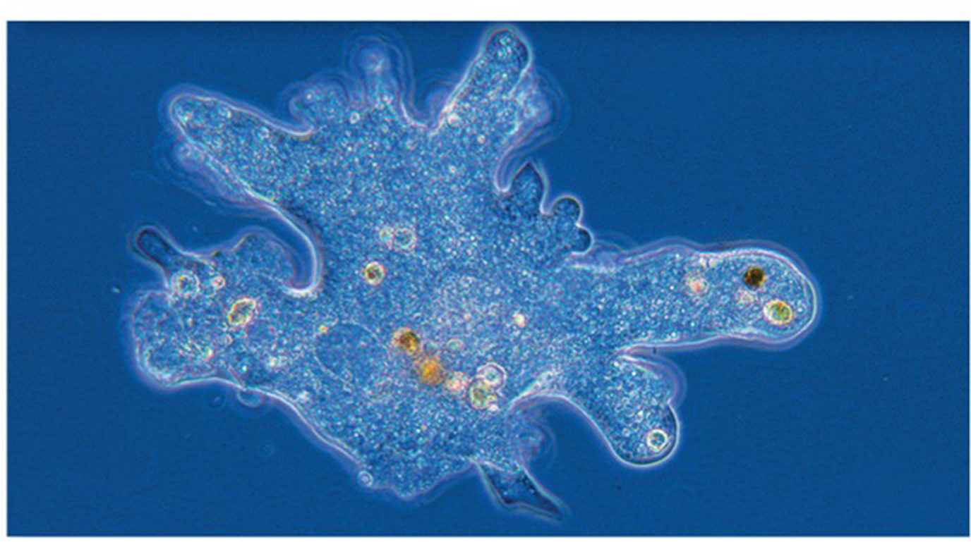
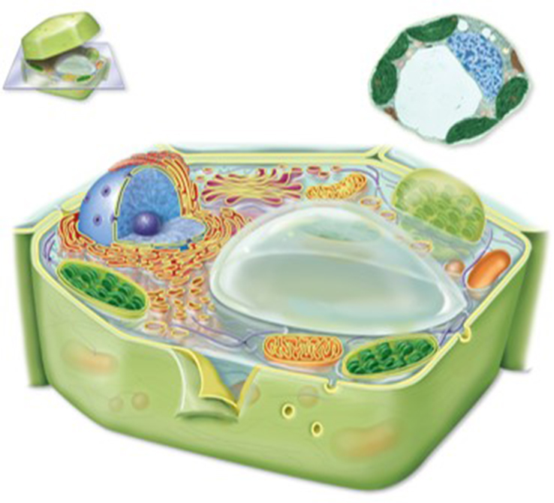
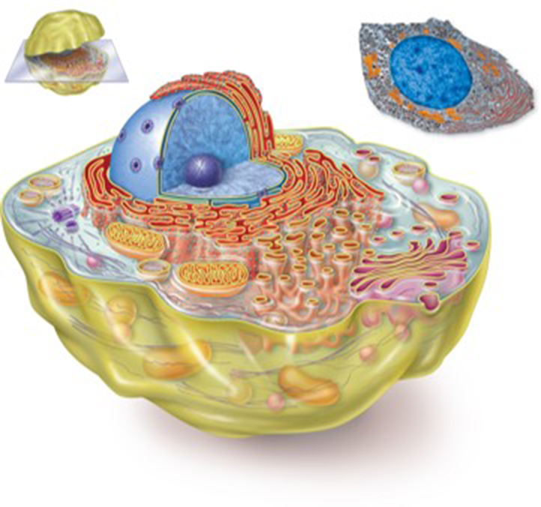
Protists are the most ancient eukaryotes
Protists are helpful in piecing together the development of modern-day eukaryotic cells.
©Melba Photo Agency/PunchStock RF
Section 18.1
©Biophoto Associates/Science Source
©Biophoto Associates/Science Source
Figures 18.1, 3.8. 3.9

Slide 8
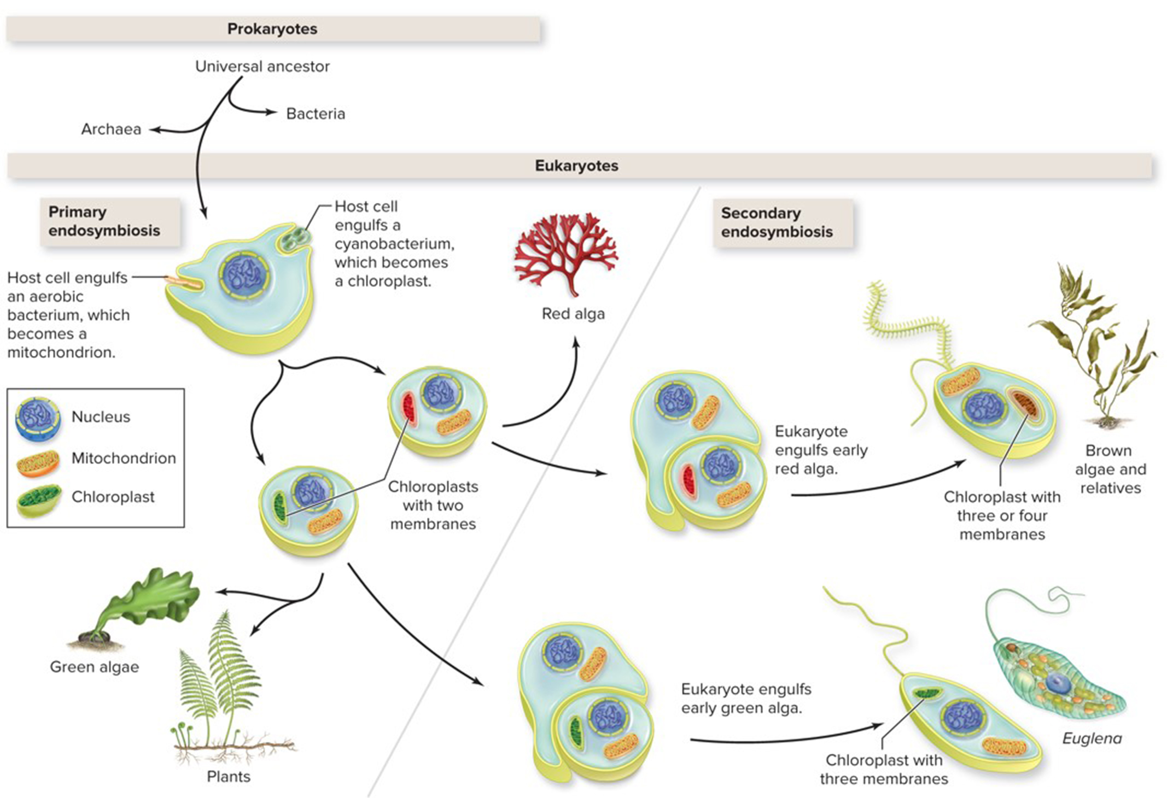
Protists help trace endosymbiosis events
Endosymbiosis explains the origin of mitochondria and chloroplasts, which developed from free-living bacteria.
Section 18.1
Figure 18.2

Slide 9
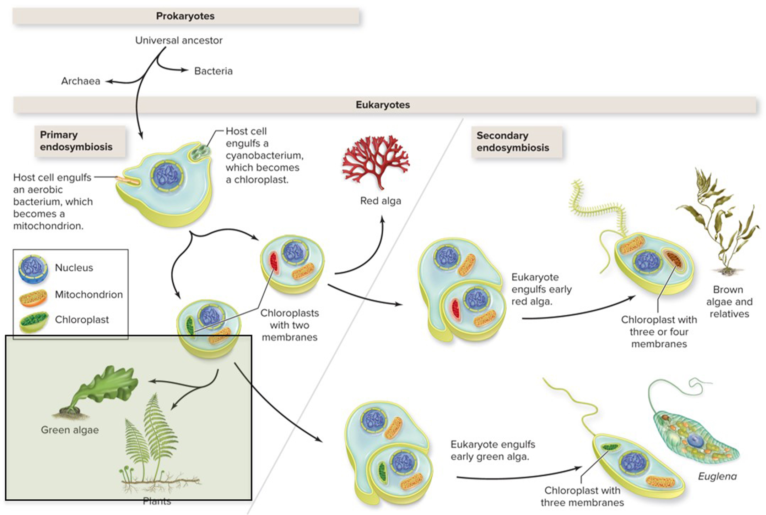
Protists show primary endosymbiosis
Chloroplasts in red algae, green algae, and plant cells have two membranes, indicating they developed from a single endosymbiosis event.
Section 18.1
Figure 18.2

Slide 10
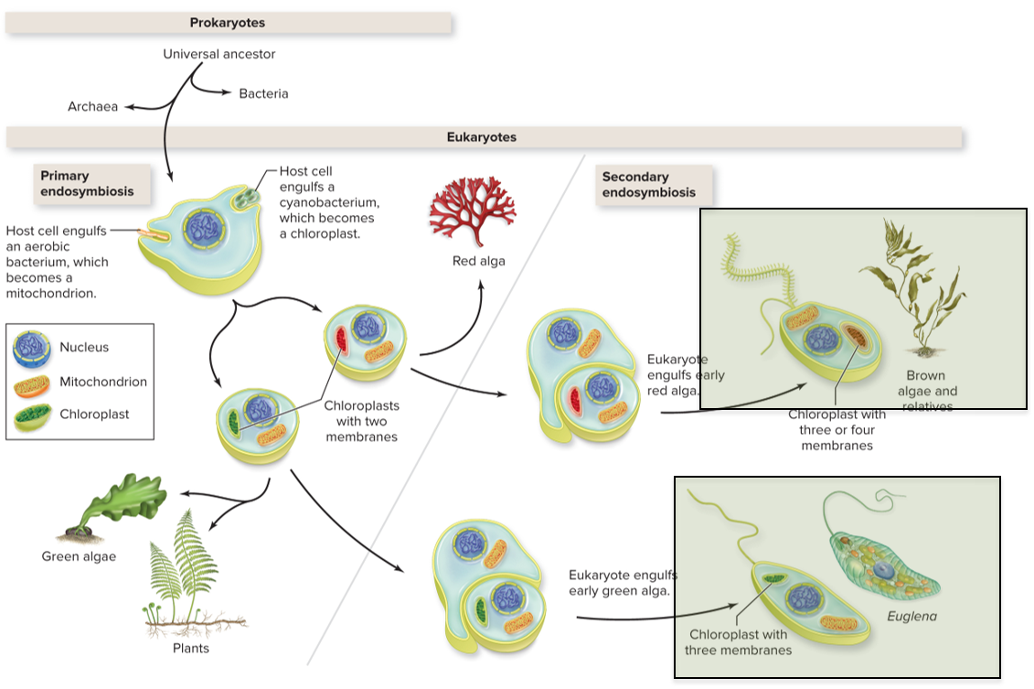
Protists show secondary endosymbiosis
Chloroplasts in brown algae and euglena have three membranes, indicating they developed from two successive endosymbiosis events.
Section 18.1
Figure 18.2

Slide 11
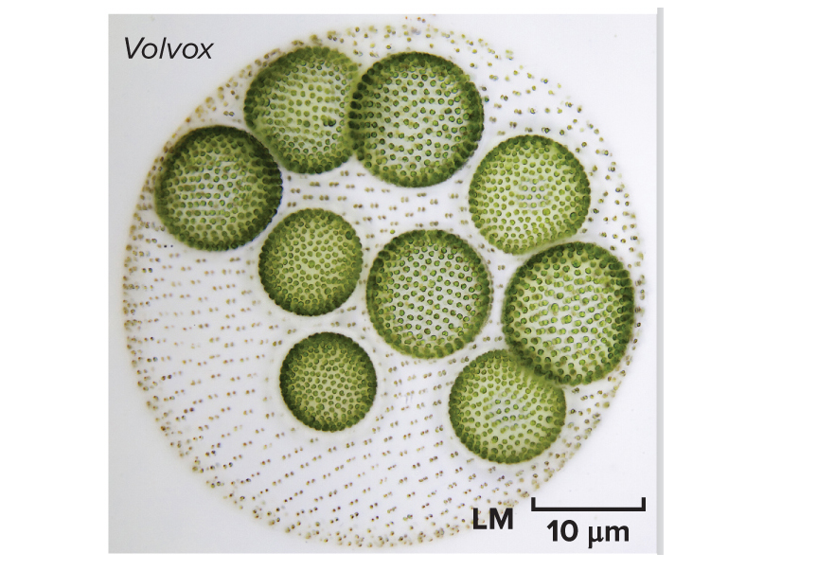
Volvox colonies show clues to multicellularity
This Volvox colony is somewhere between a group of individuals and a multicellular organism.
©Frank Fox/Science Source
Section 18.1
Figure 18.11

Slide 12
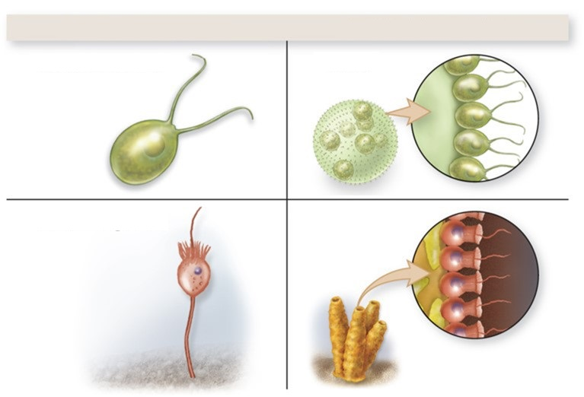
Single-celled protists show clues to multicellularity
Single-celled Chlamydomonas protists closely resemble certain Volvox cells.
Single-celled Choanoflagellate protists closely resemble cells of the simplest multicellular animals, sponges.
Unicellular organism
Multicellular relative
Chlamydomonas
Volvox
Choanoflagellate
Sponge
Section 18.1
Figure 15.11

Slide 13
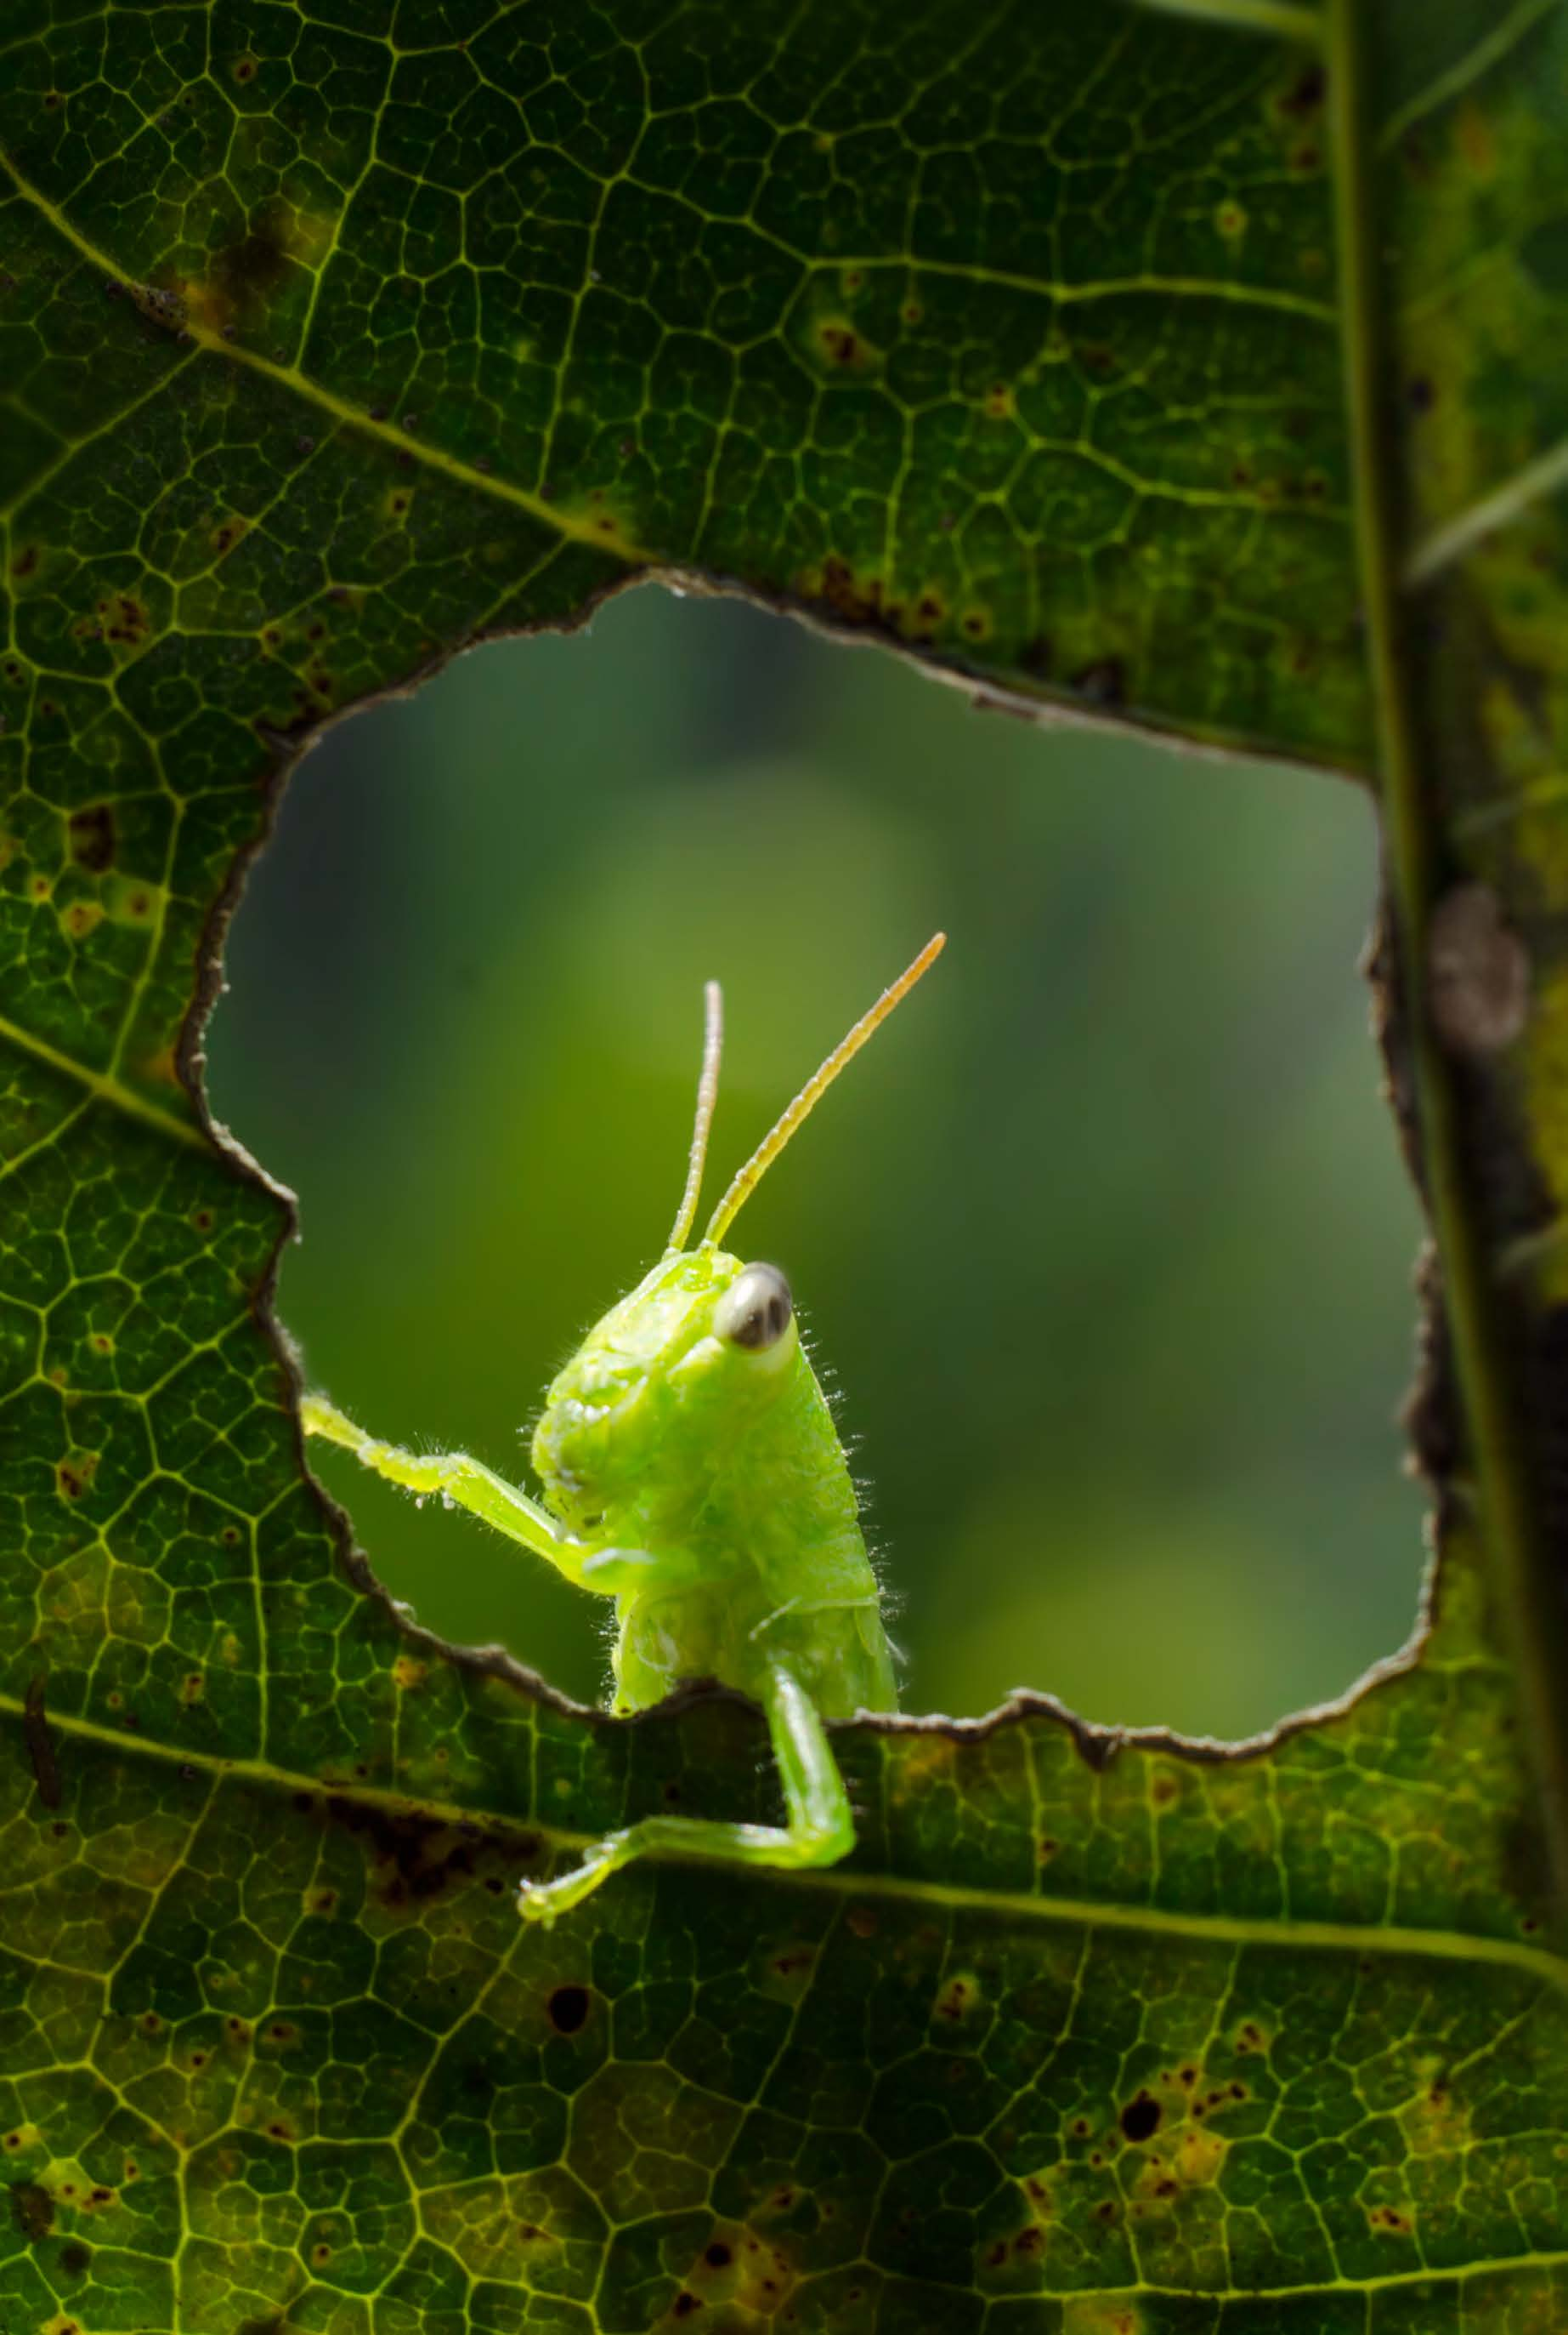
Clicker question #1
Suppose you are looking at a protist in the lab that has three membranes around its chloroplasts. How did these chloroplasts arise?
A eukaryotic cell engulfed a cell with a chloroplast.
An Archaean engulfed a cyanobacterium.
A eukaryotic cell engulfed an aerobic bacterium.
An Archaean engulfed another Archaean.
A eukaryotic cell engulfed an Archaean.

Slide 14
Clicker question #1, solution
Suppose you are looking at a protist in the lab that has three membranes around its chloroplasts. How did these chloroplasts arise?
A eukaryotic cell engulfed a cell with a chloroplast.

Slide 15
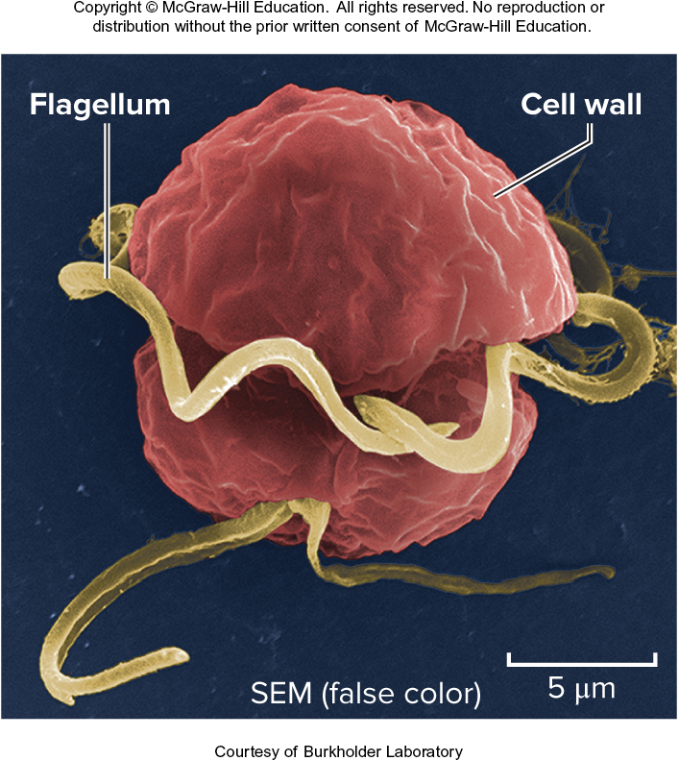
18.1 Mastering concepts
What features define the protists?
Courtesy of Burkholder Laboratory

Slide 16
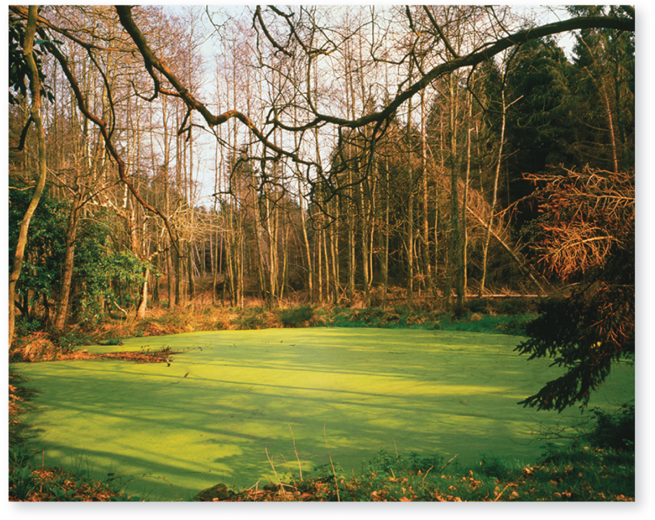
Many protists are photosynthetic
Algae are aquatic, photosynthetic protists.
Common types include euglenoids, dinoflagellates, diatoms, golden algae, brown algae, red algae, and green algae.
Section 18.2
©Michael Marten/Science Source
Figure 18.A

Slide 17
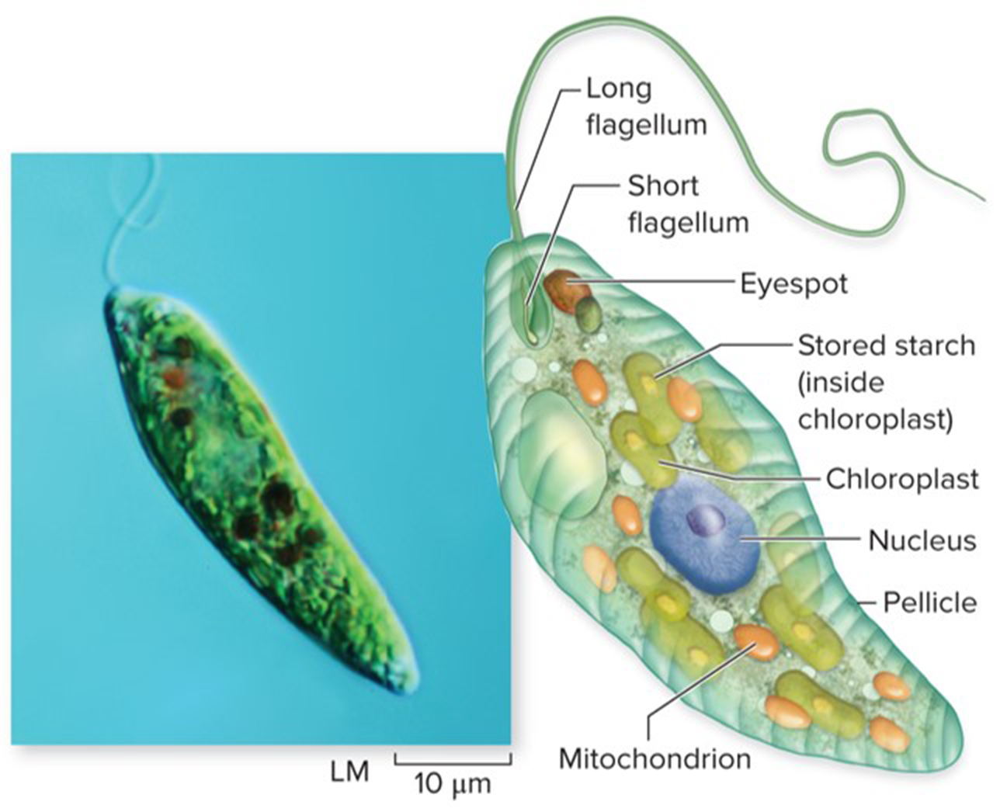
Euglenoids are both autotrophic and heterotrophic
These protists use their flagella to swim around their fresh water habitats.
Euglenoids have triple-membrane, green chloroplasts for photosynthesis when there is light, and in the dark feed on organic matter.
©blickwinkel/Alamy
Section 18.2
Figure 18.3

Slide 18
Dinoflagellates are crucial in ocean food webs
Dinoflagellates are characterized by two flagella. They use them to whirl around in the ocean.
Some are photosynthetic, some live inside animals such as jellyfish, and some are bioluminescent.
They can overgrow and produce toxins, causing red tides.
©David M. Phillips/Science Source
Section 18.2
©Julian Nieman/Alamy
Figures 18.4, 18.5

Slide 19
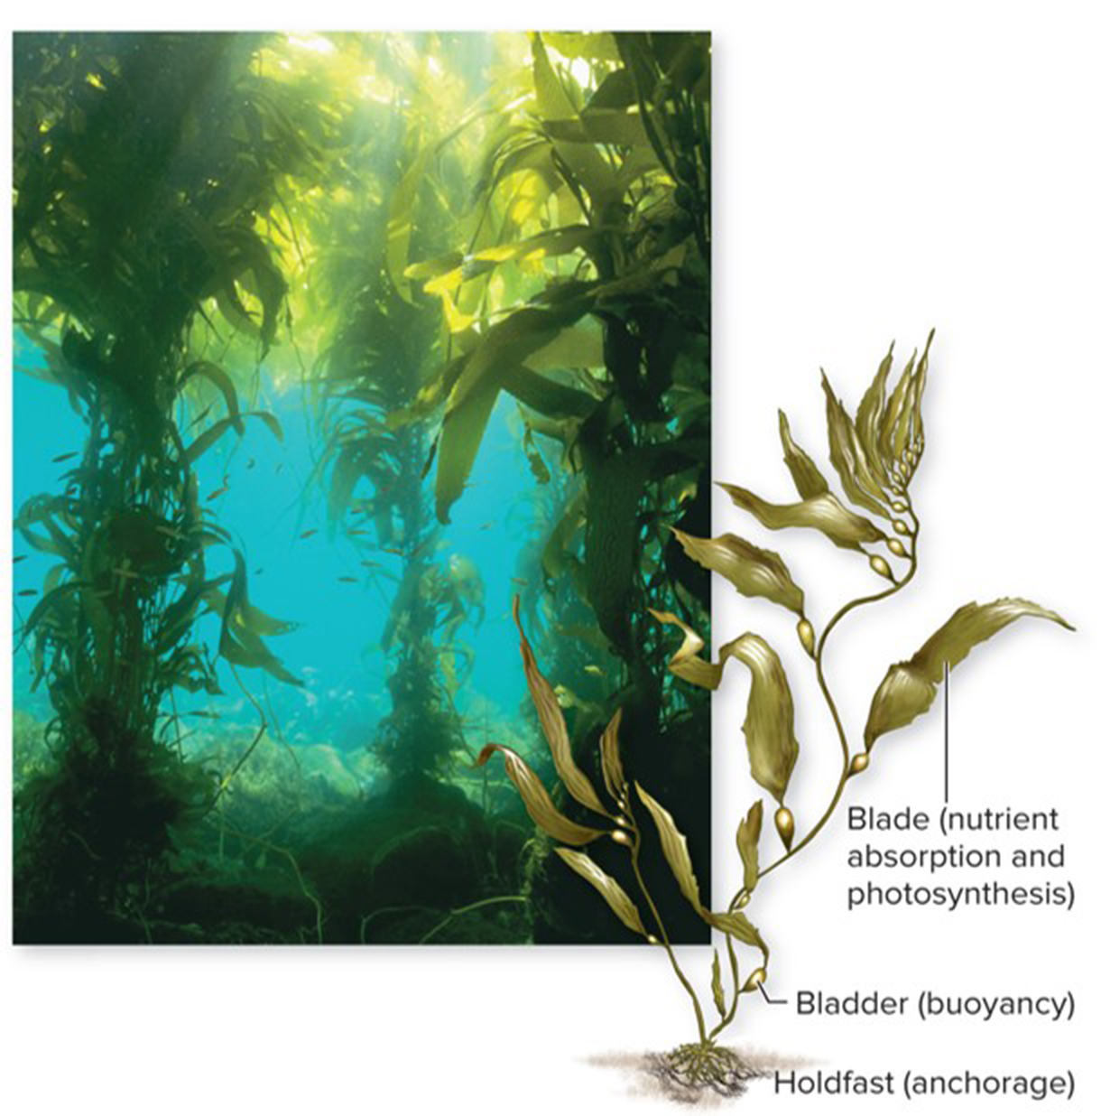
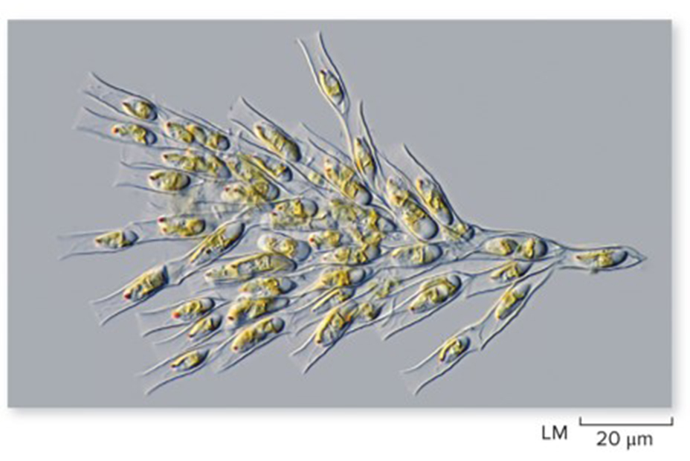
Brown and golden algae contain yellowish pigments for photosynthesis
Golden algae are unicellular or colonial autotrophs in light and heterotrophs in the dark.
Brown algae are the largest and most complex protists. They form giant underwater kelp forests.
©Ralph A. Clevenger/Corbis
Section 18.2
©Frank Fox/Science Source
Figures 18.6, 18.8

Slide 20
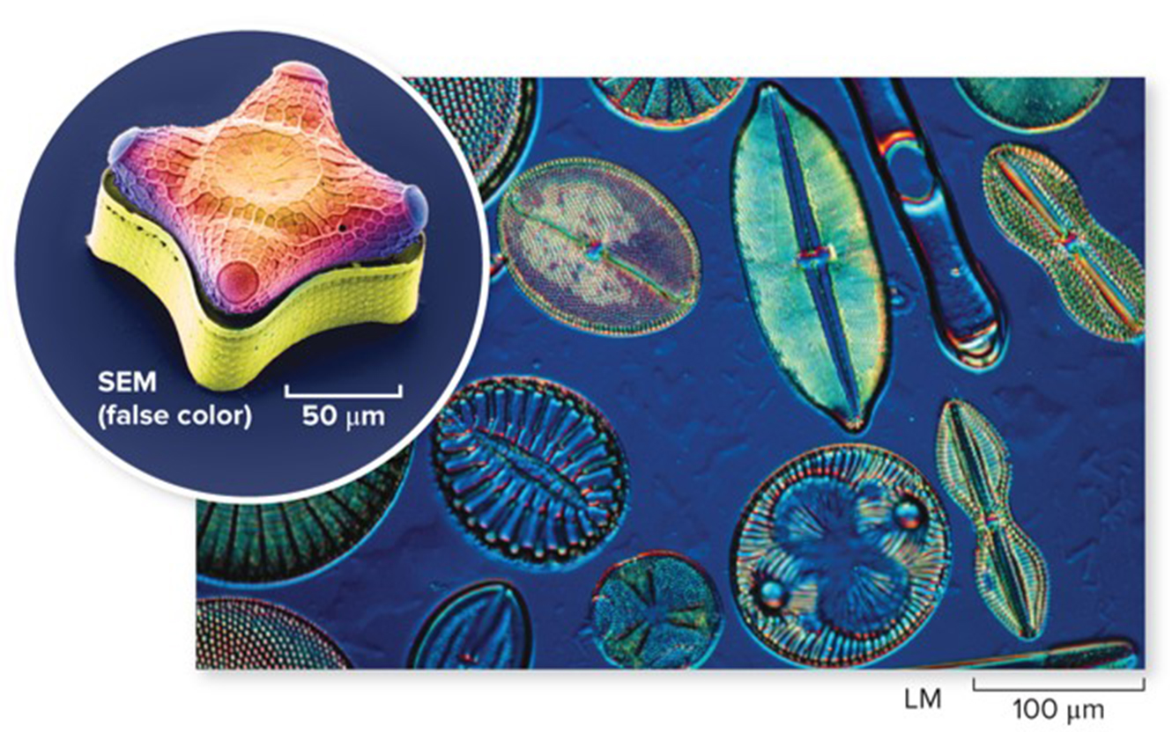
Diatoms have silica cell walls
(multiple diatoms): ©Jan Hinsch/SPL/Getty Images; (single diatom): ©Steve Gschmeissner/Science Source
Diatoms have yellowish pigments for photosynthesis and are abundant in all moist habitats.
Their cell walls are very intricate and give them unique shapes.
Section 18.2
Figure 18.7

Slide 21
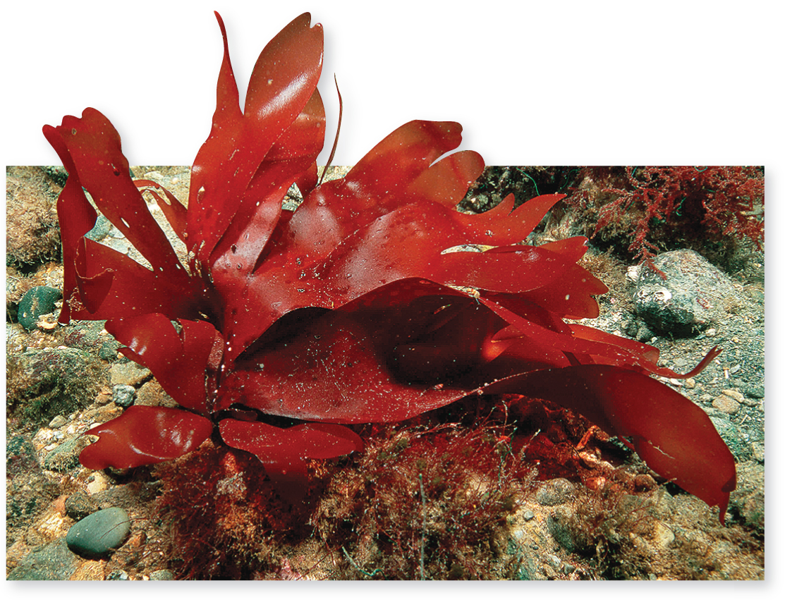
Red algae can live in deep water
Red algae have photosynthetic pigments that absorb red and blue wavelengths of light. These wavelengths do not dissipate in deep water.
People eat red algae and use the agar they produce as a thickening agent in many things.
©Andrew J. Martinez/Science Source
Section 18.2
Figure 18.9

Slide 22
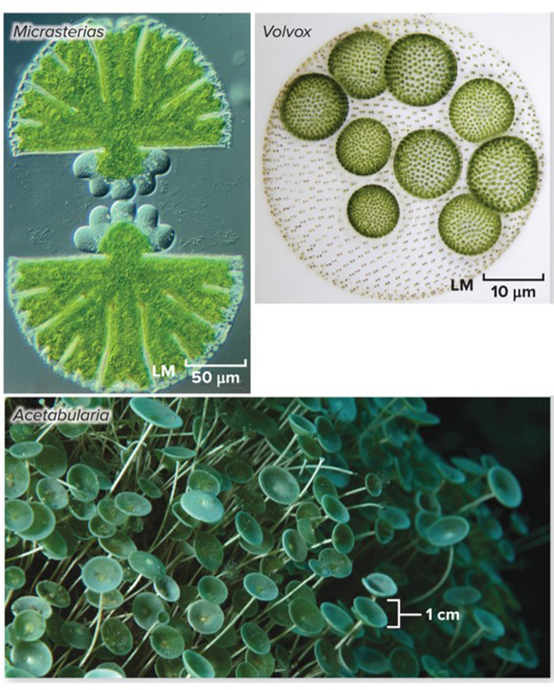
Green algae are close relatives of plants
Green algae are a diverse group – some are microscopic, others are large and multicellular
They share many features with plants, including using chlorophyll a and b for photosynthesis and producing starch.
(Micrasterias): ©M. I. Walker/Science Source; (Volvox): ©Frank Fox/Science Source; (Acetabularia): ©incamerastock/Alamy
Section 18.2
Figure 18.11

Slide 23
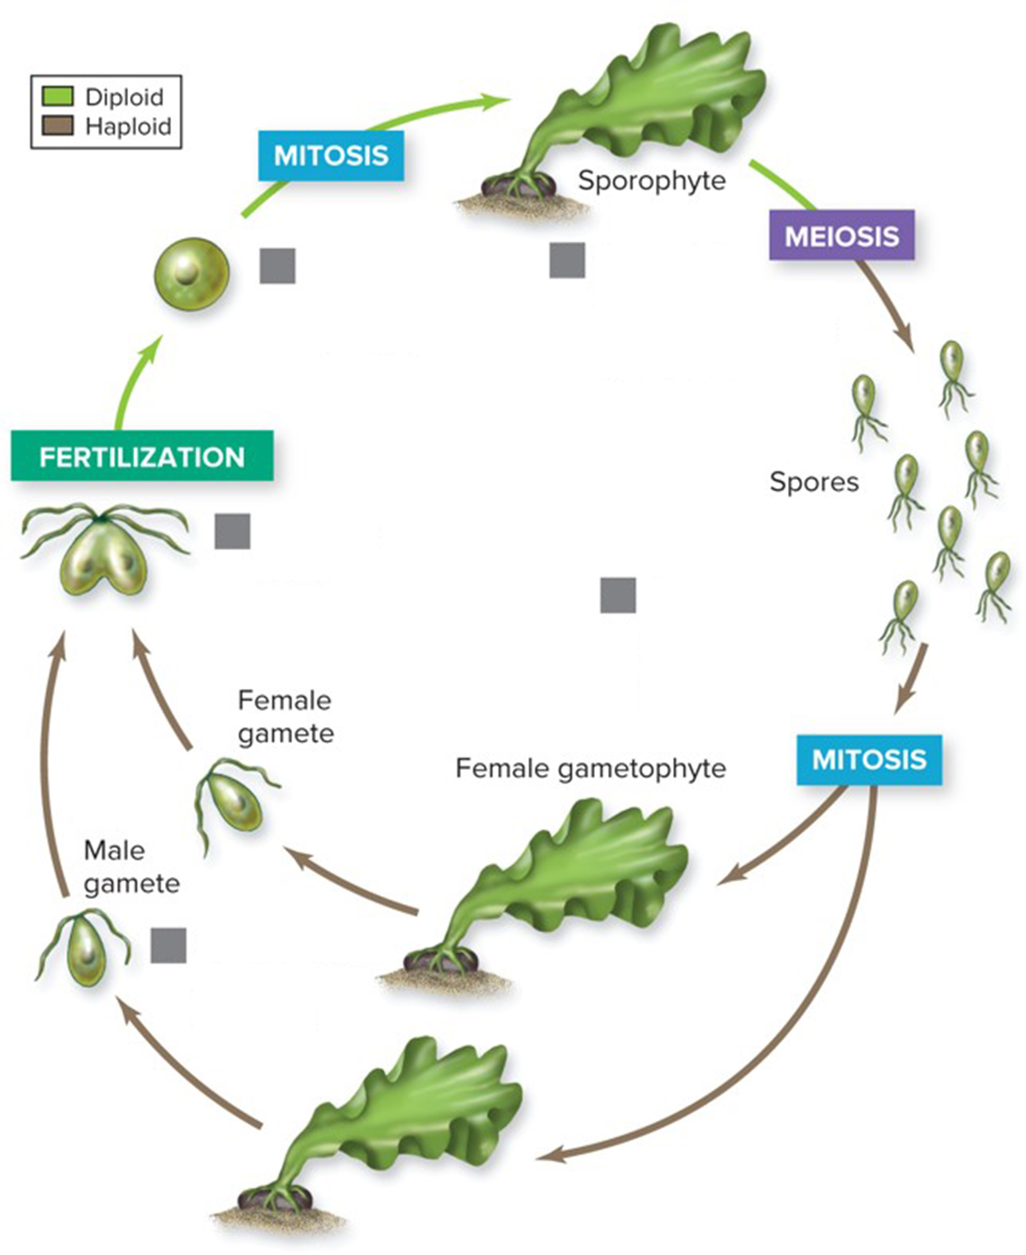
Green algae reproduce like plants
In alternation of generations, haploid gametes and diploid zygotes can both grow into adult organisms.
This life cycle, alternating between haploid and diploid forms, is only found in green algae and plants.
Zygote develops into sporophyte
Sporophyte produces male and female spores by meiosis.
Gametes fuse
Spores divide mitotically, producing gametophtes.
Gametophytes produce gametes.
Section 18.2
Figure 18.10

Slide 24
Clicker question #2
What characteristic(s) unify the algae?
multicellular
toxin production
photosynthetic
Both A and C
All of the above

Slide 25
Clicker question #2, solution
What characteristic(s) unify the algae?
C. photosynthetic

Slide 26
18.2 Mastering concepts
List and describe the characteristics of the major groups of algae. What do they have in common with plants?
Courtesy of Burkholder Laboratory

Slide 27
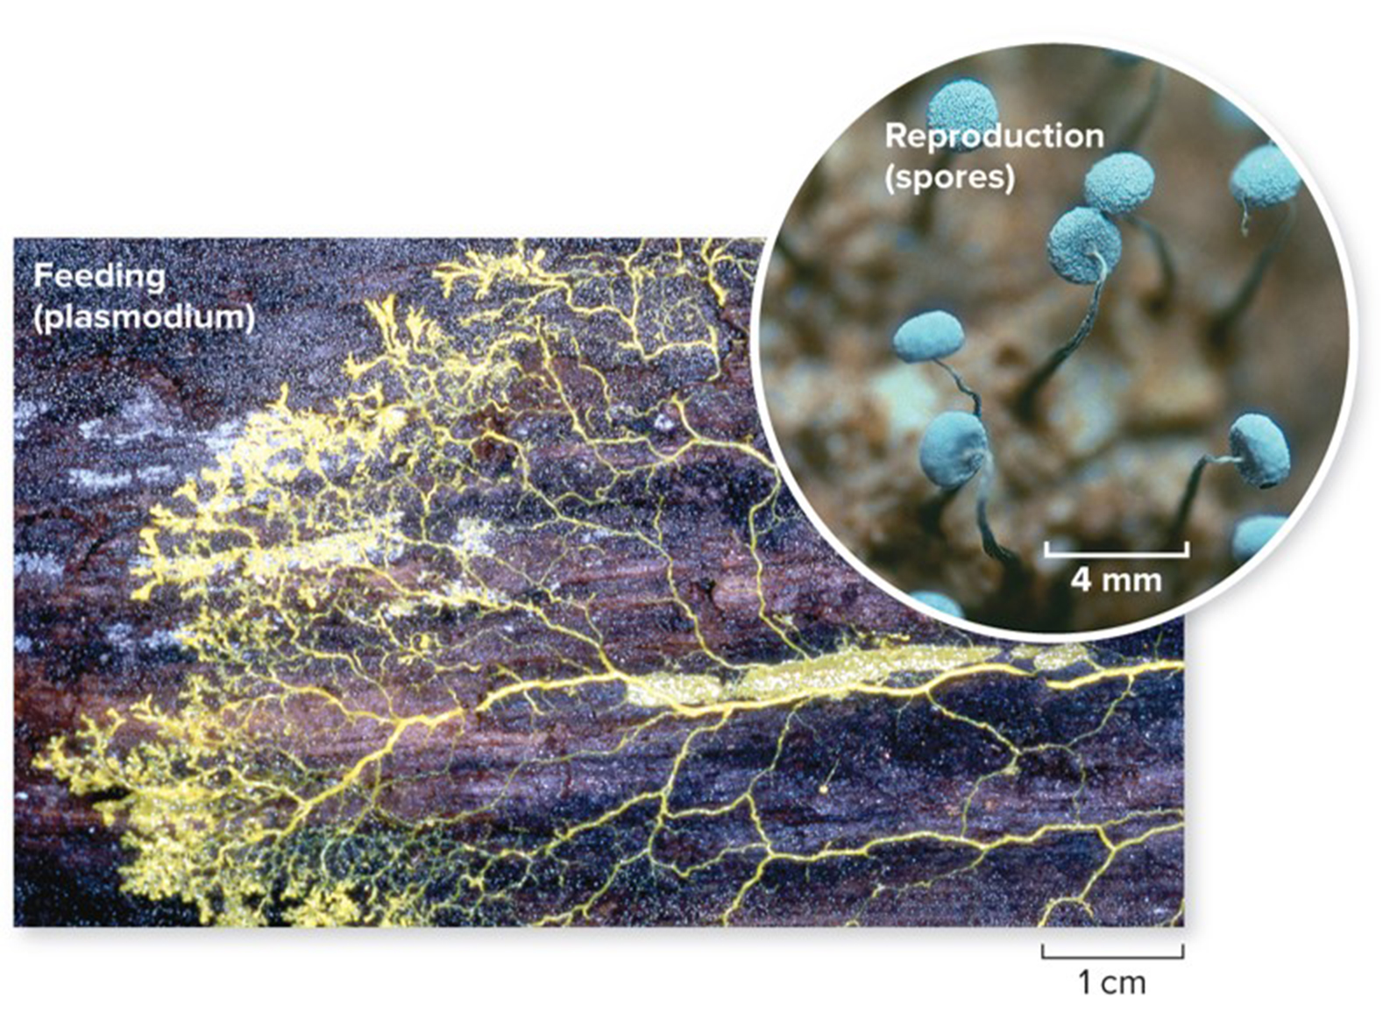
Some heterotrophic protists resemble fungi
Slime molds and water molds are heterotrophic protists that have filamentous feeding structures.
However, they are only distantly related to fungi in terms of DNA sequence.
(plasmodium): ©Steven P. Lynch/McGraw-Hill Education; (spores): ©Ray Simons/Science Source
Section 18.3
Figure 18.12

Slide 28
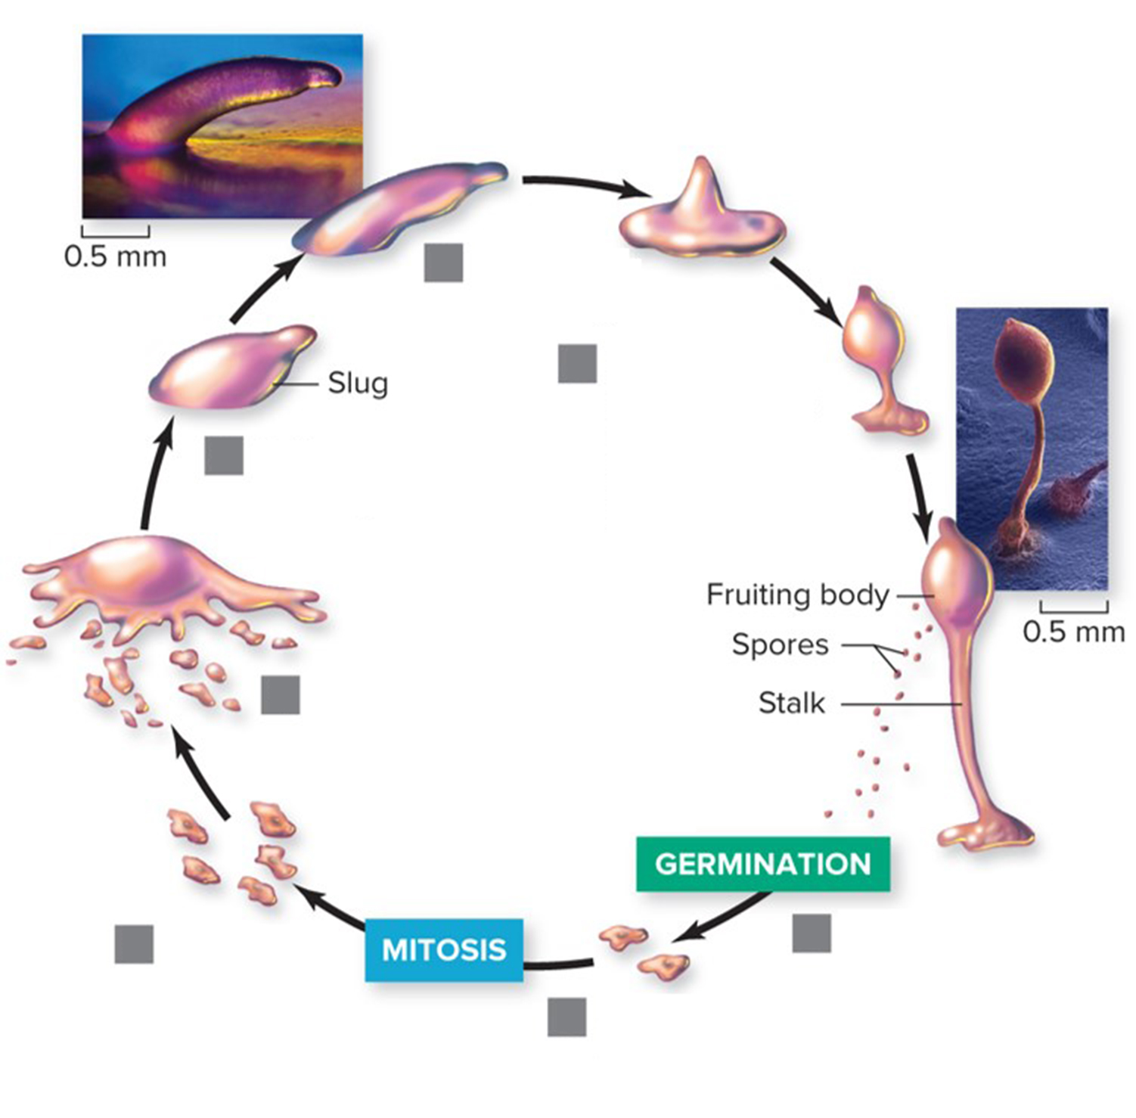
Slime molds are unicellular and multicellular protists
Slime molds can exist as single cells or as large masses that behave like a multicellular organism.
Slug travels toward light.
Slug halts, forming a stalk with a fruiting body containing spores.
Cells aggregate into slug.
When food is lacking, cells secrete biochemicals that stimulate them to aggregate.
Cells feed and divide.
Stalk cells perish.
Spores germinate in new habitats.
(slug): ©Carolina Biological Supply Company/Phototake; (fruiting body): ©David Scharf/Science Source
Section 18.3
Figure 18.13

Slide 29
Cellular slime molds keep their individual cells
Cellular slime molds, like those shown here, live as haploid cells until resources become limited. They then aggregate into a mobile “slug” and then a fruiting body, which produces spores.
Slug travels toward light.
Slug halts, forming a stalk with a fruiting body containing spores.
Cells aggregate into slug.
When food is lacking, cells secrete biochemicals that stimulate them to aggregate.
Cells feed and divide.
Stalk cells perish.
Spores germinate in new habitats.
(slug): ©Carolina Biological Supply Company/Phototake; (fruiting body): ©David Scharf/Science Source
Section 18.3
Figure 18.13

Slide 30
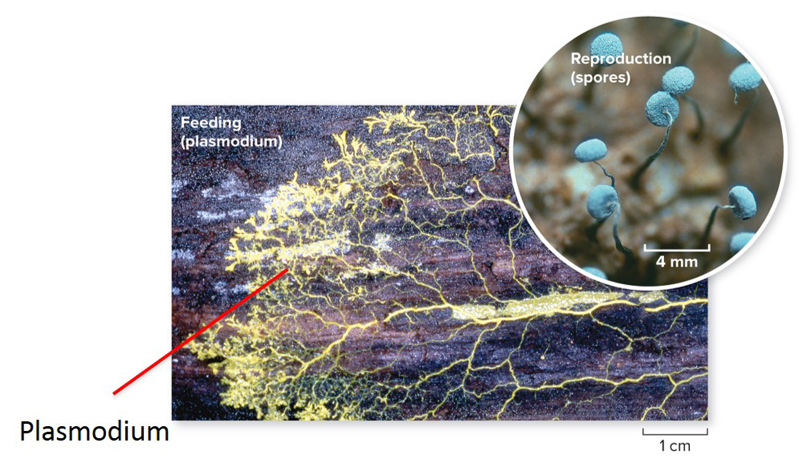
Plasmodial slime molds are one huge cell
During their feeding stage, plasmodial slime molds form a plasmodium, which is a large cell containing thousands of diploid nuclei.
(plasmodium): ©Steven P. Lynch/McGraw-Hill Education; (spores): ©Ray Simons/Science Source
Section 18.3
Figure 18.12

Slide 31
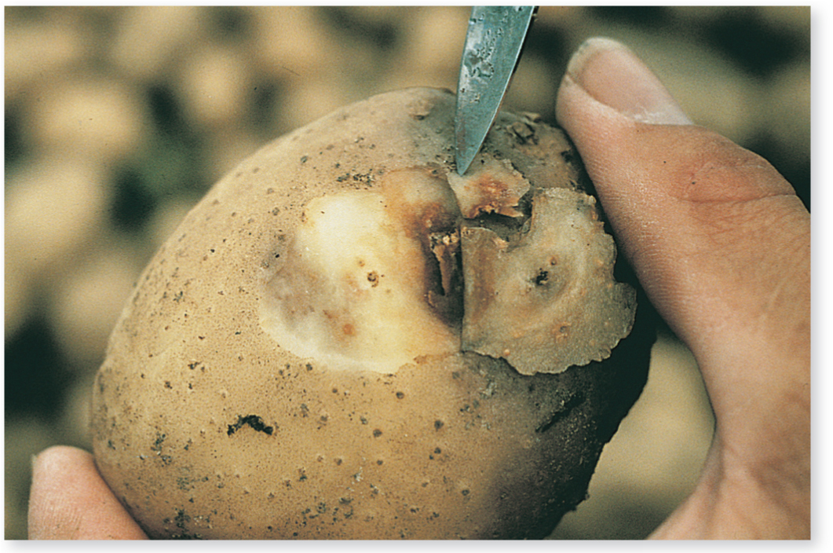
Water molds are decomposers and parasites
Water molds are decomposers and parasites.
They secrete digestive enzymes into their surroundings and absorb the nutrients.
©W.E. Fry, Plant Pathology, Cornell University
Section 18.3
Figure 18.14

Slide 32
Water molds feed on plants and animals
Some water molds ruin food crops, including potatoes, grapes and lettuce. Others grow on weak, dead, or dying aquatic organisms like fish.
©W.E. Fry, Plant Pathology, Cornell University; (b): ©sdbower/iStock/Getty Images RF
Section 18.3
Figure 18.14

Slide 33
Clicker question #3
What mode of nutrition is used by slime molds and water molds?
photoautotrophs
chemoautotrophs
heterotrophic consumers
heterotrophic decomposers
None of the above

Slide 34
Clicker question #3, solution
What mode of nutrition is used by slime molds and water molds?
D. heterotrophic decomposers

Slide 35
18.3 Mastering concepts
Compare and contrast water molds, plasmodial and cellular slime molds.
Courtesy of Burkholder Laboratory

Slide 36
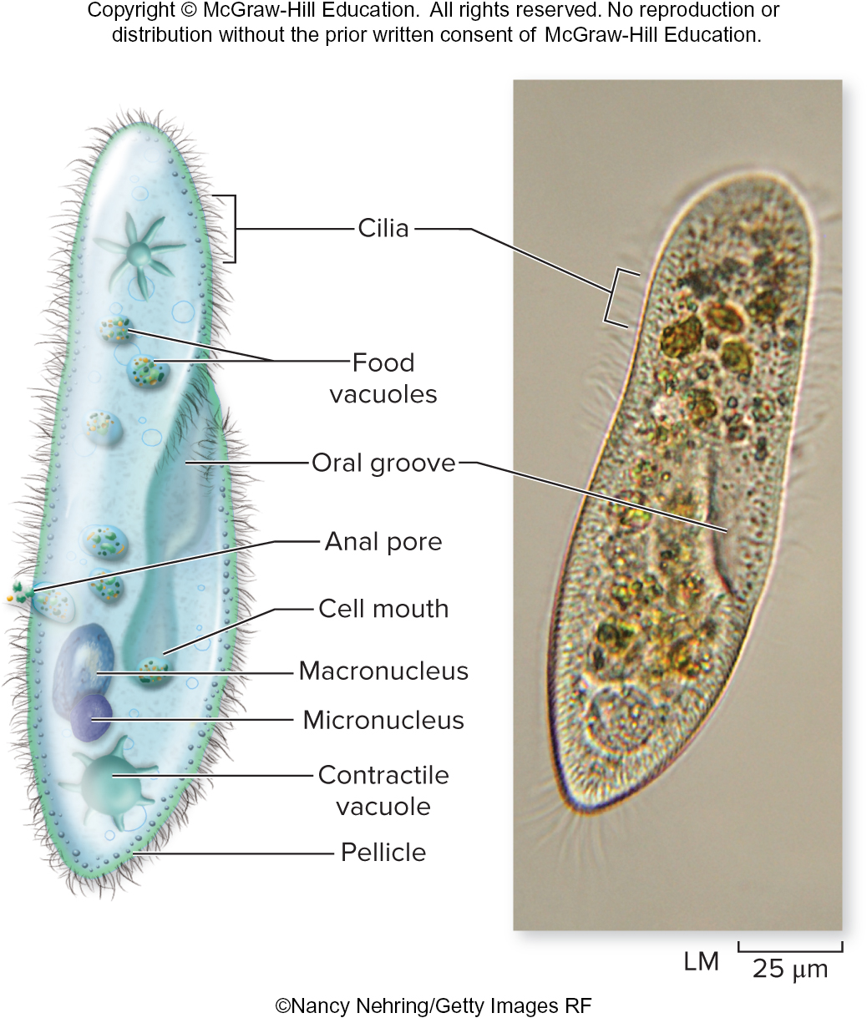
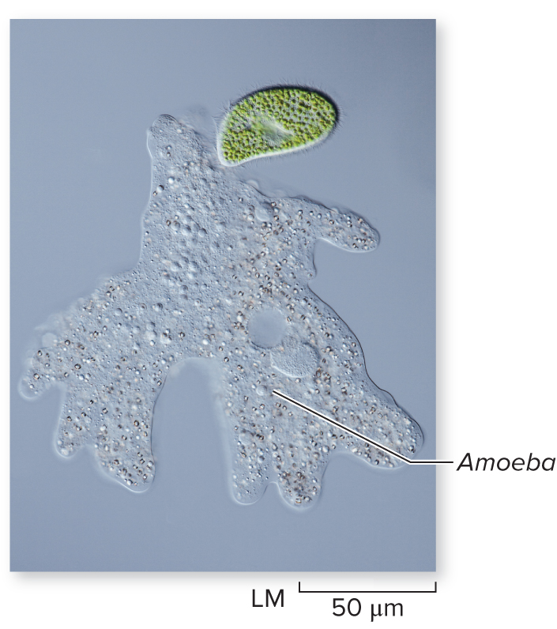
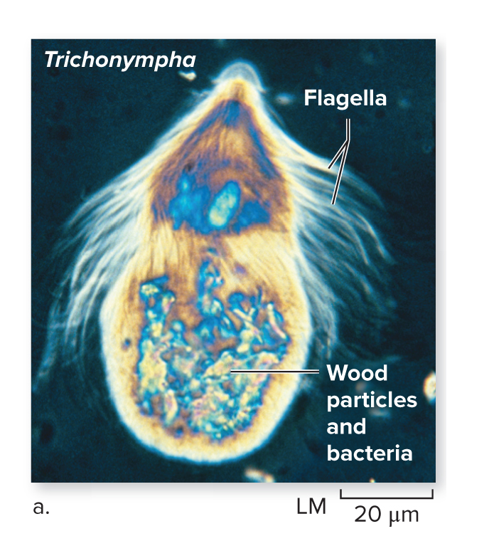
Protozoa are diverse heterotrophs
Most protozoa are one-celled, heterotrophic, and motile. They are grouped together based on morphology and locomotion but are only distantly related to each other.
©micro_photo/iStock/Getty Images RF
©Eric V. Grave/Science Source
©Nancy Nehring/Getty Images RF
Section 18.4
18.15, 18.16, 18.18

Slide 37
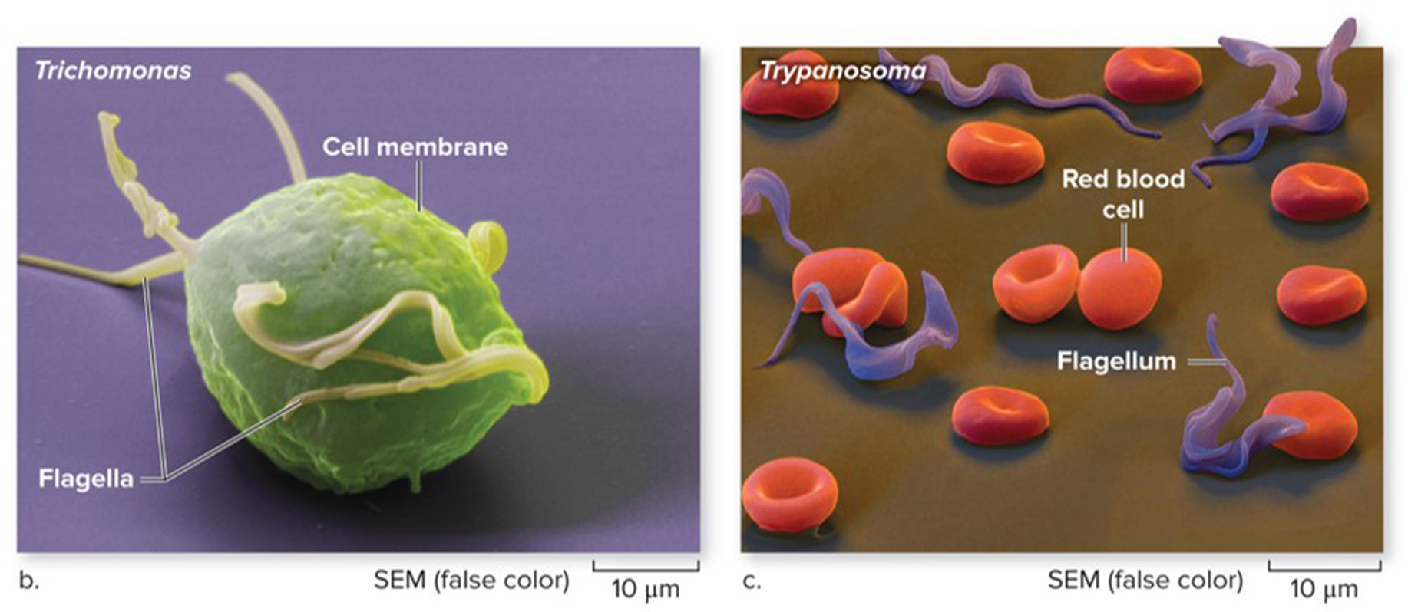
Flagellated protozoa can cause disease
Flagellated protozoa have one or more flagella, which they use to move around. They live in soil, oceans, and fresh water. Some are parasites that live in our bodies.
Trypanosoma causes African sleeping sickness.
Trichomonas causes the STD trichomoniasis.
Section 18.4
(b, c): ©Eye of Science/Science Source
Figure 18.15

Slide 38
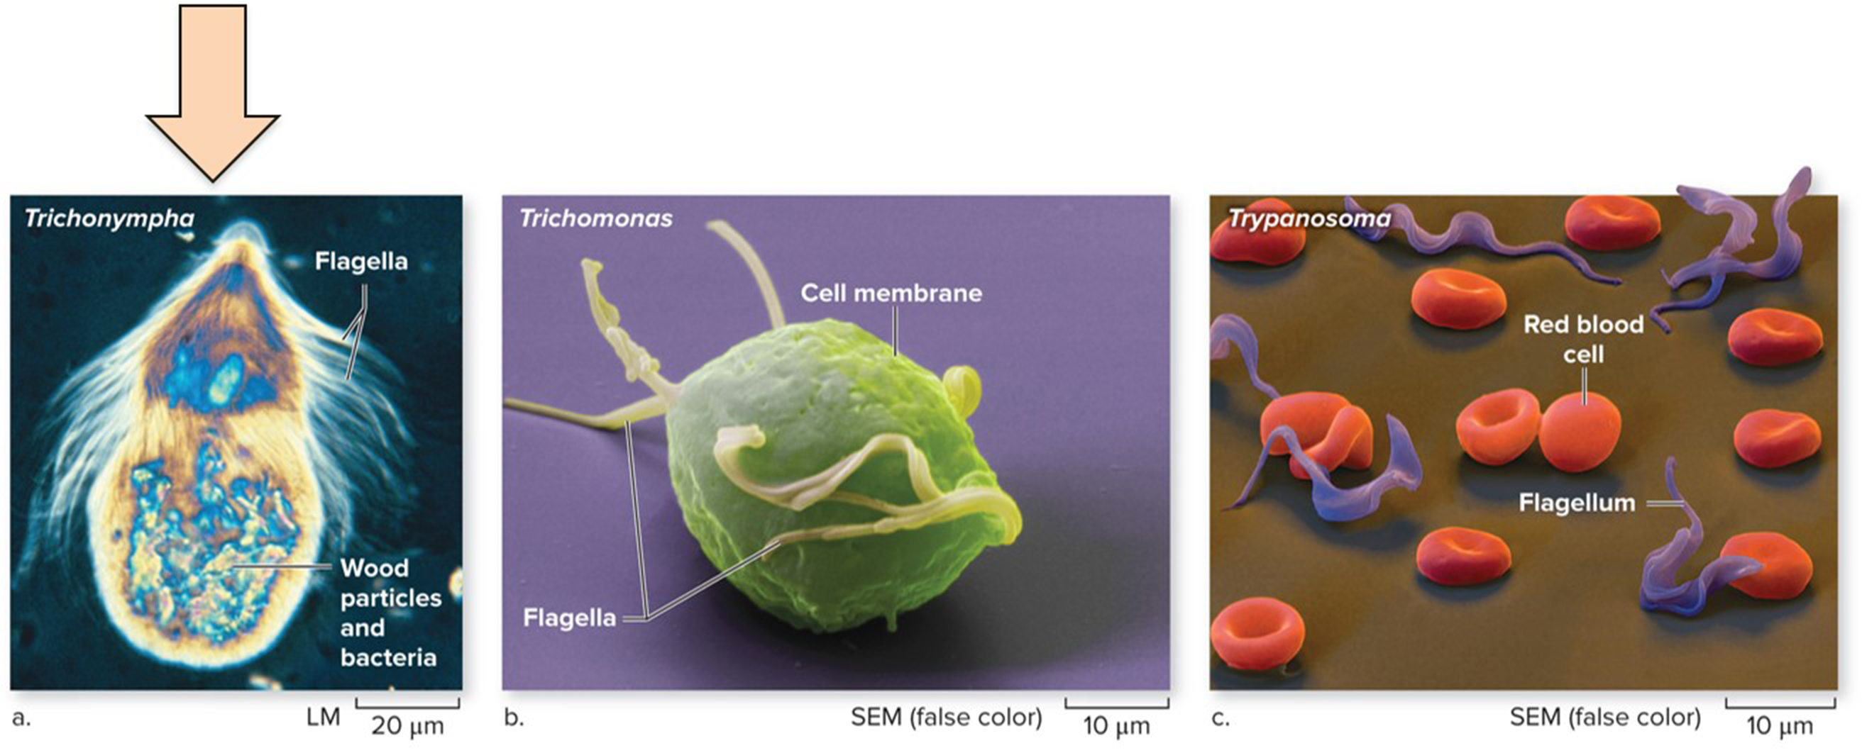
Termites rely on flagellated protozoa
Trichonympha lives in the gut of termites. Bacteria that break down wood live in each of these unicellular protists. It is because of these bacteria within a protist that termites are able to digest wood.
©Eric V. Grave/Science Source; (b, c): ©Eye of Science/Science Source
Section 18.4
Figure 18.15

Slide 39
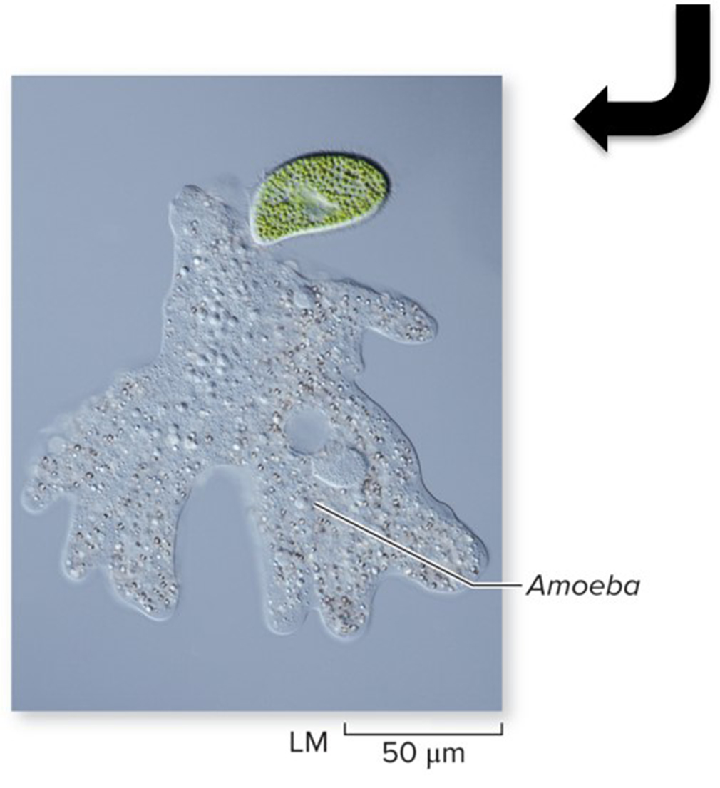
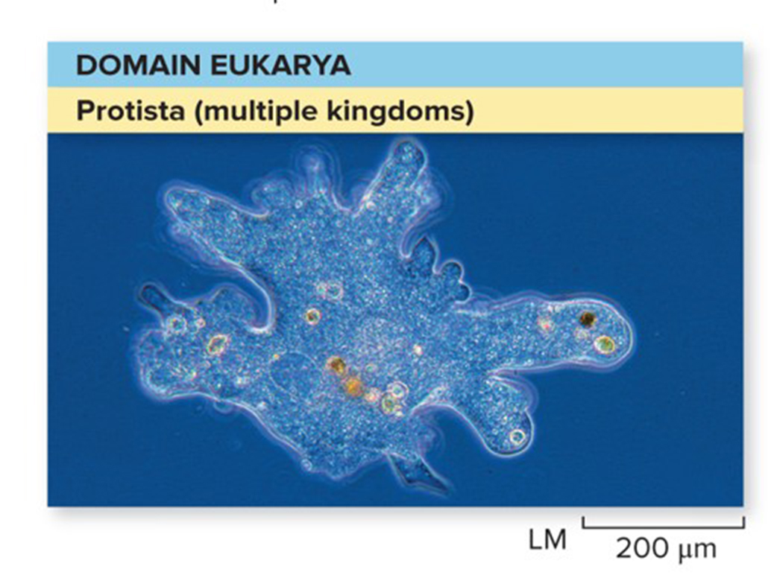
Amoeboid protozoa produce pseudopodia
Amoeboid protozoa produce extensions known as pseudopodia, which are important in locomotion and capturing food. The amoeba shown here is consuming a ciliate
©micro_photo/iStock/Getty Images RF
©Melba Photo Agency/PunchStock RF
Section 18.4
Figures 18.1, 18.16

Slide 40
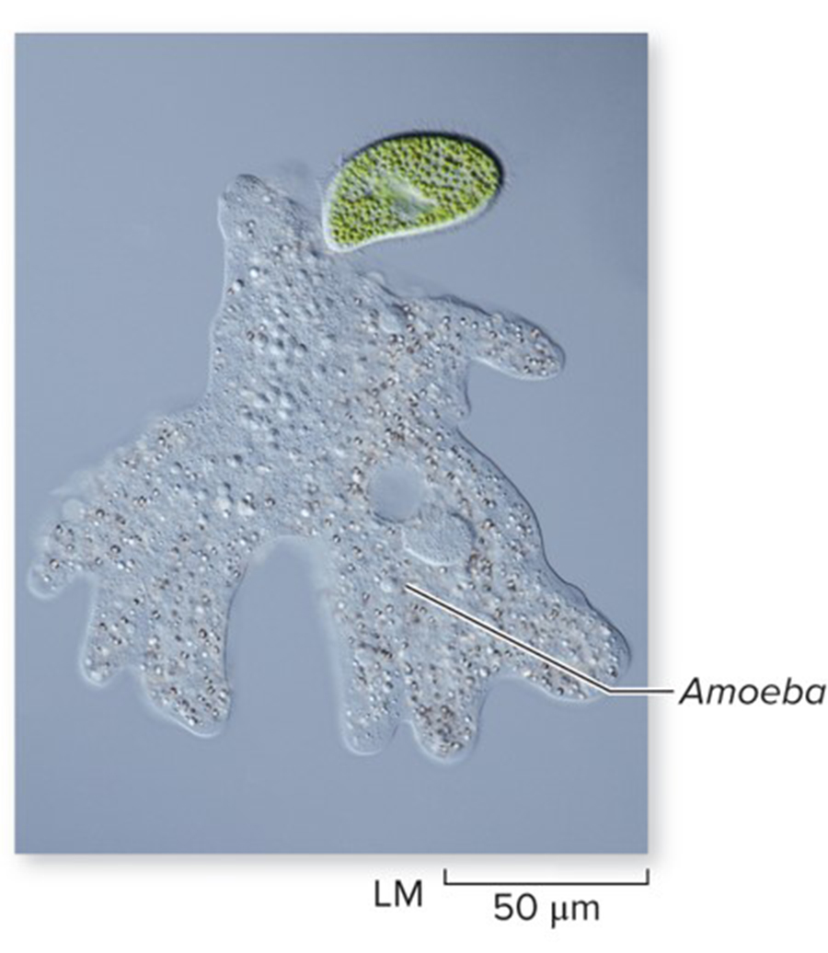
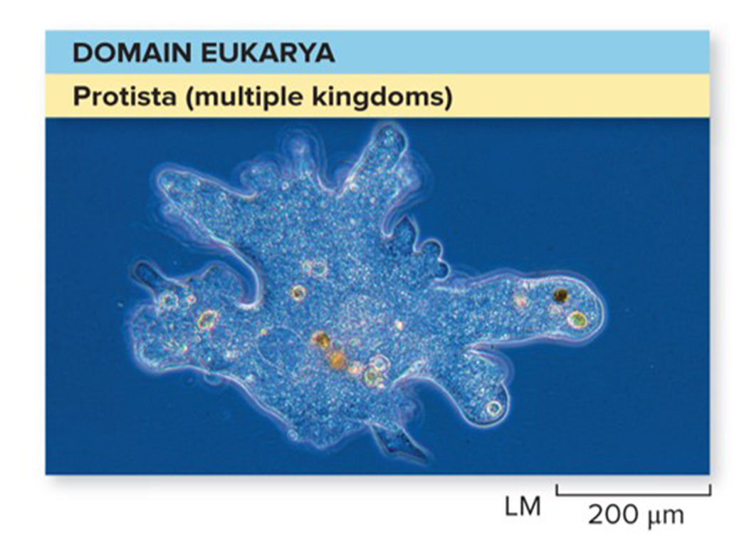
Some amoeboid protozoa cause disease
Entamoeba species invade the human digestive tract and cause fever and severe diarrhea in humans. Infection often occurs through lake water.
©micro_photo/iStock/Getty Images RF
©Melba Photo Agency/PunchStock RF
Section 18.4
Figures 18.1, 18.16

Slide 41
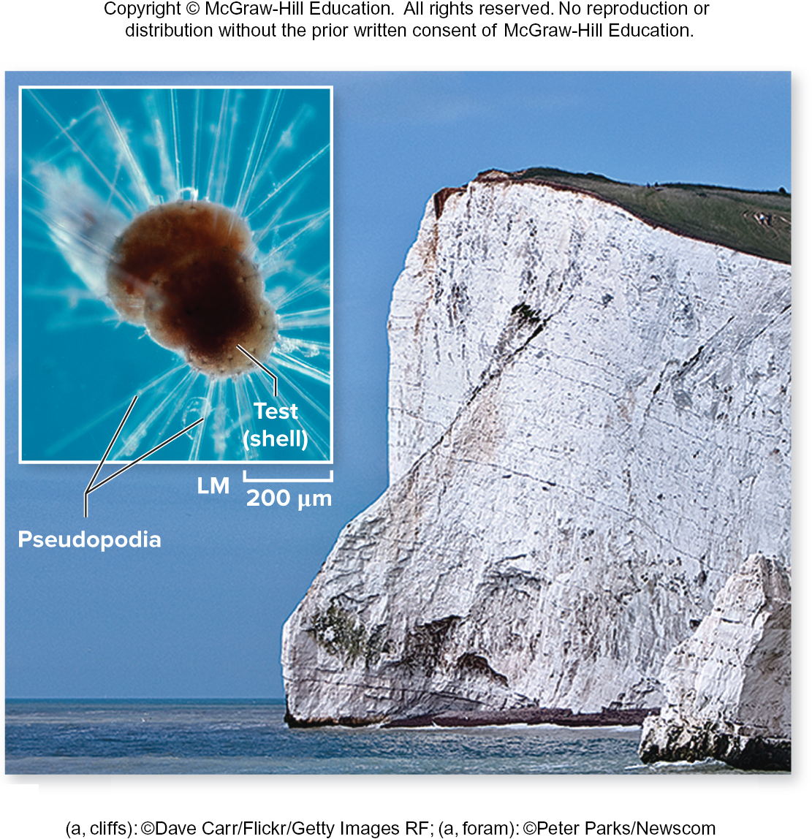
Forams are marine amoeboid protozoa
Foraminiferans (Forams) have calcium carbonate shells, which are used to date layers of rock.
Huge populations of forams live at the bottom of oceans.
(a, cliffs): ©Dave Carr/Flickr/Getty Images RF; (a, foram): ©Peter Parks/Newscom
Section 18.4
Figure 18.17

Slide 42
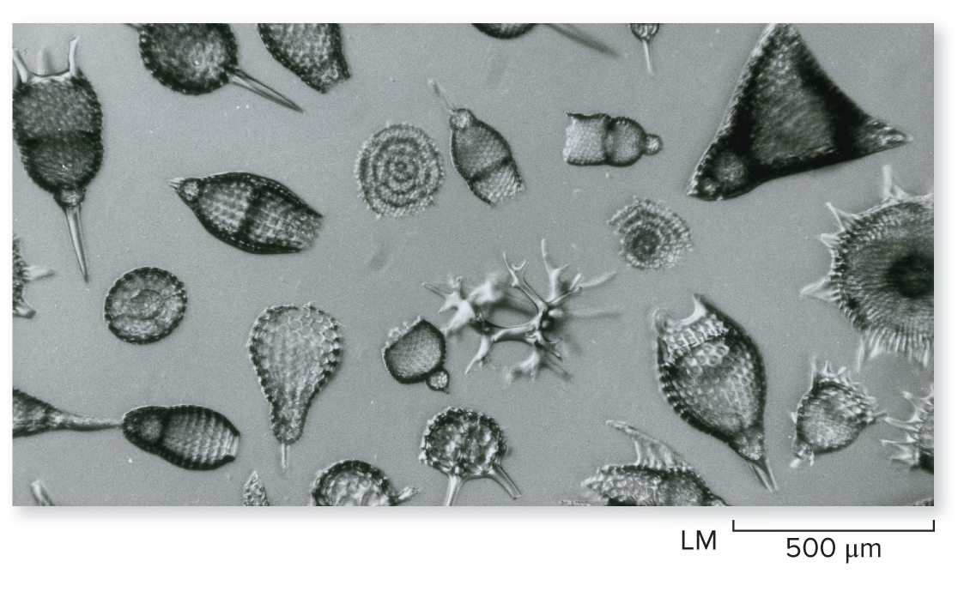
Radiolarians are close relatives of forams
Radiolarians are among the oldest protozoans.
They have intricate shells made of silica.
©Eric V. Grave/Science Source
Section 18.4
Figure 18.17

Slide 43
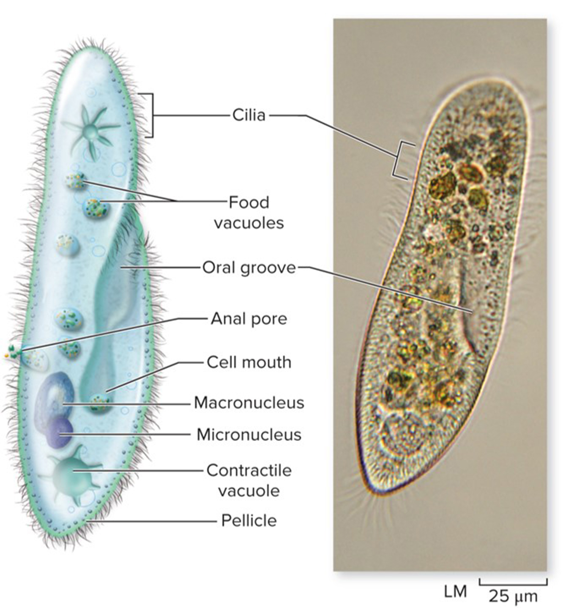
Ciliates are complex protozoa
Ciliates are mostly unicellular protozoa characterized
by abundant hairlike cilia, which propel the organism and sweep food into the cell.
They have specialized cell structures such as food vacuoles, contractile vacuoles, and an anal pore. Some have 2 types of nuclei.
©Nancy Nehring/Getty Images RF
Section 18.4
Figure 18.18

Slide 44
Ciliates are diverse protozoa
Some are symbionts that live in cattle or marine animals and help them digest food.
Some are parasites, such as the species that causes white spots on fish.
Others, such as Paramecium and Stentor, are free-living.
©Nancy Nehring/Getty Images RF
Section 18.4
Figure 18.18

Slide 45
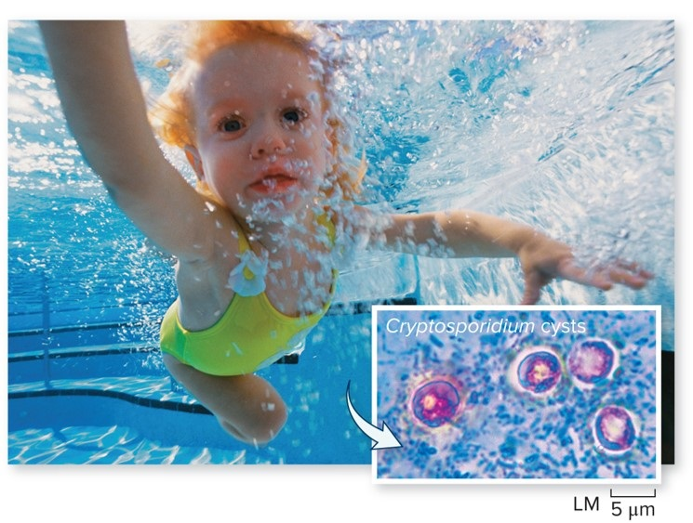
Apicomplexans are nonmotile parasites
The apicomplexans have a special cell structure that helps them attach to and invade host cells.
Cryptosporidium, the species shown here, causes waterborne diseases.
(girl swimming): ©Photodisc/Getty Images RF;
(Cryptosporidium cysts): ©Michael Abbey/Science Source
Section 18.4

Slide 46
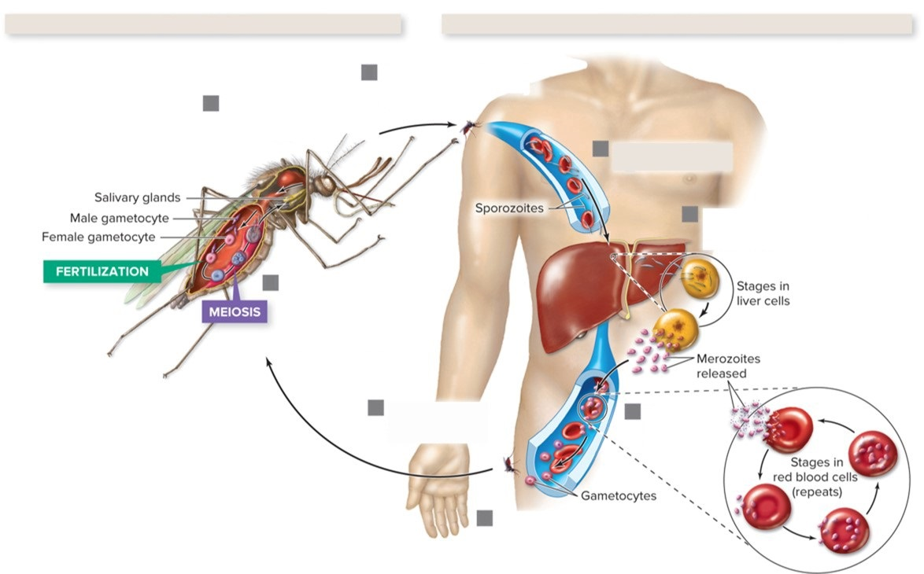
Malaria is caused by an apicomplexan protist
SEXUAL CYCLE
ASEXUAL CYCLE
Mosquito infects human by injecting saliva containing sporozoites.
Sporozoites are released and migrate to salivary glands.
Injected sporozoites migrate to liver.
Plasmodium is a protist carried by mosquitoes. When transmitted to humans it infects the red blood cells.
Sporozoites enter liver cells, multiply, and emerge as merozoites.
Gametocytes produce gametes that fuse, forming a zygote that divides by meiosis to form sporozoites.
Mosquito ingests gametocytes with blood meal.
Merozoites enter red blood cells.
Some merozoites become gametocytes.
Section 18.4
Figure 18.19

Slide 47
Clicker question #4
Which of the following is matched incorrectly?
dinoflagellate – protozoa
kelp – algae
red algae – photosynthetic protists
ciliate – protozoa

Slide 48
Clicker question #4, solution
Which of the following is matched incorrectly?
dinoflagellate – protozoa

Slide 49
18.4 Mastering concepts
What are the characteristics of each major group of protozoa?
Courtesy of Burkholder Laboratory

Slide 50
Protist classification is changing
New research based on genetic sequences is helping to assign each protist species into a lineage with its closest relatives.
TABLE 18.1 Proposed Eukaryotic “Supergroups”: A Summary
Supergroup | Distinguishing Features | Examples
Archaeplastida (a) | Photosynthetic eukaryotes with chloroplasts derived from primary endosymbiosis | Red algae, green algae, land plants
Opisthokonta (b) | Motile cells with one flagellum | Choanoflagellates, animals, fungi
Chromalveolata (c) | Chloroplasts (if present) are derived from secondary endosymbiosis
Alveolates | Flattened sacs (alveoli) beneath cell membrane | Dinoflagellates, apicomplexans, cillates (including Paramecium)
Stramenopiles | Motile cells with two flagella, one of which has tabular hairs; fucoxanthin is an accessory pigment in photosynthetic forms | Water molds, diatoms, brown algae, golden algae
Amoebozoa (d) | Amoeboid movement via pseudopodia; feed by phagocytosis; slime molds form spores | Amoeba, many slime molds (including Physarum and Dictyostelium)
Excavata (e) | Unicellular, flagellated protists; may lack mitochondria; photosynthetic or parasitic; chloroplasts (when present) are derived from secondary endosymbiosis | Trichomonas, Trichonympha, Giardia, Euglena, trypanosomes
Rhizaria (f) | Amoeboid movement; many produce shells | Radiolarians, foraminiferans
Section 18.5
Table 18.1

Slide 51
Clicker question #5
According to the proposed revision of protist classification, water molds are most closely related to which of the following groups?
Dinoflagellates
Diatoms
Amoeboids
Slime molds
Land plants

Slide 52
Clicker question #5, solution
According to the proposed revision of protist classification, water molds are most closely related to which of the following groups?
B. Diatoms

Slide 53
18.5 Mastering concepts
What features unite some of the major evolutionary lineages of protists?
Courtesy of Burkholder Laboratory

Slide 54
Investigating life: Shining a spotlight on danger
Some algae emit a beautiful blue light when agitated.
How did this bioluminescent display evolve?
©North County Times/Newscom
Section 18.6
Figure 18.20

Slide 55
Investigating life: Do dinoflagellates emit light to attract fish?
Shown here is a food chain: copepods eat dinoflagellates (a type of algae), and fish called sticklebacks eat the copepods.
Researchers hypothesized that dinoflagellates emitting light would attract the fish.
Section 18.6
Figure 18.21

Slide 56
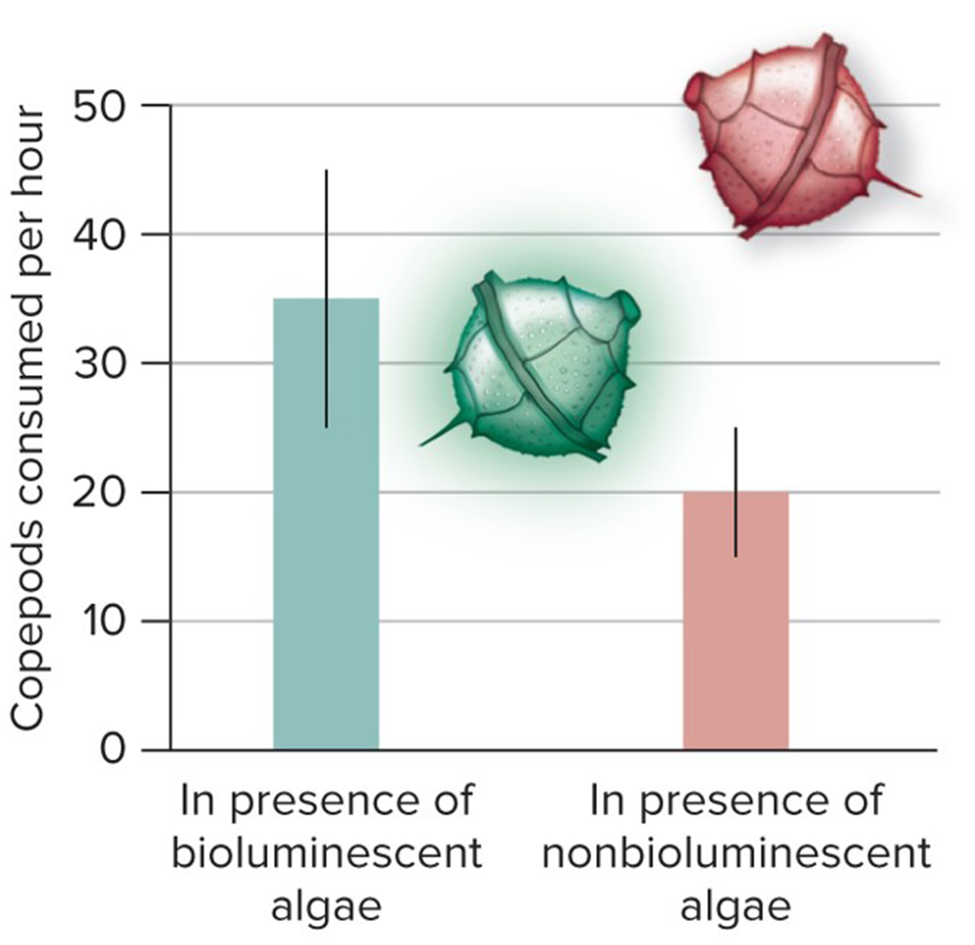
Investigating life: Emitting light is adaptive
Researchers discovered that when dinoflagellates emit light, stickleback fish eat more copepods.
Bioluminescent algae therefore increase the likelihood that their predators become dinner before they do.
Section 18.6
Figure 18.21

