Slide 1
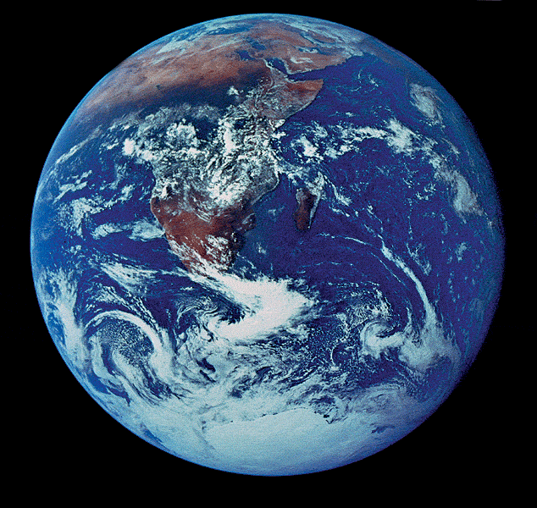
Properties of Water

Slide 2
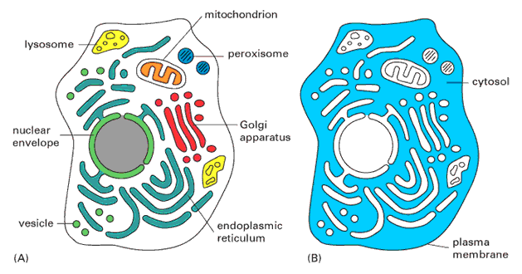
More about Water
Why are we studying water?
All life occurs in water
  inside & outside the cell

Slide 3
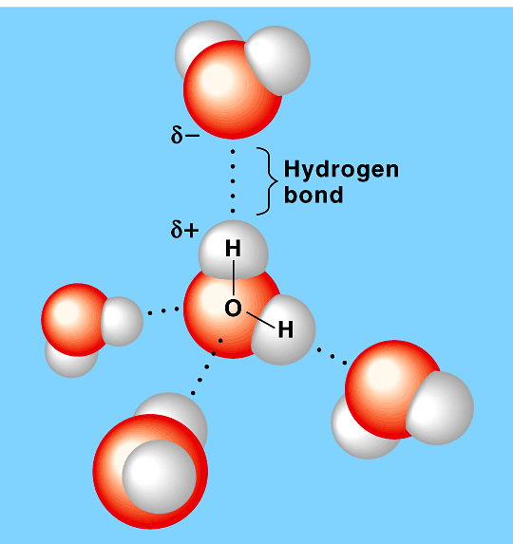
Chemistry of water
The structure of water is the key to its special properties. Water is made up of one atom of oxygen and two atoms of hydrogen, bonded to form a molecule (H₂O)
Water molecules are polar meaning one region of the molecule has a more positively charged side and a more negatively charged side.
H₂O molecules form H-bonds
with each other
  +H attracted to –O
  creates a
  sticky molecule
  Each water molecule can form a maximum of
  four hydrogen bonds at a time.
Notes:
APBio/TOPICS/Biochemistry/Movies AP/hydrogenbonds-Thinkwell.swf

Slide 4

Elixir of Life
Special properties of water
  1. cohesion & adhesion
    surface tension, capillary action
  2. good solvent
    many molecules dissolve in H₂O
    hydrophilic vs. hydrophobic
  3. lower density as a solid
    ice floats!
  4. high specific heat
    water stores heat
  5. high heat of vaporization
    heats & cools slowly
Ice!
I could use
more ice!

Slide 5
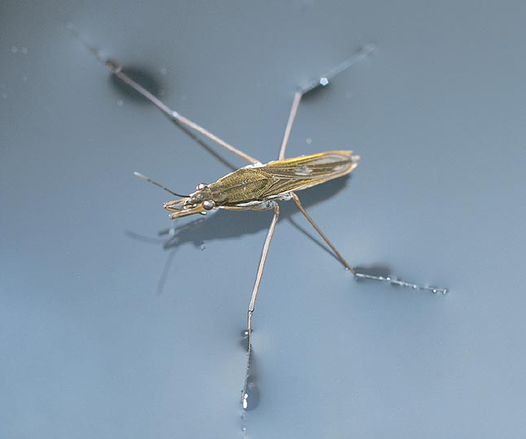
1. Cohesion & Adhesion
Cohesion (Linking of Like)
  H bonding between H₂O molecules
  water is “sticky”
    surface tension
    drinking straw
Adhesion (Linking unlike)
  H bonding between H₂O & other substances
    capillary action
    meniscus
    water climbs up
    paper towel or cloth
Try that
with flour…
or sugar…

Slide 6
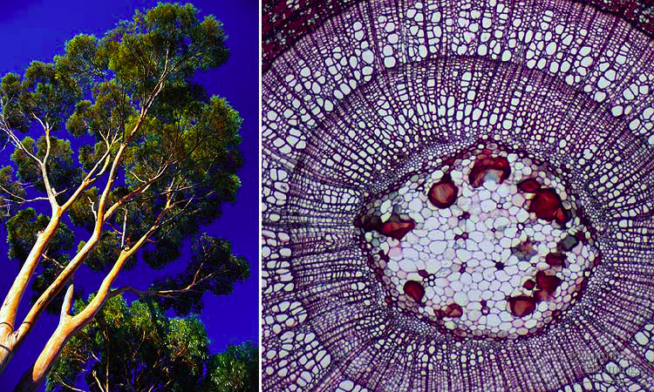
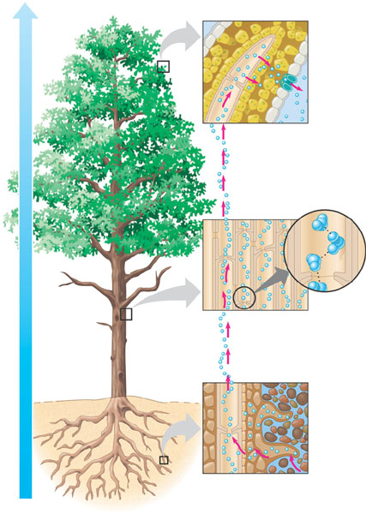
How does H₂O get to top of trees?
The movement of water molecules up the very tiny xylem tubes and their evaporation from the stomata in plants. The water molecules cling to each other by cohesion and to the walls of the xylem tubes by adhesion.
Let’s go to the
videotape!
Notes:
APBio/TOPICS/04Biochemistry/MoviesAP/03_03WaterTransport_A.swf

Slide 7
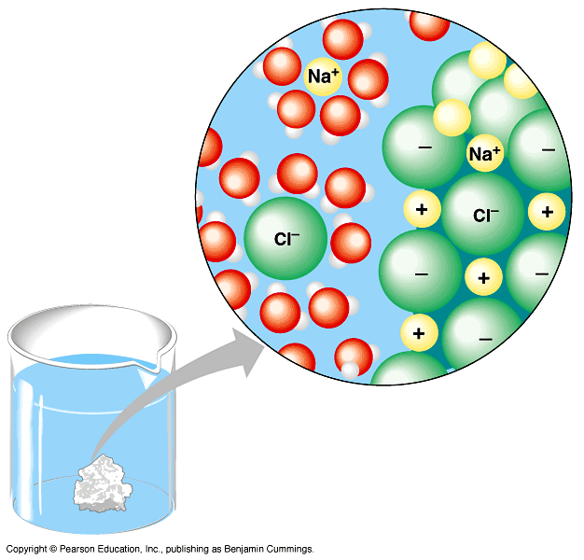
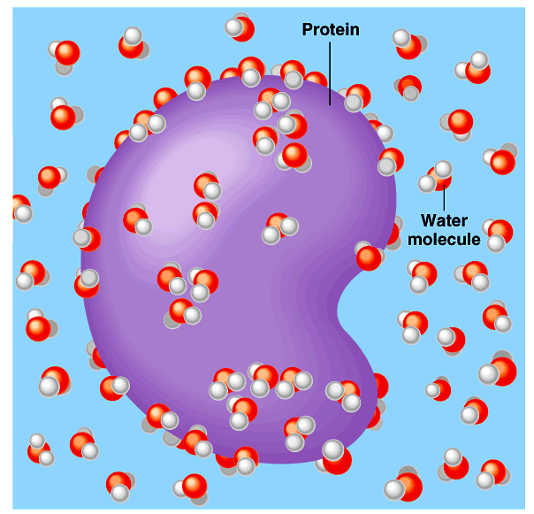
2. Water is the solvent of life
Solvent: The substance something is dissolved in
Solute: The substance being dissolved
Solution: The solvent mixed with the solute
Notes:
What dissolves in water easily?
polar or non-polar molecules?
How about Oxygen? Does that dissolve in H₂O?

Slide 8
What dissolves in water?
Hydrophilic: water-soluble. Examples: solutions which dissolve in water. Example: many salts, sugars, polar molecules, some proteins.
Hydrophobic: water repelling. Example: lipids, oils which are nonpolar.
Notes:
What dissolves in water easily?
polar or non-polar molecules?
How about Oxygen? Does that dissolve in H₂O?

Slide 9
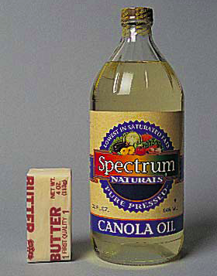
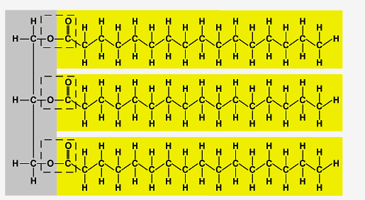
What doesn’t dissolve in water?
Hydrophobic
  substances that don’t have
  an attraction to H₂O
  polar or non-polar?
Oh, look
hydrocarbons!
fat (triglycerol)
Notes:
What dissolves in water easily?
polar or non-polar molecules?
How about Oxygen? Does that dissolve in H₂O?

Slide 10
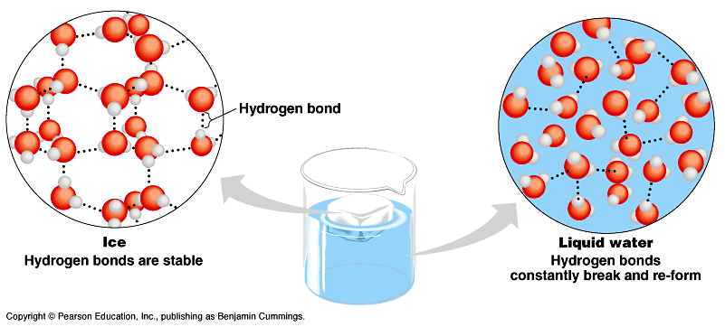
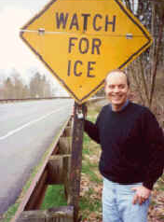
3. The special case of ice
Most (all?) substances are more dense when they are solid, but
not water…
Ice floats!
  H bonds form a crystal
And this has
made all the
difference!

Slide 11
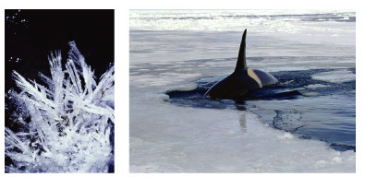
Ice floats

Slide 12
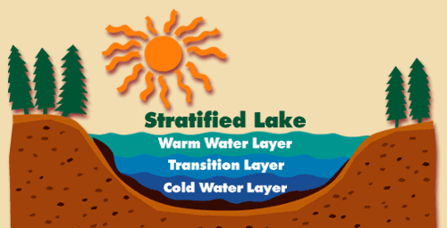
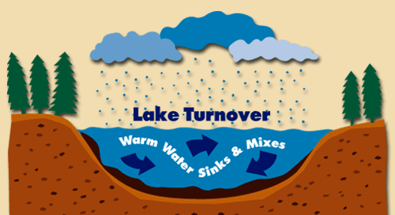
Why is “ice floats” important?
Oceans & lakes don’t freeze solid
  surface ice insulates water below
    allowing life to survive the winter
  if ice sank…
    ponds, lakes & even oceans would freeze solid
    in summer, only upper few inches would thaw
  seasonal turnover of lakes
    sinking cold H₂O cycles nutrients in autumn

Slide 13
4. Specific heat
H₂O resists changes in temperature
  high specific heat
  takes a lot to heat it up (break H-bonds)
  takes a lot to cool it down (form H-bonds)
H₂O moderates temperatures on Earth

Slide 14
Specific heat
& climate

Slide 15
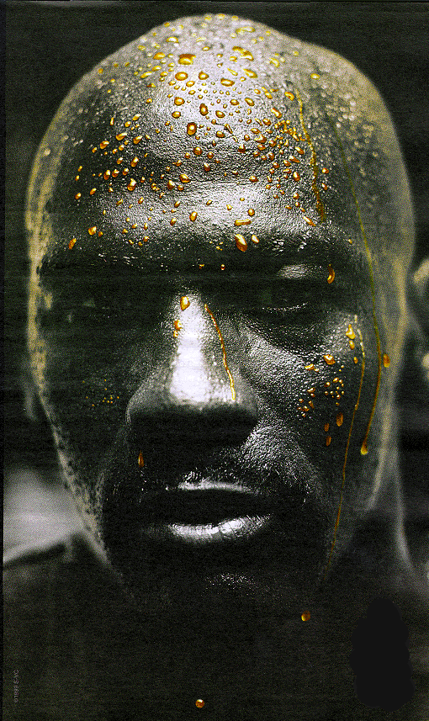
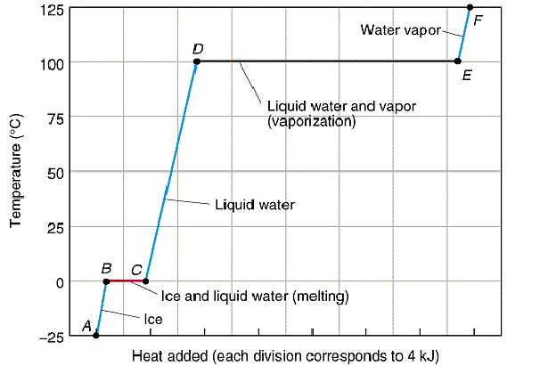
5. Heat of vaporization
Evaporative cooling
Organisms rely on heat of vaporization to remove body heat

Slide 16
Ionization of water & pH
Water ionizes
  H⁺ splits off from H₂O, leaving OH–
    if [H⁺] = [⁻OH], water is neutral
    if [H⁺] > [⁻OH], water is acidic
    if [H⁺] < [⁻OH], water is basic
pH scale
  how acid or basic solution is
  1 → 7 → 14
H₂O → H⁺ + OH–

Slide 17
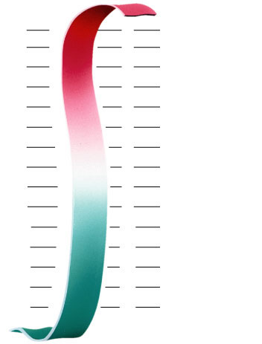
pH Scale
H⁺ Ion
Concentration
Examples of Solutions
pH
10⁰
0
Hydrochloric acid
10^{–1}
1
tenfold change
in H+ ions
pH1 → pH2
10⁻¹ → 10⁻²
10 times less H⁺
pH8 → pH7
10⁻⁸ → 10⁻⁷
10 times more H⁺
pH10 → pH8
10⁻¹⁰ → 10⁻⁸
100 times more H⁺
10^{–2}
2
Stomach acid, Lemon juice
10^{–3}
3
Vinegar, cola, beer
10^{–4}
4
Tomatoes
10^{–5}
5
Black coffee, Rainwater
10^{–6}
6
Urine, Saliva
10^{–7}
7
Pure water, Blood
10^{–8}
8
Seawater
10^{–9}
9
Baking soda
10^{–10}
10
Great Salt Lake
10^{–11}
11
Household ammonia
10^{–12}
12
Household bleach
10^{–13}
13
Oven cleaner
10^{–14}
14
Sodium hydroxide
Notes:
In pure water only 1 water molecule in every 554 million is dissociated

Slide 18
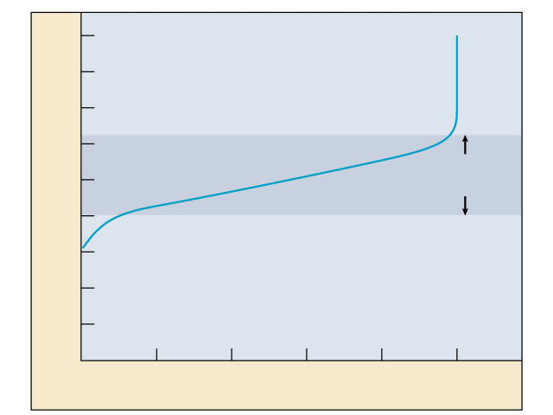
Buffers & cellular regulation
pH of cells must be kept ~7
  pH affects shape of molecules
  shape of molecules affect function
  pH affects cellular function
Control pH by buffers
  reservoir of H⁺
    donate H+ when
    [H⁺] falls
    absorb H+ when
    [H⁺] rises
9
8
7
6
5
Buffering
range
pH
4
3
2
1
0
0
1
2
3
4
5
Amount of base added
Notes:
Exercise = acidic in muscles
CO₂ = carbonic acid
lactic acid
body uses buffers to counter act this

Slide 19

He’s gonna
earn a
Darwin Award!
Any
Questions?

