Slide 1
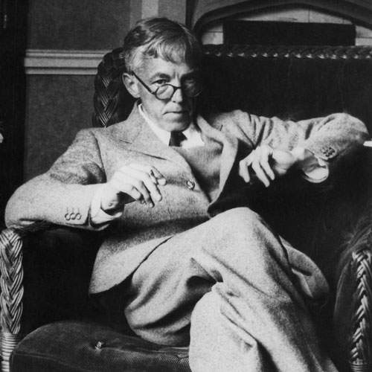
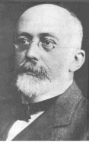
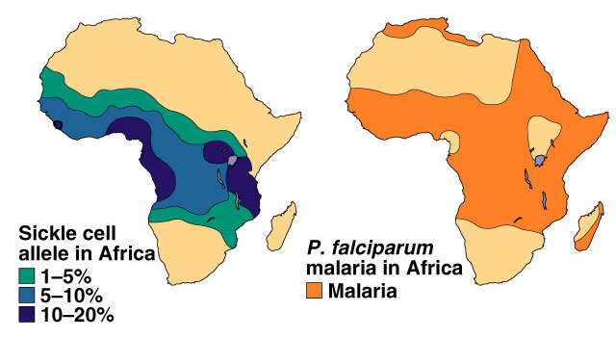
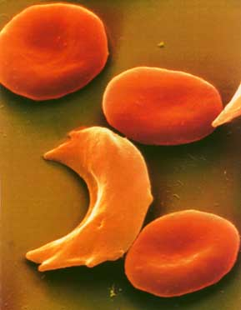
Population Genetics Notes

Slide 2
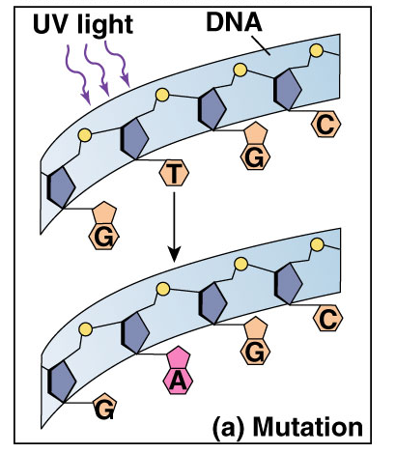
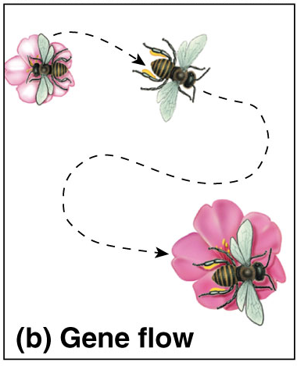
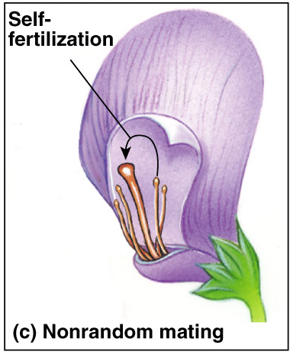
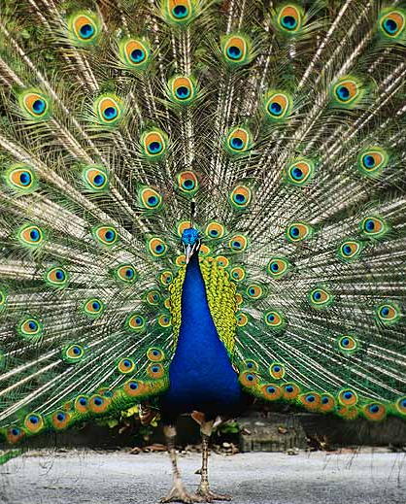
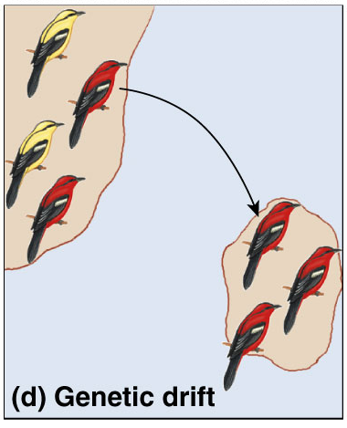
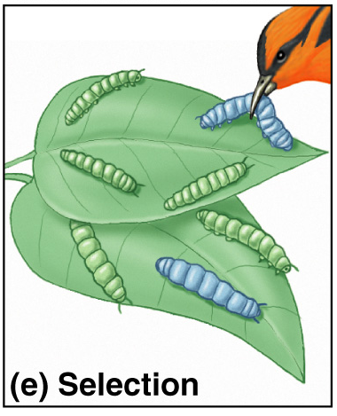
5 Agents of evolutionary change
Mutation
Gene Flow
Non-random mating
Chemical Changes to DNA
Migration
Sexual Selection
Genetic Drift
Selection
Natural Selection Differential Survival
Small population

Slide 3
Genetic Variation
Genetic variation is the substrate on which natural selection works
Quantitative characters:
Vary along a continuum within a population
Human height
Discrete characters:
“Either-or”
Usually determined by a single gene locus
Dimples/no dimples; ABO blood groups
Polymorphism
When a population has two or more different “morphs” for a given trait
Freckles/no freckles

Slide 4
Preserving Genetic Variation
What prevents natural selection from reducing a population’s variation by eliminating unfavorable genotypes?
Diploidy
Recessive alleles can “hide” in heterozygotes
Balanced polymorphism
Heterozygote advantage (sickle cell)-carriers are less likely to get malaria than homozygous normal individuals.
Frequency-dependent selection
Survival and reproduction of any one morph declines if it becomes too common

Slide 5
Mutation
A mutation is a change in an organism’s DNA
Mutation at a given gene locus is very rare, but mutations at all gene loci can have a big impact
Chromosomal Mutations=Additions; Deletions; Inversions, Translocations
Point Mutations- Substitutions & Frame Shift Mutations

Slide 6
Sexual Reproduction Variation
Sexual reproduction shuffles alleles and deals them at random to produce individual genotypes. Recall there are three mechanisms for this shuffling of alleles.
Crossing over during prophase I of meiosis
Independent assortment of chromosomes during meiosis (2^23 different combinations possible in the formation of human gametes!
Fertilization (2^23 x 2^23 different possible combinations for human sperm and egg)

Slide 7
Population Genetics
Population genetics is the study of how populations change genetically over time.
Population: A group of individuals of the same species that live in the same area and interbreed, producing fertile offspring.
Gene pool: All of alleles at all loci in all the members of a population.
In diploid species, each individual has two alleles for a particular gene, and the individual may be either homozygous or heterozygous.
If all the members of a population are homozygous for the same allele, the allele is said to be fixed. Only one allele exists at that particular locus in the population. For example, the fruit fly is heterozygous for 1,920 of its 13,700 genes-the remaining 11,780 are fixed. It follows that the greater the number of fixed alleles, the lower the species genetic diversity.

Slide 8
Hardy-Weinberg equilibrium
Hypothetical situation
serves as null hypothesis
non-evolving population
REMOVE all agents of evolutionary change
no genetic drift (very large population size )
no gene flow (no migration in or out)
no mutation (no chemical change to DNA)
random mating (no sexual selection)
no natural selection (equal survival)

Slide 9
Hardy-Weinberg Principle
The Hardy-Weinberg principle is used to describe a population that is NOT evolving. It states that the frequencies of alleles and genes in a population’s gene pool will remain constant over the course of generations unless they are acted upon by forces other than Mendelian segregation and the recombination of alleles. The population is at Hardy-Weinberg equilibrium.

Slide 10
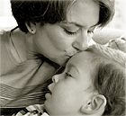
Example of strong selection pressure
Tay Sachs
primarily in Ashkenazi Jews & Cajuns
recessive disease = aa
lysosomal storage disease
lack of one functional digestive enzyme in lysosome
build up undigested fat in brain cells
children die before they are 5 years old
So where do new cases of Tay-Sachs come from?

Slide 11
Example of heterozygote advantage
Sickle cell anemia
inherit a mutation in gene coding for one of the subunits in hemoglobin
oxygen-carrying blood protein
normal allele = H^{b}
mutant allele = H^{s}
recessive trait = H^{s}H^{s}
low oxygen levels causes RBC to sickle
clogging small blood vessels
damage to organs
often lethal

Slide 12
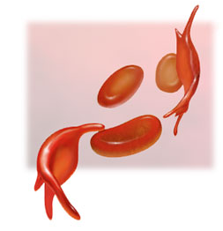
Sickle cell frequency
High frequency of heterozygotes
1 in 5 in Central Africans = H^{b}H^{s}
unusual for allele with severe detrimental effects in homozygotes
1 in 100 = H^{s}H^{s}
usually die before reproductive age
Why is the H^{s} allele maintained at such high levels in African populations?
Suggests some selective advantage of being heterozygous… H^{b}H^{s}
Notes:
Sickle Cell:
In tropical Africa, where malaria is common, the sickle-cell allele is both an advantage & disadvantage. Reduces infection by malaria parasite.
Cystic fibrosis:
Cystic fibrosis carriers are thought to be more resistant to cholera:
1:25, or 4% of Caucasians are carriers Cc

Slide 13
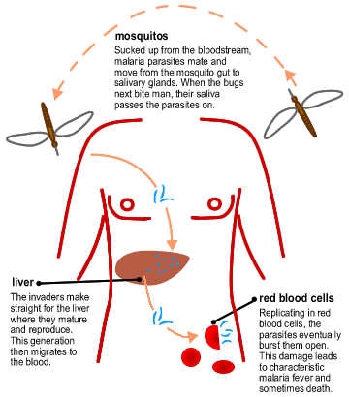
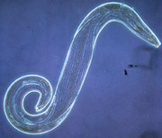
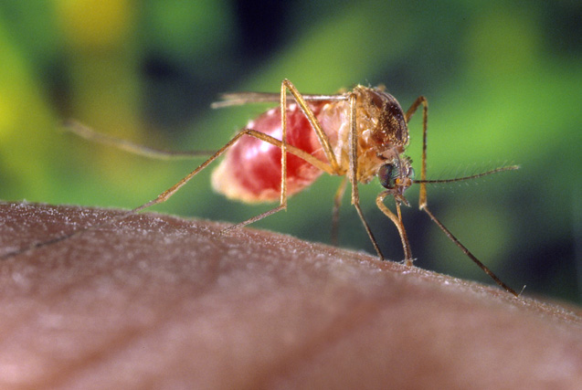
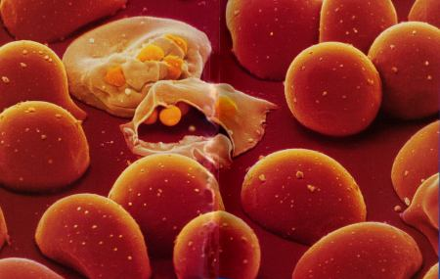
Malaria
Single-celled eukaryote parasite (Plasmodium) spends part of its life cycle in red blood cells
1
liver
2
3

Slide 14
Heterozygote Advantage
In tropical Africa, where malaria is common:
homozygous dominant (normal)
reduced survival or reproduction from malaria: H^{b}H^{b}
homozygous recessive
reduced survival & reproduction from sickle cell anemia: H^{s}H^{s}
heterozygote carriers
survival & reproductive advantage: H^{b}H^{s}
Hypothesis:
In malaria-infected cells, the O₂ level is lowered enough to cause sickling which kills the cell & destroys the parasite.
Frequency of sickle cell allele & distribution of malaria

Slide 15
Microevolution

Slide 16
Microevolution
At the population level, evolution is a generation-to-generation change in a population’s frequency of alleles
Even if the allele frequencies of only one gene (ie. flower color) are changing, the change in the gene pool is known as microevolution

Slide 17
Causes of Microevolution
There are 5 factors that cause microevolution:
1. Genetic drift
2. Natural selection
3. Gene flow
4. Mutation
5. Non-random mating (Sexual Selection= picking mates with selected traits that might aid survival/reproduction. Example: showy feathers on birds; Deer with large rack
Sexual Dimorphism- males & females showing 2 forms are common in animal kingdom.

Slide 18
Genetic Drift
Genetic drift is the chance fluctuation of a small population due to chance
700 heads, 300 tails vs. 7 heads, 3 tails
Sampling error
2 major types of genetic drift
Bottleneck effect
Founder effect

Slide 19
Bottleneck Effect
Disasters reduce the size of a population dramatically, killing victims unselectively
Result:
The small surviving population is unlikely to be representative of the original population in its genetic makeup
Some alleles may be lost

Slide 20
Founder Effect
The founder effect results when a few individuals from a larger population colonize a new, isolated habitat
The new population is unlikely to be representative of the original population

Slide 21
Natural Selection
Populations consist of varied individuals, with some variations of individuals leaving more offspring than others
Darwinian fitness:
the relative contribution an individual makes to the gene pool of the next generation
“survival of the fittest”

Slide 22
Types of Natural Selection
There are 3 major types of natural selection:
Directional selection
Diversifying/disruptive selection
Stabilizing selection

Slide 23
Directional Selection
Shifts the frequency curve for variations in some phenotypic character in one direction or another
From rare to average
Example
Average size of black bears in Europe increases in ice ages, decreases in warmer periods

Slide 24
Diversifying/Disruptive Selection
Favors variants of opposite extremes over intermediate individuals

Slide 25
Stabilizing Selection
Acts against extreme phenotypes
Favors the more common intermediate variants
Maintains the “status quo”
Example:
3 – 4 kg. average for human births

Slide 26
Gene Flow
A population may gain or lose alleles by gene flow
Gene flow is genetic exchange due to the migration of fertile individuals or gametes between populations
Sexual selection is a form of natural selection in which individuals with certain traits inherited characteristics are more likely than other individuals to obtain mates. It can result in sexual dimorphism, a difference between the ornamentation, and behavior.

Slide 27
Any Questions??
Any Questions??
Any Questions??

