Slide 1
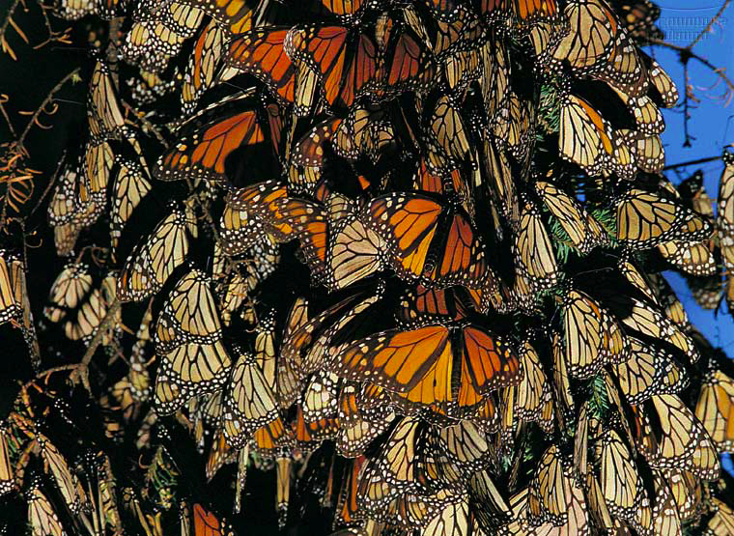
organism
population
community
ecosystem
biosphere
Population Ecology

Slide 2
Life takes place in populations
Population
group of individuals of same species in same area at same time
rely on same resources
interact
interbreed
Population Ecology: What factors affect a population?

Slide 3
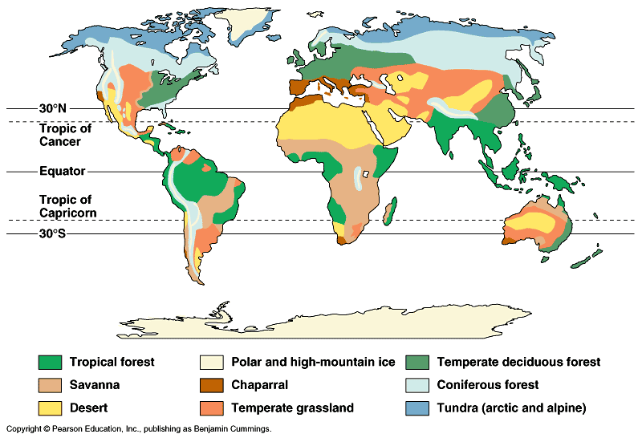
Factors that affect Population Size
Abiotic factors
sunlight & temperature
precipitation / water
soil / nutrients
Biotic factors
other living organisms
prey (food)
competitors
predators, parasites, disease
Intrinsic factors
adaptations

Slide 4
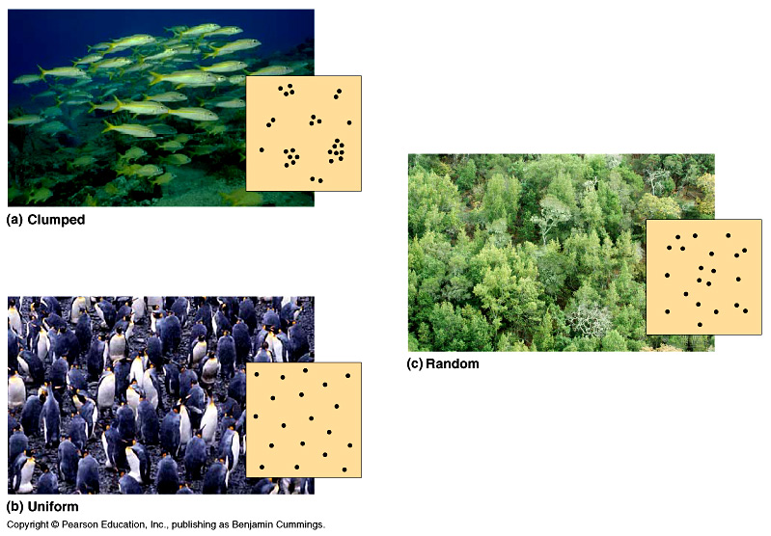
Population Spacing
Dispersal patterns within a population
Provides insight into the environmental associations & social interactions of individuals in population
clumped
random
uniform
Notes:
Within a population’s geographic range, local densities may vary substantially. Variations in local density are among the most important characteristics that a population ecologist might study, since they provide insight into the environmental associations and social interactions of individuals in the population. Environmental differences—even at a local level—contribute to variation in population density; some habitat patches are simply more suitable for a species than are others. Social interactions between members of the population, which may maintain patterns of spacing between individuals, can also contribute to variation in population density.

Slide 5
Population Size
Changes to population size
adding & removing individuals from a population
birth
death
immigration
emigration

Slide 6
Population growth rates
Factors affecting population growth rate
sex ratio
how many females vs. males?
generation time
at what age do females reproduce?
age structure
how females at reproductive age in cohort?

Slide 7
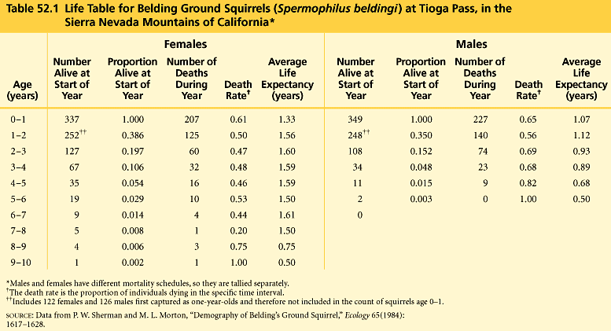
Demography
Why do teenage boys pay high car insurance rates?
Factors that affect growth & decline of populations
vital statistics & how they change over time
Life table
females
males
What adaptations have led to this difference in male vs. female mortality?

Slide 8
Survivorship curves
Graphic representation of life table
The relatively straight lines of the plots indicate relatively constant rates of death; however, males have a lower survival rate overall than females.
Belding ground squirrel

Slide 9
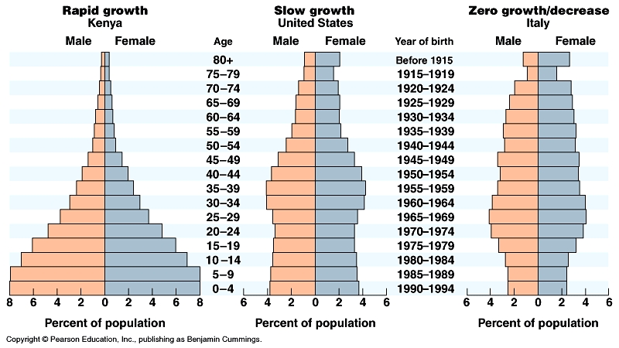
Age structure
Relative number of individuals of each age
What do these data imply about population growth in these countries?

Slide 10
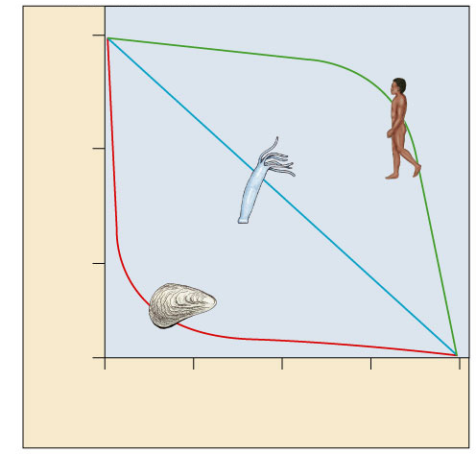
Survivorship curves
What do these graphs tell about survival & strategy of a species?
Generalized strategies
1000
Human
(type I)
I. High death rate in post-reproductive years
Hydra
(type II)
100
II. Constant mortality rate throughout life span
Survival per thousand
Oyster
(type III)
10
III. Very high early mortality but the few survivors then live long (stay reproductive)
1
0
25
50
75
100
Percent of maximum life span
Notes:
A Type I curve is flat at the start, reflecting low death rates during early and middle life, then drops steeply as death rates increase among older age groups. Humans and many other large mammals that produce few offspring but provide them with good care often exhibit this kind of curve. In contrast, a Type III curve drops sharply at the start, reflecting very high death rates for the young, but then flattens out as death rates decline for those few individuals that have survived to a certain critical age. This type of curve is usually associated with organisms that produce very large numbers of offspring but provide little or no care, such as long–lived plants, many fishes, and marine invertebrates. An oyster, for example, may release millions of eggs, but most offspring die as larvae from predation or other causes. Those few that survive long enough to attach to a suitable substrate and begin growing a hard shell will probably survive for a relatively long time. Type II curves are intermediate, with a constant death rate over the organism’s life span. This kind of survivorship occurs in Belding’s ground squirrels and some other rodents, various invertebrates, some lizards, and some annual plants.

Slide 11
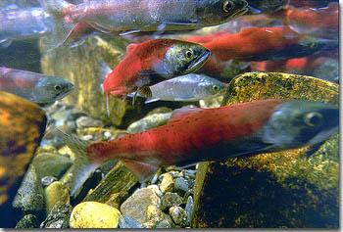
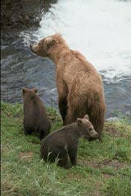
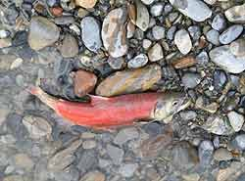
Trade-offs: survival vs. reproduction
The cost of reproduction
increase reproduction may decrease survival
age at first reproduction
investment per offspring
number of reproductive cycles per lifetime
Natural selection favors a life history that maximizes lifetime reproductive success

Slide 12
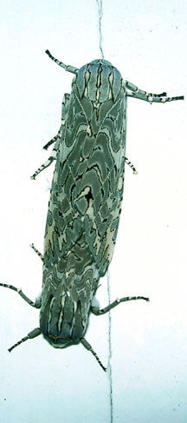
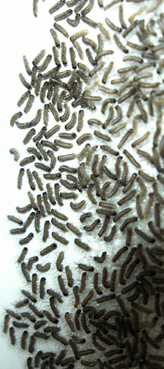
Reproductive strategies
K-selected
late reproduction
few offspring
invest a lot in raising offspring
primates
coconut
r-selected
early reproduction
many offspring
little parental care
insects
many plants
K-selected
r-selected

Slide 13
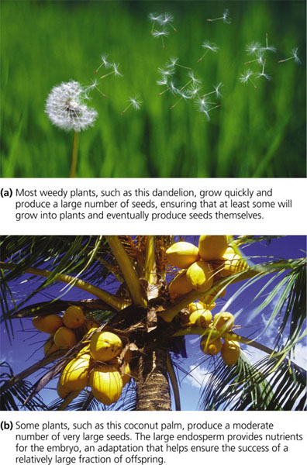
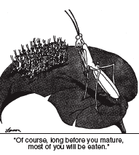
Trade offs
Number & size of offspring
vs.
Survival of offspring or parent
r-selected
K-selected
“Of course, long before you mature, most of you will be eaten.”

Slide 14
Life strategies & survivorship curves
K-selection
1000
Human
(type I)
Hydra
(type II)
100
Survival per thousand
Oyster
(type III)
10
r-selection
1
0
25
50
75
100
Percent of maximum life span
Notes:
A Type I curve is flat at the start, reflecting low death rates during early and middle life, then drops steeply as death rates increase among older age groups. Humans and many other large mammals that produce few offspring but provide them with good care often exhibit this kind of curve. In contrast, a Type III curve drops sharply at the start, reflecting very high death rates for the young, but then flattens out as death rates decline for those few individuals that have survived to a certain critical age. This type of curve is usually associated with organisms that produce very large numbers of offspring but provide little or no care, such as long–lived plants, many fishes, and marine invertebrates. An oyster, for example, may release millions of eggs, but most offspring die as larvae from predation or other causes. Those few that survive long enough to attach to a suitable substrate and begin growing a hard shell will probably survive for a relatively long time. Type II curves are intermediate, with a constant death rate over the organism’s life span. This kind of survivorship occurs in Belding’s ground squirrels and some other rodents, various invertebrates, some lizards, and some annual plants.

Slide 15
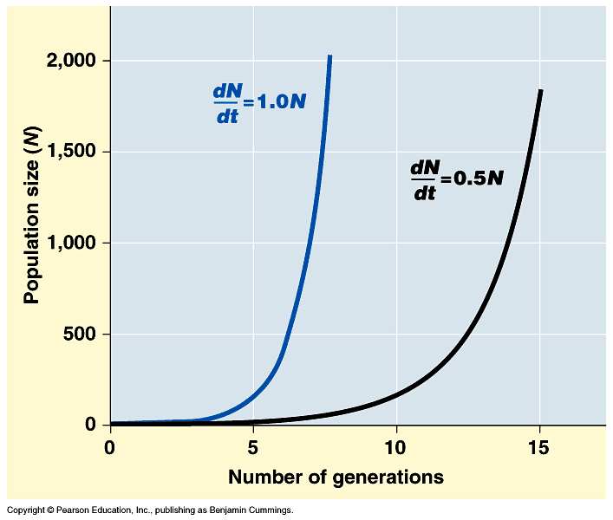
Population growth
change in population = births – deaths
Exponential model (ideal conditions)
dN = r_{i}N
dt
growth increasing at constant rate
N = # of individuals
r = rate of growth
r_{i} = intrinsic rate
t = time
d = rate of change
every pair has 4 offspring
every pair has 3 offspring
intrinsic rate = maximum rate of growth

Slide 16
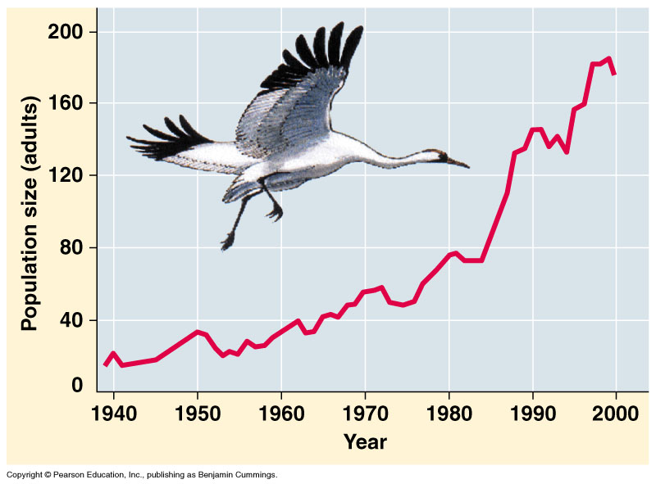
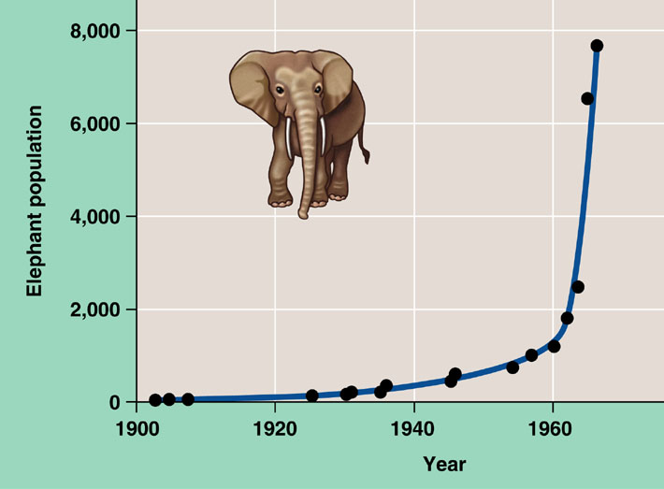
Exponential growth rate
Characteristic of populations without limiting factors
introduced to a new environment or rebounding from a catastrophe
Whooping crane
coming back from near extinction
African elephant
protected from hunting
Notes:
The J–shaped curve of exponential growth is characteristic of some populations that are introduced into a new or unfilled environment or whose numbers have been drastically reduced by a catastrophic event and are rebounding. The graph illustrates the exponential population growth that occurred in the population of elephants in Kruger National Park, South Africa, after they were protected from hunting. After approximately 60 years of exponential growth, the large number of elephants had caused enough damage to the park vegetation that a collapse in the elephant food supply was likely, leading to an end to population growth through starvation. To protect other species and the park ecosystem before that happened, park managers began limiting the elephant population by using birth control and exporting elephants to other countries.

Slide 17
Regulation of population size
marking territory = competition
Limiting factors
density dependent
competition: food, mates, nesting sites
predators, parasites, pathogens
density independent
abiotic factors
sunlight (energy)
temperature
rainfall
swarming locusts
competition for nesting sites

Slide 18
A population can produce a density of individuals that exceeds the system’s resource availability.

Slide 19
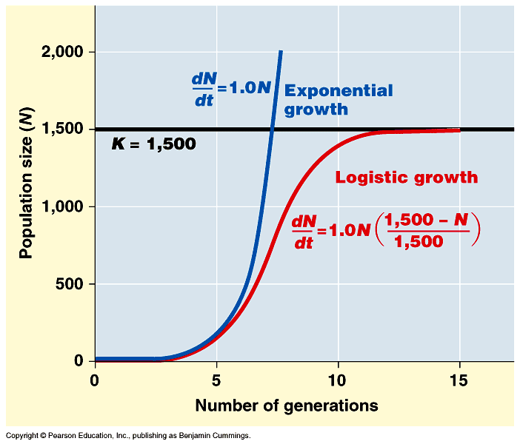
Logistic rate of growth
Can populations continue to grow exponentially?
Of course not!
no natural controls
K = carrying capacity
What happens as N approaches K?
effect of natural controls
Notes:
Decrease rate of growth as N reaches K

Slide 20
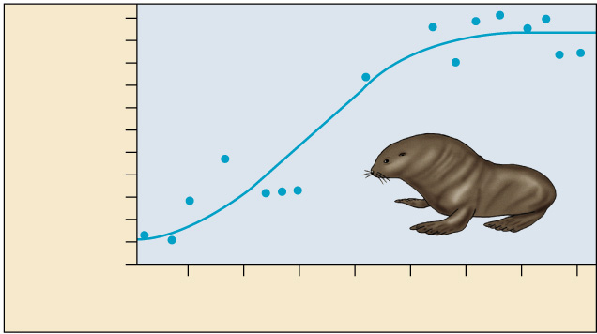
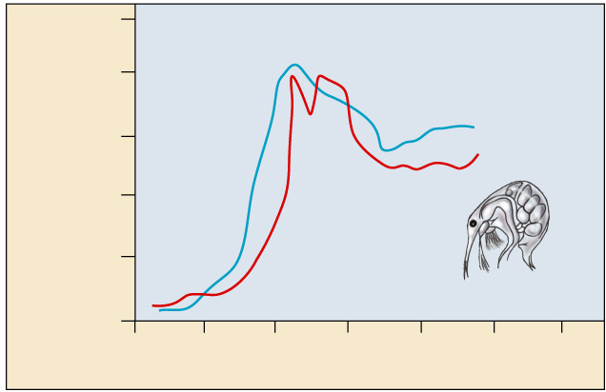
Carrying capacity
Maximum population size that environment can support with no degradation of habitat
varies with changes in resources
10
8
Number of breeding male
fur seals (thousands)
6
4
2
0
1915
1925
1935
1945
Time (years)
500
400
Number of cladocerans
(per 200 ml)
300
What’s going on with the plankton?
200
100
0
0
10
20
30
40
50
60
Time (days)

Slide 21
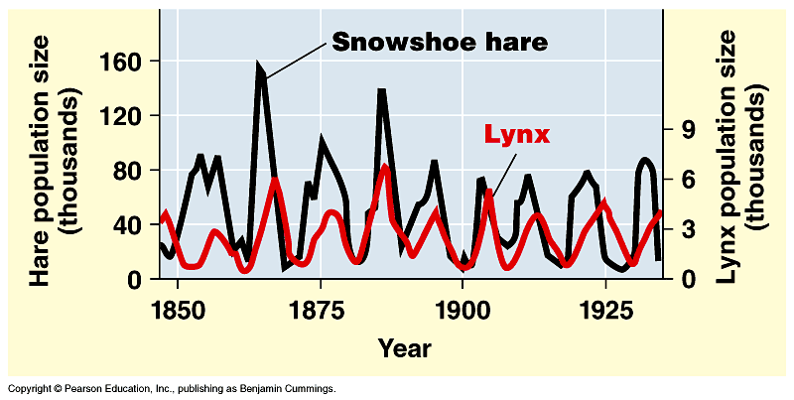
Changes in Carrying Capacity
Population cycles
predator – prey interactions
At what population level is the carrying capacity?
K
K

Slide 22
Logistical growth equation
RELEVANT EQUATION
where: dt = change in time
N = population size rmax = maximum per capita growth rate
of population K = carrying capacity

Slide 23
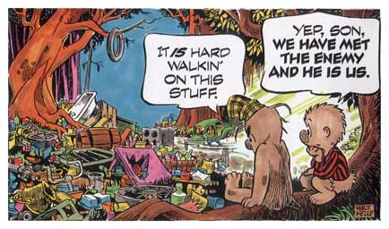
Any Questions?

