Slide 1
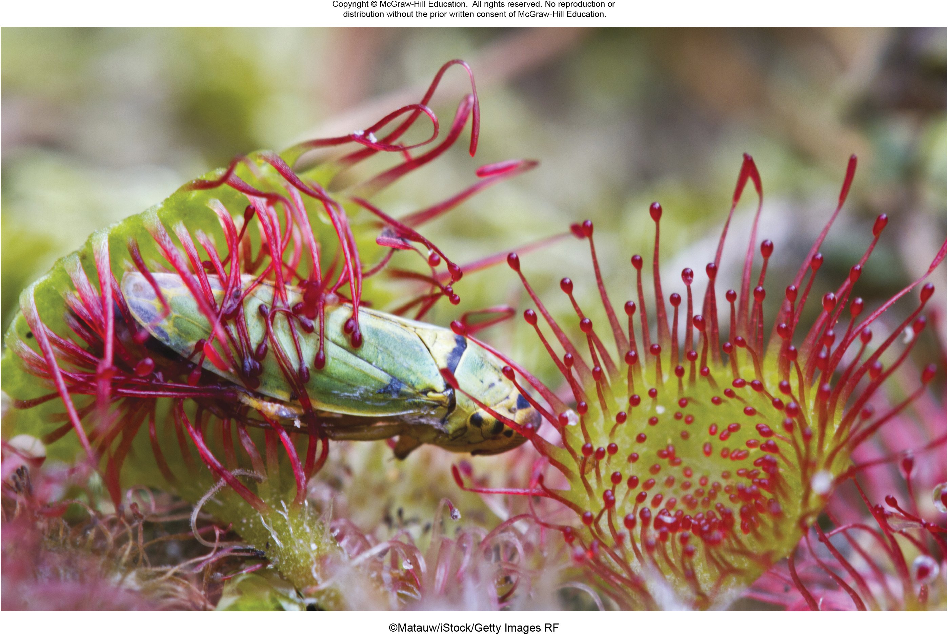
Chapter 23
Plant Nutrition and Transport
©Matauw/iStock/Getty Images RF
©McGraw-Hill Education. All rights reserved. Authorized only for instructor use in the classroom.
No reproduction or further distribution permitted without the prior written consent of McGraw-Hill Education.

Slide 2
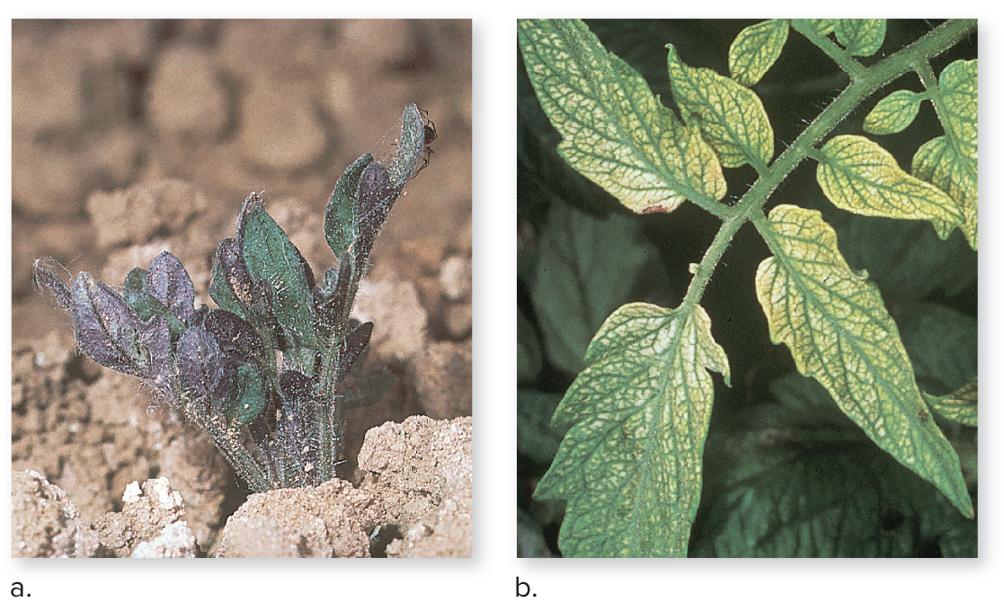
Plants require 16 essential elements
All plants require several nutrients to stay healthy.
These plants have nutrient deficiencies.
(both): ©1991 Regents University of California Statewide IPM Project
Section 23.1
Figure 23.2

Slide 3
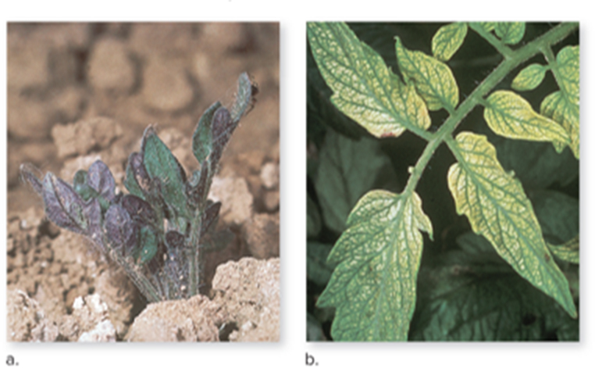
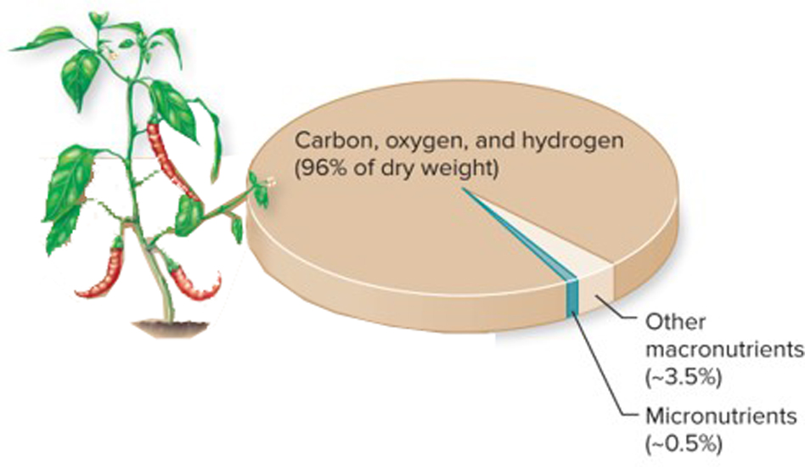
16 essential elements
Essential elements are required for
metabolism, growth, and reproduction.
(both): ©1991 Regents University of California Statewide IPM Project
Macronutrients | Form Taken Up by Plants | Percent Dry Weight | Selected Functions
Carbon (C) | $${CO}_{2}$$ | 45 | Part of organic compounds
Oxygen (O) | $H2O$, $O_{2}$, ${CO}_{2}$ | 45 | Part of organic compounds
Hydrogen (H) | $$H2O$$ | 6 | Part of organic compounds
Nitrogen (N) | $${NO}_{3}^{−},{NH}_{4}^{+}$$ | 1.5 | Part of nucleic acids, amino acids, coenzymes, chlorophyll, ATP
Potassium (K) | $$K^{+}$$ | 1.0 | Controls opening and closing of stomata, activates enzymes
Calcium (Ca) | $${Ca}^{2+}$$ | 0.5 | Cell wall component, activates enzymes, second messenger in signal transduction, maintains membranes
Magnesium (Mg) | $${Mg}^{2+}$$ | 0.2 | Part of chlorophyll, activates enzymes, participates in protein synthesis
Phosphorus (P) | $H_{2}{PO}_{4}^{−}$, ${HPO}_{4}^{2−}$ | 0.2 | Part of nucleic acids, sugar phosphates, ATP, coenzymes, phospholipids
Sulfur (S) | $${SO}_{4}^{2−}$$ | 0.1 | Part of cysteine and methionine (amino acids), coenzyme A
Micronutrients | Form Taken Up by Plants | Percent Dry Weight | Selected Functions
Chlorine (CI) | $${Cl}^{−}$$ | 0.01 | Water balance
Iron (Fe) | ${Fe}^{3+}$, ${Fe}^{2+}$ | 0.01 | Chlorophyll synthesis, cofactor for enzymes, part of electron carriers
Boron (B) | $${BO}_{3}^{−},B_{4}O_{7}^{2−}$$ | 0.002 | Growth of pollen tubes, sugar transport, regulates certain enzymes
Zinc (Zn) | $${Zn}^{2+}$$ | 0.002 | Hormone synthesis, activates enzymes, stabilizes ribosomes
Manganese (Mn) | $${Mn}^{2+}$$ | 0.005 | Activates enzymes, electron transfer, photosynthesis
Copper (Cu) | $${Cu}^{2+}$$ | 0.0006 | Part of plastid pigments, lignin synthesis, activates enzymes
Molybdenum (Mo) | $${MoO}_{4}^{2−}$$ | 0.00001 | Nitrate reduction
Section 23.1
Figures 23.1, 23.2

Slide 4
Essential elements: macronutrients
Macronutrients are required in large amounts. Carbon, oxygen, and hydrogen are the most abundant macronutrients.
(both): ©1991 Regents University of California Statewide IPM Project
Macronutrients | Form Taken Up by Plants | Percent Dry Weight | Selected Functions
Carbon (C) | $${CO}_{2}$$ | 45 | Part of organic compounds
Oxygen (O) | $H2O$, $O_{2}$, ${CO}_{2}$ | 45 | Part of organic compounds
Hydrogen (H) | $$H2O$$ | 6 | Part of organic compounds
Nitrogen (N) | $${NO}_{3}^{−},{NH}_{4}^{+}$$ | 1.5 | Part of nucleic acids, amino acids, coenzymes, chlorophyll, ATP
Potassium (K) | $$K^{+}$$ | 1.0 | Controls opening and closing of stomata, activates enzymes
Calcium (Ca) | $${Ca}^{2+}$$ | 0.5 | Cell wall component, activates enzymes, second messenger in signal transduction, maintains membranes
Magnesium (Mg) | $${Mg}^{2+}$$ | 0.2 | Part of chlorophyll, activates enzymes, participates in protein synthesis
Phosphorus (P) | $H_{2}{PO}_{4}^{−}$, ${HPO}_{4}^{2−}$ | 0.2 | Part of nucleic acids, sugar phosphates, ATP, coenzymes, phospholipids
Sulfur (S) | $${SO}_{4}^{2−}$$ | 0.1 | Part of cysteine and methionine (amino acids), coenzyme A
Micronutrients | Form Taken Up by Plants | Percent Dry Weight | Selected Functions
Chlorine (CI) | $${Cl}^{−}$$ | 0.01 | Water balance
Iron (Fe) | ${Fe}^{3+}$, ${Fe}^{2+}$ | 0.01 | Chlorophyll synthesis, cofactor for enzymes, part of electron carriers
Boron (B) | $${BO}_{3}^{−},B_{4}O_{7}^{2−}$$ | 0.002 | Growth of pollen tubes, sugar transport, regulates certain enzymes
Zinc (Zn) | $${Zn}^{2+}$$ | 0.002 | Hormone synthesis, activates enzymes, stabilizes ribosomes
Manganese (Mn) | $${Mn}^{2+}$$ | 0.005 | Activates enzymes, electron transfer, photosynthesis
Copper (Cu) | $${Cu}^{2+}$$ | 0.0006 | Part of plastid pigments, lignin synthesis, activates enzymes
Molybdenum (Mo) | $${MoO}_{4}^{2−}$$ | 0.00001 | Nitrate reduction
Section 23.1
Figures 23.1, 23.2

Slide 5
Essential elements: micronutrients
Micronutrients are required in much smaller amounts.
(both): ©1991 Regents University of California Statewide IPM Project
Macronutrients | Form Taken Up by Plants | Percent Dry Weight | Selected Functions
Carbon (C) | $${CO}_{2}$$ | 45 | Part of organic compounds
Oxygen (O) | $H2O$, $O_{2}$, ${CO}_{2}$ | 45 | Part of organic compounds
Hydrogen (H) | $$H2O$$ | 6 | Part of organic compounds
Nitrogen (N) | $${NO}_{3}^{−},{NH}_{4}^{+}$$ | 1.5 | Part of nucleic acids, amino acids, coenzymes, chlorophyll, ATP
Potassium (K) | $$K^{+}$$ | 1.0 | Controls opening and closing of stomata, activates enzymes
Calcium (Ca) | $${Ca}^{2+}$$ | 0.5 | Cell wall component, activates enzymes, second messenger in signal transduction, maintains membranes
Magnesium (Mg) | $${Mg}^{2+}$$ | 0.2 | Part of chlorophyll, activates enzymes, participates in protein synthesis
Phosphorus (P) | $H_{2}{PO}_{4}^{−}$, ${HPO}_{4}^{2−}$ | 0.2 | Part of nucleic acids, sugar phosphates, ATP, coenzymes, phospholipids
Sulfur (S) | $${SO}_{4}^{2−}$$ | 0.1 | Part of cysteine and methionine (amino acids), coenzyme A
Micronutrients | Form Taken Up by Plants | Percent Dry Weight | Selected Functions
Chlorine (CI) | $${Cl}^{−}$$ | 0.01 | Water balance
Iron (Fe) | ${Fe}^{3+}$, ${Fe}^{2+}$ | 0.01 | Chlorophyll synthesis, cofactor for enzymes, part of electron carriers
Boron (B) | $${BO}_{3}^{−},B_{4}O_{7}^{2−}$$ | 0.002 | Growth of pollen tubes, sugar transport, regulates certain enzymes
Zinc (Zn) | $${Zn}^{2+}$$ | 0.002 | Hormone synthesis, activates enzymes, stabilizes ribosomes
Manganese (Mn) | $${Mn}^{2+}$$ | 0.005 | Activates enzymes, electron transfer, photosynthesis
Copper (Cu) | $${Cu}^{2+}$$ | 0.0006 | Part of plastid pigments, lignin synthesis, activates enzymes
Molybdenum (Mo) | $${MoO}_{4}^{2−}$$ | 0.00001 | Nitrate reduction
Section 23.1
Figures 23.1, 23.2

Slide 6
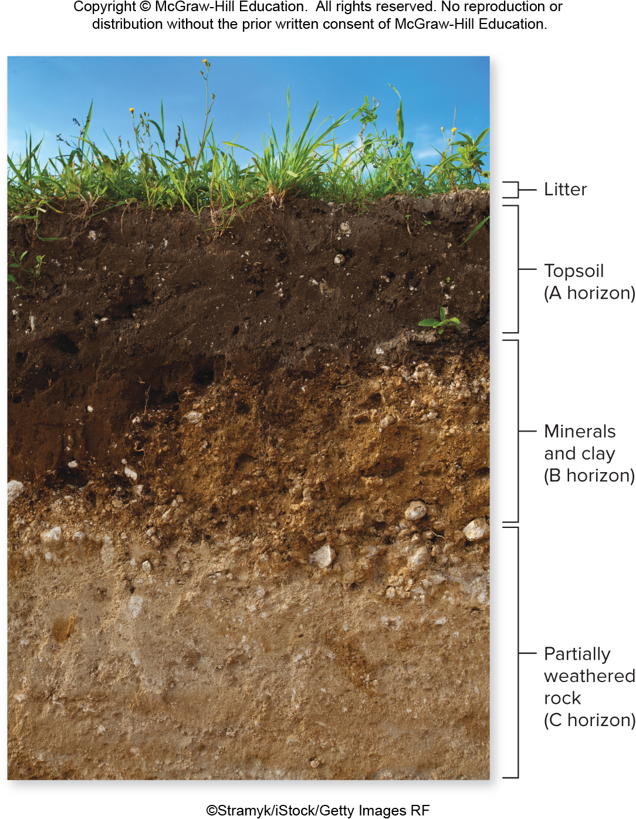
Soil
Plant roots absorb nutrients from the soil.
©Stramyk/iStock/Getty Images RF
Section 23.1
Figure 23.3

Slide 7
What is soil?
Soil is a complex mixture of rock particles, organic matter, air, and water.
©Stramyk/iStock/Getty Images RF
Section 23.1
Figure 23.3

Slide 8
Soil is home to many organisms
Many organisms live in the soil, decomposing organic matter and releasing inorganic nutrients.
©Stramyk/iStock/Getty Images RF
Section 23.1
Figure 23.3

Slide 9
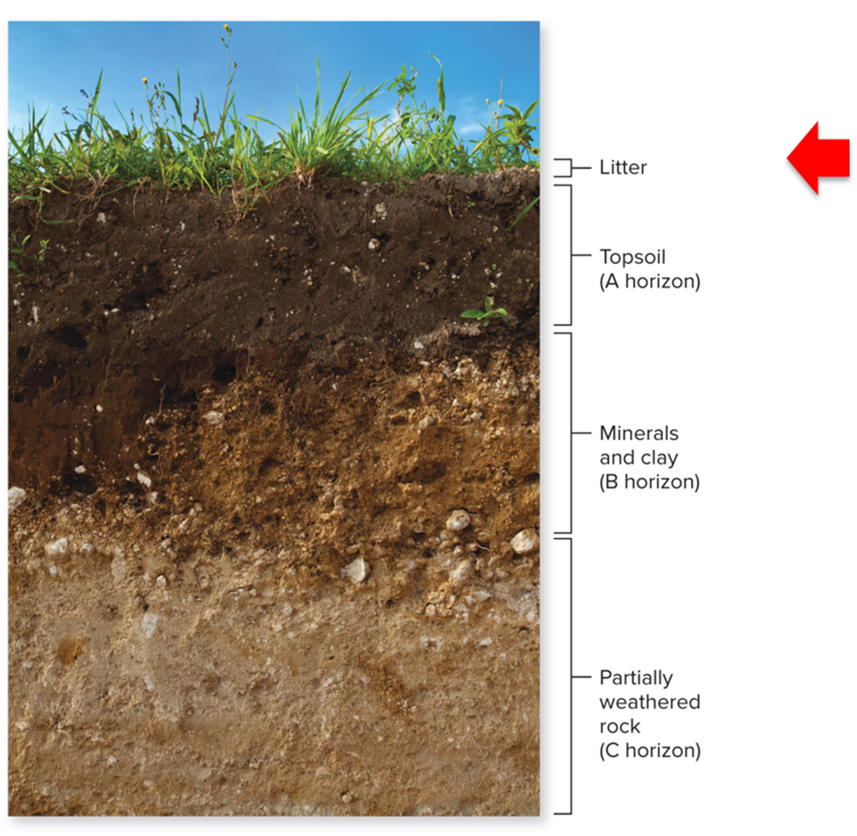
Soil layers: litter
Lying on the soil’s surface is litter, which consists of decomposing leaves and stems.
©Stramyk/iStock/Getty Images RF
Section 23.1
Figure 23.3

Slide 10
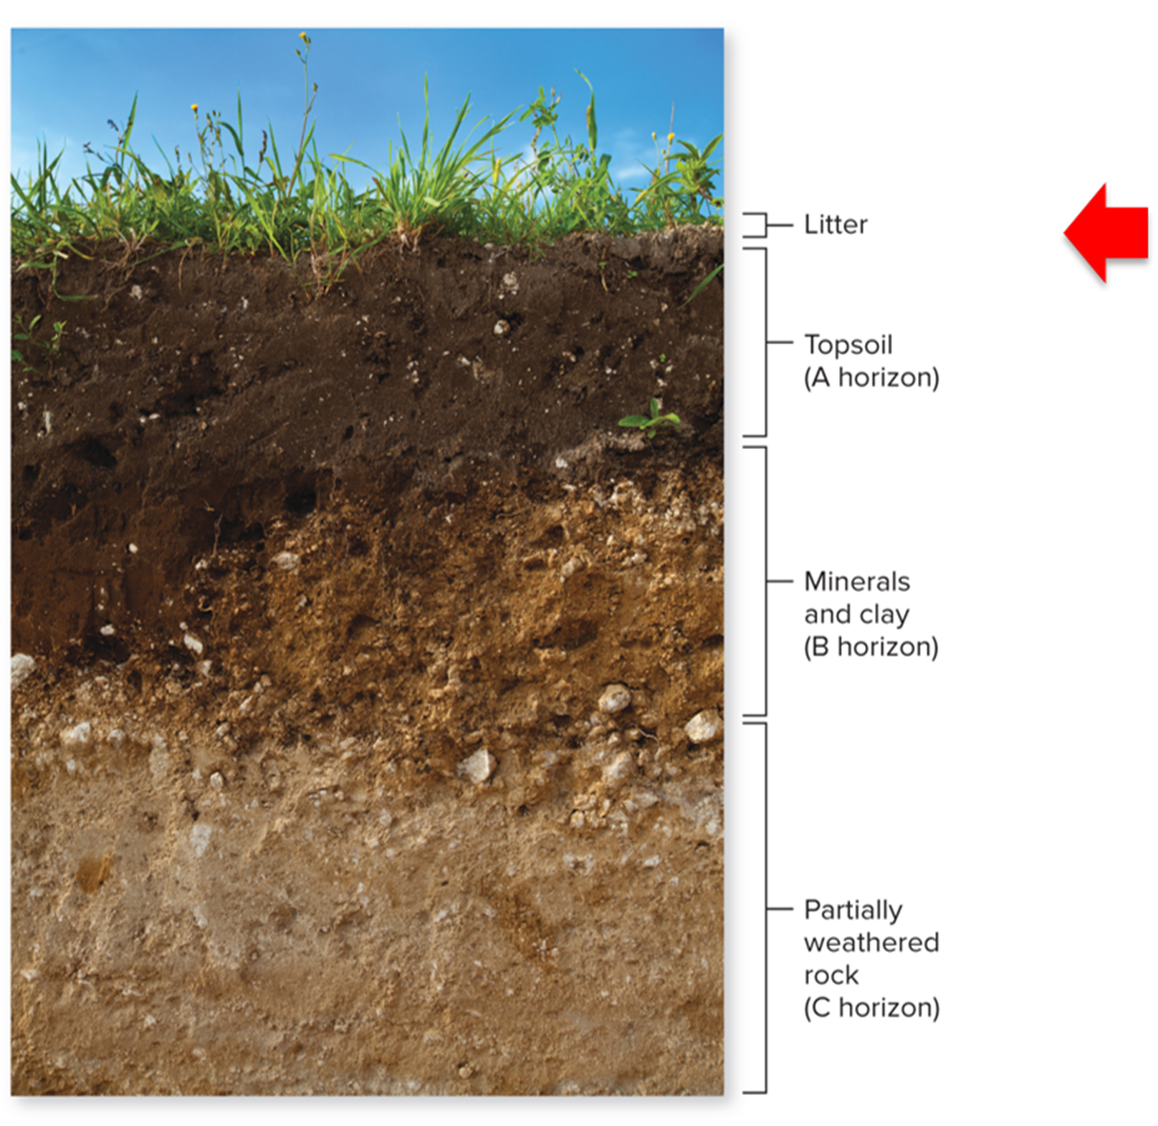
Soil layers: humus
As microbes decompose the litter, carbon dioxide is released into the atmosphere. The carbon that remains in the soil forms a layer of soil called humus.
©Stramyk/iStock/Getty Images RF
Section 23.1
Figure 23.3

Slide 11
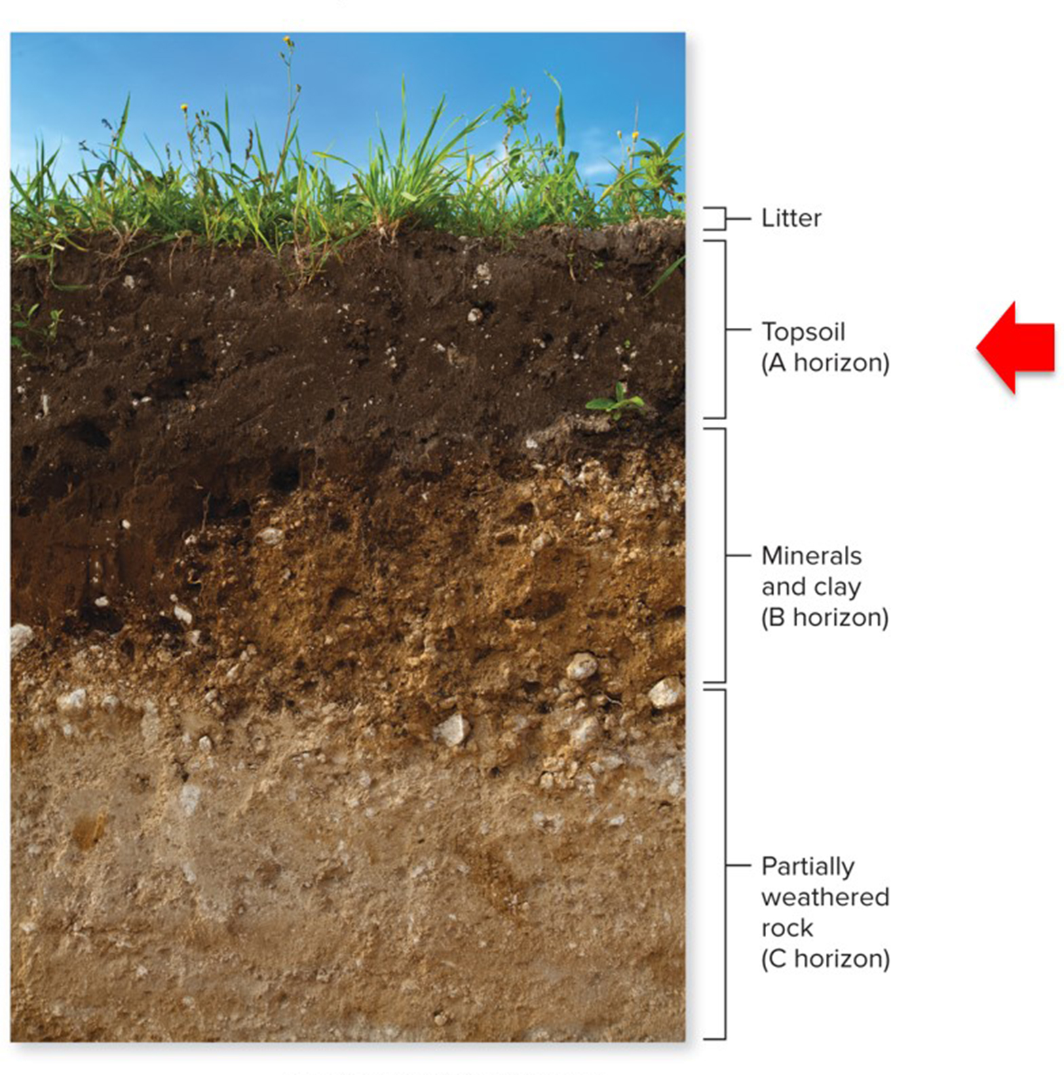
Soil layers: A horizon
Most humus is in the topsoil (the A horizon). This layer of soil also supplies most of a plant’s water and nutrients.
Plant roots stabilize the topsoil, helping to prevent erosion.
©Stramyk/iStock/Getty Images RF
Section 23.1
Figure 23.3

Slide 12
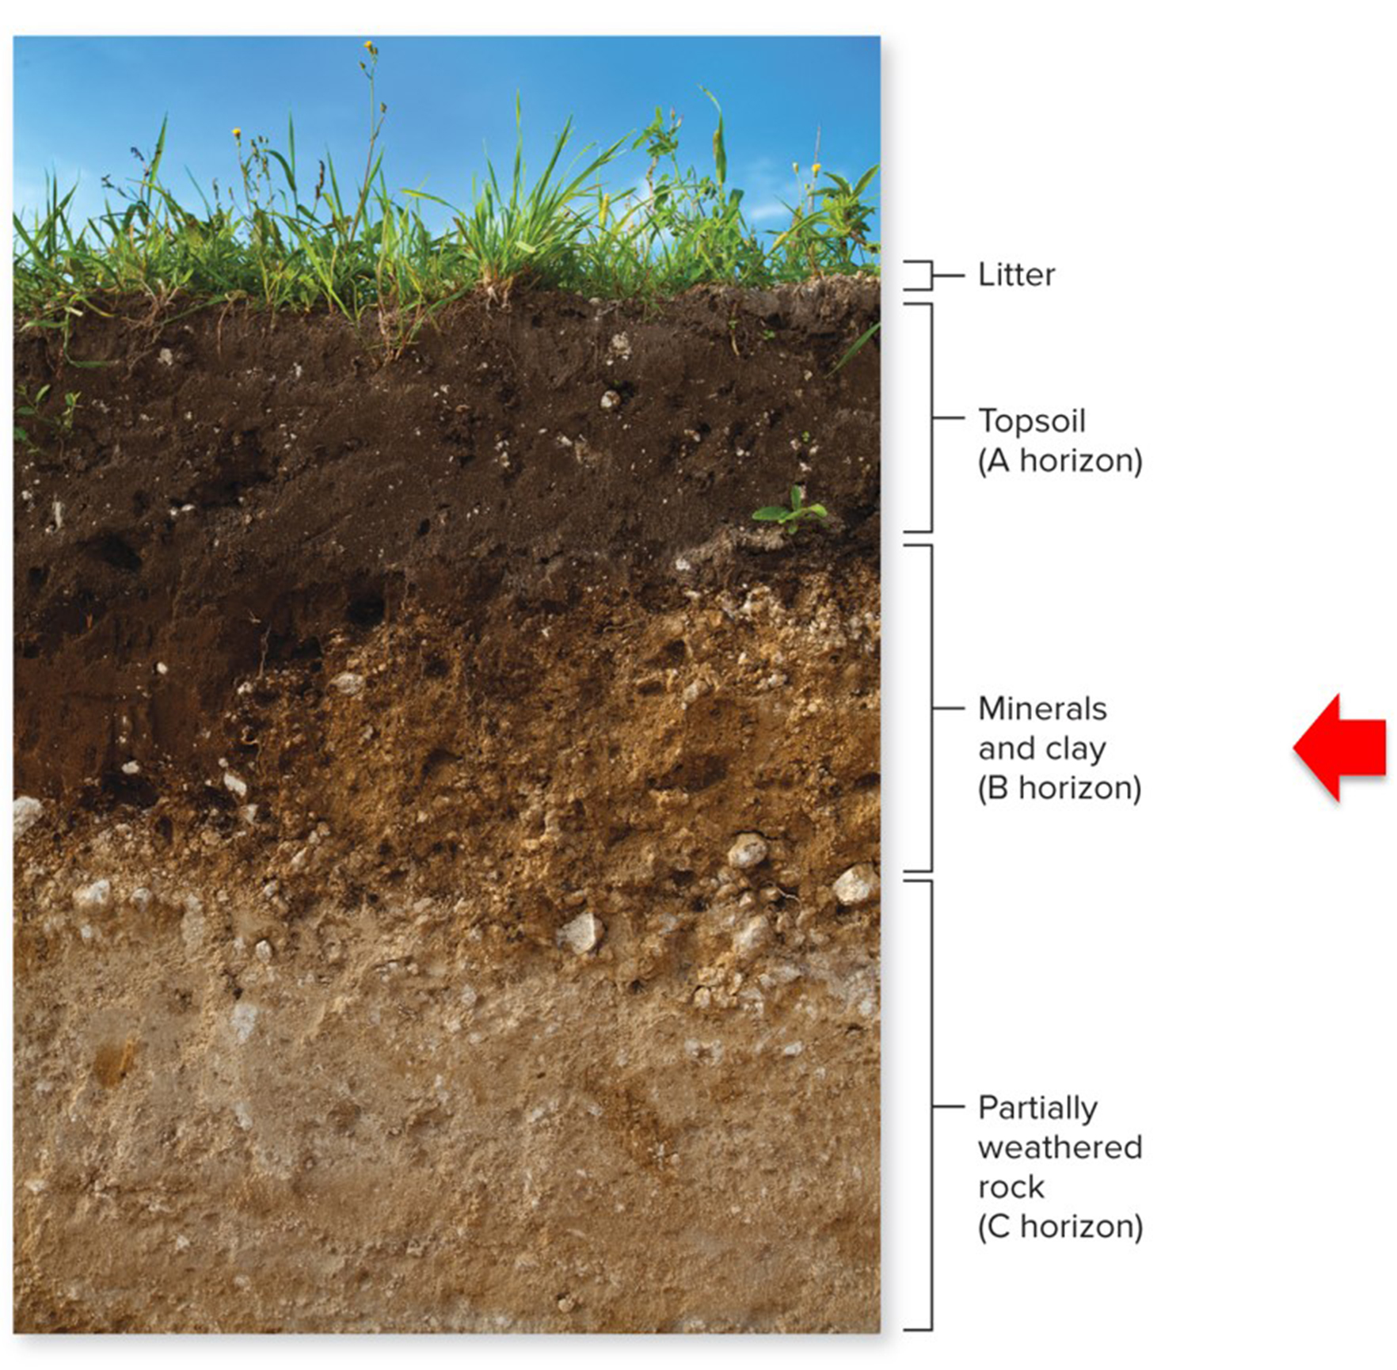
Soil layers: B horizon
Below the topsoil is the B horizon, which has less organic matter. Roots extend into the B horizon.
©Stramyk/iStock/Getty Images RF
Section 23.1
Figure 23.3

Slide 13
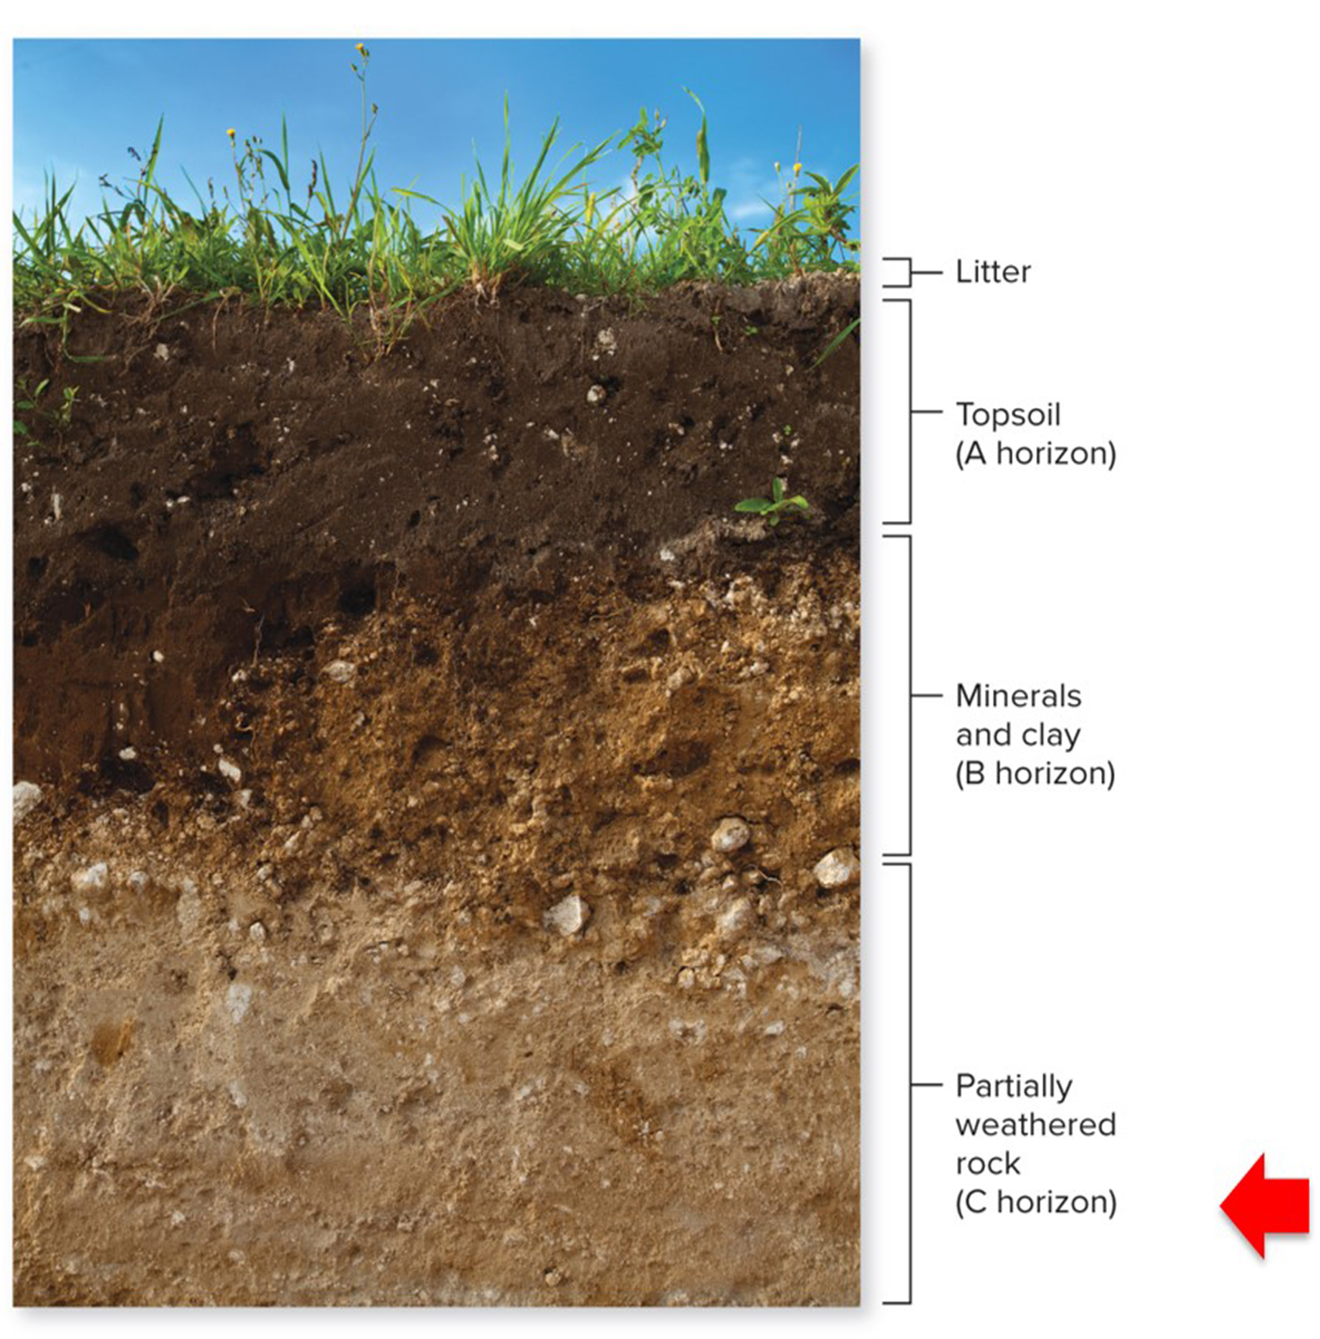
Soil layers: C horizon
The C horizon mostly has weathered rocks.
©Stramyk/iStock/Getty Images RF
Figure 23.3
Section 23.1

Slide 14
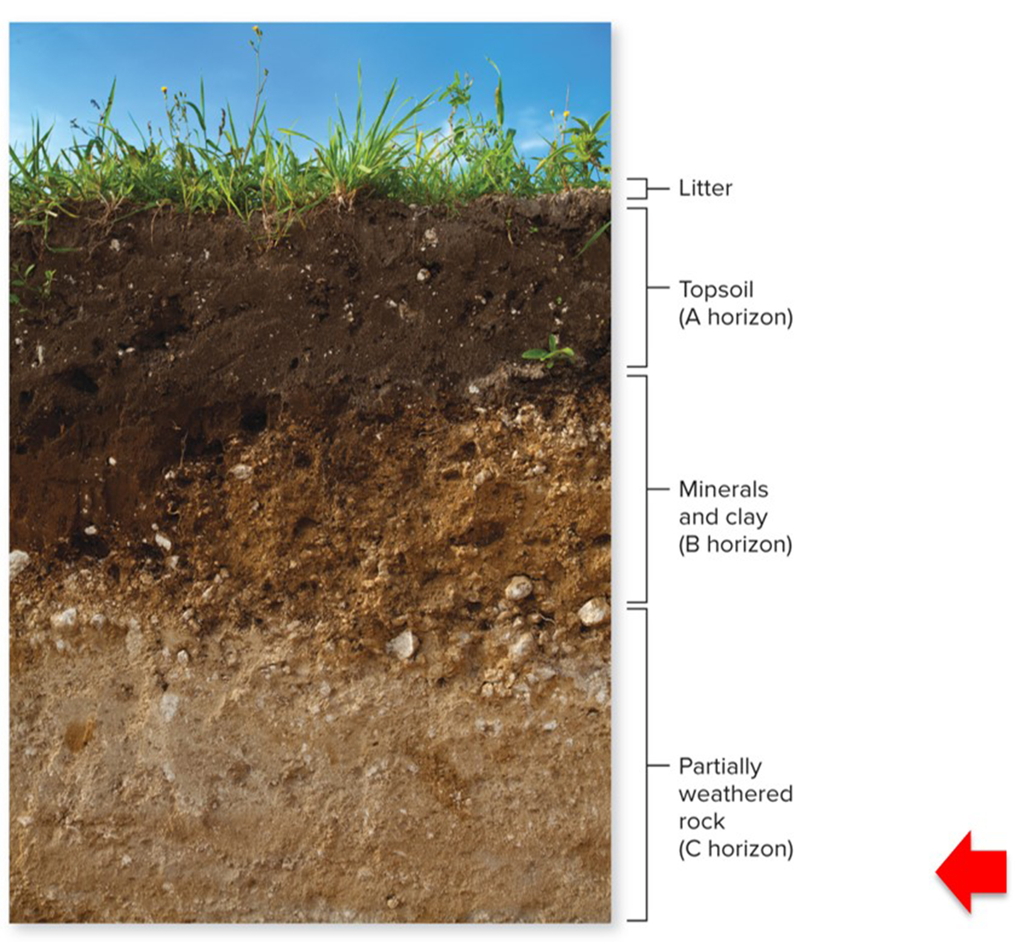
Soil layers: bedrock
Below the C horizon is bedrock.
©Stramyk/iStock/Getty Images RF
Section 23.1
Figure 23.3

Slide 15
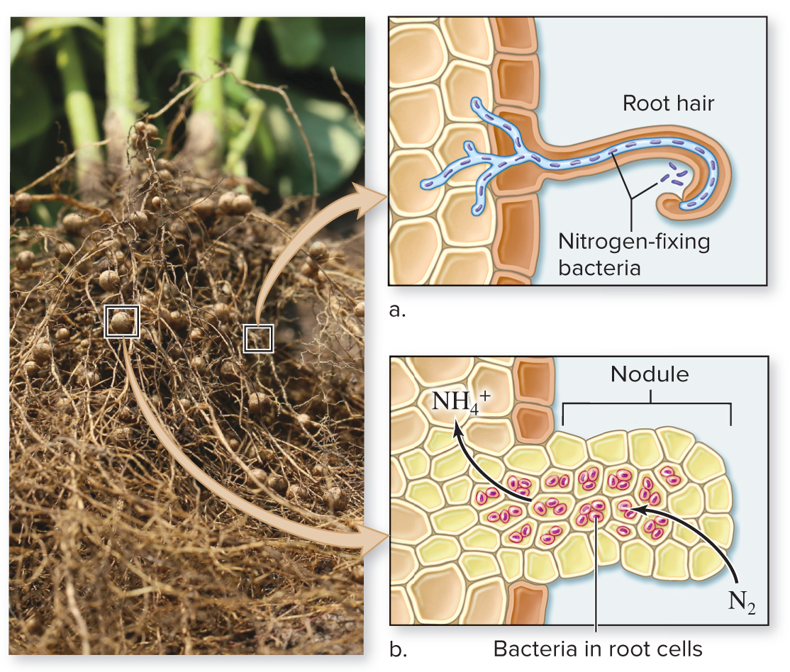
Plants obtain nutrients from soil and air
Symbiotic relationships with nitrogen-fixing bacteria help plants obtain useful forms of nitrogen.
©Kelly Marken/Shutterstock RF
Section 23.1
Figure 23.4

Slide 16
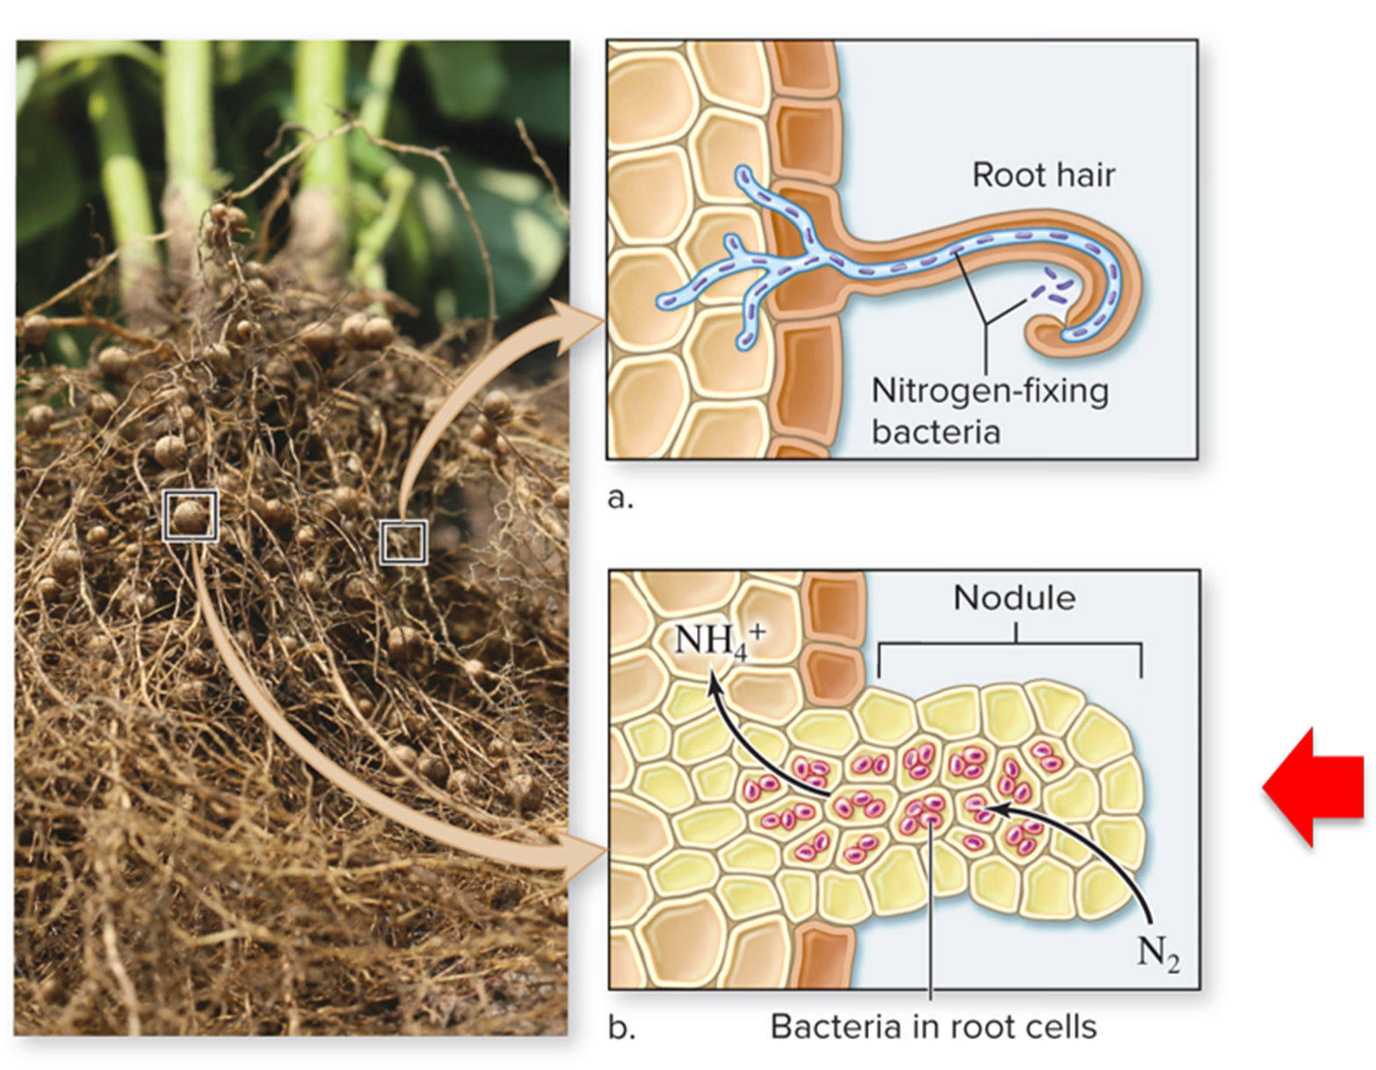
How plants obtain nutrients: nodules
Some nitrogen-fixing bacteria live in growths called nodules on the roots of plants.
©Kelly Marken/Shutterstock RF
Section 23.1
Figure 23.4

Slide 17
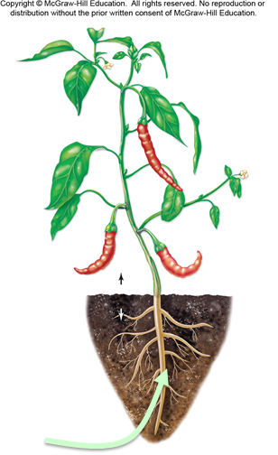
How plants obtain nutrients: roots
Plants take up other nutrients through their roots as well. These nutrients dissolve in the soil’s water and move into the plant as it absorbs water.
Nitrogen, potassium, calcium, etc. dissolved in water
Section 23.1
Figure 23.5

Slide 18
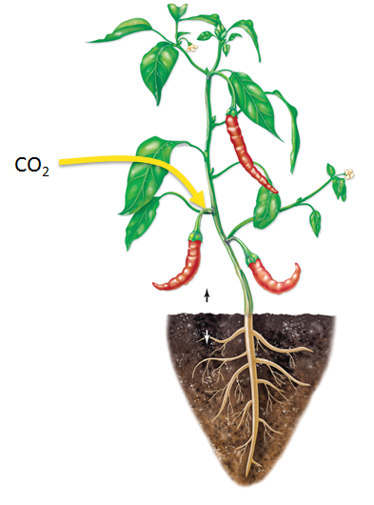
How plants obtain nutrients: gas exchange
Plants obtain carbon and oxygen from the atmosphere, in the form of ${CO}_{2}$.
Section 23.1
Figure 23.5

Slide 19
Clicker question #1
Plants require abundant carbon and nitrogen. These elements occur in some of the same organic molecules, including:
proteins.
ATP.
DNA.
sugar.
Proteins, ATP, and DNA are all correct.

Slide 20
Clicker question #1, solution
Plants require abundant carbon and nitrogen. These elements occur in some of the same organic molecules, including:
Proteins, ATP, and DNA are all correct.

Slide 21
Clicker question #2
Plants extract the most nutrients from this layer of soil.
A horizon
B horizon
C horizon
bedrock

Slide 22
Clicker question #2, solution
Plants extract the most nutrients from this layer of soil.
A horizon

Slide 23
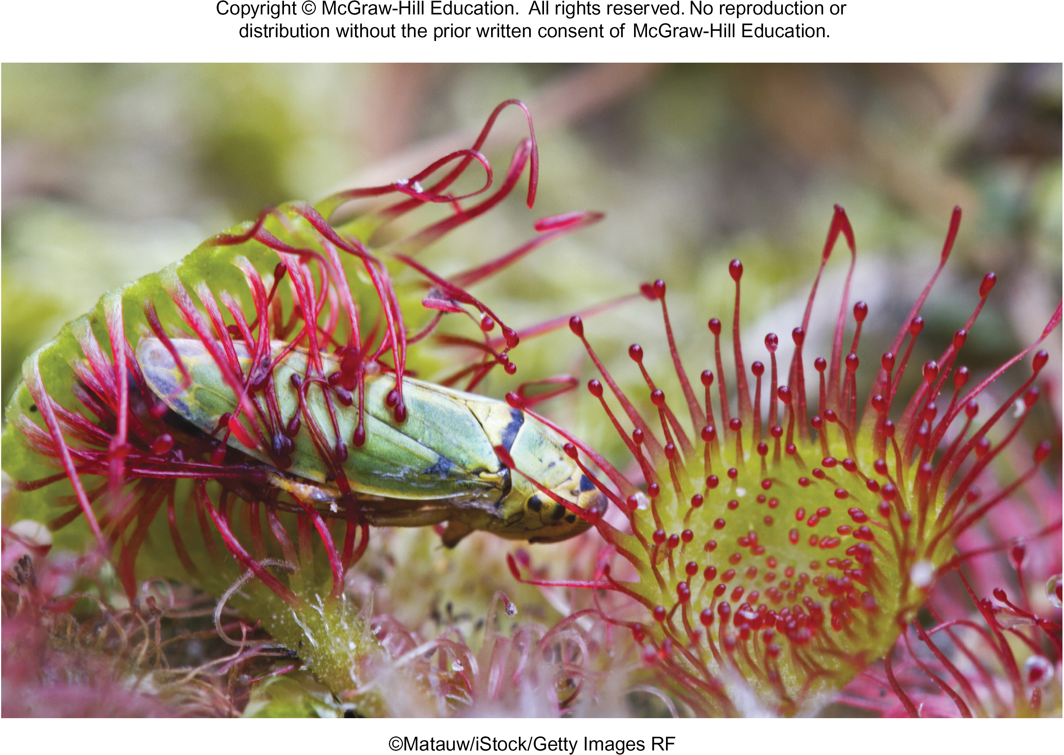
21.1 Mastering concepts
Which macro- and micronutrients do all plants require?
©Matauw/iStock/Getty Images RF

Slide 24
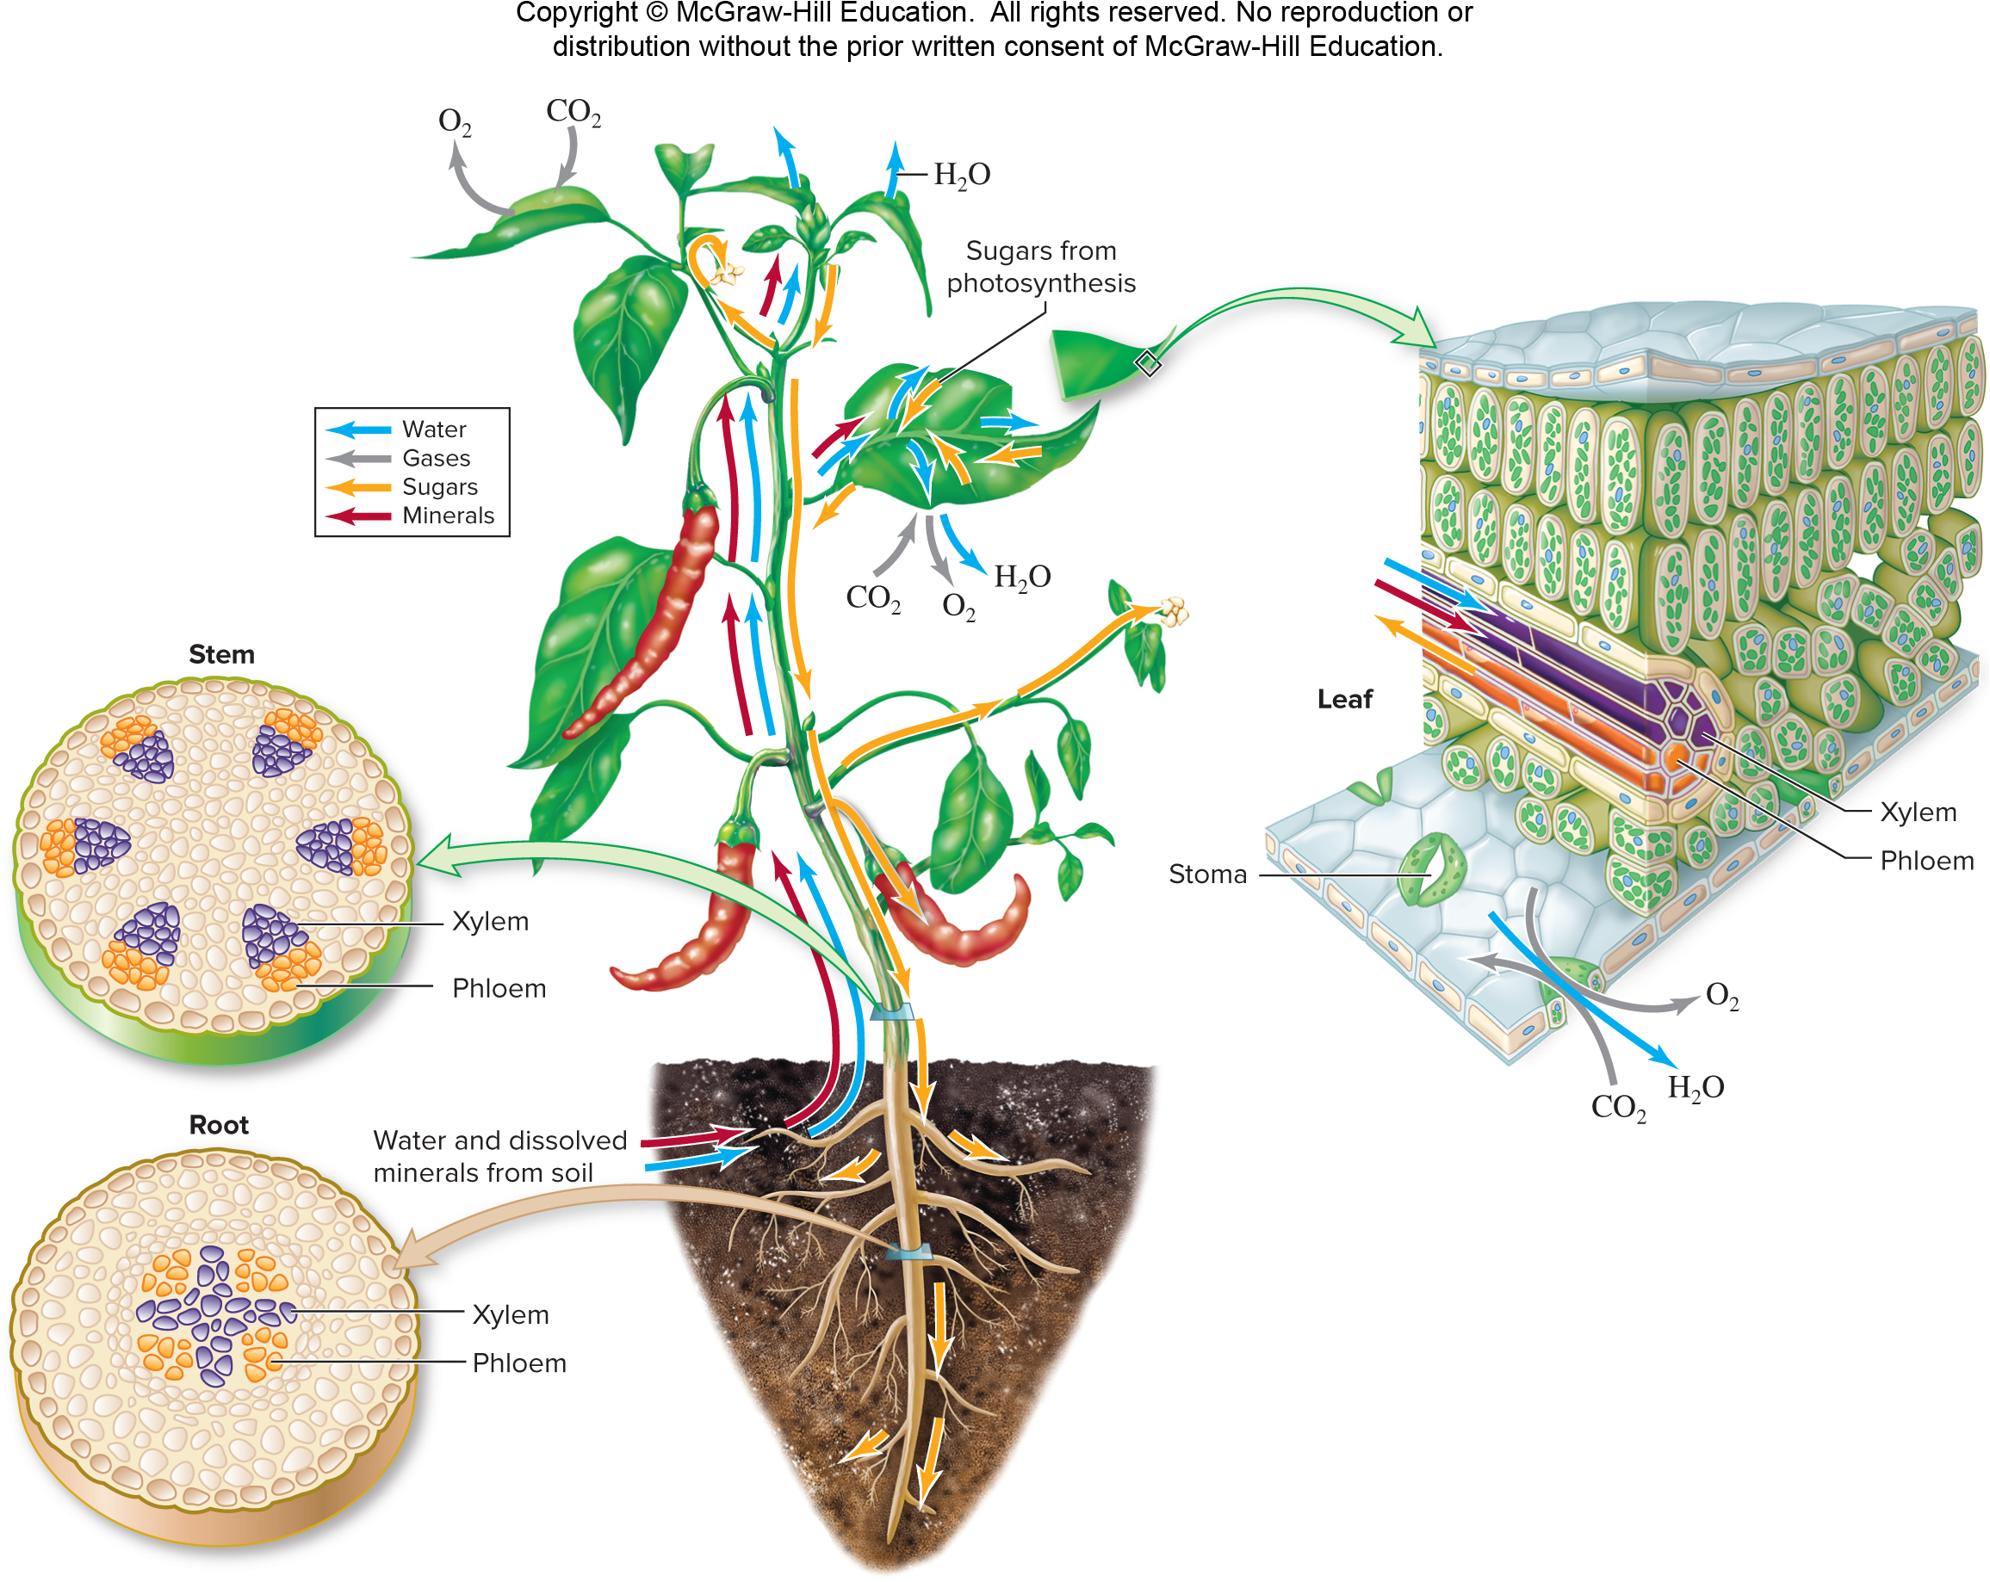
Vascular tissue transports substances
Vascular tissue forms the transportation system that connects plant parts.
Xylem and phloem function in different ways.
Section 23.2
Figure 23.5

Slide 25
Vascular tissue transport: xylem
First, let’s look at how water and minerals are pulled up to leaves in xylem.
Section 23.2
Figure 23.5

Slide 26
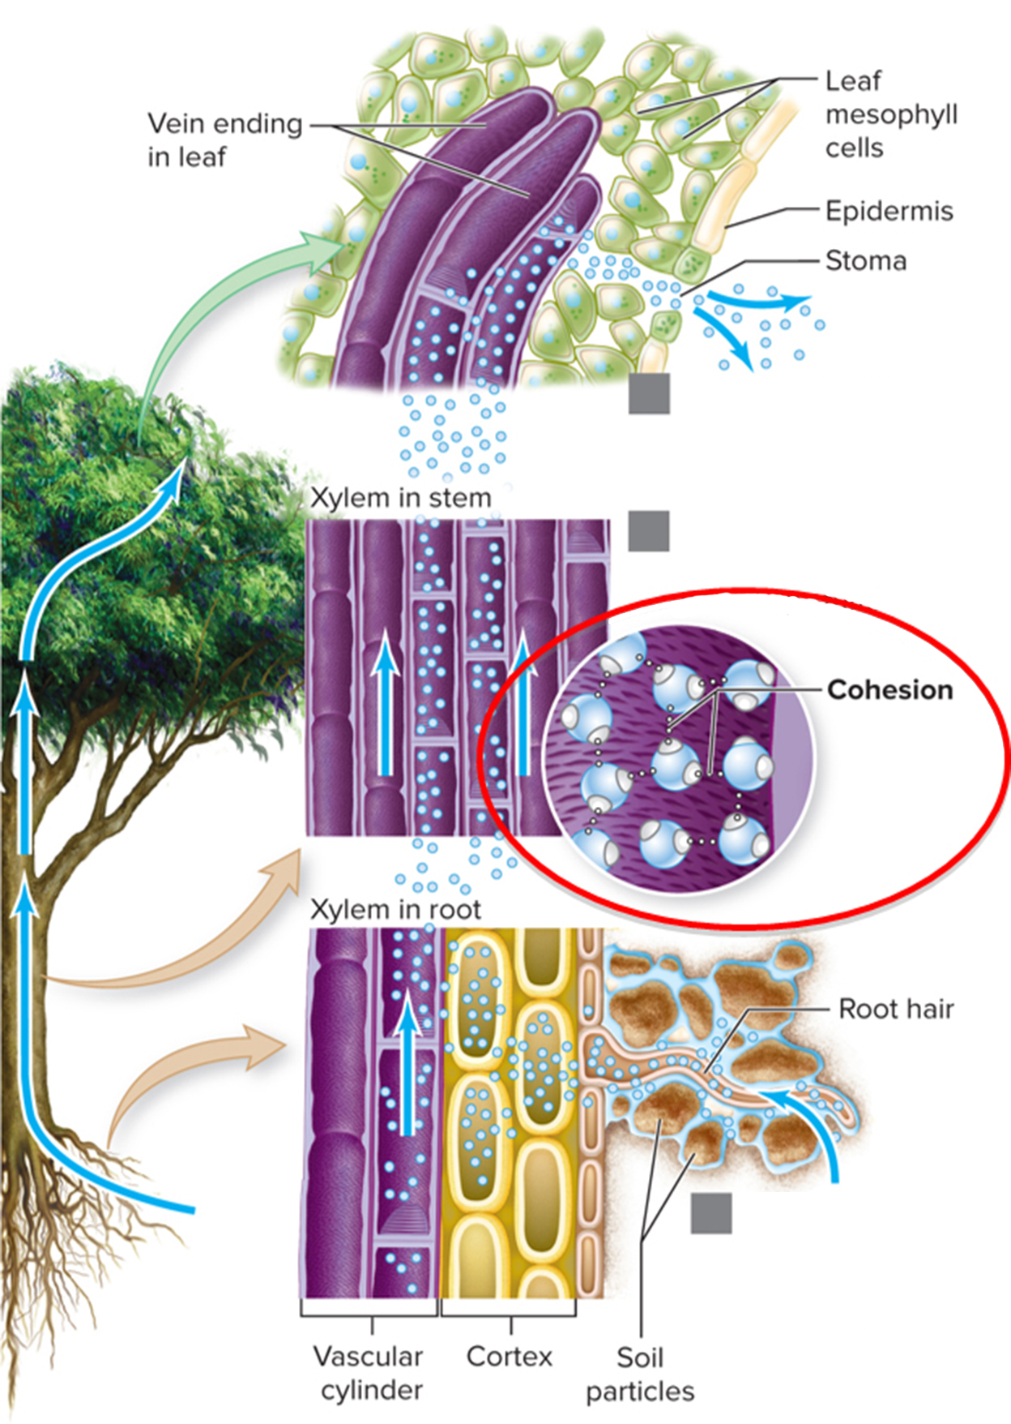
Xylem transports water and minerals
Xylem transport is explained by cohesion-tension theory. Cohesion is the tendency for water molecules to form hydrogen bonds with one another.
Transpiration: Water molecules evaporate from leaves.
Xylem transport: Water molecules are Pulled up stem.
Absorption: Water molecules are pulled into roots.
Section 23.2
Figure 23.7

Slide 27
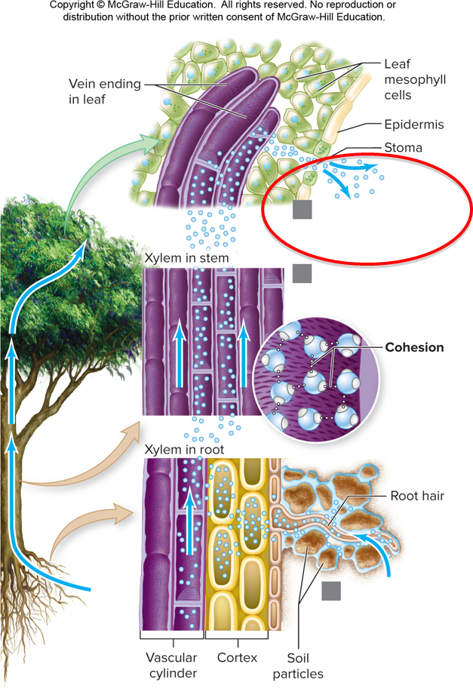
Xylem and water transport: transpiration
Because of cohesion, when water evaporates from the leaves, in a process called transpiration, it pulls adjacent molecules closer to the stomata.
Transpiration: Water molecules evaporate from leaves.
Xylem transport: Water molecules are Pulled up stem.
Absorption: Water molecules are pulled into roots.
Section 23.2
Figure 23.7

Slide 28
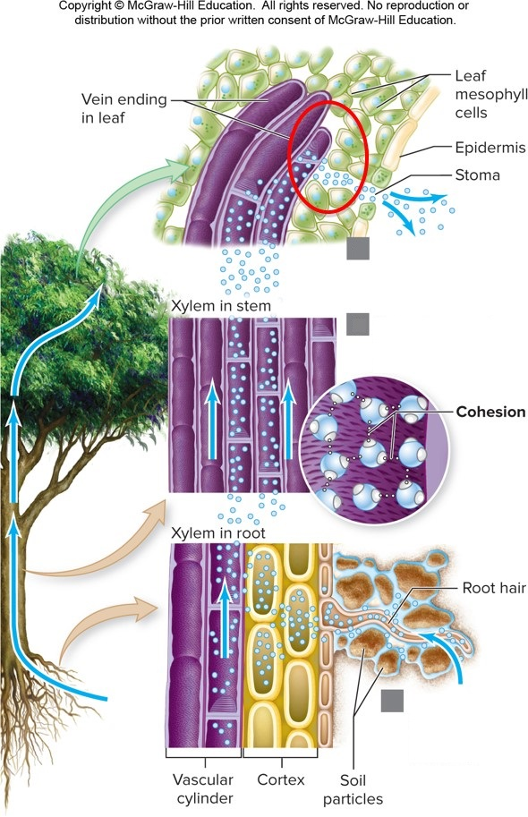
Xylem and water transport: diffusion
As the concentration of water within the mesophyll decreases, water molecules diffuse out of nearby veins. Those molecules, in turn, pull neighboring water molecules up the xylem.
Transpiration: Water molecules evaporate from leaves.
Xylem transport: Water molecules are Pulled up stem.
Absorption: Water molecules are pulled into roots.
Section 23.2
Figure 23.7

Slide 29
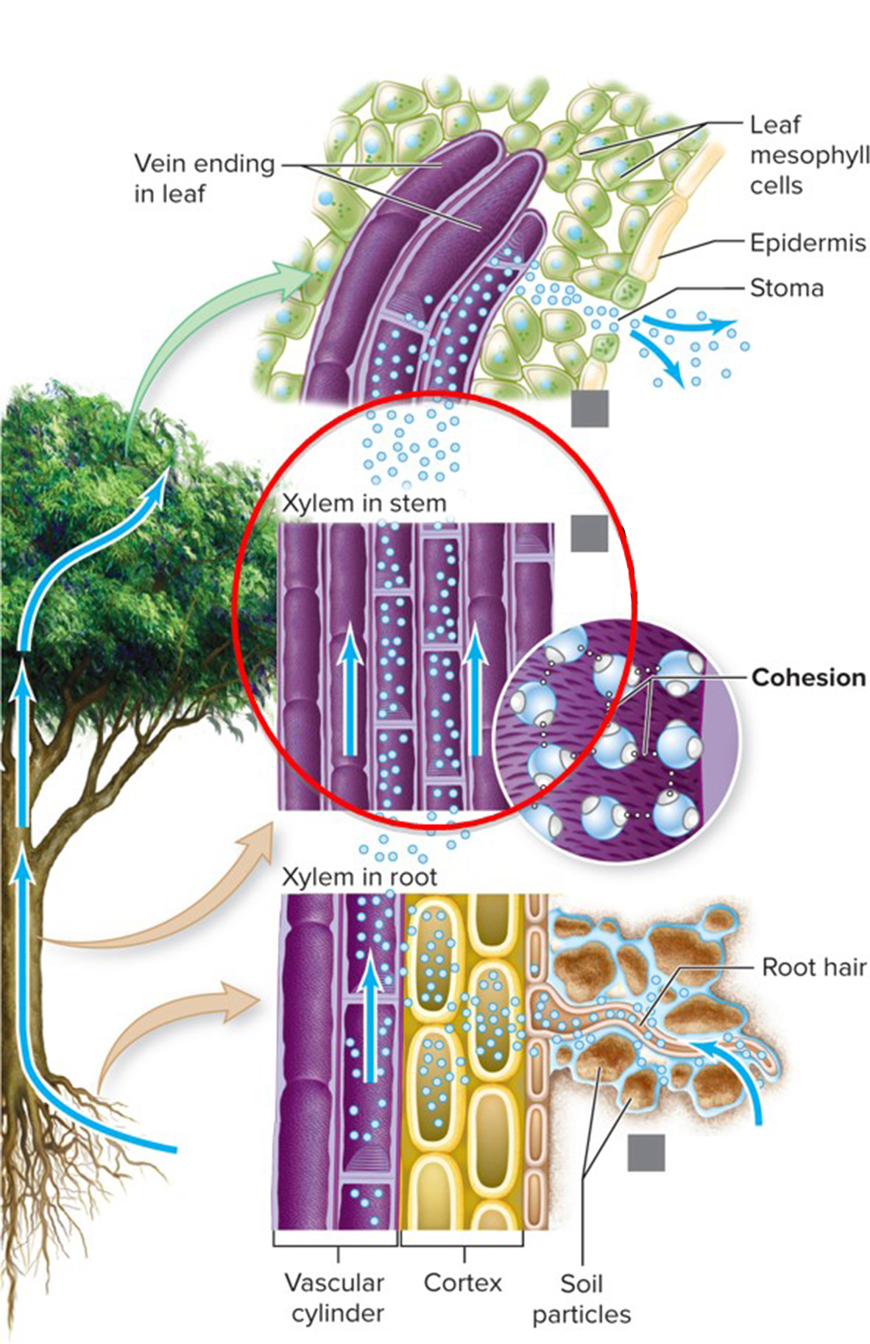
Xylem transports water into tissues
This movement of water molecules is repeated all the way down the xylem. Along the way, water molecules diffuse into “thirsty” tissues.
Transpiration: Water molecules evaporate from leaves.
Xylem transport: Water molecules are Pulled up stem.
Absorption: Water molecules are pulled into roots.
Section 23.2
Figure 23.7

Slide 30
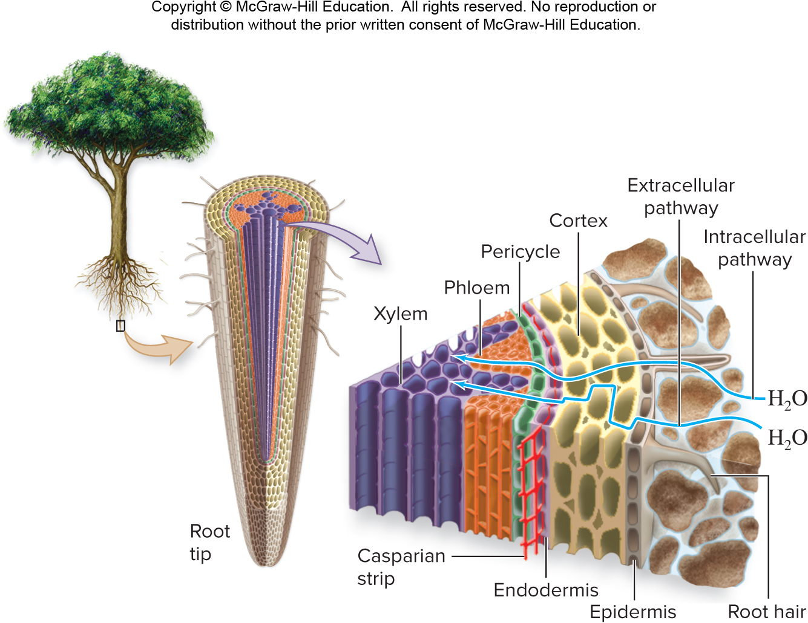
Xylem and water transport: Casparian strip
Water molecules are pulled in to roots. The Casparian strip is a waxy barrier that ensures all incoming material passes through cells.
Section 23.2
Figure 23.6

Slide 31
Xylem and water transport: stomata
Water: abundant|Stomata: open|Gas exchange: yes
A waxy layer on leaves called the cuticle helps prevent water loss.
Also, pores in leaves called stomata close when the plant needs to conserve water.
Water: scarce|Stomata: closed|Gas exchange: no
(both): ©Ray Simons/Science Source
Section 23.2
Figure 23.8

Slide 32
Xylem and water transport: guard cells
Water: abundant|Stomata: open|Gas exchange: yes
Guard cells determine whether a stoma is open or closed.
Water: scarce|Stomata: closed|Gas exchange: no
(both): ©Ray Simons/Science Source
Section 23.2
Figure 23.8

Slide 33
Clicker question #3
If all stomata in a plant are closed, then
no water evaporates from the leaves.
no water moves through the xylem.
no water enters the roots.
All of the above are true.

Slide 34
Clicker question #3, solution
If all stomata in a plant are closed, then
All of the above are true.

Slide 35
23.2 Mastering concepts
Summarize cohesion-tension theory.
©Matauw/iStock/Getty Images RF

Slide 36
Phloem pushes sugars
Now, let’s see how sugars are pushed to nonphotosynthetic cells in phloem.
Section 23.3
Figure 23.5

Slide 37
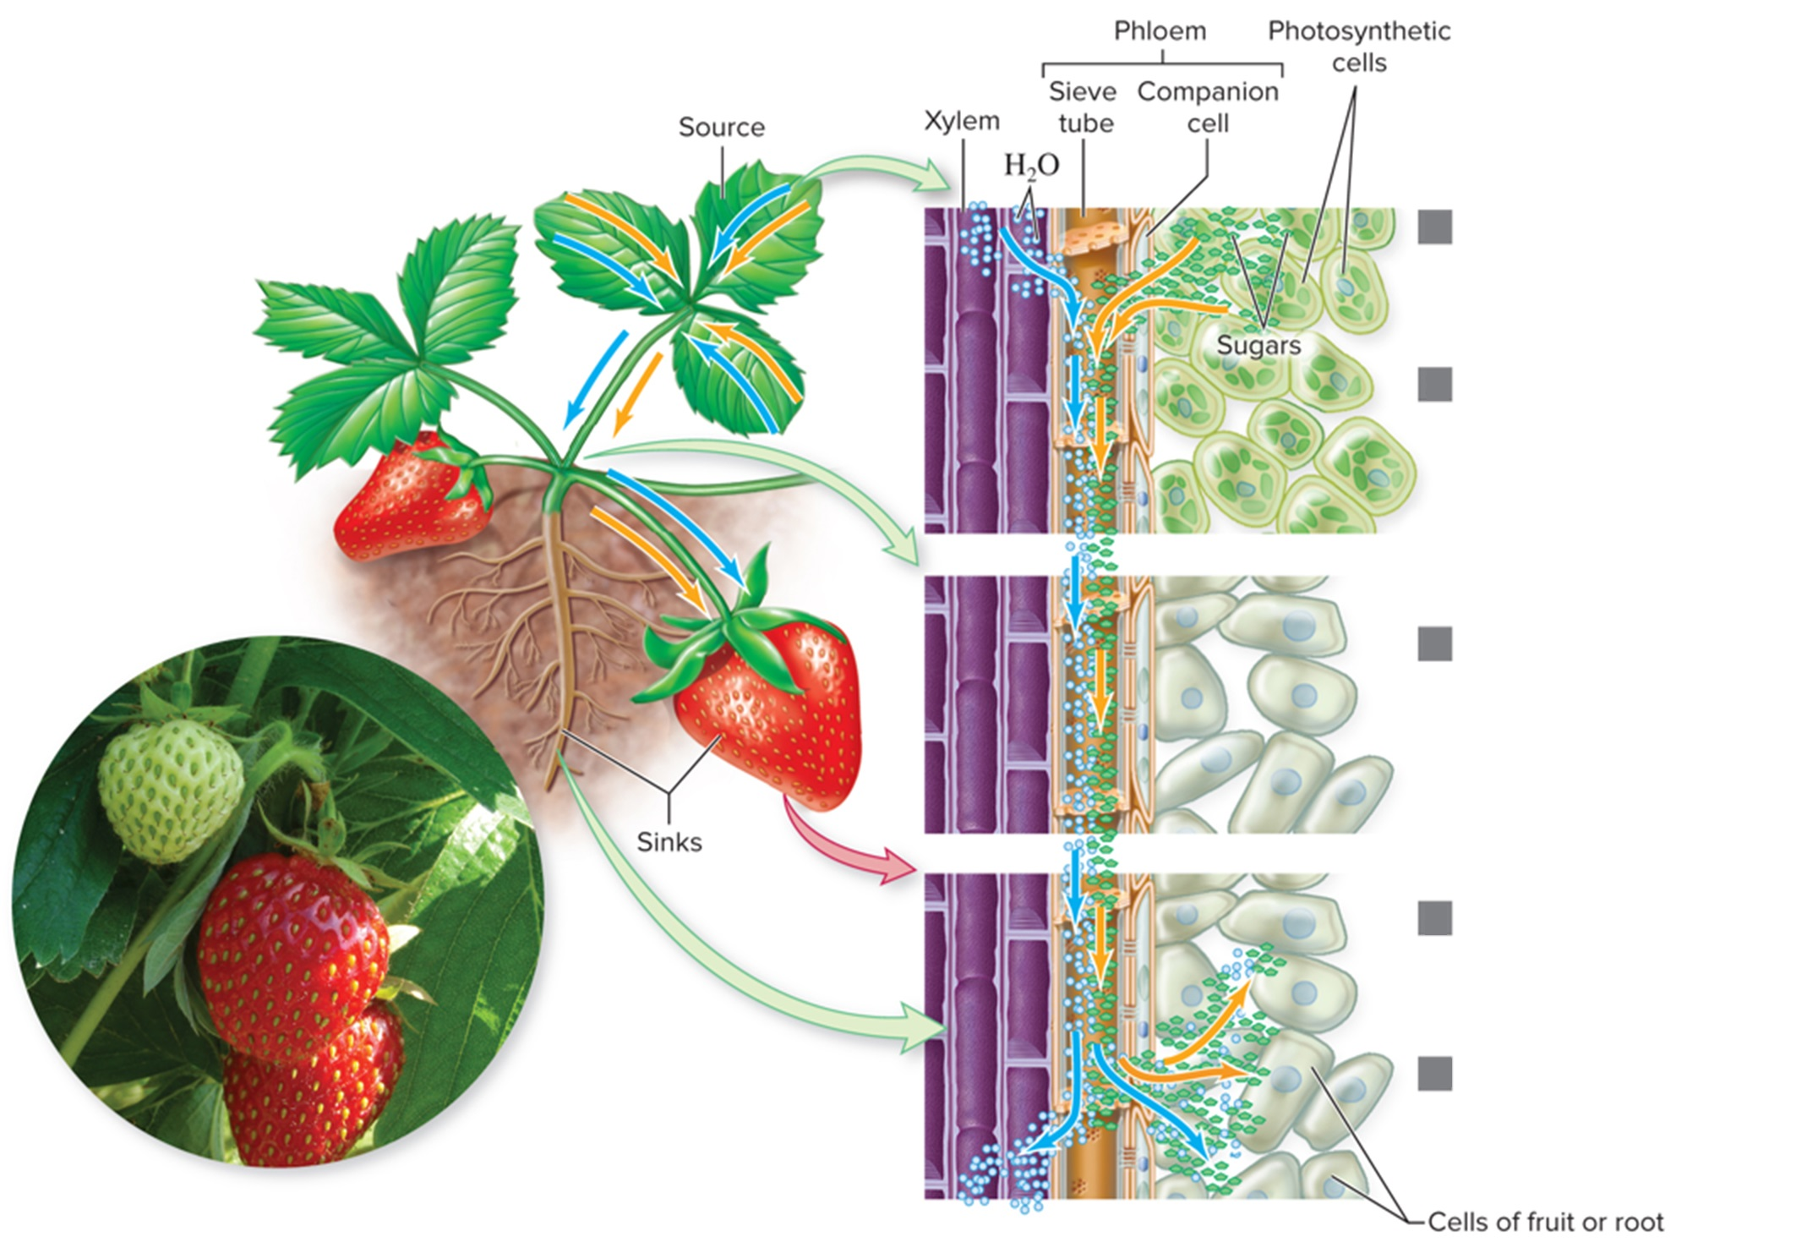
Phloem and sugar transport: sources
The green leaves of this strawberry plant are sugar “sources” because they carry out photosynthesis.
Loading at the source
Solutes (sugars produced in photosynthesis) enter a sieve tube by active transport.
Water enters the sieve tube from the xylem by osmosis, increasing pressure in the sieve tube.
Phloem transport in sieve tube
Pressure pushes the solutes toward the sink.
Unloading at the sink
As the sink is reached, solutes are unloaded by facilitated diffusion or active transport into the sink cells.
Water moves out of the pholem to the xylem by osmosis, decreasing pressure in the sieve tube.
©Ingram Publishing RF
Section 23.3
Figure 23.10

Slide 38
Phloem and sugar transport: sinks
Roots and fruits, which require sugar but do not carry out photosynthesis, are “sinks.”
Loading at the source
Solutes (sugars produced in photosynthesis) enter a sieve tube by active transport.
Water enters the sieve tube from the xylem by osmosis, increasing pressure in the sieve tube.
Phloem transport in sieve tube
Pressure pushes the solutes toward the sink.
Unloading at the sink
As the sink is reached, solutes are unloaded by facilitated diffusion or active transport into the sink cells.
Water moves out of the pholem to the xylem by osmosis, decreasing pressure in the sieve tube.
©Ingram Publishing RF
Section 23.3
Figure 23.10

Slide 39
Phloem and sugar transport: pressure flow
According to pressure flow theory, phloem sap moves from high pressure at sources to low pressure at sinks. Water movement causes the pressure changes in the phloem tissue.
Loading at the source
Solutes (sugars produced in photosynthesis) enter a sieve tube by active transport.
Water enters the sieve tube from the xylem by osmosis, increasing pressure in the sieve tube.
Phloem transport in sieve tube
Pressure pushes the solutes toward the sink.
Unloading at the sink
As the sink is reached, solutes are unloaded by facilitated diffusion or active transport into the sink cells.
Water moves out of the pholem to the xylem by osmosis, decreasing pressure in the sieve tube.
©Ingram Publishing RF
Section 23.3
Figure 23.10

Slide 40
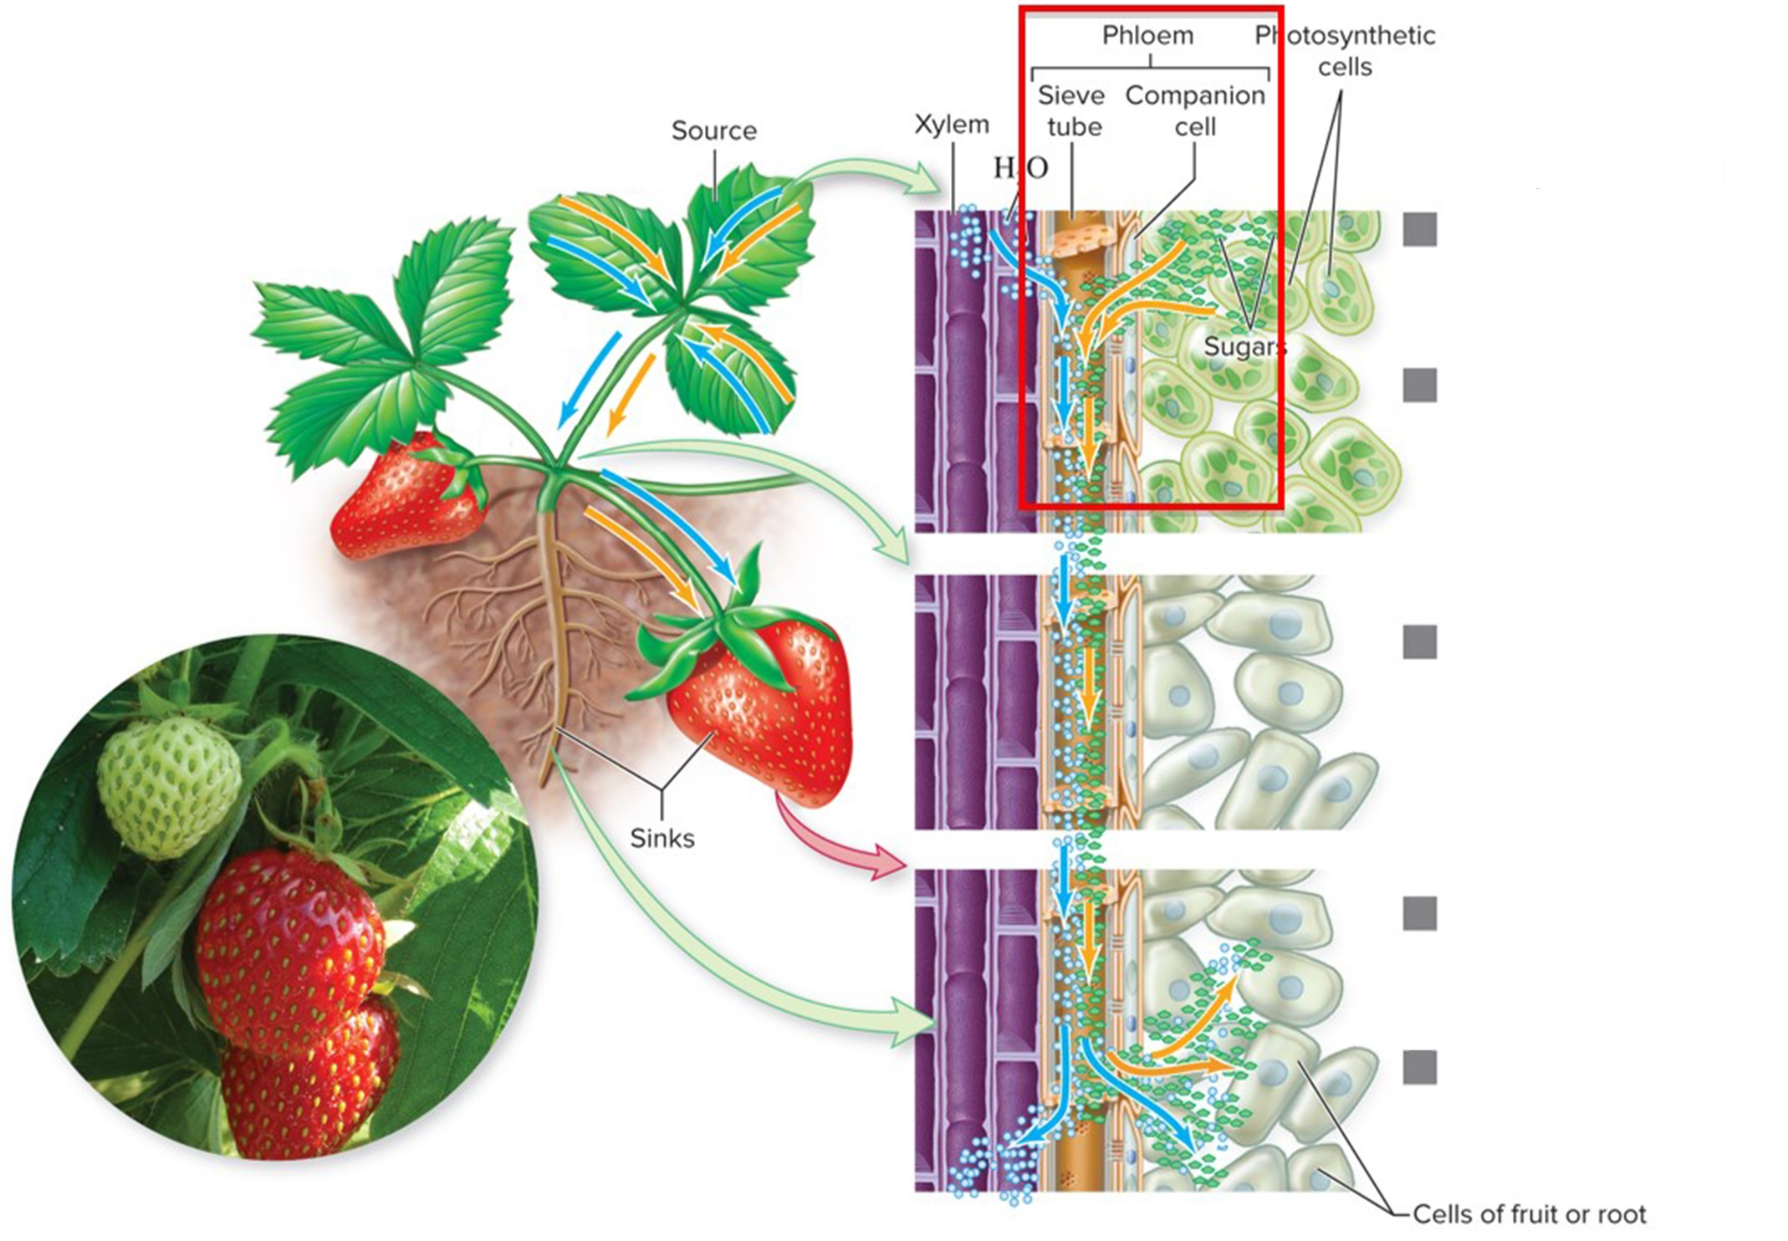
Phloem and sugar transport: pathway of sugar flow
First, sugars are actively transported from photosynthetic cells to companion cells and then into the sieve tube.
Loading at the source
Solutes (sugars produced in photosynthesis) enter a sieve tube by active transport.
Water enters the sieve tube from the xylem by osmosis, increasing pressure in the sieve tube.
Phloem transport in sieve tube
Pressure pushes the solutes toward the sink.
Unloading at the sink
As the sink is reached, solutes are unloaded by facilitated diffusion or active transport into the sink cells.
Water moves out of the pholem to the xylem by osmosis, decreasing pressure in the sieve tube.
Section 23.3
©Ingram Publishing RF
Figure 23.10

Slide 41
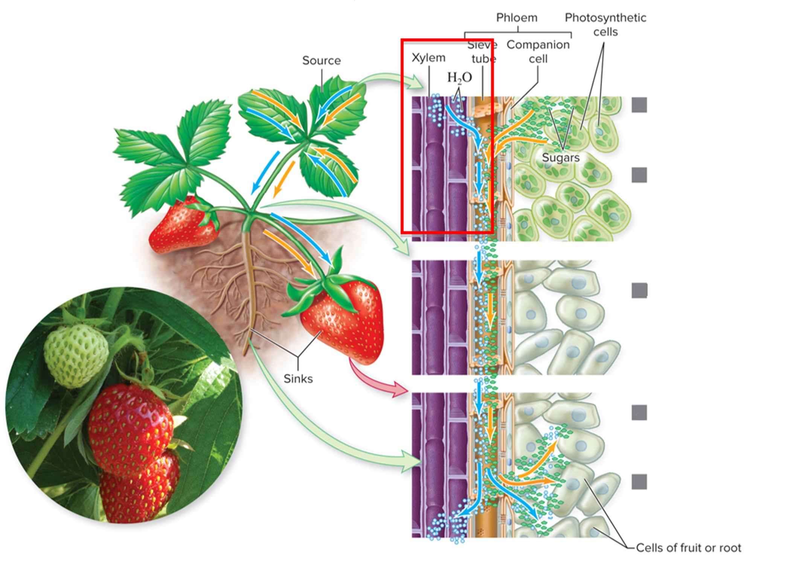
Phloem receives water from the xylem
Then, water moves by osmosis from xylem into the sieve tube, increasing sieve tube pressure.
Loading at the source
Solutes (sugars produced in photosynthesis) enter a sieve tube by active transport.
Water enters the sieve tube from the xylem by osmosis, increasing pressure in the sieve tube.
Phloem transport in sieve tube
Pressure pushes the solutes toward the sink.
Unloading at the sink
As the sink is reached, solutes are unloaded by facilitated diffusion or active transport into the sink cells.
Water moves out of the pholem to the xylem by osmosis, decreasing pressure in the sieve tube.
©Ingram Publishing RF
Section 23.3
Figure 23.10

Slide 42
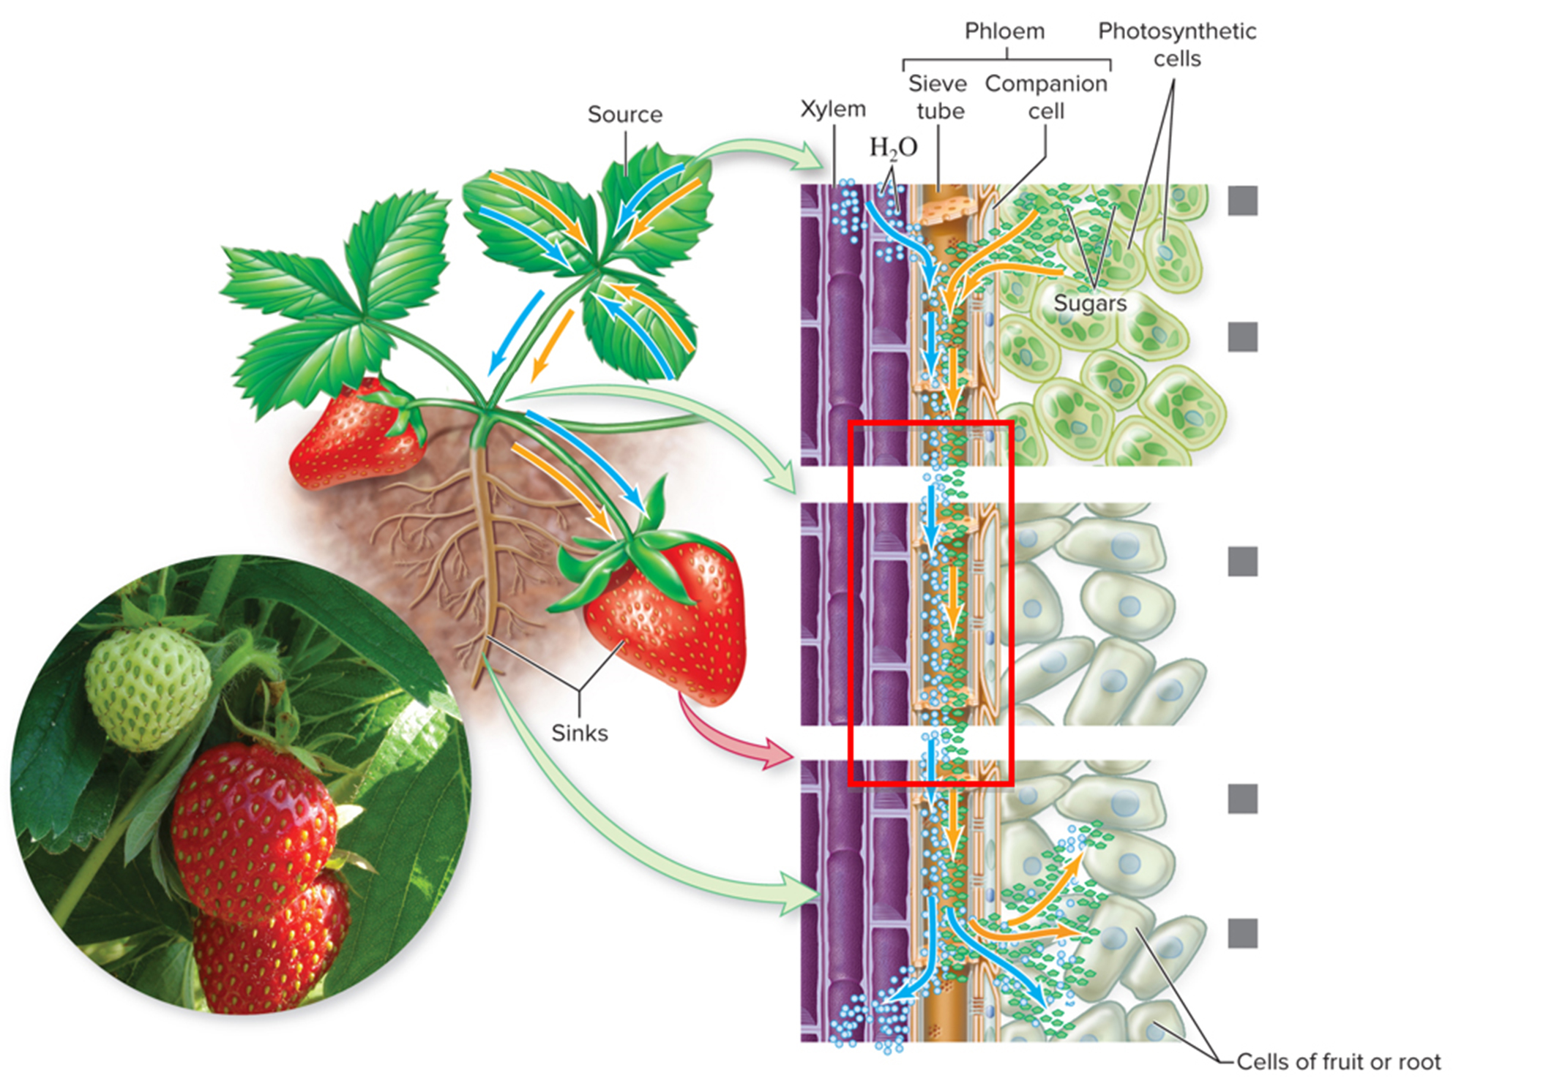
Pressure pushes sugars towards the sink
This pressure pushes the sugars toward the sink.
Loading at the source
Solutes (sugars produced in photosynthesis) enter a sieve tube by active transport.
Water enters the sieve tube from the xylem by osmosis, increasing pressure in the sieve tube.
Phloem transport in sieve tube
Pressure pushes the solutes toward the sink.
Unloading at the sink
As the sink is reached, solutes are unloaded by facilitated diffusion or active transport into the sink cells.
Water moves out of the pholem to the xylem by osmosis, decreasing pressure in the sieve tube.
©Ingram Publishing RF
Section 23.3
Figure 23.10

Slide 43
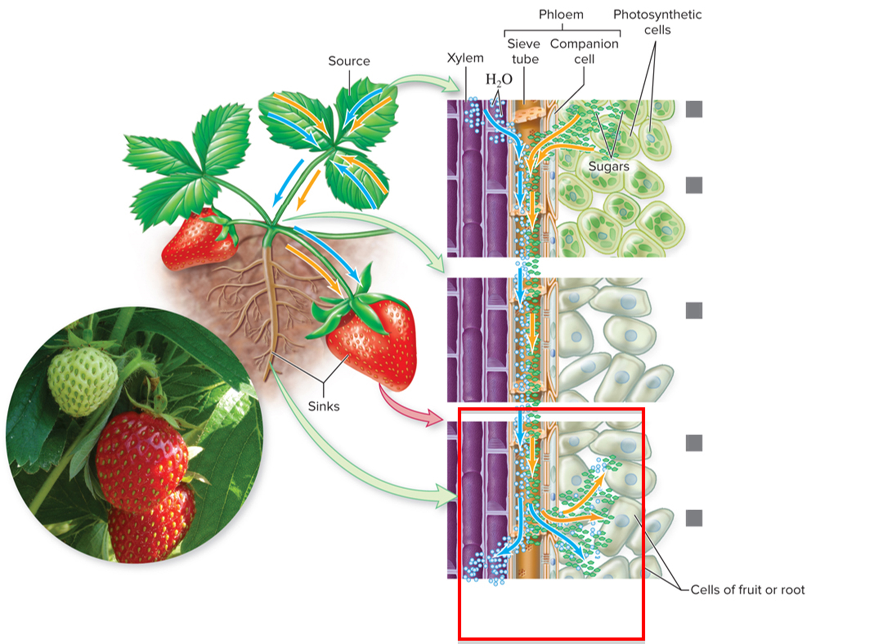
Sugars are deposited in the sink
At the sink, transport proteins move sugars out of the sieve tube. Since the solute concentration in the phloem decreased, water leaves the sieve tube by osmosis.
Loading at the source
Solutes (sugars produced in photosynthesis) enter a sieve tube by active transport.
Water enters the sieve tube from the xylem by osmosis, increasing pressure in the sieve tube.
Phloem transport in sieve tube
Pressure pushes the solutes toward the sink.
Unloading at the sink
As the sink is reached, solutes are unloaded by facilitated diffusion or active transport into the sink cells.
Water moves out of the pholem to the xylem by osmosis, decreasing pressure in the sieve tube.
©Ingram Publishing RF
Section 23.3
Figure 23.10

Slide 44
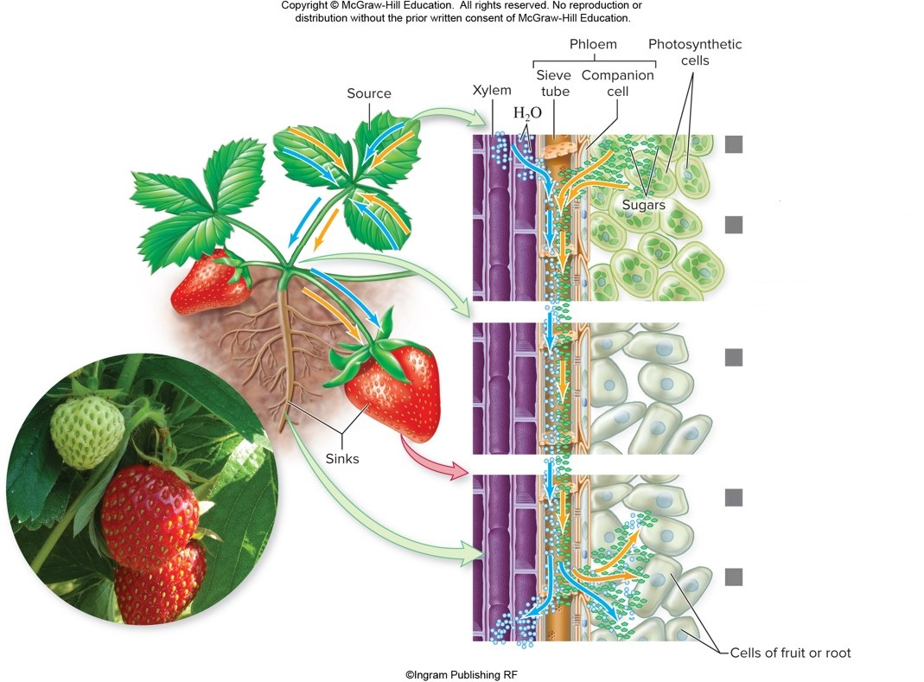
Why fruits are sweet
Transport of sugars from sources to sinks explains how non-photosynthetic cells obtain sugars (and why fruits are often sweet).
Loading at the source
Solutes (sugars produced in photosynthesis) enter a sieve tube by active transport.
Water enters the sieve tube from the xylem by osmosis, increasing pressure in the sieve tube.
Phloem transport in sieve tube
Pressure pushes the solutes toward the sink.
Unloading at the sink
As the sink is reached, solutes are unloaded by facilitated diffusion or active transport into the sink cells.
Water moves out of the pholem to the xylem by osmosis, decreasing pressure in the sieve tube.
©Ingram Publishing RF
Section 23.3
Figure 23.10

Slide 45
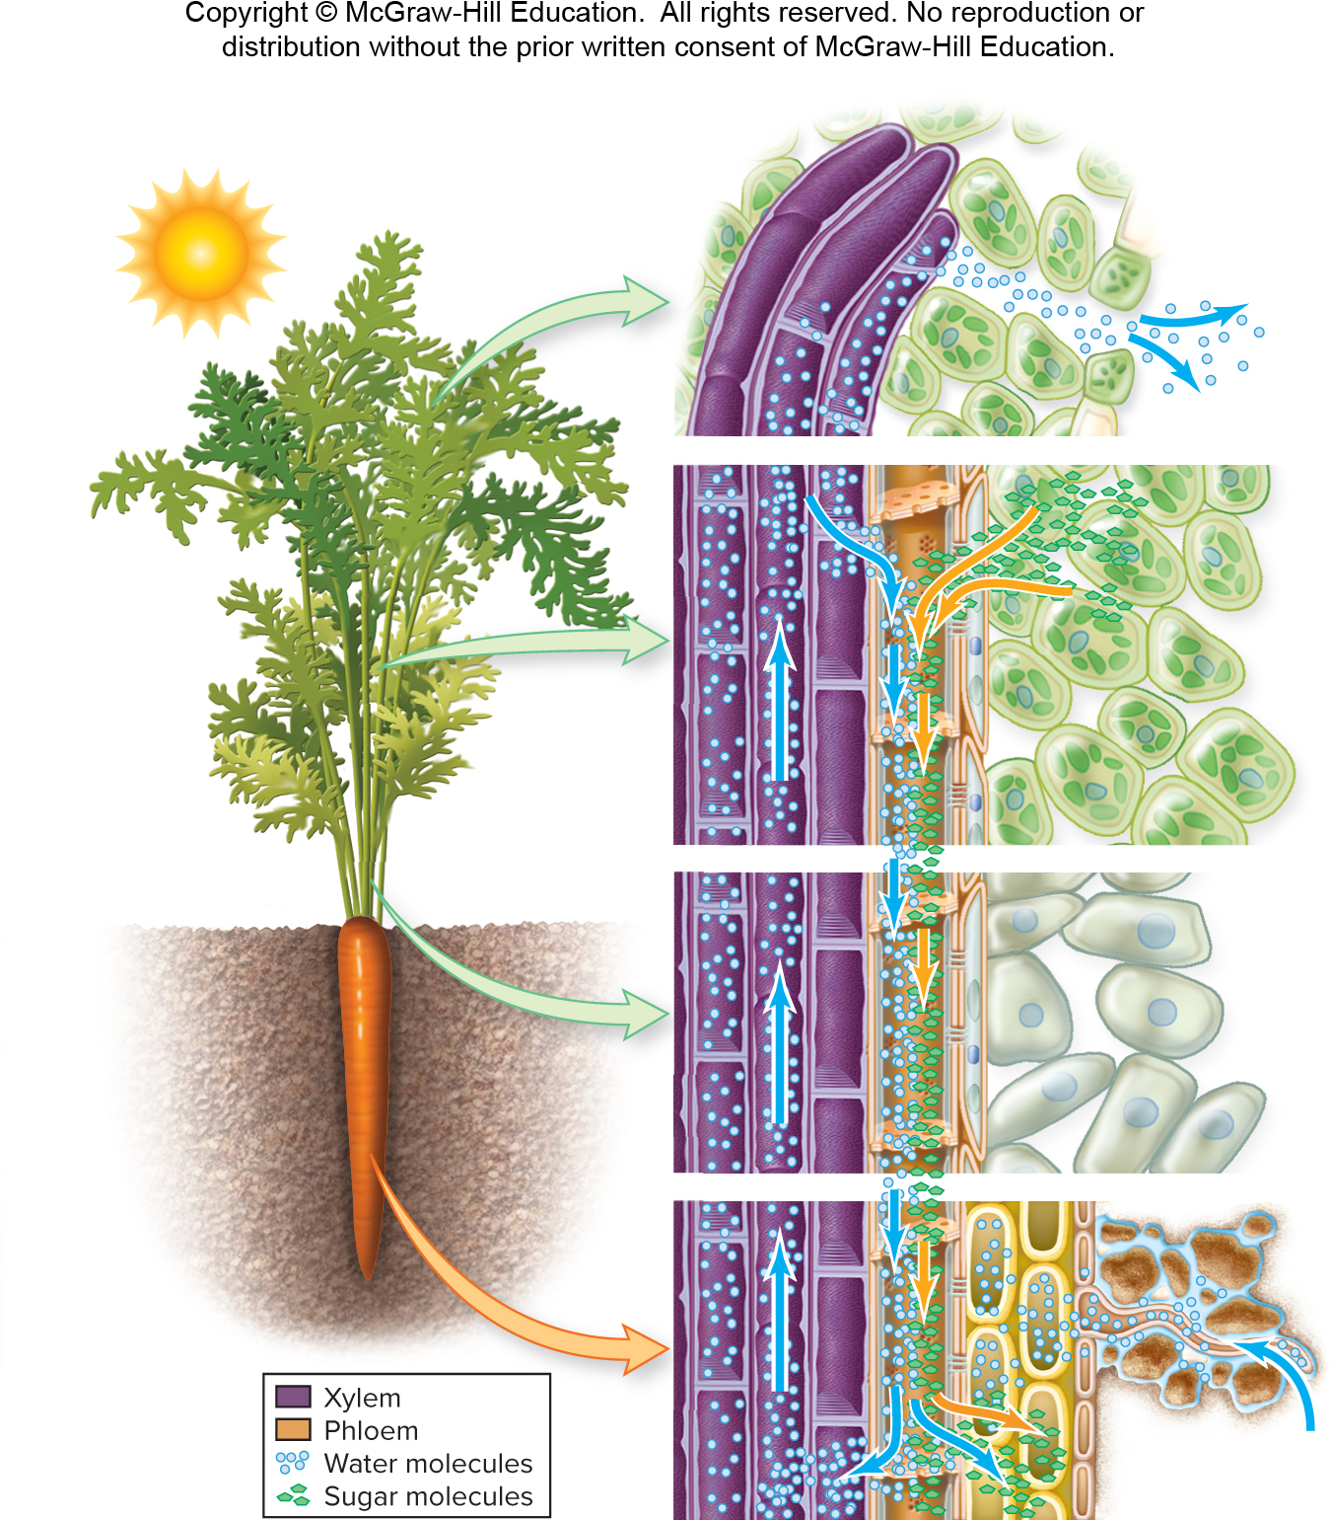
Xylem and phloem
This figure summarizes xylem and phloem transport.
Figure 23.14

Slide 46
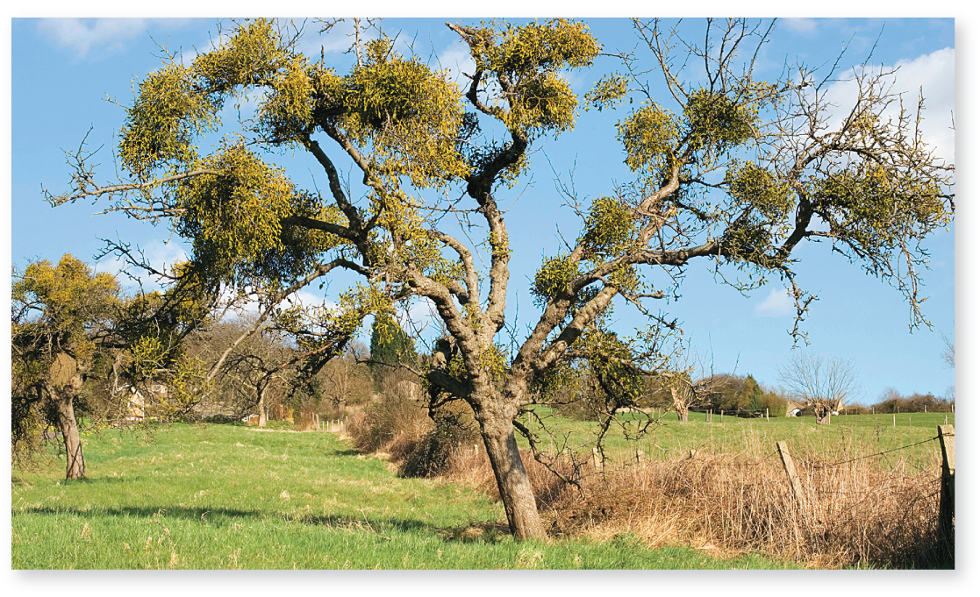
Phloem parasites
Parasitic plants tap into the vascular tissue of other plants. Mistletoe roots push through the epidermis of this tree, connecting to its xylem and phloem.
©Mark Boulton/Alamy
Section 23.4
Figure 23.11

Slide 47
Clicker question #4
Throughout a growing season, a plant uses up to 1,000 liters (or kg) of water to produce just one kilogram of tissue. What happens to most of the remaining 999 kg of water?
It fills the cytoplasm of the plant’s cells.
It is consumed in photosynthesis.
It evaporates.
It passes back through roots into the soil.
It enters the phloem.

Slide 48
Clicker question #4, solution
Throughout a growing season, a plant uses up to 1,000 liters (or kg) of water to produce just one kilogram of tissue. What happens to most of the remaining 999 kg of water?
It evaporates.

Slide 49
Clicker question #5
A potato tuber stores starches for a potato plant. When the rate of photosynthesis is low (that is, during the winter), the plant uses the sugars stored in potato tubers to survive. In the winter, the tuber is mainly
a source of phloem sap.
a sink for phloem sap.
a photosynthetic tissue.

Slide 50
Clicker question #5, solution
A potato tuber stores starches for a potato plant. When the rate of photosynthesis is low (that is, during the winter), the plant uses the sugars stored in potato tubers to survive. In the winter, the tuber is mainly
a source of phloem sap.

Slide 51
23.3 to 23.4 Mastering concepts
Explain the pressure flow theory of phloem transport.
©Matauw/iStock/Getty Images RF

Slide 52
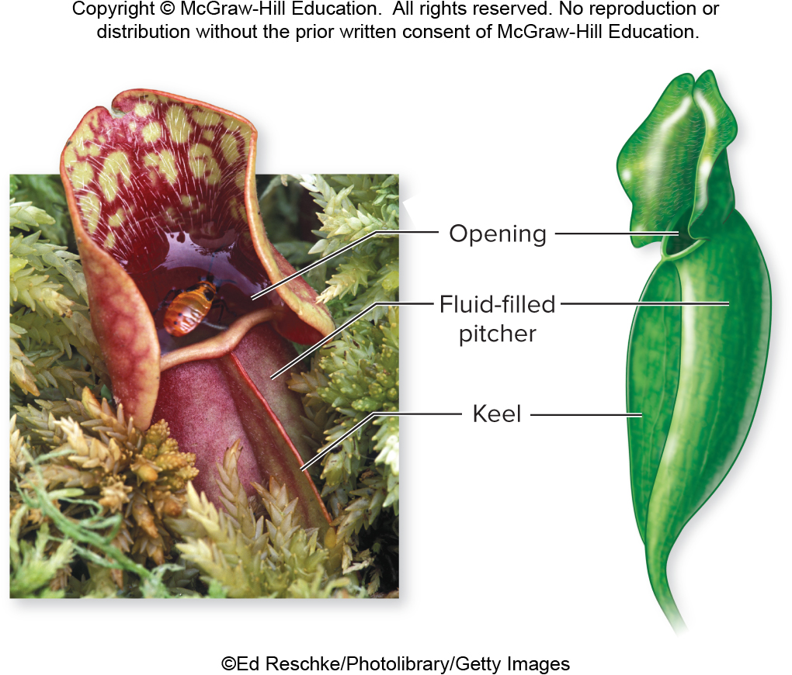
Investigating life: The hidden cost of traps
Carnivorous plants have modified leaves that trap invertebrate prey, which provide nutrients that the soil lacks.
©Ed Reschke/Photolibrary/Getty Images
Section 23.5
Figure 23.12

Slide 53
Investigating life: When are traps advantageous?
But larger traps mean less surface area for photosynthesis. So traps are only advantageous in sunny habitats with nutrient-poor soils.
©Ed Reschke/Photolibrary/Getty Images
Section 23.5
Figure 23.12

Slide 54
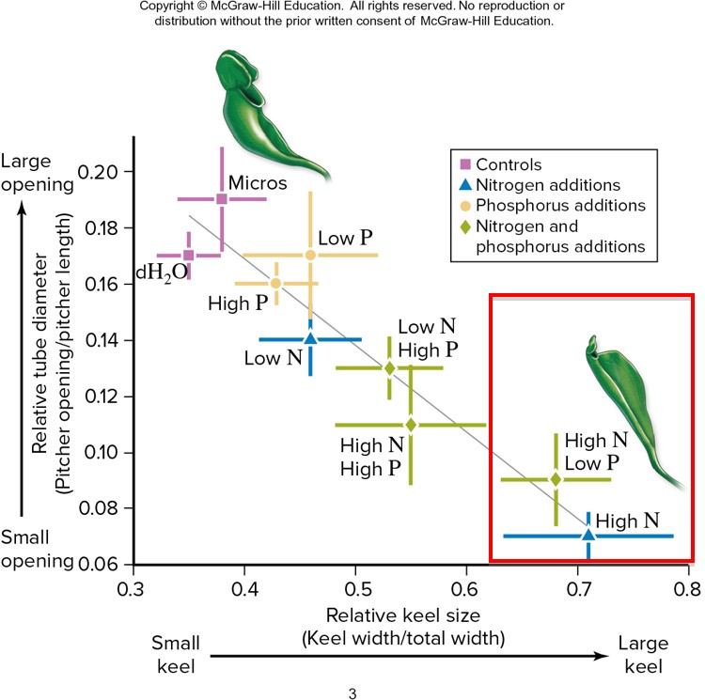
Investigating life: Analyzing the data
In nutrient-rich soils, pitcher plants invest more energy in producing photosynthetic tissue (called keels) and less energy producing traps.
Section 23.5
Figure 23.13

