Slide 1
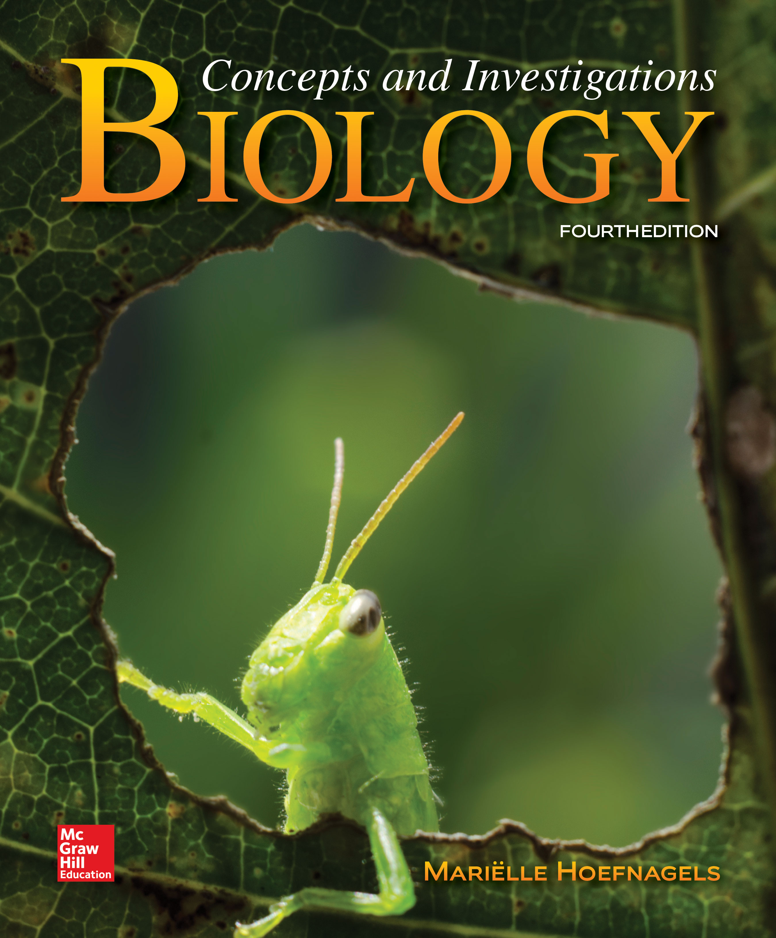
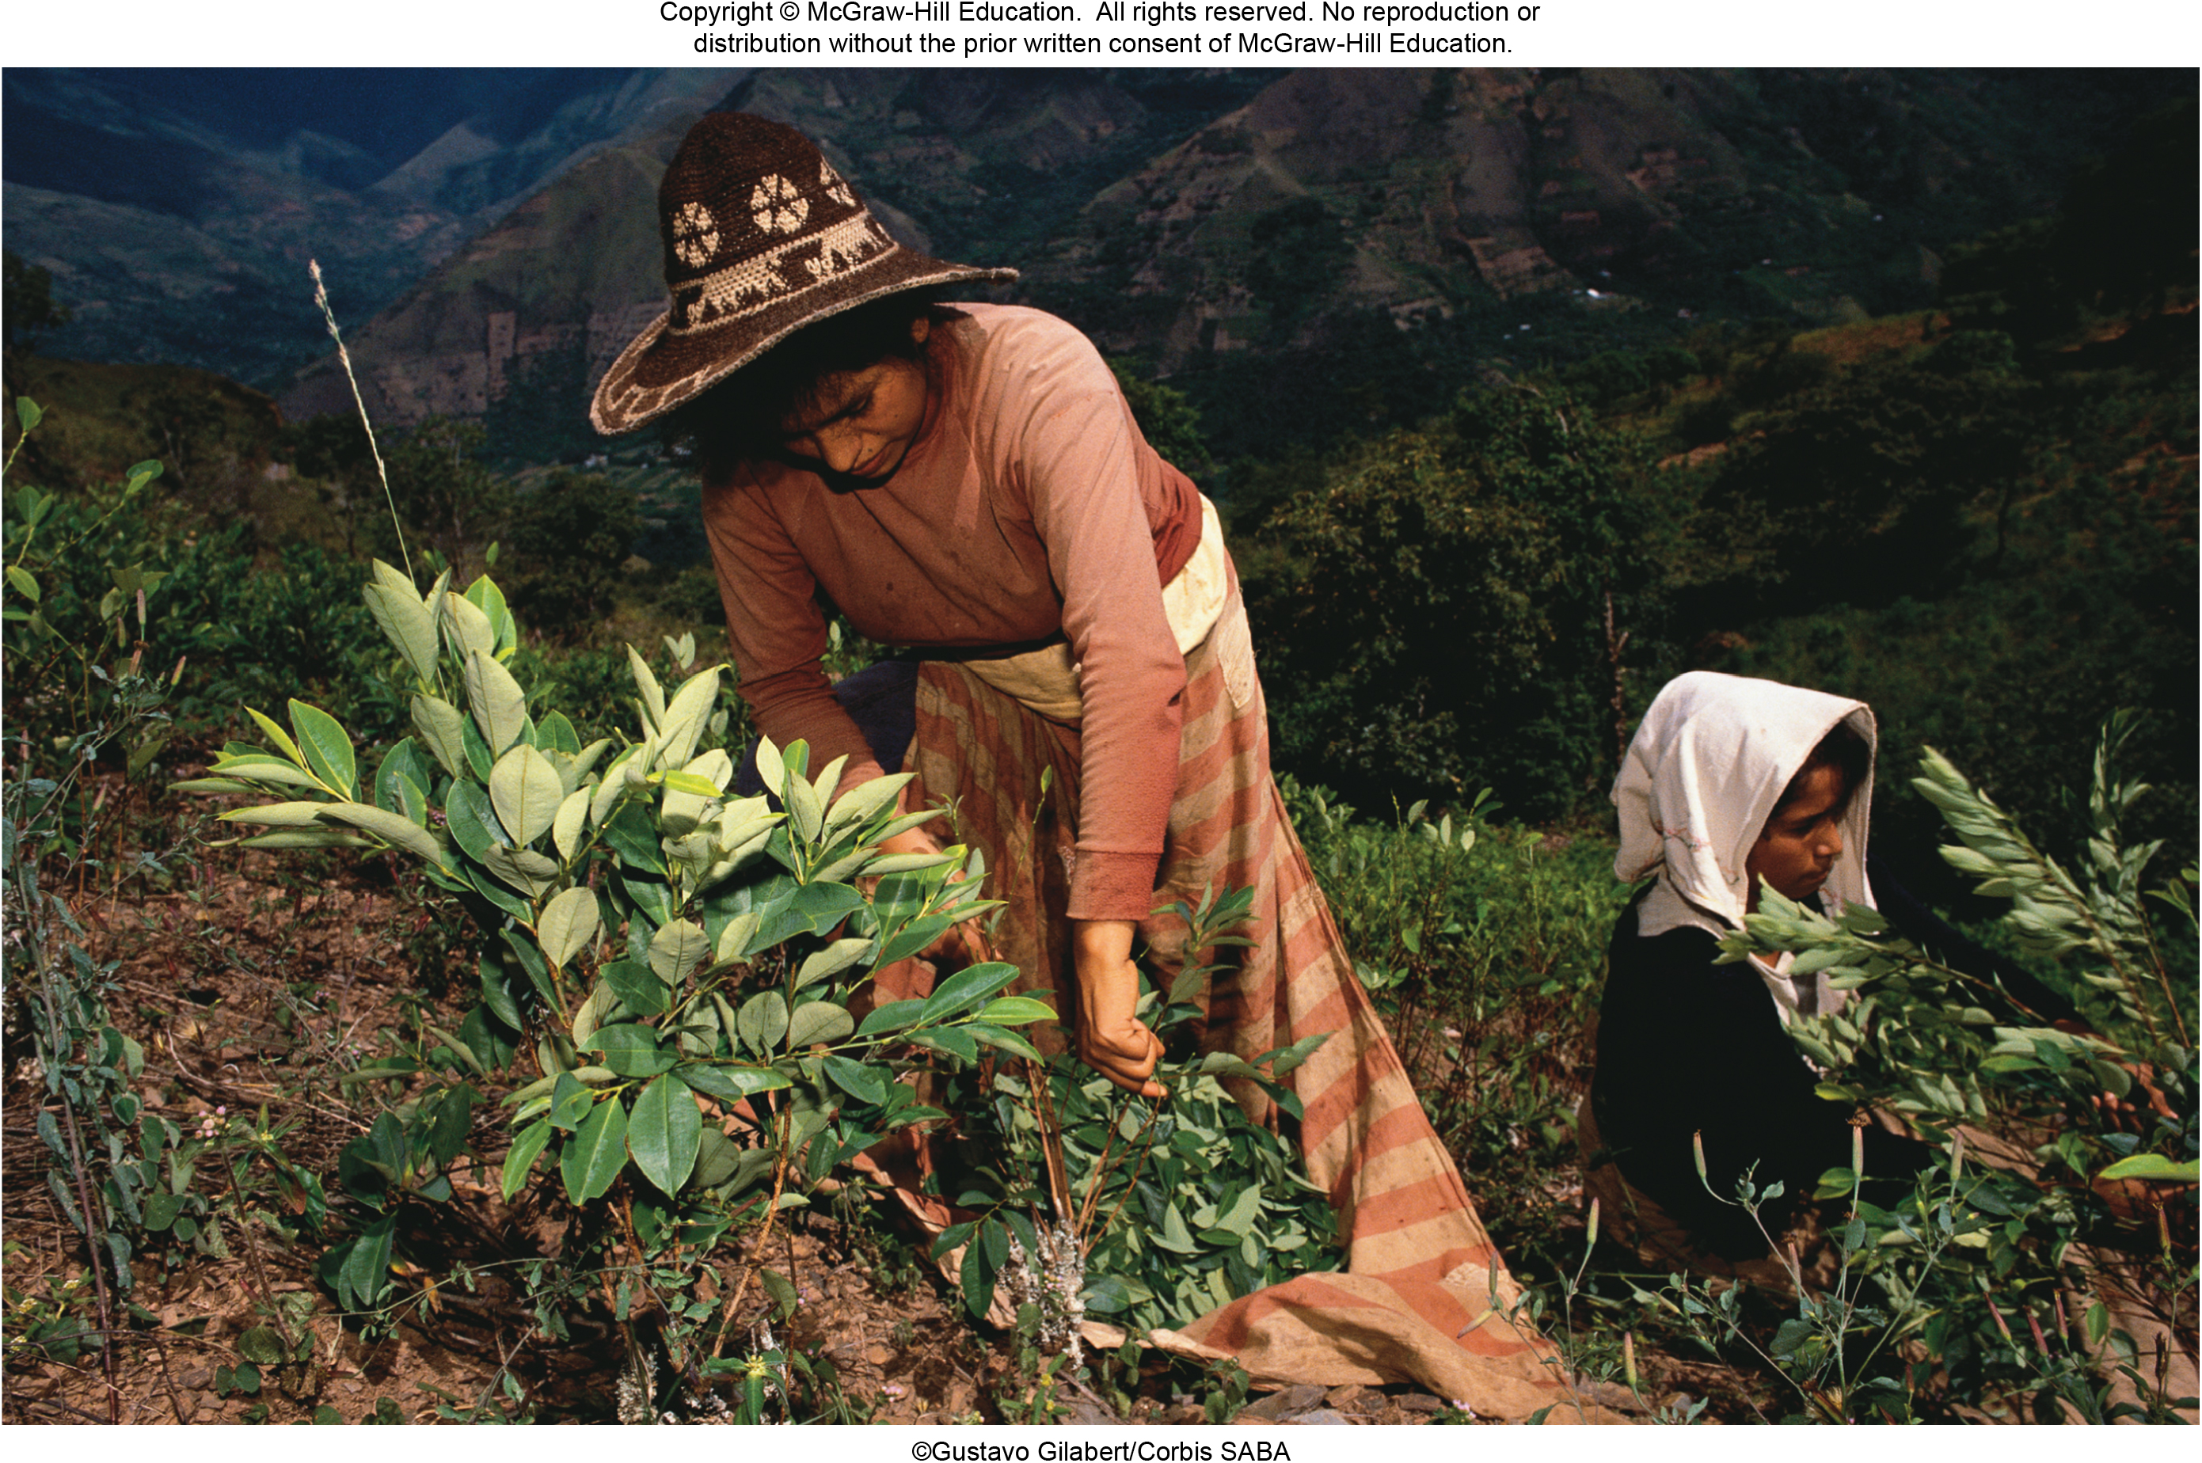
Chapter 22
Plant Form and Function
©Gustavo Gilabert/Corbis SABA
©McGraw-Hill Education. All rights reserved. Authorized only for instructor use in the classroom. No reproduction or further distribution permitted without the prior written consent of McGraw-Hill Education.

Slide 2
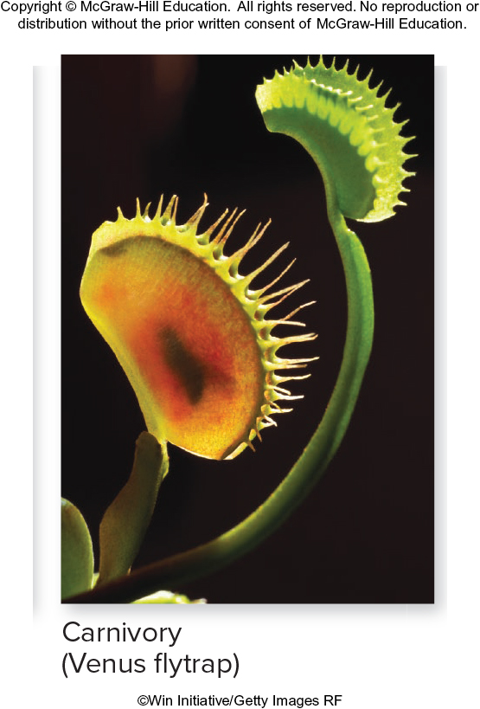
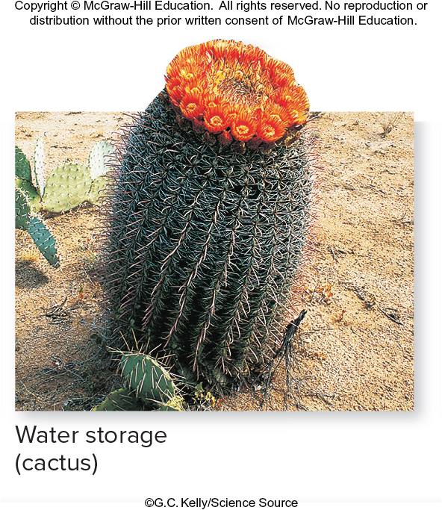
Introduction: vegetative plant parts
If asked to picture a plant, you probably wouldn’t think of unusual examples like a Venus flytrap or a barrel cactus.
Carnivory (Venus flytrap)
Water storage (cactus)
©Win Initiative/Getty Images RF
©G.C. Kelly/Science Source
Section 22.1
Figure 22.3

Slide 3
Vegetative plant parts
But like other flowering plants, these have roots, stems, leaves, flowers, fruits, and seeds.
Carnivory (Venus flytrap)
Water storage (cactus)
©Win Initiative/Getty Images RF
©G.C. Kelly/Science Source
Section 22.1
Figure 22.3

Slide 4
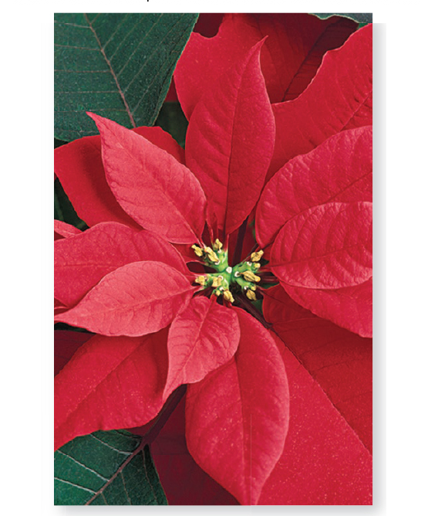
Vegetative plant parts: modified leaves
Harsh environments have selected for adaptions in these plants, such as modified leaves.
Modified leaves
Pollinator attraction (poinsettia)
Carnivory (Venus flytrap)
©Design Pics/Don Hammond RF
©Win Initiative/Getty Images RF
Section 22.1
Figure 22.3

Slide 5
Vegetative plant parts = nonreproductive plant parts
This chapter explores the anatomy and physiology of vegetative (nonreproductive) plant parts.
Water storage (cactus)
Carnivory (Venus flytrap)
©Win Initiative/Getty Images RF
©G.C.Kelly/Science Source
Section 22.1
Figure 22.3

Slide 6
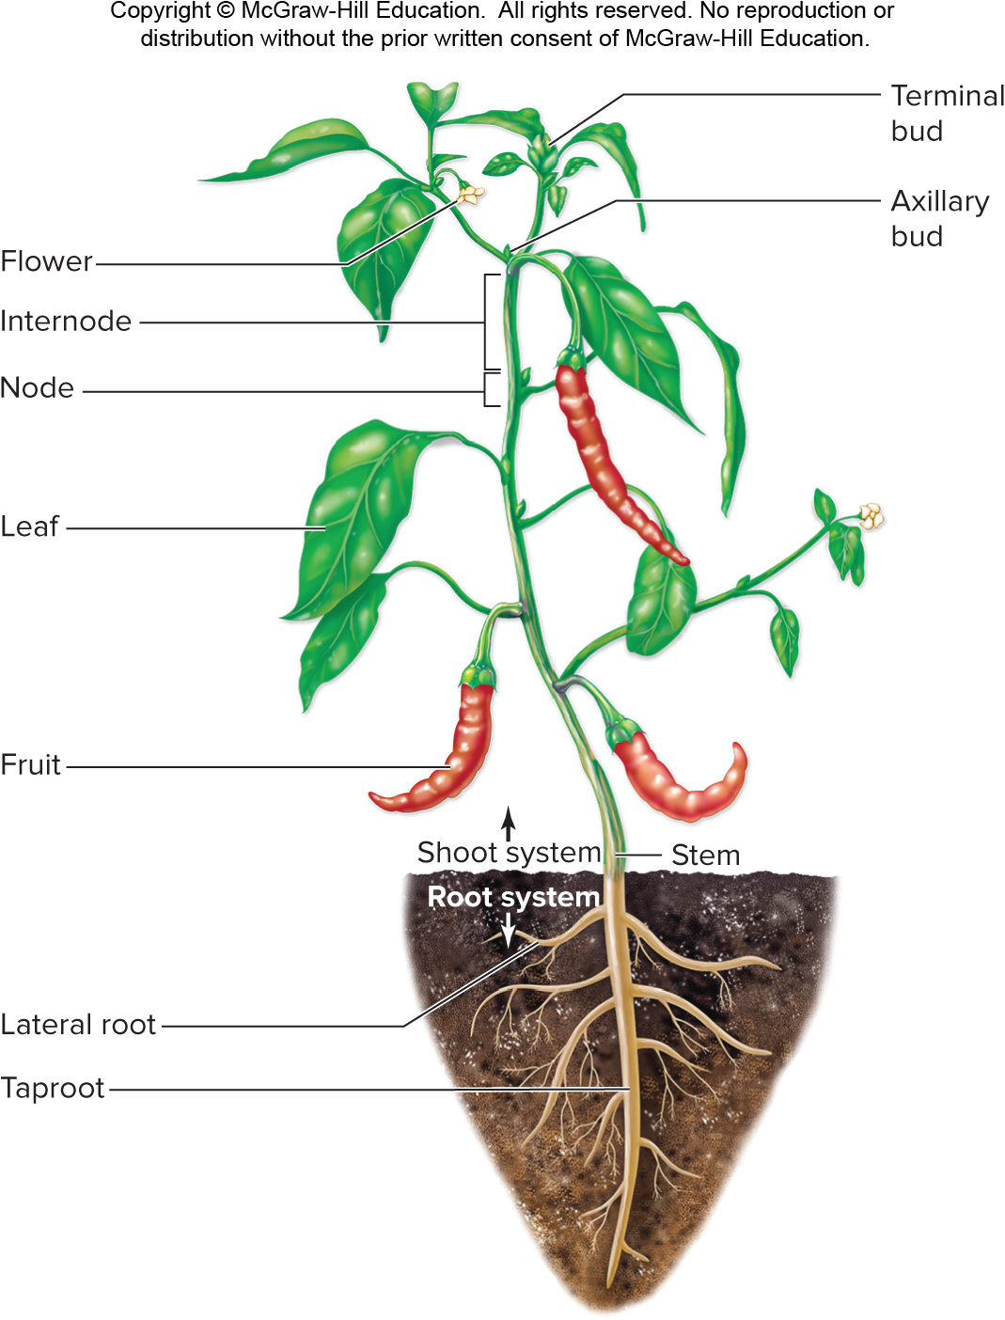
Naming the vegetative plant parts
Vegetative plant parts include stems, leaves, and roots. These organs work together.
Section 22.1
Figure 22.1

Slide 7
Vegetative plant parts: the shoot
The shoot is the aboveground part of the plant.
Section 22.1
Figure 22.1

Slide 8
Vegetative plant parts: the stem
The shoot’s stem supports the leaves, which produce carbohydrates by photosynthesis.
Section 22.1
Figure 22.1

Slide 9
Vegetative plant parts: the roots
Some of the sugar produced in the shoot system travels through the stem to the roots, which are usually below ground.
Section 22.1
Figure 22.1

Slide 10
Vegetative plant parts: functions of roots
Roots anchor the plant and absorb water and minerals that move via the stem to the leaves.
Later, we will explore how water, minerals, and sugars travel through plants.
Section 22.1
Figure 22.1

Slide 11
Vegetative plant parts: nodes and internodes
Leaves attach to stems at nodes. Spaces between nodes are internodes.
Section 22.1
Figure 22.1

Slide 12
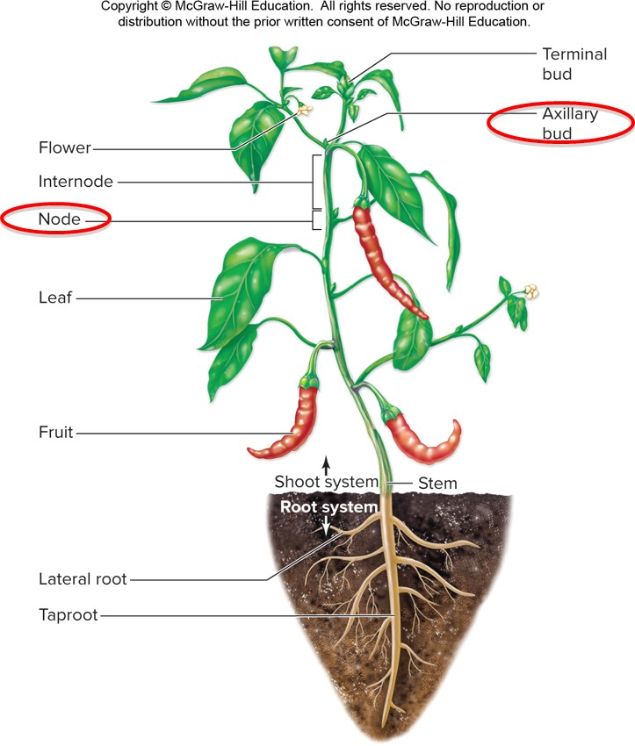
Vegetative plant parts: axillary buds
Each node also features an axillary bud, an undeveloped shoot that could form
a new branch or flower.
Section 22.1
Figure 22.1

Slide 13
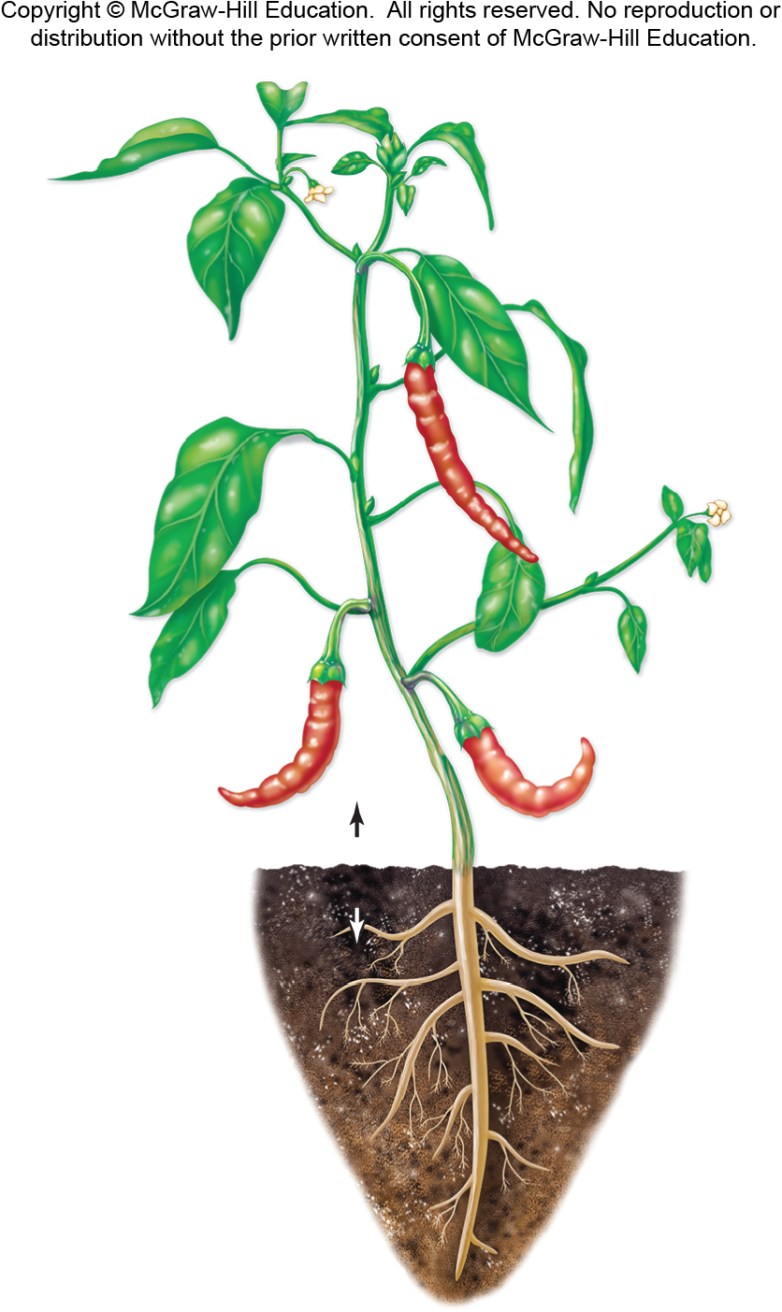
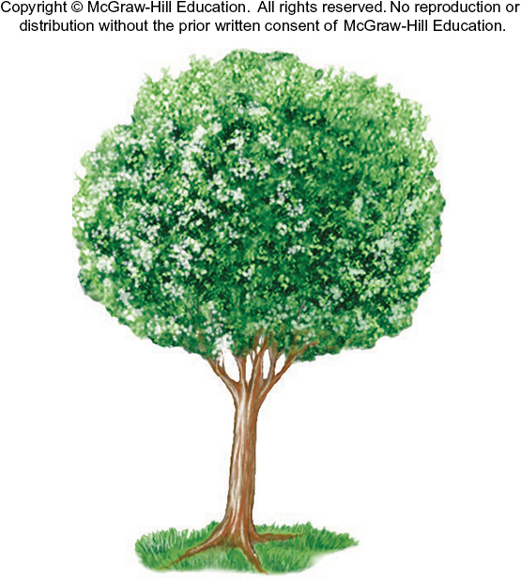
Two types of plants
Biologists divide plants into two categories based on the characteristics of the stem.
Section 22.1
Figures 22.1, 24.4

Slide 14
Herbaceous and woody plants
A herbaceous plant has a green, soft stem.
A woody plant is made of tough, bark-covered wood.
Section 22.1
Figures 22.1, 24.4

Slide 15
Vegetative plant parts: specialized stems
Natural selection produces stems, leaves, and roots with various forms.
Specialized stems
Climbing (grape tendrils)
Underground nutrient storage (iris rhizomes)
Water storage (cactus)
Defense
(honey locust thorns)
(a, vine): ©Franz Krenn/Science Source; (a, iris): ©Dwight Kuhn; (a, cactus): ©G.C. Kelly/Science Source; (a, thorns): ©Kenneth W. Fink/Science Source
Section 22.1
Figure 22.3

Slide 16
Vegetative plant parts: specialized leaves
Natural selection produces stems, leaves, and roots with various forms.
Specialized leaves
Nutrient storage (onion)
Pollinator attraction (poinsettia)
Carnivory (Venus flytrap)
Asexual reproduction (kalanchöe)
(b, onion): ©YAY Media AS/Alamy RF; (b, poinsettia): ©Design Pics/Don Hammond RF; (b, flytrap): ©Win Initiative/Getty Images RF; (b, kalanchoe)
Section 22.1
Figure 22.3

Slide 17
Vegetative plant parts: specialized roots
Natural selection produces stems, leaves, and roots with various forms.
Specialized roots
Nutrient storage (carrot)
Oxygen absorption (mangrove trees)
Photosynthesis (orchid aerial roots)
Support
(prop roots of screw pine)
(c, carrots): ©Huw Jones/Photolibrary/Getty Images; (c, mangrove): ©Tim Laman/Getty Images RF; (c, orchid): ©Settawut Visedbubpha/123R; (c, screw pine): ©Steven P. Lynch/McGraw-Hill Education
Section 22.1
Figure 22.3

Slide 18
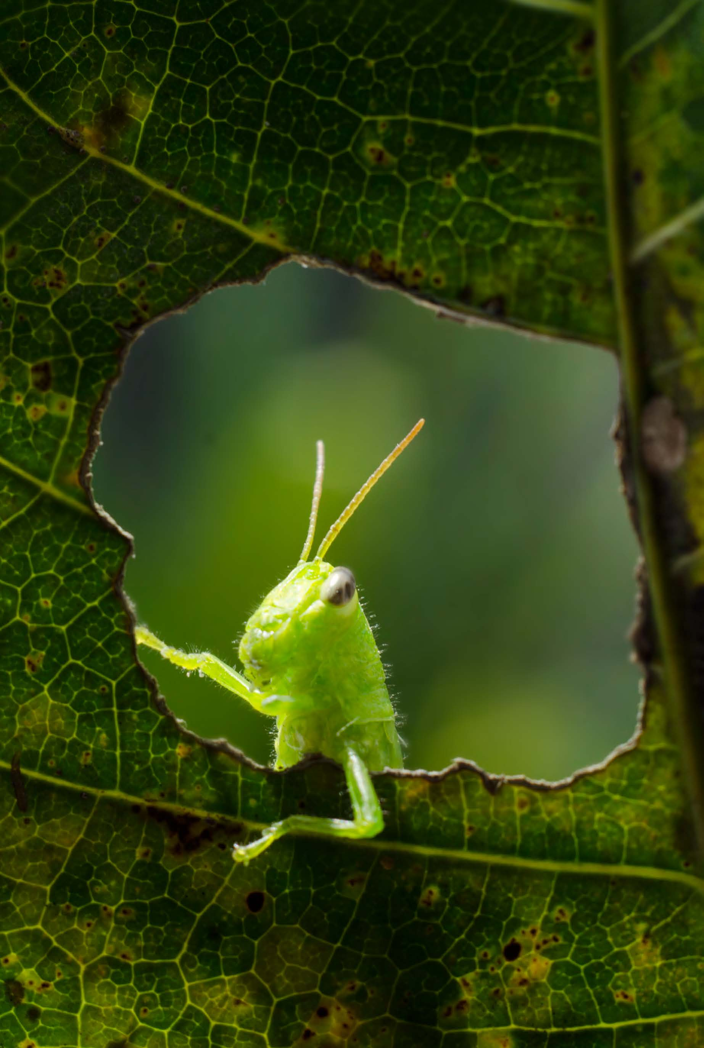
Clicker question #1
Roots depend on shoots because shoots ____, which is transported to the roots.
absorb water
absorb $O_{2}$
produce sugar
release ${CO}_{2}$
All of the choices are correct.

Slide 19
Clicker question #1, solution
Roots depend on shoots because shoots ____, which is transported to the roots.
produce sugar

Slide 20
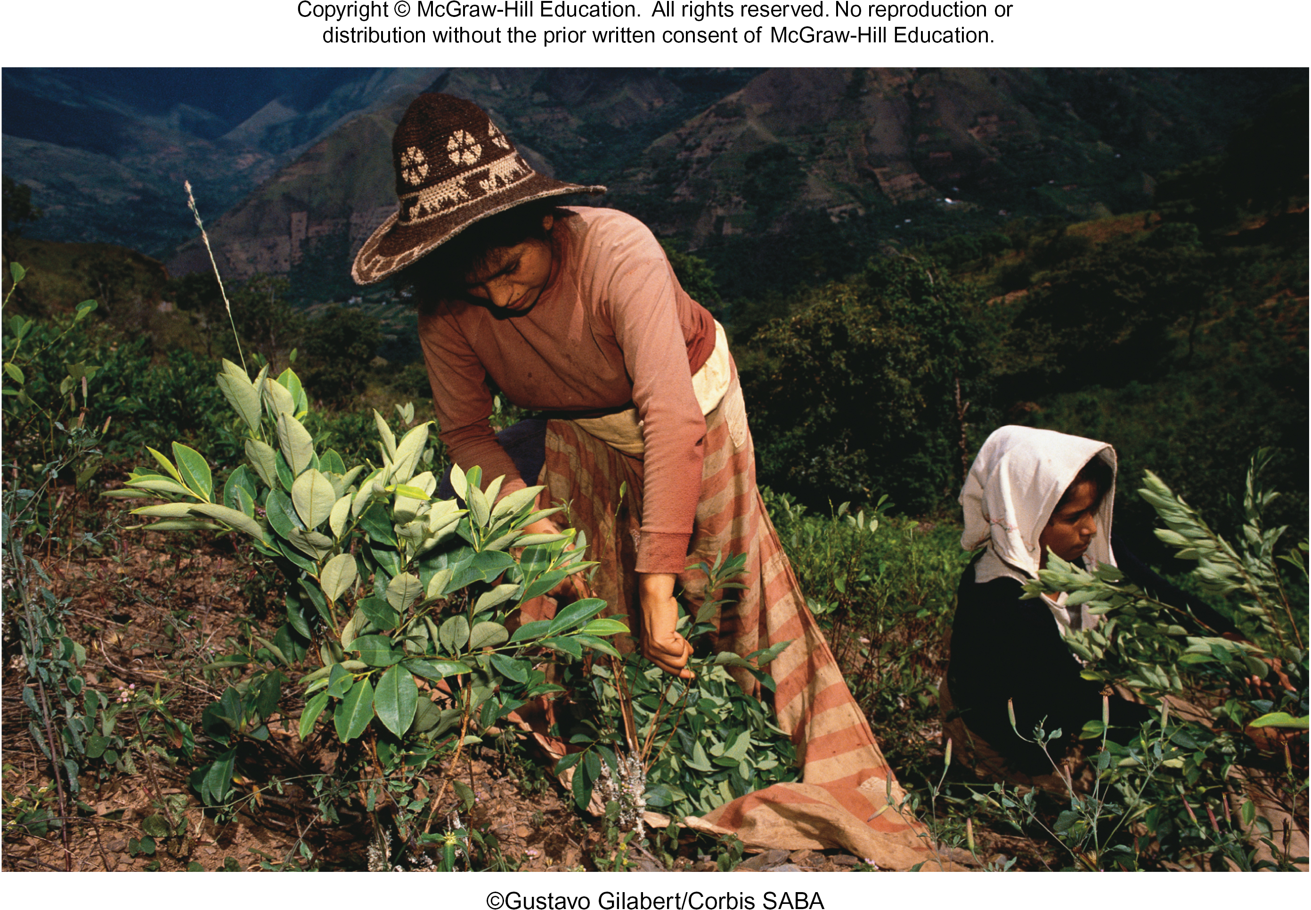
22.1 Mastering concepts
What are the major parts of the plant body?
©Gustavo Gilabert/Corbis SABA

Slide 21
Plant cells build tissues
We’ve seen the organs and organ systems of plants. Now let’s zoom in and learn about the cells and tissues that make up these organs.
Section 22.3
Figure 22.1

Slide 22
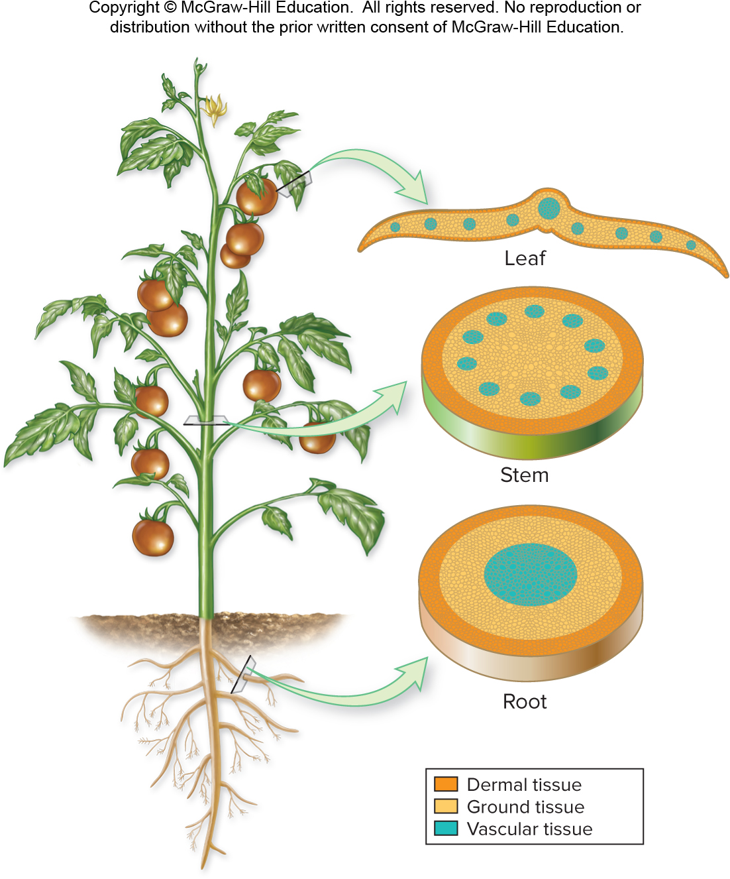
Three main tissue types
Plants have three main tissue types:
Ground tissue makes up most of the plant body.
Vascular tissues (xylem and phloem) transport materials within the plant.
Dermal tissue covers the plant.
Section 22.2
Figure 22.6

Slide 23
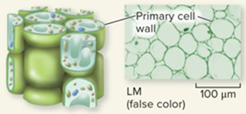
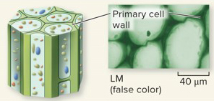
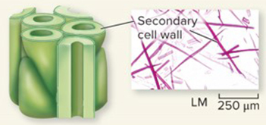
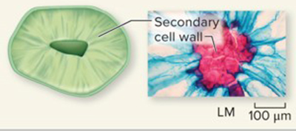
Ground tissue
Cell Type
Description
Alive at Maturity
Functions
Parenchyma
Most abundant cell type in primary plant body
Thin primary cell walls
Unspecialized
Can divide at maturity
Yes
Make up most nonwoody tissues; carry out photosynthesis, respiration, gas exchange, secretion, wound repair, and storage
Ground tissue consists of three main cell types: parenchyma, collenchyma, and sclerenchyma.
Collenchyma
Elongated cells
Unevenly thickened primary cell walls
Yes
Elastic support for growing stems and leaves
Sclerenchyma:
Fiber
Long, slender cells
Thick secondary cell walls high in lignin
No
Inelastic support for nongrowing plant parts
Sclerenchyma:
Sclereid
Variable shapes, generally not elongated
Thick secondary cell walls high in lignin
No
Inelastic support for nongrowing plant parts
(parenchyma): ©Malcolm Park microimages/Alamy; (collenchyma): ©Biophoto Associates/Science Source; (fibers): ©Steven P. Lynch/McGraw-Hill Education; (sclereid): ©Garry Delong/Oxford Scientific/Getty Images
Section 22.2
Figure 22.4

Slide 24
Functions of ground tissue
Cell Type
Description
Alive at Maturity
Functions
Parenchyma
Most abundant cell type in primary plant body
Thin primary cell walls
Unspecialized
Can divide at maturity
Yes
Make up most nonwoody tissues; carry out photosynthesis, respiration, gas exchange, secretion, wound repair, and storage
The cells that compose ground tissue are important sites of photosynthesis, respiration, storage, and support.
Collenchyma
Elongated cells
Unevenly thickened primary cell walls
Yes
Elastic support for growing stems and leaves
Sclerenchyma:
Fiber
Long, slender cells
Thick secondary cell walls high in lignin
No
Inelastic support for nongrowing plant parts
Sclerenchyma:
Sclereid
Variable shapes, generally not elongated
Thick secondary cell walls high in lignin
No
Inelastic support for nongrowing plant parts
(parenchyma): ©Malcolm Park microimages/Alamy; (collenchyma): ©Biophoto Associates/Science Source; (fibers): ©Steven P. Lynch/McGraw-Hill Education; (sclereid): ©Garry Delong/Oxford Scientific/Getty Images
Section 22.2
Figure 22.4

Slide 25
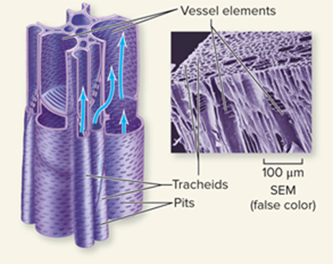
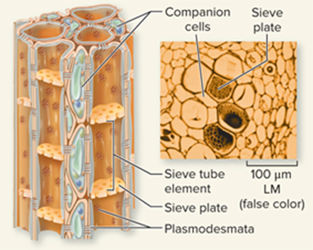
Vascular tissue
Cell Type
Functions
XYLEM
Tracheid
Conduct water and minerals through pits
Vascular tissues transport water, minerals, carbohydrates, and other dissolved compounds.
Vessel element
Conduct water and minerals through pits and perforated end walls
PHLOEM
Sieve tube element
Conduct dissolved sucrose and other organic compounds through sieve plates
Companion cell
Transfer materials into and out of
sieve tube elements
©Biophoto Associates/Science Source
Section 22.2
Figure 22.5

Slide 26
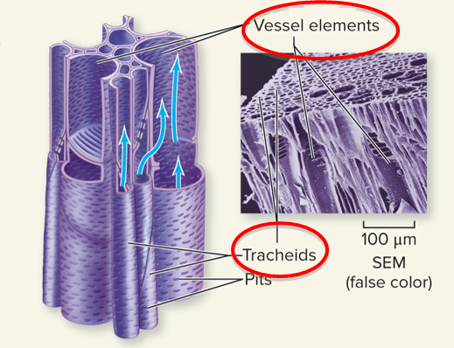
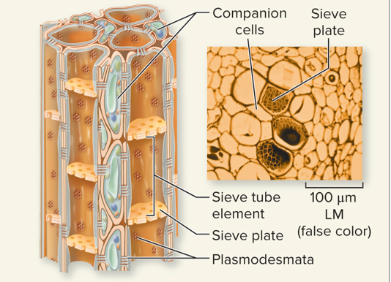
Vascular tissue: xylem
Cell Type
Functions
XYLEM
Tracheid
Conduct water and minerals through pits
Xylem tissue transports water and minerals from the roots to other plant parts. It consists of long, narrow cells called tracheids and wide, barrel-shaped cells called vessel elements.
Vessel element
Conduct water and minerals through pits and perforated end walls
PHLOEM
Sieve tube element
Conduct dissolved sucrose and other organic compounds through sieve plates
Companion cell
Transfer materials into and out of
sieve tube elements
©Biophoto Associates/Science Source
Section 22.2
Figure 22.5

Slide 27
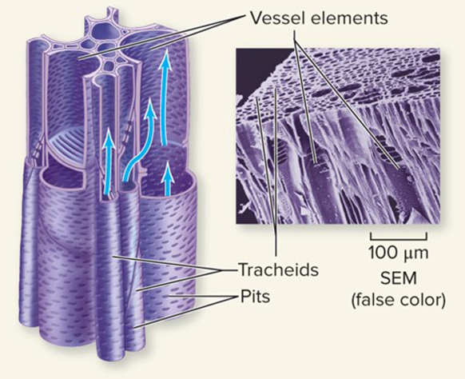
Vascular tissue: phloem
Cell Type
Functions
XYLEM
Tracheid
Conduct water and minerals through pits
Phloem tissue transports dissolved organic compounds like sugars. Sieve tube elements are the conducting cells; they are separated by sieve plates.
Vessel element
Conduct water and minerals through pits and perforated end walls
PHLOEM
Sieve tube element
Conduct dissolved sucrose and other organic compounds through sieve plates
Companion cell
Transfer materials into and out of
sieve tube elements
©Biophoto Associates/Science Source
Section 22.2
Figure 22.5

Slide 28
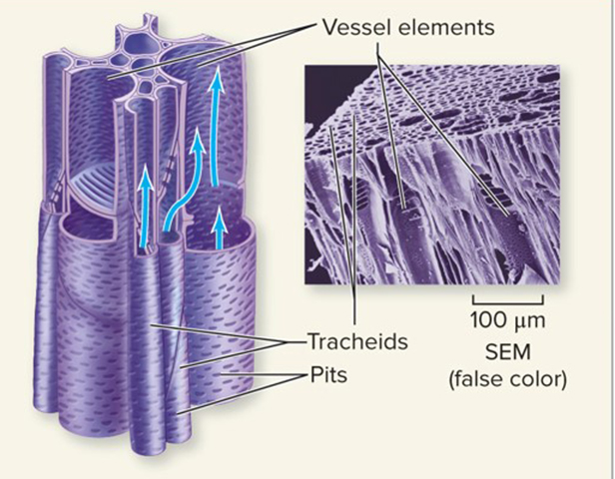
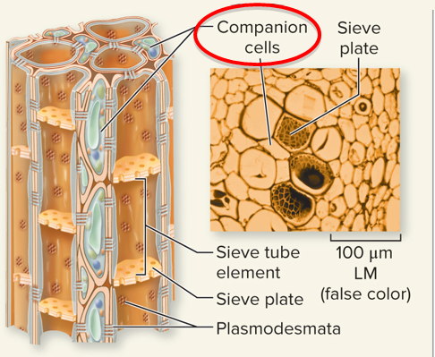
Vascular tissue: phloem cells
Cell Type
Functions
XYLEM
Tracheid
Conduct water and minerals through pits
Companion cells transfer materials in and out of sieve tubes.
Vessel element
Conduct water and minerals through pits and perforated end walls
PHLOEM
Sieve tube element
Conduct dissolved sucrose and other organic compounds through sieve plates
Companion cell
Transfer materials into and out of
sieve tube elements
©Biophoto Associates/Science Source
Section 22.2
Figure 22.5

Slide 29
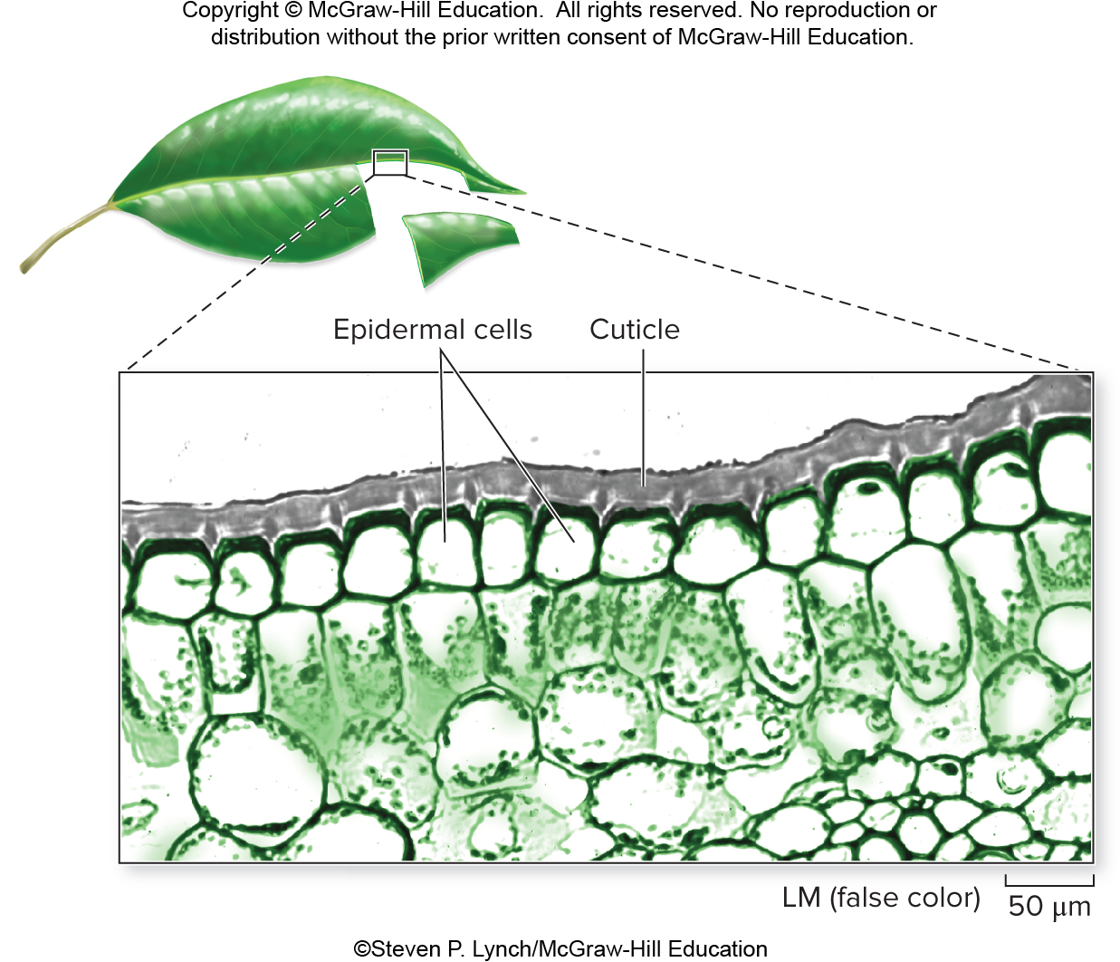
Dermal tissues
Dermal tissue covers the plant; it consists of the epidermis, which is coated with a waxy cuticle.
©Steven P. Lynch/McGraw-Hill Education
Section 22.2
Figure 22.7

Slide 30
Cuticle and stomata
The cuticle conserves water and protects the plant. Pores in the cuticle, called stomata, allow leaves to exchange gases with the atmosphere.
©Steven P. Lynch/McGraw-Hill Education
Section 22.2
Figure 22.7

Slide 31
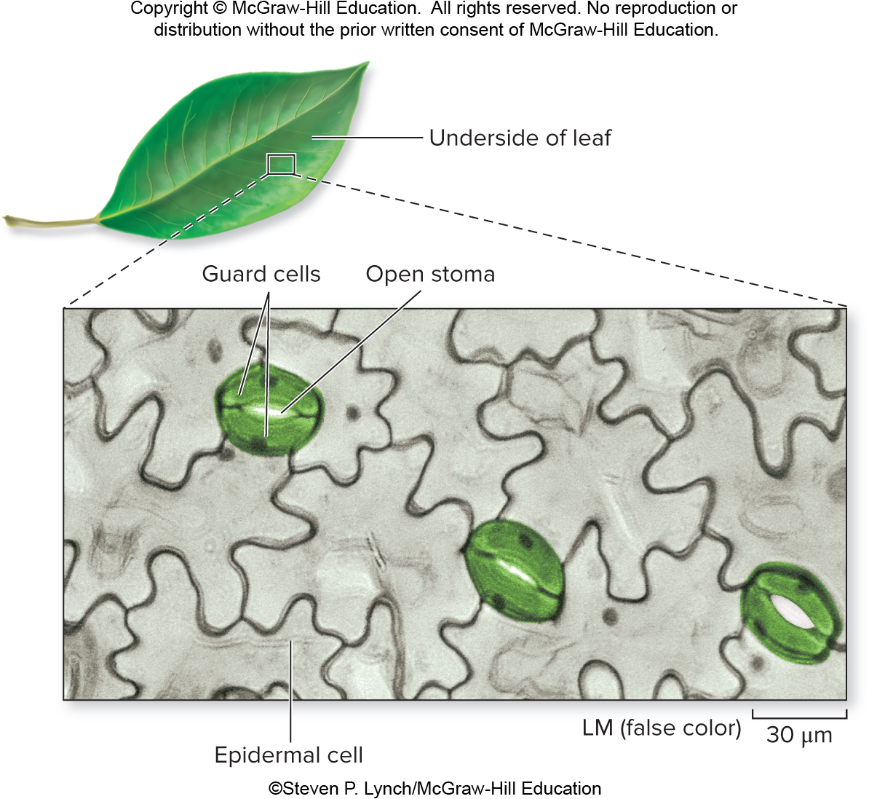
Guard cells
Guard cells surround each stoma and control its opening and closing.
©Steven P. Lynch/McGraw-Hill Education
Section 22.2
Figure 22.8

Slide 32
Clicker question #2
If you cut a stalk of celery and put the bottom of it in a glass of water containing red food coloring, the next morning the celery will be red. The food coloring is taken up through the
phloem.
stomata.
xylem.
epidermis.
ground tissue.

Slide 33
Clicker question #2, solution
If you cut a stalk of celery and put the bottom of it in a glass of water containing red food coloring, the next morning the celery will be red. The food coloring is taken up through the
xylem.

Slide 34
22.2 Mastering concepts
What are the functions of dermal tissue and vascular tissue?
©Gustavo Gilabert/Corbis SABA

Slide 35
Tissues build stems, leaves, and roots
The three tissue types make up the stems, leaves, and roots of the plant.
Let’s look at each of these organs, starting with the stem.
Section 22.3
Figure 22.6

Slide 36
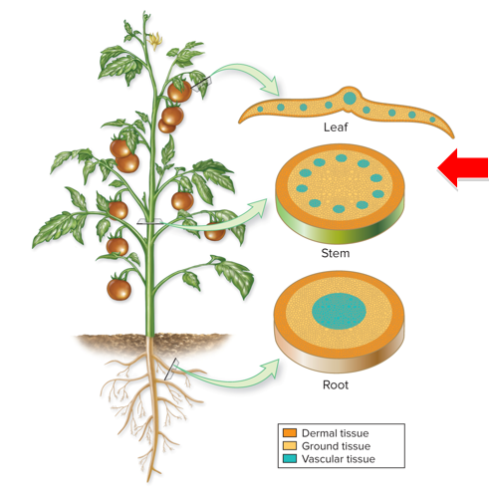
Tissue types found in a stem
Ground tissue occupies most of the stem of a herbaceous plant.
Vascular bundles are embedded in the ground tissue.
Dermal tissue covers the stem.
Section 22.3
Figure 22.6

Slide 37
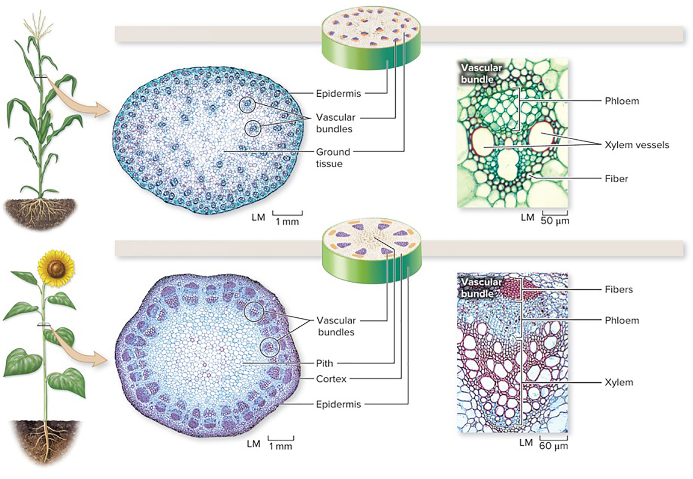
Arrangement of tissues differs in monocots and eudicots
Monocots and eudicots have different arrangements of vascular tissue and ground tissue in their stems.
Corn (monocot)
Sunflower (eudicot)
(a, stem): ©Steven P. Lynch/RF; (a, corn close up; b, both): ©Steven P. Lynch/McGraw-Hill Education
Section 22.3
Figure 22.9

Slide 38
Vascular bundles in monocot and eudicot stems
Corn (monocot)
In monocots, vascular bundles are scattered throughout the stem.
In eudicots, vascular bundles are arranged in a ring near the epidermis.
The cortex is ground tissue that fills the space between the epidermis and vascular bundles. The pith occupies the center of the stem.
Sunflower (eudicot)
(a, stem): ©Steven P. Lynch/RF; (a, corn close up; b, both): ©Steven P. Lynch/McGraw-Hill Education
Section 22.3
Figure 22.9

Slide 39
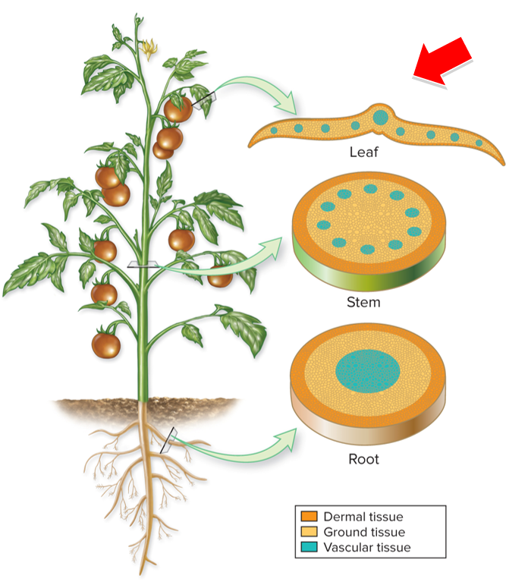
Tissues found in leaves
Ground tissue occupies most of a leaf.
Vascular bundles are embedded in the ground tissue.
Dermal tissue covers the leaf.
Section 22.3
Figure 22.6

Slide 40
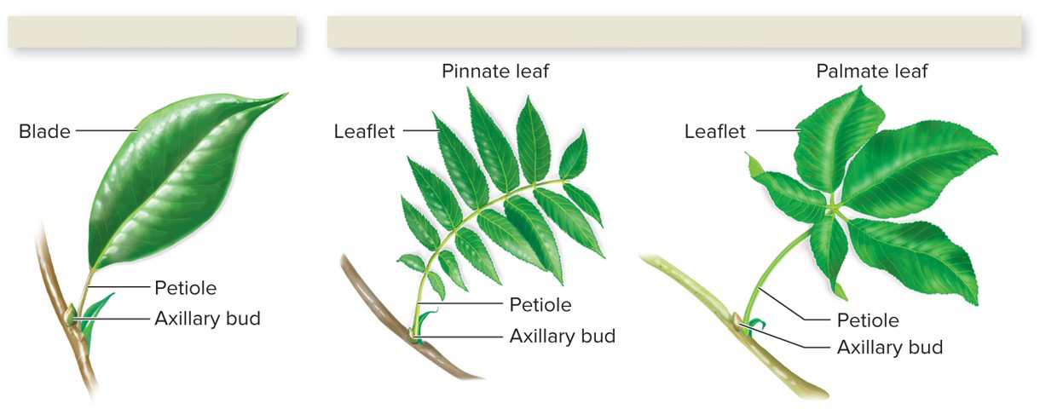
The structure of leaves
Leaves are flattened blades supported with a stalklike petiole.
Simple leaf
Compound leaves
Section 22.3
Figure 22.10

Slide 41
Simple vs. compound leaves
Simple leaves have undivided blades.
Compound leaves are divided into leaflets attached to one petiole.
Simple leaf
Compound leaves
Section 22.3
Figure 22.10

Slide 42
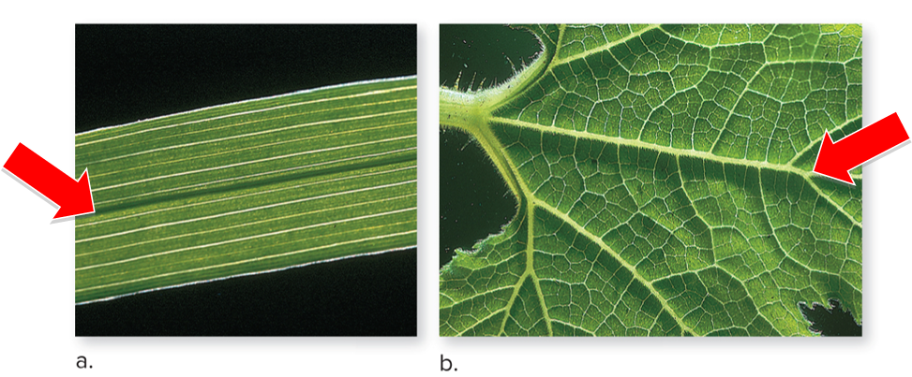
Vein patterns on monocot and eudicot leaves
Veins are vascular bundles inside leaves. Many monocots have parallel veins; most eudicots have netted veins.
Veins on typical monocot leaf
Veins on typical eudicot leaf
(both): ©Dwight Kuhn
Section 22.3
Figure 22.11

Slide 43
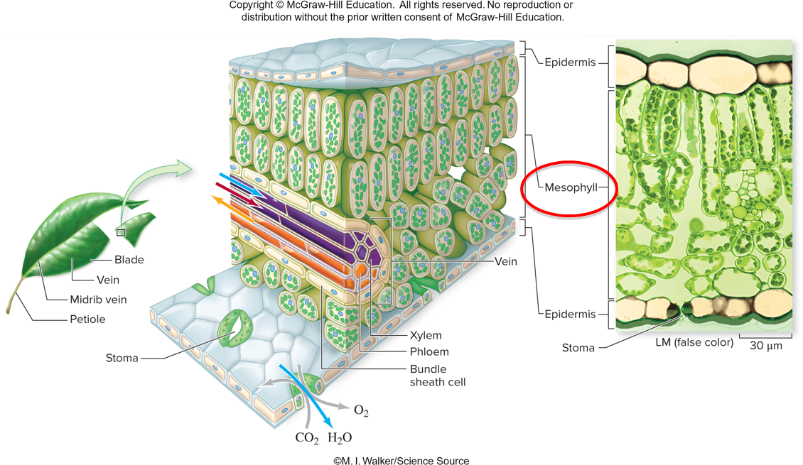
Mesophyll: the middle of a leaf
Leaf anatomy shown here is that of a eudicot plant.
The ground tissue inside a leaf is called mesophyll, which consists of cells with abundant chloroplasts that produce sugars by photosynthesis.
©M. I. Walker/Science Source
Section 22.3
Figure 22.12

Slide 44
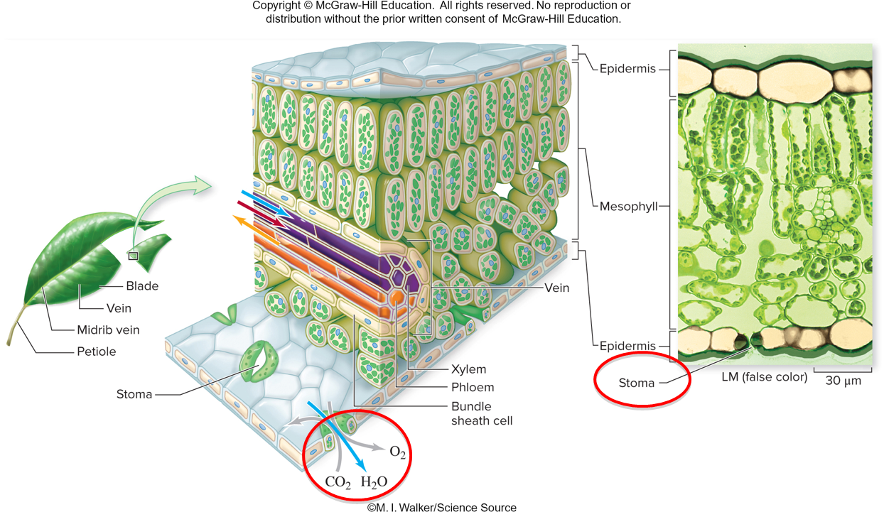
Stomata: locations of gas exchange
When stomata are open, mesophyll cells exchange gases with the atmosphere.
©M. I. Walker/Science Source
Section 22.3
Figure 22.12

Slide 45
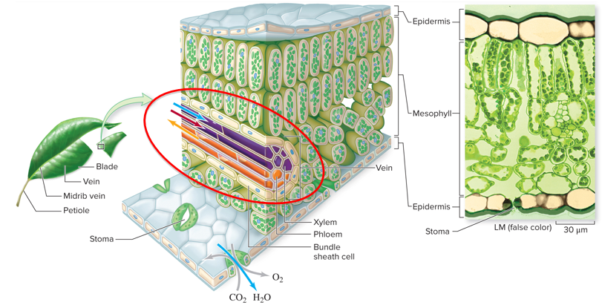
Mesophyll cells interact with vascular tissue
Mesophyll cells also exchange materials with vascular tissues.
©M. I. Walker/Science Source
Section 22.3
Figure 22.12

Slide 46
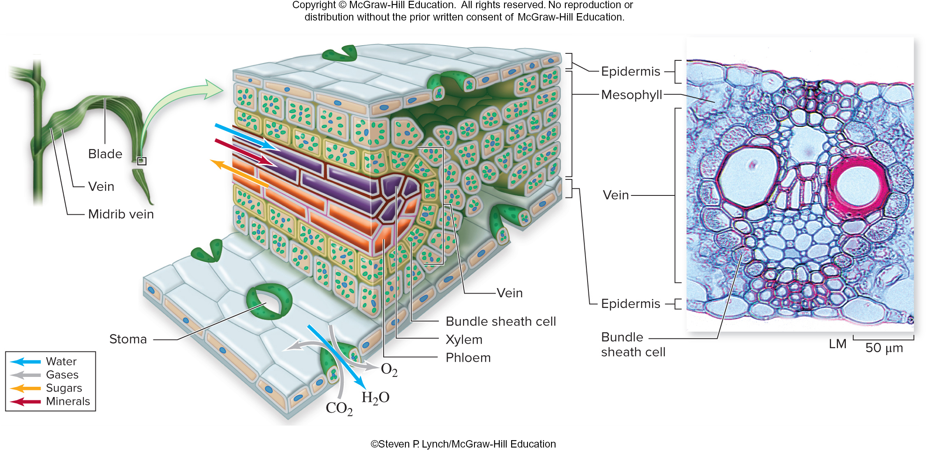
Monocot leaf structures
Monocots have similar leaf anatomy to dicots. Note the prominent bundle sheath cells in this monocot leaf, surrounded by a layer of mesophyll.
©Steven P. Lynch/McGraw-Hill Education
Section 22.3
Figure 22.12

Slide 47
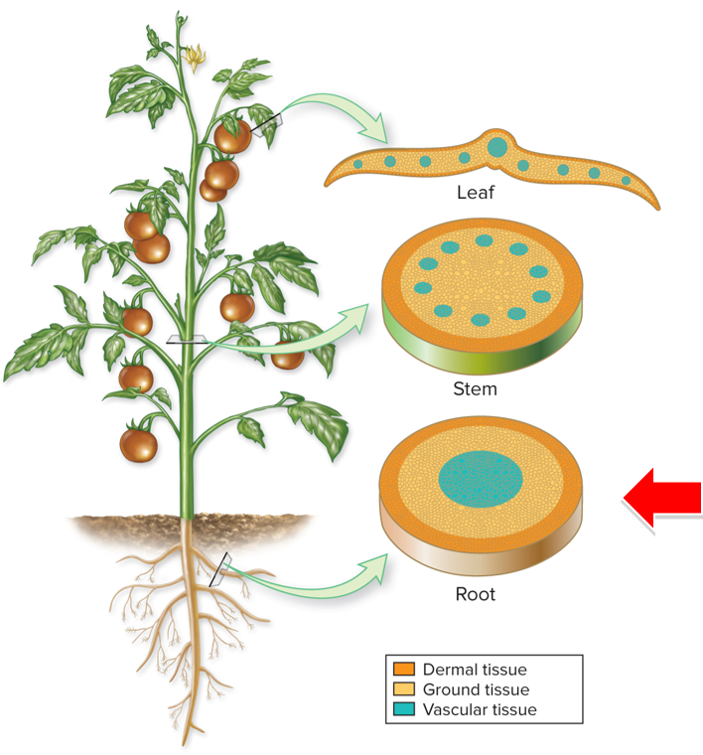
Tissues of the root
In a root, ground tissue surrounds a central core of vascular tissue.
Dermal tissue forms the root epidermis.
Section 22.3
Figure 22.6

Slide 48
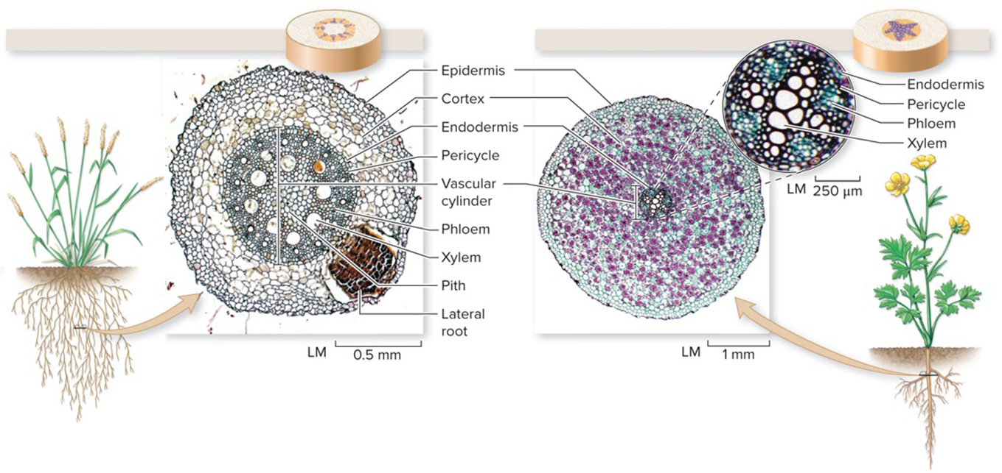
Fibrous roots vs. taproots
Roots might form a fibrous root system or a taproot system.
Fibrous roots are slender, shallow, and arise from the base of the stem.
Taproots are thick, deep, and have fewer branches than fibrous roots.
Barley (monocot)
Buttercup (eudicot)
(a): ©AI Telser/McGraw-Hill Education; (b): ©Ed Reschke/Photolibrary/Getty Images
Section 22.3
Figure 22.13

Slide 49
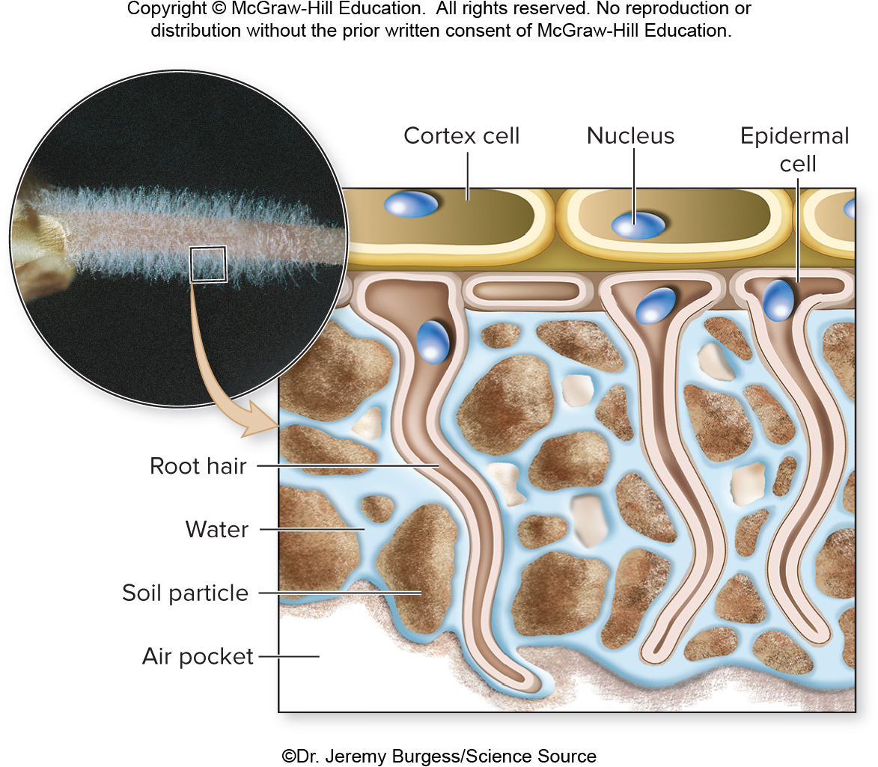
Root hairs
Near each root’s tip, root hairs are extensions of the epidermis that
absorb water and minerals.
©Dr. Jeremy Burgess/Science Source
Section 22.3
Figure 22.14

Slide 50
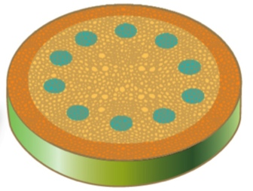
Clicker question #3
The cross section shown at right comes from
eudicot root.
eudicot stem.
monocot root.
monocot stem.
Figure 22.6

Slide 51
Clicker question #3, solution
The cross section shown at right comes from
eudicot stem.
Figure 22.6

Slide 52
22.3 Mastering concepts
Describe the internal anatomy of a stem, leaf, and root.
©Gustavo Gilabert/Corbis SABA

Slide 53
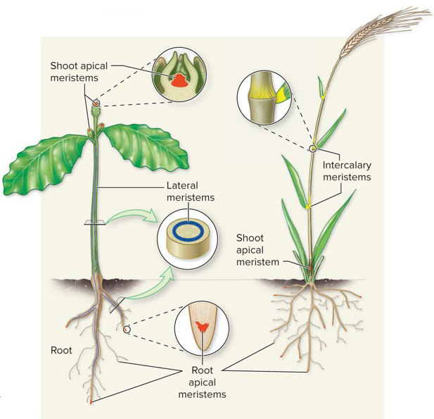
Plants have flexible growth patterns
TABLE 22.3 Meristem Types: A Summary
Some plants never stop growing. These plants have indeterminate growth.
Plants that stop growing when they reach their mature size have determinate growth.
Type | Locations | Function
Apical | Terminal and axillary buds of shoots; root tips | Produces tissues that lengthen the tips of shoots and roots
Lateral | Internal cylinder along the length of roots and stems of woody plants | Thickens roots and stems
Intercalary | Between nodes of mature stems in grasses and other monocots | Regrowth of tissue if tip of stem is removed
Section 22.4
Table 22.3

Slide 54
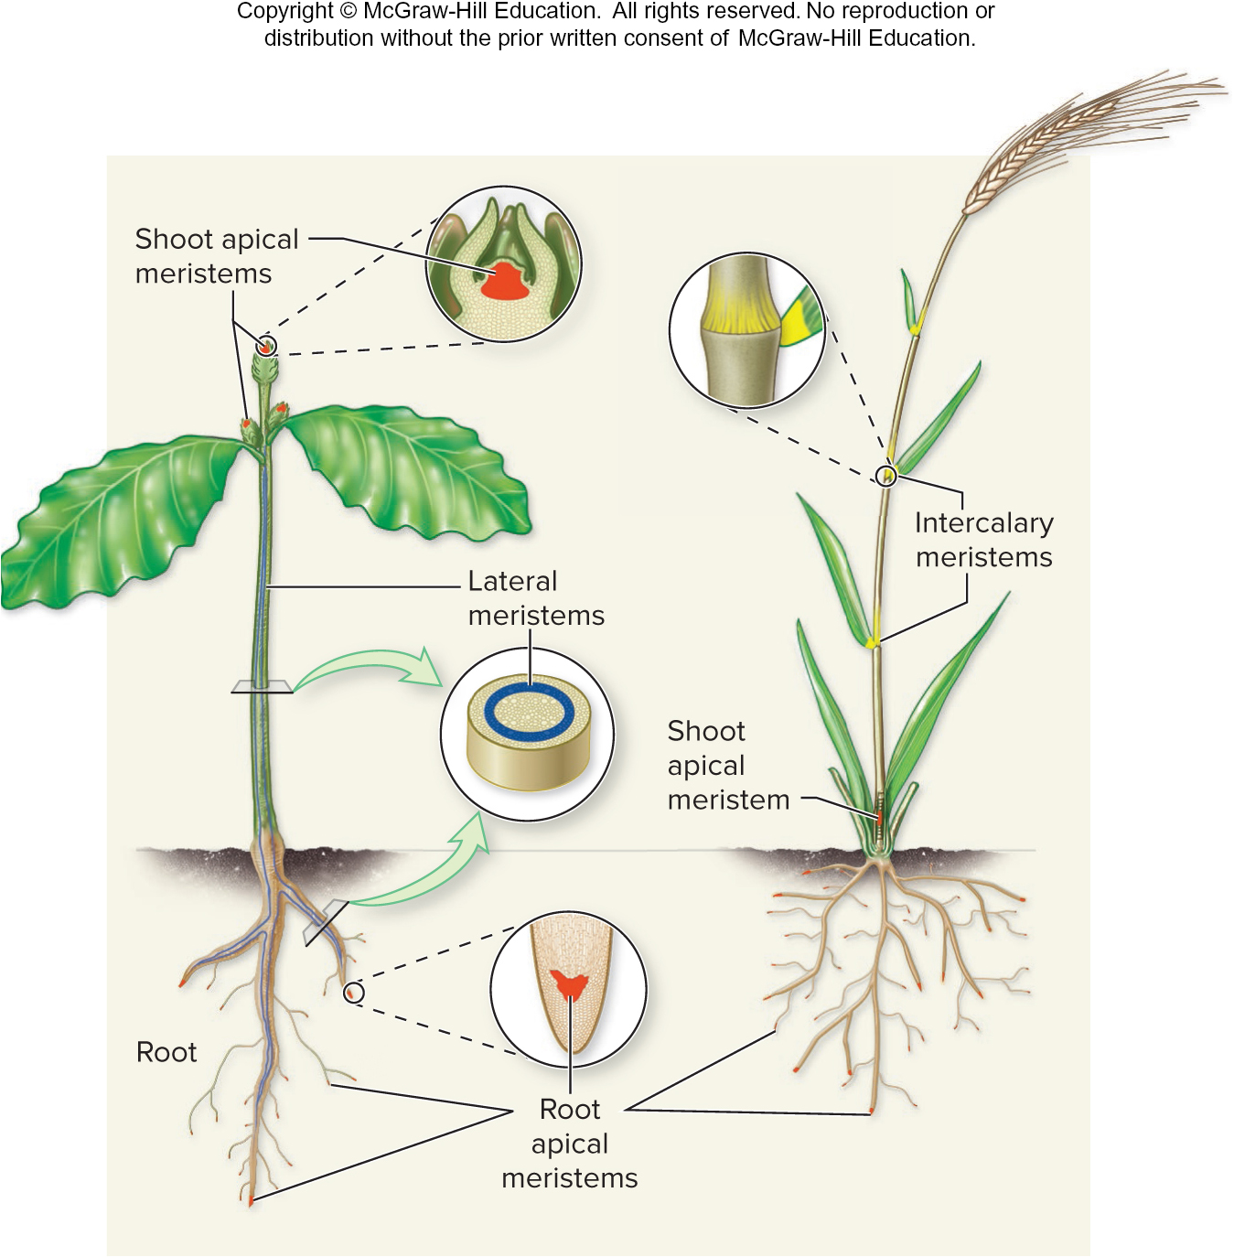
Meristems
Plants grow by adding units, or modules, consisting of repeated nodes and internodes. Growth occurs at meristems, regions of active cell division.
Section 22.4
Table 22.3

Slide 55
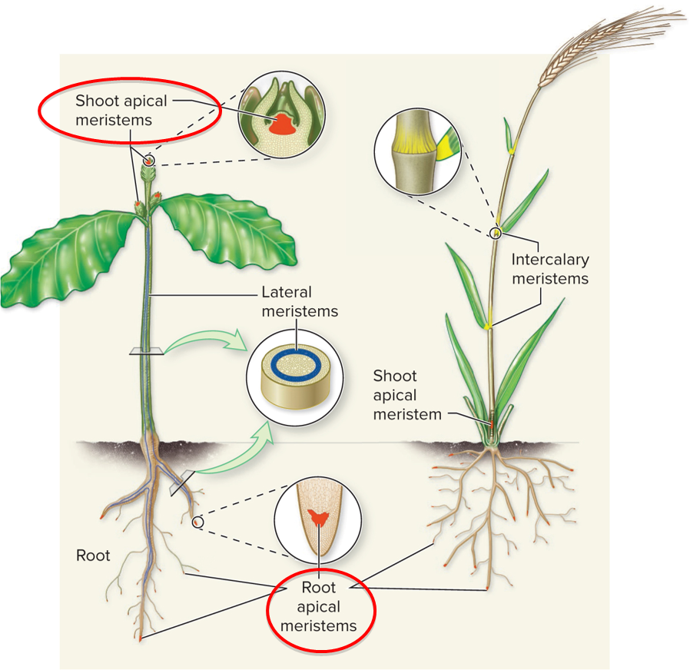
Apical meristems
Apical meristems produce tissues that lengthen the tips of shoots and roots.
Section 22.4
Table 22.3

Slide 56
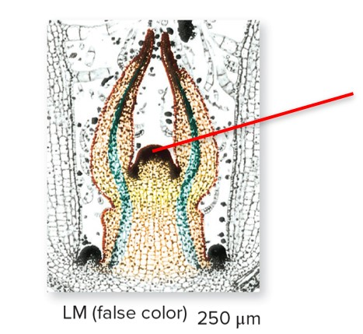
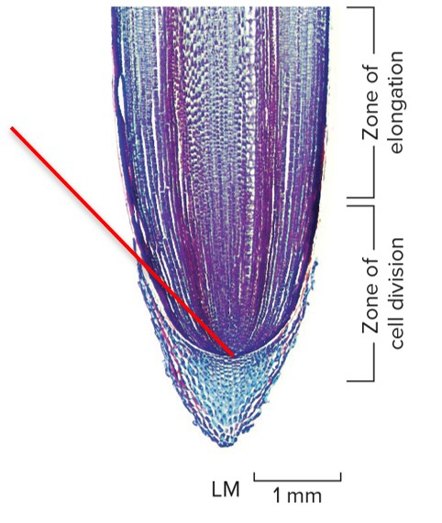
Primary growth
Primary growth occurs at the apical meristems. New cells can differentiate into any tissue type.
Apical meristems
©Steven P.Lynch/McGraw-Hill Education
©Steven P.Lynch/McGraw-Hill Education
Section 22.4
Figs. 22.15, 22.16

Slide 57
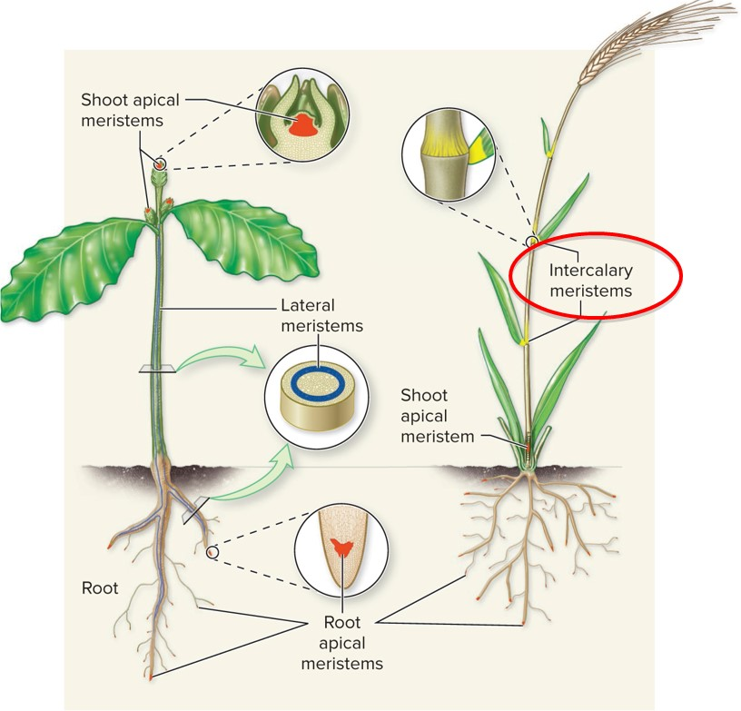
Intercalary meristems
Intercalary meristems occur at the base of a leaf blade. Grasses tolerate grazing because they have intercalary meristems that regrow a leaf from its base when the tip is munched off.
Section 22.4
Table 22.3

Slide 58
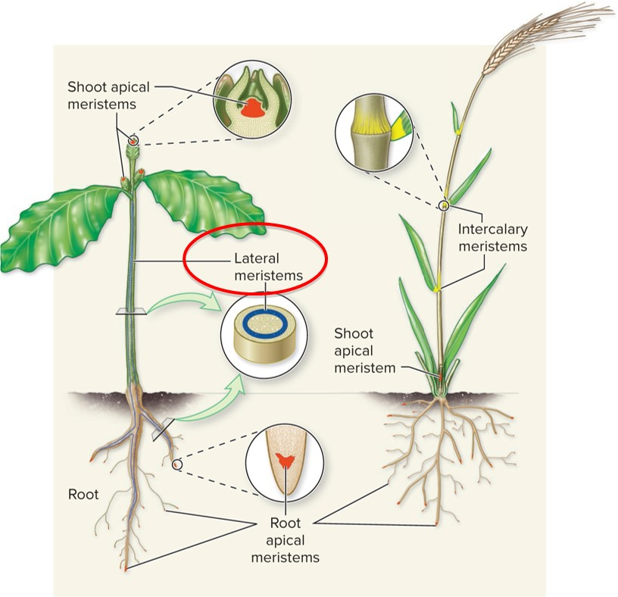
Secondary growth
Secondary growth thickens roots and stems; this growth occurs at lateral meristems.
Section 22.4
Table 22.3

Slide 59
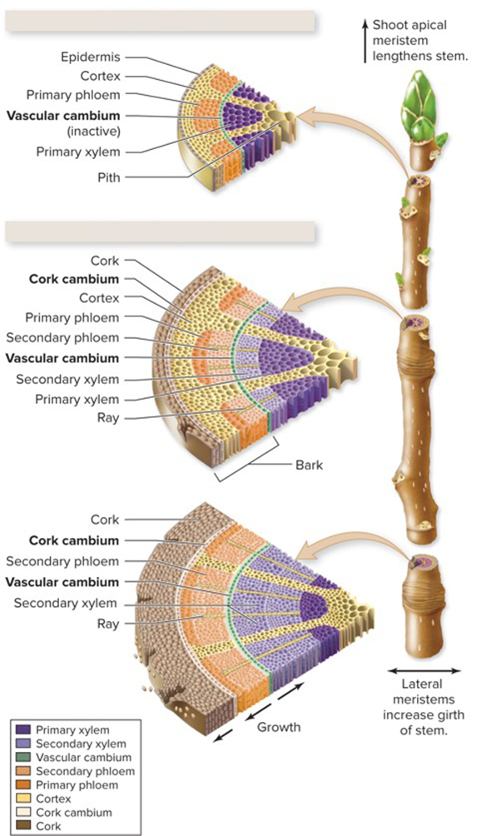
Secondary growth in woody plants
Primary growth
Secondary growth
Secondary growth occurs in woody plants. Two types of lateral meristems produce wood and bark:
Vascular cambium
Cork cambium
Section 22.4
Figure 22.17

Slide 60
Vascular cambium
Primary growth
The vascular cambium (highlighted green) produces secondary xylem toward the inside of the stem and secondary phloem toward the outside.
Secondary growth
Section 22.4
Figure 22.17

Slide 61
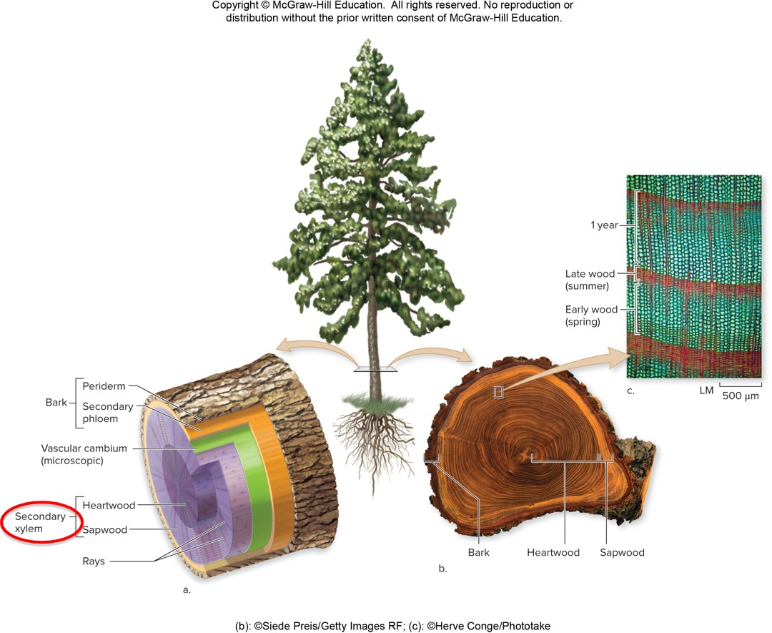
Wood
Secondary xylem is more commonly called wood.
(b): ©Siede Preis/Getty Images RF; (c): ©Herve Conge/Phototake
Section 22.4
Figure 22.18

Slide 62
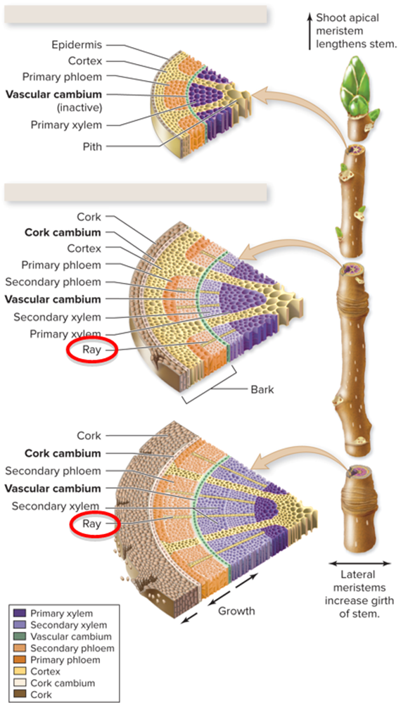
Rays
Primary growth
Secondary growth
The vascular cambium also produces rays (highlighted with yellow), bands of parenchyma that extend from the center of the stem or root and transport nutrients laterally.
Section 22.4
Figure 22.17

Slide 63
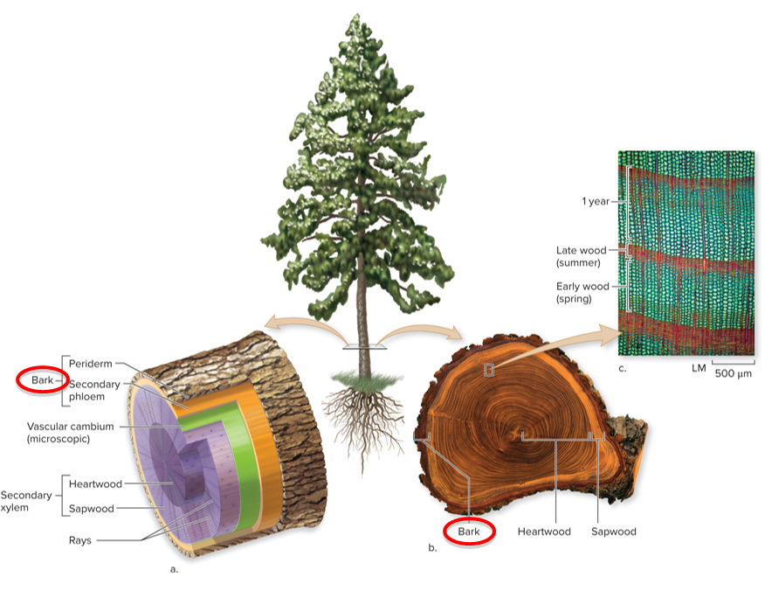
Bark
Secondary growth produces bark, a collective term for all tissues outside of the vascular cambium.
(b): ©Siede Preis/Getty Images RF; (c): ©Herve Conge/Phototake
Section 22.4
Figure 22.18

Slide 64
Cork cambium
Primary growth
The cork cambium (highlighted white) produces parenchyma cells toward the inside and dense, waxy cells called cork toward the outside.
Cork is the outer protective layer of bark.
Secondary growth
Section 22.4
Figure 22.17

Slide 65
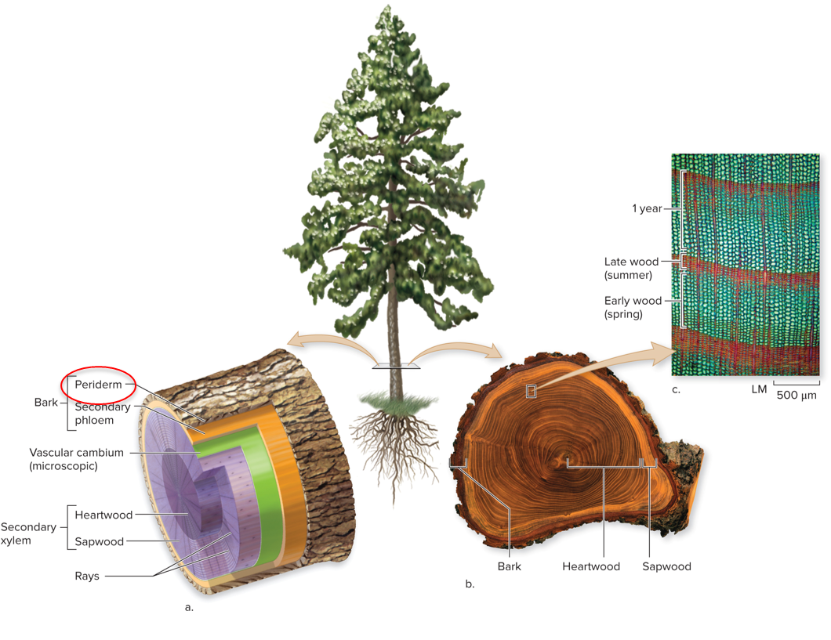
Periderm
Together, the cork cambium, parenchyma cells, and nonliving cork make up the periderm, a protective layer that covers a woody stem or root.
(b): ©Siede Preis/Getty Images RF; (c): ©Herve Conge/Phototake
Section 22.4
Figure 22.18

Slide 66
Heartwood
Secondary xylem eventually becomes unable to conduct water, forming heartwood.
(b): ©Siede Preis/Getty Images RF; (c): ©Herve Conge/Phototake
Section 22.4
Figure 22.18

Slide 67
Sapwood
The lighter sapwood transports water and dissolved minerals.
(b): ©Siede Preis/Getty Images RF; (c): ©Herve Conge/Phototake
Section 22.4
Figure 22.18

Slide 68
Tree rings
Tree rings arise from alternating moist and dry seasons. Wood that forms in the spring has larger cells than wood that forms in the summer.
(b): ©Siede Preis/Getty Images RF; (c): ©Herve Conge/Phototake
Section 22.4
Figure 22.18

Slide 69
Clicker question #4
If you have ever used a microscope to study cells undergoing mitosis, you may have examined onion root tips. Why are root tips ideal specimens?
They contain lots of rapidly dividing cells.
They carry out photosynthesis.
They have root hairs that absorb water.
They don’t require $O_{2}$.
They don’t contain vascular tissue.

Slide 70
Clicker question #4, solution
If you have ever used a microscope to study cells undergoing mitosis, you may have examined onion root tips. Why are root tips ideal specimens?
They contain lots of rapidly dividing cells.

Slide 71
22.4 Mastering concepts
What are the locations and functions of meristems?
©Gustavo Gilabert/Corbis SABA

Slide 72
Investigating life: an army of tiny watchdogs
In some plants, evolution has selected adaptations in anatomy that benefit ants.
©Dr. Morley Read/Science Source
Section 22.5
Figure 22.19

Slide 73
A mutualistic relationship
The ants make their homes in hollow stems called domatia. The ants also eat the nectar of the plant’s young leaves.
©Dr. Morley Read/Science Source
Section 22.5
Figure 22.19

Slide 74
The ants protect the tree
How does the tree benefit from the ants’ presence?
Protection. Trees with ant residents sustained less damage by intruders than trees without ant residents.
Section 22.5
Figure 22.20

