Slide 1
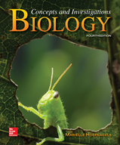
Chapter 19
Plants
©G. R.“Dick” Roberts/Natural Sciences Image Library
©McGraw-Hill Education. All rights reserved. Authorized only for instructor use in the classroom.
No reproduction or further distribution permitted without the prior written consent of McGraw-Hill Education.

Slide 2
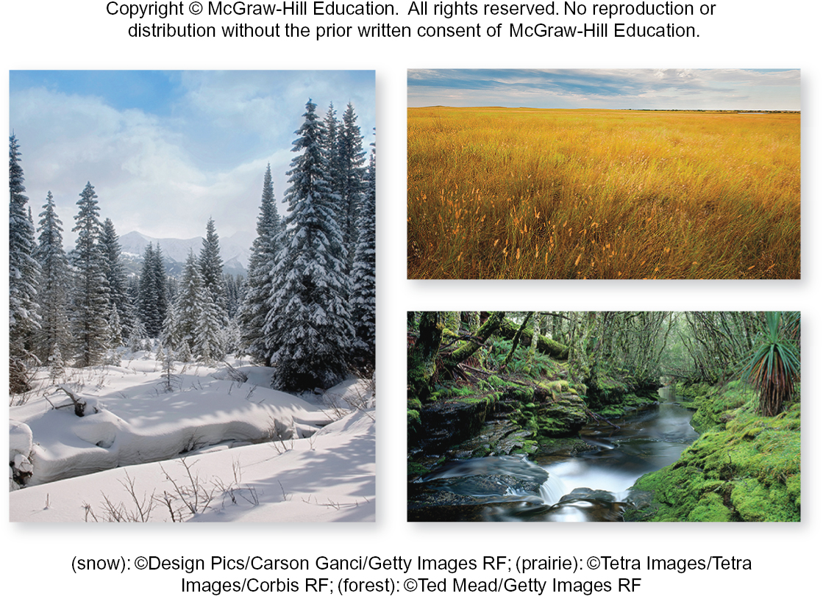
Plants have changed the world
Members of kingdom Plantae are nearly everywhere.
Plants harness the energy that sustains ecosystems. They also release $O_{2}$, which consumers use for respiration.
(snow): ©Design Pics/Carson Ganci/Getty Images RF; (prairie): ©Tetra Images/Tetra Images/Corbis RF; (forest): ©Ted Mead/Getty Images RF
Section 19.1
Figure 19.1

Slide 3
Plants are essential for life
On land and in water, plants provide habitats and food to countless species of microbes, fungi, and animals.
(snow): ©Design Pics/Carson Ganci/Getty Images RF; (prairie): ©Tetra Images/Tetra Images/Corbis RF; (forest): ©Ted Mead/Getty Images RF
Section 19.1
Figure 19.1

Slide 4
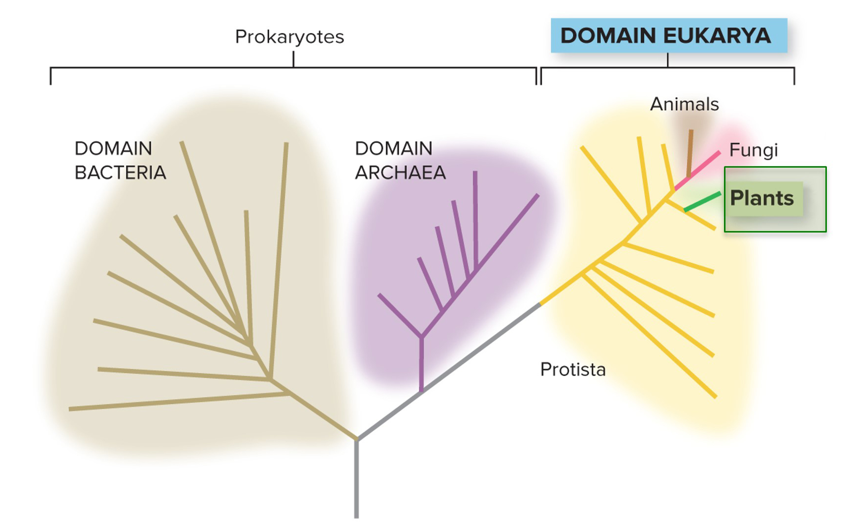
Plants share a lineage with protists
All plants are multicellular, autotrophic eukaryotes that use photosynthesis to obtain energy.
Section 19.1
Figure 19.3

Slide 5
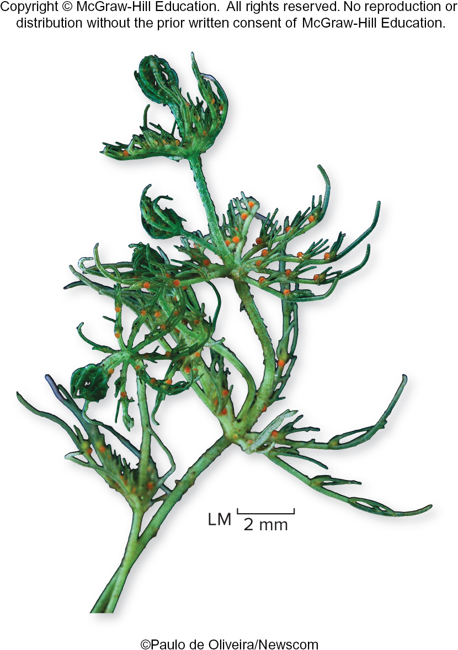
Green algae are the closest relatives of plants
Charophytes are a group of modern green algae.
Biologists believe they are similar to the ancestors of plants.
©Paulo de Oliveira/Newscom
Section 19.1
Figure 19.2

Slide 6
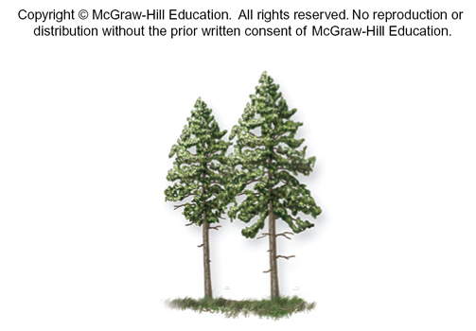
Green algae share many molecular features with plants
DNA sequences reveal a close evolutionary relationship.
Chloroplasts contain the same pigments.
Cell walls contain cellulose.
Both use starch as a storage molecule.
©Paulo de Oliveira/Newscom
Section 19.1
Figures 19.2, 19.3

Slide 7
Green algae live in water, plants on land
The different environments select for different body types and reproductive strategies.
©Paulo de Oliveira/Newscom
Section 19.1
Figures 19.2, 19.3

Slide 8
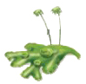
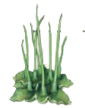
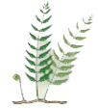
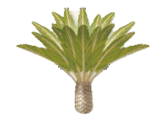
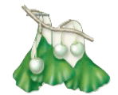
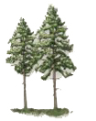
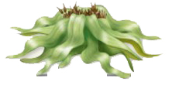
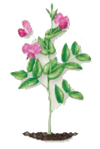
Plants are divided into four groups
TABLE 19.1 Phyla of Plants
Plants arose during the Paleozoic era and diversified into thousands of different species.
Modern-day plants include
Bryophytes
Seedless vascular plants
Gymnosperms
Angiosperms
Number of Existing Species
Phylum
Examples
Nonvascular plants
Marchantiophyta
Liverworts
9000
Anthocerotophyta
Hornworts
100
Bryophyta
True mosses
15,000
Seedless vascular plants
Lycopodiophyta
Club mosses, spike mosses
1200
Pteridophyta
Whisk ferns, true ferns, horsetails
11,500
Gymnosperms
Cycadophyta
Cycads
130
Ginkgophyta
Ginkgo
1
Pinophyta
Pines, firs, and other conifers
630
Gnetophyta
Gnetophytes
80
Angiosperms
Magnoliophyta
All flowering plants, including roses, grasses, fruit trees, maples, and oaks
> 260,000
Section 19.1
Table 19.1

Slide 9
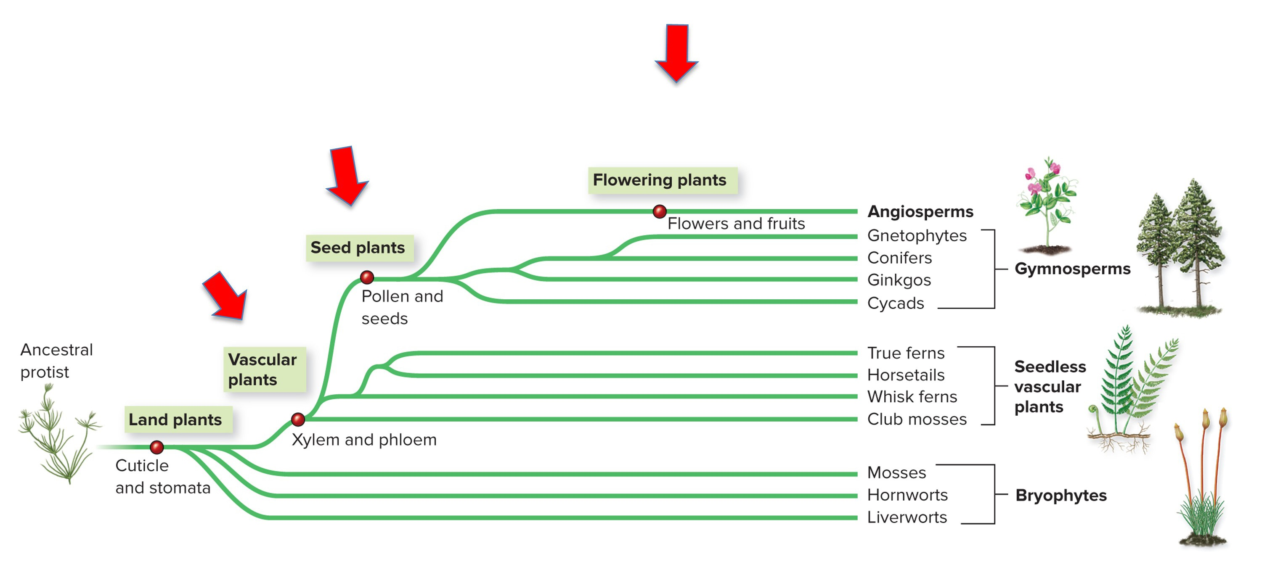
Plants evolved key adaptations
The four plant groups are defined by a series of features that plants developed over time, including having vascular tissue, seeds, and flowers/fruits.
Section 19.1
Figure 19.3

Slide 10
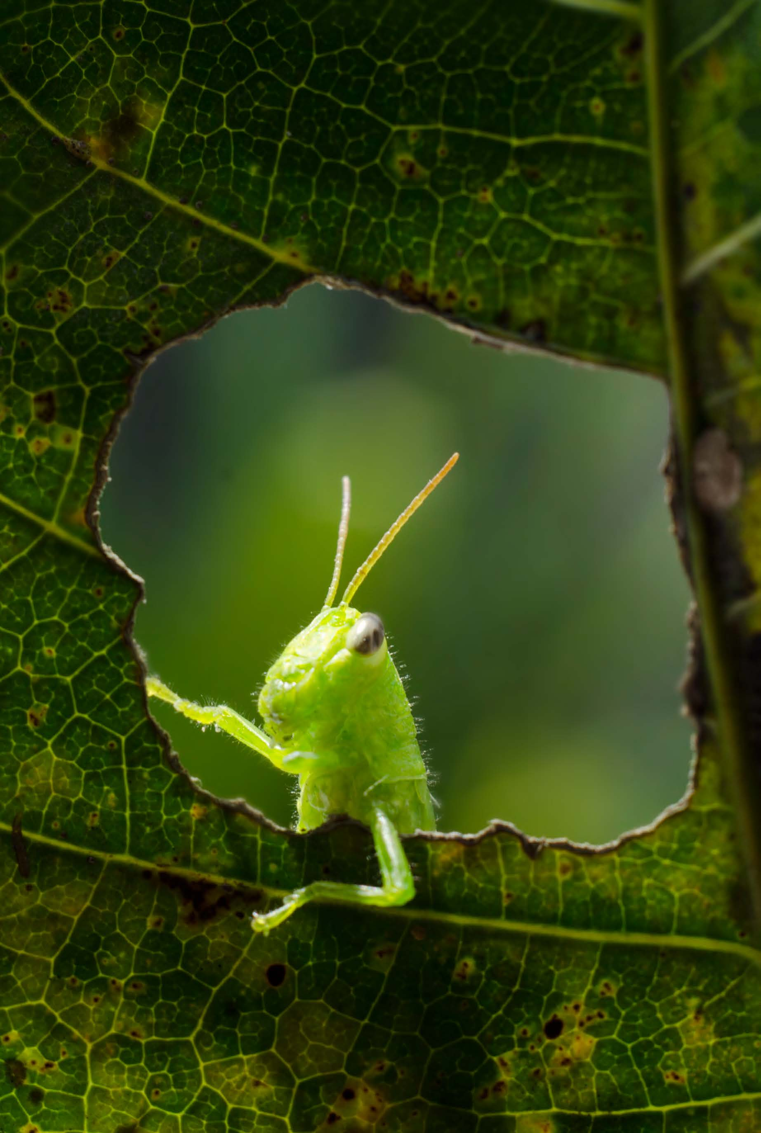
Clicker question #1
A newly discovered plant in the rain forest has vascular tissues and seeds, but no flowers. What is it?
a bryophyte
a seedless vascular plant
a gymnosperm
an angiosperm

Slide 11
Clicker question #1, solution
A newly discovered plant in the rain forest has vascular tissues and seeds, but no flowers. What is it?
a gymnosperm

Slide 12
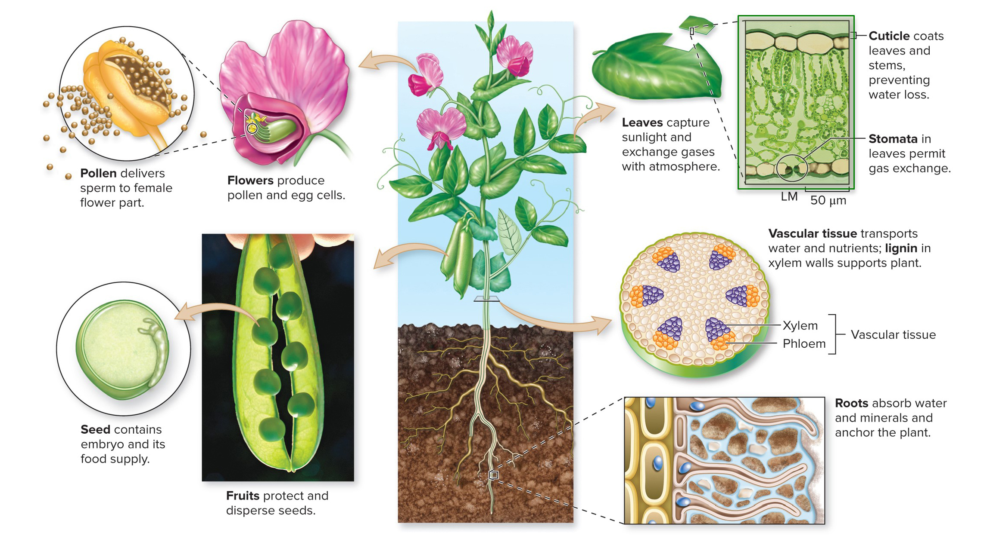
A leaf is an adaption to life on land
Leaves capture sunlight and ${CO}_{2}$ for photosynthesis. Plant leaves have evolved a cuticle to keep from drying out and stomata to allow gas exchanges.
(peas): ©Corbis RF; (leaf micrograph): ©M. I. Walker/Science Source
Section 19.1
Figure 19.4

Slide 13
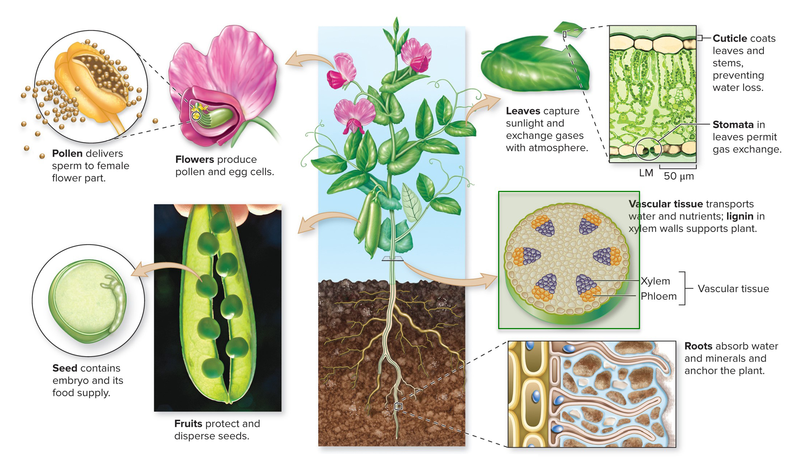
Vascular tissue is an adaption to life on land
Plant vascular tissue is a bundle of tubes that transports water, minerals, and sugar throughout the plant.
(peas): ©Corbis RF; (leaf micrograph): ©M. I. Walker/Science Source
Section 19.1
Figure 19.4

Slide 14
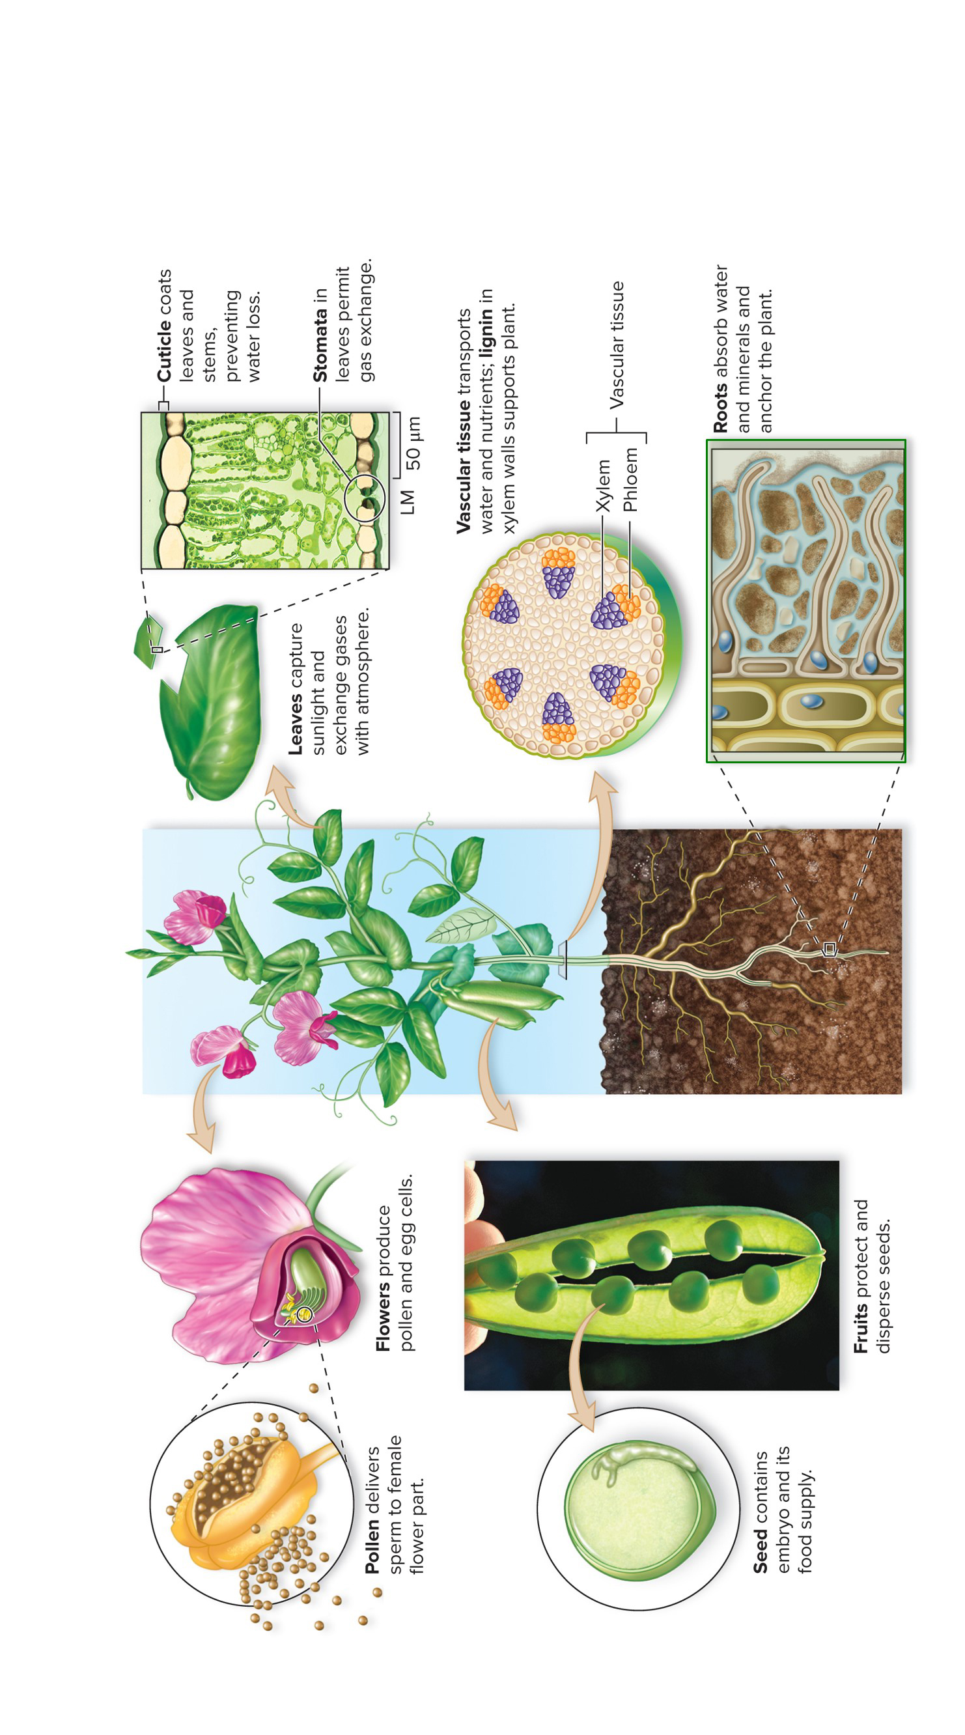
A root is an adaption to life on land
Roots below the ground absorb water and minerals while anchoring the plant in the soil.
(peas): ©Corbis RF; (leaf micrograph): ©M.I. Walker/Science Source
Section 19.1
Figure 19.4

Slide 15
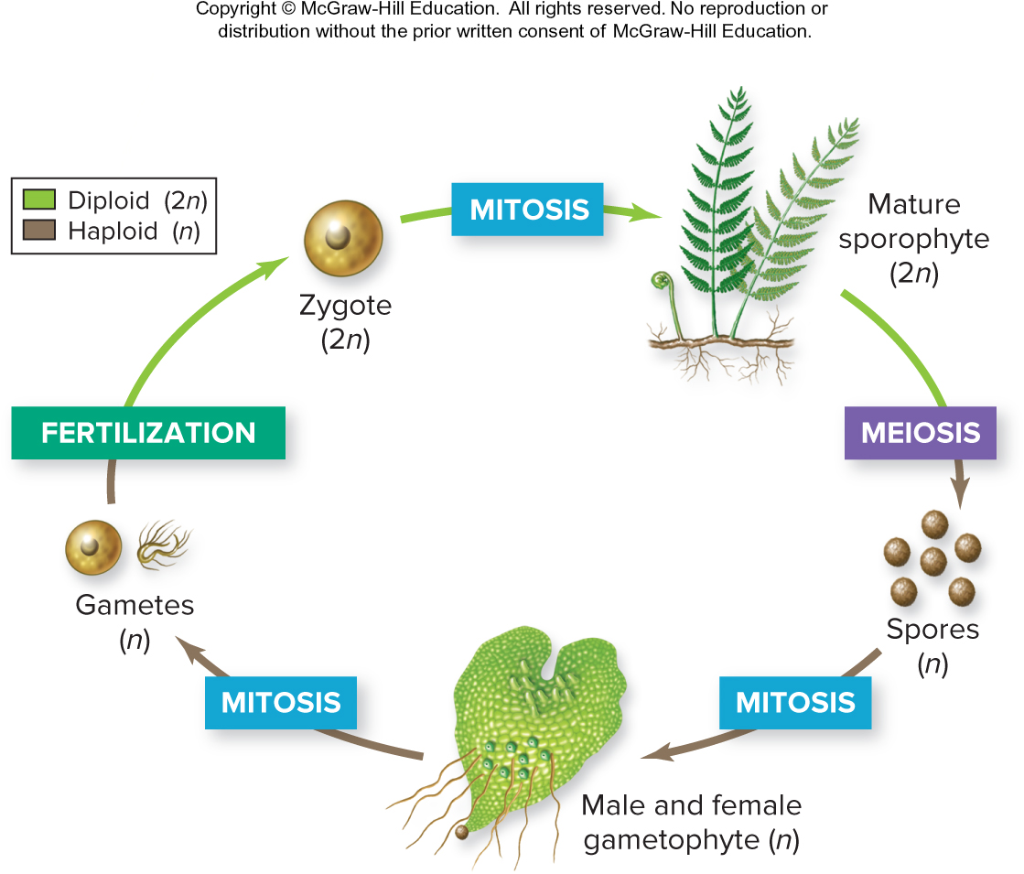
All plants have similar life cycles
The similarity among plant life cycles is evidence that all plants share a common ancestor.
Section 19.1
Figure 19.5

Slide 16
Plant reproduction is complex
Plant gametes and zygotes can both grow into adult organisms and reproduce.
Section 19.1
Figure 19.5

Slide 17
Plants alternate generations
The plant life cycle is called alternation of generations.
A multicellular diploid stage alternates with a multicellular haploid stage.
Section 19.1
Figure 19.5

Slide 18
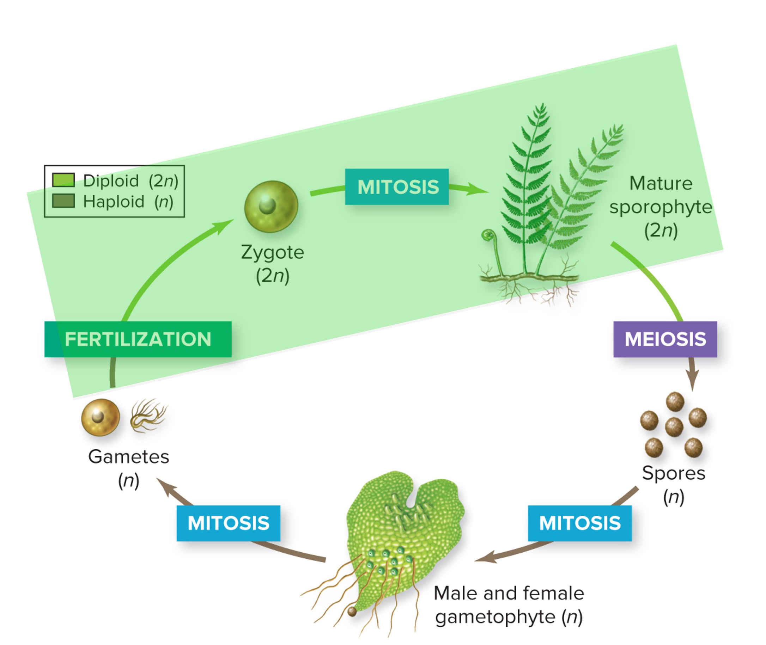
Sporophyte generation is diploid
A fertilized egg forms a diploid zygote, which develops by mitotic cell division into a multicellular, diploid plant called a sporophyte.
Section 19.1
Figure 19.5

Slide 19
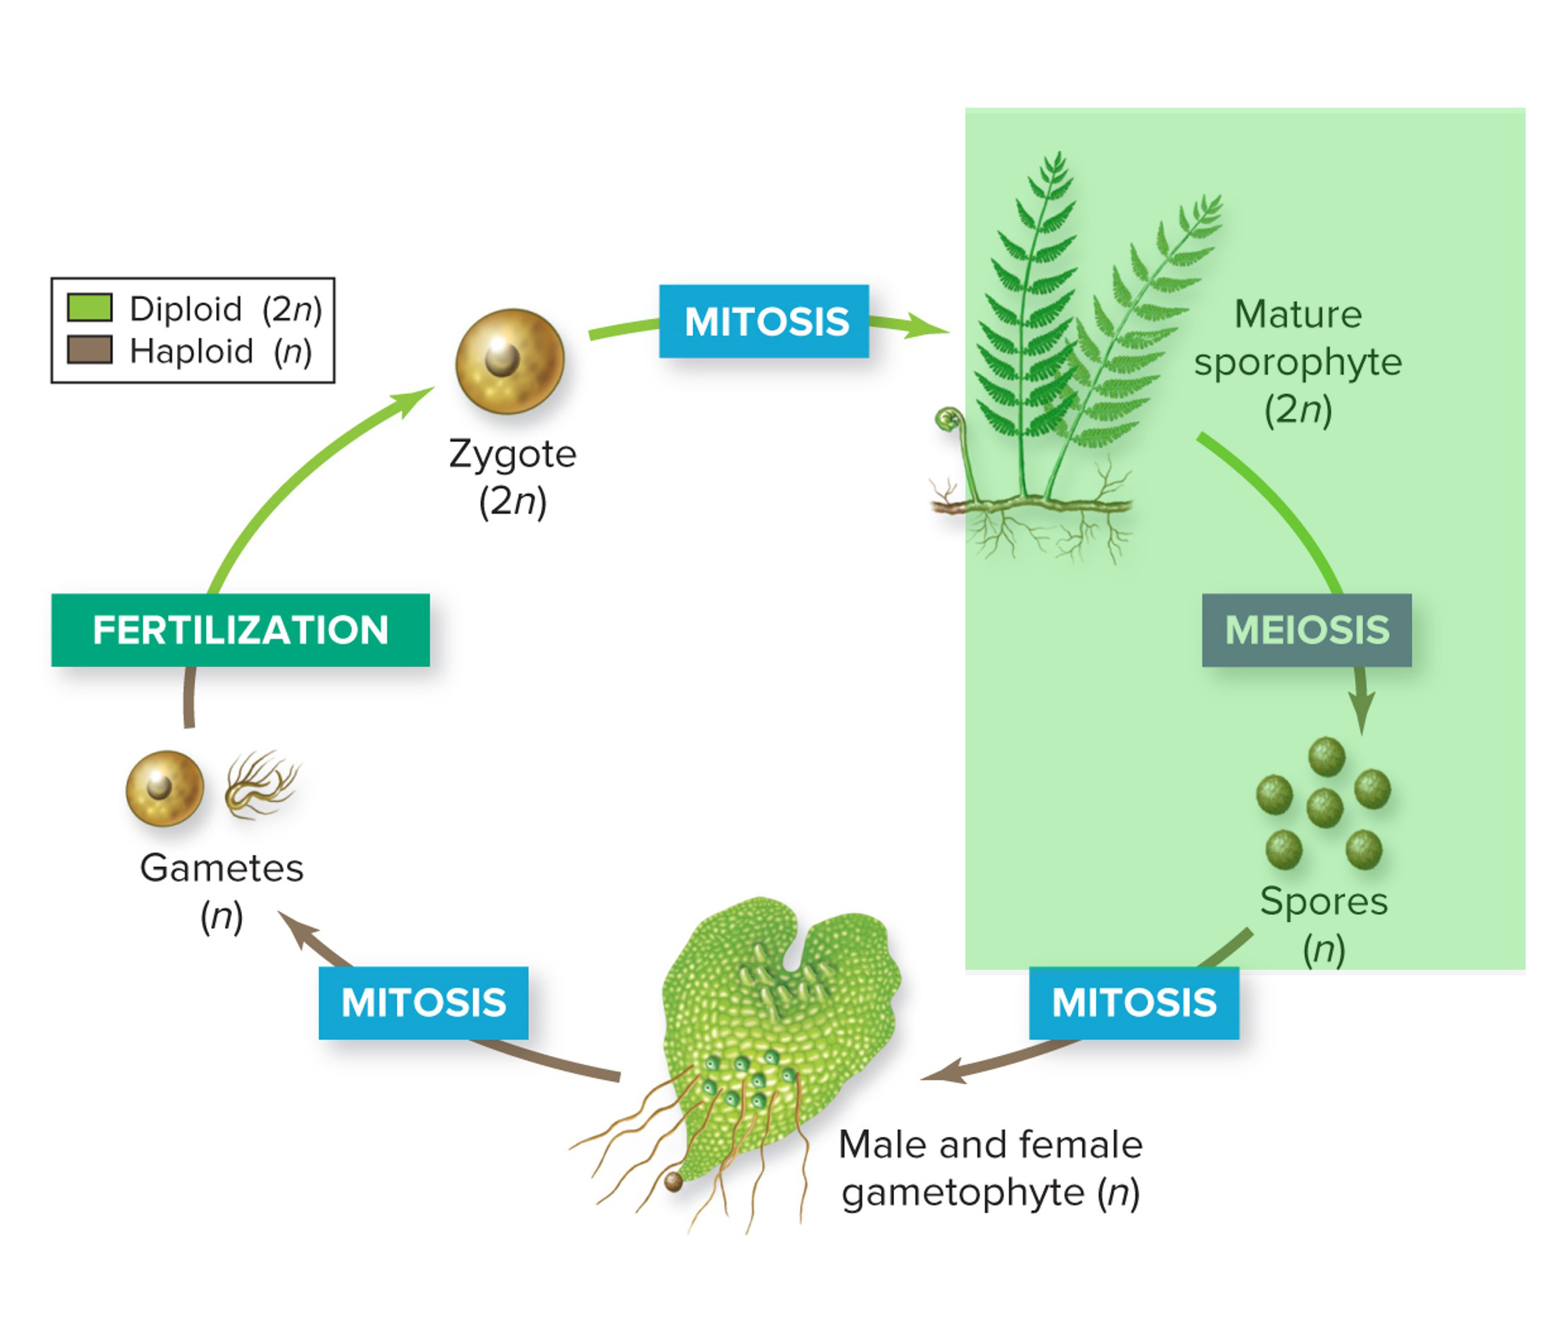
Sporophytes produce spores
The sporophyte plant produces haploid spores by meiosis.
Section 19.1
Figure 19.5

Slide 20
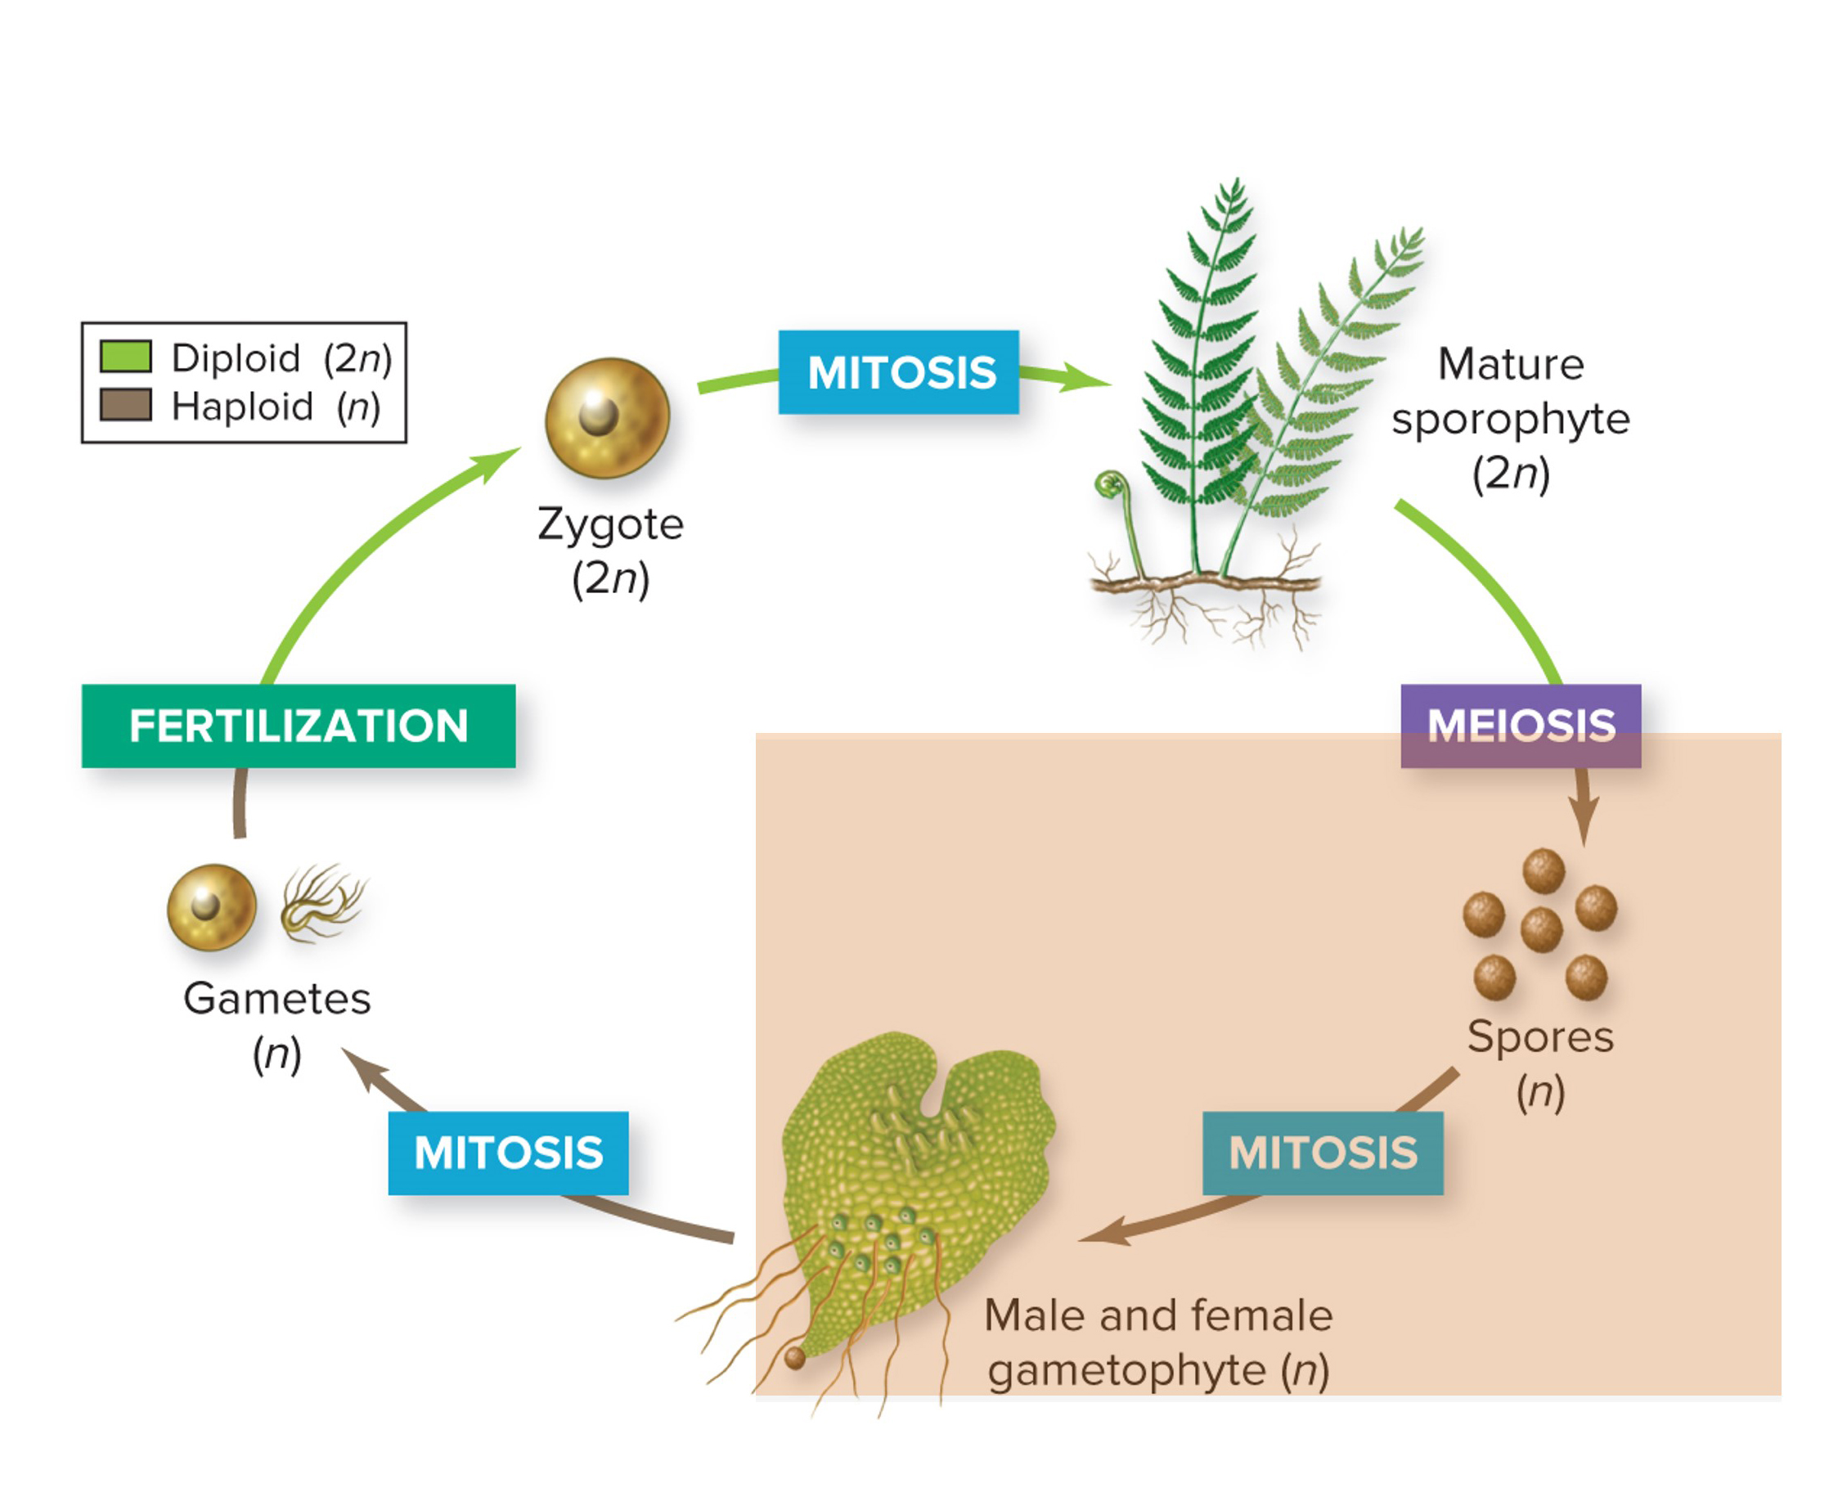
Gametophyte generation is haploid
Spores divide by mitosis into a multicellular, haploid gametophyte.
Section 19.1
Figure 19.5

Slide 21
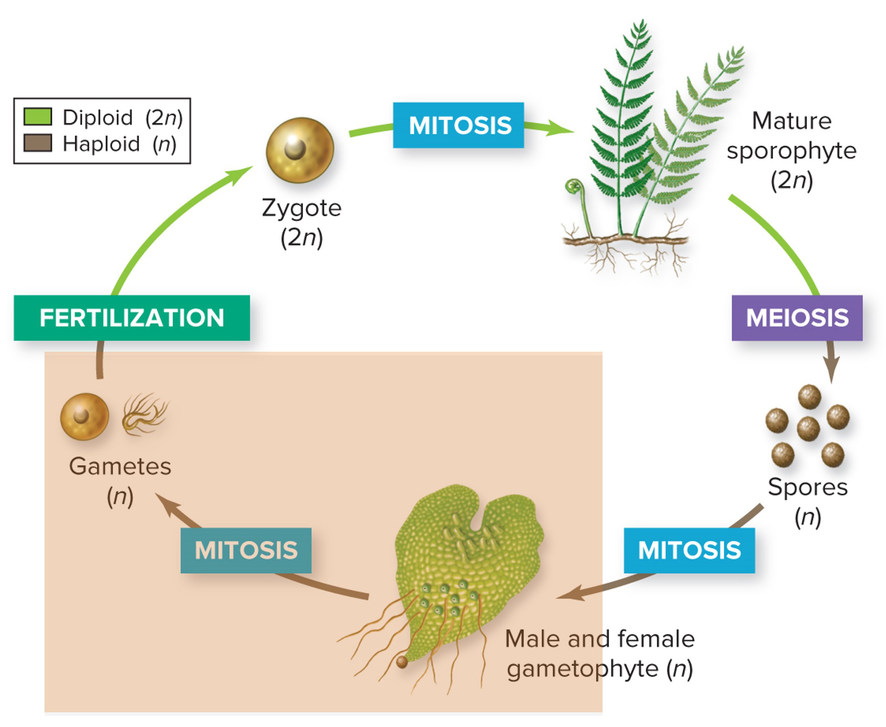
Gametophytes produce gametes
The haploid
gametophyte produces gametes by mitosis.
Section 19.1
Figure 19.5

Slide 22
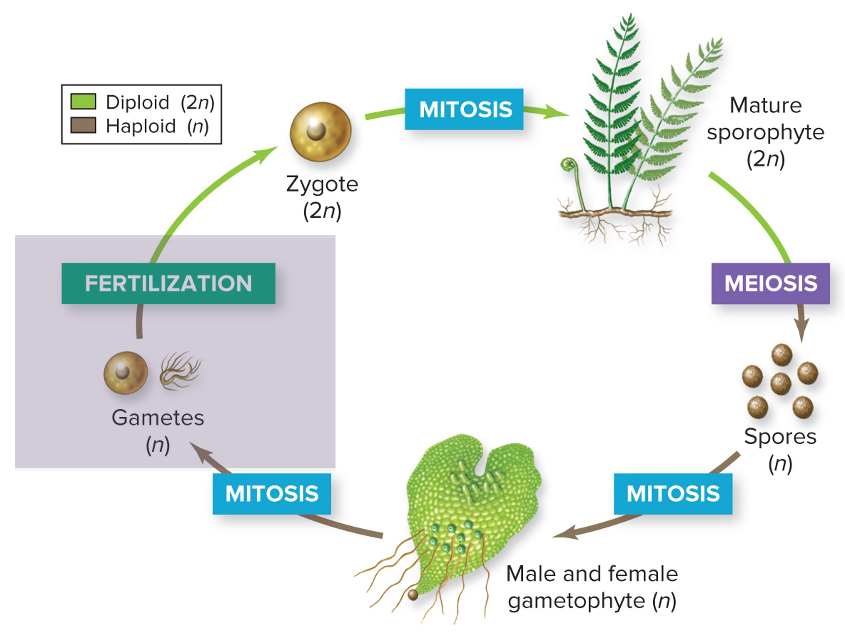
Fertilization forms a zygote
The gametes fuse at fertilization, forming a diploid zygote and starting the cycle again.
Section 19.1
Figure 19.5

Slide 23
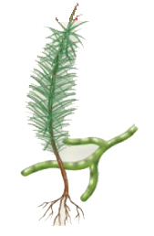
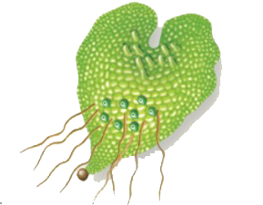
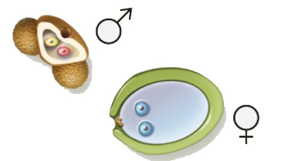
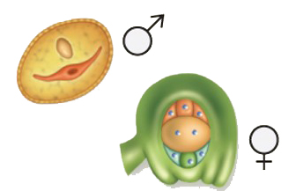
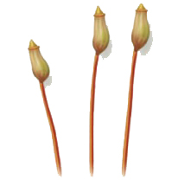
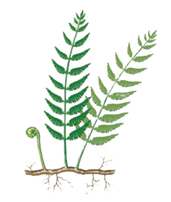
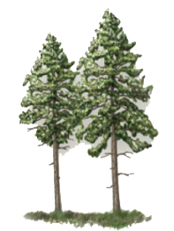
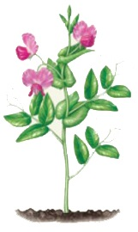
The lifestyle of gametophytes varies through plant phyla
In simpler plants the gametophyte is larger and less dependent on the sporophyte; in more complex plants the reverse is true.
Bryophytes
Seedless Vascular Plants
Gymnosperms
Angiosperms
Gametophyte (haploid generation)
Size relative to sporophyte?
Varies
Small
Microscopic
Microscopic
Depends on sporophyte for nutrition?
No
No
Yes
Yes
Sporophyte (diploid generation)
Size relative to gametophyte?
Varies
Large
Large
Large
Depends on gametophyte for nutrition?
Yes
No
No
No
Section 19.1
Figure 19.6

Slide 24
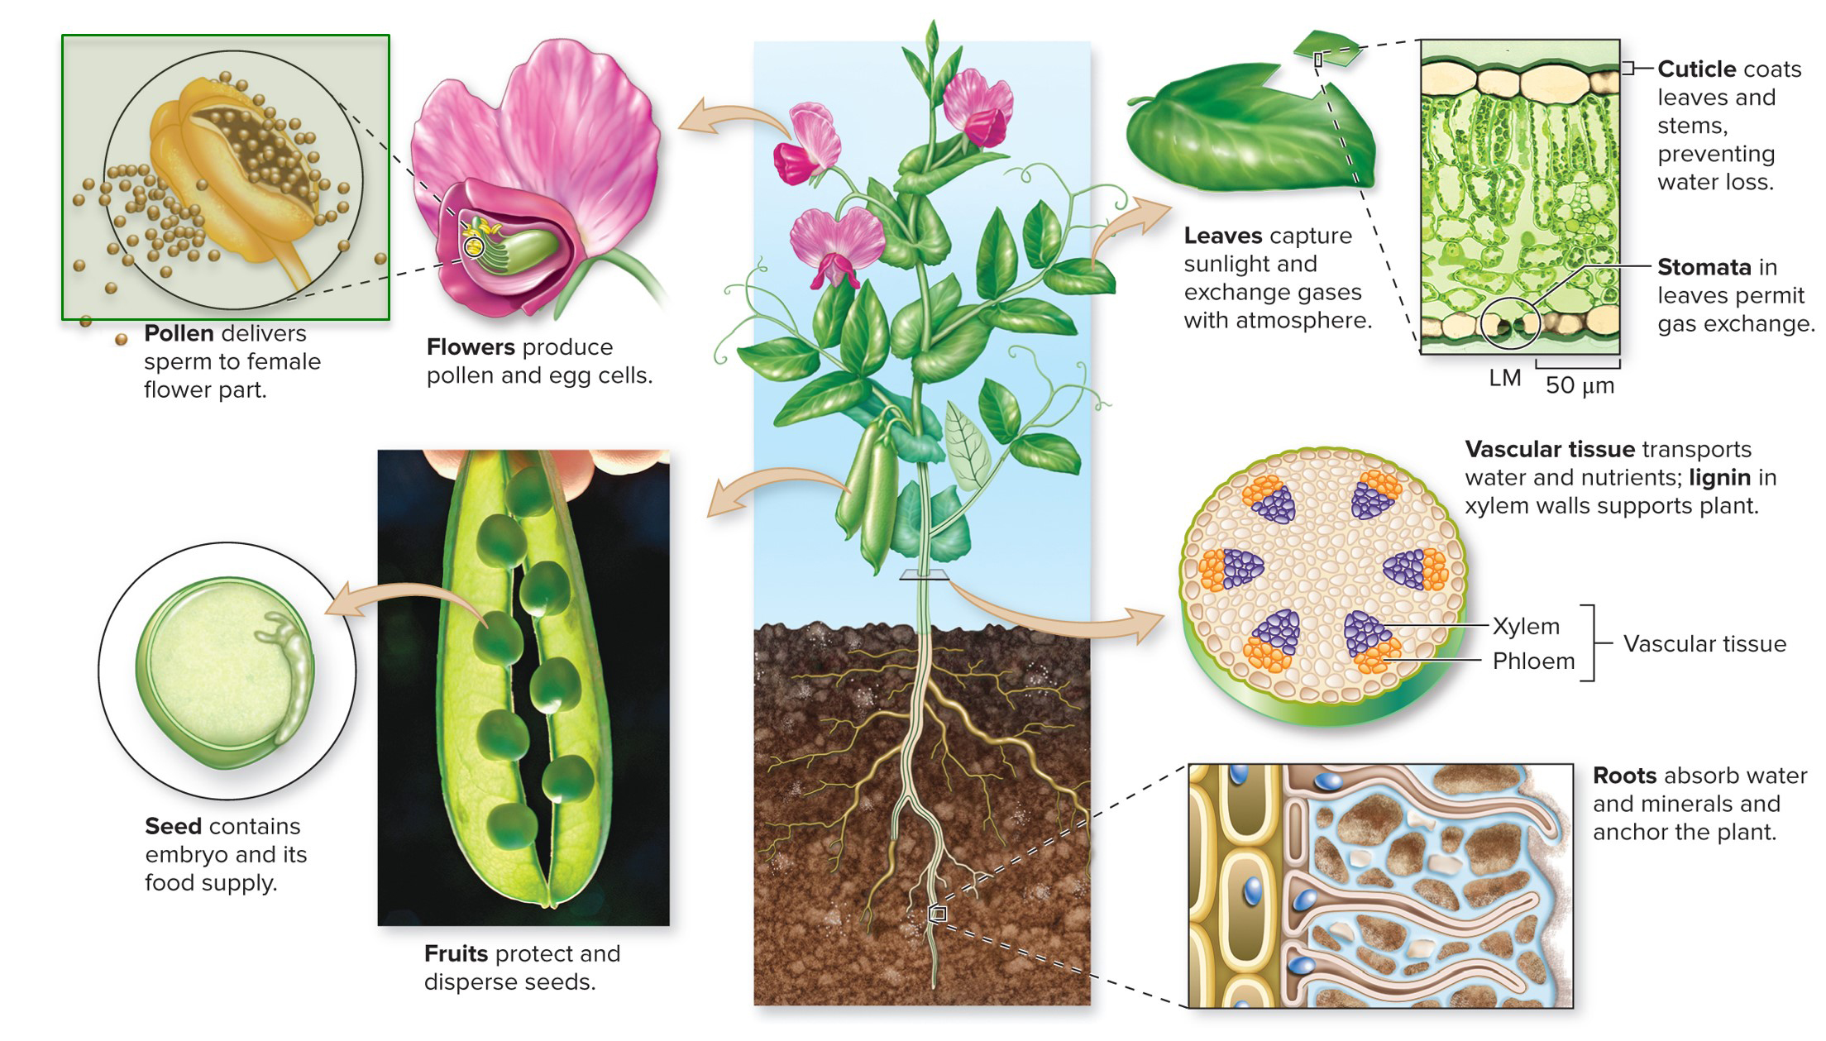
Pollen is an adaption to life on land
Seed plants produce pollen, which contains the male gametophyte. Pollination can occur without water, and often animals help spread the pollen to new plants.
(peas): ©Corbis RF; (leaf micrograph): ©M. I. Walker/Science Source
Section 19.1
Figure 19.4

Slide 25
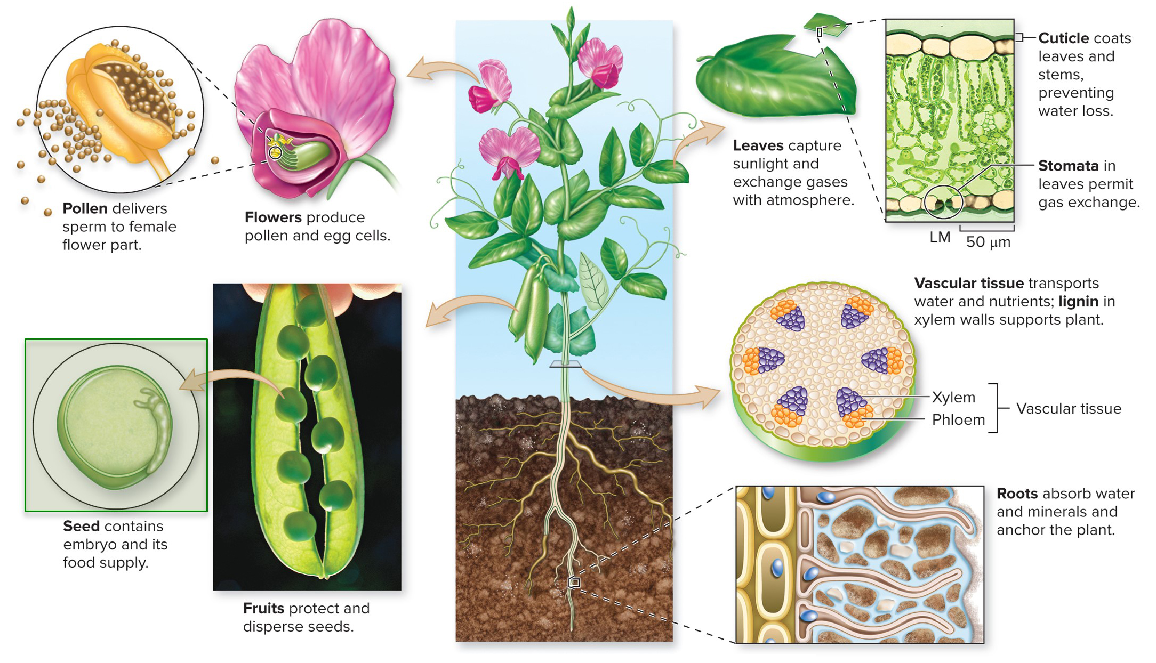
A seed is an adaption to life on land
Seeds carry dormant plant embryos packaged with a food supply and protected from drying out. They can be dispersed long distances and remain dormant until conditions are favorable.
(peas): ©Corbis RF; (leaf micrograph): ©M. I. Walker/Science Source
Section 19.1
Figure 19.4

Slide 26
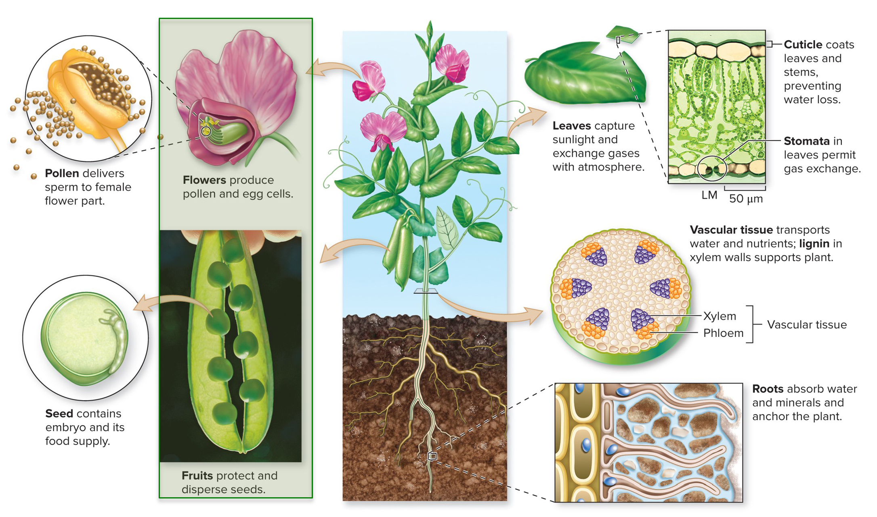
Flowers and fruit are adaptions to life on land
Flowers produce pollen and egg cells. Fruits develop after fertilization, to protect and disperse the plant offspring.
(peas): ©Corbis RF; (leaf micrograph): ©M. I. Walker/Science Source
Section 19.1
Figure 19.4

Slide 27
Clicker question #2
How many of the items in the following list are haploid?
zygote, gamete, sporophyte, spore, gametophyte
one
two
three
four
five

Slide 28
Clicker question #2, solution
How many of the items in the following list are haploid?
zygote, gamete, sporophyte, spore, gametophyte
three

Slide 29
19.1 Mastering concepts
What is the evidence that plants are closely related to green algae? Which adaptations set plants apart from green algae?
©G. R. “Dick” Roberts/Natural Sciences Image Library

Slide 30
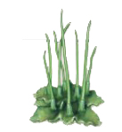
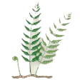
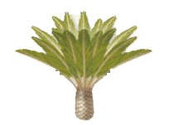
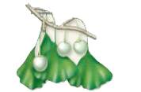
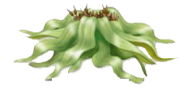
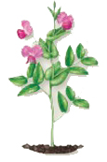
Bryophytes are the simplest plants
TABLE 19.1 Phyla of Plants
Number of Existing Species
Phylum
Examples
Nonvascular plants
Marchantiophyta
Liverworts
9000
Anthocerotophyta
Hornworts
100
Bryophyta
True mosses
15,000
Seedless vascular plants
There are about 24,000 existing species of bryophytes, or “nonvascular” plants.
Mosses, hornworts, and liverworts are bryophytes.
Lycopodiophyta
Club mosses, spike mosses
1200
Pteridophyta
Whisk ferns, true ferns, horsetails
11,500
Gymnosperms
Cycadophyta
Cycads
130
Ginkgophyta
Ginkgo
1
Pinophyta
Pines, firs, and other conifers
630
Gnetophyta
Gnetophytes
80
Angiosperms
Magnoliophyta
All flowering plants, including roses, grasses, fruit trees, maples, and oaks
> 260,000
Section 19.2
Table 19.1

Slide 31
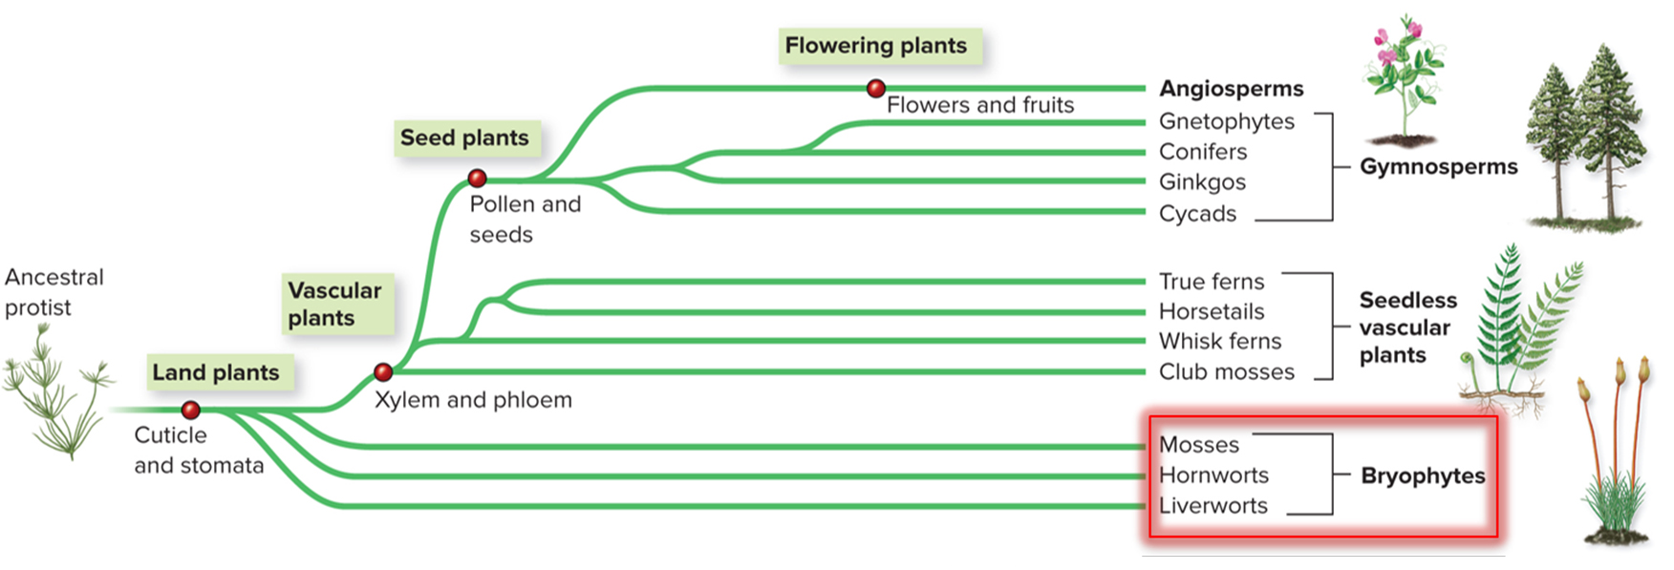
Bryophytes are nonvascular and seedless
The earliest plants probably resembled modern bryophytes. Bryophytes have no vascular tissue, roots, leaves, seeds, or flowers.
Section 19.2
Figure 19.3

Slide 32
Bryophytes are small, compact plants
Without vascular tissue and lignin (which strengthens the cell wall), bryophytes lack physical support.
Materials move from cell to cell within the plant by diffusion and osmosis.
They live in moist shady habitats where they will not dry out.
Liverwort
Hornwort
Moss
(a): ©Dr. Jeremy Burgess/Science Source; (b, c): ©Steven P. Lynch RF
Section 19.2
Figure 19.7

Slide 33
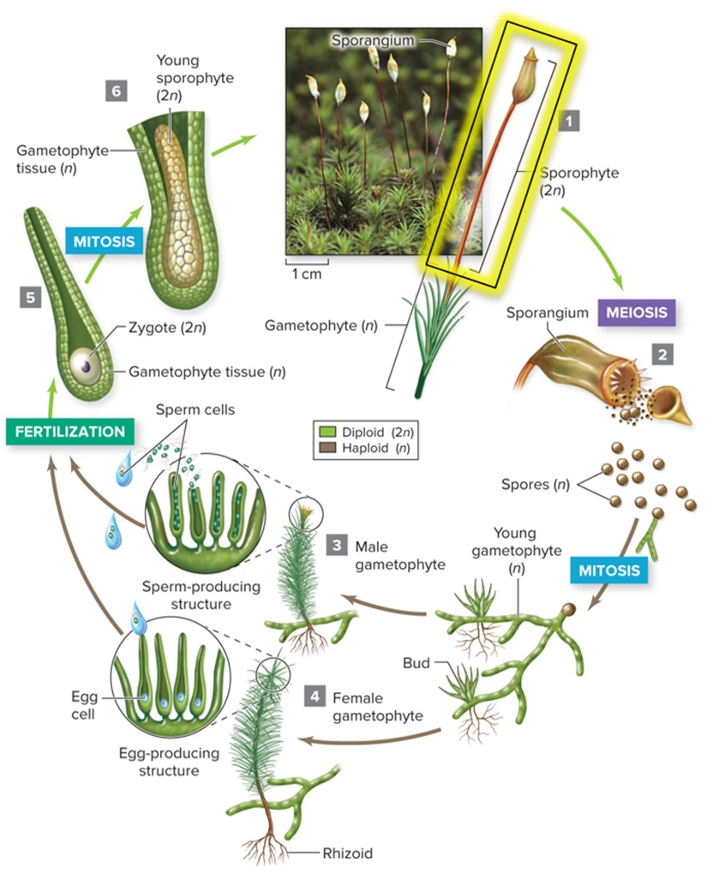
Bryophytes have a small sporophyte
The sporophyte is a stalk attached to the gametophyte.
The sporophyte produces spores that grow into new haploid gametophyte plants.
Sporophyte
©Ed Reschke/Photolibrary/Getty Images
Section 19.2
Figure 19.9

Slide 34
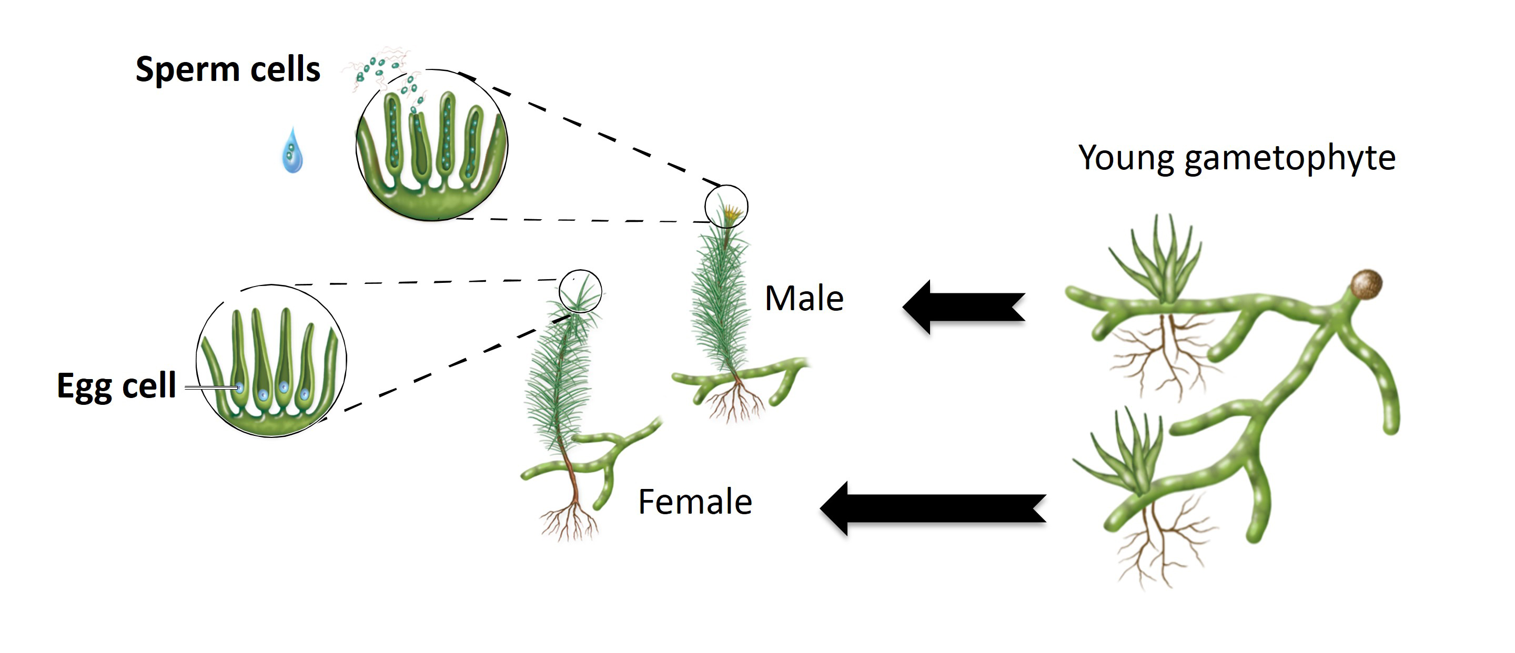
Bryophyte sexual reproduction requires water
Gametophytes have male and female structures that produce gametes (eggs and sperm). The sperm swim to the eggs.
Section 19.2
Figure 19.9

Slide 35
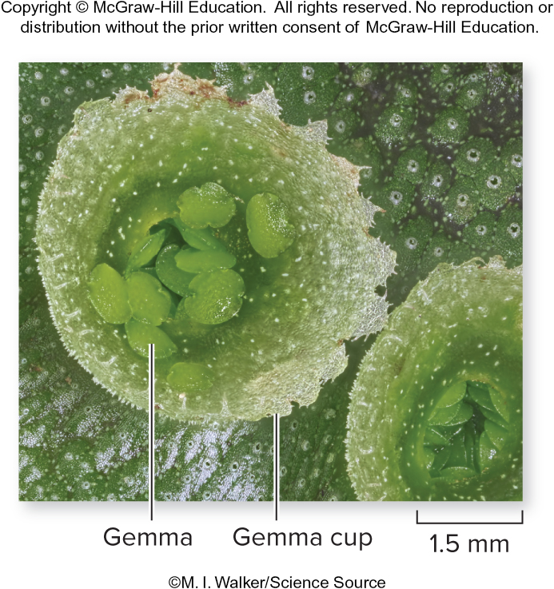
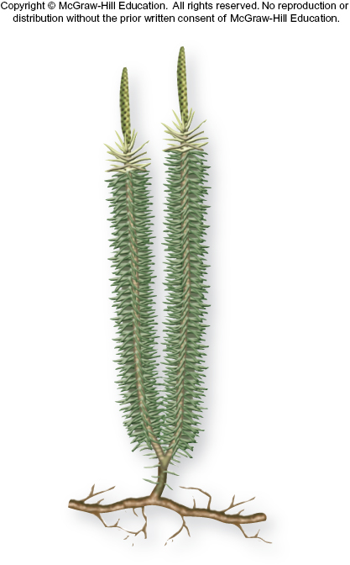
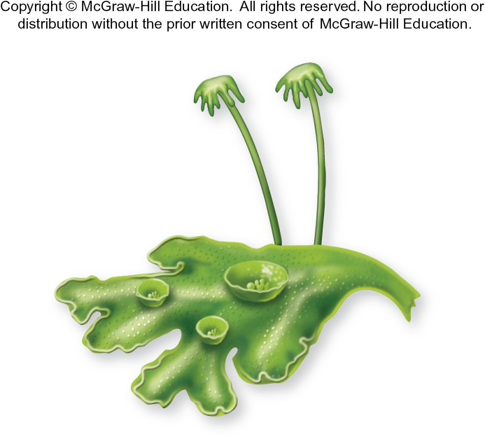
Bryophytes also reproduce asexually
Mosses and liverworts produce structures called gemmae, which are small pieces of tissue that detach from the gametophyte and grow into new plants.
©M. I. Walker/Science Source
Table 19.1
Figure 19.8
Section 19.2

Slide 36
Clicker question #3
What does the structure indicated by the arrow produce?
spores
phloem
gametes
pollen
©Steven P. Lynch RF
Figure 19.7

Slide 37
Clicker question #3, solution
What does the structure indicated by the arrow produce?
spores
©Steven P. Lynch RF
Figure 19.7

Slide 38
19.2 Mastering concepts
Name two reasons mosses usually live in moist, shady habitats.
©G. R. “Dick” Roberts/Natural Sciences Image Library

Slide 39
Seedless vascular plants have no seeds
TABLE 19.1 Phyla of Plants
Number of Existing Species
Phylum
Examples
Nonvascular plants
Marchantiophyta
Liverworts
9000
Anthocerotophyta
Hornworts
100
Bryophyta
True mosses
15,000
Seedless vascular plants
There are about 12,700 existing species of plants with vascular tissue, but no seeds.
This phylum is composed of ferns and their close relatives.
Lycopodiophyta
Club mosses, spike mosses
1200
Pteridophyta
Whisk ferns, true ferns, horsetails
11,500
Gymnosperms
Cycadophyta
Cycads
130
Ginkgophyta
Ginkgo
1
Pinophyta
Pines, firs, and other conifers
630
Gnetophyta
Gnetophytes
80
Angiosperms
Magnoliophyta
All flowering plants, including roses, grasses, fruit trees, maples, and oaks
> 260,000
Section 19.3
Table 19.1

Slide 40
Seedless vascular plants have true roots, stems, and leaves
Vascular tissue allowed these plants to grow much larger than bryophytes, which gave them an edge in competing for sunlight.
(a): ©ImageBROKER/Alamy RF; (b): ©Howard Rice/Garden Picture Library/Getty Images; (c): ©Biosphoto/Superstock; (d): ©Ed Reschke/Photolibrary/Getty Images; (e): ©Rod Planck/Science Source
Section 19.3
Figure 19.10

Slide 41
There are four groups of seedless vascular plants
Seedless vascular plants include:
Club mosses
Whisk ferns
Horsetails
True ferns
(a): ©ImageBROKER/Alamy RF; (b): ©Howard Rice/Garden Picture Library/Getty Images; (c): ©Biosphoto/Superstock;(d): ©Ed Reschke/Photolibrary/Getty Images; (e): ©Rod Planck/Science Source
Section 19.3
Figure 19.10

Slide 42
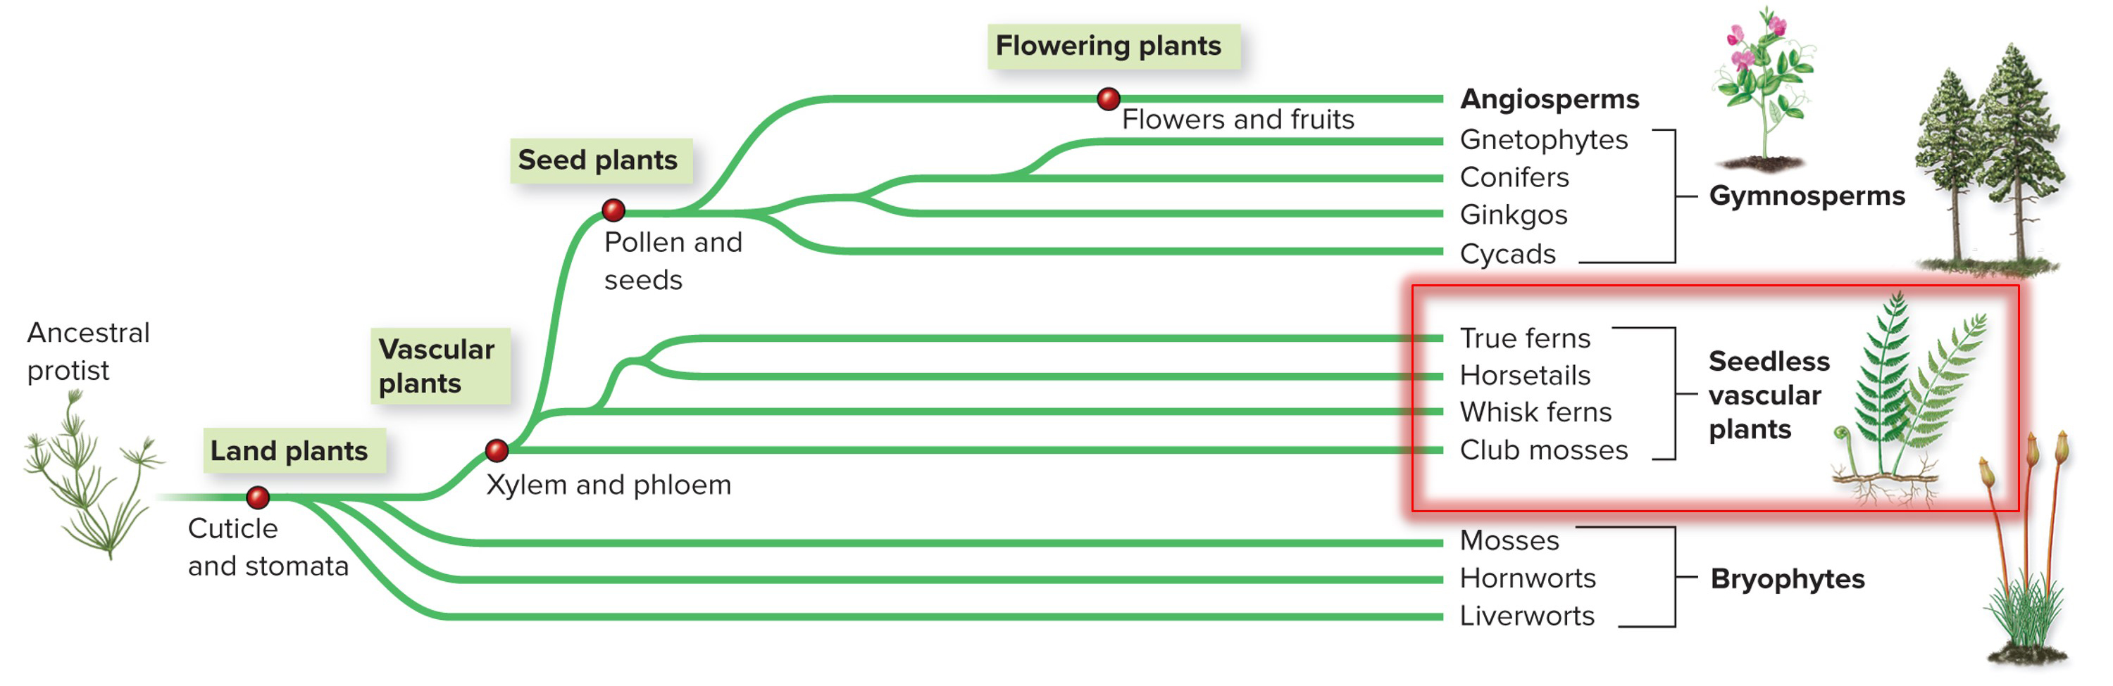
The earliest seedless vascular plants were probably modern club mosses
Fossil evidence suggests the first vascular plants originated around 425 million years ago. Club mosses are different from true mosses, which are bryophytes. They are placed in their own phylum.
Section 19.3
Figure 19.3

Slide 43
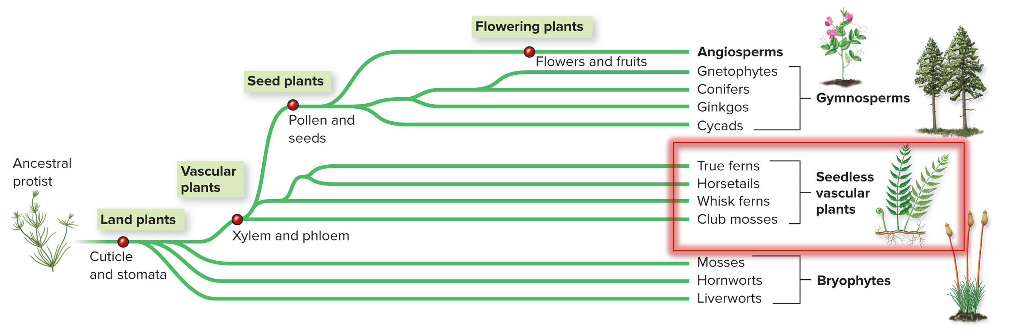
Ferns and their relatives evolved later
Whisk ferns, horsetails, and true ferns make up a second phylum of seedless vascular plants that first appeared around 375 million years ago. Most, but not all, of these species live on land.
Section 19.3
Figure 19.3

Slide 44
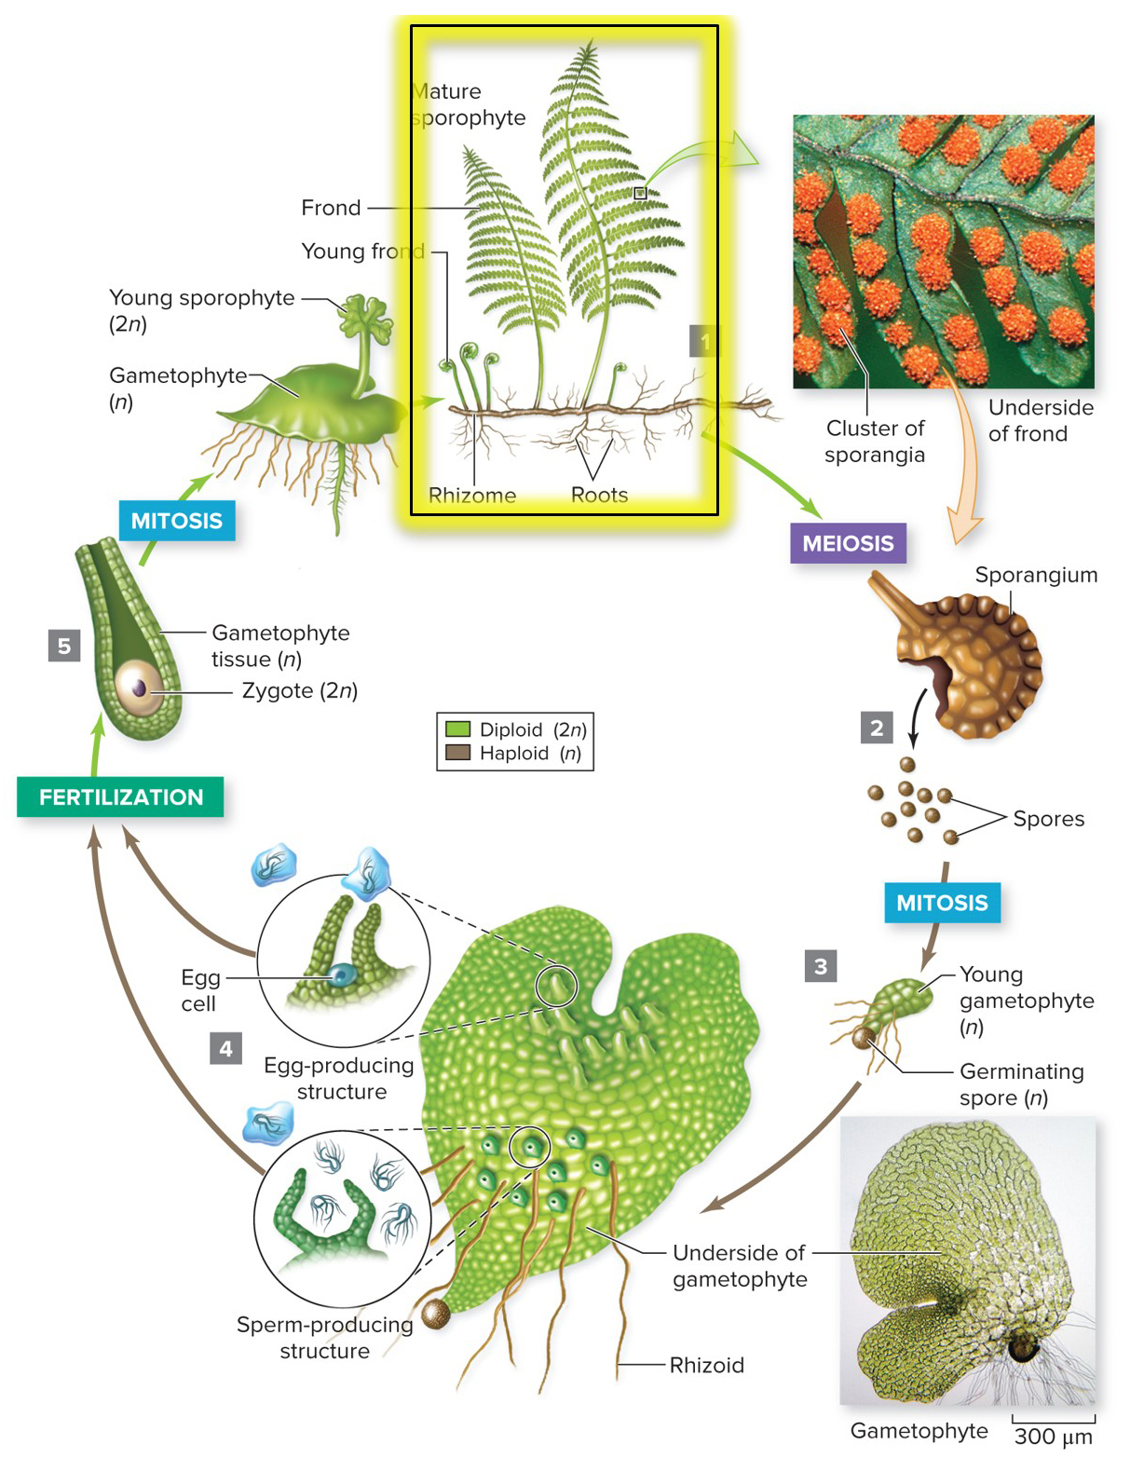
Seedless vascular plants have a conspicuous sporophyte
The sporophyte develops from a zygote, then grows up and out of the gametophyte.
As it matures, the sporophyte detaches and grows separately from the gametophyte.
(spores): ©Ed Reschke/Photolibrary/Getty Images; (gametophyte): ©Les Hickok and Thomas Warne, C-Fern
Section 19.3
Figure 19.11

Slide 45
Spores form under the leaves of the sporophyte
Haploid spores grow on the underside of sporophyte leaves.
The spores form by meiosis and then develop into gametophytes.
(spores): ©Ed Reschke/Photolibrary/Getty Images; (gametophyte): ©Les Hickok and Thomas Warne, C-Fern
Section 19.3
Figure 19.11

Slide 46
Seedless vascular plants require water for reproduction
Gametophytes produce male and female gametes. Sperm swim to the eggs in water.
Section 19.3
Figure 19.11

Slide 47
19.3 Mastering concepts
How are seedless vascular plants similar to and different from bryophytes?
©G. R. “Dick Roberts/Natural Sciences Image Library

Slide 48
All plants alternate generations
In bryophytes and seedless vascular plants, the gametophyte is more prominent than the sporophyte.
In gymnosperms and angiosperms, the sporophyte is much more prominent than the gametophyte.
Section 19.1
Figure 19.19

Slide 49
Gymnosperms have pollen and seeds
TABLE 19.1 Phyla of Plants
Number of Existing Species
Phylum
Examples
Nonvascular plants
Marchantiophyta
Liverworts
9000
Anthocerotophyta
Hornworts
100
Bryophyta
True mosses
15,000
Seedless vascular plants
There are about 850 existing species of gymnosperms.
They evolved about 300 million years ago.
Lycopodiophyta
Club mosses, spike mosses
1200
Pteridophyta
Whisk ferns, true ferns, horsetails
11,500
Gymnosperms
Cycadophyta
Cycads
130
Ginkgophyta
Ginkgo
1
Pinophyta
Pines, firs, and other conifers
630
Gnetophyta
Gnetophytes
80
Angiosperms
Magnoliophyta
All flowering plants, including roses, grasses, fruit trees, maples, and oaks
> 260,000
Section 19.4
Table 19.1

Slide 50
Gymnosperms are “naked seed” plants
New reproductive adaptations allowed gymnosperms to outcompete seedless vascular plants in many habitats. Gymnosperms produce seeds but do not enclose them in fruit.
Section 19.4
Figure 19.3

Slide 51
Gymnosperms include cycads
Cycads were prevalent in the Mesozoic era, but many species are near extinction in the wild today. They have palmlike leaves and produce large cones.
Cycads
Ginkgo
Conifers
Gnetophytes
(spores): ©Ed Reschke/Photolibrary/Getty Images; (gametophyte): ©Les Hickok and Thomas Warne, C-Fern(a, cycad): ©Alena Brozova/Alamy;
(a, cycad cone): ©Pat Pendarvis; (b, ginkgo): ©Light of Peace/Flickr/Getty Images RF; (b, ginkgo seed): ©G. R. “Dick” Roberts/Natural Sciences Image Library;
(c, conifer): ©Jack Dykinga/Nature Picture Library; (c, conifer cone): ©Ed Reschke/Peter Arnold/Getty Images;
(d, gnetophyte): ©Jeff Foott/Discovery Channel Images/Getty Images; (d, gnetophyte cone): ©Steven P. Lynch/McGraw-Hill Education
Section 19.4
Figure 19.12

Slide 52
Gymnosperms include the ginkgo
Only one species exists today, and it no longer grows wild in nature. The ginkgo tree has distinctive, fan-shaped leaves.
Cycads
Ginkgo
Conifers
Gnetophytes
(spores): ©Ed Reschke/Photolibrary/Getty Images; (gametophyte): ©Les Hickok and Thomas Warne, C-Fern(a, cycad): ©Alena Brozova/Alamy;
(a, cycad cone): ©Pat Pendarvis; (b, ginkgo): ©Light of Peace/Flickr/Getty Images RF; (b, ginkgo seed): ©G. R. “Dick” Roberts/Natural Sciences Image Library; (c, conifer): ©Jack Dykinga/Nature Picture Library; (c, conifer cone): ©Ed Reschke/Peter Arnold/Getty Images;
(d, gnetophyte): ©Jeff Foott/Discovery Channel Images/Getty Images; (d, gnetophyte cone): ©Steven P. Lynch/McGraw-Hill Education
Section 19.4
Figure 19.12

Slide 53
Gymnosperms include conifers
Conifers such as pine trees are familiar gymnosperms. Their leaves are needlelike and they produce egg cells and pollen in cones.
Cycads
Ginkgo
Conifers
Gnetophytes
(spores): ©Ed Reschke/Photolibrary/Getty Images; (gametophyte): ©Les Hickok and Thomas Warne, C-Fern(a, cycad): ©Alena Brozova/Alamy;
(a, cycad cone): ©Pat Pendarvis; (b, ginkgo): ©Light of Peace/Flickr/Getty Images RF; (b, ginkgo seed): ©G. R. “Dick” Roberts/Natural Sciences Image Library;
(c, conifer): ©Jack Dykinga/Nature Picture Library; (c, conifer cone): ©Ed Reschke/Peter Arnold/Getty Images;
(d, gnetophyte): ©Jeff Foott/Discovery Channel Images/Getty Images; (d, gnetophyte cone): ©Steven P. Lynch/McGraw-Hill Education
Section 19.4
Figure 19.12

Slide 54
Gymnosperms include gnetophytes
These plants have a mixture of traits that make them difficult to classify. Ephedra, shown here, has cones that resemble tiny flowers.
Cycads
Ginkgo
Conifers
Gnetophytes
(spores): ©Ed Reschke/Photolibrary/Getty Images; (gametophyte): ©Les Hickok and Thomas Warne, C-Fern(a, cycad): ©Alena Brozova/Alamy;
(a, cycad cone): ©Pat Pendarvis; (b, ginkgo): ©Light of Peace/Flickr/Getty Images RF; (b, ginkgo seed): ©G. R. “Dick” Roberts/Natural Sciences Image Library;
(c, conifer): ©Jack Dykinga/Nature Picture Library; (c, conifer cone): ©Ed Reschke/Peter Arnold/Getty Images;
(d, gnetophyte): ©Jeff Foott/Discovery Channel Images/Getty Images; (d, gnetophyte cone): ©Steven P. Lynch/McGraw-Hill Education
Section 19.4
Figure 19.12

Slide 55
Gymnosperm sporophytes are large and conspicuous
The sporophytes of most gymnosperms are woody trees or shrubs. Reproductive structures and leaf types are diverse.
Sporophytes produce both male and female cones, where spores form by meiosis.
Section 19.4
Figure 19.13

Slide 56
Gymnosperm sporophytes produce spores in cones
Male cones produce microspores on cone scales.
Ovules on female cone scales produce megaspores.
Section 19.4
Figure 19.13

Slide 57
Gymnosperm gametophytes are microscopic
Male gametophytes are enclosed inside grains of pollen. Pollen can be dispersed by wind to settle on new plants.
The tiny female gametophytes stay in the cone, enclosed inside the ovule.
Section 19.4
Figure 19.13

Slide 58
Pollination gets male and female gametophytes together
The male gametophyte produces a pollen tube that grows through the ovule until it reaches the egg cells inside.
Section 19.4
Figure 19.13

Slide 59
Fertilization in gymnosperms does not require water
Sperm do not need to swim through water to eggs for fertilization.
Section 19.4
Figure 19.13

Slide 60
Gymnosperms zygotes stay inside seeds
The zygote is the first cell of the sporophyte.
It grows mitotically into an embryo, inside a seed, on a female cone scale.
Section 19.4
Figure 19.13

Slide 61
Seeds protect sporophyte embryos
Gymnosperm seeds have a tough outer coat and can be dispersed by wind or animals.
When conditions are favorable they will germinate into seedlings, which develop into mature sporophyte trees.
Section 19.4
Figure 19.13

Slide 62
Clicker question #4
How is gymnosperm reproduction different from that of ferns?
Gymnosperms produce seeds; ferns don’t.
Gymnosperms produce swimming sperm; ferns don’t.
Gymnosperms produce zygotes; ferns don’t.
Gymnosperms don’t produce spores; ferns do.

Slide 63
Clicker question #4, solution
How is gymnosperm reproduction different from that of ferns?
Gymnosperms produce seeds; ferns don’t.

Slide 64
19.4 Mastering concepts
What happens during and after pollination in gymnosperms?
©G. R. ”Dick” Roberts/Natural Sciences Image Library

Slide 65
Angiosperms have flowers and fruit
TABLE 19.1 Phyla of Plants
Number of Existing Species
Phylum
Examples
Nonvascular plants
Marchantiophyta
Liverworts
9000
Anthocerotophyta
Hornworts
100
Bryophyta
True mosses
15,000
Seedless vascular plants
Lycopodiophyta
Club mosses, spike mosses
1200
95% of all living plant species are angiosperms.
They evolved about 144 million years ago and rapidly diversified into over 260,000 different species.
11,500
Pteridophyta
Whisk ferns, true ferns, horsetails
Gymnosperms
Cycadophyta
Cycads
130
Ginkgophyta
Ginkgo
1
Pinophyta
Pines, firs, and other conifers
630
Gnetophyta
Gnetophytes
80
Angiosperms
Magnoliophyta
All flowering plants, including roses, grasses, fruit trees, maples, and oaks
> 260,000
Section 19.5
Table 19.1

Slide 66
Angiosperms produce seeds in fruits
Angiosperms produce pollen and egg cells in flowers, which develop into fruit after fertilization.
Section 19.5
Figure 19.3

Slide 67
97% of angiosperms are either eudicots or monocots
Scientists classify the diverse angiosperms into several groups, notably the eudicots and monocots.
The other 3% of angiosperms are a paraphyletic group called basal angiosperms.
Section 19.5
Figure 19.14

Slide 68
Most angiosperms are eudicots
Eudicots have two cotyledons, which are the first leaves to emerge during germination. Their pollen grains have three pores.
Examples include roses, daisies, sunflowers, oak trees, beans, and the model organism Arabidopsis.
Section 19.5
Figure 19.14

Slide 69
Many angiosperms are monocots
Monocots have one cotyledon. Their pollen grains have one pore.
Examples include orchids, lilies, grass, bananas, rice, wheat, and corn.
Section 19.5
Figure 19.14

Slide 70
Angiosperm sporophytes are large and conspicuous
Trees and other familiar angiosperms we see are the sporophytes.
Section 19.5
Figure 19.15

Slide 71
Flowers are sporophyte reproductive structures in angiosperms
Pollen sacs in flowers produce microspores that develop into male gametophytes.
The ovule in the flower produces megaspores that develop into the female gametophytes.
Section 19.4
Figure 19.15

Slide 72
Microscopic gametophytes get together at pollination
During pollination, a grain of pollen (male gametophyte) produces a pollen tube to reach the female gametophyte.
Female gametophytes consist of one egg and a central cell that contains two polar nuclei.
Section 19.5
Figure 19.15

Slide 73
Angiosperms have double fertilization
Two sperm nuclei travel through the pollen tube.
One fertilizes the egg, forming a zygote. This is the first cell of the sporophyte.
The other sperm fertilizes the central cell’s polar nuclei. This will develop into the endosperm, which feeds the embryo inside the seed.
Section 19.5
Figure 19.15

Slide 74
Seeds contain embryo and endosperm
In angiosperms, the ovule develops into a seed. At the same time, the ovary that surrounds the ovule develops into a fruit.
Section 19.5
Figure 19.15

Slide 75
Angiosperm seeds germinate when conditions are favorable
Seeds germinate into young sporophytes.
Section 19.5
Figure 19.15

Slide 76
Wind and animals assist angiosperm reproduction
Pollination by wind
Pollen is transported great distances by wind.
Plants with attractive nectar, petals, or bright colors co-evolved with animals that pollinate them.
b. Pollination by animals
(a, maple tree): ©Steven P. Lynch/McGraw-Hill Education; (a, cattails): ©Hans Reinhard/Okapia/Science Source; (b, chamomile): ©McGraw-Hill Education; (b, banana tree): ©Igor Prahin/Flickr Open/Getty Images RF
Figure 19.16

Slide 77
Clicker question #5
In the angiosperm life cycle, the seed is analogous to the ____ in the human life cycle.
male reproductive organs
female reproductive organs
uterus and fetus
sperm cell
egg cell

Slide 78
Clicker question #5, solution
In the angiosperm life cycle, the seed is analogous to the ____ in the human life cycle.
uterus and fetus

Slide 79
19.5 Mastering concepts
In what ways are the life cycles of angiosperms similar to and different from those of conifers?
©G. R. ”Dick” Roberts/Natural Sciences Image Library

Slide 80
Summary: alternation of generations
The diploid sporophyte plant produces haploid spores that grow into gametophyte plants.
Haploid gametophytes produce gametes that unite at fertilization.
Figure 19.19

Slide 81
Investigating life: Genetic messages from ancient ecosystems
Frozen soils preserve DNA from organisms that lived long ago.
Researchers drill through the permafrost to collect DNA that will help them learn about ancient ecosystems.
Courtesy of K. Schaefer
Section 19.6
Figure 19.17

Slide 82
Investigating life: Data reveals changing plant communities
Chloroplast DNA isolated from sediment samples shows that herbs predominated in Siberia from 400,000 years ago until about 10,000 years ago, when mosses and shrubs overtook them.
Section 19.6
Figure 19.18

