Slide 1
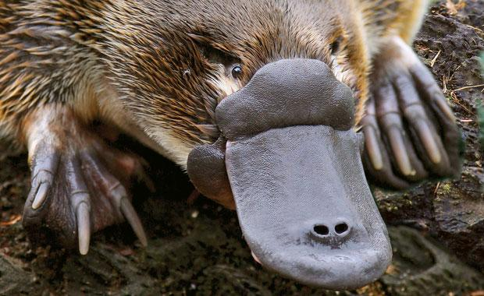
Phylogeny and the Tree of Life

Slide 2
Overview: Investigating the Tree of Life
Phylogeny is the evolutionary history of a species or group of related species
The discipline of systematics classifies organisms and determines their evolutionary relationships
Systematists use fossil, molecular, and genetic data to infer evolutionary relationships

Slide 3
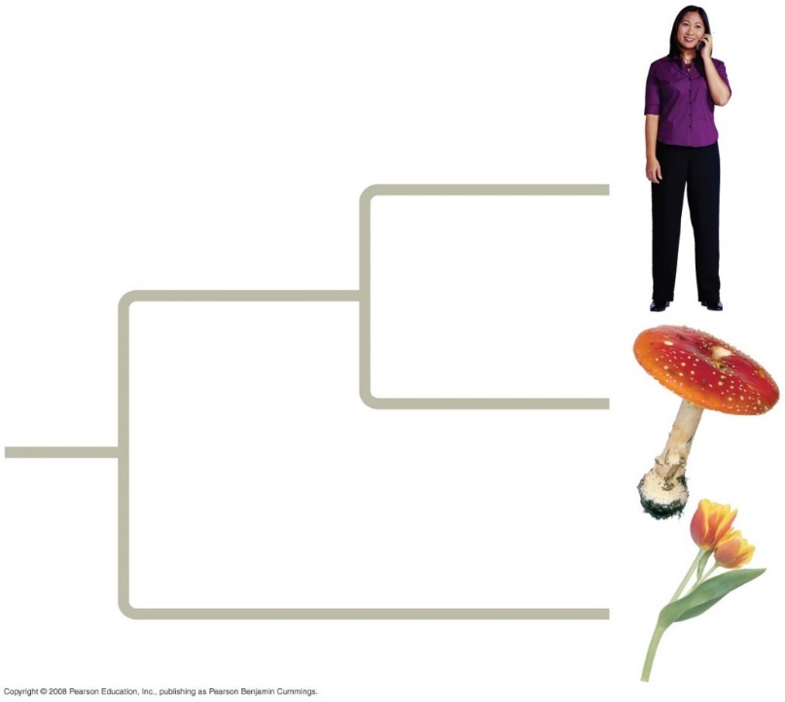
Taxonomy
The science of classifying organisms.
Tells us about the degree of relation between different organisms

Slide 4
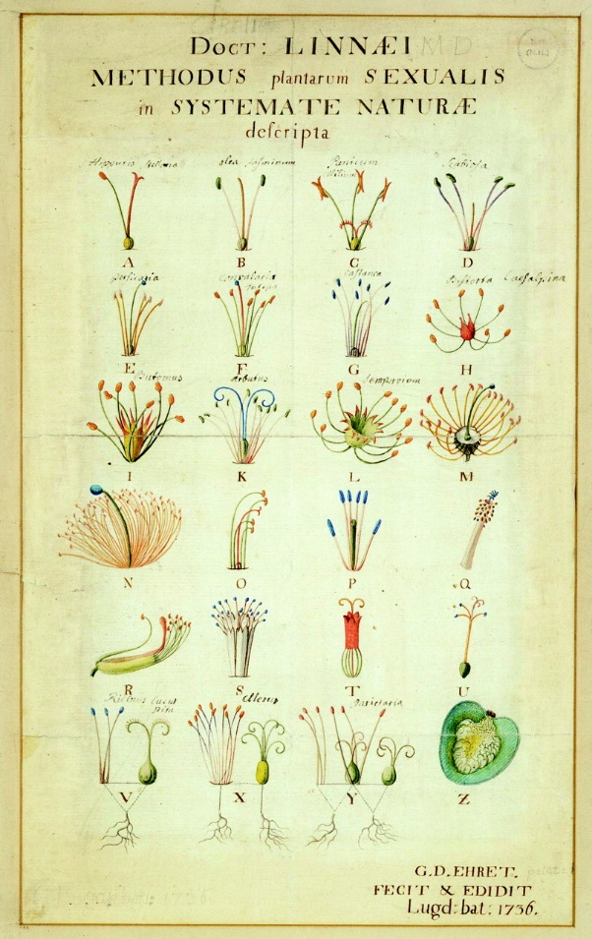
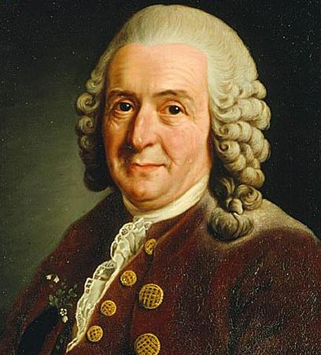
Taxonomy
Developed by Swedish biologist Carolus Linnaeus (1707 — 1778).
Binomial naming system

Slide 5
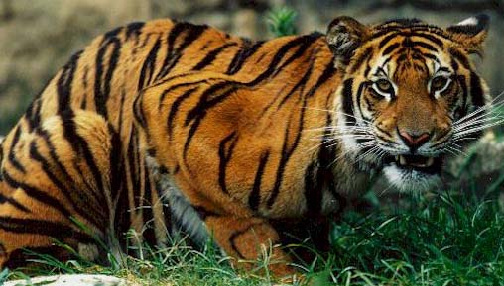
Tiger Classification
Domain: Eukarya
Kingdom Animalia
Phylum Chordata
Class Mammalia
Order Carnivora
Family Felidae
Genus Panthera
Species tigris
Dear King Phillip climbed over the fence and got shot
Dude, Keep Plates Clean Or Family Gets Sick

Slide 6
Biological Nomenclature
A species is both defined by its genus name and specific name.
Ex. Panthera tigris
Panthera- genus name
tigris- species name

Slide 7
Biological Species
Organisms that are genetically similar, and have ability to interbreed and produce viable, fertile offspring

Slide 8
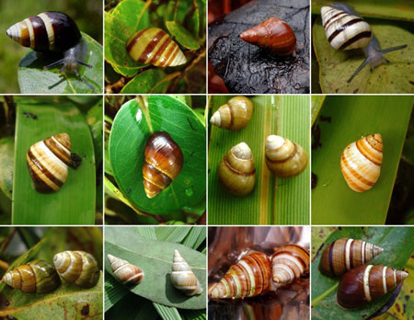
Subspecies
Might interbreed if a barrier or other challenge was removed (such as distance).
Hawaiian endemic snails (kahuli)
Notes:
http://hbs.bishopmuseum.org/pubs-online/pdf/op30p27.pdf

Slide 9
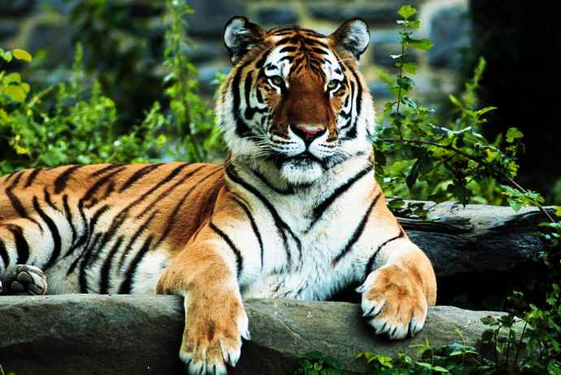
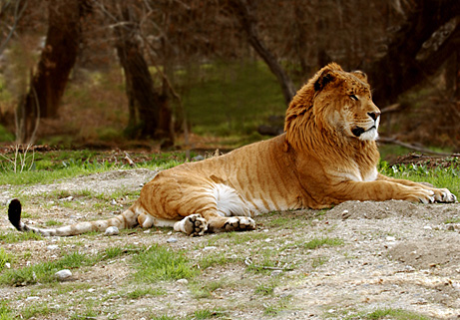
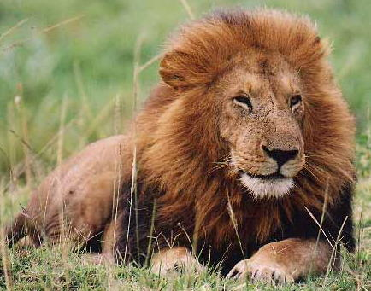
Hybrids
Offspring is sterile
Panthera tigris
Panthera leo
tigon

Slide 10
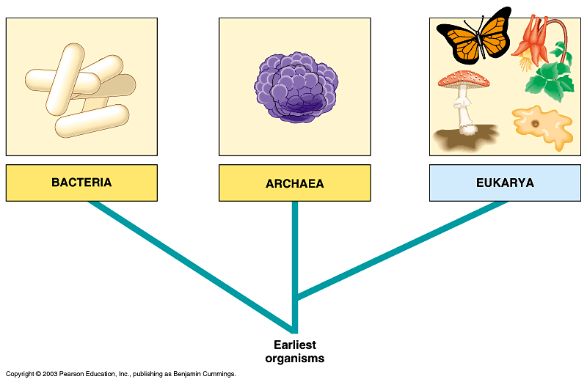
Three-domain system
Prokaryotes
Extremophiles
Eukaryotes
Look at how this evolution happened!

Slide 11
Linking Classification and Phylogeny
Systematists depict evolutionary relationships in branching phylogenetic trees
Linnaean classification and phylogeny can differ from each other
Systematists have proposed the PhyloCode, which recognizes only groups that include a common ancestor and all its descendants

Slide 12
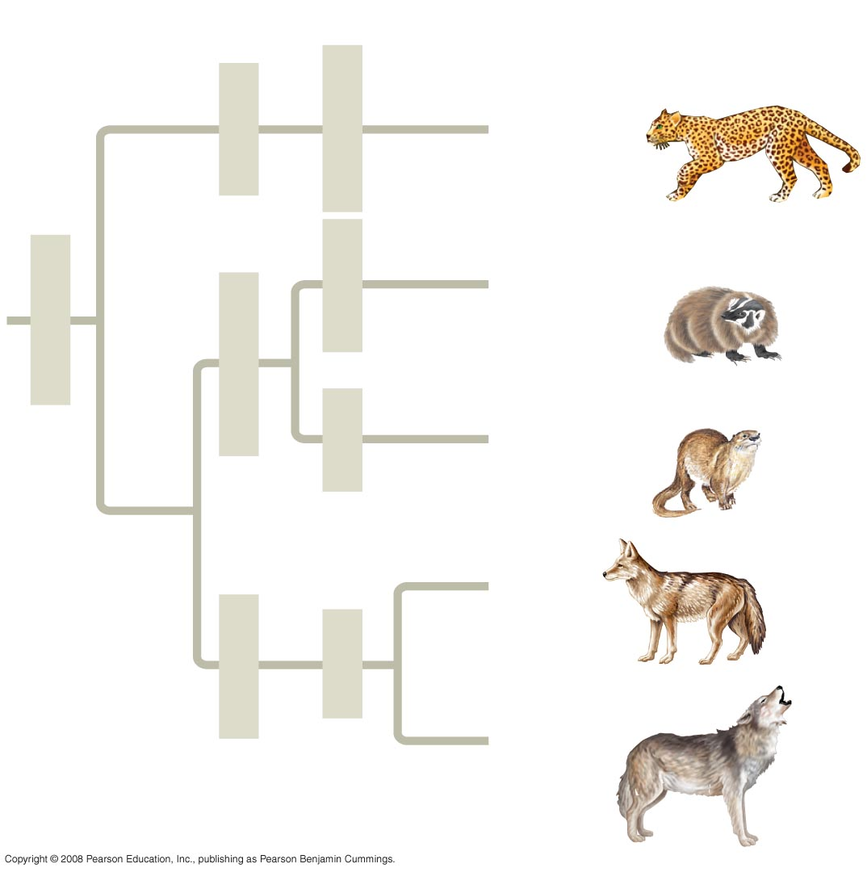
Fig. 26-4
Species
Order
Family
Genus
Felidae
Panthera
Pantherapardus
Taxidea
Taxidea
taxus
Carnivora
Mustelidae
Lutra
Lutra lutra
Canis
latrans
Canidae
Canis
Canis
lupus
Notes:
Figure 26.4 The connection between classification and phylogeny

Slide 13
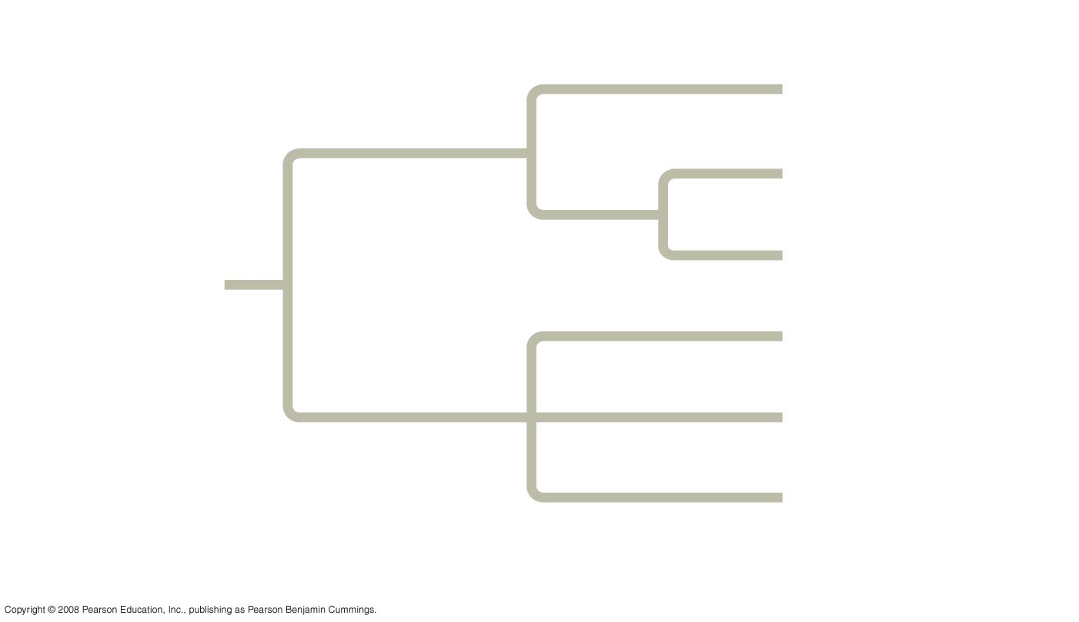
Fig. 26-5
Branch point
(node)
Taxon A
Taxon B
Sister
taxa
Taxon C
ANCESTRAL
LINEAGE
Taxon D
Taxon E
Taxon F
Common ancestor of
taxa A–F
Polytomy: more than 2 groups emerge
Notes:
Figure 26.5 How to read a phylogenetic tree

Slide 14
What We Can and Cannot Learn from Phylogenetic Trees
Phylogenetic trees do show patterns of descent
Phylogenetic trees do not indicate when species evolved or how much genetic change occurred in a lineage
It shouldn’t be assumed that a taxon evolved from the taxon next to it
Applications: whale meat sold illegally in Japan

Slide 15
Phylogenies are inferred from morphological and molecular data
To infer phylogenies, systematists gather information about morphologies, genes, and biochemistry of living organisms
Organisms with similar morphologies or DNA sequences are likely to be more closely related than organisms with different structures or sequences

Slide 16
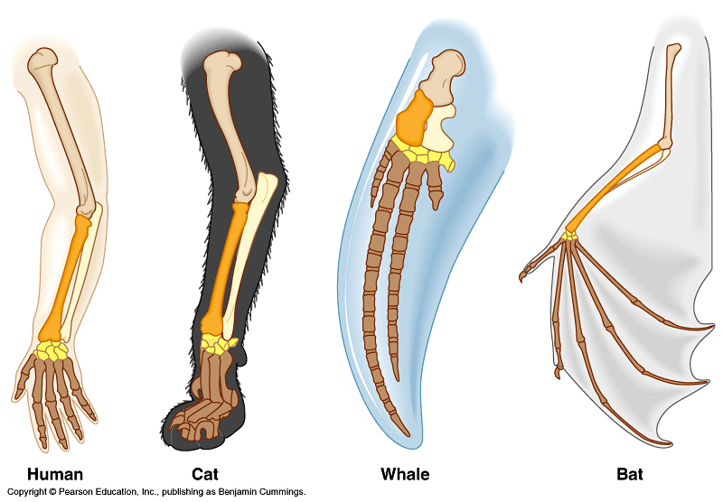
Compare the bones
Homologous Structures are similarities due to shared ancestry, such as the bones of a whale’s flipper and a tiger’s front limb.

Slide 17
Convergent Evolution
Convergent Evolution: has taken place when two organisms developed similarities as they adapted to similar environmental challenges-not because they evolved from a common ancestor.
Example: The streamlined bodies of a tuna and a dolphin show convergent evolution.

Slide 18
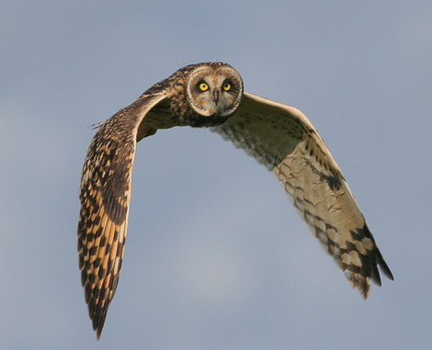
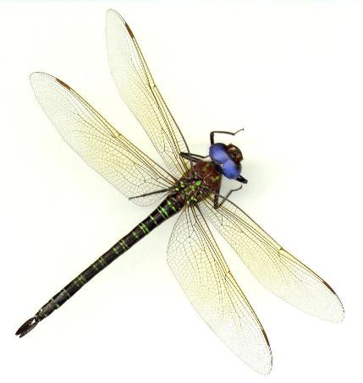
But don’t be fooled by these…
Analogous structures
look similar on the outside
Same function
different structure & development
on the inside
different origin
no evolutionary relationship
Solving a similar problem with a similar solution

Slide 19
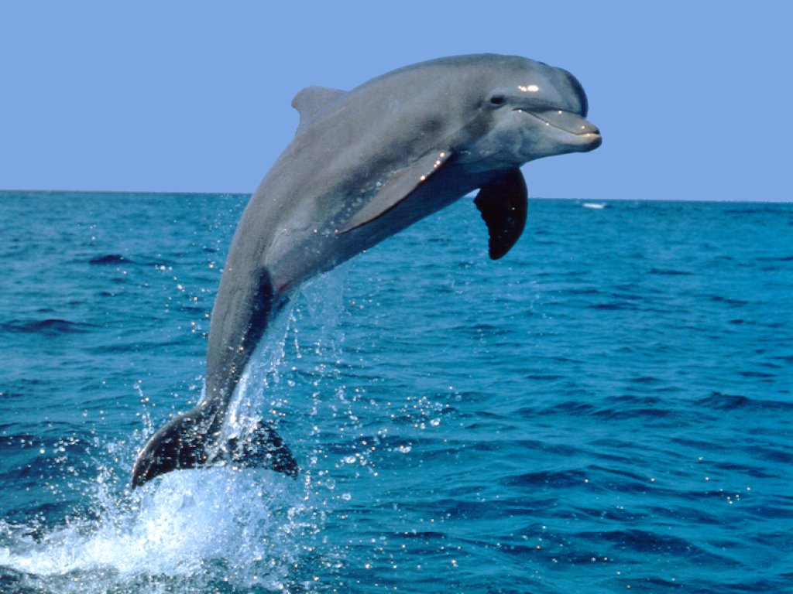
Analogous structures
Dolphins: aquatic mammal
Fish: aquatic vertebrate
both adapted to life in the sea
not closely related

Slide 20
Evaluating Molecular Homologies
Systematists use computer programs and mathematical tools when analyzing comparable DNA segments from different organisms

Slide 21
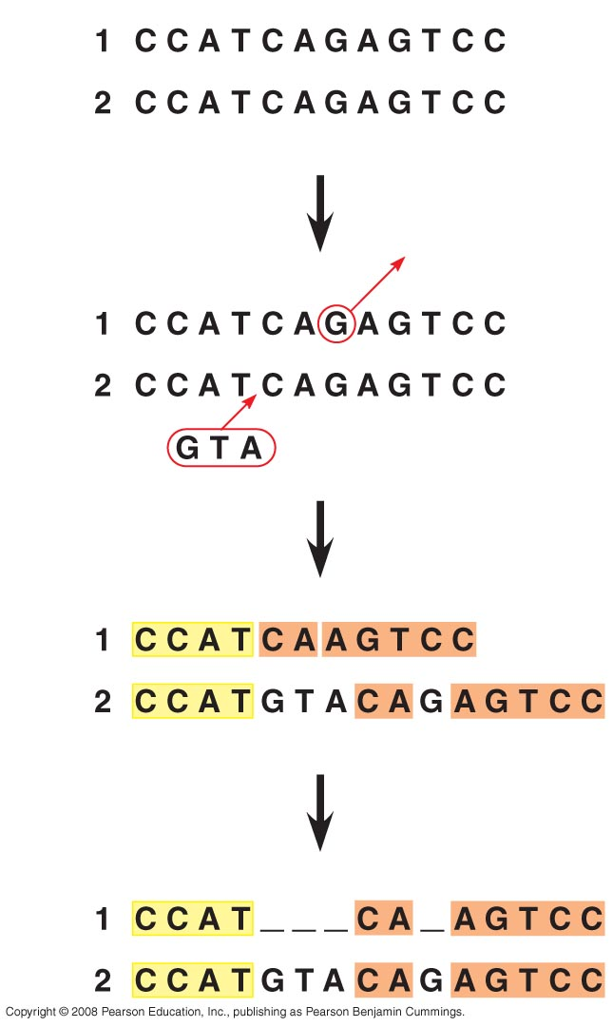
Fig. 26-8
1
Deletion
2
Types of mutations that
notmally occur
Insertion
3
Orange sections no longer align
4
only with addition of gaps
will they align
Notes:
Figure 26.8 Aligning segments of DNA

Slide 22
It is also important to distinguish homology from analogy in molecular similarities
Mathematical tools help to identify molecular homoplasies, or coincidences
Molecular systematics uses DNA and other molecular data to determine evolutionary relationships

Slide 23
Shared characters are used to construct phylogenetic trees
Cladistics groups organisms by common descent
A clade is a group of species that includes an ancestral species and all its descendants
A valid clade is monophyletic, signifying that it consists of the ancestor species and all its descendants
A paraphyletic grouping consists of an ancestral species and some, but not all, of the descendants
A polyphyletic grouping consists of various species that lack a common ancestor

Slide 24
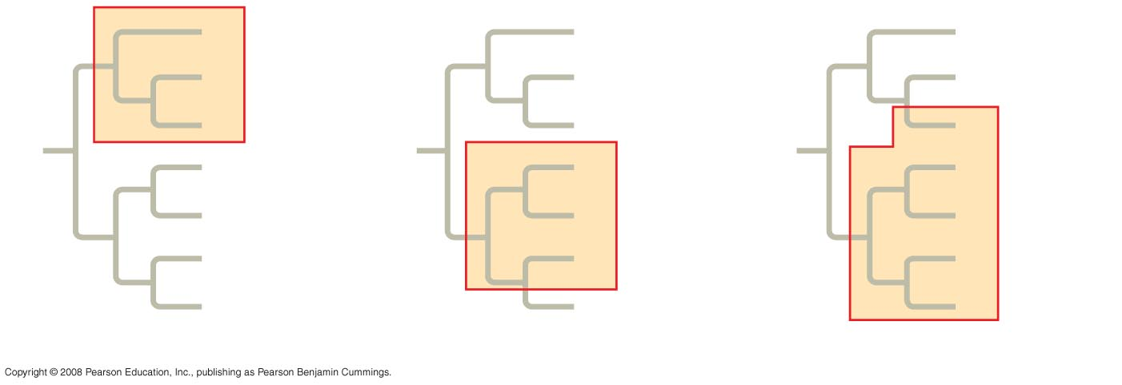
Fig. 26-10
Includes all descendants
A
A
A
B
Group I
B
B
C
C
C
D
D
D
E
E
Group II
E
Group III
F
F
F
G
G
G
(a) Monophyletic group (clade)
(b) Paraphyletic group
(c) Polyphyletic group
Notes:
Figure 26.10 Monophyletic, paraphyletic, and polyphyletic groups

Slide 25
Shared Ancestral and Shared Derived Characters
In comparison with its ancestor, an organism has both shared and different characteristics
A shared ancestral character is a character that originated in an ancestor of the taxon (vertebrae in mammals)
A shared derived character is an evolutionary novelty unique to a particular clade (hair in mammals)
A character can be both ancestral and derived, depending on the context, it is useful to know in which clade a shared derived character first appeared

Slide 26
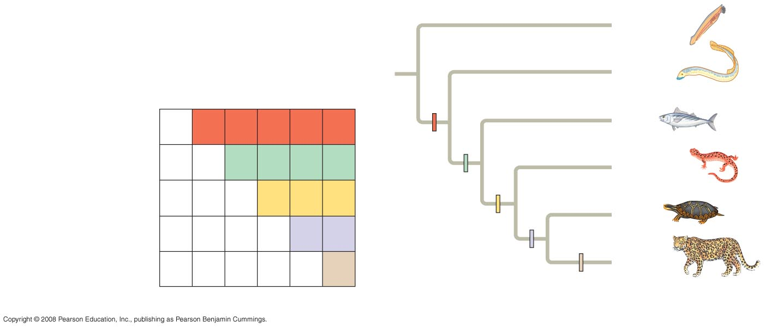
Fig. 26-11
TAXA
Lancelet
(outgroup)
Lancelet
(outgroup)
Lamprey
Salamander
Leopard
Lamprey
Tuna
Turtle
Vertebral column
(backbone)
0
1
1
1
1
1
Tuna
Vertebral
column
Hinged jaws
0
0
1
1
1
1
Salamander
Hinged jaws
CHARACTERS
Four walking legs
0
0
0
1
1
1
Four walking legs
Turtle
Amniotic (shelled) egg
0
0
0
0
1
1
Amniotic egg
Leopard
Hair
0
0
0
0
0
1
Hair
(a) Character table
(b) Phylogenetic tree
Notes:
Figure 26.11 Constructing a phylogenetic tree

Slide 27
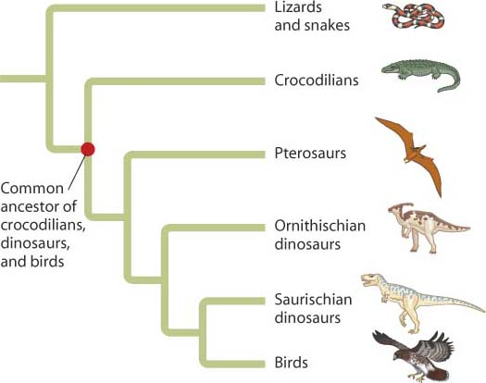

Slide 28
An organism’s evolutionary history is documented in its genome
Comparing nucleic acids or other molecules to infer relatedness is a valuable tool for tracing organisms’ evolutionary history
DNA that codes for rRNA changes relatively slowly and is useful for investigating branching points hundreds of millions of years ago
mtDNA evolves rapidly and can be used to explore recent evolutionary events

Slide 29
Gene Duplications and Gene Families
Gene duplication increases the number of genes in the genome, providing more opportunities for evolutionary changes
Like homologous genes, duplicated genes can be traced to a common ancestor
Orthologous genes are found in a single copy in the genome and are homologous between species
They can diverge only after speciation occurs

Slide 30
Paralogous genes result from gene duplication, so are found in more than one copy in the genome
They can diverge within the clade that carries them and often evolve new functions

Slide 31
Molecular Clocks
They are methods used to measure the absolute time of evolutionary change based on the observation that some genes and other regions of the genome appear to evolve at constant rates.
The underlying assumption for molecular clocks is that the number of nucleotide substitutions in related genes is proportional to the time that has elapsed since the genes branched from their common ancestor.

Slide 32
New information continues to revise our understanding of the tree of life
Recently, we have gained insight into the very deepest branches of the tree of life through molecular systematics

Slide 33
Biological Kingdoms
Five kingdom system:
Monera
Protista
Plantae
Fungi
Animalia
Six kingdom system:
Eu-
bacteria
Archae-bacteria
Protista
Plantae
Fungi
Animalia
Three domain system:
Eu-
bacteria
Archae-bacteria
E U K A R Y A
Eight kingdom system:
Eu-
bacteria
Archae-bacteria
Archezoa
Chromista
Protista
Plantae
Fungi
Animalia

Slide 34
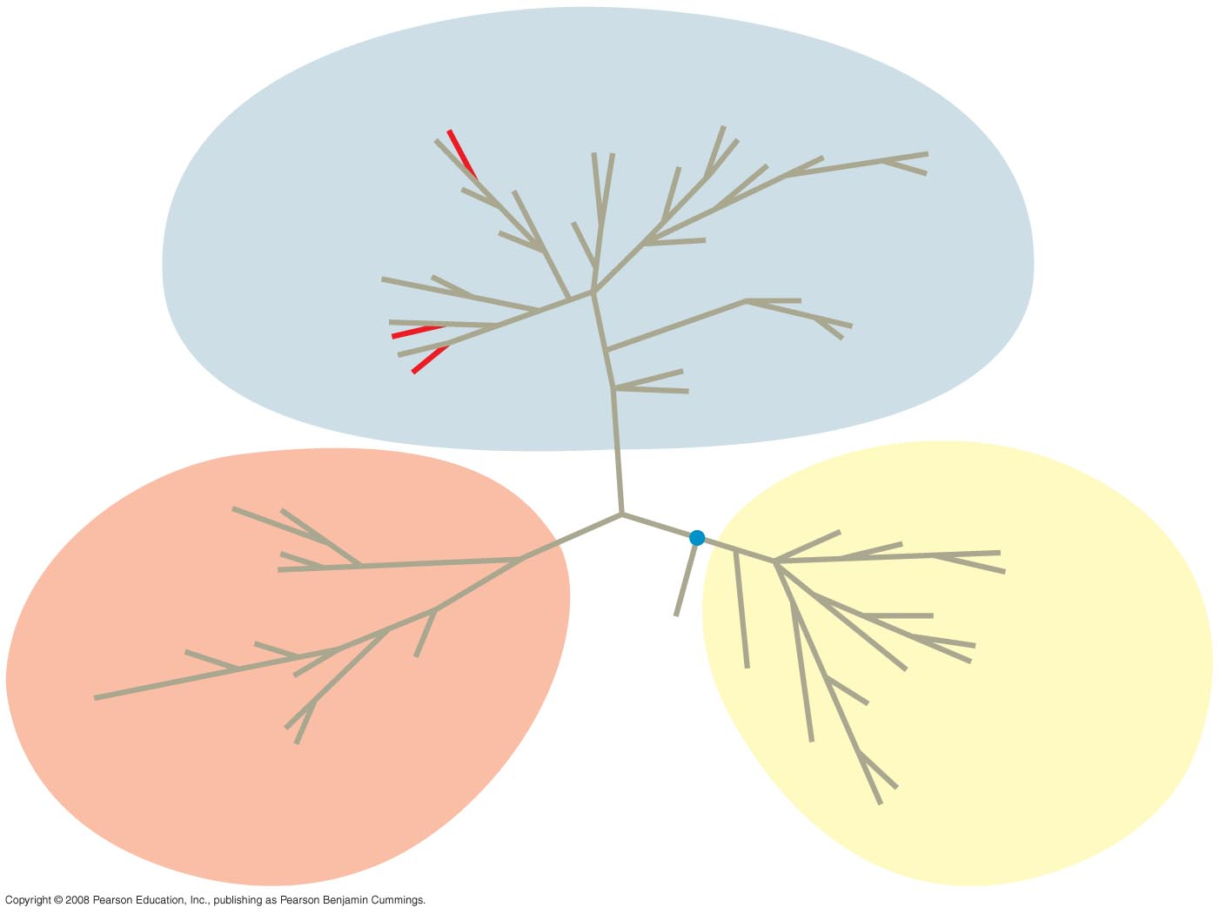
Fig. 26-21
EUKARYA
Land plants
Dinoflagellates
Green algae
Forams
Ciliates
Diatoms
Red algae
Cellular slime molds
Amoebas
Euglena
Animals
Trypanosomes
Leishmania
Fungi
Sulfolobus
Green nonsulfur bacteria
Thermophiles
(Mitochondrion)
Spirochetes
Halophiles
COMMON
ANCESTOR
OF ALL
LIFE
Chlamydia
Green
sulfur bacteria
Methanobacterium
BACTERIA
Cyanobacteria
ARCHAEA
(Plastids, including
chloroplasts)
Notes:
Figure 26.21 The three domains of life

Slide 35
A Simple Tree of All Life
The tree of life suggests that eukaryotes and archaea are more closely related to each other than to bacteria
The tree of life is based largely on rRNA genes, as these have evolved slowly

Slide 36
Is the Tree of Life Really a Ring?
Some researchers suggest that eukaryotes arose as an endosymbiosis between a bacterium and archaean
If so, early evolutionary relationships might be better depicted by a ring of life instead of a tree of life

Slide 37
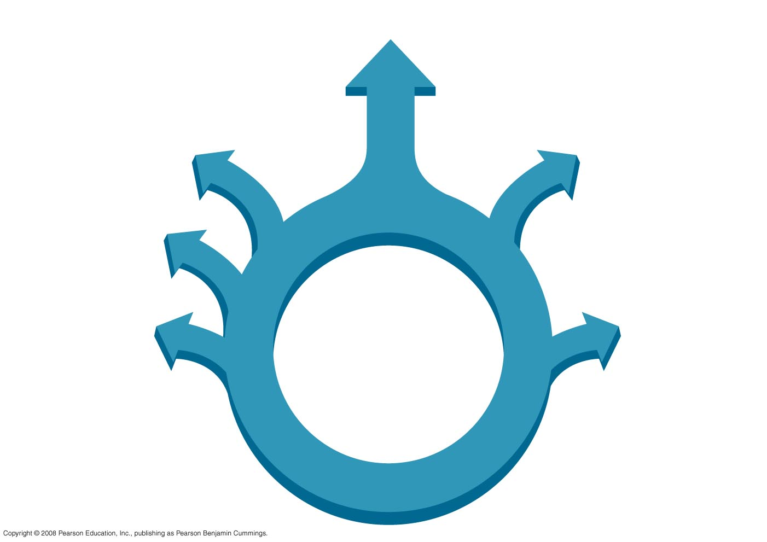
Fig. 26-23
Eukarya
Bacteria
Archaea
Notes:
Figure 26.23 A ring of life

