Slide 1
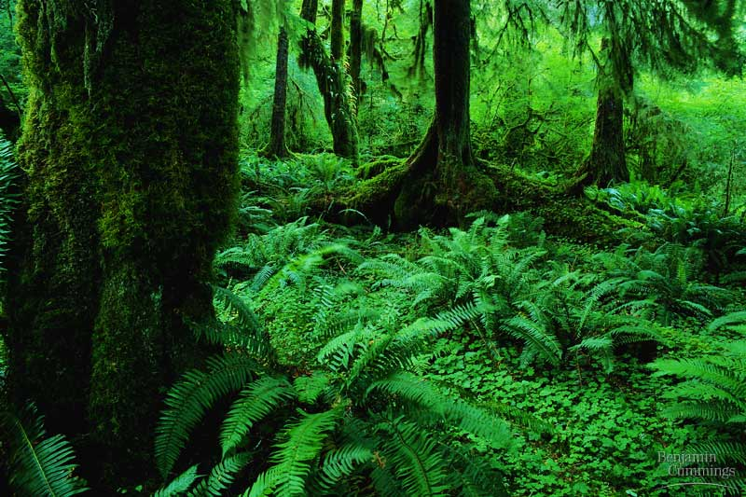
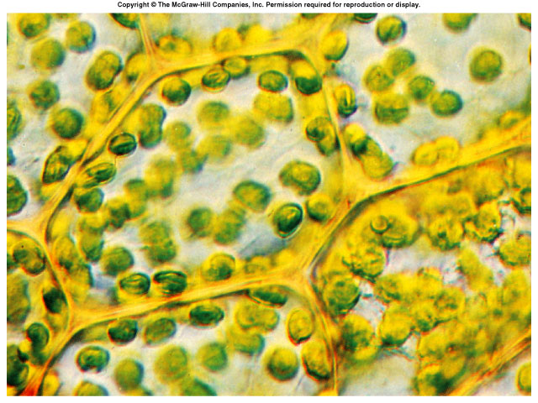
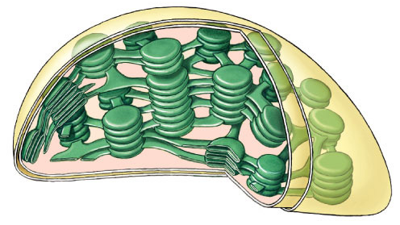
Photosynthesis:
Life from Light and Air

Slide 2
Energy needs of life
All life needs a constant input of energy
  Heterotrophs (Animals)
    get their energy from “eating others”
      eat food = other organisms = organic molecules
    make energy through respiration
  Autotrophs (Plants)
    produce their own energy (from “self”)
    convert energy of sunlight
    build organic molecules (CHO) from CO₂
    make energy & synthesize sugars through photosynthesis
consumers
producers

Slide 3

How are they connected?
Heterotrophs
making energy & organic molecules from ingesting organic molecules
glucose + oxygen → carbon + water + energy
dioxide
C₆H₁₂O₆
+
6O₂
→
6CO₂
+
6H₂O
+
ATP
oxidation = exergonic
Autotrophs
Where’s
the ATP?
making energy & organic molecules from light energy
carbon
dioxide
+ water + energy → glucose + oxygen
6CO₂
+
6H₂O
+
light
energy
→
C₆H₁₂O₆
+
6O₂
reduction = endergonic
Notes:
So, in effect, photosynthesis is respiration run backwards powered by light.
Cellular Respiration
oxidize C₆H₁₂O₆ → CO₂ & produce H₂O
fall of electrons downhill to O₂
exergonic
Photosynthesis
reduce CO₂ → C₆H₁₂O₆ & produce O₂
boost electrons uphill by splitting H₂O
endergonic

Slide 4

What does it mean to be a plant
Need to…
  collect light energy
    transform it into chemical energy
  store light energy
    in a stable form to be moved around
    the plant or stored
  need to get building block atoms
  from the environment
    C,H,O,N,P,K,S,Mg
  produce all organic molecules
  needed for growth
    carbohydrates, proteins, lipids, nucleic acids
ATP
glucose
CO₂
H₂O
N
K
P
…

Slide 5
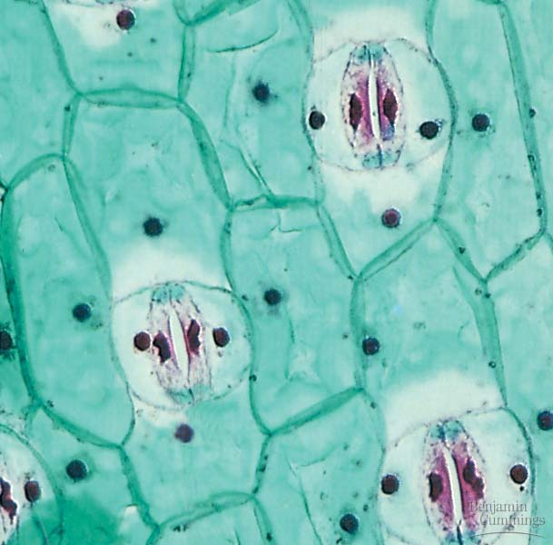

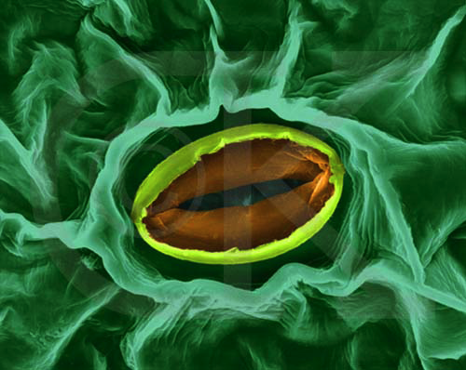
Plant structure
Obtaining raw materials
  sunlight
    leaves = solar collectors
  CO₂
    stomates = gas exchange
  H₂O
    uptake from roots
  nutrients
    N, P, K, S, Mg, Fe…
    uptake from roots
stomate
transpiration
gas exchange

Slide 6
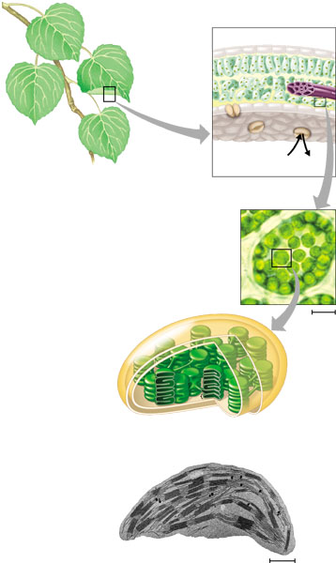
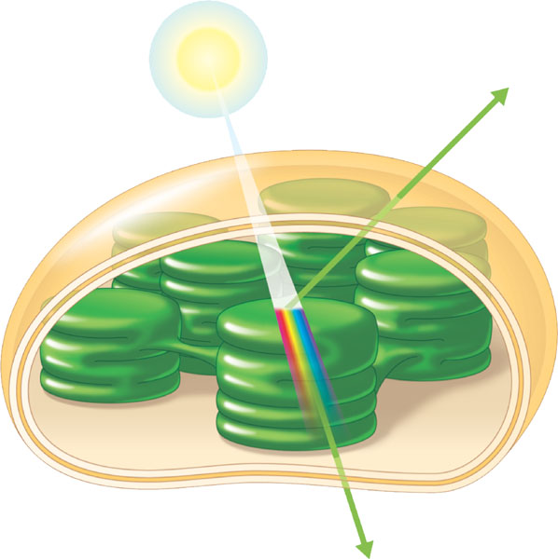
Chloroplasts
cross section
of leaf
absorb
sunlight & CO₂
leaves
CO₂
chloroplasts
in plant cell
chloroplasts
contain
chlorophyll
chloroplast
make
energy & sugar

Slide 7
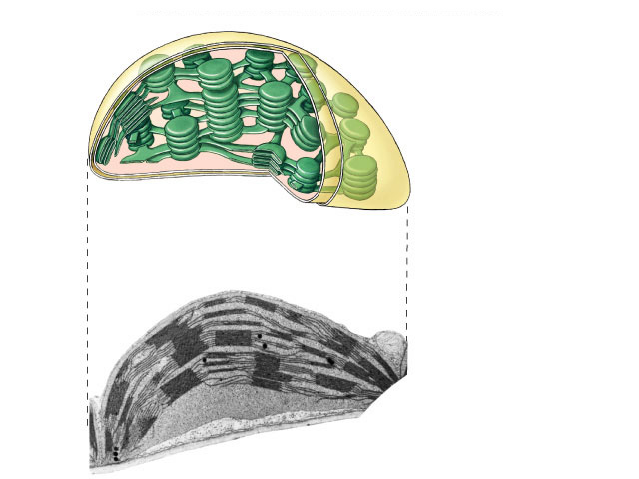
Plant structure
chloroplast
H⁺
H⁺
H⁺
H⁺
H⁺
H⁺
H⁺
H⁺
H⁺
ATP
H⁺
H⁺
thylakoid
Chloroplasts
  double membrane
  stroma
    fluid-filled interior
  thylakoid sacs
  grana stacks
Thylakoid membrane contains
  chlorophyll molecules
  electron transport chain
  ATP synthase
    H⁺ gradient built up within thylakoid sac
outer membrane
inner membrane
stroma
thylakoid
granum
Notes:
A typical mesophyll cell has 30-40 chloroplasts, each about 2-4 microns by 4-7 microns long.
Each chloroplast has two membranes around a central aqueous space, the stroma.
In the stroma are membranous sacs, the thylakoids.
These have an internal aqueous space, the thylakoid lumen or thylakoid space.
Thylakoids may be stacked into columns called grana.

Slide 8
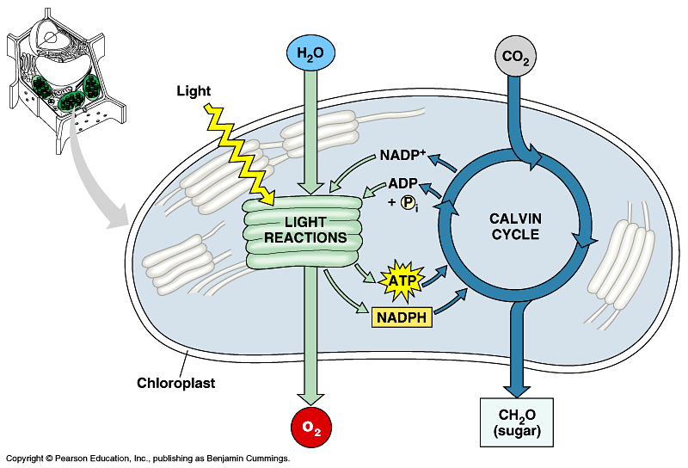


Photosynthesis
Light reactions
  light-dependent reactions
  energy conversion reactions
    convert solar energy to chemical energy
    ATP & NADPH
Calvin cycle
  light-independent reactions
  sugar building reactions
    uses chemical energy (ATP & NADPH) to reduce CO₂ & synthesize C₆H₁₂O₆
It’s not the
Dark Reactions!

Slide 9
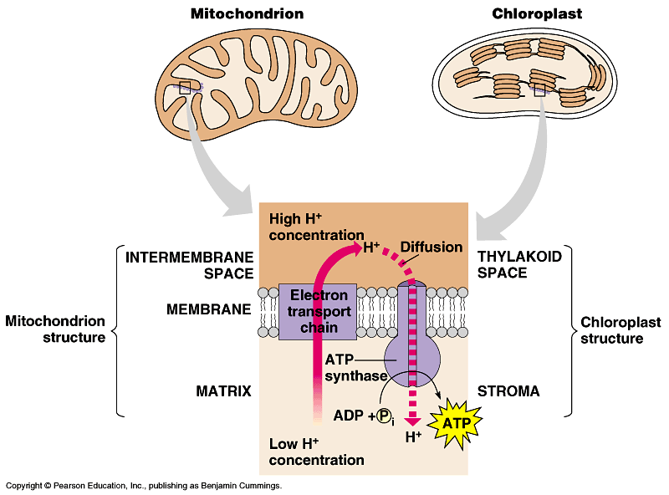
Light reactions
chloroplast
thylakoid
H⁺
H⁺
H⁺
H⁺
H⁺
H⁺
H⁺
H⁺
H⁺
H⁺
H⁺
H⁺
H⁺
H⁺
H⁺
H⁺
ATP
H⁺
H⁺
H⁺
H⁺
H⁺
H⁺
Electron Transport Chain
    like in cellular respiration
  proteins in organelle membrane
  electron acceptors
    NADPH
  proton (H⁺)
  gradient across
  inner membrane
    find the double membrane!
  ATP synthase
  enzyme
Notes:
Not accidental that these 2 systems are similar, because both derived from the same primitive ancestor.

Slide 10
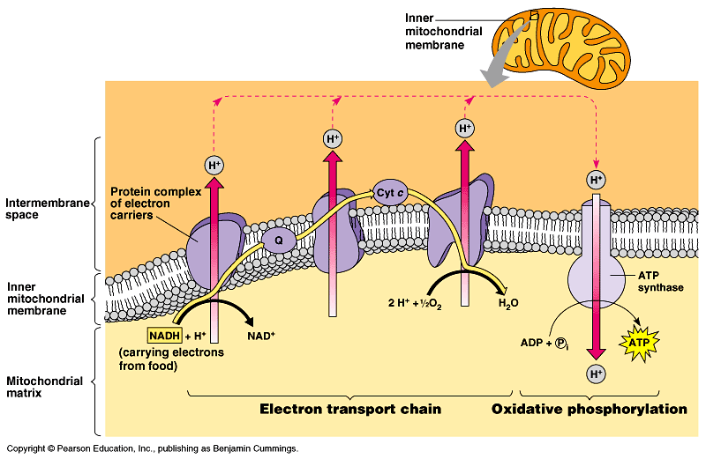
ETC of Respiration
Mitochondria transfer chemical energy from food molecules into chemical energy of ATP
  use electron carrier NADH
generates H₂O
Notes:
NADH is an input
ATP is an output
O₂ combines with H⁺’s to form water
Electron is being handed off from one electron carrier to another -- proteins, cytochrome proteins & quinone lipids
So what if it runs in reverse??

Slide 11
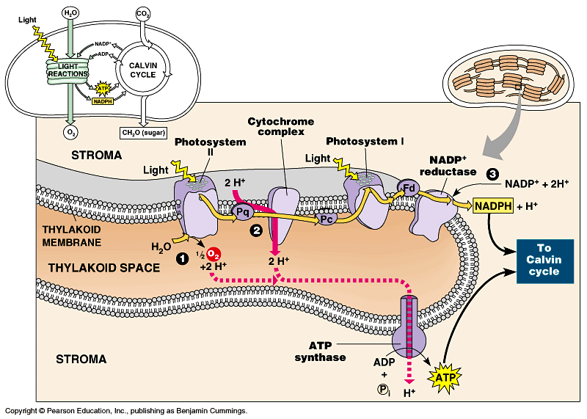
ETC of Photosynthesis
Chloroplasts transform light energy into chemical energy of ATP
  use electron carrier NADPH
generates O₂
Notes:
Two places where light comes in.
Remember photosynthesis is endergonic -- the electron transport chain is driven by light energy.
Need to look at that in more detail on next slide

Slide 12
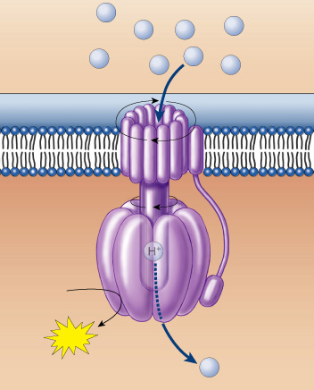
The ATP that “Jack” built
photosynthesis
respiration
sunlight
breakdown of C₆H₁₂O₆
H⁺
H⁺
H⁺
H⁺
H⁺
H⁺
H⁺
H⁺
    moves the electrons
    runs the pump
    pumps the protons
    builds the gradient
    drives the flow of protons
    through ATP synthase
    bonds P_{i} to ADP
    generates the ATP
    … that evolution built
ADP + P_{i}
ATP
H⁺

Slide 13
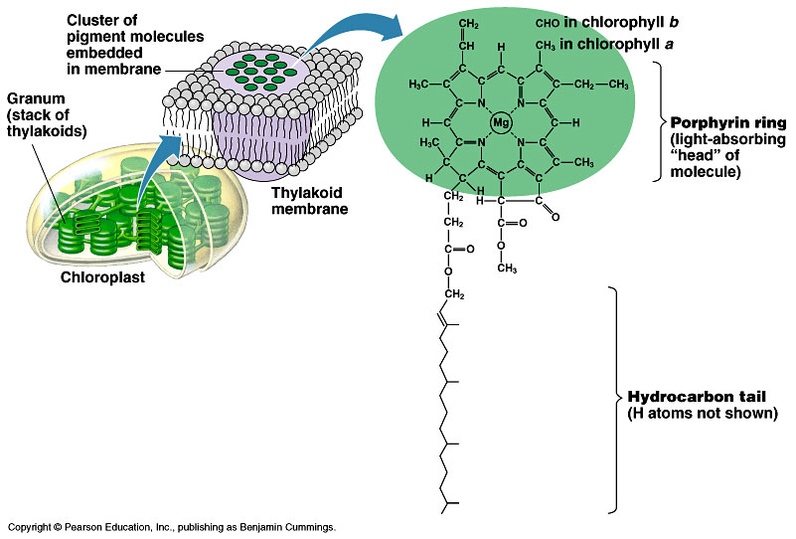
Pigments of photosynthesis
How does this
molecular structure
fit its function?
Chlorophylls & other pigments
  embedded in thylakoid membrane
  arranged in a “photosystem”
    collection of molecules
  structure-function relationship

Slide 14
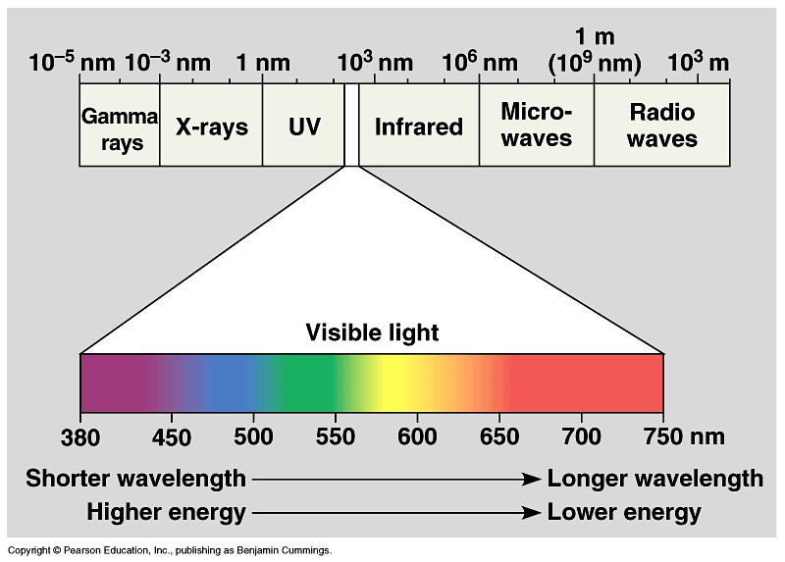
A Look at Light
The spectrum of color
V
I
B
G
Y
O
R

Slide 15
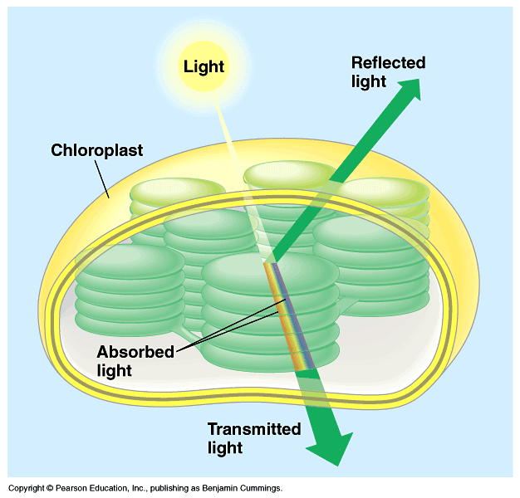
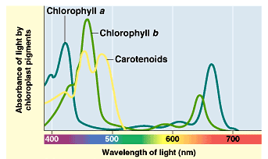
Light: absorption spectra
Photosynthesis gets energy by absorbing wavelengths of light
  chlorophyll a
    absorbs best in red & blue wavelengths & least in green
  accessory pigments with different structures absorb light of different wavelengths
    chlorophyll b, carotenoids, xanthophylls
Why are
plants green?

Slide 16
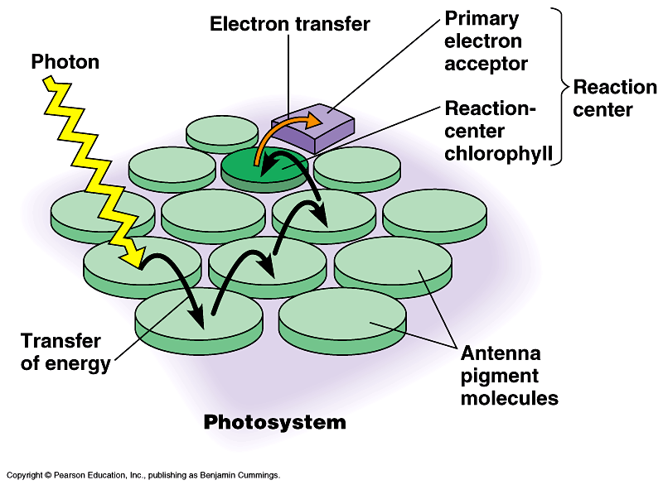
Photosystems of photosynthesis
2 photosystems in thylakoid membrane
  collections of chlorophyll molecules
  act as light-gathering molecules
  Photosystem II
    chlorophyll a
    P₆₈₀ = absorbs 680nm
    wavelength red light
  Photosystem I
    chlorophyll b
    P₇₀₀ = absorbs 700nm
    wavelength red light
reaction
center
antenna
pigments
Notes:
Photons are absorbed by clusters of pigment molecules (antenna molecules) in the thylakoid membrane.
When any antenna molecule absorbs a photon, it is transmitted from molecule to molecule until it reaches a particular chlorophyll a molecule = the reaction center.
At the reaction center is a primary electron acceptor which removes an excited electron from the reaction center chlorophyll a.
This starts the light reactions.
Don’t compete with each other, work synergistically using different wavelengths.

Slide 17
ETC of Photosynthesis
chlorophyll a
Photosystem II
chlorophyll b
Photosystem I
Notes:
Two places where light comes in.
Remember photosynthesis is endergonic -- the electron transport chain is driven by light energy.
Need to look at that in more detail on next slide

Slide 18
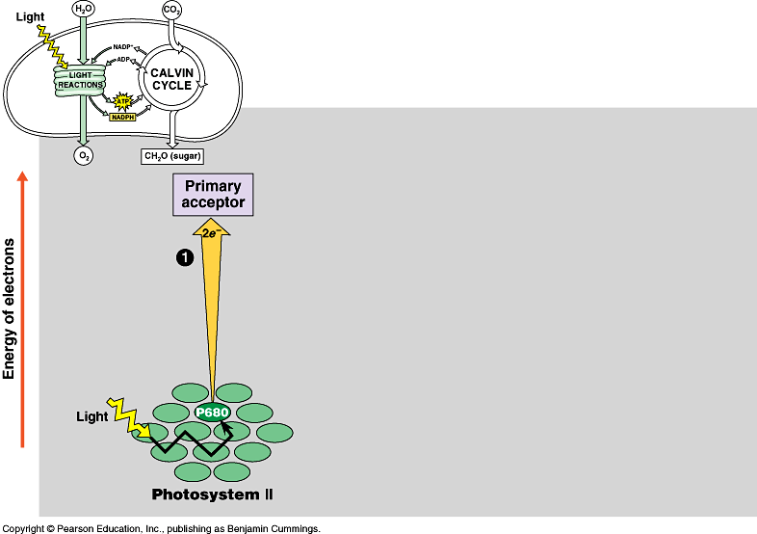
ETC of Photosynthesis
sun
1
e
e
Photosystem II
P680
chlorophyll a
Notes:
PS II absorbs light
Excited electron passes from chlorophyll to the primary electron acceptor
Need to replace electron in chlorophyll
An enzyme extracts electrons from H₂O & supplies them to the chlorophyll
This reaction splits H₂O into 2 H⁺ & O⁻ which combines with another O⁻ to form O₂
O₂ released to atmosphere
Chlorophyll absorbs light energy (photon) and this moves an electron to a higher energy state
Electron is handed off down chain from electron acceptor to electron acceptor
In process has collected H⁺ ions from H₂O & also pumped by Plastoquinone within thylakoid sac.
Flow back through ATP synthase to generate ATP.

Slide 19
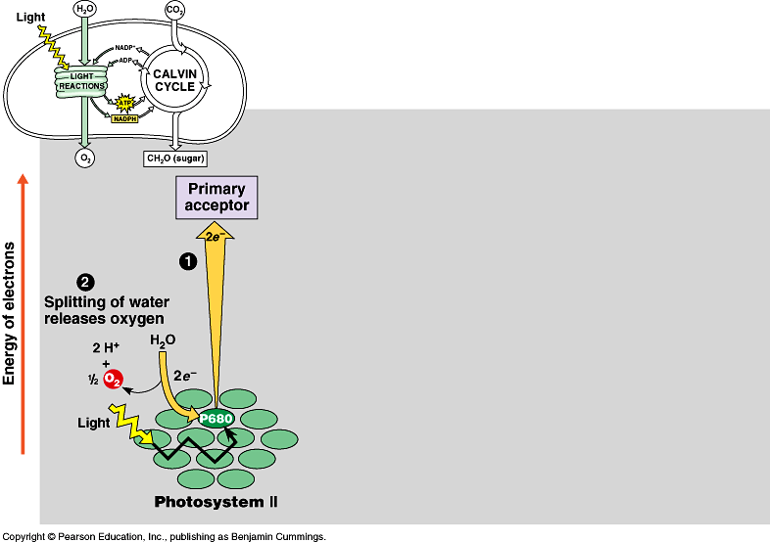
Inhale, baby!
ETC of Photosynthesis
chloroplast
thylakoid
H⁺
H⁺
H⁺
H⁺
H⁺
H⁺
H⁺
H⁺
H⁺
H⁺
H⁺
H⁺
H⁺
H⁺
H⁺
H⁺
ATP
H⁺
H⁺
H⁺
H⁺
H⁺
H⁺
Plants SPLIT water!
1
H
H
2
O
e
e
O
H
H
O
e⁻
H⁺
+H
e⁻
e
e
fill the e– vacancy
Photosystem II
P680
chlorophyll a

Slide 20
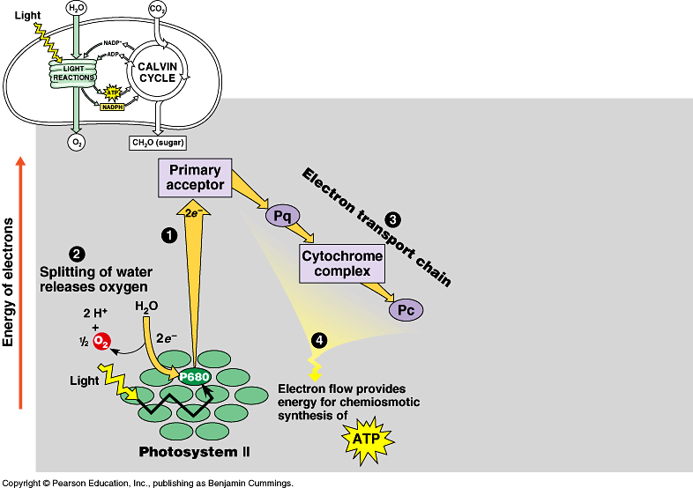
ETC of Photosynthesis
chloroplast
thylakoid
H⁺
H⁺
H⁺
H⁺
H⁺
H⁺
H⁺
H⁺
H⁺
H⁺
H⁺
H⁺
H⁺
H⁺
H⁺
H⁺
ATP
H⁺
H⁺
H⁺
H⁺
H⁺
H⁺
e
e
3
1
2
H⁺
e
e
ATP
4
H⁺
to Calvin Cycle
H⁺
H⁺
H⁺
H⁺
H⁺
H⁺
H⁺
H⁺
energy to build
carbohydrates
Photosystem II
P680
chlorophyll a
ATP
ADP + P_{i}
H⁺

Slide 21
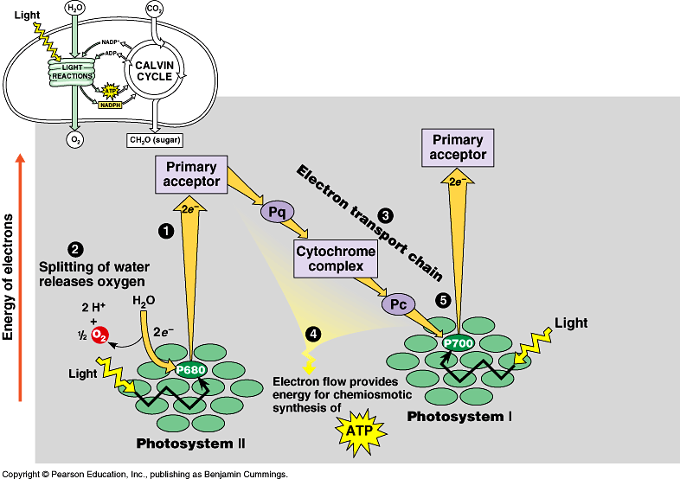
ETC of Photosynthesis
e
e
e
sun
e
fill the e– vacancy
e
5
e
e
e
Photosystem I
P700
chlorophyll b
Photosystem II
P680
chlorophyll a
Notes:
Need a 2nd photon -- shot of light energy to excite electron back up to high energy state.
2nd ETC drives reduction of NADP to NADPH.
Light comes in at 2 points.
Produce ATP & NADPH

Slide 22
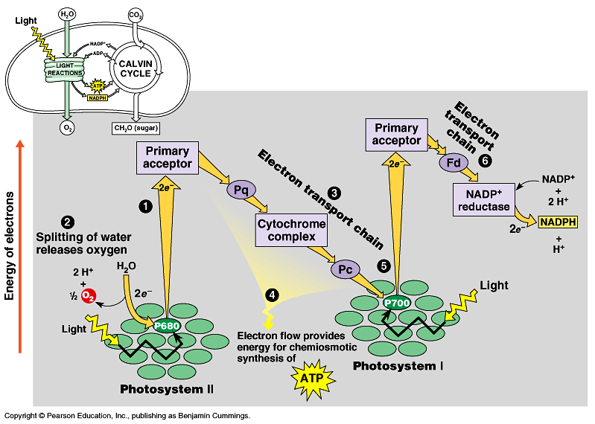
ETC of Photosynthesis
electron carrier
e
e
6
e
e
5
sun
NADPH to
Calvin Cycle
Photosystem I
P700
chlorophyll b
Photosystem II
P680
chlorophyll a
$$ in the bank…
reducing power!
Notes:
Need a 2nd photon -- shot of light energy to excite electron back up to high energy state.
2nd ETC drives reduction of NADP to NADPH.
Light comes in at 2 points.
Produce ATP & NADPH

Slide 23
ETC of Photosynthesis
sun
sun
e
e
e
e
H⁺
H⁺
H⁺
O
H⁺
H⁺
H⁺
H⁺
H⁺
to Calvin Cycle
H⁺
H⁺
H⁺
split H₂O
ATP
Notes:
Two places where light comes in.
Remember photosynthesis is endergonic -- the electron transport chain is driven by light energy.
Need to look at that in more detail on next slide

Slide 24
ETC of Photosynthesis
ETC uses light energy to produce
  ATP & NADPH
    go to Calvin cycle
PS II absorbs light
  excited electron passes from chlorophyll to “primary electron acceptor”
  need to replace electron in chlorophyll
  enzyme extracts electrons from H₂O & supplies them to chlorophyll
    splits H₂O (photolysis)
    O combines with another O to form O₂
    O₂ released to atmosphere
    and we breathe easier!

Slide 25
Experimental evidence
Where did the O₂ come from?
  radioactive tracer = O₁₈
Experiment 1
light
energy
→
6CO₂
+
6H₂O
+
light
energy
→
+
6O₂
6CO₂
+
6H₂O
+
C₆H₁₂O₆
+
6O₂
C₆H₁₂O₆
Experiment 2
6CO₂
+
6H₂O
+
light
energy
→
C₆H₁₂O₆
+
6O₂
Proved O₂ came from H₂O not CO₂ = plants split H₂O!

Slide 26
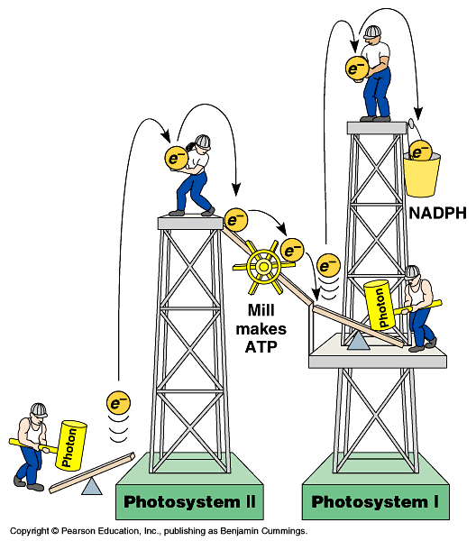
Noncyclic Photophosphorylation
Light reactions elevate electrons in
2 steps (PS II & PS I)
  PS II generates
  energy as ATP
  PS I generates
  reducing power as NADPH
ATP
Notes:
1 photosystem is not enough.
Have to lift electron in 2 stages to a higher energy level. Does work as it falls.
First, produce ATP -- but producing ATP is not enough.
Second, need to produce organic molecules for other uses & also need to produce a stable storage molecule for a rainy day (sugars). This is done in Calvin Cycle!

Slide 27
Cyclic photophosphorylation
If PS I can’t pass electron to NADP…it cycles back to PS II & makes more ATP, but no NADPH
  coordinates light reactions to Calvin cycle
  Calvin cycle uses more ATP than NADPH

ATP
18 ATP +
12 NADPH
→
1 C₆H₁₂O₆

Slide 28
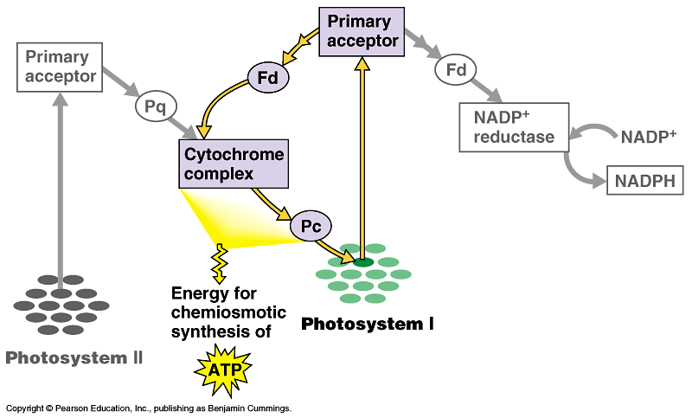
Photophosphorylation
cyclic
photophosphorylation
NADP
NONcyclic
photophosphorylation
ATP

Slide 29
Photosynthesis summary
Where did the energy come from?
Where did the electrons come from?
Where did the H₂O come from?
Where did the O₂ come from?
Where did the O₂ go?
Where did the H⁺ come from?
Where did the ATP come from?
What will the ATP be used for?
Where did the NADPH come from?
What will the NADPH be used for?
…stay tuned for the Calvin cycle
Notes:
Where did the energy come from? The Sun
Where did the electrons come from? Chlorophyll
Where did the H₂O come from?
The ground through the roots/xylem
Where did the O₂ come from? The splitting of water
Where did the O₂ go? Out stomates to air
Where did the H⁺ come from? The slitting of water
Where did the ATP come from?
Photosystem 2: Chemiosmosis (H+ gradient)
What will the ATP be used for?
The work of plant life! Building sugars
Where did the NADPH come from?
Reduction of NADP (Photosystem 1)
What will the NADPH be used for? Calvin cycle / Carbon fixation

Slide 30

Photosynthesis:
The Calvin Cycle
Life from Air

Slide 31

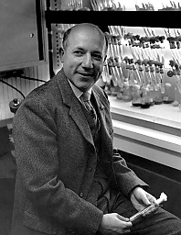
The Calvin Cycle
1950s | 1961
Whoops! Wrong Calvin…

Slide 32
Remember what it means to be a plant…
Need to produce all organic molecules necessary for growth
  carbohydrates, lipids, proteins, nucleic acids
Need to store chemical energy (ATP) produced from light reactions
  in a more stable form
  that can be moved around plant
  saved for a rainy day
carbon
dioxide
+ water + energy → glucose + oxygen
6CO₂
+
6H₂O
+
light
energy
→
C₆H₁₂O₆
+
6O₂

Slide 33
Light reactions
Convert solar energy to chemical energy
  ATP
  NADPH
What can we do now?
ATP
→ energy
→ reducing power
→ → build stuff !!
photosynthesis

Slide 34

How is that helpful?
Want to make C₆H₁₂O₆
  synthesis
  How? From what?
  What raw materials are available?
CO₂
NADPH
reduces CO₂
carbon fixation
NADP
C₆H₁₂O₆
NADP
Notes:
CO₂ contains little energy because it is fully oxidized
Reduce CO₂ in a series of steps to synthesize a stable energy storage molecule

Slide 35
From CO₂ → C₆H₁₂O₆
CO₂ has very little chemical energy
  fully oxidized
C₆H₁₂O₆ contains a lot of chemical energy
  highly reduced
Synthesis = endergonic process
  put in a lot of energy
Reduction of CO₂ → C₆H₁₂O₆ proceeds in many small uphill steps
  each catalyzed by a specific enzyme
  using energy stored in ATP & NADPH

Slide 36
From Light reactions to Calvin cycle
Calvin cycle
  chloroplast stroma
Need products of light reactions to drive synthesis reactions
  ATP
  NADPH
stroma
ATP
thylakoid

Slide 37
C
C
Calvin cycle
C
C
C
C
C
C
1C
CO₂
C
C
C
C
C
1. Carbon fixation
3. Regeneration
of RuBP
C
C
C
C
C
5C
C
C
C
C
C
C
RuBP
RuBisCo
ribulose bisphosphate
C
C
C
C
C
C
starch,
sucrose,
cellulose
& more
6C
3 ATP
ribulose
bisphosphate
carboxylase
C
C
C
C
C
C
3 ADP
5C
C
C
C
used
to make
glucose
C
C
C
glyceraldehyde-3-P
3C
C
C
C
G3P
PGA
C
C
C
C
C
C
C
C
C
phosphoglycerate
C
C
C
3C
C
=
C
=
C
C
C
C
C
C
C
C
C
C
6 ATP
C
C
C
2. Reduction
H
H
H
6 NADPH
6 ADP
|
–
|
–
|
C
C
C
3C
C
C
C
H
H
H
C
C
C
6 NADP
|
|
|
Notes:
1. A five-carbon sugar molecule called ribulose bisphosphate, or RuBP, is the acceptor that binds CO2 dissolved in the stroma. This process, called CO2 fixation, is catalyzed by the enzyme RuBP carboxylase, forming an unstable six-carbon molecule. This molecule quickly breaks down to give two molecules of the three-carbon 3-phosphoglycerate (3PG), also called phosphoglyceric acid (PGA).
2. The two 3PG molecules are converted into glyceraldehyde 3-phosphate (G3P, a.k.a. phosphoglyceraldehyde, PGAL) molecules, a three-carbon sugar phosphate, by adding a high-energy phosphate group from ATP, then breaking the phosphate bond and adding hydrogen from NADH + H+.
3. Three turns of the cycle, using three molecules of CO2, produces six molecules of G3P. However, only one of the six molecules exits the cycle as an output, while the remaining five enter a complex process that regenerates more RuBP to continue the cycle. Two molecules of G3P, produced by a total of six turns of the cycle, combine to form one molecule of glucose.

Slide 38


glucose
C-C-C-C-C-C
Remember
G3P?
ATP
2
2
ADP
glycolysis
fructose-1,6bP
P-C-C-C-C-C-C-P
glyceraldehyde
3-phosphate
DHAP
P-C-C-C
G3P
C-C-C-P
2
NAD⁺
2
4
ADP
ATP
4
Photosynthesis
pyruvate
C-C-C
Notes:
Gluconeogenesis == making new glucose

Slide 39
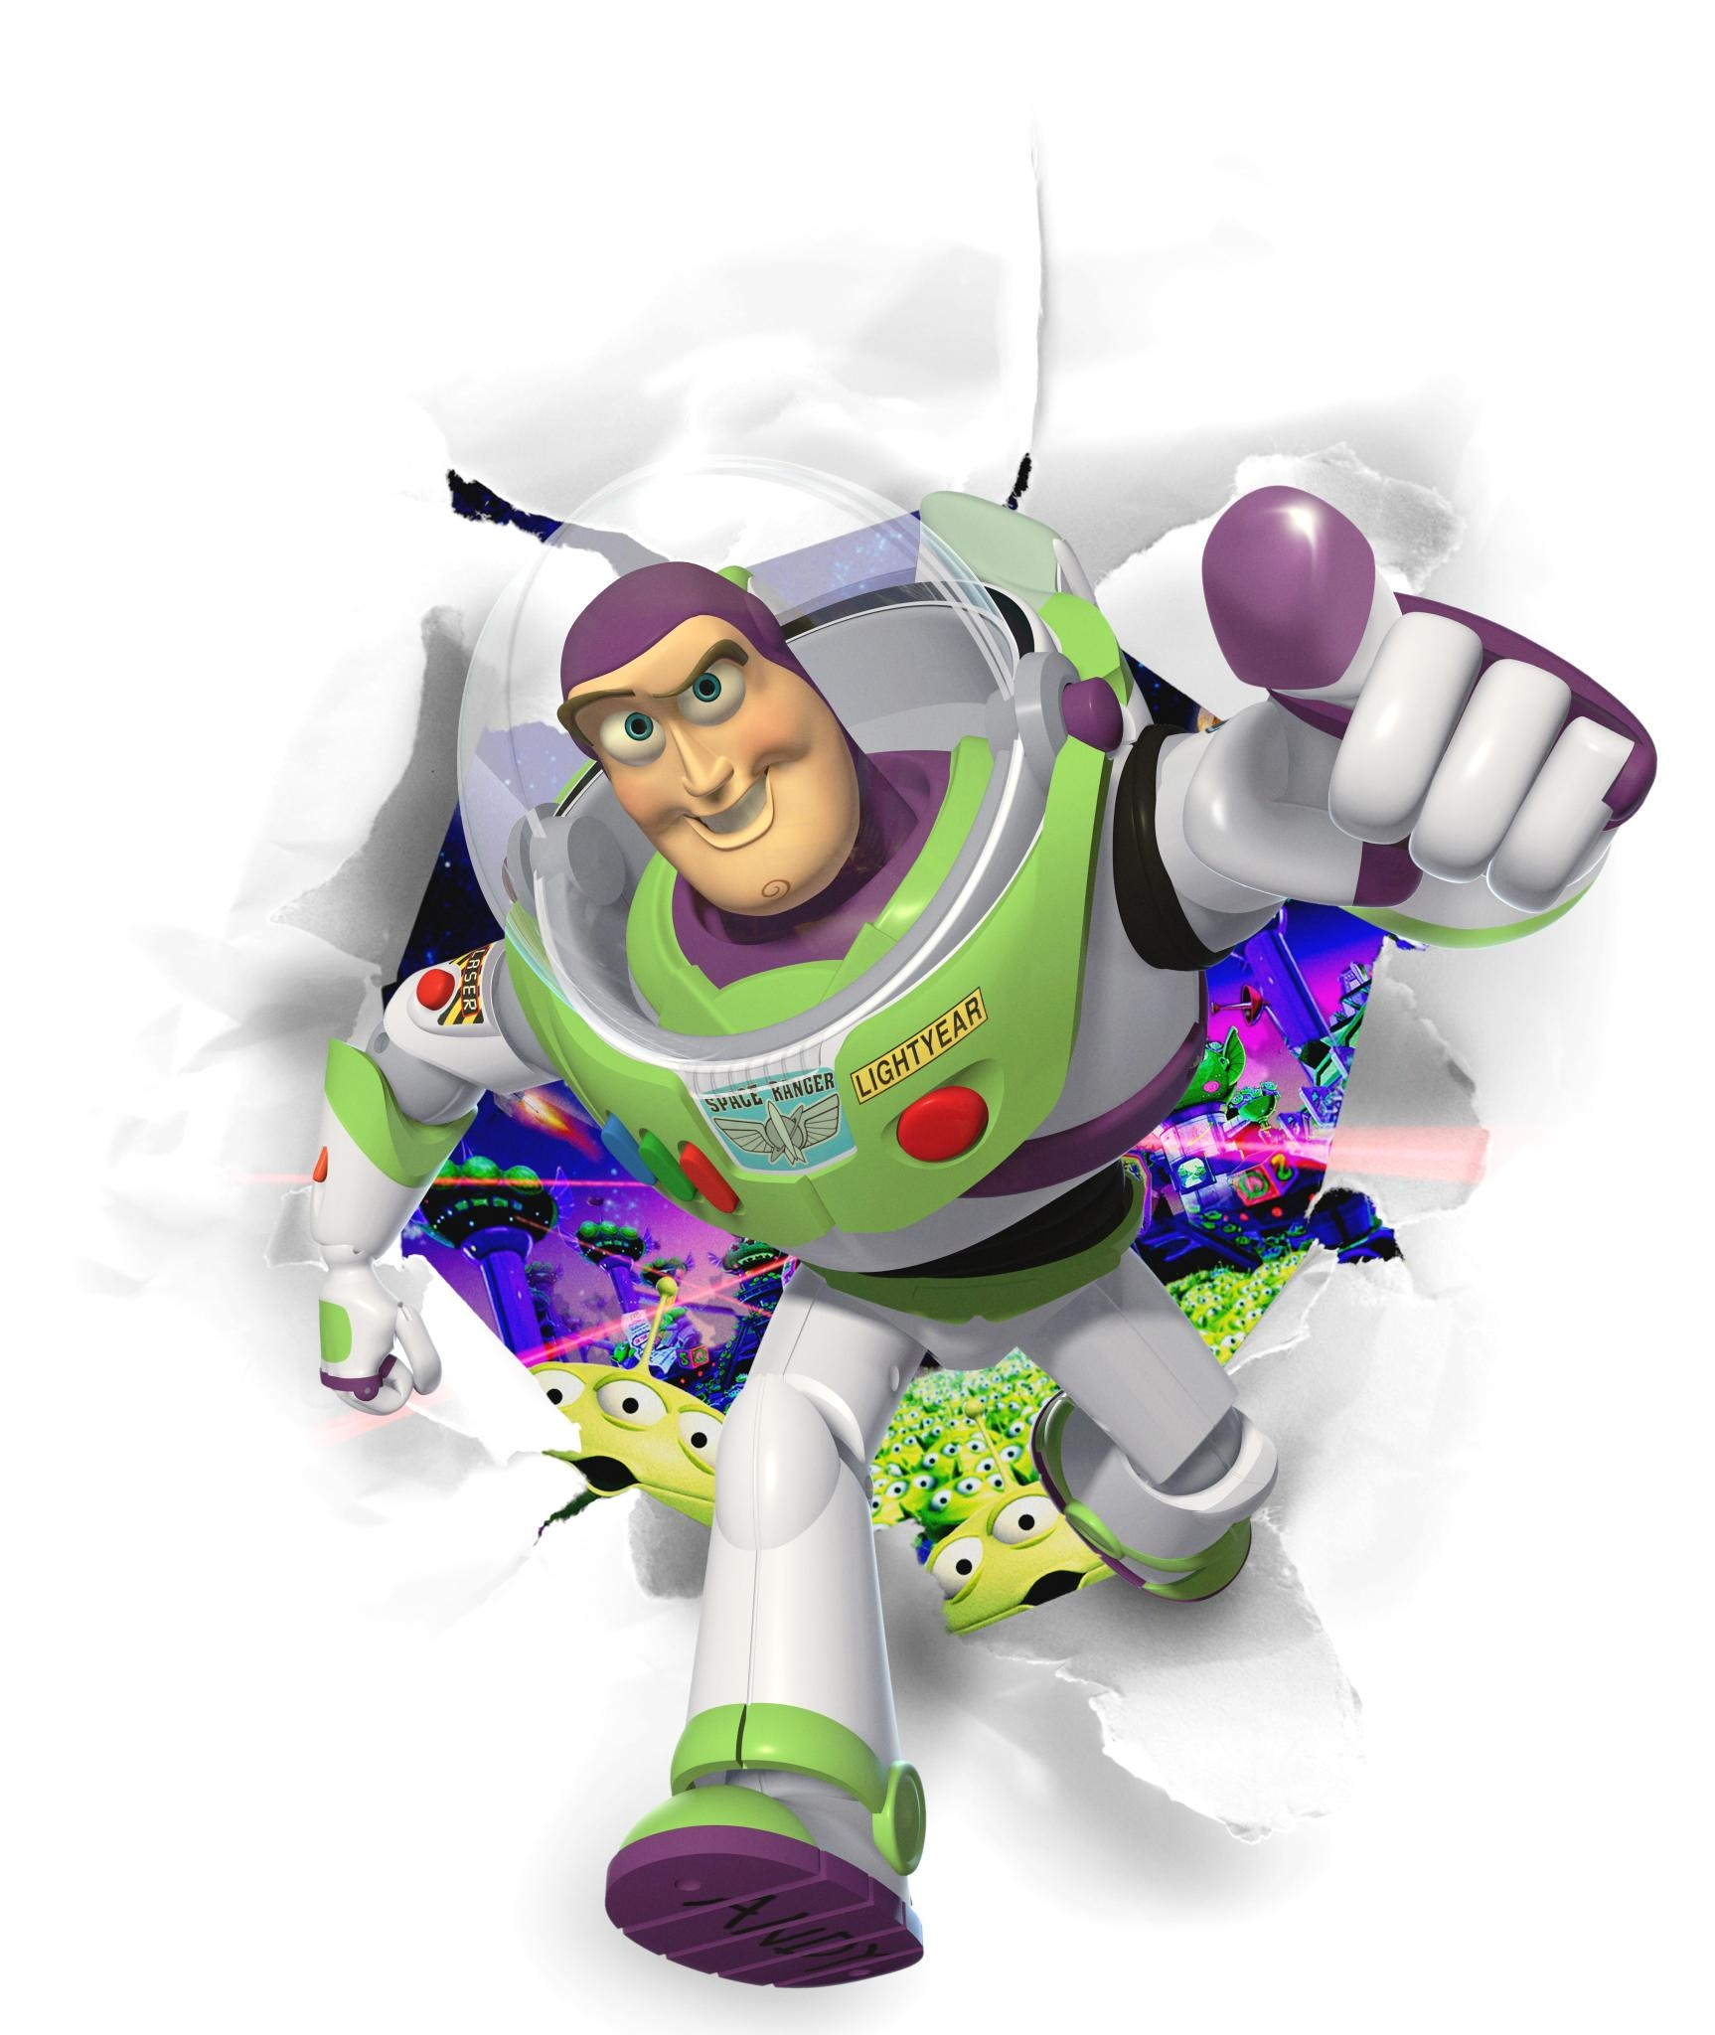
To G3P and Beyond!
To G3P
and beyond!
Glyceraldehyde-3-P
  end product of Calvin cycle
  energy rich 3 carbon sugar
  “C3 photosynthesis”
G3P is an important intermediate
G3P → → glucose → → carbohydrates
  → → lipids → → phospholipids, fats, waxes
  → → amino acids → → proteins
  → → nucleic acids → → DNA, RNA

Slide 40

RuBisCo
Enzyme which fixes carbon from air
  ribulose bisphosphate carboxylase
  the most important enzyme in the world!
    it makes life out of air!
  definitely the most abundant enzyme
I’m green
with envy!
It’s not easy
being green!

Slide 41
Accounting
The accounting is complicated
  3 turns of Calvin cycle = 1 G3P
  3 CO₂ → 1 G3P (3C)
  6 turns of Calvin cycle = 1 C₆H₁₂O₆ (6C)
  6 CO₂ → 1 C₆H₁₂O₆ (6C)
  18 ATP + 12 NADPH → 1 C₆H₁₂O₆
  any ATP left over from light reactions will be used elsewhere by the cell

Slide 42
Photosynthesis summary
Light reactions
  produced ATP
  produced NADPH
  consumed H₂O
  produced O₂ as byproduct
Calvin cycle
  consumed CO₂
  produced G3P (sugar)
  regenerated ADP
  regenerated NADP
ADP
NADP

Slide 43
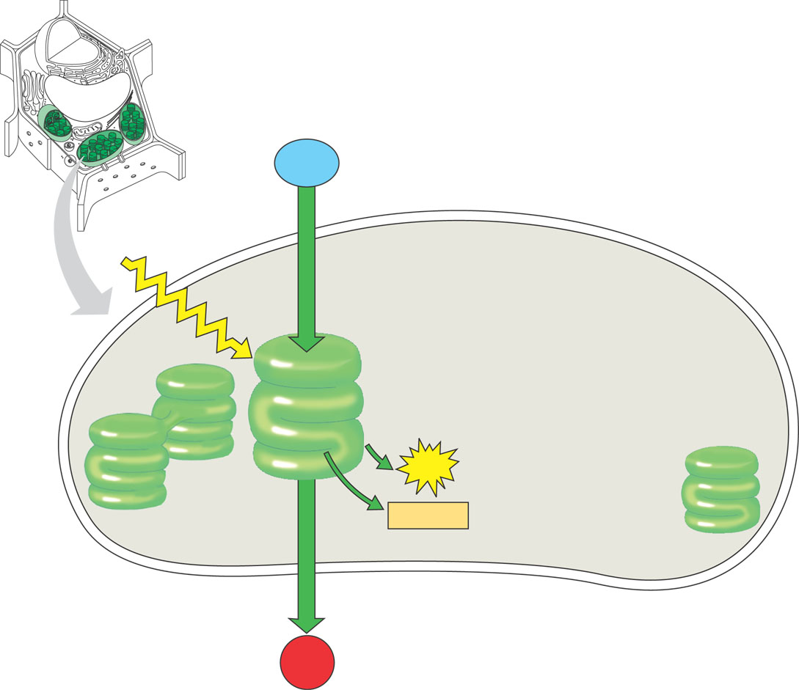
Light Reactions
H₂O
+
light
energy
→
ATP
+
NADPH
+
O₂
H₂O
produces ATP
produces NADPH
releases O₂ as a waste product
sunlight
Energy Building
Reactions
NADPH
ATP
O₂

Slide 44
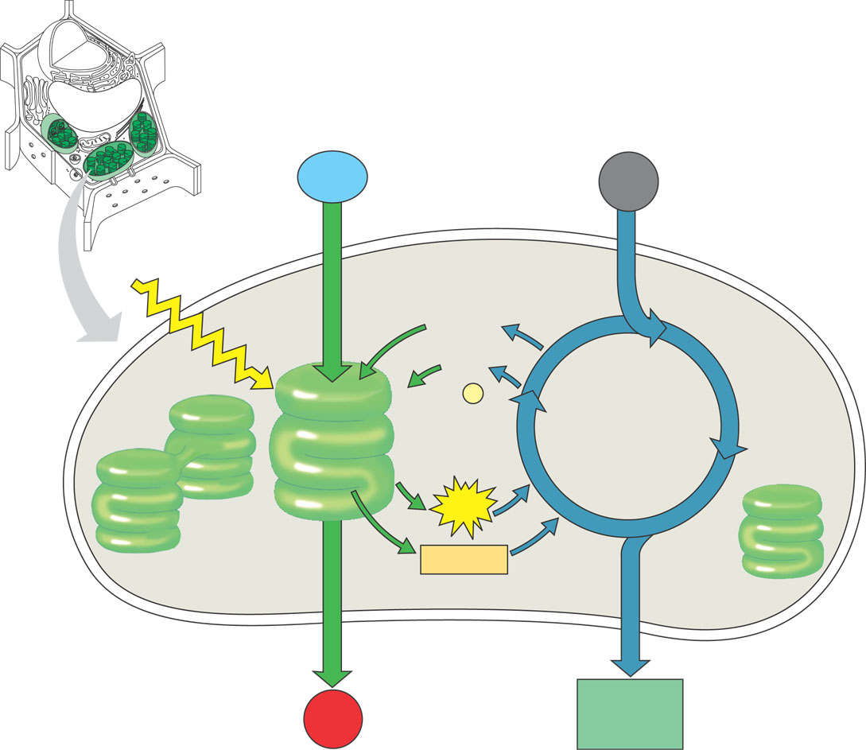
Calvin Cycle
CO₂
+
ATP
+
NADPH
→
C₆H₁₂O₆
+
ADP
+
NADP
CO₂
builds sugars
uses ATP & NADPH
recycles ADP & NADP
  back to make more ATP & NADPH
ADP
NADP
Sugar
Building
Reactions
NADPH
ATP
sugars

Slide 45
Putting it all together
CO₂
+
H₂O
+
light
energy
→
C₆H₁₂O₆
+
O₂
H₂O
CO₂
Plants make both:
  energy
    ATP & NADPH
  sugars
sunlight
ADP
Energy
Building
Reactions
NADP
Sugar
Building
Reactions
NADPH
ATP
O₂
sugars

Slide 46
Energy cycle
even though
this equation
is a bit of a lie…
it makes a
better story
sun
Photosynthesis
CO₂
+
H₂O
+
light
energy
→
C₆H₁₂O₆
+
O₂
plants
CO₂
H₂O
glucose
O₂
animals, plants
C₆H₁₂O₆
+
O₂
→
ATP
energy
+
CO₂
+
H₂O
Cellular Respiration
ATP
The Great Circle
of Life,Mufasa!

Slide 47
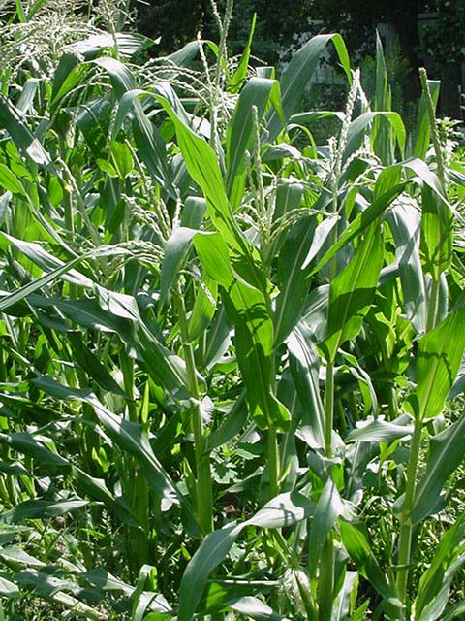
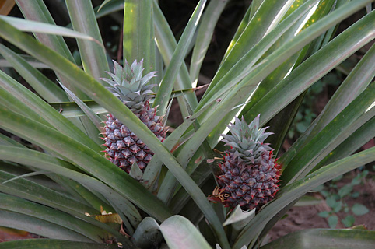
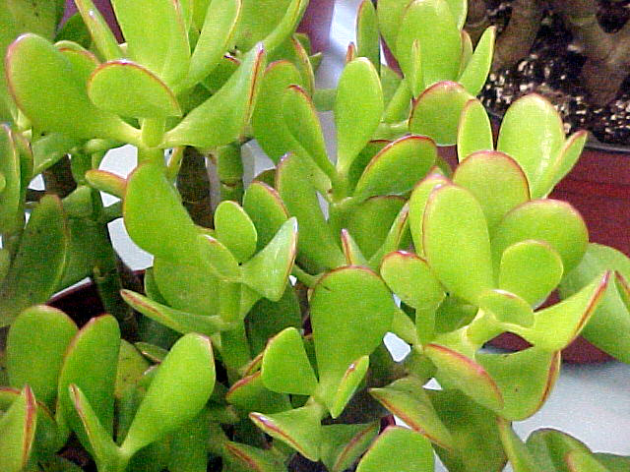
Photosynthesis:
Variations on the Theme

Slide 48
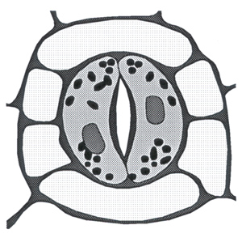
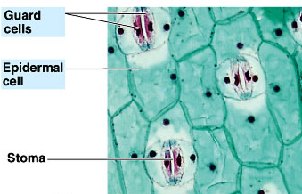
C3 Plants: Controlling water loss from leaves
Hot or dry days
  stomates close to conserve water
  guard cells
    gain H₂O = stomates open
    lose H₂O = stomates close
  No CO2 uptake
  when they are closed
Notes:
On sunny hot days, balancing 2 processes/ 2 forces:
Lots of sun so guard cells producing glucose, therefore increasing sugar concentration, therefore increase osmosis into guard cells = turgid & open
Lots of sun so plant starts to wilt, therefore guard cells shrink = flaccid & closed

Slide 49

When stomates close…
Closed stomates lead to…
  O₂ build up → from light reactions
  CO₂ is depleted → in Calvin cycle
    causes problems in Calvin Cycle
The best laid
schemes of
mice and men…
and plants!
O₂
xylem (water)
phloem (sugars)


CO₂
O₂
CO₂
H₂O

Slide 50
Calvin cycle when CO₂ is abundant
1C
CO₂
RuBP
ATP
5C
RuBisCo
unstable
intermediate
ADP
6C
G3P
to make
glucose
5C
C3 plants
PGA
3C
G3P
3C
NADPH
ATP
NADP
ADP
3C

Slide 51
Calvin cycle when O₂ is high
to
mitochondria
–––––––
lost as CO₂
without
making ATP
O₂
RuBP
5C
Hey Dude,
are you high
on oxygen!
RuBisCo
2C
3C
It’s so
sad to see a
good enzyme,
go BAD!
photorespiration

Slide 52
Impact of Photorespiration
Oxidation of RuBP
  short circuit of Calvin cycle
  loss of carbons to CO₂
    can lose 50% of carbons fixed by Calvin cycle
  reduces production of photosynthesis
    no ATP (energy) produced
    no C₆H₁₂O₆ (food) produced
  if photorespiration could be reduced, plant would become 50% more efficient
    strong selection pressure to evolve alternative carbon fixation systems

Slide 53
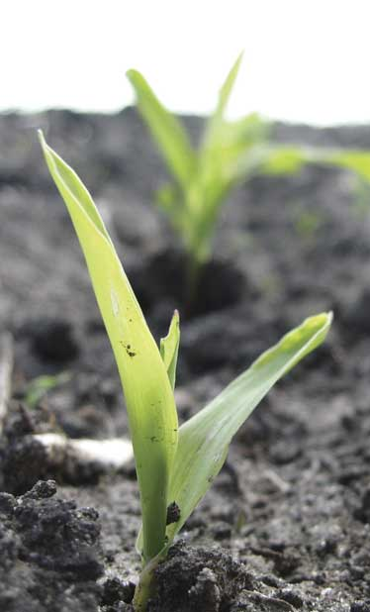
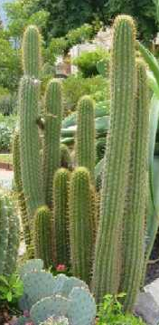
Reducing photorespiration
Separate carbon fixation from Calvin cycle
  C3 Plants, photosynthesis the light reactions and the Calvin cycle occur in the same cell. This puts the production of O₂ in close proximity to rubisco, leading to photorespiration.
  C4 plants
    PHYSICALLY separate carbon fixation from Calvin cycle
      different cells to fix carbon vs. where Calvin cycle occurs
        One cell specializes in the light reactions and the other in the Calvin cycle.
        store carbon in 4C compounds
    different enzyme to capture CO₂ (fix carbon)
      PEP carboxylase: Acts as a CO2 pump, helping to keep the concentration of CO2 higher in the cells specializing in the Calvin cycle, again reducing photorespiration. C4 plants still do the Calvin cycle and still use rubisco but have structural and biochemical adaptations that allow photosynthesis to occur even on hot, dry days.
    different leaf structure
Notes:
The key point is how carbon dioxide is grabbed out of the air -- carbon fixation -- and then handed off to the Calvin cycle.
C4 plants separate the 2 steps of carbon fixation anatomically. They use 2 different cells to complete the process.
CAM plants separate the 2 steps of carbon fixation temporally. They do them at 2 different times.
The key problem they are trying to overcome is that Rubisco is a very inefficient enzyme in the presence of high O2. In high O2, Rubisco bonds oxygen to RuBP rather than carbon, so the plants have to keep O2 away from Rubsico.
C4 & CAM should be seen as variations on *carbon fixation*, because plants had to evolve alternative systems given the limitations of their enzymes and their need to conserve water.

Slide 54
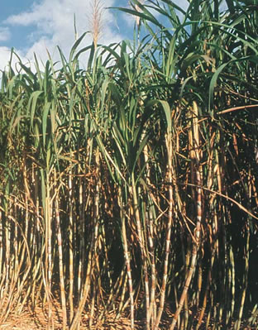
C4 plants
A better way to capture CO₂
  1st step before Calvin cycle,
  fix carbon with enzyme
  PEP carboxylase
    store as 4C compound
  adaptation to hot,
  dry climates
    have to close stomates a lot
    different leaf anatomy
  sugar cane, corn,
  other grasses…
corn
sugar cane

Slide 55
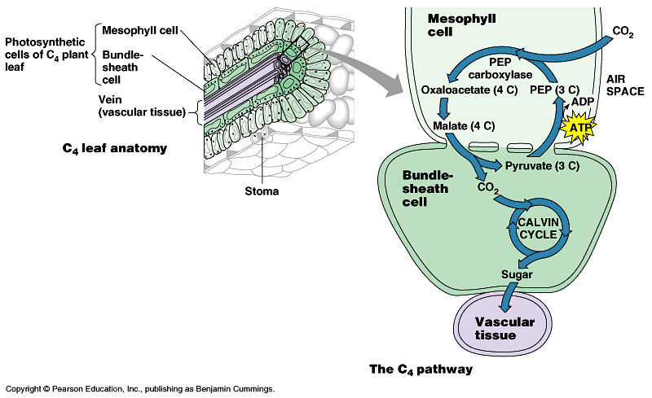
C4 leaf anatomy
PEP (3C) + CO₂ → oxaloacetate (4C)
O₂
light reactions
CO₂
PEP
carboxylase
C3 anatomy
bundle
sheath
cell
stomate
CO₂
PEP carboxylase enzyme
  higher attraction for CO₂ than O₂
    better than RuBisCo
  fixes CO₂ in 4C compounds
  regenerates CO₂ in inner cells for RuBisCo
    keeping O₂ away from RuBisCo
RuBisCo
C4 anatomy
Notes:
PEP = phosphoenolpyruvate
C4 plants solve the photorespiration problem by fixing carbon in outer ring of mesophyll cells using a different enzyme -- PEP carboxylase -- which has a higher affinity for CO2 than O2 (better than Rubisco), so it fixes CO2 in 4C "storage" compounds (oxaloacetate, malate). It then passes the carbon on by regenerating CO2 in the inner bundle sheath cells for Rubisco to use in the Calvin cycle.

Slide 56
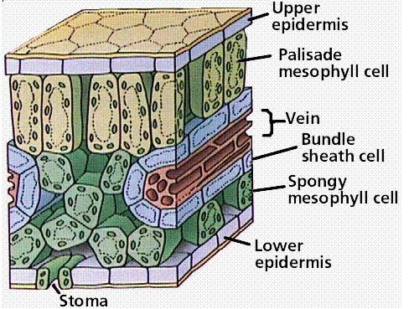
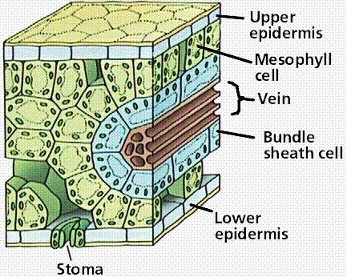
Comparative anatomy
Location,
location,location!
C3
C4
PHYSICALLY separate C fixation from Calvin cycle

Slide 57
CAM (Crassulacean Acid Metabolism) plants
Adaptation to hot, dry climates
  separate carbon fixation from Calvin cycle by TIME
    close stomates during day
    open stomates during night
  at night: open stomates & fix carbon
  in 4C “storage” compounds
  in day: release CO₂ from 4C acids
  to Calvin cycle
    increases concentration of CO₂ in cells
  succulents, some cacti, pineapple
It’s all in
the timing!
Notes:
Crassulacean Acid Metabolism (CAM)
Succulents are in the family Crassulaceae
the name Crassula is derived from the Latin "crassus" meaning thick and refers to the leaves of these succulent plants
CAM plants solve the photorespiration problem by fixing carbon at night (when stomates are open), and put it in "storage" compounds (organic acids like malic acid, isocitric acid) and then in the day (when stomates are closed), they release the CO2 from the "storage" compounds to the Calvin cycle
(thereby increasing CO2 in the cells, improving Rubisco's efficiency)

Slide 58
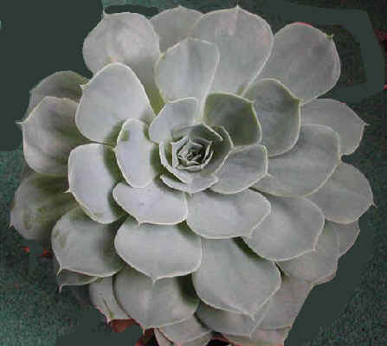
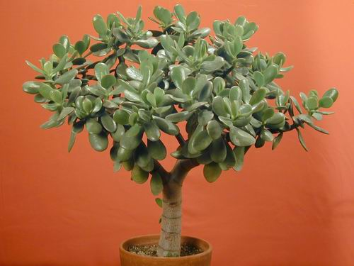
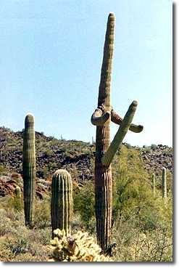
CAM plants
cacti
succulents
pineapple

Slide 59
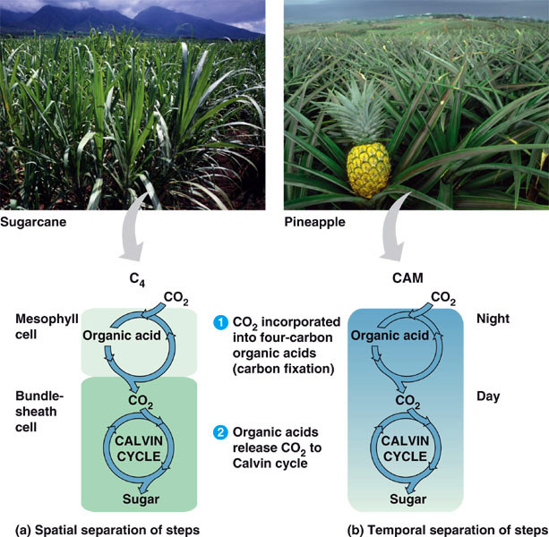
C4 vs CAM Summary
solves CO₂ / O₂ gas exchange vs. H₂O loss challenge
C4 plants
separate 2 steps of C fixation anatomically in 2 different cells
CAM plants
separate 2 steps of C fixation temporally =
2 different times
night vs. day
Notes:
C3, C4, and CAM truly refer to the alternative method of carbon fixation -- grabbing carbon out of the air -- and not the Calvin Cycle itself. They *all* use the Calvin Cycle for sugar generation, but they differ in how they turn carbon from thin air into solid stuff.
In C4, CO2 is fixed into 4-carbon "storage" compounds like oxaloacetate & malate (hence C4)
In CAM, CO2 is fixed into organic acids like malic acid & isocitric acid (hence Crassulacean Acid Metabolism)
In C3, while CO2 is initially fixed into a 6-carbon molecule, it is unstable & quickly breaks down to 3-carbon phosphoglycerate (PGA) (hence C3)
C4 & CAM should be seen as variations on *carbon fixation*, because plants had to evolve alternative systems given the limitations of their enzymes and their need to conserve water.

Slide 60
Why the C3 problem?
We’ve all got
baggage!
Possibly evolutionary baggage
  Rubisco evolved in high CO₂ atmosphere
    there wasn’t strong selection against active site of Rubisco accepting both CO₂ & O₂
Today it makes a difference
  21% O₂ vs. 0.03% CO₂
  photorespiration can drain away 50% of carbon fixed by Calvin cycle on a hot, dry day
  strong selection pressure to evolve better way
  to fix carbon & minimize photorespiration

