Slide 1
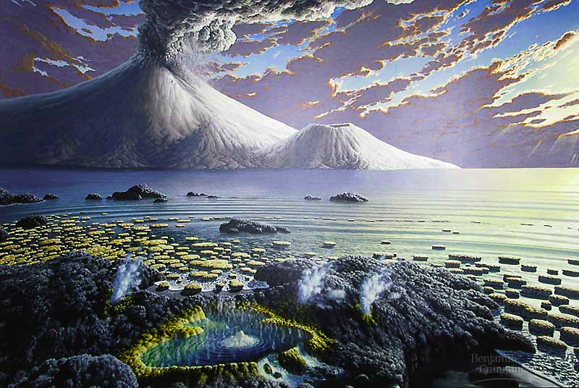
“…sparked by just the right combination of physical events & chemical processes…”
Origin of Life

Slide 2
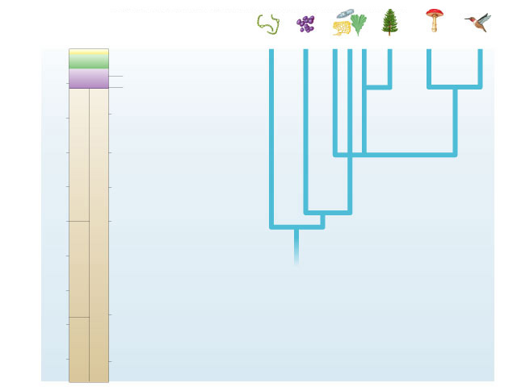
0
Bacteria
Archae-
bacteria
Protista
Plantae
Fungi
Animalia
Cenozoic
Mesozoic
Colonization of land
by animals
500
Paleozoic
Appearance of animals
and land plants
1000
First multicellular
organisms
PROTEROZOIC
Oldest definite fossils
of eukaryotes
1500
2000
Appearance of oxygen
in atmosphere
PRECAMBRIAN
Millions of years ago
2500
Oldest definite fossils
of prokaryotes
3000
The evolutionary tree of life can be documented with evidence.
The Origin of Life on Earth is another story…
ARCHEAN
3500
Molten-hot surface of
earth becomes cooler
4000
4500
Formation of earth

Slide 3
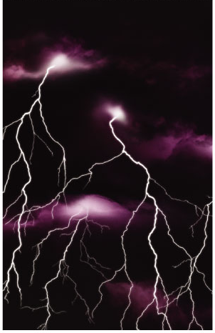
The Origin of Life is Hypothesis
Special Creation
  Was life created by a supernatural or divine force?
  not testable
Extra-terrestrial Origin
  Was the original source of organic (carbon) materials comets & meteorites striking early Earth?
  testable
Spontaneous Abiotic Origin
  Did life evolve spontaneously from inorganic molecules?
  testable

Slide 4
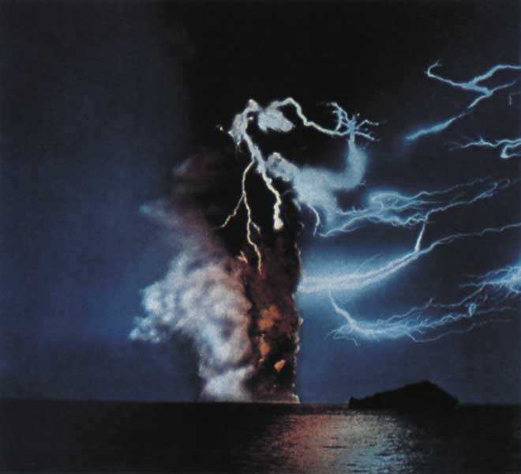
Conditions on early Earth
Reducing atmosphere
  water vapor (H₂O), CO₂, N₂, NO_{x}, H₂, NH₃, CH₄, H₂S
  lots of available H & its electron
  no free oxygen
Energy source
  lightning, UV radiation,
  volcanic
low O₂ =
organic molecules do not breakdown as quickly
What’s missing
from that
atmosphere?
Notes:
It is unclear whether young Earth’s atmosphere contained enough methane and ammonia to be reducing. Growing evidence suggests that the early atmosphere was made up primarily of nitrogen and carbon dioxide and was neither reducing nor oxidizing (electron–removing). Miller–Urey–type experiments using such atmospheres have not produced organic molecules. Still, it is likely that small “pockets” of the early atmosphere—perhaps near volcanic openings—were reducing.
Instead of forming in the atmosphere, the first organic compounds on Earth may have been synthesized near submerged volcanoes and deep–sea vents—weak points in Earth’s crust where hot water and minerals gush into the ocean.

Slide 5
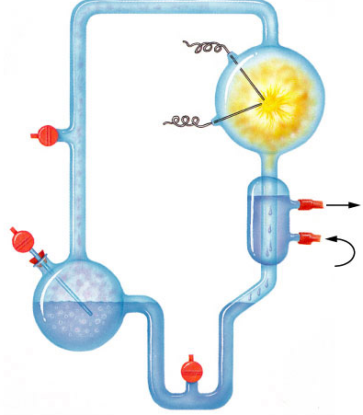
Origin of Organic Molecules
Electrodes discharge
sparks
(lightning simulation)
Abiotic synthesis
  1920
  Oparin & Haldane propose reducing atmosphere hypothesis
  1953
  Miller & Urey
  test hypothesis
    formed organic compounds
      amino acids
      adenine
CH₄
Water vapor
H₂
NH₃
Mixture of gases
("primitive
atmosphere")
Condenser
Water
Condensed liquid with complex, organic
molecules
Heated water
("ocean")

Slide 6

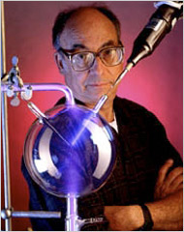
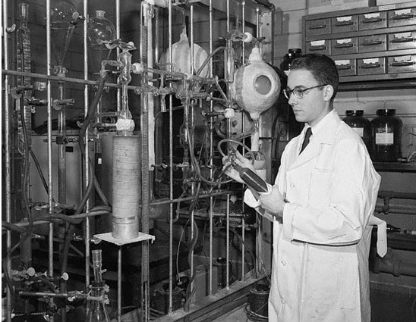
Stanley Miller
University of Chicago
produced
-amino acids
-hydrocarbons
-nitrogen bases
-other organics
Why was
this experiment
important??!

Slide 7
Key Events in Origin of Life
Origin of Cells (Protobionts)
  lipid bubbles → separate inside from outside
→ metabolism & reproduction
Origin of Genetics
  RNA is likely first genetic material
  multiple functions: encodes information (self-replicating), enzyme, regulatory molecule, transport molecule (tRNA, mRNA)
    makes inheritance possible
    makes natural selection & evolution possible
Origin of Eukaryotes
  endosymbiosis
Notes:
Life is defined partly by two properties: accurate replication and metabolism. Neither property can exist without the other. Self–replicating molecules and a metabolism–like source of the building blocks must have appeared together. How did that happen?
The necessary conditions for life may have been met by protobionts, aggregates of abiotically produced molecules surrounded by a membrane or membrane–like structure. Protobionts exhibit some of the properties associated with life, including simple reproduction and metabolism, as well as the maintenance of an internal chemical environment different from that of their surroundings.
Laboratory experiments demonstrate that protobionts could have formed spontaneously from abiotically produced organic compounds. For example, small membrane–bounded droplets called liposomes can form when lipids or other organic molecules are added to water.

Slide 8
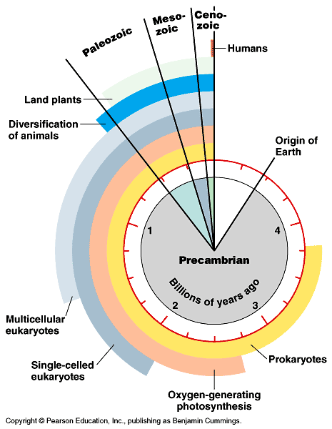
Timeline
Key events in evolutionary history of life on Earth
  3.5–4.0 bya:
  life originated
  2.7 bya:
  free O₂ = photosynthetic bacteria
  2 bya:
  first eukaryotes

Slide 9
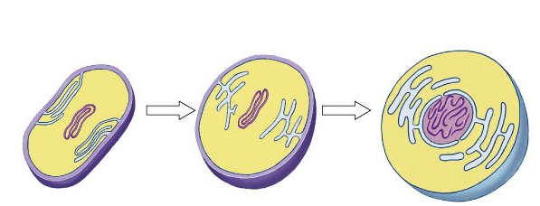
First Eukaryotes
~2 bya
Development of internal membranes
  create internal micro-environments
  advantage: specialization = increase efficiency
    natural selection!
endoplasmic
reticulum (ER)
nuclear envelope
infolding of the
plasma membrane
plasma
membrane
nucleus
DNA
cell wall
plasma
membrane
Prokaryotic
cell
Prokaryotic ancestor of eukaryotic cells
Eukaryotic
cell

Slide 10
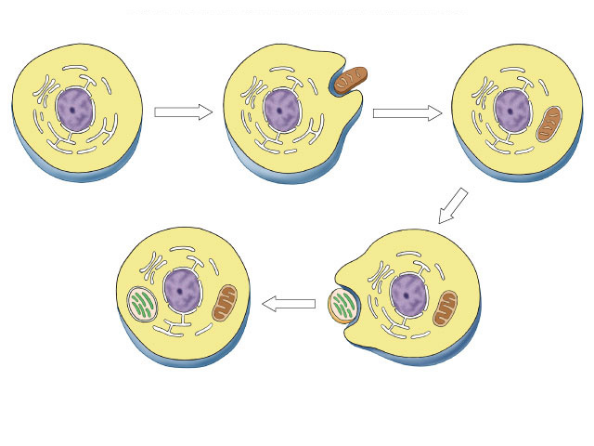
1st Endosymbiosis
Evolution of eukaryotes
  origin of mitochondria
  engulfed aerobic bacteria, but
  did not digest them
  mutually beneficial relationship
    natural selection!
internal membrane system
aerobic bacterium
mitochondrion
Endosymbiosis
Ancestral
eukaryotic cell
Eukaryotic cell
with mitochondrion

Slide 11
2nd Endosymbiosis
Eukaryotic
cell with
mitochondrion
Evolution of eukaryotes
  origin of chloroplasts
  engulfed photosynthetic bacteria,
  but did not digest them
  mutually beneficial relationship
    natural selection!
photosynthetic
bacterium
chloroplast
Endosymbiosis
mitochondrion
Eukaryotic cell with
chloroplast & mitochondrion

Slide 12
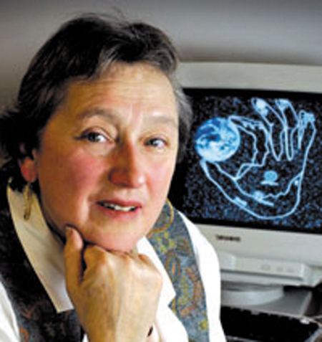
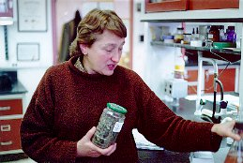
Theory of Endosymbiosis
Evidence
  structural
    mitochondria & chloroplasts
    resemble bacterial structure
  genetic
    mitochondria & chloroplasts
    have their own circular DNA, like bacteria
  functional
    mitochondria & chloroplasts
    move freely within the cell
    mitochondria & chloroplasts
    reproduce independently
    from the cell
Lynn Margulis

Slide 13
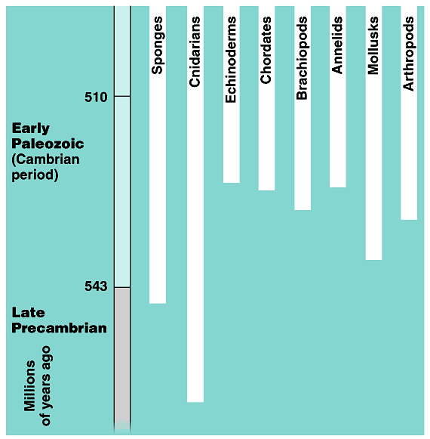
Cambrian explosion
Diversification of Animals
  within 10–20 million years most of the major phyla of animals appear in fossil record
543 mya

Slide 14
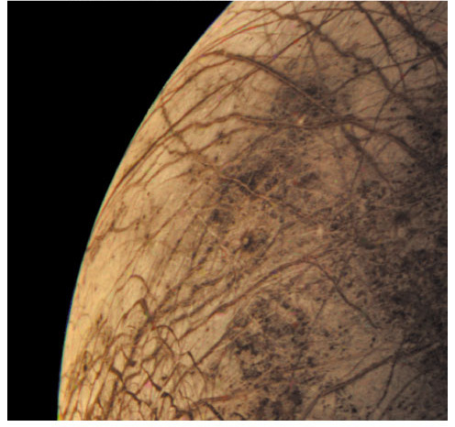
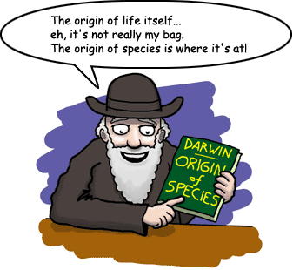
Is there life elsewhere?
Does it look like life on Earth?
They would
Ask Questions!

Slide 15
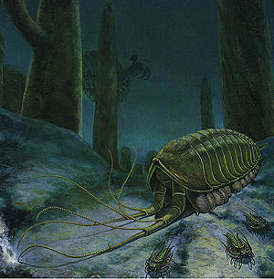
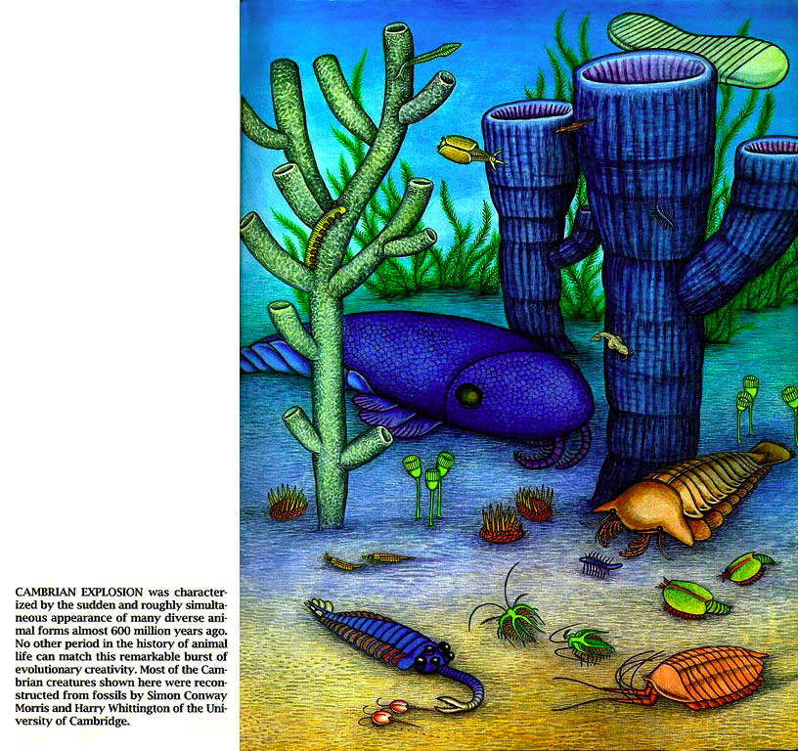
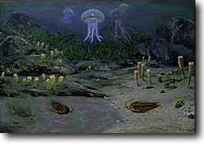


Slide 16
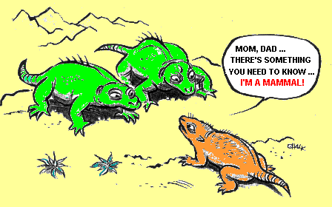
The Origin of Species
Mom, Dad…
There’s something
you need to know…
I’m a MAMMAL!

Slide 17
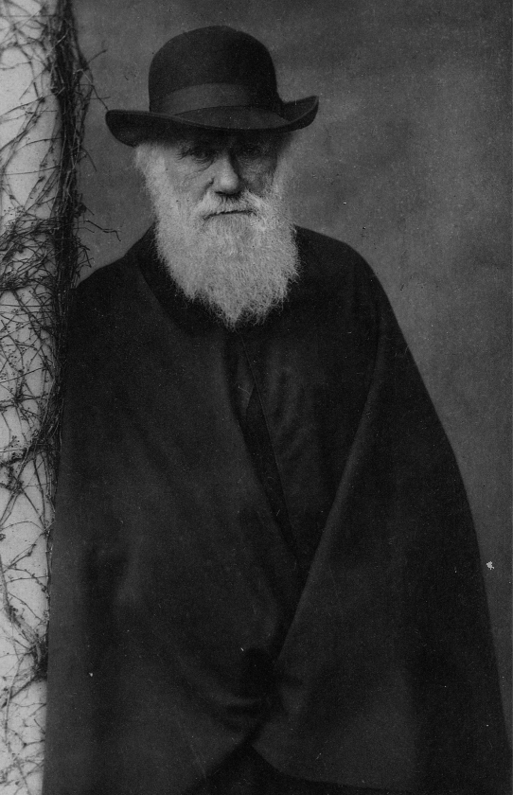
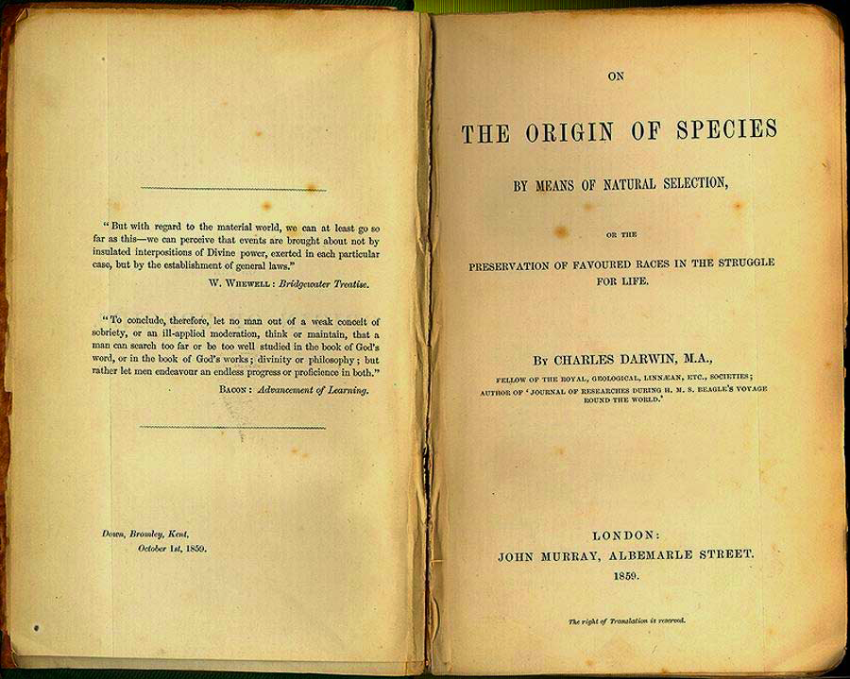
“That mystery of mysteries…”
Darwin never actually tackled how new species arose…
Both in space and time,
we seem to be brought
somewhat near to that great fact
—that mystery of mysteries—
the first appearance of
new beings on this Earth.

Slide 18
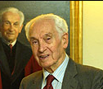
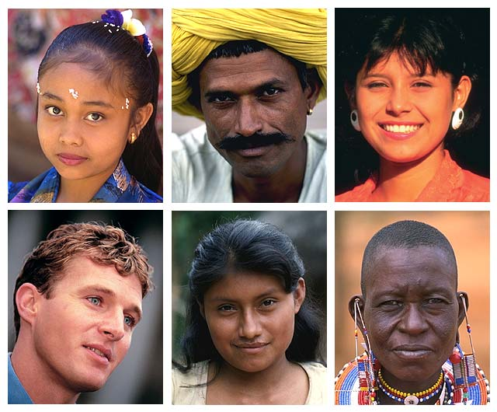
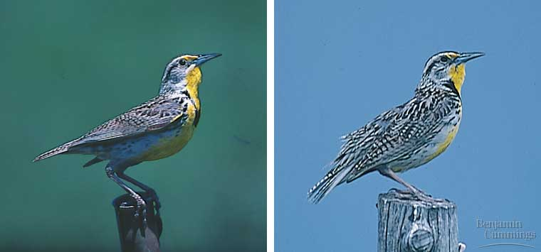
So…what is a species?
Biological species concept
  defined by Ernst Mayr
  population whose members can interbreed & produce viable, fertile offspring
  reproductively compatible
Distinct species:
songs & behaviors are different enough to prevent interbreeding
Eastern Meadowlark
Western Meadowlark
Notes:
Humans re so diverse but considered one species, whereas these Meadowlarks look so similar but are considered different species.
Meadowlarks
Similar body & colorations, but are distinct biological species because their songs & other behaviors are different enough to prevent interbreeding

Slide 19
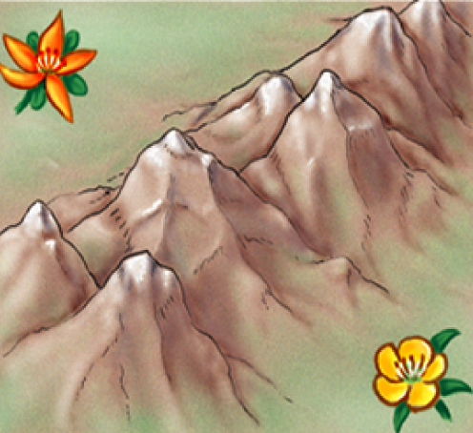
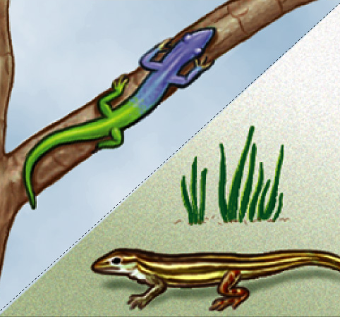
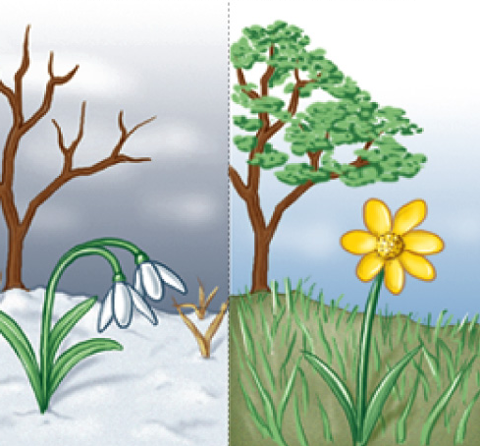
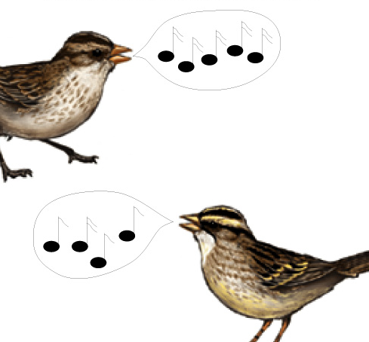
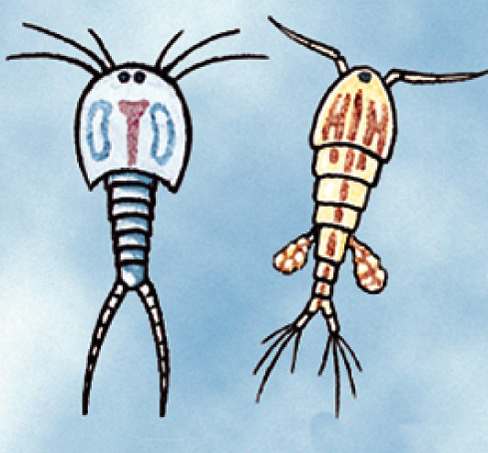
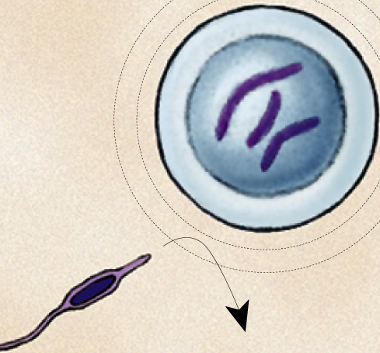
PRE-reproduction barriers
Obstacle to mating or to fertilization if mating occurs
geographic isolation
ecological isolation
temporal isolation
behavioral isolation
mechanical isolation
gametic isolation

Slide 20
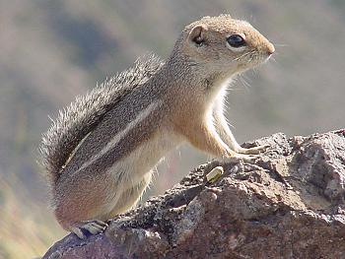
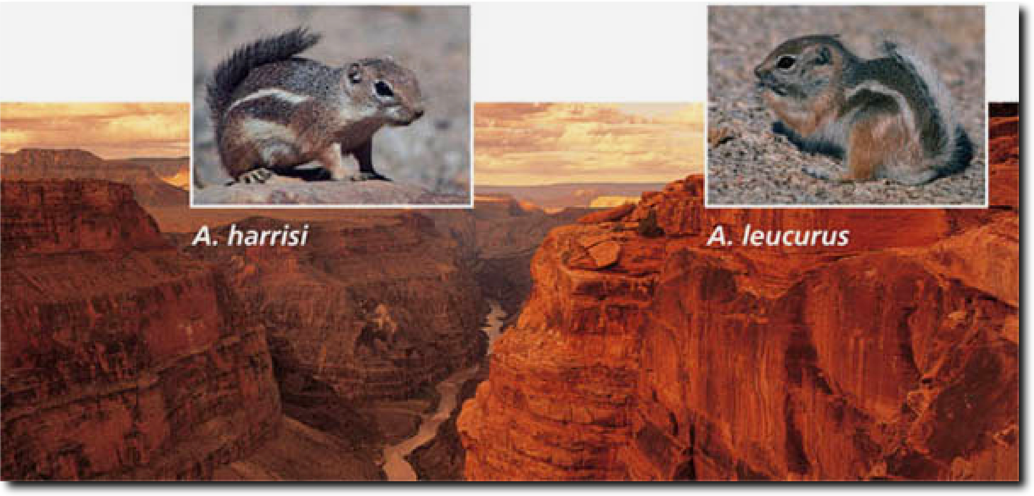
Geographic isolation
Ammospermophilus spp
Species occur in different areas
  physical barrier
  Allopatric speciation is geographic isolation. All other barriers are sympatric speciation.
Harris’s antelope squirrel inhabits the canyon’s south rim (L). Just a few miles away on the north rim (R) lives the closely related white-tailed antelope squirrel

Slide 21
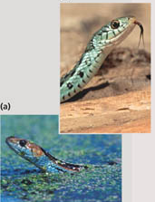
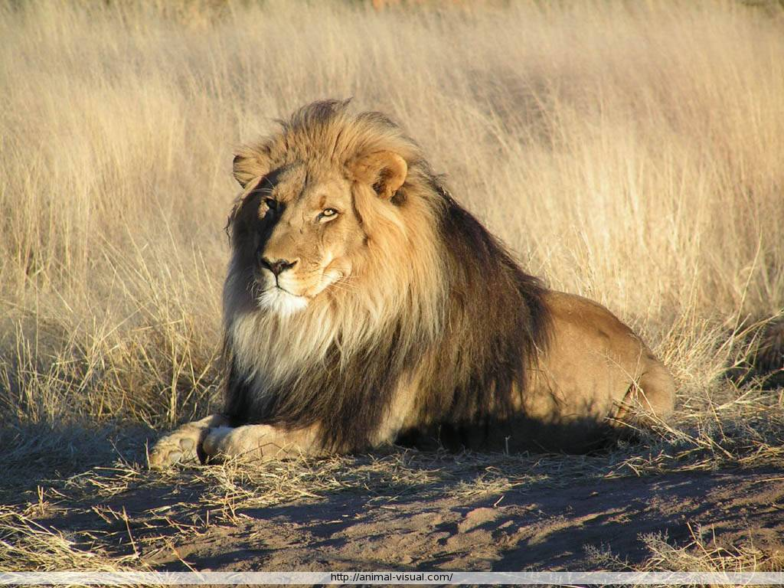
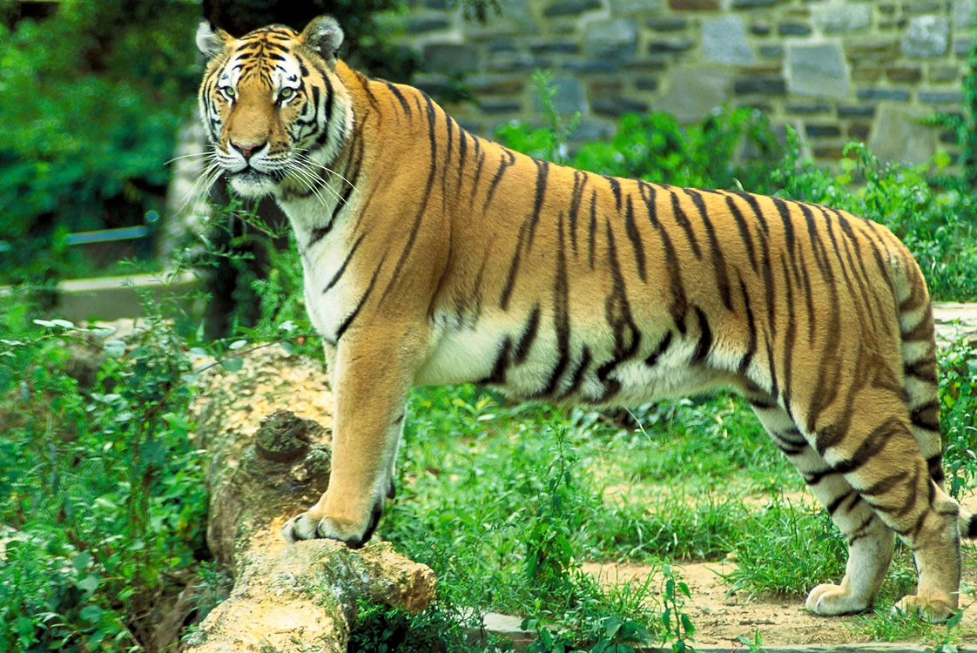
Ecological isolation
sympatric speciation
Species occur in same region, but occupy different habitats so rarely encounter each other
2 species of garter snake, Thamnophis, occur in same area, but one lives in water & other is terrestrial
lions & tigers could hybridize, but they live in different habitats:
lions in grasslands
tigers in rainforest

Slide 22
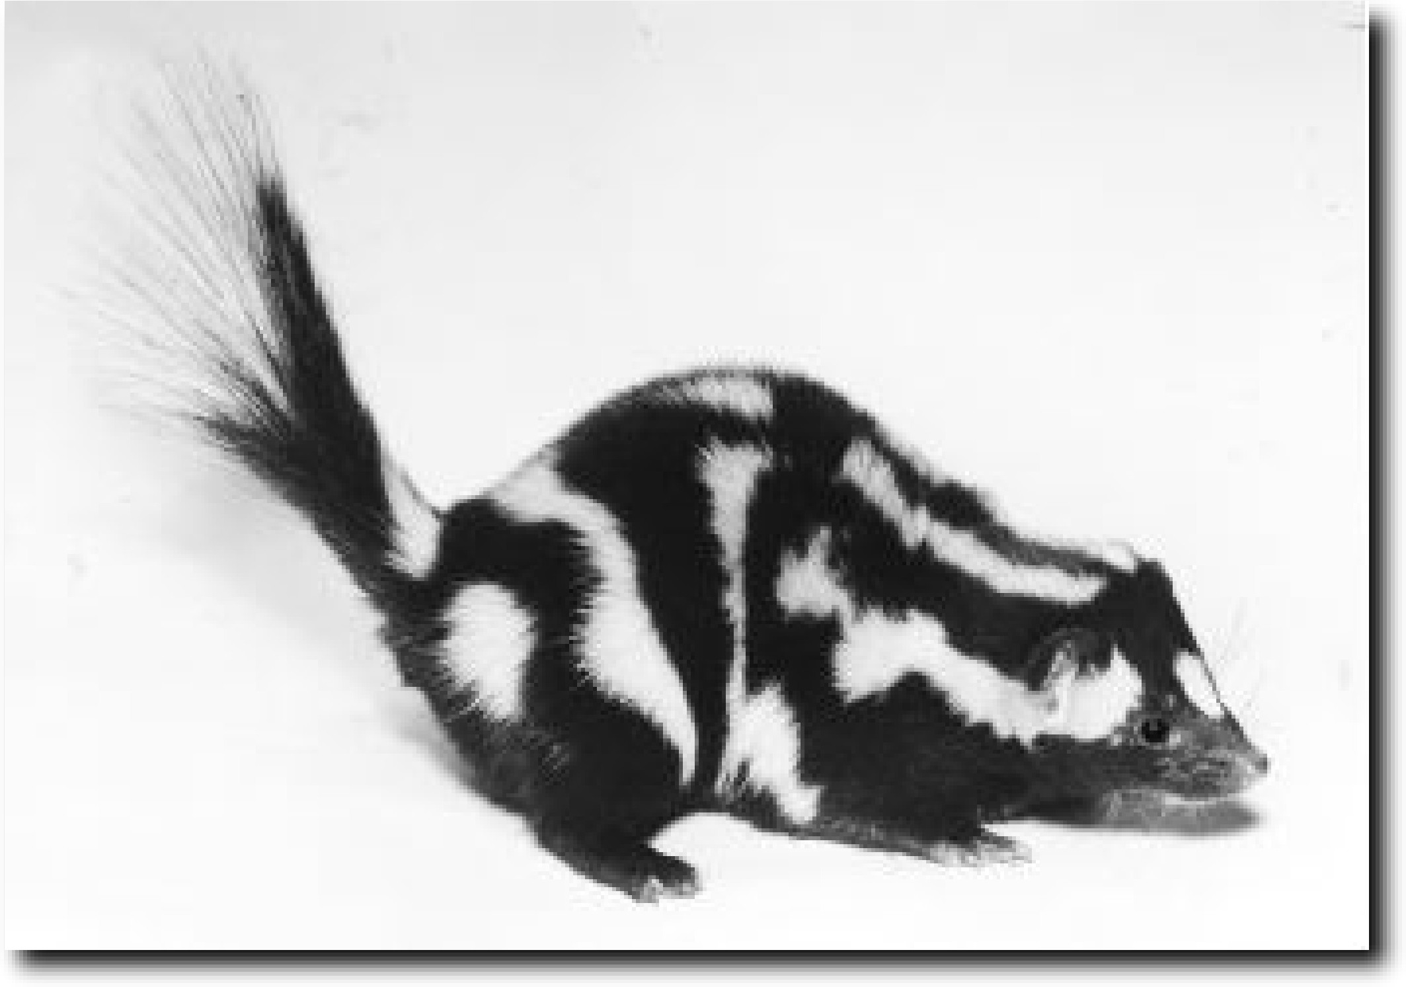
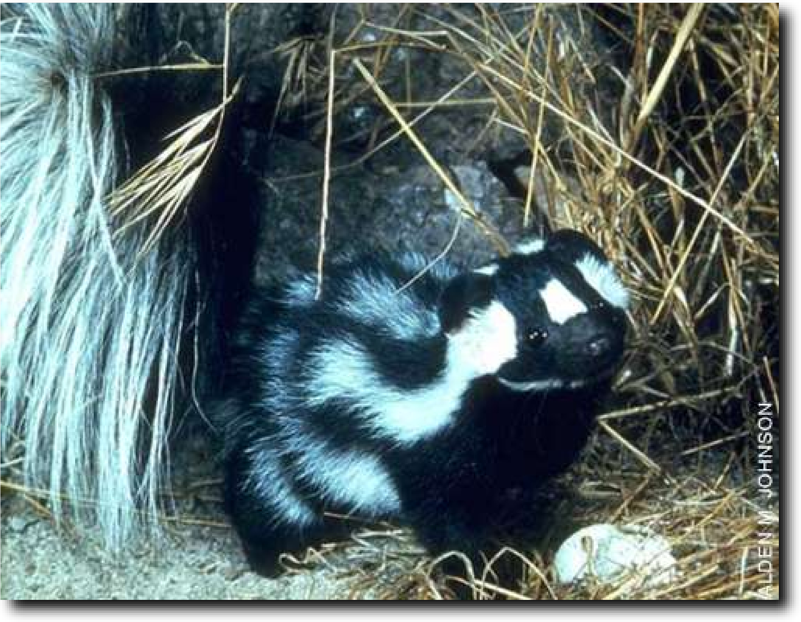
Temporal isolation
Species that breed during different times of day, different seasons, or different years cannot mix gametes
Eastern spotted skunk (L) & western spotted skunk (R) overlap in range but eastern mates in late winter & western mates in late summer

Slide 23
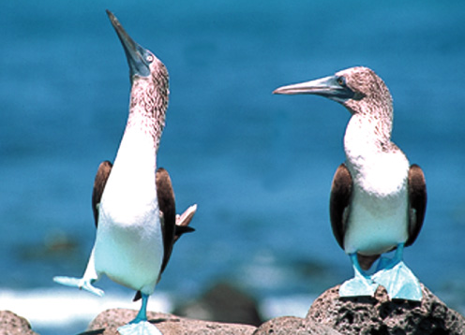
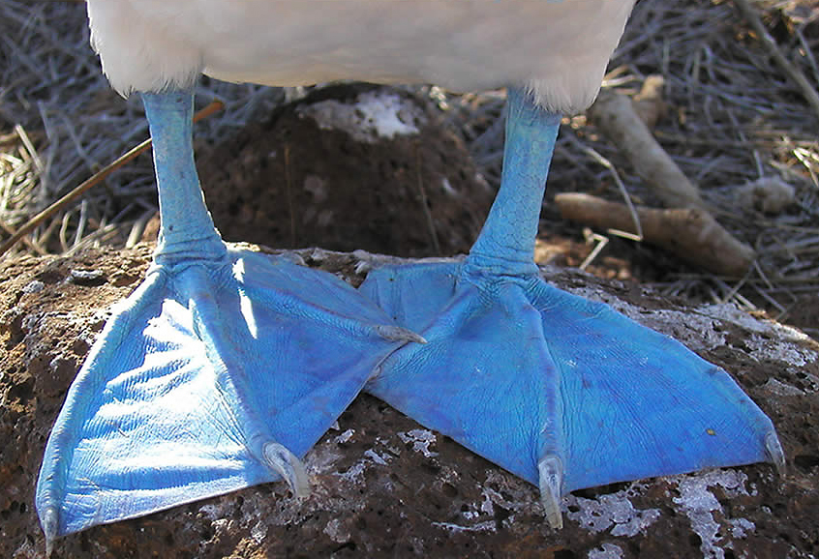
Behavioral isolation
sympatric speciation?
Unique behavioral patterns & rituals isolate species
  identifies members of species
  attract mates of same species 
    courtship rituals, mating calls
Blue footed boobies mate only after a courtship display unique to their species
Notes:
The most comedic species of the Galapagos Islands is the Blue Footed Booby, what a ridiculous outfit and expression! Their name is in fact taken from the Spanish 'bobo' which means clown.
The Blue Footed Boobies above display part of their humorous courtship ritual whereby they raise their feet one at a time and then swivel their heads away from the prospective mate looking to the sky.
Other interesting Booby features are the highly evolved airbag systems in their skulls which allow them to dive bomb into the sea for fish from great height, and the egg and hatchling nesting boundaries they make which are rings of Boobie poop. They aren't the only Booby on the island — there are also Masked and Red Footed Boobies about.

Slide 24
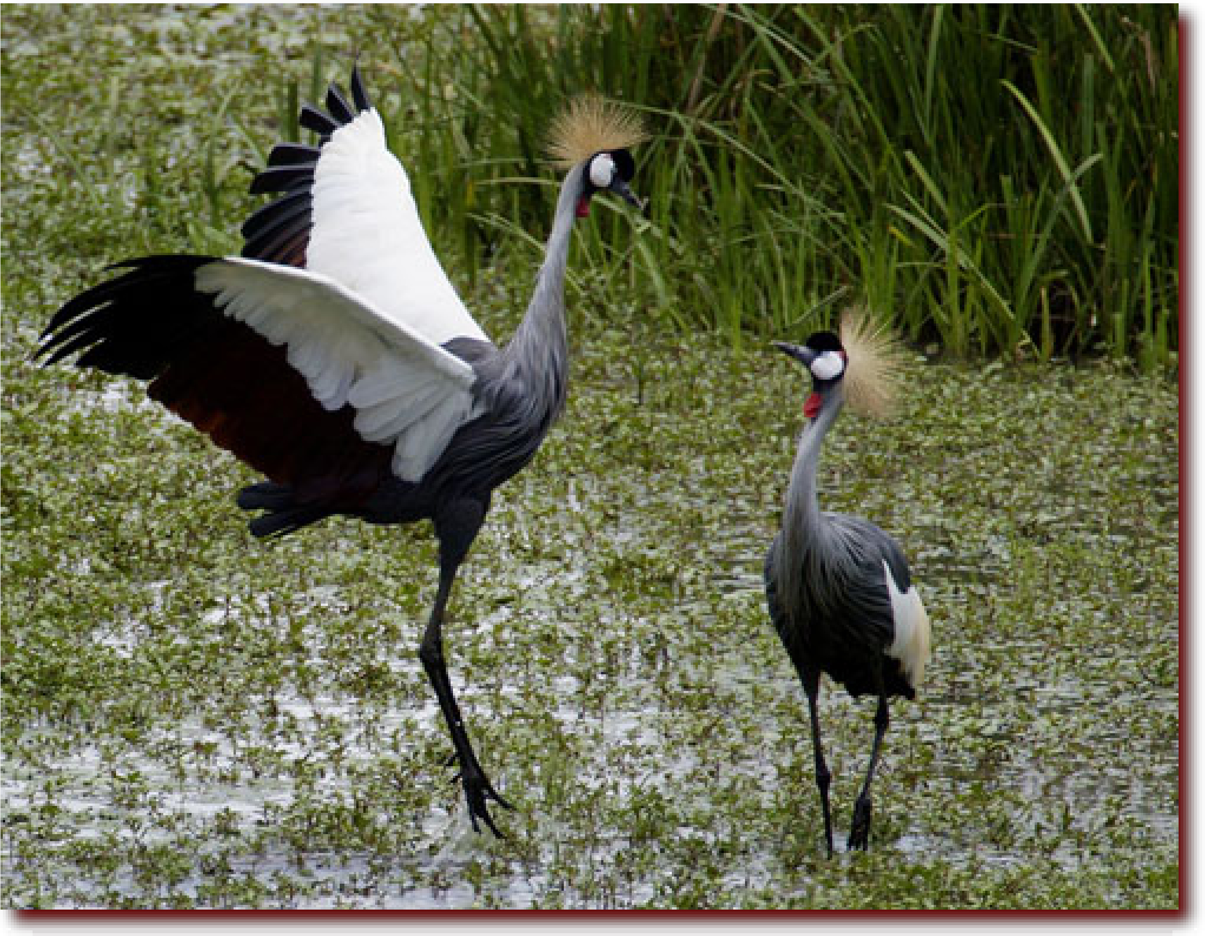

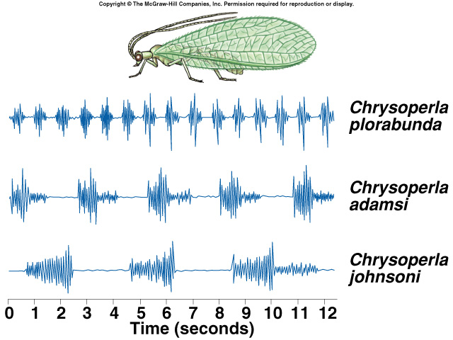
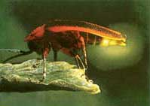
Recognizing your own species
courtship songs of sympatric
species of lacewings
courtship display of
Gray-Crowned Cranes, Kenya
firefly courtship displays

Slide 25
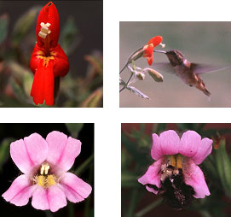
Mechanical isolation
sympatric speciation?
Morphological differences can prevent successful mating
Plants
Even in closely related species of plants, the flowers often have distinct appearances that attract different pollinators.
These 2 species of monkey flower differ greatly in shape & color, therefore cross-pollination does not happen.
Notes:
The most comedic species of the Galapagos Islands is the Blue Footed Booby, what a ridiculous outfit and expression! Their name is in fact taken from the Spanish 'bobo' which means clown.
The Blue Footed Boobies above display part of their humorous courtship ritual whereby they raise their feet one at a time and then swivel their heads away from the prospective mate looking to the sky.
Other interesting Booby features are the highly evolved airbag systems in their skulls which allow them to dive bomb into the sea for fish from great height, and the egg and hatchling nesting boundaries they make which are rings of Boobie poop. They aren't the only Booby on the island — there are also Masked and Red Footed Boobies about.

Slide 26
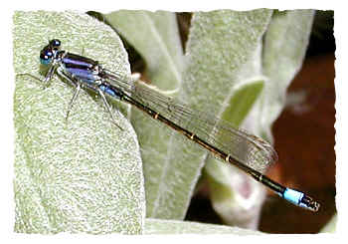

Mechanical isolation
Animals
For many insects, male &
female sex organs of
closely related species do
not fit together, preventing
sperm transfer
  lack of “fit” between sexual organs:
  hard to imagine for us… but a big issue for insects with different shaped genitals!
I can’t even imagine!
Damsel fly penises
Notes:
The selection is intense because it directly affects offspring production -- it is affecting sex itself

Slide 27
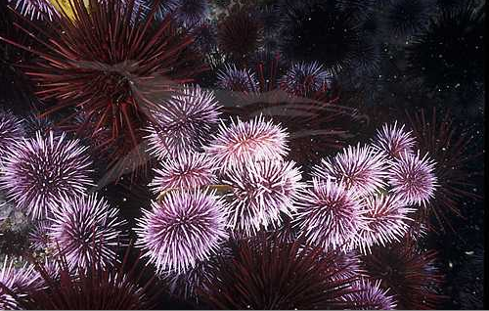
Gametic isolation
sympatric speciation?
Sperm of one species may not be able to fertilize eggs of another species
  mechanisms
    biochemical barrier so sperm cannot penetrate egg
      receptor recognition: lock & key between egg & sperm
    chemical incompatibility
      sperm cannot survive in female reproductive tract
Sea urchins release sperm & eggs into surrounding waters where they fuse & form zygotes. Gametes of different species— red & purple —are unable to fuse.

Slide 28
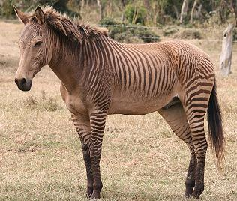
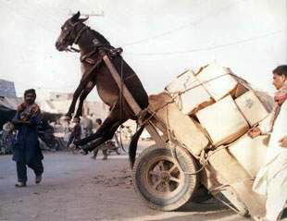
POST-reproduction barriers
Prevent hybrid offspring from developing into a viable, fertile adult
zebroid

Slide 29
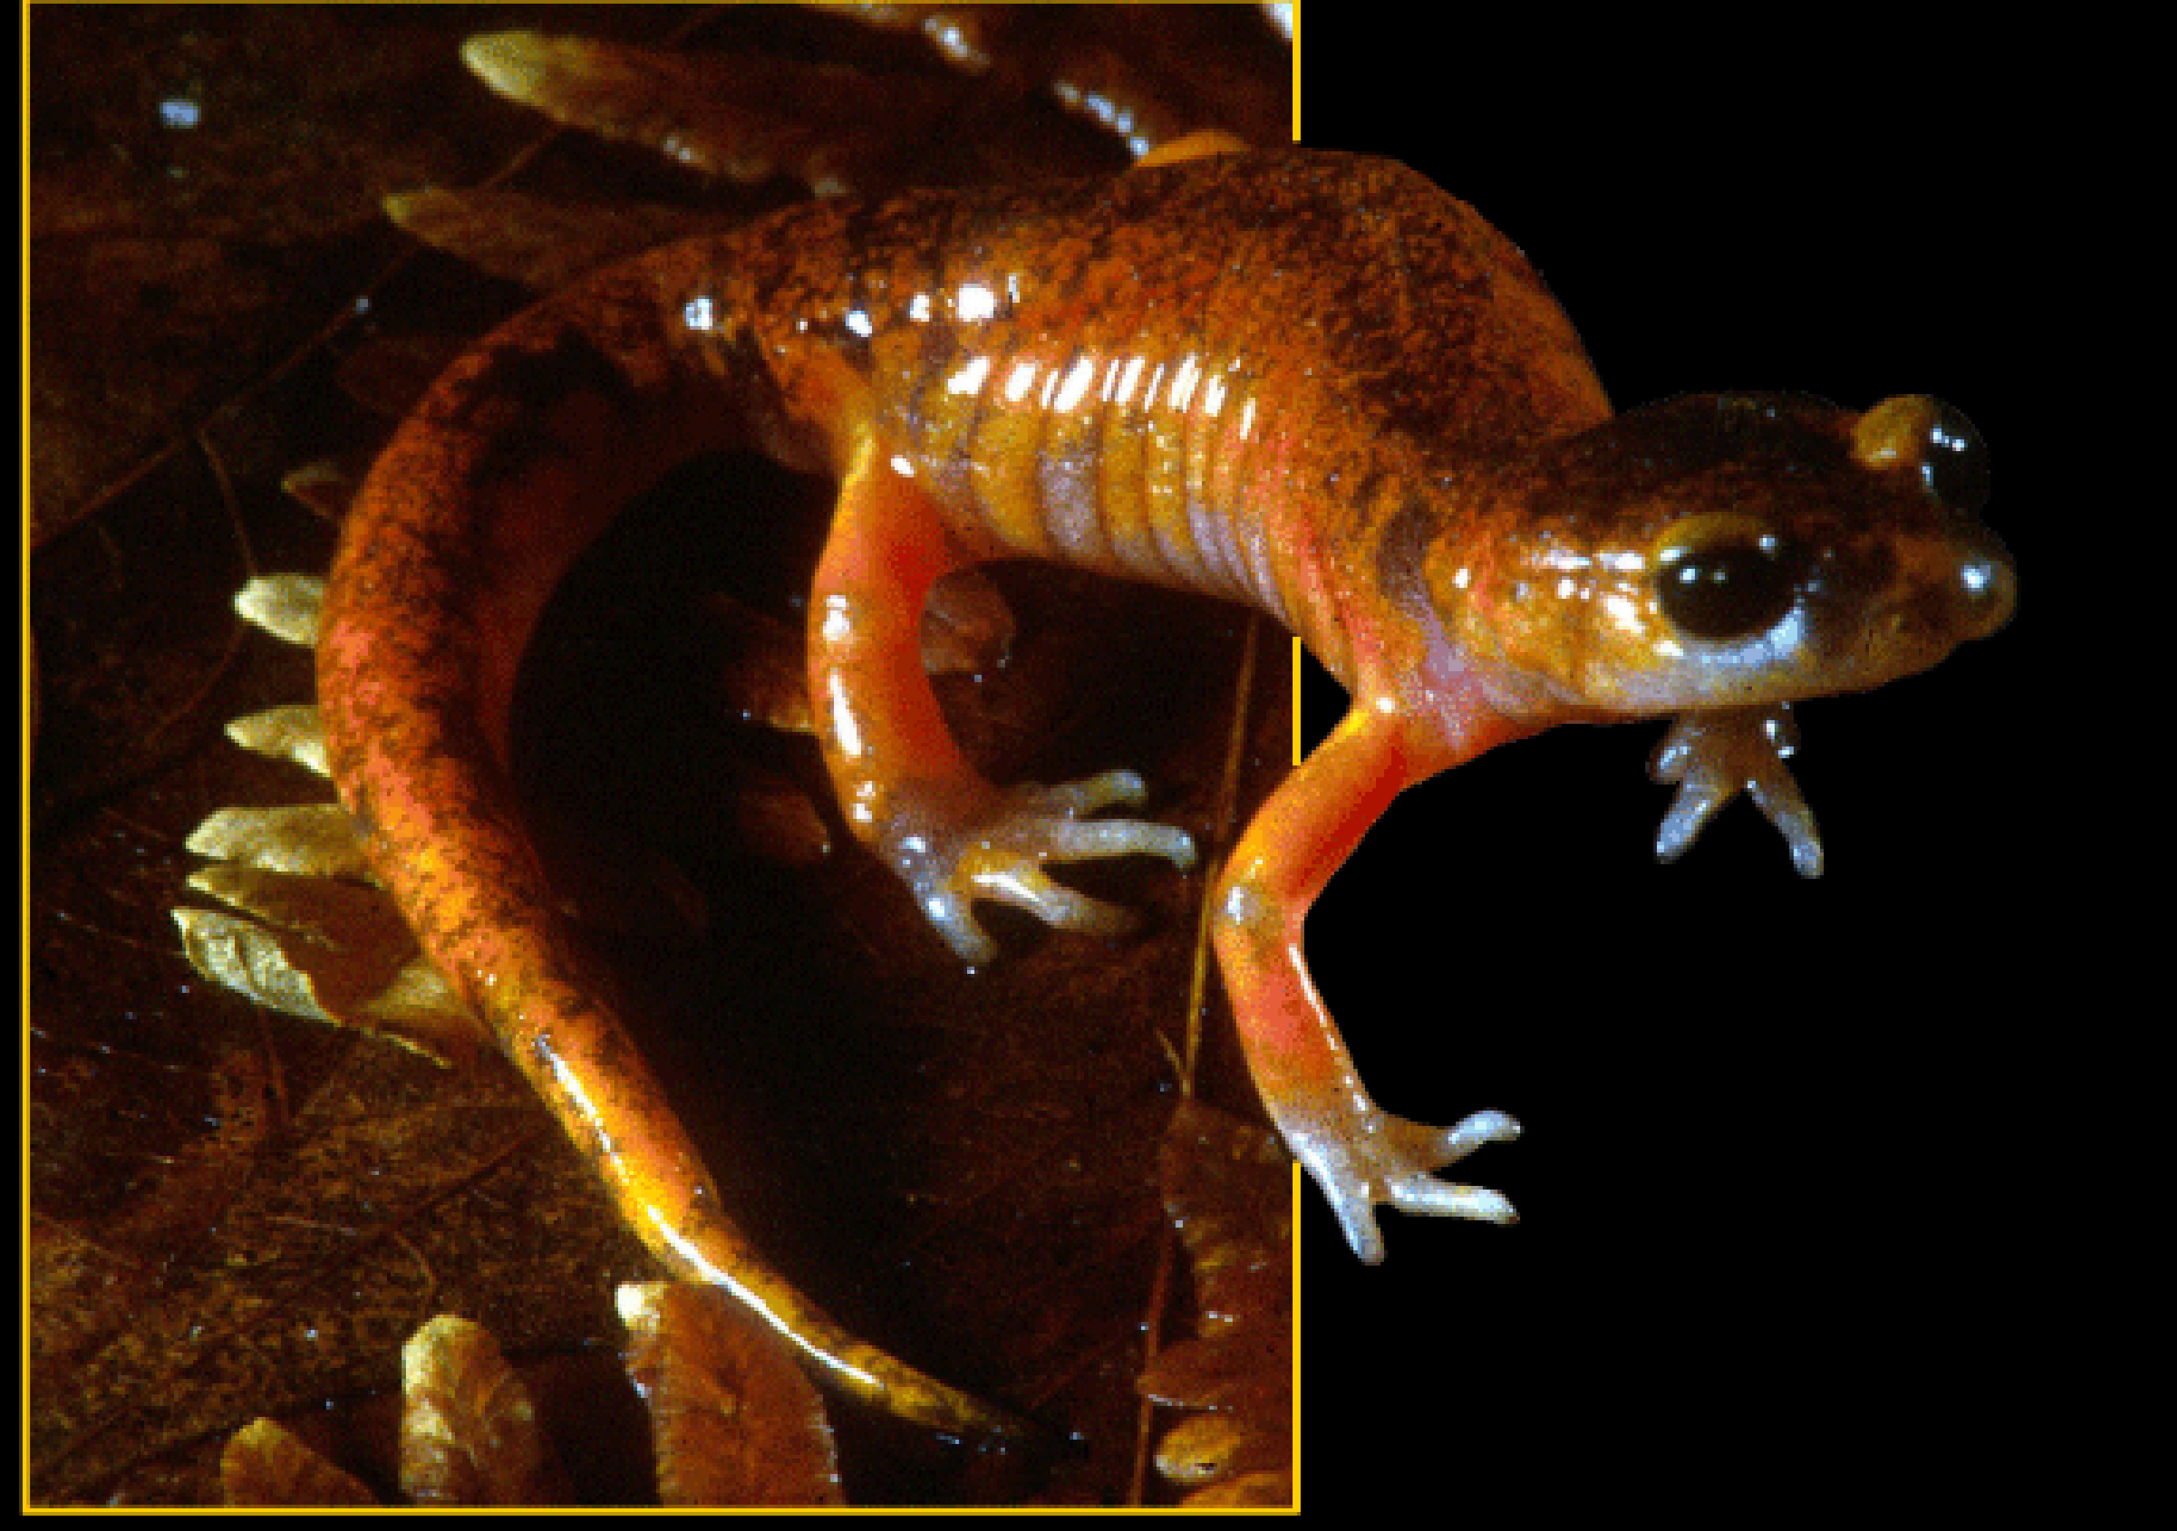
Reduced hybrid viability
sympatric speciation?
Genes of different parent species may interact & impair the hybrid’s development
Species of salamander genus, Ensatina, may interbreed, but most hybrids do not complete development & those that do are frail.

Slide 30
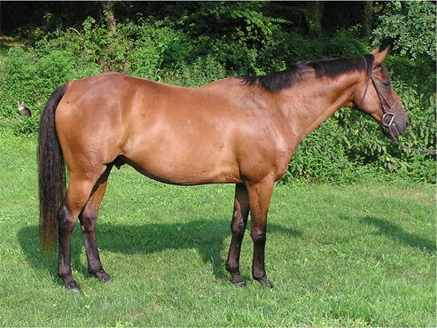
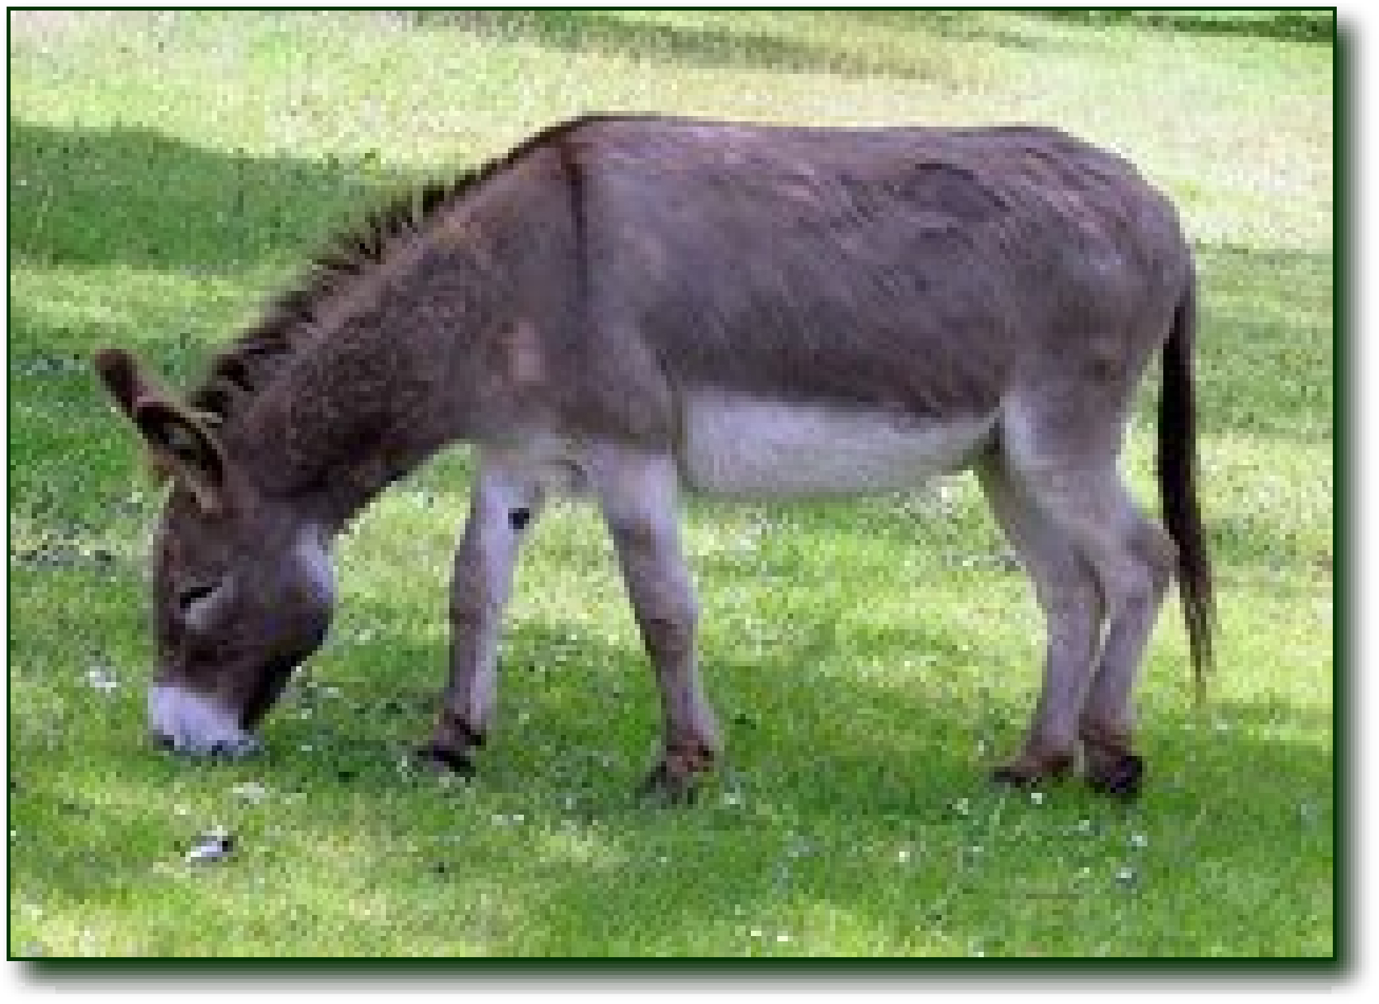

Reduced hybrid fertility
Even if hybrids are vigorous
they may be sterile
  chromosomes of parents may differ in number or structure & meiosis in hybrids may fail to produce normal gametes
Mules are vigorous, but sterile
Horses have 64 chromosomes
(32 pairs)
Donkeys have 62 chromosomes
(31 pairs)
Mules have 63 chromosomes!
Notes:
What’s wrong with having 63 chromosomes?
Odd number! Cannot pair up in meiosis.

Slide 31


Hybrid breakdown
sympatric speciation?
Hybrids may be fertile & viable in first generation, but when they mate offspring are feeble or sterile
In strains of cultivated rice, hybrids are vigorous but plants in next generation are small & sterile.
On path to separate species.

Slide 32

Figure 24.3_a
Prezygotic barriers
Postzygotic barriers
Habitat
Isolation
Temporal
Isolation
Behavioral
Isolation
Mechanical
Isolation
Gametic
Isolation
Reduced Hybrid
Viability
Reduced Hybrid
Fertility
Hybrid
Breakdown
Individuals
of
different
species
MATING
ATTEMPT
FERTILIZATION
VIABLE,
FERTILE
OFFSPRING
(a)
(c)
(e)
(f)
(g)
(h)
(i)
(l)
(d)
(j)
(b)
(k)
Notes:
Figure 24.3 Exploring: Reproductive Barriers

Slide 33

Rate of Speciation
Does speciation happen gradually or rapidly
Gradualism
Punctuated Equilibrium
gradual accumulation of small changes over long time
  rapid bursts of change mixed with long periods of little or no change
Charles Darwin
Charles Lyell
Stephen Jay Gould
Niles Eldredge

Slide 34
Gradualism vs. Punctuated Equilibrium
____________________________
  gradual divergence over long spans of time
  assume that big changes occur as the accumulation of many small ones
____________________________
  rapid bursts of change
  long periods of little or no change
  species undergo rapid change when they 1st bud from parent population

Slide 35



Stephen Jay Gould
Niles Eldredge
Life can change quickly…
Ask Questions!

