Slide 1
Mutations
10th Grade Biology
Mr. Walker

Slide 2
Genetic Changes
A mutation is any change to the DNA sequence.
Chromosomal mutations
Frameshift mutations
Point mutations
Only mutations in sex cells can be transmitted to offspring.
Potentially can produce new species

Slide 3
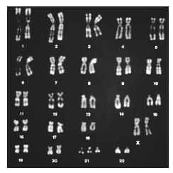
Chromosomal mutations
Deletions: When part of a chromosome is left out.
Insertion: When part of a chromatid breaks off and attaches to its sister chromatid
Inversion: When part of a chromosome breaks off and reattaches backwards
Translocation: When part of one chromosome breaks off and is added to a different chromosome.

Slide 4
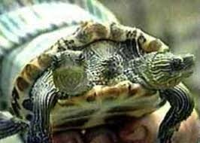
Frameshift mutations
A mutation in which a single base is added to or deleted from DNA
THE DOG BIT THE CAT
THE DOB ITT HEC AT

Slide 5
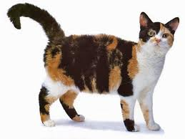
Point mutations
A change in a single base pair in DNA
THE DOG BIT THE CAT
THE DOG BIT THE CAR
Example: Tay Sachs dz

Slide 6
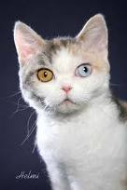
Causes of mutations
Mutagens are any agent which can cause a change in DNA.
Radiation
X-rays
UV light
Chemicals like asbestos, benzene, formaldehyde

Slide 7
Are mutations bad?

Slide 8
Are mutations bad?
It depends
If the change causes disease (Dz). For example….. cancer
If the change allows the organism to be faster, stronger, smarter?
EVOLUTION BABY!

