Slide 1
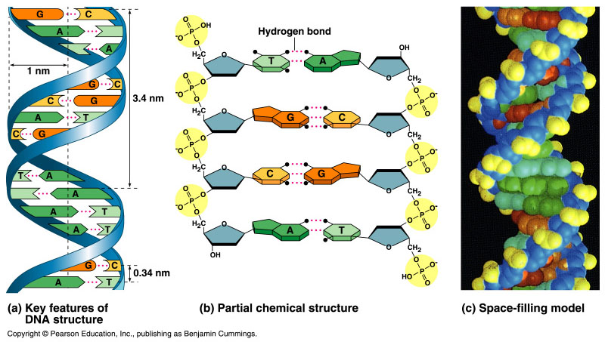
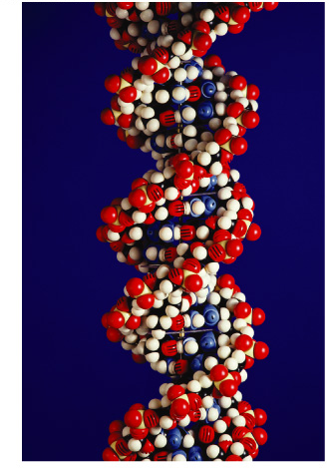

DNA
The Genetic Material

Slide 2
Scientific History
The march to understanding that DNA is the genetic material
  T.H. Morgan (1908)
  Frederick Griffith (1928)
  Avery, McCarty & MacLeod (1944)
  Hershey & Chase (1952)
  Watson & Crick (1953)
  Meselson & Stahl (1958)

Slide 3
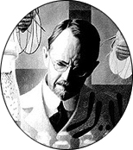
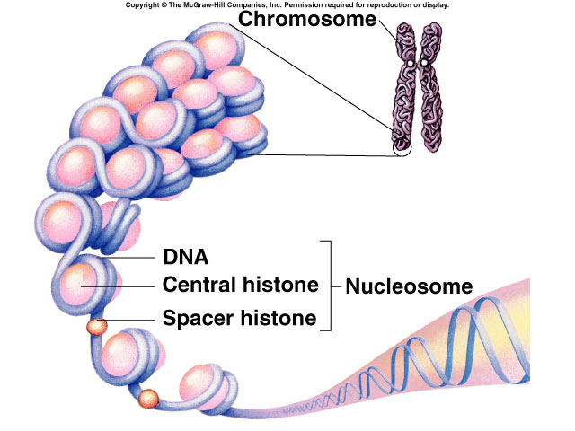
Genes are on chromosomes
1908 | 1933
T.H. Morgan
  working with Drosophila (fruit flies)
  genes are on chromosomes
  but is it the protein or the DNA of the chromosomes that are the genes?
    through 1940 proteins
    were thought to be
    genetic material… Why?
What’s so impressive
about proteins?!

Slide 4
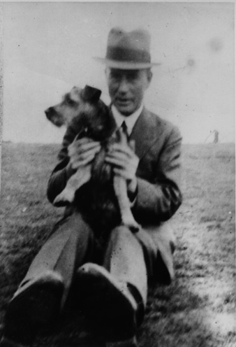
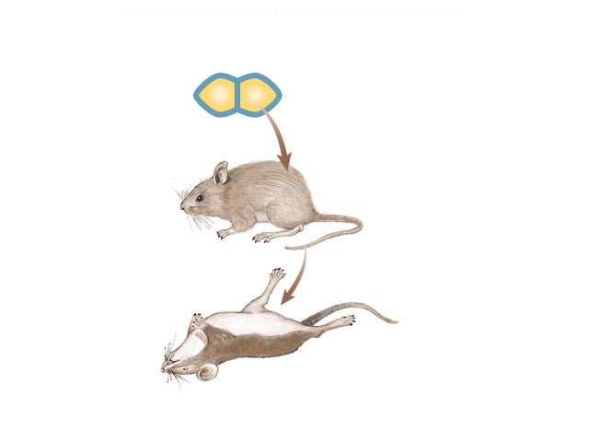
The “Transforming Factor”
1928
Frederick Griffith
  Streptococcus pneumonia bacteria
    was working to find cure for pneumonia
  harmless live bacteria mixed with heat-killed infectious bacteria causes disease in mice
  substance passed from dead bacteria to live bacteria = “Transforming Factor”
Notes:
Fred Griffith, English microbiologist, dies in the Blitz in London in 1941

Slide 5
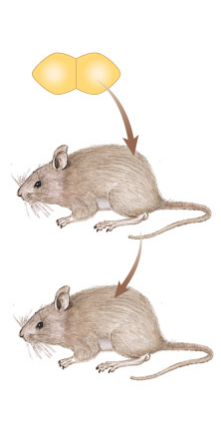
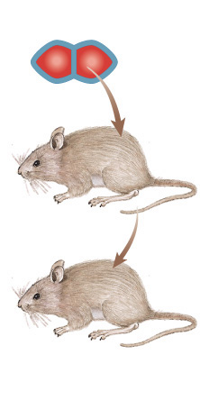
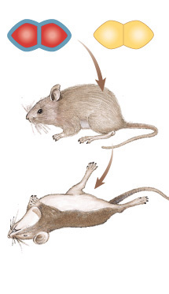
The “Transforming Factor”
mix heat-killed
pathogenic &
non-pathogenic
bacteria
live pathogenic
strain of bacteria
live non-pathogenic
strain of bacteria
heat-killed
pathogenic bacteria
A.
B.
C.
D.
mice die
mice live
mice live
mice die
Transformation?
something in heat-killed bacteria could still transmit disease-causing properties

Slide 6
DNA is the “Transforming Factor”
1944
Avery, McCarty & MacLeod
  purified both DNA & proteins from Streptococcus pneumonia bacteria
    which will transform non-pathogenic bacteria?
  injected protein into bacteria
    no effect
  injected DNA into bacteria
    transformed harmless bacteria
    into virulent bacteria
What’s the
conclusion?

Slide 7
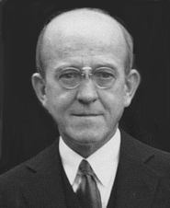
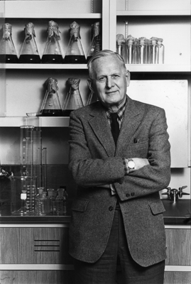
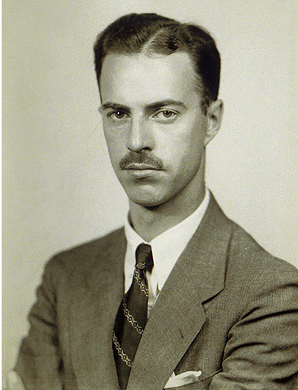
Avery, McCarty & MacLeod
1944
Oswald Avery
Colin MacLeod
Maclyn McCarty
Notes:
Maclyn McCarty (June 9, 1911 – January 2, 2005) was an American geneticist.
Oswald Avery (October 21, 1877–2 February 1955) was a Canadian-born American physician and medical researcher.
Colin Munro MacLeod (January 28, 1909 — February 11, 1972) was a Canadian-American geneticist.

Slide 8
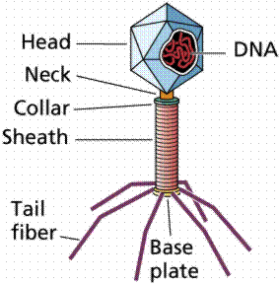
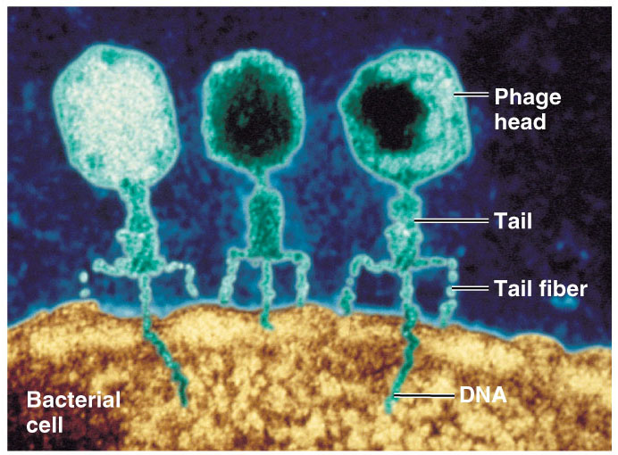
Confirmation of DNA
1952 | 1969
Hershey
Hershey & Chase
  classic “blender” experiment
  worked with bacteriophage
    viruses that infect bacteria
  grew phage viruses in 2 media, radioactively labeled with either
    ³⁵S in their proteins
    ³²P in their DNA
  infected bacteria with
  labeled phages
Why use
Sulfur
vs.
Phosphorus?

Slide 9
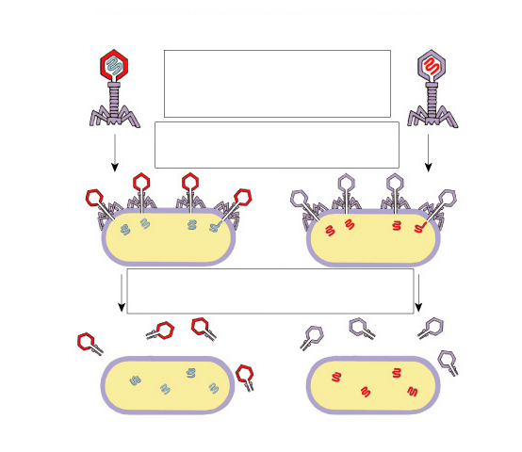
Hershey & Chase
Protein coat labeled
with ³⁵S
DNA labeled with ³²P
T2 bacteriophages
are labeled with
radioactive isotopes
S vs. P
bacteriophages infect
bacterial cells
bacterial cells are agitated
to remove viral protein coats
Which radioactive marker is found inside the cell?
Which molecule carries viral genetic info?
³⁵S radioactivity
found in the medium
³²P radioactivity found
in the bacterial cells

Slide 10
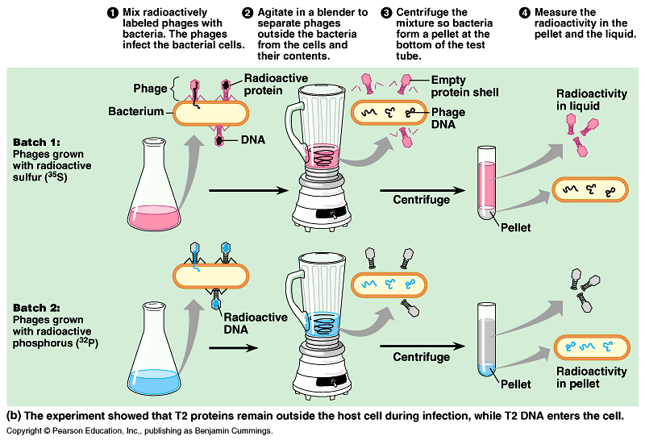

Slide 11
Blender experiment
Radioactive phage & bacteria in blender
  ³⁵S phage
    radioactive proteins stayed in supernatant
    therefore protein did NOT enter bacteria
  ³²P phage
    radioactive DNA stayed in pellet
    therefore DNA did enter bacteria
  Confirmed DNA is “transforming factor”
Taaa-Daaa!

Slide 12
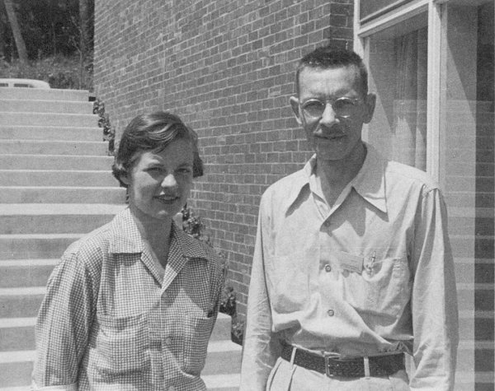
Hershey & Chase
1952 | 1969
Hershey
Martha Chase
Alfred Hershey
Notes:
Martha Cowles Chase (1927 – August 8, 2003) was a young laboratory assistant in the early 1950s when she and Alfred Hershey conducted one of the most famous experiments in 20th century biology. Devised by American bacteriophage expert Alfred Hershey at Cold Spring Harbor Laboratory New York, the famous experiment demonstrated the genetic properties of DNA over proteins. By marking bacteriophages with radioactive isotopes, Hershey and Chase were able to trace protein and DNA to determine which is the molecule of heredity.
Hershey and Chase announced their results in a 1952 paper. The experiment inspired American researcher James D. Watson, who along with England's Francis Crick figured out the structure of DNA at the Cavendish Laboratory of the University of Cambridge the following year.
Hershey shared the 1969 Nobel Prize in Physiology or Medicine with Salvador Luria and Max Delbrück. Chase, however, did not reap such rewards for her role. A graduate of The College of Wooster in Ohio (she had grown up in Shaker Heights, Ohio), she continued working as a laboratory assistant, first at the Oak Ridge National Laboratory in Tennessee and then at the University of Rochester before moving to Los Angeles in the late 1950s. There she married biologist Richard Epstein and earned her Ph.D. in 1964 from the University of Southern California. A series of personal setbacks through the 1960s ended her career in science. She spent decades suffering from a form of dementia that robbed her of short-term memory. She died on August 8, 2003.

Slide 13
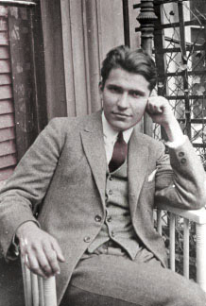
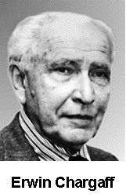
Chargaff
1947
DNA composition: “Chargaff’s rules”
  varies from species to species
  all 4 bases not in equal quantity
  bases present in characteristic ratio
    humans:
    A = 30.9%
    T = 29.4%
    G = 19.9%
    C = 19.8%
That’s interesting!
What do you notice?

Slide 14
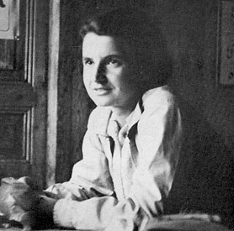
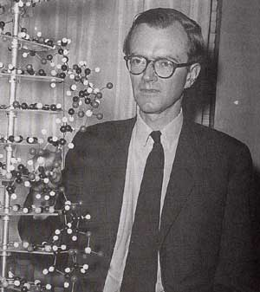
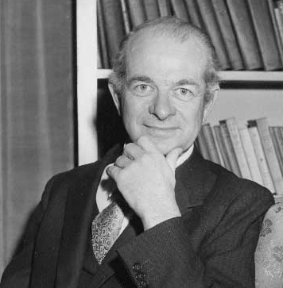
Structure of DNA
1953 | 1962
Watson & Crick
  developed double helix model of DNA
    other scientists working on question:
      Rosalind Franklin
      Maurice Wilkins
      Linus Pauling
Franklin
Wilkins
Pauling
Notes:
Watson & Crick’s model was inspired by 3 recent discoveries:
Chargaff’s rules
Pauling’s alpha helical structure of a protein
X-ray crystallography data from Franklin & Wilkins

Slide 15
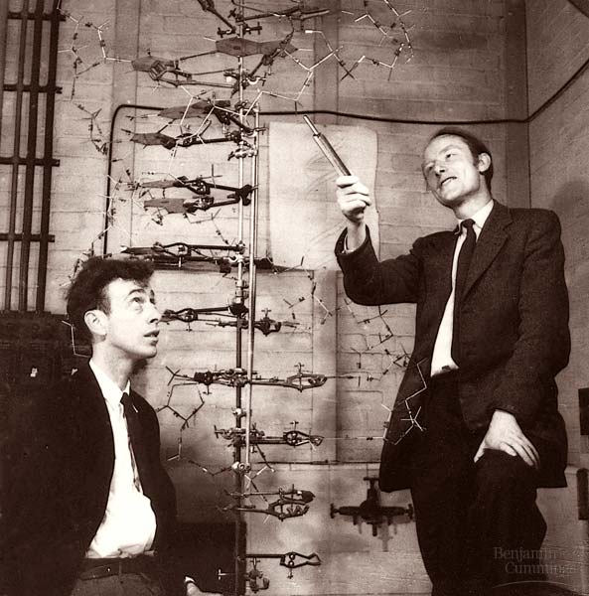
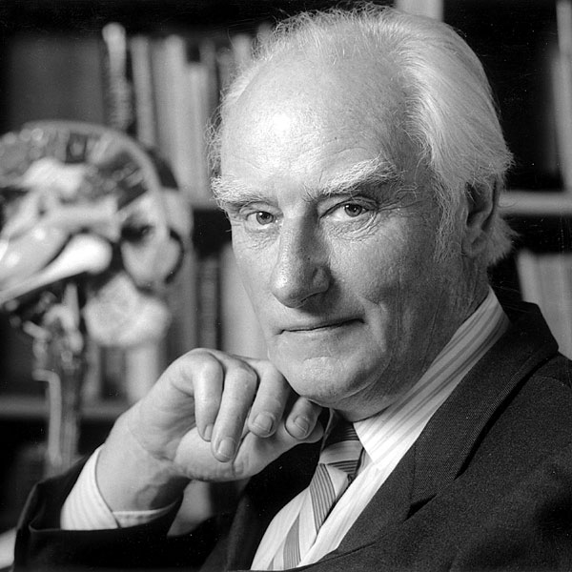
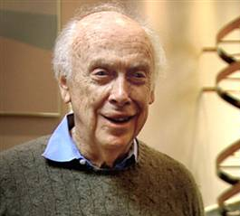
Watson and Crick
1953 article in Nature
Watson
Crick

Slide 16
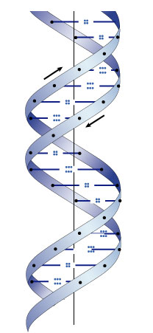
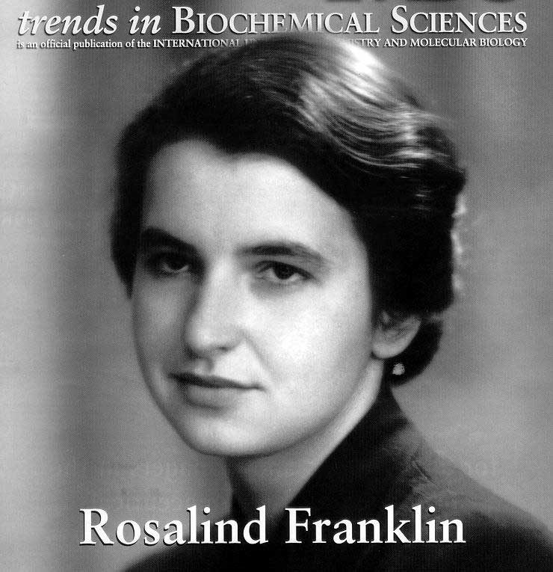
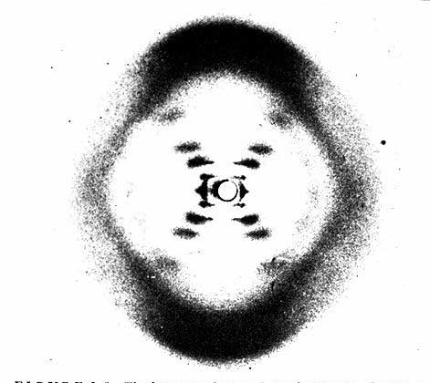
Rosalind Franklin (1920-1958)
Notes:
A chemist by training, Franklin had made original and essential contributions to the understanding of the structure of graphite and other carbon compounds even before her appointment to King's College. Unfortunately, her reputation did not precede her. James Watson's unflattering portrayal of Franklin in his account of the discovery of DNA's structure, entitled "The Double Helix," depicts Franklin as an underling of Maurice Wilkins, when in fact Wilkins and Franklin were peers in the Randall laboratory. And it was Franklin alone whom Randall had given the task of elucidating DNA's structure. The technique with which Rosalind Franklin set out to do this is called X-ray crystallography. With this technique, the locations of atoms in any crystal can be precisely mapped by looking at the image of the crystal under an X-ray beam. By the early 1950s, scientists were just learning how to use this technique to study biological molecules. Rosalind Franklin applied her chemist's expertise to the unwieldy DNA molecule. After complicated analysis, she discovered (and was the first to state) that the sugar-phosphate backbone of DNA lies on the outside of the molecule. She also elucidated the basic helical structure of the molecule.
After Randall presented Franklin's data and her unpublished conclusions at a routine seminar, her work was provided - without Randall's knowledge - to her competitors at Cambridge University, Watson and Crick. The scientists used her data and that of other scientists to build their ultimately correct and detailed description of DNA's structure in 1953. Franklin was not bitter, but pleased, and set out to publish a corroborating report of the Watson-Crick model. Her career was eventually cut short by illness. It is a tremendous shame that Franklin did not receive due credit for her essential role in this discovery, either during her lifetime or after her untimely death at age 37 due to cancer.

Slide 17
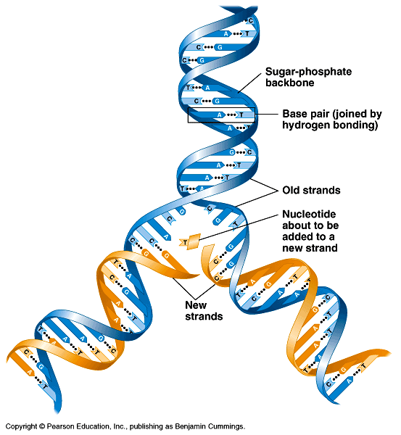
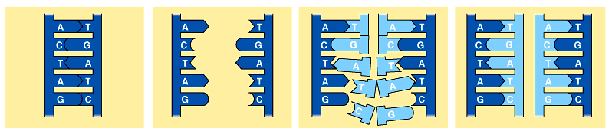
Copying DNA
Replication of DNA
  base pairing allows each strand to serve as a template for a new strand

Slide 18
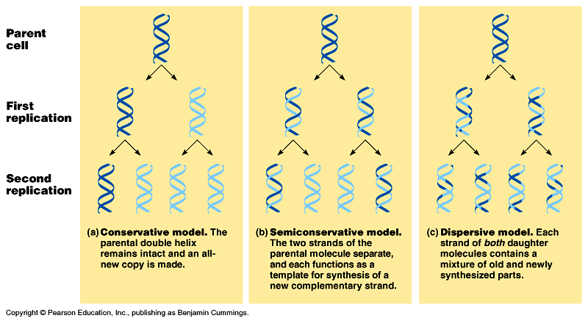
Models of DNA Replication
Can you design
a nifty experiment
to verify?
Alternative models
  so how is DNA copied?
conservative
semiconservative
dispersive

Slide 19
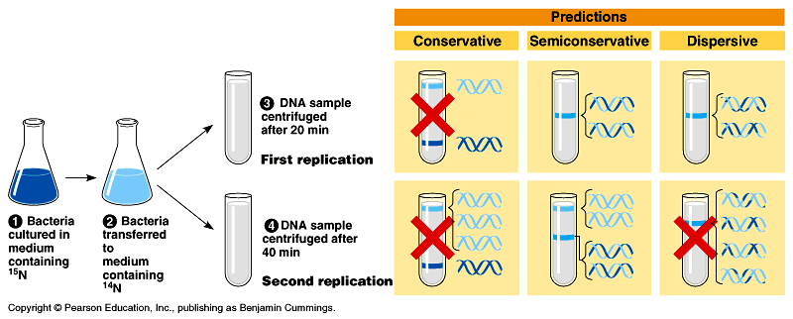
Semi-conservative replication
1958
Meselson & Stahl
  label “parent” nucleotides in DNA strands with
  heavy nitrogen = ¹⁵N
  label new nucleotides with lighter isotope = ¹⁴N
“The Most Beautiful Experiment in Biology”
parent
replication
Make predictions…

Slide 20
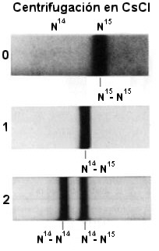
Semi-conservative replication
1958
Make predictions…
  ¹⁵N strands replicated in ¹⁴N medium
  1st round of replication?
  2nd round?
where should the bands be?
Notes:
Matthew Stanley Meselson (b. May 24, 1930) is an American geneticist and molecular biologist whose research was important in showing how DNA replicates, recombines and is repaired in cells. In his mature years, he has been an active chemical and biological weapons activist and consultant. He is married to the medical anthropologist and biological weapons writer Jeanne Guillemin.
Dr. Franklin William Stahl (born October 8, 1929) is an American molecular biologist. With Matthew Meselson, Stahl conducted the famous Meselson-Stahl experiment showing that DNA is replicated by a semiconservative mechanism, meaning that each strand of the DNA serves as a template for the "replicated" strand.
He is Emeritus Professor of Biology[1] at the University of Oregon's Institute of Molecular Biology in Eugene, Oregon.

Slide 21
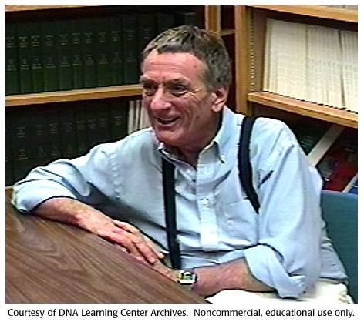
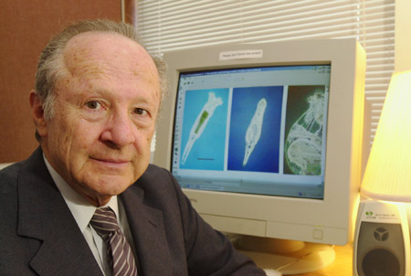
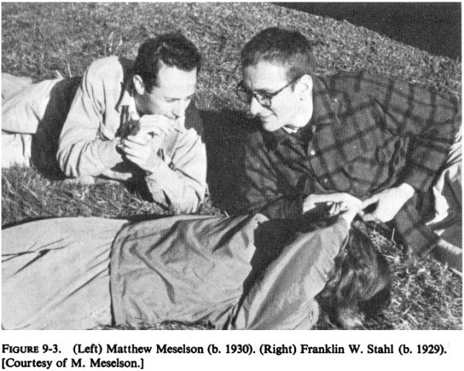
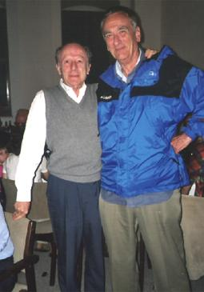
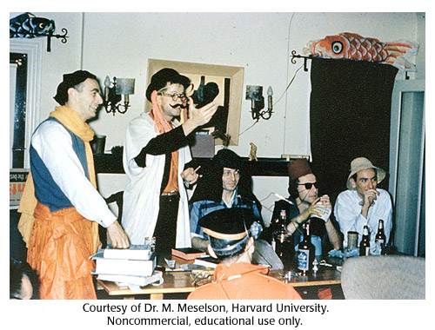
Meselson & Stahl
Matthew Meselson
Franklin Stahl
Franklin Stahl
Matthew Meselson

Slide 22
The “Central Dogma”
Flow of genetic information in a cell
transcription
translation
DNA
RNA
protein
replication

Slide 23
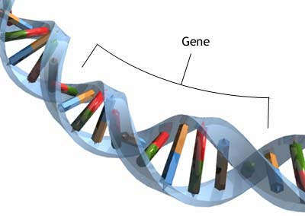
DNA Replication

Slide 24
Watson and Crick
1953 article in Nature

Slide 25
Double helix structure of DNA
“It has not escaped our notice that the specific pairing we have postulated immediately suggests a possible copying mechanism for the genetic material.” Watson & Crick

Slide 26
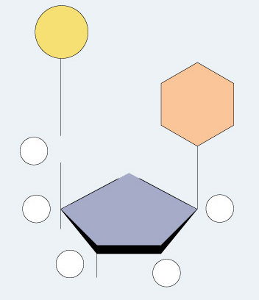
Directionality of DNA
You need to number the carbons!
  it matters!
nucleotide
PO₄
N base
5′
CH₂
This will be
IMPORTANT!!
O
4′
ribose
1′
3′
2′
OH

Slide 27
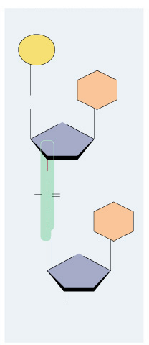
The DNA backbone
5′
PO₄
Putting the DNA backbone together
  refer to the 3′ and 5′ ends of the DNA
    the last trailing carbon
base
5′
CH₂
O
4′
C
1′
3′
2′
O
–O
P
O
Sounds trivial, but…
this will be
IMPORTANT!!
O
base
5′
CH₂
O
4′
1′
3′
2′
OH
3′

Slide 28
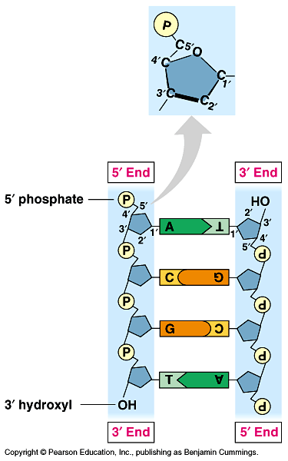
Anti-parallel strands
Nucleotides in DNA backbone are bonded from phosphate to sugar between 3′ & 5′ carbons
  DNA molecule has “direction”
  complementary strand runs in opposite direction
5′
3′
3′
5′

Slide 29
Bonding in DNA
hydrogen
bonds
5′
3′
covalent
phosphodiester
bonds
3′
5′
….strong or weak bonds?
How do the bonds fit the mechanism for copying DNA?

Slide 30
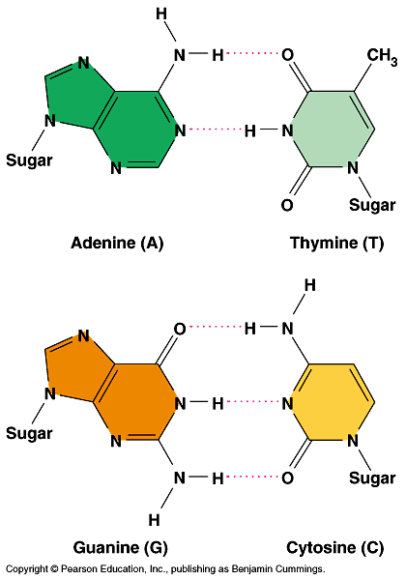
Base pairing in DNA
Purines
  adenine (A)
  guanine (G)
Pyrimidines
  thymine (T)
  cytosine (C)
Pairing
  A : T
    2 bonds
  C : G
    3 bonds

Slide 31
Copying DNA
Replication of DNA
  base pairing allows each strand to serve as a template for a new strand
  new strand is 1/2 parent template &
  1/2 new DNA

Slide 32
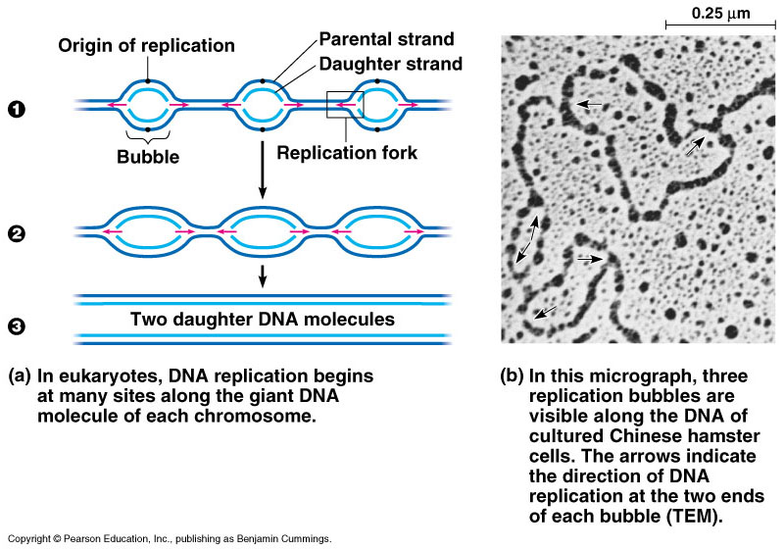
DNA Replication
Let’s meet
the team…
Large team of enzymes coordinates replication
Notes:
Enzymes
more than a dozen enzymes & other proteins participate in DNA replication

Slide 33
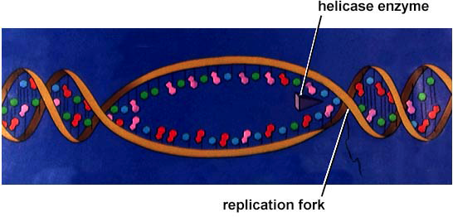
Replication: 1st step
Unwind DNA
  helicase enzyme
    unwinds part of DNA helix
    stabilized by single-stranded binding proteins
helicase
single-stranded binding proteins
replication fork

Slide 34
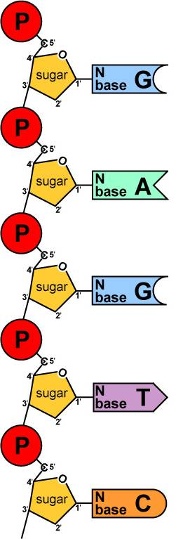
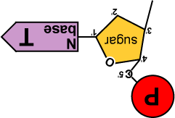
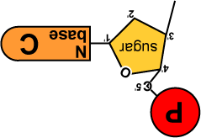
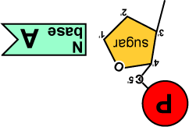
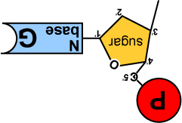
Replication: 2nd step
Build daughter DNA strand
  add new complementary bases
  DNA polymerase III
But…
We’re missing
something!
What?
Where’s the
ENERGY
for the bonding!
DNA
Polymerase III

Slide 35











Energy of Replication
Where does energy for bonding usually come from?
We come
with our own
energy!
energy
You
remember
ATP!
Are there
other ways
to get energy
out of it?
energy
Are there
other energy
nucleotides?
You bet!
And we
leave behind a
nucleotide!
ATP
GTP
TTP
CTP
ADP
AMP
GMP
TMP
CMP
modified nucleotide

Slide 36
Energy of Replication
The nucleotides arrive as nucleosides
  DNA bases with P–P–P
    P-P-P = energy for bonding
  DNA bases arrive with their own energy source for bonding
  bonded by enzyme: DNA polymerase III
ATP
GTP
TTP
CTP

Slide 37





Replication
5′
3′
energy
DNA
Polymerase III
Adding bases
  can only add nucleotides to
  3′ end of a growing DNA strand
    need a “starter” nucleotide to
    bond to
  strand only grows
  5′→3′
DNA
Polymerase III
energy
DNA
Polymerase III
energy
DNA
Polymerase III
energy
B.Y.O. ENERGY!
The energy rules
the process
3′
5′
Notes:
The energy rules the process.

Slide 38









5′
3′
5′
need “primer” bases to add on to
3′
energy
no energy to bond
✗
energy
energy
energy
energy
ligase
energy
energy
3′
5′
3′
5′

Slide 39

Leading & Lagging strands
Okazaki
Limits of DNA polymerase III
  can only build onto 3′ end of an existing DNA strand
5′
✗
Okazaki fragments
5′
3′
3′
5′
3′
5′
5′
Lagging strand
3′
ligase
growing
replication fork
3′
5′
✓
Leading strand
3′
5′
Lagging strand
  Okazaki fragments
  joined by ligase
    “spot welder” enzyme
3′
DNA polymerase III
Leading strand
  continuous synthesis

Slide 40
Replication fork / Replication bubble
3′
5′
5′
3′
DNA polymerase III
leading strand
3′
5′
3′
5′
5′
5′
5′
3′
3′
lagging strand
3′
5′
5′
3′
5′
lagging strand
leading strand
growing
replication fork
3′
5′
5′
growing
replication fork
leading strand
5′
3′
3′
lagging strand
5′
5′
5′

Slide 41
Starting DNA synthesis: RNA primers
Limits of DNA polymerase III
  can only build onto 3′ end of an existing DNA strand
5′
3′
5′
3′
3′
5′
3′
5′
growing
replication fork
3′
primase
5′
DNA polymerase III
RNA
5′
RNA primer
  built by primase
  serves as starter sequence for DNA polymerase III
3′

Slide 42
Replacing RNA primers with DNA
DNA polymerase I
  removes sections of RNA primer and replaces with DNA nucleotides
DNA polymerase I
5′
3′
3′
ligase
5′
growing
replication fork
3′
5′
RNA
5′
3′
But DNA polymerase I still can only build onto 3′ end of an existing DNA strand

Slide 43
Chromosome erosion
Houston, we
have a problem!
All DNA polymerases can only add to 3′ end of an existing DNA strand
DNA polymerase I
5′
3′
3′
5′
growing
replication fork
3′
5′
DNA polymerase III
RNA
5′
Loss of bases at 5′ ends
in every replication
  chromosomes get shorter with each replication
  limit to number of cell divisions?
3′

Slide 44
Telomeres
Repeating, non-coding sequences at the end of chromosomes = protective cap
  limit to ~50 cell divisions
5′
3′
3′
5′
growing
replication fork
3′
telomerase
5′
Telomerase
  enzyme extends telomeres
  can add DNA bases at 5′ end
  different level of activity in different cells
    high in stem cells & cancers -- Why?
5′
TTAAGGG
TTAAGGG
TTAAGGG
3′

Slide 45

Replication fork
DNA
polymerase III
lagging strand
DNA
polymerase I
3’
Okazaki
fragments
primase
5’
5’
ligase
3’
5’
SSB
3’
helicase
DNA
polymerase III
5’
leading strand
3’
direction of replication
SSB = single-stranded binding proteins

Slide 46




DNA polymerases
DNA polymerase III
  1000 bases/second!
  main DNA builder
DNA polymerase I
  20 bases/second
  editing, repair & primer removal
Roger Kornberg
2006
DNA polymerase III
enzyme
Arthur Kornberg
1959
Notes:
In 1953, Kornberg was appointed head of the Department of Microbiology in the Washington University School of Medicine in St. Louis. It was here that he isolated DNA polymerase I and showed that life (DNA) can be made in a test tube. In 1959, Kornberg shared the Nobel Prize for Physiology or Medicine with Severo Ochoa — Kornberg for the enzymatic synthesis of DNA, Ochoa for the enzymatic synthesis of RNA.

Slide 47

Editing & proofreading DNA
1000 bases/second =
lots of typos!
DNA polymerase I
  proofreads & corrects typos
  repairs mismatched bases
  removes abnormal bases
    repairs damage
    throughout life
  reduces error rate from
  1 in 10,000 to
  1 in 100 million bases

Slide 48
Fast & accurate!
It takes E. coli <1 hour to copy
5 million base pairs in its single chromosome
  divide to form 2 identical daughter cells
Human cell copies its 6 billion bases & divide into daughter cells in only few hours
  remarkably accurate
  only ~1 error per 100 million bases
  ~30 errors per cell cycle

Slide 49

What does it really look like?
1
2
3
4

Slide 50
Chromosomes
A bacterial chromosome is one double-stranded, circular DNA molecule associated with a small amount of protein.
Eukaryotic chromosomes are linear DNA molecules associated with large amounts of protein.
In eukaryotic cells, DNA and proteins are packed together as chromatin.
As DNA becomes more highly packaged, it becomes less accessible to transcription enzymes, which reduces gene expression.
In interphase cells, most chromatin is in the highly extended form (euchromatin) and is available for transcription.
When the euchromatin condenses to chromosomes during mitotic division, the more condensed chromatin (heterochromatin) is no longer available for transcription. Heterochromatin is largely inaccessible to transcription enzymes and thus generally not transcribed.
Barr bodies are another example of heterochromatin.

