Slide 1
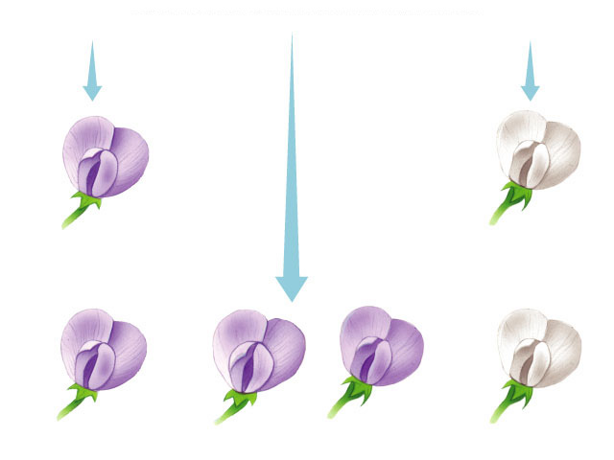
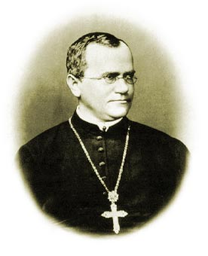
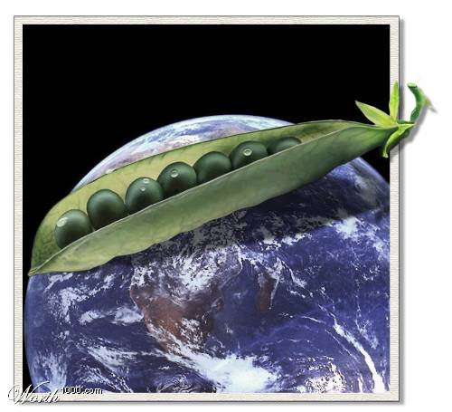
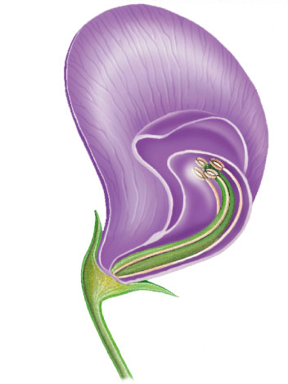
Genetics
&
The Work of Mendel

Slide 2
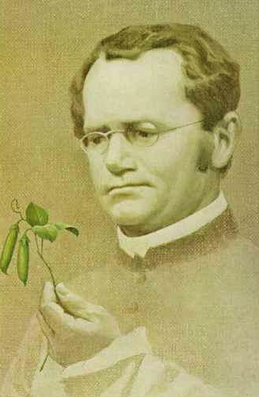
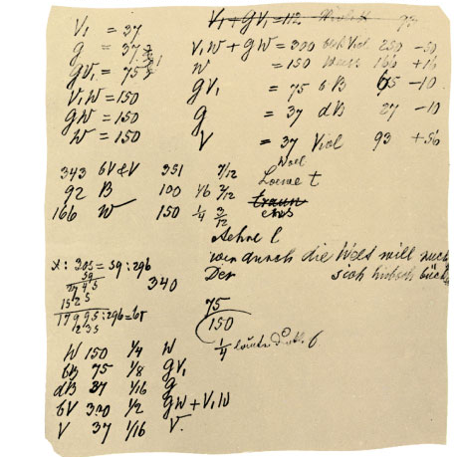
Gregor Mendel
Modern genetics began in the mid-1800s in an abbey garden, where a monk named Gregor Mendel documented inheritance in peas
  used experimental method
  used quantitative analysis
    collected data & counted them
  excellent example of scientific method
Notes:
He studied at the University of Vienna from 1851 to 1853 where he was influenced by a physicist who encouraged experimentation and the application of mathematics to science and a botanist who aroused Mendel’s interest in the causes of variation in plants. After the university, Mendel taught at the Brunn Modern School and lived in the local monastery.
The monks at this monastery had a long tradition of interest in the breeding of plants, including peas. Around 1857, Mendel began breeding garden peas to study inheritance.

Slide 3
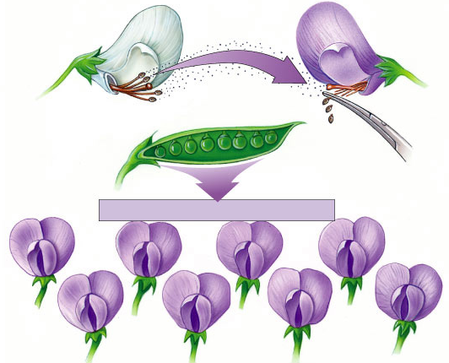
Mendel’s work
Pollen transferred from white flower to stigma of purple flower
Bred pea plants
  cross-pollinate
  true breeding parents (P)
    P = parental
  raised seed & then
  observed traits (F₁)
    F = filial
  allowed offspring
  to self-pollinate
  & observed next
  generation (F₂)
P
anthers
removed
all purple flowers result
F₁
self-pollinate
F₂
Notes:
P = parents
F = filial generation

Slide 4
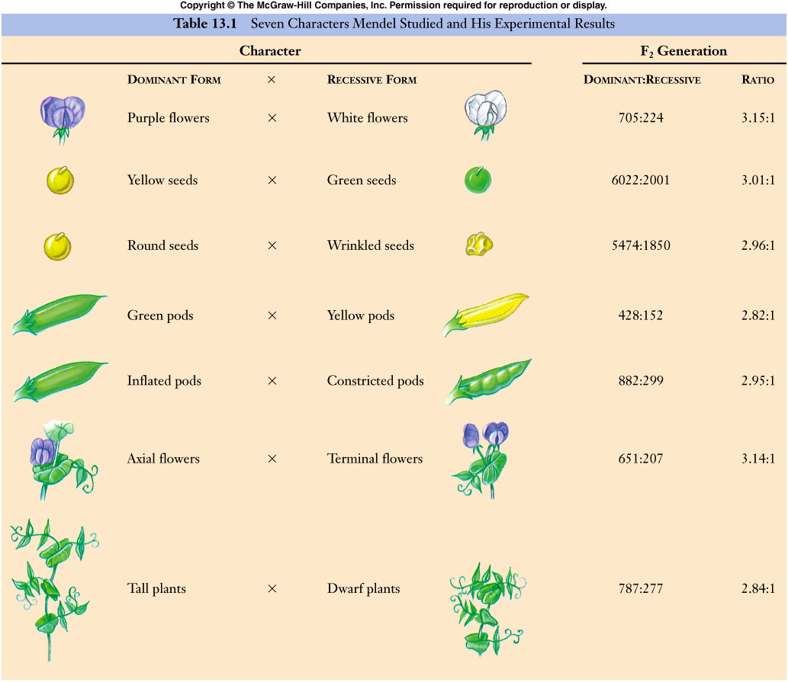
Mendel collected data for 7 pea traits

Slide 5
Looking closer at Mendel’s work
true-breeding
purple-flower peas
true-breeding
white-flower peas
P
X
F₁
generation
(hybrids)
100%
purple-flower peas
100%
self-pollinate
75%
purple-flower peas
25%
white-flower peas
3:1
F₂
generation
Notes:
In a typical breeding experiment, Mendel would cross-pollinate (hybridize) two contrasting, true-breeding pea varieties.
The true-breeding parents are the P generation and their hybrid offspring are the F₁ generation.
Mendel would then allow the F₁ hybrids to self-pollinate to produce an F₂ generation.

Slide 6
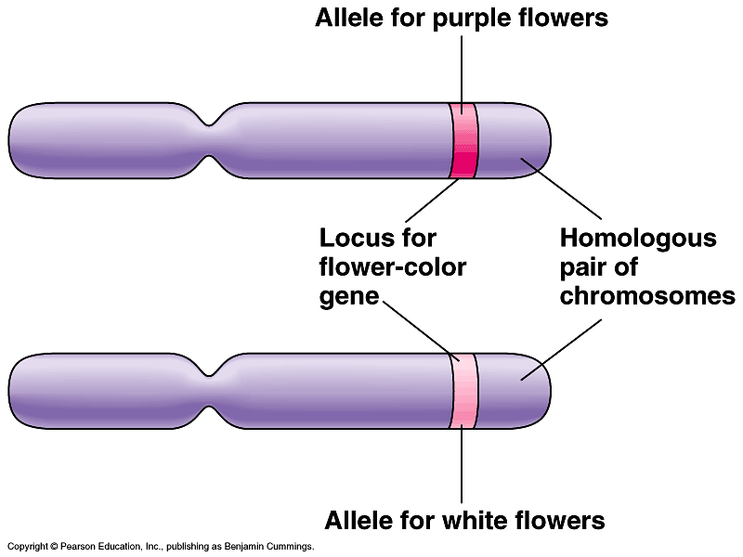
What did Mendel’s findings mean?
Traits come in alternative versions
  purple vs. white flower color
  alleles
    different alleles vary in the sequence of nucleotides at the specific locus of a gene
      some difference in sequence of A, T, C, G
purple-flower allele &
white-flower allele are two DNA variations at flower-color locus
different versions of gene at same location on homologous chromosomes

Slide 7
Traits are inherited as discrete units
For each characteristic, an organism inherits 2 alleles, 1 from each parent
  diploid organism
    inherits 2 sets of chromosomes,
    1 from each parent
    homologous chromosomes
    like having 2 editions of encyclopedia
      Encyclopedia Britannica
      Encyclopedia Americana
What are the
advantages of
being diploid?

Slide 8
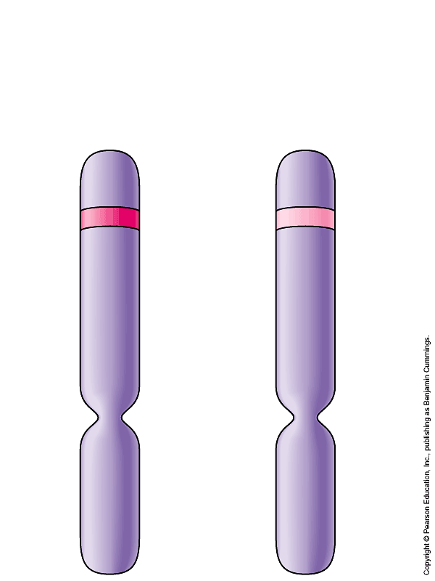
What did Mendel’s findings mean?
Some traits mask others
  purple & white flower colors are separate traits that do not blend
    purple x white ≠ light purple
    purple masked white
  dominant allele
    functional protein
      affects characteristic
    masks other alleles
  recessive allele
    no noticeable effect
    allele makes a
    malfunctioning protein
I’ll speak for
both of us!
allele producing
functional protein
mutant allele
malfunctioning
protein
homologous
chromosomes

Slide 9
Genotype vs. phenotype
Difference between how an organism “looks” & its genetics
  phenotype
    description of an organism’s trait
  genotype
    description of an organism’s genetic makeup
P
X
Explain Mendel’s results using
…dominant & recessive
…phenotype & genotype
purple
white
F₁
all purple

Slide 10
Making crosses
Can represent alleles as letters
  flower color alleles → P or p
  true-breeding purple-flower peas → PP
  true-breeding white-flower peas → pp
PP
x
pp
P
X
purple
white
F₁
Pp
all purple

Slide 11
Looking closer at Mendel’s work
true-breeding
purple-flower peas
true-breeding
white-flower peas
phenotype
P
X
PP
pp
genotype
F₁
generation
(hybrids)
100%
purple-flower peas
100%
Pp
Pp
Pp
Pp
self-pollinate
75%
purple-flower peas
25%
white-flower peas
3:1
F₂
generation
?
?
?
?
Notes:
In a typical breeding experiment, Mendel would cross-pollinate (hybridize) two contrasting, true-breeding pea varieties.
The true-breeding parents are the P generation and their hybrid offspring are the F₁ generation.
Mendel would then allow the F₁ hybrids to self-pollinate to produce an F₂ generation.

Slide 12
Punnett squares
Aaaaah,
phenotype & genotype
can have different
ratios
Pp x Pp
F₁
generation
(hybrids)
%
genotype
%
phenotype
male / sperm
PP
P
p
25%
Pp
75%
P
PP
Pp
50%
Pp
female / eggs
p
Pp
pp
25%
25%
pp
1:2:1
3:1

Slide 13
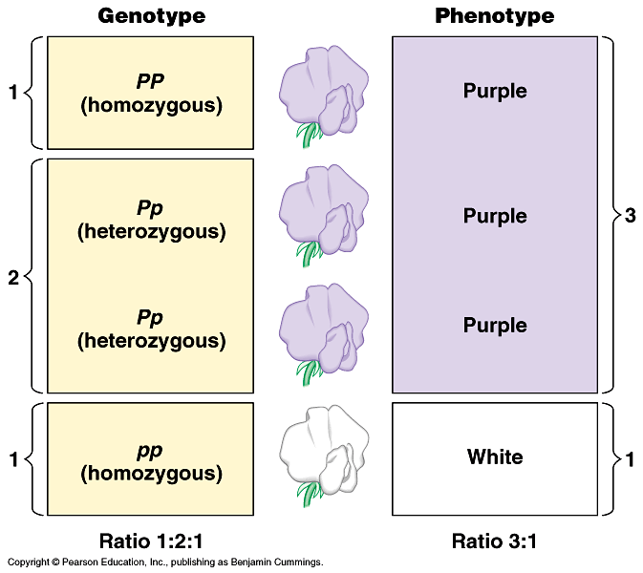
Genotypes
Homozygous = same alleles = PP, pp
Heterozygous = different alleles = Pp
homozygous
dominant
heterozygous
homozygous
recessive

Slide 14
Phenotype vs. genotype
2 organisms can have the same phenotype but have different genotypes
purple
PP
homozygous dominant
purple
Pp
heterozygous
Can’t tell
by lookin’
at ya!
How do you determine the
genotype of an individual with
with a dominant phenotype?

Slide 15
Test cross
Breed the dominant phenotype —
the unknown genotype — with a homozygous recessive (pp) to determine the identity of the unknown allele
How does
that work?
x
is it
PP or Pp?
pp

Slide 16
How does a Test cross work?
x
x
PP
pp
Pp
pp
p
p
p
p
P
Pp
Pp
P
Pp
Pp
P
p
Pp
Pp
pp
pp
100% purple
50% purple:50% white or 1:1

Slide 17
Mendel’s 1st law of heredity
P
PP
Law of segregation
  during meiosis, alleles segregate
    homologous chromosomes separate
  each allele for a trait is packaged into a separate gamete
P
p
pp
p
P
Pp
p

Slide 18
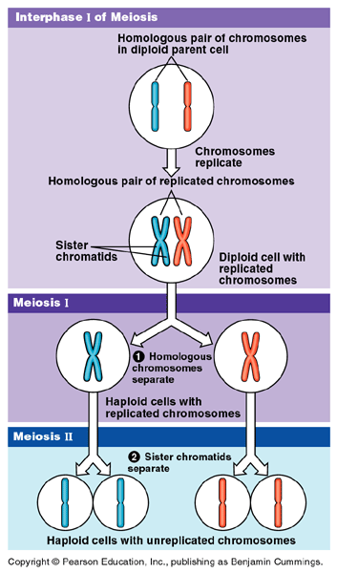
Law of Segregation
Which stage of meiosis creates the
law of segregation?
Metaphase 1
Whoa!
And Mendel
didn’t even know
DNA or genes
existed!

Slide 19
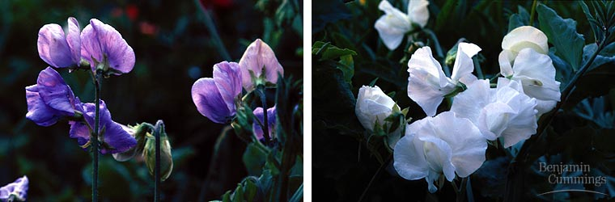
Monohybrid cross
Some of Mendel’s experiments followed the inheritance of single characters
  flower color
  seed color
  monohybrid crosses

Slide 20
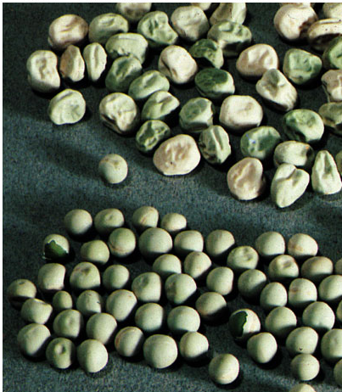
Dihybrid cross
Other of Mendel’s experiments followed the inheritance of 2 different characters
  seed color and
  seed shape
  dihybrid crosses
Mendel
was working out
many of the
genetic rules!

Slide 21
Dihybrid cross
P
true-breeding
yellow, round peas
x
true-breeding
green, wrinkled peas
YYRR
yyrr
Y = yellow
R = round
y = green
r = wrinkled
F₁
generation
(hybrids)
yellow, round peas
100%
YyRr
self-pollinate
9:3:3:1
F₂
generation
9/16
yellow
round
peas
3/16
green
round
peas
3/16
yellow
wrinkled
peas
1/16
green
wrinkled
peas
Notes:
Wrinkled seeds in pea plants with two copies of the recessive allele are due to the accumulation of monosaccharides and excess water in seeds because of the lack of a key enzyme. The seeds wrinkle when they dry.
Both homozygous dominants and heterozygotes produce enough enzyme to convert all the monosaccharides into starch and form smooth seeds when they dry.

Slide 22
What’s going on here?
If genes are on different chromosomes…
  how do they assort in the gametes?
  together or independently?
YyRr
Is it this?
Or this?
YyRr
YR
yr
YR
Yr
yR
yr
Which system
explains the
data?

Slide 23
Is this the way it works?
YyRr
or
YyRr
YyRr
x
YyRr
YR
yr
YR
Yr
yR
yr
9/16
yellow
round
YR
yr

3/16
green
round
YR
Well, that’s
NOT right!
YYRR
YyRr
3/16
yellow
wrinkled
yr
YyRr
yyrr
1/16
green
wrinkled

Slide 24
Dihybrid cross
YyRr
or
YyRr
YyRr
x
YyRr
YR
yr
YR
Yr
yR
yr
9/16
yellow
round
YR
Yr
yR
yr
YR
YYRR

3/16
green
round
YYRr
YyRR
YyRr
Yr
BINGO!
YYRr
YYrr
YyRr
Yyrr
3/16
yellow
wrinkled
yR
YyRR
YyRr
yyRR
yyRr
yr
YyRr
Yyrr
yyRr
yyrr
1/16
green
wrinkled

Slide 25
Mendel’s 2nd law of heredity
Can you think
of an exception
to this?
Law of independent assortment
  different loci (genes) separate into gametes independently
    non-homologous chromosomes align independently
    classes of gametes produced in equal amounts
      YR = Yr = yR = yr
    only true for genes on separate chromosomes or
    on same chromosome but so far apart that crossing over happens frequently
yellow
green
round
wrinkled
YyRr
Yr
Yr
yR
yR
YR
YR
yr
yr
1
:
1
:
1
:
1

Slide 26
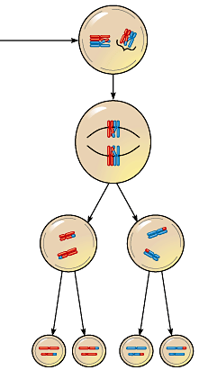
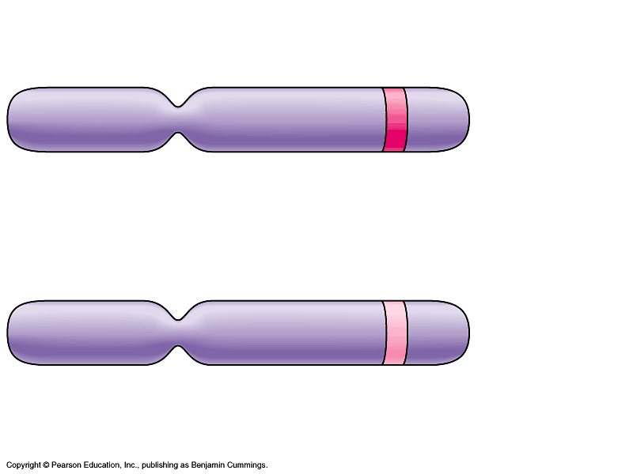
Law of Independent Assortment
Which stage of meiosis creates the law of independent assortment?
Remember
Mendel didn’t
even know DNA
—or genes—
existed!
Metaphase 1
EXCEPTION
If genes are on same chromosome & close together
  will usually be inherited together
  rarely crossover separately
  “linked”

Slide 27
Linked Genes
Sometimes genes on the same chromosomes stay together during assortment and move as a group. The group of genes is considered linked and tends to be inherited together. For example, the genes for flower color and pollen shape are linked on the same chromosomes and show up together. Since linked genes are found on the same chromosome, they cannot segregate independently, this violates the law of independent assortment.
Lets pretend that height and color genes are linked. A heterozygote for both traits still have two alleles for height (T or t) and two alleles for color (G and g). However, because height and color are located on the same chromosome, the allele for height and the allele for color are physically linked. For example, maybe the heterozygote has one chromosome with Tg and one chromosome with tG. When gametes formed, the T and g will travel together, and the t and G will travel together and be packaged into a gamete together. So, in the unlinked dihybrid shown earlier there were four possible gamete combinations (TG, Tg, tG, tg), but now there are only two (Tg and tG). The only way to physically separate linked alleles is by crossing over. If a crossover even occurs between the linked genes, then recombinant gametes can occur.
If the genes were unlinked, then the four gametes (TG, Tg, tG, tg) would be equally likely. However, if certain combinations of alleles are found more often in offspring, then this is a sign of possible linkage.

Slide 28
Linkage Maps
A linkage map is a genetic map put together using crossover frequencies. Another unit of measurement, the map unit (also known as a centigram), is used to geographically relate genes on the basis of the frequencies. One map unit is equal to a 1 percent crossover frequency. A linkage map does not provide the exact location of genes, it gives only the relative location.
Imagine that you want to determine the relative location of four genes: A, B, C, and D. You know that A crosses over with C 20 percent of the time, B crosses over with C 15 percent of the time, A crosses over with D 10 percent of the time, and D crosses over with B 5 percent of the time. From this information you can determine the sequence. Gene A must be 20 units from gene C. Gene B must be 15 units from C, but B could be 5 or 35 units from B, you can determine that B must be 5 units from A as well, if A is also to be 10 units from D. This gives you the sequence of genes as ABDC.

Slide 29
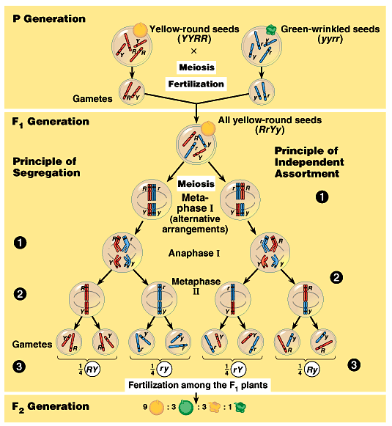
The chromosomal
basis of Mendel’s
laws…
Trace the genetic
events through
meiosis, gamete
formation &
fertilization to offspring

Slide 30
Review: Mendel’s laws of heredity
Law of segregation
  monohybrid cross
    single trait
  each allele segregates into separate gametes
    established by Metaphase 1
Law of independent assortment
  dihybrid (or more) cross
    2 or more traits
  genes on separate chromosomes
  assort into gametes independently
    established by Metaphase 1
EXCEPTION
linked genes
metaphase1

Slide 31
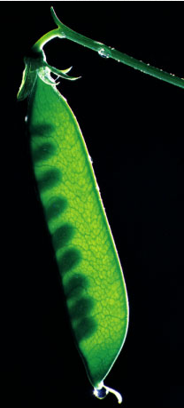
Mendel chose peas wisely
Pea plants are good for genetic research
  available in many varieties with distinct heritable features with different variations
    flower color, seed color, seed shape, etc.
  Mendel had strict control over
  which plants mated with which
    each pea plant has male & female
    structures
    pea plants can self-fertilize
    Mendel could also cross-pollinate
    plants: moving pollen from one plant
    to another

Slide 32
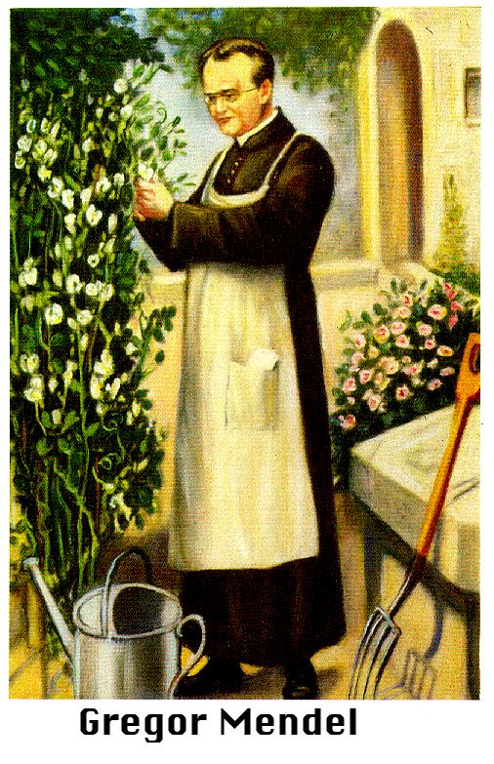

Mendel chose peas luckily
Pea plants are good for genetic research
  relatively simple genetically
    most characters are controlled by a single gene with each gene having only 2 alleles,
      one completely dominant over
      the other

Slide 33
Laws of Probability
Understanding how to predict offspring of genetic crosses involves familiarity with the basic laws of probability. There are two laws that you will use directly in solving genetic problems.
-The rule of multiplication: When calculating the probability that two or more independent events will occur together in a specific combination, multiply the probabilities of each of the two events. Thus, the probability of a coin landing face up two times in two flips is ½ x ½ = ¼. IF you cross two organisms with the genotypes AABbCc and AbBbCc, the probability of an offspring having the genotype AaBbcc is ½ x ½ x ¼ = 1/16
-The rule of addition: When calculating the probability that any of two or more mutually exclusive events will occur, you need to add together their individual probabilities. For example, if you are tossing a die, what is the probability that it will land on either the side with 4 spots or the side with 5 spots? (1/6 + 1/6 = 2/6=1/3)

Slide 34
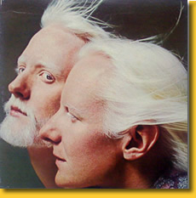
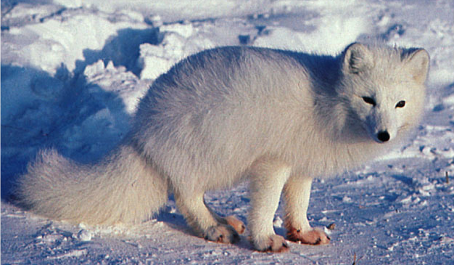
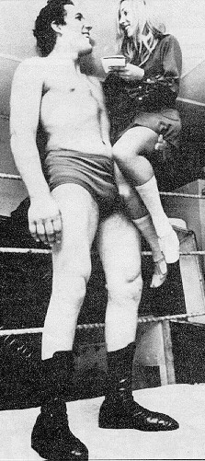
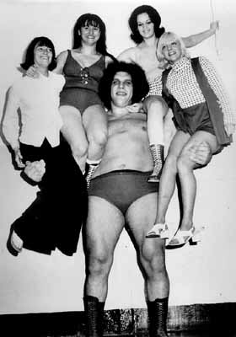
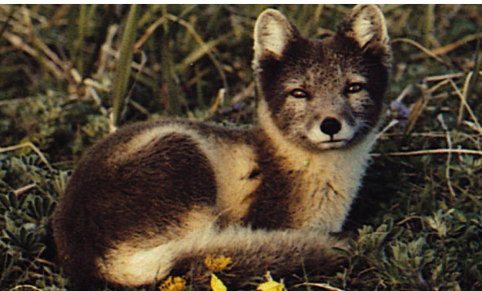
Beyond Mendel’s Laws
of Inheritance

Slide 35
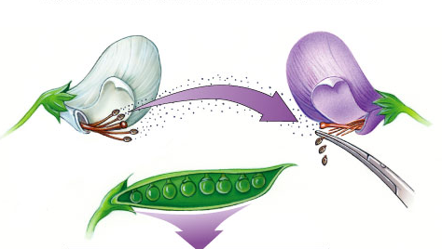
Extending Mendelian genetics
Mendel worked with a simple system
  peas are genetically simple
  most traits are controlled by a single gene
  each gene has only 2 alleles, 1 of which
  is completely dominant to the other
The relationship between
genotype & phenotype
is rarely that simple

Slide 36
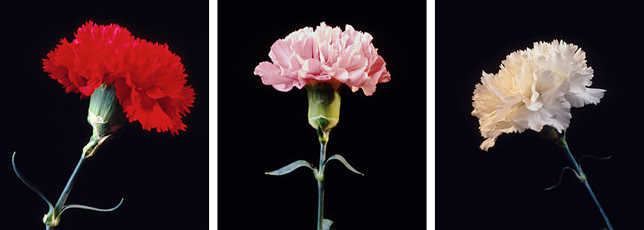
Incomplete dominance
Heterozygote shows an intermediate, blended phenotype
  example:
    RR = red flowers
    rr = white flowers
    Rr = pink flowers
      make 50% less color
RR
Rr
rr

Slide 37
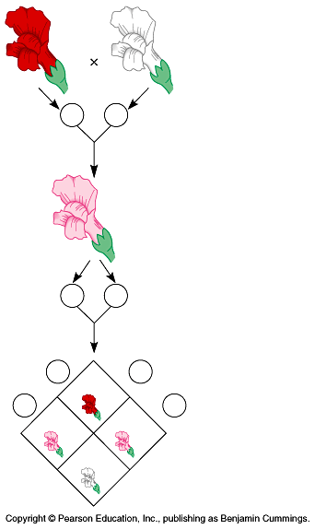
Incomplete dominance
P
true-breeding
red flowers
X
true-breeding
white flowers
100% pink flowers
F₁
generation
(hybrids)
100%
It’s like
flipping 2
pennies!
self-pollinate
25%
red
50%
pink
25%
white
1:2:1
F₂
generation

Slide 38
Incomplete dominance
C^{R}C^{W} x C^{R}C^{W}
%
genotype
%
phenotype
C^{R}C^{R}
25%
25%
male / sperm
C^{R}
C^{W}
C^{R}C^{W}
50%
50%
C^{R}C^{R}
C^{R}C^{W}
C^{R}
C^{R}C^{W}
female / eggs
C^{R}C^{W}
C^{W}C^{W}
C^{W}C^{W}
25%
25%
C^{W}
1:2:1
1:2:1

Slide 39
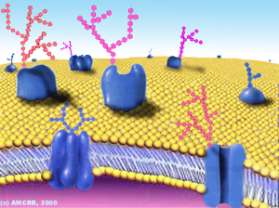
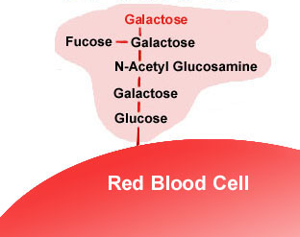
Co-dominance
2 alleles affect the phenotype equally & separately
  not blended phenotype
  example: ABO blood groups
  3 alleles
    I^{A}, I^{B}, i
    I^{A} & I^{B} alleles are co-dominant to each other
      both antigens are produced
    both I^{A} & I^{B} are dominant to i allele
  produces glycoprotein
  antigen markers on the
  surface of red blood cells

Slide 40
Genetics of Blood type
pheno-type | genotype | antigen on RBC | antibodies in blood | donation status
A | I^{A} I^{A or} I^{A} i | type A antigens on surface of RBC | anti-B antibodies | __
B | I^{B} I^{B or} I^{B} i | type B antigens on surface of RBC | anti-A antibodies | __
AB | I^{A} I^{B} | both type A & type B antigens on surface of RBC | no antibodies | universal recipient
O | i i | no antigens on surface of RBC | anti-A & anti-B antibodies | universal donor

Slide 41
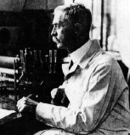
Blood compatibility
1901 | 1930
Matching compatible blood groups
  critical for blood transfusions
A person produces antibodies against antigens in foreign blood
  wrong blood type
    donor’s blood has A or B antigen that is foreign to recipient
    antibodies in recipient’s blood bind to foreign molecules
    cause donated blood cells to clump together
    can kill the recipient
Karl Landsteiner
(1868-1943)

Slide 42
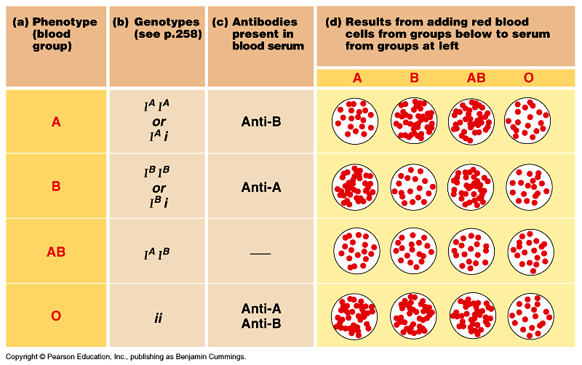
Blood donation
clotting
clotting
clotting
clotting
clotting
clotting
clotting

Slide 43
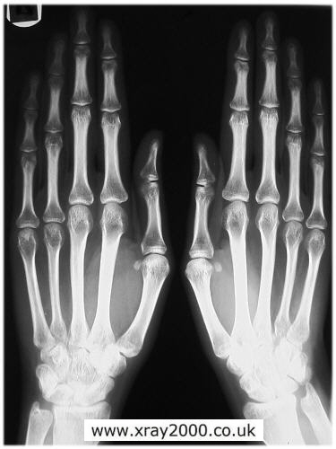
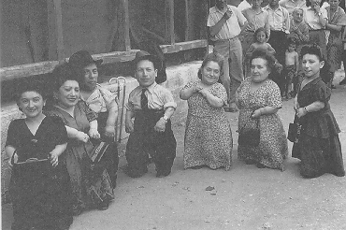
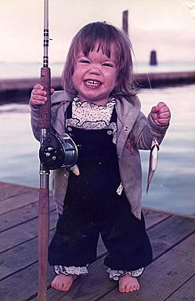
Pleiotropy
Most genes are pleiotropic
  one gene affects more than one phenotypic character
    wide-ranging effects due to a single gene
    dwarfism (achondroplasia)
    gigantism (acromegaly)
Notes:
The genes that we have covered so far affect only one phenotypic character, but most genes are pleiotropic

Slide 44
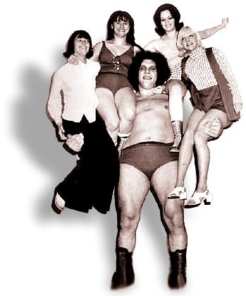
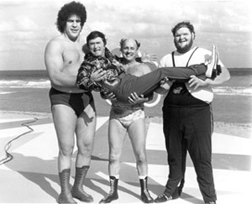

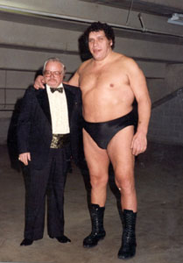
Acromegaly: André the Giant

Slide 45
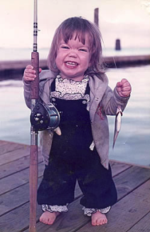
Inheritance pattern of Achondroplasia
Aa x aa
Aa x Aa
a
a
A
a

A
Aa
Aa
A
AA
Aa
a
aa
aa
a
Aa
aa
50% dwarf:50% normal or 1:1
67% dwarf:33% normal or 2:1

Slide 46
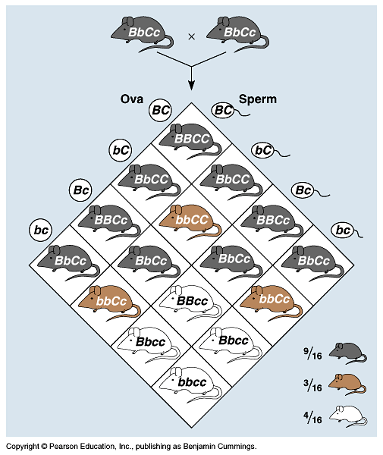
Epistasis
One gene completely masks another gene
  coat color in mice = 2 separate genes
    C,c:
    pigment (C) or
    no pigment (c)
    B,b:
    more pigment (black=B)
    or less (brown=b)
    cc = albino,
    no matter B allele
    9:3:3:1 becomes 9:3:4
B_C_
B_C_
bbC_
bbC_
_ _cc
_ _cc
How would you know that
difference wasn’t random chance?
Chi-square test!

Slide 47
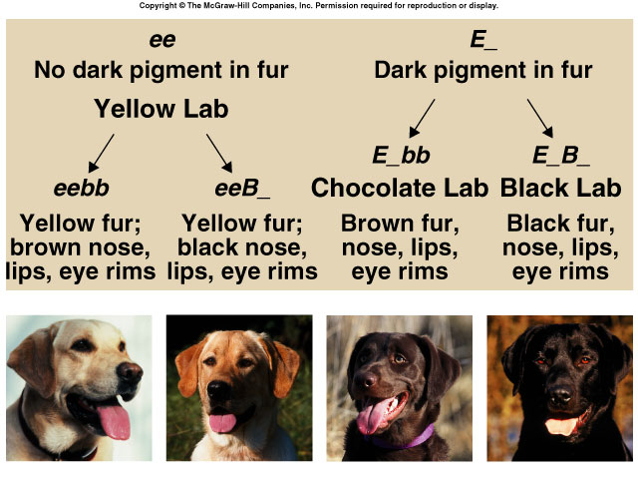
Epistasis in Labrador retrievers
2 genes: (E,e) & (B,b)
  pigment (E) or no pigment (e)
  pigment concentration: black (B) to brown (b)
eebb
eeB–
E–bb
E–B–

Slide 48
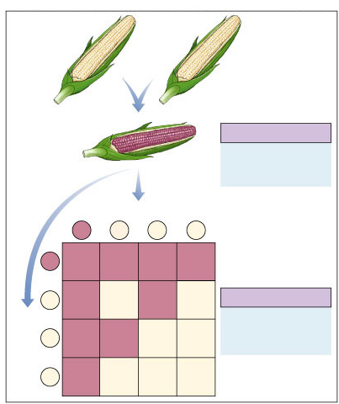
Epistasis in grain color
X
White
(AAbb)
White
(aaBB)
F₁ generation
A = enzyme 1
+
B = enzyme 2
↓
purple color
(anthocyanin)
All purple
(AaBb)
Eggs
AB
Ab
aB
ab
AB
AABB
AABb
AaBB
AaBb
Ab
AABb
AAbb
AaBb
Aabb
F₂ generation
Sperm
9/16 purple
7/16 white
9:3:3:1
aB
AaBB
AaBb
aaBB
aaBb
9:7
ab
AaBb
Aabb
aaBb
aabb

Slide 49
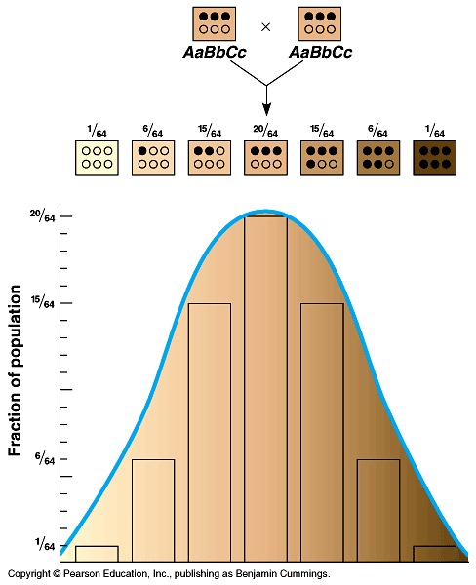
Polygenic inheritance
Some phenotypes determined by additive effects of 2 or more genes on a single character
  phenotypes on a continuum
  human traits
    skin color
    height
    weight
    eye color
    intelligence
    behaviors

Slide 50
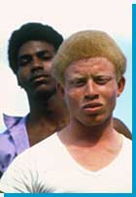
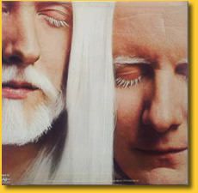
Skin color: Albinism
However albinism can be inherited as a single gene trait
albino
Africans
melanin = universal brown color
enzyme
tyrosine
melanin
albinism

Slide 51
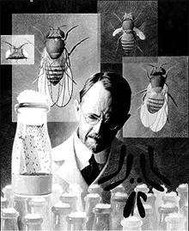
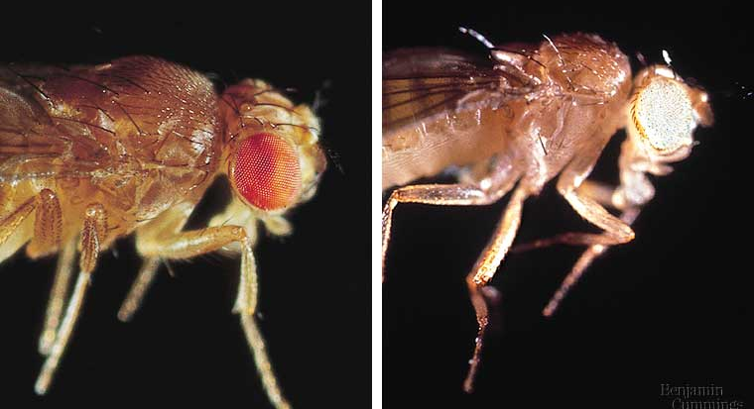
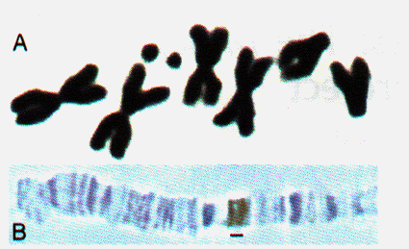
Sex linked traits
1910 | 1933
Genes are on sex chromosomes
  as opposed to autosomal chromosomes
  first discovered by T.H. Morgan at Columbia U.
  Drosophila breeding
    good genetic subject
      prolific
      2 week generations
      4 pairs of chromosomes
      XX=female, XY=male

Slide 52
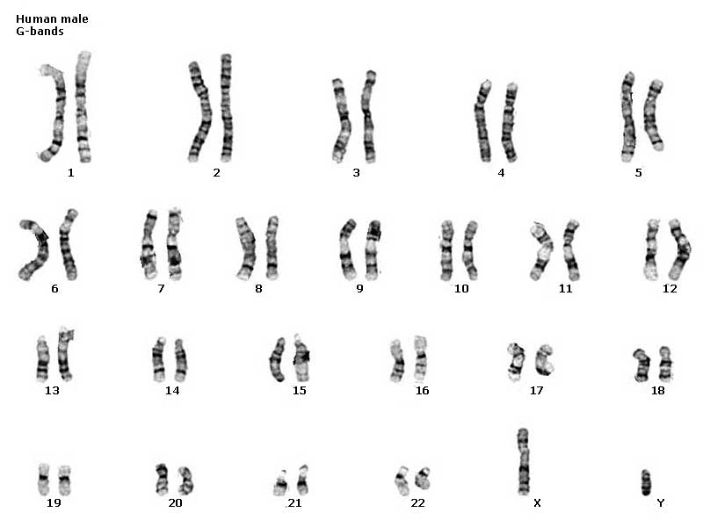
Classes of chromosomes
autosomal
chromosomes
sex
chromosomes

Slide 53
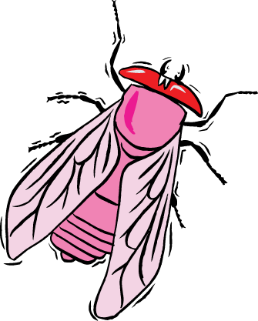


Discovery of sex linkage
true-breeding
red-eye female
true-breeding
white-eye male
P
X
Huh!
Sex matters?!
100%
red eye offspring
F₁
generation
(hybrids)
100%
red-eye female
50% red-eye male
50% white eye male
F₂
generation

Slide 54


What’s up with Morgan’s flies?
x
x
RR
rr
Rr
Rr

r
r
R
r
R
Rr
Rr
R
RR
Rr
Doesn’t work
that way!
R
Rr
Rr
r
Rr
rr
100% red eyes
3 red : 1 white

Slide 55
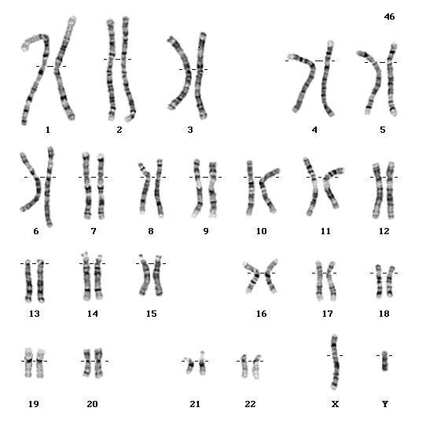
Genetics of Sex
In humans & other mammals, there are 2 sex chromosomes: X & Y
  2 X chromosomes
    develop as a female: XX
    gene redundancy,
    like autosomal chromosomes
  an X & Y chromosome
    develop as a male: XY
    no redundancy
X
Y
X
XX
XY
X
XX
XY
50% female : 50% male

Slide 56



What’s up with Morgan’s flies?
x
x
X^{R}X^{R}
X^{r}Y
X^{R}X^{r}
X^{R}Y
X^{r}
Y
X^{R}
Y

X^{R}
X^{R}
X^{R}X^{r}
X^{R}Y
X^{R}X^{R}
X^{R}Y
BINGO!
X^{R}
X^{r}
X^{R}X^{r}
X^{R}Y
X^{R}X^{r}
X^{r}Y
100% red eyes
100% red females
50% red males; 50% white males

Slide 57
Genes on sex chromosomes
Y chromosome
  few genes other than SRY
    sex-determining region
    master regulator for maleness
    turns on genes for production of male hormones
      many effects = pleiotropy!
X chromosome
  other genes/traits beyond sex determination
    mutations:
      hemophilia
      Duchenne muscular dystrophy
      color-blindness
Notes:
Duchenne muscular dystrophy affects one in 3,500 males born in the United States.
Affected individuals rarely live past their early 20s.
This disorder is due to the absence of an X-linked gene for a key muscle protein, called dystrophin.
The disease is characterized by a progressive weakening of the muscles and loss of coordination.

Slide 58

Human X chromosome
Ichthyosis, X-linked
Placental steroid sulfatase deficiency
Kallmann syndrome
Chondrodysplasia punctata,
X-linked recessive
Sex-linked
  usually means
  “X-linked”
  more than
  60 diseases traced to genes on X chromosome
Hypophosphatemia
Aicardi syndrome
Hypomagnesemia, X-linked
Ocular albinism
Retinoschisis
Duchenne muscular dystrophy
Becker muscular dystrophy
Chronic granulomatous disease
Retinitis pigmentosa-3
Adrenal hypoplasia
Glycerol kinase deficiency
Norrie disease
Retinitis pigmentosa-2
Ornithine transcarbamylase
deficiency
Incontinentia pigmenti
Wiskott-Aldrich syndrome
Menkes syndrome
Sideroblastic anemia
Aarskog-Scott syndrome
PGK deficiency hemolytic anemia
Androgen insensitivity
Charcot-Marie-Tooth neuropathy
Choroideremia
Cleft palate, X-linked
Spastic paraplegia, X-linked,
uncomplicated
Deafness with stapes fixation
Anhidrotic ectodermal dysplasia
Agammaglobulinemia
Kennedy disease
PRPS-related gout
Pelizaeus-Merzbacher disease
Alport syndrome
Fabry disease
Lowe syndrome
Lesch-Nyhan syndrome
HPRT-related gout
Immunodeficiency, X-linked,
with hyper IgM
Lymphoproliferative syndrome
Hunter syndrome
Hemophilia B
Hemophilia A
G6PD deficiency: favism
Drug-sensitive anemia
Chronic hemolytic anemia
Manic-depressive illness, X-linked
Colorblindness, (several forms)
Dyskeratosis congenita
TKCR syndrome
Adrenoleukodystrophy
Adrenomyeloneuropathy
Emery-Dreifuss muscular dystrophy
Diabetes insipidus, renal
Myotubular myopathy, X-linked
Albinism-deafness syndrome
Fragile-X syndrome

Slide 59
Map of Human Y chromosome?
< 30 genes on
Y chromosome
Sex-determining Region Y (SRY)
Channel Flipping (FLP)
Catching & Throwing (BLZ-1)
Self confidence (BLZ-2)
note: not linked to ability gene
Devotion to sports (BUD-E)
Addiction to death &
destruction movies (SAW-2)
Air guitar (RIF)
Scratching (ITCH-E)
linked
Spitting (P2E)
Inability to express
affection over phone (ME-2)
Selective hearing loss (HUH)
Total lack of recall for dates (OOPS)

Slide 60
Sex-linked traits summary
X-linked
  follow the X chromosomes
  males get their X from their mother
  trait is never passed from father to son
Y-linked
  very few genes / traits
  trait is only passed from father to son
  females cannot inherit trait

Slide 61


Pedigrees
A pedigree is a diagram that shows the relationship between parents and offspring across two or more generations. In a typical pedigree circles represent females and squares represent males. White open circles or squares indicate that the individual did not or does not express a particular trait, whereas the shaded ones indicate that the individual expresses or expressed that trait. Through the patterns they reveal, pedigrees can help determine the genome of individuals that comprise them; pedigrees can also help predict the genome of future off spring.
Recessive inherited disorders: (Cystic fibrosis, Tay-Sachs, Sickle Cell)

Slide 62


Dominant Pedigrees
Example: Huntington's disease

Slide 63
Chromosome Theory of inheritance
The chromosome theory of inheritance states that genes have specific locations (loci) on chromosomes and that it is chromosomes that segregate and assort independently. It is important to connect this physical movement of chromosomes in meiosis to Mendel’s laws of inheritance

Slide 64


X-inactivation
Female mammals inherit 2 X chromosomes
  one X becomes inactivated during embryonic development
    condenses into compact object = Barr body
    which X becomes Barr body is random
      patchwork trait = “mosaic”
X^{H}
X^{H}X^{h}
X^{h}

Slide 65

X-inactivation & tortoise shell cat
2 different cell lines in cat

Slide 66


Male pattern baldness
Sex influenced trait
  autosomal trait influenced by sex hormones
    age effect as well = onset after 30 years old
  dominant in males & recessive in females
    B_ = bald in males; bb = bald in females

Slide 67




Nature vs. nurture
Phenotype is controlled by both environment & genes
Human skin color is influenced by both genetics & environmental conditions
Coat color in arctic fox influenced by heat sensitive alleles
Color of Hydrangea flowers is influenced by soil pH
Notes:
The relative importance of genes & the environment in influencing human characteristics is a very old & hotly contested debate
a single tree has leaves that vary in size, shape & color, depending on exposure to wind & sun
for humans, nutrition influences height, exercise alters build, sun-tanning darkens the skin, and experience improves performance on intelligence tests
even identical twins — genetic equals — accumulate phenotypic differences as a result of their unique experiences

Slide 68


Mechanisms of Inheritance
How do we go from DNA to trait?
?
vs.

Slide 69

Mechanisms of inheritance
What causes the differences in alleles of a trait?
  yellow vs. green color
  smooth vs. wrinkled seeds
  dark vs. light skin
  sickle cell anemia vs. no disease
What causes dominance vs. recessive?

Slide 70

Molecular mechanisms of inheritance
Molecular basis of inheritance
  genes code for polypeptides
  polypeptides are processed into proteins
  proteins function as…
    enzymes
    structural proteins
    regulators
      hormones
      gene activators
      gene inhibitors
DNA
RNA
protein
trait

Slide 71
How does dominance work: enzyme
= allele coding for
functional enzyme
protein
= allele coding for
non-functional enzyme
protein
= 50% functional enzyme
  sufficient enzyme present
  normal trait is expressed
  normal trait is DOMINANT
heterozygous
Aa
carrier
homozygous
= 100% non-functional enzyme
  mutant trait is expressed
aa
recessive
= 100% functional enzyme
  normal trait is expressed
homozygous
AA
dominant
example: enzyme has incorrect structure at active site

Slide 72
How does dominance work: structure
= allele coding for
functional structural
protein
= allele coding for
non-functional structural
protein
= 50% functional structure
  50% proteins malformed
  mutant trait is expressed
  mutant trait is DOMINANT
heterozygous
Aa
homozygous
= 100% non-functional structure
  mutant trait is expressed
AA
dominant
= 100% functional structure
  normal trait is expressed
homozygous
aa
recessive
example: malformed channel protein, “stuck open”
example: malformed receptor protein, “stuck on”
Notes:
EXAMPLE:
structural proteins (gain of function effect):
If the mutation in the gene for a structural protein causes it to have a new function or an improper function, like a cell membrane channel locked in the open position, then this allele would be dominant to the normal allele - genotype Aa would exhibit the disorder. An example is myotonia congenita (Becker's or Thomsen's disease), a neuromuscular disorder in which chloride channels are malformed and now allow sodium ions to leak into muscle cells. This constant inflow of cations causes slow relaxation of voluntary muscles, muscle stiffness primarily in leg muscles, and hypertrophy (muscle enlargement).

Slide 73



Prevalence of dominance
Because an allele is dominant
does not mean…
  it is better, or
  it is more common
Polydactyly
dominant allele

