Slide 1
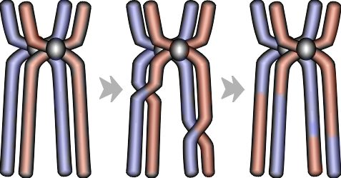
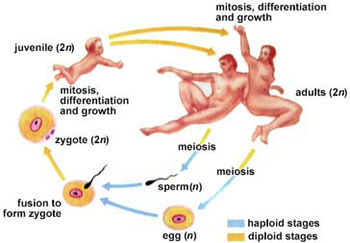
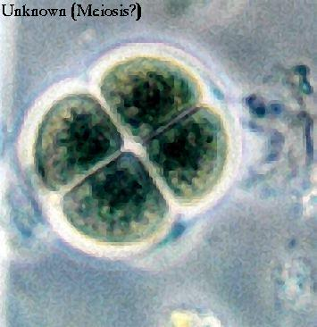
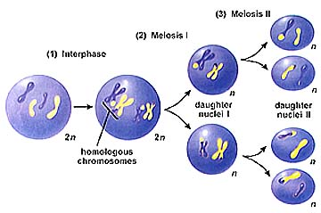
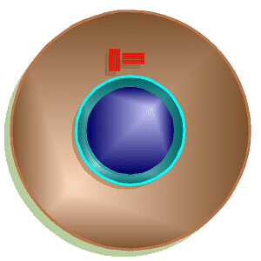
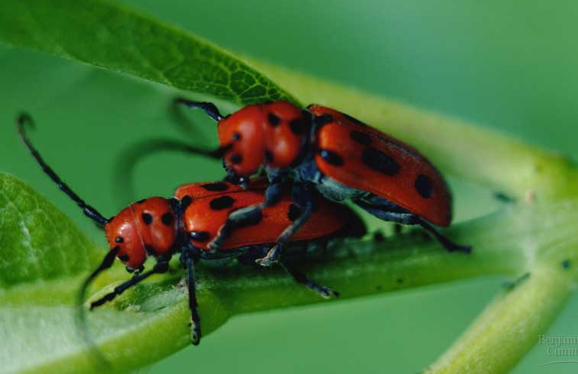
Meiosis &
Sexual Reproduction

Slide 2
Offspring acquire genes from parents
Genes are segments of DNA that code for the basic units of heredity and are transmitted from one generation to the net. In animals and plants, reproductive cells that transmit genes from one generation to the next are called gametes.
A locus (plural, loci) is the location of a gene on a chromosome
-In asexual reproduction a single parent is the sole parent and passes copies of all its genes to its offspring. In asexual reproduction the new offspring arise by mitosis and have virtually exact copies of the parents genome. An individual that reproduces asexually gives rise to a clone, a group of genetically identical individuals.
Mitosis
  produce cells with same information
Aaaargh!
I’m seeing
double!

Slide 3
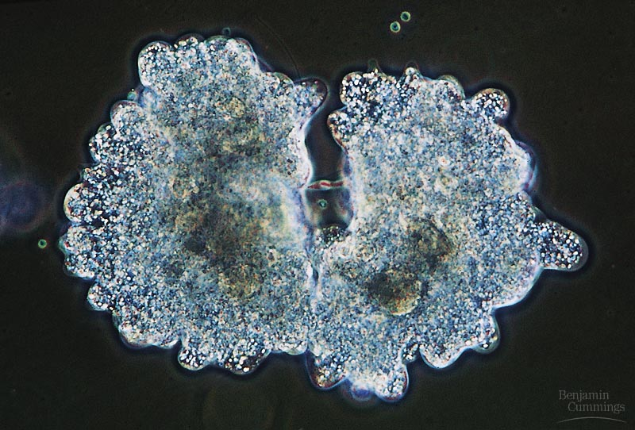
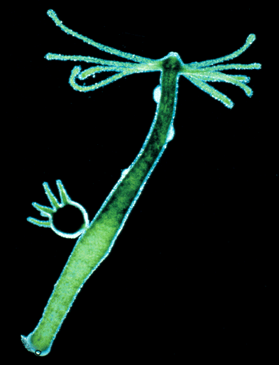
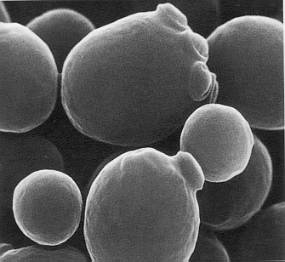
Asexual reproduction
Single-celled eukaryotes
  yeast (fungi)
  Protists
    Paramecium
    Amoeba
Simple multicellular eukaryotes
  Hydra
budding
budding
What are the
disadvantages of
asexual reproduction?
What are the
advantages?

Slide 4
How about the rest of us?
What if a complex multicellular organism (like us) wants to reproduce?
  joining of egg + sperm
Do we make egg & sperm by mitosis?
What if we did, then….
46
+
46
92
egg
sperm
zygote
Doesn’t work!

Slide 5
Advantage of Sexual Reproduction
In sexual reproduction, two individuals (parents) contribute genes to the offspring. This form of reproduction results in greater genetic variation in the offspring than asexual reproduction.
A life cycle is the generation-to generation sequence of stages in the reproductive history of an organism, from conception to production of its own offspring.
Somatic cells are any cells in the body that are not gametes. Each somatic cell in humans has 46 chromosomes. Liver cells and neurons are somatic cells.
The karyotype of an organism refers to a picture of its complete set of chromosomes, arranged in pairs of homologous chromosomes from the largest pair to the smallest pair.

Slide 6
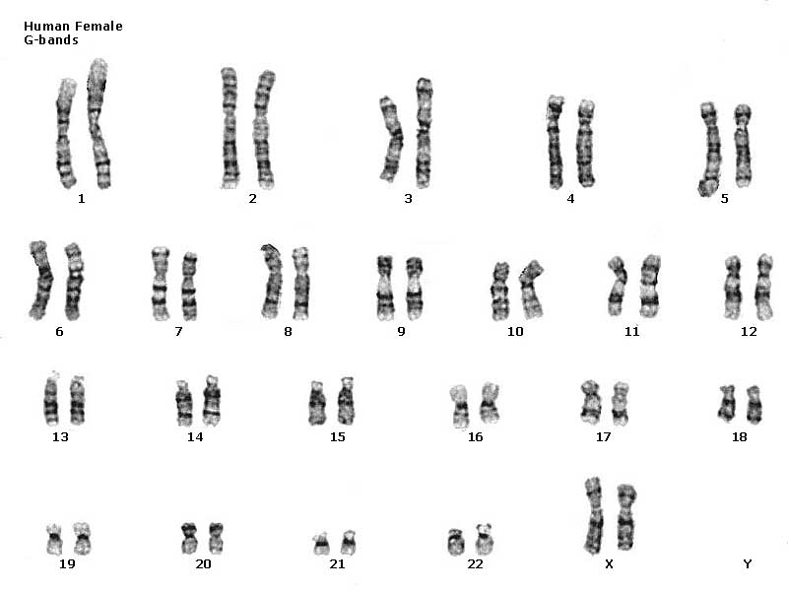
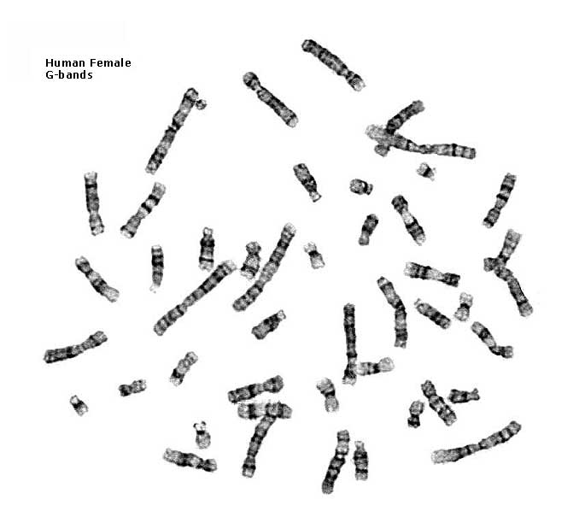
Human female karyotype
46 chromosomes
23 pairs

Slide 7
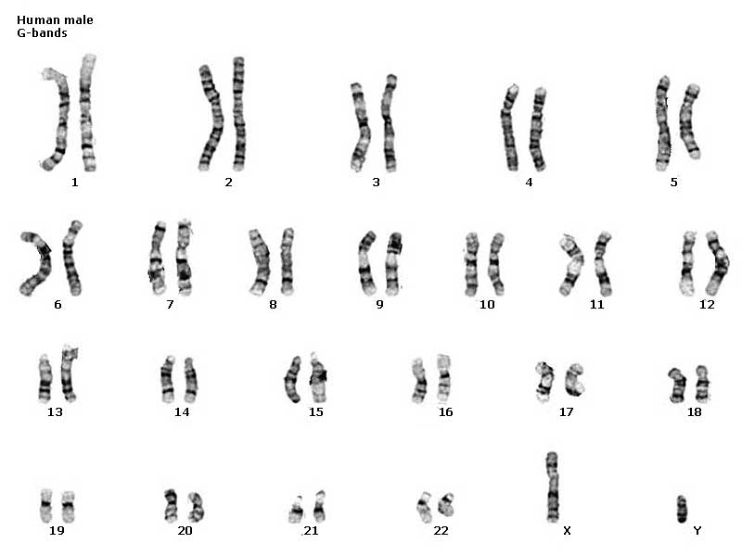
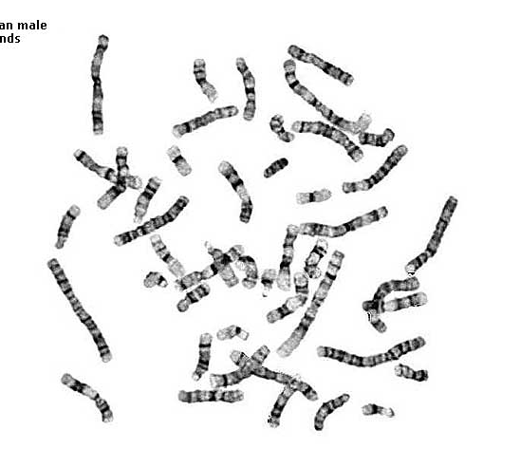
Human male karyotype
46 chromosomes
23 pairs

Slide 8
Homologous chromosomes
Paired chromosomes
  both chromosomes of a pair carry “matching” genes
    control same inherited characters
    homologous = same information
diploid
2n
2n = 4
single stranded
homologous
chromosomes
double stranded
homologous chromosomes

Slide 9
Homologous chromosomes
In homologous chromosomes both chromosomes of each pair carry genes that control the same inherited characteristics. If a gene for eye color is found at a specific locus on one chromosome, its homologs will have the same gene at the same locus.
  Homologous chromosomes are similar in length and centromere position, and they have the same staining pattern.
  One homologous chromosome from each pair is inherited from each parent, in other words, half of the set of 46 chromosomes in your somatic cells was inherited from your mother, and the other half was inherited from your father.
Exceptions to the rule that all chromosomes are part of a homologous pair may be found with the sex chromosomes-in humans, it is the X and Y. Human females have a homologous pair of chromosomes XX, but males have one X chromosome and one Y chromosome. Nonsex chromosomes; that is, all the chromosomes (1-22) except the X and Y are autosomes.

Slide 10
How do we make sperm & eggs?
Must reduce 46 chromosomes → 23
  must half the number of chromosomes
23
zygote
46
23
egg
46
meiosis
23
46
23
fertilization
sperm
gametes

Slide 11
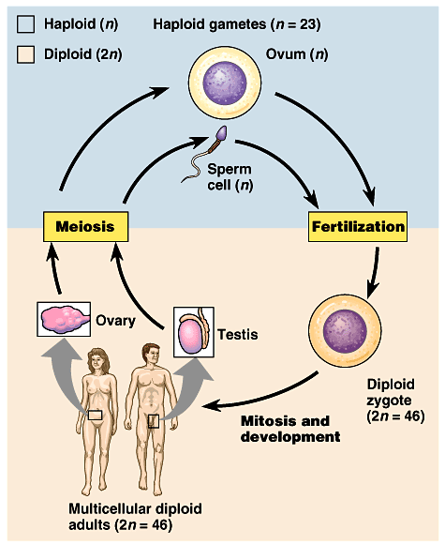
Meiosis: production of gametes
Alternating stages
  chromosome number must be reduced
    diploid → haploid
    2n → n
      humans: 46 → 23
    meiosis reduces chromosome number
    makes gametes
  fertilization restores chromosome number
    haploid → diploid
    n → 2n

Slide 12
Gametes
Gametes - meaning sperm and ova (eggs)-are haploid cells. Haploid cells contain half the number of chromosomes of somatic cells. In humans, gametes contain 22 autosomes plus a single sex chromosome (X in female, either X or Y in Male), giving them a haploid number of 23. The haploid number of chromosomes is symbolized by n.
Meiosis and fertilization are the key events in sexually reproducing life cycles. The human life cycle is typical of a sexually reproducing animal. During fertilization (the combination of a sperm cell and an egg cell), one haploid gamete from the father fuses with one haploid gamete from the mother. The result is a fertilized egg called a zygote. It is diploid (has two sets of chromosomes) and may be symbolized by 2n.
Meiosis is the type of cell division that reduces the numbers of sets of chromosomes from two to one. Fertilization restores the diploid number as gametes are combined. Fertilization and meiosis alternate in the life cycles of sexually reproducing organisms.

Slide 13
Sexual reproduction lifecycle
2 copies
diploid
2n
1 copy
haploid
1n
1 copy
haploid
1n
fertilization
meiosis
We’re mixing
things up here!
A good thing?

Slide 14
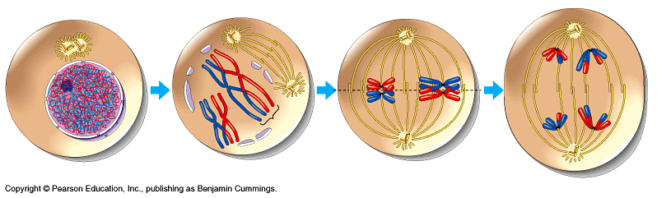
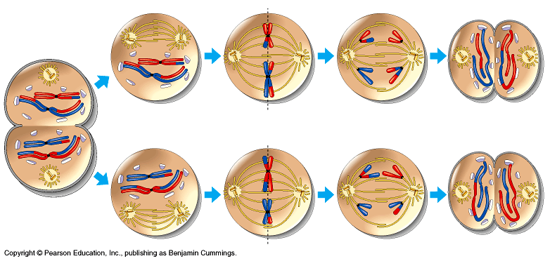
Overview of meiosis
I.P.M.A.T.P.M.A.T
2n=4
interphase 1
prophase 1
metaphase 1
anaphase 1
n=2
prophase 2
metaphase 2
anaphase 2
telophase 2
telophase 1

Slide 15
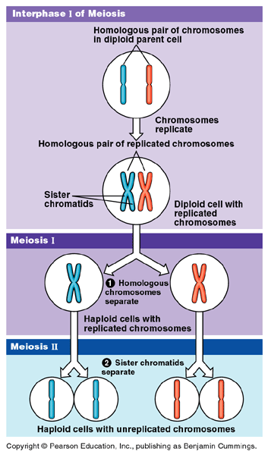
Double division of meiosis
DNA replication
Repeat
after me!
I can’t
hear you!
1st division of
meiosis separates homologous pairs
Meiosis 1
Meiosis 2
2nd division of meiosis separates sister chromatids

Slide 16
Preparing for meiosis
1st step of meiosis
  Duplication of DNA
  Why bother?
    meiosis evolved after mitosis
    convenient to use
    “machinery” of mitosis
    DNA replicated in
    S phase of interphase
    of MEIOSIS
    (just like in mitosis)
2n = 6
single
stranded
2n = 6
double
stranded
M1 prophase

Slide 17
Meiosis 1
2n = 4
single
stranded
1st division of meiosis separates homologous pairs
2n = 4
double
stranded
prophase 1
synapsis
2n = 4
double
stranded
metaphase 1
tetrad
telophase 1
Repeat
after me!
1n = 2
double
stranded
I can’t
hear you!

Slide 18
Meiosis 2
2nd division of meiosis separates sister
chromatids
1n = 2
double
stranded
prophase 2
What does
this division
look like?
1n = 2
double
stranded
metaphase 2
1n = 2
single
stranded
4
telophase 2

Slide 19
Steps of meiosis
Meiosis 1
  interphase
  prophase 1
  metaphase 1
  anaphase 1
  telophase 1
Meiosis 2
  prophase 2
  metaphase 2
  anaphase 2
  telophase 2
1st division of
meiosis separates homologous pairs
(2n → 1n)
“reduction division”
2nd division of meiosis separates sister chromatids
(1n → 1n)
* just like mitosis *

Slide 20
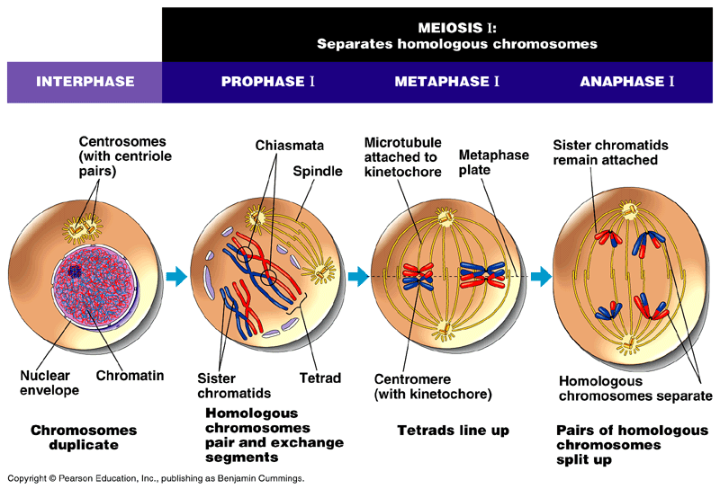

Slide 21
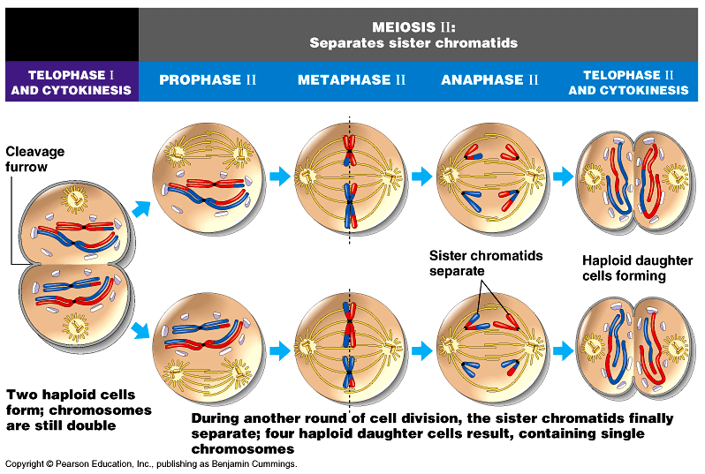

Slide 22
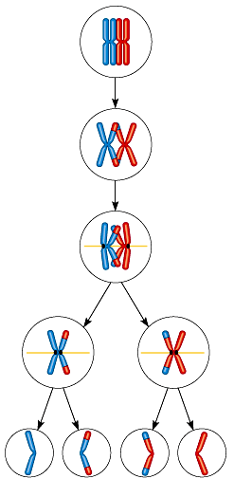

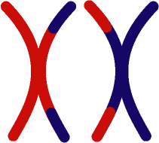
Trading pieces of DNA
Crossing over
  during Prophase 1, sister chromatids intertwine
    synapsis
    This newly formed structure is called a tetrad and precisely aligns the homologous chromosomes gene by gene.
    homologous pairs swap
    pieces of chromosome
      DNA breaks & re-attaches
prophase 1
synapsis
tetrad

Slide 23
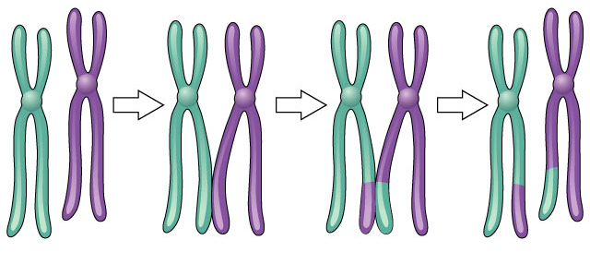
Crossing over
What are the
advantages of
sexual reproduction?
3 steps
  cross over
  breakage of DNA
  re-fusing of DNA
New combinations of traits
Notes:
Sexual reproduction is advantageous to species that benefit from genetic variability. However, since evolution occurs because of changes in an individual's DNA, crossing over and chromosome segregation is likely to result in progeny that are less well-adapted than their parents. On the other hand, asexual reproduction ensures the production of progeny as fit as the parent since they are identical to the parent. Remember the adage, “if it's not broken, don't fix it.” There are several hypotheses regarding the evolution of sexual reproduction. One is associated with repairing double-stranded DNA breaks induced by radiation or chemicals. The contagion hypothesis suggests that sex arose from infection by mobile genetic elements. The Red Queen hypothesis theorizes that sex is needed to store certain recessive alleles in case they are needed in the future. Along similar lines, eukaryotic cells build up large numbers of harmful mutations. Sex, as explained by Miller's rachet hypothesis, may simply be a way to reduce these mutations. The “whole truth” is likely a combination of these factors. Regardless of how and why, the great diversity of vertebrates and higher plants and their ability to adapt to the highly varied habitats is indeed a result of their sexual reproduction.

Slide 24
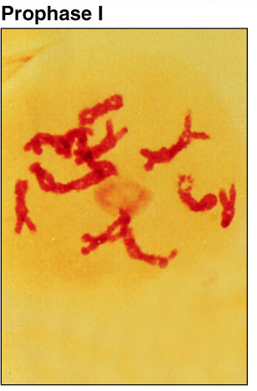
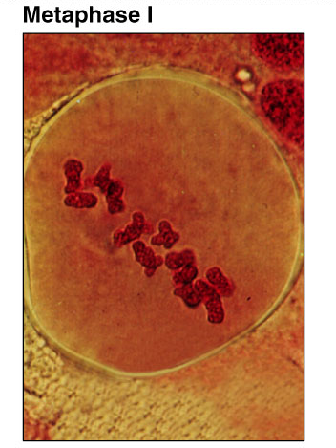
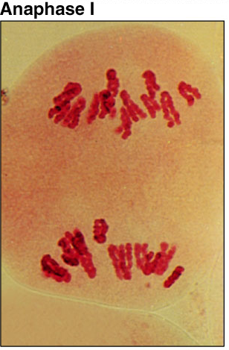
Meiosis 1

Slide 25
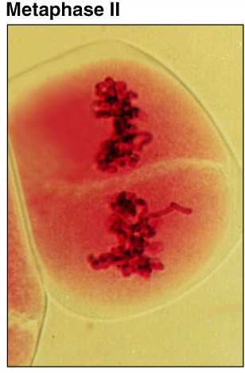
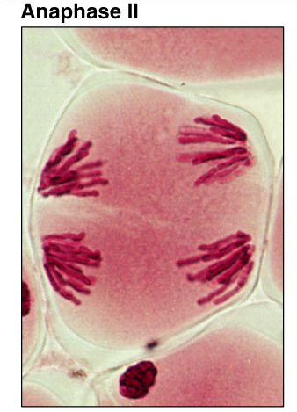
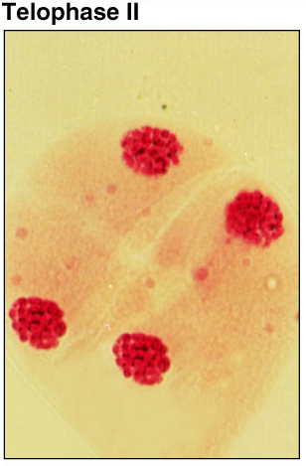
Meiosis 2

Slide 26
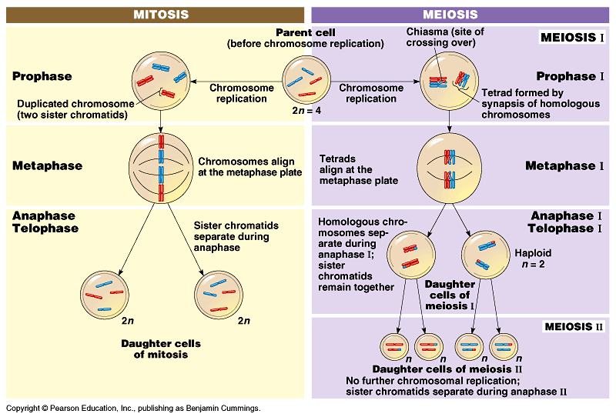
Mitosis vs. Meiosis

Slide 27
Mitosis vs. Meiosis
Mitosis
  1 division
  daughter cells genetically identical to parent cell
  produces 2 cells
  2n → 2n
  produces cells for growth & repair
  no crossing over
Meiosis
  2 divisions
  daughter cells genetically different from parent
  produces 4 cells
  2n → 1n
  produces gametes
  crossing over

Slide 28
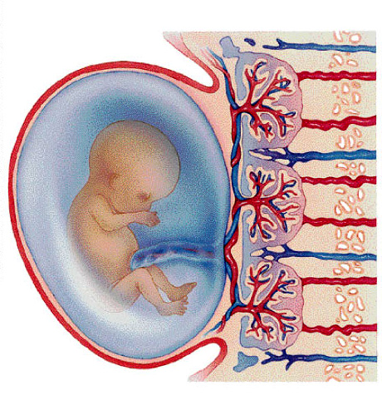
Putting it all together…
meiosis → fertilization → mitosis + development
gametes
46
23
46
23
46
46
46
46
46
meiosis
egg
46
46
23
46
46
23
zygote
fertilization
mitosis &
development
mitosis
sperm

Slide 29
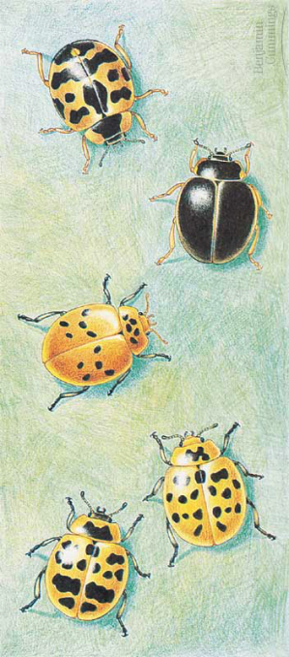
The value of sexual reproduction
Sexual reproduction introduces genetic variation
  genetic recombination during meiosis
    independent assortment of chromosomes
      random alignment of homologous chromosomes in Meiosis 1
  crossing over
    mixing of alleles across homologous chromosomes
  random fertilization
    which sperm fertilizes which egg?
Driving evolution
  variation for natural selection
metaphase1

Slide 30
Variation from genetic recombination
Independent assortment of chromosomes
  meiosis introduces genetic variation
  gametes of offspring do not have same combination of genes as gametes from parents
    random assortment in humans produces
    2²³ (8,388,608) different combinations in gametes
new gametes
made by offspring
from Mom
from Dad
offspring

Slide 31
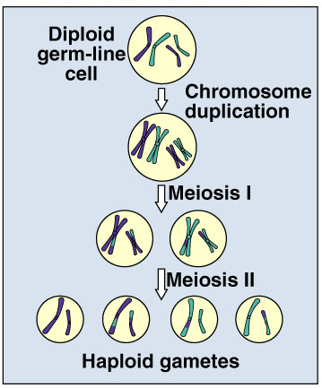
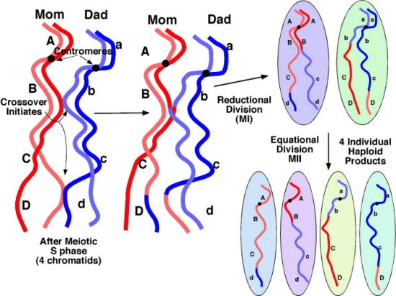
Variation from crossing over
Crossing over creates completely new combinations of traits on each chromosome
  creates an infinite
  variety in gametes

Slide 32
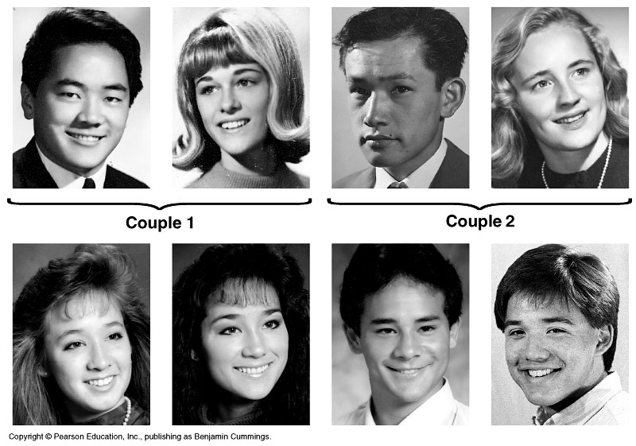
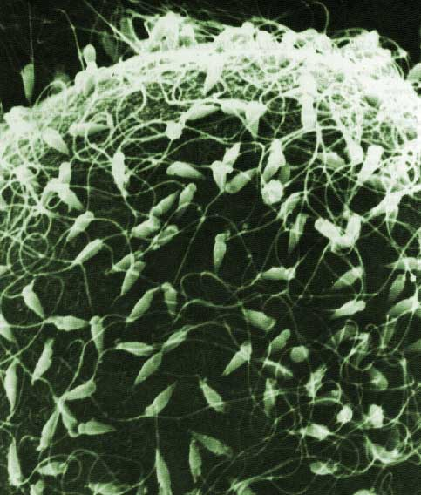
Variation from random fertilization
Sperm + Egg = ?
  any 2 parents will produce a zygote with over 70 trillion (2²³ x 2²³) possible diploid combinations

Slide 33
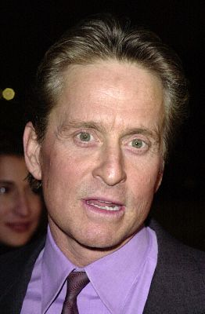
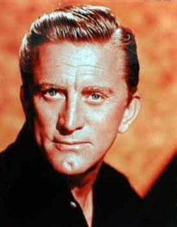
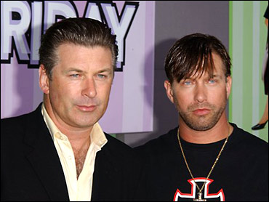



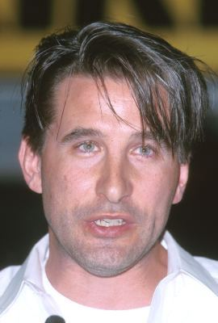

Sexual reproduction creates variability
Sexual reproduction allows us to maintain both genetic similarity & differences.
Michael & Kirk
Douglas
Baldwin brothers
Martin & Charlie Sheen, Emilio Estevez

Slide 34
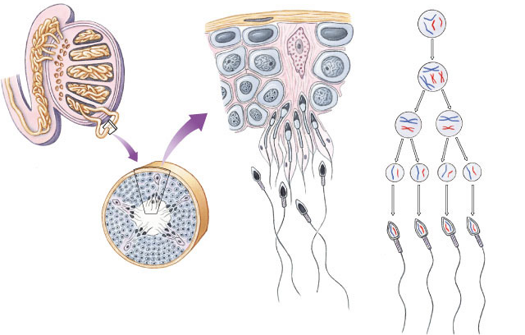
Sperm production
Epididymis
Testis
germ cell
(diploid)
Coiled
seminiferous
tubules
primary
spermatocyte
(diploid)
MEIOSIS I
secondary
spermatocytes
(haploid)
Vas deferens
spermatids
(haploid)
MEIOSIS II
spermatozoa
Spermatogenesis
  continuous & prolific process
  each ejaculation =
  100-600 million sperm
Cross-section of
seminiferous tubule

Slide 35
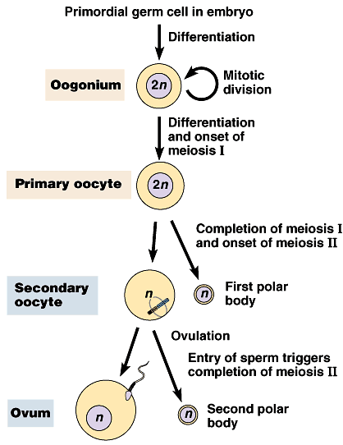
Egg production
Oogenesis
  eggs in ovaries halted before Anaphase 1
  Meiosis 1 completed during maturation
  Meiosis 2 completed after fertilization
  1 egg + 2 polar bodies
unequal division
Meiosis 1 completed
during egg maturation
ovulation
What is the advantage of this development system?
Meiosis 2 completed
triggered by fertilization

Slide 36
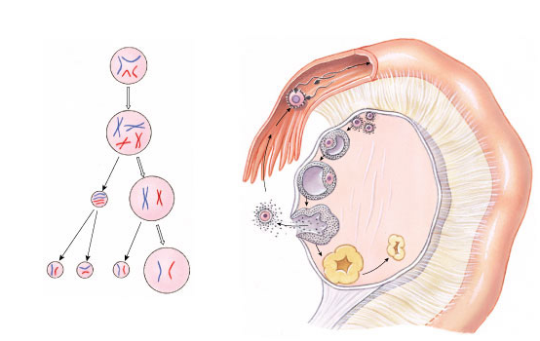
Oogenesis
primary follicles
germinal cell
(diploid)
fallopian tube
fertilization
primary
oocyte
(diploid)
developing
follicle
MEIOSIS I
mature follicle with
secondary oocyte
secondary
oocyte
(haploid)
first polar body
ruptured follicle
(ovulation)
MEIOSIS II
after fertilization
ovum
(haploid)
second
polar body
corpus luteum

Slide 37
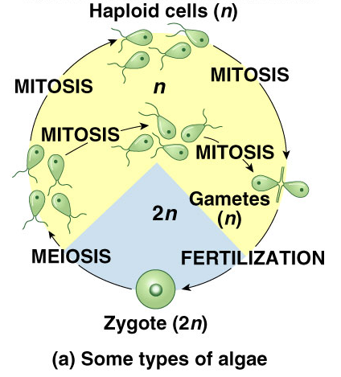
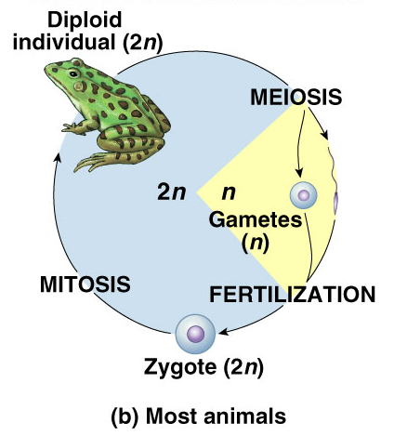
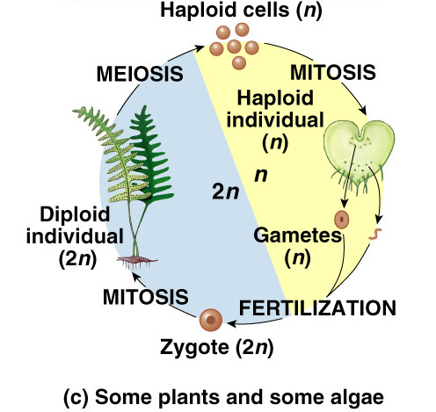
Differences across kingdoms
Not all organisms use haploid & diploid stages in same way
  which one is dominant (2n or n) differs
  but still alternate between haploid & diploid
    must for sexual reproduction

