Slide 1
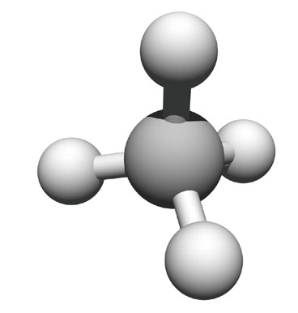
Macromolecules and Carbon
Building Blocks of Life

Slide 2
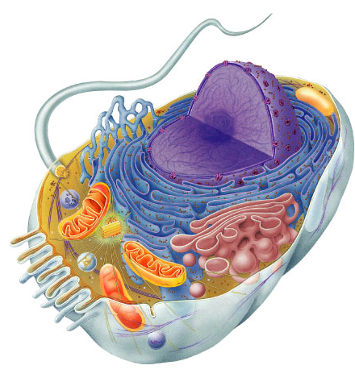
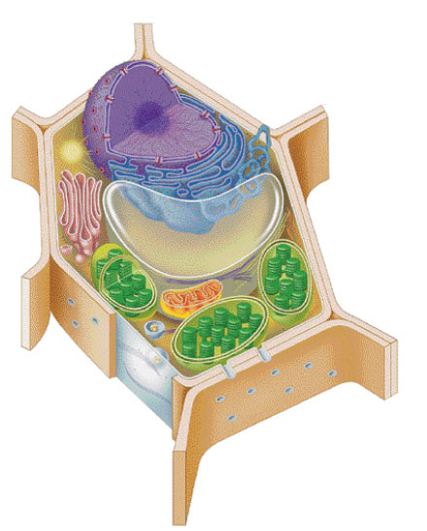
Why study Carbon?
All of life is built on carbon.
  A molecule associated with life containing carbon.
Cells
  ~72% H₂O
  ~25% carbon compounds
    carbohydrates
    lipids
    proteins
    nucleic acids
  ~3% salts
    Na, Cl, K…
The major elements of life are C, H, O, N, S, and P. CHNOPS
Notes:
Why do we study carbon -- is it the most abundant element in living organisms?
H & O most abundant
C is the next most abundant

Slide 3
Carbon: Life’s Element
Organic molecules consisting of only carbon and hydrogen.
Carbon is unparalleled in its ability to form molecules that are large, complex, and diverse. Why?
It has 4 valence electrons
It can form up to covalent bonds
These can be single, double, or triple covalent bonds
It can form large molecules
These molecules can be chains, ring-shaped, or branched
Monomers: Repeating units that serve as building blocks of a polymer.
Polymer: A long molecule consisting of many similar of identical building blocks linked by covalent bonds. Like a train consists of a chain of train cars.

Slide 4
Isomers
Molecules with same molecular formula but different structures (shapes)
  different chemical properties
  different biological functions
6 carbons
6 carbons
6 carbons
Notes:
Same formula but different structurally & therefore different functionally. Molecular shape determines biological properties.
Ex. Isomers may be ineffective as medicines

Slide 5
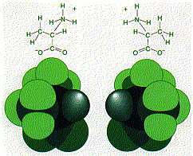
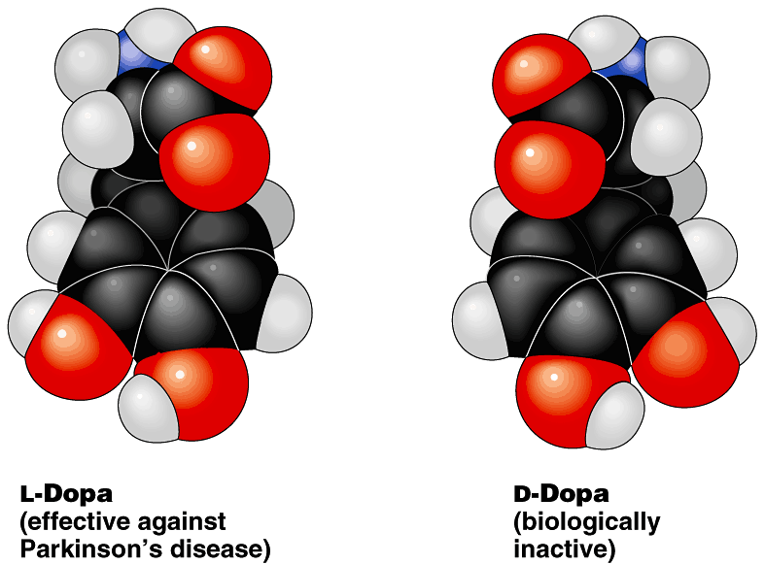
Form affects function
Structural differences create important functional significance
  amino acid alanine
    L-alanine used in proteins
    but not D-alanine
  medicines
    L-version active
    but not D-version
  sometimes with
  tragic results…
stereoisomers

Slide 6
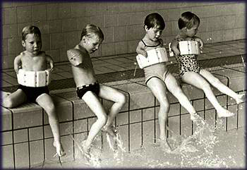
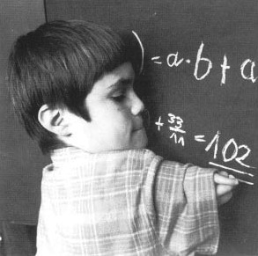
Form affects function
Thalidomide
  prescribed to pregnant women in 50s & 60s
  reduced morning sickness, but…
  stereoisomer caused severe birth defects

Slide 7
Bonds and Chemical Formula
C2H6
Single Bonds
C2 H4
Double covalent bonds
C2 H2
Triple Covalent bonds

Slide 8
Macromolecules
Smaller organic molecules join together to form larger molecules
  Macromolecules: Large molecules which are important in the complexity of life.
4 major classes of
macromolecules:
  carbohydrates
  lipids
  proteins
  nucleic acids

Slide 9
Monosaccharides
The least complicated carbohydrates.
The chemical formula for all monosaccharides is: C_{x}H_{2x}O_{x}
The three most common are glucose, galactose, fructose. Each has the same chemical formula (C₆H₁₂O₆).

Slide 10
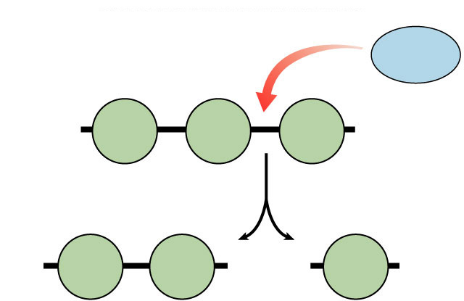
How to break down a polymer
Digestion
  use H₂O to breakdown polymers
    reverse of dehydration synthesis
    cleave off one monomer at a time
    H₂O is split into H⁺ and OH–
      H⁺ & OH– attach to ends
  requires enzymes
  releases energy
Breaking up
is hard to do!
H₂O
HO
enzyme
H
Hydrolysis
C₆H₁₂O₆ + C₆H₁₂O₆ → C₁₂H₂₂H₁₁ + H₂0
HO
H
HO
H
Notes:
Most macromolecules are polymers
• build:
condensation (dehydration) reaction
• breakdown:
hydrolysis
An immense variety of polymers can be built from a small set of monomers

Slide 11
Hydrolysis of Maltose (C₁₂H₂₂O₁₁)
-Maltose: Glucose + Glucose
-Sucrose (Table Sugar): Glucose + Fructose
-Lactose(Milk Sugar): Glucose + Galactose
----Chemical formula for Maltose, Sucrose, and Lactose:
C₁₂H₂₂O₁₁

Slide 12
Polysaccharides and Polymers
The most complex carbohydrates which are made up of long chains of monosaccharides (glucose-like units). Starch, cellulose, and glycogen are examples. They differ because of how the subunits are bonded together.
Two functions of Polysaccharides are energy storage and structural support.
  Energy Storage polysaccharides
    Starch is a storage polysaccharide found in plants (Example: potatoes)
    Glycogen is a storage polysaccharide found in animals, vertebrate muscle cells, and liver cells.
  Structural support polysaccharides
    Cellulose is a major component of plant cell walls
    Chitin is found in the exoskeleton of arthropods, such as lobsters and insects, and the cell walls of fungi. It gives cockroaches their “crunch”.

Slide 13
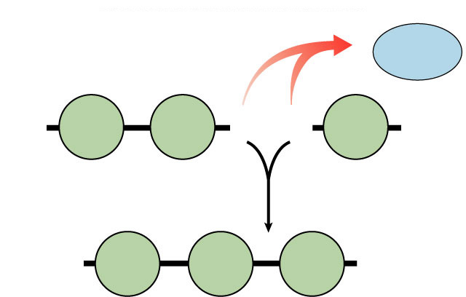
Polymers
Long molecules built by linking repeating building blocks in a chain
  monomers
    building blocks
    repeated small units
  covalent bonds
Polysaccharides, Proteins, Nucleic Acids
each use monomers. Lipids to NOT.
H₂O
HO
H
HO
H
Dehydration synthesis
HO
H
Notes:
• great variety of polymers can be built from a small set of monomers
• monomers can be connected in many combinations like the 26 letters in the alphabet can be used to create a great diversity of words
• each cell has millions of different macromolecules

Slide 14
How to build a polymer
You gotta
be open to
“bonding”!
Synthesis
  joins monomers by “taking” H₂O out
    one monomer donates OH–
    other monomer donates H⁺
    together these form H₂O
  requires energy & enzymes
H₂O
HO
H
HO
H
enzyme
Dehydration synthesis
Condensation reaction
HO
H

Slide 15
Lipids
A group of organic compounds that include fats, oils, waxes, and related substances. Made of Carbon, hydrogen, and oxygen. There is no definite ratio of hydrogen to oxygen atoms like in carbohydrates. Simple lipids are the most common and are made up of three fatty acid molecules (C_{n}H2_{n}COOH) and one glycerol molecule (C₃H₈O₃). They are held together with chemical bonds
(Alcohol)
C₁₆H₃₂O₂

Slide 16
Saturated Fats vs Unsaturated Fats vs Trans Fats

Slide 17
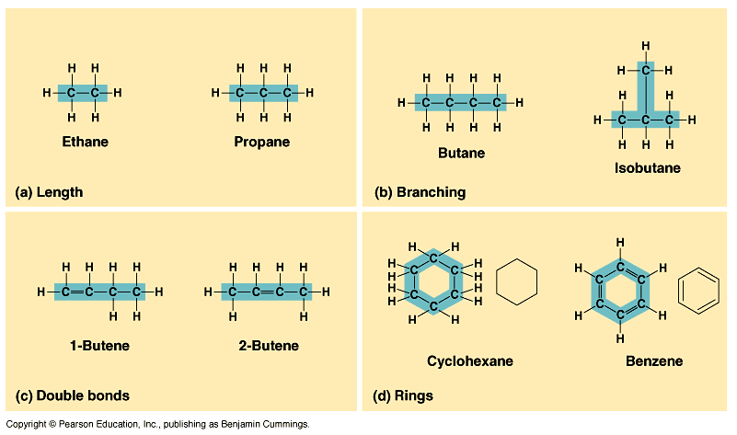
Hydrocarbons can grow

Slide 18
Lipids are Hydrophobic.
Fats (also called triglycerides): made of a glycerol molecule and 3 fatty acid molecules
Fatty Acids: hydrocarbon chains of variable lengths. These chains are nonpolar and therefore hydrophobic.
Saturated fatty acids: No double bonds between carbons, pack solidly at room temperature, produced by animals. Examples: butter and lard
Unsaturated fatty acids: have some C=C (carbon double bonds); tend to be liquid at room temp. produced by plants. Examples: corn oil and olive oil

Slide 19
Function of lipids:
-Energy Storage. Fats store twice as many calories/gram as carbohydrates!
-Protection of vital organs and insulation. In humans and other mammals, fat is stored in adipose (fat) cells.
-Phospholipids make up cell membranes. They:
-have hydrophilic (polar) head that includes a phosphate group.
-have two fatty acid tails, which are hydrophobic.

Slide 20
Proteins
Made of amino acids bonded together. They can be very large and complex. They play a wide variety of roles in the cell.
Some are structural, others are hormones, enzymes, or pigments.
They are made off carbon, hydrogen, oxygen, and nitrogen; some contain sulfur. They are bonded by dehydration synthesis. Bonds between amino acids are called peptide bonds. Meat, beans, eggs, nuts, and milk contain a lot of proteins.

Slide 21
Protein Structure:
Amino Acids: Contain a central carbon bonded to a carboxyl group (COOH) at one end, an amino group (NH2) at the other end, a hydrogen atom, and an R group (variable group or side chain)
Peptide Bonds: link amino acids together. They are formed by dehydration synthesis between the amino and carboxyl groups of adjacent monomers.

Slide 22
4 Levels of Protein Structure
Primary Structure
Secondary Structure
Tertiary Structure
Quaternary Structure

Slide 23
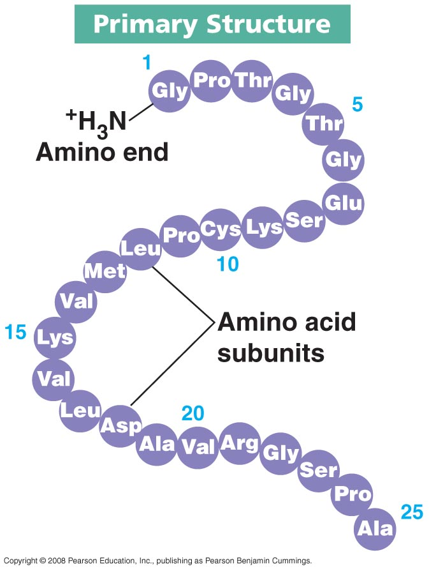
Primary Structure
Primary Structure is the unique sequence of which amino acids are joined.

Slide 24
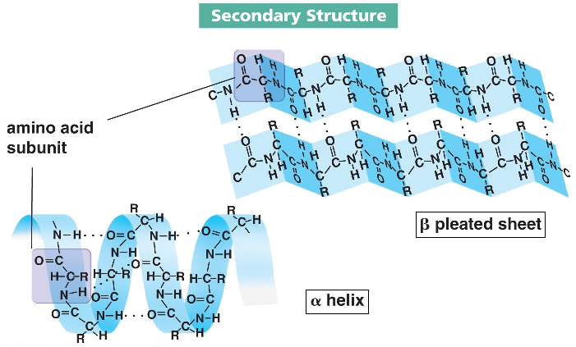
Secondary Structure
Secondary Structure: one of two three-dimensional shapes that are the result of hydrogen bonding between members of the polypeptide backbone (not the amino acid side chains)
Alpha helix: a coiled shape much like a slinky
Beta pleated sheet: is like an accordion shape

Slide 25
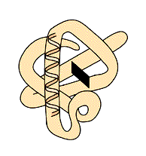
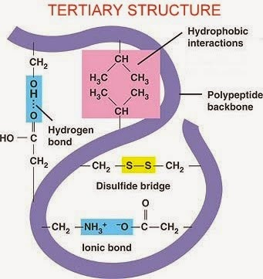
Tertiary Structure
Tertiary Structure: a complex globular shape due to interactions between the side chains (R groups), such as hydrophobic interactions, van der waals interactions, hydrogen bonds, and disulfide bridges. Example: enzymes.

Slide 26
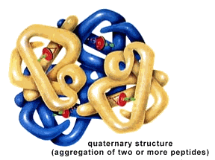
Quaternary Structure
Quaternary Structure: refers to the association of two or more polypeptide chains into one large protein. Hemoglobin is a globular protein with quaternary structure because it is composed of four chains.

Slide 27
Enzymes (Specialized Proteins)
Enzymes act as catalysts in living cells. A catalyst increases the rate of a chemical reaction, allowing it to proceed rapidly when it would otherwise occur very slowly.
Enzymes lower the activation energy needed for a reaction to occur. Each enzyme has an optimum range of temperature and pH at which is operates most efficiently.
Without enzymes in our cells, reactions would take too long and cells would die.
Cofactors are nonprotein molecules that assist enzymes.
  Coenzymes are organic cofactors that usually function to donate or accept some component of a reaction, often electrons. Some vitamins are coenzymes or components of coenzymes.
  Inorganic cofactors are often metal ions, like Fe and Mg.

Slide 28
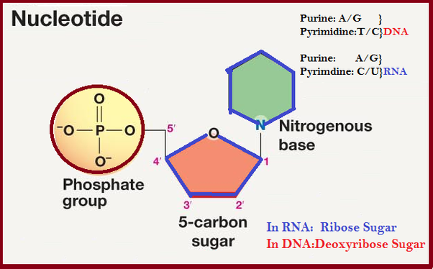
Nucleic Acids
DNA (deoxyribonucleic acid) and RNA (ribonucleic acid) are the two nucleic acids. Their monomers are nucleotides.
Nucleotides are made up of three parts
-Nitrogenous base (adenine, thymine, cytosine, and guanine in DNA, adenine, uracil, cytosine, and guanine in RNA)
-Pentose (5 carbon) sugar: deoxyribose in DNA, ribose in RNA
-Phosphate group

Slide 29
Nucleic Acids (Two Types: DNA and RNA)
DNA is the molecule of heredity
-Double Stranded helix
-Nucleotides consist of adenine, thymine, cytosine, and guanine
-Adenine always binds with thymine, cytosine always binds with guanine
RNA is
-Single stranded.
-Nucleotides consist of adenine, uracil, cytosine, and guanine
-3 forms of RNA
-mRNA-Carries DNA code to ribosomes
-rRNA-Assembles proteins
-tRNA-Transfers amino acids to ribosomes

Slide 30
Functional groups
Parts of organic molecules that are involved in chemical reactions
  give organic molecules distinctive properties
    ■ hydroxyl  amino
    ■ carbonyl  sulfhydryl
    ■ carboxyl  phosphate
Affect reactivity
  makes hydrocarbons hydrophilic
  increase solubility in water
It is recommended that you know the following functional groups by sight and not the particular details of each.

Slide 31
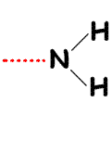
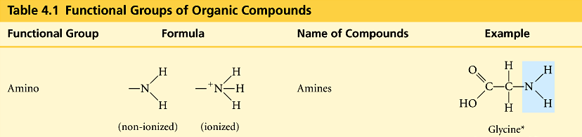
Amino
-NH₂
  N attached to 2 H
    compounds with NH₂ = amines
      amino acids
    NH₂ acts as base
      ammonia picks up H⁺ from solution

Slide 32
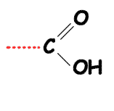
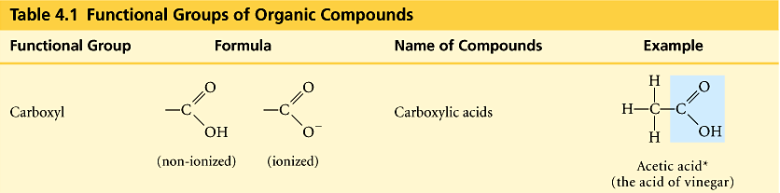
Carboxyl
–COOH
  C double bonded to O & single bonded to OH group
    compounds with COOH = acids
      fatty acids
      amino acids

Slide 33
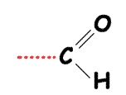
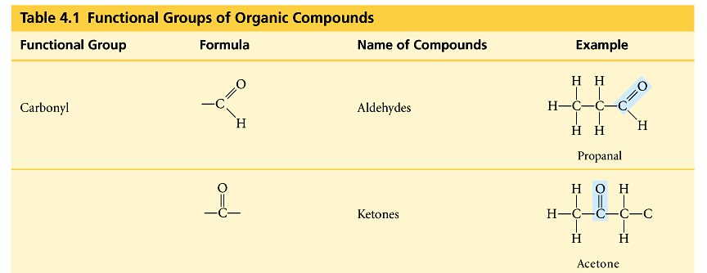
Carbonyl
C=O
  O double bonded to C
    if C=O at end molecule = aldehyde
    if C=O in middle of molecule = ketone

Slide 34
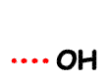
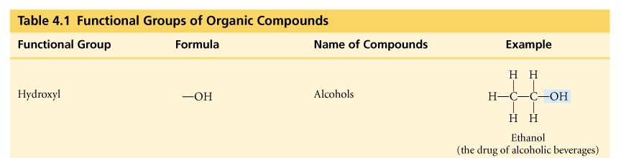
Hydroxyl
–OH
  organic compounds with OH = alcohols
  names typically end in -ol
    ethanol

Slide 35
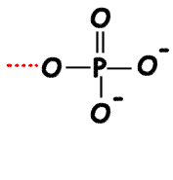
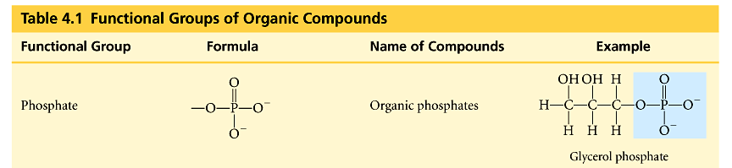
Phosphate
–PO₄
  P bound to 4 O
    connects to C through an O
    lots of O = lots of negative charge
      highly reactive
    transfers energy between organic molecules
      ATP, GTP, etc.

Slide 36
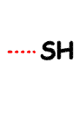
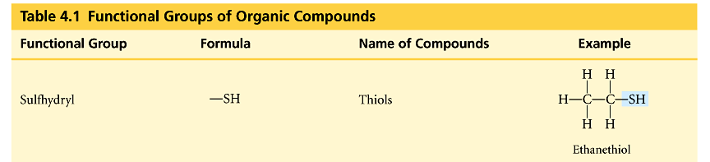
Sulfhydryl
–SH
  S bonded to H
    compounds with SH = thiols
    SH groups stabilize the structure of proteins

