Slide 1
Gene Expression/ Inheritance Patterns
10th Grade Biology
Mr. Walker

Slide 2
Genes
Can be dominant or recessive
Not always this simple
Why do muscle cells differ from skin cells?
Each cell reads the DNA code differently. Each mRNA codon can produce different amino acids in a protein. Thus cells differ in form and function.
Homozygous, heterozygous
Can have the trait even though it is not being expressed.

Slide 3
Incomplete dominance
The phenotype of the offspring is a mix between the two genotypes of the parents. Example: a red flower x a white flower= a pink flower

Slide 4
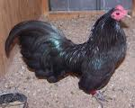
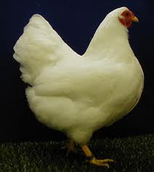
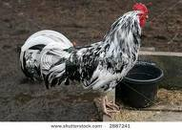
Codominant Alleles
Causes the offspring to have both genotypes which are equally expressed. Example: a Black rooster x a white chicken= a checkered rooster.

Slide 5
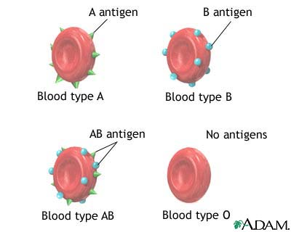
Polygenic Inheritance
The pattern controlled by two or more genes.
Example: height in humans, Skin color.
Multiple alleles
Traits can have more than 1 allele.
Example is blood type
4 types of blood

Slide 6
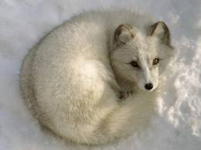
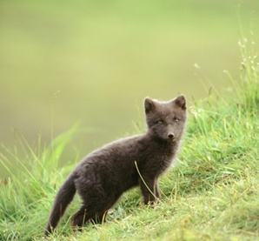
Influences in Gene Expression
Internal Factors:
Proteins, mRNA, organelles, and other substances are not evenly distributed in cells. These regulate gene expression differently and can create different types of cells.
Cells communicate with each other by sending/receiving messages in the form of molecules. These molecules can turn genes on and off.
External Factors:
-The environment around the organism can influence the genotype. Example: Arctic Fox
-The presence of drugs and chemicals can change gene expression (depression medicines etc)
-The amount of light can affect the color of butterflies when they develop as caterpillars

