Slide 1
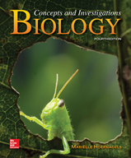
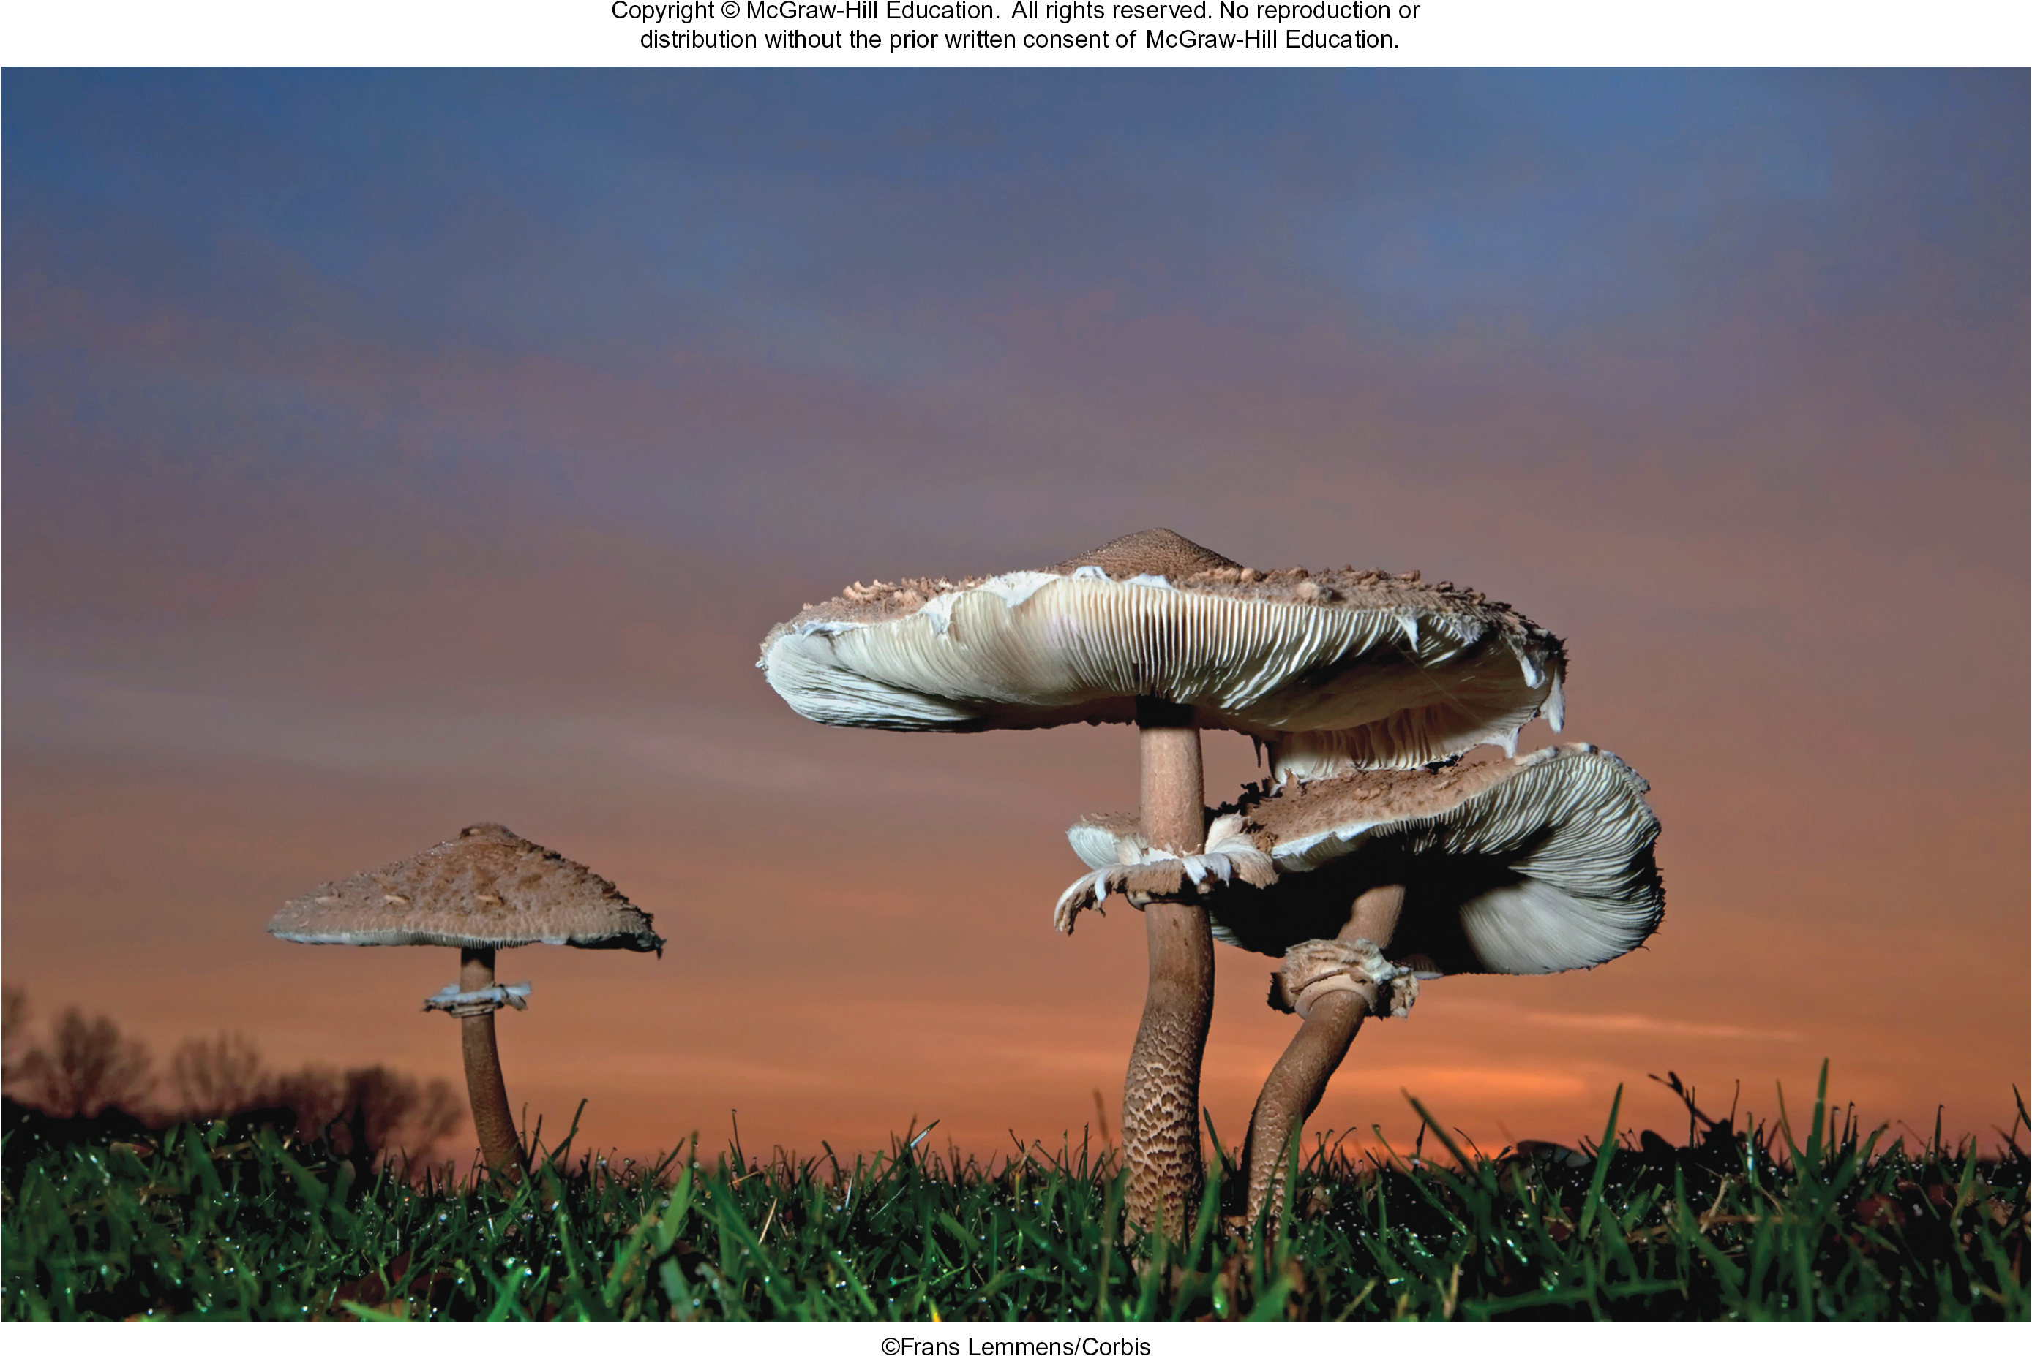
Chapter 20
Fungi
©Frans Lemmens/Corbis
©McGraw-Hill Education. All rights reserved. Authorized only for instructor use in the classroom.
No reproduction or further distribution permitted without the prior written consent of McGraw-Hill Education.

Slide 2
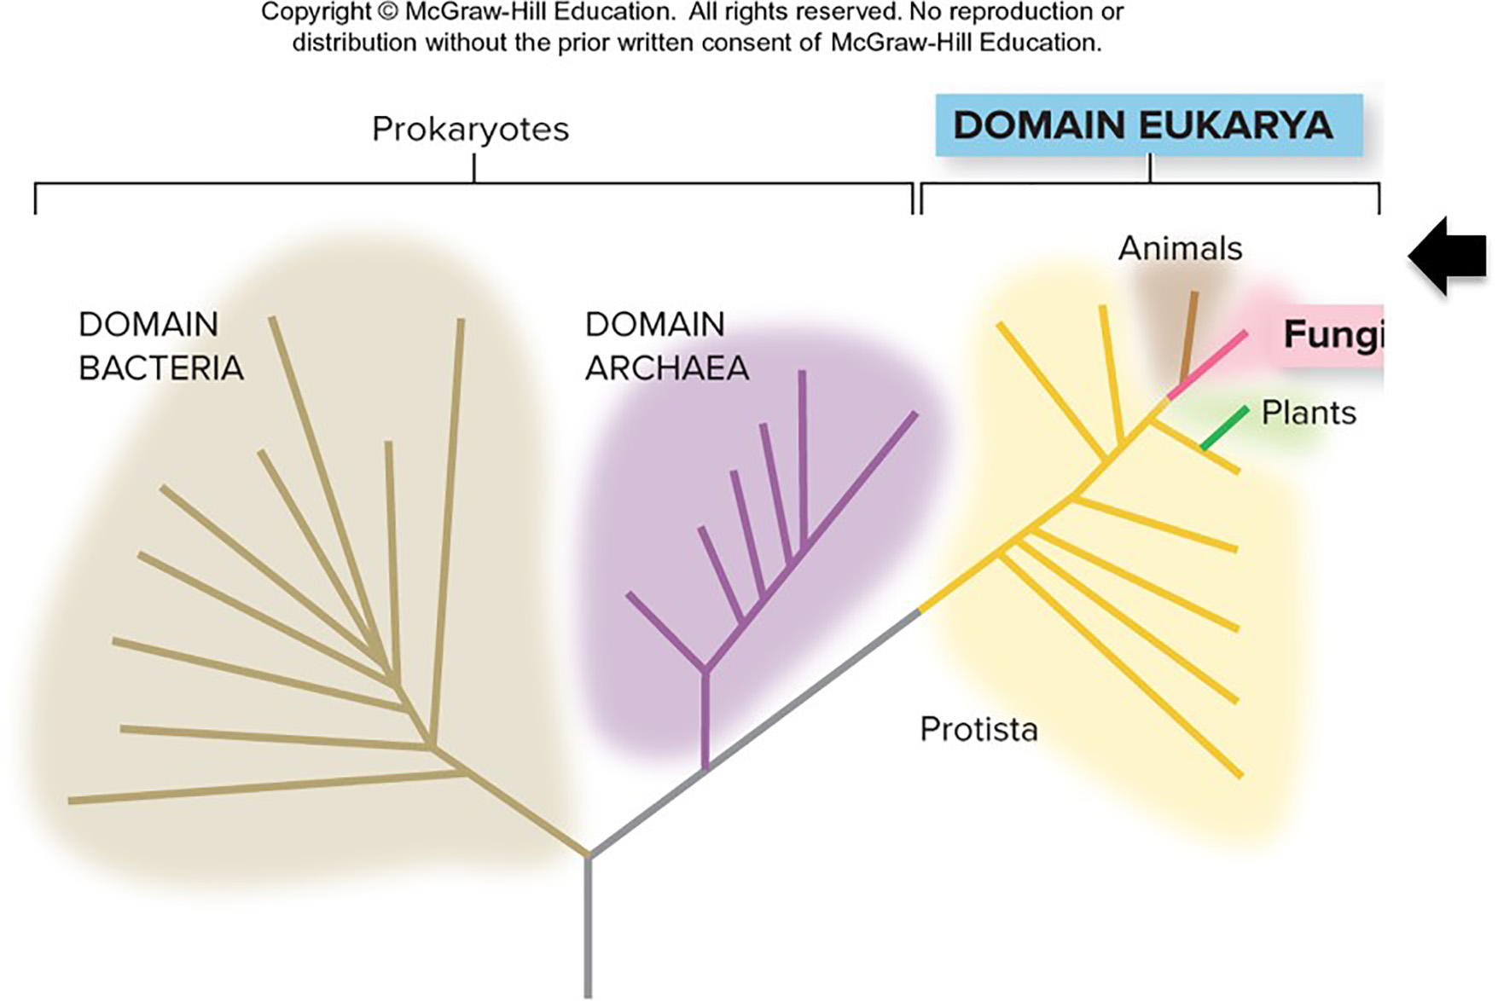
Fungi are the closest relatives of animals
Fungi and animals share many metabolic and chemical features.
For instance, both are heterotrophs and use glycogen to store carbohydrates.
Section 20.1
Figure 20.5

Slide 3
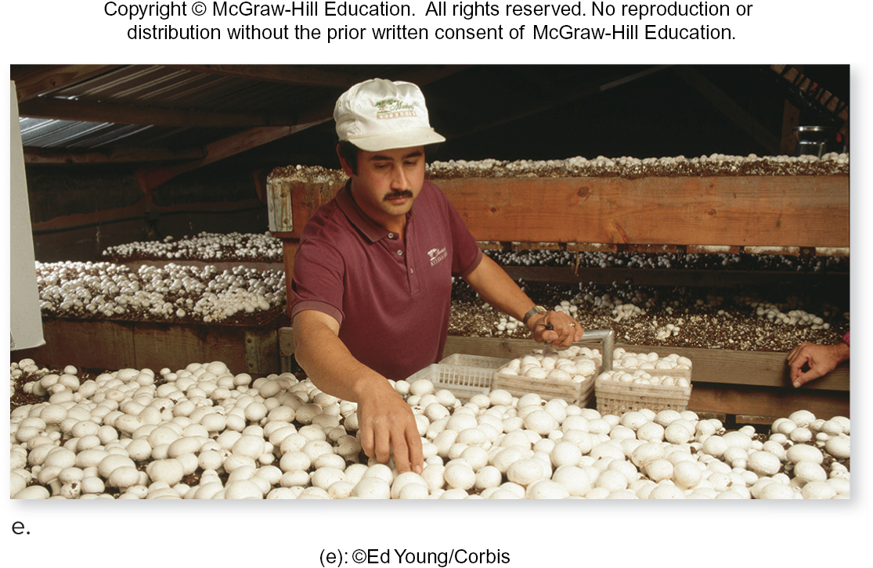
Fungi are a diverse group
Fungi come in all shapes and sizes. Some are microscopic parasites; others are millions of meters long.
(e): ©Ed Young/Corbis
(a): ©Scimat/Science Source; (b): ©Steven P. Lynch/McGraw-Hill Education; (b, micrograph): ©Scenics & Science/Alamy; (c): ©Morley Read/Alamy;
(d): ©WSL Handout/Reuters/Corbis
Section 20.1
Figure 20.1

Slide 4
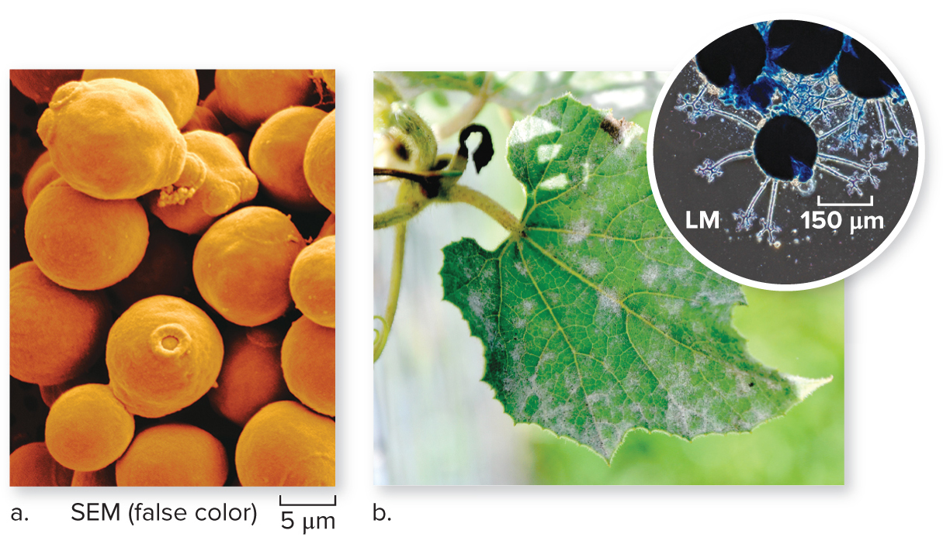
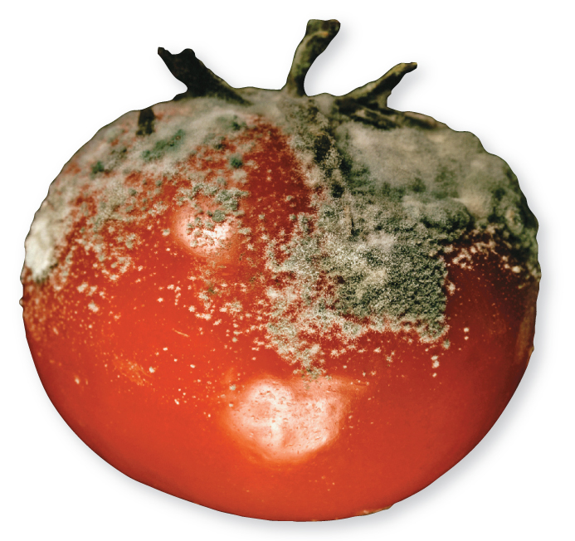
Fungi are essential decomposers
Fungi are the planet’s garbage processors. They break down dead plants and animals, releasing nutrients to be recycled.
(a): ©Scimat/Science Source; (b): ©Steven P.Lynch/McGraw-Hill Education;
(b, micrograph): ©Scenics & Science/Alamy
©Emily Keegin/fStop/ Getty Images RF
Section 20.1
Figure 20.1

Slide 5
Fungi are heterotrophic
All fungi feed by external digestion. They excrete digestive enzymes and absorb minerals and nutrients.
(e): ©Ed Young/Corbis
(a): ©Scimat/Science Source; (b): ©Steven P. Lynch/McGraw-Hill Education; (b, micrograph): ©Scenics & Science/Alamy; (c): ©Morley Read/Alamy;
(d): ©WSL Handout/Reuters/Corbis
Section 20.1
Figure 20.1

Slide 6
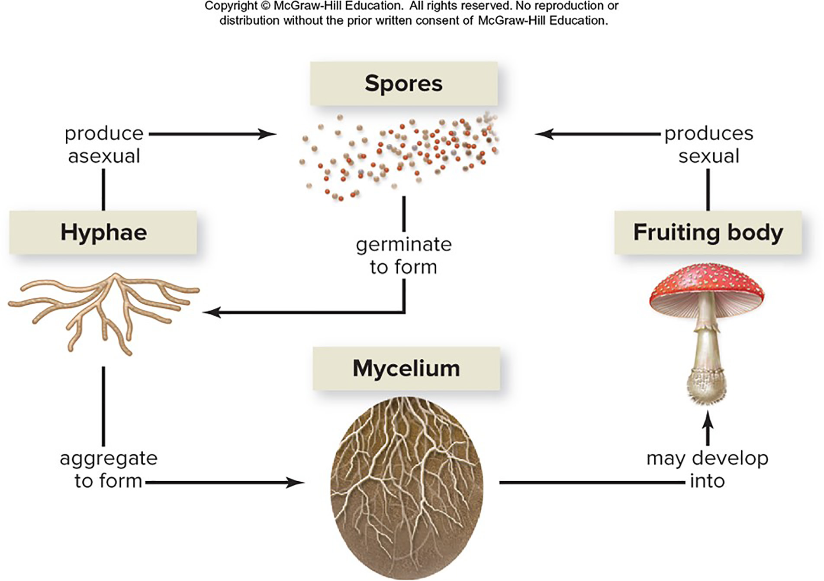
Fungi have unique reproductive cycles
Unlike plants and animals, fungi spend most of their lives in the haploid stage. The diploid stage may be brief.
Section 20.1
Figure 20.23

Slide 7
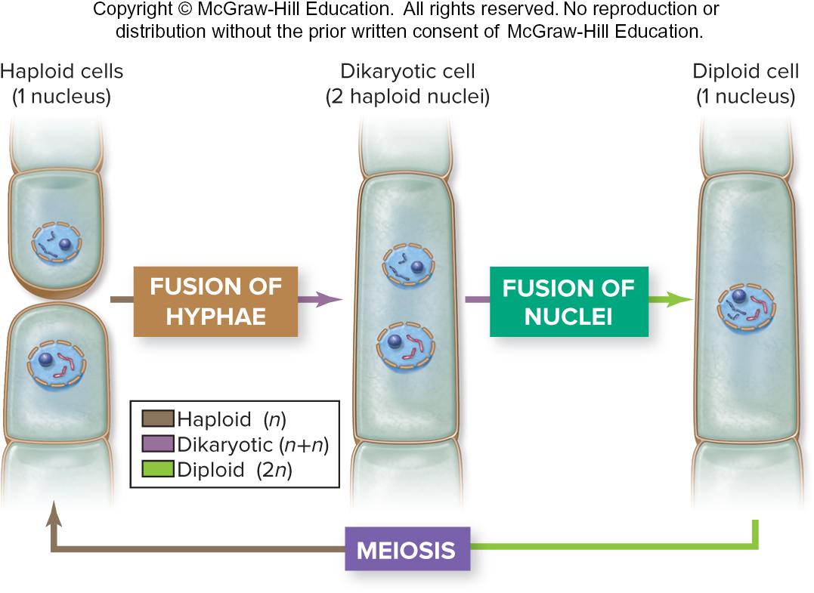
Some fungi have a dikaryotic stage
Two haploid cells from different individuals fuse, but the nuclei stay separate. Dikaryotic cells have two genetically unique nuclei.
Section 20.1
Figure 20.2

Slide 8
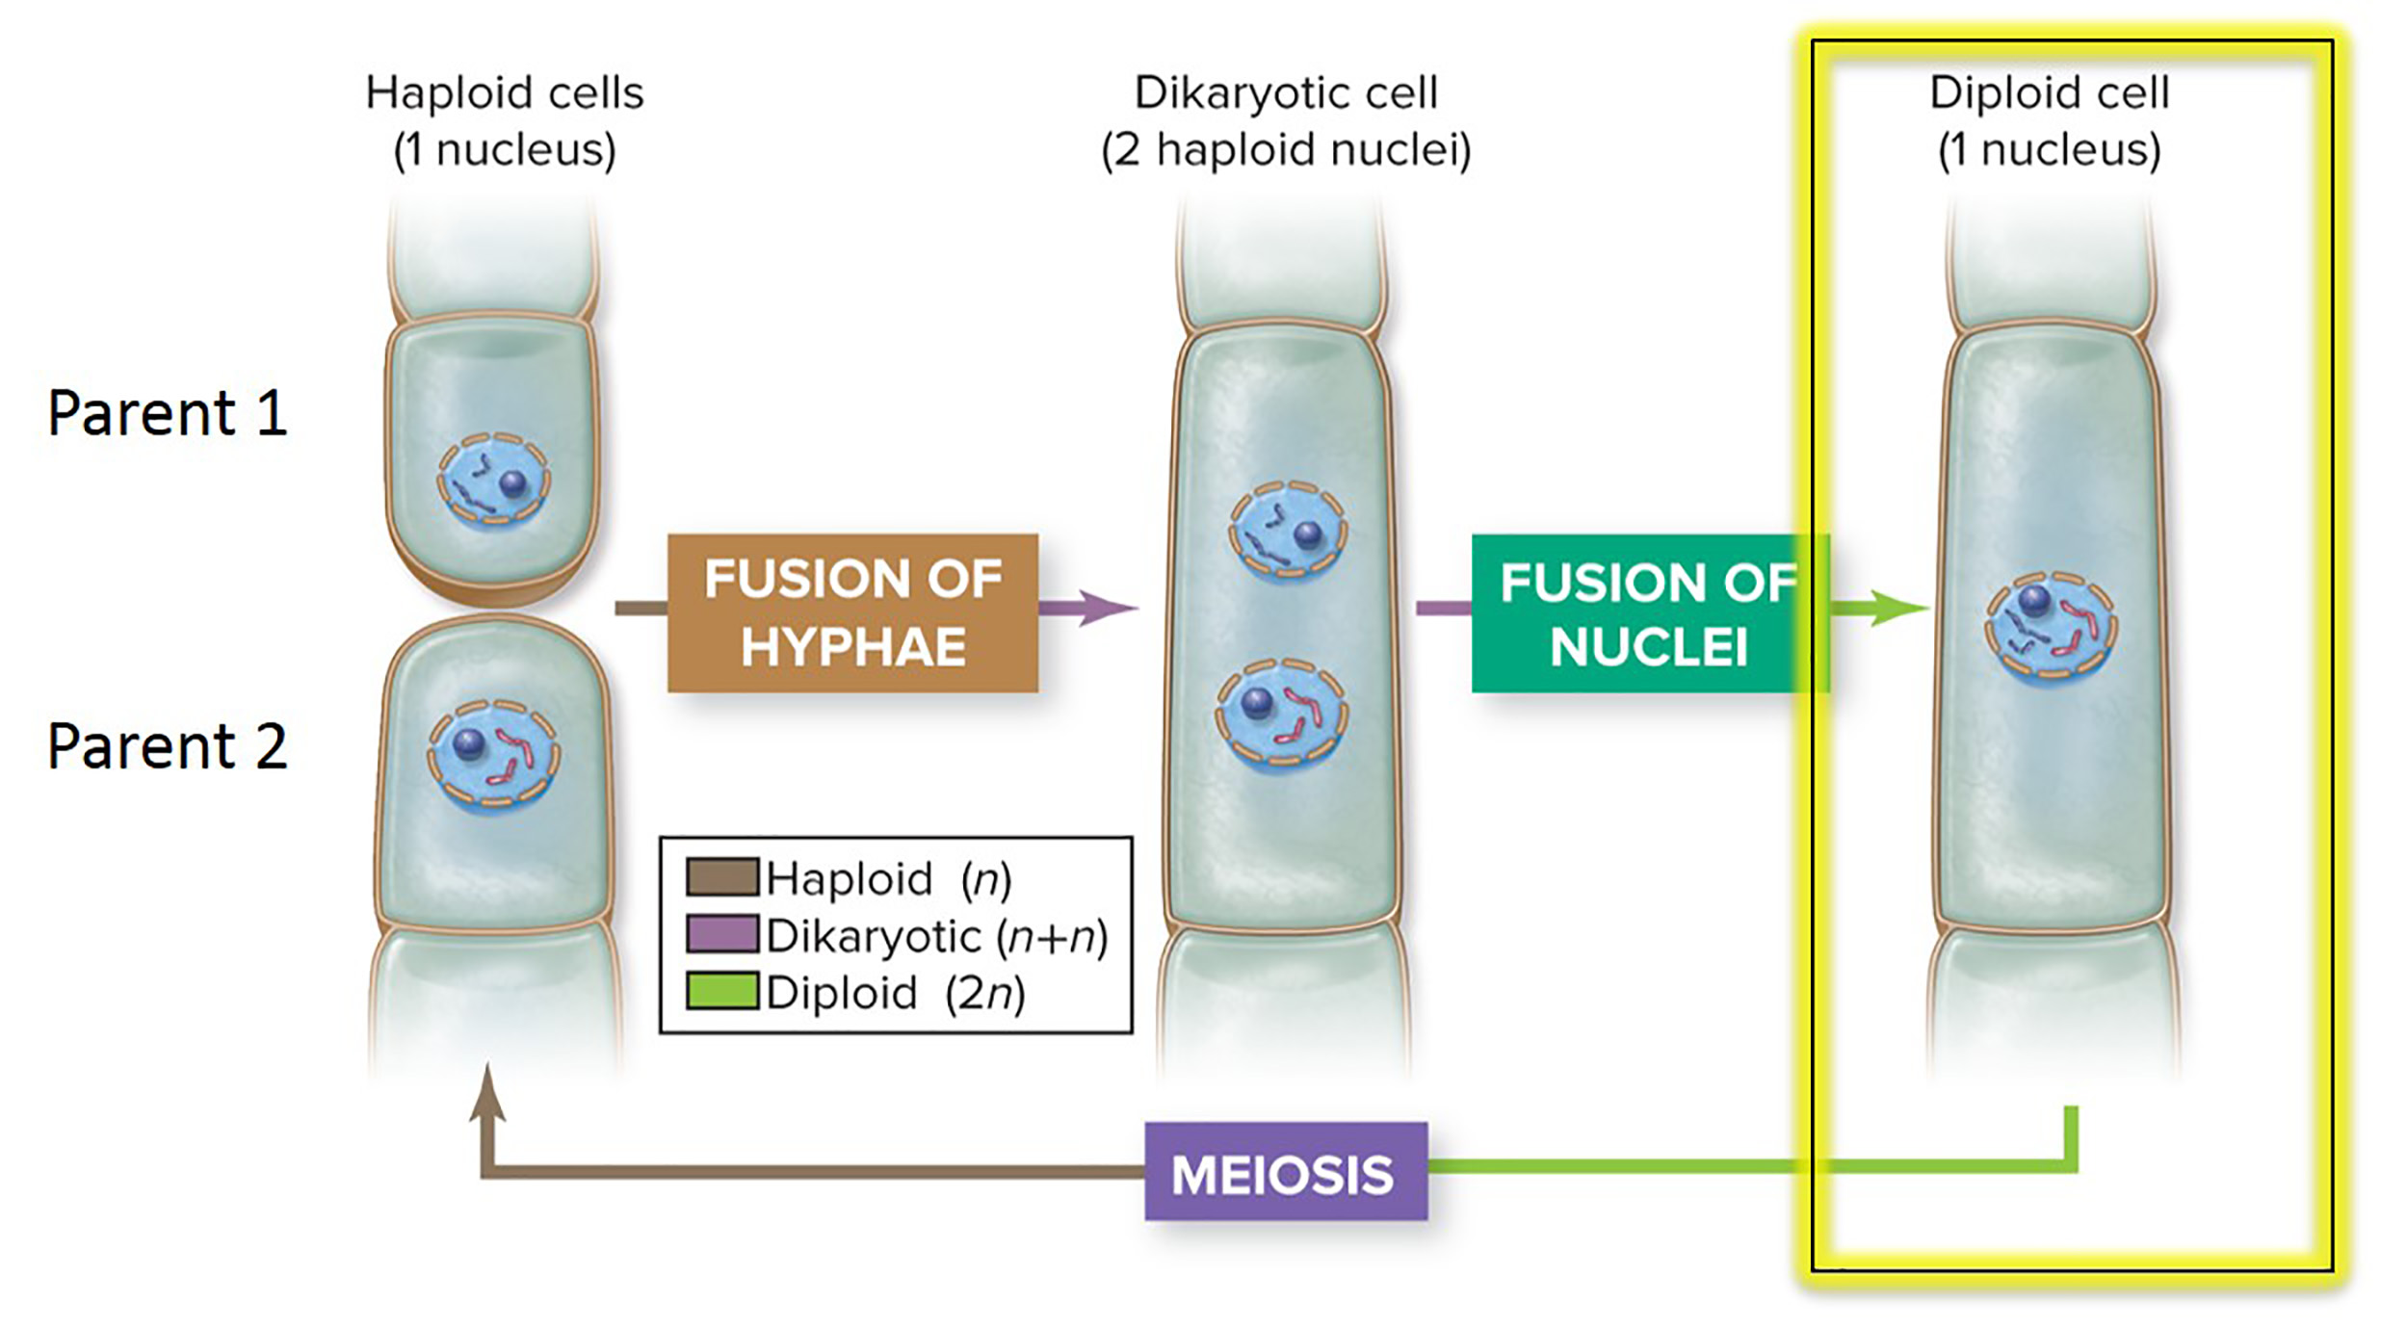
In fungi, the diploid stage is very short
In most fungi, the zygote is the only diploid cell; it immediately divides by meiosis. New haploid cells divide by mitosis as the organism grows.
Section 20.1
Figure 20.2

Slide 9
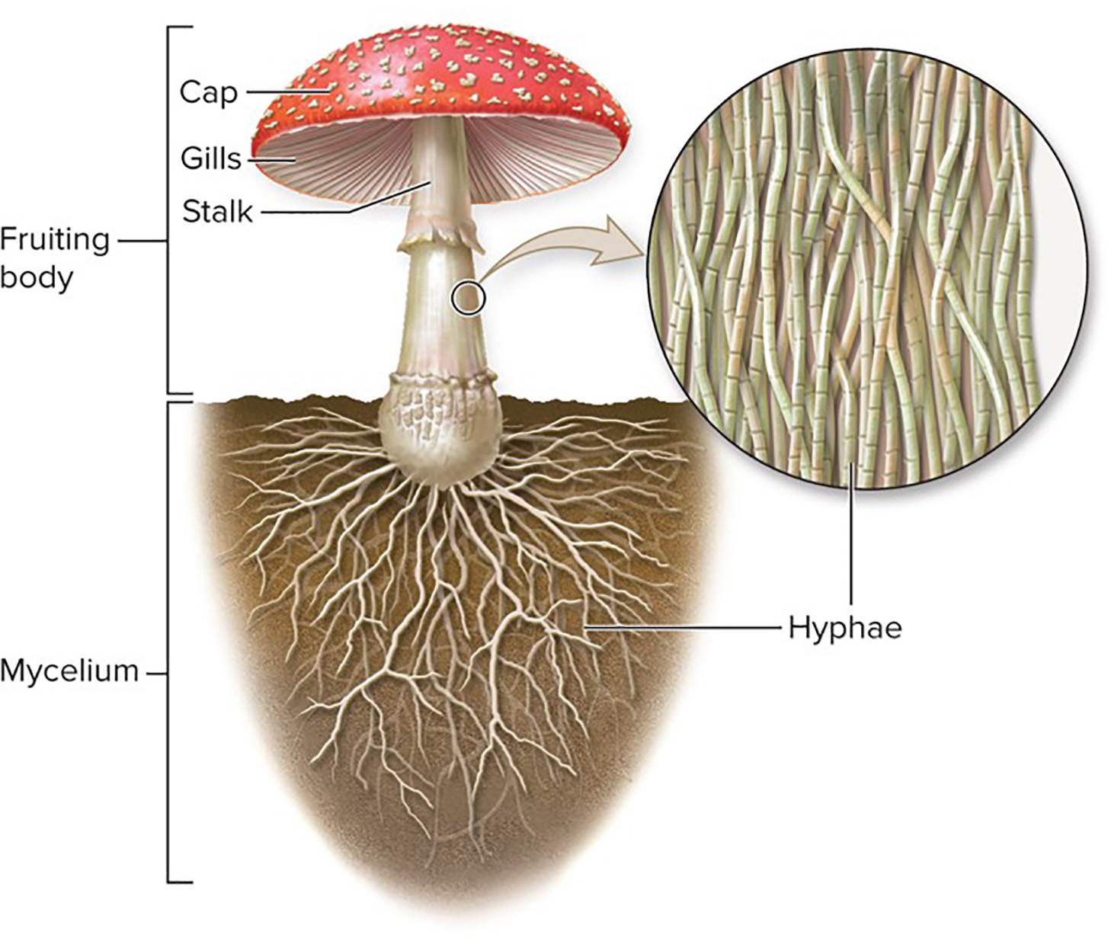
Hyphae are the underground feeding structures
Most fungi are composed of threadlike filaments called hyphae that branch toward food sources.
Collectively the hyphae are called the mycelium.
Section 20.1
Figure 20.3

Slide 10
Mushrooms are strictly reproductive structures
Hyphae above the surface aggregate into a fruiting body, such as this mushroom.
As the mycelium absorbs nutrients, the fruiting body produces spores, which are microscopic reproductive cells.
Section 20.1
Figure 20.3

Slide 11
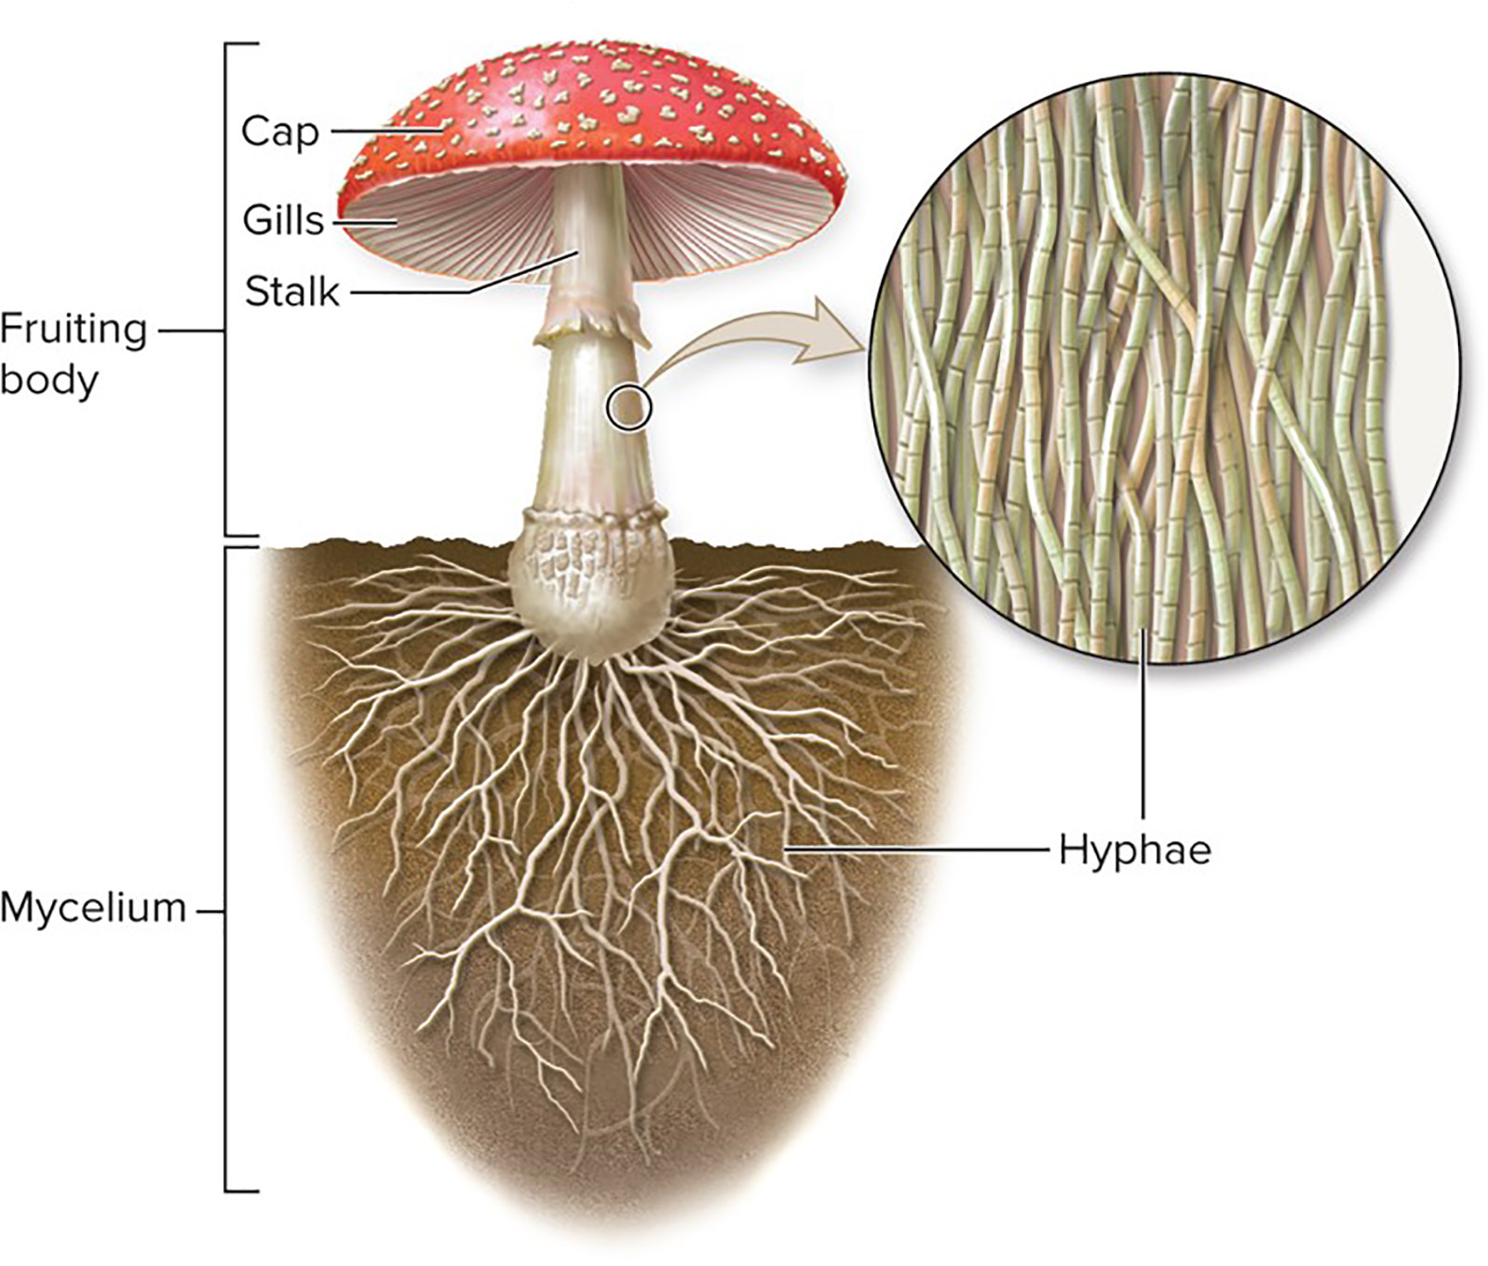
Spores are sex cells
Spores can be produced either sexually or asexually.
They are dispersed from fruiting bodies and later germinate into new fungal colonies.
Section 20.1
Figure 20.3

Slide 12
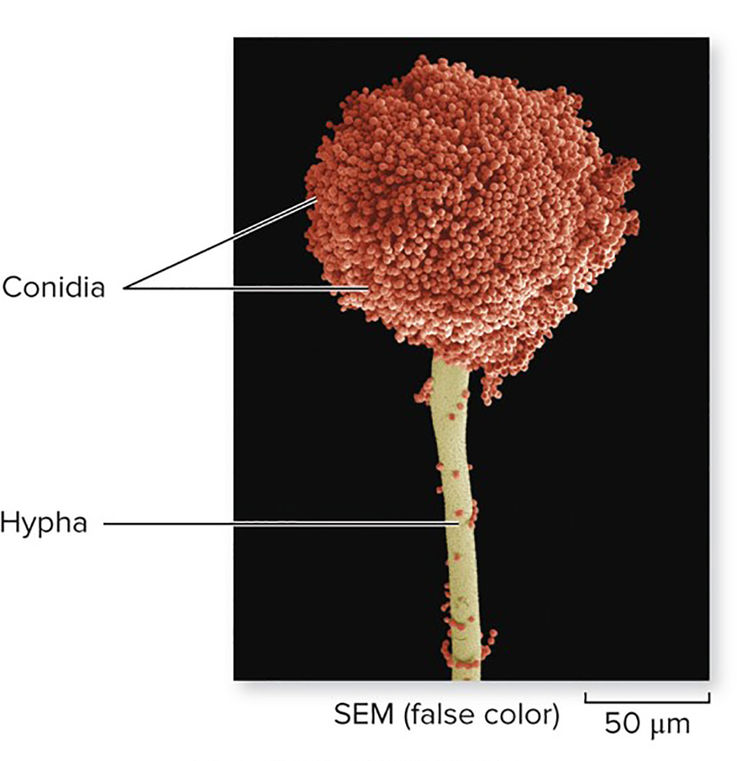
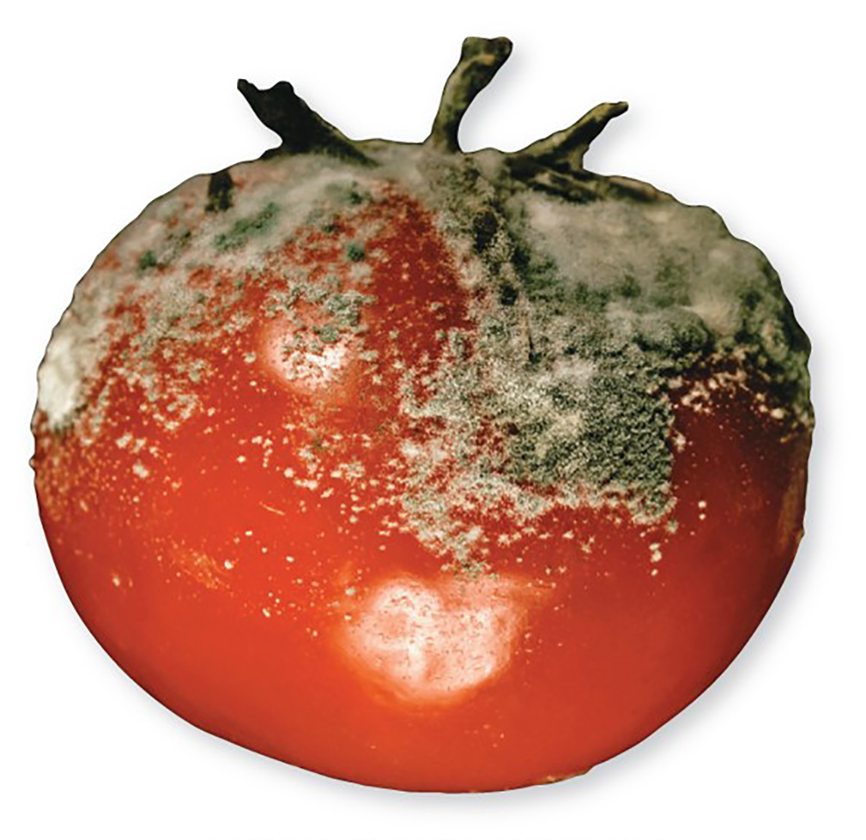
Conidia are asexual spores
Hyphae produce conidia by mitosis. The fuzz we see on moldy foods consists of conidia.
©Steve Gschmeissner/Science Source
©Emily Keegin/fStop/ Getty Images RF
Section 20.1
Figure 20.4

Slide 13
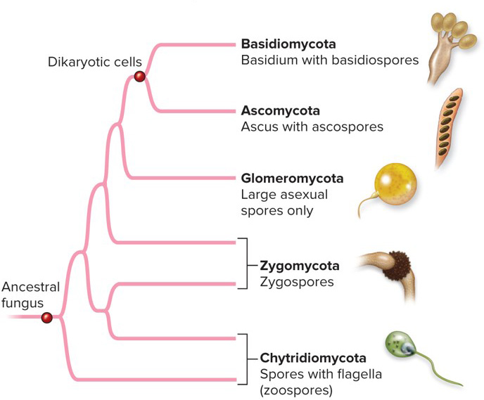
Fungi are classified by reproductive structures
Basidiomycota and Ascomycota are the only fungi with a dikaryotic stage in the life cycle.
Biologists are still clarifying the relationships between Chytrids, Zygomycota, and Glomeromycota
Section 20.1
Figure 20.5

Slide 14
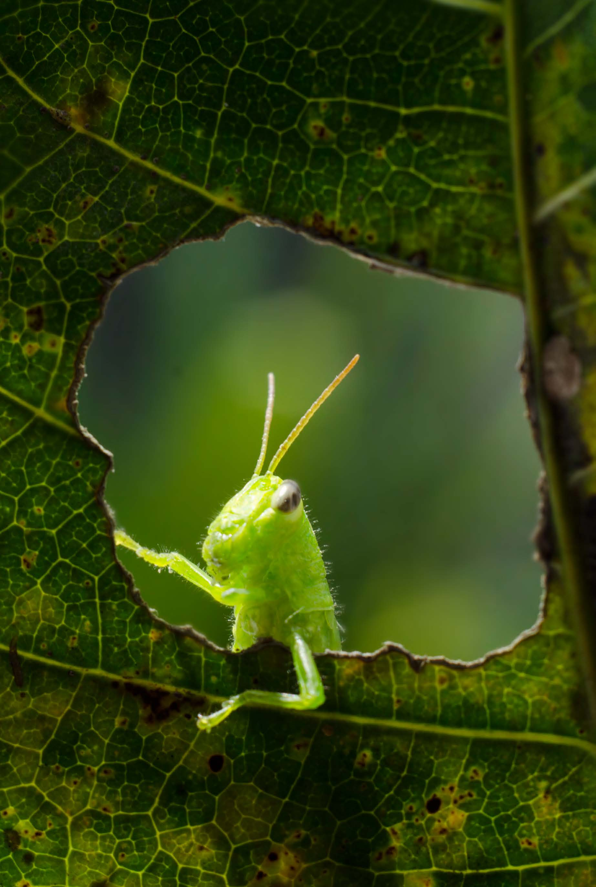
Clicker question #1
What is a dikaryotic cell?
a cell with two sets of chromosomes
a cell with two nuclei
a cell without any nucleic acids
a cell that is dividing its cytoplasm
Both A and B

Slide 15
Clicker question #1, solution
What is a dikaryotic cell?
Both A and B

Slide 16
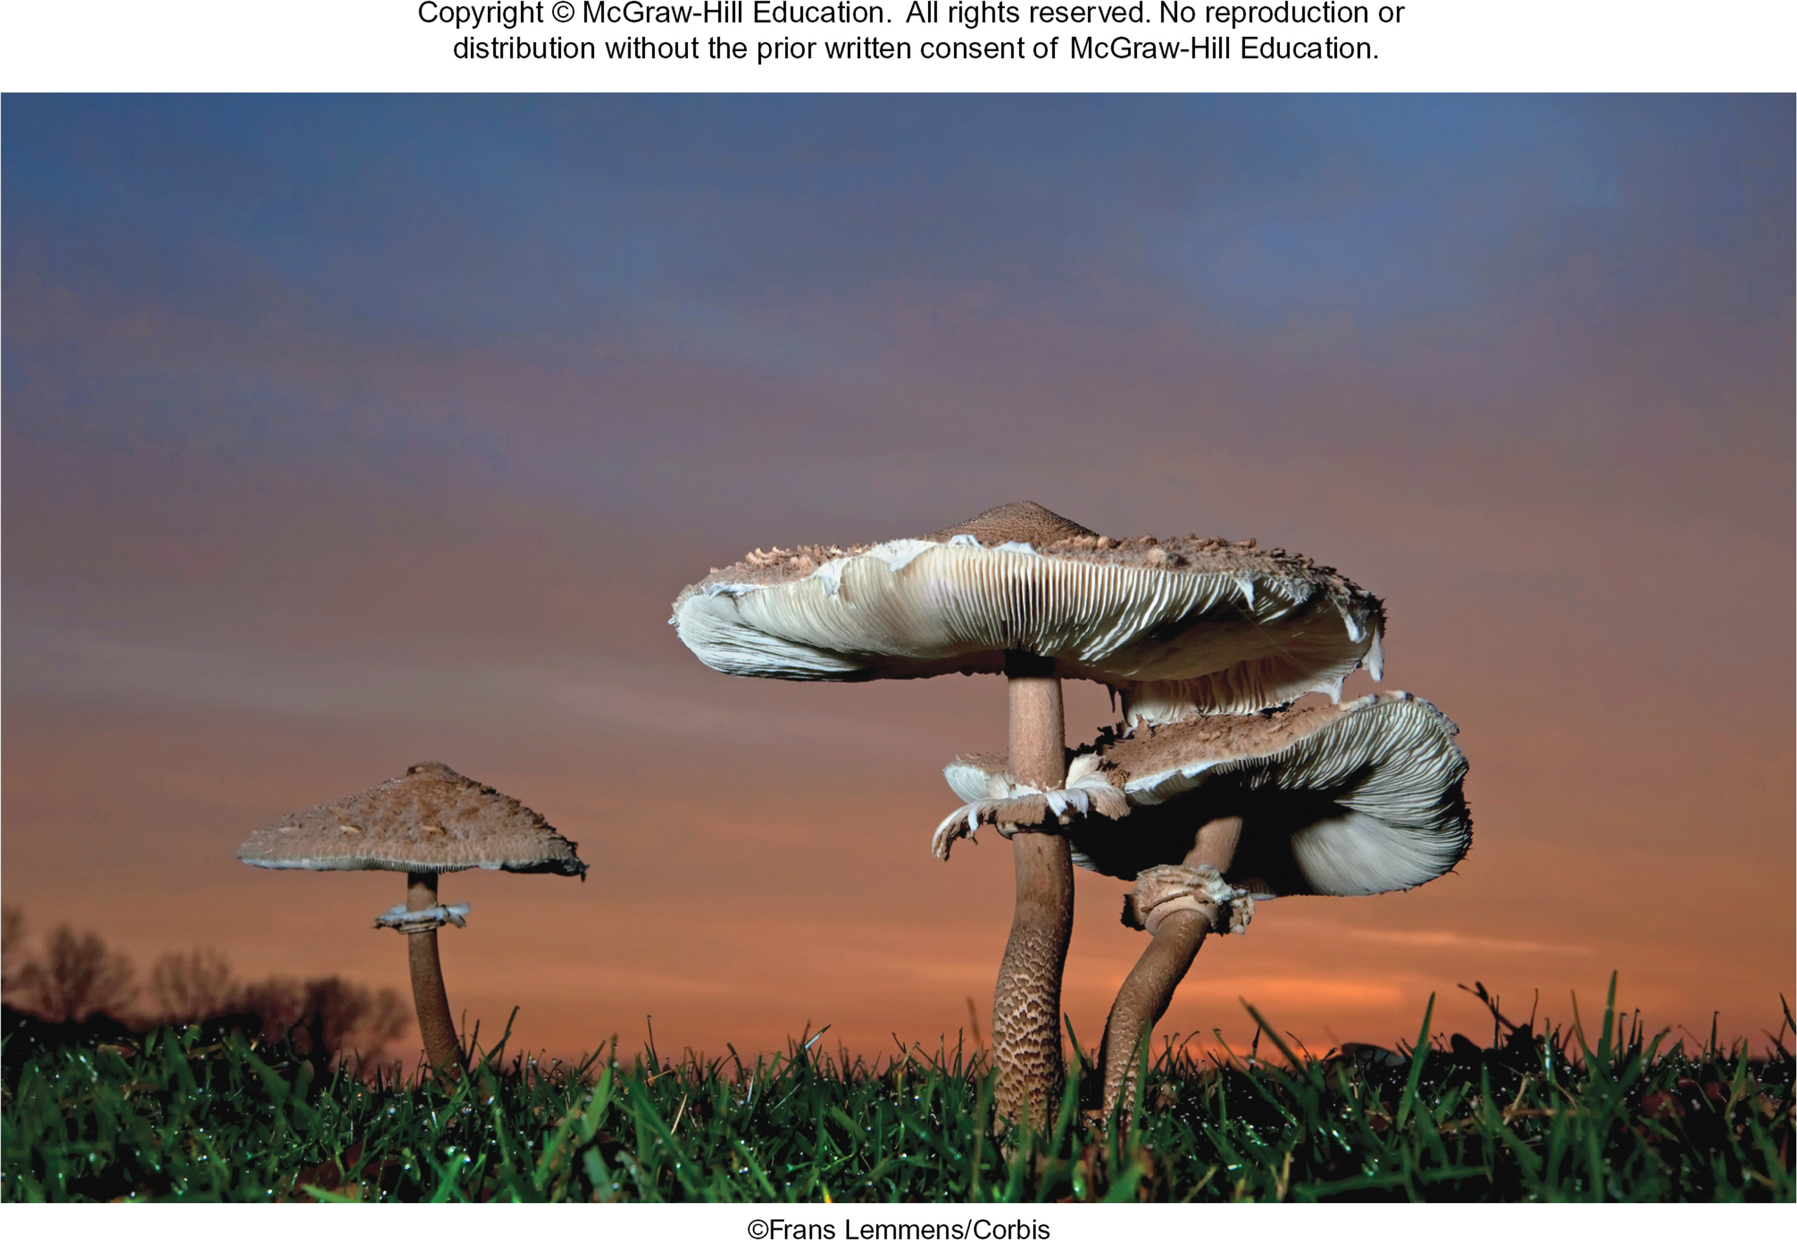
20.1 Mastering concepts
What characteristics define the fungi?
©Frans Lemmens/Corbis

Slide 17
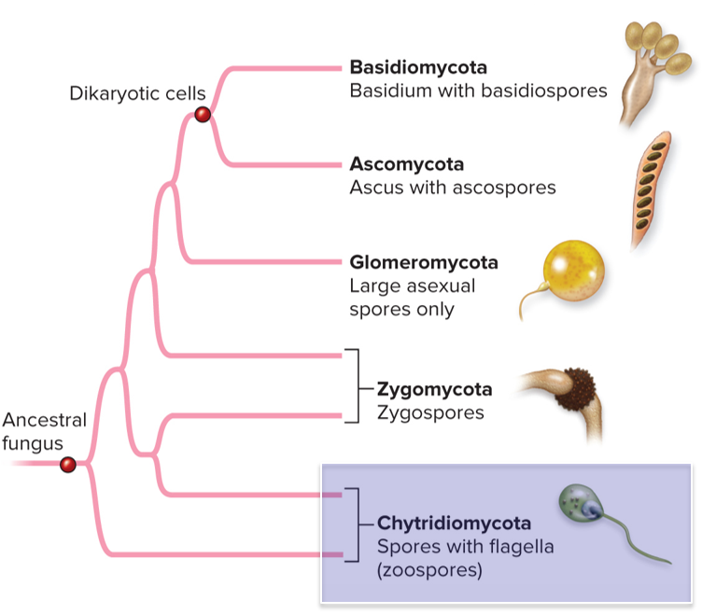
Chytrids produce swimming spores
Chytridiomycetes (chytrids) are thought to resemble the earliest fungi.
They produce motile spores called zoospores that swim using flagella.
Section 20.2
Figure 20.5

Slide 18
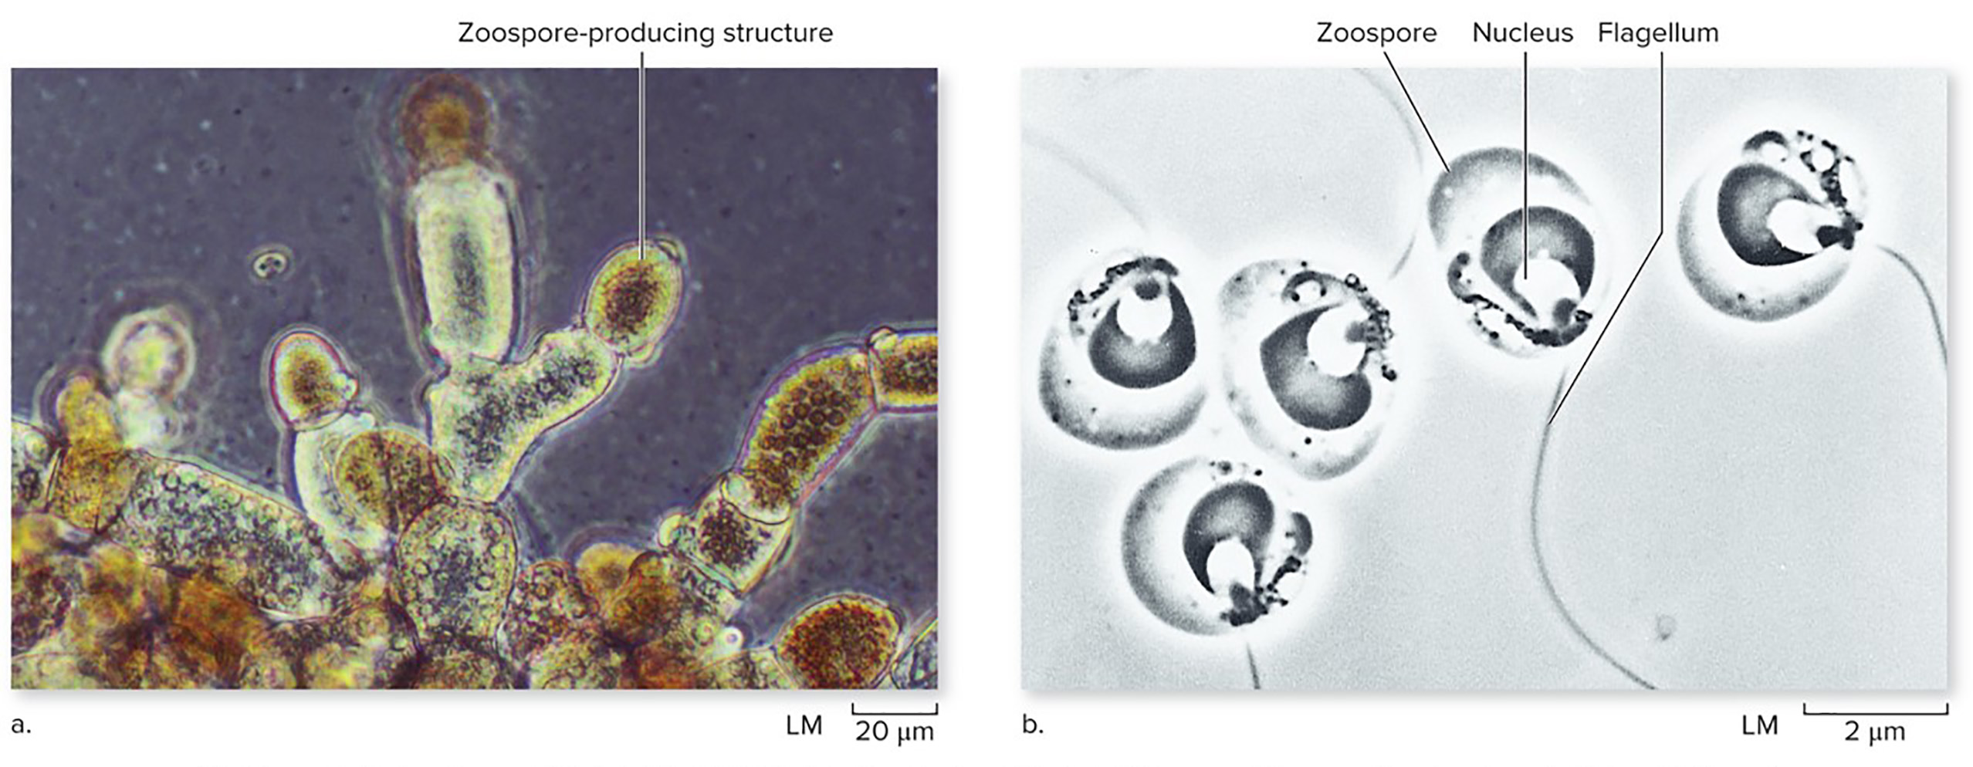
Chytrids are structurally simple
Some chytrids are single cells. Others have slender hyphae. The structures at the ends of these hyphae produce gametes.
(a): ©Biology Pics/Science Source; (b): R. E. Reichle, M. S. Fuller, ‟The Fine Structure of Blastocladiella emersonii Zoospores,” American Journal of Botany, Vol. 54, no. 1,
January 1967, pp. 81 to 92. © 1967 Botanical Society of America. All rights reserved. Used with permission.
Section 20.2
Figure 20.6

Slide 19
Chytrids are valuable for ecosystems
Chytrids produce enzymes that break down molecules in animal, plant, and fungal cells. Some live in cow digestive tracts, where they digest cellulose in the grass cows eat.
(a): ©Biology Pics/Science Source; (b): R. E. Reichle, M. S. Fuller, ‟The Fine Structure of Blastocladiella emersonii Zoospores,” American Journal of Botany, Vol. 54, no. 1,
January 1967, pp. 81 to 92. © 1967 Botanical Society of America. All rights reserved. Used with permission.
Section 20.2
Figure 20.6

Slide 20
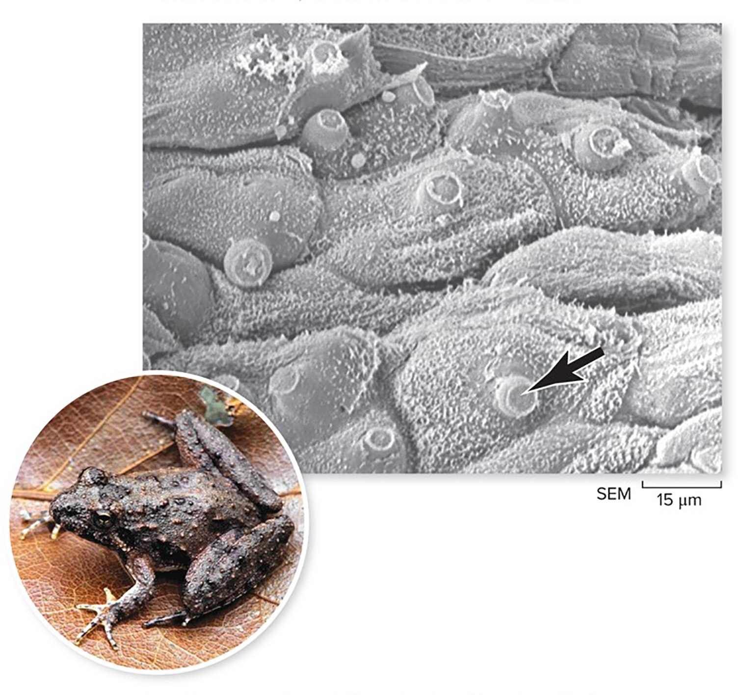
Some chytrids are parasites
These chytrids feed on keratin protein in frog skin. The frog loses its ability to breathe through its skin, and dies.
World frog populations have been declining for years due to a chytrid epidemic.
(chytrid): ©Lee Berger, James Cook University; (frog): ©Dr. Janalee Caldwell
Section 20.2
Figure 20.7

Slide 21
Clicker question #2
What distinguishes chytrids from other groups of fungi?
They are single-celled.
They have cells with two nuclei.
Their spores can swim.
They are anaerobic.

Slide 22
Clicker question #2, solution
What distinguishes chytrids from other groups of fungi?
Their spores can swim.

Slide 23
20.2 Mastering concepts
How do flagellated cells adapt chytrids to moist environments?
©Frans Lemmens/Corbis

Slide 24
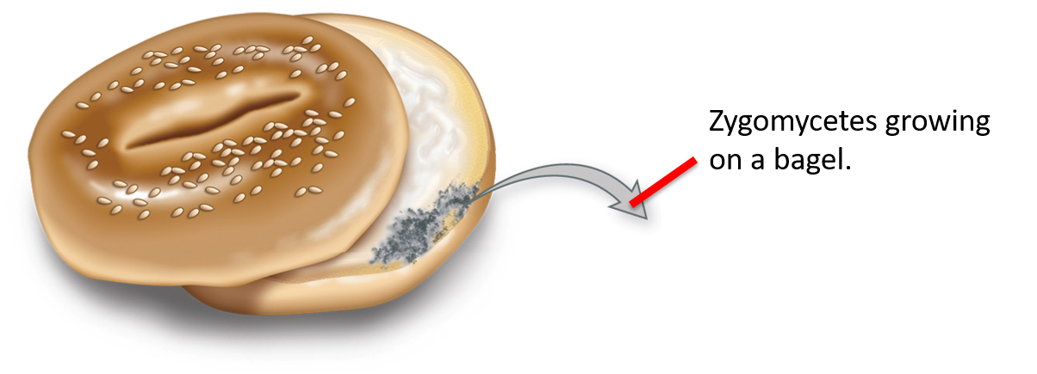
Zygomycetes are fast growing and prolific
Zygomycetes fungi include molds that grow on bread, fruit, and vegetables. They are common in the soil where they feed on decaying plants and animals.
Section 20.3
Figure 20.8

Slide 25
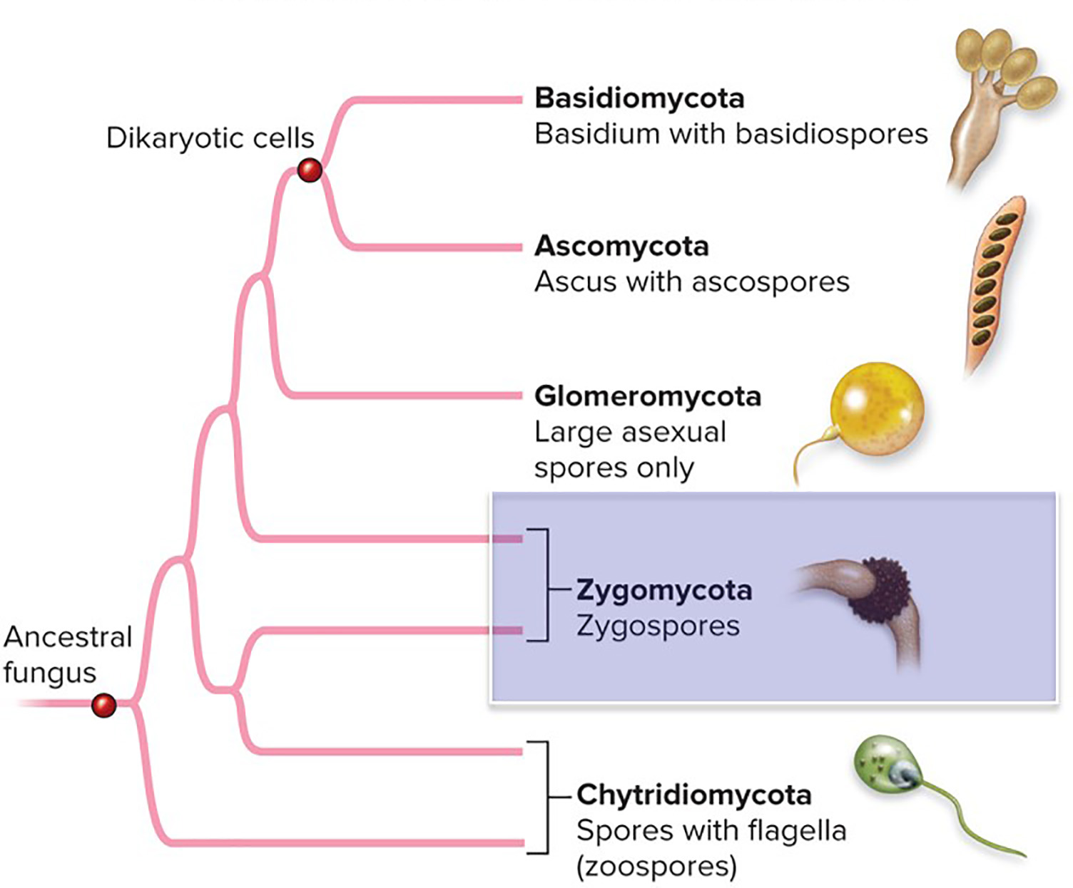
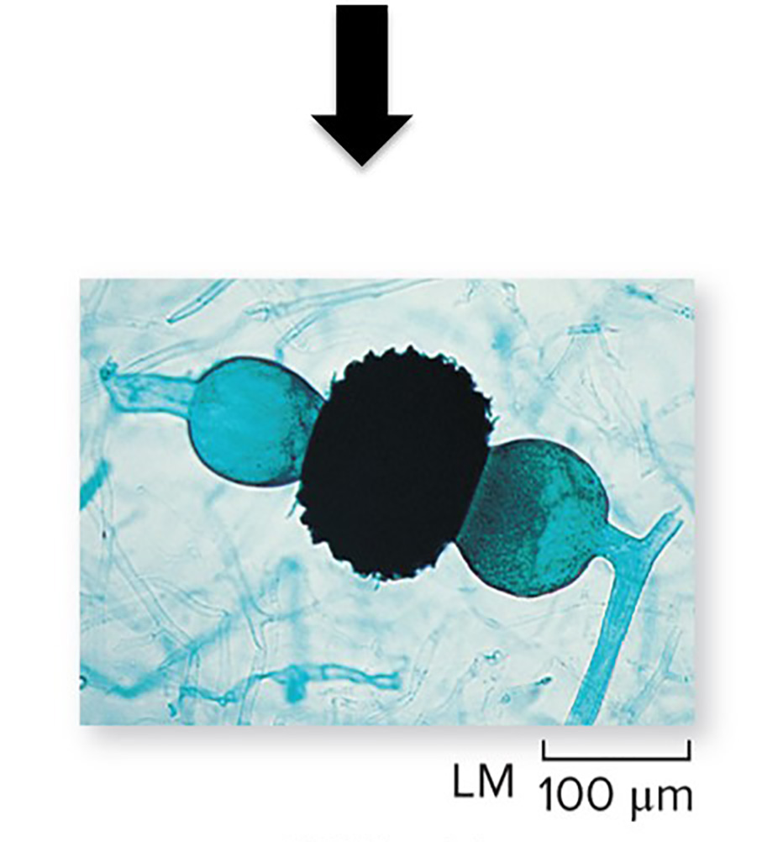
Zygomycetes produce zygospores
This group of fungi produce a distinctive structure when 2 hyphae fuse to form a diploid zygote.
©Ed Reschke
Section 20.3
Figure 20.5, 20.8

Slide 26
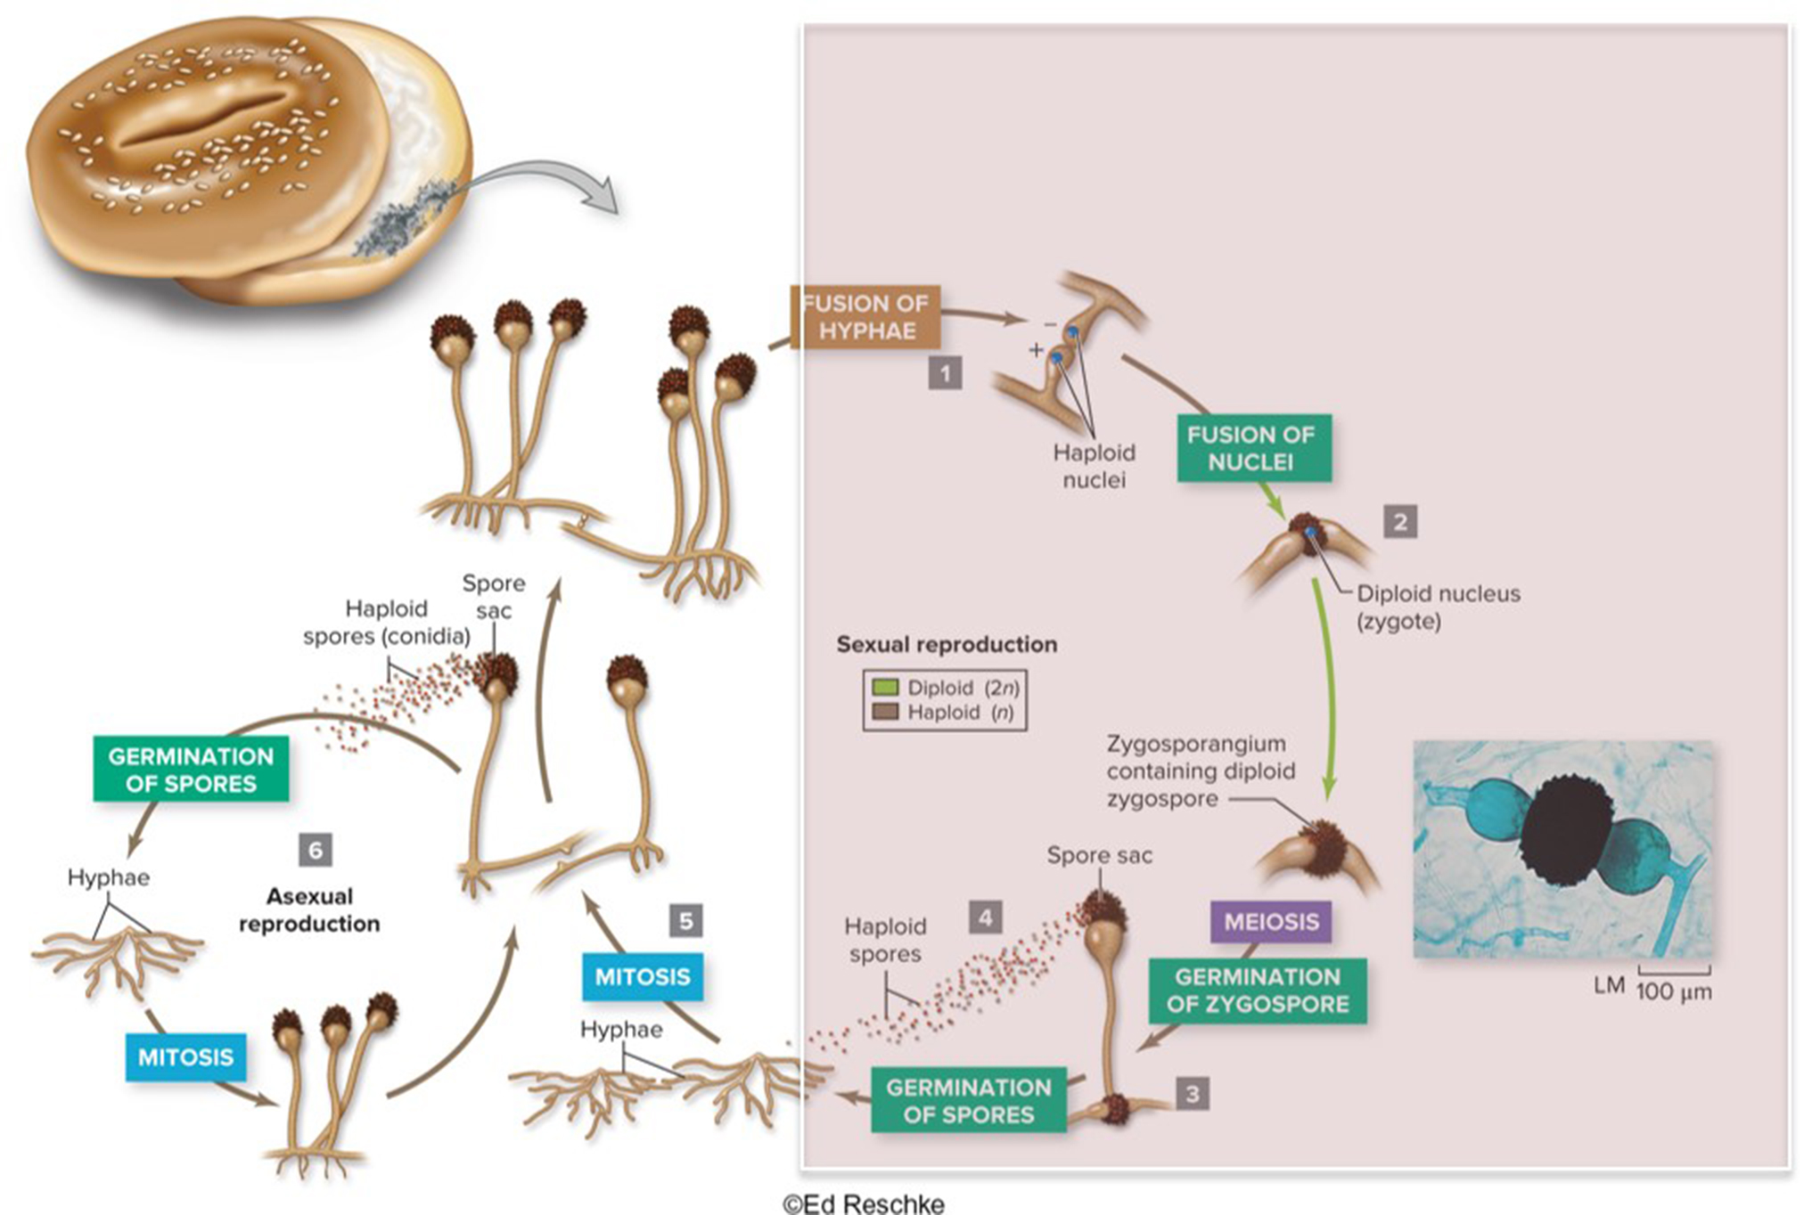
Zygomycetes reproduce sexually
Hyphae fuse to form a diploid zygospore with a spiny coat, which produces haploid spores.
©Ed Reschke
Section 20.3
Figure 20.8

Slide 27
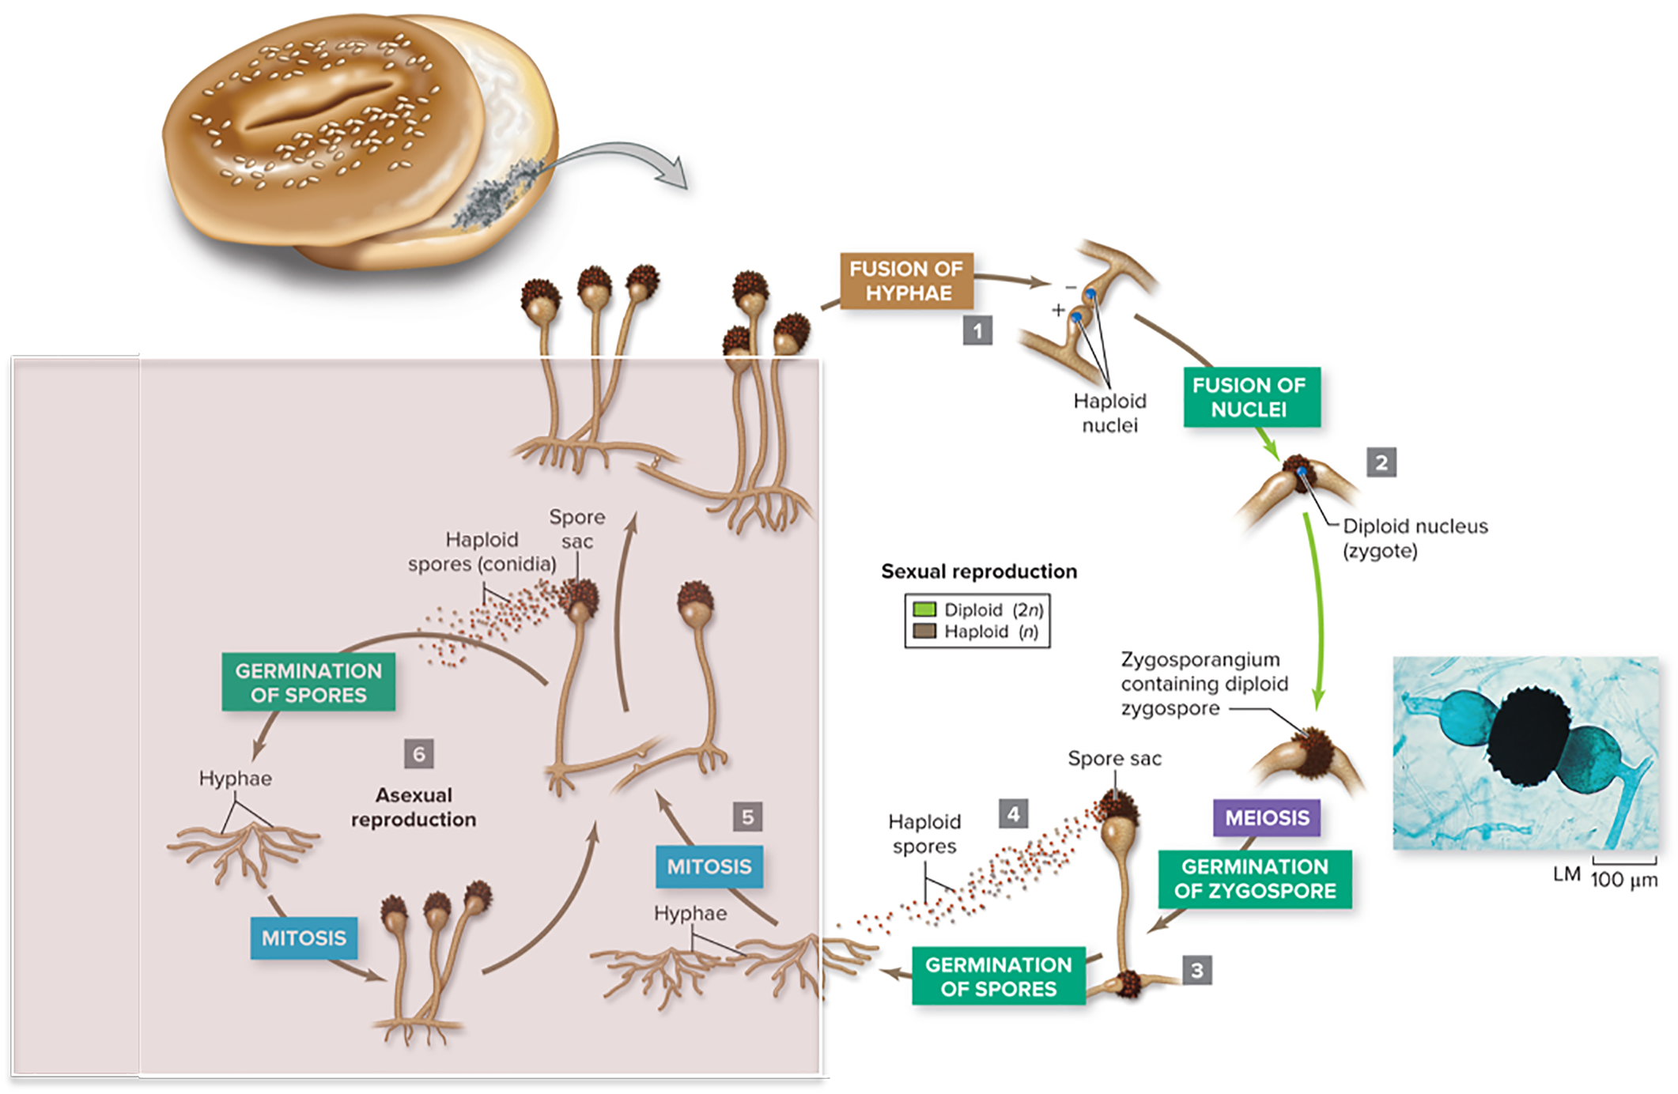
Zygomycetes reproduce asexually
Each hypha produces spore sacs by mitosis. All spores are genetically identical.
©Ed Reschke
Section 20.3
Figure 20.8

Slide 28
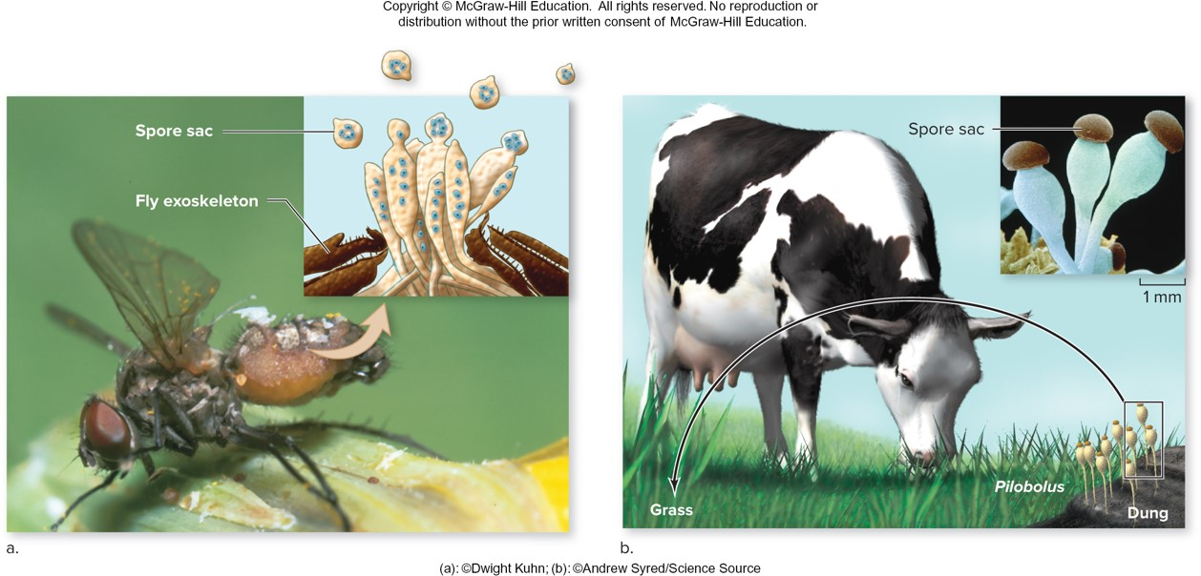
Zygomycetes disperse spores in unusual ways
These hyphae penetrate the fly’s exoskeleton and produce spores inside the fly’s body as it dies.
These hyphae release spores in grass, which multiply inside the cow and germinate in cow dung.
(a): ©Dwight Kuhn; (b): ©Andrew Syred/Science Source
Section 20.3
Figure 20.9

Slide 29
20.3 Mastering concepts
How does the zygospore fit into the zygomycete life cycle?
©Frans Lemmens/Corbis

Slide 30
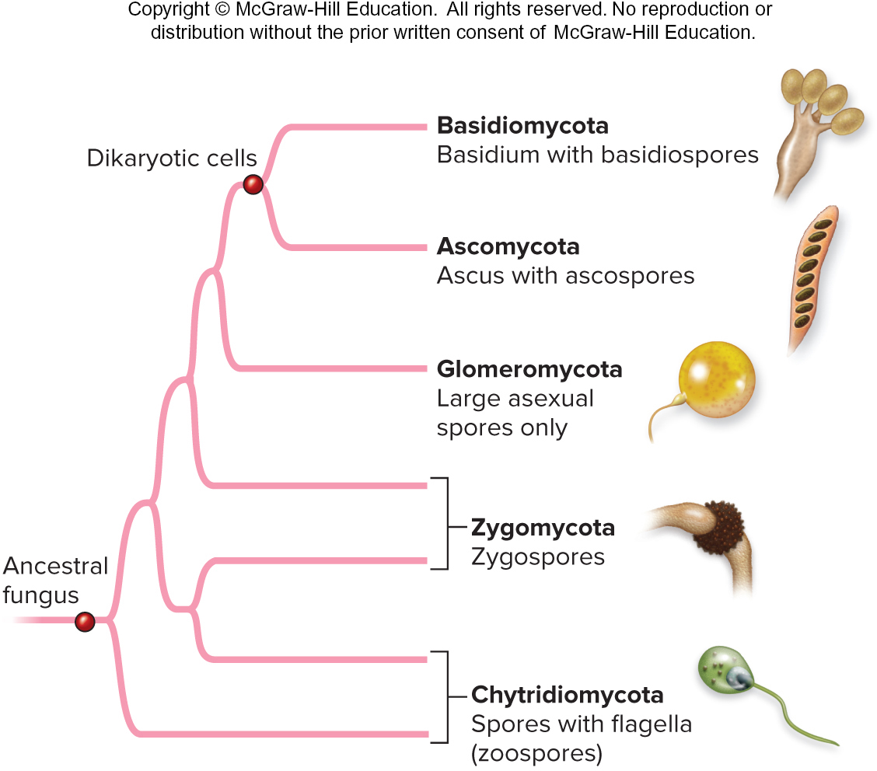
Glomeromycetes produce large, asexual spores
This group of fungi do not have a sexual life cycle, which makes them difficult to place in the family tree.
Figure 20.5

Slide 31
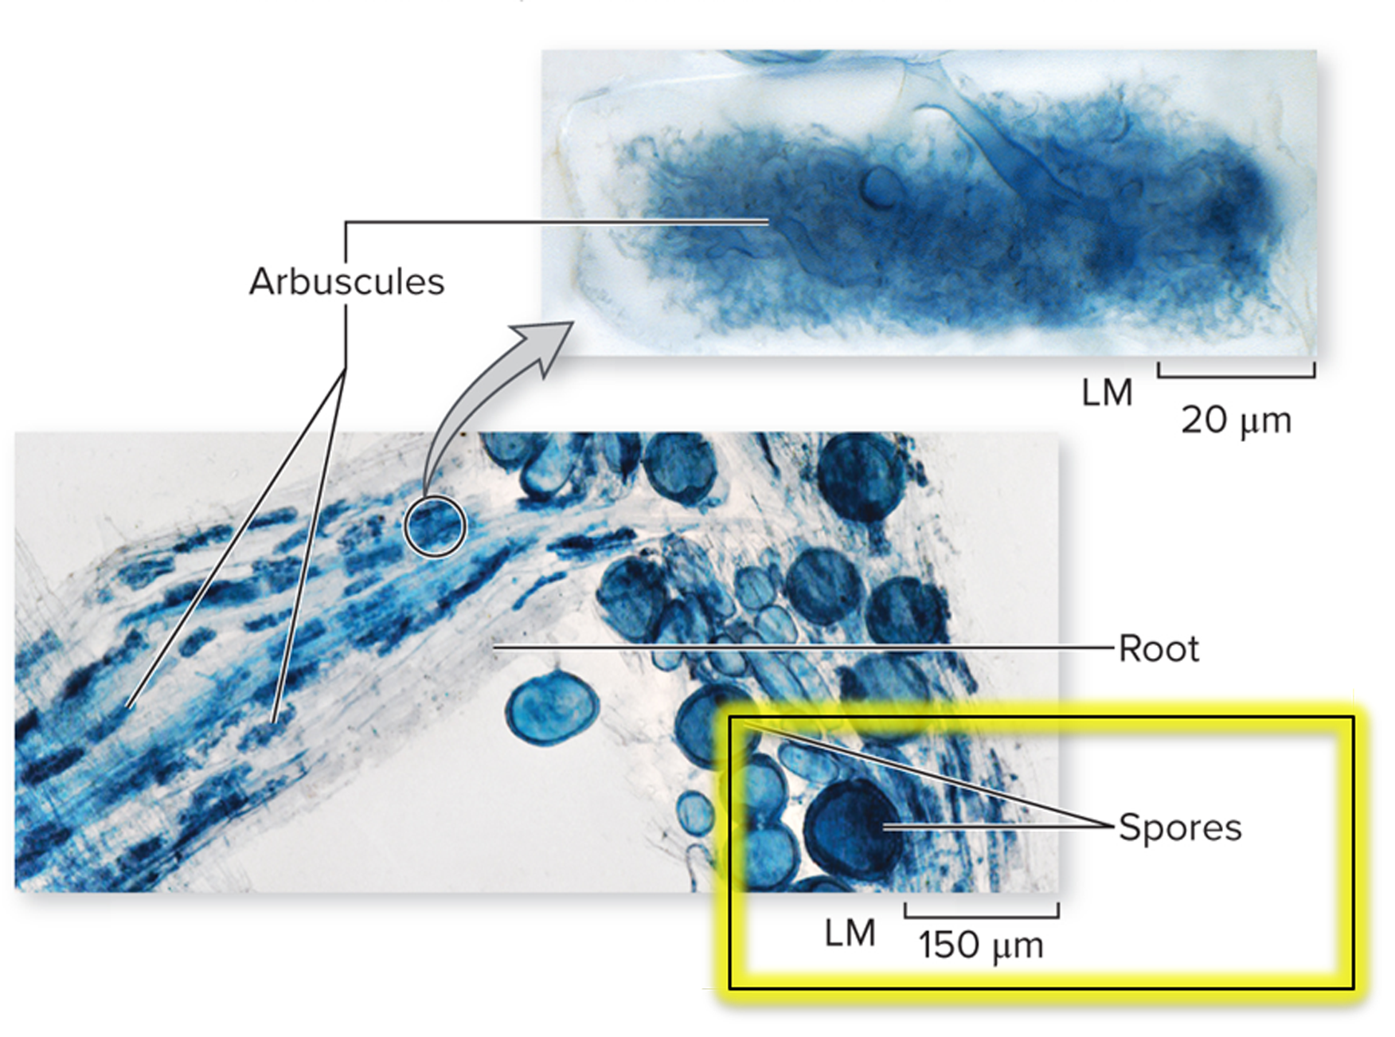
Glomeromycetes spores are unusually large
Some are hundreds of nanometers in diameter, and can be seen by the naked eye.
©Joseph B. Morton
Section 20.4
Figure 20.10

Slide 32
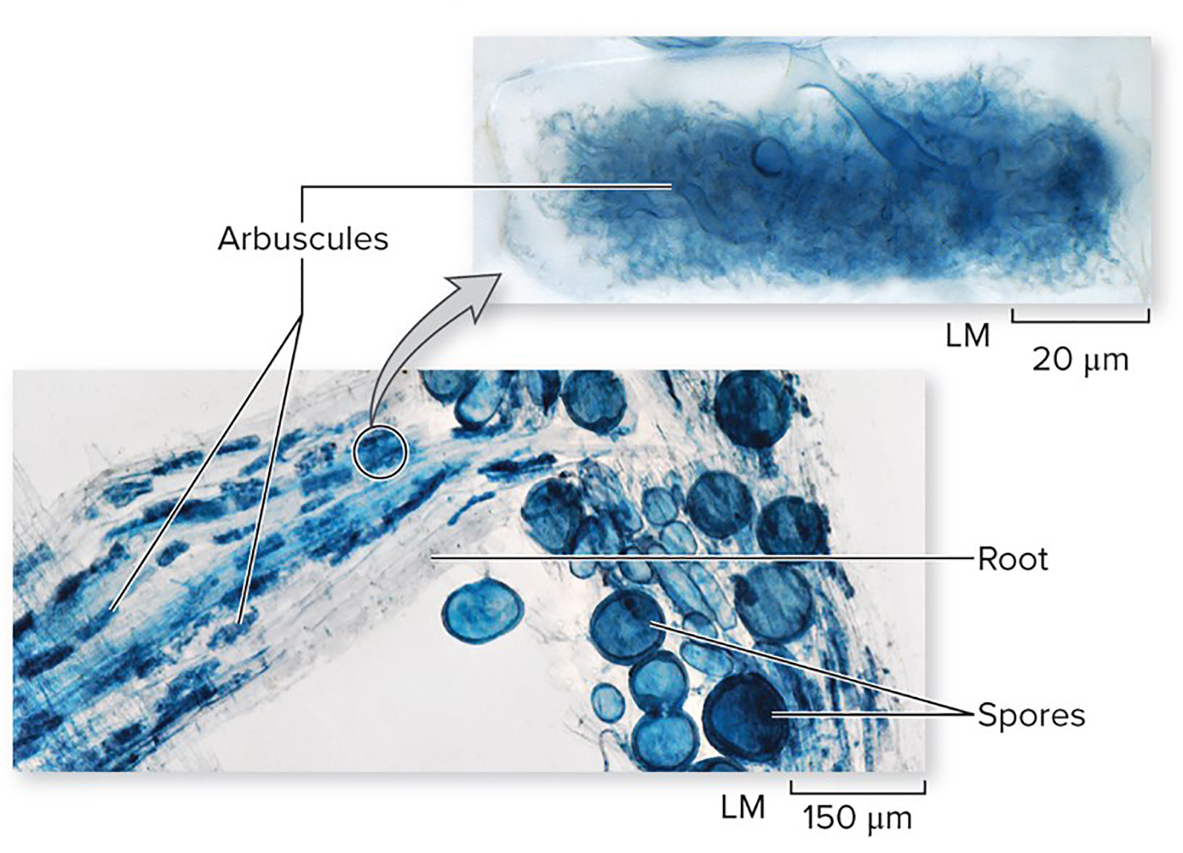
Glomeromycetes colonize plant roots
Glomeromycetes only live in association with plant roots. A fungus-plant root combination is called a mycorrhiza.
The fungus exchanges minerals and nutrients with the plant root at structures called arbuscules.
©Joseph B. Morton
Section 20.4
Figure 20.10

Slide 33
Mycorrhiza are mutually beneficial
Hyphae absorb water and nutrients from the soil and share them with the plant. The plant produces sugars that the fungus uses for energy.
©Joseph B. Morton
Section 20.4
Figure 20.10

Slide 34
20.4 Mastering concepts
Why can’t glomeromycetes live apart from plants? Use the following words in your answer:
Arbuscule
Mycorrhiza
Hyphae
©Frans Lemmens/Corbis

Slide 35
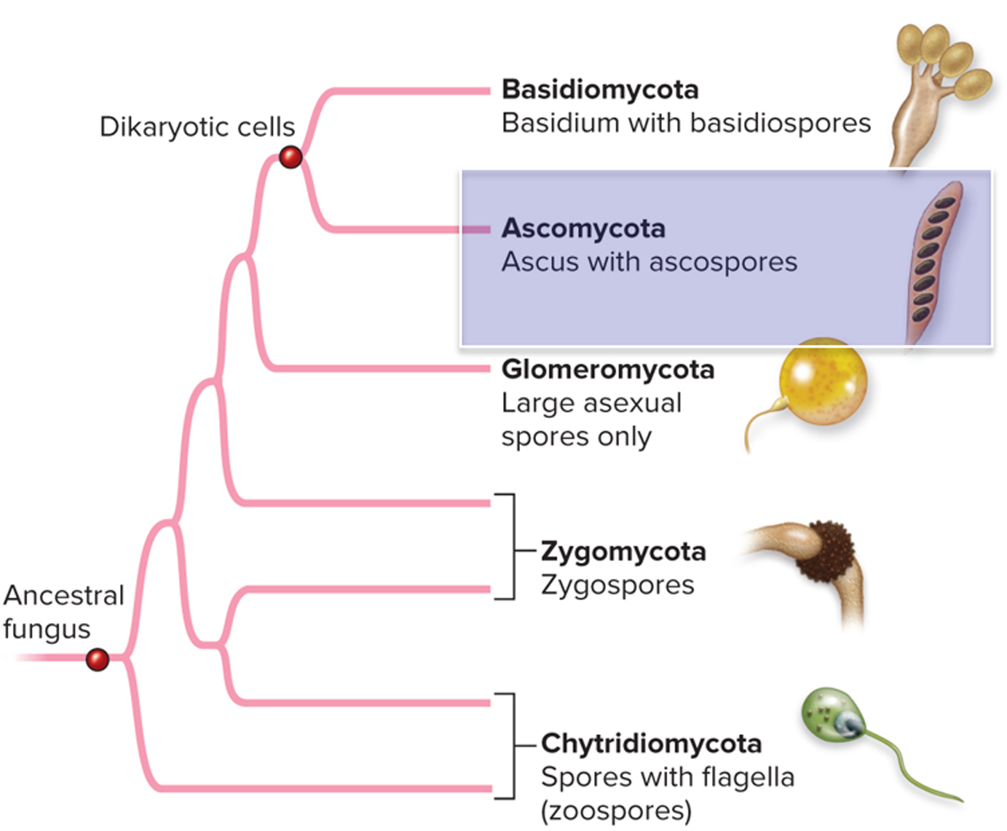
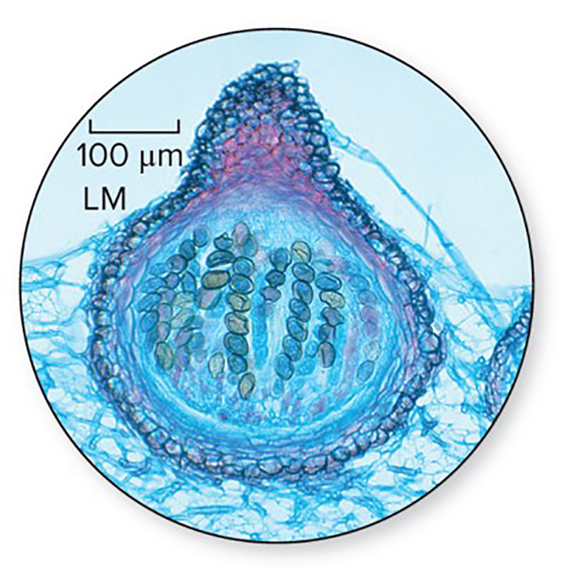
Ascomycetes produce spores in sacs
Ascomycetes is the largest group of fungi, containing more than 50,000 species. The red bread mold below is a valuable model organism.
©Steven P. Lynch/McGraw-Hill Education
Section 20.5
Figure 20.5

Slide 36
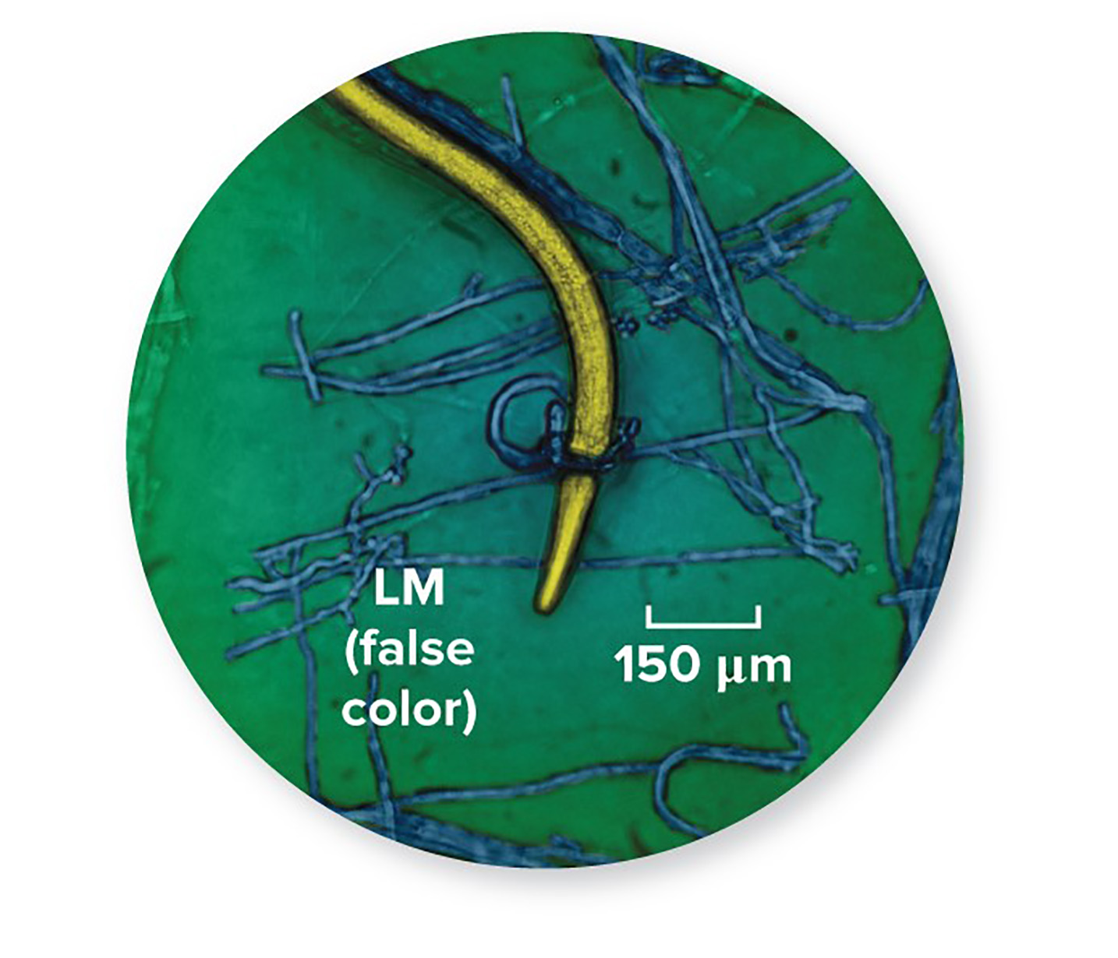
Ascomycetes have varying lifestyles
Some decompose organic matter. Others live in symbiosis with other organisms, either as parasites or mutualists.
The fungus shown here is carnivorous. It is devouring a worm.
©Photo Researchers/Science Source
Section 20.5
Figure 20.11

Slide 37
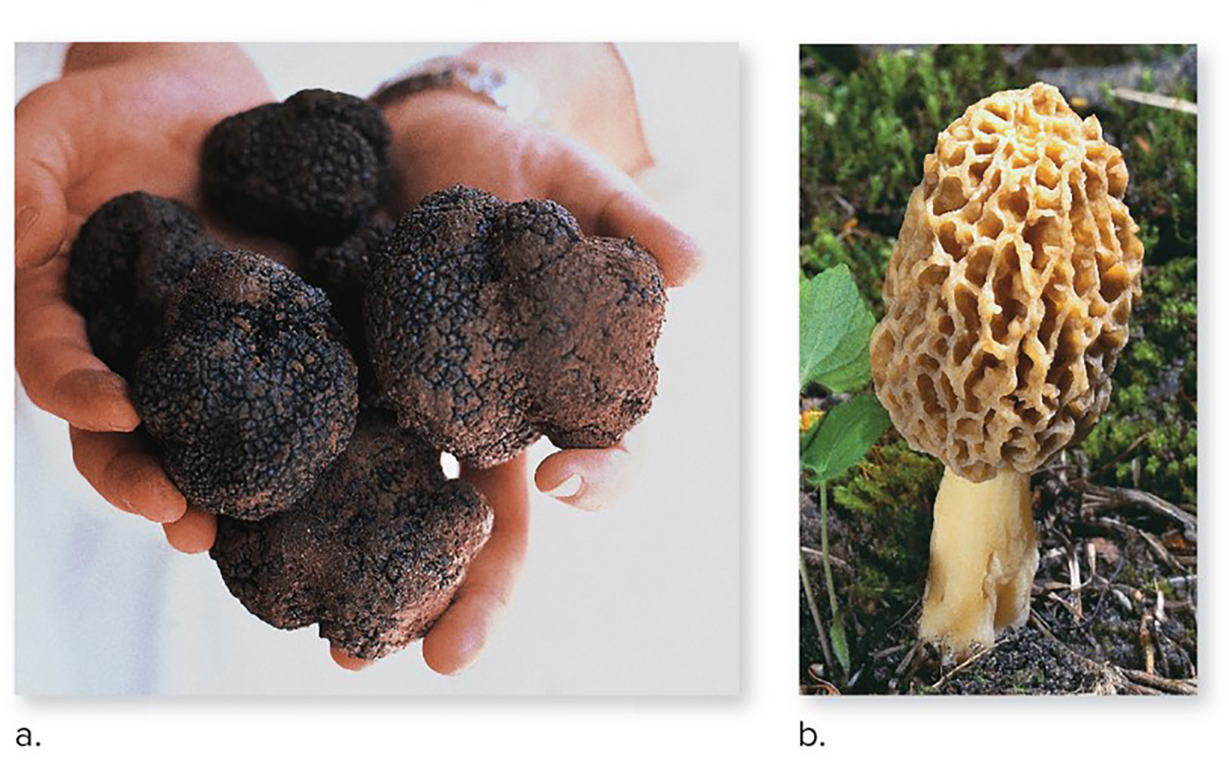
Some ascomycetes benefit humans
Ascomycetes that humans use include edible fungi, yeasts used for fermenting alcohol, and fungi that produce medicines. These truffles and morels are considered delicacies.
(a): ©DEA/G. Cozzi/Getty Images; (b): ©Robert Marien/Corbis RF
Section 20.5
Figure 20.13

Slide 38
Some ascomycetes are pests
A few species cause diseases in plants and animals.
Others grow on our food and homes. Their spores can make it difficult to breathe.
©Julie Dermansky/Science Source
Section 20.5
Figure 20.12

Slide 39
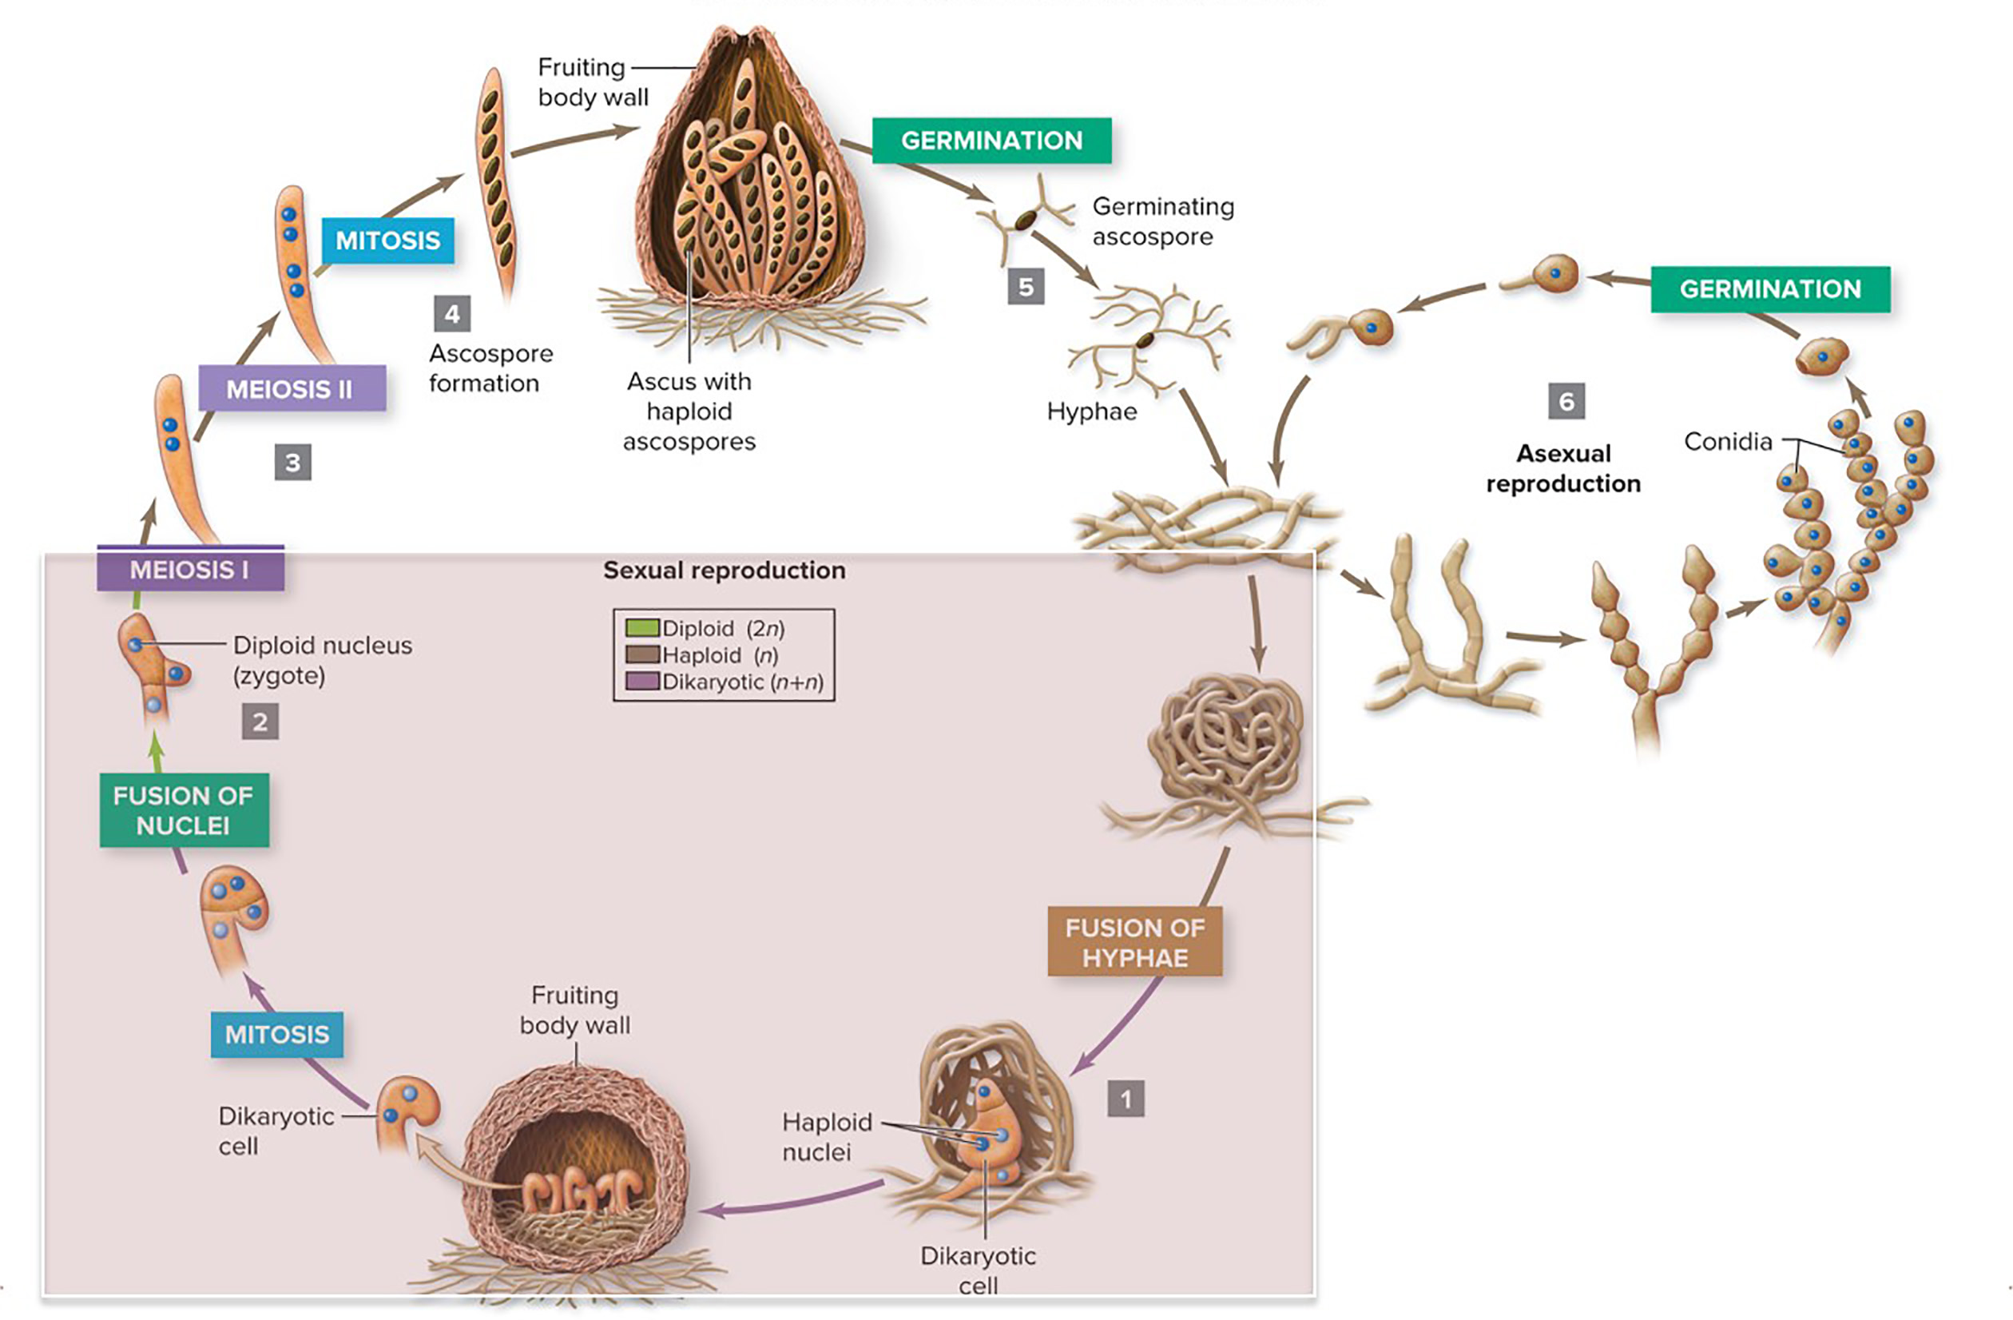
Ascomycetes form dikaryotic cells
Separate haploid hyphae fuse, forming a dikaryotic cell. The nuclei eventually fuse, forming a diploid zygote.
Section 20.5
Figure 20.14

Slide 40
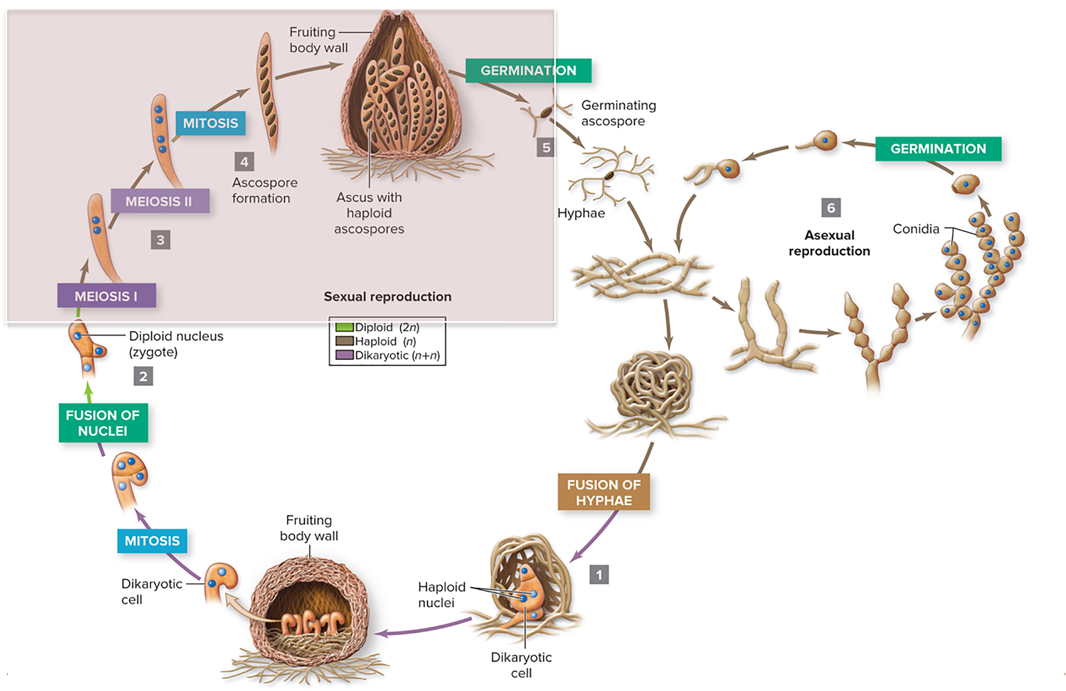
Ascomycetes spores are in an ascus
The zygote produces sets of eight haploid spores inside an elongated sac called an ascus. Many asci together form a fruiting body.
Section 20.5
Figure 20.14

Slide 41
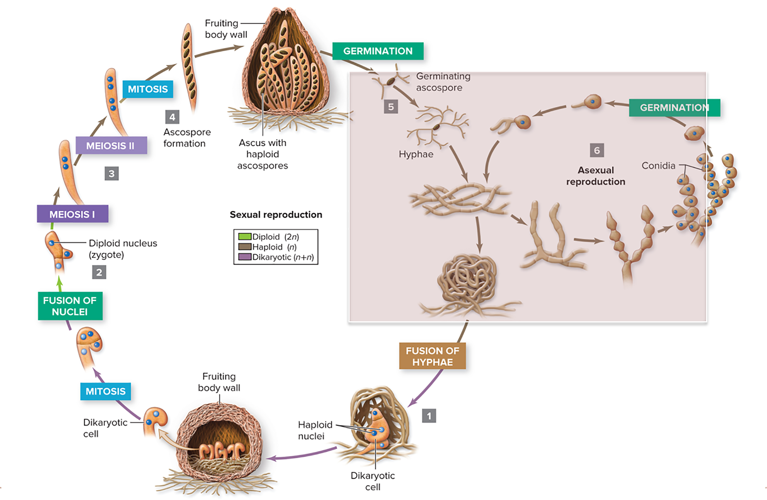
Ascomycetes reproduce asexually
During asexual reproduction, a hypha produces identical haploid spores, each of which germinates into a haploid hypha.
Section 20.5
Figure 20.14

Slide 42
20.5 Mastering concepts
Describe asexual and sexual reproduction in an ascomycete.
©Frans Lemmens/Corbis

Slide 43
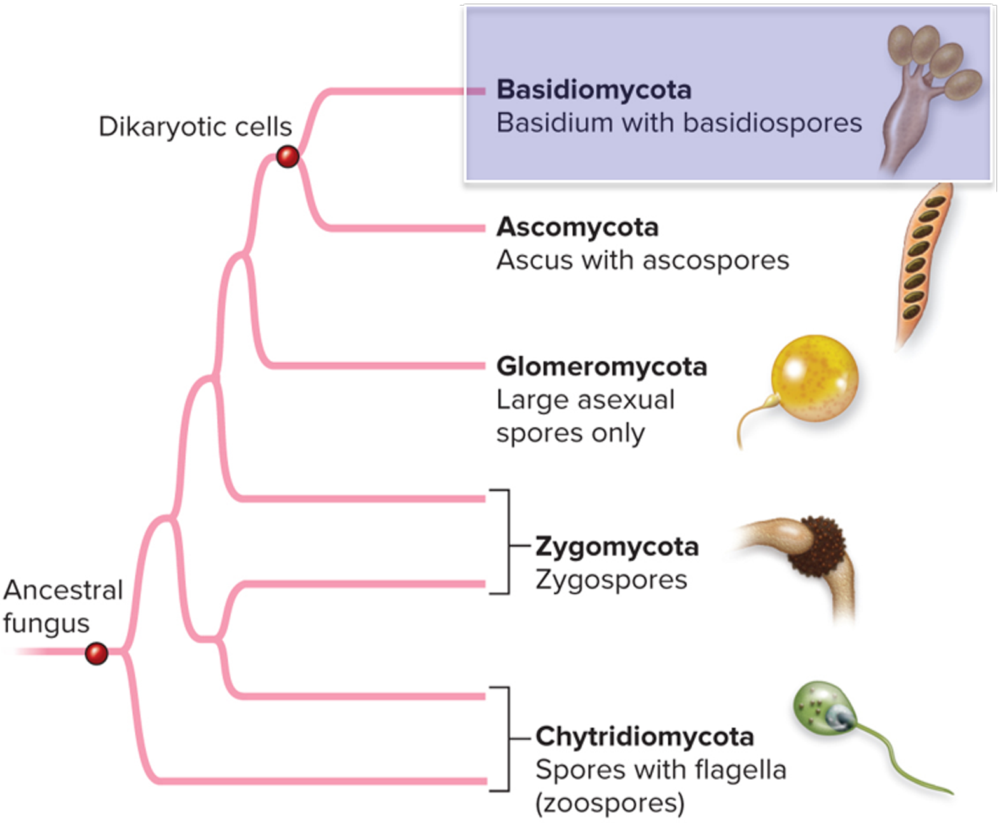
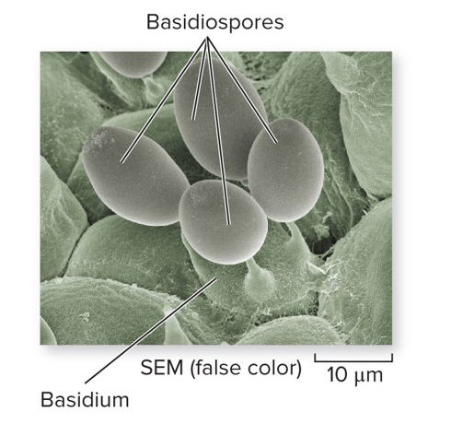
Basidiomycetes spores are shaped like clubs
Basidiomycetes include mushrooms and other fungi.
©Cultura RM Exclusive/Rolf Ritter/Getty Images
Section 20.5
Figures 20.5, 20.16

Slide 44
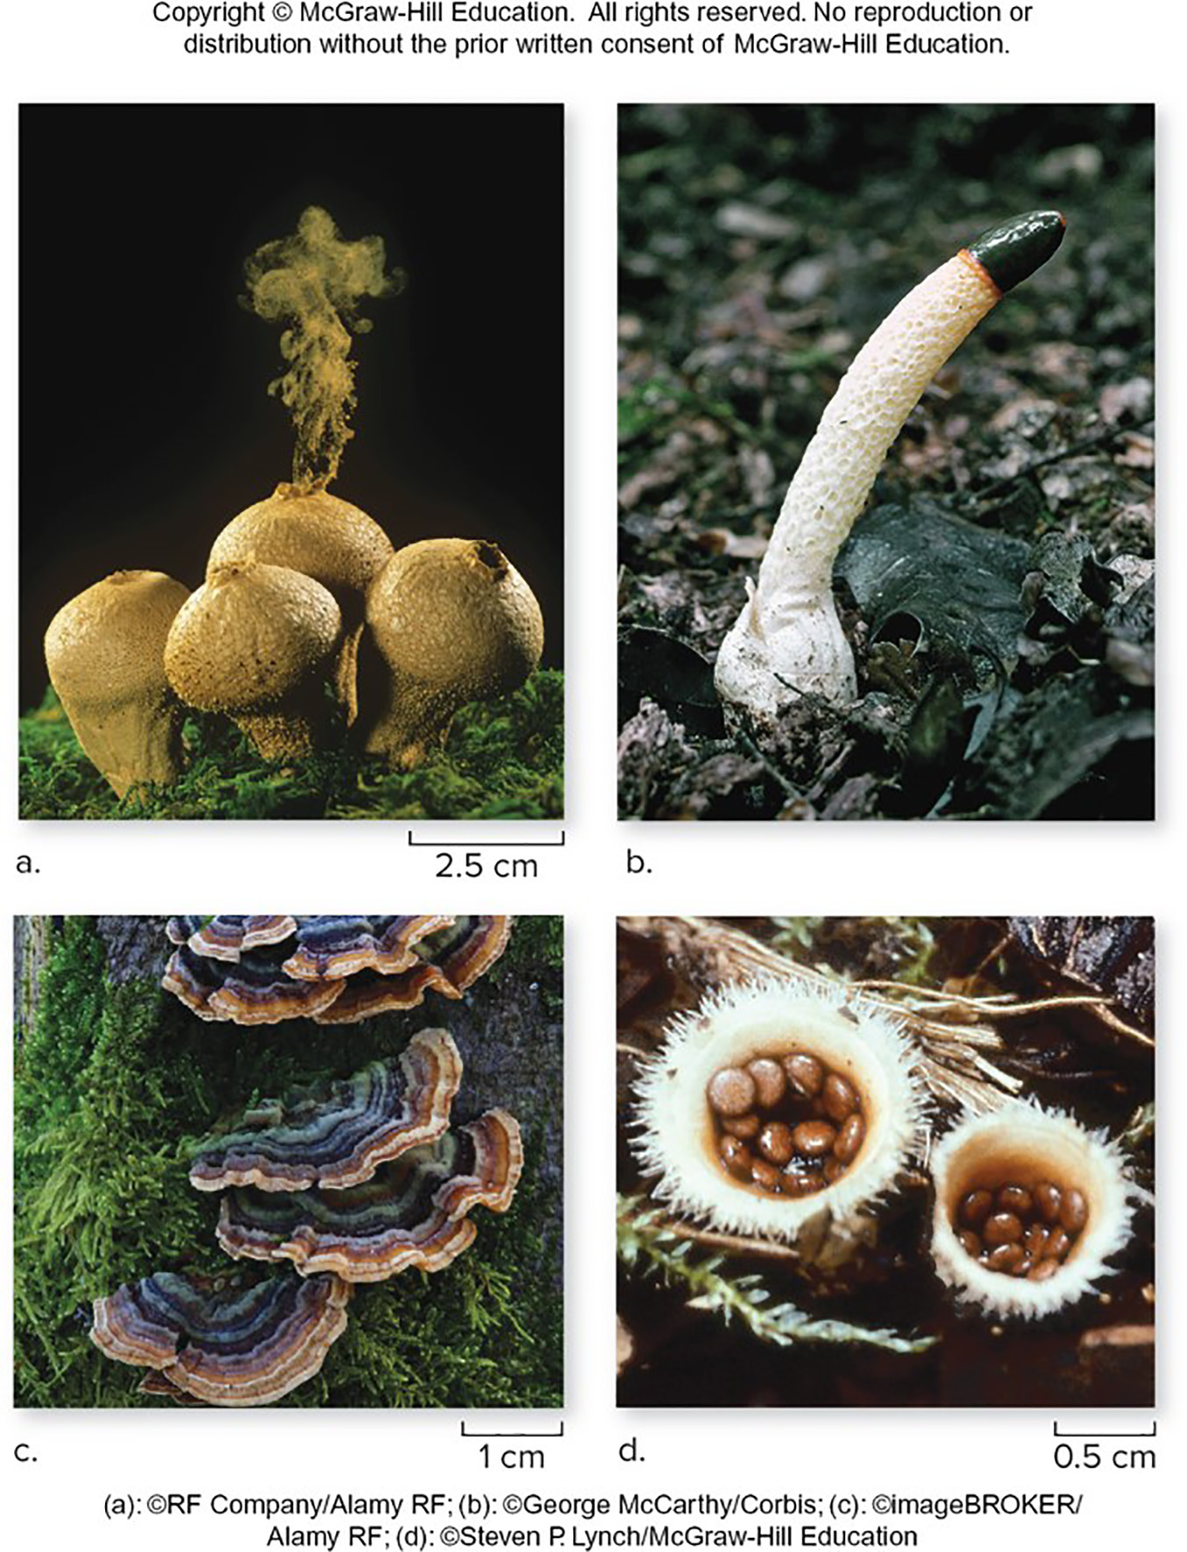
Basidiomycetes disperse spores in many ways
The putrid odor of the stinkhorn’s slimy spore mass attracts flies,
which carry the spores on their feet.
Raindrops splash the spore-laden “eggs” out of a bird’s nest fungus.
Puffballs disperse spores in the wind.
(a): ©RF Company/Alamy RF; (b): ©George McCarthy/Corbis; (c): ©imageBROKER/
Alamy RF; (d): ©Steven P. Lynch/McGraw-Hill Education
Section 20.6
Figure 20.15

Slide 45
Basidiomycetes play roles in human life
Mushrooms are sometimes edible, although they can also be poisonous or can induce hallucinations.
(a): ©RF Company/Alamy RF; (b): ©George McCarthy/Corbis; (c): ©imageBROKER/
Alamy RF; (d): ©Steven P. Lynch/McGraw-Hill Education
Section 20.6
Figure 20.15

Slide 46
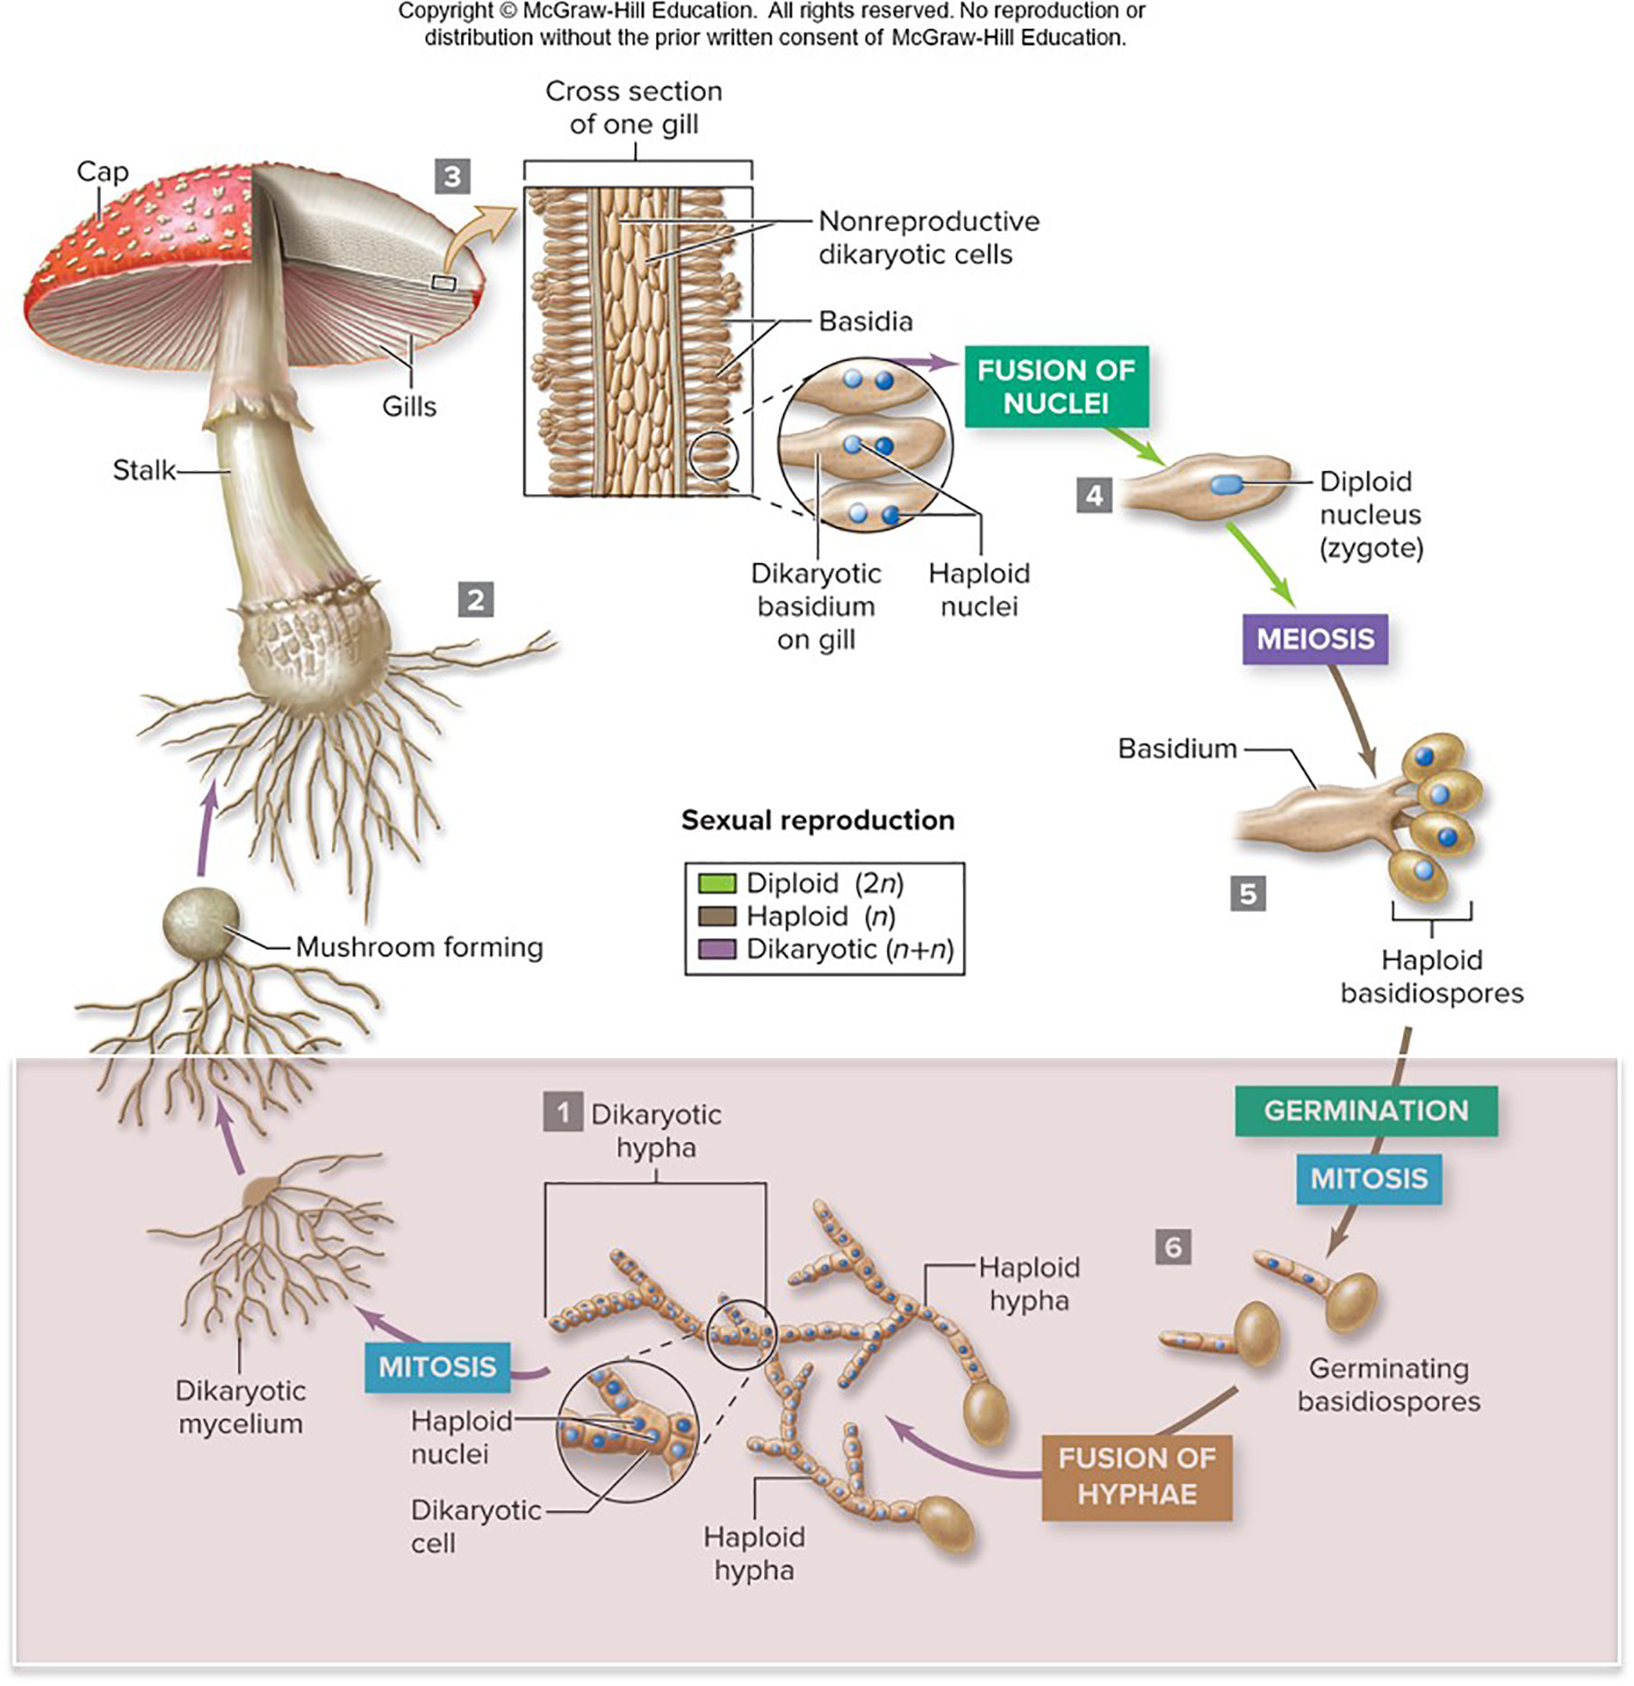
Basidiomycetes reproduce sexually
Most of the life cycle is devoted to sexual reproduction.
Haploid hyphae grow from spores and fuse, forming a dikaryotic cell. Mitosis of the dikaryotic cell produces a dikaryotic mycelium.
Section 20.6
Figure 20.16

Slide 47
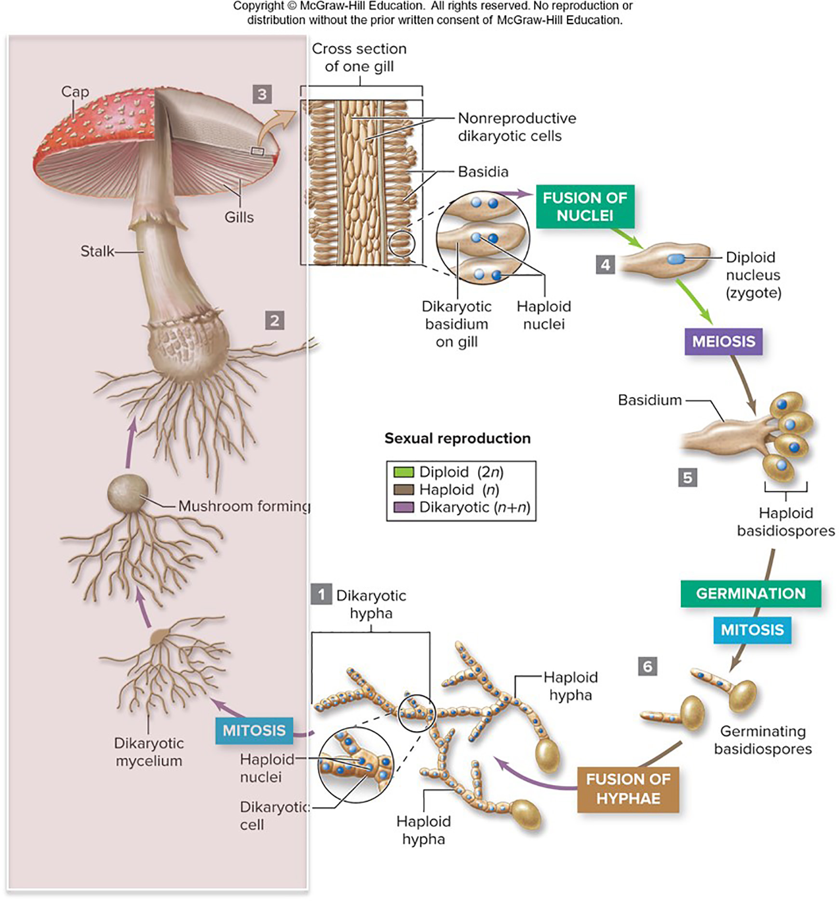
Mushrooms are reproductive structures
The dikaryotic mycelium grows into a mushroom.
The mushroom cap contains gills on which club-shaped cells called basidia form.
Section 20.6
Figure 20.16

Slide 48
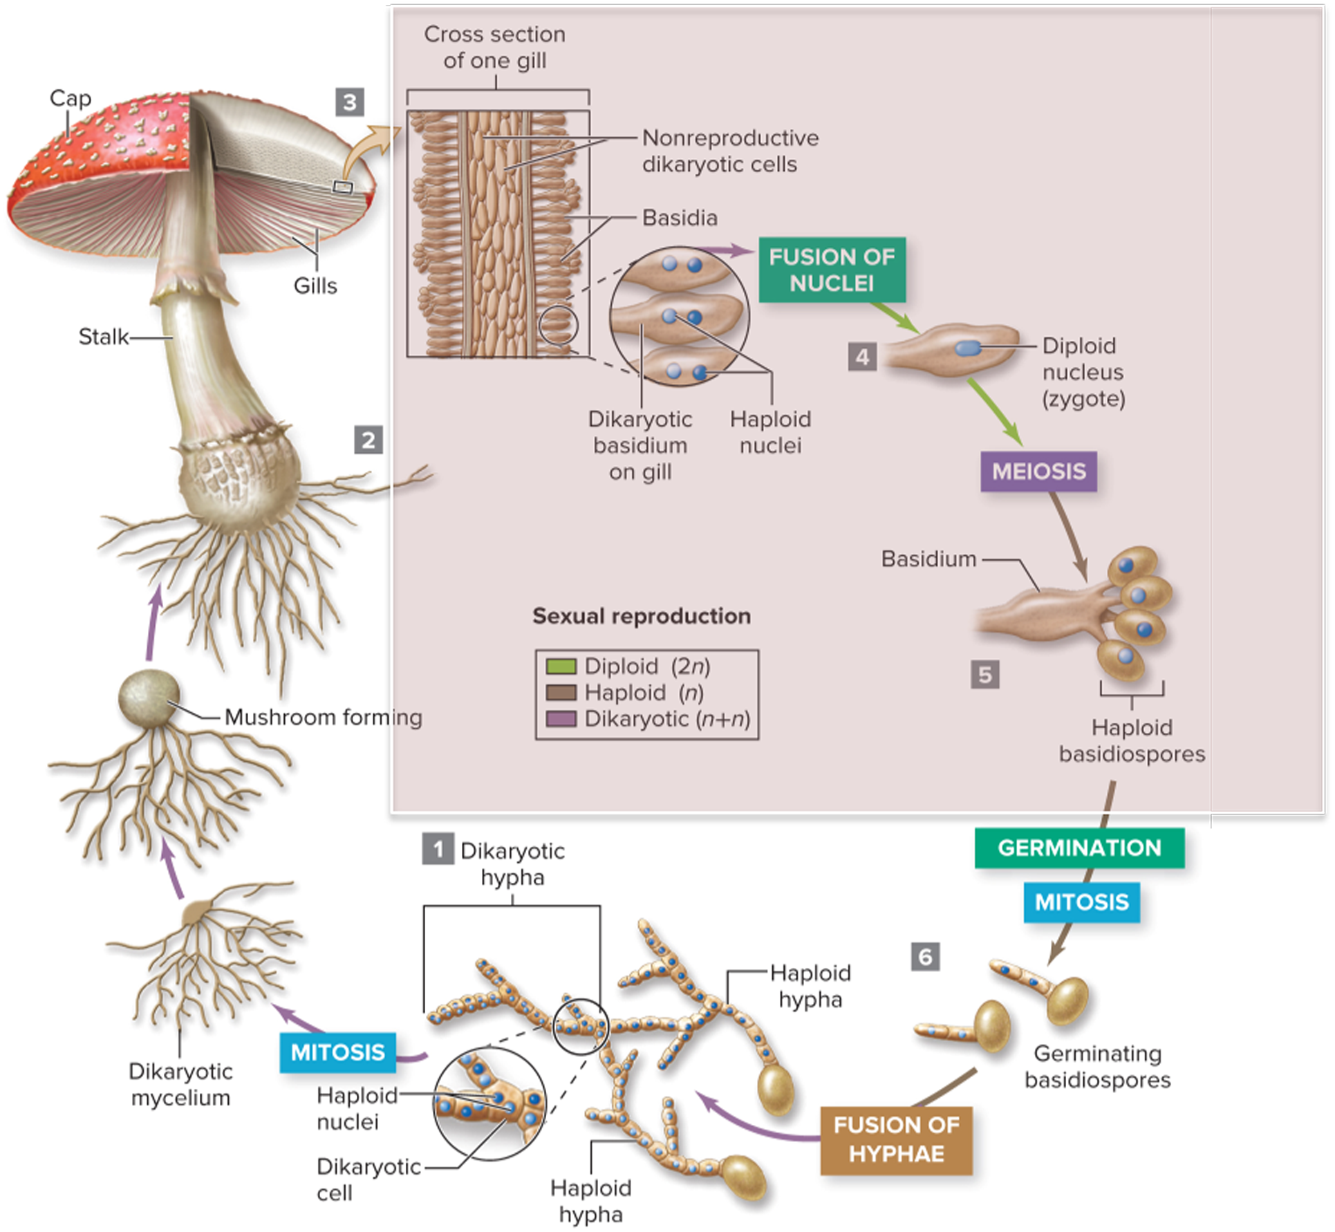
The zygote grows in the basidium
Within each basidium, the two haploid nuclei fuse into a diploid zygote.
The zygote then divides by meiosis, forming four haploid, genetically unique basidiospores.
Section 20.6
Figure 20.16

Slide 49
Clicker question #3
At what point in the life cycle of basidiomycetes do two haploid nuclei fuse, forming a new diploid organism?
in the mycelium, before it grows into a mushroom
when the hyphae fuse
when basidiospores form
after the mushroom has formed

Slide 50
Clicker question #3, solution
At what point in the life cycle of basidiomycetes do two haploid nuclei fuse, forming a new diploid organism?
after the mushroom has formed

Slide 51
20.6 Mastering concepts
Describe the sexual life cycle of basidiomycetes.
©Frans Lemmens/Corbis

Slide 52
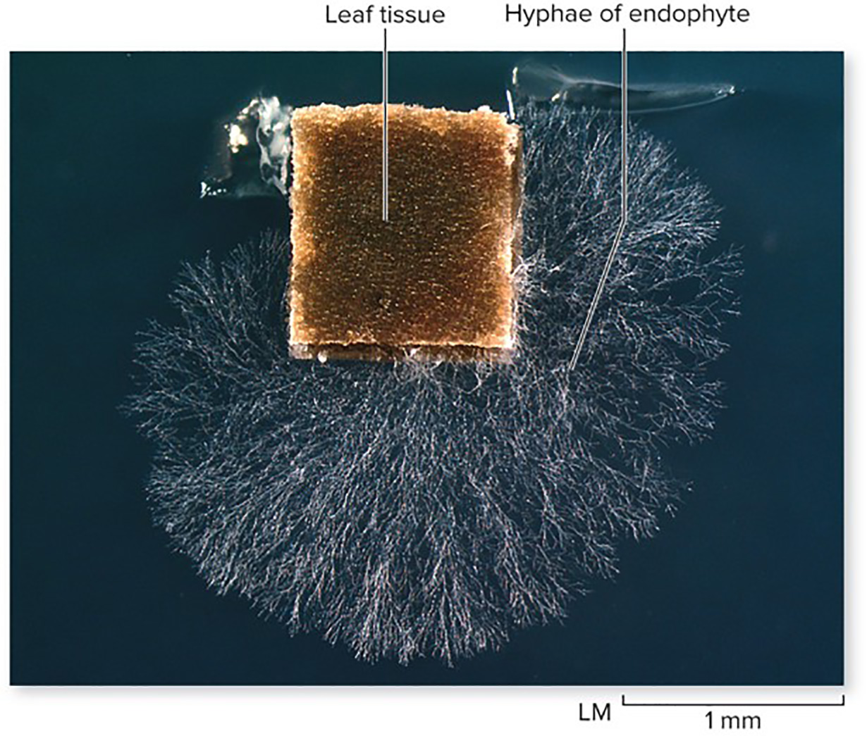
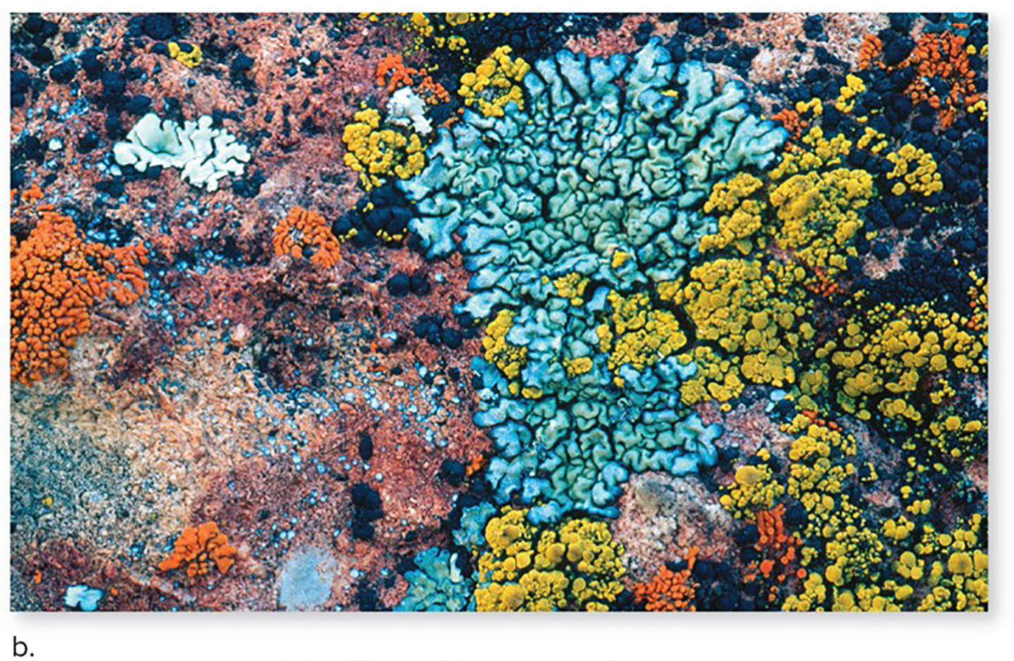
Fungi interact with other organisms
Fungi form symbiotic relationships, in which both the fungi and the other organism benefit.
©Dr. Elizabeth Arnold
(b): ©William H. Mullins/Science Source;
Section 20.7
Figure 20.17, 20.20

Slide 53
Endophytes live inside plant tissues
These fungi do not trigger disease symptoms or otherwise harm plants. Some produce substances that help defend plants against herbivores.
All plants harbor endophytes.
©Dr. Elizabeth Arnold
Section 20.7
Figure 20.17

Slide 54
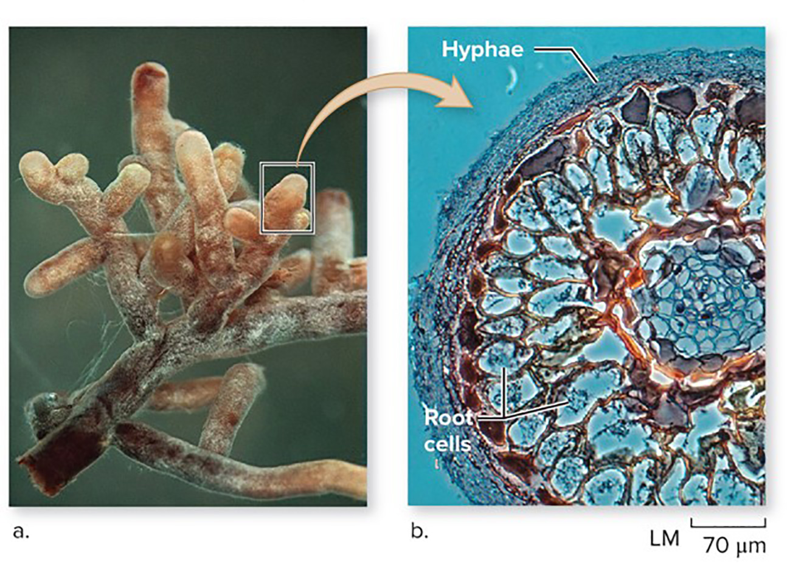
Mycorrhizal fungi exchange material with roots
Most land plants form mycorrhizae with fungi. Some plants cannot live without their fungi.
Glomeromycetes form the most common types of mycorrhizae.
©Dr. Elizabeth Arnold(a): ©R Henrik Nilsson; (b): ©Biology Pics/Science Source
©Joseph B. Morton
Section 20.7
Figures 20.10, 20.18

Slide 55
Ectomycorrhizae wrap around the roots
Basidiomycetes and ascomycetes form ectomycorrhizae, in which the fungal hyphae wrap around the root but do not penetrate root cells.
©Dr. Elizabeth Arnold(a): ©R Henrik Nilsson; (b): ©Biology Pics/Science Source
Section 20.7
Figure 20.18

Slide 56
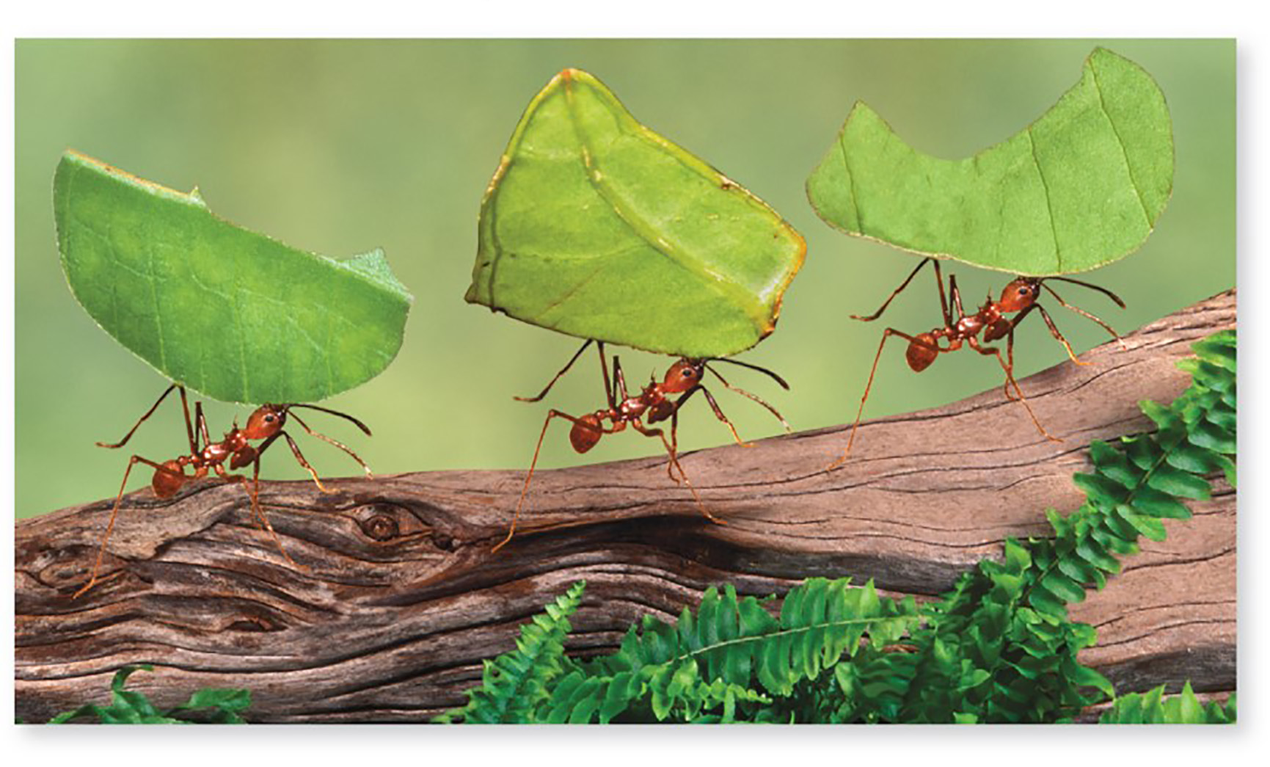
Some ants cultivate fungi
Leaf-cutter ants build underground chambers and fill them with leaves.
Basidiomycetes use the leaves as a food source. Ants eat the growing hyphae.
Bacteria coating the ants secretes a toxin that protects the basidiomycetes.
©Gail Shumway/Photographer’s Choice/Getty Images
Section 20.7
Figure 20.19

Slide 57
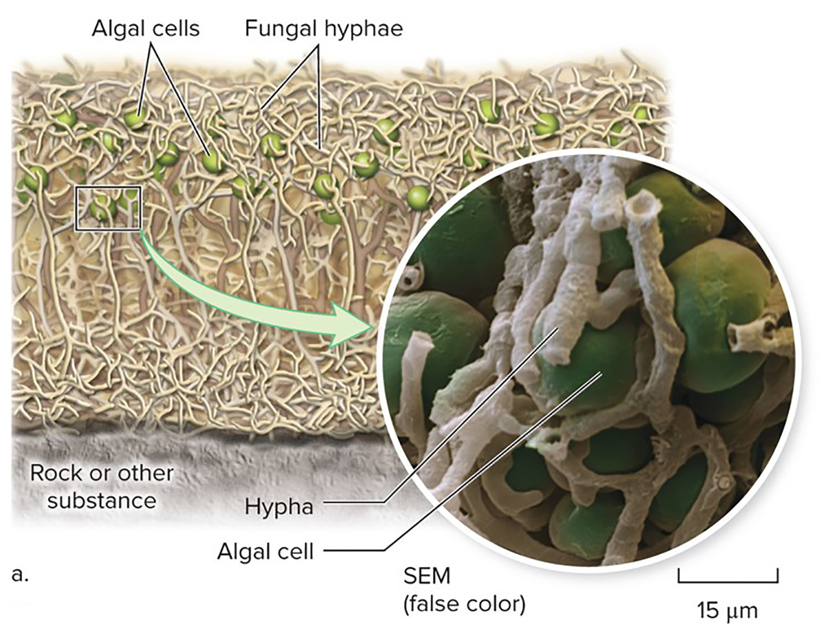
Lichens are dual organisms
Lichens are fungi with green algae or cyanobacteria living among their hyphae.
The fungi absorb minerals and water while the algal cells produce sugars by photosynthesis.
©Eye of Science/Science Source
Section 20.7
Figure 20.20

Slide 58
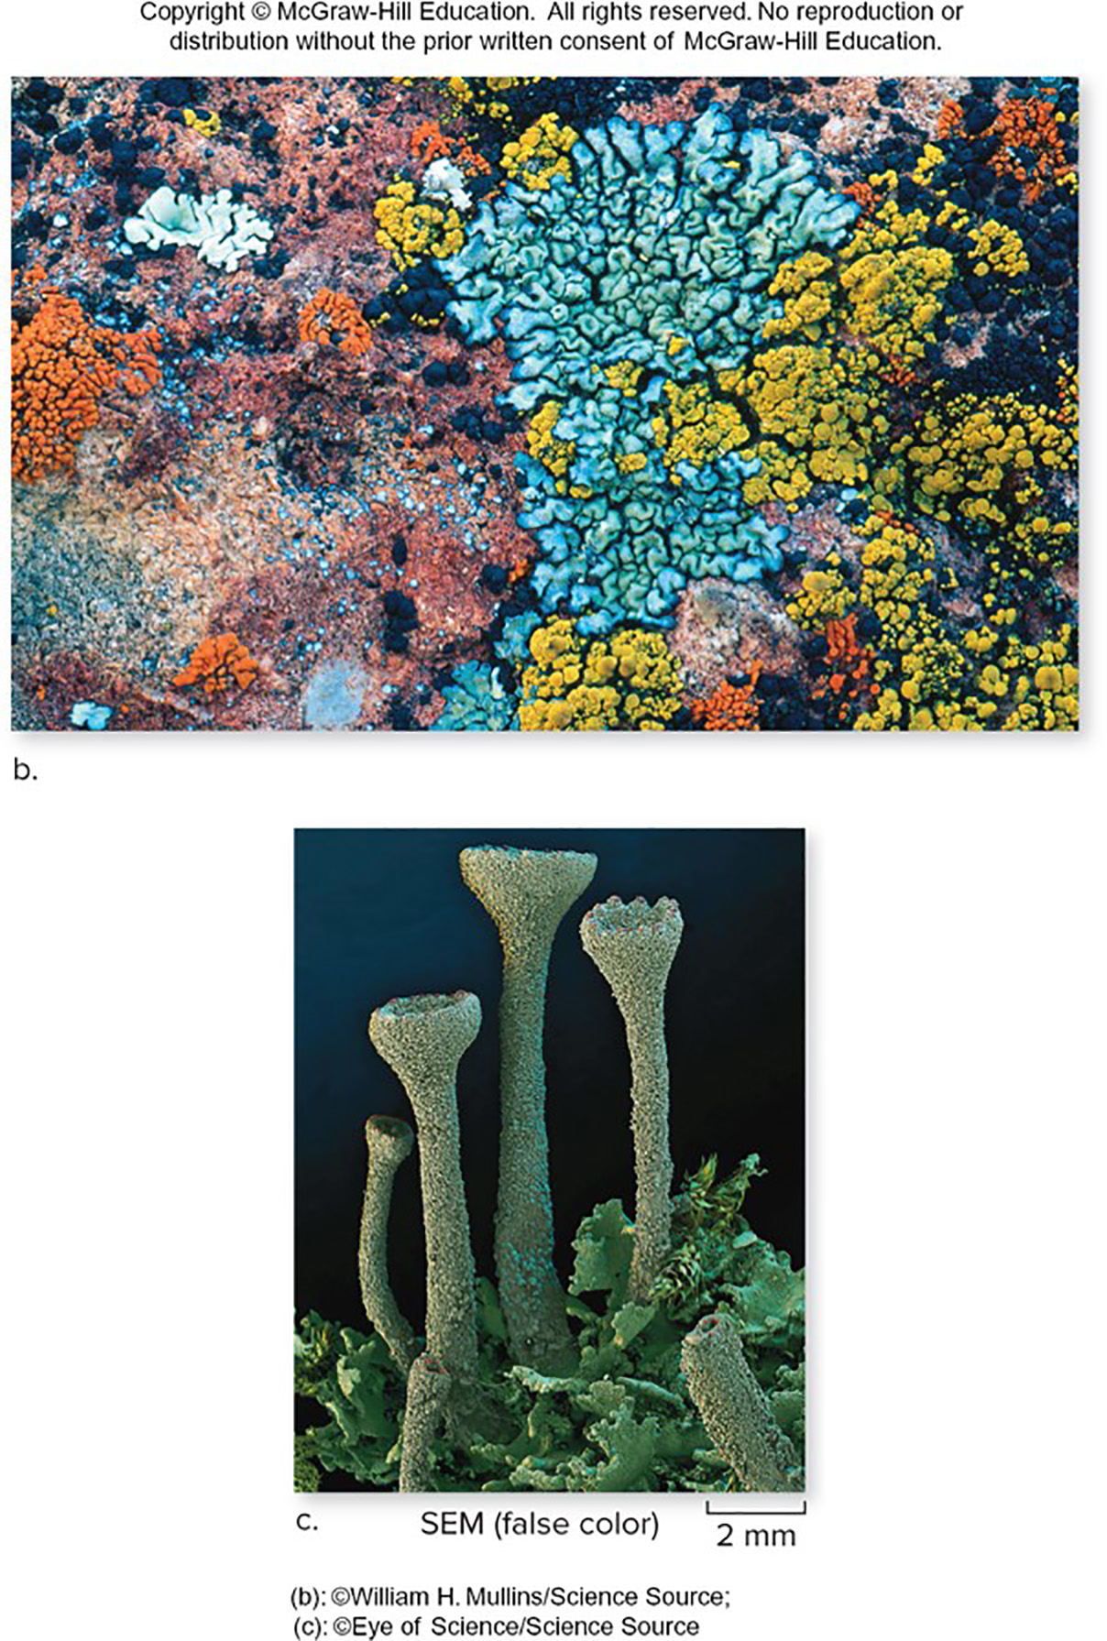
Lichens are ecologically important
They secrete acids that break down rock, which starts to develop into soil.
Many harbor nitrogen-fixing bacteria needed by plants.
Animals such as caribou eat lichens.
(b): ©William H. Mullins/Science Source;
(c): ©Eye of Science/Science Source
Section 20.7
Figure 20.20

Slide 59
Clicker question #4
Which of the following is physically the largest?
sugar molecule
hypha
fungal spore
lichen

Slide 60
Clicker question #4, solution
Which of the following is physically the largest?
lichen

Slide 61
Clicker question #5
What kind of fungus produces zoospores with flagella?
basidiomycetes
zygomycetes
chytrids
ascomycetes
glomeromycetes

Slide 62
Clicker question #5, solution
What kind of fungus produces zoospores with flagella?
chytrids

Slide 63
20.7 Mastering concepts
How are lichens similar to mycorrhizae?
©Frans Lemmens/Corbis

Slide 64
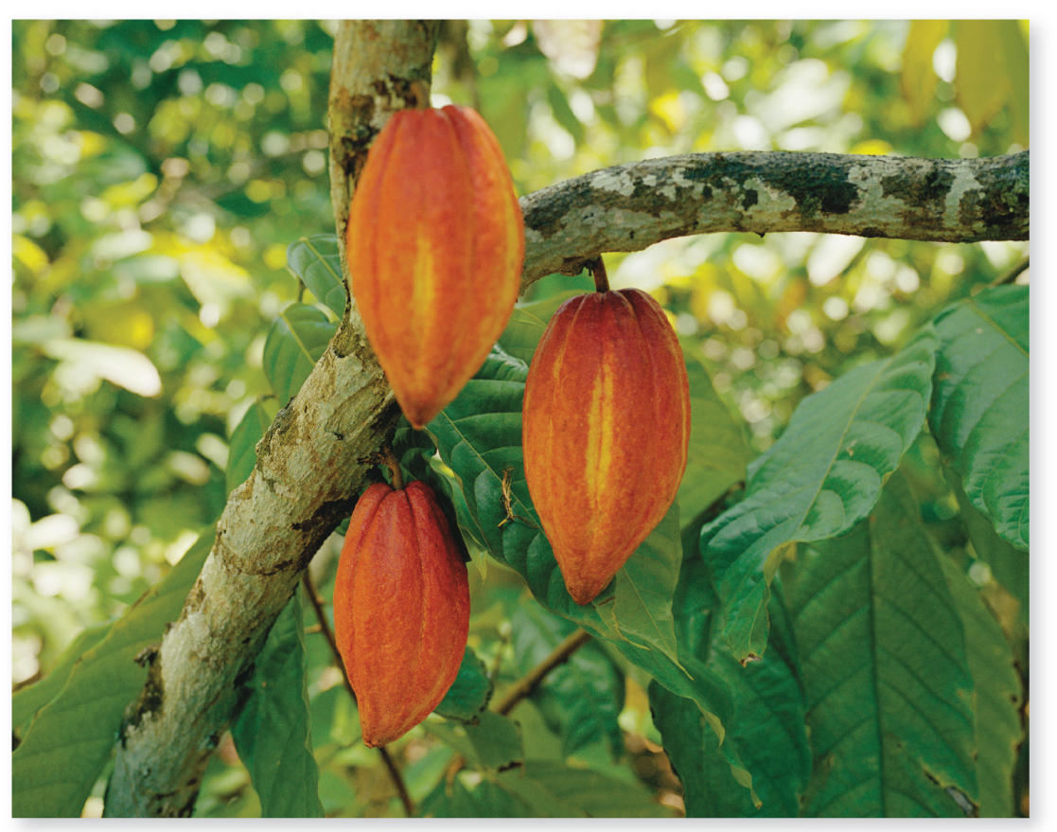
Investigating life: The battle for position in cacao tree leaves
Cacao trees are often attacked by harmful parasites, and they also harbor many endophytes.
©Robert van der Hilst/Corbis
Section 20.8
Figure 20.21

Slide 65
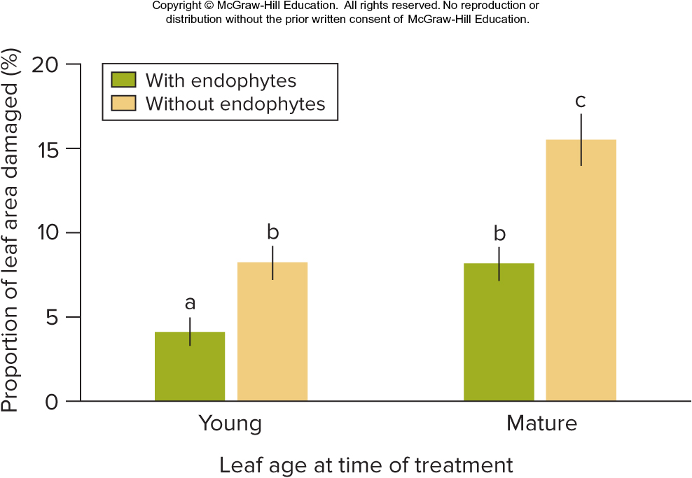
Investigating life: Endophytes protect trees from disease
When cacao trees were inoculated with a pathogenic water mold, trees with endophytes were damaged less than those without.
Section 20.8
Figure 20.22

