Slide 1
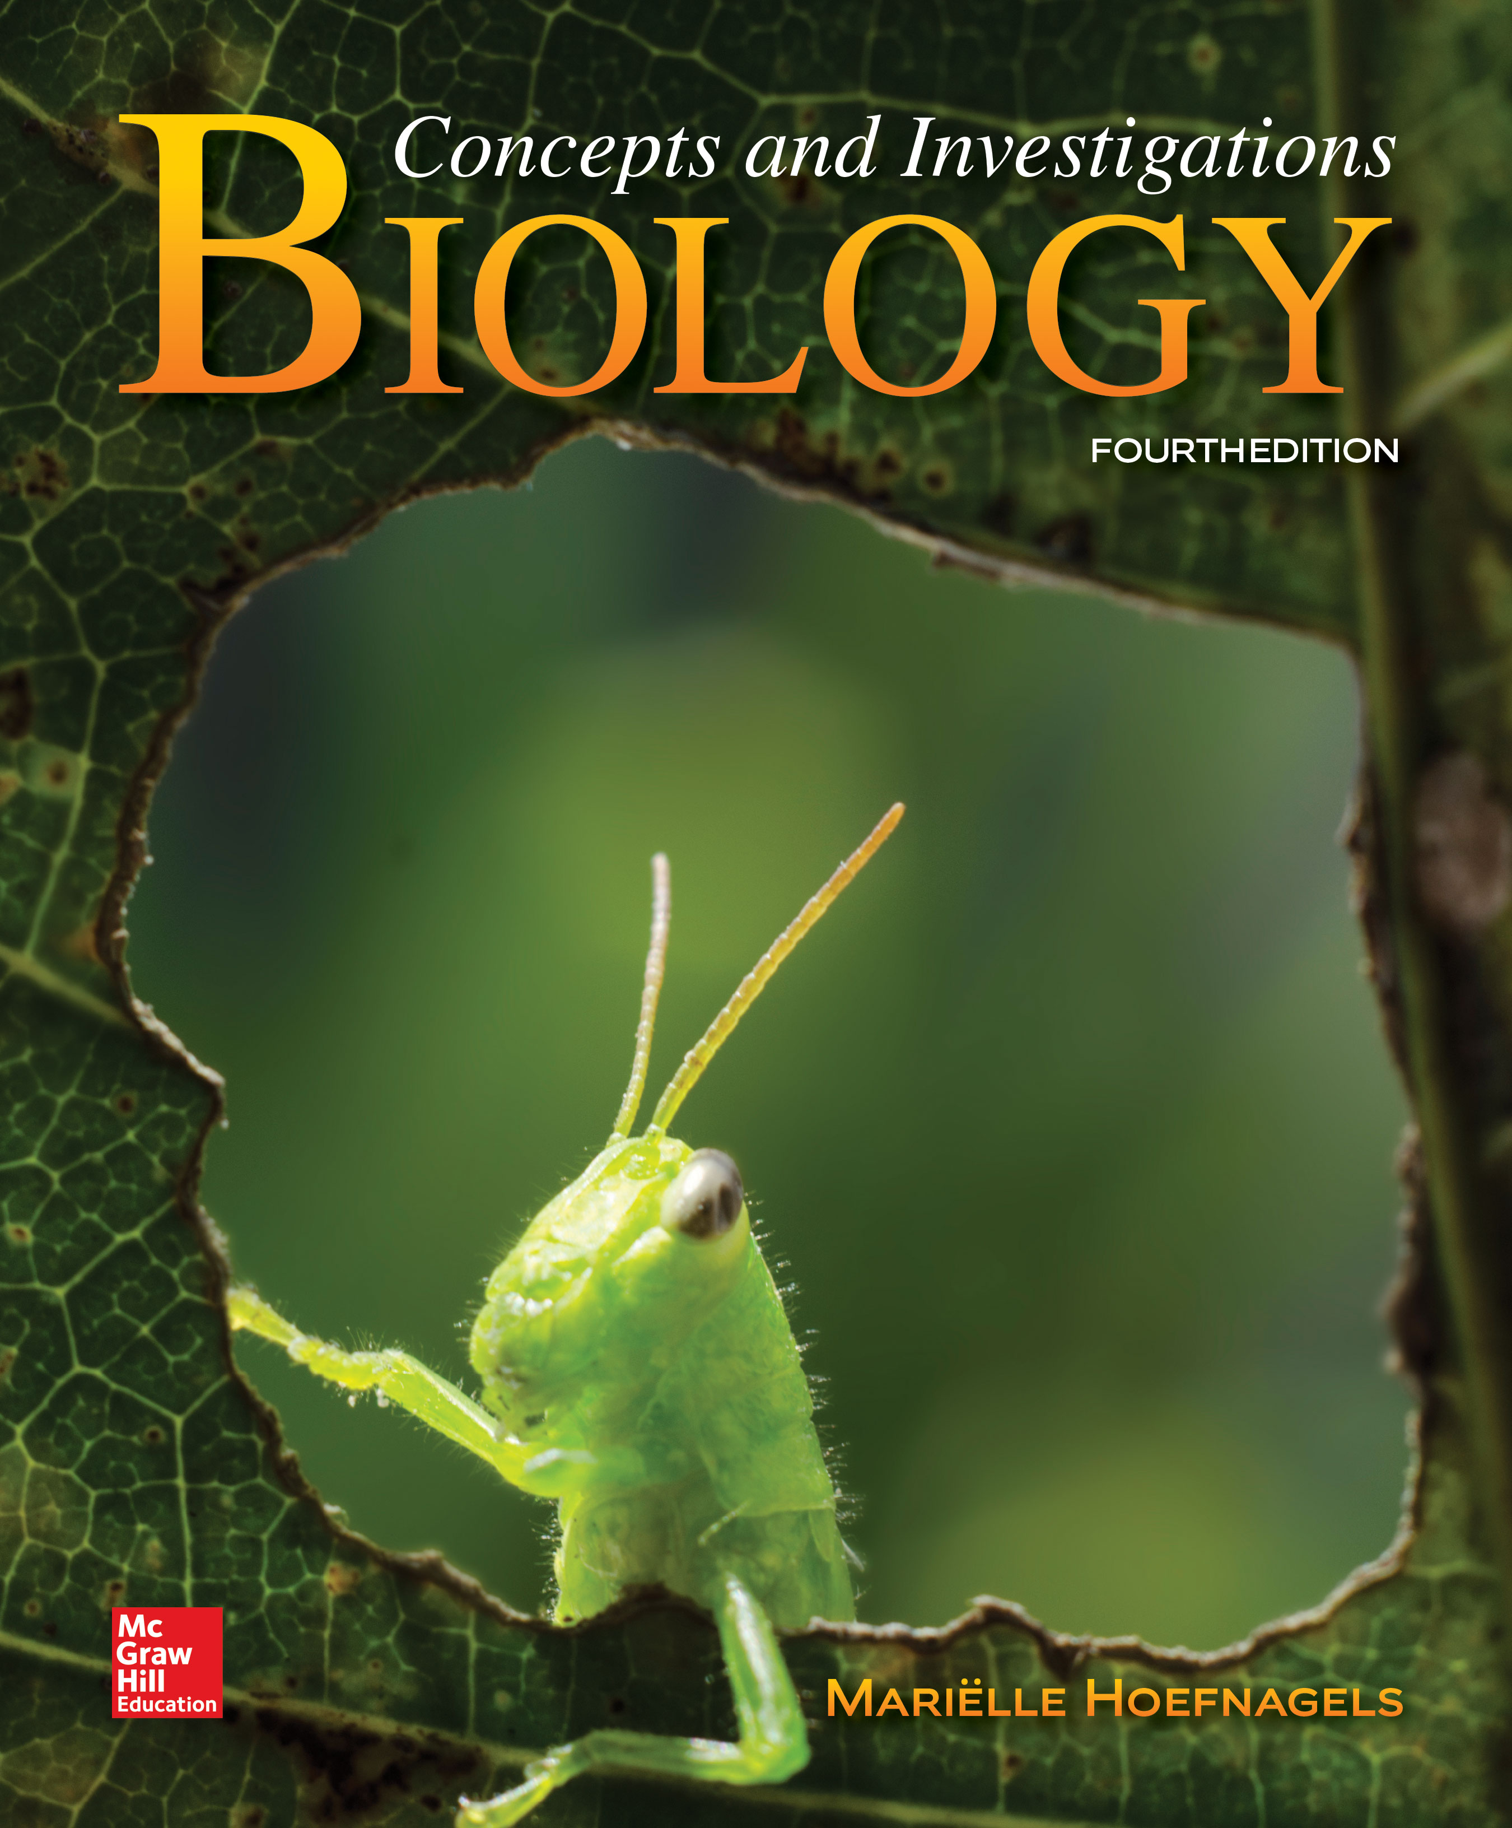
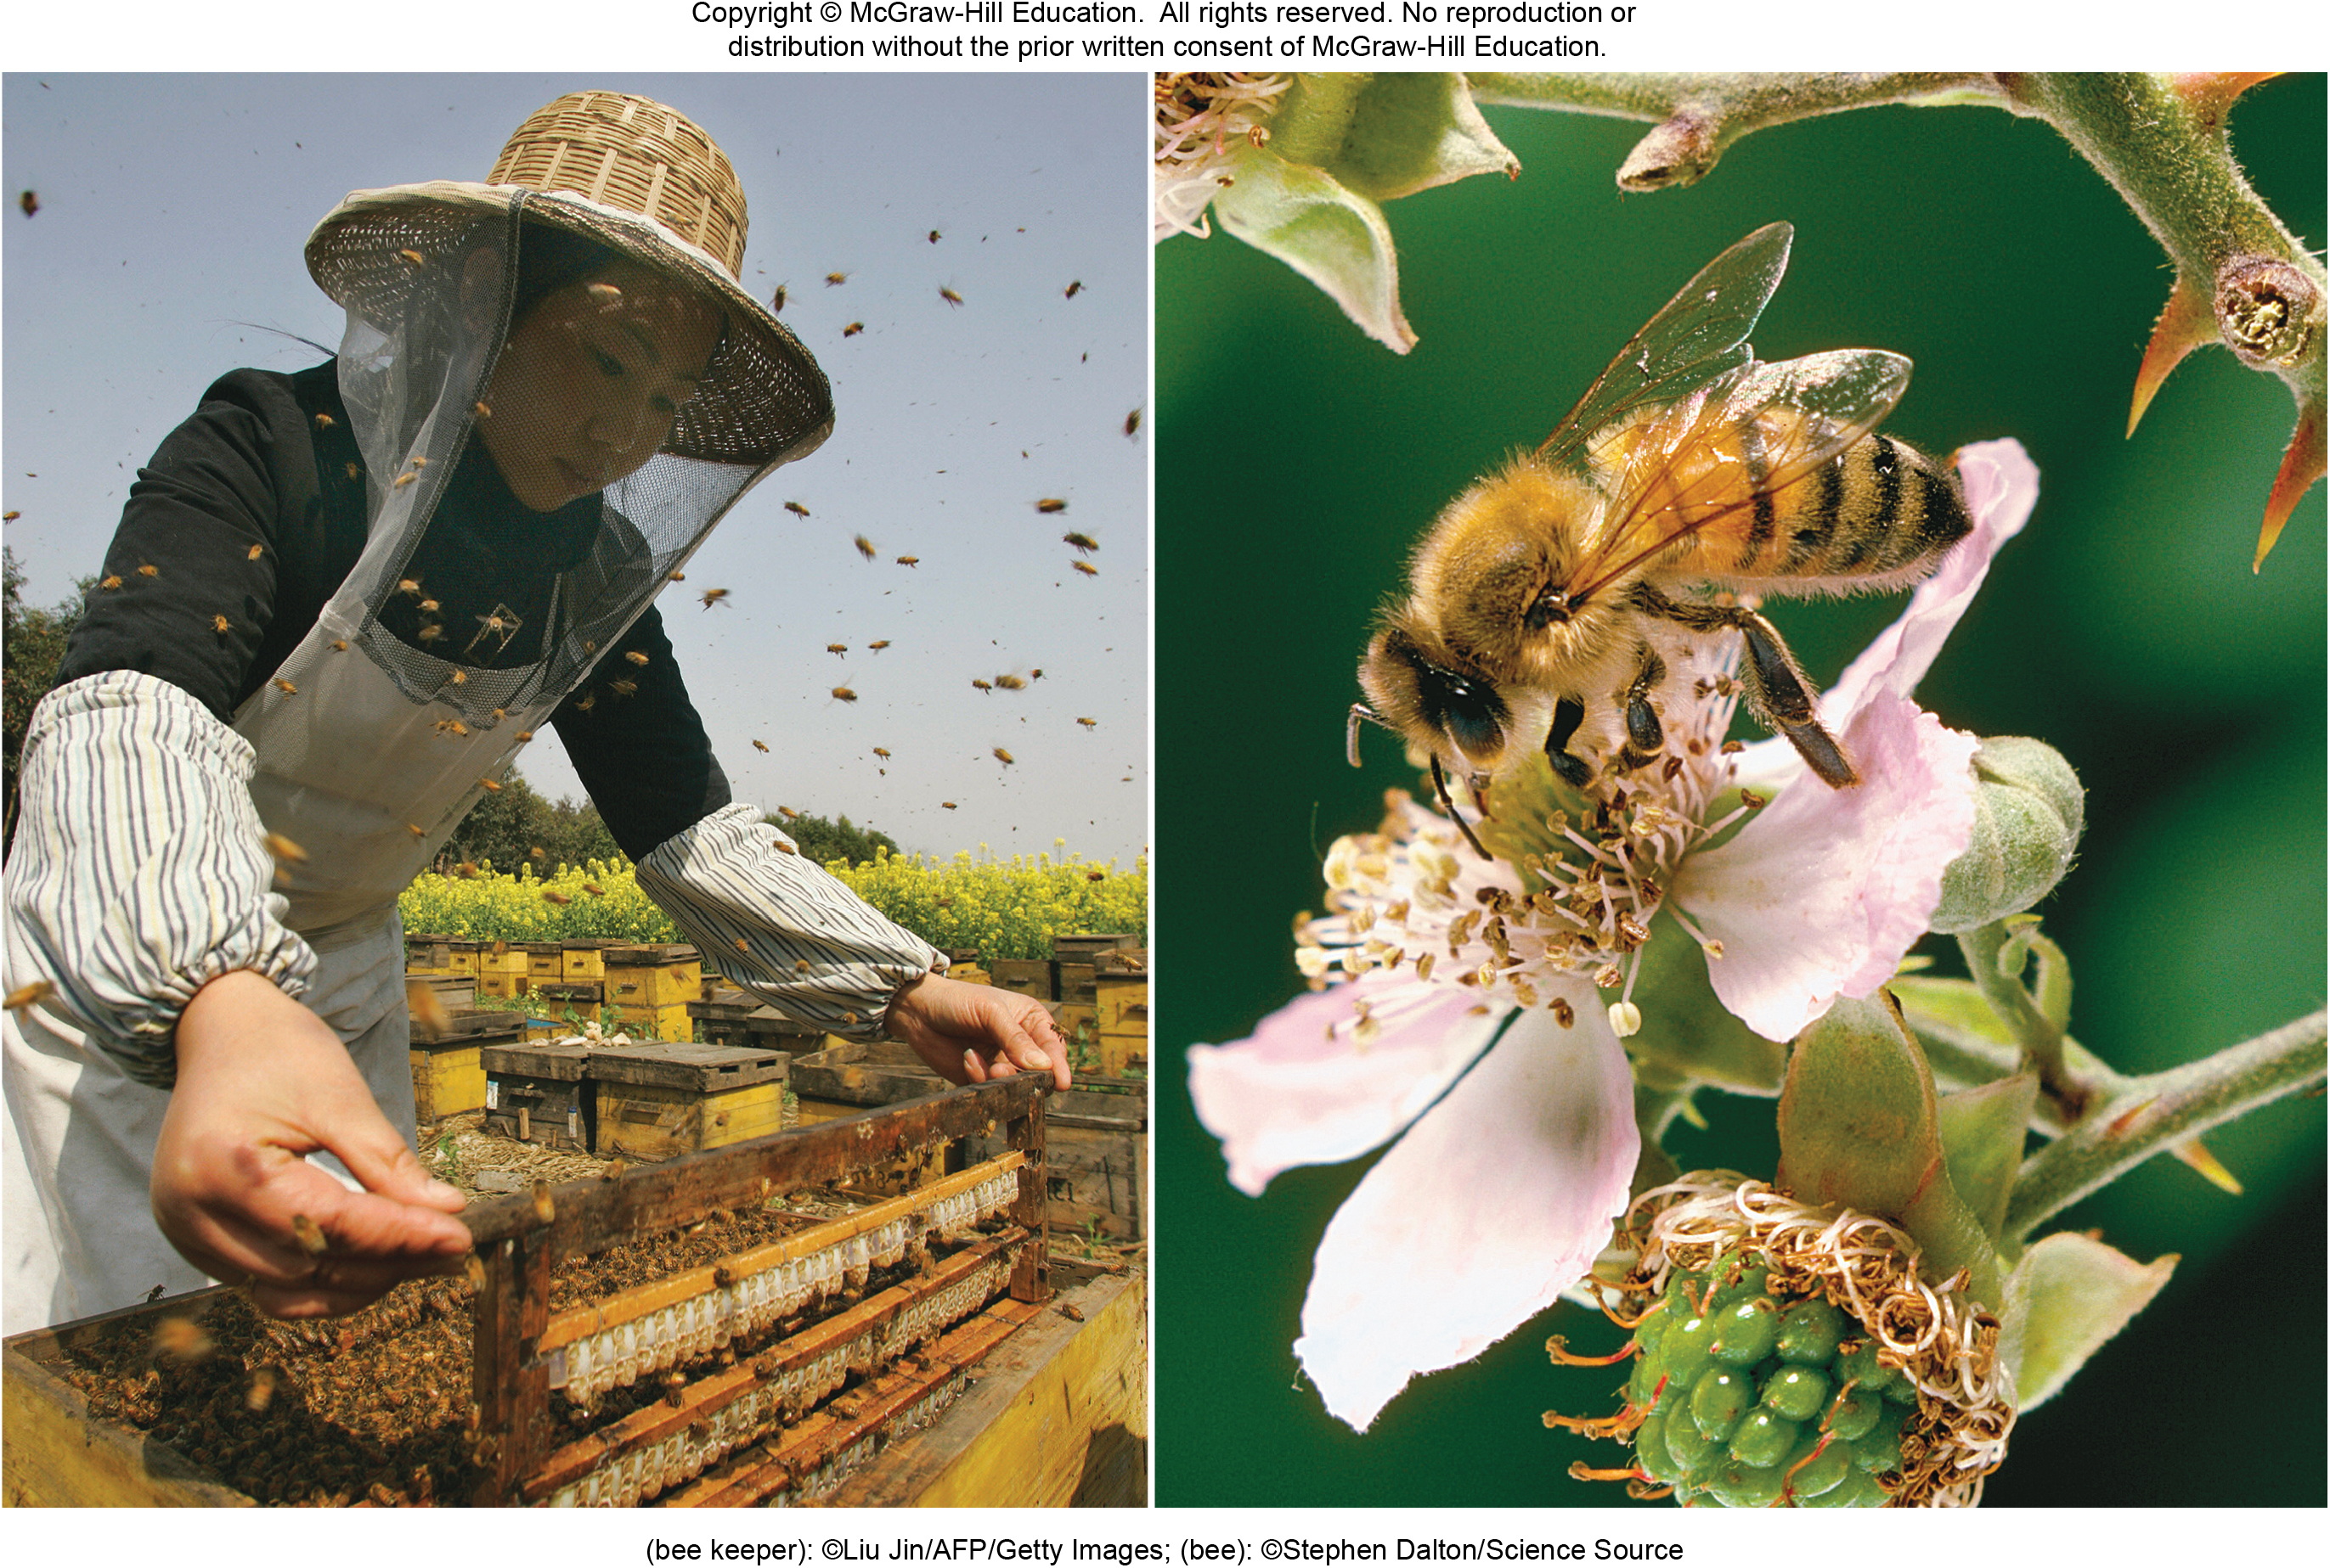
Chapter 24
Reproduction and Development of Flowering Plants
(bee keeper) ©Liu Jin/AFP/Getty Images; (bee): ©Stephen Dalton/Science Source
© McGraw-Hill Education. All rights reserved. Authorized only for instructor use in the classroom.
No reproduction or further distribution without the prior written consent of McGraw-Hill Education.

Slide 2
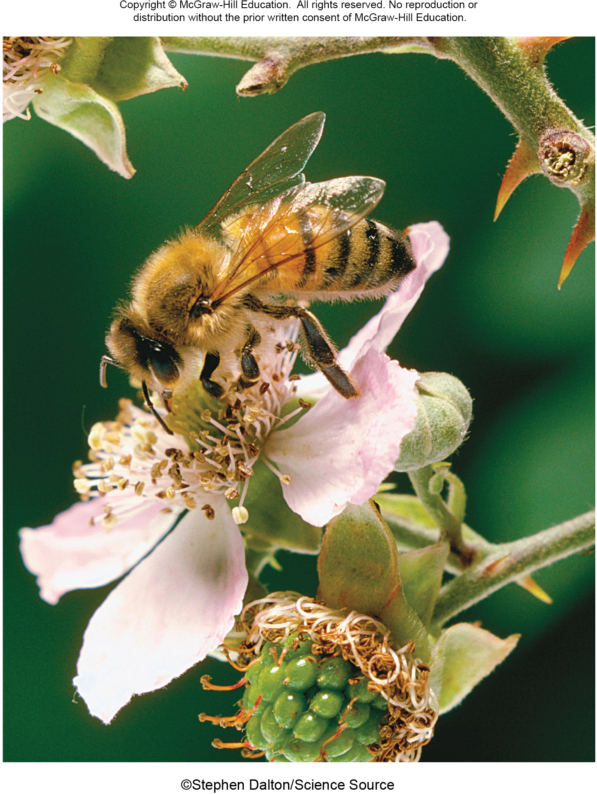
Most angiosperms reproduce sexually
Flowers are the sex organs of angiosperms. This bee is gathering pollen that might deliver sperm to the next flower it visits.
©Stephen Dalton/Science Source
Section 24.1

Slide 3
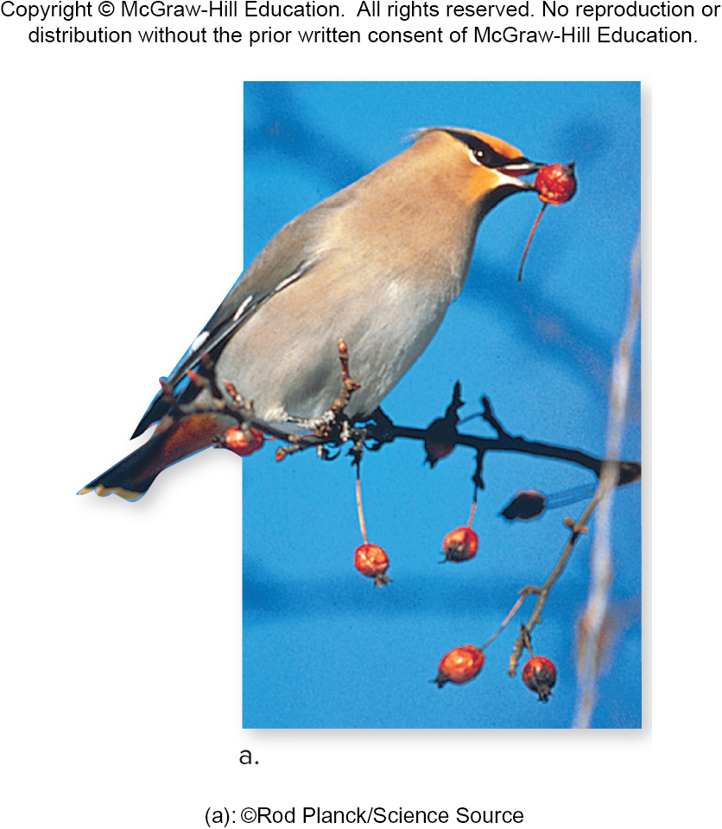
Angiosperms seeds develop from fertilized egg cells
This cedar waxwing is carrying a seed, which developed from a fertilized egg cell.
(a): ©Rod Planck/Science Source
Section 24.1
Figure 24.11

Slide 4
Sexual reproduction results in genetically unique offspring
Flowers and seeds are produced by angiosperms that
sexually reproduce, yielding genetically unique offspring
with traits derived from two parents.
(a): ©Rod Planck/Science Source
©Stephen Dalton/Science Source
Section 24.1
Figure 24.11

Slide 5
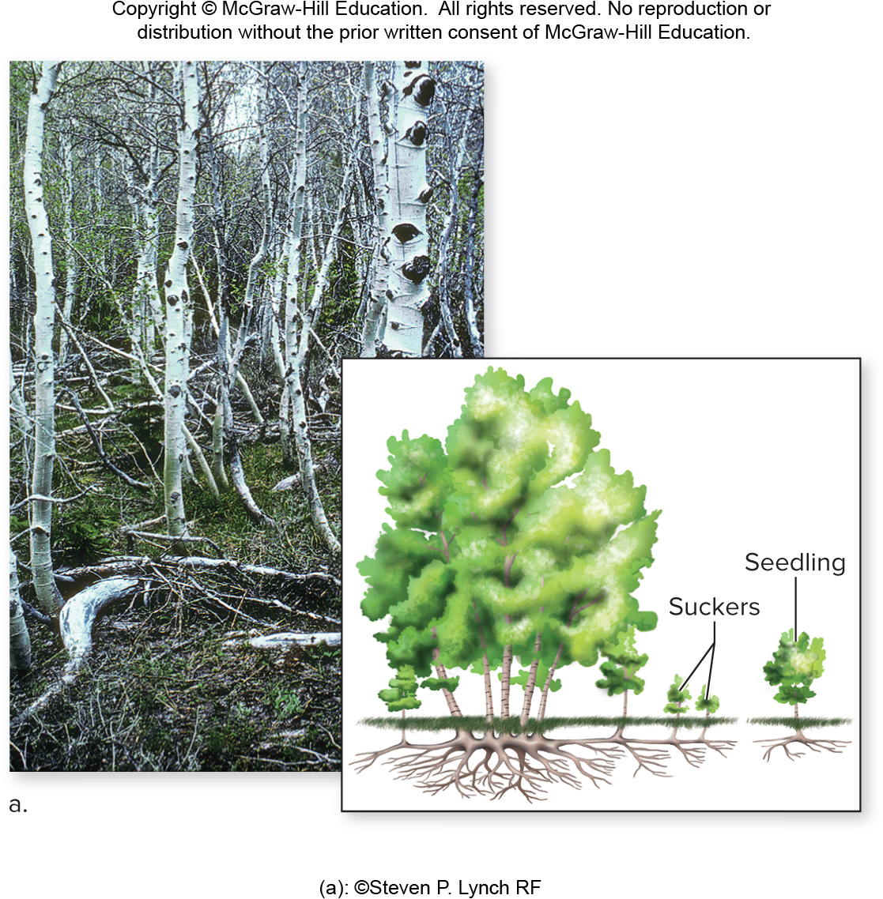
Some angiosperms reproduce asexually
Some species of angiosperms also reproduce asexually, forming new individuals by mitotic division.
Section 24.1
(a): ©Steven P. Lynch RF
Figure 24.1

Slide 6
Asexual reproduction produces clones
Offspring produced asexually are genetically identical
to each other and to their parents.
Section 24.1
(a): ©Steven P. Lynch RF
Figure 24.1

Slide 7
Some angiosperms can reproduce sexually or asexually
These aspen trees can reproduce either asexually, as suckers grow from roots, or sexually via seeds.
Section 24.1
(a): ©Steven P. Lynch RF
Figure 24.1

Slide 8
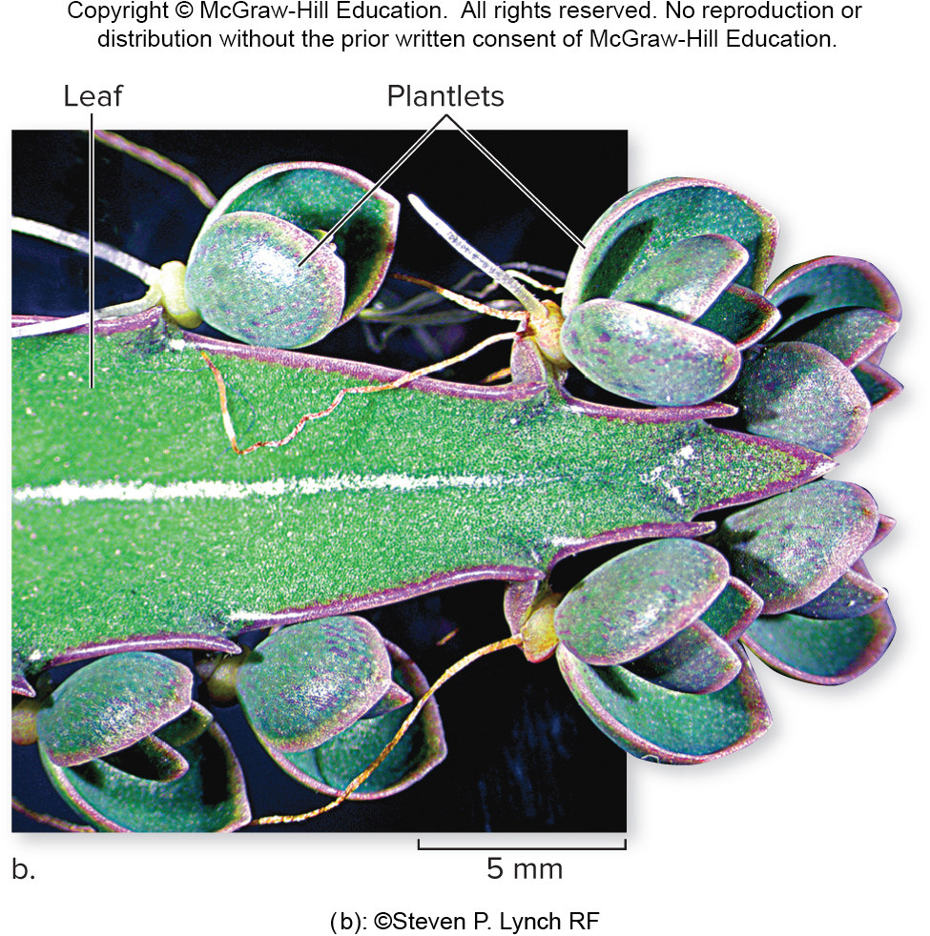
An example of asexual reproduction
Similarly, the leaves of this kalanchoe plant produce genetically identical plantlets.
(b): ©Steven P. Lynch RF
Section 24.1
Figure 24.1

Slide 9
Advantages of asexual and sexual reproduction
Asexual reproduction is advantageous when conditions are stable and plants are well-adapted to their surroundings.
Sexual reproduction produces variable offspring,
increasing reproductive success in a changing world.
(b): ©Steven P. Lynch RF
Figures 24.1 24.11
(a): ©Rod Planck/Science Source
Section 24.1

Slide 10
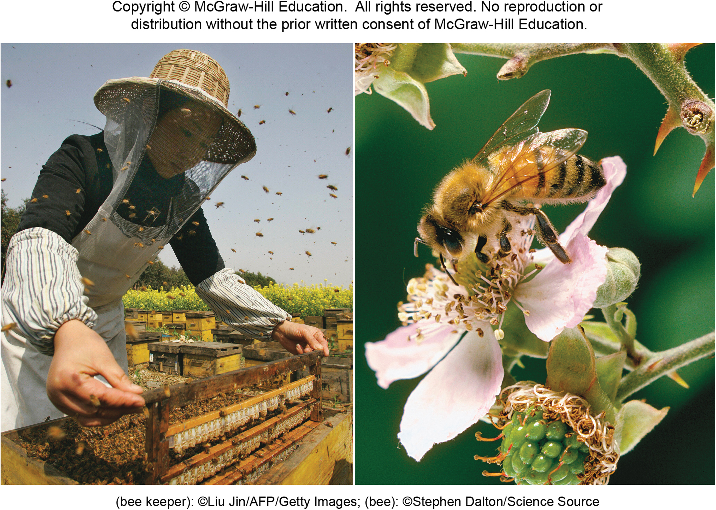
24.1 Mastering concepts
When are sexual and asexual reproduction each adaptive?
(bee keeper): ©Liu Jin/AFP/Getty Images; (bee): ©Stephen Dalton/Science Source

Slide 11
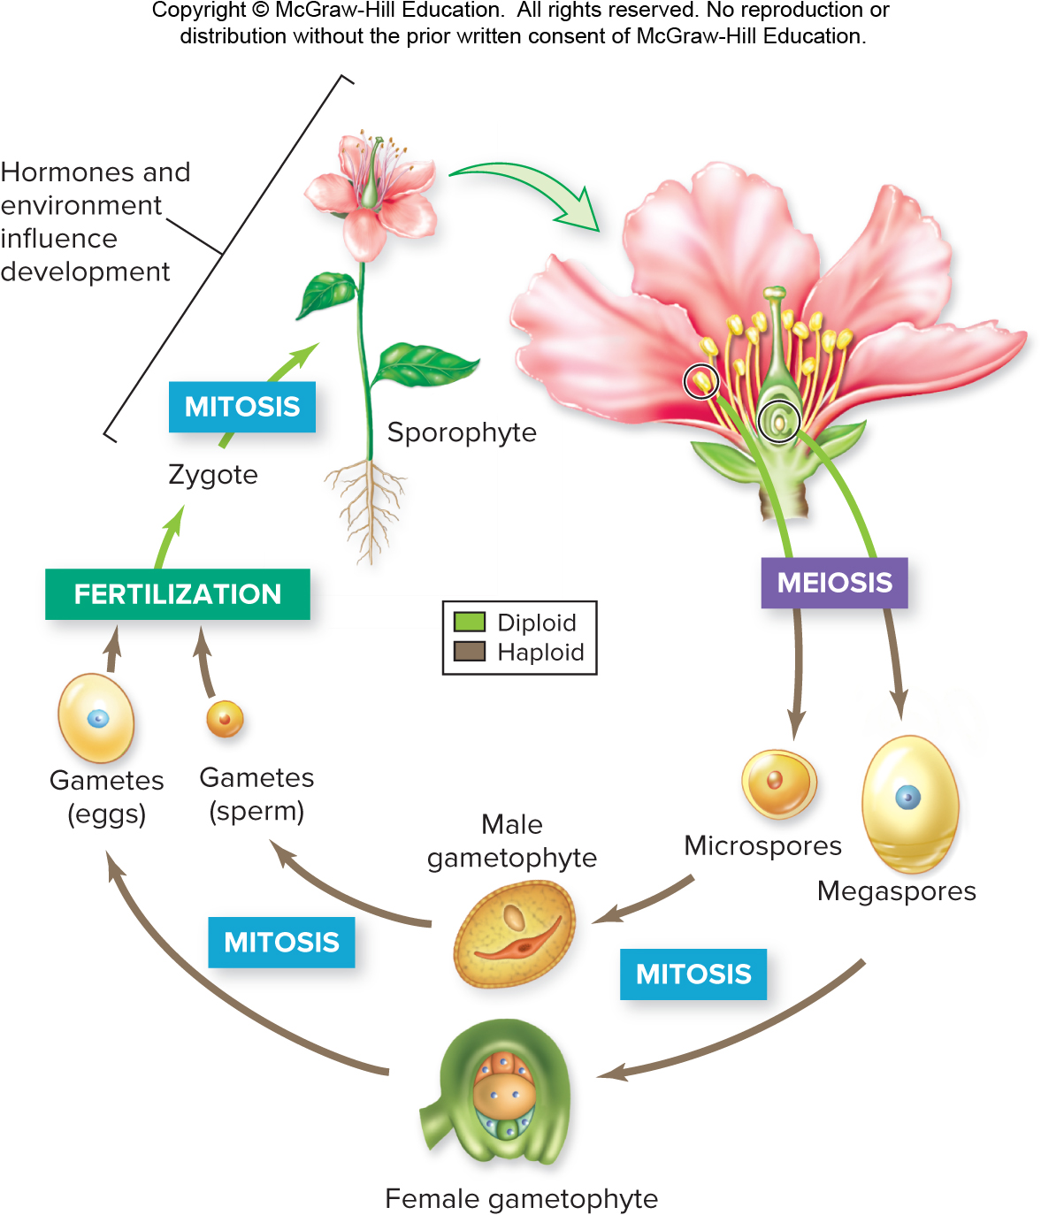
Angiosperm sex: Flowers, fruits, and seeds
The angiosperm life cycle is an alternation of generations with multicellular diploid and haploid stages.
Section 24.2
Figure 24.3

Slide 12
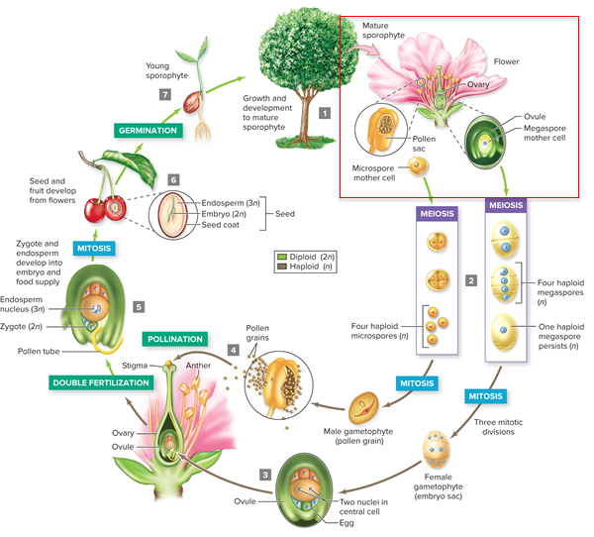
Alternation of generations
This diagram is an overview of the angiosperm life cycle.
Let’s start with the flower.
Section 24.2
Figure 24.4

Slide 13
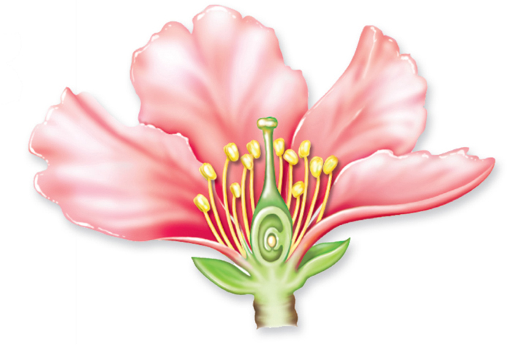
Angiosperm sex: Flowers
The first step in angiosperm reproduction is the formation of flowers on the mature sporophyte.
Section 24.2
Figure 24.5

Slide 14
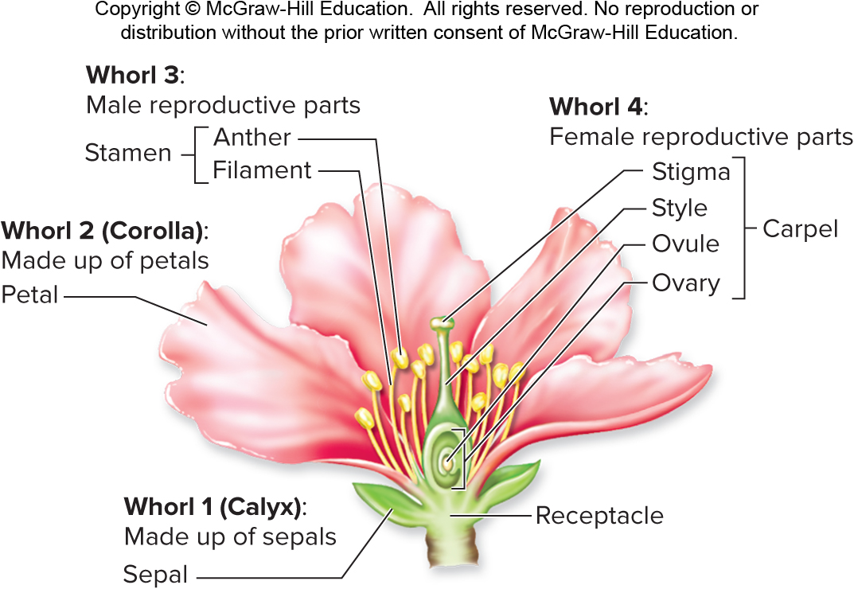
Angiosperm flower structures
A typical flower has four whorls of structures, all of which are modified leaves.
Section 24.2
Figure 24.5

Slide 15
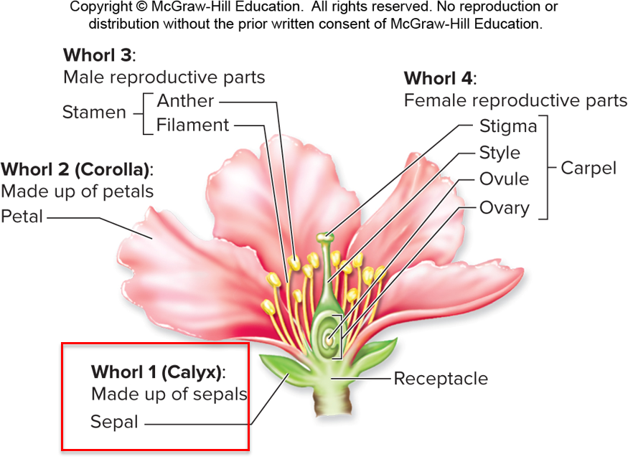
Angiosperm flower structures: Calyx
The outer whorl is the calyx. It consists of sepals, which enclose and protect the inner floral parts.
Section 24.2
Figure 24.5

Slide 16
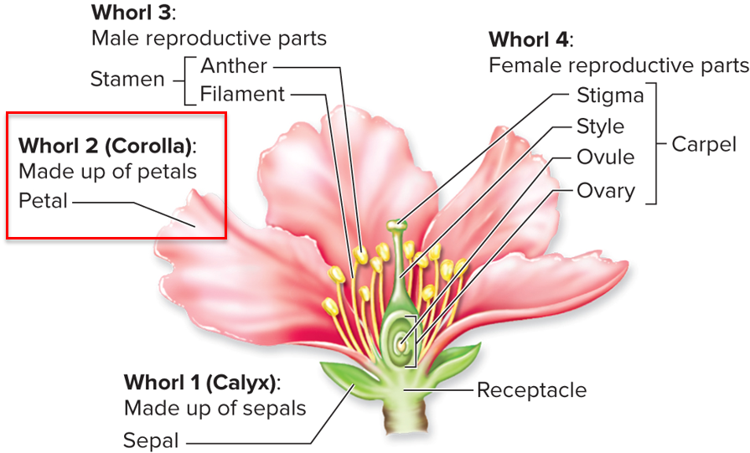
Angiosperm flower structures: Corolla
The second whorl is the corolla, which is made of petals.
Section 24.2
Figure 24.5

Slide 17
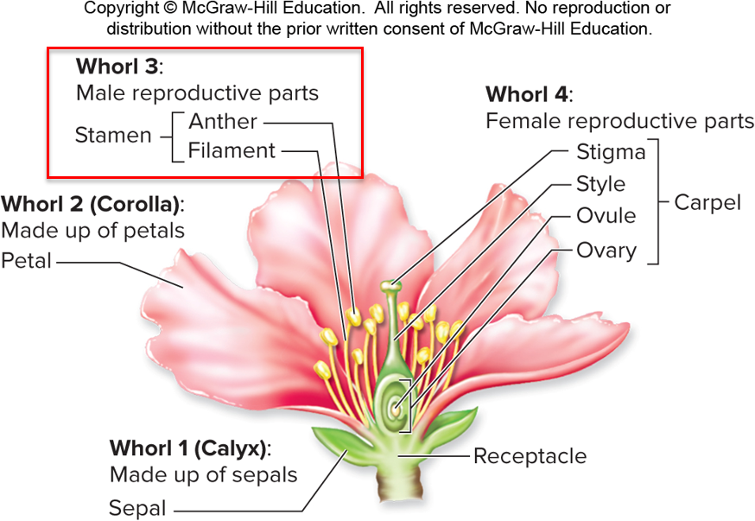
Angiosperm flower structures: Stamen
The third whorl is the male reproductive parts. Stamens are filaments with pollen-producing anthers on top.
Section 24.2
Figure 24.5

Slide 18
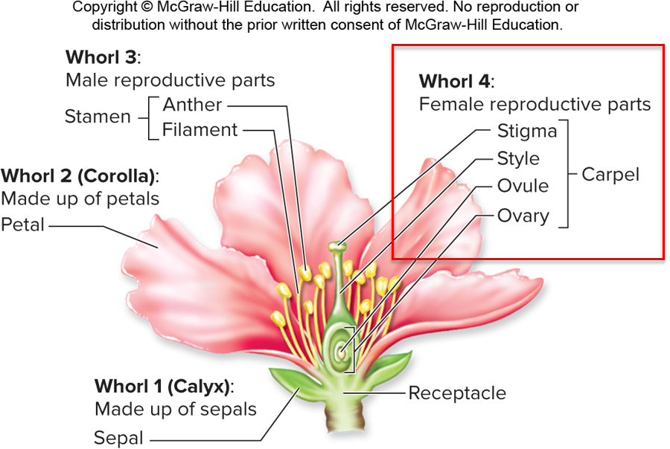
Angiosperm flower structures: Carpel
The fourth whorl is the female reproductive parts. A carpel includes:
-the ovary, which encloses one or more ovules.
-a stalklike style. The top of the style, called the stigma, receives pollen.
Section 24.2
Figure 24.5

Slide 19
Inside the flower: Meiosis
Inside the flower, meiosis produces haploid spores that develop into gametophytes.
Section 24.2
Figure 24.3

Slide 20
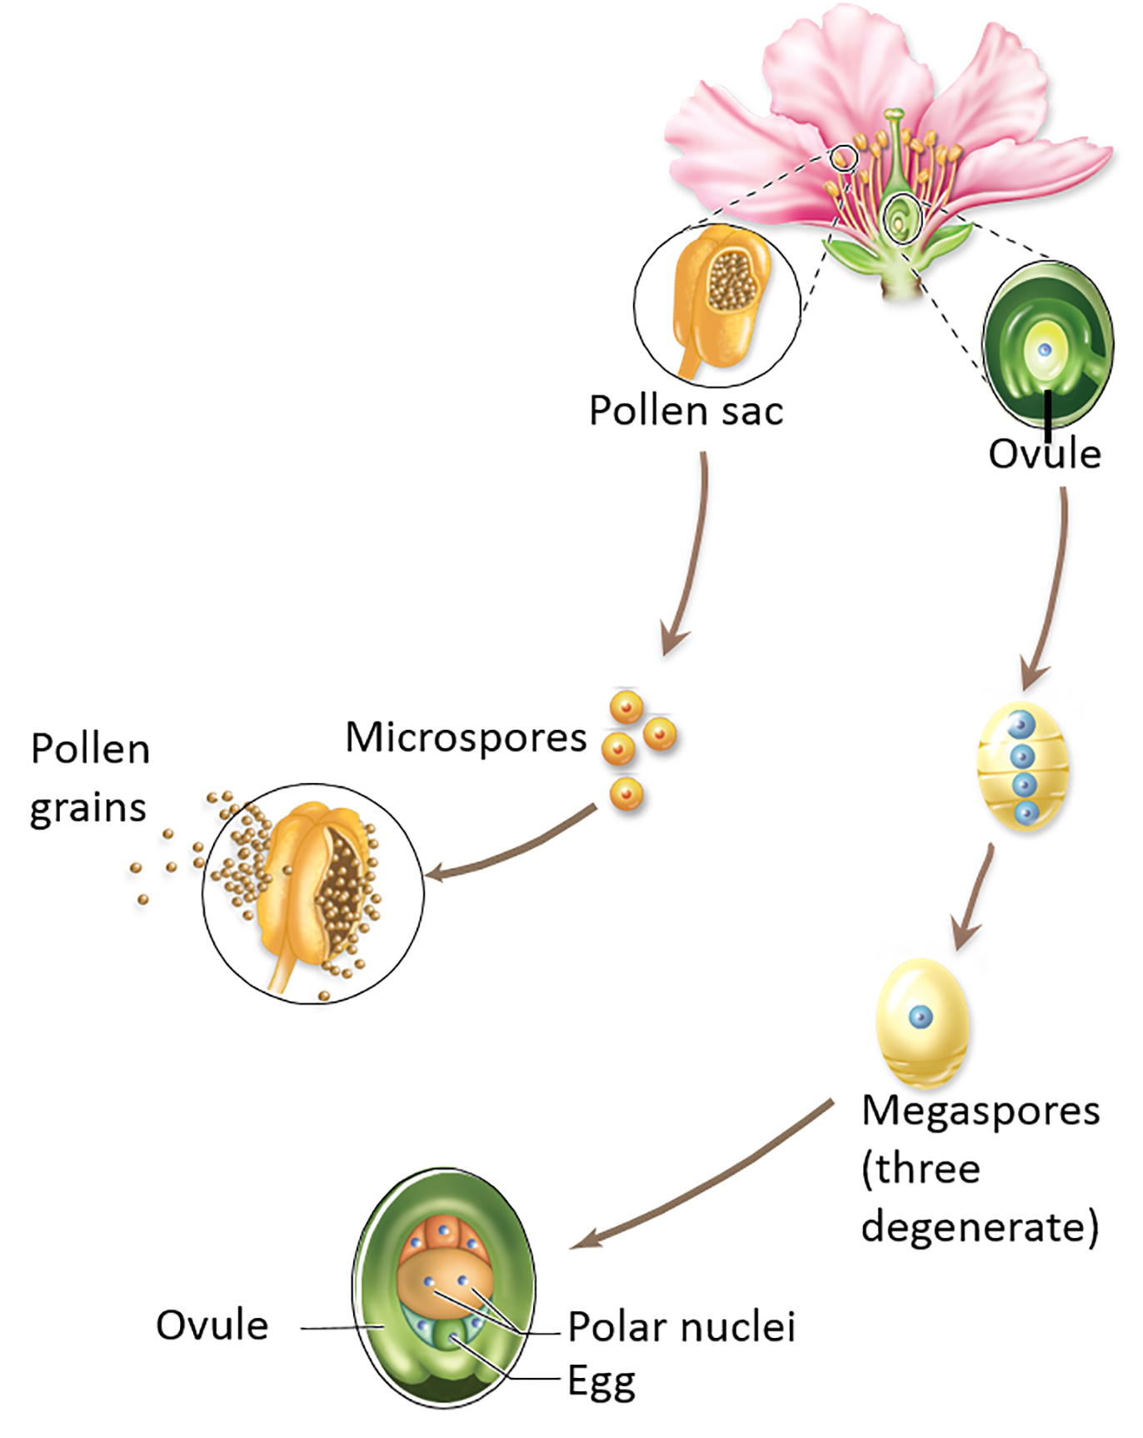
Inside the flower: Microspores and megaspores
Anthers produce microspores, which divide into male gametophytes (pollen grains).
Ovules produce megaspores, which divide into female gametophytes (embryo sacs).
Section 24.2
Figure 24.4

Slide 21
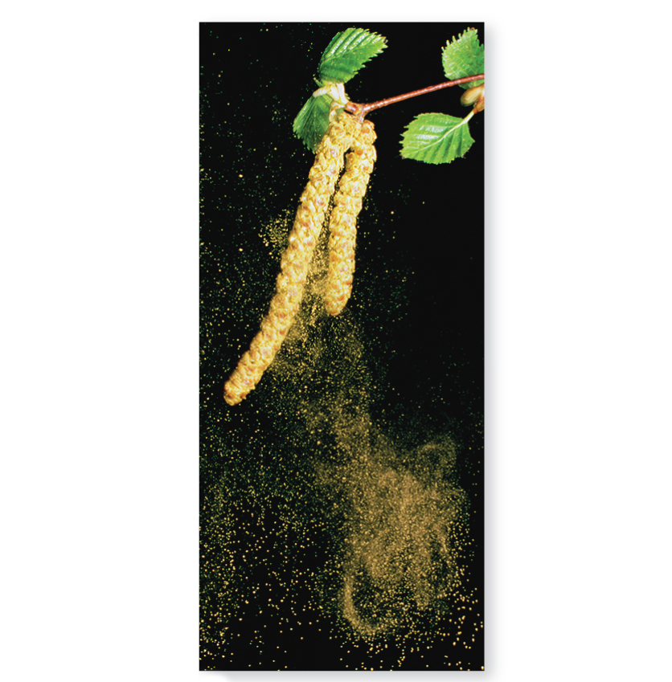
Modes of pollen dispersal: Wind
Some flowers release pollen grains in the wind.
©Dr. Jeremy Burgess/Science Source
Section 24.2
Figure 24.6

Slide 22
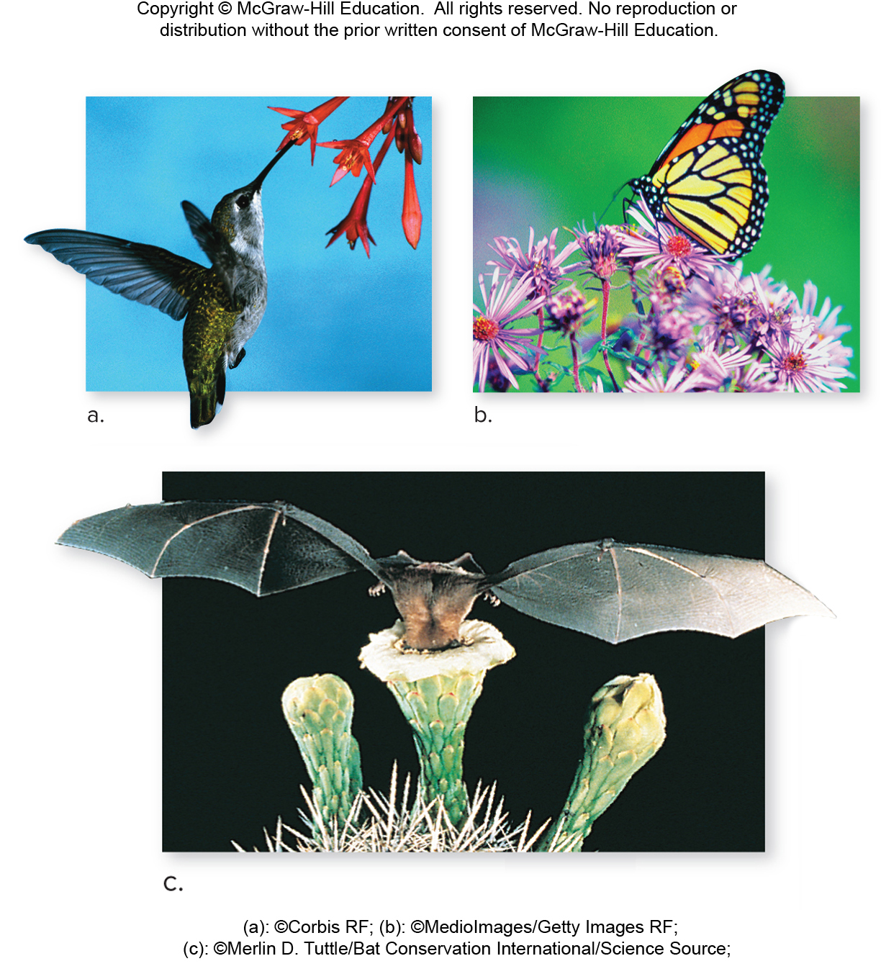
Modes of pollen dispersal: Animals
Other flowers attract animal pollinators, which unwittingly carry pollen between plants.
(a): ©Corbis RF; (b): ©MedioImages/Getty Images RF;
(c): ©Merlin D. Tuttle/Bat Conservation International/Science Source
Section 24.2
Figure 24.6

Slide 23
Plant and pollinator: A mutualistic relationship
Often, the pollinator benefits from its association with plants—animals use plants for food, shelter, or a mating ground.
(a): ©Corbis RF; (b): ©MedioImages/Getty Images RF;
(c): ©Merlin D. Tuttle/Bat Conservation International/Science Source
Section 24.2
Figure 24.6

Slide 24
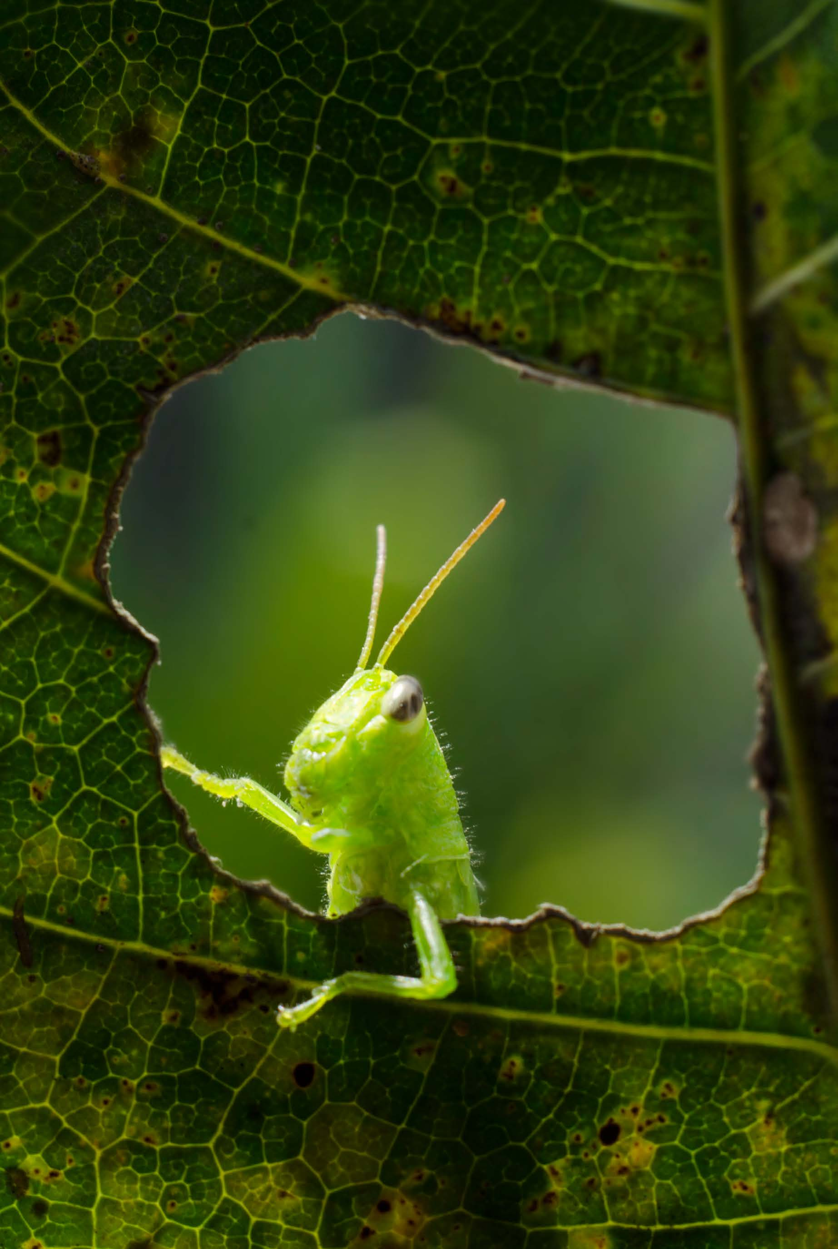
Clicker question #1
An “imperfect” flower is one that lacks either male or female parts. A flower lacking male parts would still produce
pollen.
anthers.
an embryo sac.
egg cells.
Both an embryo sac and eggs cells are correct.

Slide 25
Clicker question #1, solution
An “imperfect” flower is one that lacks either male or female parts. A flower lacking male parts would still produce
Both an embryo sac and egg cells are correct.

Slide 26
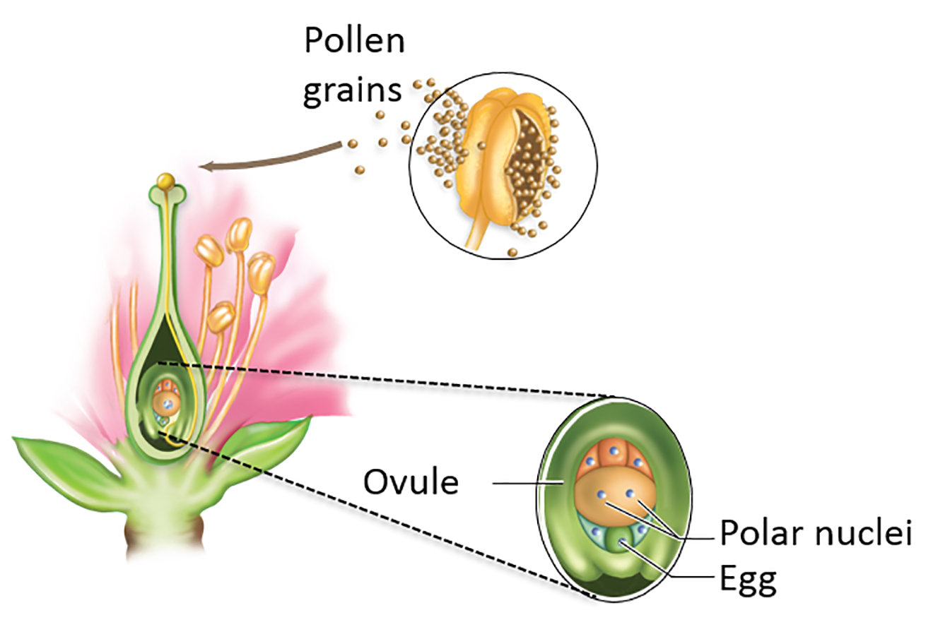
Angiosperm sex: Pollination
If a pollen grain lands on a receptive stigma, pollination occurs.
Section 24.2
Figure 24.4

Slide 27
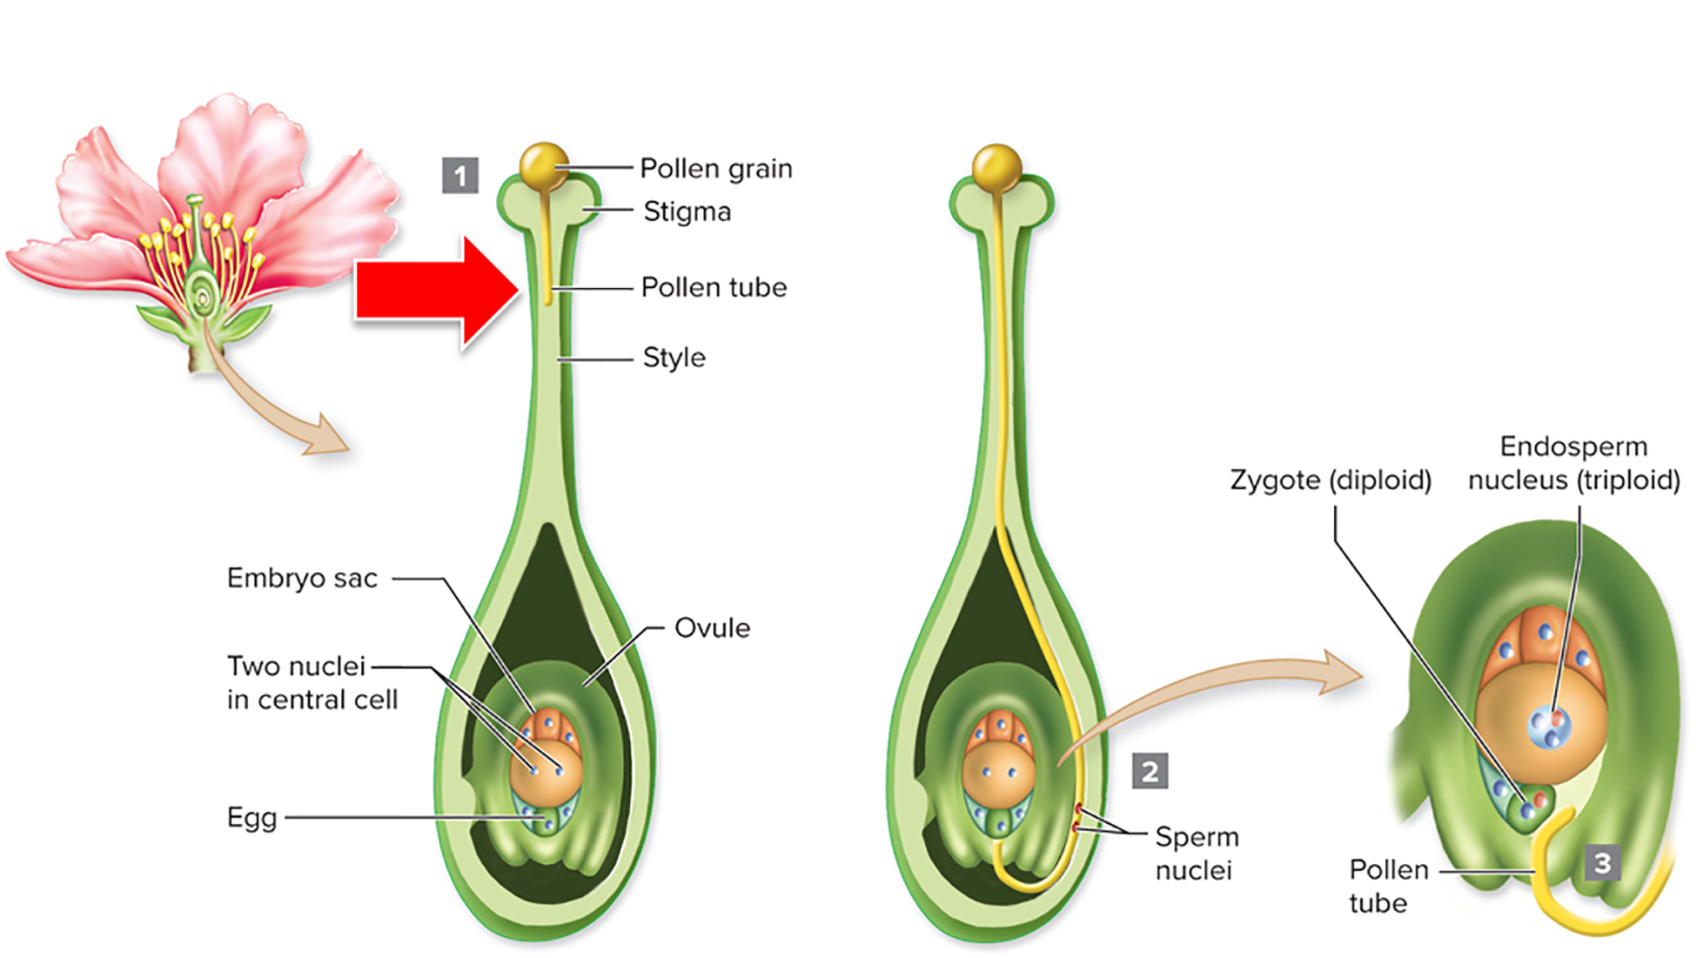
Angiosperm sex: Pollen tube
When the pollen grain germinates, a pollen tube begins to grow toward the ovule.
Section 24.2
Figure 24.7

Slide 28
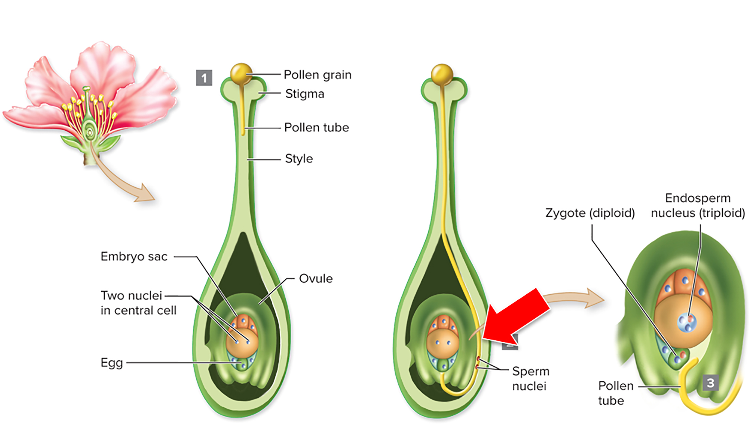
Angiosperm sex: Two sperm nuclei
Two sperm nuclei travel through the pollen tube to the ovule.
Section 24.2
Figure 24.7

Slide 29
Angiosperm sex: Fertilization
The stage is now set for fertilization.
Section 24.2
Figure 24.3

Slide 30
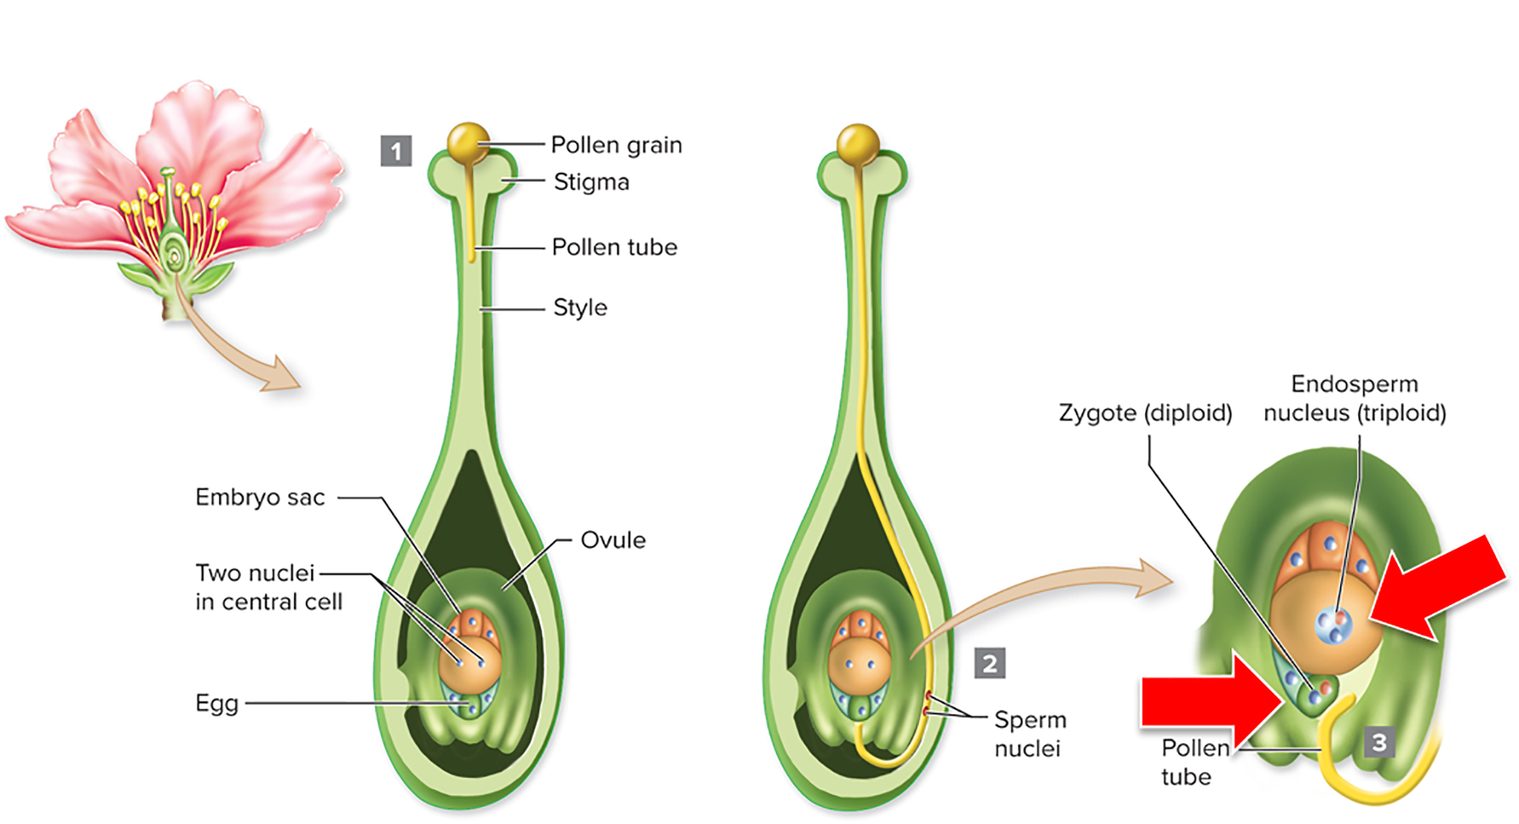
Angiosperm sex: Double fertilization
In double fertilization, these sperm nuclei fertilize the egg and the two polar nuclei.
Section 24.2
Figure 24.7

Slide 31
Angiosperm sex: Triploid endosperm
Double fertilization results in a diploid zygote and triploid endosperm nucleus.
Section 24.2
Figure 24.7

Slide 32
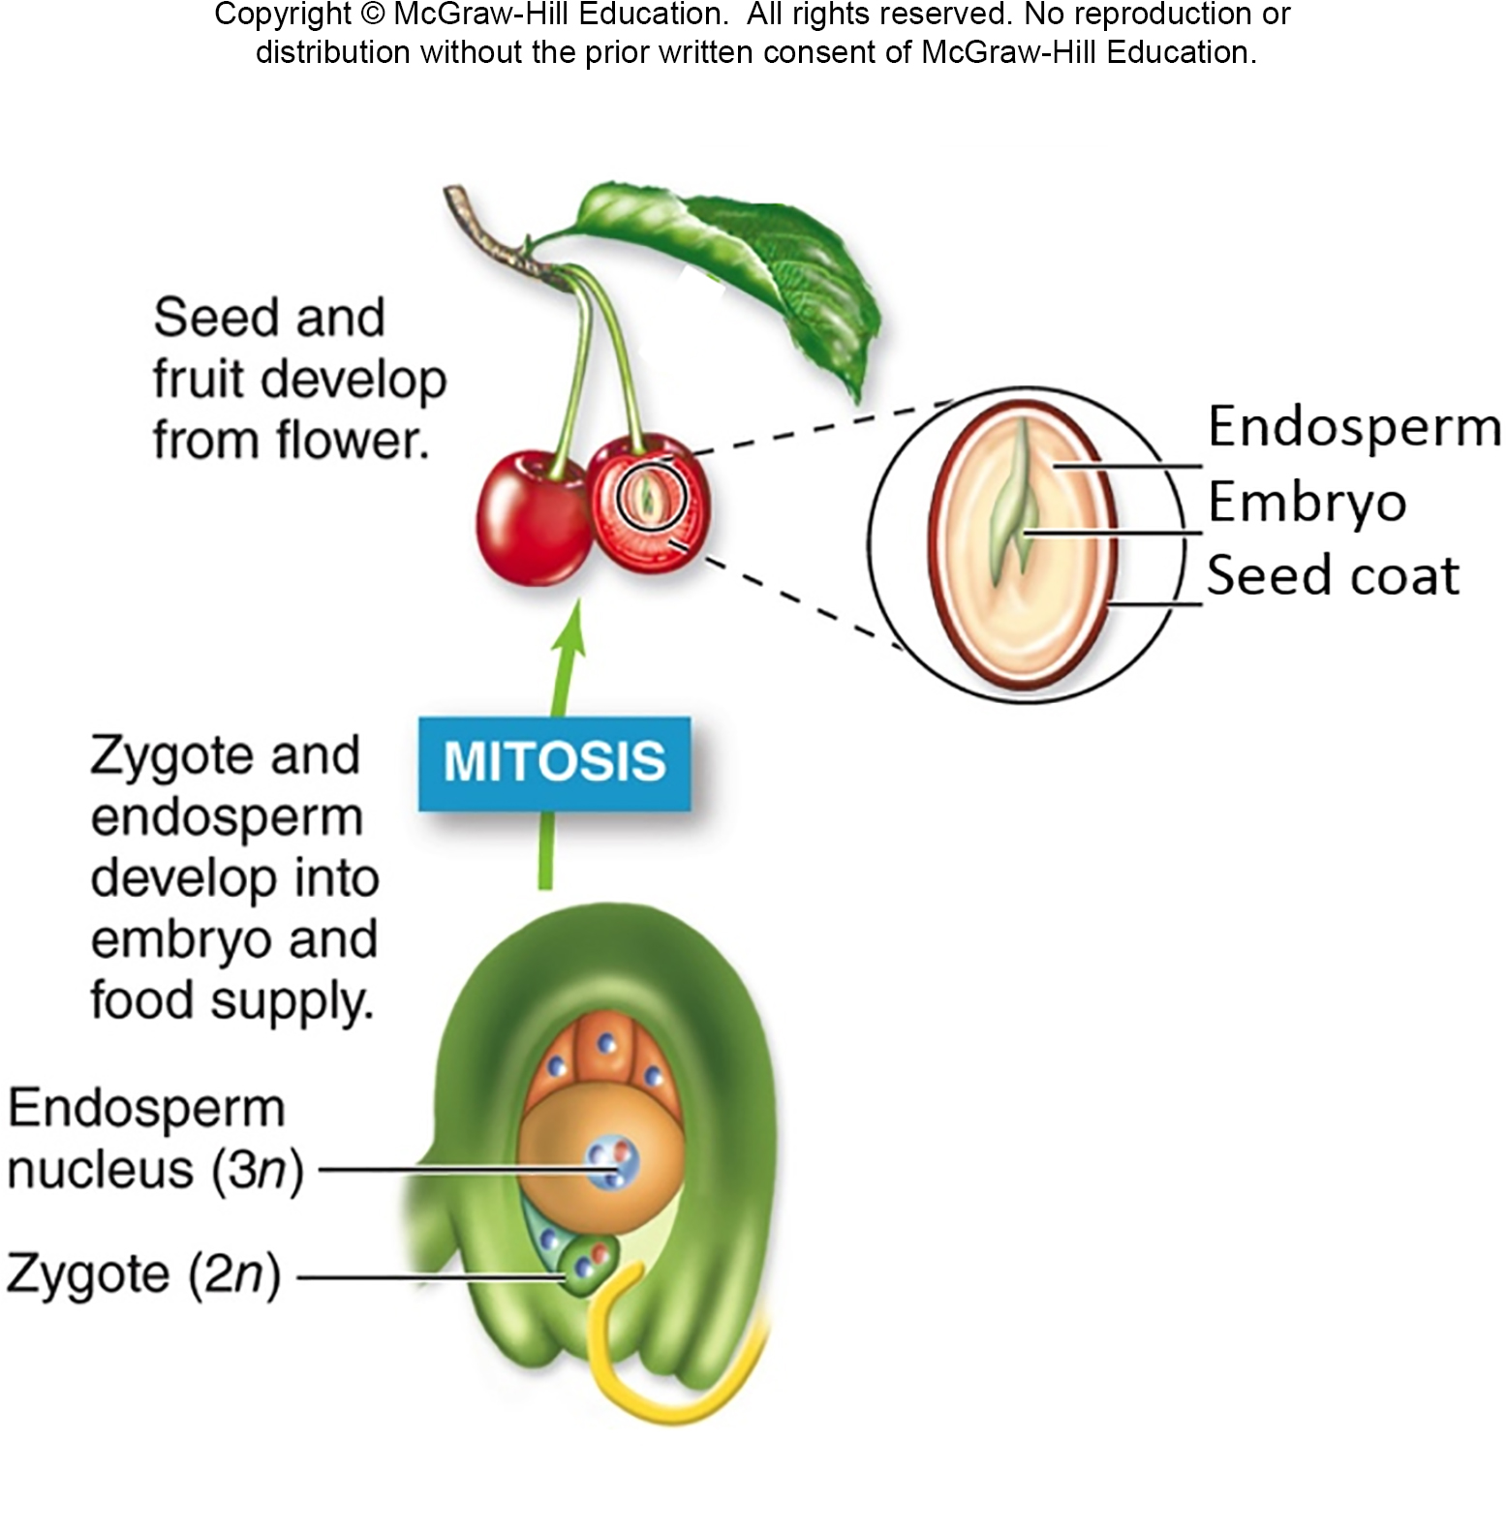
Angiosperm sex: Seeds
After fertilization, the seed starts to develop.
A seed consists of an embryo, endosperm, and seed coat.
Section 24.2
Figure 24.4

Slide 33
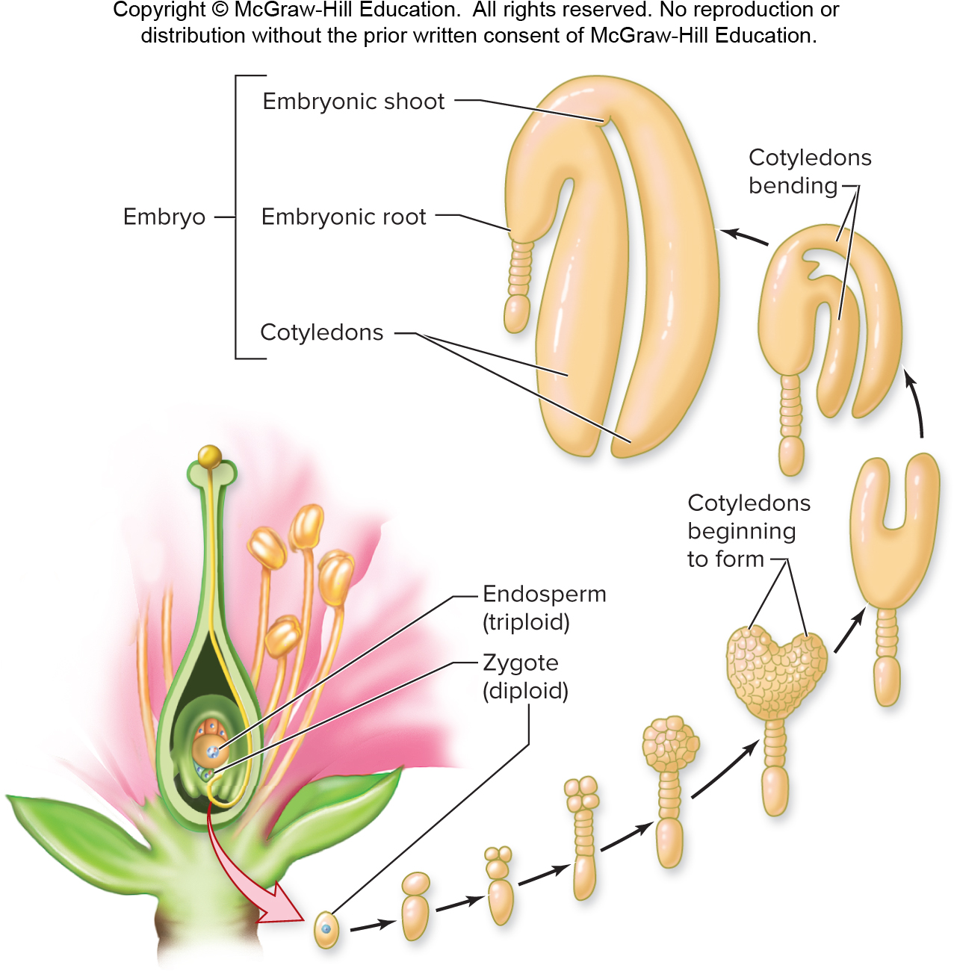
Seeds contain an embryo
The zygote develops from a single cell into an embryo.
Section 24.2
Figure 24.8

Slide 34
Seeds contain cotyledons
Cotyledons are the embryo’s “seed leaves.” Embryonic shoots and roots also form.
Section 24.2
Figure 24.8

Slide 35
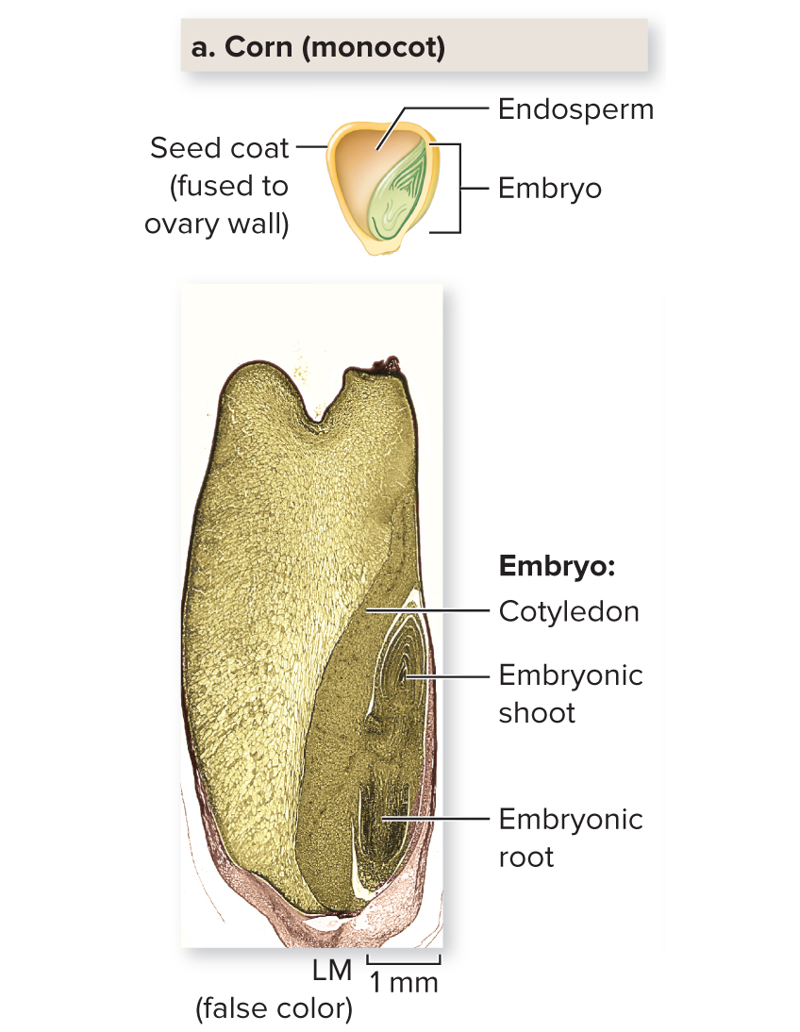
Endosperm feeds the embryo
Endosperm cells divide rapidly and nourish the embryo.
(a): ©Steven P. Lynch/McGraw-Hill Education
Section 24.2
Figure 24.9

Slide 36
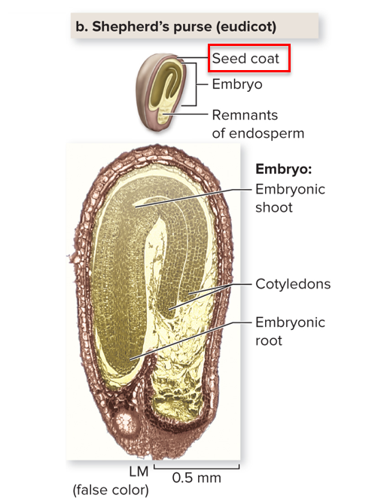
The seed coat
The seed coat is a tough outer layer that protects
the embryo from damage, dehydration, and predators.
Section 24.2
(b): ©Steven P. Lynch RF
Figure 24.9

Slide 37
Angiosperm sex: Fruits
At the same time, a fruit develops from the ovary enclosing the developing seed(s).
Section 24.2
Figure 24.4

Slide 38
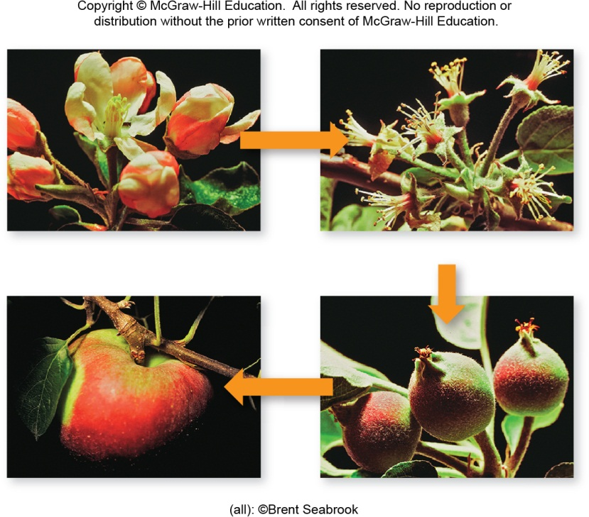
Fruit formation
These photos show how the fruit forms.
After pollination, the flower loses its petals.
Pollination occurs.
Petals are shed.
Fruit protects and disperses seeds.
Ovary and receptacle swell as seeds develop.
(all): ©Brent Seabrook
Section 24.2
Figure 24.10

Slide 39
Hormones and fruit formation
A developing seed releases hormones that trigger
fruit formation. The ovary swells.
Pollination occurs.
Petals are shed.
Fruit protects and disperses seeds.
Ovary and receptacle swell as seeds develop.
(all): ©Brent Seabrook
Section 24.2
Figure 24.10

Slide 40
Clicker question #2
Angiosperms and humans reproduce sexually. Pollination in plants is analogous to ___ in humans; seed development in plants is analogous to ___ in humans.
sexual intercourse; growth of the fetus
dating; going through puberty
fertilization; early childhood
gamete formation; birth
None of the choices is correct.

Slide 41
Clicker question #2, solution
Angiosperms and humans reproduce sexually. Pollination in plants is analogous to ___ in humans; seed development in plants is analogous to ___ in humans.
sexual intercourse; growth of the fetus
Flower: © Doug Sherman/Geofile/RF

Slide 42
There are many types of fruit
TABLE 24.1 Types of Fruits: A Summary
Fruits come in many forms.
Fruit Type
Characteristics
Example(s)
Simple
Derived from one flower with one carpel
Olive, cherry, peach, plum, coconut, grape, tomato, pepper, eggplant, apple, pear
©Ingram Publishing/ Alamy RF
Aggregate
Derived from one flower with many separate carpels
Blackberry, strawberry, raspberry, magnolia
©Corbis RF
Multiple
Derived from tightly clustered flowers whose ovaries fuse as the fruit develops
Pineapple, fig
©Ingram Publishing/ Alamy RF
Section 24.2
Table 24.1

Slide 43
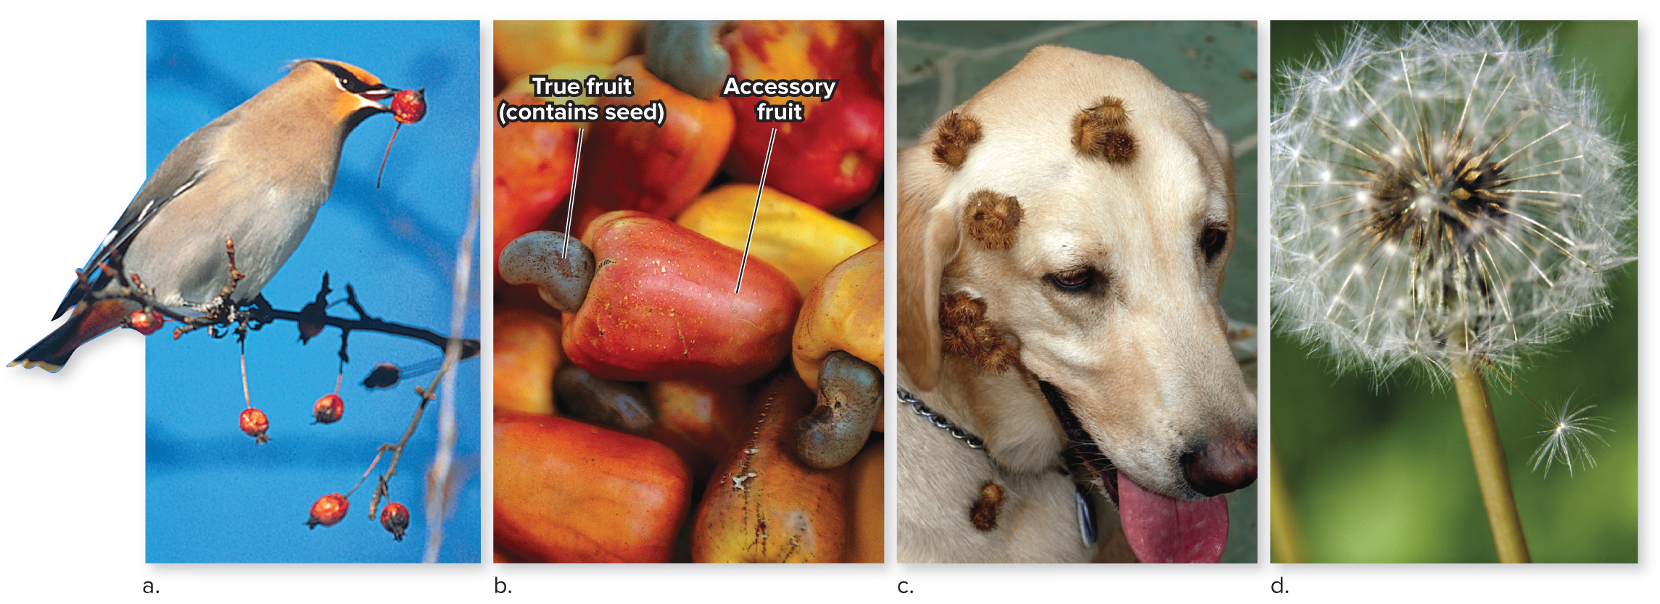
The function of fruit
Fruits protect and disperse seeds.
Seeds carried away from parent plants decrease the
chance of competition among parents, offspring, and siblings.
(a): ©Rod Planck/Science Source; (b): ©Barry Barker/McGraw-Hill Education; (C) ©Scott Camazine/Science Source; (d): ©Ingram Publishing/SuperStock RF
Section 24.2
Figure 24.11

Slide 44
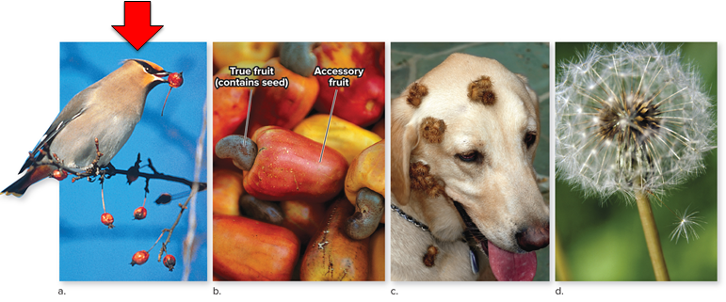
When does fruit ripen?
Unripe fruits, which contain immature seeds, are usually distasteful. Ripe fruits are tasty; mature seeds are deposited in droppings.
(a): ©Rod Planck/Science Source; (b): ©Barry Barker/McGraw-Hill Education; (C) ©Scott Camazine/Science Source; (d): ©Ingram Publishing/SuperStock RF
Section 24.2
Figure 24.11

Slide 45
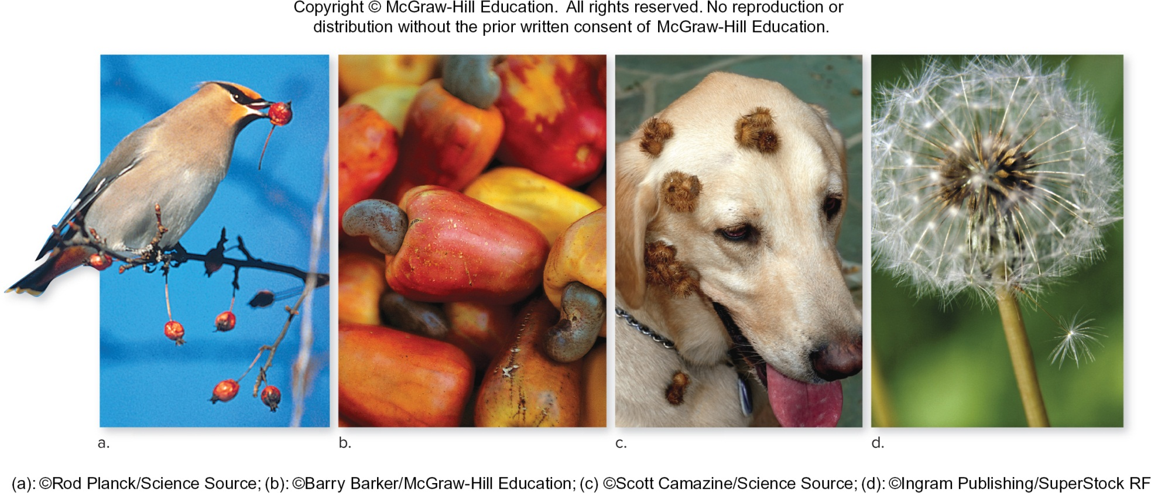
Prickly fruits
Prickly fruits stick to feathers or fur.
Section 24.2
Figure 24.11

Slide 46
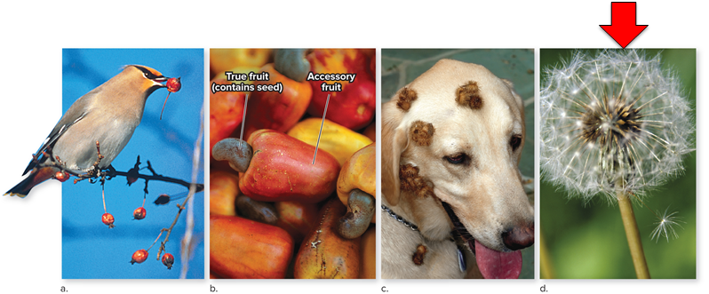
Flying and floating fruit
Some fruits catch the wind with tufts of fluff.
Still others float in water currents.
(a): ©Rod Planck/Science Source; (b): ©Barry Barker/McGraw-Hill Education; (C) ©Scott Camazine/Science Source; (d): ©Ingram Publishing/SuperStock RF
Section 24.2
Figure 24.11

Slide 47
24.2 Mastering concepts
How does pollen move from one flower to another, and why is this process essential for sexual reproduction?
(bee keeper): ©Liu Jin/AFP/Getty Images; (bee): ©Stephen Dalton/Science Source

Slide 48
Plant growth begins with seed germination
How does the embryo continue developing into a mature sporophyte?
Section 24.3
Figure 24.3

Slide 49
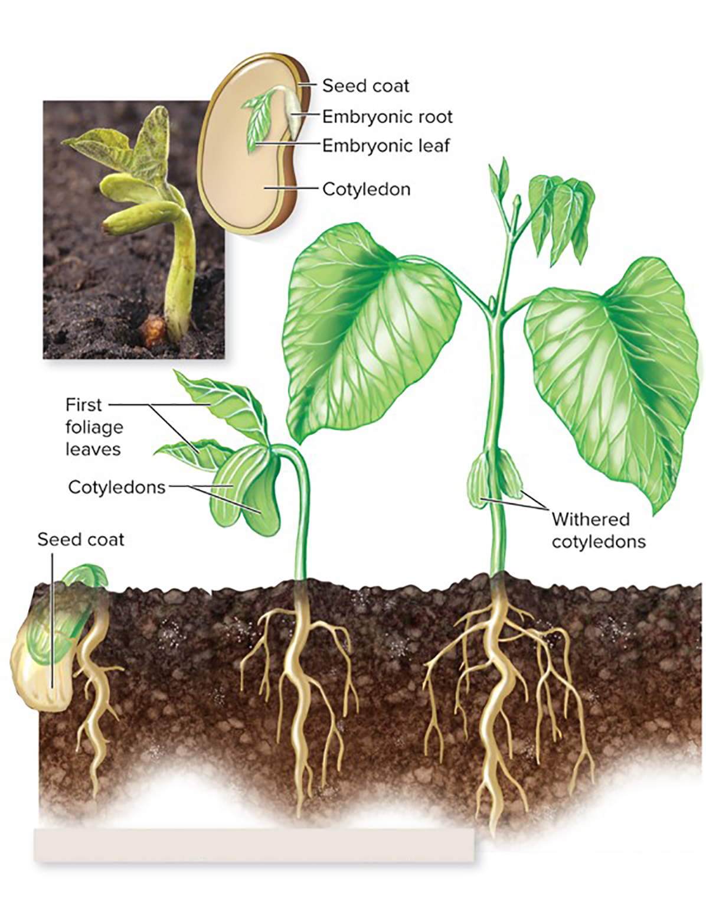
Seed germination
Continued development requires seed germination, the resumption of growth and development after a period of seed dormancy.
Germination requires water, $O_{2}$, and a favorable temperature.
Bean (eudicot) germination and development
(b): ©Ed Reschke/Photolibrary/Getty Images
Section 24.3
Figure 24.12

Slide 50
Seed germination: Rupturing the seed coat
The seed absorbs water and swells, rupturing the seed coat and exposing the embryo to $O_{2}$.
Bean (eudicot) germination and development
(b): ©Ed Reschke/Photolibrary/Getty Images
Section 24.3
Figure 24.12

Slide 51
Seed germination: Endosperm fuels the growth of the embryo
Meanwhile, enzymes break down the endosperm’s starch into sugars.
The availability of $O_{2}$ and sugars means cellular respiration can resume in the embryo. Cell division at apical meristems rapidly lengthens the young roots and shoot.
Bean (eudicot) germination and development
(b): ©Ed Reschke/Photolibrary/Getty Images
Section 24.3
Figure 24.12

Slide 52
Plant growth before photosynthesis
At first, the only energy source is fuel stored in the endosperm.
Bean (eudicot) germination and development
(b): ©Ed Reschke/Photolibrary/Getty Images
Section 24.3
Figure 24.12

Slide 53
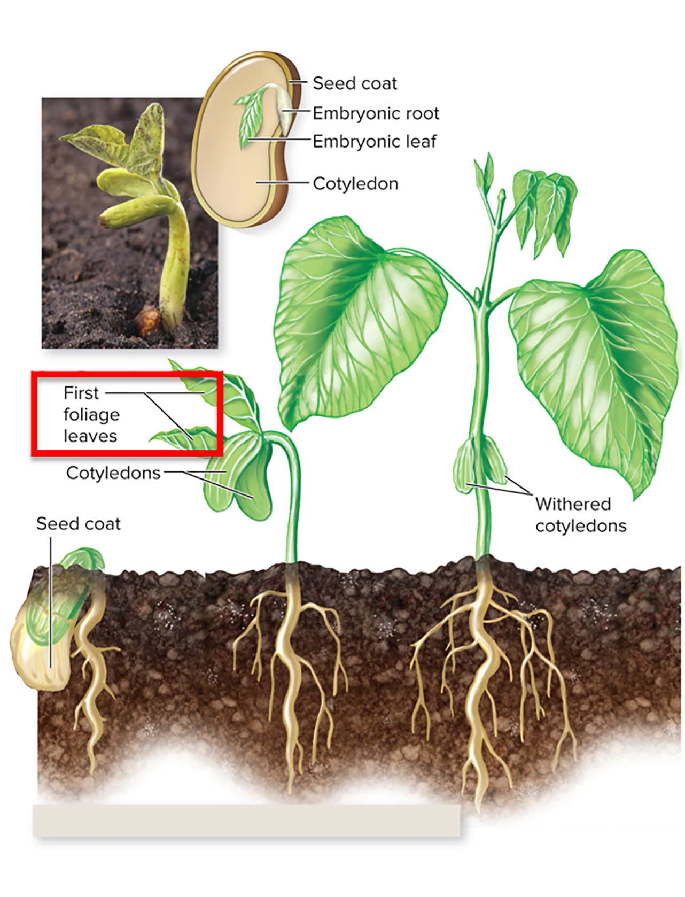
Photosynthesis takes over
After the shoot emerges from the ground and the first leaves unfold, photosynthesis begins.
Bean (eudicot) germination and development
(b): ©Ed Reschke/Photolibrary/Getty Images
Section 24.3
Figure 24.12

Slide 54
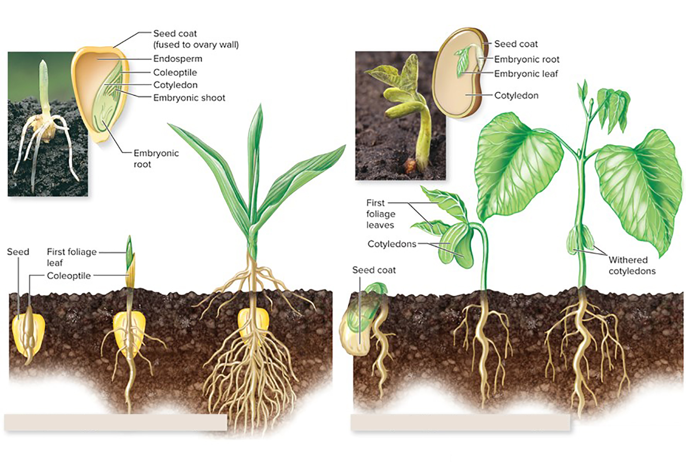
Seed germination in monocots and dicots
Monocots and eudicots, two groups of plants, have slightly different development patterns.
Monocot development
Eudicot development
Corn (monocot) germination and development
Bean (eudicot) germination and development
Section 24.3
(a): ©Dwight Kuhn; (b): ©Ed Reschke/Photolibrary/Getty Images
Figure 24.12

Slide 55
Clicker question #3
A seed that lands on dry pavement is unlikely to germinate because it does not receive enough
light.
oxygen.
food.
water.

Slide 56
Clicker question #3, solution
A seed that lands on dry pavement is unlikely to germinate because it does not receive enough
water.

Slide 57
24.3 Mastering concepts
What are the events of early seedling development?
(bee keeper): ©Liu Jin/AFP/Getty Images; (bee): ©Stephen Dalton/Science Source

Slide 58
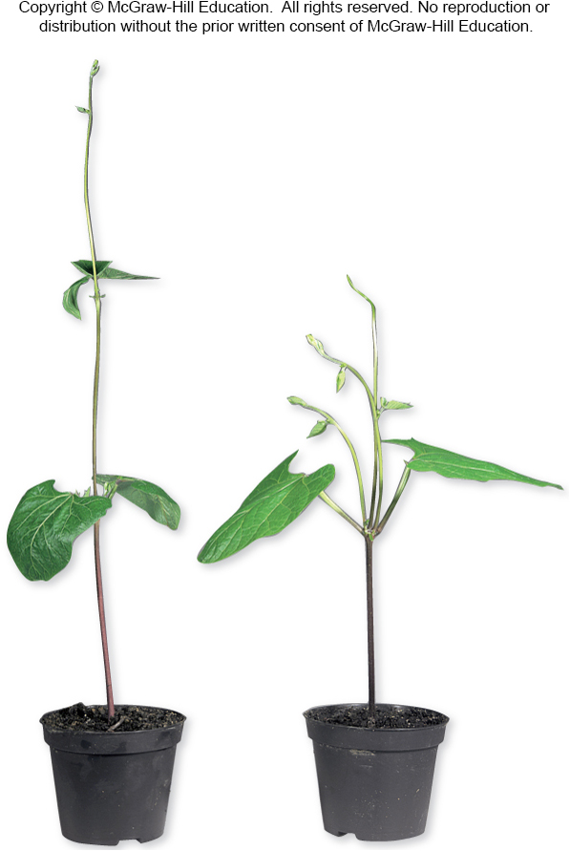
Hormones regulate plant growth
Chemicals called hormones travel between cells and regulate many aspects of plant growth.
©Nigel Cattlin/Alamy
Section 24.4
Figure 24.14

Slide 59
Five hormones regulate most plant growth
Five hormones cue many of the major changes in plant growth and development:
auxins,
cytokinins,
gibberellins,
ethylene,
abscisic acid.
©Nigel Cattlin/Alamy
Section 24.4
Figure 24.14

Slide 60
Hormones regulate plant growth: Auxin
Auxins control plant responses to light and gravity, promote elongation of cells in a stem, and suppress the growth of lateral buds.
©Nigel Cattlin/Alamy
Section 24.4
Figure 24.14

Slide 61
Hormones regulate plant growth: Cytokinins
Cytokinins stimulate cell division in many plant parts, delay shedding of leaves, and stimulate growth of lateral buds.
©Nigel Cattlin/Alamy
Section 24.4
Figure 24.14

Slide 62
Apical dominance
Auxins are primarily released from the shoot tip, and cytokinins are primarily released from the roots.
The counteracting effect of these hormones is called apical dominance.
©Nigel Cattlin/Alamy
Section 24.4
Figure 24.14

Slide 63
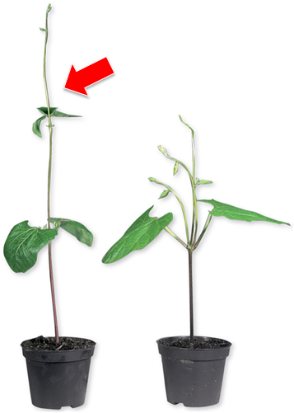
The role of auxin
Apical dominance
If the shoot tip is in place, auxins suppress the growth of lateral buds.
©Nigel Cattlin/Alamy
Section 24.4
Figure 24.14

Slide 64
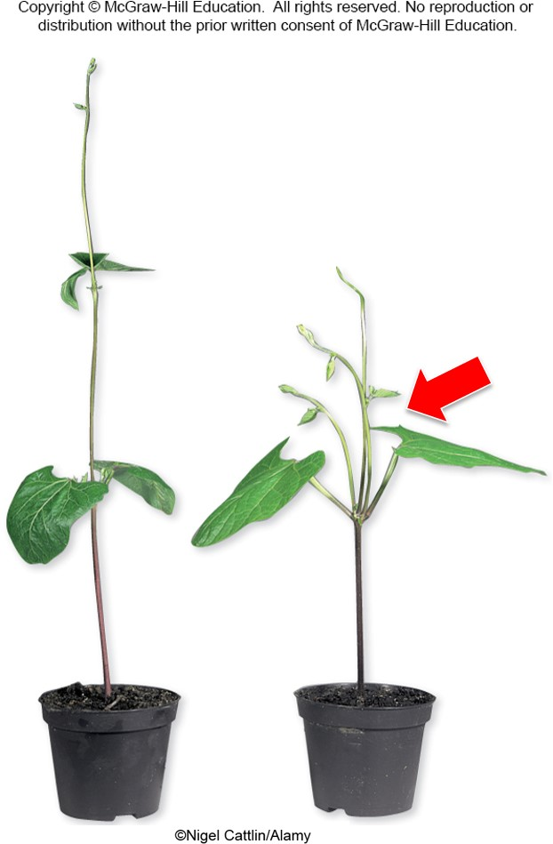
The role of cytokinins
Apical dominance
Removing the shoot tip reduces the auxin concentration. Cytokinins stimulate cell division in lateral buds.
The plant’s growth becomes bushier.
Section 24.4
©Nigel Cattlin/Alamy
Figure 24.14

Slide 65
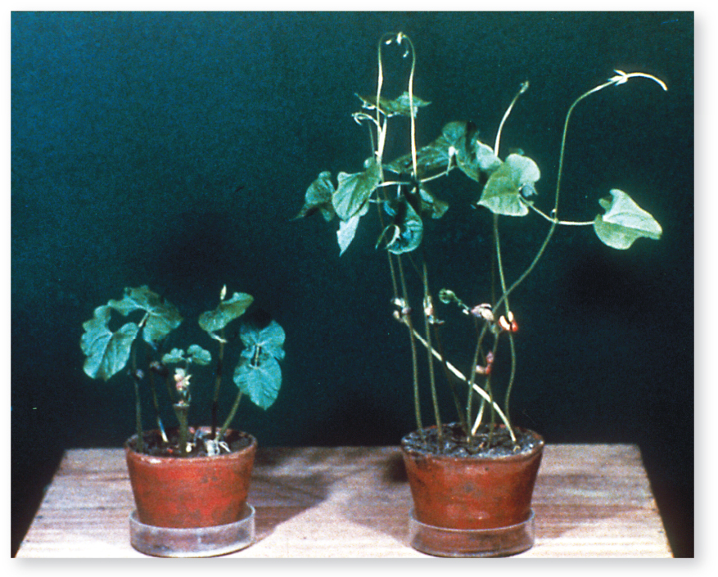
Hormones regulate plant growth: Gibberellins
Gibberellins also stimulate shoot elongation. Farmers use these hormones to stimulate stem elongation and fruit growth.
©Custom medical Stock Photo/Newscom
Section 24.4
Figure 24.15

Slide 66
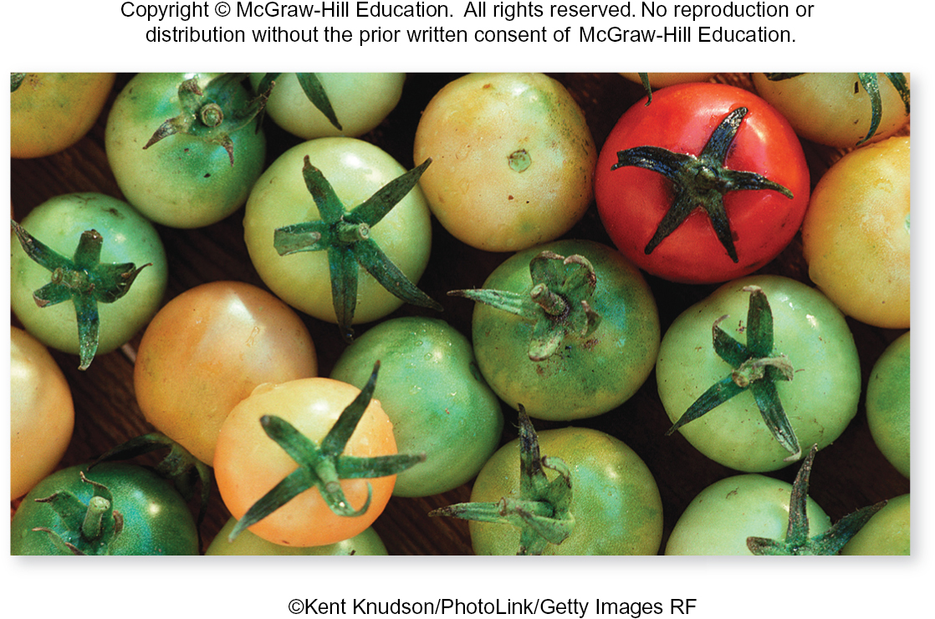
Hormones regulate plant growth: Ethylene
Ethylene hastens fruit ripening and stimulates shedding of leaves, flowers, and fruits.
©Kent Knudson/PhotoLink/Getty Images RF
Section 24.4
Figure 24.16

Slide 67
The effects of ethylene
Ethylene is the hormone responsible for the changes in texture, softening, color, and other processes involved in ripening. Ethylene gas is used commercially to ripen tomatoes. If the tomatoes on the left were exposed to ethylene, they would turn red.
©Kent Knudson/PhotoLink/Getty Images RF
Section 24.4
Figure 24.16

Slide 68
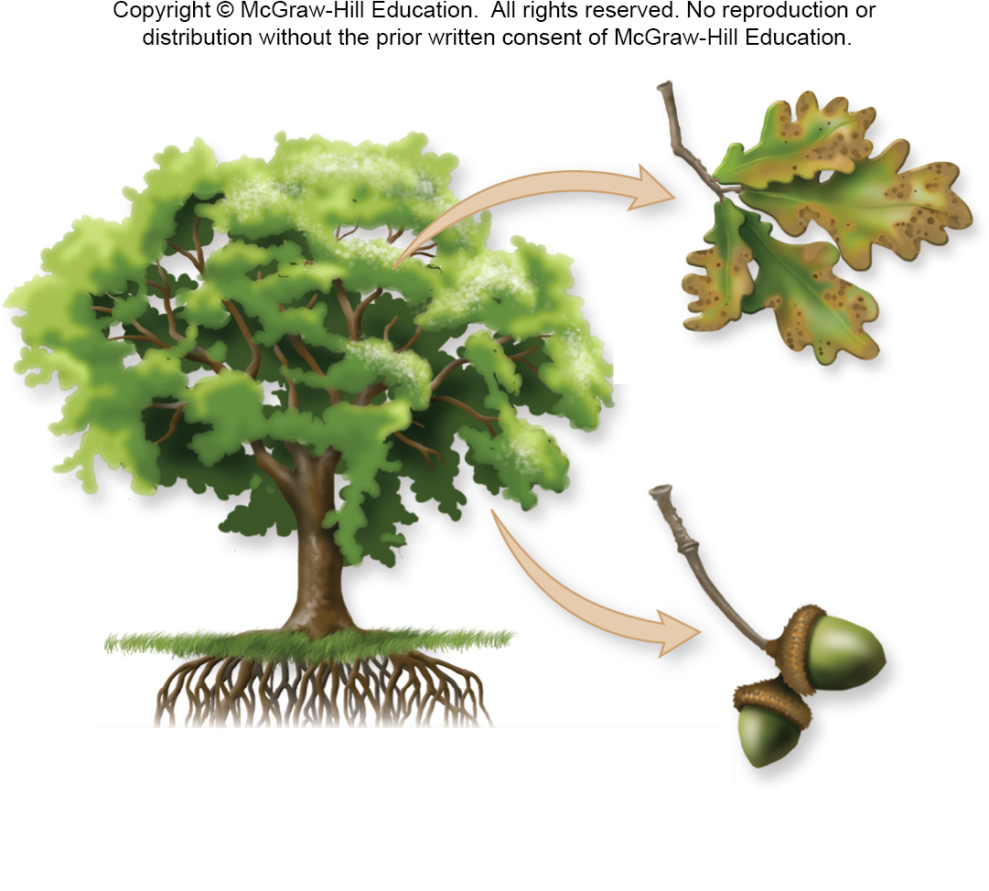
Hormones regulate plant growth: Abscisic acid
Abscisic acid inhibits shoot growth, maintains seed dormancy, and stimulates closure of stomata.
Section 24.4
Figure 24.30

Slide 69
A summary of hormones and plant growth
This table summarizes how hormones affect plant germination and development.
TABLE 24.2 The “Classic Five” Plant Hormones: A Summary
Class | Synthesis Site(s) | Mode of Transport | Selected Actions
Auxins | Shoot apical meristem, developing leaves and fruits | Diffusion between parenchyma cells associated with vascular tissue | Stimulate elongation of cells in stem Control phototropism, gravitropism, thigmotropism Stimulate growth of adventitious roots from stem cuttings Suppress growth of lateral buds in stem (apical dominance)
Cytokinins | Root apical meristem | In xylem | Stimulate cell division in seeds, roots, young leaves, fruits Delay leaf senescence Stimulate cell division in stem's lateral buds when auxin concentrations are low
Gibberellins | Young shoot, developing seeds | In xylem and phloem | Stimulate cell division and elongation in roots, shoots, young leaves Break seed dormancy
Ethylene | All parts, especially under stress, aging, or ripening | Diffusion of gas | Hastens fruit ripening Stimulates leaf and flower senescence Stimulates leaf and fruit abscission (shedding) Participates in thigmotropism
Abscisic acid | Mature leaves, especially in plants under drought or freezing stress | In xylem and phloem | Inhibits shoot growth and maintains bud dormancy Induces and maintains seed dormancy Stimulates closure of stomata
Section 24.4
Table 24.2

Slide 70
Clicker question #4
Researchers first discovered gibberellins in diseased rice plants. A gibberellin-producing fungus infected the plants, causing abnormal growth. How do you think the researchers could identify the infected plants in the field?
The plants were abnormally short.
The plants were abnormally tall.
The plants shed their leaves.

Slide 71
Clicker question #4, solution
Researchers first discovered gibberellins in diseased rice plants. A gibberellin-producing fungus infected the plants, causing abnormal growth. How do you think the researchers could identify the infected plants in the field?
The plants were abnormally tall.

Slide 72
24.4 Mastering concepts
List the major classes of plant hormones and name some of their functions.
(bee keeper): ©Liu Jin/AFP/Getty Images; (bee): ©Stephen Dalton/Science Source

Slide 73
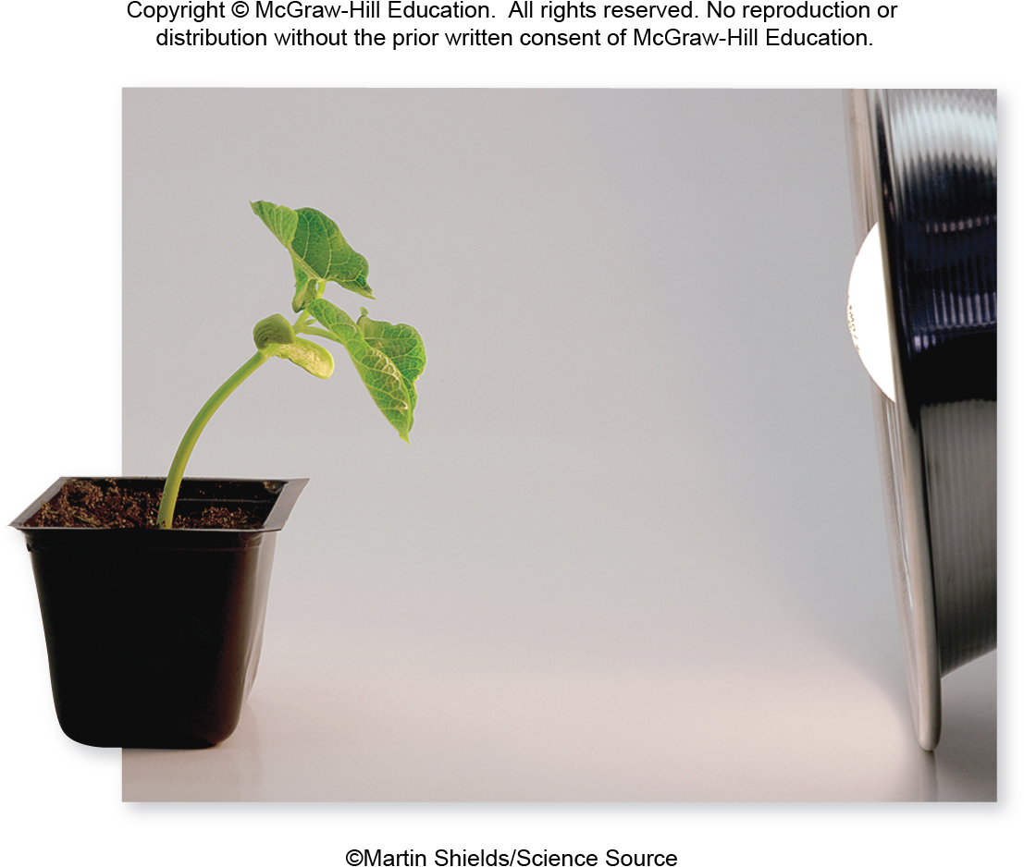
Light is a powerful influence on plant life
Many plants grow toward light.
©Martin Shields/Science Source
Section 24.5
Figure 24.17

Slide 74
Phototropism
Phototropism is a plant’s tendency to grow toward or away from light. How does this process occur?
©Martin Shields/Science Source
Section 24.5
Figure 24.17

Slide 75
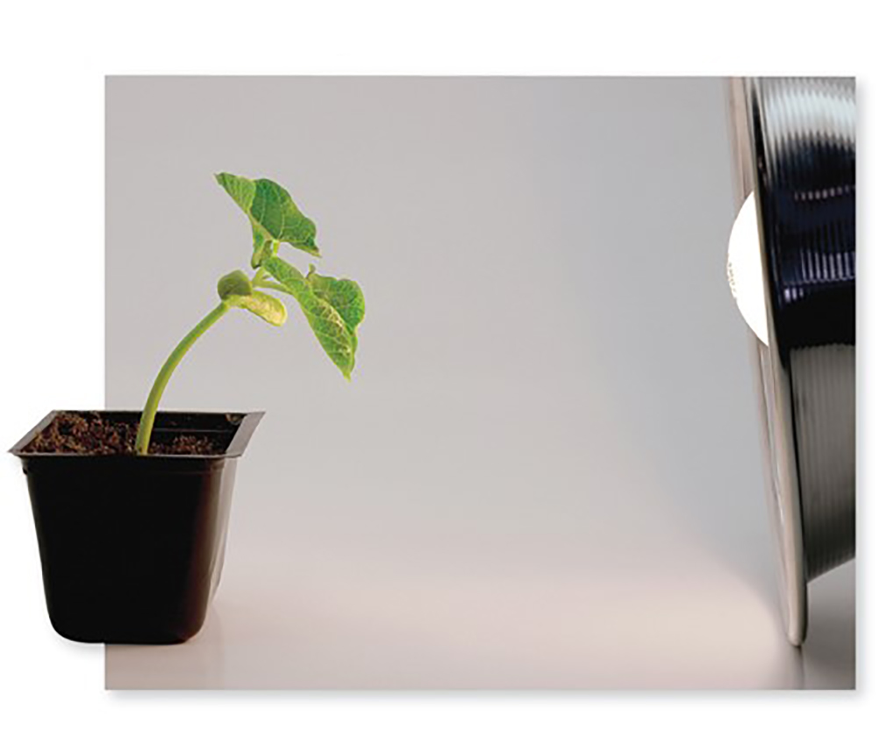
Light and auxin
Auxin accumulation on the shaded side of the shoot
©Martin Shields/Science Source
How auxins stimulate cell elongation
The hormone auxin has a role in phototropism. As auxin molecules migrate away from light, they accumulate on the shaded side of a stem.
Auxins stimulate proteins in cell membrane to pump protons out of cytoplasm into the cell wall.
Cell elongates as water moves in by osmosis and turgor pressure stretches the weakened cell wall.
High acidity in cell wall loosens bonds between cellulose fibers.
Section 24.5
Figs. 24.17, 24.18

Slide 76
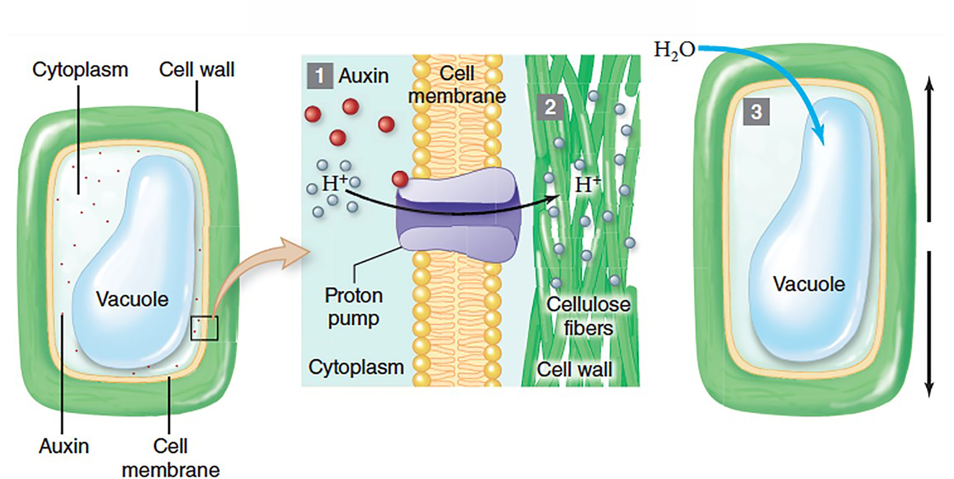
Auxin and phototropism
Auxin binds to proton pumps, which transport hydrogen ions out of the cell. As the acidity in the cell wall increases, the bonds between cellulose fibers loosen.
Section 24.5
Figure 24.18

Slide 77
Auxin and phototropism, continued
Water enters cells on the shaded side of the stem by osmosis. Since the cell wall is less rigid, inflowing water causes the cells elongate.
Section 24.5
Figure 24.18

Slide 78
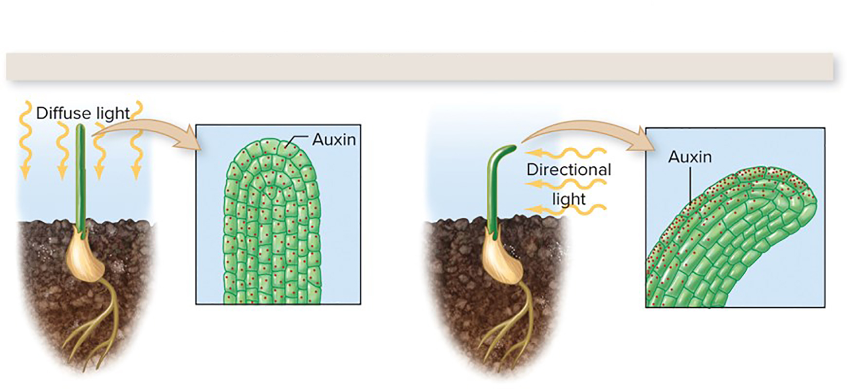
The effect of phototropism
Auxin accumulation on the shaded side of the shoot
©Martin Shields/Science Source
Elongation of these cells causes the stem to bend toward the light.
Section 24.5
Figs. 24.17, 24.18

Slide 79
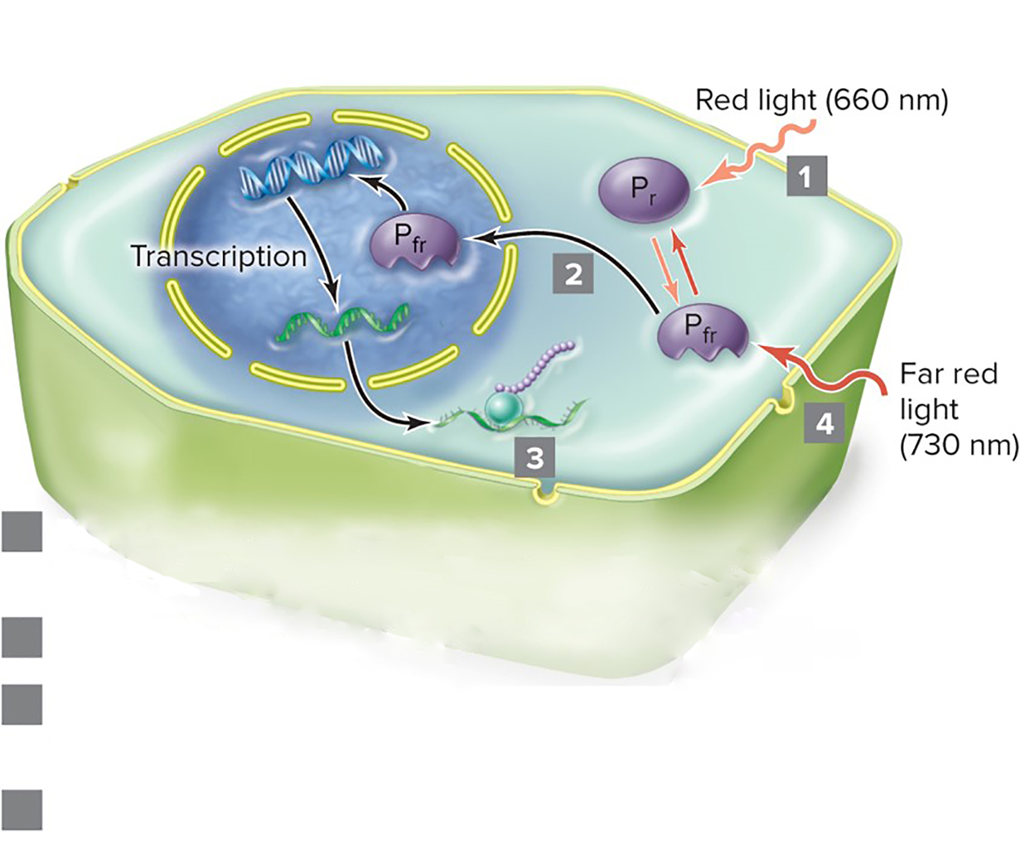
Light and phytochrome
Light also regulates seed germination, daily rhythms, and flowering by means of a photoreceptor in plants called phytochrome.
Red light converts phytochrome from its inactive form $\left(P_{r}\right)$to its active form$\left(P_{fr}\right)$.
Some $P_{fr}$ enters the nucleus and alters gene transcription.
Translation produces proteins controlling seed germination, flowering, etc.
Far red light converts $P_{fr}$ back to $P_{r}$. $P_{fr}$ also slowly converts to $P_{r}$ in darkness.
Section 24.5
Figure 24.19

Slide 80
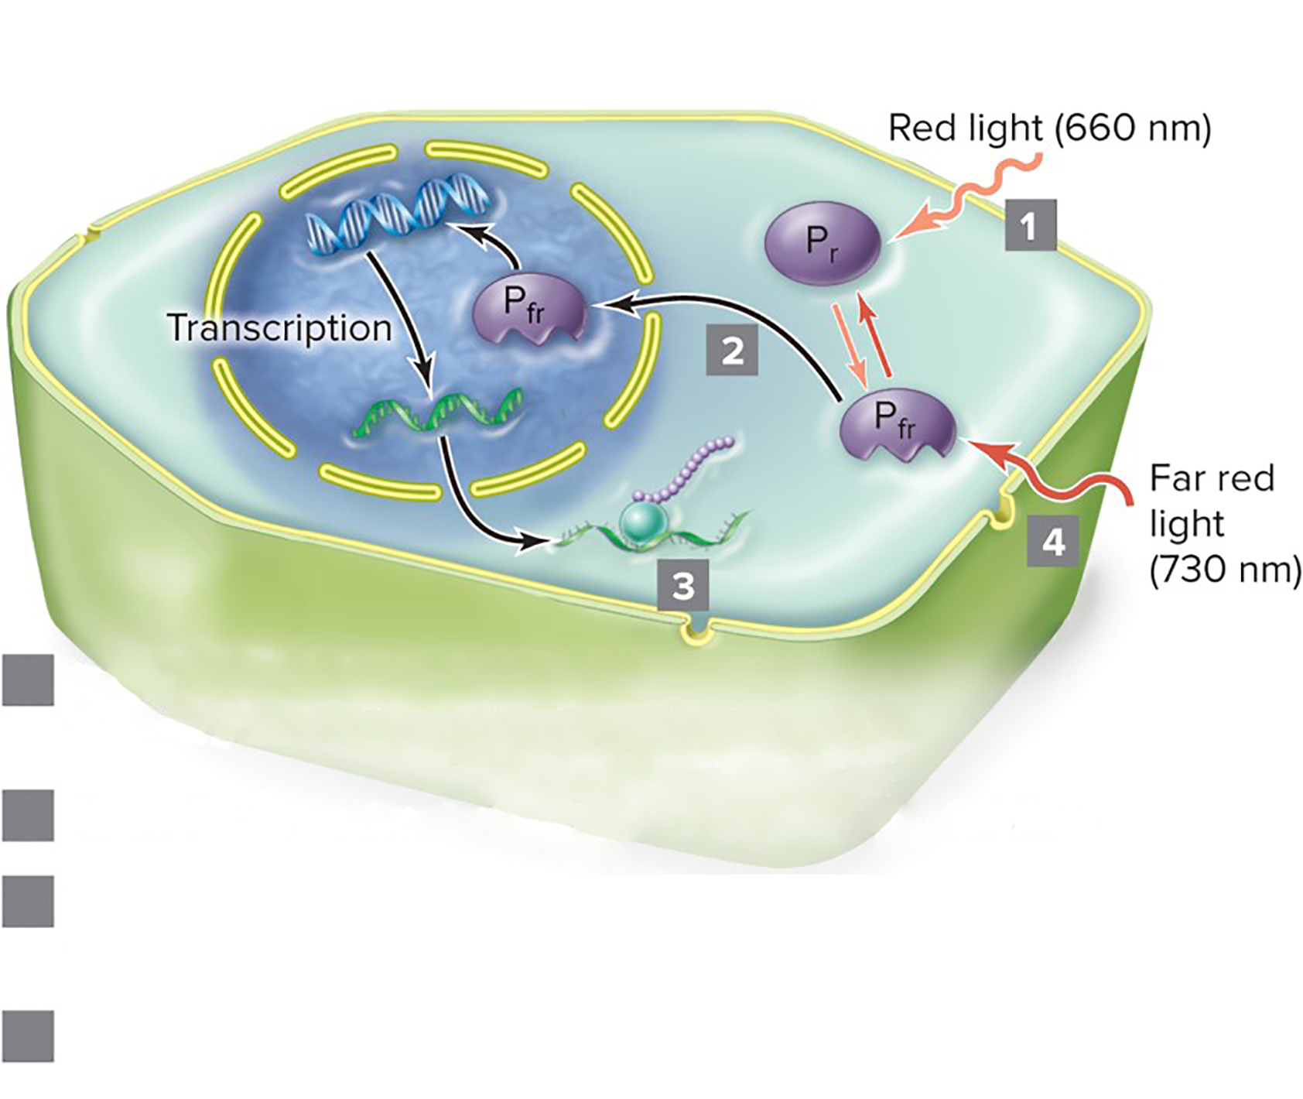
Phytochrome
Phytochrome transforms to its active form when it absorbs red light.
Red light converts phytochrome from its inactive form $\left(P_{r}\right)$to its active form$\left(P_{fr}\right)$.
Some $P_{fr}$ enters the nucleus and alters gene transcription.
Translation produces proteins controlling seed germination, flowering, etc.
Far red light converts $P_{fr}$ back to $P_{r}$. $P_{fr}$ also slowly converts to $P_{r}$ in darkness.
Section 24.5
Figure 24.19

Slide 81
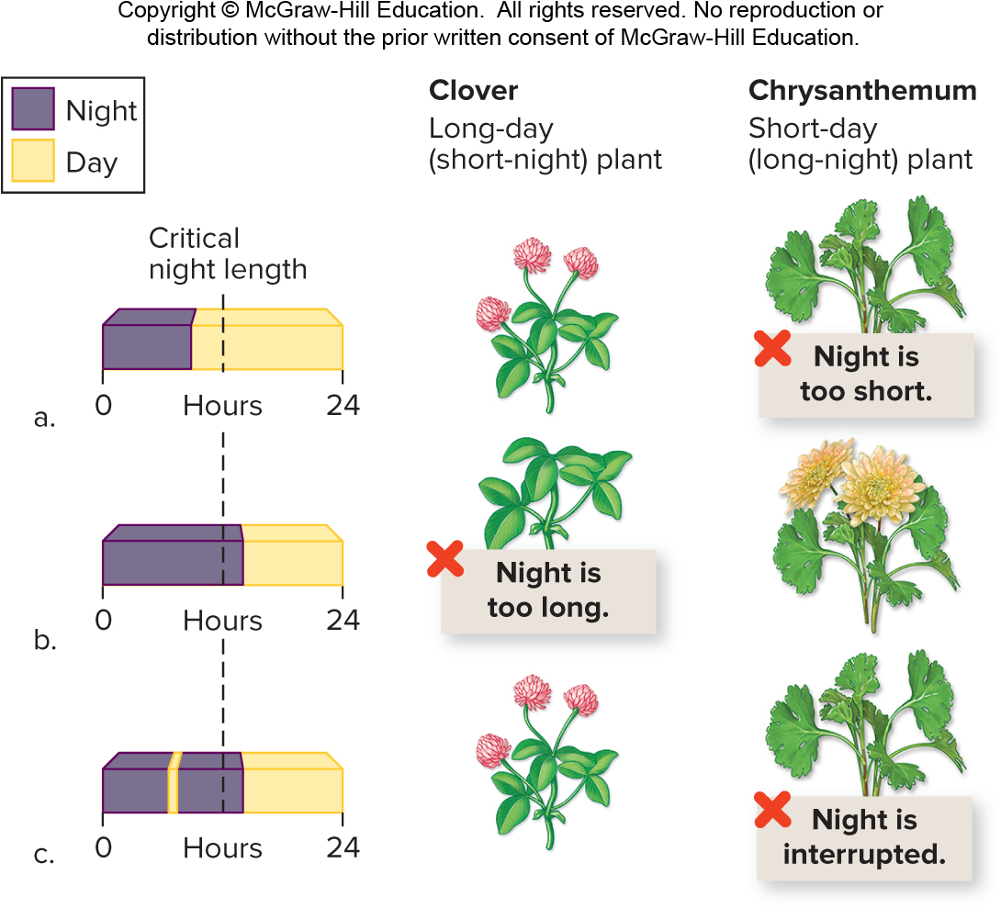
The effects of phytochrome
Phytochrome helps plants sense day length. Plants flower when periods of darkness meet certain thresholds.
Section 24.5
Figure 24.22

Slide 82
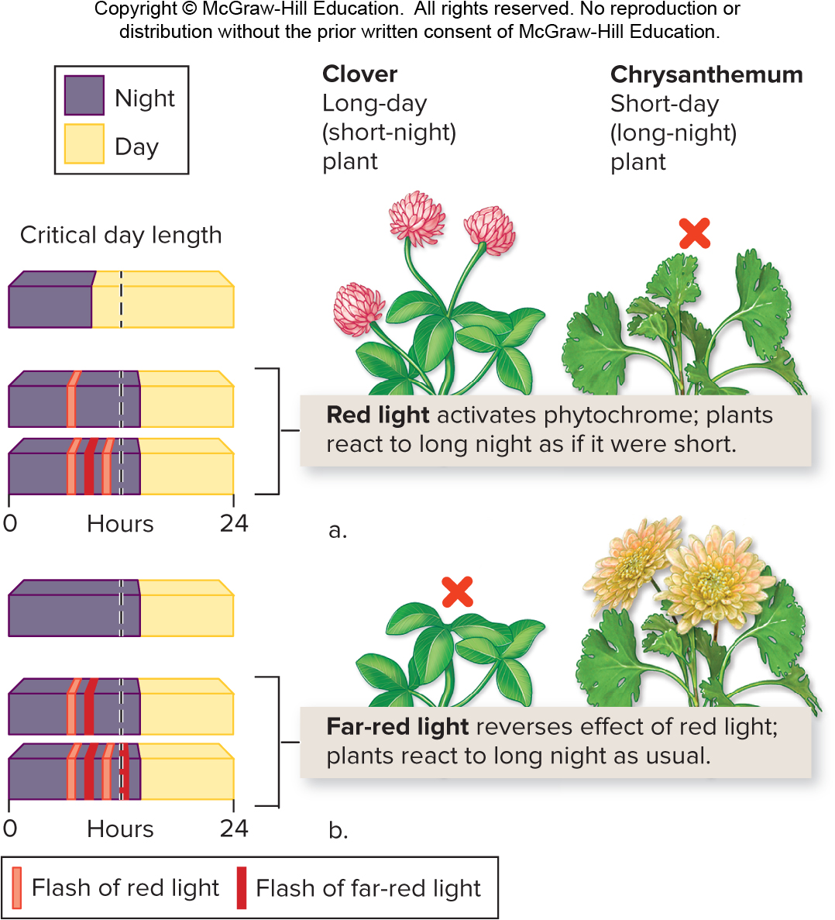
Phytochrome and flowering
The dominant form of phytochrome determines whether flowering will occur. In this experiment, the last flash of light determines the prevalent form of phytochrome.
Section 24.5
Figure 24.23

Slide 83
24.5 Mastering concepts
What is auxin’s role in phototropism?
(bee keeper): ©Liu Jin/AFP/Getty Images; (bee): ©Stephen Dalton/Science Source

Slide 84
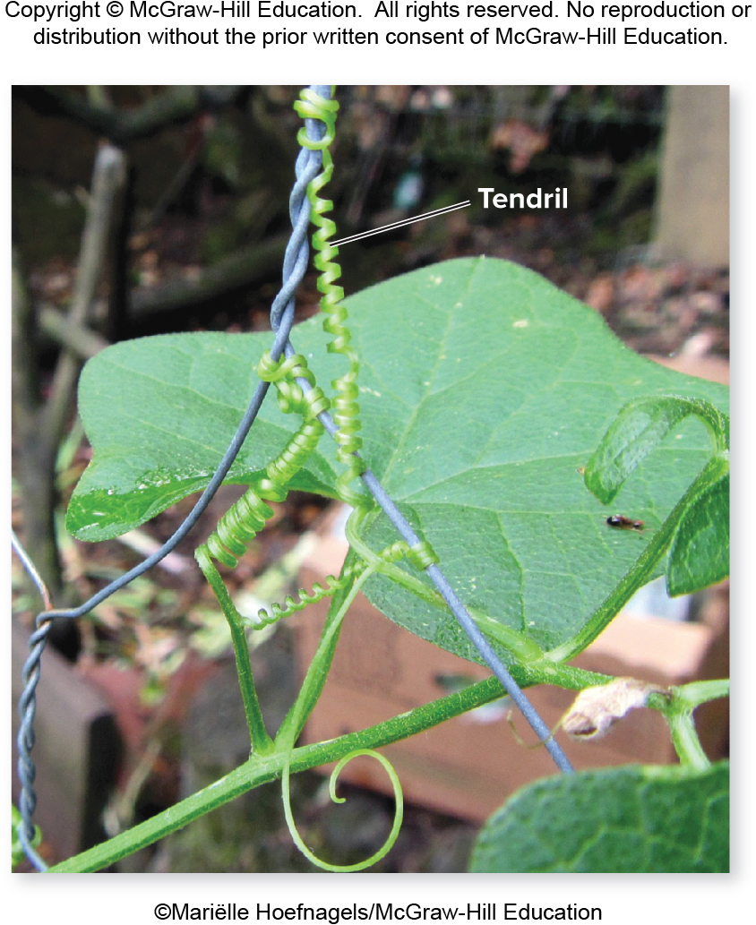
Plants respond to gravity and touch
Gravity is another important environmental cue.
©Mariëlle Hoefnagels/McGraw-Hill Education
Section 24.6
Figure 24.25

Slide 85
Gravitropism
Gravitropism is directional growth in response to gravity. Shoots always grow upward.
©Mariëlle Hoefnagels/McGraw-Hill Education
Section 24.6
Figure 24.25

Slide 86
Gravitropism and statoliths
Roots always grow downward. Statoliths sink to the bottom of cells and therefore might help plants detect gravity.
(a): ©Martin Shields/Science Source
Section 24.6
Figure 24.24

Slide 87
Thigmotropism
Plants also respond to touch, a reaction called thigmotropism.
©Mariëlle Hoefnagels/McGraw-Hill Education
Section 24.6
Figure 24.25

Slide 88
An example of thigmotropism
Specialized epidermal cells detect contact with an object, which stimulates the tendril to bend.
©Mariëlle Hoefnagels/McGraw-Hill Education
Section 24.6
Figure 24.25

Slide 89
Clicker question #5
Thigmotropism allows climbing plants to wrap tendrils around a supportive structure (like a trellis). This adaptation improves the plant’s ability to
absorb food through their roots.
absorb food through their leaves.
absorb $O_{2}$.
acquire light.
absorb water.

Slide 90
Clicker question #5, solution
Thigmotropism allows climbing plants to wrap tendrils around a supportive structure (like a trellis). This adaptation improves the plant’s ability to
acquire light.

Slide 91
24.6 Mastering concepts
How do statoliths participate in gravitropism?
(bee keeper): ©Liu Jin/AFP/Getty Images; (bee): ©Stephen Dalton/Science Source

Slide 92
Plant parts die or become dormant
During senescence, metabolism changes from synthesis to breakdown.
©Steven P. Lynch RF
Section 24.7
Figure 24.26

Slide 93
Senescence
Senescence also occurs in plants that survive for multiple growing seasons (perennial plants).
©Steven P. Lynch RF
Section 24.7
Figure 24.26

Slide 94
An example of senescence
Each year, deciduous trees loose their leaves.
©Steven P. Lynch RF
Section 24.7
Figure 24.26

Slide 95
Ethylene and senescence
Influenced by a high level of ethylene, the leaf separates from the tree at the abscission zone.
©Steven P. Lynch RF
Section 24.7
Figure 24.26

Slide 96
Dormancy
During the winter, some plants enter a seasonal state of dormancy, during which metabolism slows down.
©L. West/Science Source
Section 24.7
Figure 24.27

Slide 97
24.7 Mastering concepts
How is dormancy different from senescence?
(bee keeper): ©Liu Jin/AFP/Getty Images; (bee): ©Stephen Dalton/Science Source

Slide 98
Investigating life: A red hot chili pepper paradox
©Sierra Vista Herald, Jonathon Shacat/AP Images
Why would natural selection favor spicy chili peppers, when one of the main function of fruits is seed dispersal?
Section 24.7
Figure 24.28

Slide 99
Investigating life: A red hot chili pepper paradox — who eats spicy food?
©Sierra Vista Herald, Jonathon Shacat/AP Images
Mammals, but not birds, avoid the spicy chemical in pungent chili peppers.
Section 24.7
Figs. 24.28, 24.29

Slide 100
Investigating life: A red hot chili pepper paradox— why think about digestion?
©Sierra Vista Herald, Jonathon Shacat/AP Images
Chili seeds eaten by mice and pack rats are destroyed, but they pass through birds intact.
Section 24.7
Figs. 24.28, 24.29

Slide 101
Investigating Life: A red hot chili pepper paradox — seed destroyers vs seed dispersers
©Sierra Vista Herald, Jonathon Shacat/AP Images
Natural selection favors adaptations that deter seed-destroyers but not beneficial dispersers.
Section 24.7
Figs. 24.28, 24.29

