Slide 1
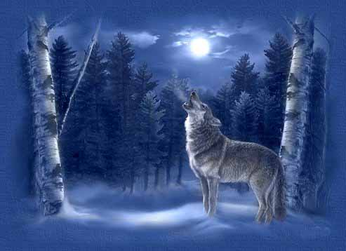
Wolves and Dogs
Evolution Notes

Slide 2
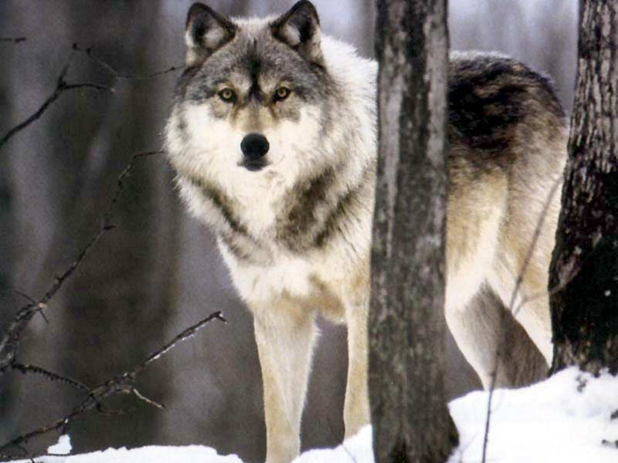
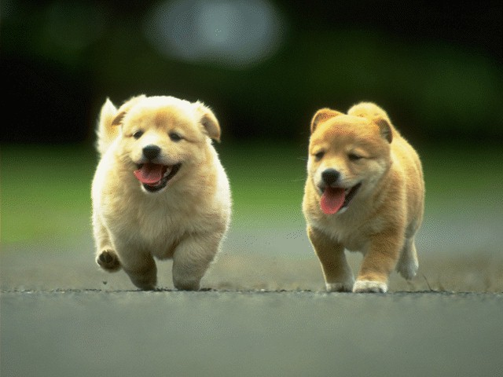

Slide 3
Charles Darwin (Chapt 10)
1831 Darwin set sail on the H.M.S. Beagle as the ships Naturalist.
He studied the environments in the Galapagos Islands and found a lot of animal diversity.
He found that the animals on the main land were similar but not identical to those on the islands.
He studied his collection from the trip for the rest of his life.
He wrote a book called Natural Selection: the Origin of Species.
Biogeography: The study of the distribution of organisms around the world.

Slide 4
Objective 1: Describe evidences of evolution including genetic information, fossil records, similar DNA sequences, anatomical structures, and order of appearance of structures in embryological development.
Evolution is the changing of a populations genotype (genetics) over time.
Terms to Know:
  Homologous structures
  Analogous structures
  Vestigial structures
  Polyploids
  Embryological structures
  Fossil records
  DNA evidence

Slide 5
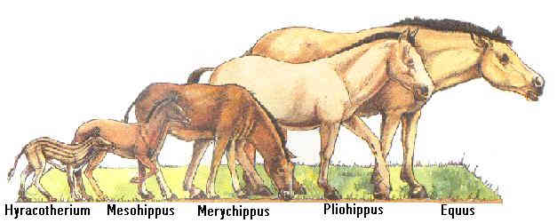
Fossil Records
Fossils indicate how a species lived and what they looked like.

Slide 6
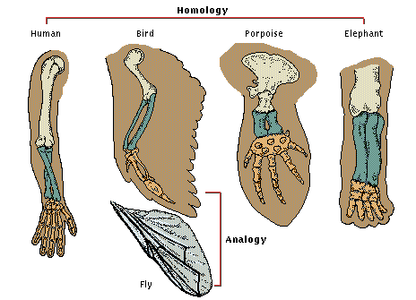
Homologous Structures
Structures that have a common evolutionary origin

Slide 7
Analogous Structures
Body parts of organisms that do not have a common evolutionary origin but are similar in function.

Slide 8
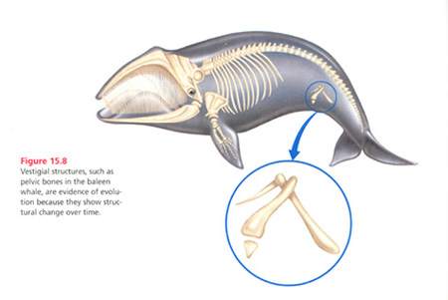
Vestigial Organ/Structures
A body structure in a present-day organism that is no longer needed.

Slide 9
Other Evidences
There are 3.1 Billion letters in our gene pool. Most of it is no longer used but is in the genome. It is vestigial DNA.
Embryology: How animals are formed from an egg to an infant. All animal species develop from an egg through a fetus with the same development processes.

Slide 10
Objective 2: Explain what natural selection is and how it occurs
  Natural Selection: The choosing of favorable traits in a population which allow the population to better survive or reproduce. More successful individuals are “naturally selected” to live longer and to produce more offspring that share those adaptations for their environment.
    Natural selection acts on phenotypes, or physical traits, rather than on genetic material itself. New alleles are not made by natural selection —they occur by genetic mutations. Natural selection can act only on traits that already exist.
Variation: The heritable differences that exist in every population are the basis for natural selection. The differences among individuals result from differences in the genetic material of the organisms, whether inherited from a parent or resulting from a genetic mutation.

Slide 11
Variation in Populations
Genetic variation comes from two main sources: mutation and recombination.
  Mutation: A mutation is a random change in the DNA of a gene. This change can form a new allele. Mutations in reproductive cells can be passed on to offspring. This increases the genetic variation in the gene pool. Because there are many genes in each individual and many individuals in a population, new mutations form frequently in gene pools.
  Recombination: New allele combinations form in offspring through a process called recombination. Most recombination occurs during meiosis—the type of cell division needed for sexual reproduction. When gametes are made, each parent’s alleles are arranged in new ways. This shuffling of alleles results in many different genetic combinations.
-Speciation: The development of new species from existing species

Slide 12
After the change in climate, jaguars that had larger teeth and jaws had a higher fitness than other jaguars in the population. Jaguars that ate less didn’t necessarily all die or stop producing altogether; they just reproduced a little less. Today, large teeth and jaws are considered typical traits of jaguars.

Slide 13
Types of Natural Selection
Stabilizing Selection:
  This selection favors the average individual in a population
Directional Selection:
  This selection favors one extreme form of a trait. An example would be antibiotic resistance in which bacteria are increasingly unable to be killed by antibiotics.
Disruptive Selection:
  This selection favors two extreme forms of a trait.

Slide 14
Vocabulary to Know:
Fitness: A measure of the ability to survive and produce more offspring relative to other members of the population in a given environment.
-Gene Pool: All the genes in the population
-Allelic Frequency: The percentage of the gene pool with any specific allele (trait).
-Genetic Equilibrium: The frequency of the alleles in the population remaining the same over generations. If the frequencies remain the same, no evolution can take place.

Slide 15
Objective 3: Explain how behavior, morphology and physiology changes can result in evolution.
-Morphology: The form and structure of animals and plants.
-Sexual Selection: The choosing of a mate due to specific physical traits.
-Vestigial structure: A body structure in a present-day organism that is no longer needed.
-Reproductive isolation: When two populations cannot reproduce and create viable offspring. It can be behavior, geographic, or genetic. Reproductive isolation occurs when formerly interbreeding organisms can no longer mate and produce fertile offspring.
-Polyploidy: An individual or species with multiple of the normal set of chromosomes. This is the fastest form of speciation because it results in immediate reproductive isolation.

Slide 16
Objective 4: Explain the role of group behavior on individual species' ability to survive and reproduce.
Courtship dances of birds and courtship songs of frogs are examples of behavioral sexual signals used to attract mates. Changes in these signals can prevent mating between populations.
-Sexual Selection: The choosing of a mate due to specific physical or behavioral traits.
-Behavioral isolation: Isolation caused by differences in courtship or mating behaviors. Over 2000 species of fireflies are isolated in this way. Male and female fireflies produce patterns of flashes that attract mates of their own species. For example, Photuris frontalis emits one flash every second, P. hebes emits one flash every 2 seconds, and P. fairchildi produces a double flash every 5.5 seconds.
-Divergent Evolution: The pattern of evolution in which species that once were similar to an ancestral species diverge or become increasingly distinct. Example: Darwin's finches, Honeycreepers in Hawaii.

Slide 17
Objective 5: Explain how competition for limited resources can result in evolution
-Competition: When species must compete for a limited resource. If there is less food/resources, competition increases.
-Divergent Evolution: The pattern of evolution in which species that once were similar to an ancestral species diverge or become increasingly distinct. Example: Darwin’s finches, Honeycreepers in Hawaii.
-Adaptive radiation: Occurs when an ancestral species evolves into an array of species to fit a number of diverse habitats.
Convergent Evolution: Distantly related organisms evolve similar traits due to environmental pressures. Example: The tail fins of whales and sharks. They each evolved to be similar due to similar environmental conditions.

Slide 18
Objective 6: Explain why species go extinct due to changes in the environment
Natural disasters occur including: flooding, hurricanes, tornados, earthquakes, meteor strikes, and climate change.
When the environment changes species will be required to adapt or die. These adaptations to new environmental influences can drive a species to evolve into a new species.

