Slide 1
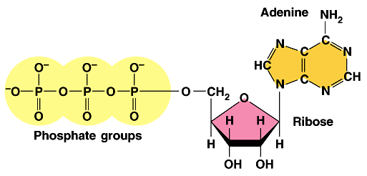
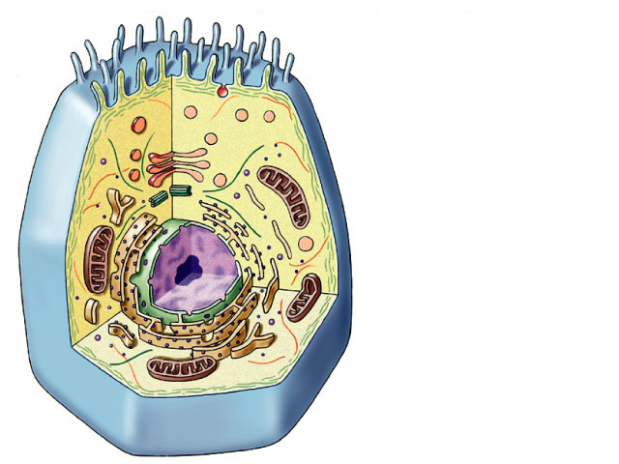
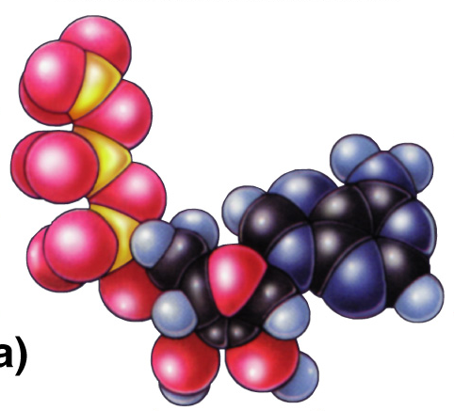
Energy of Life Notes
ATP
The point
is to make
ATP!

Slide 2
Metabolism
Metabolism is the totality of an organisms chemical reactions. Metabolism as a whole manages the material and energy resources of the cell.
A catabolic pathway leads to the release of energy by the breakdown of complex molecules to simpler compounds. Example: Catabolic pathway occur when your digestive enzymes break down food and release energy.
Anabolic pathways consume energy to build complicated molecules from simpler ones. Example: Anabolic pathways occur when your body links together amino acids to form muscle protein in response to physical exercise.

Slide 3
Energy Types
Energy is defined as the capacity to do work.
Anything that is moving is said to possess kinetic energy.
An object at rest can possess potential energy if it has stored energy as a result of its position or structure.
Chemical energy, a form of potential energy, is stored in molecules, and the amount of chemical energy a molecule possesses depends on its chemical bonds.
Thermodynamics is the study of energy transformations that occur in matter.
  The first law of thermodynamics states that the energy of the universe is constant and that energy can be transferred and transformed but it cannot be created or destroyed.
  The second law of thermodynamics states that every energy transfer or transformation increases the entropy, or the amount of disorder or randomness in the universe.

Slide 4
Gibbs Free Energy
Free energy is defined as the part of a system’s energy that is able to perform work when the temperature of a system is uniform.
Δ G is a symbol for a change in free energy. Δ G = ΔH - TΔS
  An exergonic reaction is one in which energy is released. Exergonic reactions occur spontaneously (that does not necessarily mean quickly) and release free energy to the system. Δ G<0.
  An endergonic reaction is one that requires energy in order to proceed. Endergonic reactions absorb free energy; that is they require free energy from the system. Δ G>0
  Is the breakdown of glucose in cellular respiration exergonic or endergonic? (Δ G is -686kcal/mol.)
T=Temperature, H=enthalpy (a measure of energy in a thermodynamic system), S denotes entropy.

Slide 5

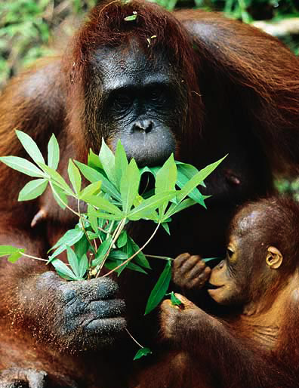
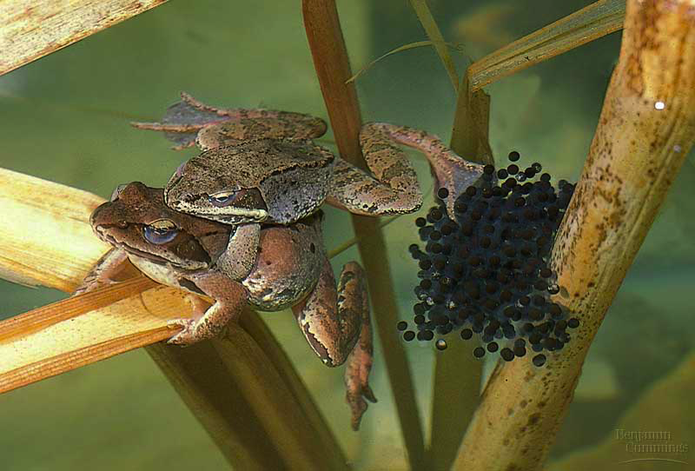
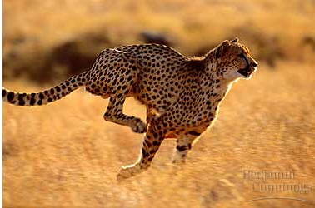
The energy needs of life
Organisms are endergonic systems
  What do we need energy for?
    synthesis
      building biomolecules
    reproduction
    movement
    active transport
    temperature regulation
Notes:
Which is to say… if you don’t eat, you die… because you run out of energy.
The 2nd Law of Thermodynamics takes over!

Slide 6
Where do we get the energy from?
Work of life is done by energy coupling
  use exergonic (catabolic) reactions to fuel endergonic (anabolic) reactions
digestion
energy
+
+
synthesis
energy
+
+

Slide 7

Living economy
Fueling the body’s economy
  eat high energy organic molecules
    food = carbohydrates, lipids, proteins, nucleic acids
  break them down
    digest = catabolism
  capture released energy in a form the cell can use
Need an energy currency
  a way to pass energy around
  need a short term energy
  storage molecule
ATP
Whoa!
Hot stuff!

Slide 8
ATP
Adenosine TriPhosphate
  modified nucleotide
    nucleotide =
    adenine + ribose + P_{i} → AMP
    AMP + P_{i} → ADP
    ADP + P_{i} → ATP
  adding phosphates is endergonic
How efficient!
Build once,
use many ways
high energy bonds
Notes:
Marvel at the efficiency of biological systems!
Build once = re-use over and over again.
Start with a nucleotide and add phosphates to it to make this high energy molecule that drives the work of life.
Let’s look at this molecule closer.
Think about putting that Pi on the adenosine-ribose ==>
EXERGONIC or ENDERGONIC?

Slide 9
How does ATP store energy?
I think
he’s a bit
unstable…
don’t you?
O–
O–
O–
O–
P
O–
O–
O–
O–
P
P
P
P
P
P
P
–O
–O
–O
–O
–O
O–
O–
O–
–O
O–
O–
–O
O–
–O
O–
O–
O
O
O
O
AMP
O
O
O
O
ADP
ATP
Each negative PO₄ more difficult to add
  a lot of stored energy in each bond
    most energy stored in 3rd P_{i}
    3rd P_{i} is hardest group to keep bonded to molecule
Bonding of negative P_{i} groups is unstable
  spring-loaded
  P_{i} groups “pop” off easily & release energy
Instability of its P bonds makes ATP an excellent energy donor
Notes:
Not a happy molecule
Add 1st Pi → Kerplunk!
Big negatively charged functional group
Add 2nd Pi → EASY or DIFFICULT to add?
DIFFICULT→ takes energy to add = same charges repel
→ Is it STABLE or UNSTABLE?
UNSTABLE = 2 negatively charged functional groups not strongly bonded to each other
So if it releases Pi → releases ENERGY
Add 3rd Pi → MORE or LESS UNSTABLE?
MORE = like an unstable currency
• Hot stuff!
• Doesn’t stick around
• Can’t store it up
• Dangerous to store = wants to give its Pi to anything

Slide 10
How does ATP transfer energy?
7.3
energy
O–
O–
O–
O–
P
P
P
P
–O
–O
O–
–O
O–
O–
–O
O–
+
ADP
O
O
O
O
ATP
ATP → ADP
  releases energy
    ∆G = -7.3 kcal/mole
Fuel other reactions
Phosphorylation
  released P_{i} can transfer to other molecules
    destabilizing the other molecules
  enzyme that phosphorylates = “kinase”
Notes:
How does ATP transfer energy?
By phosphorylating
Think of the 3rd Pi as the bad boyfriend ATP tries to dump off on someone else = phosphorylating
How does phosphorylating provide energy?
Pi is very electronegative. Got lots of OXYGEN!! OXYGEN is very electronegative. Steals e’s from other atoms in the molecule it is bonded to. As e’s fall to electronegative atom, they release energy.
Makes the other molecule “unhappy” = unstable. Starts looking for a better partner to bond to. Pi is again the bad boyfriend you want to dump.
You’ve got to find someone else to give him away to. You give him away and then bond with someone new that makes you happier (monomers get together).
Eventually the bad boyfriend gets dumped and goes off alone into the cytoplasm as a free agent = free Pi.

Slide 11
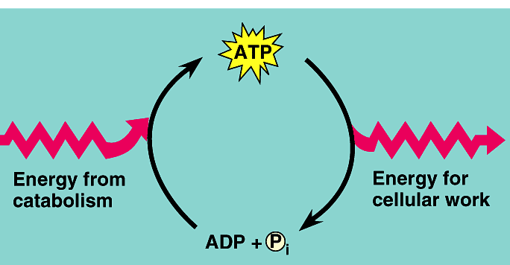



ATP / ADP cycle
Can’t store ATP
  good energy donor,
  not good energy storage
    too reactive
    transfers P_{i} too easily
    only short term energy storage
      carbohydrates & fats are long term energy storage
ATP
cellular
respiration
7.3
kcal/mole
ADP
+
P_{i}
A working muscle recycles over
10 million ATPs per second
Whoa!
Pass me
the glucose
(and O₂)!

Slide 12
Cells spend a lot of time making ATP!
The
point is to make
ATP!
What’s the
point?

Slide 13
Enzymes as Catalysts
Catalysts are substances that can change the rate of a reaction without being altered in the process.
Enzymes are macromolecules that are biological catalysts. They accomplish this by lowering the activation energy and helping the transition state to form. Thus, the reaction can occur more quickly because the transition state is not as much of a hurdle to overcome. Enzymes do NOT change the energy of the starting point or the ending point of the reaction. They only lower the activation energy.
The activation energy of a reaction is the amount of energy it takes to start a reaction-the amount of energy it takes to break the bonds of the reactant molecules. Enzymes speed up reactions by lowering the activation energy of the reaction=but without changing the free-energy change of the reaction. The reactant that the enzyme acts on is called a substrate.
The active site is the part of the enzyme that binds to the substrate. The enzyme and substrate form a complex called an enzyme-substrate complex that is generally held together by weak interactions. The substrate is then converted into products, and the products are released from the enzyme.

Slide 15
Cells need enzymes
Most of the crucial reactions that occur in the cell require enzymes. Yet enzymes themselves are highly specific-in fact, each enzyme catalyzes only one kind of reaction. This is known as enzyme specificity.
Because of this, enzymes are usually named after the molecules they target. In enzymatic reactions, the targeted molecules are known as substrates. For example, maltose, a disaccharide, can be broken down into two glucose molecules. Our substrate, maltose, gives its name to the enzyme that catalyzes this reaction: maltase.
Many enzymes are named simply by replacing the suffix of the substrate with –ase. Using this nomenclature, maltose becomes maltase.

Slide 16
Enzyme Activity
The activity of an enzyme can be affected by several factors:
-Protein enzymes have complicated three-dimensional shapes that are dramatically affected by changes in pH and temperature. Changes in the precise shape of an enzyme usually mean the enzyme will not be effective.
-Many enzymes require nonprotein helpers, termed cofactors, to function properly. Cofactors include metal ions like zinc, iron, and copper and function in some crucial way to allow catalysis to occur. If the cofactor is organic, it is more properly referred to as a coenzyme. Coenzymes are organic cofactors; vitamins are examples of coenzymes.
-Competitive inhibitors are reversible inhibitors that compete with the substrate for the active site on the enzyme. Competitive inhibitors are often chemically very similar to the normal substrate molecule and reduce the efficiency of the enzyme as it competes for the active site.
-Noncompetitive inhibitors do not directly compete with the substrate molecule; instead, they impede enzyme activity by binding to another part of the enzyme. This causes the enzyme to change its shape, rendering the active site nonfunctional.

Slide 17
Enzyme Regulation
Many enzyme regulators bind to an allosteric site on the enzyme, which is a specific binding site, but not the active site. Once bound, the shape of the enzyme is changed, and this can either stimulate or inhibit enzyme activity.
The end product on an enzymatic pathway can switch off its pathway by binding to the allosteric site of the enzyme in the pathway. This type of allosteric inhibition is termed feedback inhibition.
Feedback inhibition increases the efficiency of the pathway by turning it off when the end product accumulates in the cell.

Slide 18
