Slide 1
Processes of DNA
10th Grade
Biology

Slide 2
DNA Replication
The process of making a copy of DNA is DNA Replication
This process occurs in INTERPHASE of the cell cycle
The first stage of DNA replication is the separation of the strands.

Slide 3
DNA Helicases
The double helix unwinds by enzymes called DNA helicases.
Helicases break the hydrogen bonds that link the nitrogen bases .

Slide 4
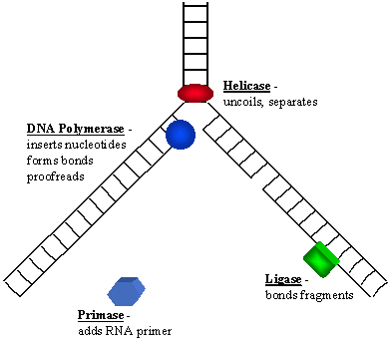
DNA Polymerase
After the strand separates, DNA polymerase move along each DNA strand.
DNA Polymerase adds nucleotides to the exposed nitrogenous bases.
As DNA polymerases move along, two new double helixes are formed.

Slide 5
Final Step
Once the DNA polymerase has finished copying the DNA strand, two new strands which are identical are created.

Slide 6
Links:
http://www.johnkyrk.com/DNAreplic.swf
http://www.hhmi.org/biointeractive/dna/DNAi_replication_schematic.html
http://www.hhmi.org/biointeractive/dna/DNAi_replication_vo1.html

Slide 7
Errors
During DNA replication, errors can sometimes occur, and the wrong nucleotide is added to the new strand.
DNA polymerase III also goes along the strand and “proofreads” the strand and corrects any errors. This reduces the number of errors to about 1 error per 1 billion nucleotides

Slide 8
Rate of Replication
The DNA strand has an estimated 3.1 billion base pairs (A,C,T,G).
The DNA strand is not replicated from start to finish.
Rather, it is divided into 100 sequences about 100,000 bases and DNA replication begins

