Slide 1

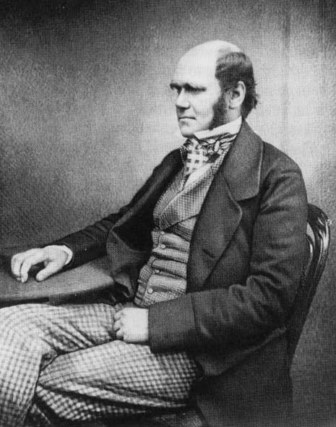
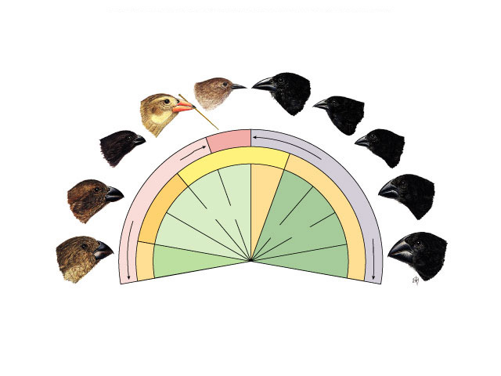
Darwin’s Principles

Slide 2
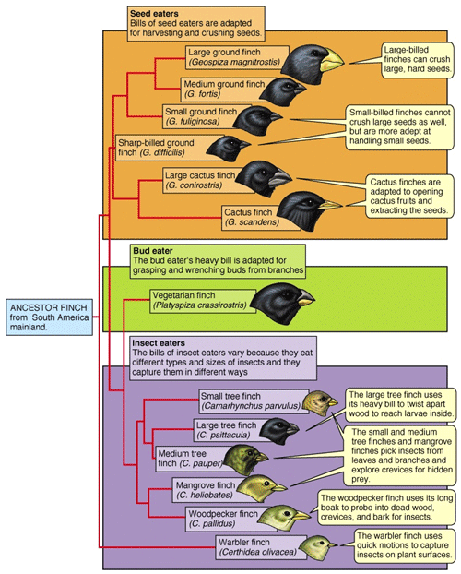
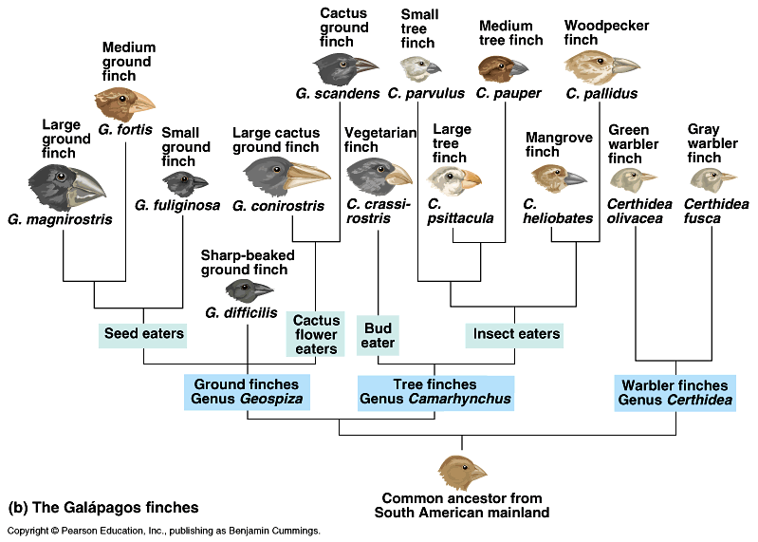
Darwin’s finches
Differences in beaks allowed some finches to…
  ________________________________
  ________________
  ________________________________
    pass successful traits onto their offspring

Slide 3
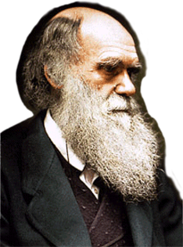
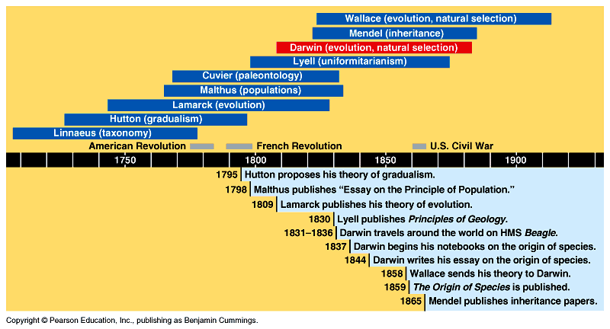
In historical context
Other people’s ideas paved the path for Darwin’s thinking
competition:
struggle for survival
population growth
exceeds food supply
land masses change over
immeasurable time

Slide 4
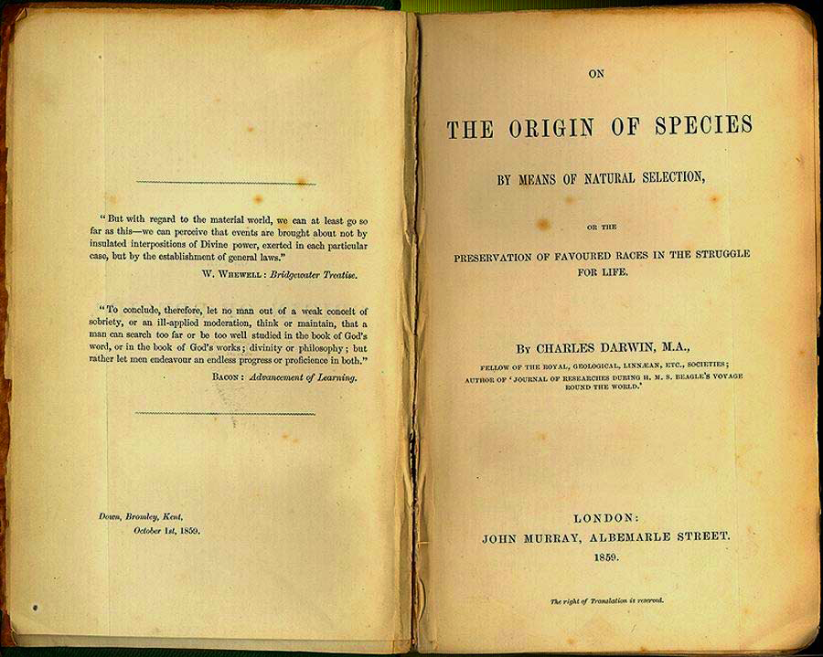
Voyage: 1831-1836
November 24, 1859, Darwin published
“On the Origin of Species by Means of Natural Selection”

Slide 5
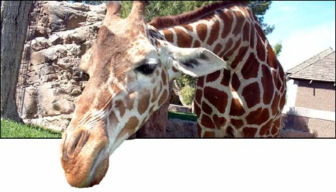
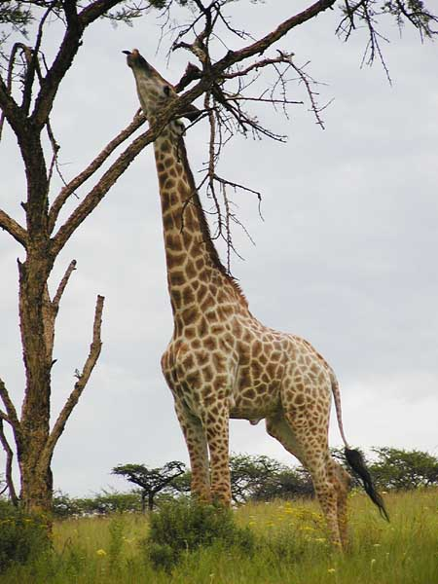
LaMarckian vs. Darwinian view
LaMarck: Developed an early theory of evolution based on two principles:
  Use and disuse is the idea that parts of the body that are used extensively become larger and stronger, while those that are not used deteriorate.
  Inheritance of acquired characteristics assumes that characteristics acquired during an organism’s lifetime could be passed on to the next generation. Example: A weightlifter’s child could be born with a more muscular anatomy.
Importance: Lamarck recognized that species evolve and the match of organisms to their environment occurs through gradual evolutionary change. His explanatory mechanism, however, was flawed.

Slide 6
Binomial Nomenclature
Carolus Linnaeus (1707-1778) grouped similar species into increasingly general categories, reflecting what he considered the pattern of their creation.
  Developed taxonomy, the branch of biology dedicated to the naming and classification of all forms of life.
  Developed binomial nomenclature, a two-part naming system that includes the organism’s genus and species

Slide 7
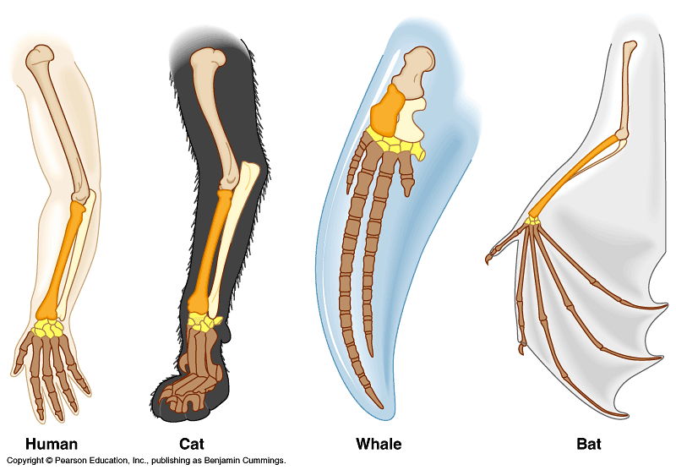
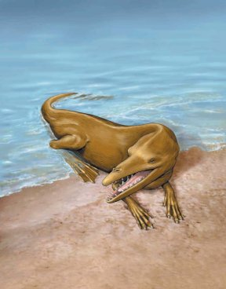
Evidence for
Evolution
by
Natural Selection
Raven Chapters 1 & 22

Slide 8
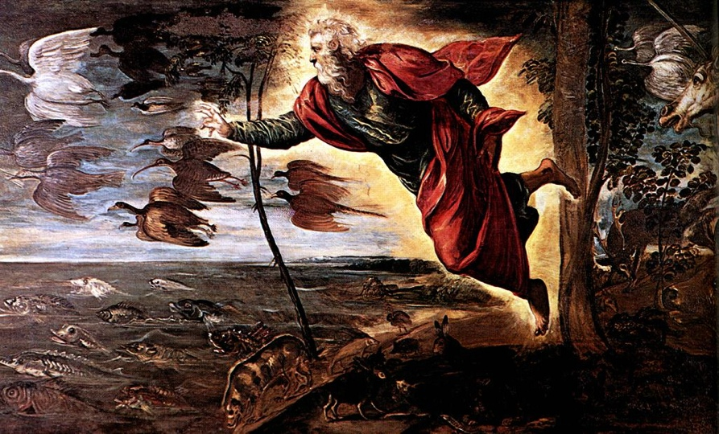
Science happens within a culture
What was
the doctrine
of the time?
TINTORETTO The Creation of the Animals 1550

Slide 9
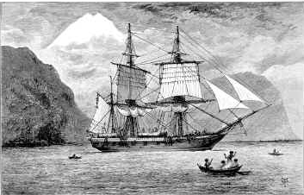
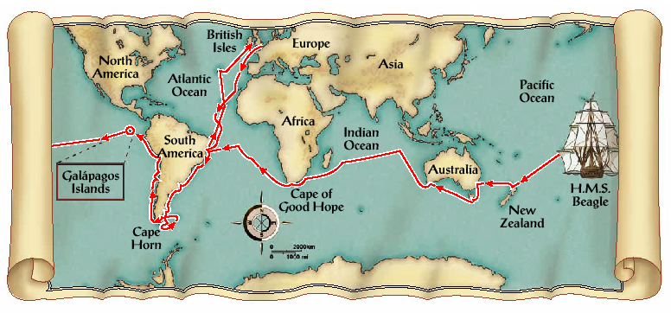
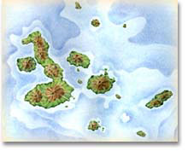
Then along comes Darwin…
1831-1836
22 years old!

Slide 10
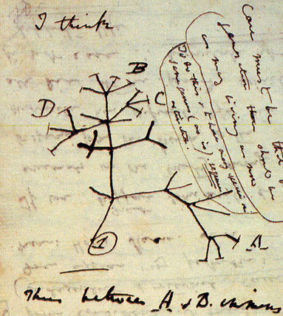
Then along comes Darwin…
& those dang finches!
Descendant
species
Warbler finch
Cactus finch
Ancestral
species
Woodpecker finch
Sharp-beaked finch
Small insectivorous
tree finch
Small ground
finch
Warbler
finch
Large
insectivorous
tree finch
Cactus
eater
Tree finches
Medium
ground finch
Ground finches
Insect eaters
Seed eaters
Vegetarian
tree finch
Large
ground finch
Bud eater

Slide 11
Correlation of species to food source
Seed
eaters
Flower
eaters
Insect
eaters
Rapid speciation:
new species filling niches,
because they inherited
successful adaptations.
Adaptive radiation

Slide 12
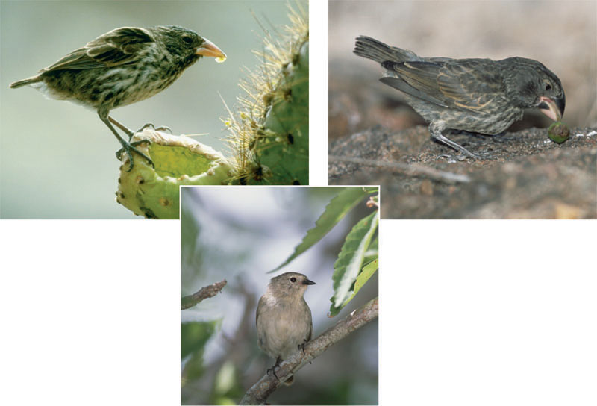
Beak variation in Galapagos finches
(a) Cactus eater. The long,
sharp beak of the cactus
ground finch (Geospiza
scandens) helps it tear
and eat cactus flowers
and pulp.
(c) Seed eater. The large ground
finch (Geospiza magnirostris)
has a large beak adapted for
cracking seeds that fall from
plants to the ground.
(b) Insect eater. The green warbler
finch (Certhidea olivacea) uses its
narrow, pointed beak to grasp insects.

Slide 13
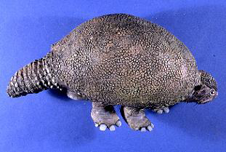
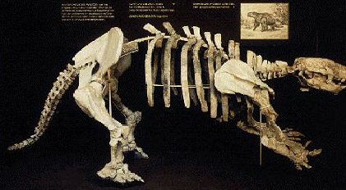
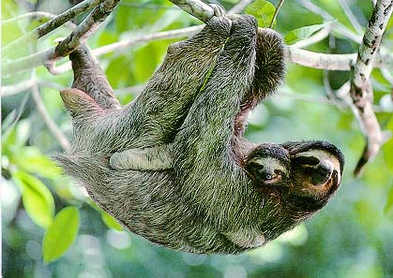
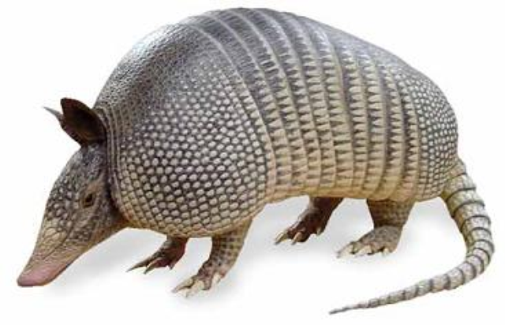
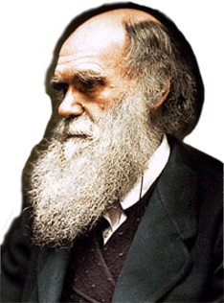
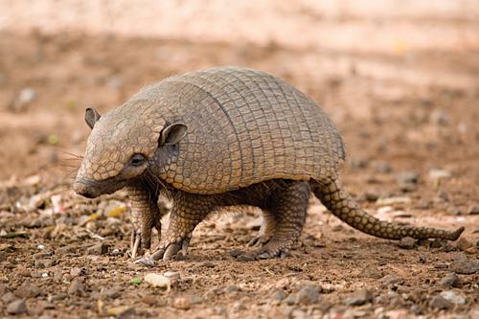
Glyptodont fossils
Sloth fossils
Modern sloth
Modern armadillos
Why should extinct
species & living species
be found on the
same continent?

Slide 14
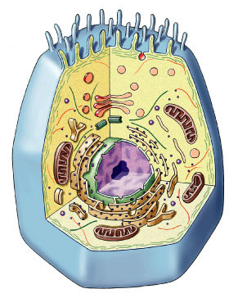
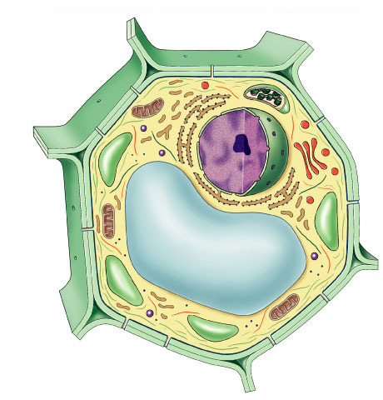
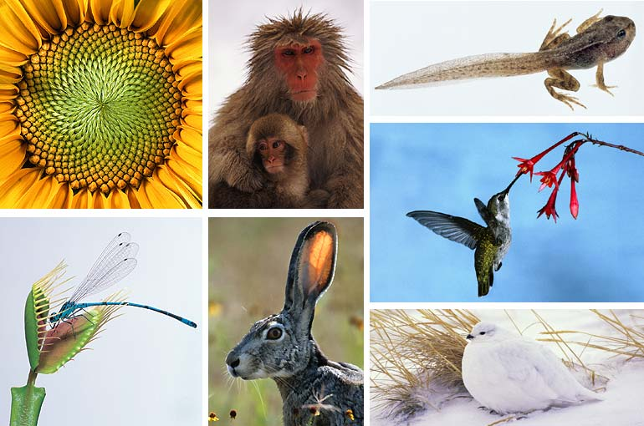
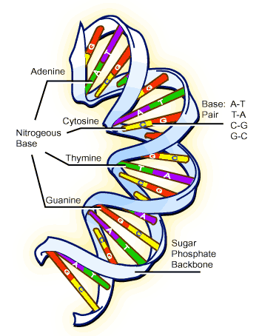
Big Idea 1
The process of evolution drives the diversity and unity of life
cells
DNA
Notes:
Differences vs. Commonalities

Slide 15
Natural Selection
Natural Selection explains how adaptations arise.
Adaptations are heritable characteristics that enhance organisms’ ability to survive and reproduce in specific environments. Example: Desert foxes have large ears, which radiate heat. Arctic foxes have small ears, which conserve body heat.
Darwin’s theory of natural selection involves these important points:
1. Individuals in a population vary in their traits, many of which are heritable.
2. A population can produce far more offspring than can survive. With more individuals than the environment can support, competition is inevitable.
3. Individuals with inherited traits that are better suited to the local environment are more likely to survive and reproduce than individuals less well-suited. This is sometimes phrased as “differential reproductive success.”
4. Evolution occurs as the unequal reproductive success of individuals ultimately leading to adaptations to their environment. Over time, natural selection can increase the match between organisms and their environment.
If an environment changes, or if individuals move to a new environment, natural selection may result in adaptation to these new conditions, sometimes giving rise to new species in the process.

Slide 16
Artificial Selection
The process by which species are modified by humans. Example: Selective breeding for milk or meat production; development of dog breeds.
Individuals do NOT evolve! Populations evolve.

Slide 17
Sexual Selection:
The choosing of a mate by specific characteristics that may not be beneficial to the population. Example: Peacocks.

Slide 18
Direct Observations of Evolutionary Change
Insect populations can rapidly become resistant to pesticides such as DDT.
Evolution of drug-resistant viruses and antibiotic-resistant bacteria.

Slide 19
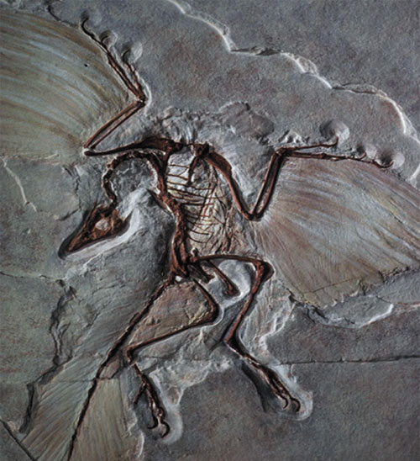

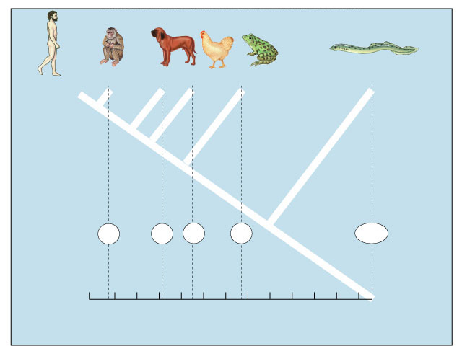
What are the 4 lines of evidence that support Darwin’s ideas?…
Human
Macaque
Dog
Bird
Frog
Lamprey
8
32
45
67
125
0
10
20
30
40
50
60
70
80
90
100
110
120
Notes:
Fossil Record

Slide 20
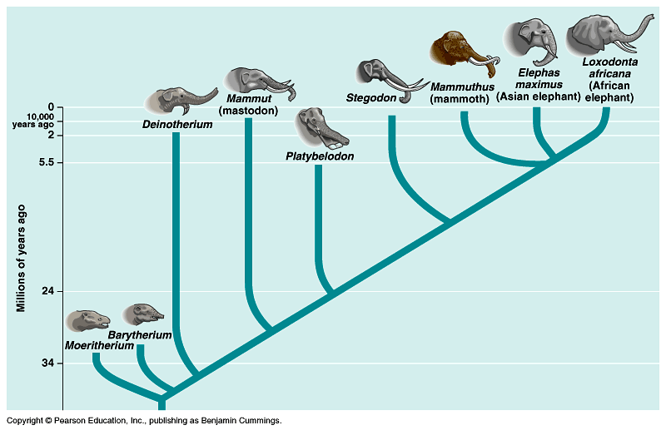
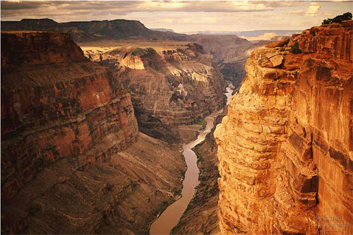
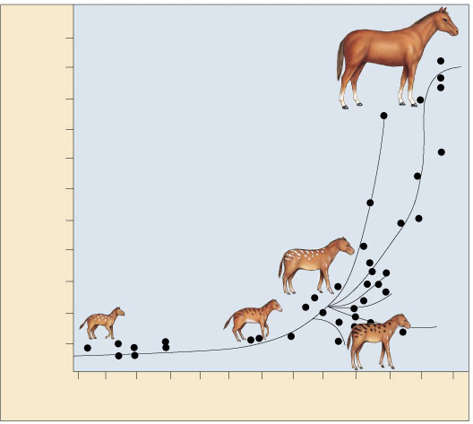
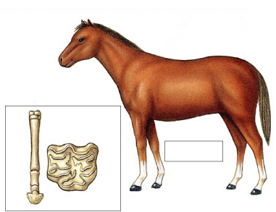
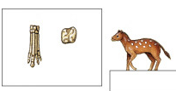
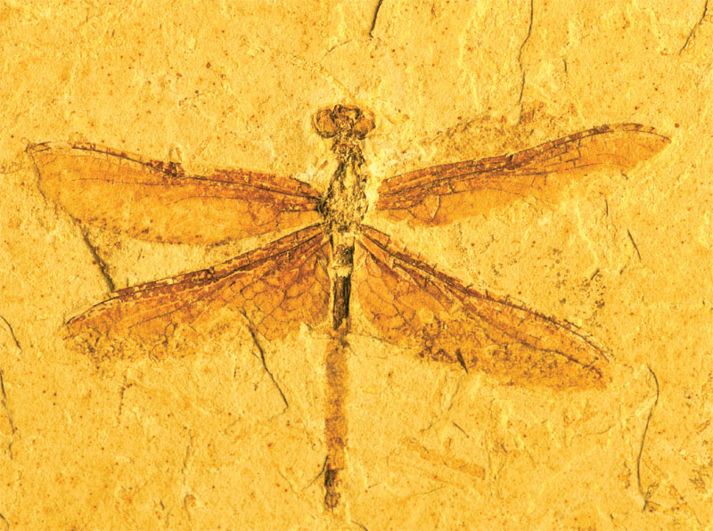
Fossil record
1. What are the lines of evidence that support Darwin’s ideas?
550
500
450
Equus
400
350
Body size (kg)
300
250
Merychippus
200
150
Mesohippus
Hyracotherium
100
50
Nannippus
60
55
50
45
40
35
30
25
20
15
10
5
0
Millions of years ago
Notes:
sedimentary rock
sequence: older fossls on bottom, younger fossls on top

Slide 21
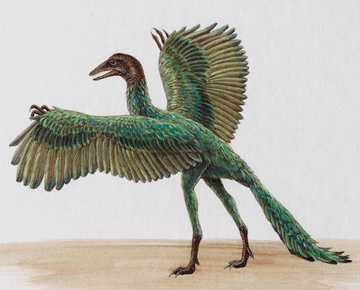
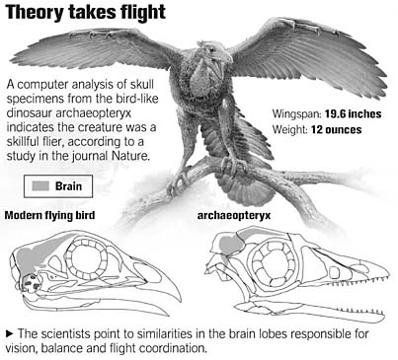
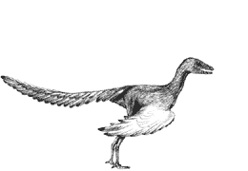
Evolution of birds
Archaeopteryx
  lived about 150 mya
  links reptiles & birds
Smithsonian Museum,
Washington, DC
Notes:
The avian nature of the brain and inner ear of Archaeopteryx (Alonso et al. 2004) - Archaeopteryx, the earliest known flying bird from the Late Jurassic period, exhibits many shared primitive characters with more basal coelurosaurian dinosaurs (the clade including all theropods more bird-like than Allosaurus), such as teeth, a long bony tail and pinnate feathers. However, Archaeopteryx possessed asymmetrical flight feathers on its wings and tail, together with a wing feather arrangement shared with modern birds. This suggests some degree of powered flight capability but, until now, little was understood about the extent to which its brain and special senses were adapted for flight. Alonso et al. (2004) investigated this problem by computed tomography scanning and three-dimensional reconstruction of the braincase of the London specimen of Archaeopteryx. A reconstruction of the braincase and endocasts of the brain and inner ear suggest that Archaeopteryx closely resembled modern birds in the dominance of the sense of vision and in the possession of expanded auditory and spatial sensory perception in the ear. Alonso et al. (2004) concluded that Archaeopteryx had acquired the derived neurological and structural adaptations necessary for flight. An enlarged forebrain suggests that it had also developed enhanced somatosensory integration with these special senses demanded by a lifestyle involving flying ability.

Slide 22
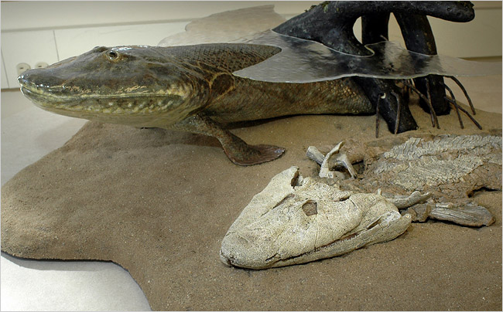
Evolution of land animals
2006 Fossil Discovery of Early Tetrapod
  “Tiktaalik”
  “missing link” from sea to land animals
    from swimming (0 legs) to walking (4 legs)

Slide 23
Fossil Record
The Fossil Record: Fossils provide evidence for the theory of evolution.
  Fossils are remains or traces of organisms from the past. They are found in sedimentary rock. Paleontology is the study of fossils.
  Fossils show that evolutionary changes have occurred over time and the origin of major new groups of organisms.
  Darwin’s theory of evolution through natural selection explains the succession of forms in the fossil record. Transitional fossils have been found that link ancient organism to modern species, just as Darwin’s theory predicts.

Slide 24
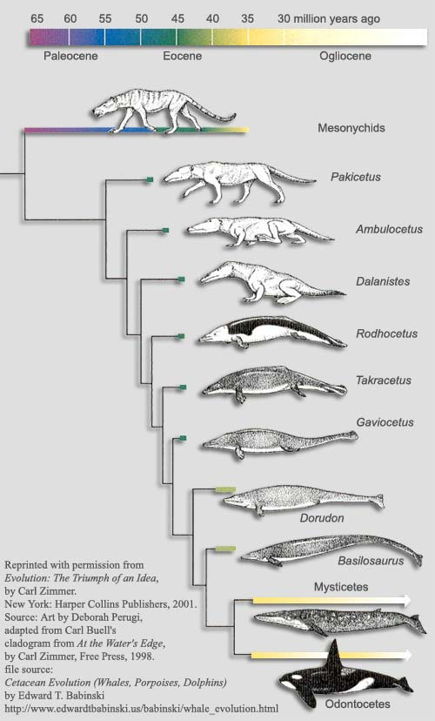
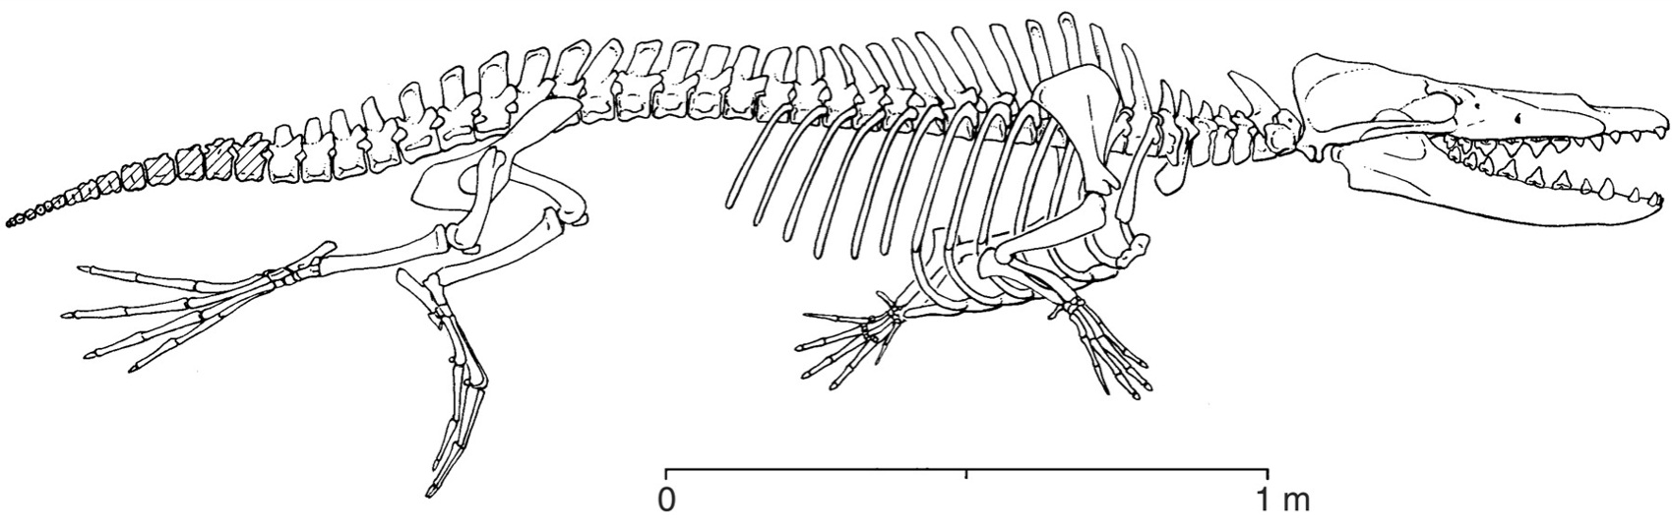
Evolution of marine mammals
Land Mammal
?
?
?
But then,
they actually
found my fossil!
Where are the
transitional fossils?
?
At first,
I was just
a joke!
Aquatic Mammal
Notes:
There are innumerable intermediate & transitional forms
Whales as land creatures returning to the water….
Where are the intermediate forms of whale ancestors?
Cartoon making fun of this idea.
The cartoons disappeared 10-12 years ago when this fossil was found.
Ambilocetic natans = “Walking whale who likes to swim”
4-5 intermediate forms all found in last 2 decades
Indus River valley in between India & Pakistan.

Slide 25
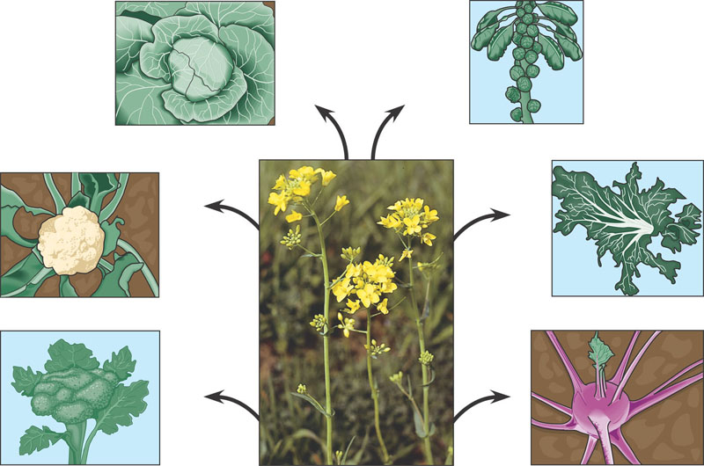
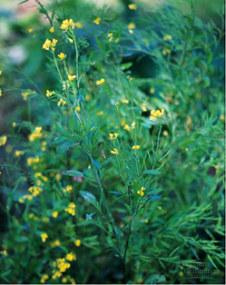
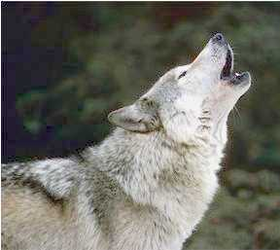
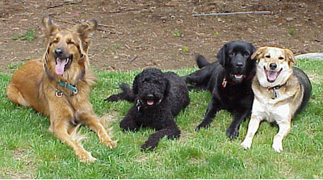
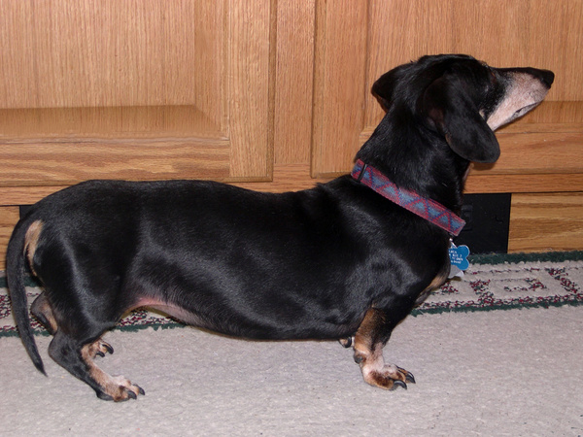
Artificial selection
2. What are the lines of evidence that support Darwin’s ideas?
Cabbage
Terminal
bud
Brussels sprouts
Lateral
buds
Flower cluster
Leaves
Kale
Cauliflower
Stem
Flower
and
stems
Broccoli
Wild mustard
Kohlrabi
Notes:
Artificial selection
Hidden variation can be exposed through selection!

Slide 26
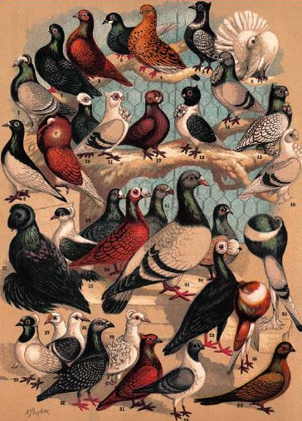
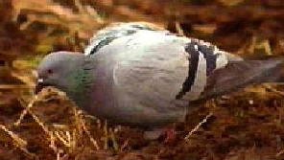
Selective breeding
the raw genetic material (variation) is hidden there

Slide 27
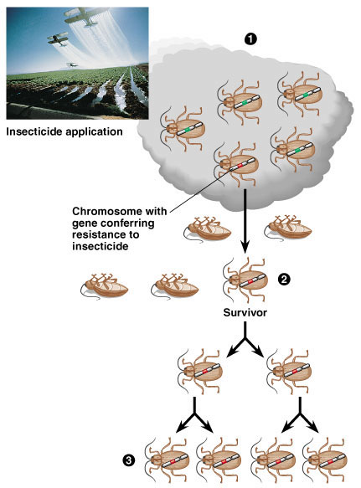
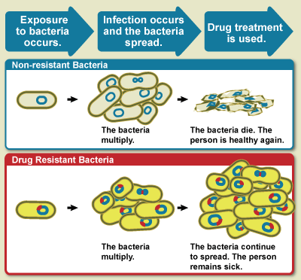
Natural selection in action
MRSA
Notes:
Insecticide & drug resistance
insecticide didn’t kill all individuals
resistant survivors reproduce
resistance is inherited
insecticide becomes less & less effective

Slide 28





Anatomical evidence
3. What are the lines of evidence that support Darwin’s ideas?
Notes:
Anatomical evidence
1. These structures are called… homologous
2. These structures are evidence for…. common ancestry
3. similar internal structure = similar development
4. different function = different environment & niche
5. close evolutionary r’ship!

Slide 29










Homologous structures
spines
leaves
succulent leaves
Don’t forget
our plant friends!
tendrils
needles
colored leaves

Slide 30
Homology
Homology: Characteristics in related species can have an underlying similarity even though they have very different functions. Similarity resulting from common ancestry is known a homology.
-Homologous structures are anatomical signs of evolution. Examples: Forelimbs of mammals that are now used for a variety of purposes, such as flying in bats or swimming in whales, but were present and used in a common ancestor for walking.

Slide 31





Analogous structures
Don’t be fooled
by their looks!
Convergent
evolution
Those fins & tails
& sleek bodies are
analogous structures!
Does this mean
they have a
recent common ancestor?
Solving a similar problem with a similar solution
Notes:
same function
different development & anatomy
Those fins & tails & sleek bodies are analogous structures!
convergent evolution - NOT common ancestor

Slide 32


Convergent evolution
These animals
look very similar but does
that mean they have a
recent common ancestor?
What is this
evidence of?
marsupial
mammals
placental
mammals
Notes:
Biogeographical evidence
No!
Convergent / parallel evolution
similar environments & niches lead to natural selection of similar traits

Slide 33
Convergent Evolution
Convergent evolution explain why distantly related species can resemble one another. Convergent evolution has taken place when two organisms developed similarities as they adapted to similar environmental challenges-not because they evolved from a common ancestor. The likenesses that result from convergent evolution are considered analogous rather than homologous. Think of it like this: Similar problems have similar solutions. Here are some examples:
The torpedo shapes of a penguin, dolphin, and shark are the solution to movement through an aqueous environment.
Sugar gliders (marsupial mammals) and flying squirrels (eutherian mammals) occupy similar niches and their respective habitats.

Slide 34



Parallel/convergent evolution
Convergent evolution
of analogous
burrowing characteristics
Niche
Placental Mammals
Australian Marsupials
Burrower
Marsupial mole
Mole
Anteater
Anteater
Numbat
Nocturnal
insectivore
Marsupial mouse
Mouse
Climber
Spotted cuscus
Lemur
Glider
Sugar glider
Flying
squirrel
Stalking
predator
Ocelot
Tasmanian cat
Chasing
predator
Wolf
Tasmanian “wolf”
Notes:
evolution on different continents of similar looking species filling similar niches

Slide 35


Vestigial organs
Why would whales
have pelvis & leg bones
if they were always
sea creatures?
  These are
  remnants of
  structures that were
  functional in
  ancestral species
Notes:
Remains of ancestral structures = mutations can occur without affecting survival & reproduction
Evolutionary relationship
snakes & whales — remains of pelvis & leg bones of walking ancestors
eyes on blind cave fish
human tail bone

Slide 36
4. What are the lines of evidence that support Darwin’s ideas?
The sequence in
DNA & proteins
is a molecular
record of evolutionary
relationships.
Why compare
DNA & proteins
across species?
Human
Macaque
Dog
Bird
Frog
Lamprey
Comparative hemoglobin structure
8
32
45
67
125
Why compare
these genes?
0
10
20
30
40
50
60
70
80
90
100
110
120
Number of amino acid differences between
hemoglobin (146 aa) of vertebrate species and that of humans
Notes:
Molecular Record
What are we comparing here? -→ comparing DNA (base sequence) & proteins (amino acid sequence)
What assumption do we make
about genes and relatedness? → the more closely related, the more DNA bases & amino acids you have in common
have to compare genes for protein the organisms have in common… can’t compare genes for proteins you don’t have

Slide 37
Comparative hemoglobin structure/molecular relationships
Embryonic homologies: Comparison of early stages of animal development reveals many anatomical homologies in embryos that are not visible in adult organisms. Examples: All vertebrate embryos have a post-anal tail and pharyngeal pouches.
Vestigial organs are structure so marginal, if any, importance to the organism. They are remnants of structures that served important functions in the organisms’ ancestors. Example: Remnants of the pelvis and leg bones are found in some snakes.
Molecular homologies are shared characteristics on the molecular level. Examples: all life-forms use the same genetic language of DNA and RNA. Amino acid sequences coding for hemoglobin in primate species shows great similarity, thus indicating a common ancestor.

Slide 38
Biogeography:
Biogeography: The geographic distribution of species.
Species in a discrete geographic area tend to be more closely related to each other than to species in distant geographic areas. Example: In South America, desert animals are more closely related to local animals in other habitats than they are to the desert animals of Asia. This reflects evolution, not creation.
Continental drift and the break-up of Pangaea can explain the similarity of species on continents that are distant today.
Endemic species are found at a certain geographic location and nowhere else. Example: Marine iguanas are endemic to the Galapagos.

Slide 39

Building “family” trees
Notes:
Closely related species (branches) share same line of descent until their divergence from a common ancestor

Slide 40


"Nothing in biology makes sense except in the light of evolution."
-- Theodosius Dobzhansky
March 1973
Geneticist, Columbia University
(1900-1975)
Notes:
Theodosius Dobzhansky: Integrating Genetics and Evolution
Theodosius Dobzhansky, a Russian geneticist who moved to the United States, provided laboratory evidence for natural selection and variation where previously there had been only field observation. Dobzhansky's work with Drosophila, or fruit flies, provided new evidence that supported Darwin's theory that natural selection, acting on genetic variation in populations, is a driving force in evolution.

Slide 41


Evolution is "so overwhelmingly established that it has become irrational to call it a theory."
-- Ernst Mayr
What Evolution Is
2001
Professor Emeritus, Evolutionary Biology
Harvard University
(1904-2005)
Notes:
Born in 1904 in Germany, Mayr trained as a medical student but realized he had a greater passion for studying birds and biology. Emigrating to the United States, he became a curator at the American Museum of Natural History, working on bird classification while formulating his key ideas about evolution. In 1942 he published his most important work, Systematics and the Origin of Species. Mayr moved to Harvard University in 1953 and served as director of the school's Museum of Comparative Zoology from 1961 to 1970. Since then, he has published a number of books and chapters and received the prestigious Japan Prize for Biology in 1983.
In his landmark 1942 book, Mayr proposed that Darwin's theory of natural selection could explain all of evolution, including why genes evolve at the molecular level. On the stubborn question of how species originate, Mayr proposed that when a population of organisms becomes separated from the main group by time or geography, they eventually evolve different traits and can no longer interbreed.
It's this isolation or separation that creates new species, said Mayr. The traits that evolve during the period of isolation are called "isolating mechanisms," and they discourage the two populations from interbreeding.
Moreover, Mayr declared that the development of many new species is what leads to evolutionary progress. "Without speciation, there would be no diversification of the organic world, no adaptive radiation, and very little evolutionary progress. The species, then, is the keystone of evolution."

Slide 42

Evidence of Evolution
by Natural Selection
Testable Hypotheses

Slide 43



Peppered Moths
Dark vs. light variants
Year % dark % light
1848 5 95
1895 98 2
1995 19 81

Slide 44

Peppered moth
What was the selection factor?
  early 1800s = pre-industrial England
    low pollution
    lichen growing on trees = light colored bark
  late 1800s = industrial England
    factories = soot coated trees
    killed lichen = dark colored bark
  mid 1900s = pollution controls
    clean air laws
    return of lichen = light colored bark
  _________________________________

Slide 45

Evolution in Darwin’s finches now
Rosemary and Peter Grant
Prediction:
Since dry years produce thicker shelled seeds, then in dry years, larger beaks will be more frequent in the population.
Data…
Wet year
Beak depth
Dry year
Dry year
Dry year
1977
1980
1982
1984
11
10
Beak depth of
offspring (mm)
9
8
Medium ground finch
8
9
10
11
Mean beak depth of parents (mm)

Slide 46


Natural selection in action
Insecticide &
drug resistance
  insecticide didn’t
  kill all individuals
  resistant survivors reproduce
  resistance is inherited
  more of population is resistant
    insecticide becomes less & less effective
Resistance…
NOT immunity!
Pesticide
molecule
Target site
Resistant
target site
Insect cell
membrane
Target site
Decreased number of target sites
Notes:
Insecticide & drug resistance
insecticide didn’t kill all individuals
resistant survivors reproduce
resistance is inherited
insecticide becomes less & less effective

Slide 47


Genome sequencing
What can data from whole genome sequencing tell us about evolution of humans?

Slide 48



Primate Common Ancestry?
Chromosome Number in the Great Apes (Hominidae)
orangutan (Pogo) 48
gorilla (Gorilla) 48
chimpanzee (Pan) 48
human (Homo) 46
Could we have
just lost a pair of
chromosomes?
Hypothesis:
Change in chromosome number?
If these organisms share a common ancestor, then is there evidence in the genome for this change in chromosome number

Slide 49
Chromosomal fusion
Testable prediction:
If common ancestor had 48 chromosomes (24 pairs),
then humans carry a fused chromosome (23 pairs).
What we should find:
Ancestral Chromosomes
Fusion
Homo sapiens
Chromosome Number in the Great Apes (Hominidae)
orangutan (Pogo) 48
gorilla (Gorilla) 48
chimpanzee (Pan) 48
human (Homo) 46
Inactivated centromere
Telomere sequences
in middle of chromosome
Testable!
This is what makes
evolution science
& not belief!
Centromere: bonding point between chromosomes
Telomere: at ends of chromosomes

Slide 50


Guess what we found?!?
Hillier et al (2005) “Generation and Annotation of the DNA sequences of human chromosomes 2 and 4,” Nature 434: 724 – 731.
Ancestral Chromosomes
Chromosome 2 in
Homo sapiens
“Chromosome 2 is unique to the human lineage of evolution, having emerged as a result of head-to-head fusion of two chromosomes that remained separate in other primates. The precise fusion site has been located in 2q13–2q14.1, where our analysis confirmed the presence of multiple subtelomeric duplications to chromosomes 1, 5, 8, 9, 10, 12, 19, 21 and 22. During the formation of human chromosome 2, one of the two centromeres became inactivated (2q21, which corresponds to the centromere from chimp chromosome 13) and the centromeric structure quickly deterioriated.”
Fusion
Inactivated centromere
Telomere sequences
in middle of chromosome
Well I’ll
be a monkey’s
…or an ape’s…
uncle!
Human Chromosome #2 shows the exact point at which this fusion took place

