Slide 1
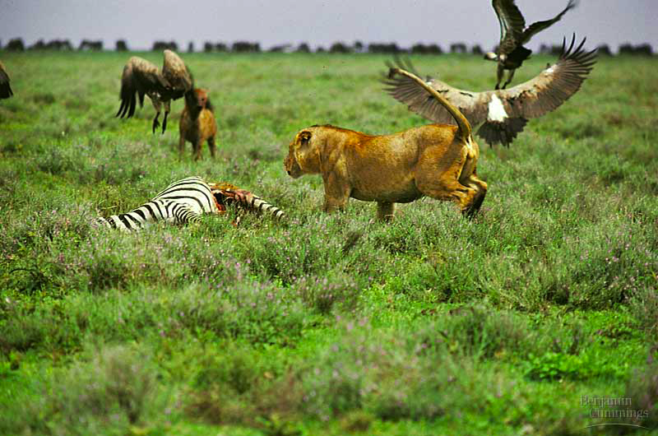
organism
population
Community Ecology
community
ecosystem
biosphere

Slide 2
Community Ecology
Community
all the organisms that live together in a place
interactions
Community Ecology
study of interactions among all populations in a common environment
To answer:
In what way do the populations interact?

Slide 3
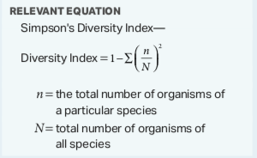
Describe the structure of a community according to its species composition and diversity.
The structure of a community is measured and described in terms of species composition and species diversity.

Slide 4
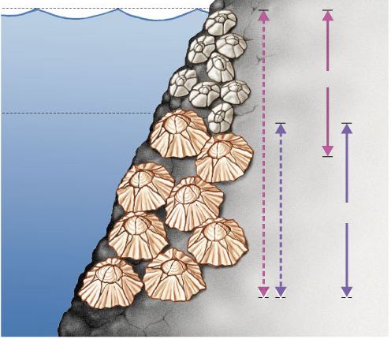
Niche
An organism’s niche is its ecological role
habitat = address vs. niche = job
High tide
Competitive Exclusion
If Species 2 is removed, then Species 1 will occupy whole tidal zone. But at lower depths Species 2 out-competes Species 1, excluding it from its potential (fundamental) niche.
Species 1
Low tide
Chthamalus sp.
Species 2
Fundamental
niches
Realized
niches
Semibalanus sp.

Slide 5
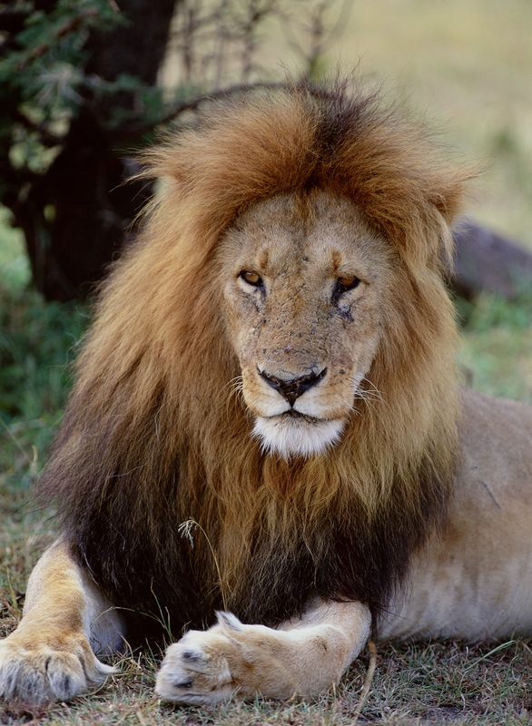
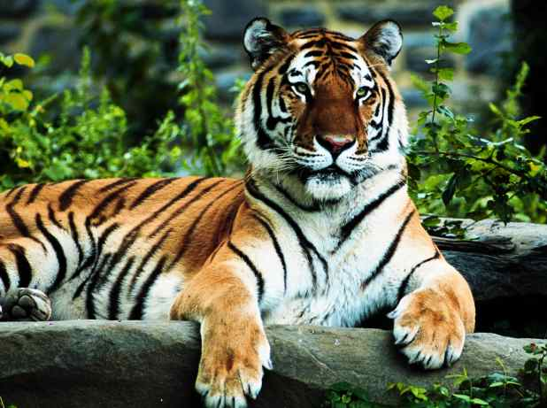
Niche & competition
Competitive Exclusion
No two similar species can occupy the same niche at the same time

Slide 6
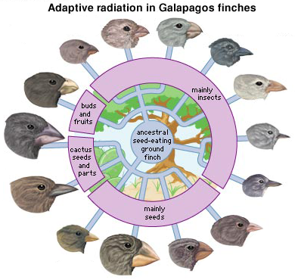
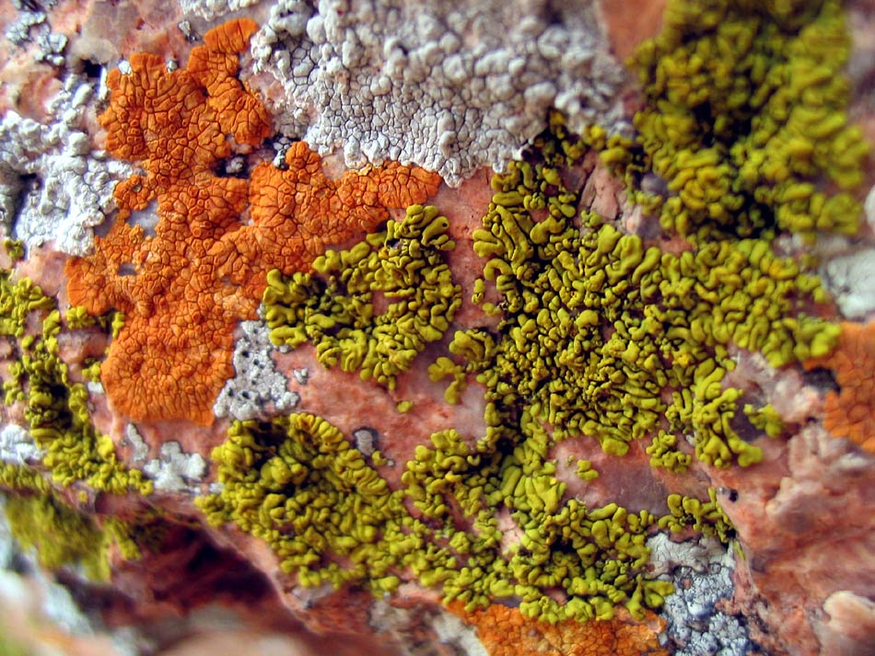
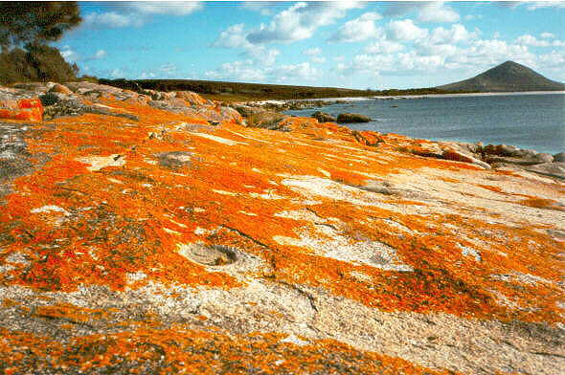
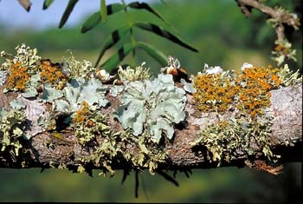
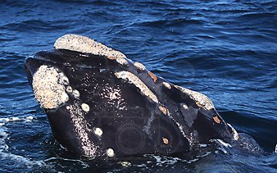
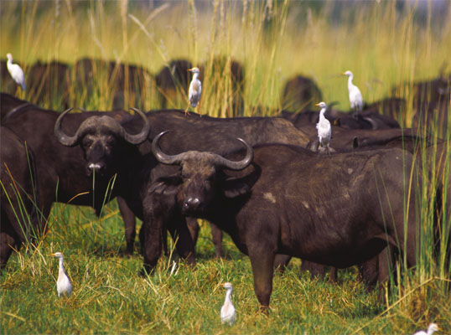
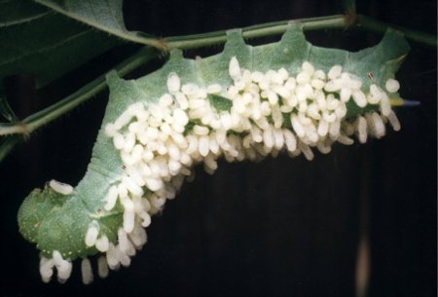
Interspecific interactions
Symbiotic interactions
competition (-/-)
compete for limited resource
competitive exclusion!
predation / parasitism (-/+)
mutualism (+/+)
lichens (algae & fungus)
commensalism (+/0)
barnacles attached to whale

Slide 7
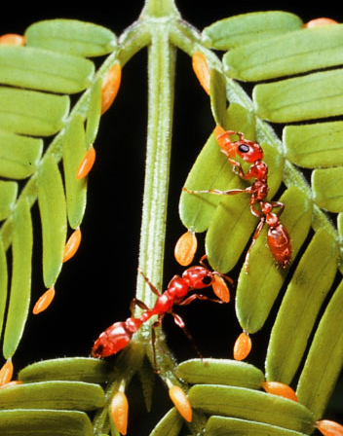
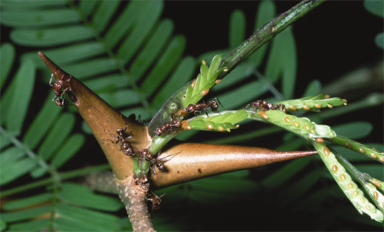
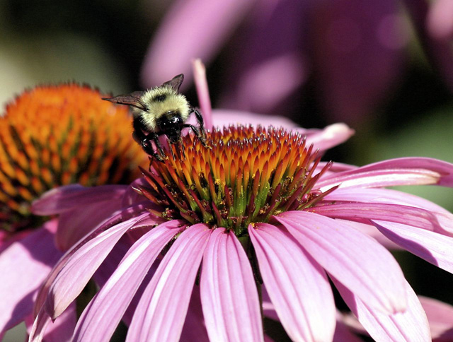
What relationship is this?
Notes:
clown fish & sea anemone
ants & acacia
impala & oxpeckers

Slide 8
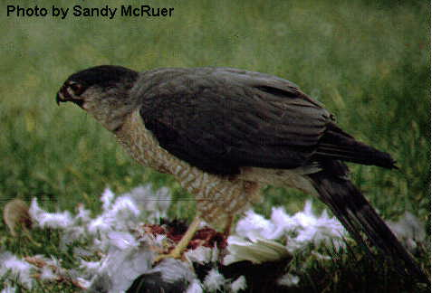
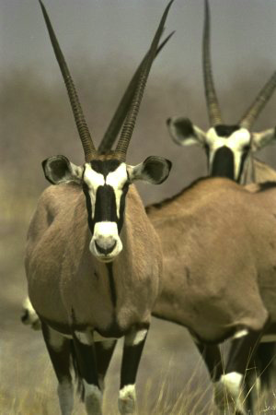
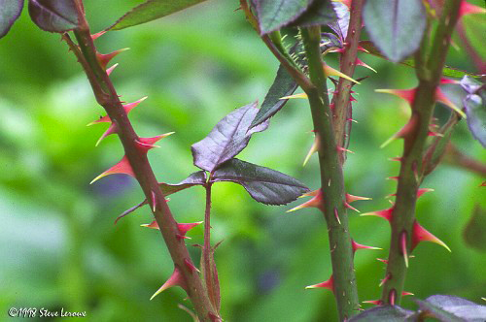
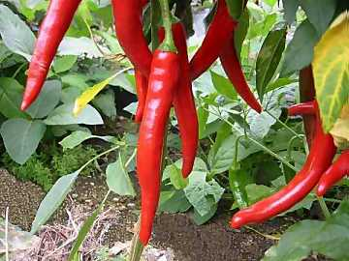
Predation drives evolution
Predators adaptations
locate & subdue prey
Prey adaptations
elude & defend
Predation provides a strong selection pressure on both prey & predator
horns, speed, coloration
spines, thorns, toxins
Notes:
Predation provides a strong selective pressure on prey populations. Ay feature that would decrease the probability of capture should be strongly favored.

Slide 9
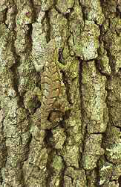
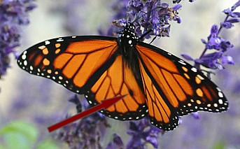
Anti-predator adaptations
Hide from predators
avoid detection
camouflage
Warn predators
advertise how undesirable you are as prey
aposematic coloration
apo = away & sematic = sign/meaning
Batesian mimicry
Mullerian mimicry

Slide 10
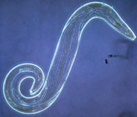
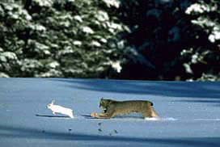
Coevolution in Community
Predator-prey relationships
Parasite-host relationships
Flowers & pollinators
Long term evolutionary adjustments between species

Slide 11
Characterizing a community
Community structure
species diversity
how many different species
composition
dominant species
most abundant species or highest biomass (total weight)
keystone species
changes over time
succession

Slide 12
Species diversity
greater diversity = greater stability
Greater biodiversity offers:
more food resources
more habitats
more resilience in face of environmental change

Slide 13
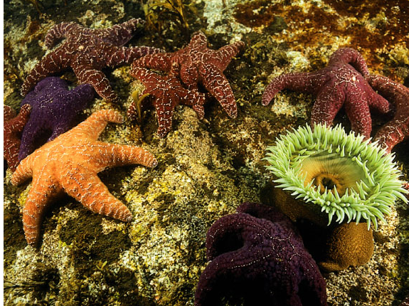
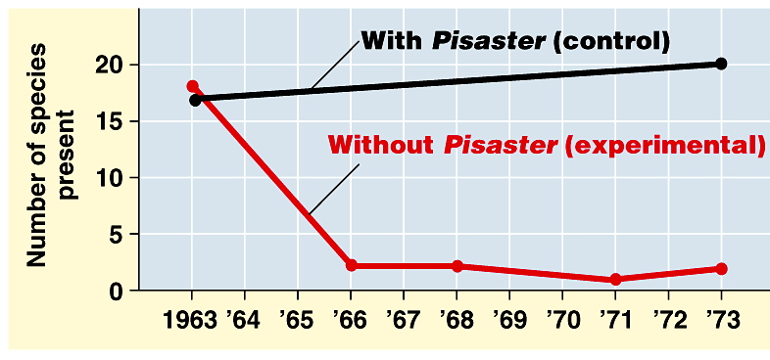
Keystone species
Pisaster ochraceous
Influential ecological role
exert important regulating effect on other species in community
keystone species increases diversity in habitat
Sea star
diversity increases
diversity decreases
mussels out-compete other species
Washington coast

Slide 14
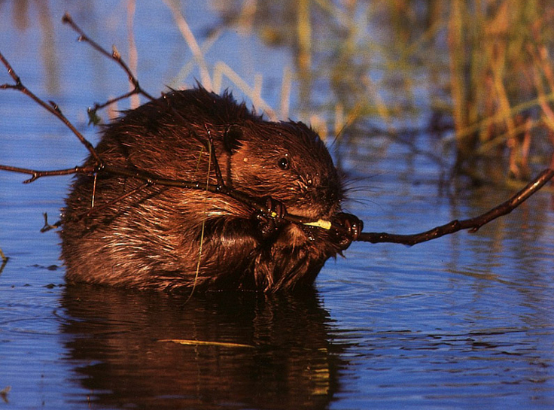
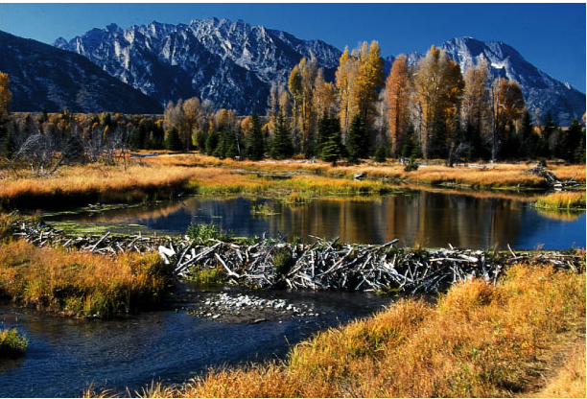
Keystone species
Beaver is a keystone species in Northeast & West
dams transform flowing streams into ponds creating new habitat

Slide 15
Variation in Populations
The structure of a community is measured and described in terms of species composition and species diversity.
An adaptation is a genetic variation that is favored by selection and is manifested as a trait that provides an advantage to an organism in a particular environment.
Mutations are random and are not directed by specific environmental pressures.

Slide 16
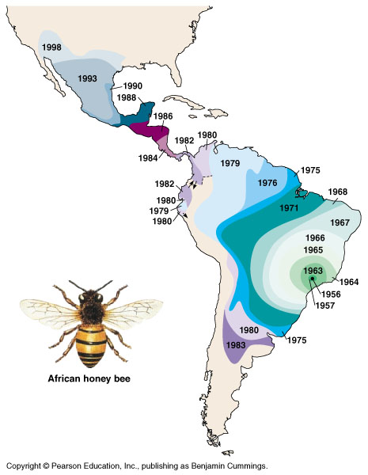
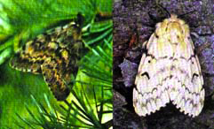
Introduced species
Non-native species
transplanted populations grow exponentially in new area
out-compete native species (invasive species)
loss of natural controls
lack of predators, parasites, competitors
reduce diversity
examples
African honeybee
gypsy moth
zebra mussel
purple loosestrife
gypsy moth
kudzu

Slide 17
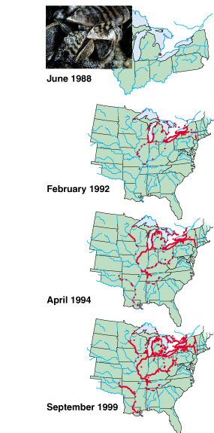
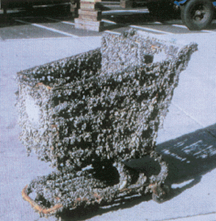
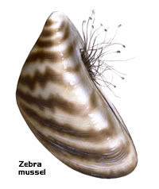
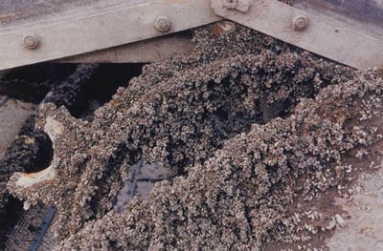
Zebra mussel
~2 months
reduces diversity
loss of food & nesting sites for animals
economic damage
ecological & economic damage

Slide 18
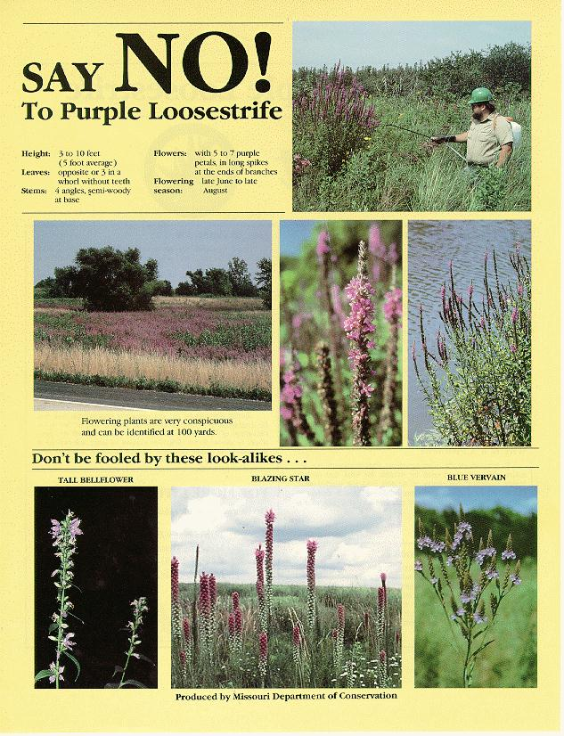
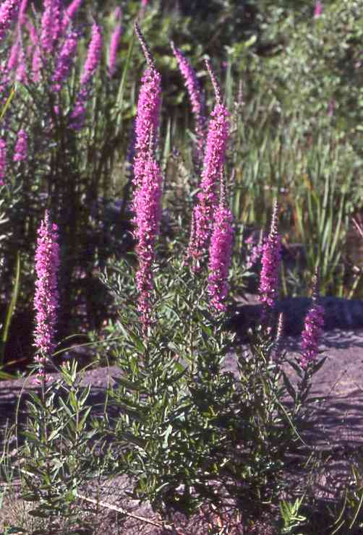
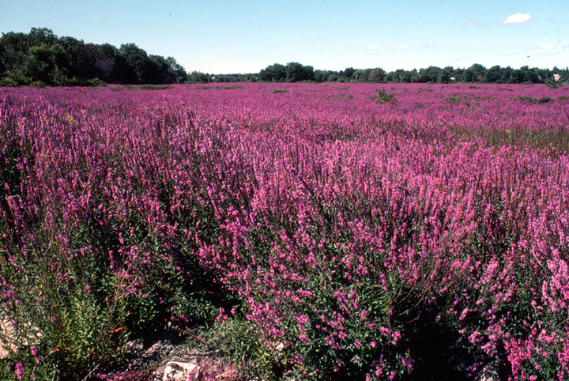
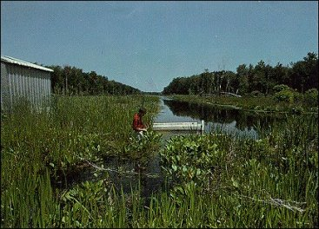
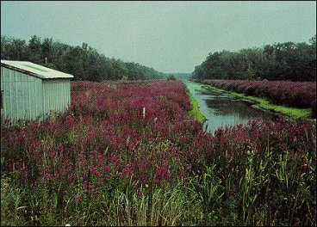
Purple loosestrife
1968
1978
reduces diversity
loss of food & nesting sites for animals

Slide 19
Describe human activities that lead to changes in ecosystem structure and/ or dynamics.
The distribution of local and global ecosystems changes over time.
Human impact accelerates change at local and global levels—
The introduction of new diseases can devastate native species.
Habitat change can occur because of human activity.

Slide 20
Explain how geological and meteorological activity leads to changes in ecosystem structure and/or dynamics.
Geological and meteorological events affect habitat change and ecosystem distribution. Biogeographical studies illustrate these changes.

Slide 21
Describe the relationship between ecosystem diversity and its resilience to changes in the environment.
Natural and artificial ecosystems with fewer component parts and with little diversity among the parts are often less resilient to changes in the environment.

Slide 22
Explain how the addition or removal of any component of an ecosystem will affect its overall short-term and long- term structure.
The diversity of species within an ecosystem may influence the organization of the ecosystem.
The effects of keystone species on the ecosystem are disproportionate relative to their abundance in the ecosystem, and when they are removed from the ecosystem, the ecosystem often collapses.

Slide 23
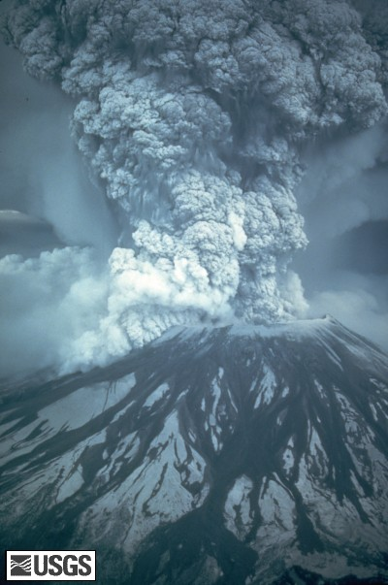
Don’t blow your top!
Ask Questions!

