Slide 1
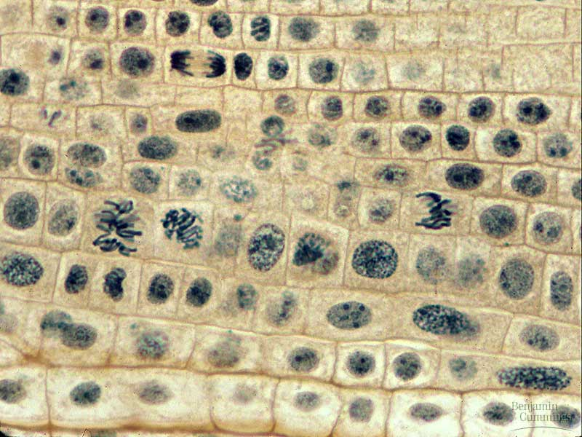
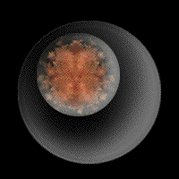
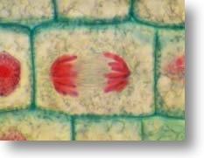
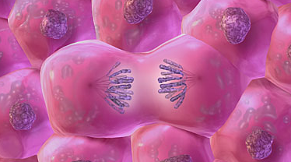
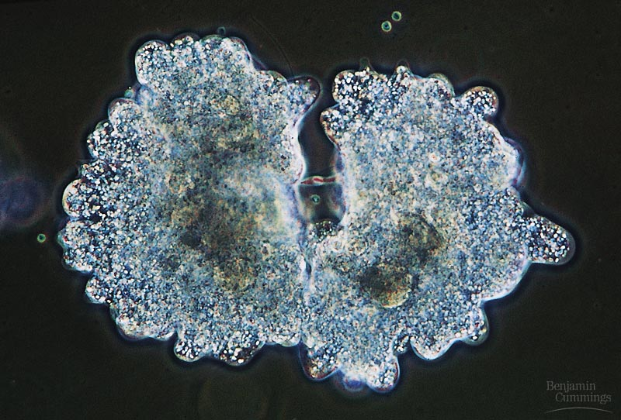
Biology is the only subject in which multiplication is the same thing as division…
The Cell Cycle:
Cell Growth, Cell Division

Slide 2
Where it all began…
You started as a cell smaller than
a period at the end of a sentence…

Slide 3
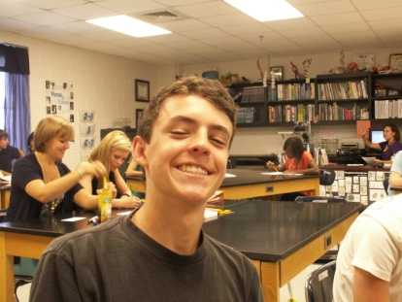
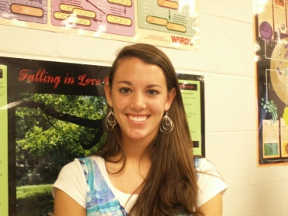
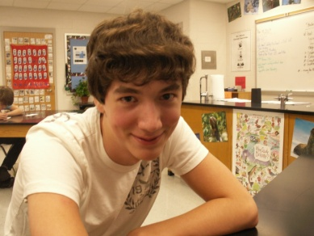
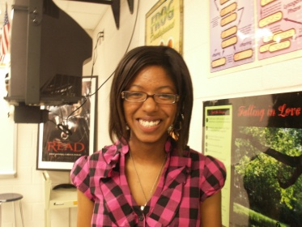
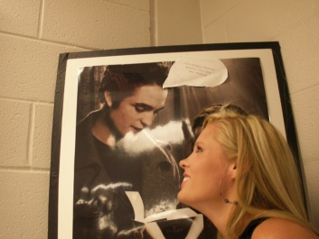
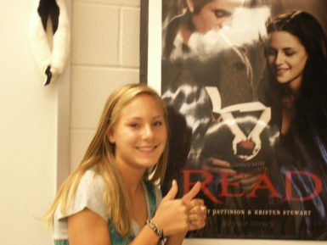
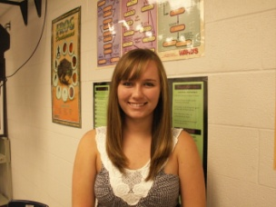
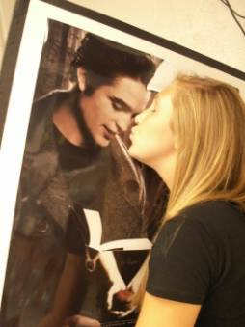
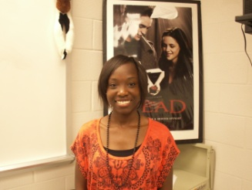
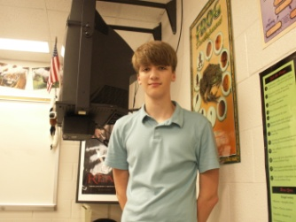
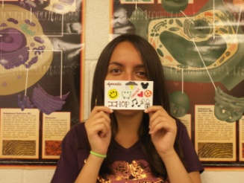
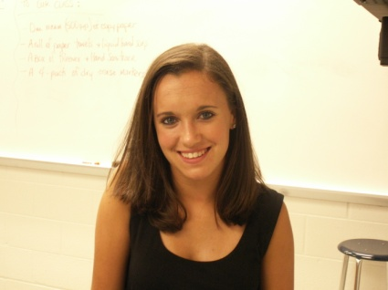
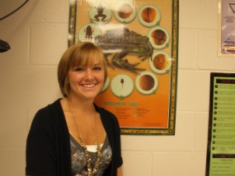
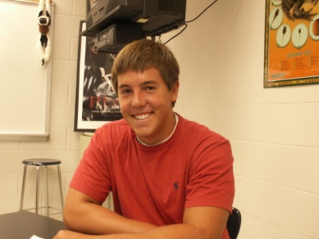
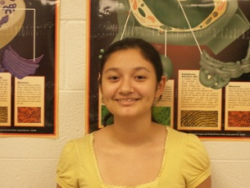
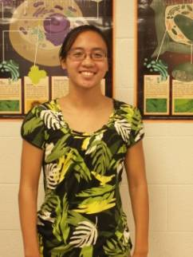
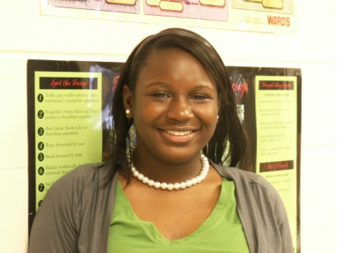
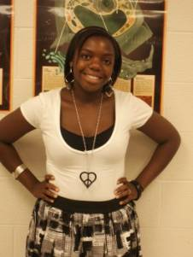
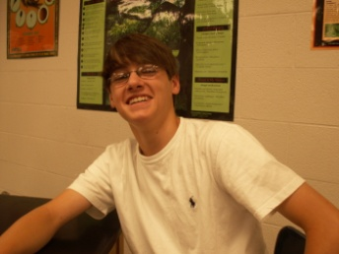
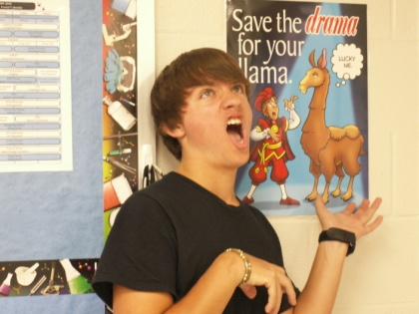
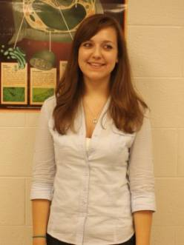
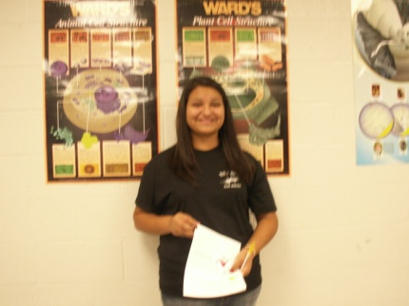
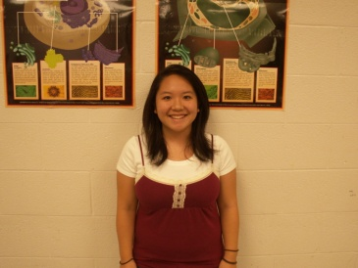
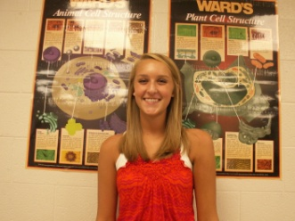
And now look at you…
How did you get from there to here?

Slide 4
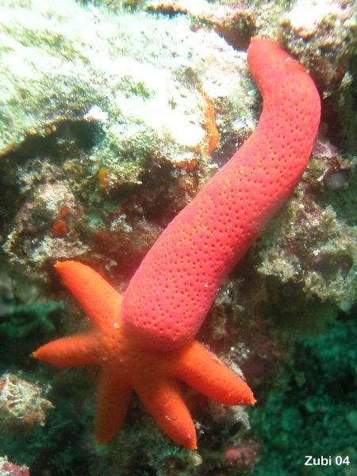

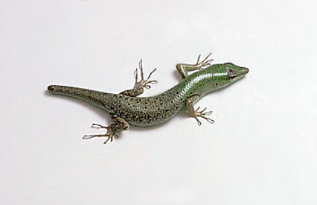
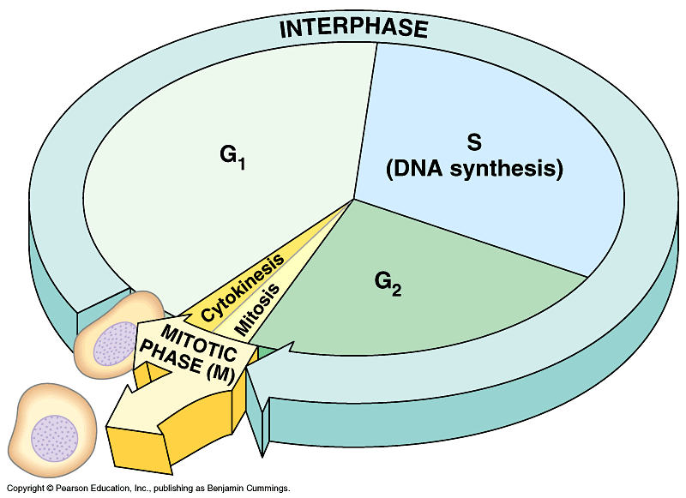
Getting from there to here…
Function of cell division
  making new cells
  continuity of life
    asexual reproduction
      unicellular organisms
    growth
    repair & renew
Cell cycle
  life of a cell from
  origin to division into
  2 new daughter cells
amoeba
Notes:
Unicellular organisms
Cell division = reproduction
Reproduces entire organism& increase population
Multicellular organisms
Cell division provides for growth & development in a multicellular organism that begins as a fertilized egg
Also use cell division to repair & renew cells that die from normal wear & tear or accidents

Slide 5
Cell Division in Prokaryotes
Prokaryotes are single celled organisms without a nucleus. Their genetic material is arranged in a single circular chromosome of DNA, which is anchored to the cell membrane.
As in eukaryotes, the genetic material of prokaryotes is duplicated before division. However, instead of entering into a complex cycle for cell division, prokaryotes simply elongate until they are double their original size.
At this point, the cell pinches in and separates into two identical daughter cells in a process known as binary fission.

Slide 6
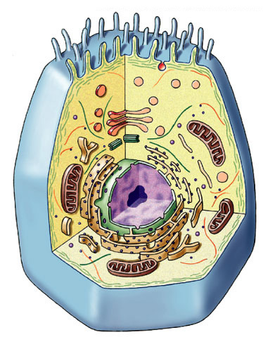
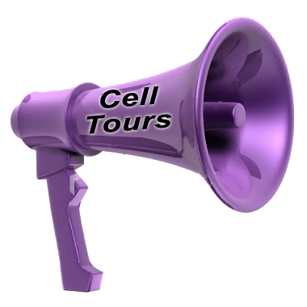
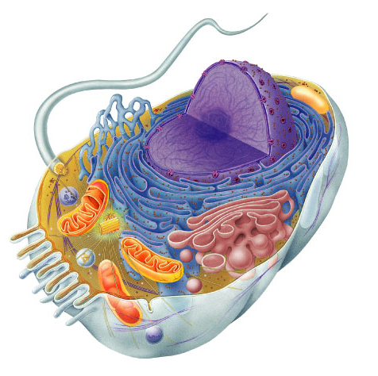
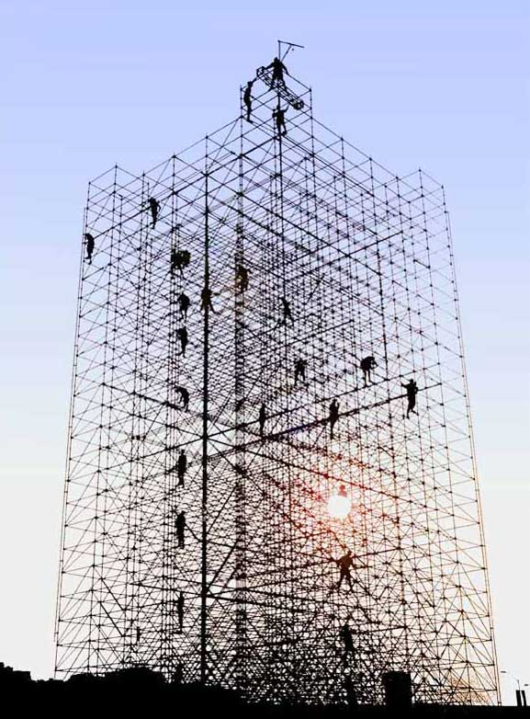
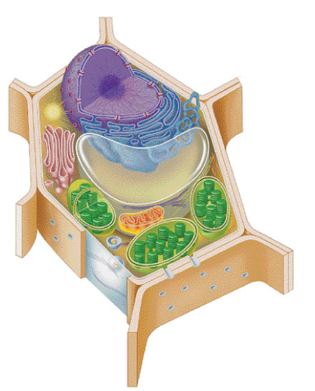
Making new cells
Nucleus
  chromosomes
  DNA
Cytoskeleton
  centrioles
    in animals
  microtubule spindle fibers

Slide 7
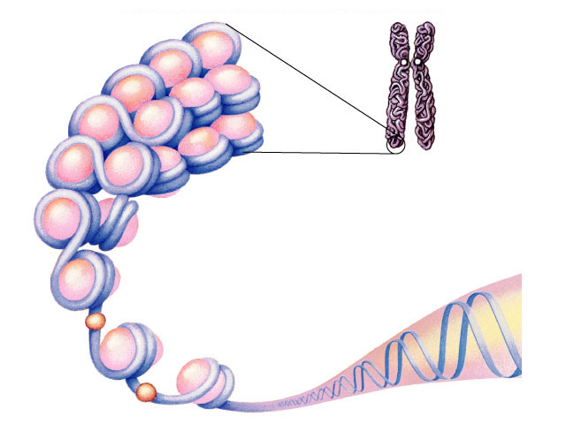
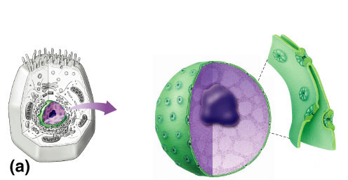
Nucleus
DNA
Function
  protects DNA (genetic information)
    All the cells DNA is its genome
Structure
  nuclear envelope
    double membrane
    membrane fused in spots to create pores
      allows large macromolecules to pass through
chromosome
histone protein
nuclear
pores
What kind of
molecules need to
pass through?
nuclear
pore
nucleolus
nuclear envelope

Slide 8
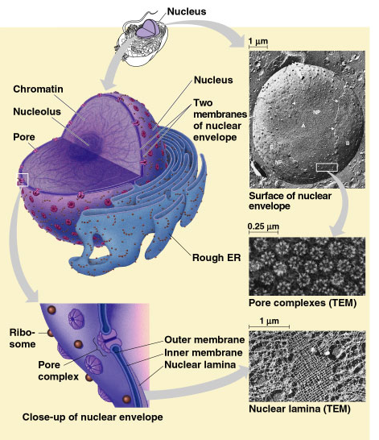
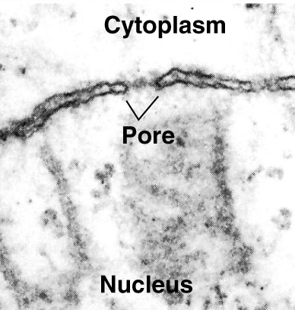

Slide 9
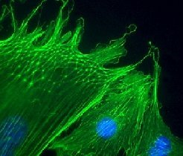
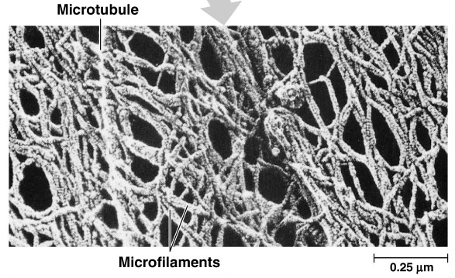
Cytoskeleton
Function
  structural support
    maintains shape of cell
    provides anchorage for organelles
      protein fibers
        microfilaments, intermediate filaments, microtubules
  motility
    cell locomotion
    cilia, flagella, etc.
  regulation
    organizes structures
    & activities of cell

Slide 10
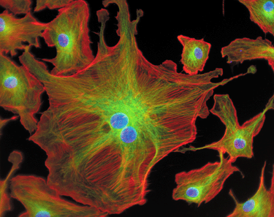
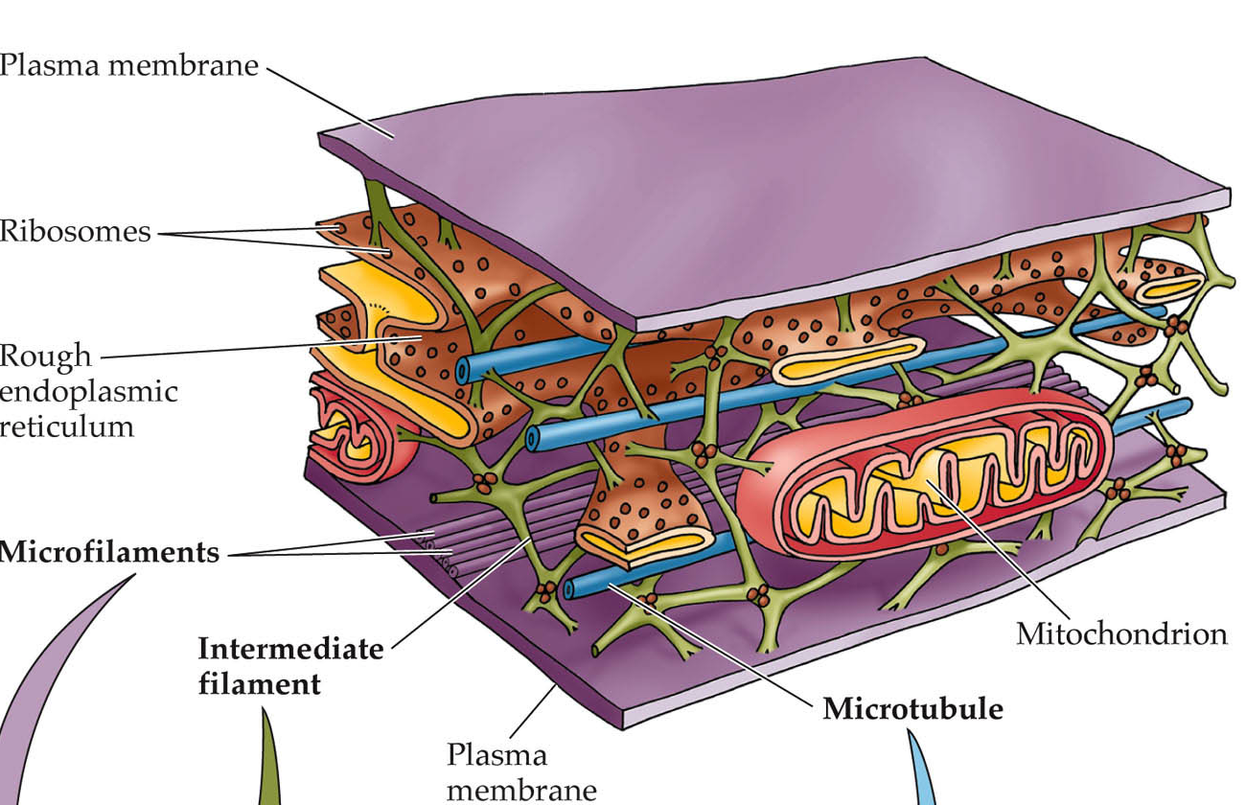
Cytoskeleton
actin
microtubule
nuclei

Slide 11
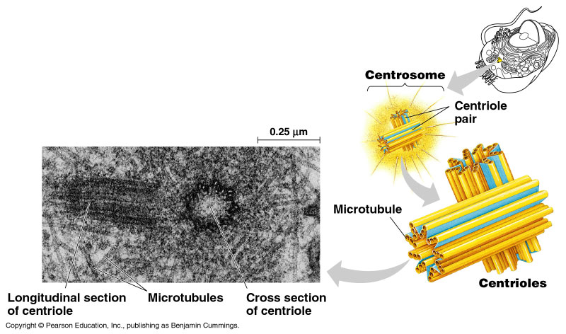
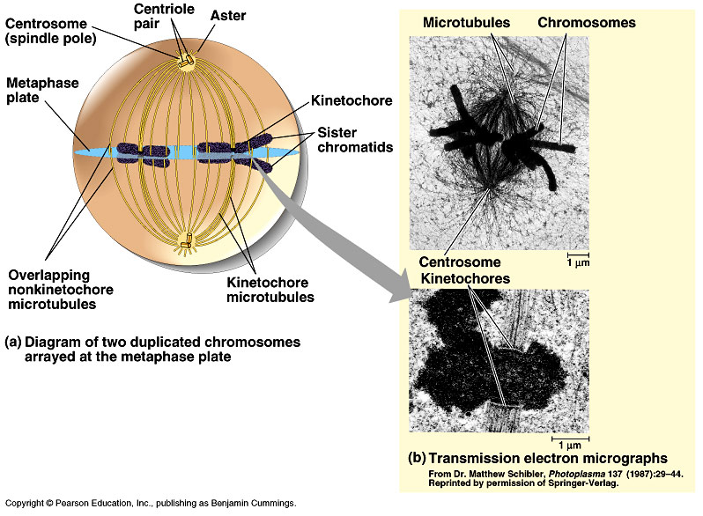
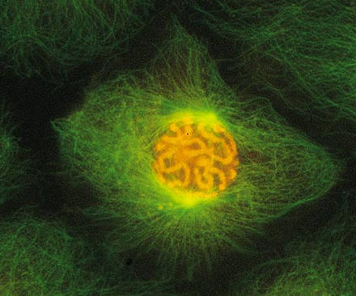
Centrioles
Cell division
  in animal cells, pair of centrioles
  organize microtubules
    spindle fibers
  guide chromosomes in mitosis

Slide 12
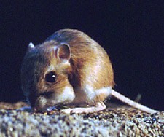
Getting the right stuff
What is passed on to daughter cells?
  exact copy of genetic material = DNA
    mitosis
  division of organelles & cytoplasm
    cytokinesis
chromosomes (stained orange)
in kangaroo rat epithelial cell
→notice cytoskeleton fibers

Slide 13
Cell Division
Eukaryotic cells have chromosomes in their nuclei. Example: Humans have 46 chromosomes in somatic cells (body cells). These cells are diploid meaning there are 2 sets of similar chromosomes in each cell. They divide through a process called mitosis. Mitosis is the division of the cell’s nucleus. It may be followed by cytokinesis, the division of the cell’s organelles and cytoplasm.
Gametes -sperm and egg cells- are haploid and have half the number of chromosomes of the diploid cells. Example: Humans have 23 chromosomes in each gamete. They divide through a process called Meiosis.

Slide 14
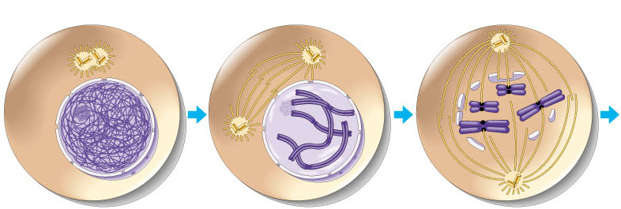

Overview of mitosis
I.P.M.A.T.
interphase
prophase
(pro-metaphase)
cytokinesis
metaphase
anaphase
telophase

Slide 15
Interphase
90% of cell life cycle
  cell doing its “everyday job”
    produce RNA, synthesize proteins/enzymes
  prepares for duplication if triggered

Slide 16
Cell cycle
Cell has a “life cycle”
cell is formed from
a mitotic division
cell grows & matures
to divide again
cell grows & matures
to never divide again
G₁, S, G₂, M
liver cells
G₁→G₀
epithelial cells,
blood cells,
stem cells
brain / nerve cells
muscle cells

Slide 17

Interphase
Divided into 3 phases:
  G₁ = 1st Gap
    cell doing its “everyday job”
    cell grows
  S = DNA Synthesis
    copies chromosomes
  G₂ = 2nd Gap
    prepares for division
    cell grows (more)
    produces organelles,
    proteins, membranes
G₀
signal to divide

Slide 18

Interphase
Nucleus well-defined
  DNA loosely packed in long chromatin fibers
Prepares for mitosis
  replicates chromosome
    DNA & proteins
  produces proteins & organelles

Slide 19


Copying / Replicating DNA
Synthesis phase of Interphase
  dividing cell replicates DNA
  must separate DNA copies correctly to 2 daughter cells
    human cell duplicates ~3 meters DNA
    each daughter cell gets complete
    identical copy
    error rate = ~1 per 100 million bases
      3 billion base pairs in mammalian genome
      ~30 errors per cell cycle
        mutations (to somatic cells)

Slide 20

Organizing DNA
ACTGGTCAGGCAATGTC
DNA
DNA is organized in
chromosomes
  double helix DNA molecule
  wrapped around histone proteins
    like thread on spools
  DNA-protein complex =
  chromatin
    organized into long thin fiber
  condensed further during mitosis
histones
chromatin
double stranded chromosome
duplicated mitotic chromosome

Slide 21

Chromosome structure
scaffold
protein
chromatin loop
30 nm
DNA
nucleosome
histone
rosettes of
chromatin loops
chromosome
DNA double helix

Slide 22

double-stranded
mitotic human
chromosomes

Slide 23


Mitotic Chromosome
Duplicated chromosome
  2 sister chromatids
  narrow at centromeres
  contain identical
  copies of original DNA
homologous
chromosomes
homologous
chromosomes
single-stranded
sister chromatids
homologous = “same information”
double-stranded
Notes:
Centromeres are segments of DNA which have long series of tandem repeats = 100,000s of bases long. The sequence of the repeated bases is quite variable. It has proven difficult to sequence.

Slide 24
Mitosis
Dividing cell’s DNA between
2 daughter nuclei
  “dance of the chromosomes”
4 phases
  prophase
  metaphase
  anaphase
  telophase

Slide 25
Prophase
Chromatin condenses
  visible chromosomes
    chromatids
Centrioles move to opposite poles of cell
  animal cell
Protein fibers cross cell to form mitotic spindle
  microtubules
    actin, myosin
  coordinates movement of chromosomes
Nucleolus disappears
Nuclear membrane breaks down

Slide 26

Transition to Metaphase
Prometaphase
  spindle fibers attach to centromeres
    creating kinetochores
  microtubules attach at kinetochores
    connect centromeres to centrioles
  chromosomes begin moving

Slide 27

Metaphase
Chromosomes align along middle of cell
  metaphase plate
    meta = middle
  spindle fibers coordinate movement
  helps to ensure chromosomes separate properly
    so each new nucleus receives only 1 copy of each chromosome

Slide 29
Anaphase
Sister chromatids separate at kinetochores
  move to opposite poles
  pulled at centromeres
  pulled by motor proteins “walking”along microtubules
    actin, myosin
    increased production of
    ATP by mitochondria
Poles move farther apart
  polar microtubules lengthen

Slide 30

Separation of chromatids
In anaphase, proteins holding together sister chromatids are inactivated
  separate to become individual chromosomes
1 chromosome
2 chromatids
2 chromosomes
single-stranded
double-stranded

Slide 31

Chromosome movement
Kinetochores use motor proteins that “walk” chromosome along attached microtubule
  microtubule shortens by dismantling at kinetochore (chromosome) end
Notes:
Microtubules are NOT reeled in to centrioles like line on a fishing rod.
The motor proteins walk along the microtubule like little hanging robots on a clothes line.
In dividing animal cells, non-kinetochore microtubules are responsible for elongating the whole cell during anaphase, readying fro cytokinesis

Slide 32
Telophase
Chromosomes arrive at opposite poles
  daughter nuclei form
  nucleoli form
  chromosomes disperse
    no longer visible under light microscope
Spindle fibers disperse
Cytokinesis begins
  cell division

Slide 33
Cytokinesis
Animals
  constriction belt of actin microfilaments around equator of cell
    cleavage furrow forms
    splits cell in two
    like tightening a draw string
Notes:
Division of cytoplasm happens quickly.

Slide 34

Cytokinesis in Animals
(play Cells Alive movies here)
(play Thinkwell movies here)

Slide 35

Mitosis in whitefish blastula

Slide 36

Mitosis in animal cells

Slide 37
Cytokinesis in Plants
Plants
  cell plate forms
    vesicles line up at equator
      derived from Golgi
    vesicles fuse to form 2 cell membranes
  new cell wall laid down between membranes
    new cell wall fuses with existing cell wall

Slide 38

Cytokinesis in plant cell

Slide 39

Mitosis in plant cell

Slide 40
onion root tip

Slide 41

Evolution of mitosis
Origin of replication
chromosome:
double-stranded DNA
Mitosis in eukaryotes
likely evolved from binary fission in bacteria
  single circular chromosome
  no membrane-bound organelles
replication
of DNA
elongation of cell
ring of proteins
cell pinches
in two

Slide 42

Evolution of mitosis
prokaryotes
(bacteria)
protists
dinoflagellates
A possible progression of mechanisms intermediate between binary fission & mitosis seen in modern organisms
protists
diatoms
eukaryotes
yeast
eukaryotes
animals
Notes:
Prokaryotes (bacteria)
No nucleus; single circular chromosome. After DNA is replicated, it is partitioned in the cell. After cell elongation, FtsZ protein assembles into a ring and facilitates septation and cell division.
Protists (dinoflagellates)
Nucleus present and nuclear envelope remains intact during cell division. Chromosomes linear. Fibers called microtubules, composed of the protein tubulin, pass through tunnels in the nuclear membrane and set up an axis for separation of replicated
chromosomes, and cell division.
Protists (diatoms)
A spindle of microtubules forms between two pairs of centrioles at
opposite ends of the cell. The spindle passes through one tunnel in the intact nuclear envelope. Kinetochore microtubules form between kinetochores on the chromosomes and the spindle
poles and pull the chromosomes to each pole.
Eukaryotes (yeast)
Nuclear envelope remains intact; spindle microtubules form inside the nucleus between spindle pole bodies. A single kinetochore microtubule attaches to each chromosome and pulls each to a pole.
Eukaryotes (animals)
Spindle microtubules begin to form between centrioles outside of nucleus. As these centrioles move to the poles, the nuclear envelope breaks down, and kinetochore microtubules attach kinetochores of chromosomes to spindle poles. Polar microtubules extend toward the center of the cell and overlap.

Slide 43


Dinoflagellates
algae
  “red tide”
  bioluminescence

Slide 44


Diatoms
microscopic algae
  marine
  freshwater

Slide 45



Regulation of Cell Division

Slide 46

Coordination of cell division
A multicellular organism needs to coordinate cell division across different tissues & organs
  critical for normal growth,
  development & maintenance
    coordinate timing of
    cell division
    coordinate rates of
    cell division
    not all cells can have the
    same cell cycle

Slide 47

Frequency of cell division
Frequency of cell division varies by cell type
  embryo
    cell cycle < 20 minute
  skin cells
    divide frequently throughout life
    12-24 hours cycle
  liver cells
    retain ability to divide, but keep it in reserve
    divide once every year or two
  mature nerve cells & muscle cells
    do not divide at all after maturity
    permanently in G₀
M
metaphase
anaphase
prophase
telophase
C
G₂
interphase (G₁, S, G₂ phases)
mitosis (M)
S
cytokinesis (C)
G₁

Slide 48
Overview of Cell Cycle Control
There’s no
turning back,
now!
Two irreversible points in cell cycle
  replication of genetic material
  separation of sister chromatids
Checkpoints
  process is assessed & possibly halted
sister chromatids
✓
✓
centromere
single-stranded
chromosomes
double-stranded
chromosomes

Slide 49

Checkpoint control system
Checkpoints
  cell cycle controlled by STOP & GO chemical signals at critical points
  signals indicate if key cellular
  processes have been
  completed correctly

Slide 50

Checkpoint control system
3 major checkpoints:
  G₁/S
    can DNA synthesis begin?
  G₂/M
    has DNA synthesis been completed correctly?
    commitment to mitosis
  spindle checkpoint
    are all chromosomes attached to spindle?
    can sister chromatids separate correctly?

Slide 51
G₁/S checkpoint
G₁/S checkpoint is most critical
  primary decision point
    “restriction point”
  if cell receives “GO” signal, it divides
    internal signals: cell growth (size), cell nutrition
    external signals: “growth factors”
  if cell does not receive
  signal, it exits cycle &
  switches to G₀ phase
    non-dividing, working state

Slide 52
G₀ phase
G₀ phase
  non-dividing, differentiated state
  most human cells in G₀ phase
liver cells
  in G₀, but can be “called back” to cell cycle by external cues
nerve & muscle cells
  highly specialized
  arrested in G₀ & can never divide

Slide 53

Activation of cell division
How do cells know when to divide?
  cell communication signals
    chemical signals in cytoplasm give cue
    signals usually mean proteins
      activators
      inhibitors
experimental evidence: Can you explain this?

Slide 54

“Go-ahead” signals
Protein signals that promote cell growth & division
  internal signals
    “promoting factors”
  external signals
    “growth factors”
Primary mechanism of control
  phosphorylation
    kinase enzymes
    either activates or inactivates cell signals
Notes:
We still don’t fully understanding the regulation of the cell cycle. We only have “snapshots” of what happens in specific cases.

Slide 55
Cell cycle signals
inactivated Cdk
Cell cycle controls
  cyclins
    regulatory proteins
    levels cycle in the cell
  Cdk’s
    cyclin-dependent kinases
    phosphorylates cellular proteins
      activates or inactivates proteins
  Cdk-cyclin complex
    triggers passage through different stages of cell cycle
activated Cdk

Slide 56




Cyclins & Cdks
1970s-’80s | 2001
Interaction of Cdk’s & different cyclins triggers the stages of the cell cycle
Leland H. Hartwell
checkpoints
Tim Hunt
Cdks
Sir Paul Nurse
cyclins
Notes:
There are multiple cyclins, each with a specific role. Cyclins are unstable. Some are triggered for destruction by phosphorylation. Others are inherently unstable and are synthesized discontinuously during the cell cycle.
Oscillations in the activities of cyclin-dependent kinases (CDKs) dictate orderly progression through the cell division cycle. In the simplest case of yeast, a progressive rise in the activity of a single cyclin-CDK complex can initiate DNA synthesis and then mitosis, and the subsequent fall in CDK activity resets the system for the next cell cycle.
In most organisms, however, the cell cycle machinery relies on multiple cyclin-CDKs, whose individual but coordinated activities are each thought to be responsible for just a subset of cell cycle events.

Slide 57

Spindle checkpoint
G₂ / M checkpoint
Chromosomes attached at metaphase plate
Replication completed
DNA integrity
Inactive
Active
Active
Inactive
Cdk / G₂
cyclin (MPF)
M
cytokinesis
APC
C
G₂
mitosis
G₁
S
Cdk / G₁
cyclin
MPF = Mitosis Promoting Factor
APC = Anaphase Promoting Complex
Inactive
Active
G₁ / S checkpoint
Growth factors
Nutritional state of cell
Size of cell

Slide 58

Cyclin & Cyclin-dependent kinases
CDKs & cyclin drive cell from
one phase to next in cell cycle
proper regulation of cell cycle is so key to life that the genes for these regulatory proteins have been highly conserved through
evolution
the genes are basically the same in yeast, insects, plants & animals (including humans)
Notes:
CDK and cyclin together form an enzyme that activates other proteins by chemical modification (phosphorylation). The amount of CDK molecules is constant during the cell cycle, but their activities vary because of the regulatory function of the cyclins. CDK can be compared with an engine and cyclin with a gear box controlling whether the engine will run in the idling state or drive the cell forward in the cell cycle.

Slide 59

External signals
Growth factors
  coordination between cells
  protein signals released by body cells that stimulate other cells to divide
    density-dependent inhibition
      crowded cells stop dividing
      each cell binds a bit of growth factor
        not enough activator left to trigger division in any one cell
    anchorage dependence
      to divide cells must be attached to a substrate
        “touch sensor” receptors

Slide 60

Growth factor signals
growth factor
nuclear pore
nuclear membrane
P
P
cell division
cell surface
receptor
Cdk
protein kinase
cascade
P
E2F
P
chromosome
Rb
E2F
P
cytoplasm
Rb
nucleus

Slide 61



Example of a Growth Factor
Platelet Derived Growth Factor (PDGF)
  made by platelets in blood clots
  binding of PDGF to cell receptors stimulates cell division in fibroblast (connective tissue)
    heal wounds
Don’t forget
to mention
erythropoietin!
(EPO)
Notes:
Erythropoietin (EPO): A hormone produced by the kidney that promotes the formation of red blood cells in the bone marrow. EPO is a glycoprotein (a protein with a sugar attached to it).
The kidney cells that make EPO are specialized and are sensitive to low oxygen levels in the blood. These cells release EPO when the oxygen level is low in the kidney. EPO then stimulates the bone marrow to produce more red cells and thereby increase the oxygen-carrying capacity of the blood.
EPO is the prime regulator of red blood cell production. Its major functions are to promote the differentiation and development of red blood cells and to initiate the production of hemoglobin, the molecule within red cells that transports oxygen.
EPO has been much misused as a performance-enhancing drug (“blood doping”) in endurance athletes including some cyclists (in the Tour de France), long-distance runners, speed skaters, and Nordic (cross-country) skiers. When misused in such situations, EPO is thought to be especially dangerous (perhaps because dehydration can further increase the viscosity of the blood, increasing the risk for heart attacks and strokes. EPO has been banned by the Tour de France, the Olympics, and other sports organizations.

Slide 62
Growth Factors and Cancer
Growth factors can create cancers
  proto-oncogenes
    normal growth factor genes that become oncogenes (cancer-causing) when mutated
    stimulates cell growth
    if switched “ON” can cause cancer
    example: RAS (activates cyclins)
  tumor-suppressor genes
    inhibits cell division
    if switched “OFF” can cause cancer
    example: p53

Slide 63
Cancer & Cell Growth
Cancer is essentially a failure
of cell division control
  unrestrained, uncontrolled cell growth
What control is lost?
  lose checkpoint stops
  gene p53 plays a key role in G₁/S restriction point
    p53 protein halts cell division if it detects damaged DNA
      options:
        stimulates repair enzymes to fix DNA
        forces cell into G₀ resting stage
        keeps cell in G₁ arrest
        causes apoptosis of damaged cell
    ALL cancers have to shut down p53 activity
p53 is the
Cell Cycle
Enforcer
p53 discovered at Stony Brook by Dr. Arnold Levine

Slide 64

p53 — master regulator gene
NORMAL p53
p53 allows cells
with repaired
DNA to divide.
p53
protein
DNA repair enzyme
p53
protein
Step 1
Step 2
Step 3
DNA damage is caused
by heat, radiation, or
chemicals.
Cell division stops, and
p53 triggers enzymes to
repair damaged region.
p53 triggers the destruction
of cells damaged beyond repair.
ABNORMAL p53
abnormal
p53 protein
cancer
cell
Step 1
Step 2
DNA damage is
caused by heat,
radiation, or
chemicals.
The p53 protein fails to stop
cell division and repair DNA.
Cell divides without repair to
damaged DNA.
Step 3
Damaged cells continue to divide.
If other damage accumulates, the
cell can turn cancerous.

Slide 65
Development of Cancer
Cancer develops only after a cell experiences ~6 key mutations (“hits”)
  unlimited growth
    turn on growth promoter genes
  ignore checkpoints
    turn off tumor suppressor genes (p53)
  escape apoptosis
    turn off suicide genes
  immortality = unlimited divisions
    turn on chromosome maintenance genes
  promotes blood vessel growth
    turn on blood vessel growth genes
  overcome anchor & density dependence
    turn off touch-sensor gene
It’s like an
out of control
car!

Slide 66

What causes these “hits”?
Mutations in cells can be triggered by
  UV radiation
  chemical exposure
  radiation exposure
  heat
  cigarette smoke
  pollution
  age
  genetics

Slide 67
Tumors
Mass of abnormal cells
  Benign tumor
    abnormal cells remain at original site as a lump
      p53 has halted cell divisions
    most do not cause serious problems &
    can be removed by surgery
  Malignant tumors
    cells leave original site
      lose attachment to nearby cells
      carried by blood & lymph system to other tissues
      start more tumors = metastasis
    impair functions of organs throughout body

Slide 68



Traditional treatments for cancers
Treatments target rapidly dividing cells
  high-energy radiation
    kills rapidly dividing cells
  chemotherapy
    stop DNA replication
    stop mitosis & cytokinesis
    stop blood vessel growth

Slide 69



New “miracle drugs”
Drugs targeting proteins (enzymes) found only in cancer cells
  Gleevec
    treatment for adult leukemia (CML)
    & stomach cancer (GIST)
    1st successful drug targeting only cancer cells
without
Gleevec
with
Gleevec
Novartes
Notes:
Proof of Principle: you can treat cancer by targeting cancer-specific proteins.
GIST = gastrointestinal stromal tumors, which affect as many as 5,000 people in the United States
CML = chronic myelogenous leukemia, adult leukemia, which affect as many as 8,000 people in the United States
Fastest FDA approval — 2.5 months

Slide 70
Any Questions??

