Slide 1
Cell Communication

Slide 2
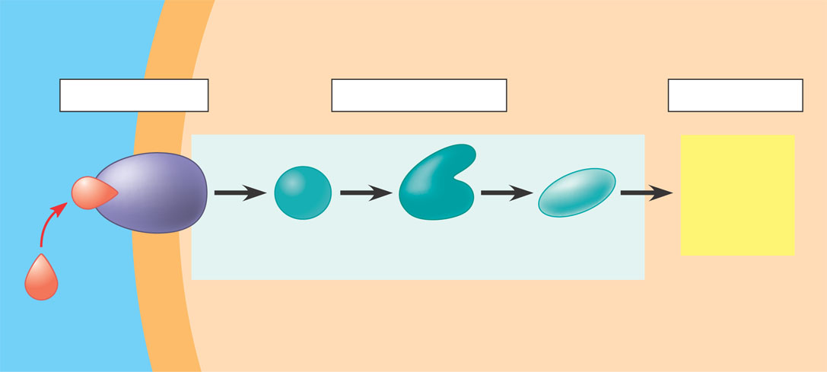
3 Phases of Signal Transduction
EXTRACELLULAR
FLUID
CYTOPLASM
Plasma membrane
Reception
Transduction
Response
Receptor
Activation
of cellular
response
1
2
3
Relay molecules in a signal transduction pathway
Signal
molecule
Reception-The target cell’s detection of a signal molecule coming from the outside.
Transduction-The conversion of the signal to a form that can bring about a specific cellular response.
Response-The specific cellular response to the signal molecule.

Slide 3
Communication Takes Two
Ligand (key)
Receptor (lock)
The Signaling Molecule
Ex: proteins, individual amino acids, steroids, ions, etc…
Protein that detects specific ligands
Lock and Key type fit
Notes:
Receptors only bind certain ligands. Like someone listening to a single person in a noisy, crowded room. Ligand needs to be a certain shape.

Slide 4
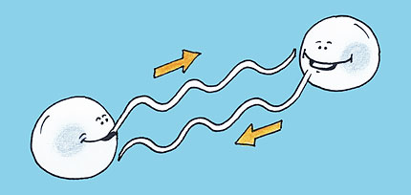
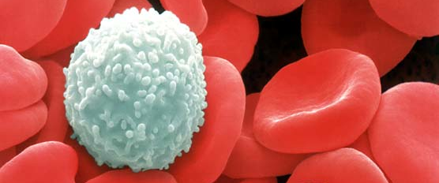
Types of Cell Signaling
The type of signaling a cell uses is based on the distance between the cell it is trying to signal
4 Main types of cell signaling:
Juxtacrine / Direct Communication
Paracrine Signaling
Endocrine Signaling
Synaptic Signaling
Autocrine Signaling is another important signaling event
This occurs when a cell signals itself. The production and secretion of an extracellular mediator by a cell followed by the binding of that mediator to receptors on the same cell to initiate signal transduction.
Examples include: cancer cells making their own growth hormone rather than relying on its release from the pituitary gland, macrophages which attack infected cells. Used in the development of embryos so cells can take on and reinforce their correct identities.

Slide 5
4 Types of Cell Signaling
1. Juxtacrine/Direct Contact: Cells are touching. One cell can recognize the molecules on the adjacent cell.
Example from Plants: ______________________
Example from Animals: ____________
Orchestrates early embryo development
Plasmodesmata
Gap Junctions
Similar to two people having a personal conversation

Slide 6
Cell Junctions in Animal and Plant cells
Tight Junctions: Belts around the epithelial cells that line organs and serve as a barrier to prevent leakage into or out of those organs.
Desmosomes: “spot welds” found in many tissues that are subjected to severe mechanical stress such as skin epithelium or the neck of the uterus, which must expand greatly during childbirth
Gap junctions permit the passage of materials directly from the cytoplasm from one cell to the cytoplasm of an adjacent cell. In the muscle tissue of the heart, the flow of ions through the gap junctions coordinate the contractions of the cardiac cells.
Plasmodesmata: connect one plant cell to the next. They are analogous to gap junctions in animal cells.

Slide 7
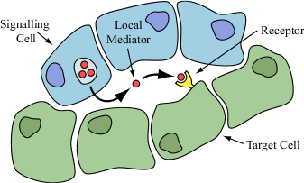
4 Types of Cell Signaling
2. Paracrine Signaling: Ligands produced by cells can travel through extracellular fluid (diffusion) and be read by other local cells
Short-lived molecules
Two Outcomes:
Read by another cell
Degraded by enzymes
Similar to a teacher teaching a class
Notes:
Para – Aside or next to
Crine – to secret

Slide 8
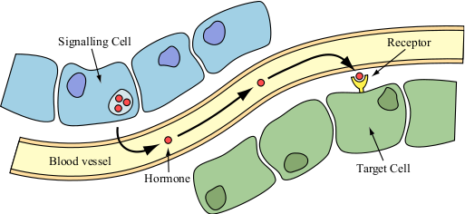
4 Types of Cell Signaling
3. Endocrine Signaling: Ligand released by a cell and makes it way to the (blood) circulatory system
Can be spread to the entire body
Long-lived molecules known as hormones
Used extensively in plants and animals
Similar to someone making an announcement over the PA system
Notes:
Endo – Eternal or within
Crine – to secret

Slide 9
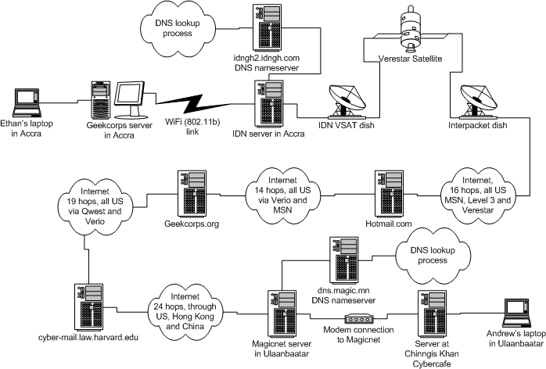
4 Types of Cell Signaling
4. Synaptic Signaling: Rapid communication with distant cells using nerve cells’ long fiber-like extensions
Ligands are called neurotransmitters
Chemical Synapse: association of the neuron and its target cell
Used by the nervous system - ex: touch
Similar to emailing where emails bounce from server to server until they reach their destination

Slide 10
4 Types of Cell Signaling
Direct Contact
Paracrine Signaling
Endocrine Signaling
Synaptic Signaling
Teacher Teaching
Emailing
Personal Conversation
Announcement over PA

Slide 11
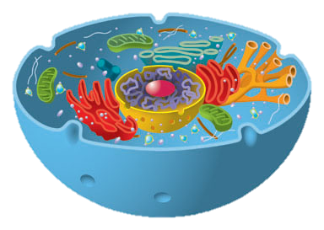
Process of Cell Communication
Ligand
Receptor
1. Ligand-Receptor Binding
2. Signal Transduction: Receptor sends signal throughout the cell
3. Cell responds to the signal

Slide 12
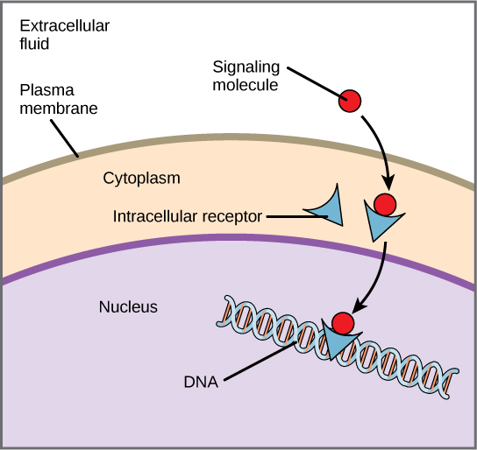
Step One - Reception
Reception occurs when a signal molecule (ligand) binds to a receptor protein.
Found in two places:
• plasma membrane receptor proteins
-Binds to water-soluble ligands
• intracellular receptor proteins
-Found inside the plasma membrane in the cytoplasm or nucleus. The signal molecule (ligand) must cross the plasma membrane and therefore must be hydrophobic, like the steroid hormone testosterone.

Slide 13
G Protein-coupled receptor
G Protein-coupled receptor is a membrane receptor that works with the help of a G protein.
Step 1: The ligand or signaling molecule has bound to the G protein-coupled receptor. This causes a conformational change in the receptor so that it may now bind to an inactive G protein, causing a GTP (Guanine Triphosphate) to displace the GDP (Guanine Diphosphate). This activates the G Protein.
Step 2: The G protein binds to a specific enzyme and activates it. When the enzyme is activated, it can trigger the next step in a pathway leading to a cellular response. All the molecular shape changes are temporary. To continue the cellular response, new signal molecules are required.

Slide 14
G Protein-coupled receptor

Slide 15
Receptor Tyrosine Kinase
Step 1: The binding of signal molecules to the receptors and the subsequent formation of a dimer. In the dimer configuration each tyrosine kinase adds a phosphate from ATP molecule.
Step 2: The fully activated receptor protein as it initiates a unique cellular response for each phosphorylated tyrosine.
The key ability of a single ligand to activate multiple cellular responses is a key difference between G protein-coupled receptors and receptor tyrosine kinases.
Protein kinase receptors belong to a class of plasma membrane receptors that function as enzymes. One example is RTK, receptor tyrosine kinase. Steroid messengers diffuse directly through the cell membrane and once inside the cell, bind to a second messenger, like cAMP.

Slide 16
Receptor Tyrosine Kinases

Slide 17
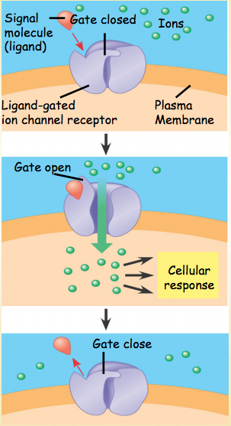
Plasma Membrane Receptor Proteins

Slide 18
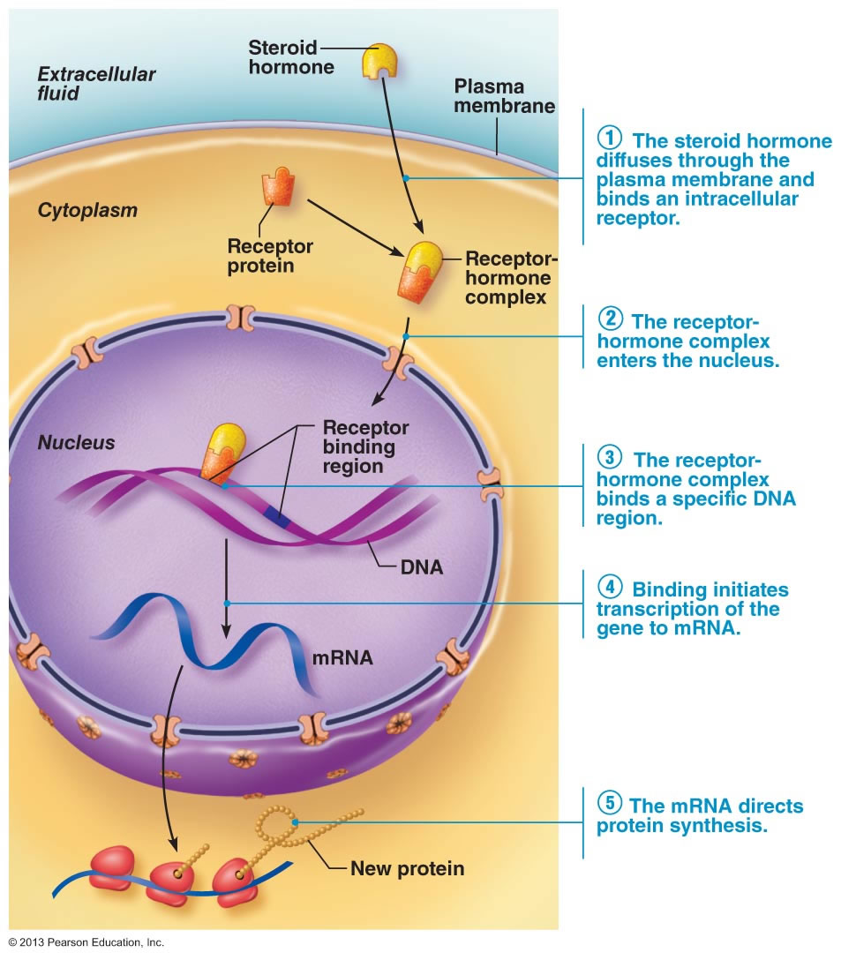
Intracellular Receptors
Intracellular Receptors bind hydrophobic ligands
Hydrophobic ligands can easily cross the plasma membrane
Main class of Intracellular Receptors are Nuclear Receptors

Slide 20
Step Two - Transduction
At each step, the signal is transduced into a different form
-Commonly a shape change in a protein
-Shape change is brought about by phosphorylation (addition of a phosphate group)
-Signal transduction often involve a phosphorylation cascade.
When receptors are membrane proteins, the transduction stage is usually a multistep pathway
-Multistep pathways can amplify a signal
-Enzymes called protein kinases phosphorylate and thereby activate many proteins at the next level. This cascade of phosphorylation greatly enhances the signal, allowing for a large cellular response.
Kinase Proteins
Enzyme that adds a phosphate to an amino acid

Slide 21
Step Two - Transduction
Dephosphorylation occurs when a phosphate group is removed
-Phosphatases
-Enzyme that removes phosphate groups.
-Thus, the signal can be turned on by kinases and off by phosphatases.
-Not all components of signal transduction pathways are proteins.
-Many signaling pathways involve small, nonprotein water-soluble molecules or ions called second messengers. Calcium ions and cyclic AMP are two common second messengers. The second messengers, once activated, can initiate a phosphorylation cascade resulting in a cellular response.
-Earl Sutherland received the Nobel Prize for his discovery of cAMP as a second messenger. Sutherland noticed that glycogen was broken down only when a hormone epinephrine was administered to intact cells. Epinephrine is the ligand (signal molecule) that activates the G protein-coupled receptor which is responsible for glycogen breakdown. Epinephrine does not enter the cell, suggesting a second messenger. Only in intact cells could the first messenger (epinephrine) be translated to a cellular response-glycogen breakdown.

Slide 22
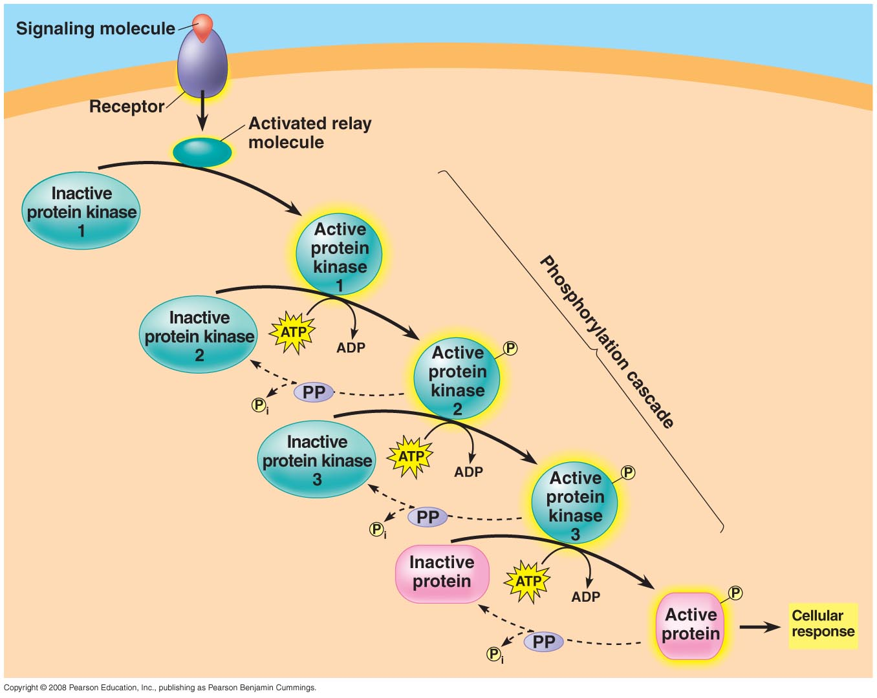

Slide 23
Step Three - Response
Signal Transduction results in a cellular response
Leads to regulation of cytoplasmic activities or transcription
Many signaling pathways ultimately regulate protein synthesis, usually by turning on or off in the nucleus. Often, the final activated molecule in a signaling pathway functions as a transcription factor.
In the cytoplasm, signaling pathways often regulate the activity of proteins rather than their synthesis. For example, the final step in the signaling pathway may affect the activity of enzymes or cause cytoskeleton rearrangement.
One of the main responses is a change in protein composition
Some proteins are activated
Other proteins are deactivated
How does the cell do this?
Phosphorylation!

Slide 24
Apoptosis (Controlled Cell Suicide)
An example of cell signaling is a program of controlled cell suicide called apoptosis.
During apoptosis the cell is systematically dismantled and digested.
This protects neighboring cells from damage that would occur if a dying cell merely leaked out its digestive and other enzymes
Apoptosis is triggered by signals that activate a cascade of “suicide” proteins in the cell.
In vertebrates (organisms with backbones), apoptosis is a normal part of development and is essential for a normal nervous system, for the operation of the immune system, and for normal morphogenesis of hands and feet in humans.

Slide 25
Concept: Feedback regulation and antagonistic hormone pairs are common in endocrine systems
Hormones are assembled into regulatory pathways
© 2011 Pearson Education, Inc.

Slide 26
Simple Hormone Pathways
Hormones are released from an endocrine cell, travel through the bloodstream, and interact with specific receptors within a target cell to cause a physiological response
For example, the release of acidic contents of the stomach into the duodenum stimulates endocrine cells there to secrete secretin
This causes target cells in the pancreas, a gland behind the stomach, to raise the pH in the duodenum
© 2011 Pearson Education, Inc.

Slide 27
In a simple neuroendocrine pathway, the stimulus is received by a sensory neuron, which stimulates a neurosecretory cell
The neurosecretory cell secretes a neurohormone, which enters the bloodstream and travels to target cells
© 2011 Pearson Education, Inc.

Slide 28
Feedback Regulation
A negative feedback loop inhibits a response by reducing the initial stimulus, thus preventing excessive pathway activity
Positive feedback reinforces a stimulus to produce an even greater response
For example, in mammals oxytocin causes the release of milk, causing greater suckling by offspring, which stimulates the release of more oxytocin
© 2011 Pearson Education, Inc.

Slide 29
Insulin and Glucagon: Control of Blood Glucose
Insulin (decreases blood glucose) and glucagon (increases blood glucose) are antagonistic hormones that help maintain glucose homeostasis
The pancreas has clusters of endocrine cells called pancreatic islets with alpha cells that produce glucagon and beta cells that produce insulin
© 2011 Pearson Education, Inc.

Slide 30
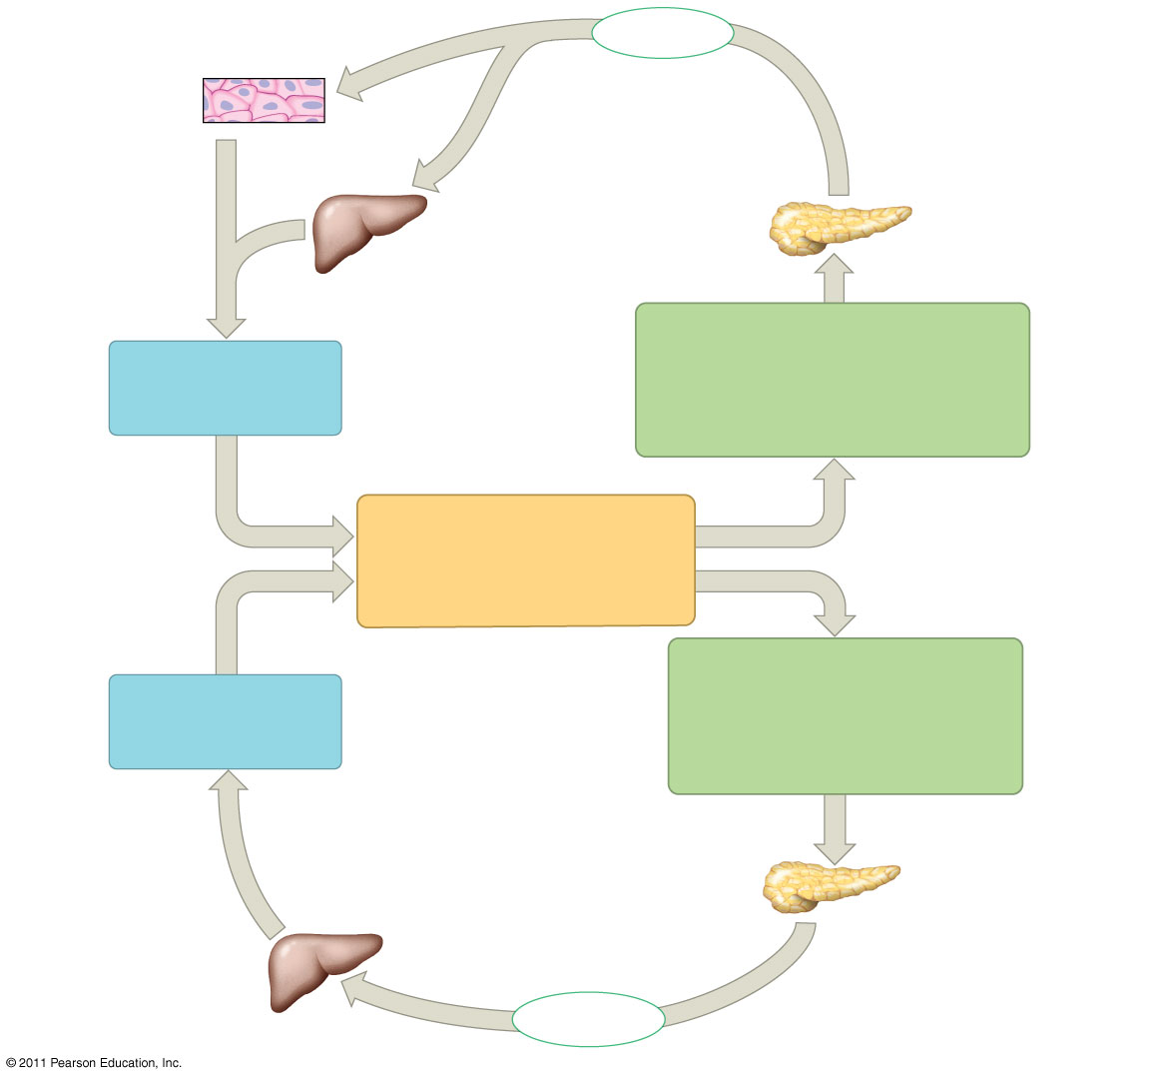
Figure 45.13
Body cells take up more glucose.
Insulin
Beta cells of pancreas release insulin into the blood.
Liver takes up glucose and stores it as glycogen.
STIMULUS: Blood glucose level rises (for instance, after eating a carbohydrate-rich meal).
Blood glucose level declines.
Homeostasis: Blood glucose level (70–110 mg/m100mL)
STIMULUS: Blood glucose level falls (for instance, after skipping a meal).
Blood glucose level rises.
Liver breaks down glycogen and releases glucose into the blood.
Alpha cells of pancreas release glucagon into the blood.
Glucagon
Notes:
Figure 45.13 Maintenance of glucose homeostasis by insulin and glucagon.

Slide 31
Target Tissues for Insulin and Glucagon
Insulin reduces blood glucose levels by
Promoting the cellular uptake of glucose
Slowing glycogen breakdown in the liver
Promoting fat storage, not breakdown
© 2011 Pearson Education, Inc.

Slide 32
Glucagon increases blood glucose levels by
Stimulating conversion of glycogen to glucose in the liver
Stimulating breakdown of fat and protein into glucose
© 2011 Pearson Education, Inc.

