Slide 1
Chapter 27
Bacteria and Archaea

Slide 2
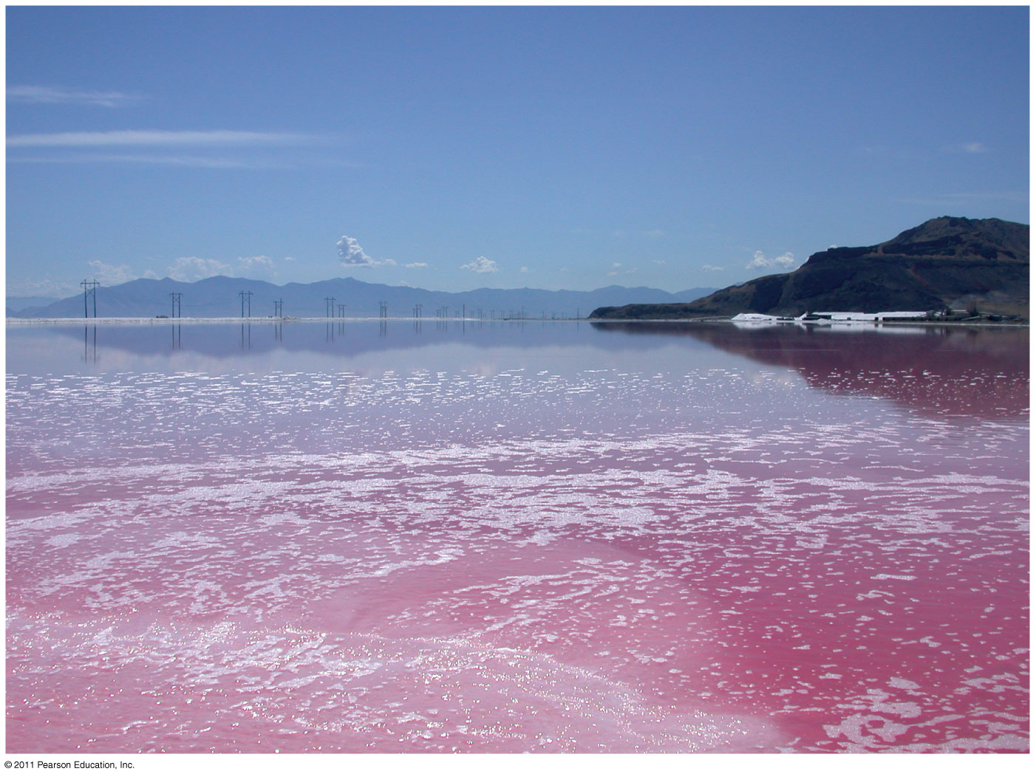
Overview: Masters of Adaptation
Utah’s Great Salt Lake can reach a salt concentration of 32%
Its pink color comes from living prokaryotes
© 2011 Pearson Education, Inc.

Slide 3
Prokaryotes thrive almost everywhere, including places too acidic, salty, cold, or hot for most other organisms
Most prokaryotes are microscopic, but what they lack in size they make up for in numbers
There are more in a handful of fertile soil than the number of people who have ever lived
Prokaryotes are divided into two domains: bacteria and archaea
© 2011 Pearson Education, Inc.

Slide 4
Concept 27.1: Structural and functional adaptations contribute to prokaryotic success
Earth’s first organisms were likely prokaryotes
Most prokaryotes are unicellular, although some species form colonies
Most prokaryotic cells are 0.5–5 µm, much smaller than the 10–100 µm of many eukaryotic cells
Prokaryotic cells have a variety of shapes
The three most common shapes are spheres (cocci), rods (bacilli), and spirals
© 2011 Pearson Education, Inc.

Slide 5
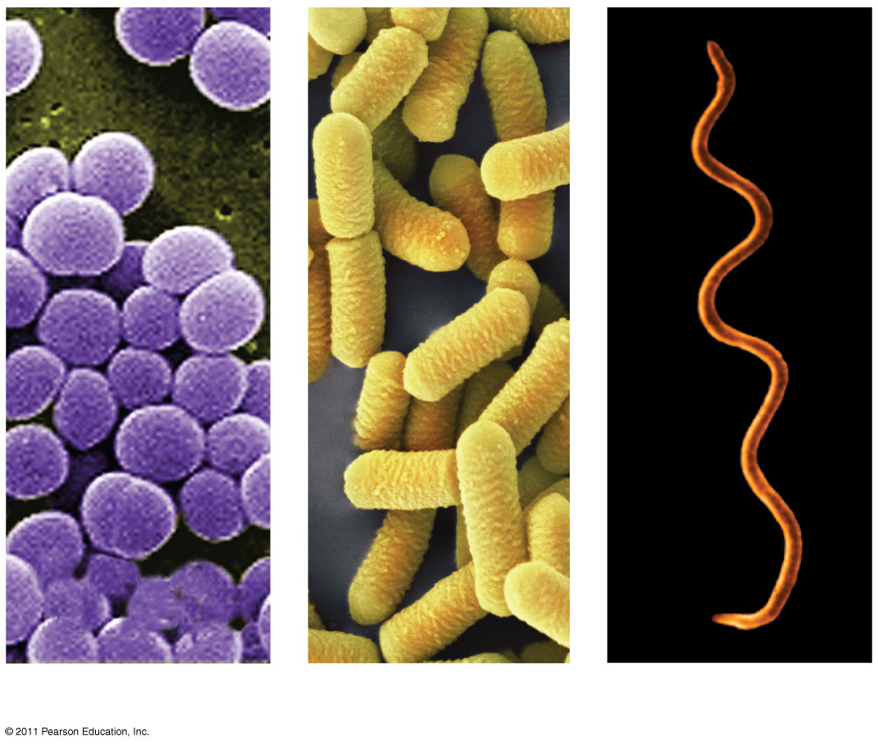
Figure 27.2
1 μm
1 μm
3 μm
(a) Spherical
(b) Rod-shaped
(c) Spiral
Notes:
Figure 27.2 The most common shapes of prokaryotes.

Slide 6
Cell-Surface Structures
An important feature of nearly all prokaryotic cells is their cell wall, which maintains cell shape, protects the cell, and prevents it from bursting in a hypotonic environment
Eukaryote cell walls are made of cellulose or chitin
Bacterial cell walls contain peptidoglycan, a network of sugar polymers cross-linked by polypeptides
© 2011 Pearson Education, Inc.

Slide 7
Archaea contain polysaccharides and proteins but lack peptidoglycan
Scientists use the Gram stain to classify bacteria by cell wall composition
Gram-positive bacteria have simpler walls with a large amount of peptidoglycan
Gram-negative bacteria have less peptidoglycan and an outer membrane that can be toxic
© 2011 Pearson Education, Inc.

Slide 8
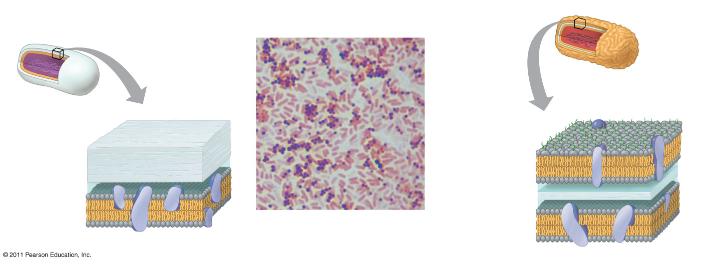
Figure 27.3
(a) Gram-positive bacteria: peptidoglycan traps crystal violet.
(b) Gram-negative bacteria: crystal violet is easily rinsed
away, revealing red dye.
Gram-positive
bacteria
Gram-negative
bacteria
Carbohydrate portion
of lipopolysaccharide
Cell
wall
Peptido-
glycan
layer
Outer
membrane
Cell
wall
Peptido-
glycan
layer
Plasma
membrane
10 μm
Plasma membrane
Notes:
Figure 27.3 Gram staining.

Slide 9
Many antibiotics target peptidoglycan and damage bacterial cell walls
Gram-negative bacteria are more likely to be antibiotic resistant
A polysaccharide or protein layer called a capsule covers many prokaryotes
© 2011 Pearson Education, Inc.

Slide 10
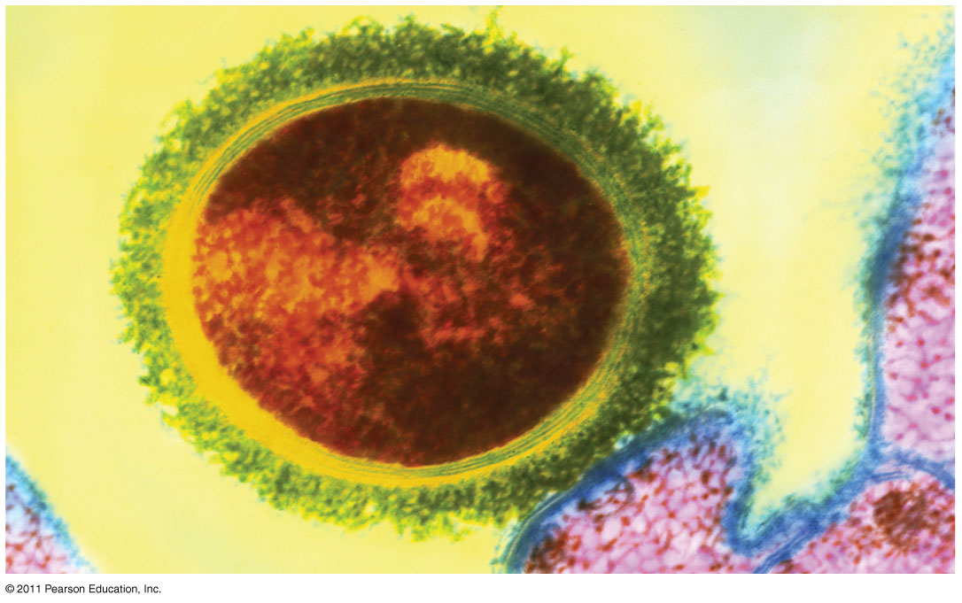
Figure 27.4
Bacterial
capsule
Bacterial
cell wall
Tonsil
cell
200 nm
Notes:
Figure 27.4 Capsule.

Slide 11
Some prokaryotes have fimbriae, which allow them to stick to their substrate or other individuals in a colony
Pili (or sex pili) are longer than fimbriae and allow prokaryotes to exchange DNA
© 2011 Pearson Education, Inc.

Slide 12
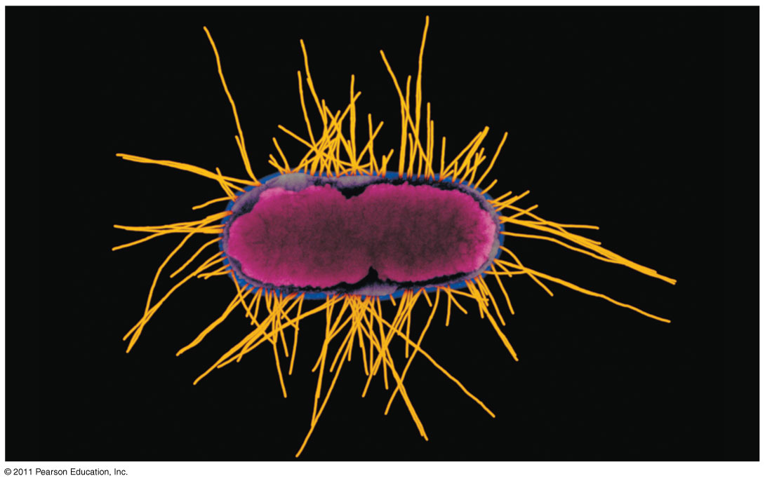
Figure 27.5
Fimbriae
1 μm
Notes:
Figure 27.5 Fimbriae.

Slide 13
Motility
In a heterogeneous environment, many bacteria exhibit taxis, the ability to move toward or away from a stimulus
Chemotaxis is the movement toward or away from a chemical stimulus
© 2011 Pearson Education, Inc.

Slide 14
Most motile bacteria propel themselves by flagella scattered about the surface or concentrated at one or both ends
Flagella of bacteria, archaea, and eukaryotes are composed of different proteins and likely evolved independently
© 2011 Pearson Education, Inc.

Slide 15
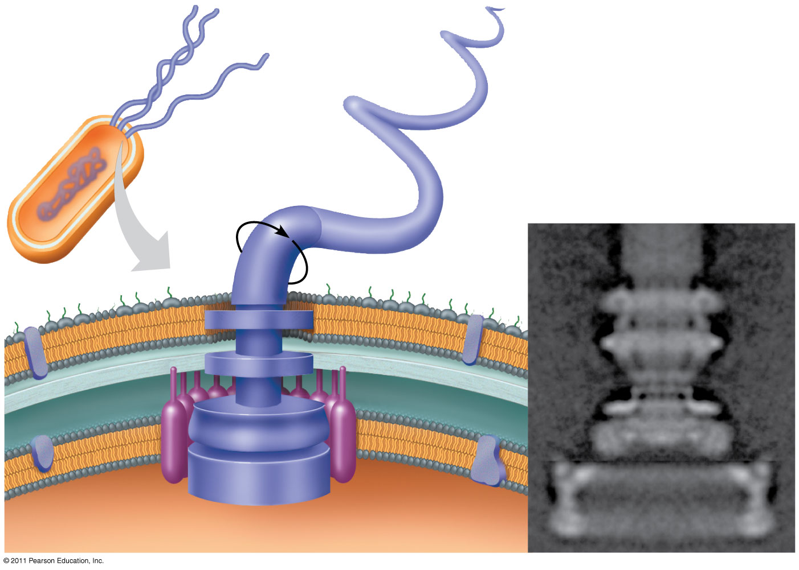
Figure 27.6
Flagellum
Filament
20 nm
Hook
Cell wall
Motor
Plasma
membrane
Peptidoglycan
layer
Rod
Notes:
Figure 27.6 A prokaryotic flagellum.

Slide 16
Internal Organization and DNA
Prokaryotic cells usually lack complex compartmentalization
Some prokaryotes do have specialized membranes that perform metabolic functions
These are usually infoldings of the plasma membrane
© 2011 Pearson Education, Inc.

Slide 17
The prokaryotic genome has less DNA than the eukaryotic genome
Most of the genome consists of a circular chromosome
The chromosome is not surrounded by a membrane; it is located in the nucleoid region
Some species of bacteria also have smaller rings of DNA called plasmids
© 2011 Pearson Education, Inc.

Slide 18
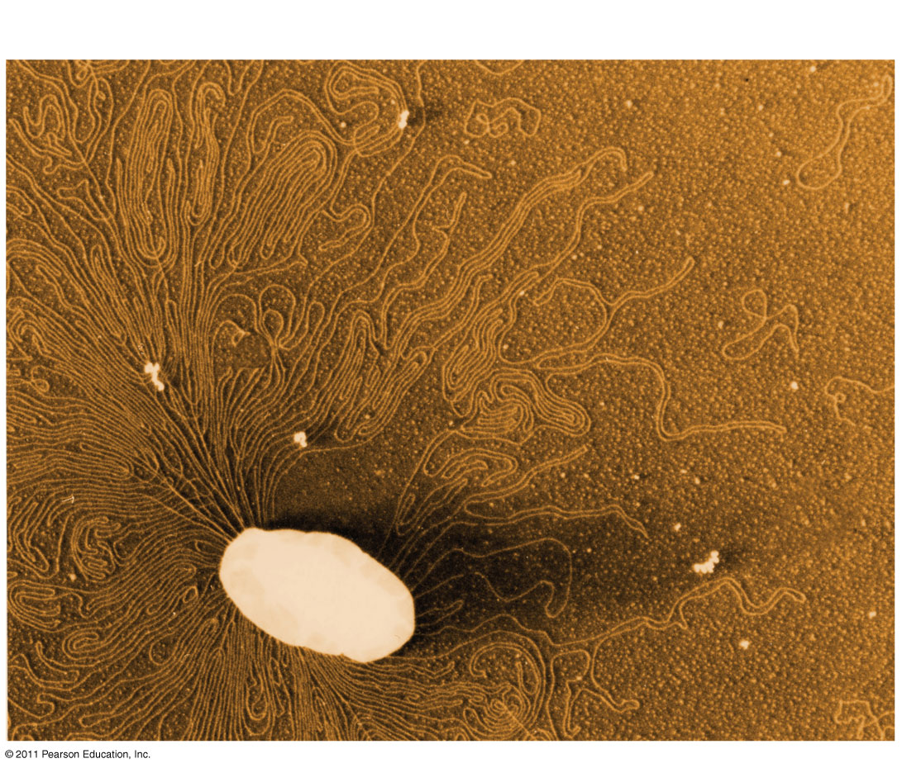
Figure 27.8
Chromosome
Plasmids
1 μm
Notes:
Figure 27.8 A prokaryotic chromosome and plasmids.

Slide 19
There are some differences between prokaryotes and eukaryotes in DNA replication, transcription, and translation
These allow people to use some antibiotics to inhibit bacterial growth without harming themselves
© 2011 Pearson Education, Inc.

Slide 20
Reproduction and Adaptation
Prokaryotes reproduce quickly by binary fission and can divide every 1–3 hours
Key features of prokaryotic reproduction:
They are small
They reproduce by binary fission
They have short generation times
Many prokaryotes form metabolically inactive endospores, which can remain viable in harsh conditions for centuries
© 2011 Pearson Education, Inc.

Slide 21
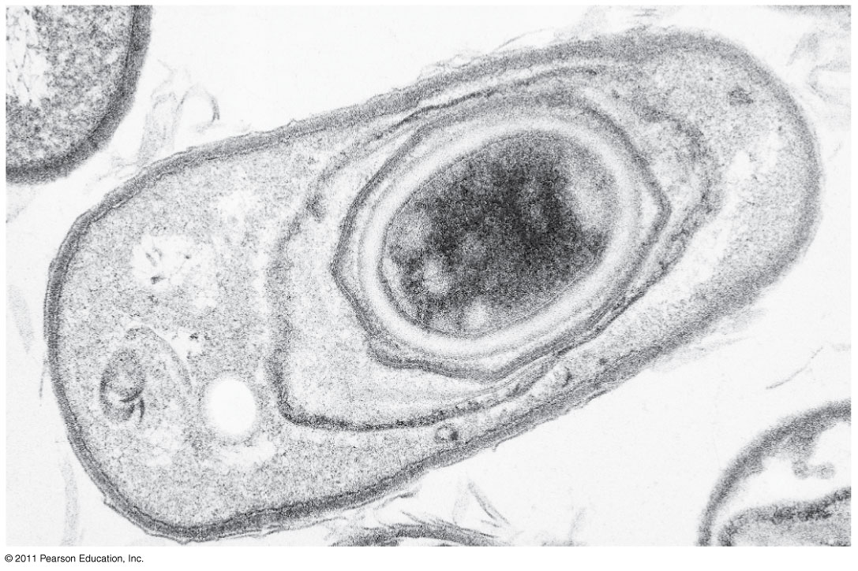
Figure 27.9
Endospore
Coat
0.3 μm
Notes:
Figure 27.9 An endospore.

Slide 22
Their short generation time allows prokaryotes to evolve quickly
For example, adaptive evolution in a bacterial colony was documented in a lab over 8 years
Prokaryotes are not “primitive” but are highly evolved
© 2011 Pearson Education, Inc.

Slide 23
Rapid reproduction, mutation, and genetic recombination promote genetic diversity in prokaryotes
Prokaryotes have considerable genetic variation
Three factors contribute to this genetic diversity:
Rapid reproduction
Mutation
Genetic recombination
© 2011 Pearson Education, Inc.

Slide 24
Rapid Reproduction and Mutation
Prokaryotes reproduce by binary fission, and offspring cells are generally identical
Mutation rates during binary fission are low, but because of rapid reproduction, mutations can accumulate rapidly in a population
High diversity from mutations allows for rapid evolution
© 2011 Pearson Education, Inc.

Slide 25
Genetic Recombination
Genetic recombination, the combining of DNA from two sources, contributes to diversity
Prokaryotic DNA from different individuals can be brought together by transformation, transduction, and conjugation
Movement of genes among individuals from different species is called horizontal gene transfer
© 2011 Pearson Education, Inc.

Slide 26
Transformation and Transduction
A prokaryotic cell can take up and incorporate foreign DNA from the surrounding environment in a process called transformation
Transduction is the movement of genes between bacteria by bacteriophages (viruses that infect bacteria)
© 2011 Pearson Education, Inc.

Slide 27
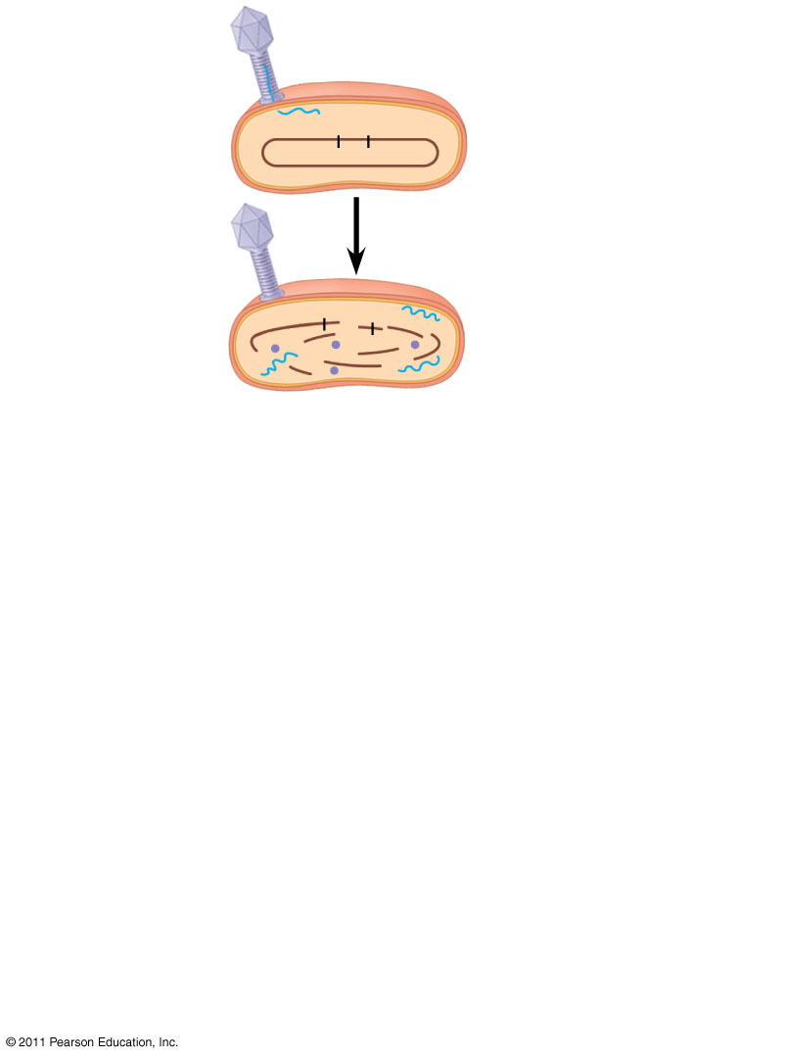
Figure 27.11-1
Phage
A⁺
B⁺
Donor cell
A⁺
B⁺
Notes:
Figure 27.11 Transduction.

Slide 28
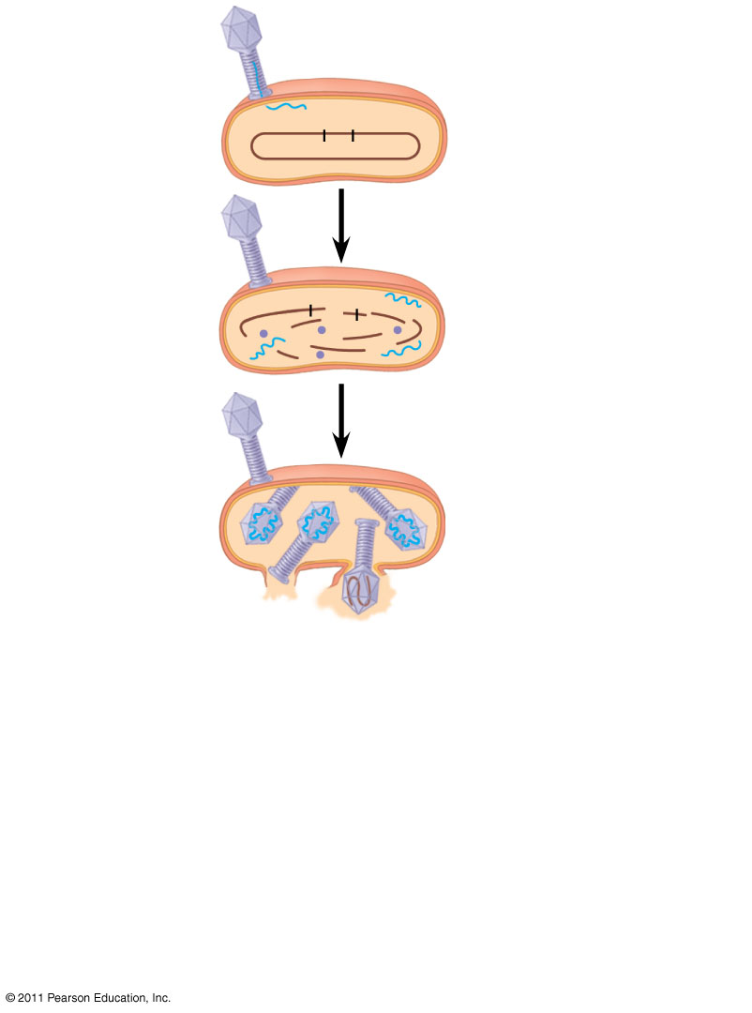
Figure 27.11-2
Phage
A⁺
B⁺
Donor cell
A⁺
B⁺
A⁺
Notes:
Figure 27.11 Transduction.

Slide 29
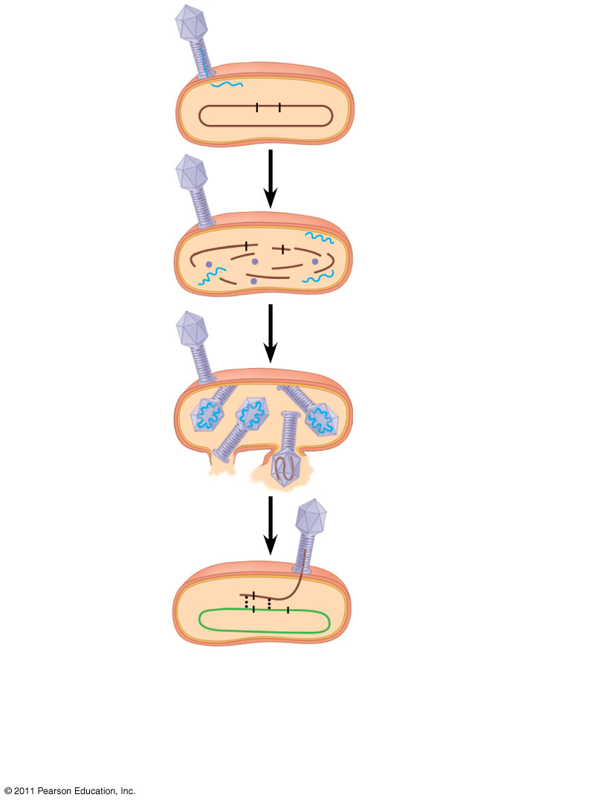
Figure 27.11-3
Phage
A⁺
B⁺
Donor cell
A⁺
B⁺
A⁺
Recombination
A⁺
A⁻
B⁻
Recipient
cell
Notes:
Figure 27.11 Transduction.

Slide 30
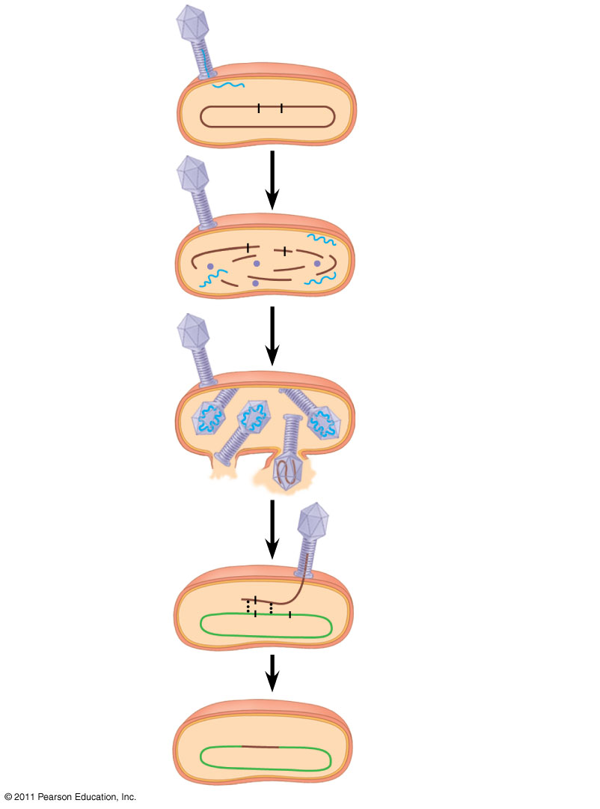
Figure 27.11-4
Phage
A⁺
B⁺
Donor cell
A⁺
B⁺
A⁺
Recombination
A⁺
A⁻
B⁻
Recipient
cell
A⁺
B⁻
Recombinant cell
Notes:
Figure 27.11 Transduction.

Slide 31
Conjugation and Plasmids
Conjugation is the process where genetic material is transferred between prokaryotic cells
In bacteria, the DNA transfer is one way
A donor cell attaches to a recipient by a pilus, pulls it closer, and transfers DNA
A piece of DNA called the F factor is required for the production of pili
© 2011 Pearson Education, Inc.

Slide 32
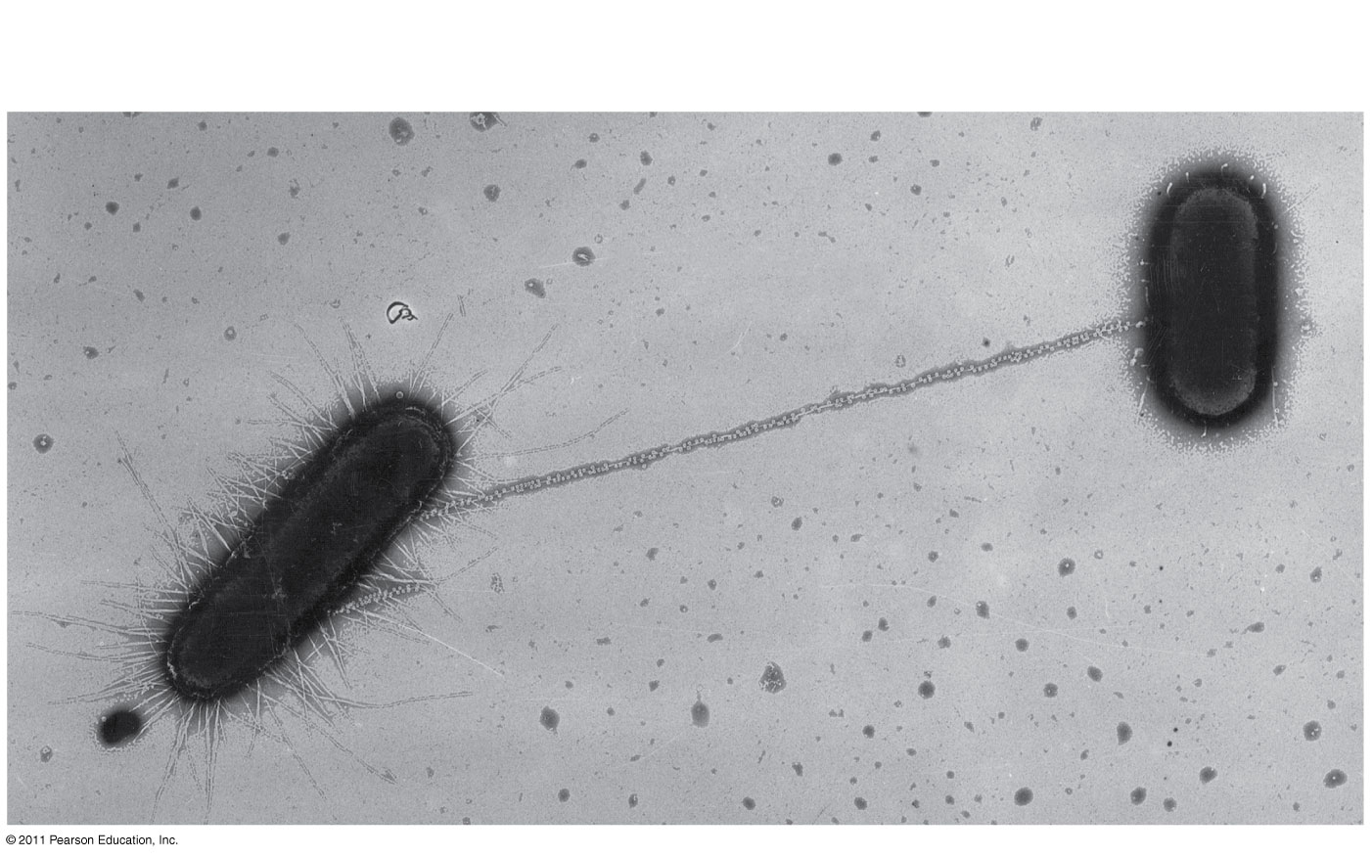
Figure 27.12
1 μm
Sex pilus
Notes:
Figure 27.12 Bacterial conjugation.

Slide 33
The F Factor as a Plasmid
Cells containing the F plasmid function as DNA donors during conjugation
Cells without the F factor function as DNA recipients during conjugation
The F factor is transferable during conjugation
© 2011 Pearson Education, Inc.

Slide 34
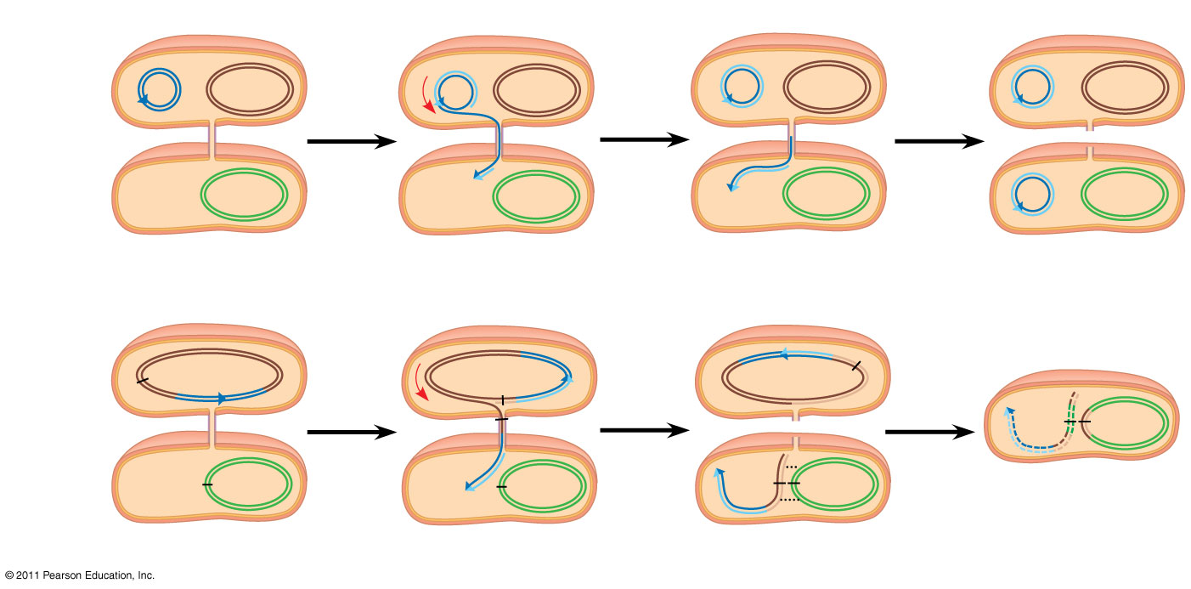
Figure 27.13
F plasmid
Bacterial chromosome
F⁺ cell
(donor)
F⁺ cell
Mating
bridge
F⁻ cell
(recipient)
F⁺ cell
Bacterial
chromosome
(a) Conjugation and transfer of an F plasmid
Hfr cell
(donor)
A⁺
A⁺
A⁺
F factor
A⁺
A⁻
A⁺
F⁻ cell
(recipient)
A⁻
A⁻
A⁺
A⁻
Recombinant
F⁻ bacterium
(b) Conjugation and transfer of part of an Hfr bacterial chromosome
Notes:
Figure 27.13 Conjugation and recombination in E. coli.

Slide 35
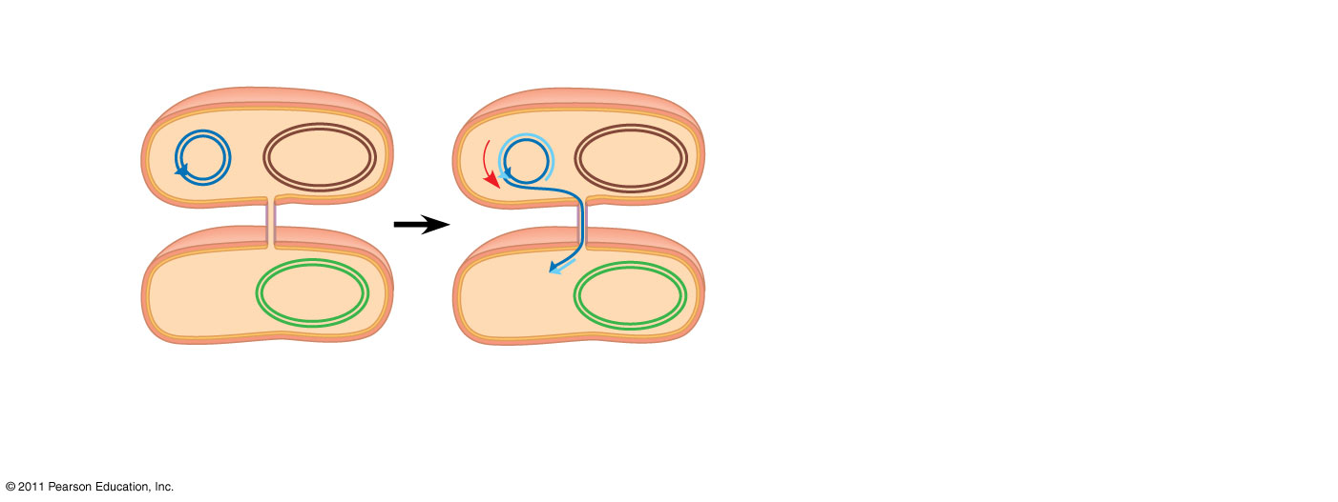
Figure 27.13a-1
Bacterial
chromosome
F plasmid
F⁺ cell
(donor)
Mating
bridge
F⁻ cell
(recipient)
Bacterial
chromosome
(a) Conjugation and transfer of an F plasmid
Notes:
Figure 27.13 Conjugation and recombination in E. coli.

Slide 36
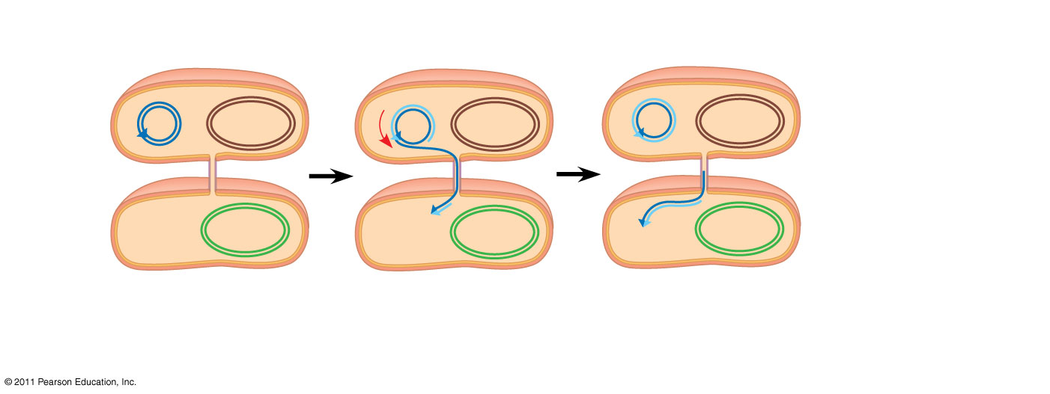
Figure 27.13a-2
Bacterial
chromosome
F plasmid
F⁺ cell
(donor)
Mating
bridge
F⁻ cell
(recipient)
Bacterial
chromosome
(a) Conjugation and transfer of an F plasmid
Notes:
Figure 27.13 Conjugation and recombination in E. coli.

Slide 37
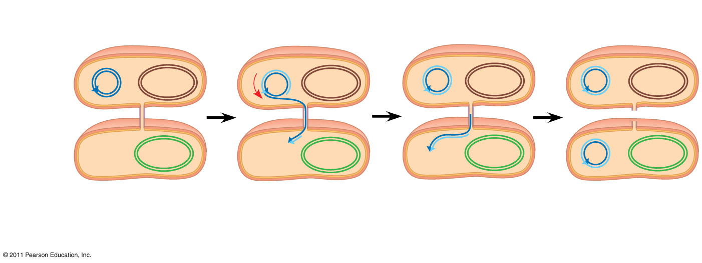
Figure 27.13a-3
Bacterial
chromosome
F plasmid
F⁺ cell
F⁺ cell
(donor)
Mating
bridge
F⁻ cell
(recipient)
Bacterial
chromosome
F⁺ cell
(a) Conjugation and transfer of an F plasmid
Notes:
Figure 27.13 Conjugation and recombination in E. coli.

Slide 38
The F Factor in the Chromosome
A cell with the F factor built into its chromosomes functions as a donor during conjugation
The recipient becomes a recombinant bacterium, with DNA from two different cells
© 2011 Pearson Education, Inc.

Slide 39
Figure 27.13b-1
Hfr cell
(donor)
A⁺
A⁺
F factor
A⁺
F⁻ cell
(recipient)
A⁻
A⁻
(b) Conjugation and transfer of part of an Hfr bacterial chromosome
Notes:
Figure 27.13 Conjugation and recombination in E. coli.

Slide 40
Figure 27.13b-2
Hfr cell
(donor)
A⁺
A⁺
A⁺
F factor
A⁺
F⁻ cell
(recipient)
A⁻
A⁻
A⁺
A⁻
(b) Conjugation and transfer of part of an Hfr bacterial chromosome
Notes:
Figure 27.13 Conjugation and recombination in E. coli.

Slide 41
Figure 27.13b-3
Hfr cell
(donor)
A⁺
A⁺
A⁺
F factor
A⁺
A⁻
A⁺
F⁻ cell
(recipient)
A⁻
A⁻
A⁺
A⁻
Recombinant
F⁻ bacterium
(b) Conjugation and transfer of part of an Hfr bacterial chromosome
Notes:
Figure 27.13 Conjugation and recombination in E. coli.

Slide 42
R Plasmids and Antibiotic Resistance
R plasmids carry genes for antibiotic resistance
Antibiotics kill sensitive bacteria, but not bacteria with specific R plasmids
Through natural selection, the fraction of bacteria with genes for resistance increases in a population exposed to antibiotics
Antibiotic-resistant strains of bacteria are becoming more common
© 2011 Pearson Education, Inc.

Slide 43
Diverse nutritional and metabolic adaptations have evolved in prokaryotes
Prokaryotes can be categorized by how they obtain energy and carbon
Phototrophs obtain energy from light
Chemotrophs obtain energy from chemicals
Autotrophs require CO₂ as a carbon source
Heterotrophs require an organic nutrient to make organic compounds
© 2011 Pearson Education, Inc.

Slide 44
Energy and carbon sources are combined to give four major modes of nutrition:
Photoautotrophy
Chemoautotrophy
Photoheterotrophy
Chemoheterotrophy
© 2011 Pearson Education, Inc.

Slide 45
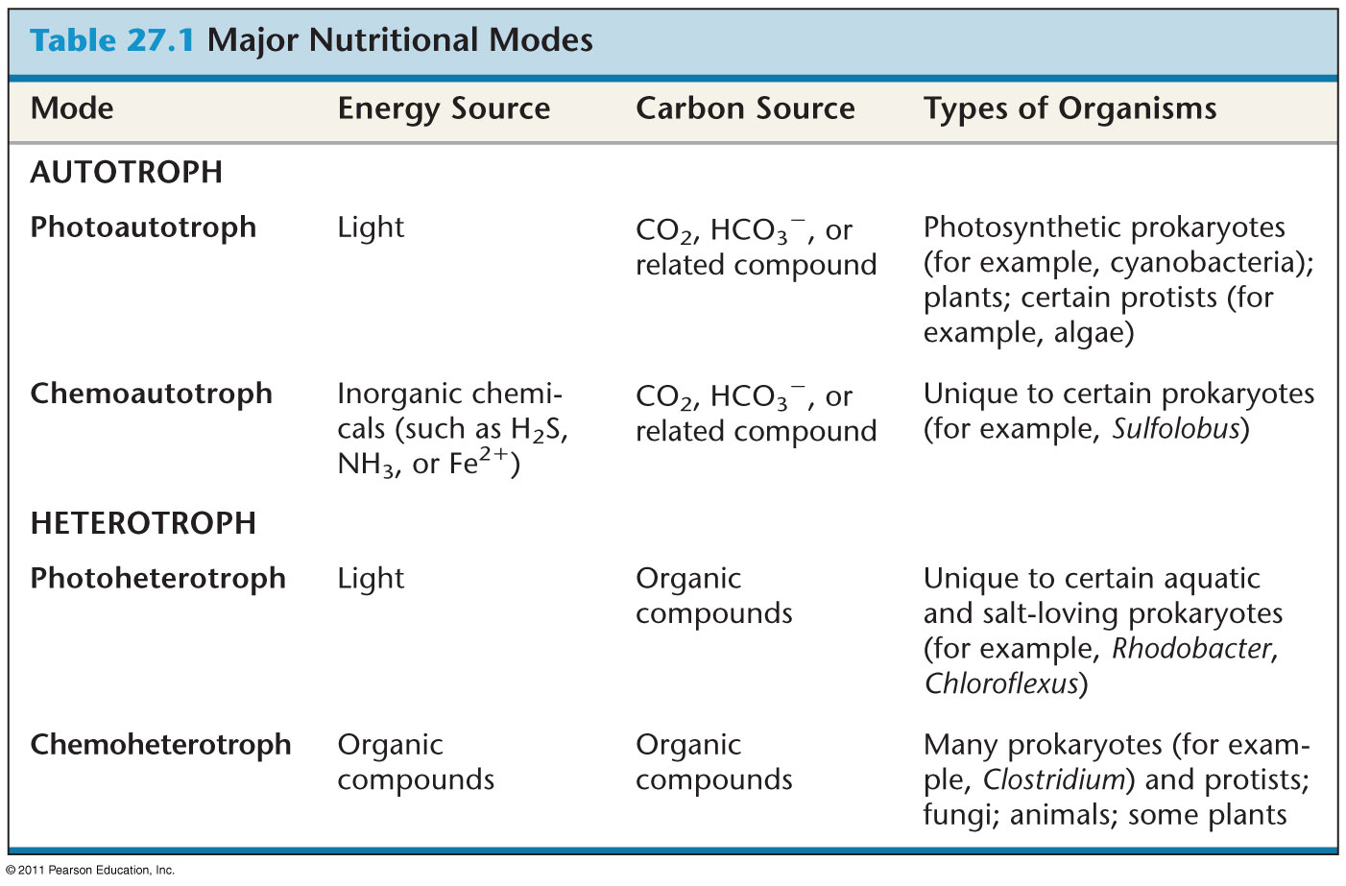
Table 27.1
Notes:
Table 27.1 Major Nutritional Modes

Slide 46
The Role of Oxygen in Metabolism
Prokaryotic metabolism varies with respect to O₂
Obligate aerobes require O₂ for cellular respiration
Obligate anaerobes are poisoned by O₂ and use fermentation or anaerobic respiration
Facultative anaerobes can survive with or without O₂
© 2011 Pearson Education, Inc.

Slide 47
Nitrogen Metabolism
Nitrogen is essential for the production of amino acids and nucleic acids
Prokaryotes can metabolize nitrogen in a variety of ways
In nitrogen fixation, some prokaryotes convert atmospheric nitrogen (N₂) to ammonia (NH₃)
© 2011 Pearson Education, Inc.

Slide 48
Metabolic Cooperation
Cooperation between prokaryotes allows them to use environmental resources they could not use as individual cells
In the cyanobacterium Anabaena, photosynthetic cells and nitrogen-fixing cells called heterocysts (or heterocytes) exchange metabolic products
In some prokaryotic species, metabolic cooperation occurs in surface-coating colonies called biofilms
© 2011 Pearson Education, Inc.

Slide 49
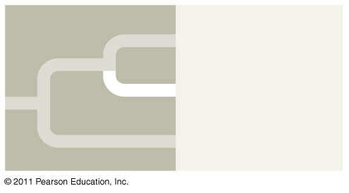
Archaea
Almost since their origin 3.5 billion years ago, prokaryotes have evolved in two separate lineages, the bacteria and archaea. The first prokaryotes that were classified in the domain Archaea are known as extremophiles and live in extreme environments.
Eukarya
Archaea
Bacteria
© 2011 Pearson Education, Inc.

Slide 50
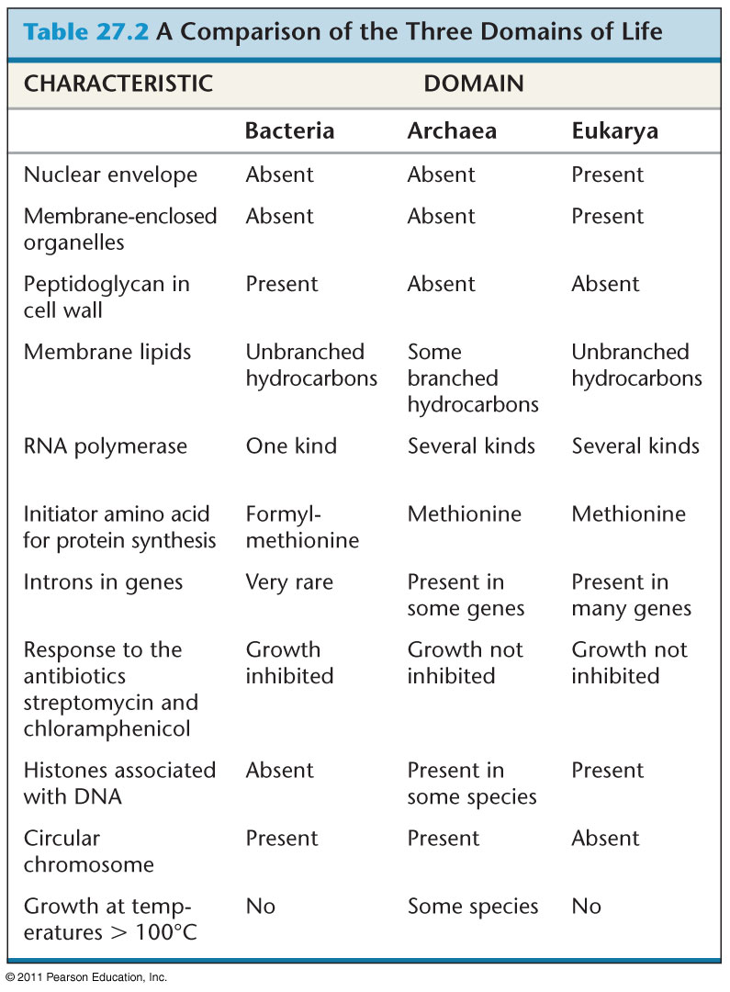
Table 27.2
Notes:
Table 27.2 A Comparison of the Three Domains of Life

Slide 51
Some archaea live in extreme environments and are called extremophiles
Extreme halophiles live in highly saline environments
Extreme thermophiles thrive in very hot environments
© 2011 Pearson Education, Inc.

Slide 52
Methanogens live in swamps and marshes and produce methane as a waste product
Methanogens are strict anaerobes and are poisoned by O₂
In recent years, genetic prospecting has revealed many new groups of archaea
Some of these may offer clues to the early evolution of life on Earth
© 2011 Pearson Education, Inc.

Slide 53
Prokaryotes play crucial roles in the biosphere
Prokaryotes are so important that if they were to disappear the prospects for any other life surviving would be dim
© 2011 Pearson Education, Inc.

Slide 54
Chemical Recycling
Prokaryotes play a major role in the recycling of chemical elements between the living and nonliving components of ecosystems
Chemoheterotrophic prokaryotes function as decomposers, breaking down dead organisms and waste products
Prokaryotes can sometimes increase the availability of nitrogen, phosphorus, and potassium for plant growth
Prokaryotes can also “immobilize” or decrease the availability of nutrients
© 2011 Pearson Education, Inc.

Slide 55
Ecological Interactions
Symbiosis is an ecological relationship in which two species live in close contact: a larger host and smaller symbiont
Prokaryotes often form symbiotic relationships with larger organisms
In mutualism, both symbiotic organisms benefit
In commensalism, one organism benefits while neither harming nor helping the other in any significant way
In parasitism, an organism called a parasite harms but does not kill its host
Parasites that cause disease are called pathogens
© 2011 Pearson Education, Inc.

Slide 56
Prokaryotes have both beneficial and harmful impacts on humans
Some prokaryotes are human pathogens, but others have positive interactions with humans
Mutualistic Bacteria
Human intestines are home to about 500–1,000 species of bacteria
Many of these are mutualists and break down food that is undigested by our intestines
© 2011 Pearson Education, Inc.

Slide 57
Pathogenic Bacteria
Prokaryotes cause about half of all human diseases
For example, Lyme disease is caused by a bacterium and carried by ticks
Prokaryotes are the principal agents in bioremediation, the use of organisms to remove pollutants from the environment
Bacteria can be engineered to produce vitamins, antibiotics, and hormones
Bacteria are also being engineered to produce ethanol from waste biomass
© 2011 Pearson Education, Inc.

