Slide 1
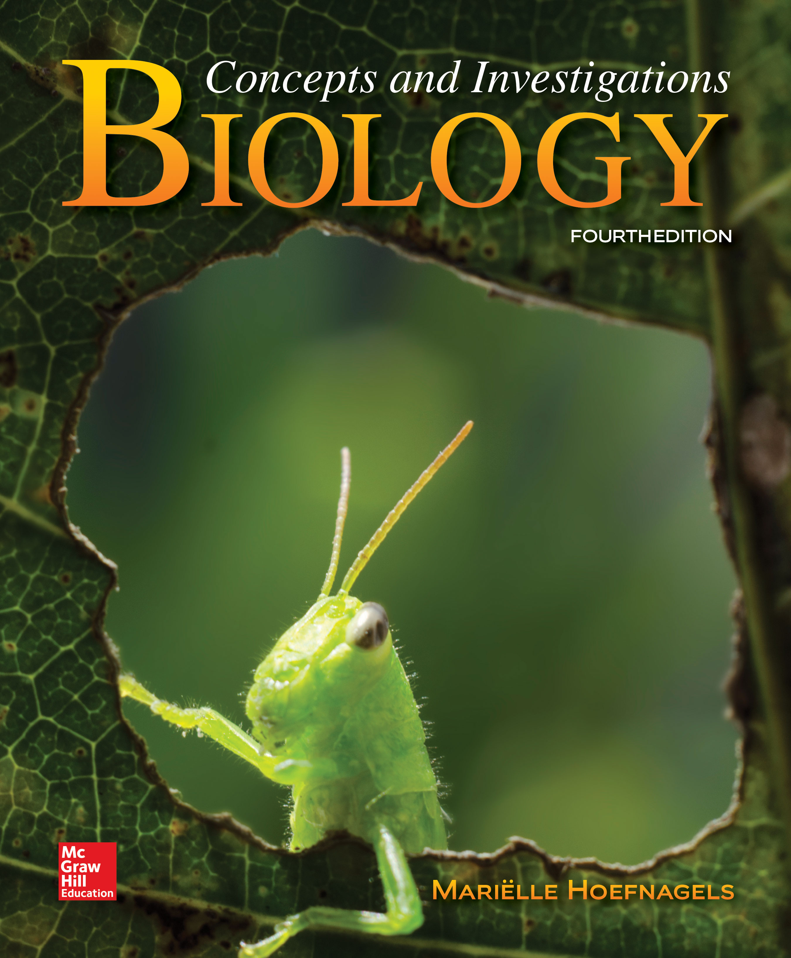
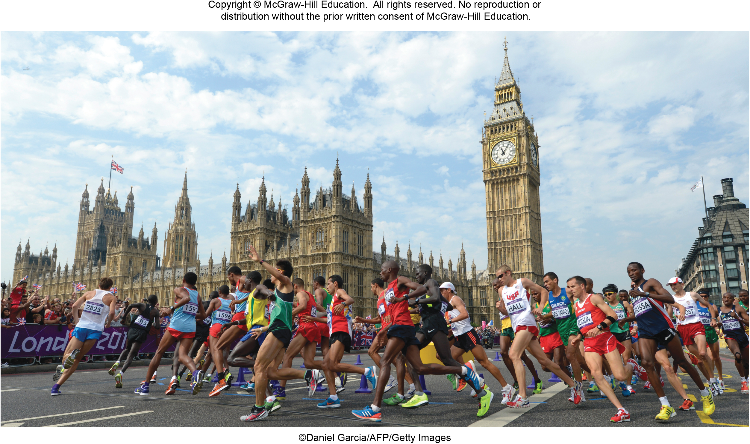
Chapter 25
Animal Tissues and Organ Systems
©Daniel Garcia/AFP/Getty Images
©McGraw-Hill Education. All rights reserved. Authorized only for instructor use in classroom.
No reproduction or further distribution permitted without the prior written consent of McGraw-Hill Education.

Slide 2
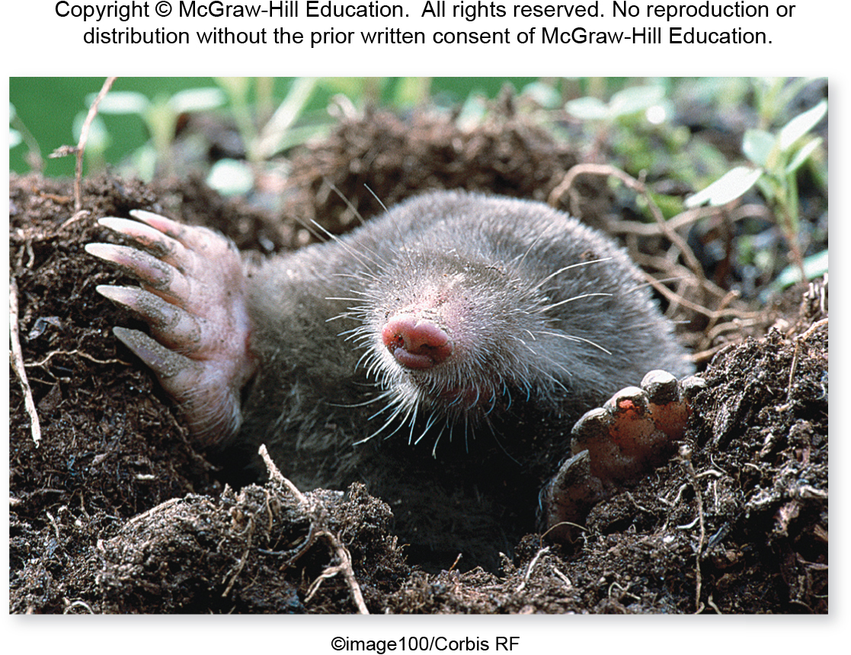
Specialized cells build animal bodies
This chapter introduces the anatomy and physiology of animals.
©image100/Corbis RF
Section 25.1
Figure 25.1

Slide 3
What is anatomy?
Anatomy is the study of an organism’s structure.
©image100/Corbis RF
Section 25.1
Figure 25.1

Slide 4
What is physiology?
Physiology considers how an organism’s body works.
©image100/Corbis RF
Section 25.1
Figure 25.1

Slide 5
Structure fits function
In this mole, and in all organisms, anatomy and physiology are closely related. The structure of his broad front paws fits their function: digging.
©image100/Corbis RF
Section 25.1
Figure 25.1

Slide 6
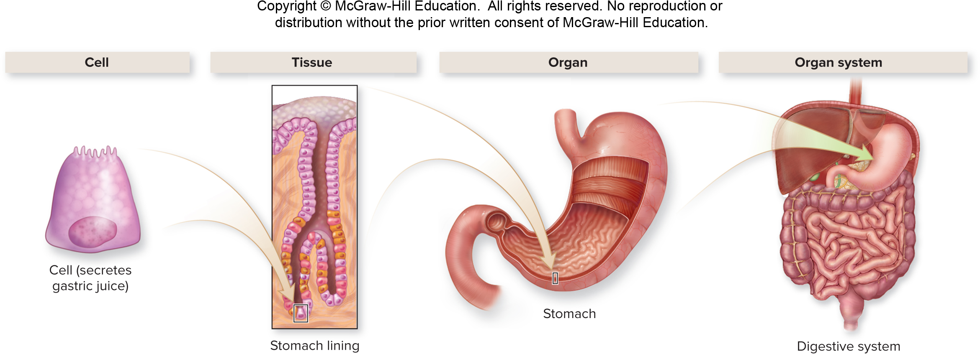
The organizational hierarchy of the body
Biologists describe the animal body in terms of an organizational hierarchy.
Section 25.1
Figure 25.2

Slide 7
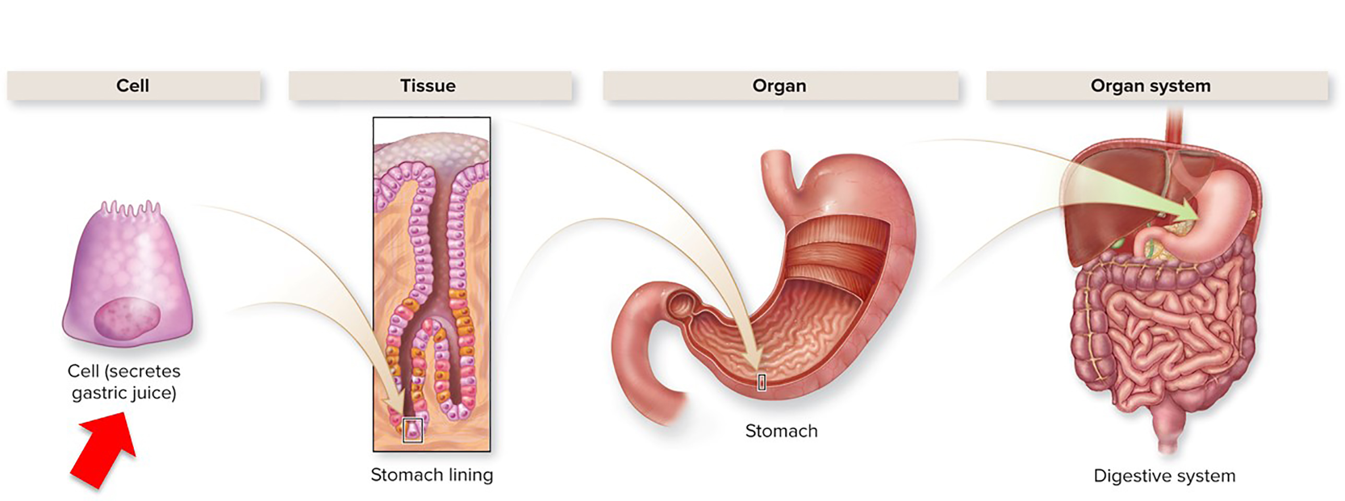
Cells
Cells are the building blocks of animal bodies.
Section 25.1
Figure 25.2

Slide 8
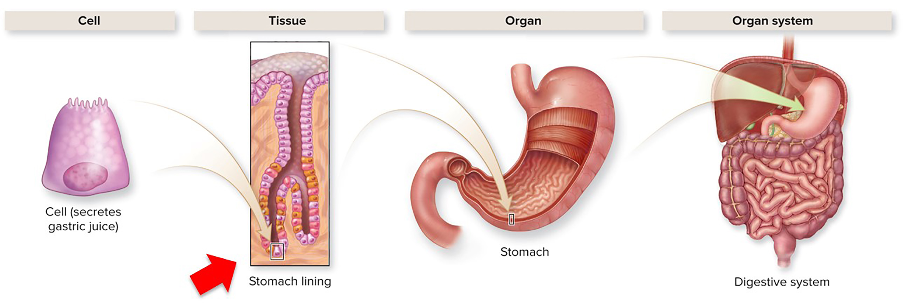
Tissues
Cells are organized into tissues, groups of cells that interact and provide a specific function.
Section 25.1
Figure 25.2

Slide 9
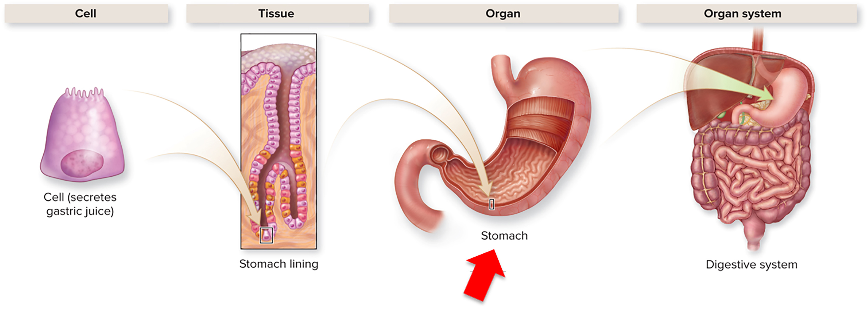
Organs
Different tissues interact and function as units called organs.
Section 25.1
Figure 25.2

Slide 10
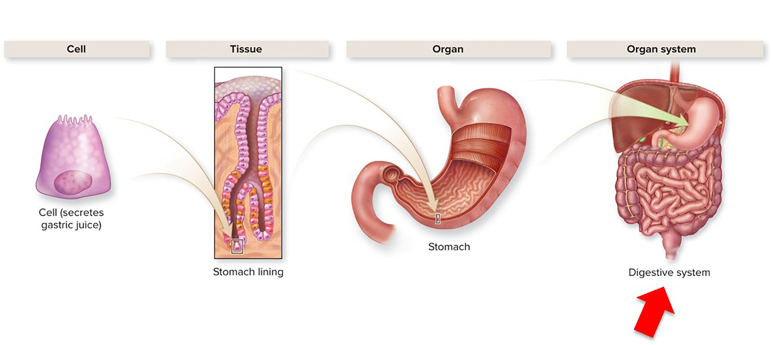
Organ systems
Organ systems consist of two or more organs that are physically or functionally joined.
Section 25.1
Figure 25.2

Slide 11
Anatomical terminology, 1
Scientists use terms to refer to the relative position of structures within an organism.
Anterior or ventral view
Lateral or side view (human)
Lateral or side view (non-human)
Section 25.1
Figure 25.3

Slide 12
Anatomical terminology, 2
Scientists use terms to refer to the relative position of structures within an organism.
Anterior or ventral view
Lateral or side view (human)
Lateral or side view (non-human)
Lateral: away from the midline
Medial: toward the midline
Anterior: toward the front
Posterior: toward the back
Proximal: toward the point of attachment
Distal: away from the point of attachment
Dorsal: toward the spine
Ventral: toward the belly
Section 25.1
Figure 25.3

Slide 13
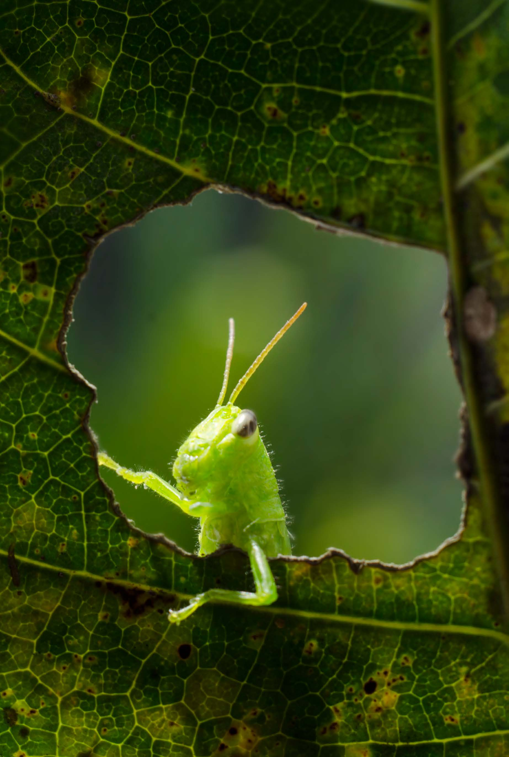
Clicker question #1
Which of the following is physically the smallest?
respiratory system
DNA
$O_{2}$
lung
red blood cell

Slide 14
Clicker question #1, solution
Which of the following is physically the smallest?
C. $O_{2}$

Slide 15
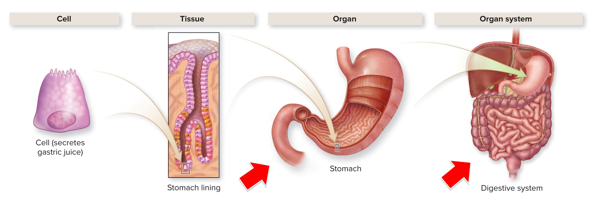
Organ systems are interconnected
Organs are arranged in organ systems that have
interconnected structures and functions.
Section 25.3
Figure 25.2

Slide 16
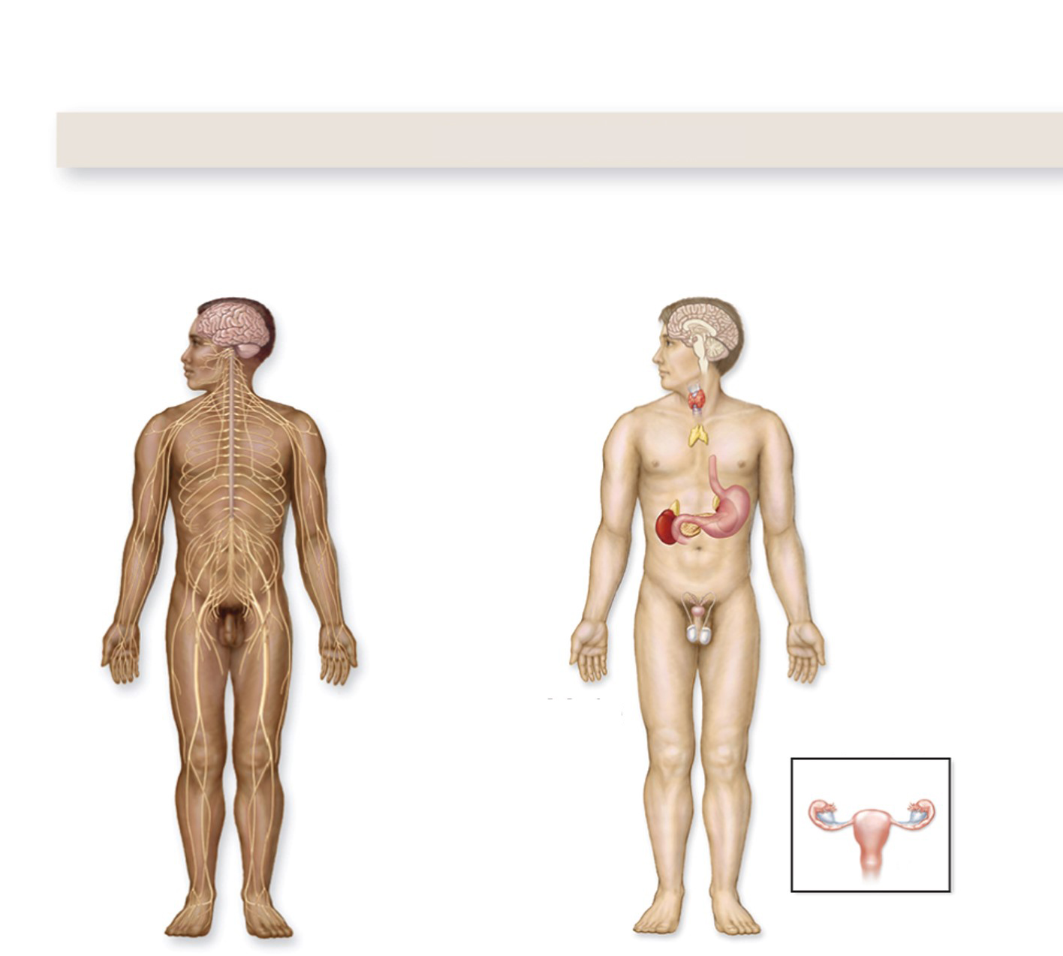
The nervous system and endocrine system are interconnected
Communication
Nervous system
Endocrine system
The nervous and endocrine systems coordinate communication.
Male
Female
Detects, interprets, and responds to stimuli from outside and within the body. With endocrine system, coordinates all organ functions.
Produces hormones and works with the nervous system to control many body functions, including reproduction, response to stress, and metabolism.
Section 25.3
Figure 25.8

Slide 17
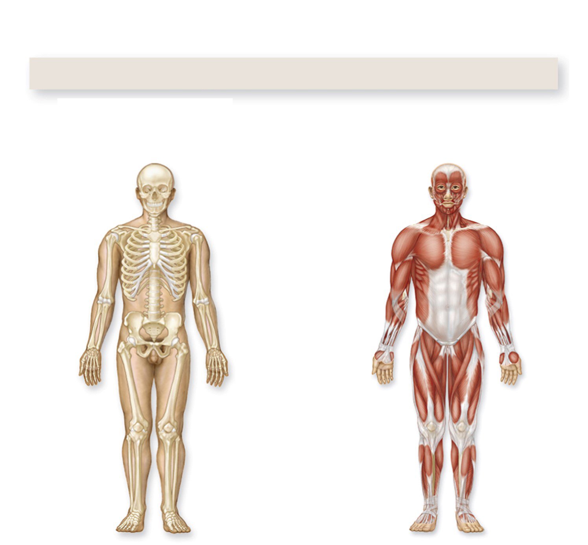
The skeletal system and the muscular system are interconnected
Support and movement
Skeletal system
Muscular system
The skeletal and muscular systems support and move the body.
Provides framework for muscles to attach, making movement possible. Houses bone marrow. Protects soft organs. Stores minerals.
Supports posture and enables body to move. Helps maintain body temperature.
Section 25.3
Figure 25.8

Slide 18
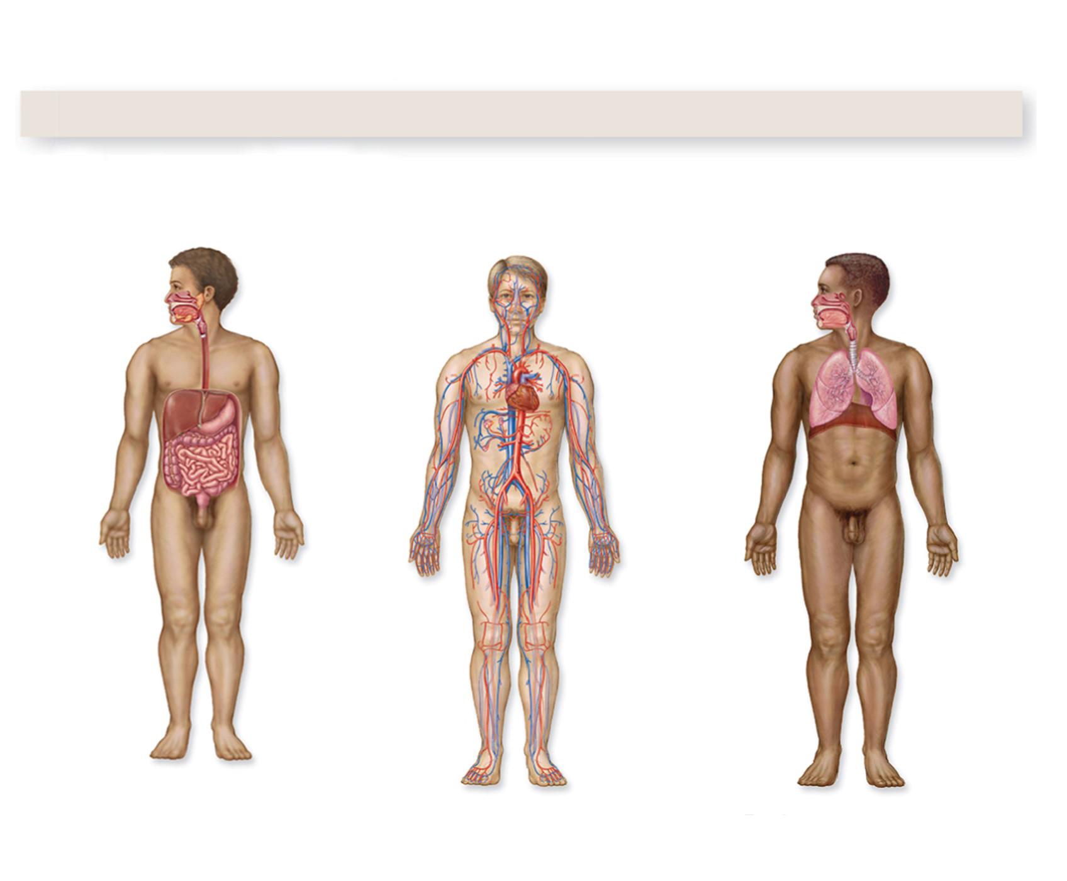
The digestive, circulatory, and respiratory systems are interconnected
Acquiring energy
Digestive system
Circulatory system
Respiratory system
The digestive, circulatory, and respiratory systems work together to acquire energy.
Breaks down nutrients into chemical components that are small enough to enter the blood. Eliminates undigested food.
Vessels carry blood throughout body, nourishing cells, delivering oxygen, and removing wastes.
Delivers oxygen to blood and removes carbon dioxide.
Section 25.3
Figure 25.8

Slide 19
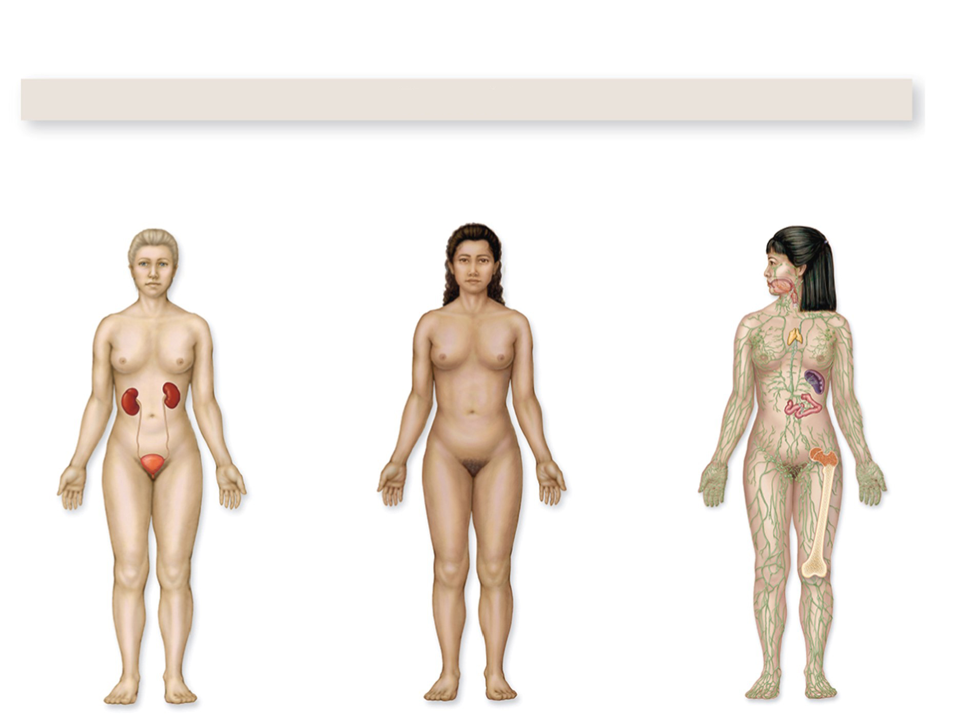
The urinary, integumentary and the lymphatic systems are interconnected
Protection
Urinary system
Integumentary system
Immune and lymphatic systems
The urinary, integumentary, immune, and lymphatic systems protect the body.
Excretes nitrogenous wastes and maintains volume and composition of body fluids.
Protects the body, controls temperature, and conserves water.
Protect the body from infection, injury, and cancer.
Section 25.3
Figure 25.8

Slide 20
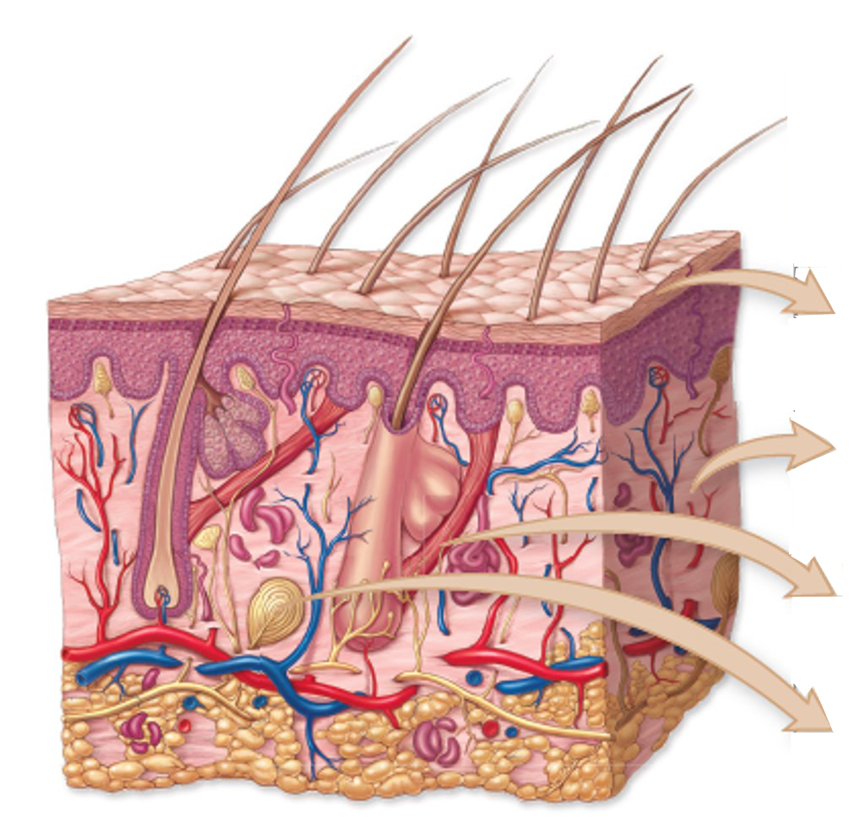
The integumentary system regulates temperature and conserves moisture
Skin is an organ. It consists of multiple interacting tissue types.
Multiple Tissue Types Interact in Each Organ System
Tissue type | Description | Functions
Epithelial | Single or multiple layer of flattened, cube-shaped, or columnar cells | Cover interior and exterior surfaces of organs; protection; secretion; absorption
Connective | Cells scattered in prominent extracellular matrix | Support, adhesion, insulation, attachment, and transportation
Muscle | Elongated cells that contract when stimulated | Movement
Nervous | Cells that transmit electrical impulses | Rapid communication among cells
Section 25.5
Figure 25.11

Slide 21
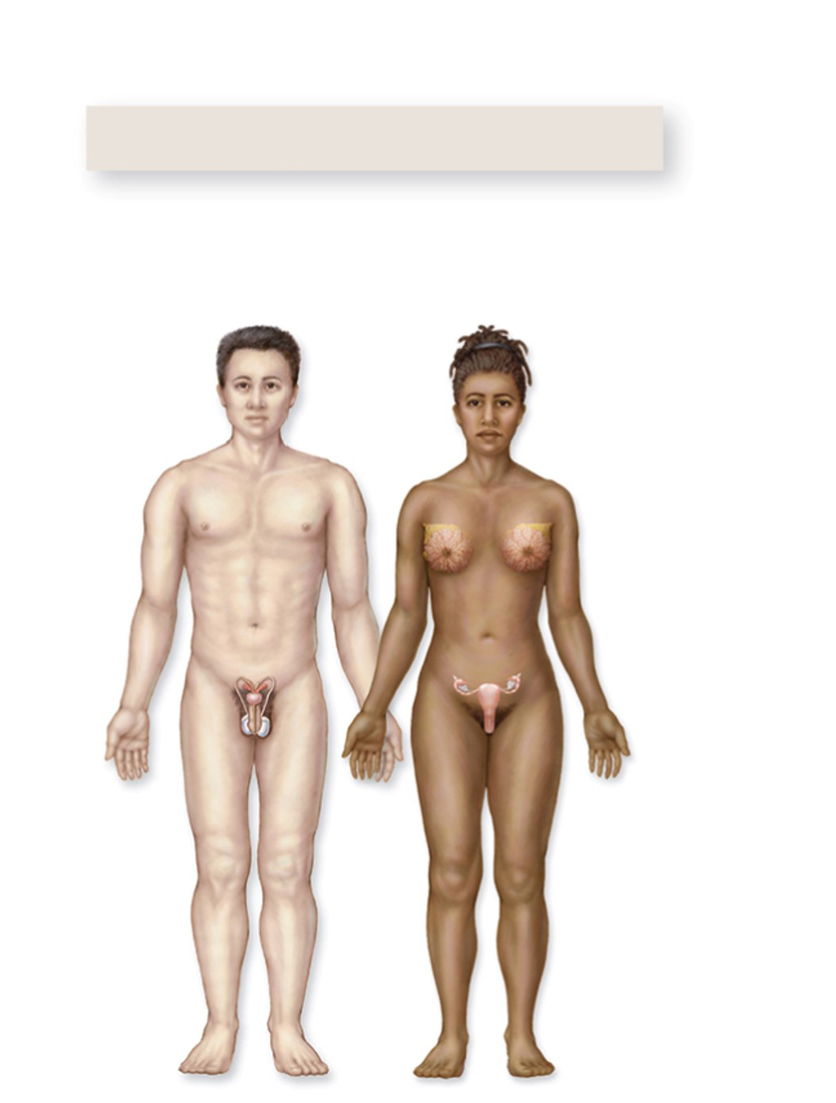
The male and female reproductive systems are interconnected
Reproduction
Reproductive system
Male
Female
The reproductive system produces the next generation.
Manufactures gametes and enables the female to carry and give birth to offspring.
Section 25.3
Figure 25.8

Slide 22
25.3 Mastering concepts
©Daniel Garcia/AFP/Getty Images
Which organ systems contribute to each of the five general functions of life?

Slide 23
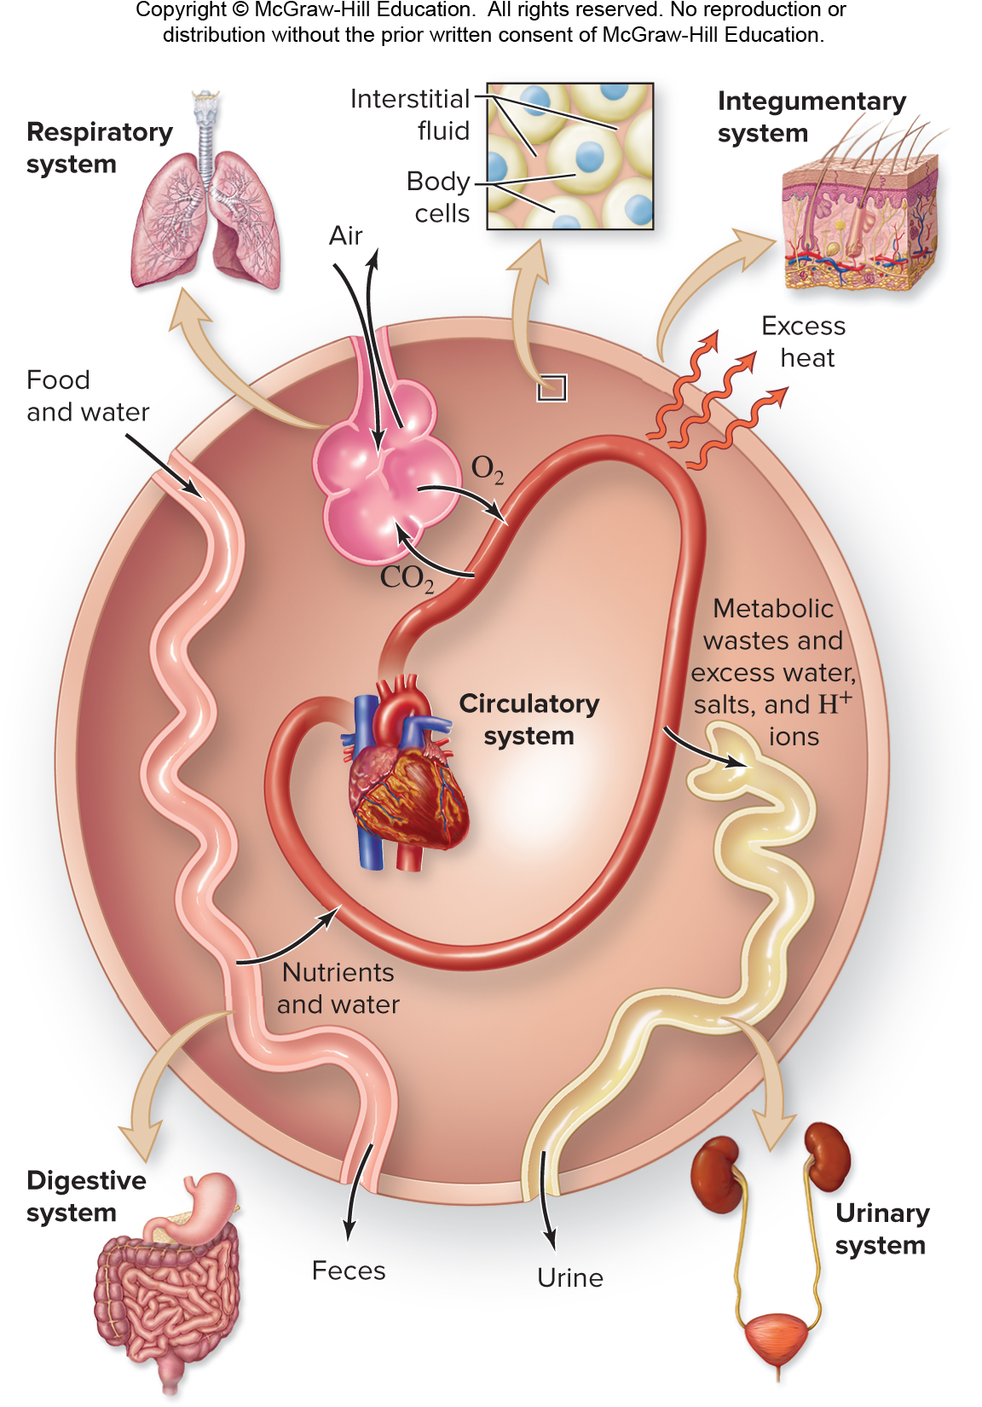
Homeostasis
Homeostasis is a state of internal constancy.
Section 25.4
Figure 25.9

Slide 24
Organ system interactions promote homeostasis
Organ systems interact in many ways. For example, the circulatory system exchanges substances with other organ systems to maintain homeostasis.
Organ systems interact to maintain a stable temperature, blood pressure, and fluid composition in an animal’s body.
Section 25.4
Figure 25.9

Slide 25
Interstitial fluid
Interstitial fluid bathes all body cells. Substances move through interstitial fluid as they pass between organ systems.
Section 25.4
Figure 25.9

