Slide 1
Animal Form and Function Notes
Basic Principles of Animal Form and Function

Slide 2
Overview: Diverse Forms, Common Challenges
Anatomy is the study of the biological form of an organism
Physiology is the study of the biological functions an organism performs
The comparative study of animals reveals that form and function are closely correlated
© 2011 Pearson Education, Inc.

Slide 3
Concept: Animal form and function are correlated at all levels of organization
Size and shape affect the way an animal interacts with its environment
Many different animal body plans have evolved and are determined by the genome
© 2011 Pearson Education, Inc.

Slide 4
Evolution of Animal Size and Shape
Physical laws constrain strength, diffusion, movement, and heat exchange
As animals increase in size, their skeletons must be proportionately larger to support their mass
Evolutionary convergence reflects different species’ adaptations to a similar environmental challenge
© 2011 Pearson Education, Inc.

Slide 5
Hierarchical Organization of Body Plans
Most animals are composed of specialized cells organized into tissues that have different functions
Tissues make up organs, which together make up organ systems
Some organs, such as the pancreas, belong to more than one organ system
© 2011 Pearson Education, Inc.

Slide 6
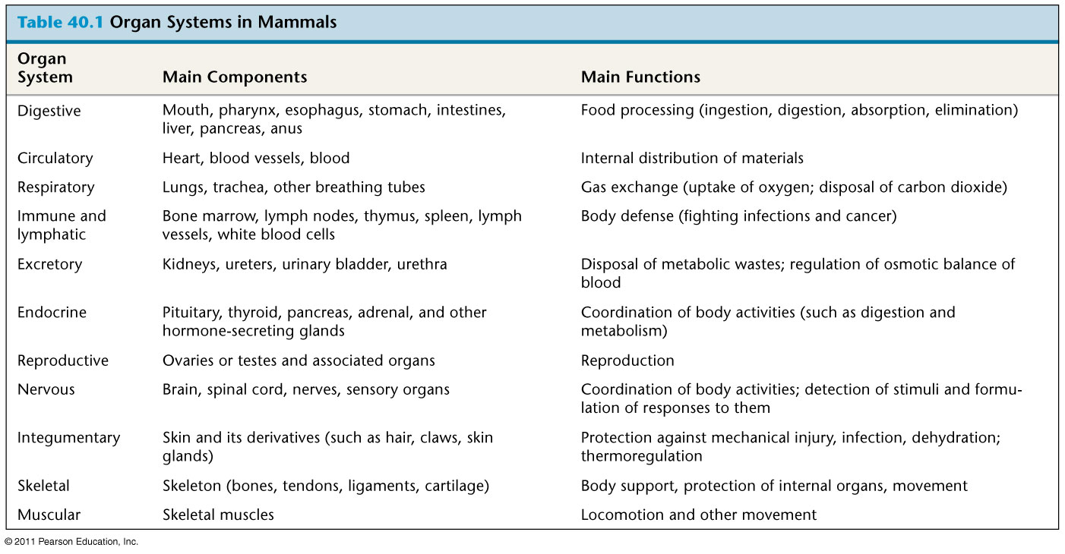
Table 40.1
Notes:
6
Table 40.1 Organ Systems in Mammals

Slide 7
Exploring Structure and Function in Animal Tissues
Different tissues have different structures that are suited to their functions
Tissues are classified into four main categories: epithelial, connective, muscle, and nervous
© 2011 Pearson Education, Inc.

Slide 8
Epithelial Tissue
Epithelial tissue covers the outside of the body and lines the organs and cavities within the body
It contains cells that are closely joined
The shape of epithelial cells may be cuboidal (like dice), columnar (like bricks on end), or squamous (like floor tiles)
The arrangement of epithelial cells may be simple (single cell layer), stratified (multiple tiers of cells), or pseudostratified (a single layer of cells of varying length)
© 2011 Pearson Education, Inc.

Slide 9
Connective Tissue
Connective tissue mainly binds and supports other tissues
It contains sparsely packed cells scattered throughout an extracellular matrix
The matrix consists of fibers in a liquid, jellylike, or solid foundation
© 2011 Pearson Education, Inc.

Slide 10
There are three types of connective tissue fiber, all made of protein:
Collagenous fibers provide strength and flexibility
Elastic fibers stretch and snap back to their original length
Reticular fibers join connective tissue to adjacent tissues
© 2011 Pearson Education, Inc.

Slide 11
In vertebrates, the fibers and foundation combine to form six major types of connective tissue:
Loose connective tissue binds epithelia to underlying tissues and holds organs in place
Cartilage is a strong and flexible support material
Fibrous connective tissue is found in tendons, which attach muscles to bones, and ligaments, which connect bones at joints
© 2011 Pearson Education, Inc.

Slide 12
It is divided in the vertebrate body into three types:
Skeletal muscle, or striated muscle, is responsible for voluntary movement
Smooth muscle is responsible for involuntary body activities
Cardiac muscle is responsible for contraction of the heart
© 2011 Pearson Education, Inc.

Slide 13
Nervous Tissue
Nervous tissue senses stimuli and transmits signals throughout the animal
Nervous tissue contains
Neurons, or nerve cells, that transmit nerve impulses
Glial cells, or glia, that help nourish, insulate, and replenish neurons
© 2011 Pearson Education, Inc.

Slide 14
Coordination and Control
Control and coordination within a body depend on the endocrine system and the nervous system
The endocrine system transmits chemical signals called hormones to receptive cells throughout the body via blood
A hormone may affect one or more regions throughout the body
Hormones are relatively slow acting, but can have long-lasting effects
© 2011 Pearson Education, Inc.

Slide 15
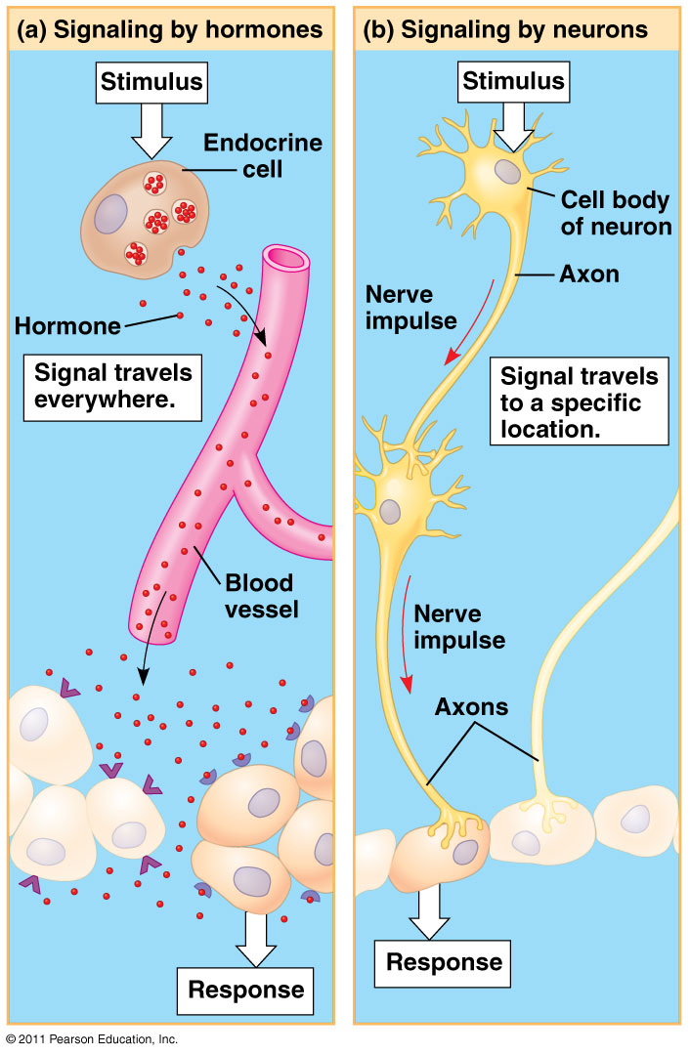
Figure 40.6
Notes:
15
Figure 40.6 Signaling in the endocrine and nervous systems

Slide 16
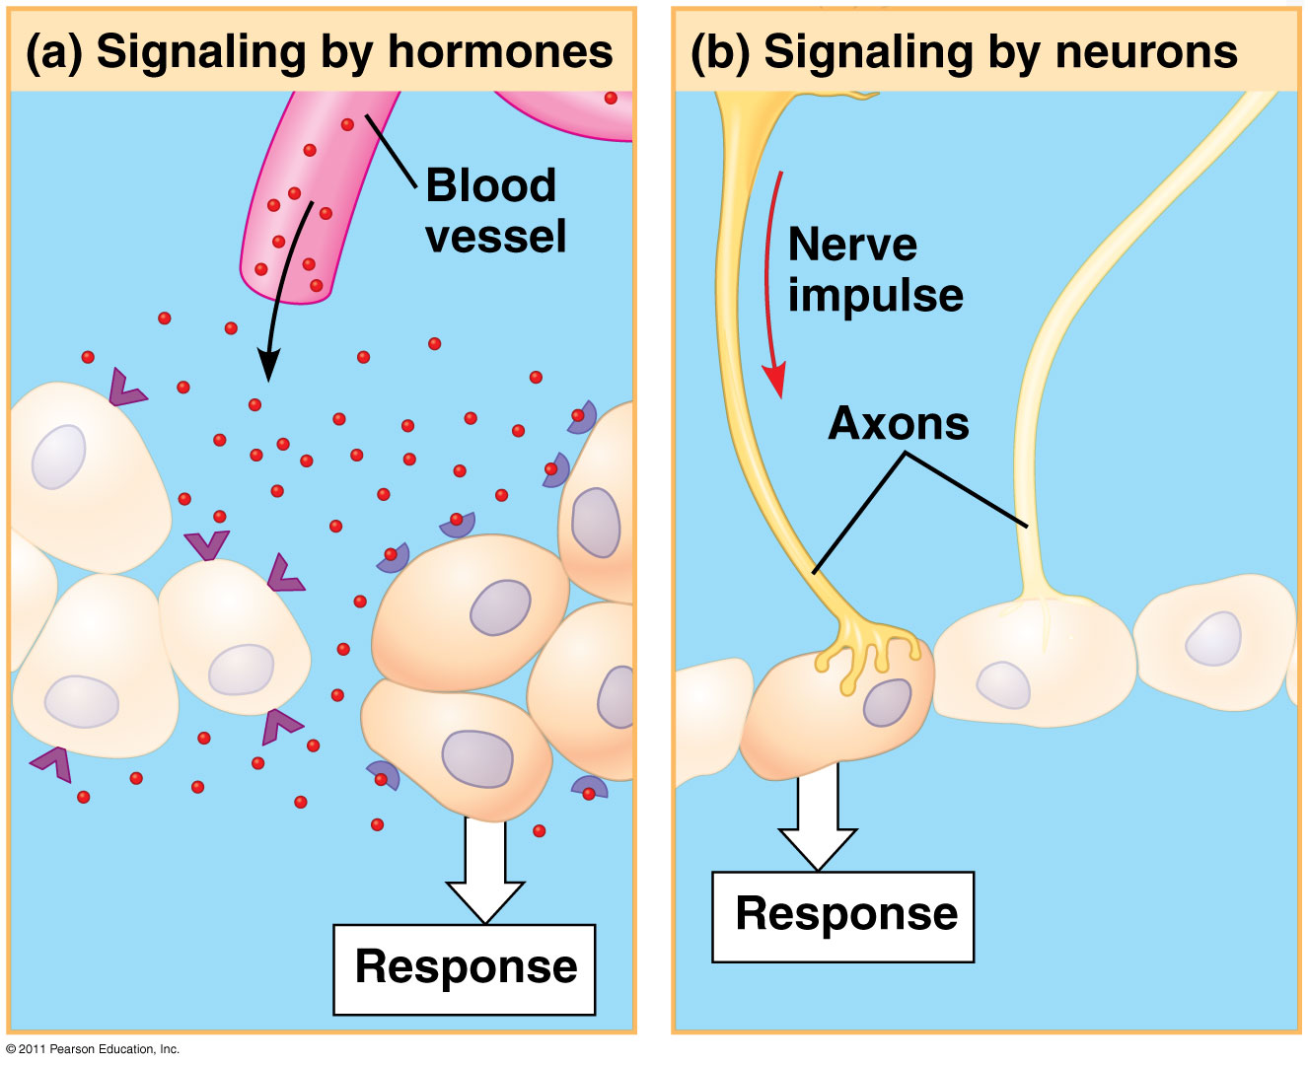
Figure 40.6b
Notes:
16
Figure 40.6 Signaling in the endocrine and nervous systems

Slide 17
Concept: Feedback control maintains the internal environment in many animals
Animals manage their internal environment by regulating or conforming to the external environment
© 2011 Pearson Education, Inc.

Slide 18
Regulating and Conforming
A regulator uses internal control mechanisms to moderate internal change in the face of external, environmental fluctuation
A conformer allows its internal condition to vary with certain external changes
Animals may regulate some environmental variables while conforming to others
© 2011 Pearson Education, Inc.

Slide 19
Homeostasis
Organisms use homeostasis to maintain a “steady state” or internal balance regardless of external environment
In humans, body temperature, blood pH, and glucose concentration are each maintained at a constant level
© 2011 Pearson Education, Inc.

Slide 20
Mechanisms of Homeostasis
Mechanisms of homeostasis moderate changes in the internal environment
For a given variable, fluctuations above or below a set point serve as a stimulus; these are detected by a sensor and trigger a response
The response returns the variable to the set point
© 2011 Pearson Education, Inc.

Slide 21
Feedback Control in Homeostasis
The dynamic equilibrium of homeostasis is maintained by negative feedback, which helps to return a variable to a normal range
Most homeostatic control systems function by negative feedback, where buildup of the end product shuts the system off
Positive feedback amplifies a stimulus and does not usually contribute to homeostasis in animals
© 2011 Pearson Education, Inc.

Slide 22
Alterations in Homeostasis
Set points and normal ranges can change with age or show cyclic variation
In animals and plants, a circadian rhythm governs physiological changes that occur roughly every 24 hours
Homeostasis can adjust to changes in external environment, a process called acclimatization
© 2011 Pearson Education, Inc.

Slide 23
Concept: Homeostatic processes for thermoregulation involve form, function, and behavior
Thermoregulation is the process by which animals maintain an internal temperature within a tolerable range
© 2011 Pearson Education, Inc.

Slide 24
Endothermy and Ectothermy
Endothermic animals generate heat by metabolism; birds and mammals are endotherms
Ectothermic animals gain heat from external sources; ectotherms include most invertebrates, fishes, amphibians, and nonavian reptiles
© 2011 Pearson Education, Inc.

Slide 25
In general, ectotherms tolerate greater variation in internal temperature, while endotherms are active at a greater range of external temperatures
Endothermy is more energetically expensive than ectothermy
© 2011 Pearson Education, Inc.

Slide 26
The arrangement of blood vessels in many marine mammals and birds allows for countercurrent exchange
Countercurrent heat exchangers transfer heat between fluids flowing in opposite directions and reduce heat loss
© 2011 Pearson Education, Inc.

Slide 27
Some bony fishes and sharks also use countercurrent heat exchanges
Many endothermic insects have countercurrent heat exchangers that help maintain a high temperature in the thorax
© 2011 Pearson Education, Inc.

Slide 28
Concept: Energy requirements are related to animal size, activity, and environment
Bioenergetics is the overall flow and transformation of energy in an animal
It determines how much food an animal needs and it relates to an animal’s size, activity, and environment
© 2011 Pearson Education, Inc.

Slide 29
Energy Allocation and Use
Animals harvest chemical energy from food
Energy-containing molecules from food are usually used to make ATP, which powers cellular work
After the needs of staying alive are met, remaining food molecules can be used in biosynthesis
Biosynthesis includes body growth and repair, synthesis of storage material such as fat, and production of gametes
© 2011 Pearson Education, Inc.

Slide 30
Quantifying Energy Use
Metabolic rate is the amount of energy an animal uses in a unit of time
Metabolic rate can be determined by
An animal’s heat loss
The amount of oxygen consumed or carbon dioxide produced
© 2011 Pearson Education, Inc.

Slide 31
Minimum Metabolic Rate and Thermoregulation
Basal metabolic rate (BMR) is the metabolic rate of an endotherm at rest at a “comfortable” temperature
Standard metabolic rate (SMR) is the metabolic rate of an ectotherm at rest at a specific temperature
Both rates assume a nongrowing, fasting, and nonstressed animal
Ectotherms have much lower metabolic rates than endotherms of a comparable size
© 2011 Pearson Education, Inc.

Slide 32
Influences on Metabolic Rate
Metabolic rates are affected by many factors besides whether an animal is an endotherm or ectotherm
Two of these factors are size and activity
© 2011 Pearson Education, Inc.

Slide 33
Size and Metabolic Rate
Metabolic rate is proportional to body mass to the power of three quarters (m^{3/4})
Smaller animals have higher metabolic rates per gram than larger animals
The higher metabolic rate of smaller animals leads to a higher oxygen delivery rate, breathing rate, heart rate, and greater (relative) blood volume, compared with a larger animal
© 2011 Pearson Education, Inc.

Slide 34
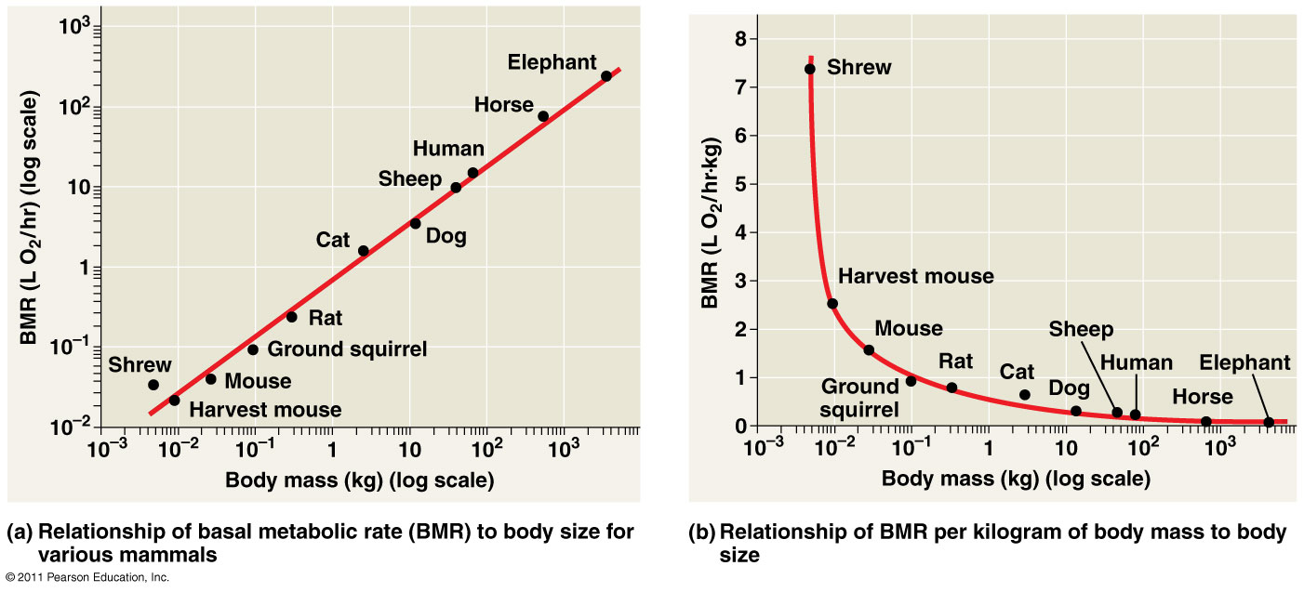
Figure 40.19
Notes:
34
Figure 40.19 The relationship of metabolic rate to body size.

Slide 35
Activity and Metabolic Rate
Activity greatly affects metabolic rate for endotherms and ectotherms
In general, the maximum metabolic rate an animal can sustain is inversely related to the duration of the activity
© 2011 Pearson Education, Inc.

Slide 36
Torpor and Energy Conservation
Torpor is a physiological state in which activity is low and metabolism decreases
Torpor enables animals to save energy while avoiding difficult and dangerous conditions
Hibernation is long-term torpor that is an adaptation to winter cold and food scarcity
© 2011 Pearson Education, Inc.

Slide 37
Summer torpor, called estivation, enables animals to survive long periods of high temperatures and scarce water
Daily torpor is exhibited by many small mammals and birds and seems adapted to feeding patterns
© 2011 Pearson Education, Inc.

Slide 38
Concept: Both asexual and sexual reproduction occur in the animal kingdom
Sexual reproduction is the creation of an offspring by fusion of a male gamete (sperm) and female gamete (egg) to form a zygote
Asexual reproduction is creation of offspring without the fusion of egg and sperm
© 2011 Pearson Education, Inc.

Slide 39
Mechanisms of Asexual Reproduction
Many invertebrates reproduce asexually by fission, separation of a parent into two or more individuals of about the same size
© 2011 Pearson Education, Inc.

Slide 40
In budding, new individuals arise from outgrowths of existing ones
Fragmentation is breaking of the body into pieces, some or all of which develop into adults
Fragmentation must be accompanied by regeneration, regrowth of lost body parts
Parthenogenesis is the development of a new individual from an unfertilized egg
© 2011 Pearson Education, Inc.

Slide 41
Sexual Reproduction: An Evolutionary Enigma
Sexual females have half as many daughters as asexual females; this is the “twofold cost” of sexual reproduction
Despite this, almost all eukaryotic species reproduce sexually
© 2011 Pearson Education, Inc.

Slide 42
Sexual reproduction results in genetic recombination, which provides potential advantages
An increase in variation in offspring, providing an increase in the reproductive success of parents in changing environments
An increase in the rate of adaptation
A shuffling of genes and the elimination of harmful genes from a population
© 2011 Pearson Education, Inc.

Slide 43
Some organisms can reproduce sexually or asexually, depending on conditions
Several genera of fishes, amphibians, and lizards reproduce only by a complex form of parthenogenesis that involves the doubling of chromosomes after meiosis
Asexual whiptail lizards are descended from a sexual species, and females still exhibit mating behaviors
© 2011 Pearson Education, Inc.

Slide 44
Variation in Patterns of Sexual Reproduction
For many animals, finding a partner for sexual reproduction may be challenging
One solution is hermaphroditism, in which each individual has male and female reproductive systems
Two hermaphrodites can mate, and some hermaphrodites can self-fertilize
© 2011 Pearson Education, Inc.

Slide 45
Individuals of some species undergo sex reversals
Some species exhibit male to female reversal (for example, certain oysters), while others exhibit female to male reversal (for example, a coral reef fish)
© 2011 Pearson Education, Inc.

Slide 46
Concept: Fertilization depends on mechanisms that bring together sperm and eggs of the same species
The mechanisms of fertilization, the union of egg and sperm, play an important part in sexual reproduction
In external fertilization, eggs shed by the female are fertilized by sperm in the external environment
© 2011 Pearson Education, Inc.

Slide 47
In internal fertilization, sperm are deposited in or near the female reproductive tract, and fertilization occurs within the tract
Internal fertilization requires behavioral interactions and compatible copulatory organs
All fertilization requires critical timing, often mediated by environmental cues, pheromones, and/or courtship behavior
© 2011 Pearson Education, Inc.

Slide 48
Ensuring the Survival of Offspring
Internal fertilization is typically associated with production of fewer gametes but the survival of a higher fraction of zygotes
Internal fertilization is also often associated with mechanisms to provide protection of embryos and parental care of young
© 2011 Pearson Education, Inc.

Slide 49
The embryos of some terrestrial animals develop in eggs with calcium- and protein-containing shells and several internal membranes
Some other animals retain the embryo, which develops inside the female
In many animals, parental care helps ensure survival of offspring
© 2011 Pearson Education, Inc.

Slide 50
Gamete Production and Delivery
To reproduce sexually, animals must produce gametes
In most species individuals have gonads, organs that produce gametes
Some simple systems do not have gonads, but gametes form from undifferentiated tissue
More elaborate systems include sets of accessory tubes and glands that carry, nourish, and protect gametes and developing embryos
© 2011 Pearson Education, Inc.

Slide 51
A cloaca is a common opening between the external environment and the digestive, excretory, and reproductive systems
A cloaca is common in nonmammalian vertebrates; mammals usually have a separate opening to the digestive tract
© 2011 Pearson Education, Inc.

