Slide 1
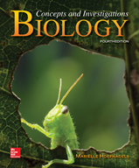
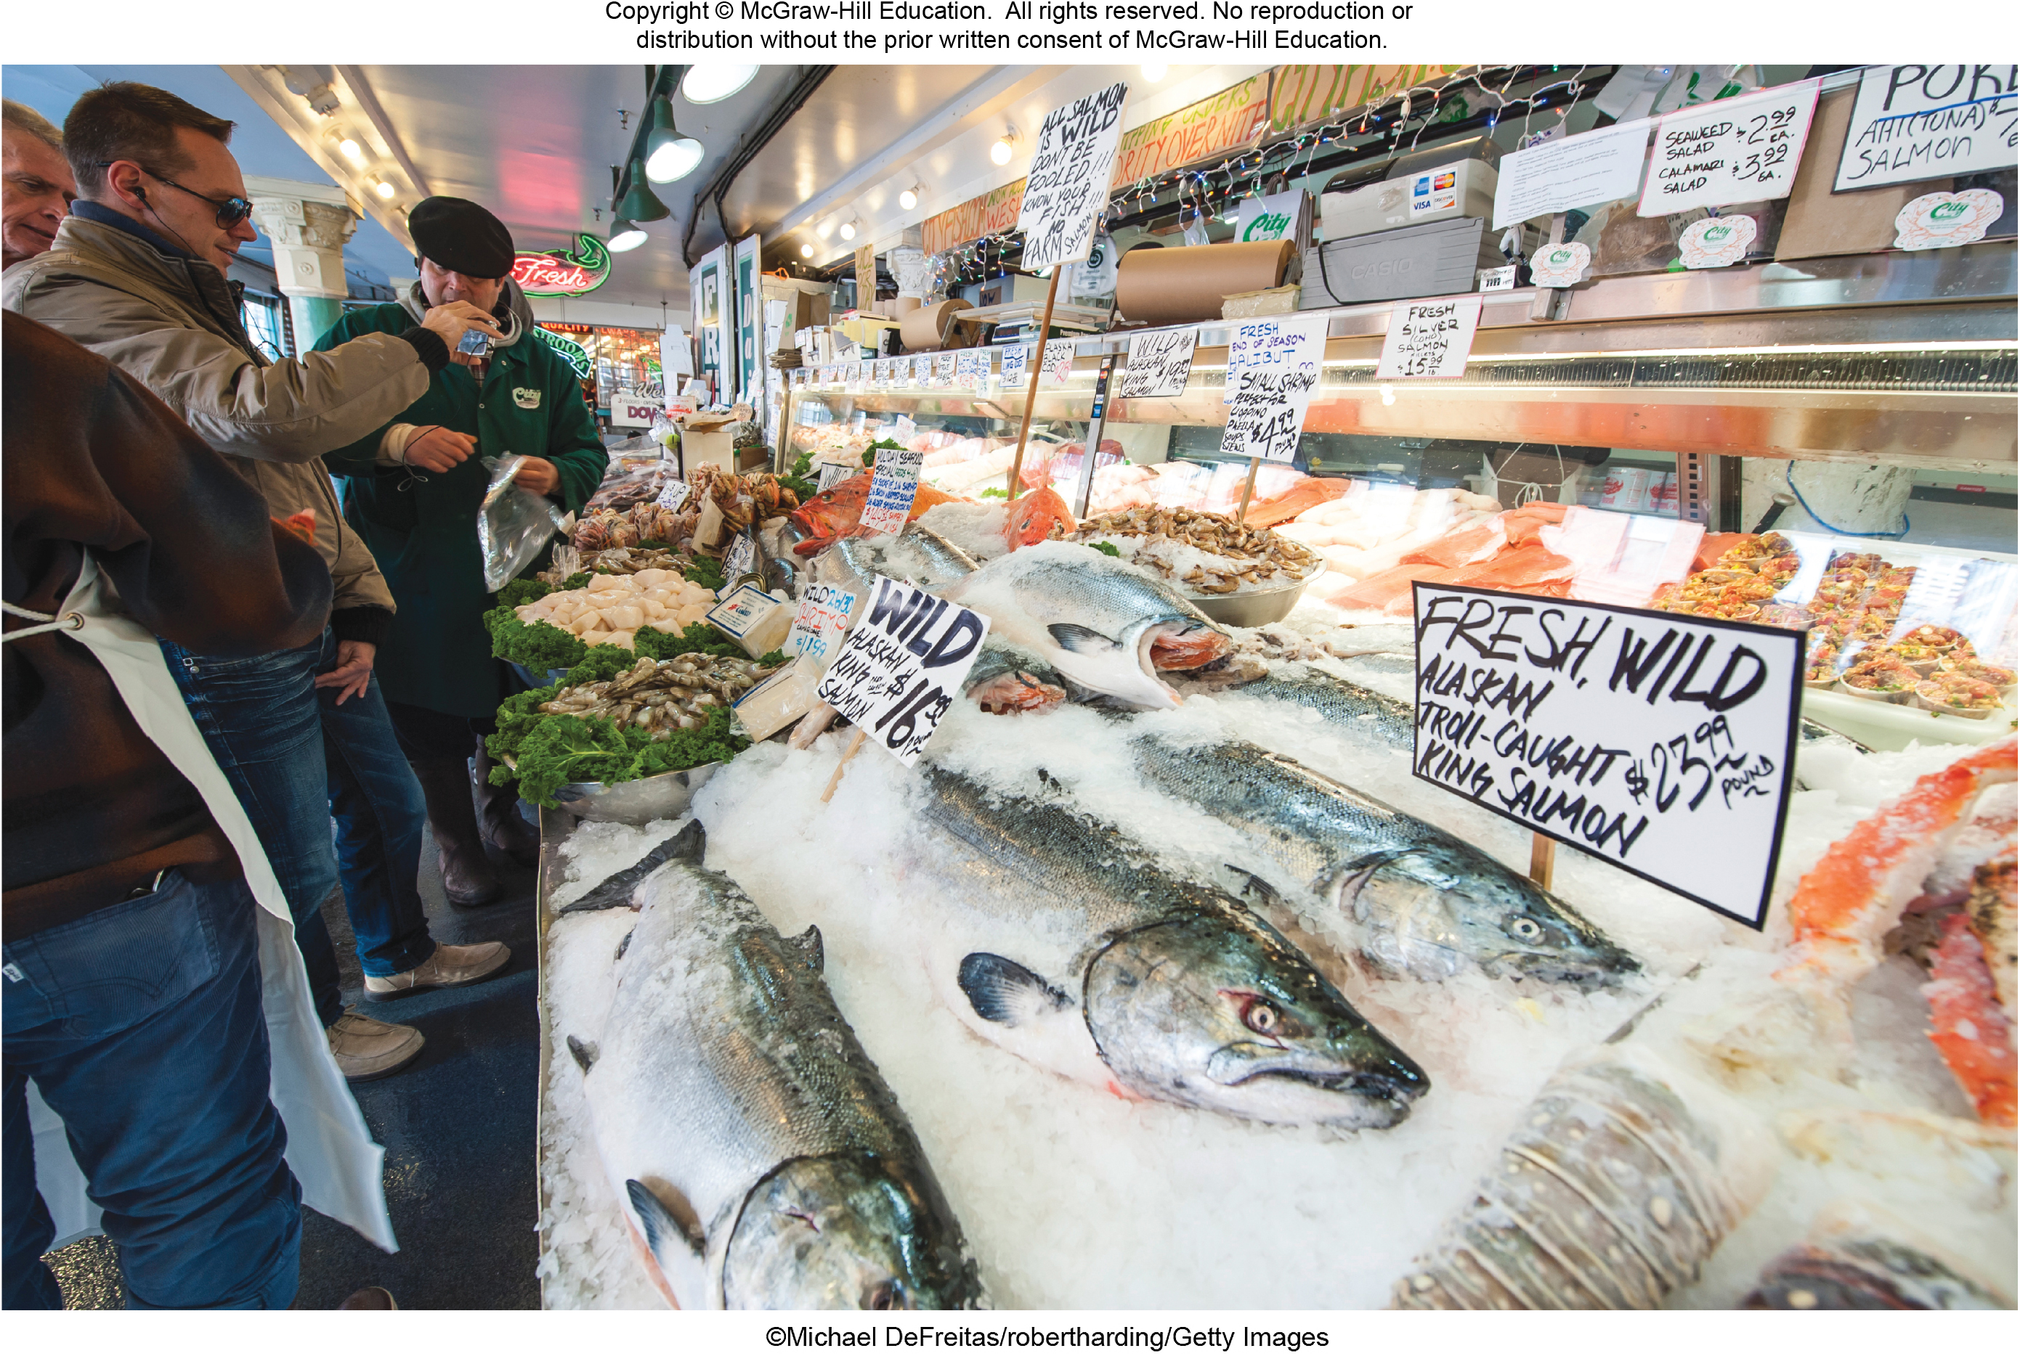
Chapter 21
Animals
©Michael DeFreitas/robertharding/Getty Images
©McGraw-Hill Education. All rights reserved. Authorized only for instructor use in the classroom.
No reproduction or further distribution permitted without the prior written consent of McGraw-Hill Education.

Slide 2
Animals are extremely diverse
There are over 1.3 million known animal species. Animals vary greatly in size, habitat, body form, and intelligence.
Chordates
~60,000 species
Notochord, dorsal hollow nerve cord,
pharyngeal slits, postanal tail
Fishes, amphibians, reptiles
(including birds), mammals
Roundworms
~80,000 species
Unsegmented, cylindrical worms
Free-living or parasitic
Pinworms, hookworms,
heartworms
Flatworms
~25,000 species
Flat bodies
Free-living or parasitic
Marine flatworms, planarians,
flukes, tapeworms
Echinoderms
~ 7000 species
Five-part symmetry
Water vascular system
Sea stars, sea urchins, sand dollars
Annelids
~15,000 species
Segmented worms
Earthworms, polychaetes,
leeches
Cnidarians
~11,000 species
Medusa or polyp forms
Stinging cells
Hydra, jellyfish, coral
Arthropods
› 1,000,000 species
Jointed appendages; exoskeleton
Trilobites, spiders and other arachnids,
crustaceans, insects, millipedes, centipedes
Mollusks
~112,000 species
Mantle secretes shell
Chitons, bivalves, cephalopods,
gastropods
Sponges
~5000 species
Porous bodies
Filter feeders
Section 21.1
Figure 21.45

Slide 3
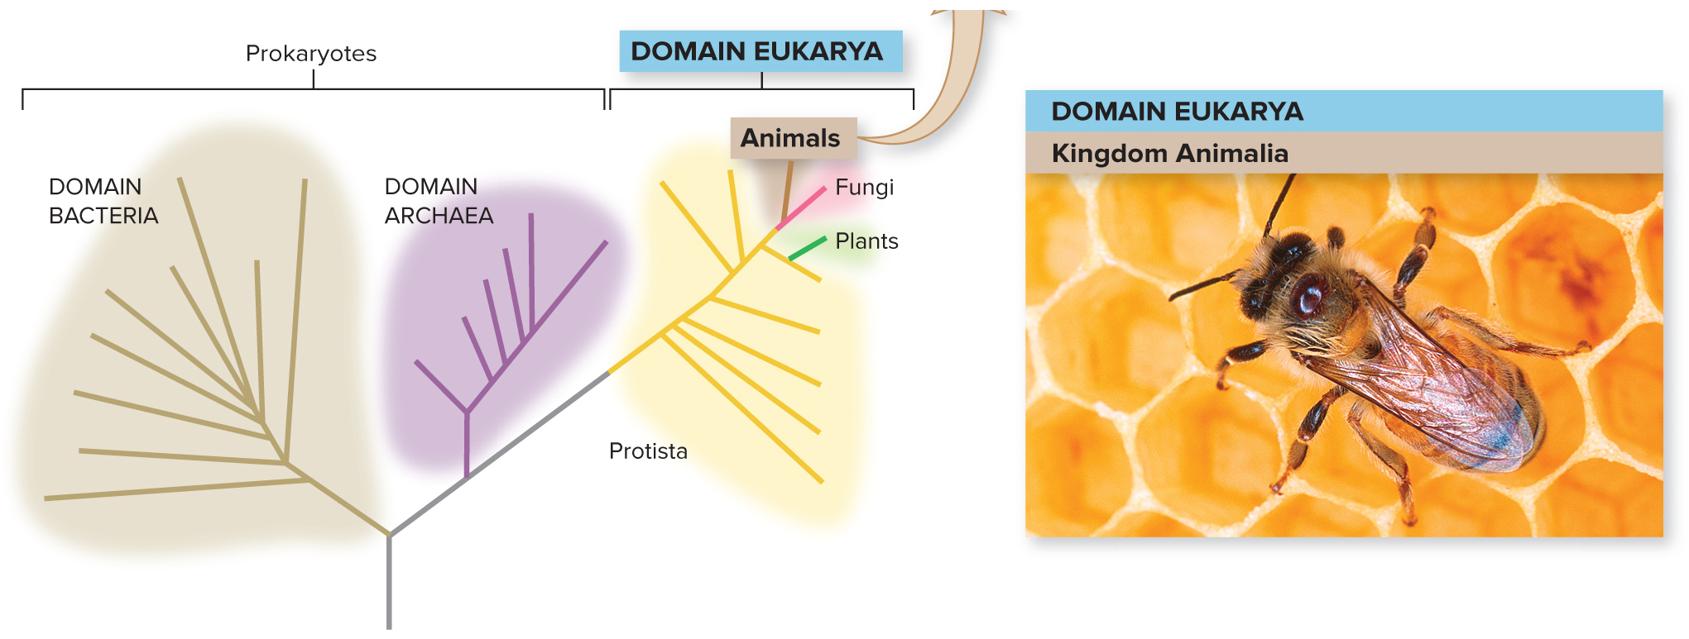
What makes it an animal?
Animals all have a specific set of features in common:
They have eukaryotic cells that lack cell walls.
Their cells produce an extracellular matrix.
They have multicellular bodies.
They go through a blastula stage of development.
They are heterotrophic, by ingestion.
USDA/ARS/Scott Bauer
Section 21.1
Figure 21.2

Slide 4
There are nine main animal phyla
TABLE 21.1 Nine Phyla of Animals
Most animals are invertebrates, which lack backbones. Many fewer animals are vertebrates, which have backbones.
Vertebrates (which include familiar mammals, amphibians, reptiles, and fish) are in phylum Chordata.
Phylum | Examples | Number of Exiting Species
Porifera | Sponges | 5000
Cnidaria | Hydras, jellyfishes, corals, sea, anemones | 11,000
Platyhelminthes (flatworms) | Planaria, tapeworms, flukes | 25,000
Mollusca | Bivalves, chitons, snails, slugs, squids, octopuses | 112,000
Annelida | Eartworms, leeches, polychaetes | 15,000
Nematoda (roundworms) | Pinworms, hookworms, C. elegans | 80,000
Arthropoda | Horseshoe crabs, spiders, scorpions, crustaceans, insects | More than 1,000,000
Echinodermata | Sea stars, sea urchins, sand dollars | 7000
Chordata | Tunicates, Iancelets, fishes, amphibians, reptiles, mammals | 60,000
Section 21.1
Table 21.1

Slide 5
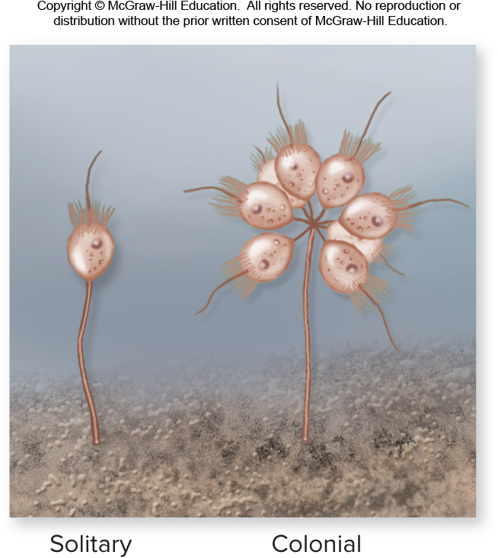
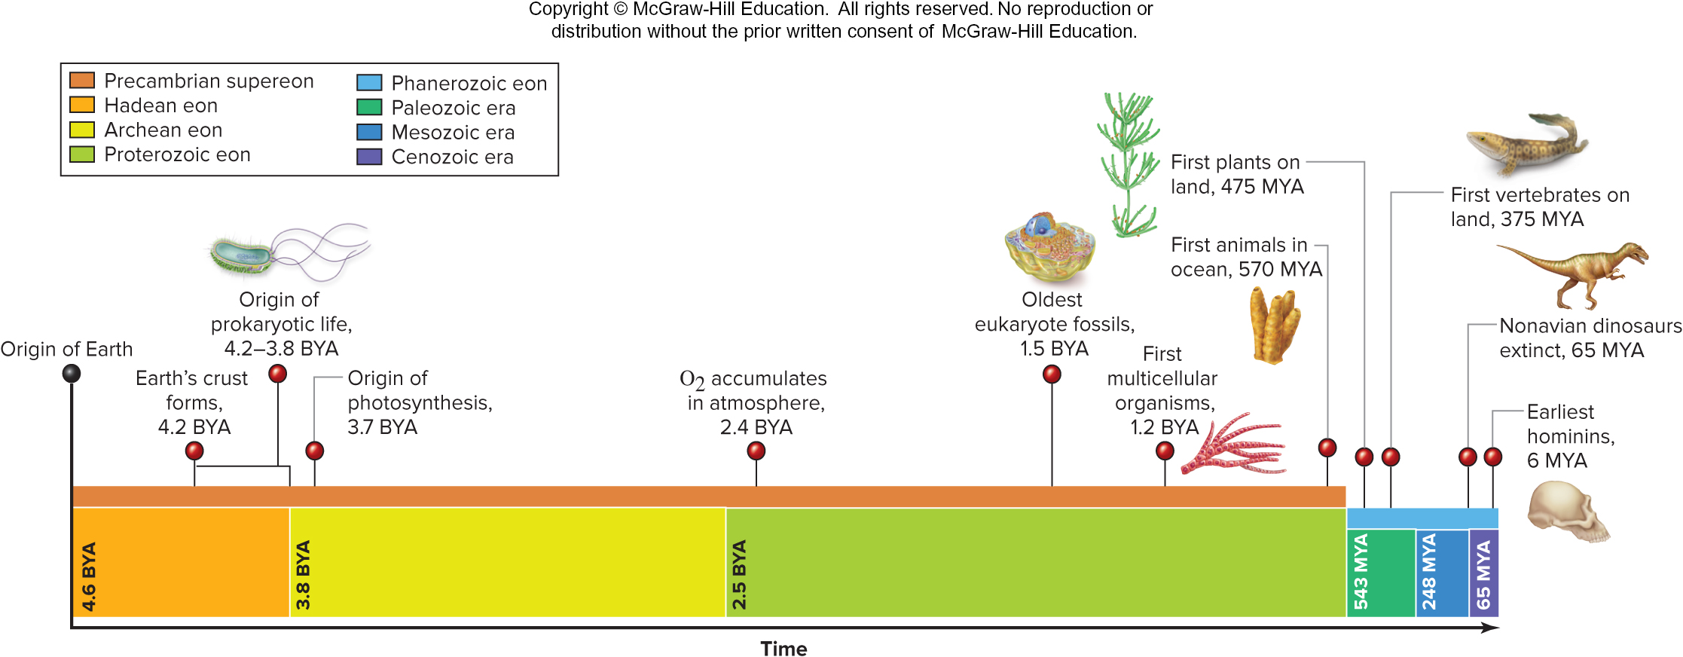
Animal life began in water
The first animals arose about 570 million years ago. They probably resembled aquatic protists called choanoflagellates.
Section 21.1
Figures 15.1, 21.1

Slide 6
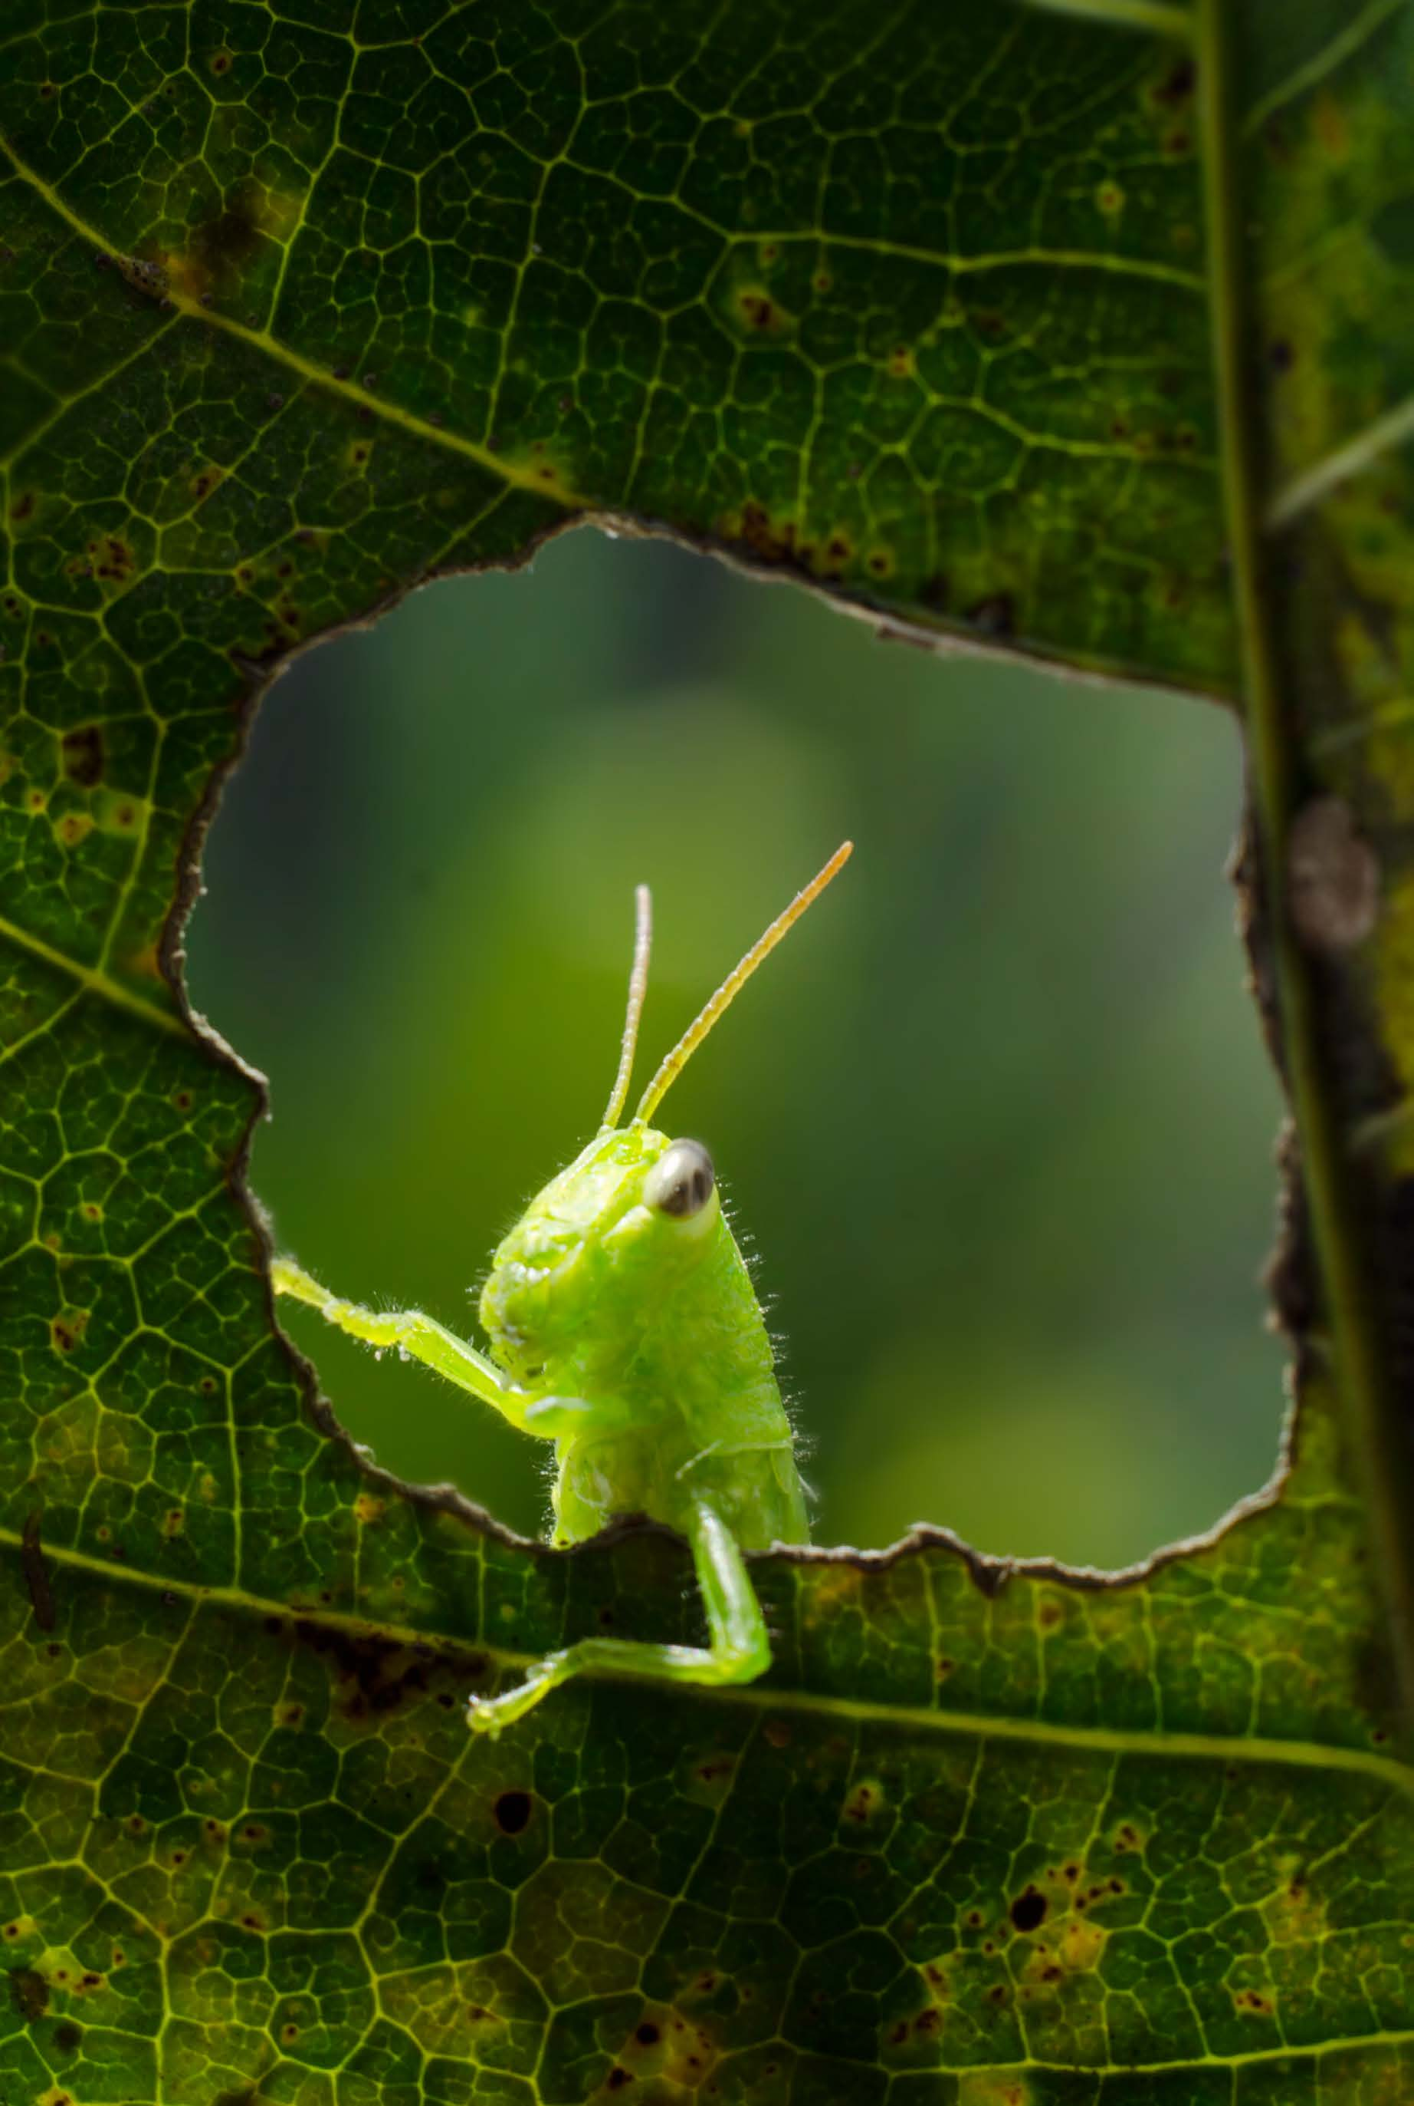
Clicker question #1
What combination of characteristics do all animals share?
multicellular, eukaryotic, heterotrophic
unicellular, eukaryotic, heterotrophic
multicellular, prokaryotic, autotrophic
multicellular, eukaryotic, autotrophic
unicellular, prokaryotic, autotrophic

Slide 7
Clicker question #1, solution
What combination of characteristics do all animals share?
multicellular, eukaryotic, heterotrophic

Slide 8
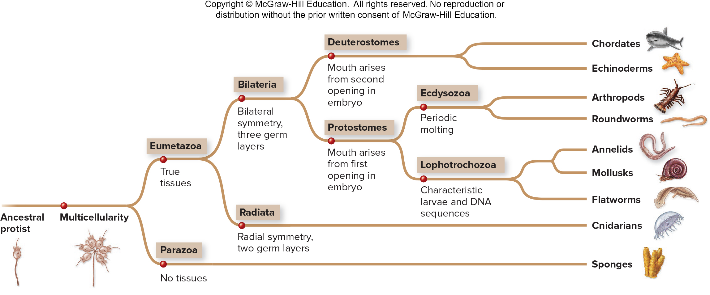
Animal features reflect shared ancestry
Animals are grouped by shared features of body form, developmental characteristics, and DNA.
Section 21.1
Figure 21.2

Slide 9
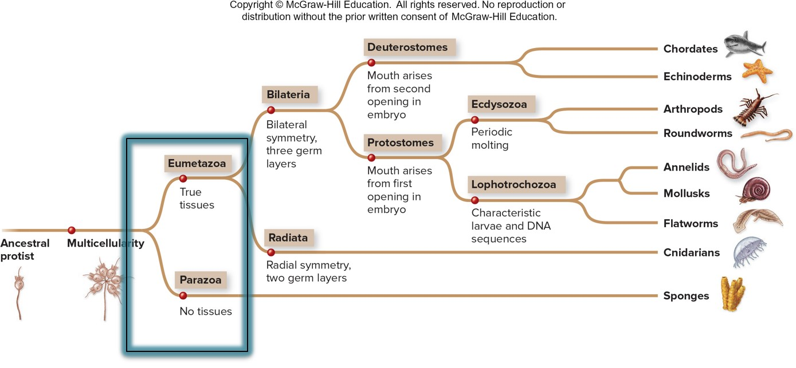
Animals are classified by having tissues
The first branching point in animal taxonomy distinguishes eumetazoans (animals with true body tissues) from parazoans (animals with no true body tissues).
Most animal phyla have tissues
Section 21.1
Figure 21.2

Slide 10
Animals are classified by symmetry
The second branching point distinguishes radially symmetrical from bilaterally symmetrical animals.
Most eumetazoan phyla have bilateral symmetry
Section 21.1
Figure 21.2

Slide 11
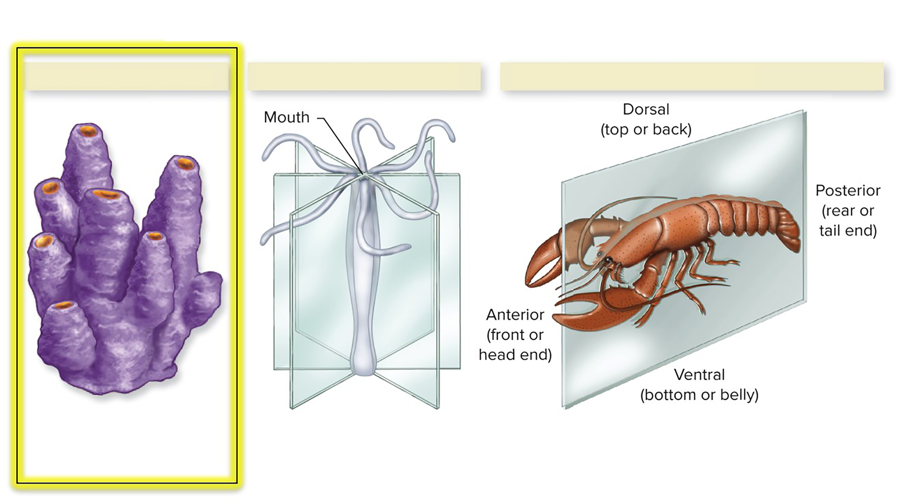
Some animals have no symmetry
Many sponges (phylum Porifera) are asymmetrical.
Sponge (asymmetry)
Hydra (radial symmetry)
Crayfish (bilateral symmetry)
Section 21.1
Figure 21.3

Slide 12
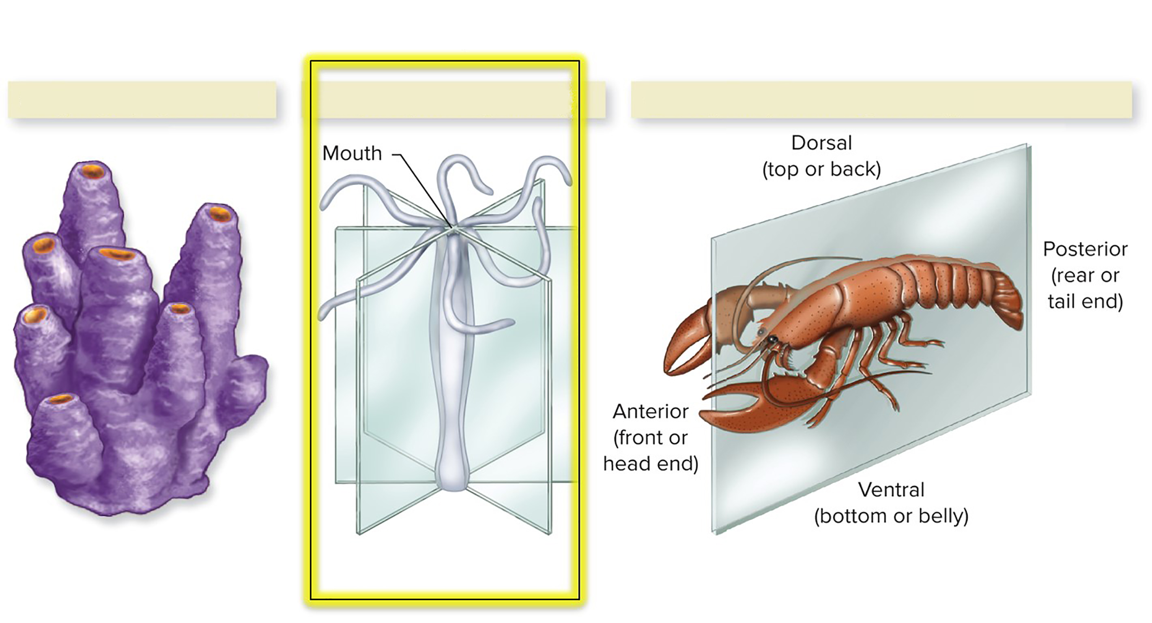
Some animals have radial symmetry
An organism has radial symmetry if any plane passing through the body from the mouth to the opposite end creates mirror images.
a. Sponge (asymmetry)
b. Hydra (radial symmetry)
c. Crayfish (bilateral symmetry)
Section 21.1
Figure 21.3

Slide 13
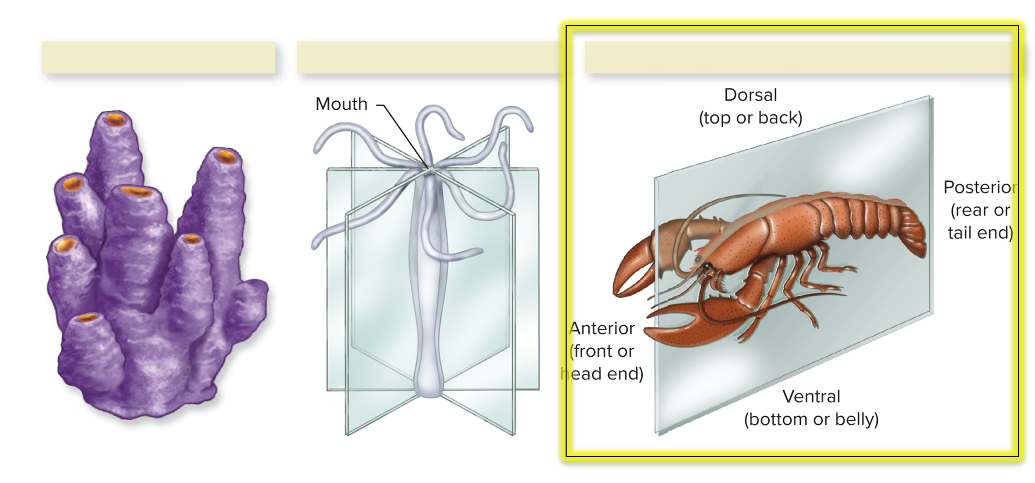
Some animals have bilateral symmetry
An organism has bilateral symmetry if only one plane can divide the animal into mirror images.
a. Sponge (asymmetry)
b. Hydra (radial symmetry)
c. Crayfish (bilateral symmetry)
Section 21.1
Figure 21.3

Slide 14
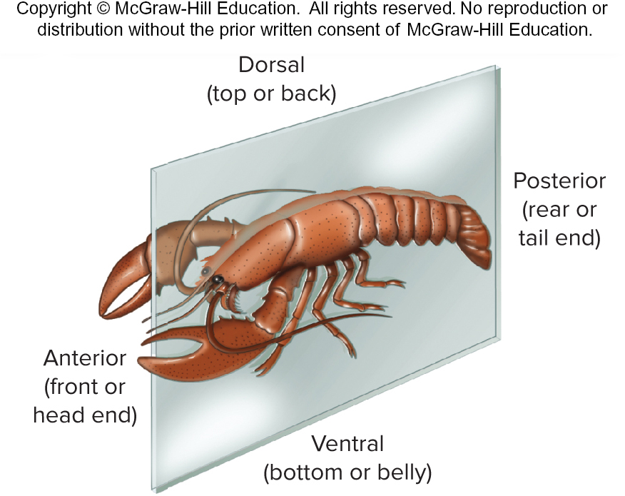
Bilaterally symmetric animals have a head and a tail
This body type correlates with cephalization, which is the tendency to concentrate sensory cells and a brain at the animal’s head.
Typically this is accompanied by greater sensory complexity.
Section 21.1
Figure 21.3

Slide 15
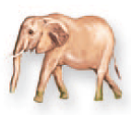
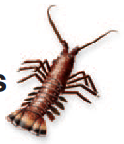
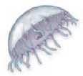
Clicker question #2
How many of the following animals have bilateral symmetry?
one
two
three
four
five
Figures 21.45, 21.47

Slide 16
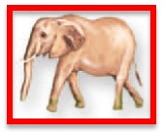
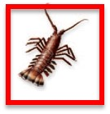
Clicker question #2, solution
How many of the following animals have bilateral symmetry?
two
Figures 21.45, 21.47

Slide 17
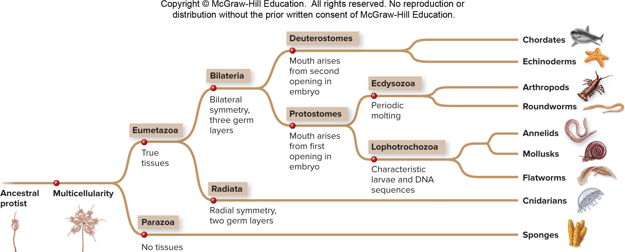
Animals are classified by germ layers
The same branching point also distinguishes animals with two embryonic germ layers from animals with three.
Most eumetazoan phyla have 3 germ layers
Section 21.1
Figure 21.2

Slide 18
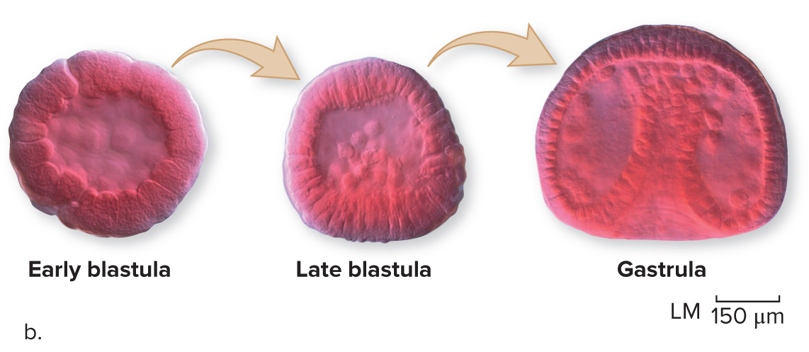
The gastrula is an early embryonic structure
In eumetazoans, the embryonic ball of cells called
a blastula folds in on itself, forming a gastrula.
©Herve Conge/Phototake
Figure 21.4

Slide 19
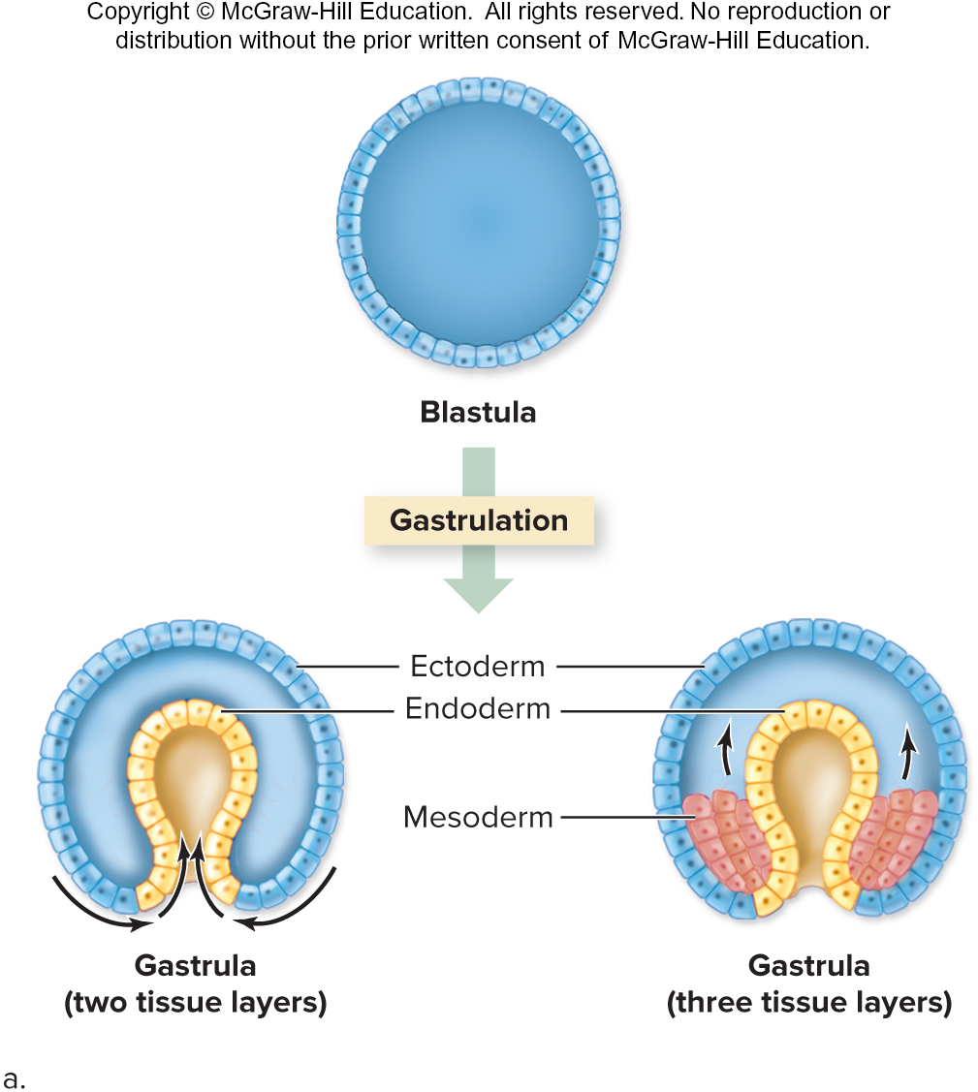
Animal embryos develop germ layers
In some animals, the gastrula only develops two tissue layers (endoderm and ectoderm).
In others, a third tissue layer (mesoderm) develops.
Figure 21.4

Slide 20
The germ layers develop into body parts
Ectoderm develops into the skin and nervous system.
Endoderm becomes the digestive tract.
Mesoderm gives rise to the muscles and circulatory system.
Figure 21.4

Slide 21
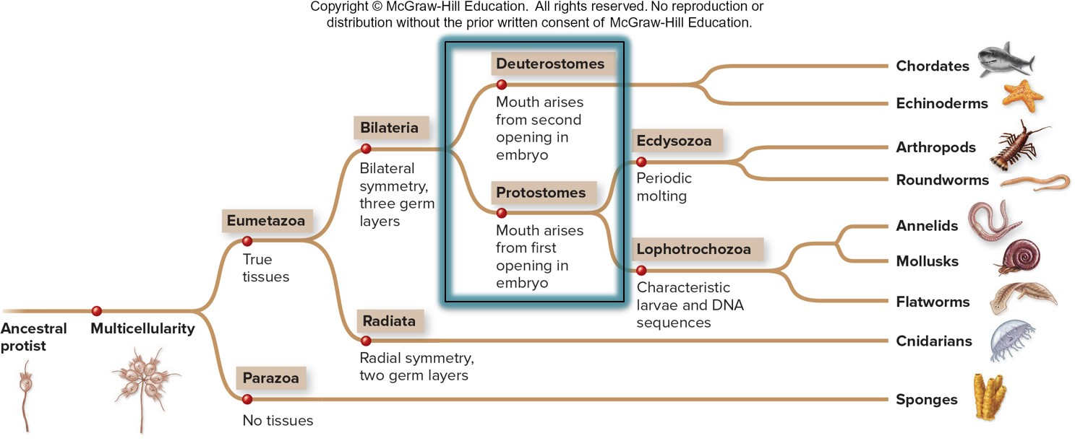
Animals are classified by early embryonic development
The third branching point distinguishes animals by how their gastrula develops.
Section 21.1
Figure 21.2

Slide 22
Protostomes are “mouth first”
If the first indention of the gastrula develops into the mouth,
the organism is a protostome.
The anus will develop from the second opening.
Section 21.1
Figure 21.4

Slide 23
Deuterostomes are “anus first”
If the first indention of the gastrula develops into the anus,
the organism is a deuterostome.
The mouth will develop from the second opening.
Section 21.1
Figure 21.4

Slide 24
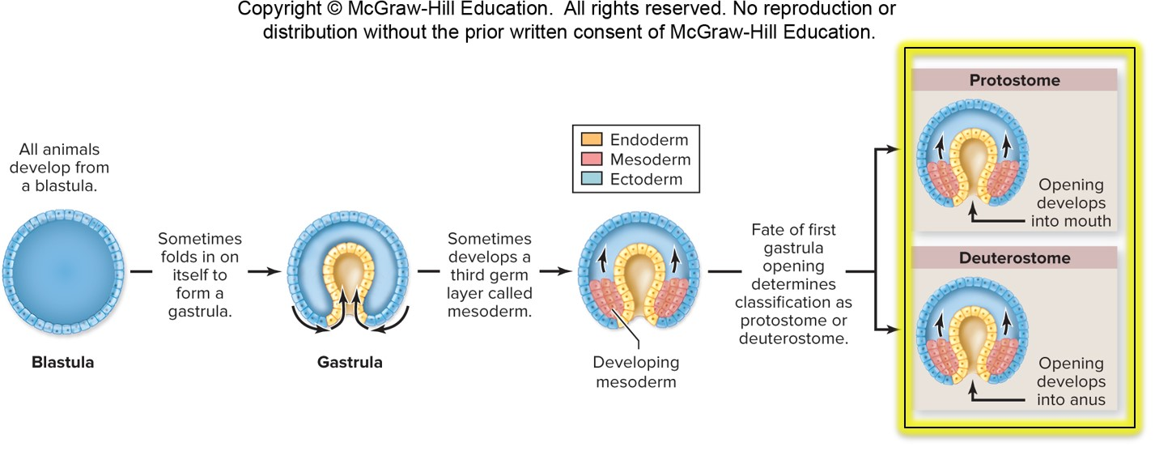
Protostomes and deuterostomes are fundamentally different
Figure 21.46

Slide 25
Animals are classified by body cavity
Coelom
A coelom is a body cavity surrounded on all sides
by mesoderm.
Bilaterally symmetrical animals have different types of body cavities.
Pseudocoelom
No coelom
Section 21.1
Figure 21.5

Slide 26
Some animals have a true coelom
Coelom
This sheep’s body cavity is fully surrounded by mesoderm.
This is where the internal organs will grow.
Pseudocoelom
No coelom
Section 21.1
Figure 21.5

Slide 27
Some animals have a pseudocoelom
Coelom
Pseudocoelom
This roundworm’s body cavity is surrounded by mesoderm on one side and ectoderm on the other side.
No coelom
Section 21.1
Figure 21.5

Slide 28
Some animals have no coelom
Coelom
Pseudocoelom
No coelom
This flatworm lacks a body cavity.
Section 21.1
Figure 21.5

Slide 29
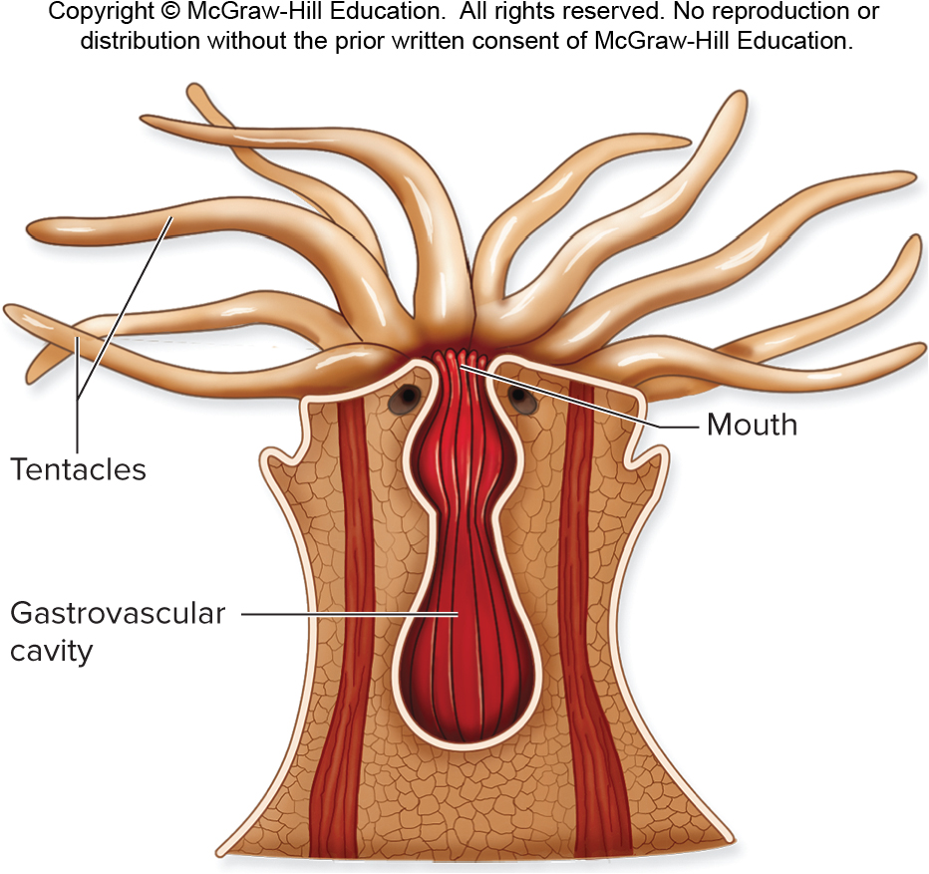
Animals are classified by digestive tract
Animals have an
incomplete digestive tract
if the mouth both takes in food and ejects wastes.
Animals have a
complete digestive tract
if food passes in one direction from mouth to anus.
Figures 21.6,
32.13
Section 21.1

Slide 30
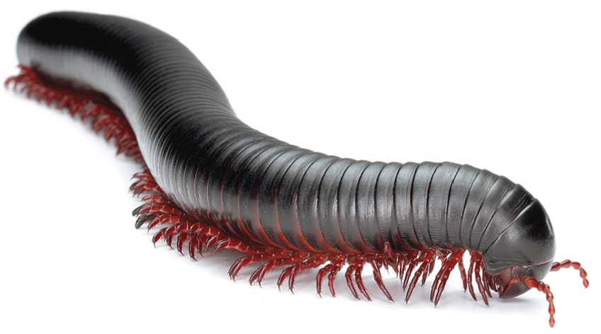
Animals are classified by segmentation
This millipede’s body is segmented: it is divided into repeated parts.
©Don Farrall/Getty Images RF
Segmented bodies are more flexible and have more potential for developing specialized body parts than unsegmented bodies.
Section 21.1
Figure 21.7

Slide 31
Animals are classified by reproduction and development
Animals with direct development resemble adults in their juvenile stage. The baby fish looks like a smaller version of the adult fish.
Direct development
Indirect development
Section 21.1
Figure 21.8

Slide 32
Some animals reproduce larvae
Animals with indirect development have a larval stage that does not resemble the adult form. The larva undergoes metamorphosis as it matures into an adult.
Direct development
Indirect development
Section 21.1
Figure 21.8

Slide 33
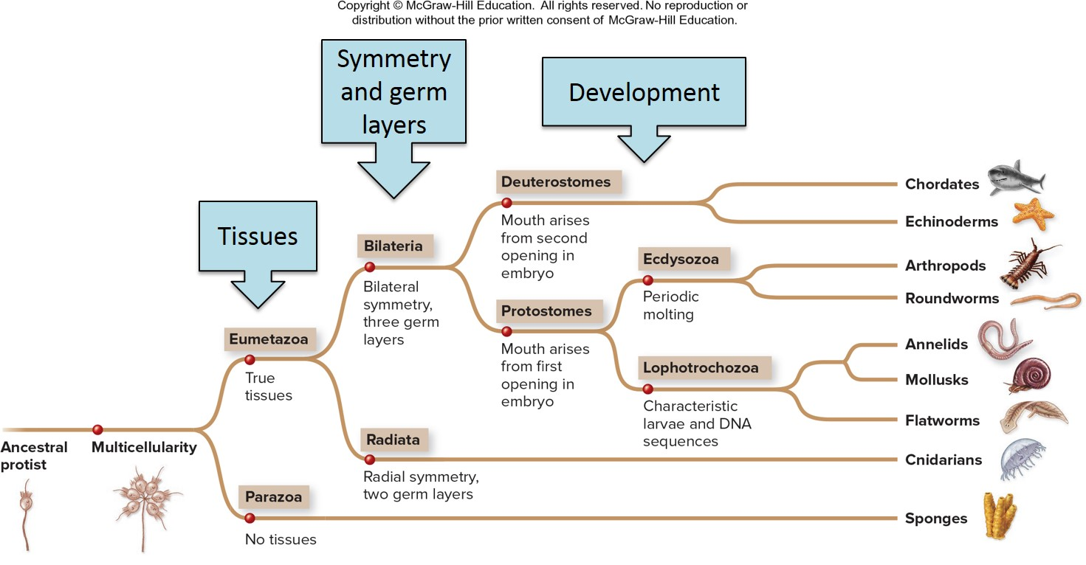
Each animal phylum has a unique combination of features
Section 21.1
Figure 21.2

Slide 34
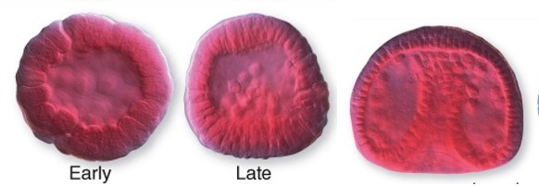
Clicker question #3
Which type of animal does NOT go through this sequence in its early development?
sea star
shark
snail
sponge
flatworm
Figure 21.4

Slide 35
Clicker question #3, solution
Which type of animal does NOT go through this sequence in its early development?
D. sponge
Figure 21.4

Slide 36
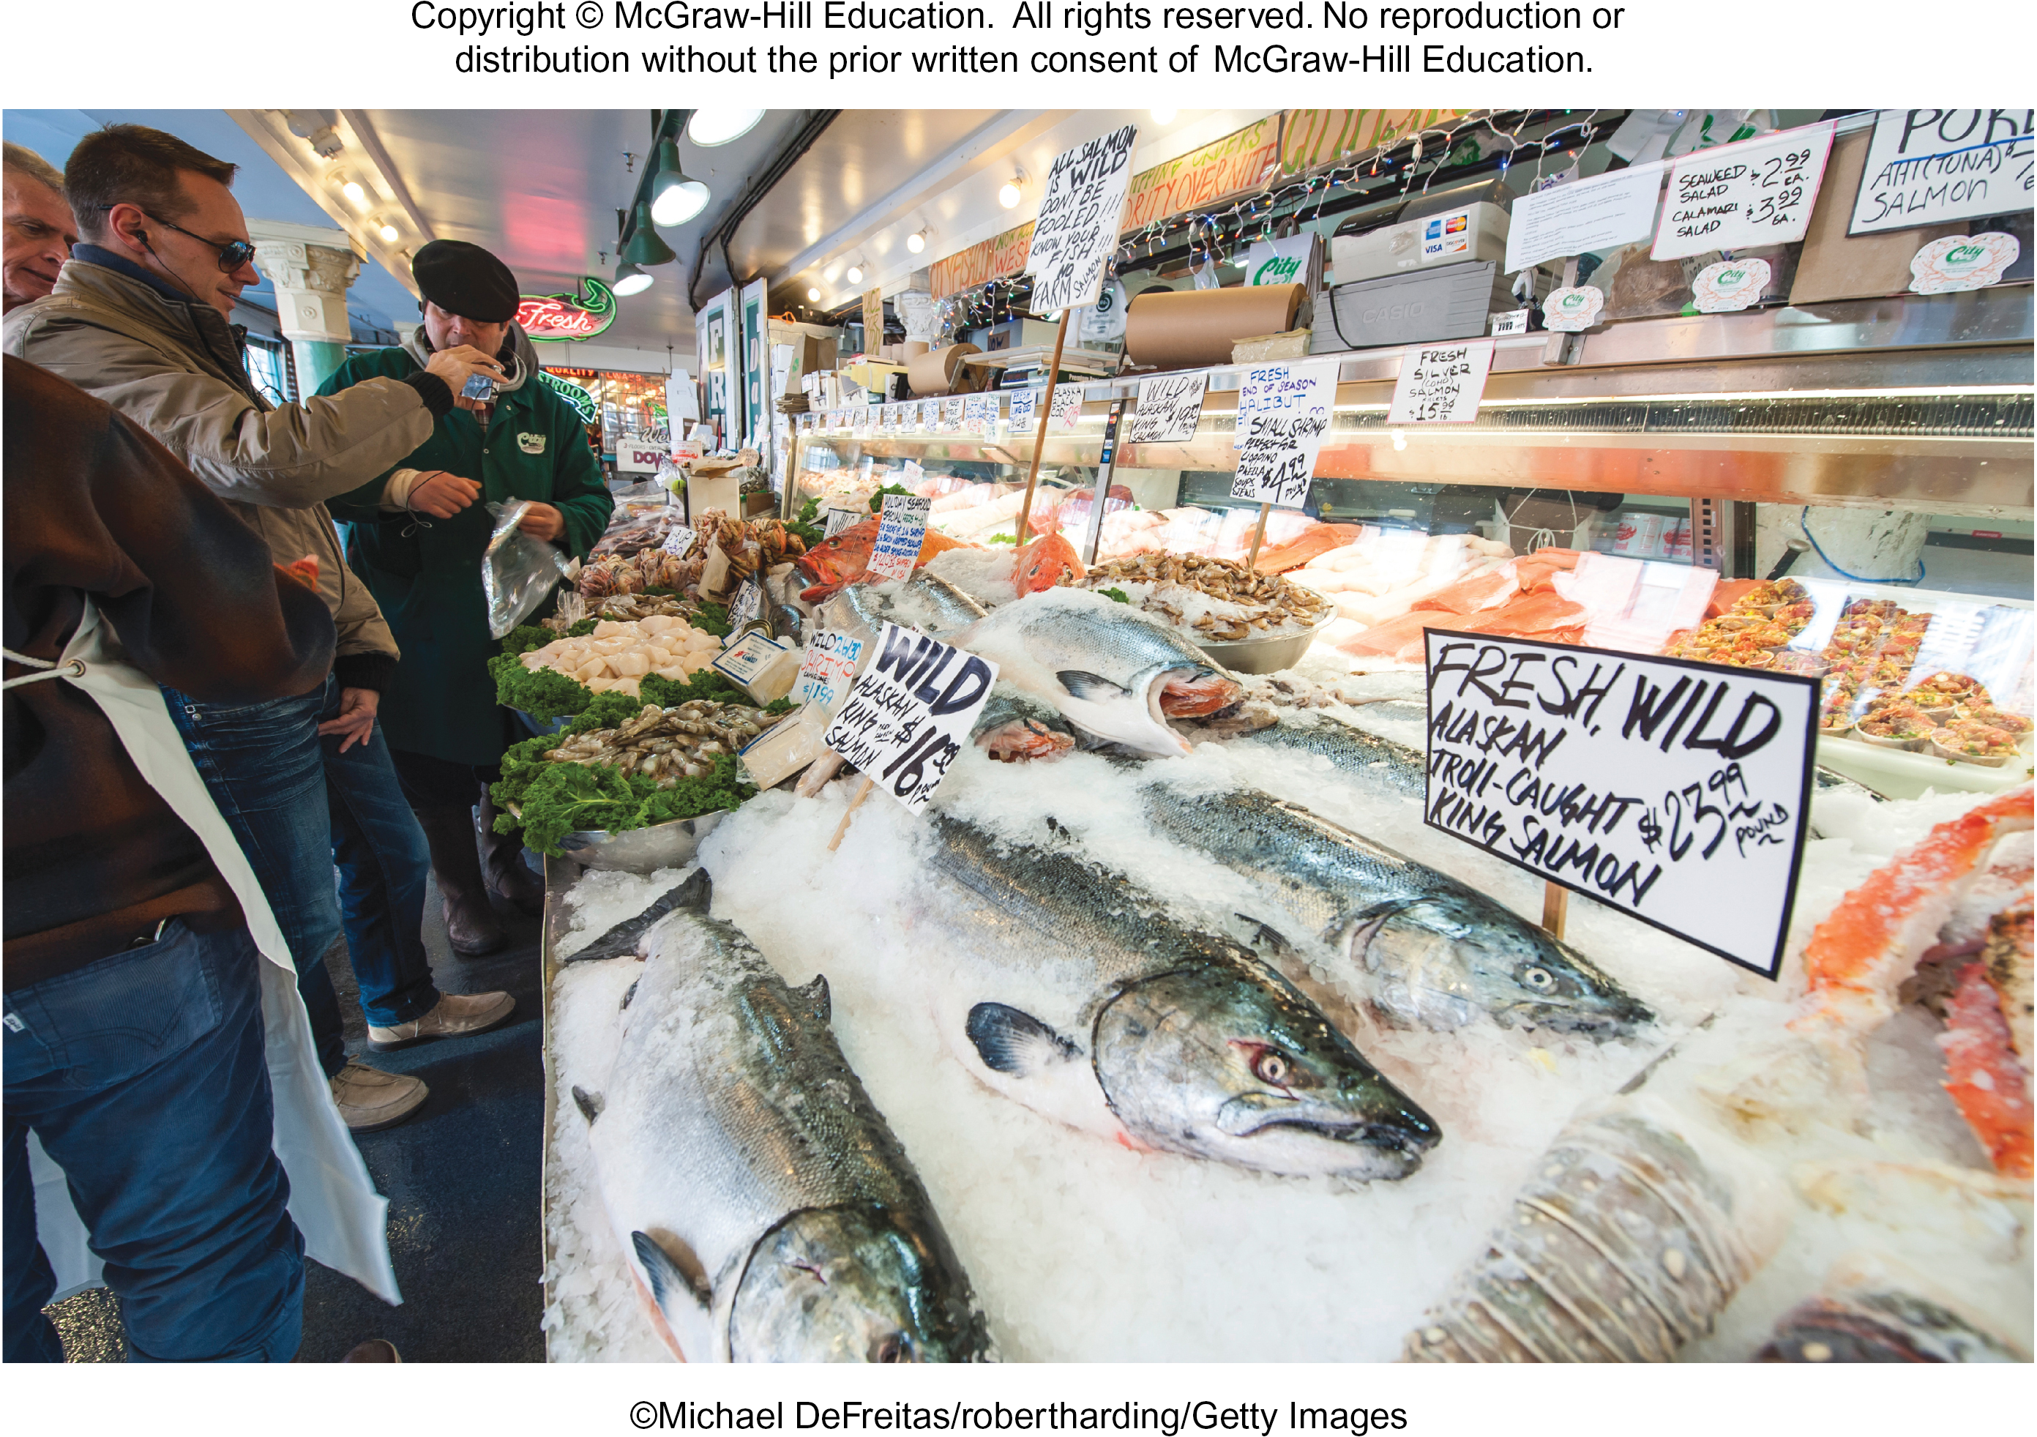
21.1 Mastering concepts
What features were used to build the animal phylogenetic tree?
©Michael DeFreitas/robertharding/Getty Images

Slide 37
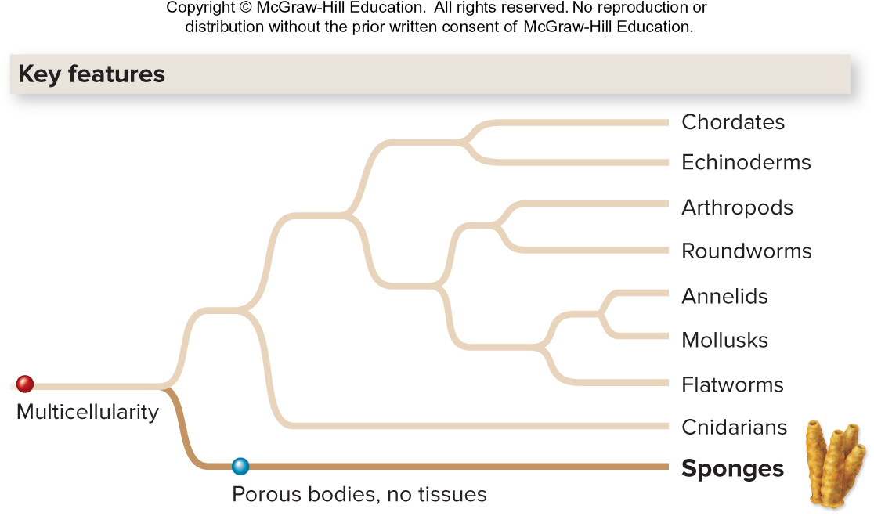
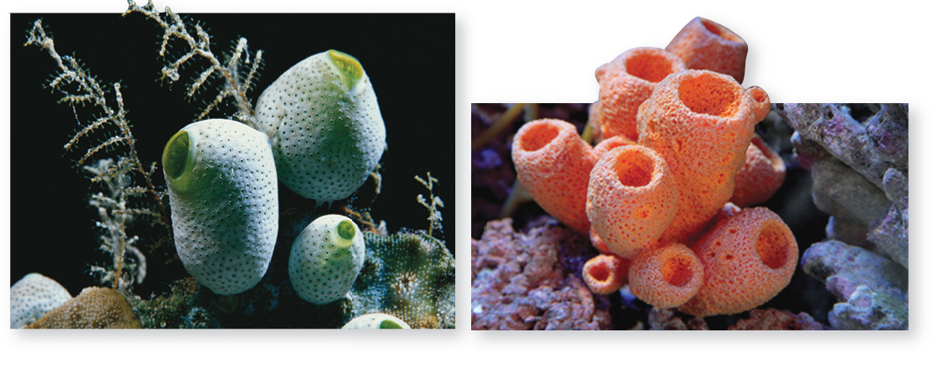
Sponges (Porifera) are simple animals
Sponges are aquatic and sessile (anchored to a surface). They do not have true tissues.
They have hollow bodies that are either asymmetric or radially symmetric.
(diversity green): ©Getty Images RF; (diversity pink): ©Laurence F Tapper/YAY Micro/age fotostock RF
Section 21.2
Figure 21.9

Slide 38
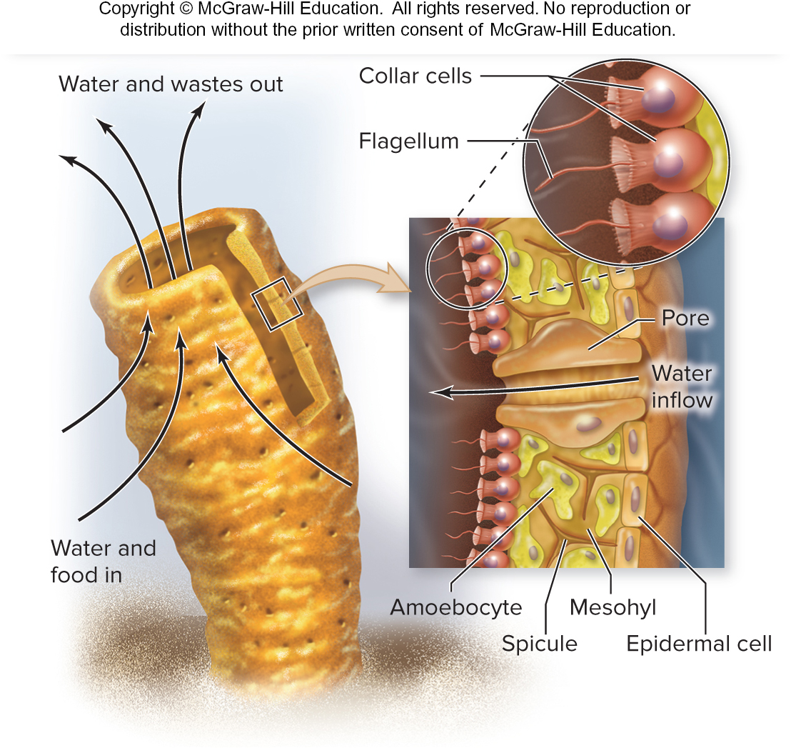
Sponges are filter feeders
Water moves into a sponge’s body through pores in its sides, then out through a hole at the top.
This allows the sponge to trap food and eliminate waste.
Section 21.2
Figure 21.9

Slide 39
Sponges have specialized cells
Collar cells trap food and start to digest it.
Amoebocytes digest food and distribute it to other parts of the body.
Section 21.2
Figure 21.9

Slide 40
Sponges are hermaphrodites
Reproduction can be asexual (by budding) or sexual.
Sperm are released into the water and fertilize eggs retained in the body of the sponge.
Section 21.2
Figure 21.9

Slide 41
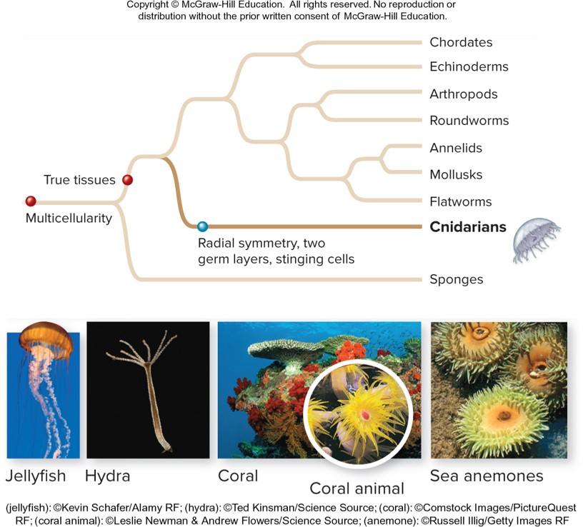
Cnidarians are simple eumetazoans
Cnidarians are aquatic and radially symmetric, with 2 germ layers.
The 4 groups of cnidarians are jellyfish, hydra, coral, and sea anemones.
(jellyfish): ©Kevin Schafer/Alamy RF; (hydra): ©Ted Kinsman/Science Source; (coral): ©Comstock Images/PictureQuest RF; (coral animal): ©Leslie Newman & Andrew Flowers/Science Source; (anemone): ©Russell llig/Getty Images RF
Section 21.3
Figure 21.10

Slide 42
Cnidarians’ unique feature is mesoglea
Mesoglea is a jellylike, noncellular substance found between the 2 cell layers that make up a cnidarian’s body
Polyp
Medusa
Section 21.3
Figure 21.10

Slide 43
Cnidarians have stinging cells
In the outer body layer there are cells called cnidocytes, which contain tiny sharp harpoons used to sting predators or prey.
The sting can irritate, paralyze or kill other animals.
Polyp
Medusa
Section 21.3
Figure 21.10

Slide 44
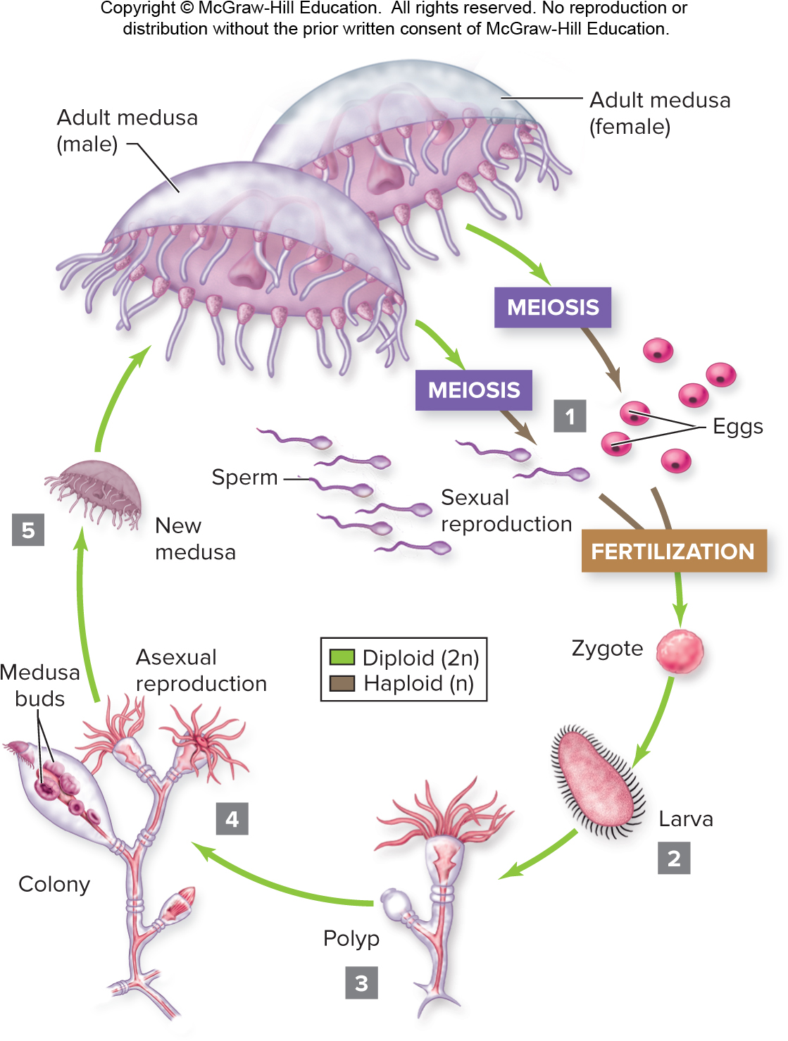
Cnidarians reproduce sexually and asexually
Adults release sperm or eggs into the water. When they meet up fertilization occurs to form a zygote.
The zygote develops into a larva and then a polyp, which can form a colony and release new medusae.
Section 21.3
Figure 21.11

Slide 45
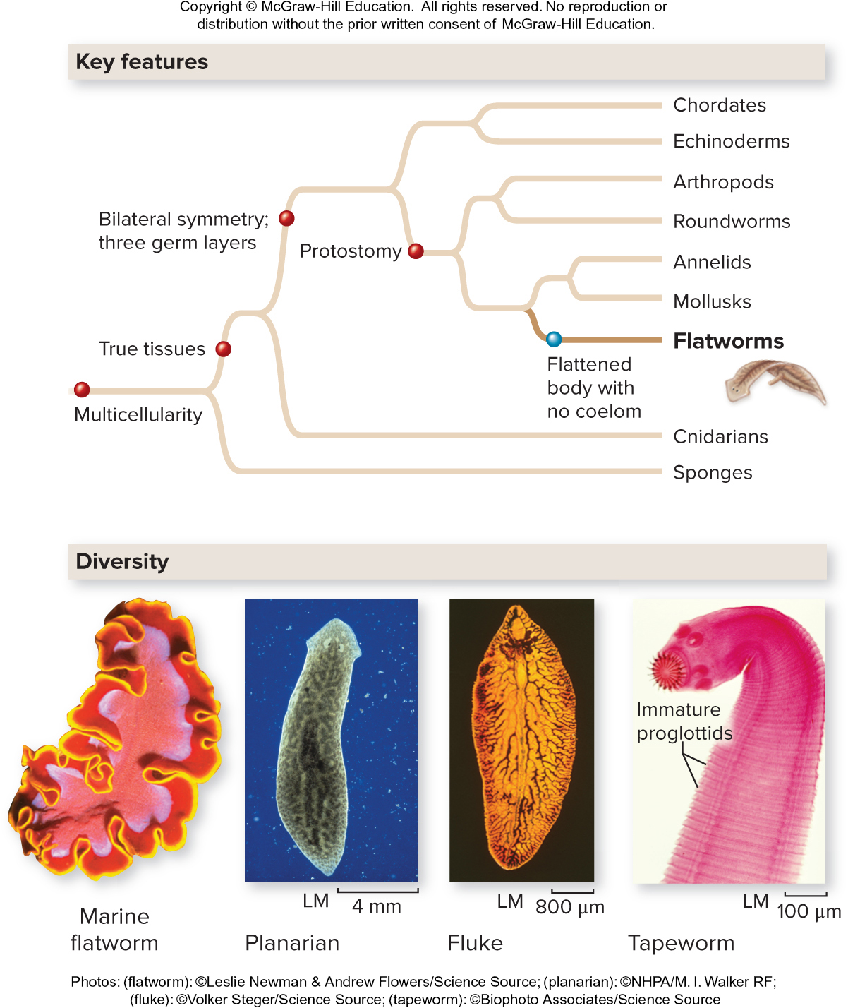
Flatworms are simple protostomes
Flatworms (phylum Platyhelminthes) are bilaterally symmetric, with three germ layers.
Planarians, flukes, and tapeworms are three groups of flatworms.
Photos: (flatworm): ©Leslie Newman & Andrew Flowers/Science Source; (planarian): ©NHPA/M. I. Walker RF; (fluke): ©Volker Steger/Science Source; (tapeworm): ©Biophoto Associates/Science Source
Section 21.4
Figure 21.12

Slide 46
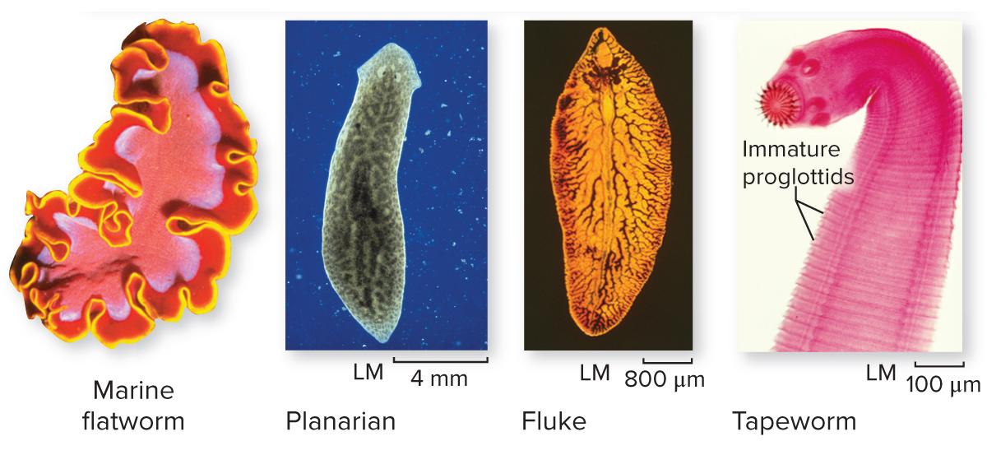
Flatworms have no coelom
The flat body shape increases surface area and allows for efficient gas exchange in the absence of a coelom and without a specialized respiratory or circulatory system.
(flatworm): ©Leslie Newman & Andrew Flowers/Science Source; (planarian): ©NHPA/M. I. Walker RF; (fluke): ©Volker Steger/Science Source; (tapeworm): ©Biophoto Associates/Science Source
Section 21.3
Figure 21.12

Slide 47
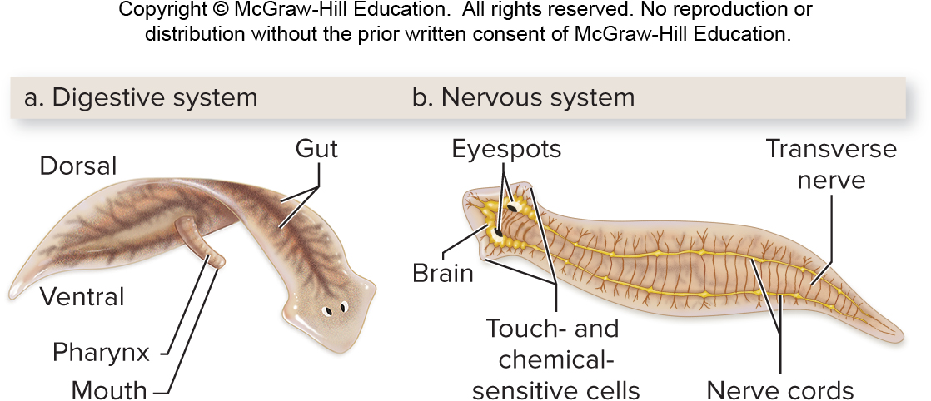
Planarians are free-living flatworms
A feeding structure called a pharynx brings food into the body and excretes undigested food.
A brain and nerve cords make up the nervous system. It can sense touch, chemicals, and light.
Section 21.4
Figure 21.13

Slide 48
Flukes and tapeworms are parasitic
Fluke matures in veins surrounding intestines or bladder.
Some flatworms are parasitic, such as the blood fluke. They reproduce in the human intestine.
Fluke infects human through skin.
Eggs are passed with feces or urine.
Larvae leave intermediate host.
Larvae infect intermediate host.
Egg hatches into swimming larva.
Section 21.4
Figure 21.14

Slide 49
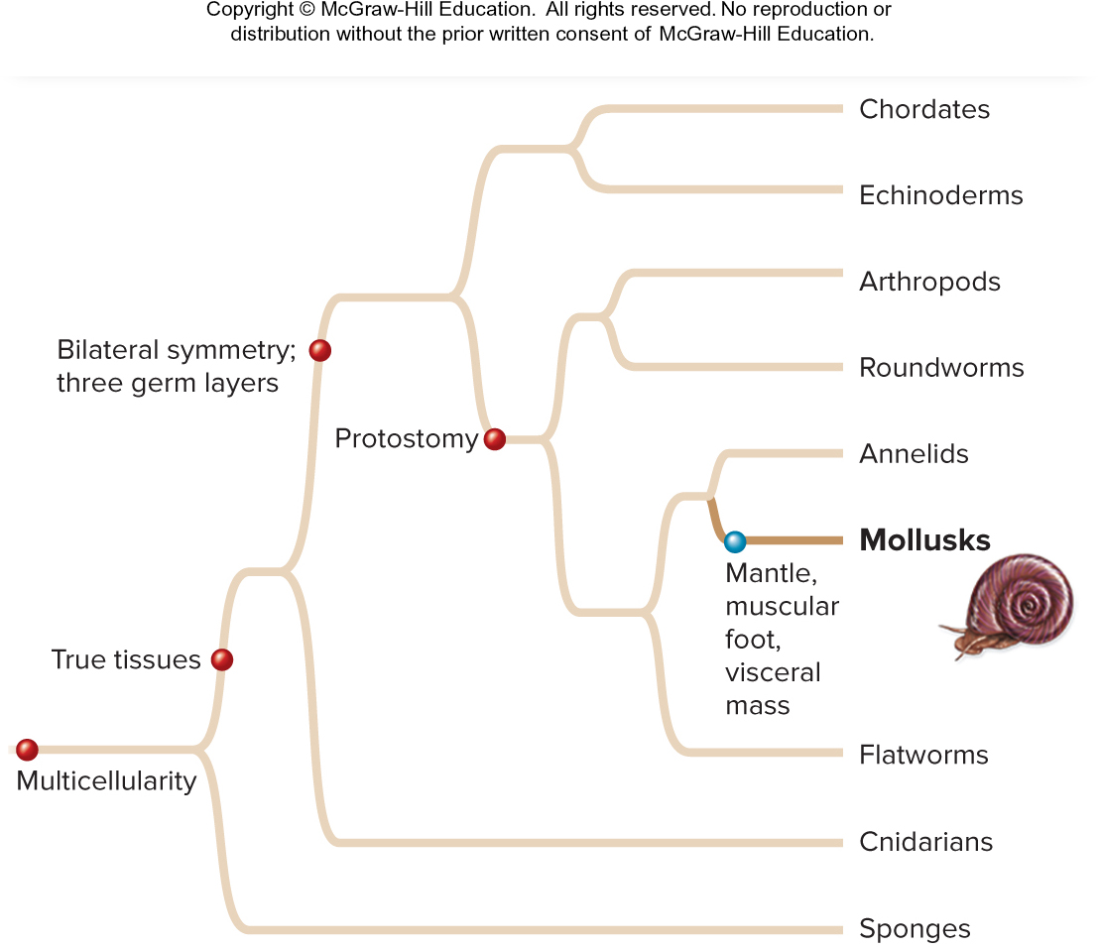
Mollusks are soft, unsegmented protostomes
Mollusks are a large, diverse phylum with a true coelom.
Mollusk features:
A mantle that secretes the shell
A muscular foot used for locomotion
A visceral mass where organs are found
A radula for feeding
Section 21.5
Figure 21.15

Slide 50
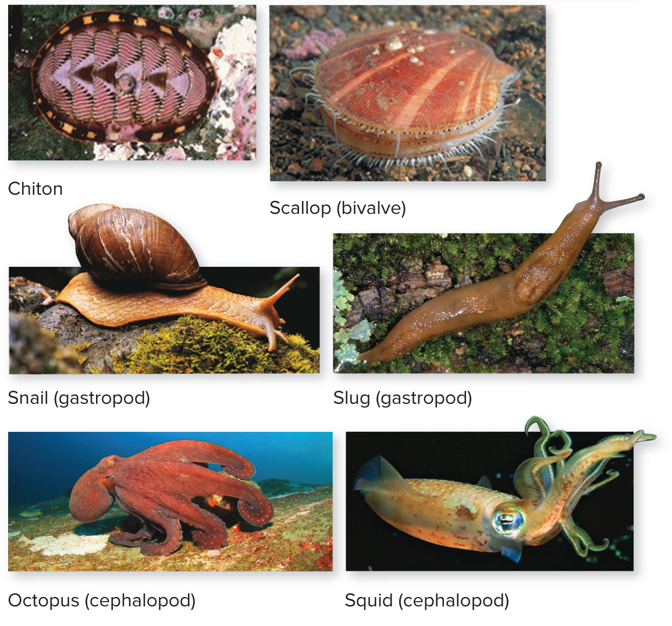
Mollusks are a diverse group
Chitons have eight overlapping shells.
Bivalves have hinged shells.
Gastropods have spiral shells.
Cephalopods have internal or absent shells.
(chiton): ©Kjell B. Sandved/Science Source; (bivalve): ©Andrew J. Martinez/Science Source; (snail): ©Digital Vision RF; (slug): ©Steven P. Lynch RF; (octopus): ©Rich Carey/Shutterstock RF; (squid): ©Comstock Images/PictureQuest RF
Section 21.5
Figure 21.15

Slide 51
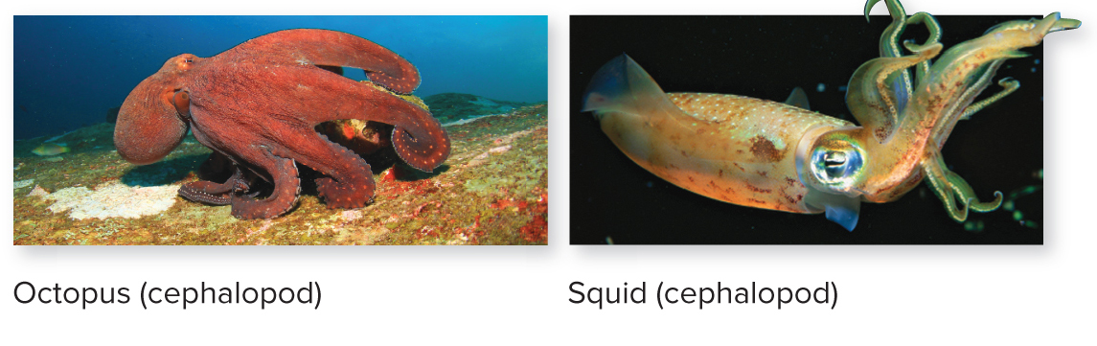
Mollusks have several organ systems
All mollusks have an open circulatory system and reproduce sexually.
(octopus): ©Rich Carey/Shutterstock RF; (squid): ©Comstock Images/PictureQuest RF
Cephalopods have particularly well-developed nervous systems including a large brain, eyes, excellent sense of touch, and impressive problem-solving abilities.
Section 21.5
Figure 21.15

Slide 52
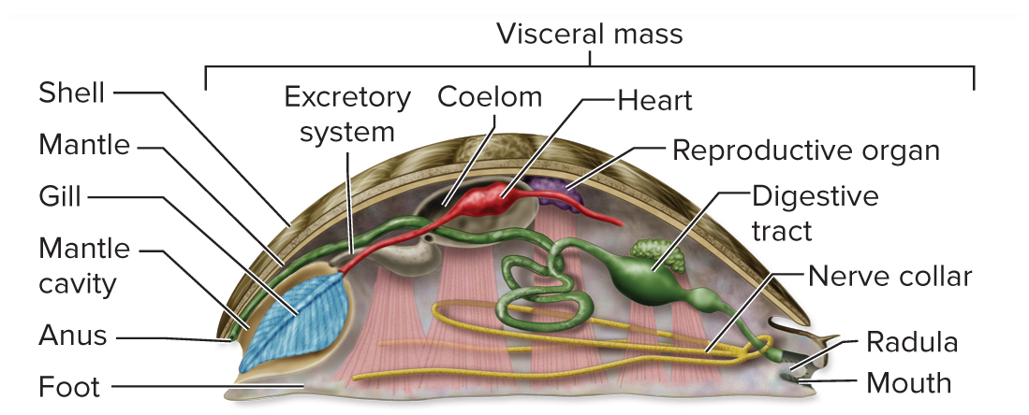
Mollusks have a complete digestive tract
In this bivalve, the radula contains teeth made of chitin. Food moves into the body through the mouth, and excretion occurs through the anus.
Section 21.5
Figure 21.15

Slide 53
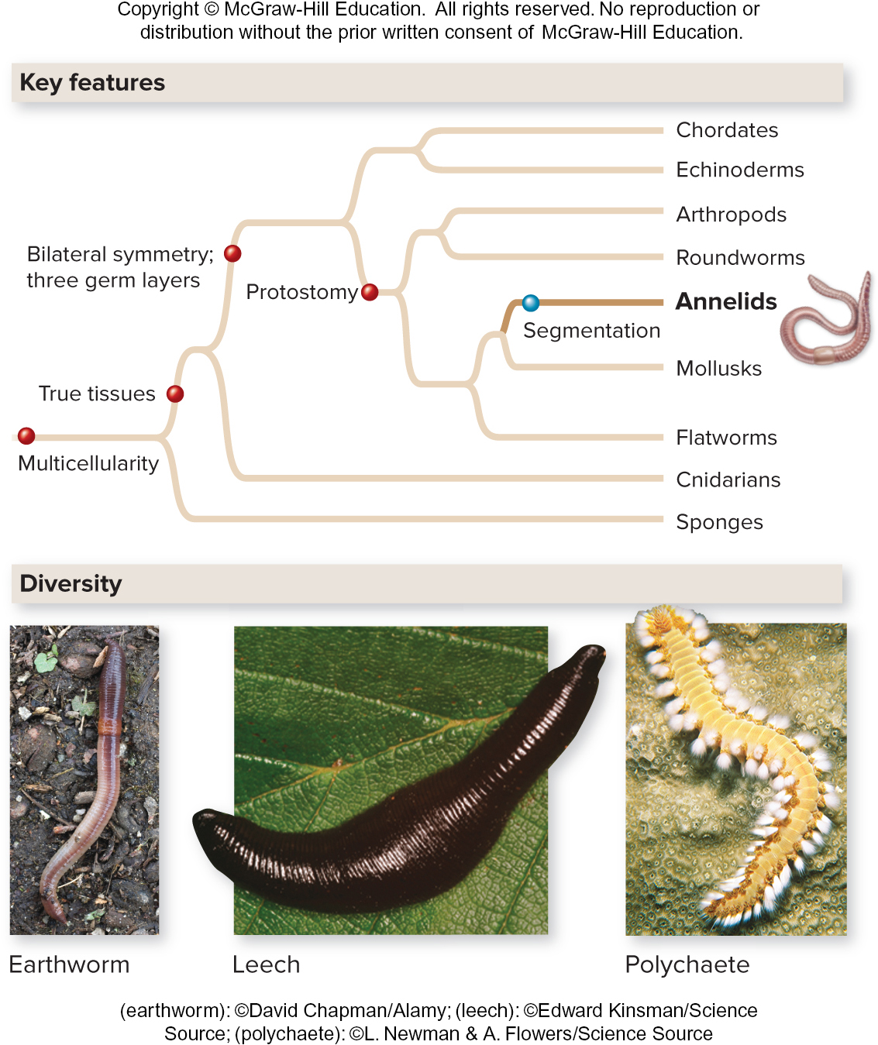
Annelids are segmented worms
Each body segment functions the same as the others
(earthworm): ©David Chapman/Alamy; (leech): ©Edward Kinsman/Science Source; (polychaete): ©L. Newman & A. Flowers/Science Source
Section 21.6
Figure 21.16

Slide 54
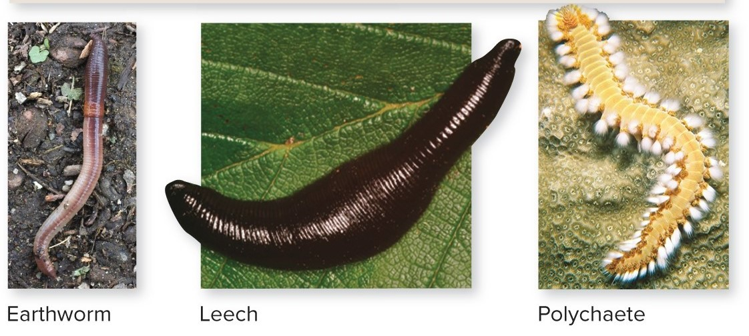
Annelids inhabit different environments
Earthworms live in soil, where they are crucial for keeping it aerated.
Leeches live in freshwater. They drink blood and eat small animals.
Polychaetes are marine worms.
(earthworm) : ©David Chapman/Alamy; (leech): ©Edward Kinsman/Science Source; (polychaete): ©L. Newman & A. Flowers/Science Source
Section 21.6
Figure 21.16

Slide 55
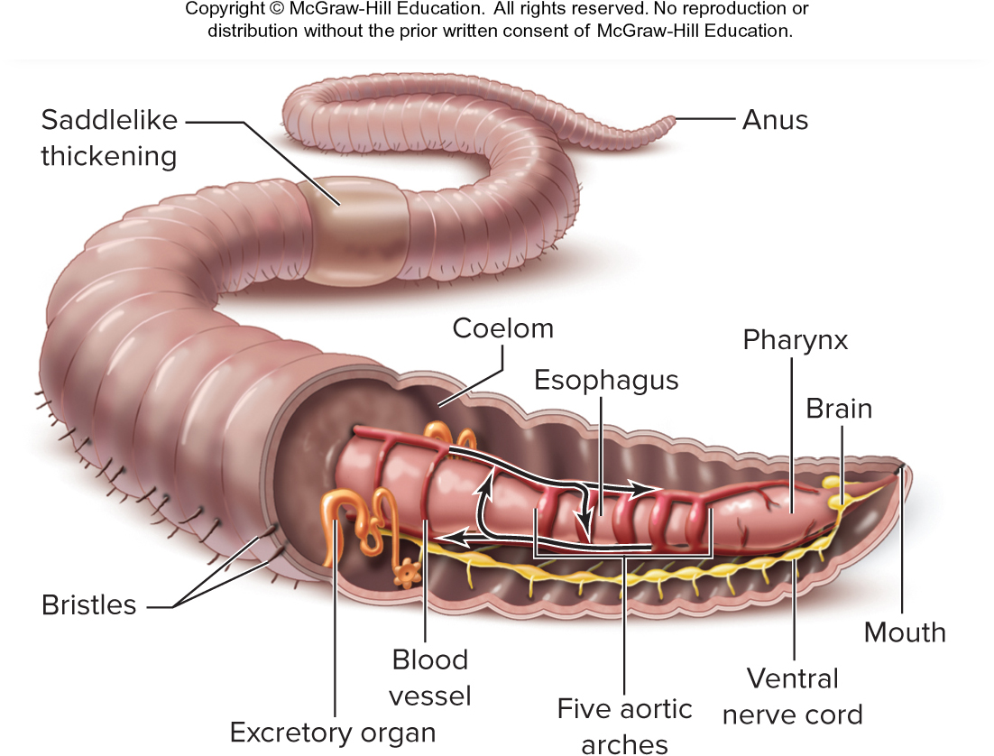
Annelids have several organ systems
This earthworm has a complete digestive system, a closed circulatory system with aortic arches, and a nervous system that includes a brain and ventral nerve cord.
Each body segment contains excretory organs.
The saddlelike thickening area holds the eggs in a specialized cocoon.
Section 21.6
Figure 21.16

Slide 56
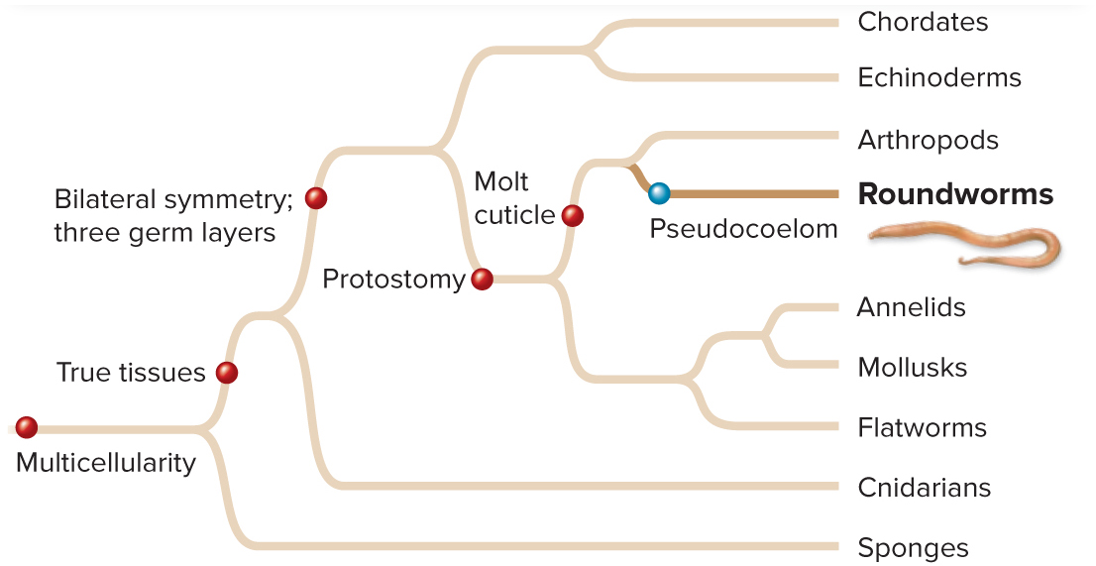
Nematodes are unsegmented worms
Phylum Nematoda is comprised of roundworms.
Although they look wormlike, the closest evolutionary relatives of roundworms are the arthropods.
(C. elegans): ©Sinclair Stammers/Science Source; (Wuchereria): CDC/Dr. Mae Melvin; (elephantiasis) ©R. Umesh Chandran, TDR, WHO/Science Source
Section 21.7
Figure 21.17

Slide 57
Some roundworms cause disease
Parasitic roundworms such as pinworms, heartworms, and hookworms infect the intestines, muscles, blood, and lungs of humans and other animals. Others such as C. elegans are free-living.
(C. elegans): ©Sinclair Stammers/Science Source; (Wuchereria): CDC/Dr. Mae Melvin; (elephantiasis) ©R. Umesh Chandran, TDR, WHO/Science Source
Section 21.7
Figure 21.17

Slide 58
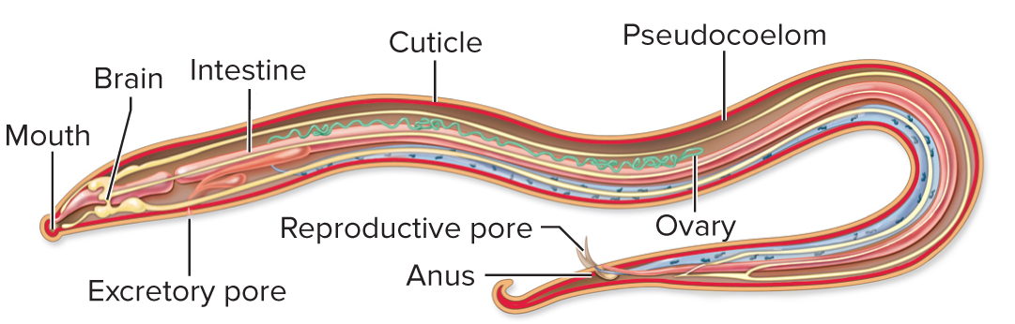
Nematodes have few organ systems
This roundworm’s nervous system includes a brain and nerve cords. Roundworms lack specialized circulatory and respiratory organs.
Fluid in the pseudocoelom distributes nutrients, oxygen, and carbon dioxide.
Section 21.7
Figure 21.17

Slide 59
Clicker question #4
Animals commonly called worms are classified into three phyla (flatworms, roundworms, and annelids). What feature distinguishes them?
Only flatworms have radial symmetry.
Only roundworms have a complete digestive tract.
Only annelids are heterotrophic.
Only roundworms have a gastrula stage of development.
Only annelids are segmented.

Slide 60
Clicker question #4, solution
Animals commonly called worms are classified into three phyla (flatworms, roundworms, and annelids). What feature distinguishes them?
E. Only annelids are segmented.

Slide 61
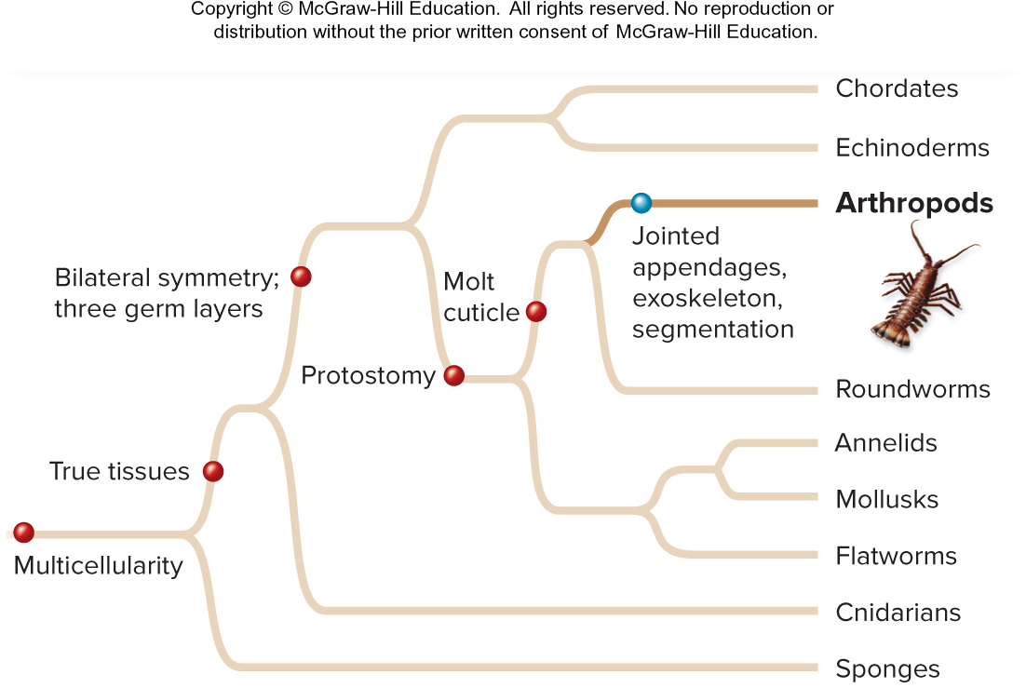
Arthropods have jointed appendages
Phylum Arthropoda is the largest, most diverse phylum of animals. Their legs, antennae, mouthparts, and other organs are jointed.
Trilobites
Chelicerates
Myriapods
Crustaceans
Insects
Over 1,000,000 species of arthropods exist!
Section 21.8
Figure 21.18

Slide 62
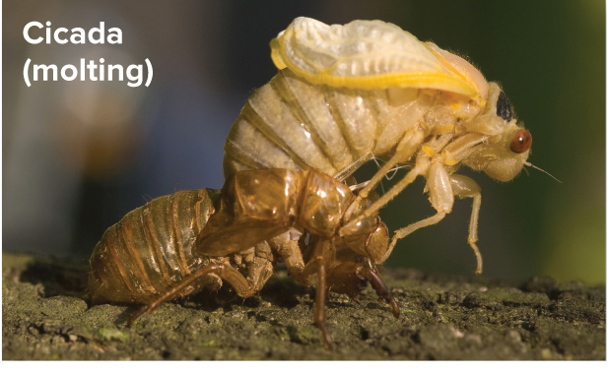
Arthropods have an exoskeleton
All arthropods produce a tough outer exoskeleton made of chitin that supports and protects the body.
©Rob Crandall/Shutterstock RF
As their bodies grow, they molt and grow a new exoskeleton.
Section 21.8
Figure 21.22

Slide 63
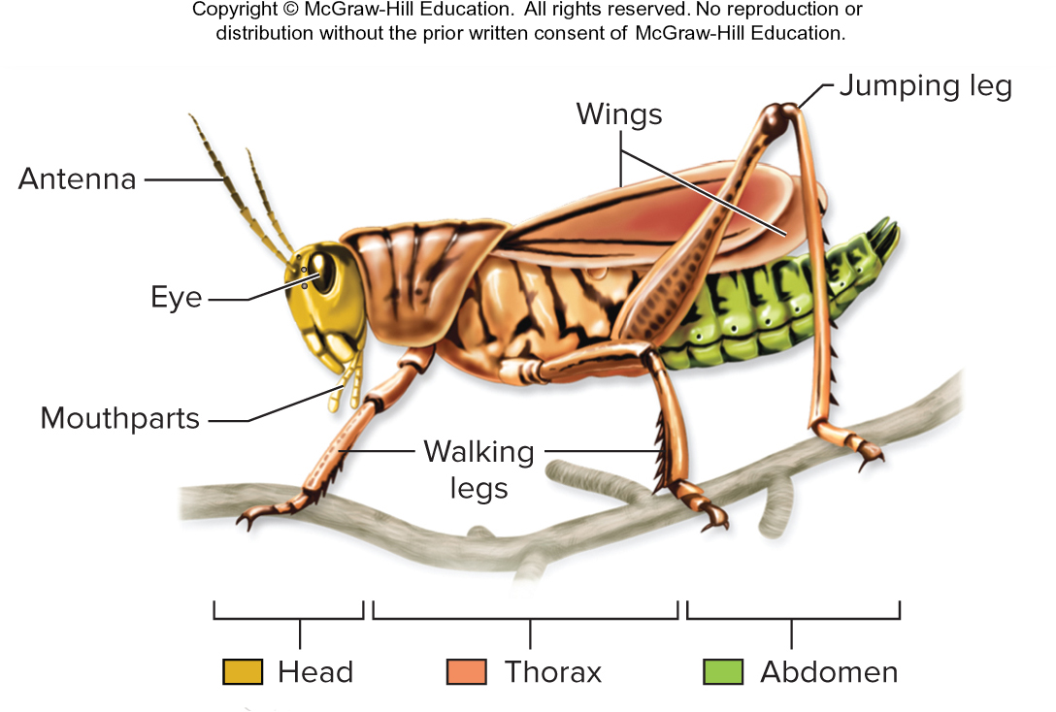
Arthropods have specialized body segments
In many arthropods, the segments group together into three major regions: head, thorax, and abdomen. Segments in each region develop specialized functions.
Section 21.8
Figure 21.18

Slide 64
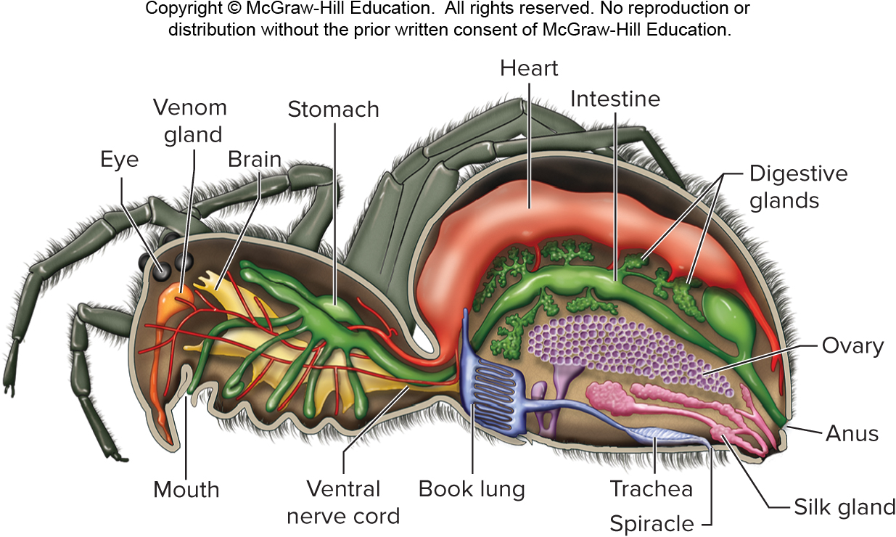
Arthropods have complex organ systems
Arthropods have a respiratory system made up of holes called spiracles for letting in air, and tubes called tracheae and book lungs for gas exchange.
The typical arthropod has a well-developed nervous system, open circulatory system, and complete digestive system.
Section 21.8
Figure 21.19

Slide 65
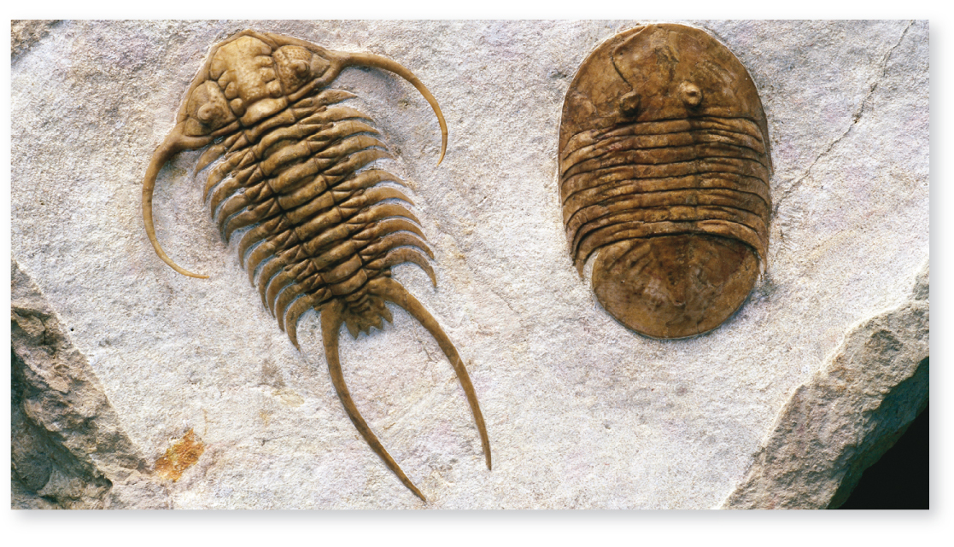
Arthropods are the most diverse animals
Arthropods are divided into five subphyla.
These trilobites are an extinct marine phylum.
©Francois Gohier/Science Source
Section 21.8
Figure 21.20

Slide 66
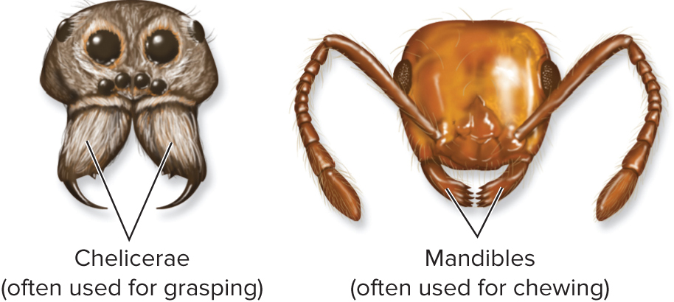
Arthropods are grouped by their mouthparts
The other four subphyla of arthropods are divided into:
Chelicerates with grasping clawlike mouthparts
Mandibulates with chewing, jawlike mouthparts
Section 21.8
Figure 21.18

Slide 67
Chelicerates are spiders and their relatives
Chelicerates include horseshoe crabs, mites, ticks, spiders, and scorpions.
(brow): ©Ingram Publishing RF; (mite): ©Andrew Syred/Science Source
(a): ©Nature’s Images/Science Source; (b): CDC/James Gathany; William Nicholson; (c): ©Corbis RF; (d): ©Digital Vision/Punchstock RF
Section 21.8
Figs. 21.18 , 21.21, 21.B

Slide 68
Myriapods are mandibulates
Millipedes and centipedes (myriapods) make up one group of mandibulates. The head has jaws and antennae; the rest of the body has pairs of legs.
Myriapods
(a, millipede): ©De Agostini Picture Library/Getty Images; (a, centipede): ©Matthijs Kuijpers/Alamy RF;
(b, crab): ©Pete Atkinson/Photoghrapher’s Choice/Getty Images RF;
(b, lobster): ©Photoshot Holdings Ltd/Alamy; (c, cicada): ©Rob Crandall/Shutterstock RF;
(c, dragonfly): ©Thomas Shahan/Flickr/Getty Images; (c, beetle): USDA/Scott Bauer; (c, moth): ©Steven P. Lynch RF
Section 21.8
Figures 21.18, 21.22

Slide 69
Crustaceans are mandibulates
Crustaceans include crabs, shrimp and lobsters. Their bodies vary, but all have two pairs of antennae
©Photoshot Holdings Ltd/Alamy
©Pete Atkinson/Photoghrapher’s Choice/Getty Images RF
Section 21.8
Figures 21.18, 21.22

Slide 70
Insects are mandibulates
There are millions of insect species. They each have one pair of antennae, six legs, and (usually) two pairs of wings.
(c, cicada): ©Rob Crandall/Shutterstock RF; (c, dragonfly): ©Thomas Shahan/Flickr/Getty Images
(c, beetle): USDA/Scott Bauer; (c, moth): ©Steven P. Lynch RF
Section 21.8
Figures 21.18, 21.22

Slide 71
Echinoderms are marine deuterostomes
Echinoderms include sea urchins, sea stars, and sea cucumbers.
They are most closely related to chordates.
(sea urchin): ©Andrew J. Martinez/Science Source; (sea star): ©Comstock/Getty Images RF; (larva): ©D P Wilson/age fotostock
(sand dollar): ©Pat Bonish/Alamy; (sea cucumber): ©Nancy Sefton/Science Source
Section 21.9
Figure 21.23

Slide 72
Echinoderm adults have radial symmetry
Larval echinoderms are bilaterally symmetric.
After metamorphosis, they develop into adults with five-part radial symmetry.
Special features include regeneration and tissues that switch between soft and hard.
Section 21.9
Figure 21.24

Slide 73
Echinoderms have a water vascular system and tube feet
The water vascular system is versatile, fulfilling the functions of a complex circulatory, respiratory, and excretory systems.
Tube feet pump out water and act as locomotion and sensory systems.
(b): ©McGraw-Hill Education; (c): ©Jeff Rotman/Alamy
Section 21.9
Figure 21.24

Slide 74
Chordata is the ninth animal phylum
Phylum Chordata is made up of chordates.
TABLE 21.2 Major Taxonomic Groups
in Phylum Chordata
Group | Examples | Approximate Number of Species
Tunicates (subphylum Urochordata) | Sea squirt | 3000
Lancelets (subphylum Cephalochordata) | Amphioxus | 30
Hagfishes and lampreys (superclass Agnatha) | Slime hag, sea lamprey | 70 (hagfishes) 38 (lampreys)
Cartilaginous and bony fishes (superclass Osteichthyes) | Shark, salmon, lungfish, coelacanth | 30,000
Amphibians (class Amphibia) | Frog, salamander, caecilian | 6000
Reptiles (class Reptilia and class Aves) | Turtle, lizard, snake, tuatara, crocodile, chicken, ostrich | 8000 to 10,000 (nonavian reptiles) 9000 to 10,000 (birds)
Mammals (class Mammalia) | Platypus, kangaroo, dog, whale, human | 5800
Figure 21.25
Table 21.2
Section 21.10

Slide 75
All chordates share four features
TABLE 21.2 Major Taxonomic Groups
in Phylum Chordata
Notochord
Dorsal nerve cord
Pharyngeal slit
Postanal tail
Group | Examples | Approximate Number of Species
Tunicates (subphylum Urochordata) | Sea squirt | 3000
Lancelets (subphylum Cephalochordata) | Amphioxus | 30
Hagfishes and lampreys (superclass Agnatha) | Slime hag, sea lamprey | 70 (hagfishes) 38 (lampreys)
Cartilaginous and bony fishes (superclass Osteichthyes) | Shark, salmon, lungfish, coelacanth | 30,000
Amphibians (class Amphibia) | Frog, salamander, caecilian | 6000
Reptiles (class Reptilia and class Aves) | Turtle, lizard, snake, tuatara, crocodile, chicken, ostrich | 8000 to 10,000 (nonavian reptiles) 9000 to 10,000 (birds)
Mammals (class Mammalia) | Platypus, kangaroo, dog, whale, human | 5800
Every chordate expresses each feature at some point during its life, since they are inherited from a common ancestor.
Figure 21.25
Table 21.2
Section 21.10

Slide 76
Some chordates are invertebrates
Tunicates, lancelets, and hagfish are invertebrate chordates.
TABLE 21.2 Major Taxonomic Groups
in Phylum Chordata
Group | Examples | Approximate Number of Species
Tunicates (subphylum Urochordata) | Sea squirt | 3000
Lancelets (subphylum Cephalochordata) | Amphioxus | 30
Hagfishes and lampreys (superclass Agnatha) | Slime hag, sea lamprey | 70 (hagfishes) 38 (lampreys)
Cartilaginous and bony fishes (superclass Osteichthyes) | Shark, salmon, lungfish, coelacanth | 30,000
Amphibians (class Amphibia) | Frog, salamander, caecilian | 6000
Reptiles (class Reptilia and class Aves) | Turtle, lizard, snake, tuatara, crocodile, chicken, ostrich | 8000 to 10,000 (nonavian reptiles) 9000 to 10,000 (birds)
Mammals (class Mammalia) | Platypus, kangaroo, dog, whale, human | 5800
Figure 21.25
Table 21.2
Section 21.10

Slide 77
Some chordates have a cranium
Vertebrates and hagfishes have a cranium, a bony or cartilage-rich case that protects the brain.
Section 21.10
Figure 21.26

Slide 78
Some chordates have vertebrae
Vertebrates have a series of small structures making up a backbone to protect the spinal column.
Section 21.10
Figure 21.26

Slide 79
Some chordates have jaws
Fishes, amphibians, reptiles, and mammals have hinged jaws that frame the mouth entrance.
Section 21.10
Figure 21.26

Slide 80
Some chordates have limbs and lungs
Most fishes have gills; amphibians, reptiles, and mammals have lungs for gas exchange.
Section 21.10
Figure 21.26

Slide 81
Some chordates have an amnion
Reptiles and mammals have several membranes that surround, protect, and feed their developing embryos
Section 21.10
Figure 21.26

Slide 82
Other features reveal chordate evolution
Body coverings, thermoregulation, and heart chambers are also used to classify chordates.
Section 21.10
Figure 21.26

Slide 83
21.2 to 21.10 Mastering concepts
Make a table comparing the features of each animal phylum.
©Michael DeFreitas/robertharding/Getty Images

Slide 84
Tunicates and lancelets resemble ancestral chordates
Tunicates and lancelets are chordate subphyla that lack a cranium and vertebrae.
Section 21.11
Figure 21.31

Slide 85
Tunicate and lancelet anatomy is distinct
Tunicate larvae are free swimming; adults are sessile.
Lancelets filter-feed with their tails buried in the sediment.
Section 21.11
Figure 21.31

Slide 86
Hagfishes and lampreys are craniates without jaws
A hagfish is a marine invertebrate with a cranium. Hagfishes secrete sticky slime, which helps them slide their bodies out of danger.
Lampreys have cartilage around their nerve cord, so they are the first animals to evolve vertebrae.
Section 21.12
Figure 21.32

Slide 87
Hagfishes and lampreys have long, slender bodies
(hagfish mouth): ©Steven Senne/AP Images; (hagfish): ©Mark Conlin/Alamy; (lamprey): ©David Hosking/Alamy; (lamprey mouth): ©Russ Kinne/Science Source
Section 21.12
Figure 21.32

Slide 88
How did jaws develop?
Early jawless fish
Early jawed fish
Modern jawed fish
Jaws can include teeth or a beak, and greatly expand the ways vertebrates can eat. In very early fishes, the skeletal elements that supported gill slits near the mouth may have developed into jaws.
Section 21.13
Figure 21.28

Slide 89
Fishes are aquatic vertebrates with jaws
Fishes originated about 500 MYA from an ancestor that had jaws, gills, and paired fins.
Fishes are the most diverse and abundant vertebrates.
Section 21.13
Figure 21.33

Slide 90
Some fishes are cartilaginous
The most ancient fishes have skeletons made of cartilage.
Sharks, rays, and skates are examples.
Stingray (cartilaginous fish)
Shark (cartilaginous fish)
(shark): ©Michele Westmorland/Getty Images RF: (snappers): ©Corbis RF
Along their sides, they have sense organs called lateral lines for detecting vibrations.
Section 21.13
Figure 21.33

Slide 91
Bony fishes have skeletons of bony tissue
Unique features of bony fishes include hinged gill coverings and a swim bladder they use to adjust their buoyancy.
Like cartilaginous fishes, bony fishes have a lateral line system.
Section 21.13
Figure 21.34

Slide 92
Bony fishes include two main lineages
Ray-finned fishes are the most familiar fishes – trout, tuna, eels, etc.
Lobe-finned fishes are most closely related to tetrapods (animals with four limbs).
Ray-finned fish (bony fish)
Lungfish (bony fish)
Coelacanth (bony fish)
(ray): ©MedioImages /SuperStock RF; (lungfish): ©Peter E. Smith/Natural Sciences Images Library; (coelacanth): ©Peter Scoones/Planet Earth Pictures/Getty Images
Section 21.13
Figures 21.33, 21.34

Slide 93
Fishes changed vertebrate evolution
Adaptations for surviving on land first arose in lobe-finned fishes.
Lungs developed from the swim bladder in a few species known as lungfish.
Strong pectoral and pelvic fin bones are the precursors for limb bones.
Lobe-finned fish
Early tetrapod
Section 21.13
Figure 21.35

Slide 94
Amphibians were the first tetrapods
Lungs and limbs facilitated amphibians’ move to land. Their eggs must remain moist, so amphibians retain
a strong link to water.
Frog
Caecilian
salamander
(frog): ©Creatas/PunchStock RF; (caecilian): ©E.D. Brodie Jr.; (salamander): ©Suzanne L. Collins & Joseph T. Collins/Science Source
Section 21.14
Figure 21.36

Slide 95
Amphibians are adapted to live on land and in water
Improved lungs coupled with porous skin used for breathing
Closed circulatory systems with a three-chambered heart
Denser, stronger skeletons
Section 21.14
Figure 21.37

Slide 96
Amphibians include three main lineages
Most amphibians are frogs: either smooth-skinned “true” frogs or warty-skinned toads.
Salamanders and newts resemble lizards.
Caecilians are amphibians that lack limbs and resemble giant earthworms.
Frog
Caecilian
salamander
(frog): ©Creatas/PunchStock RF; (caecilian): ©E.D. Brodie Jr.; (salamander): ©Suzanne L. Collins & Joseph T. Collins/Science Source
Section 21.14
Figure 21.36

Slide 97
Amniotes include reptiles and mammals
An amniotic egg has a leathery or hard outer layer surrounding a yolk that nourishes the developing embryo. Similar structures surround a mammal’s embryo.
©Creatas/PunchStock RF
Section 21.15
Figure 21.29

Slide 98
The amniotic egg broke the tie to water
The amnion allows reptiles
and mammals to breed
in dry habitats.
Birds are considered a clade of reptiles, although they used to be thought of as a separate group.
Section 21.15
Figure 21.38

Slide 99
Reptiles were the first vertebrates to thrive on land
Reptiles evolved about 310 MYA. Many reptiles that once dominated the planet are now extinct.
Reptiles are adapted to retain water inside their bodies, and reproduce outside of it.
Section 21.15
Figure 21.40

Slide 100
There are five main groups of reptiles
Turtle
Lizard
Snake
Alligator
Bird
(turtle): ©Ed Reschke/Peter Arnold/Getty Images; (lizard): ©Creatas/PunchStock RF;
(snake): ©Dorling Kindersley/Getty Iamges; (alligator): ©LaDora Sims//Flickr/Getty Images RF; (bird): ©Image Source RF
Section 21.15
Figure 21.40

Slide 101
Turtles and tortoises have a tough shell
Turtles are aquatic whereas tortoises live on land. Their shells are fused with the vertebrae, making it an integral component of the skeleton.
Section 21.15
Figure 21.39

Slide 102
Birds are warm, feathered reptiles adapted to flight
Feathers provide lift
Hollow bones keep the body lightweight
Specialized flight muscles attach to the breastbone
(b): ©Meckes/Ottawa/Science Source
Section 21.15
Figure 21.41

Slide 103
Mammals are warm, furry milk-drinkers
Mammals evolved about 200 MYA.
They are amniotes
with hair and milk-secreting mammary glands.
Section 21.16
Figure 21.42

Slide 104
Monotremes are mammals that lay eggs
These animals have distinctive anatomy that is similar to reptiles – the digestive, urinary, and reproductive tracts share a single opening to the outside of the body.
Monotremes
Platypus
Echidna
(platypus): ©JohnCarnemolla/Getty Images RF; (echidna): ©Paul Hobson/Nature Picture Library;
Section 21.16
Figure 21.42

Slide 105
Mammals and reptiles share a common ancestor
Unique mammal traits arose after mammals and reptiles diverged.
Mammary glands
Hair
Three middle ear bones
Four types of teeth
Four chambered hearts
Muscular diaphragm for breathing
Large brains
Section 21.16
Figure 21.42

Slide 106
Marsupials are mammals that bear live young
Babies are very tiny at birth and spend additional time developing in a marsupium (pocket).
Marsupials
Kangaroo
Opossum
(kangaroo): ©Anan Kaewkhammul/123RF; (opossum): ©Frank Lukasseck/Photoghrapher’s Choice/Getty Images
Section 21.16
Figure 21.42

Slide 107
Eutherians are mammals that bear live young
Babies develop inside a uterus before birth. The placenta connects the maternal and fetal circulatory systems, nourishes, and removes waste from the developing offspring.
Placental mammals
Human
Dolphin
Bat
(human): ©JGI/Blend Images LLC RF; (dolphin): ©imageBROKER/Alamy RF; (bat): ©Grzegorz Gust/Alamy RF
Section 21.16
Figure 21.42

Slide 108
Key vertebrate adaptations allowed rapid expansion and diversification
Key Vertebrate Adaptations
Adaptive
significance
Animals with
adaptation
Adaptation
Vertebrae
Expand range
of motion
Lampreys, fishes, amphibians, reptiles, mammals
Jaws
Increase feeding versatility
Fishes, amphibians,
reptiles, mammals
Lungs
Enable animal
to breathe air
Bony fishes (a few
species), amphibians,
reptiles, mammals
Limbs
Allow for
locomotion
on land
Amphibians,
reptiles, mammals
Amnion
Enables
reproduction
away from
water
Reptiles, mammals
Figure 21.48

Slide 109
Summary of chordate diversity
Mammals
~5800 species
Hair/fur and mammary glands
Amnion surrounds developing embryo
Monotremes, marsupials, placentals
Amphibians
~6000 species
Scale-less tetrapods
Can live on land but reproduce in water
Frogs, salamanders, caecilians
Hagfishes
~70 species
Fishlike bodies; jawless
Marine carnivores
“Slime hags”
Birds
~10,000 species
Feathers and hollow bones
Amniotic eggs
Fishes
~30,000 species
Scale-covered bodies
with gills and fins
Cartilaginous fishes (sharks
and rays) and bony fishes
Tunicates and lancelets
~3000 species (tunicates)
~30 species (lancelets)
Invertebrate filter feeders
Sea squirts and amphioxus
Nonavian reptiles
~8000 species
Dry, scaly skin; amniotic eggs
Turtles, lizards, snakes,
tuataras, crocodilians
Lampreys
38 species
Fishlike bodies; jawless
Consume invertebrates or parasitize fish
Figure 21.47

Slide 110
Clicker question #5
Which feature characterizes tetrapods but not other vertebrates?
amnion
skull and backbone
limbs
bilateral symmetry
tail

Slide 111
Clicker question #5, solution
Which feature characterizes tetrapods but not other vertebrates?
C. limbs

Slide 112
21.11 to 21.16 Mastering concepts
Describe the adaptations that mark the transition from fishes to amphibians, reptiles, and mammals.
©Michael DeFreitas/robertharding/Getty Images

Slide 113
Investigating life: Sponges fill holes in animal evolution
All the animal phyla appear in the fossil record during a 25-million year interval in the Cambrian period (543–490 MYA).
This trilobite fossil shows evidence of a complex body plan.
©Michael Melford/National Geographic Creative
Section 21.17
Figure 21.43

Slide 114
Investigating life: Who has genes for complex bodies?
Scientists tested a hypothesis that critical developmental genes for complex bodies were already present in animals, before the Cambrian explosion.
Section 21.17
Figure 21.44

Slide 115
Investigating life: Sponges have genes for a complex body
By testing animals for 68 different genes, the researchers found support for their hypothesis. A group of sponges contains all major types of developmental genes present in eumetazoans.
Section 21.17
Figure 21.44

Slide 116
Investigating life: The genes preceded the fossils
The appearance of new animal groups in the Cambrian “explosion” may represent the most visible, but not the initial, step in animal evolution.
©Michael Melford/National Geographic Creative
Section 21.17
Figure 21.43

